Slide 1
SoLID Magnet Update
Zhiwen Zhao (UVa), Paul Reimer (ANL)
SoLID Collboration Meeting
2013/03

Slide 2
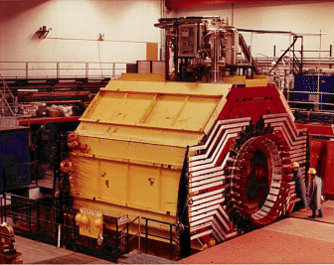
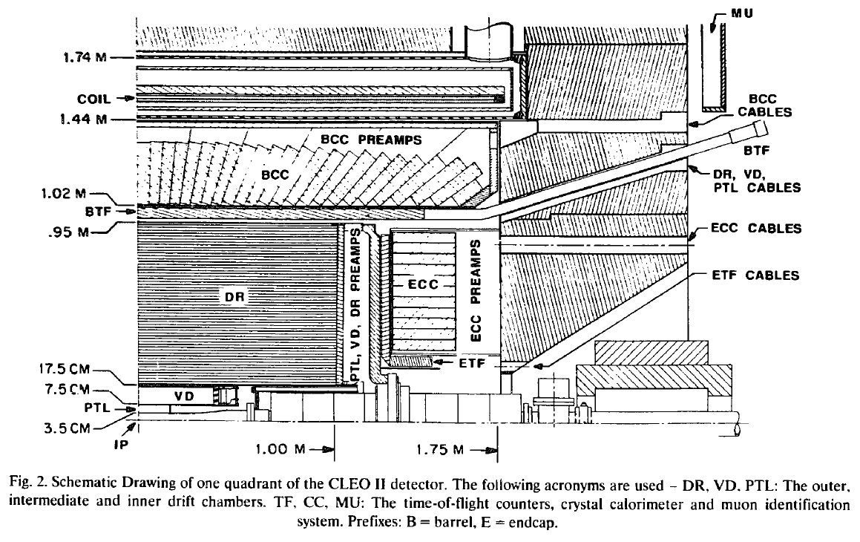
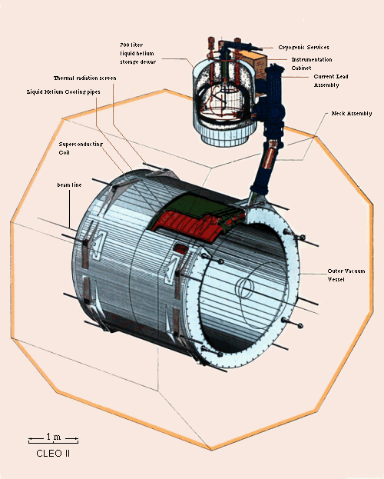
CLEO
CLEO-II magnet was built in early 1980s by Oxford in England.
Coil is divided into 3 sections, each section has two layers
Coil total 1282 turns. Upstream: 166; Central: 309; Downstream: 166 turns per layer. The current density in the end sections is 4% higher than in the middle section.
Max current is 3266A and average current density of 1.2MA/m, this reach 1.5T field

Slide 3
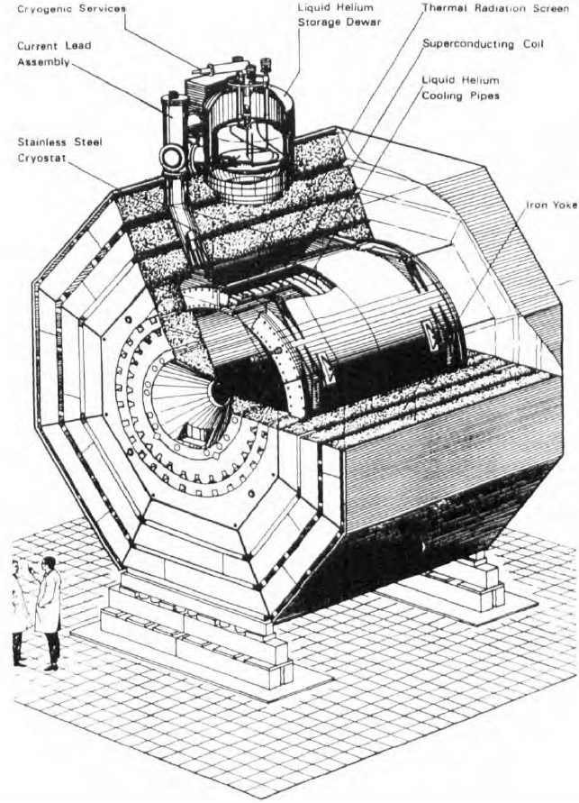
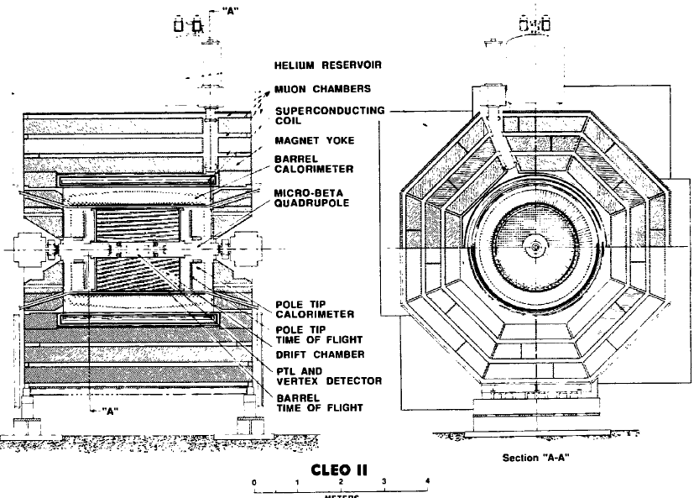
CLEO
Barrel flux return is provided by 3 layers of iron separated by spacers
It’s in octagon
2 collars supports barrel irons and holding 4 coil rods in horizontal direction.

Slide 4
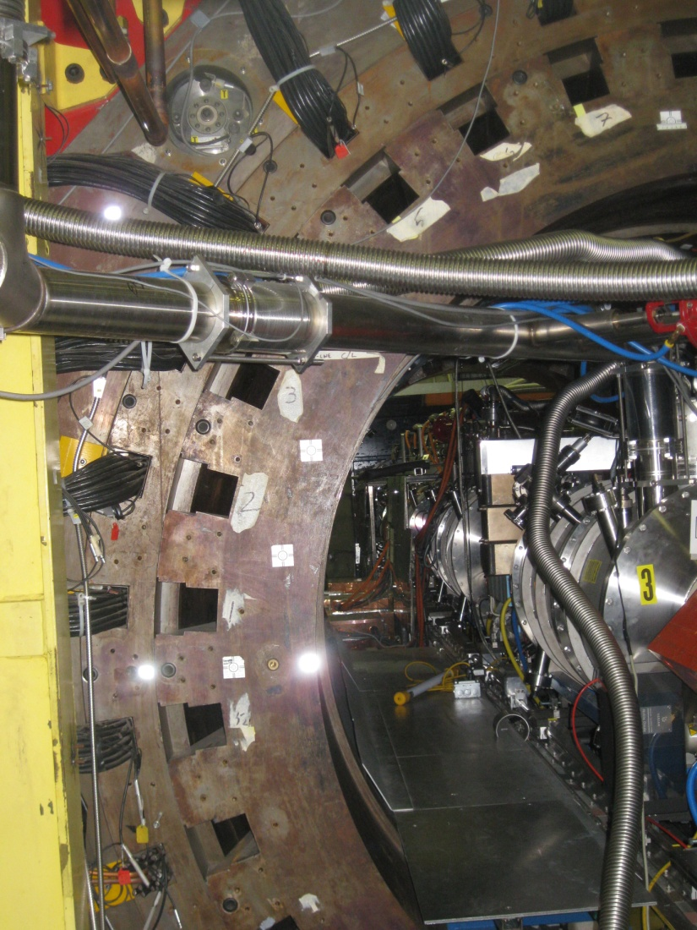
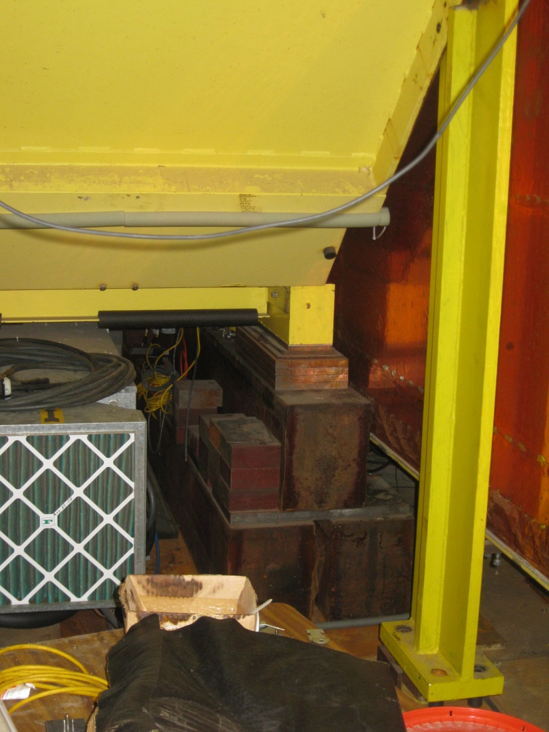
Will Oren visited Cornell

Slide 5
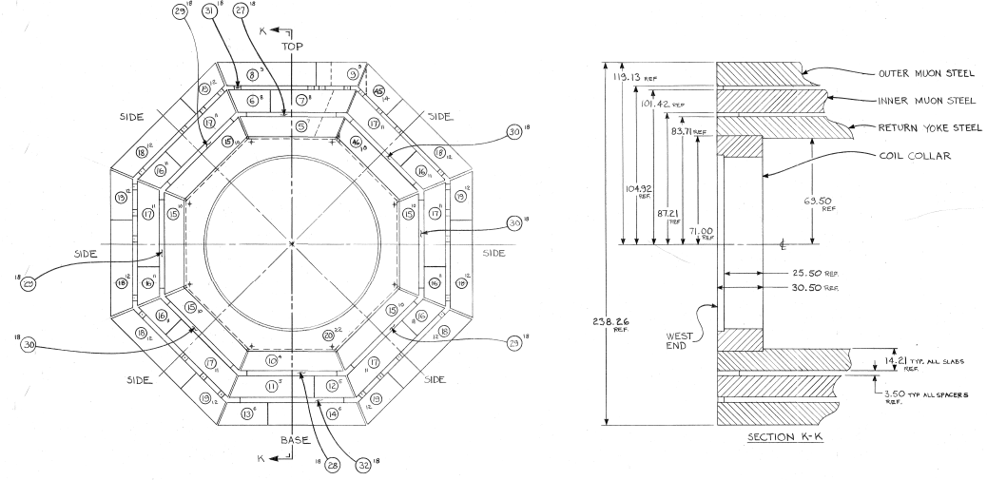
The outer layer
46cm thick

Slide 6
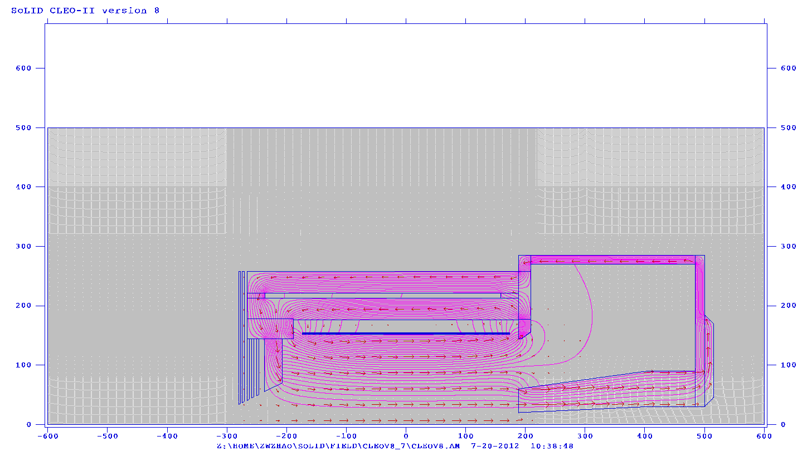
From CLEO-II to SoLID (reused parts)
Reuse coil and cryostat
Take two layers of barrel yoke and spacer, keep the upstream ends unchanged, cut the downstream ends (75cm) to our need.
Take the upstream collar unchanged, and cut the downstream collar or make a new one to satisfy the acceptance requirement. Make sure the coil rods can still be supported by two collars under axial force
All other parts of yokes are new.
Endcap Donut
Barrel Yoke Outer
Collar Downstream
Endcap Bottom
The parts from CLEO-II is in the red box
Spacer
Barrel Yoke Inner
Spacer
Collar Upstream
Coil
shield
Front Piece
Endcap Nose

Slide 7
From CLEO-II to SoLID (new parts)
All new parts need to be customized made.
But it’s unclear if they will be made of newly machined iron ($6/lb) or we can get some unused CLEO-II iron machined (cost?)
We might try to use some “stock” parts to save machining cost.
Endcap donut: 15cm thick and has 15cm clearance to HallA floor (10 feet high)
Endcap bottom: two 15cm plates
Endcap nose: flat at back to give clearance for SIDIS forward angle EC and has slope at front to give clearance for cherenkov.
Collar downstream: 20cm thick and can be in one piece
Front Piece: 30cm thick and can move along z to adjust force on coil
shielding: a few 4cm thick plates with gaps in between.
Endcap Donut
Barrel Yoke Outer
Collar Downstream
Endcap Bottom
The parts from CLEO-II is in the red box
Spacer
Barrel Yoke Inner
Spacer
Collar Upstream
Coil
shield
Front Piece
Endcap Nose

Slide 8
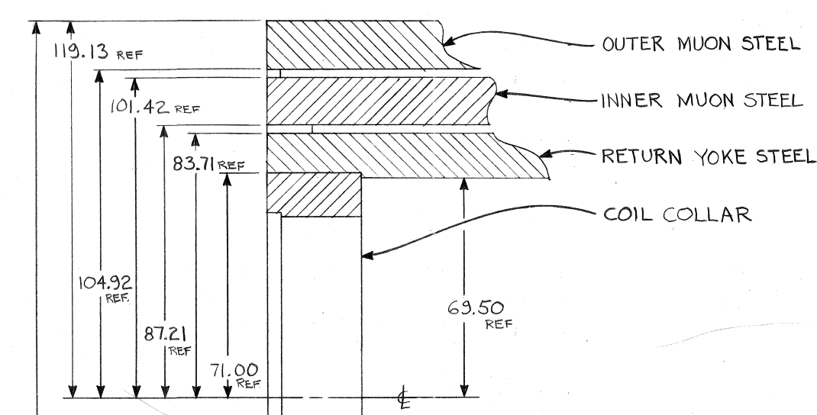
Cut the donut (15cm thick, 276cm long) out of the outer layer (46cm thick, 533cm long)
Beamline height 10 feet (305cm)

Slide 9
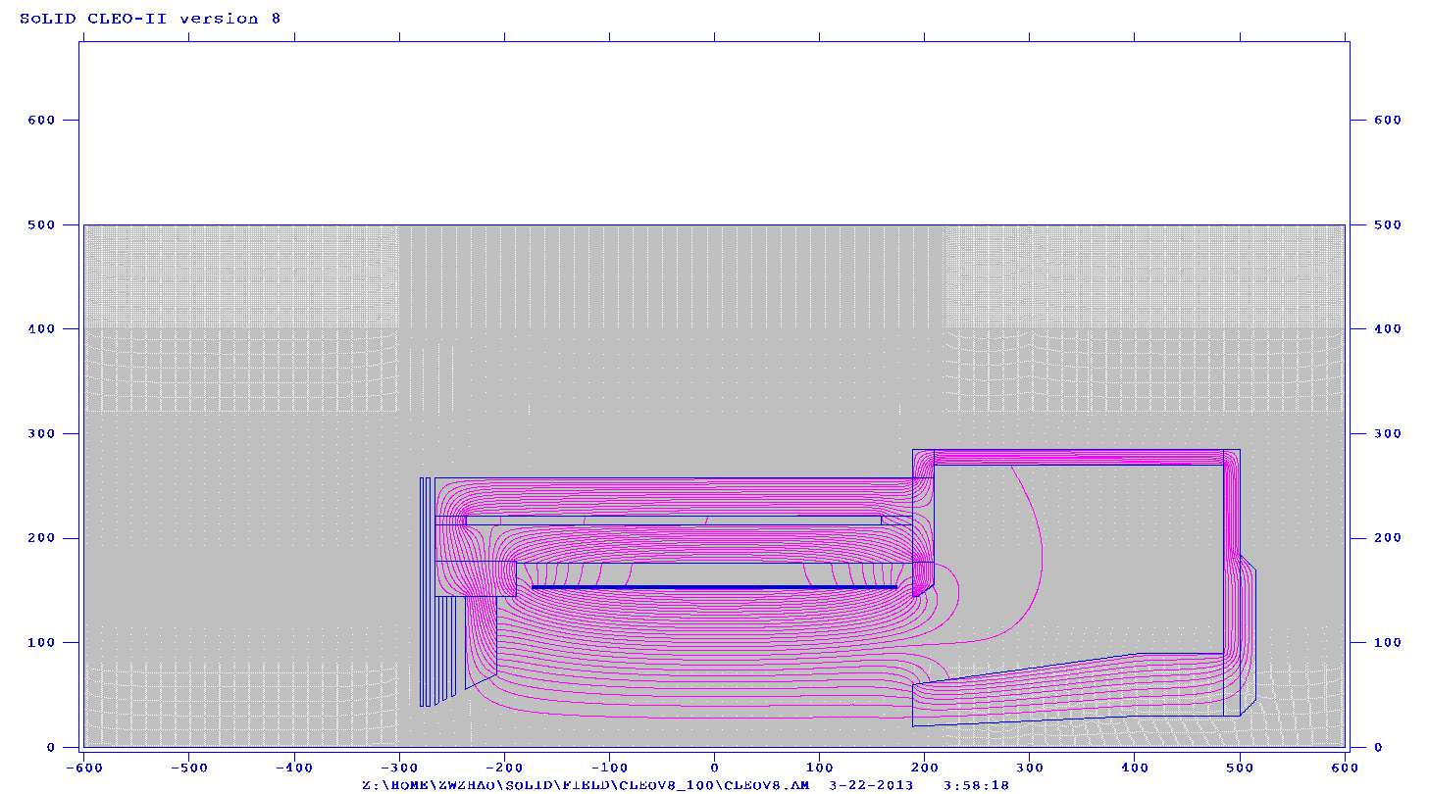
PVDIS target requirement
The chamber needs 30” clearance while we has only 26”
Make the first two planes opening to 30”
Check how field changes

Slide 10
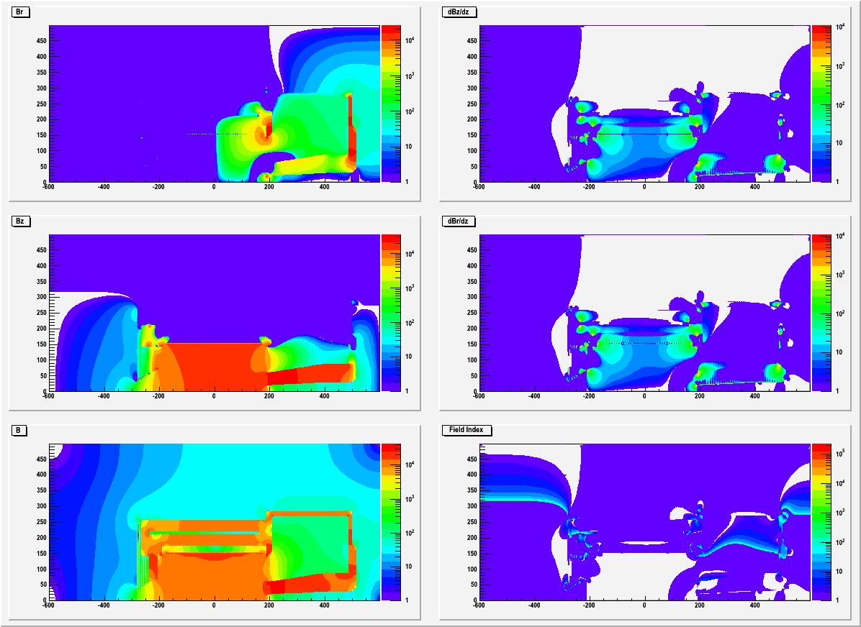
Field

Slide 11
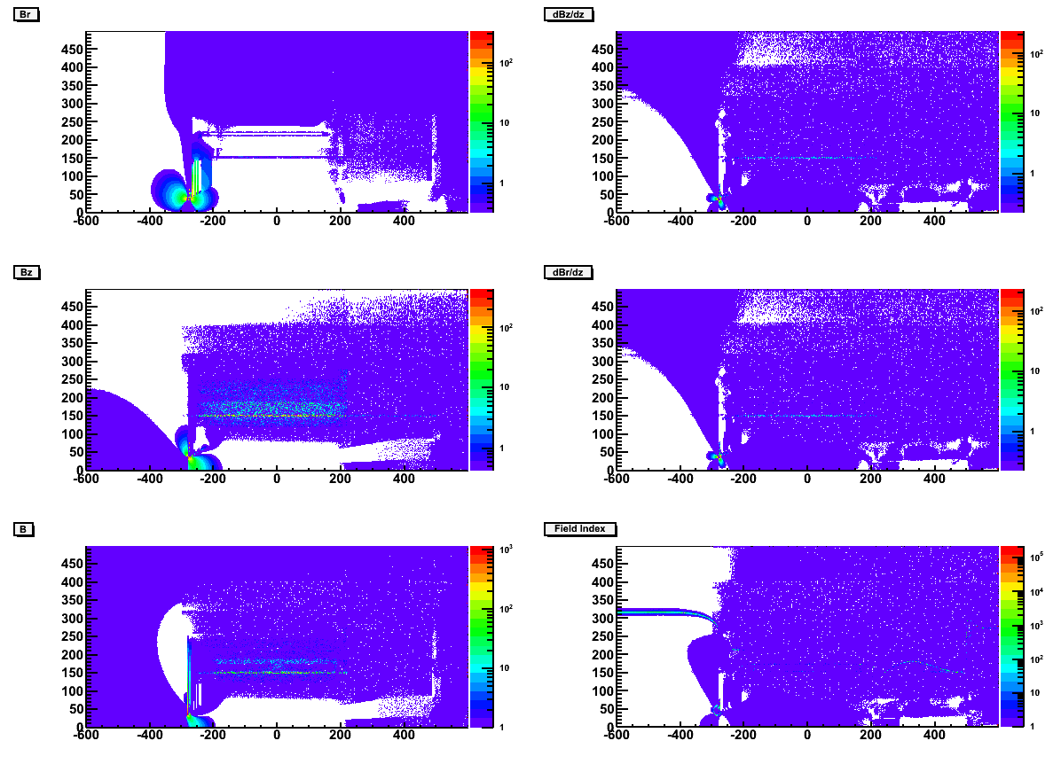
Field Difference
The field change is small within solenoid
Need to study the fringe field at SIDIS target

Slide 12
Summary
To use the extra iron or not is more or less a cost question.
Fringe field can be tuned (correction coil alike), need more time.
More advanced software like TOSCA to do further work
More input from CLEO people will help fine tune things. We need to gather more info from them.
Iteration with engineering.

Slide 13
backup

Slide 14
SOLID CLEO Acceptance
PVDIS physics requires opening angle from 22 - 35º
target at z= 10cm
geometry openings is 21 - 36º
clearance to endcup nose at endcup entrance (z=189cm) is 12cm for 22º and 8cm for 21º
clearance to endcup donut at forwardangle EC back (z=370cm) is 10cm for 35º and 5cm for 35.5º
beamline opening angle at endcup bottom is 3.5º
SIDIS physics requires opening angle from 8 - 24º, JPsi physics requires opening angle from 8 - 26º
target at z= -350cm
geometry openings is 7.5 – 26.3º
clearance to endcup nose at endcup entrance (z=189cm) is 15cm for 8º
clearance to endcup nose at forwardangle EC front (z=405cm) is 15cm for 8º
beamline opening angle at endcup bottom is 2º
PVDIS 36º
SIDIS 26º
SIDIS 14.7º
PVDIS 21º
SIDIS 8º
SIDIS 2º
PVDIS 3.5º

Slide 15
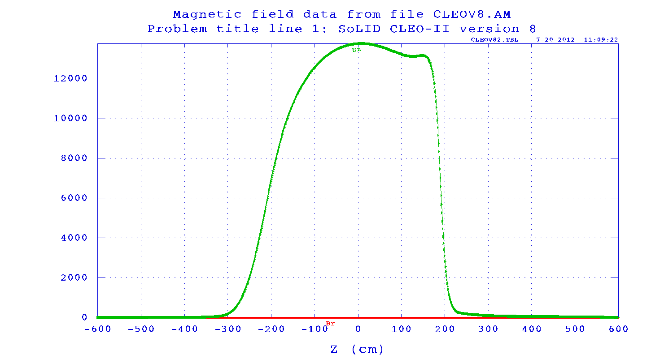
SoLID CLEO Field
CLEO-II can still reach 1.48T Bz
SoLID CLEO only reaches 1.38T Bz, due to large opening and asymmetric yoke design. Unlikely CLEO-II can run higher current (?)
The iron of the endcap nose could be saturated with >2T field.
The radial field Br can reach a few 1000G where PVDIS GEM plane 1 and 2 are.
The field drops to a few 100G in endcap. They are <200G where Cherenkov readout is.
Br
Bz
Bz along beamline
B

Slide 16
SoLID CLEO Force on coil
unit in t | upstream | middle | downstream | total
inner 2piFz | 154.1 | 3.6 | -159.1 | -1.4
outer 2piFz | 154.7 | 3.5 | -159.6 | -1.4
Total 2piFz | 308.8 | 7.1 | -318.7 | -2.4
inner Fr/radian | 87.9 | 170.2 | 87.2 | 345.3
outer Fr/radian | 24.8 | 54.5 | 24.2 | 103.5
Total Fr/radian | 112.7 | 224.7 | 111.4 | 448.8
Axial force on coil and cell cylinder are squeezing from both sides and it can be balanced under 10t.
could leave some net force to avoid accidental force direction change.
Preferred direction is negative so upstream collar (unchanged from CLEO-II) can take the force (?)
Moving the front piece in z to adjust force (moving upstream, the positive force increase, vice verse.) with gradient 3-5t/cm (It’s very sensitive)
Radial force are on the Aluminum shell cylinder
From Eugene “If all the force goes to the shell, the azimuthal tension is about 30MPa. The yield limit of aluminum is about 100MPa (to be verified for 4°K)”
305.4
6.3
-316.5
front piece

Slide 17
SoLID CLEO Force on yoke (axial force only)
2piFz (unit in t) represents the axial force integrated over the whole part in 2pi.
positive direction in black, negative direction in Red
The opposite force meets at two locations where the endcup connects.
Some analysis of potential problems with the coil and yoke mechanical integrity should be done.
no calculation of the radial force yet.
-20.3
171.2
122.9.
-269.0
8.1
0.7
-238.4
110.2
108.6
-119.2
0.008
-79.6
0.2
165.5
0.7
0.2
38.9
0.04

Slide 18
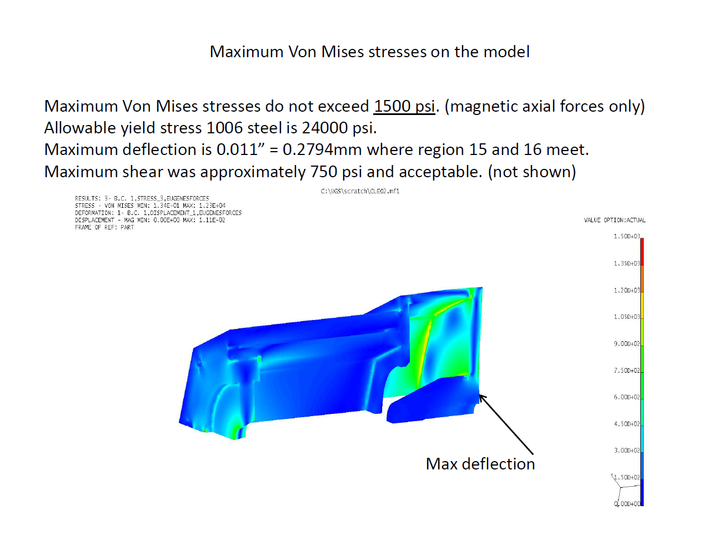
SoLID CLEO: FEA study of axial force
Static weight are ignored for now.
by Whit Seay

Slide 19
SoLID CLEO Yoke weight
assume steel density is 7.9g/cm3 , weight unit is in t
material from CLEO-II 376t
new material 200t ($2.7M if assume $6/lb machined iron)
total 576t
7.4
57
195
30
3
3
17
154
21
4.4
5
10.4
6
12.5
2
2
40
2

Slide 20
SoLID CLEO: Fringe field at SIDIS pol He3 target location
Z (cm) | Bz(G) | Br(G) | dBz/dr (mG/cm) | dBr/dz (mG/cm) | dBz/dz (mG/cm) | dBr/dr (mG/cm)
-330 | 46.1 | 0.7 | 40 | 40 | 1500 | 744
-350 | 27.3 | 0.3 | 12 | 12 | 500 | 288
-370 | 19.1 | 0.1 | 4 | 4 | 300 | 142
Multilayer of iron plates and gaps have good shielding effect
The distance between first shielding plate to the target coil is a few cm.
pol He3 holding field is 25G and we need field gradient below 100mG/cm
We need additional shielding or correction coil.
Pol He3 target
2 Helmholtz coils
Longitudinal R=75.8cm
Vertical R=66.7cm

Slide 21
SoLID CLEO: Fringe field at SIDIS pol He3 target location (with correction coil)
Z (cm) | Bz(G) | Br(G) | dBz/dr (mG/cm) | dBr/dz (mG/cm) | dBz/dz (mG/cm) | dBr/dr (mG/cm)
-330 | -0.4 | 0.11 | 42 | 42 | 170 | -106
-350 | 1.6 | 0.05 | 7 | 7 | -100 | 54
-370 | 0.8 | 0.08 | 4 | 4 | 164 | -81
Add a pair correction coil at the same position of longitudinal coil with current -3465A and -645A
No effect on the force on solenoid coil
Both field and field gradient are reduced
It can be tweaked further and there can be other ideas.
Pol He3 target
2 Helmholtz coils
Longitudinal R=75.8cm
Vertical R=66.7cm

Slide 22
SoLID CLEO summary
We have a preliminary design
It can be improved with more input from engineering
Some barrel yoke are reused, no problem to fit with Hall A beamline height.
Study by Eugene Chudukov https://userweb.jlab.org/~gen/jlab12gev/cleo_mag

