Slide 1
SoLID DAQ
August 19th 2013
Alexandre Camsonne

Slide 2
Outline
Calorimeter
Trigger
readout
Cerenkov trigger
Rates
Design
Efficiency
PVDIS
Trigger and rates
GEM event size
SIDIS update
Pion trigger
Event size
Readout mode
L3 farm
Requirement
Hall D
Updated cost and man power
Conclusion

Slide 3
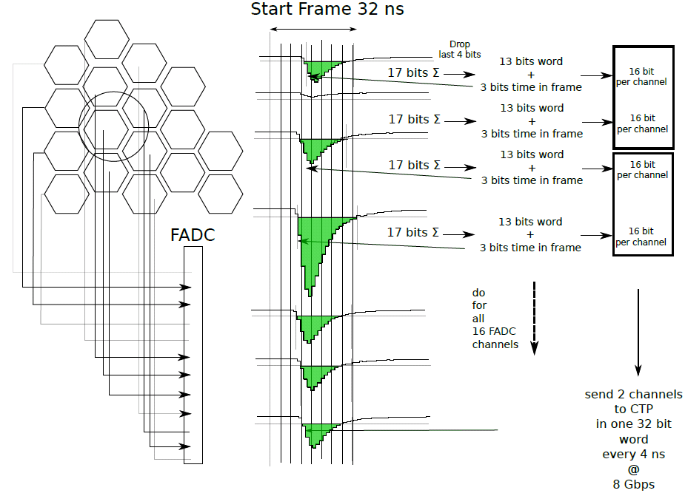
Calorimeter trigger
HPS scheme

Slide 4
Calorimeter FADC readout
Individual channel threshold sensitive to background and can reduce efficiency and resolution
Solution : generate a 64 bit pattern to trigger the FADC of each crate and use trigger path to send to FADC
Development of new firmware :
add 1 FTE/year electronics group

Slide 5
Cerenkov trigger
Coincidence between two PMTs at 2 pe
Sum of 9 PMTs ( better efficiency ) might be noisier
Send information of one sector to the two neighboring sectors to compute sum

Slide 6
Cerenkov trigger efficiency

Slide 7
Cerenkov rates
Last simulation around 3 MHz
Assuming 30 ns coincidence window :
60KHz*3MHz*30 ns = 5.4 KHz accidentals
Need to evaluate efficiency at interface as function of phi

Slide 8
PVDIS trigger rates
Coincidence cerenkov and Calorimeter
5 KHz physics rate ? + 6 KHz accidentals
11 KHz trigger rate per sector

Slide 9
GEM event occupancy and size
Sector | Rate | XY | Bytes
0 | 23 | 46 | 184
1 | 12 | 24 | 96
2 | 10 | 20 | 80
3 | 9 | 18 | 72
Total hits / sector | 54 |  | 432
Data rate / sector | 60000 |  | 25920000
Data rate ( sector Mb/s) |  |  | 25.92
Total detector | 1620 |  | 777.6
Occupancy detector | 0.011489362
Rates with deconvolution 1 sample readout
Need to check it works well
800 MB 3 sample without deconvolution
Only Geant4 pion background ( do we need to add physics pions too ? )

Slide 10
PVDIS FADC event size
Need full simulation with digitization
Assume two clusters maximum, cerenkov fires all the time
For 10 samples :
event size = 12 + n * 4/2 with n number of channels
Detector | Nb fired | Size ( bytes )
Calorimeter | 14 | 560
Preshower | 14 | 560
Cerenkov | 9 | 360
Total |  | 1480 bytes

Slide 11
PVDIS data rates
VME Backplane limitation : 100 MB/s
Max rate : 65 KHz
At 30 KHz :
45 MB/s for FADC
13 MB/s from GEM
58 MB/s data rate
Total 30 sectors : 1740 MB/s need reduction by factor of 7 by L3

Slide 12
SIDIS event size
Need to be updated
Around 2.5 Kbytes
500 MB/s with 60 crates
L3 reduction by factor of 2

Slide 13
SIDIS update
Jin’s study of background
Waveform not needed for calorimeter
Assume full waveform for scintillator
Pion trigger at MIP using clustering algorithm : has good efficiency : can use cluster readout, no issue with background
Assume 1 sample GEM readout and only integral readout for calorimeter and evaluate feasibility single trigger ( 200 KHz )

Slide 14
Tape cost
Current price DLO5 : 75 $ for 1.5 TB
DLO 6 : 2.5 TB per tape
 |  | Days | Data rate | Seconds | Total data TB | Double | DLO5 in $ | DLO6 in $
E12-11-108 | Pol proton | 120 | 250 | 10368000 | 2592 | 5184 | 259200 | 155520
E12-12-006 | J/Psi | 60 | 250 | 5184000 | 1296 | 2592 | 129600 | 77760
E12-10-006 | Transv. Pol. 3He | 90 | 250 | 7776000 | 1944 | 3888 | 194400 | 116640
E12-11-007 | Long. Pol. 3 He | 35 | 250 | 3024000 | 756 | 1512 | 75600 | 45360
E12-10-007 | PVDIS | 169 | 250 | 14601600 | 3650.4 | 7300.8 | 365040 | 219024
 | Total | 474 |  | 40953600 | 10238.4 | 20476.8 | 1,023,840 | 614,304
Actual days | Actual years |  | Time in s |  |  | Per year | 394,200 | 236,520
948 | 2.60 | 474 | 40953600
Not major limiting factor

Slide 15
L3 Farm
Hall D performance
27 Hz with tracking ( 741 cores for 20 KHz )
77 Hz without tracking ( 260 cores for 20 KHz )
For 7000 strip and 2800 calorimeter channels
128 cores server about 20 K$, price linear with rate
Rate (KHz) | CPU With tracking | Price sector | Total price | CPU No tracking | Price | Total price
10 | 500 | 80 K$ | 2.4 M$ | 130 | 20 K$ | 0.6 K$
30 | 1500 | 240 K$ | 7.2 M$ | 390 | 60 K$ | 1.8 M$
Can afford non tracking method need to check non tracking

Slide 16
L3 Farm
Data reduction strategy
Region of interest
Pulse quality
Clustering
Tracking
Need to evaluate algorithm speeds
Seems can only do non tracking, need to evaluate if sufficient

Slide 17
Updated budget ( to be checked )
Same number of preshower as shower
Added 60 additionnal FADC channel for SIDIS
2 crates : 1 for APV and 1 for FADC
3.1 M$, need to check new data rates
1.8 M$ L3 at 30 KHz 0.6 M$ at 10 KHz

Slide 18
Things needed for report
Report
Occupancy in calorimeter
Efficiency of pion trigger
Finalize rates PVDIS
Generate trigger rates SIDIS
Finalize GEM occupancy
Define L3 algorithm and speed and cost
Finalize cost

Slide 19
Ideas questions
Add more FADC channels to Cerenkov
Go with SRS in proposal instead of VME ( saves crates )

Slide 20
Things needed for review
Finalize DAQ location and radiation studies
Evaluate and test deadtime when transferring waveform
Full simulation to evaluate effect of background
Implementation of trigger at small scale to check latency and logic
Test of L3 speed
APV25 high rate test readout

Slide 21
Conclusion
Progress on PVDIS trigger and readout
Only readout of cluster allows 60 KHz
Coincidence EC and Cerenkov gives only 6 KHz accidentals
SIDIS
Pion trigger efficiency is good and can use cluster readout
Need to evaluate effect of background with full simulation
Need to evaluate L3 performance

