Slide 1
Update on SoLID
Jian-ping Chen, Jefferson Lab
SoLID Collaboration Meeting
August 19-20, 2013

Slide 2
SoLID Status Update
Main Progress:
Magnet: Formal request/response (completed)
(thanks to JLab management/physics division/Hall A)
Background:
Main background for PVDIS/baffle design/optimization (Zhiwen’s talk)
Identify source/profile of background (Rich’s talk)
Radiation (including neutron) background (Lorenzo’s talk)
EM calorimeter:
Update on pile-ups from background (Zhiwen’s talk)
Impacts on trigger and PID
Support structure design
Light Cherenkov:
Simulation with background (Michael’s talk)
Impact on trigger and PID
Combined with EC
QAD/Trigger System:
Updated design with new inputs from EC/LC (Alexandre’s talk)
Simulation/test stand

Slide 3
SoLID Status Update (II)
Progress on p-CDR
Project introduction/overview (newly added)
Major subsystem, conceptual design complete
Finalize EC/LC full simulation with realistic background
Finalized trigger/DQA design with new inputs from EC/LC
GEM modification (4 planes to 5 to be safe)
Freeze (in a week?)
Other progress:
GEMs- China progress (Yuxiang’s talk)
GEMs R&Ds/test run/production for SBB (Nilanga’s talk)
Tracking (Ole’s talk)
Heavy Cherenkov: Space availability (Mehdi’s talk)
Support structure
New collaborators

Slide 4
Milestone, Schedule
pCDR “freeze” and ready to be released: this month
Director’s review: October? (dry-run)
Discussion with DOE: in a few months?
Submit MIE/MRI: Late 2013/early 2014?
CD process: 2013-2015?
Full simulation: continuing
Pre-R&D: starting now
CDR/TDR

Slide 5
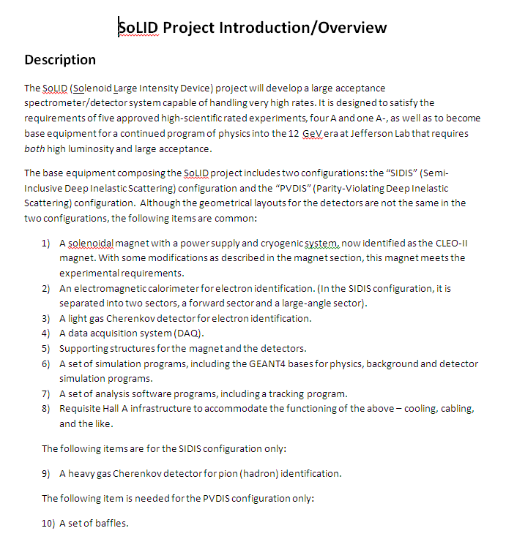

Slide 6
