Slide 1
GEM progress from Chinese collaboration
Yuxiang Zhao
University of Science and Technology of China
Aug 20, 2013

Slide 2
News from Chinese collaboration
Email list is set up
solid_gem@jlab.org
Monthly phone meeting will be held later
every Wednesday in the last week of each month
8:30am-10:30am(US time)
A new faculty is on board at USTC
Jianbei Liu ( liujianb@ustc.edu.cn )
Shandong University shows their interest in GEM R&D

Slide 3
Updates from Yi Zhou
zhouyi@mail.ustc.edu.cn

Slide 4
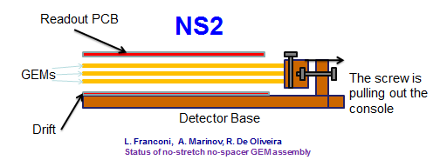
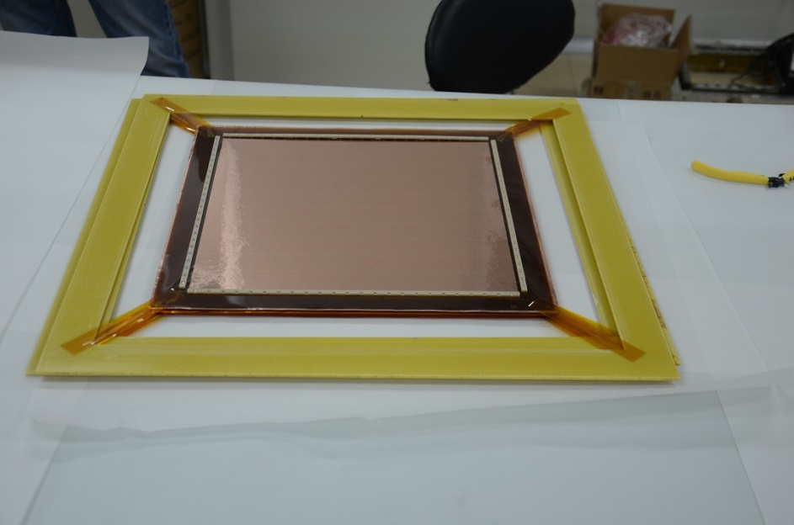
Foil assembling by using NS2 technology(30cmx30cm)

Slide 5
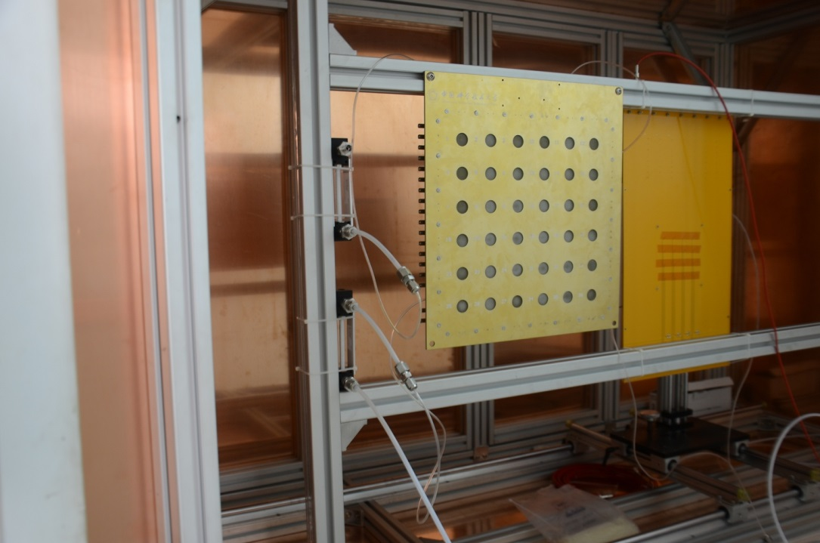
Air-tightness test
No bubbles in both tubes
→Air-tightness is good
Also gas in
Gas in

Slide 6
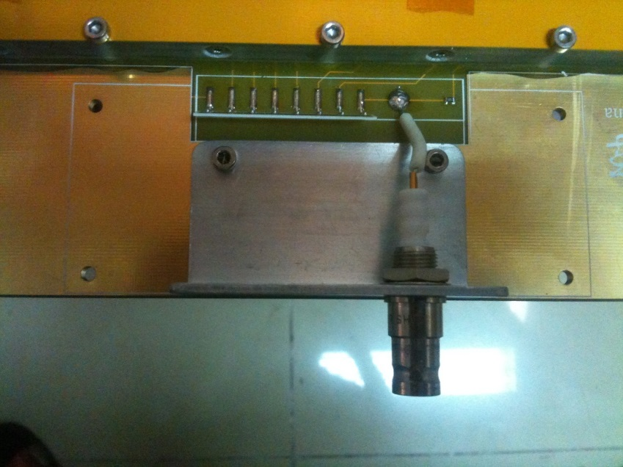
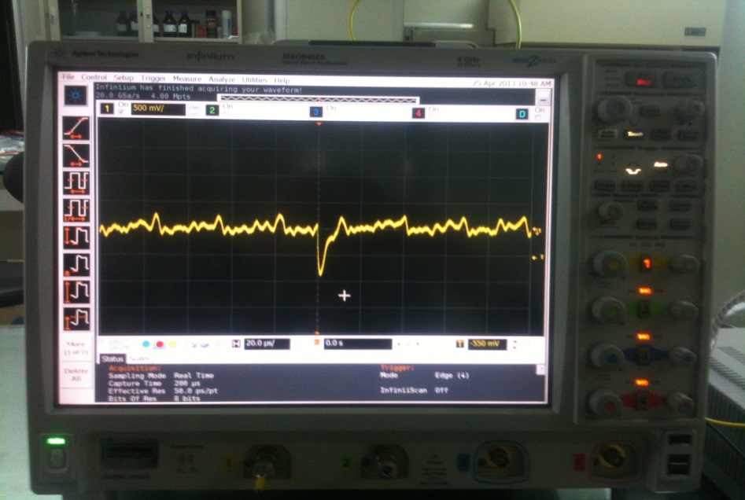
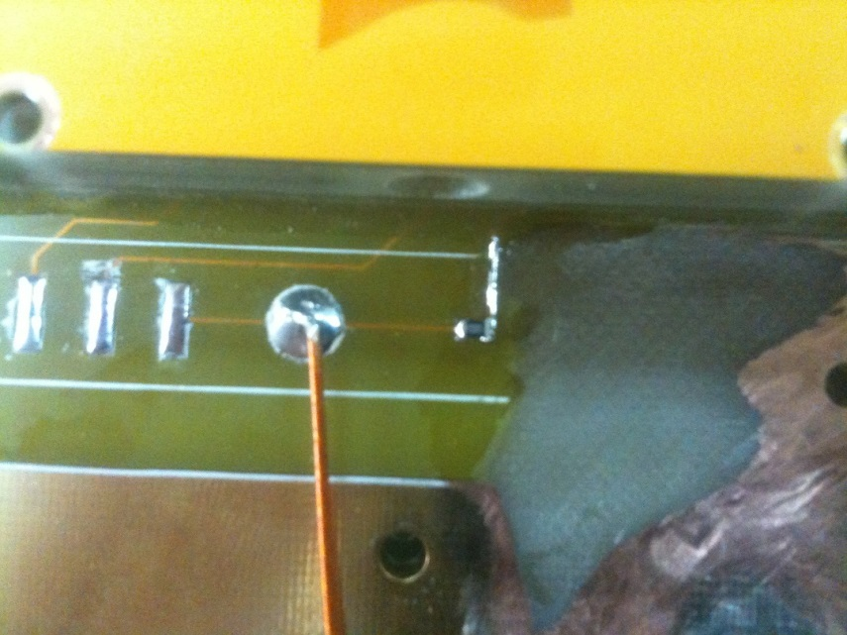
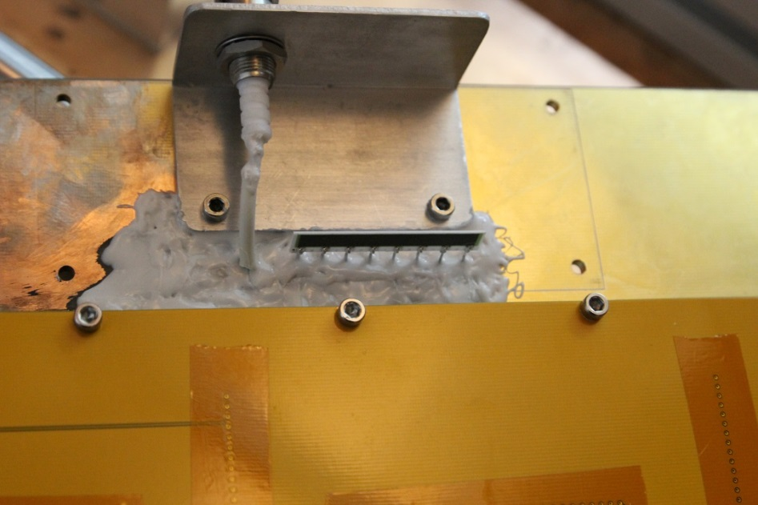
HV discharge problem & solution
Etching it out and then
Seal the divider with glue

Slide 7
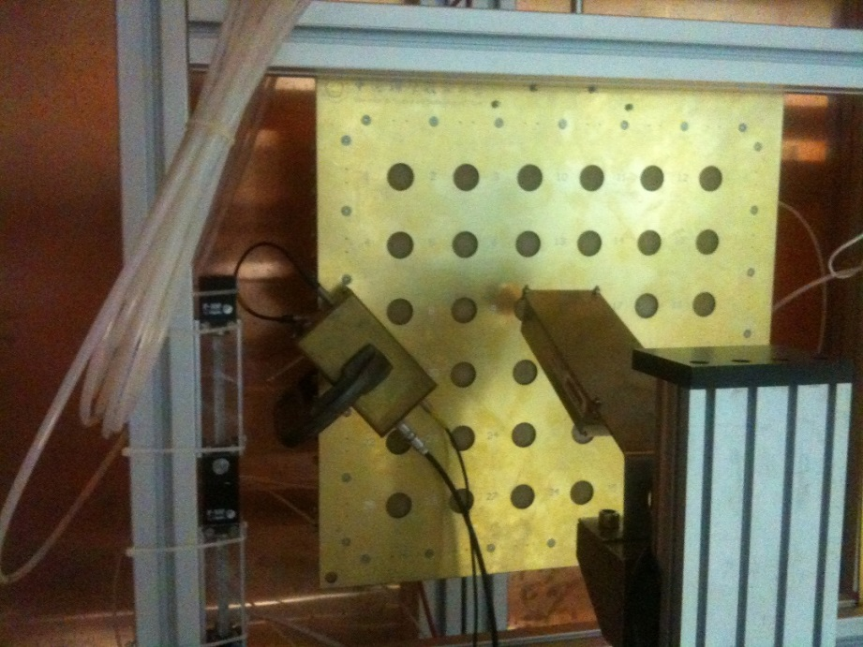
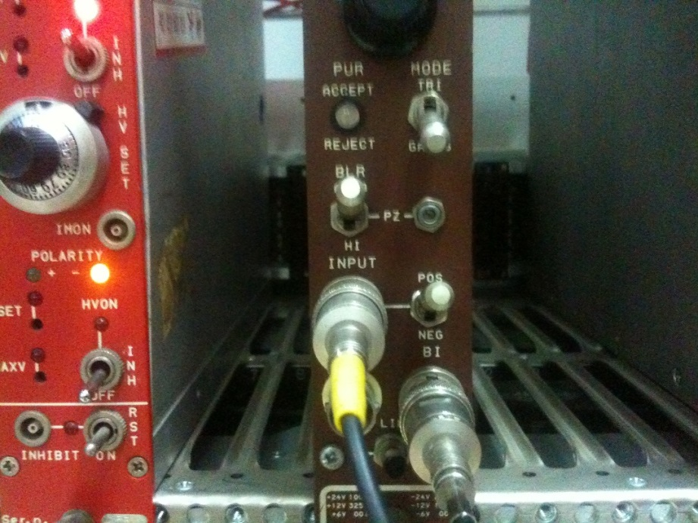
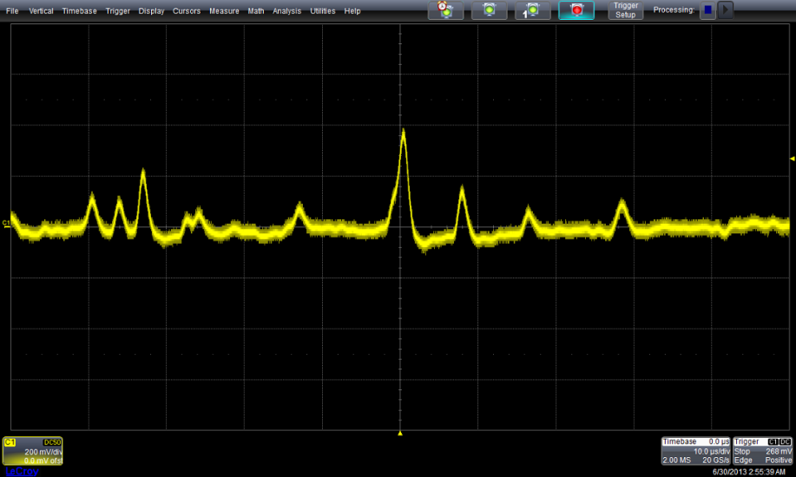
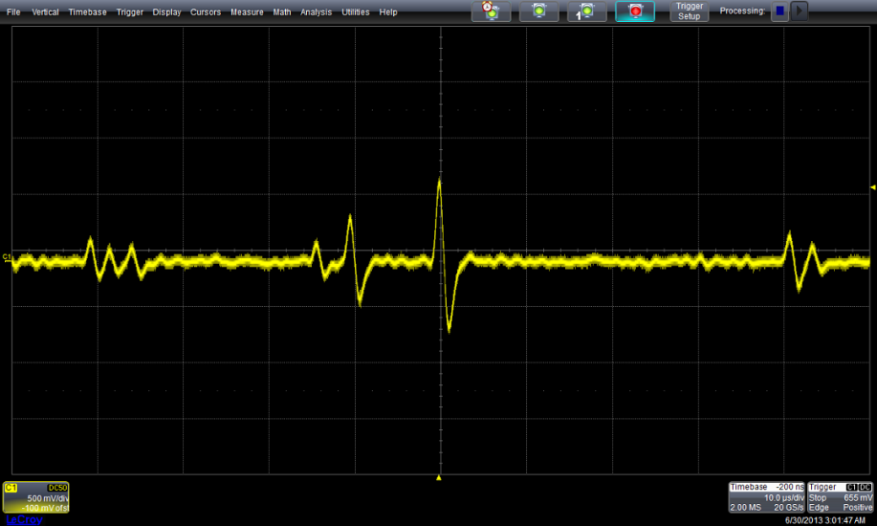
First signal for the 30cmx30cm Chamber

Slide 8
Energy resolution test(MCA, 8keV X-ray)
Energy resolution is defined as:
FWHM/Peak_location
8kev Peak
~25%
NOTE: First data taking without good calibration

Slide 9
Uniformity test by looking at energy resolution
Energy resolution for 8KeV X-ray
NOTE: First data taking without good calibration

Slide 10
To to list
A new set of 30cmX30cm foil is ordered from CERN
System calibration for the gain measurement
Set up a cleaning system for GEM foil
See next page

Slide 11
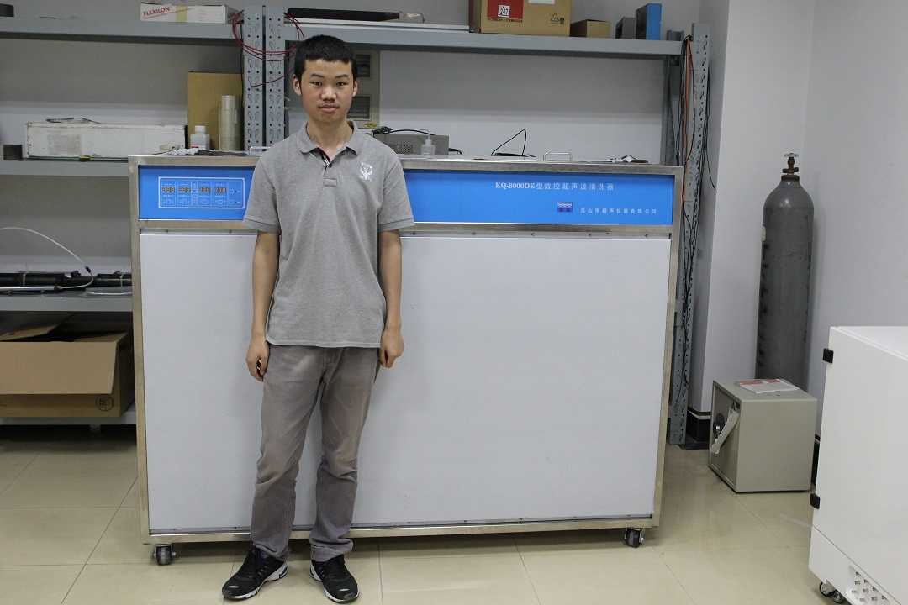
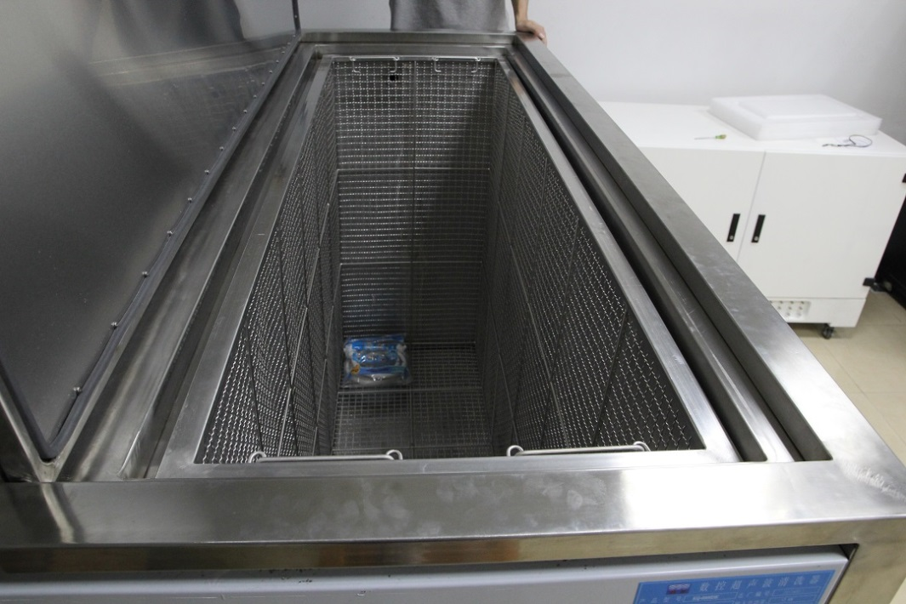
Ultrasonic bath for detector clean

Slide 12
Updates from Xiaomei Li

Slide 13
GEM foil R&D
Doing lamination and exposure of dry film photoresist, copper etching to get the optimized working condition
Order a kapton etching machine, and will do the kapton etching in the next few months

Slide 14
Updates from Zhigang Xiao

Slide 15
Foil stretching(40cmX50cm) ---@lanzhou, IMP

Slide 16
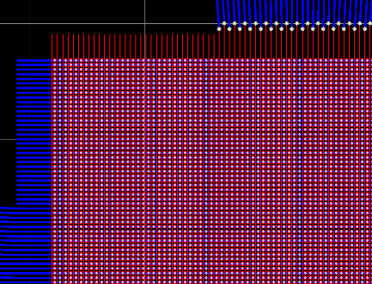
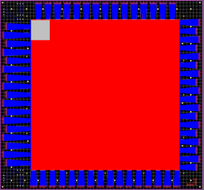
Readout board design
~300+200 um
Rate and multiplicity is lower in lab test
So we use strip readout

Slide 17
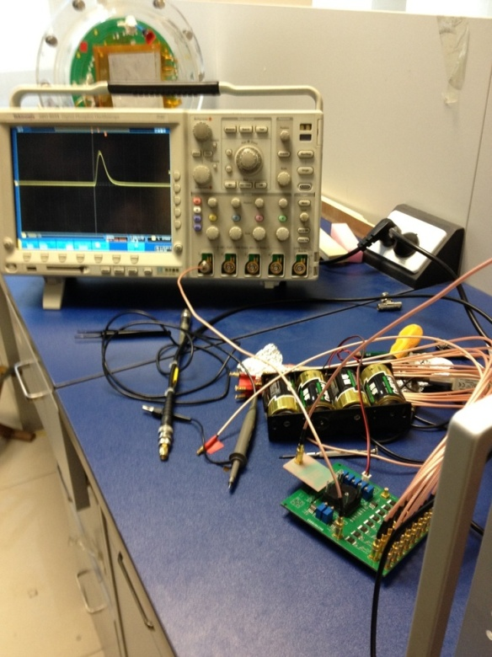
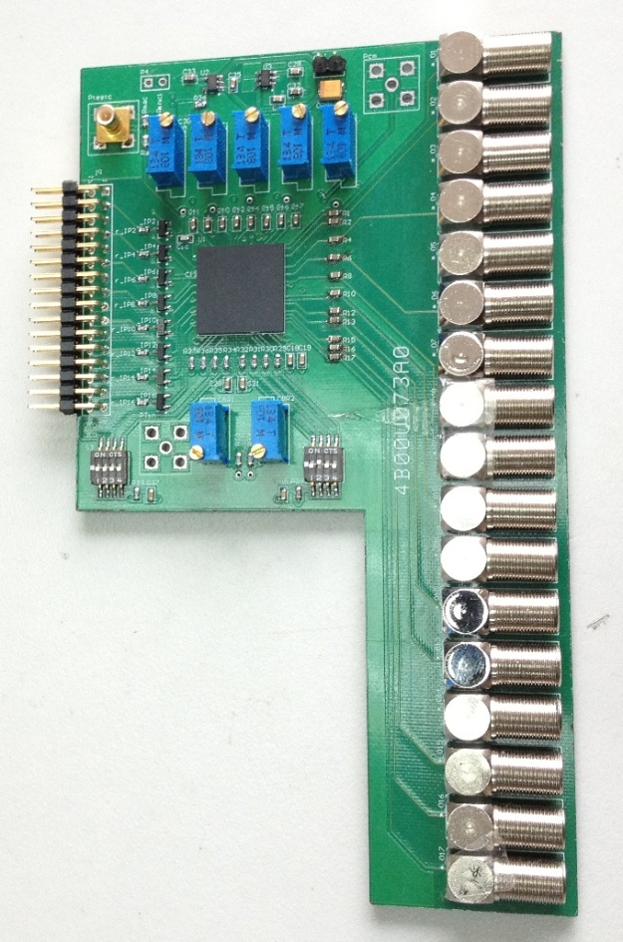
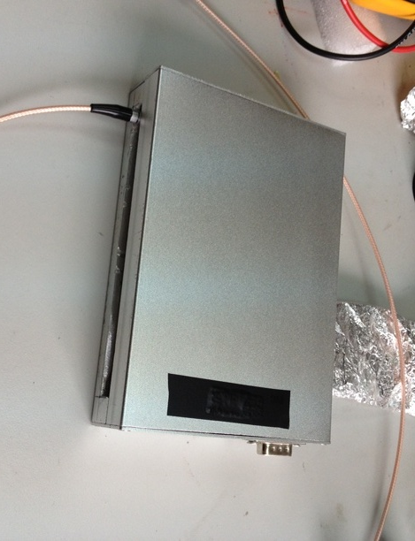
New electronics developed @Thinghua
CASAGEM
Charge Amplifier and Shaping Amplifier for GEM
Function: 16 channels for each, Amplification + Shaping
Developed by Prof. Zhi Deng from the Dept. Engin. Phys., THU

Slide 18
CASAGEM Parameters
Gain | 2~40mV/fC
Dynamic Range | 0~1000fC
Shaping time | 20~80ns
INL | <1%
Power | 10mW/ch (Anode channel), 11mW/ch (Cathode channel )
ENC | <2000e (Anode channel, Input Cap: 50pF), <3000e (Cathode channel, Input Cap: 100pF)

Slide 19
Near Future Work I
Ensure that the CASAGEM is working properly with GEM detector
Next: study inter foil distance effect
For large foil, the inter-foil distance is hard to be completely homogeneous, particularly when it is running with high current in B field
-HV
Cathode
GEM1
d1
d2
GEM2
Anode/Readout strip
Make d2>d1 to see the effect.

Slide 20
Near Future Work II
When the large GEM detector is ready:
To see first correct signals
What is the performance in cosmic ray test?
What is the performance in beam test?
What is the performance in a perpendicular B field?

