Slide 1
SoLID GEM update N. Liyanage
University of Virginia

Slide 2
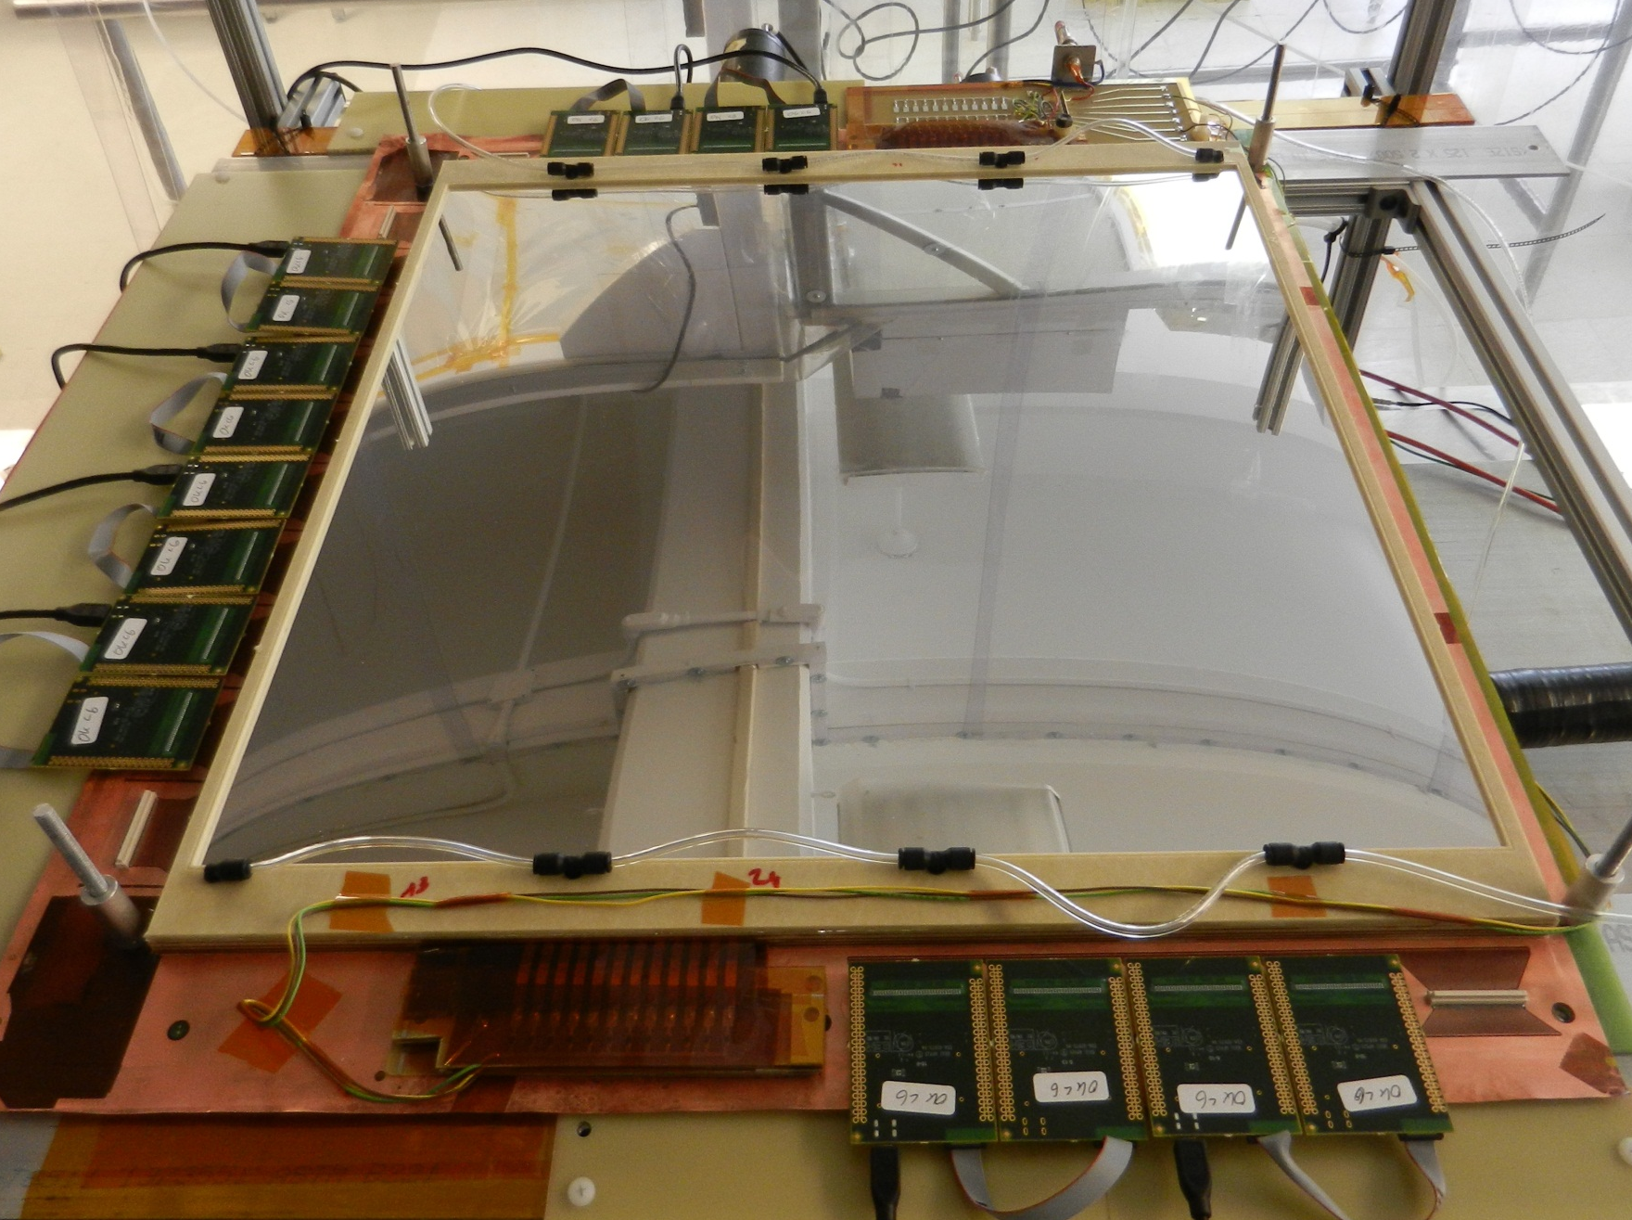
SBS Back Tracker 50 cm x 50 cm Prototype I: fully operational
APV25-SRS
FE cards
HV divider from CERN
Spark protection
resistors Board

Slide 3
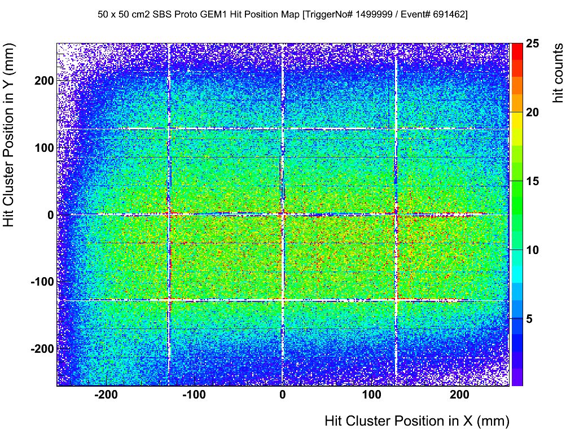
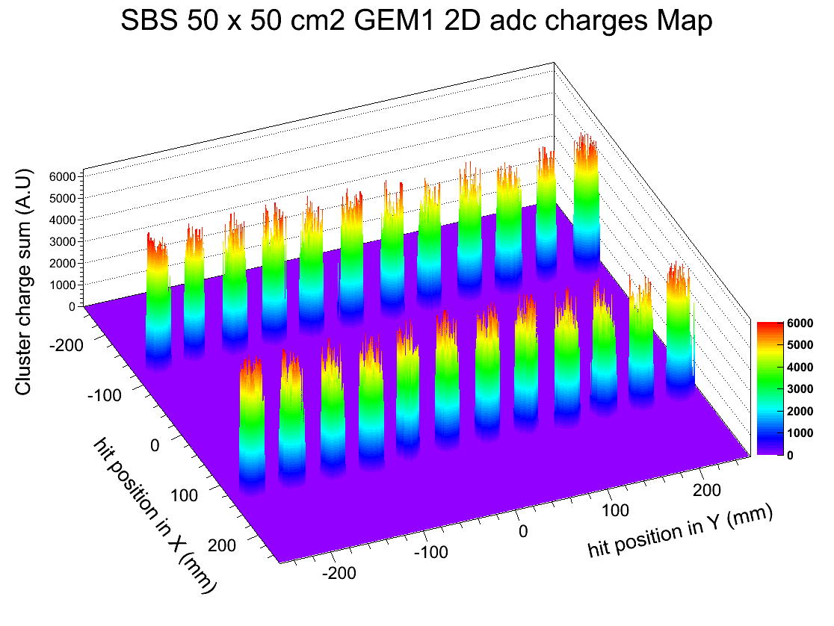
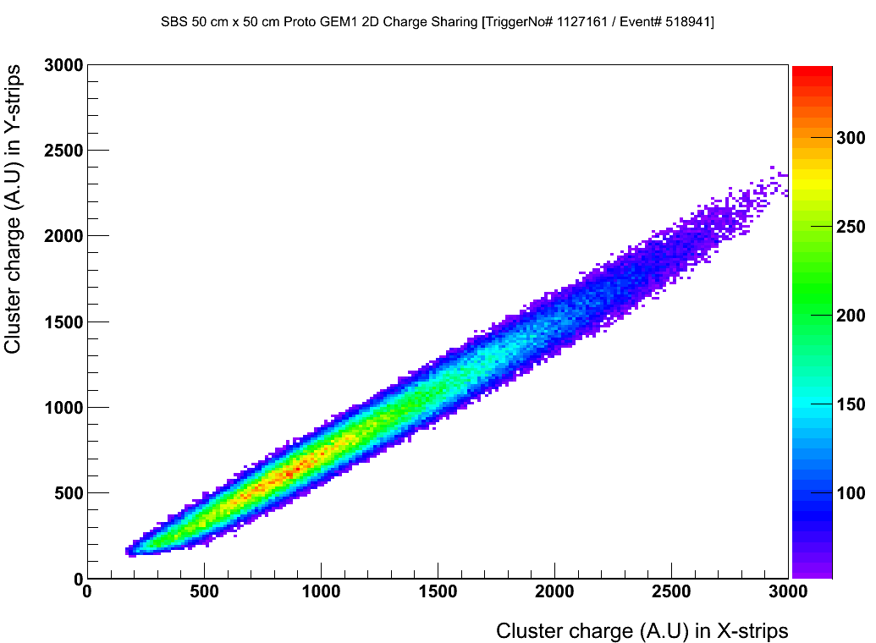
SBS GEM module full-size prototype
Ʃ (ADC counts) / N_{Hits}
Hit distribution (cosmics)
Gain Uniformity (with ⁹⁰Sr source)
X and Y hit amplitude correlation
97% detection efficiency
Prototype meets SBS design requirements
Starting production of 40 modules in September

Slide 4
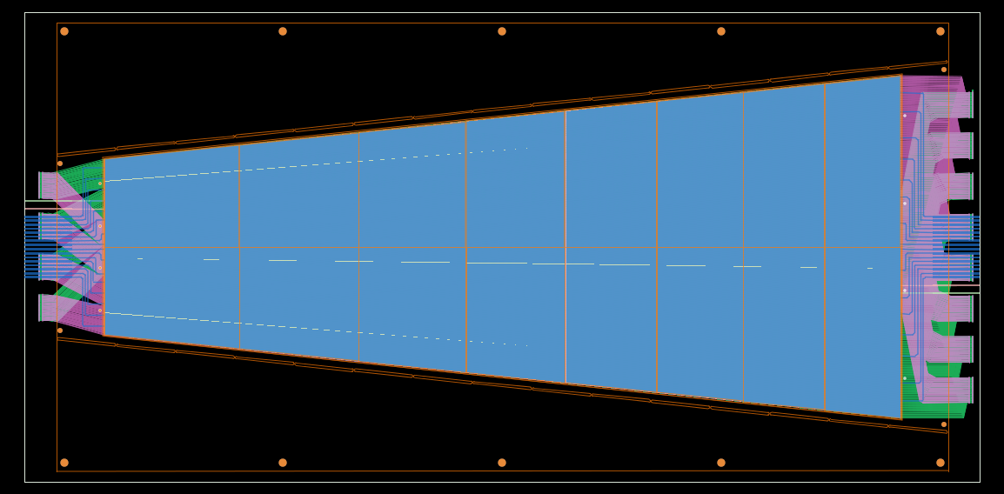
Large area GEM prototype for EIC and SoLID
We are building a large GEM prototype for EIC forward GEM tracker R&D
Size similar to largest SoLID GEMs.
All components are at Uva now
Start assembly on September 1.
Hope to complete assembly by Sept. 20, for the Fermilab beam test in October
6°
100 cm
22 cm
44 cm
120 cm
Several chambers of this size have been built under the CMS upgrade program, but they are 1D readout; our chamber will be 2D readout.
4

Slide 5
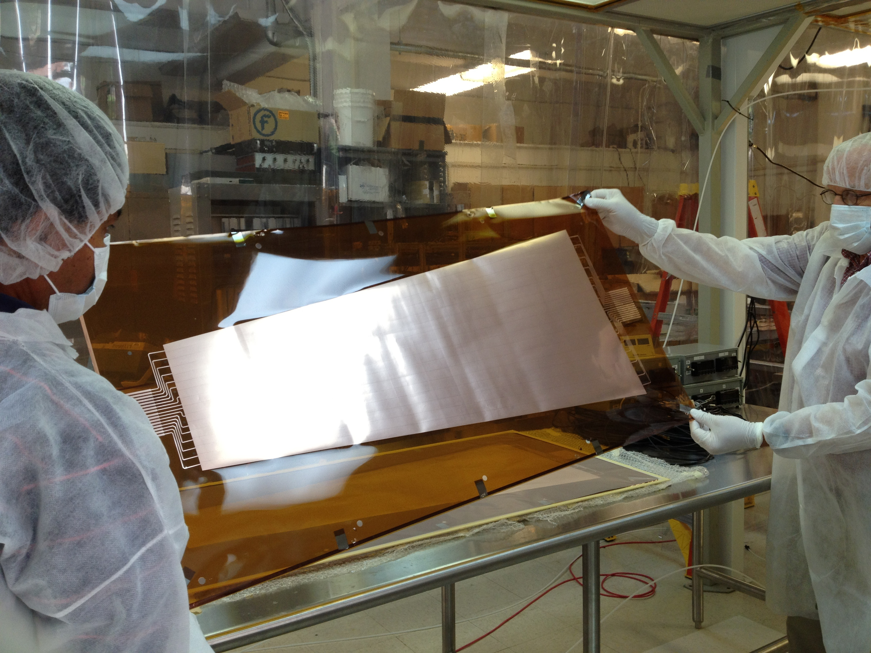
The GEM foil
The foil is divided into 32 HV sectors of roughly 100 cm² with
The V applied on the 16 sectors from the top and 16 from the bottom
The chamber from the point of view of HV is divided in two parts

Slide 6
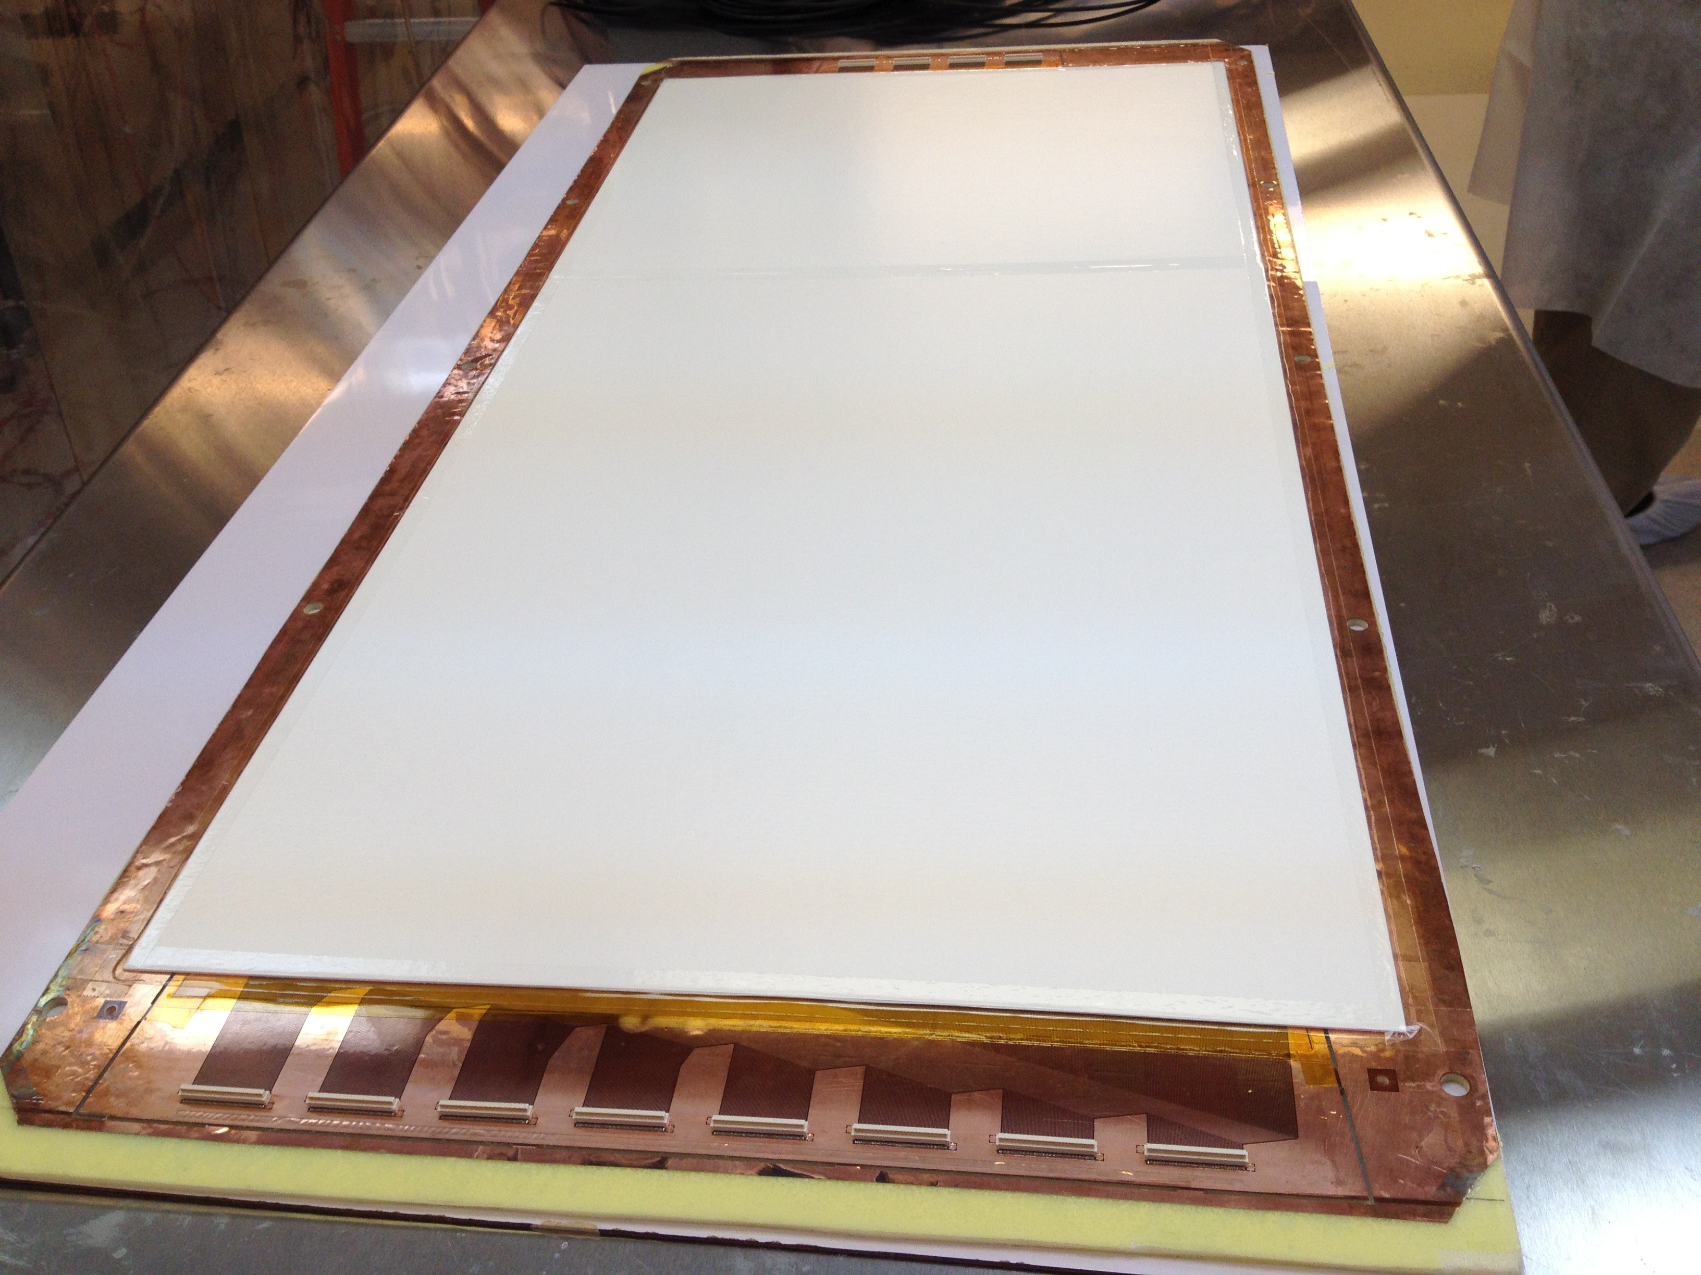
The U/V COMPASS-like readout board
COMPASS-like 2D stereo angle (12°) U/V readout
Pitch = 550 μm, top strips = 140 μm, bottom = 490 μm
The support for the r/o based on Rohacell foam instead of honeycomb sandwiched between 100 mm fiberglass
connectors on the top and bottom part of the r/o board

Slide 7
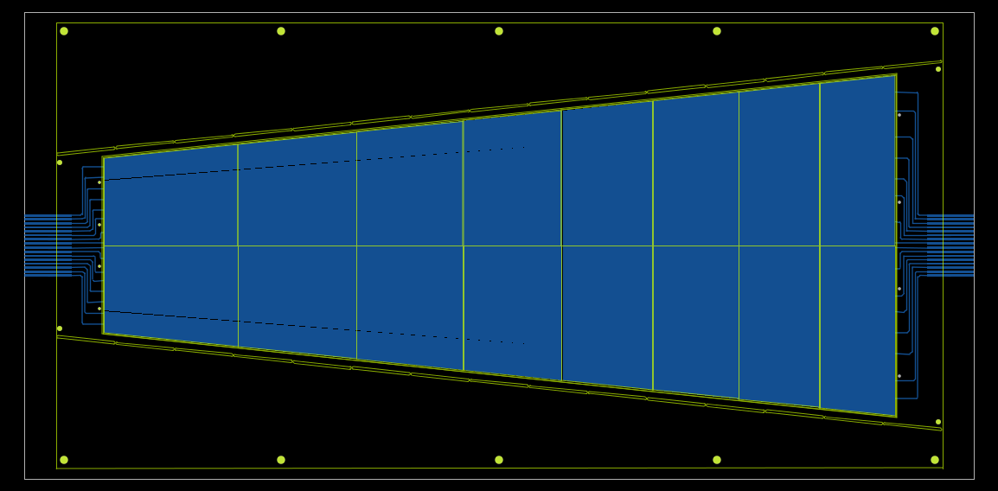
The Frames
Frames with the standard 300 μm spacers
Extra frame material for the alignment and to hold the tension on GEM foil during assembly ➔ cut out after
8 mm width on the side and 60 mm width on top and bottom
Positioning holes on top and bottom

Slide 8
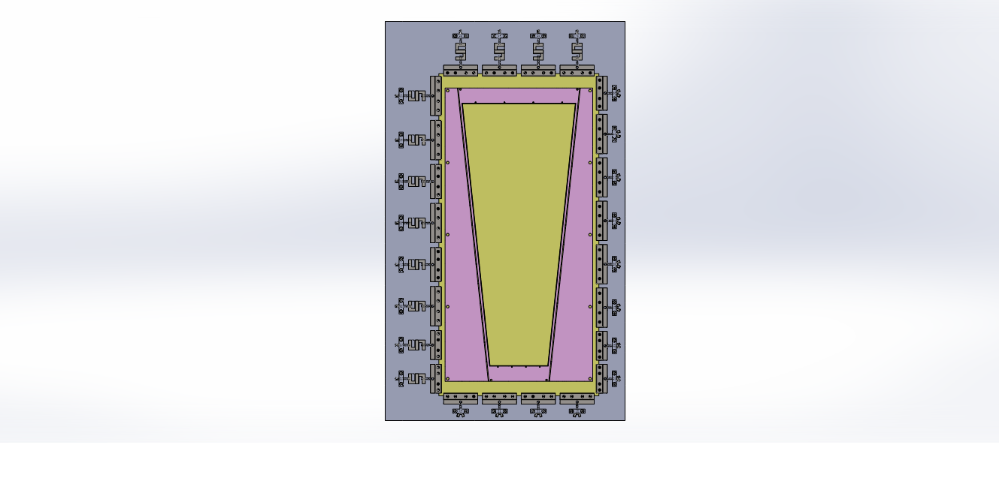
Stretcher under construction now; will be ready in 2 weeks.

Slide 9
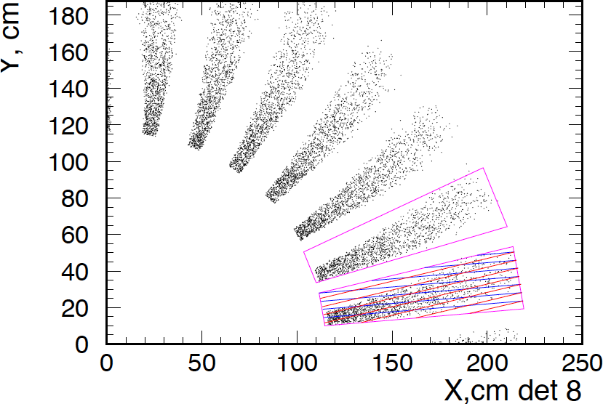
PVDIS GEM configuration
Current proposal to instrument locations 5, 6, 7, and 8 with GEM: might also need at one more location
30 GEM modules at each location: each module with a 12-degree angular width.
Plane | Z (cm) | R_{I} (cm) | R_{O} (cm) | Active area (m²)
5 | 150 | 55 | 115 | 2.7
6 | 190 | 65 | 140 | 4.0
7 | 290 | 105 | 200 | 7.6
8 | 310 | 115 | 215 | 8.6
total: |  |  |  | ~ 23
Outline of a GEM module
Largest GEM module size required: 100 cm x (20-38) cm

Slide 10
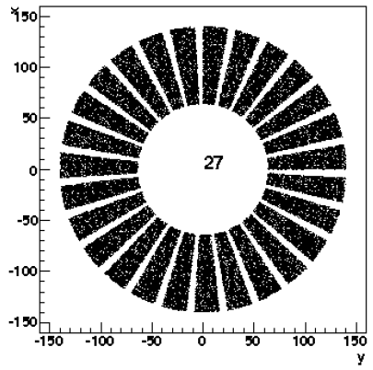
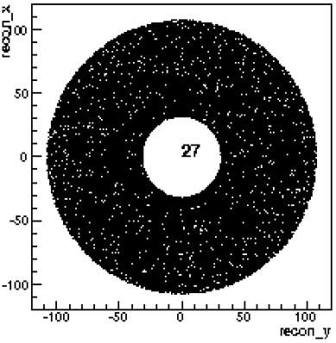
SIDIS GEM configuration
Six locations instrumented with GEM:
PVDIS GEM modules can be re-arranged to make all chamber layers for SIDIS. – move the PVDIS modules closer to the axis so that they are next to each other
More than enough electronic channels from PVDIS setup.
The two configurations will work well with no need for new GEM or electronics fabrication.
Plane | Z (cm) | R_{I} (cm) | R_{O} (cm) | Activearea | # of channels
1 | 197 | 46 | 76 | 1.1 | 24 k
2 | 250 | 28 | 93 | 2.5 | 30 k
3 | 290 | 31 | 107 | 3.3 | 33 k
4 | 352 | 39 | 135 | 5.2 | 28 k
5 | 435 | 49 | 95 | 2.1 | 20 k
6 | 592 | 67 | 127 | 3.7 | 26 k
total: |  |  |  | ~18 | ~ 161 k
SIDIS
PVDIS

Slide 11
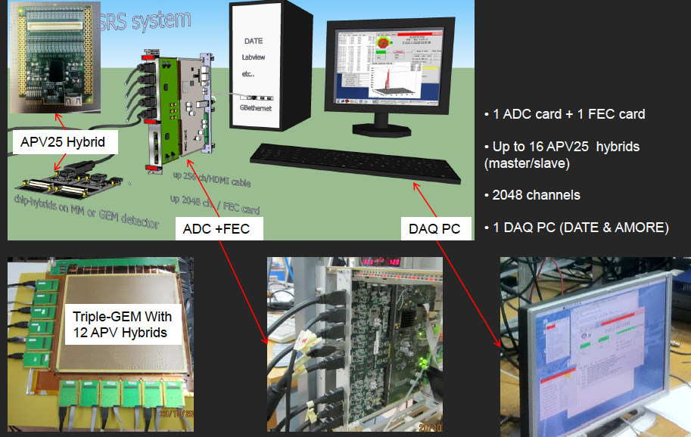
GEM chamber electronics
The RD-51 Scalable Readout System provides a low-cost, common platform that can accommodate different readout chips.
Currently tested with APV25-S1 chip
Drawback with the APV25 chip: may not be fast enough for SoLID
Need to work on finding a suitable chip for SoLID readout and incorporating it into SRS
The UVa group has a 10,000 chan SRS system and a 3000 chan. INFN APV readout system.
SRS system has the benefit of the large team effort backed by RD-51
RD-51 plans to commercialize the fabrication; there will be the possibility to get very large systems in the future.
The cost is ~< $ 3/chan

Slide 12
SoLID GEM: Issues
Large amount of GEM foils needed (~ 100 m²): CERN shop might not be able to handle: especially if CMS high-eta GEM tracker proposal is approved.
Need the large area GEM fabrication in China: however this could be a very demanding R&D process
Bernd Surrow has a lot of experience in setting up GEM foil production.
Bernd is now working within the EIC detector R&D effort to get TechEtch to manufacture large GEM foils: we are also subscribing to this effort.
This could be used as a backup option: if the Chinese foils are not ready, purchase foils from TechEtch.
For the MIE we need to have a time-line of GEM foil production R&D and validation procedure.
Target date for single mask small foil production ??
Foil validation procedure/acceptance criteria.
Target date for single mask large foil production ??
Target date for GEM module construction using the manufactured foils.

Slide 13
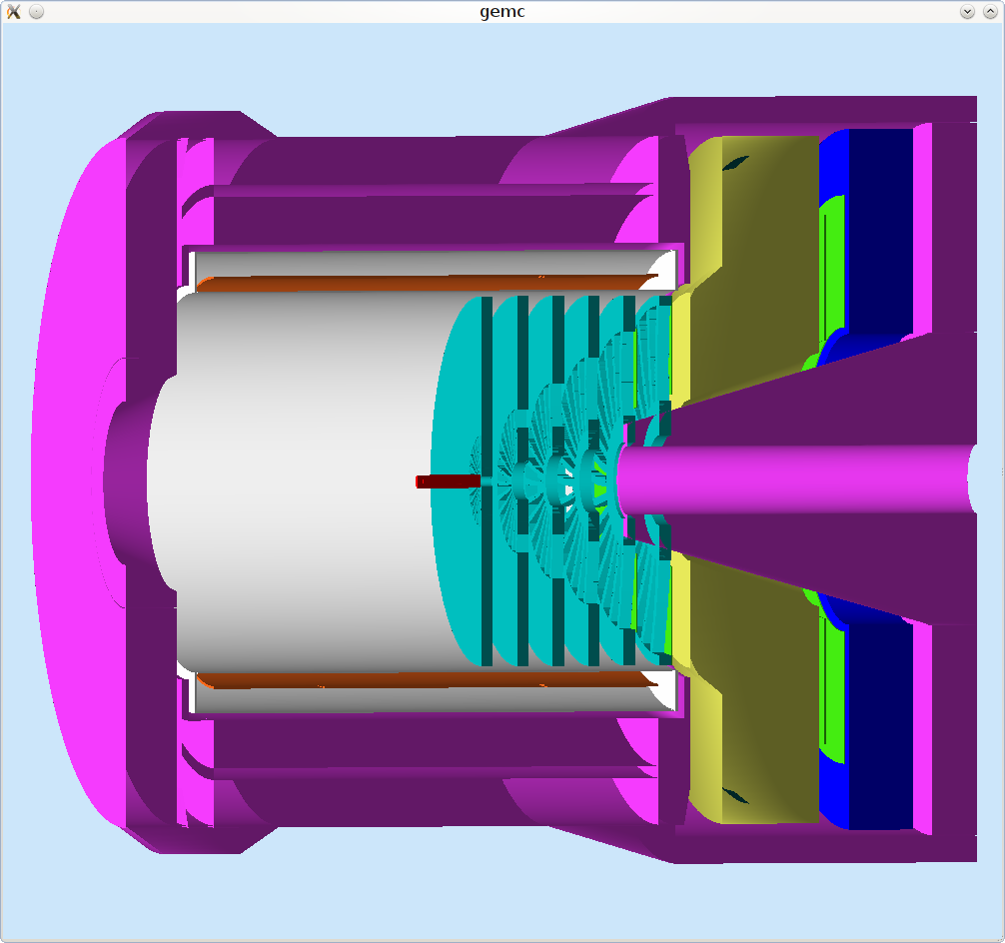
SoLID GEM: Issues – continued…
High strip occupancy resulting from high rates and long strips.
MC show that if a background hit within +/- 35 ns of a good hit on a strip, the good hit is lost: i.e; contributes to chamber inefficiency.
Estimates for SoLID conditions indicate strip occupancies of ~ 18%: leading to chamber efficiencies of ~ 80%.
A track requires hits in at least 3 chamber locations: so having only 4 chamber locations will give a tracking efficiency of ~ 82% or less.
Having at least one more location will increase the efficiency to ~ 95%
Need the simulation to answer following questions before we could freeze the GEM configuration:
What is the final strip occupancy ?
What are the optimized inner and outer radii at each location ?
Given the radial distributions of background versus good events, do we get some benefit from increasing the inner radii ?
Is there a benefit to adding a thin sheet of plastic somewhere upstream of a GEM ?
What is the best place to add the 5th GEM wheel ?

Slide 14
SoLID GEM: Issues – continued…
GEM construction techniques: No need to reinvent the wheel
Try to benefit from the work done by other groups.
We will be building/testing large GEM modules at UVa starting Sep. 2013. We would be very happy to host one of two of the Chinese collaborators during that period:
Need to stay for 2+ months to be useful.
The MIE will need to have a clear organizational chart of different GEM groups
Who is doing what ?
What are the goals and time lines for the different groups ?
Jianbei is organizing a GEM group meeting to be held last Wednesday of each month. This would be a good start.

Slide 15
SoLID GEM: Issues – continued…
Need to find a suitable readout chip, if APV25 is not fast enough.
Look for available chips / try to design our own ?
work with Dr. Hans Muller in the The RD-51-readout electronics working group to integrate a new chip to SRS/or develop our own readout ?

