Slide 1
SoLID PVDIS
Achievements, concerns,
and the way forward

Slide 2
Achievements
Started with the proposal
We now have a reasonable design for all of the detectors, etc. This was a huge job.
Mechanical structure better defined.
We have a magnet.
Pre CDR report almost finished

Slide 3
Concerns
PVDIS will operate at unprecedented luminosity.
Backgrounds must be understood and eliminated as far as possible.
Present status: backgrounds are too large, but anticipated changes should fix the problem.

Slide 4
Recent developments
Previous: beam bremsstrahlung passing through “gaps” in the baffles are the major source of backgrounds.
Now: Mollers very important
Design must prevent Mollers from striking baffles
Mollers make photons in the target
Also: Hadrons make significant GEM background

Slide 5
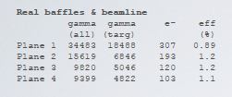
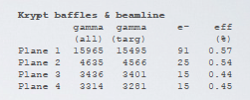
Gaps not biggest problem
Note: efficiency for gamma
conversion in GEM’s varies by
a factor of 3 due to differences
in the gamma energy.
All backgrounds
Line of sight only

Slide 6
Example: Hadron Event
GEM hits

Slide 7
GEM rates
Due to the large area of our readout strips, rates in the GEMS must be kept low.
High energy photons much worse.
Do hadrons contribute to the GEM rates?
We have a lot to finish before we demonstrate acceptable GEM performance.
Factors of 2 are important.

Slide 8
Particle ID at high rates
Serious problem
Must exploit difference is phi dependence of signal and background by shielding part of Ecal
Need to understand pion backgrounds better.

Slide 9
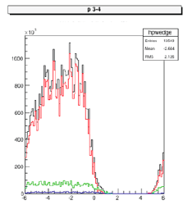
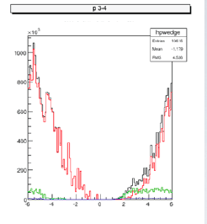
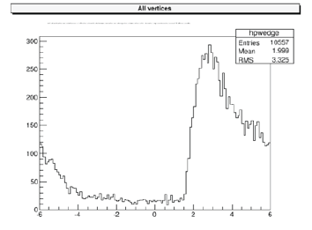
CLEO DIS
BaBar DIS
Shield
Left: DIS and gammas have
different phi.
Right: CLEO baffles lose good
events
ϒ’s

Slide 10
Baffle Improvements: one example
Backgrounds are relatively low because we only need events scattered by 20º.
Unfortunately, the inner part of the first baffle sees particles scattered at 5º from the front of the target.
By optimizing baffle parameters that we have kept fixed in the past, we can get better performance.

Slide 11
First Baffle Issues
Source of unnecessary background

Slide 12
Monte Carlo
At present, the Cerenkov and ECal are not part of the Monte Carlo.
We need a unified Mont Carlo to make progress on the backgrounds.
The unified Monte Carlo will make future document more coherent.
Seamus has a new framework that may assist in this process.

Slide 13
The Way Forward
We are planning to finalize our Pre-CDR report soon.
At the moment, our backgrounds are too high.
Different sections use different baffles (need unified Monte Carlo).
In the document, we should make clear where we are and what we need to do.

