Slide 1
SoLID Baffle and Background Update
Zhiwen Zhao
UVa
2013/08/19

Slide 2
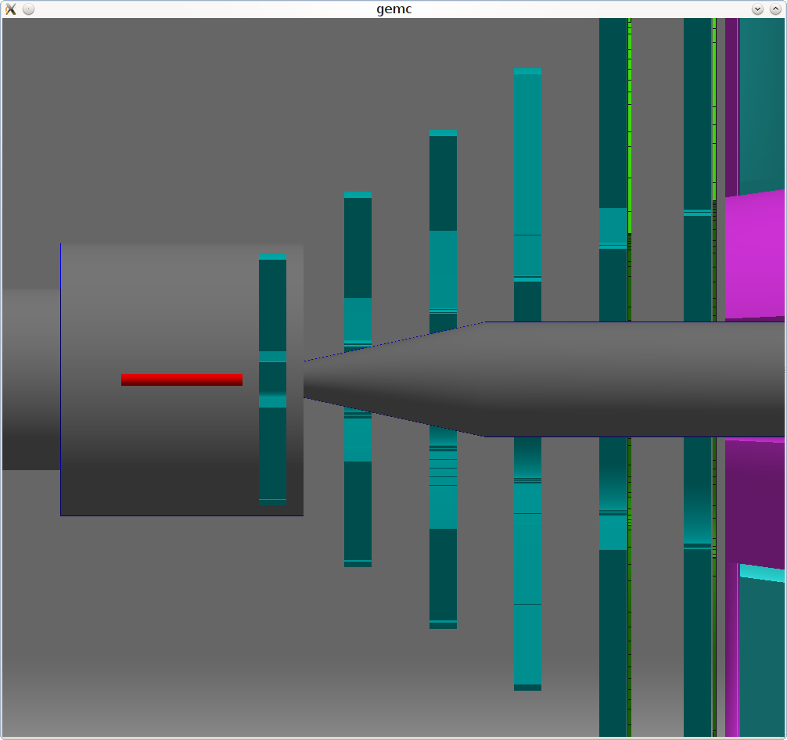
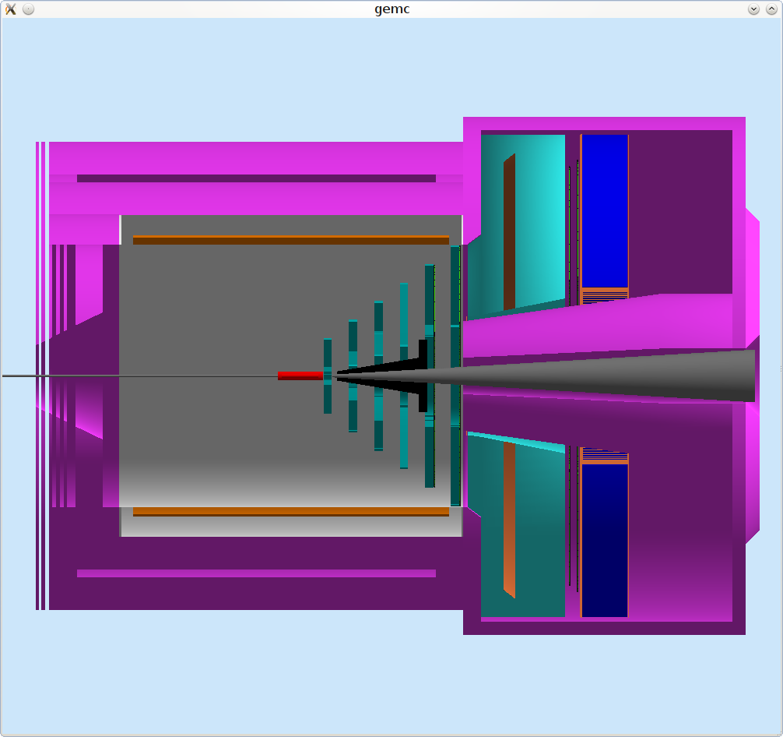
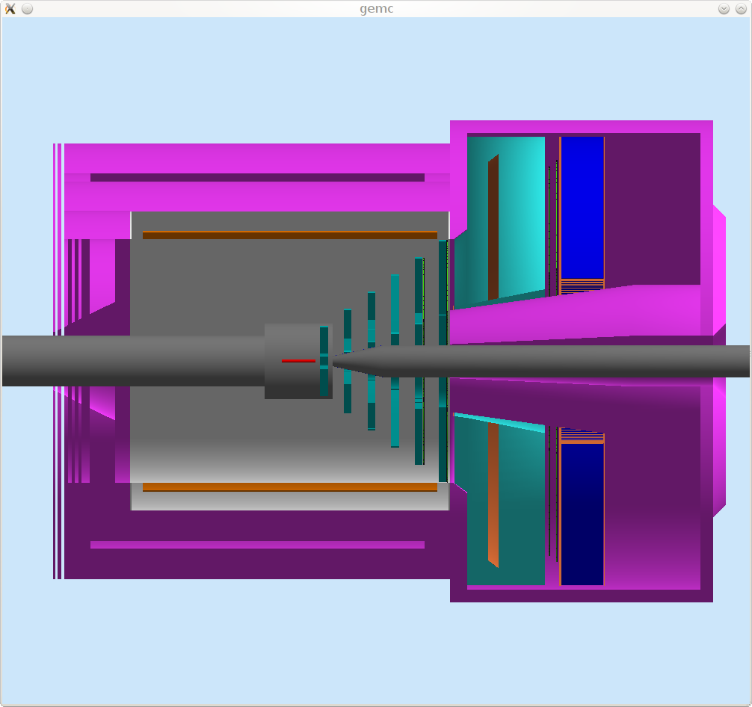
Beamline change
Wider opening
1st baffle plane in beamline
old
new

Slide 3
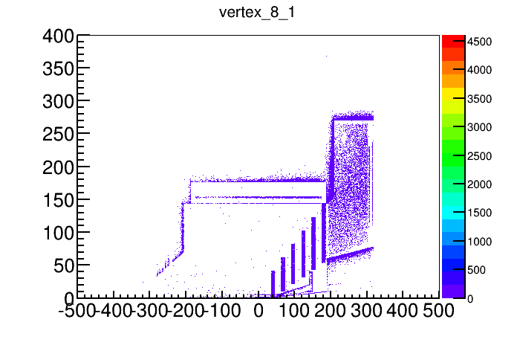
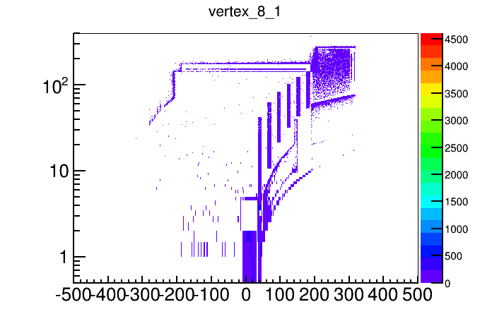
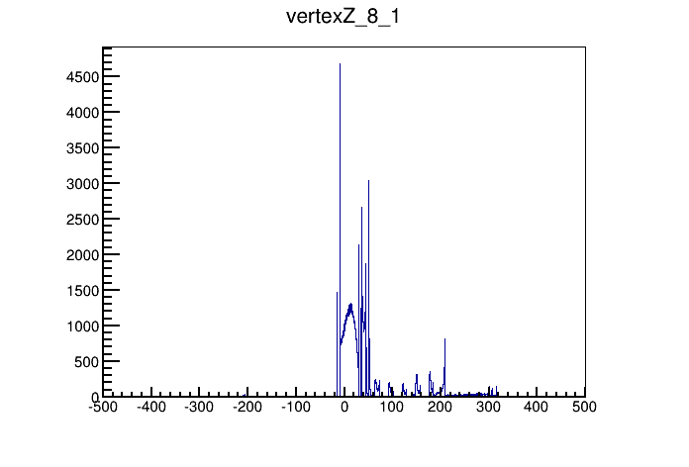
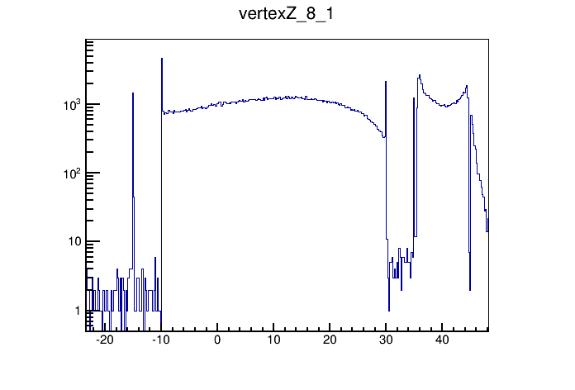
Old, 1st baffle plane 4cm inner radius, vertex of photon hits on EC

Slide 4
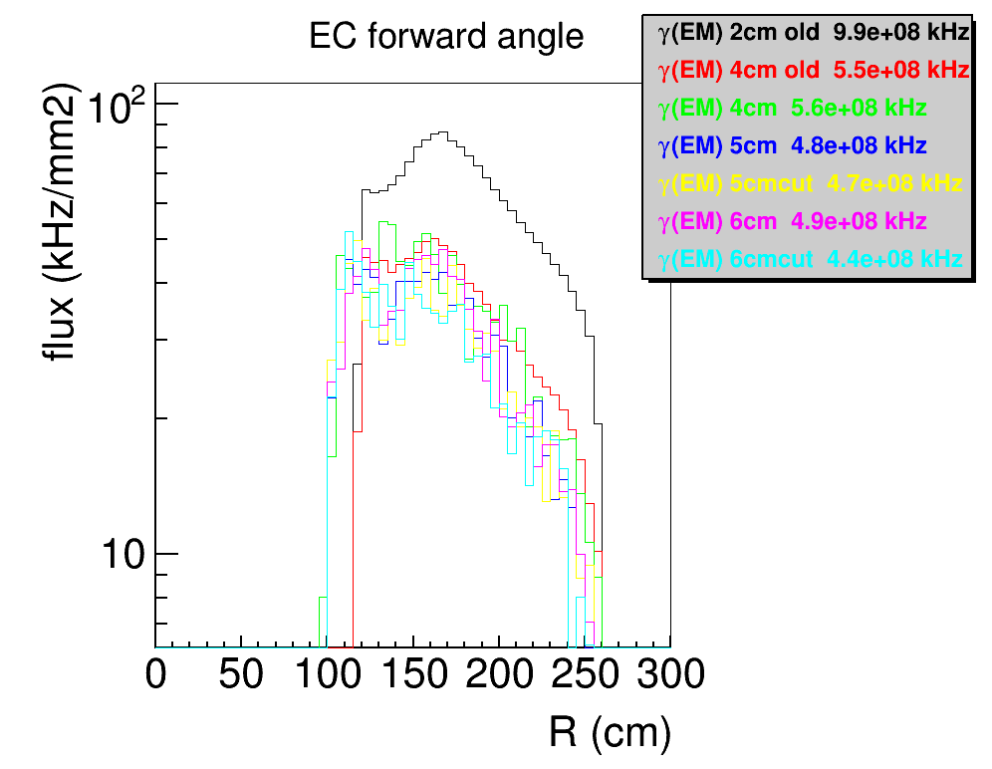
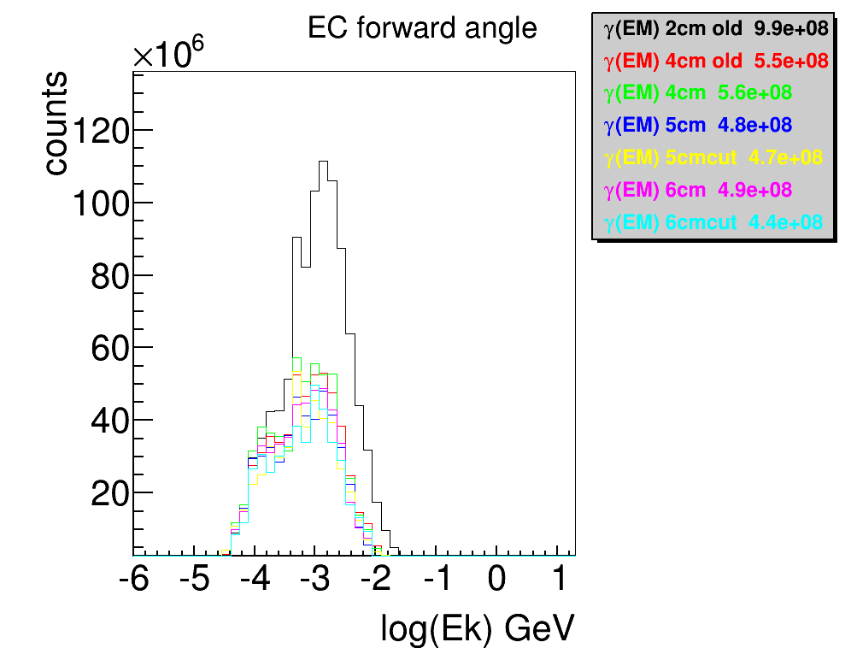
Photon background on EC

Slide 5
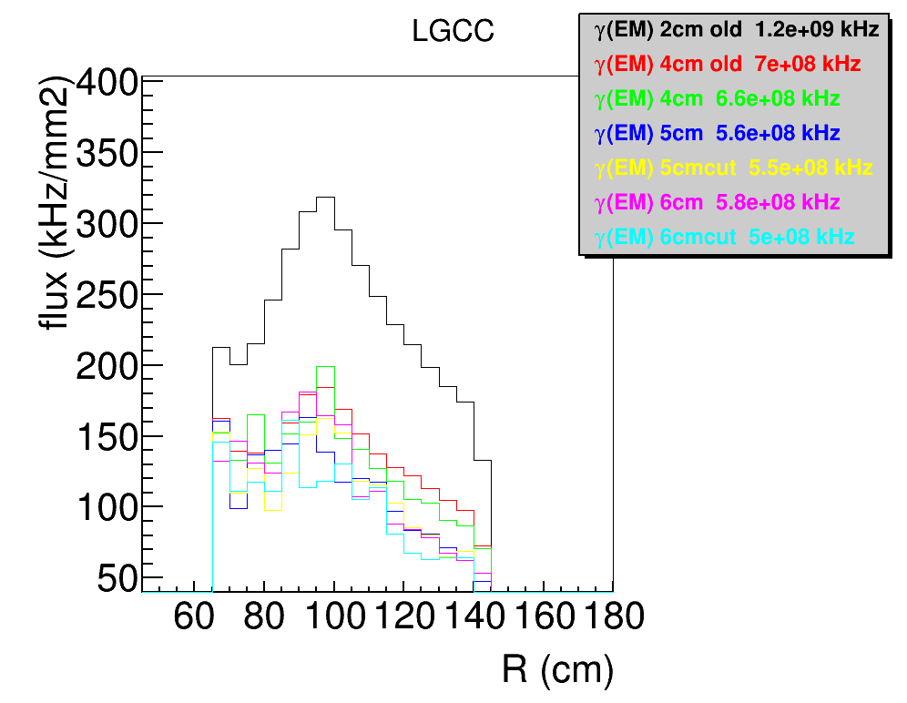
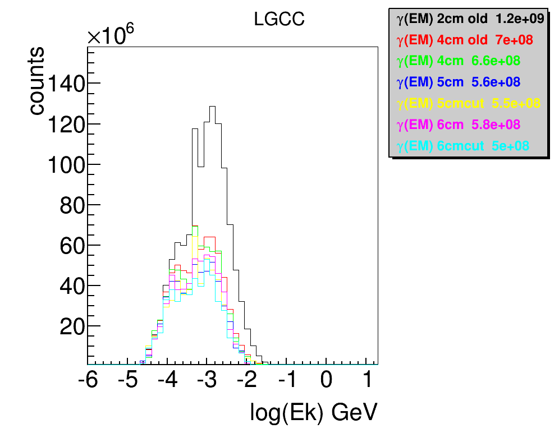
Photon background on CC entrance

Slide 6
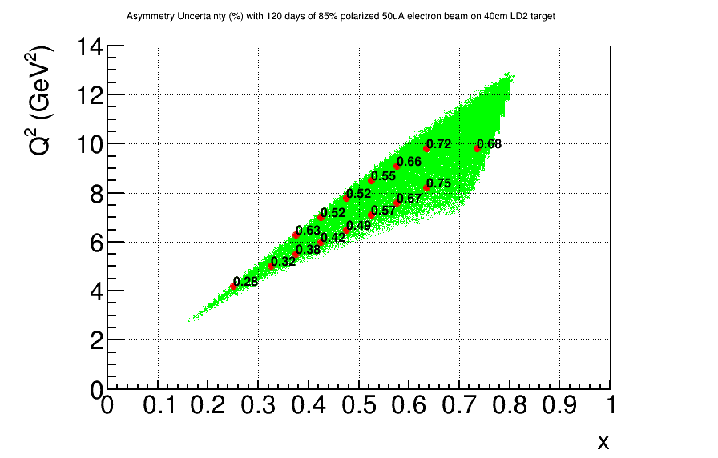
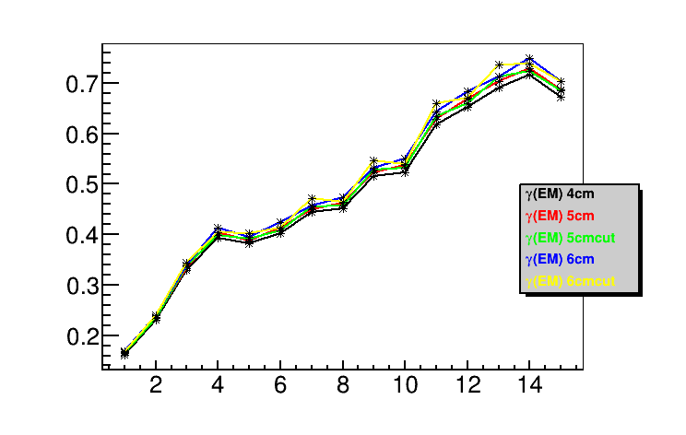
Apv Error
50uA 85% polarized 11GeV beam on 40cm LD2 for 120 days

Slide 7
backup

Slide 8
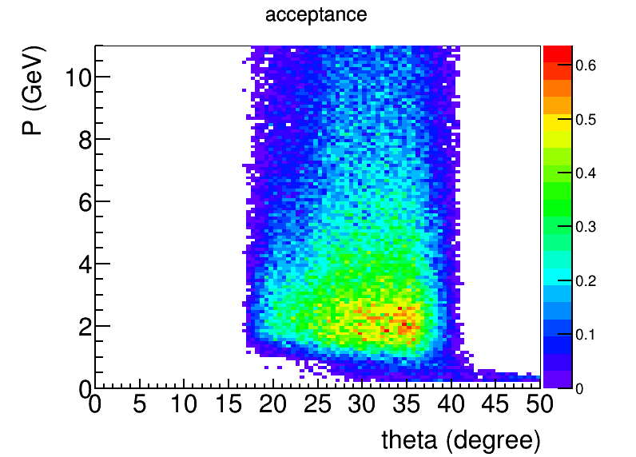
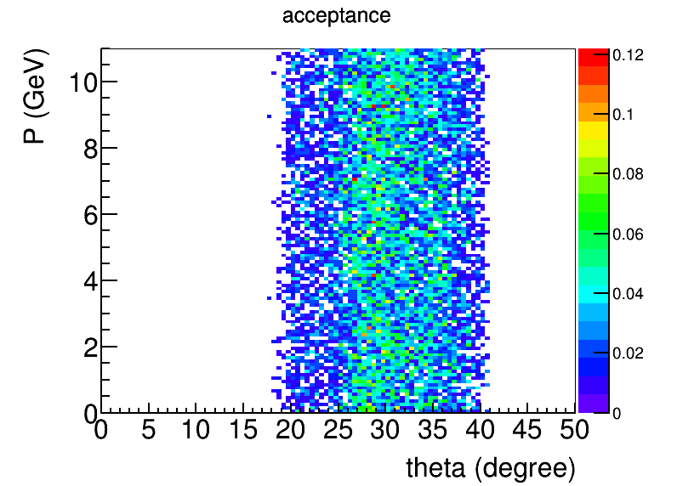
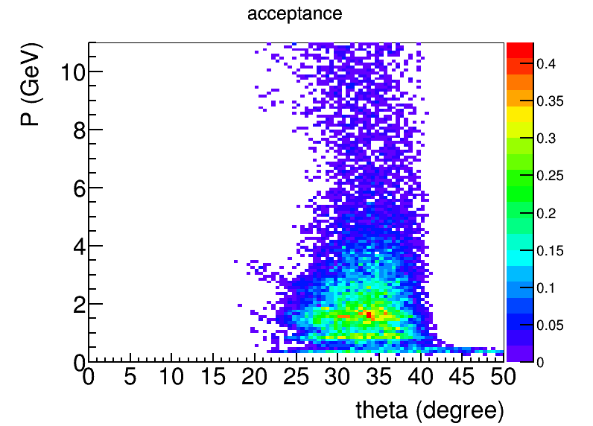
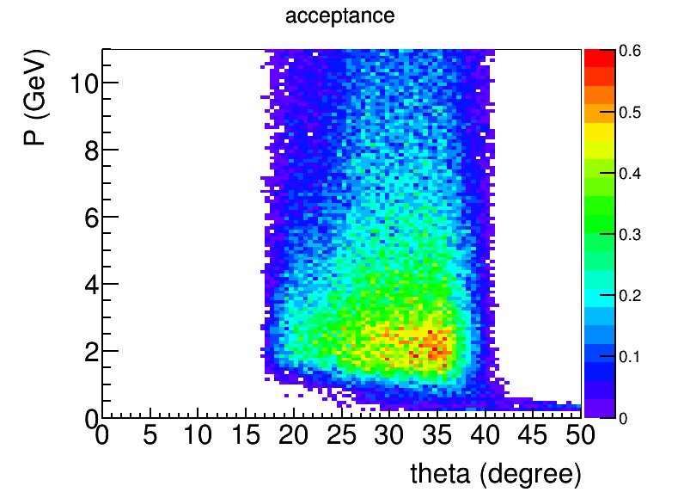
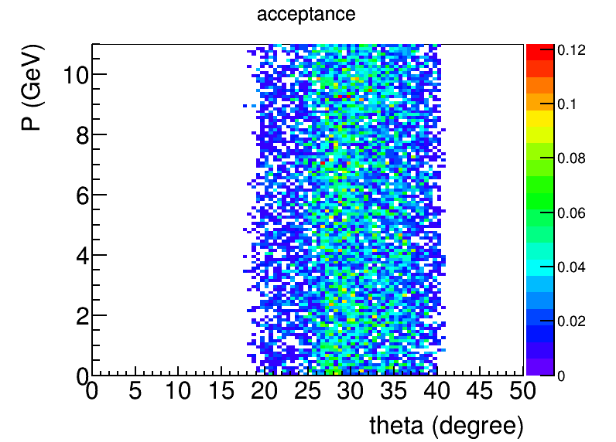
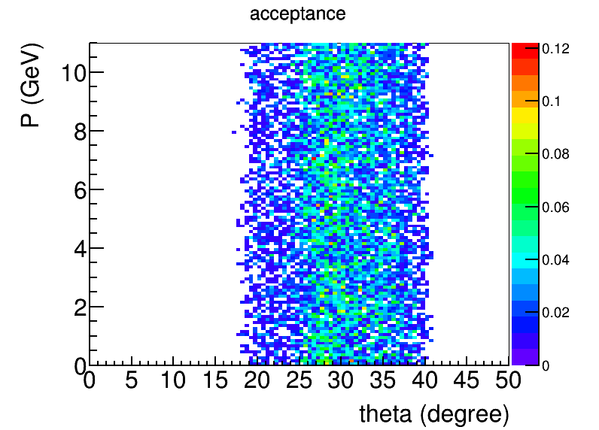
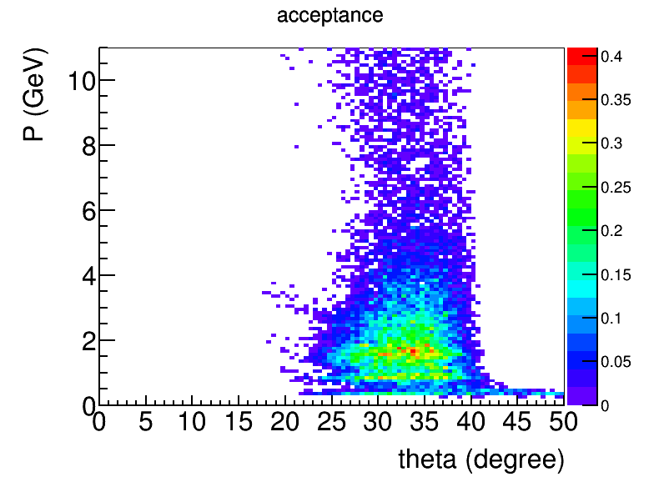
4cm
5cm
6cm
new

Slide 9
0.161644,0.231055,0.329848,0.393631,0.381304,0.402923,0.444411,0.451902,0.515566,0.522944,0.618568,0.652265,0.690853,0.71636,0.671794,
0.164413,0.235338,0.333069,0.404199,0.387706,0.412338,0.448797,0.462425,0.522628,0.536542,0.628935,0.668761,0.703644,0.729922,0.686632,
0.163825,0.234228,0.336066,0.398247,0.391227,0.406999,0.455733,0.45735,0.528566,0.531069,0.634894,0.660711,0.712002,0.724154,0.685685,
0.167824,0.240154,0.337932,0.413281,0.394852,0.423446,0.456356,0.474092,0.531722,0.550273,0.642587,0.684308,0.713186,0.749728,0.704103,
0.1664,0.238763,0.343673,0.403243,0.402984,0.412821,0.47212,0.464244,0.546446,0.538517,0.659431,0.67116,0.735684,0.738418,0.704104,

Slide 10
PVDIS challenge
High luminosity (1.27e³⁹/cm2/s for 50uA on 40cm LD2 target) causes high rate and high energy dose on detectors
Baffle shields low energy EM photons directly from target while low energy electrons are bent away by field
Most interesting physics at high Q2 and high x needs DIS electrons with highest energy which bend least and fly like photons, so comprise is needed
Positive pions contribute in background at trigger level and are better to be suppressed

Slide 11
Design Condition
SoLID latest CLEOv8 field map
30 sectors with each sector covering 12 deg
each plate is 9cm thick lead
Z (40, 68, 96, 124, 152, 180) cm
no overlap with current setup
Rin (4.00, 12.86, 23.61, 34.36, 45.10, 55.85)cm
Rout (39.60, 59.94, 80.28, 100.63, 120.97, 141.31)cm
Optimized for polar angle 21-36 deg acceptance of full 40cm long target with center at 10cm, except the first baffle inner radius needs to be at 4cm instead of 2cm to avoid more EM background

Slide 12
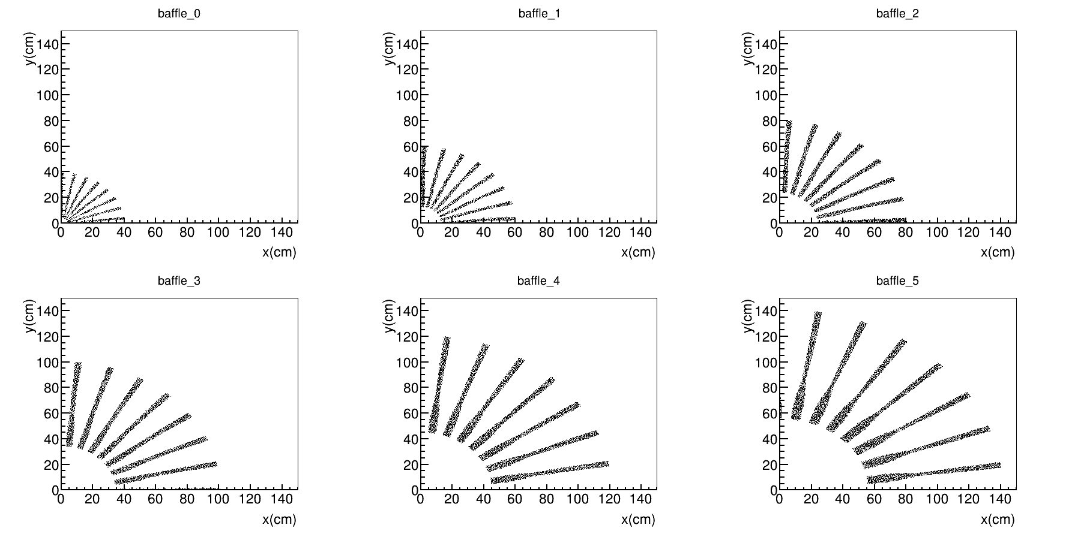
Current Baffle (Smaller Z baffle cut inner)
Continue with Seamus’s approach, but take all design conditions into account
refer to
https://hallaweb.jlab.org/wiki/index.php/Baffle_Design
https://hallaweb.jlab.org/wiki/index.php/Solid_design_FOM

Slide 13
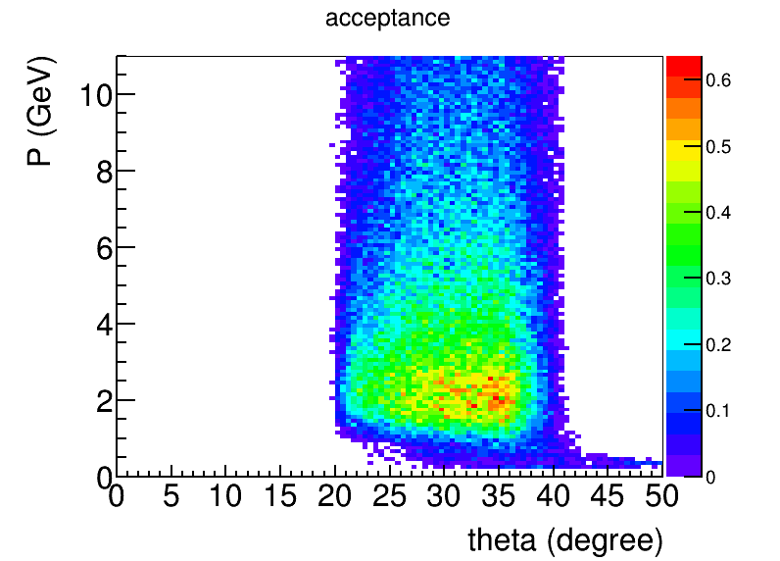
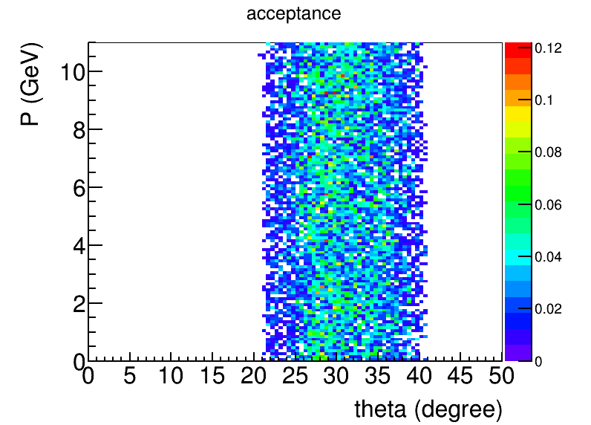
General acceptance
negative
neutral
positive
20%
5%
30%
20%
eDIS acceptance
40%
50%

Slide 14
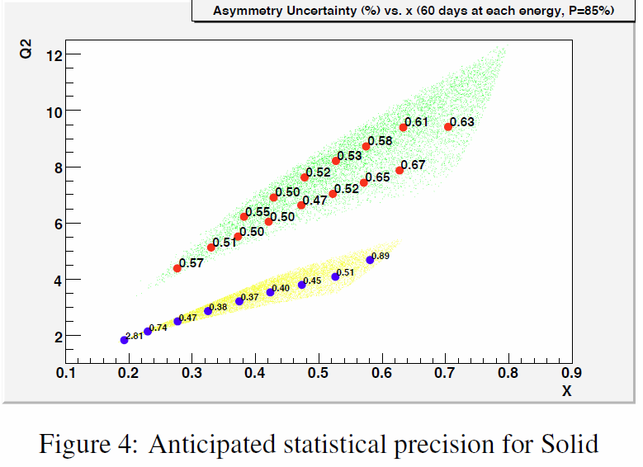
Apv Error
50uA 85% polarized 11GeV beam on 40cm LD2 for 120 days
Trigger at 2GeV
BaBar field and baffle, from proposal
CLEO field and baffle, from proposal

Slide 15
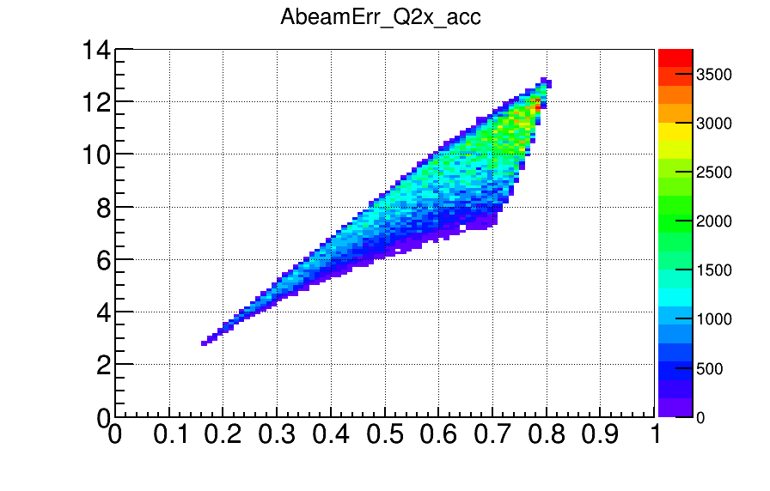
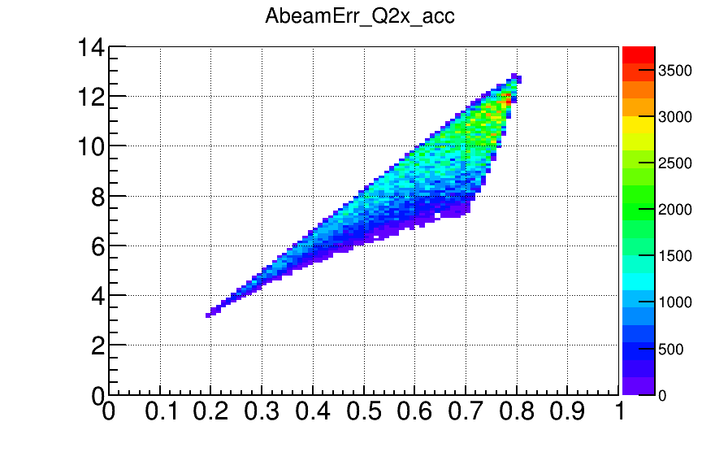
Trigger effect
ApvErr trigger (GeV)
0.17,0.24,0.36,0.38,0.42,0.39,0.48,0.44,0.56,0.51,0.66,0.64,0.75,0.70,0.67 0.0
0.20,0.26,0.36,0.40,0.42,0.40,0.48,0.44,0.56,0.51,0.66,0.64,0.75,0.70,0.67 1.5
0.27,0.31,0.37,0.62,0.45,0.51,0.48,0.51,0.56,0.54,0.66,0.65,0.75,0.70,0.67 2.0
0.38,0.37,0.39,0.96,0.42,0.74,0.48,0.65,0.56,0.65,0.66,0.75,0.75,0.74,0.67 2.3
0.53,0.43,0.43,1.46,0.44,1.03,0.48,0.86,0.56,0.80,0.66,0.89,0.75,0.83,0.69 2.5
2.13,0.84,0.63,0.00,0.56,9.22,0.56,2.83,0.60,2.14,0.68,1.97,0.75,1.40,0.81 3.0
ApvErr at large Q2 and large x starts to increase if trigger > 2GeV
trigger 2.0
trigger 2.3

Slide 16
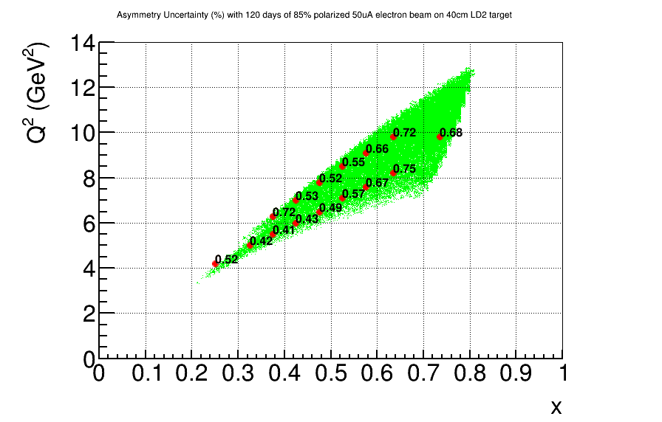
Trigger effect
ApvErr trigger (GeV)
0.28,0.32,0.38,0.63,0.42,0.52,0.49,0.52,0.57,0.55,0.67,0.66,0.75,0.72,0.68 p<2.0, r(110cm – 270cm)
1.90,0.58,0.44,0.72,0.43,0.53,0.49,0.52,0.57,0.55,0.67,0.66,0.75,0.72,0.68 p<3.0, r(110cm – 140cm)
p<2.5 ,r(140cm – 170cm)
p<2.0, r (170cm – 270cm)
0.52,0.42,0.41,0.72,0.43,0.53,0.49,0.52,0.57,0.55,0.67,0.66,0.75,0.72,0.68 p<2.5, r(110cm – 170cm)
p<2.0, r(170cm – 270cm)
This could an option for trigger
p<2.5, r(110cm – 170cm)
p<2.0, r(170cm – 270cm)
p<2.0, r(110cm – 270cm)

Slide 17
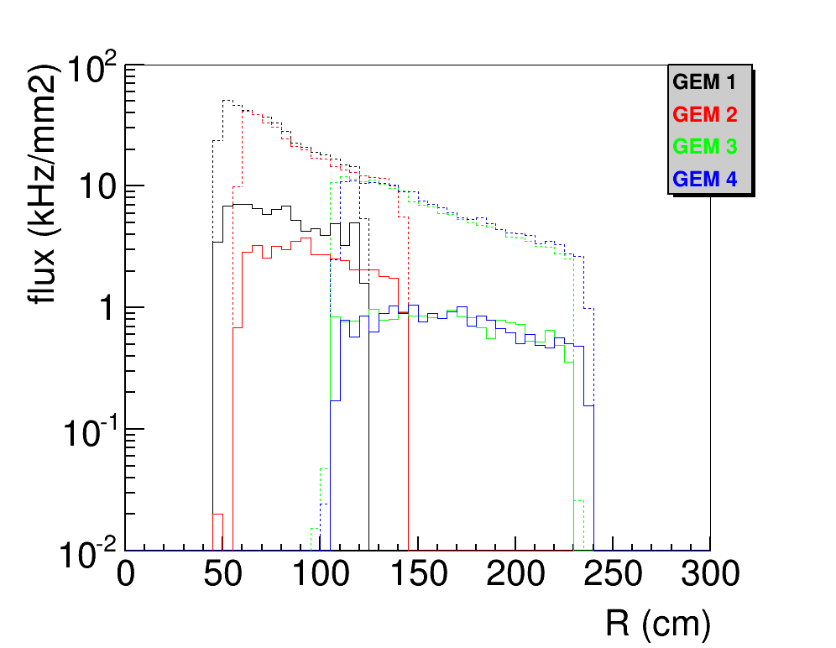
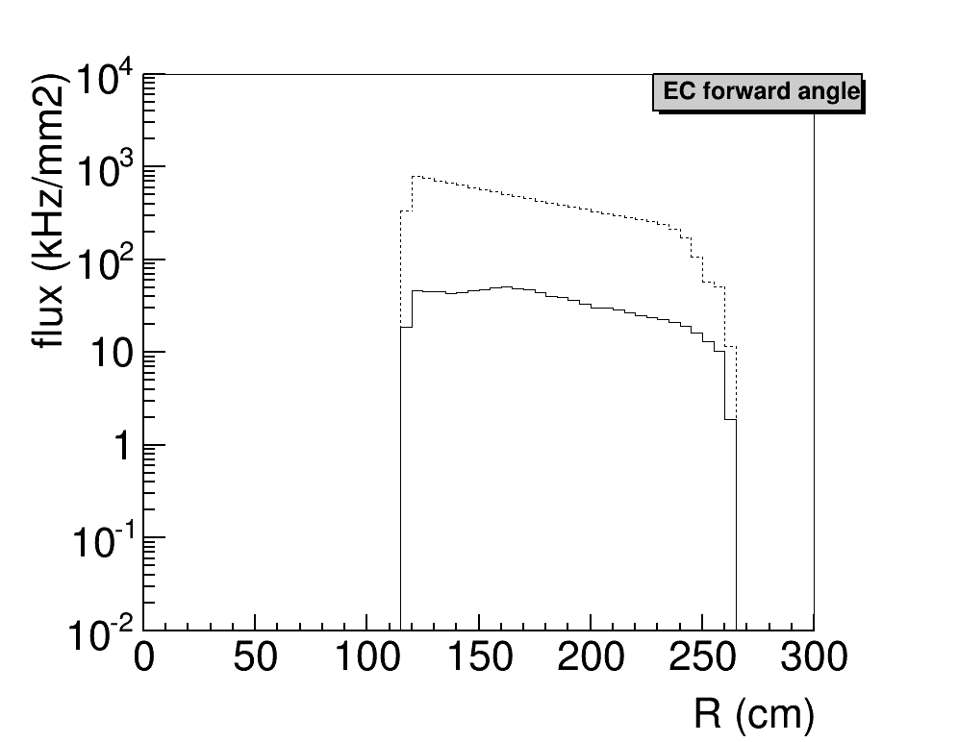
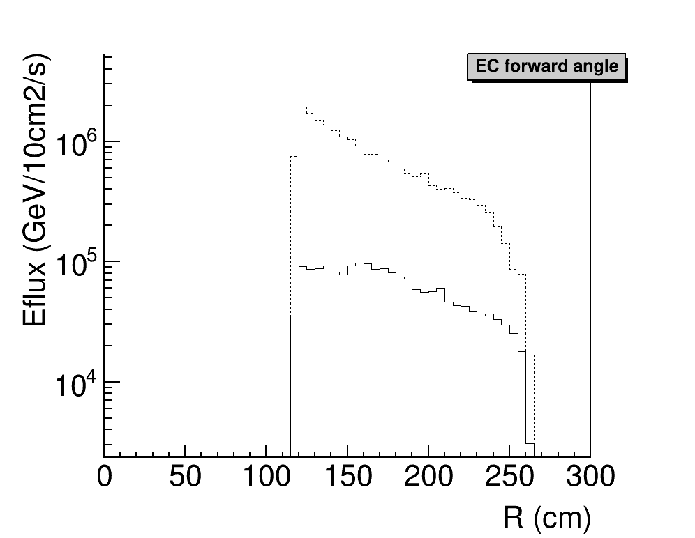
Background, baffle effect

Slide 18
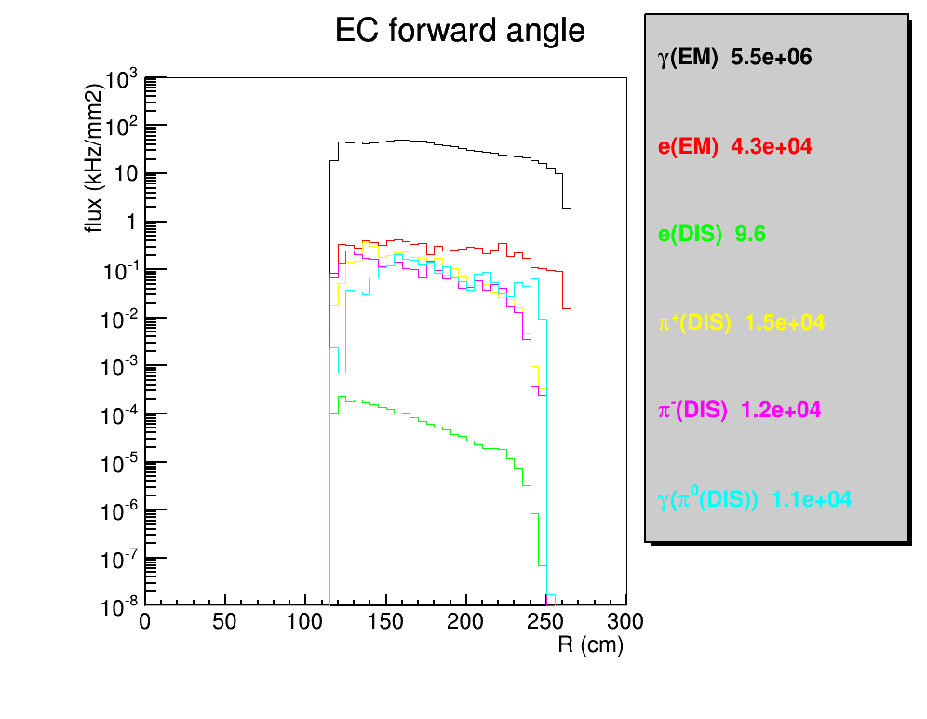
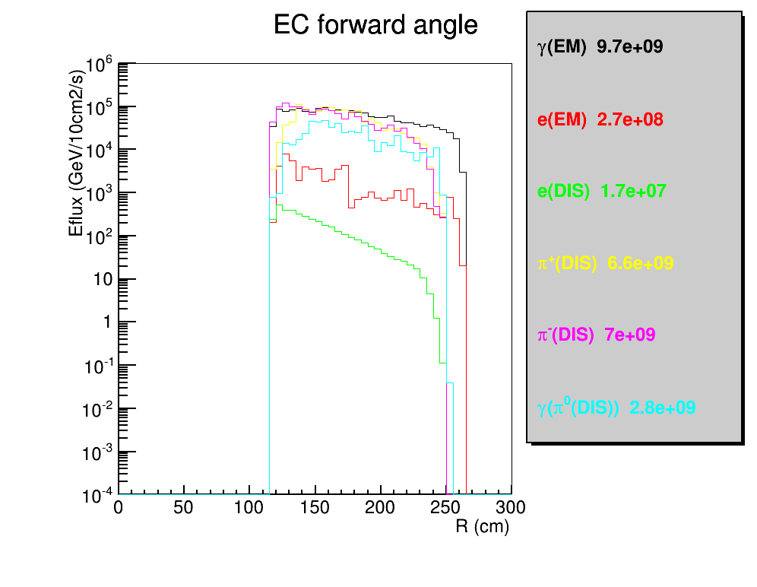
Hit on EC in R(physics+background)

Slide 19
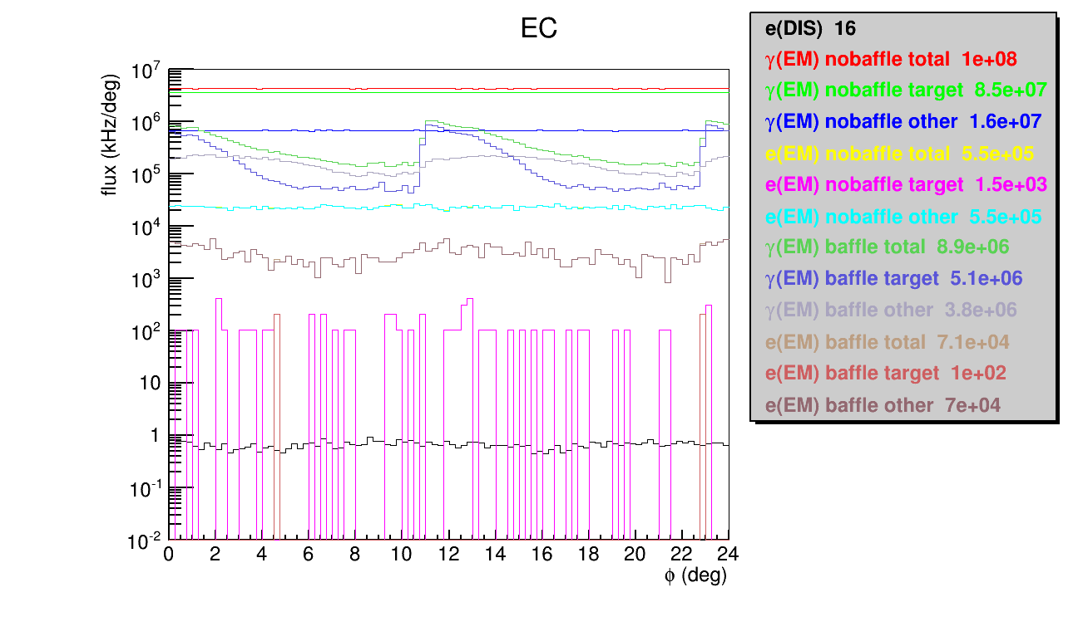
Hit on EC in Phi(physics+background)

Slide 20
GEM geometry

Slide 21
PVDIS GEM
id | Z (cm) | PVDIS target center |  | PVDIS target full
 |  | R range (cm) | Area (m2) | R range (cm) | Area (m2)
1 | 157.5 | 56-107 | 2.6116 | 48-122 | 3.9521
2 | 185.5 | 67-128 | 3.7369 | 59-143 | 5.3307
3 | 306 | 113-215 | 10.5105 | 105-230 | 13.1554
4 | 315 | 117-222 | 11.1824 | 109-237 | 13.9135
total |  |  | 28.0414 |  | 36.3517
CLEO coil center at 0.
PVDIS 40cm long target with center at 10cm
PVDIS angle 21-36 degree
Considering the CLEO baffle, plane 1 and 2 are directly behind baffle and only need partial coverage (70-80%?), plane 3 and 4 are between Cherenkov and EC and need full coverage
To cover full target, GEM needs to increase by 30%

Slide 22
SIDIS/JPsi GEM
id | Z (cm) | SIDIS target center |  | SIDIS target full |  | JPsi target center
 |  | R range (cm) | Area (m2) | R range (cm) | Area (m2) | R range needed (cm) | Area needed (m2) | Area addition to “SIDIS target center” (m2) | Area addition to “SIDIS target full” (m2)
1 | -175 | 46-78 | 1.2466 | 41-87 | 1.8498 | 36-67 | 1.0031 | 0.2576 | 0.1210
2 | -150 | 26-91 | 2.3892 | 23-98 | 2.8510 | 21-80 | 1.8720 | 0.0738 | 0.0276
3 | -119 | 30-103 | 3.0502 | 27-112 | 3.7118 | 25-97 | 2.7595 | 0.0864 | 0.0327
4 | -68 | 37-126 | 4.5575 | 34-135 | 5.3624 | 32-123 | 4.4312 | 0.1084 | 0.0415
5 | 5 | 46-95 | 2.1705 | 44-100 | 2.5334 | 42-90 | 1.9905 | 0.1106 | 0.0540
6 | 92 | 58-118 | 3.3175 | 55-123 | 3.8026 | 55-115 | 3.2044 | 0.1065 | 0.0000
total |  |  | 16.7315 |  | 20.1110 |  | 15.2607 | 0.7433 (4.5%) | 0.2768 (1.4%)
CLEO coil center at 0.
Plane (1,2,3,4) cover large angle and plane (2,3,4,5,6) cover forward angle
SIDIS 40cm long target with center at -350cm, SIDIS angle 7.5-14.85-24 degree
JPsi 15cm long target with center at -300cm tentatively, JPsi angle 8- 16.28-28 degree
Jpsi coverage is only optimized by target center as it’s length is smaller
GEM size determined by “Jpsi target center” inner and “SIDIS target full” outer
PVDIS has more than enough GEM for SIDIS/JPsi to cover full target

Slide 23
backup

Slide 24
Design Detail
Common
use SoLID CLEOv8 field map
30 sectors with each sector covering 12 deg
Still each plate is 9cm thick of lead
SCALE MIN=1.4, MAX=1.4, LASTBAF=0. in makebaf5.C
Larger Z baffle only
Z (40, 70, 100, 130, 160, 190) cm
overlap with Cherenkov and leaves no room for GEM
Rin (3.90, 15.30, 26.60, 37.90, 49.20, 61.01)cm
Rout (41.31, 62.32, 83.32, 104.33, 125.34, 142.00)cm
Not optimized for polar angle 21-36 deg acceptance of full 40cm long target with center at 10cm
Smaller Z baffle only
Z (40, 68, 96, 124, 152, 180) cm
no overlap with current setup
Rin (2.11, 12.86, 23.61, 34.36, 45.10, 55.85)cm
Rout (39.60, 59.94, 80.28, 100.63, 120.97, 141.31)cm
Optimized for polar angle 21-36 deg acceptance of full 40cm long target with center at 10cm

Slide 25
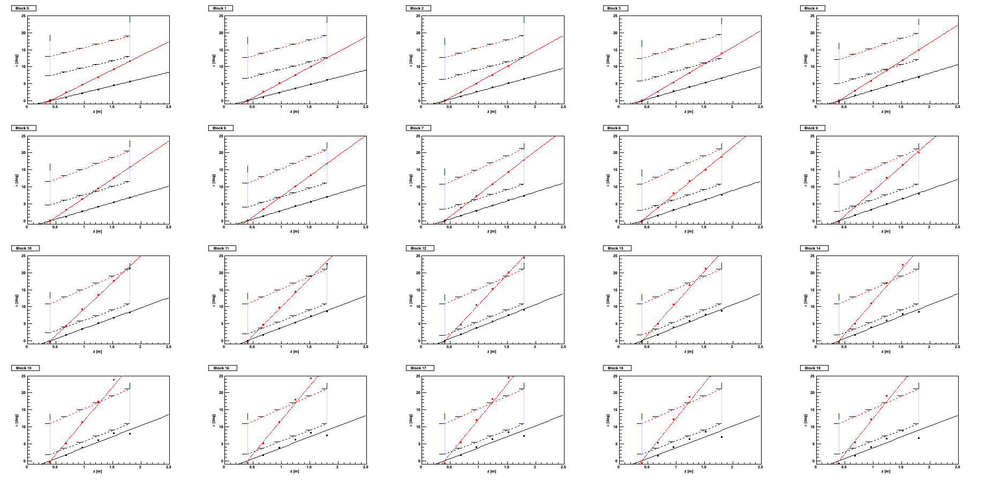
Design approach from larger Z baffle to smaller Z baffle
Continue with Seamus’s approach
In simulation, throw negative particles from target position with field, record tracks at different position
Then do linear fitting to figure out what kind of blocking should be at the assumed baffle plates position.
Output the opening (not block)
refer to
https://hallaweb.jlab.org/wiki/index.php/Baffle_Design
https://hallaweb.jlab.org/wiki/index.php/Solid_design_FOM
Fix a bug of detector plane position in the input file
Change Z, Rin, Rout to the desired values

Slide 26
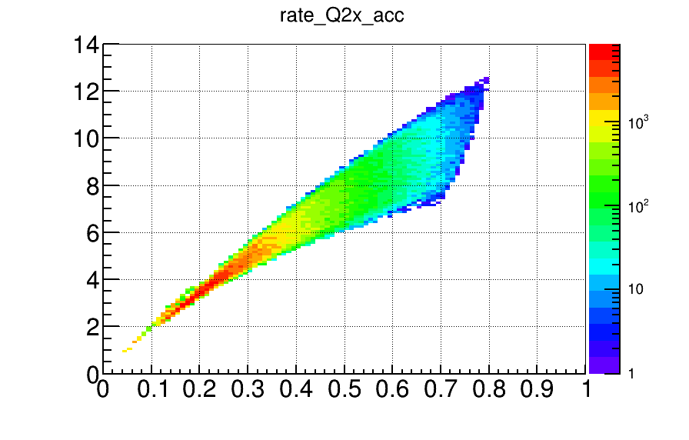
eDIS rate

