Slide 1
SoLID EC Update
Zhiwen Zhao,UVa
for EC group

Slide 2
What’s new
PVDIS
Using background produced with 1st plane baffle inner radius at 4cm (change from 2cm) which reduces low energy photons to about half, thus we have lower radiation dose and better e- efficiency and pi rejection
Trigger study
SIDIS
forward angle EC moves back 10cm to make room for HGCC which doesn’t affect EC performance.
Layout
Cost update

Slide 3
PVDIS Updated radiation dose VS layers (High radiation φ slice)
Photon (EM) <- dominant!
Photon (Pi⁰)
Electron
Pion- Pion+ Proton
Improve by two-fold
Soft EM γ
Direct Pi⁰ γ
3rd Update
New: 4th Update

Slide 4
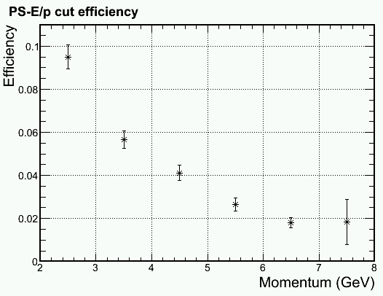
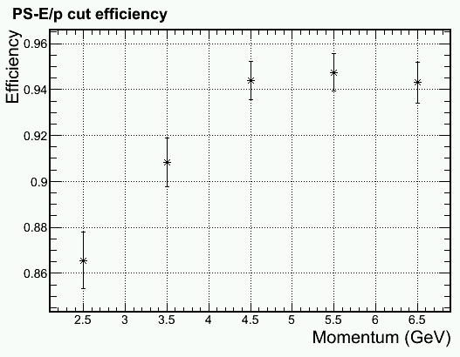
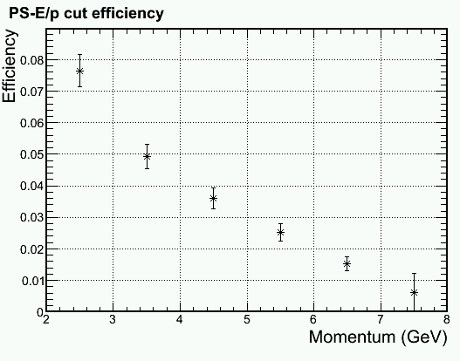
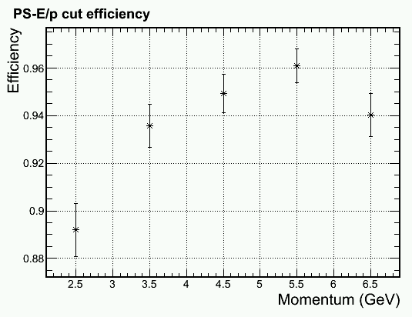
PVDIS Update on PID Mid radius, higher γ φ-band shown Other configuration also simulated
Update
Improvement
Improvement
Pion Efficiency
Electron Efficiency

Slide 5
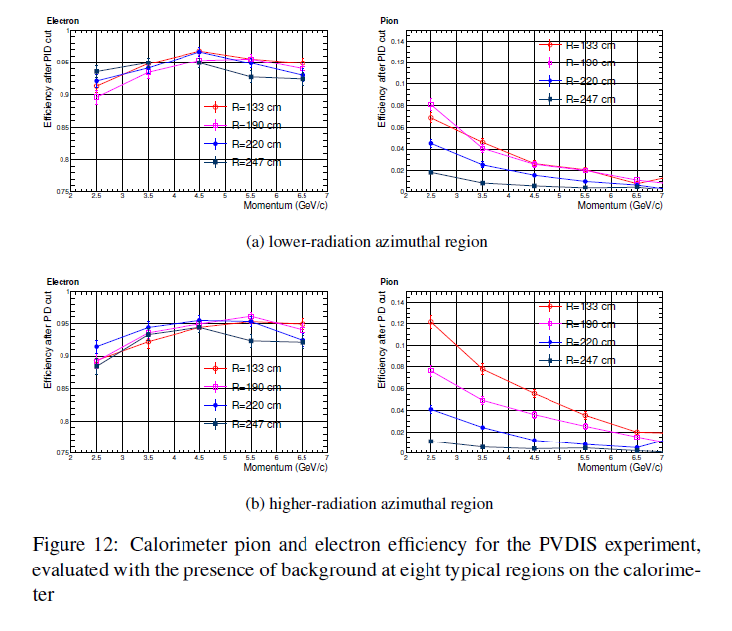
PVDIS EC Performance

Slide 6
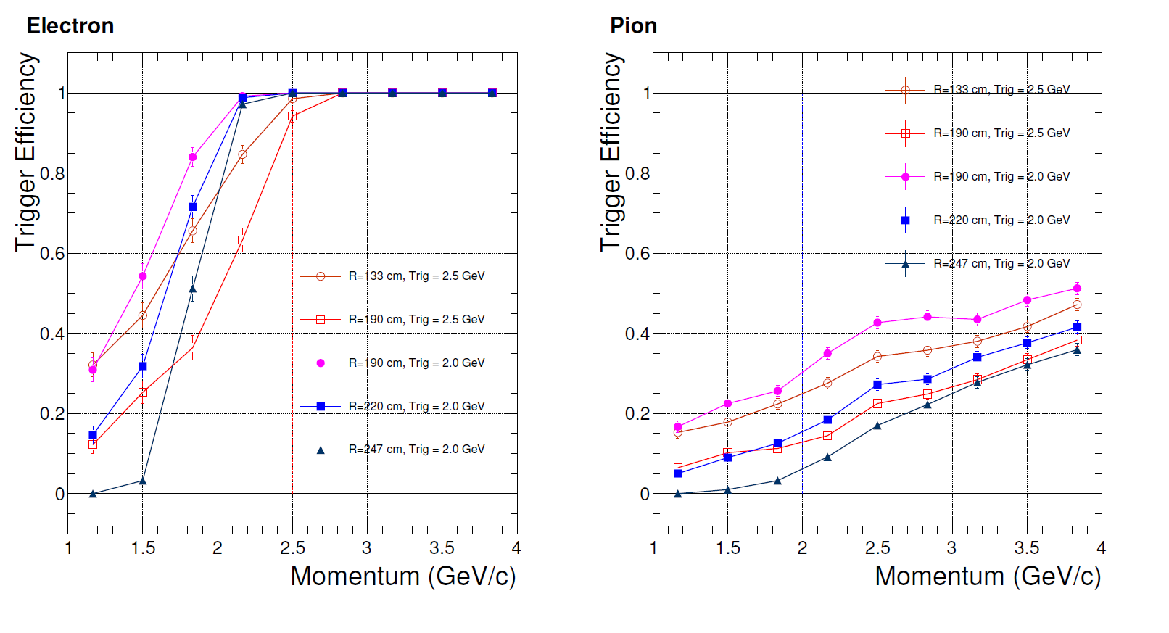
PVDIS EC Trigger Effect

Slide 7
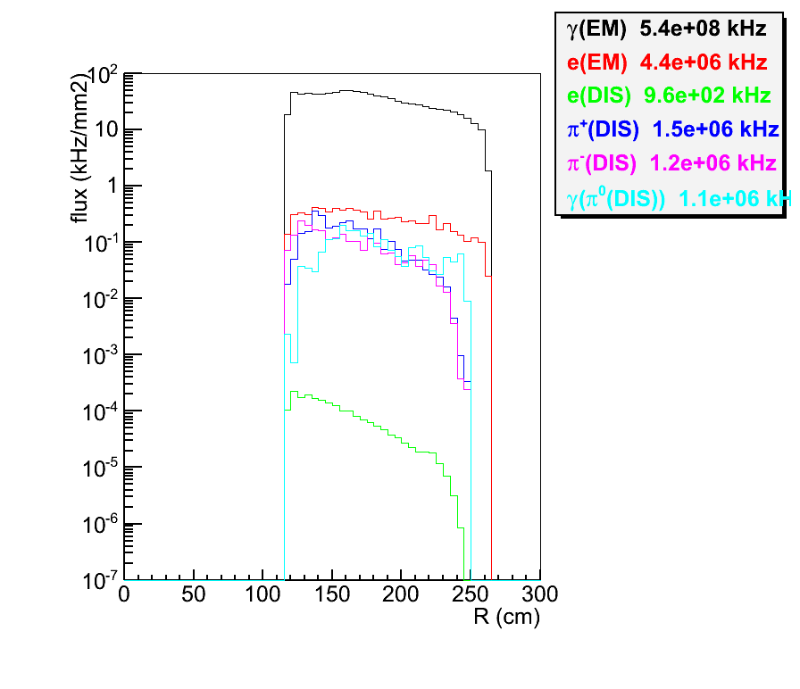
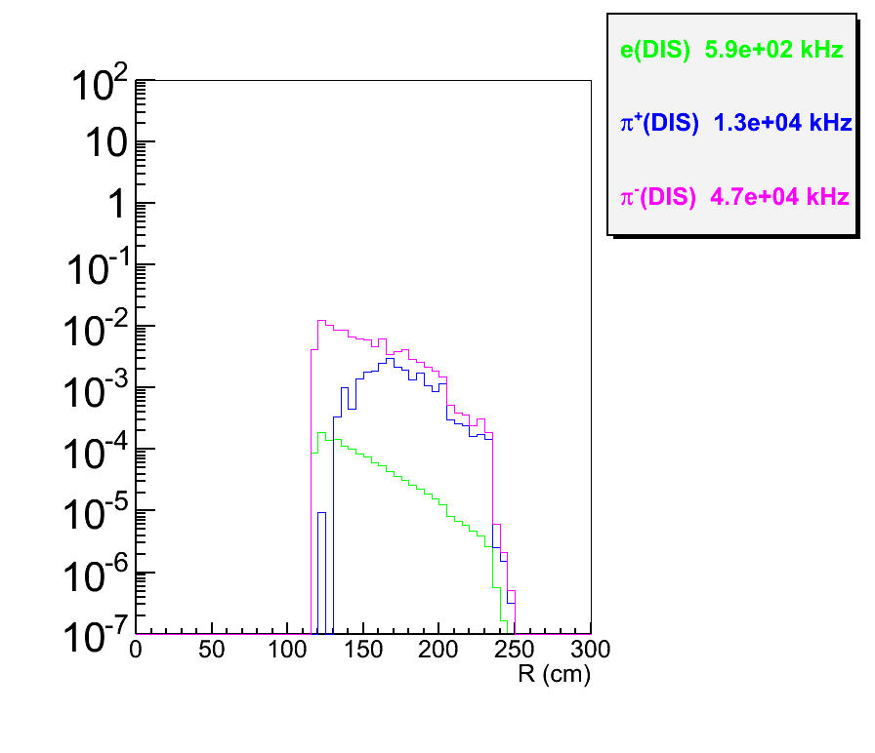
PVDIS Rate on EC
before trigger
after trigger at 2GeV

Slide 8
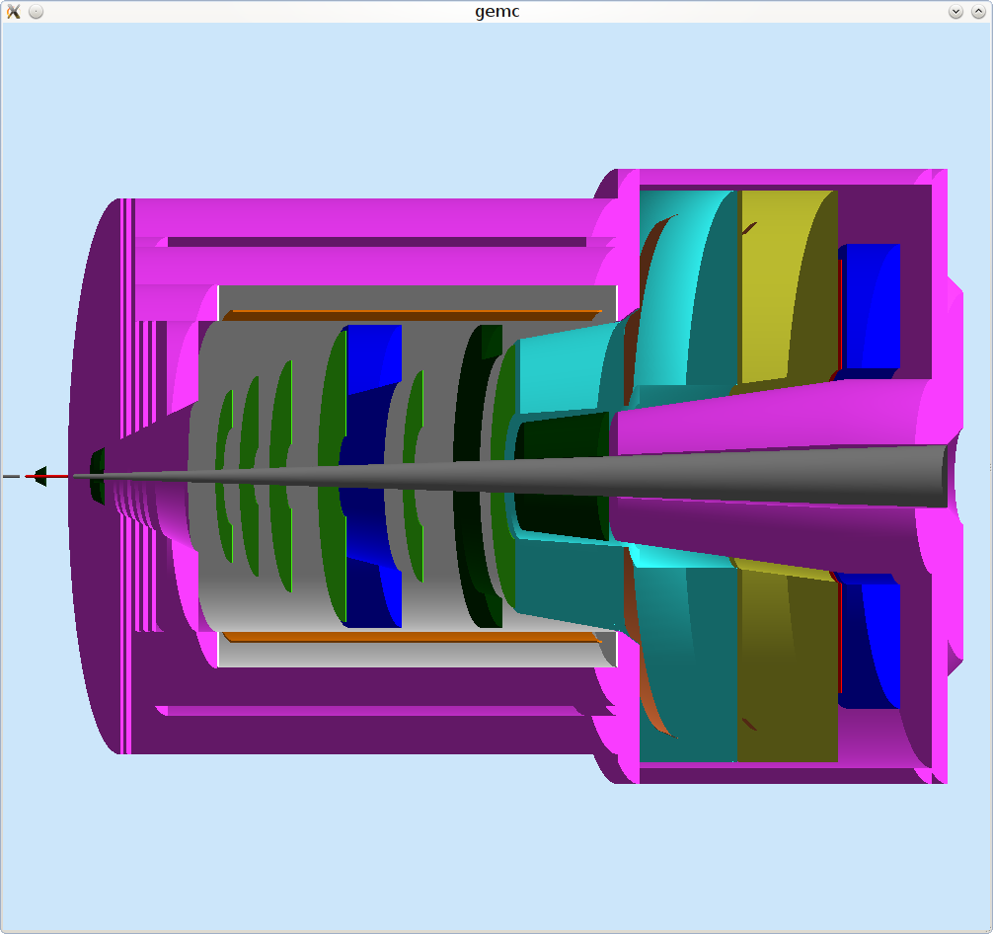
SoLID CLEO SIDIS
EM Calorimeter
(forward angle)
EM Calorimeter
(large angle)
GEM
Hadron
MRPC
Target
Collimator
Collimator
Scattered electron
Coil and Yoke
Light Gas
Cherenkov
Heavy Gas
Cherenkov

Slide 9
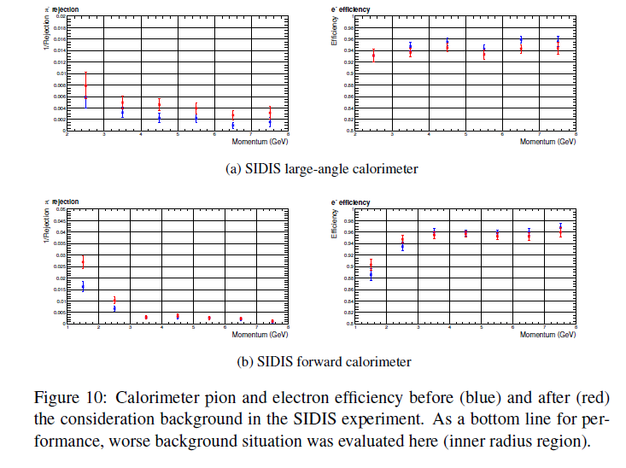
SIDIS EC Performance

Slide 10
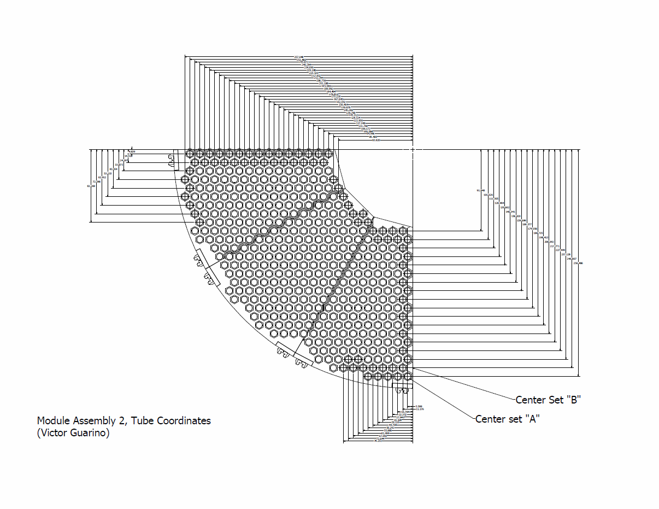
Layout: forward angle EC (FAEC) from ANL

Slide 11
Budget Estimate Update

Slide 12
Cost @ May 2013 Meeting
IHEP (not including fibers) for 1700 PS+SH
Preshower: $112k-$120k
Shower: $549k-$651k
Structure+assembly: $255k-$340k
IHEP total: ($1.22-$1.51)M + 24% overhead (2012 rate) = ($1.51-$1.87)M
Fiber connectors+tubing (Leoni+other): ~$300k
WLS+clear fibers with diamond-cutting: $777k+$448k (S.G.) - $1.66M (Kuraray)
PMTs: $640x2x(~1900)=$2.43M
Total from above (no contingency): ($5.3M-$5.7M) if using S.G.
Labor? Shipping? Contingency?
correction: this should be “structure and assembly each”, but does not affect total IHEP $ on this page.

Slide 13
Cost @ May 2013 Meeting
Based on 1700 modules
No quote yet for SPD
No quote yet for Shower fiber mirrors (IHEP)
Updated fiber cost with diamond-tool cutting (do not know yet if IHEP can cut the fibers)

Slide 14
Cost Update
Will be based on 1800 modules;
SPD quote: $(40-70)k (IHEP very rough estimate)
Quote for WLS fiber cutting, polishing, adding mirrors (IHEP): $50/piece a few years ago, now (20-30)% higher → $(108-117)k
Need to order all WLS fibers in spools and ship to IHEP, need (10-15)% longer length to allow cutting.
We still need to cut the other end of WLS fibers and all clear fibers (CLAS12 cutters).

Slide 15
Cost Update
IHEP (not including fibers) for 1800 PS+SH
Preshower: $113k-$122k
Shower: $570k-$678k
Structure+assembly: $540k-$720k
Fiber cutting + mirrors: $108k-$117k
IHEP total: ($1.38-$1.70)M + 30% overhead (changed from 24% for a conservative estimate) = ($1.80-$2.21)M
Fiber connectors+tubing (Leoni+other): ~$300k
WLS+clear fibers (S.G), rough ends: $234k+$564k
PMTs: $640x2x(~1900)=$2.43M
Total from above (no contingency): ($5.33M-$5.74M)
Labor ($0.75M)? Shipping ($0.5M)? Contingency (30%): → $8.6M - $9.2M

Slide 16
Plan for Budgeting
Plan to reduce cost:
MAPMT study, now it's clear can do gain-matching at the FADC level. Any need for small-scale tests? – potential saving of up to $800k;
Get a MAPMT quote;
Customized PMT bases? (current base cost is $912k);
Smaller PMTs for Preshower?

Slide 17
Possible Design Update – Multi-Anode PMTs
Current Preshower readout: 1 PMT ($600)/module, but each module is read out by only a couple of fibers so we are wasting cross-sectional area of the PMT;
MAPMT: about $100/channel → potential saving of PS PMT from $1.02M to $200k;
To be studied: gain-matching between channels of one MAPMT. LHCb used specialized front-end electronic modules to produce digital triggers. We could use FADC directly, no need for FE-electronics.

Slide 18
Backup

Slide 19
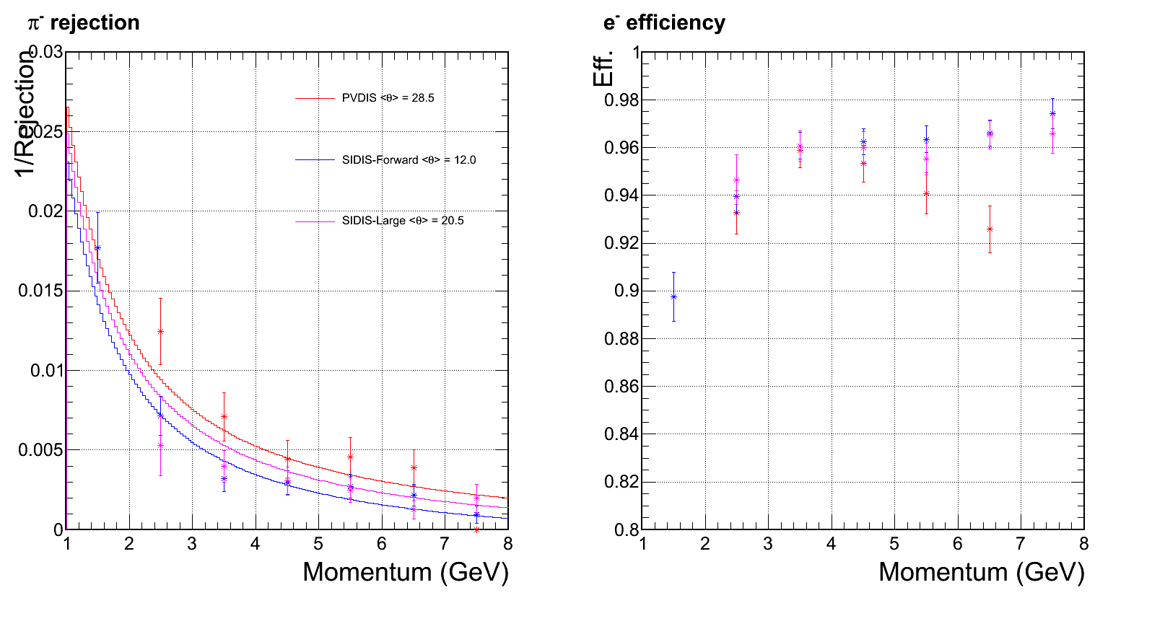
EC performance w/o background
Cited from March collaboration Meeting
Preshower ID power drop significantly at this bin

Slide 20
Forth update of CLEO background
Cutting 2cm away on 1st baffle inner radius
Received background simulation from Zhiwen on May 24

Slide 21
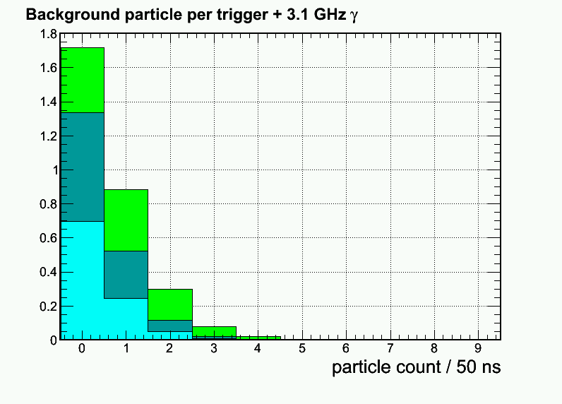
Updated: Per-event pion rate for 1+6 hexagon cluster at Mid radius, high radiation φ-slice
3rd Update
Electron (mostly absorbed in Pb)
Pion-
Pion+
New 4th Update

Slide 22
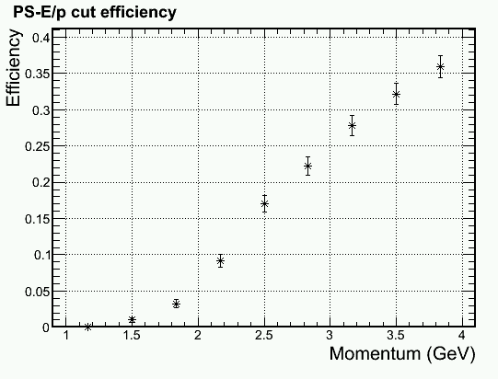
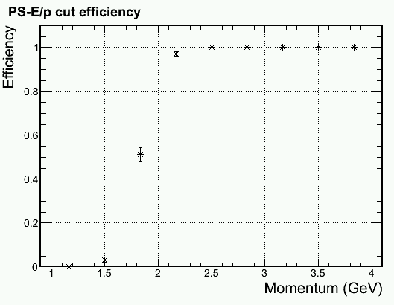
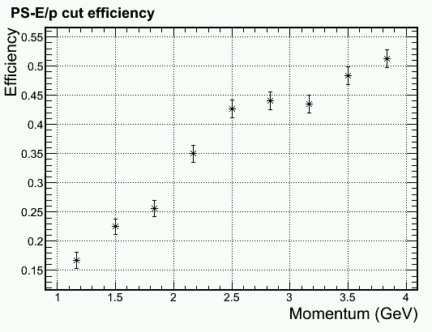
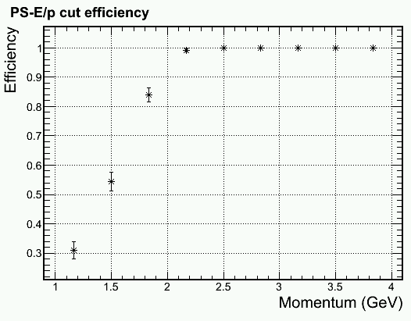
Trigger turn on curve for 2 GeV electron Shower Hex 1+6 trigger > 1.6 GeV
Outer radius, higher γ φ-band, full bgd
100% pass for ~250 events/bin
Physics
, full bgd
Middle radius, higer γ φ-band, full bgd
Physics
Pion Efficiency
Electron Efficiency

Slide 23
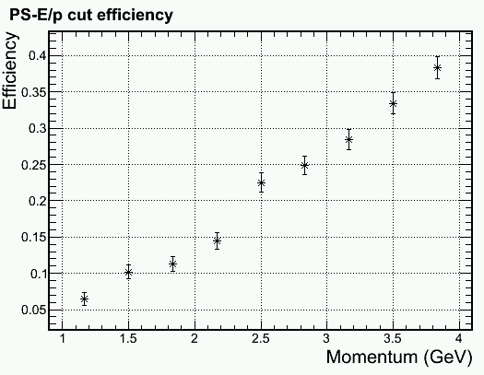
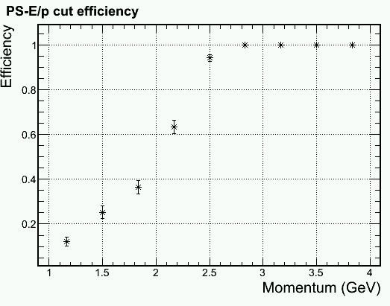
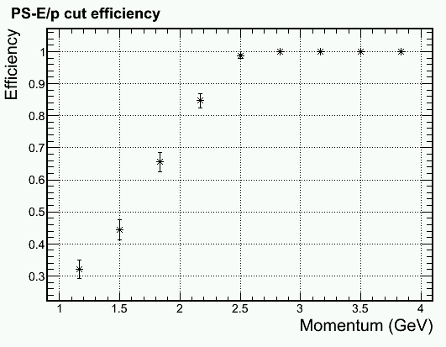
Trigger turn on curve for 2.5 GeV electron Shower Hex 1+6 trigger > 2.1 GeV
Middle radius, higher γ φ-band, full bgd
Physics
Inner radius, higer γ φ-band, full bgd
Physics
Pion Efficiency
Electron Efficiency

Slide 24
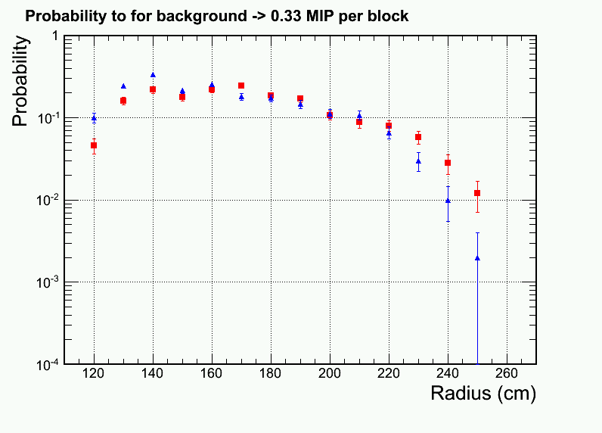
Readout occupancy per shower channel for ~75MeV zero suppression
Improvement
High radiation phi slice
Low radiation phi slice

Slide 25
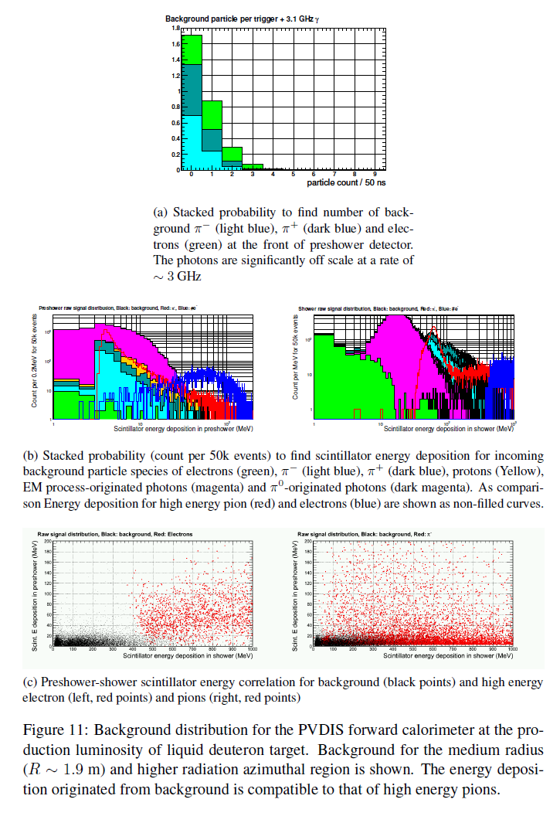

Slide 26
Third update of CLEO background
Received background simulation from Zhiwen on May 19
Running background imbedding

Slide 27
Background imbedding and distribution Mid-R, High Radiation phi slice
Photon (6GHz/6+1 Hex cluster)
Electron
Pion- Pion+ Proton

Slide 28
Updated: Per-event pion rate for 1+6 hexagon cluster at Mid radius, high radiation φ-slice
Electron (mostly absorbed in Pb)
Pion-
Pion+
+ 6 GHz photon not shown (3GHz for lower φ-radiation )

Slide 29
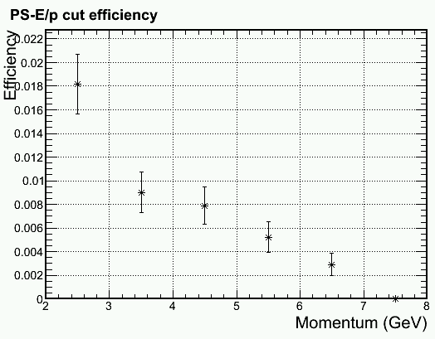
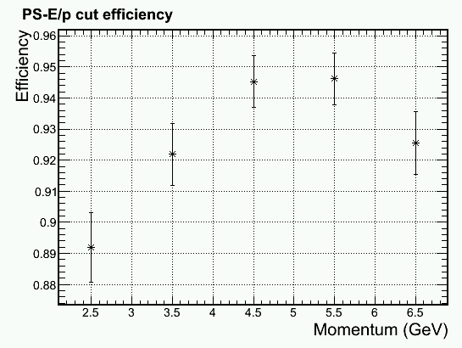
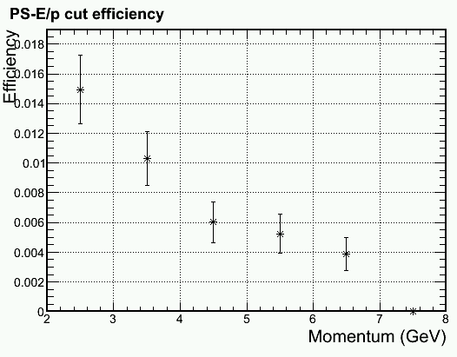
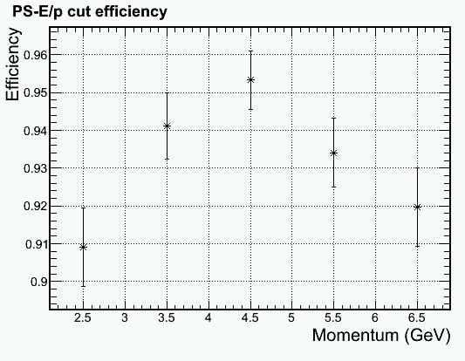
Update on PID with DC component removal (PS > MIP + Bgd + (2-3) σ)
Outer radius, higher γ φ-band
Due to Soft EM γ
Outer radius, lower γ φ-band
Pion Efficiency
Electron Efficiency

Slide 30
Update on PID with DC component removal (PS > MIP + Bgd + (2-3) σ)
Outer radius, higher γ φ-band
Mid radius, higher γ φ-band
Due to Hadron rate
Pion Efficiency
Electron Efficiency

Slide 31
More detail in PID cut Middle radius, lower γ φ-band, full bgd
Pion Efficiency
Electron Efficiency

Slide 32
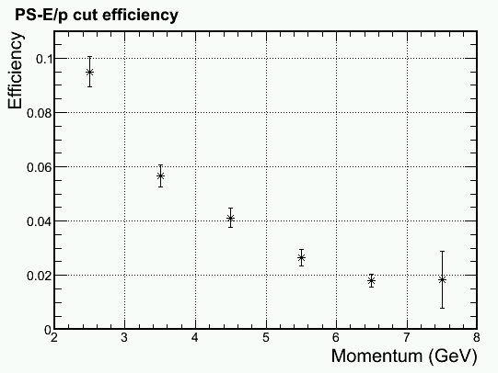
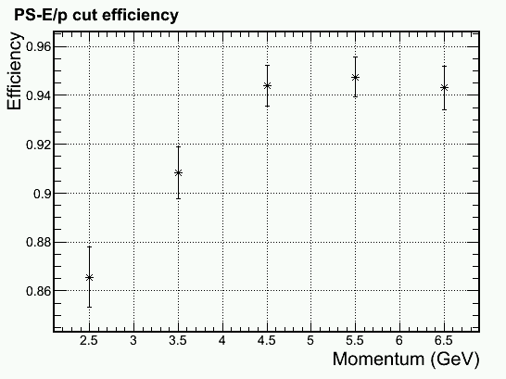
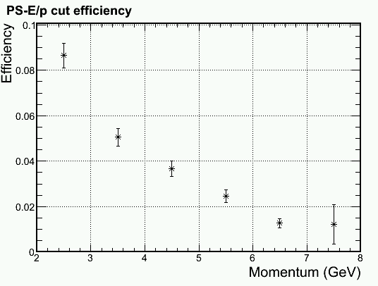
Update on PID with DC component removal (PS > MIP + Bgd + (2-3) σ)
Inner radius, higher γ φ-band
Inner radius, lower γ φ-band
Pion Efficiency
Electron Efficiency

Slide 33
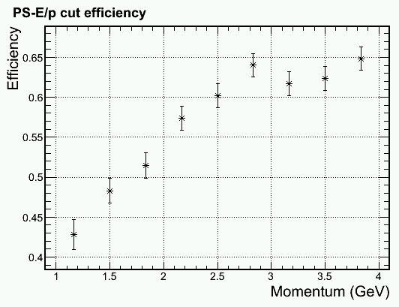
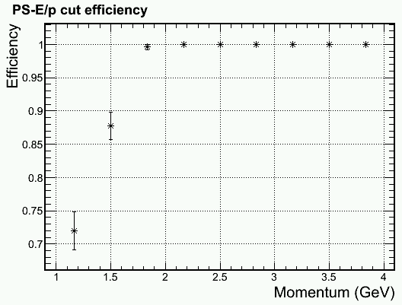
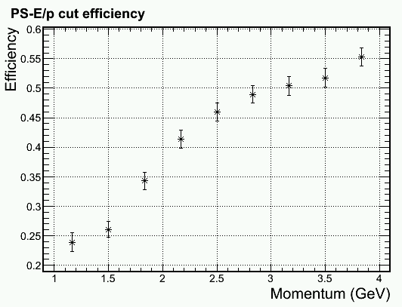
Trigger turn on curve for 2 GeV electron Shower Hex 1+6 trigger > 1.6 GeV
Inner radius, higher γ φ-band, full bgd
100% pass for ~250 events/bin
Physics
, full bgd
Middle radius, higer γ φ-band, full bgd
Physics
Pion Efficiency
Electron Efficiency

Slide 34
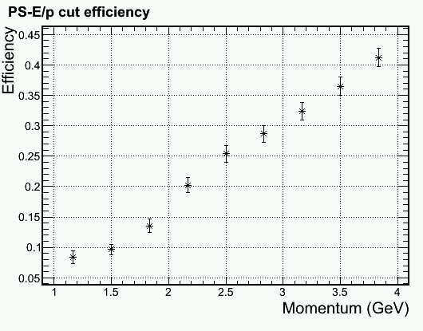
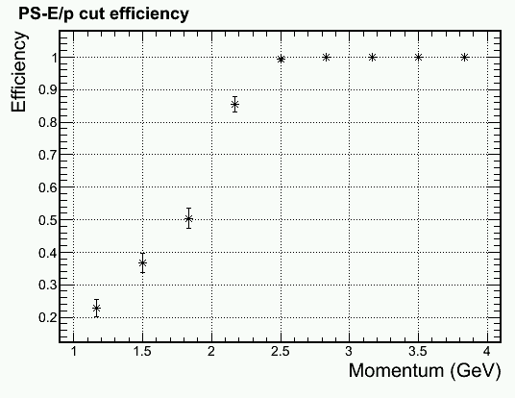
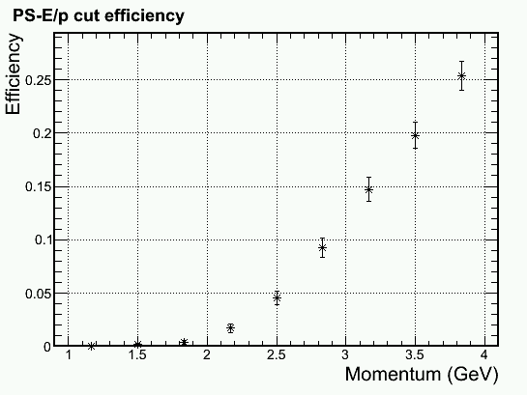
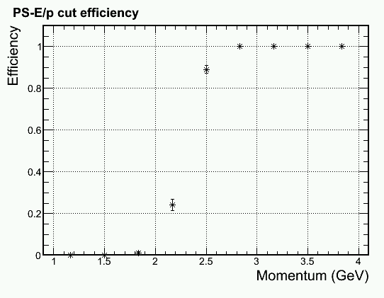
Trigger turn on curve for 2.5 GeV electron Shower Hex 1+6 trigger > 2.1 GeV
Middle radius, higher γ φ-band, full bgd
Physics
Outer radius, higer γ φ-band, full bgd
Physics
Pion Efficiency
Electron Efficiency

Slide 35
More detail in trigger cut Middle radius, higher γ φ-band, full bgd Shower Hex 1+6 trigger > 2.1 GeV
Pion Efficiency
Electron Efficiency

Slide 36
Readout occupancy per shower channel for ~75MeV zero suppression
High radiation phi slice
Low radiation phi slice

