Slide 1
PVDIS at 11 GeV with SoLID

Slide 2
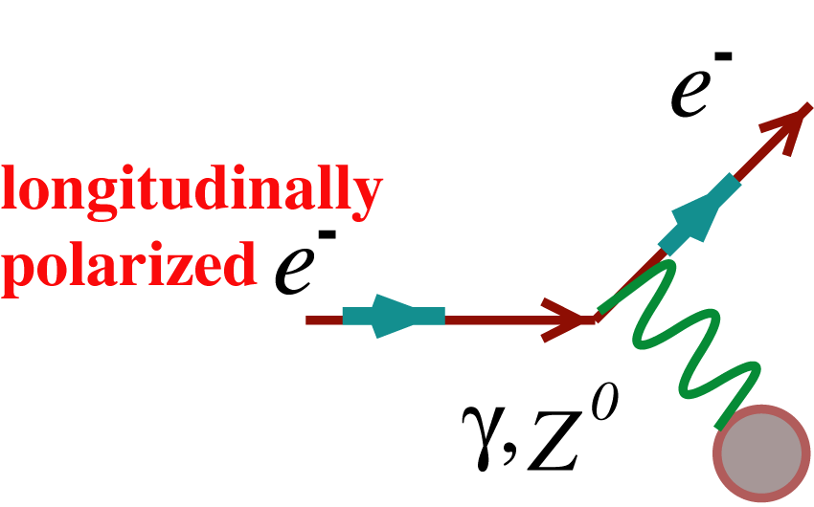
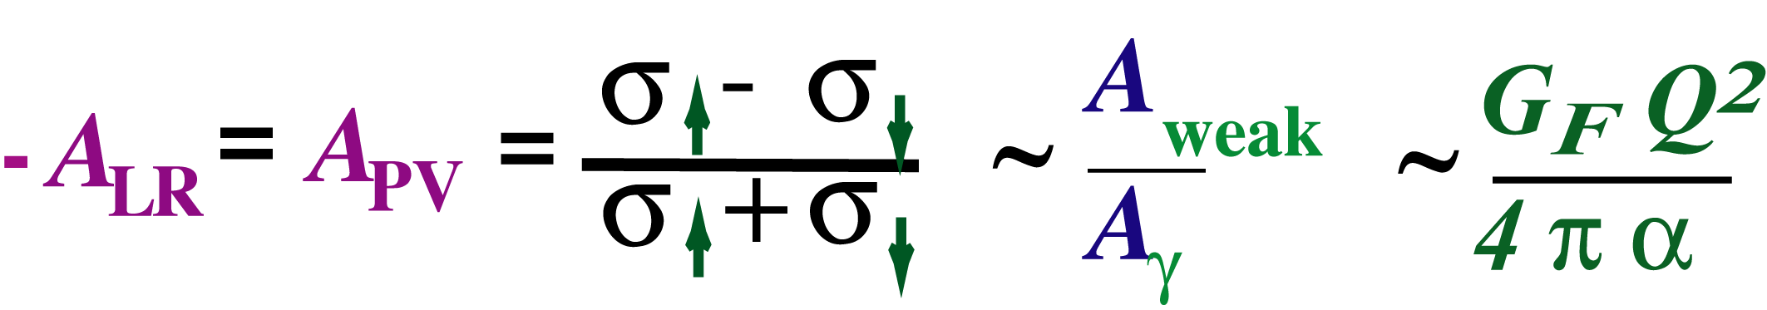
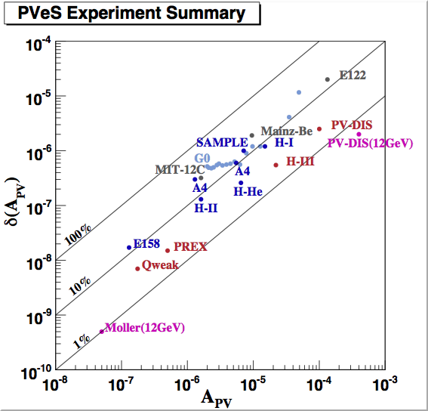
PV Electron Scattering
Continuous interplay between probing hadron structure and electroweak physics
(g_{A}^{e}g_{V}^{T} +β g_{V}^{e}g_{A}^{T})
g_{V} is a function of sin²θ_{W}
to
Parity-violating electron scattering has become a precision tool
Physics beyond Standard Model
Strange quark form factors
Neutron skin of a heavy nucleus
QCD structure of the nucleon in PV DIS
SLAC
MIT-Bates
Mainz
JLab
part per billion systematic control
<1% normalization control
photocathodes, polarimetry, high power cryotargets, nanometer beam stability, precision beam diagnostics,
low noise electronics, radiation hard detectors

Slide 3


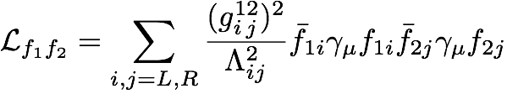
Indirect Clues to TeV Physics
Electroweak Interactions at scales much lower than the W/Z mass
Many theories predict new forces that disappeared when the universe cooled
E
Dynamics involving
particles with m > Λ
Λ (~TeV)
courtesy
V. Cirigliano
H. Maruyama
M_{W,Z}
(100 GeV)
higher dimensional operators can be systematically classified
Heavy Z’s and neutrinos, technicolor, compositeness, extra dimensions, SUSY…
flavor changing as well as flavor diagonal
charged current as well as neutral current
new contact interactions
Consider or
must reach Λ ~ several TeV

Slide 4


Neutral Currents at Low Energy
Colliders AND Fixed Target
One goal of neutral current measurements at low energy AND colliders:
Access Λ > 10 TeV for as many different flavor & L,R combinations as possible
Colliders access scales Λ’s > 10 TeV
- L,R combinations accessed are mostly parity-conserving
LHC, Tevatron, LEP, SLC, LEP200, HERA
Z boson production accessed some parity-violating combinations but…
on resonance:
AZ imaginary
no interference!
Low Energy: New Physics/Weak-Electromagnetic Interference
opposite parity transitions in heavy atoms
Spin-dependent electron scattering
Electromagnetic amplitude interferes with Z-exchange as well as any new physics

Slide 5
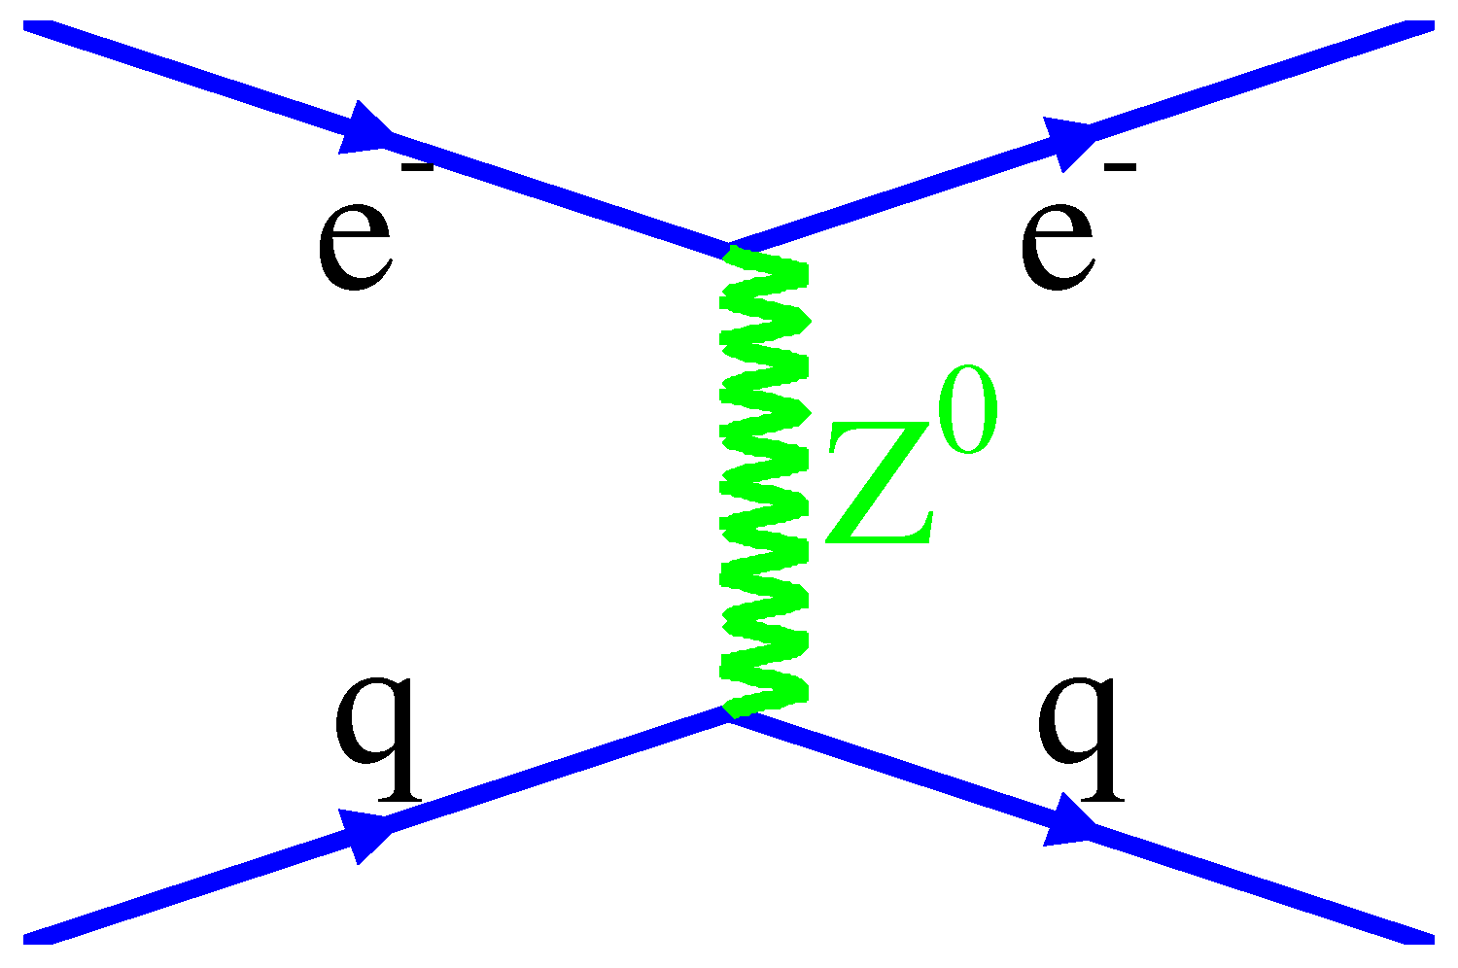
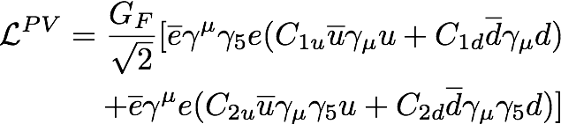
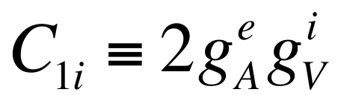
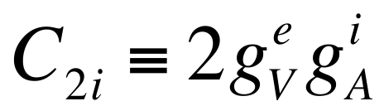
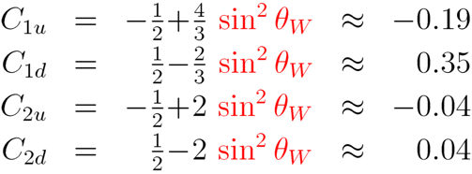

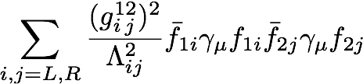
e-q coupling constants
4 phenomenological couplings: V, A & u, d combinations
A
V
V
A
new physics
+
PV elastic e-p scattering, Atomic parity violation
PV deep inelastic scattering
C2q’s involve axial hadronic currents:
large theoretical uncertainties when accessed via elastic scattering

Slide 6
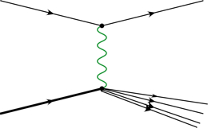

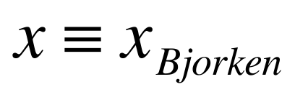
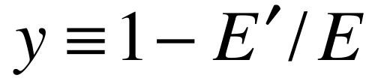
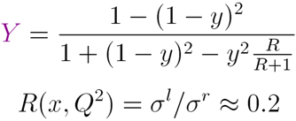
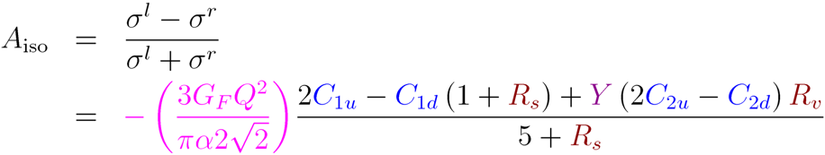
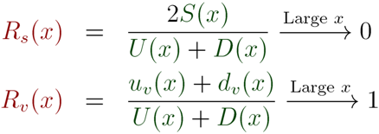
PV Deep Inelastic Scattering
off the simplest isoscalar nucleus and at high Bjorken x
e⁻
e⁻
Z*
γ*
Q² >> 1 GeV² , W² >> 4 GeV²
N
X
At high x, A_{iso} becomes independent of pdfs, x & W, with well-defined SM prediction for Q² and y
Interplay with QCD
Parton distributions (u, d, s, c)
Charge Symmetry Violation (CSV)
Higher Twist (HT)
Nuclear Effects (EMC)

Slide 7
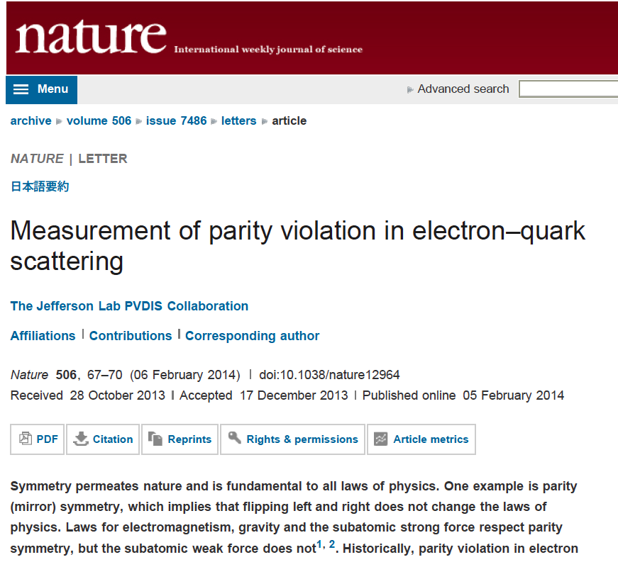
Redent Jlab Results

Slide 8
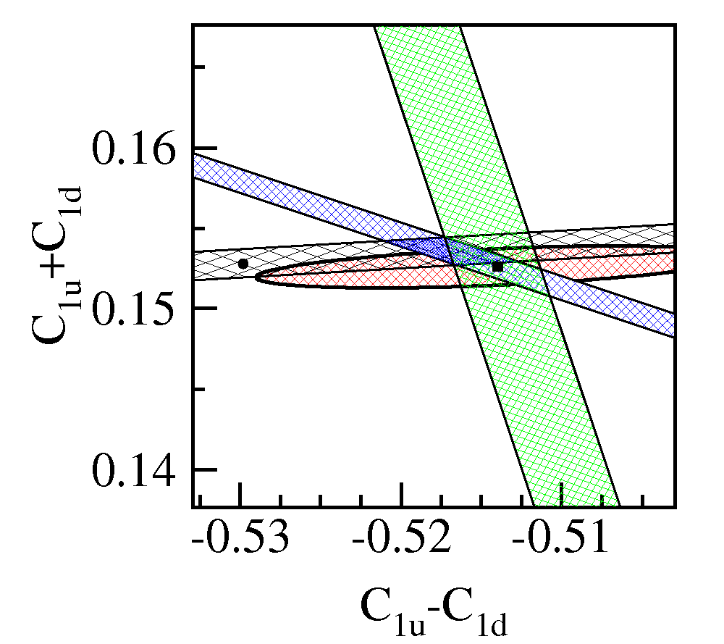
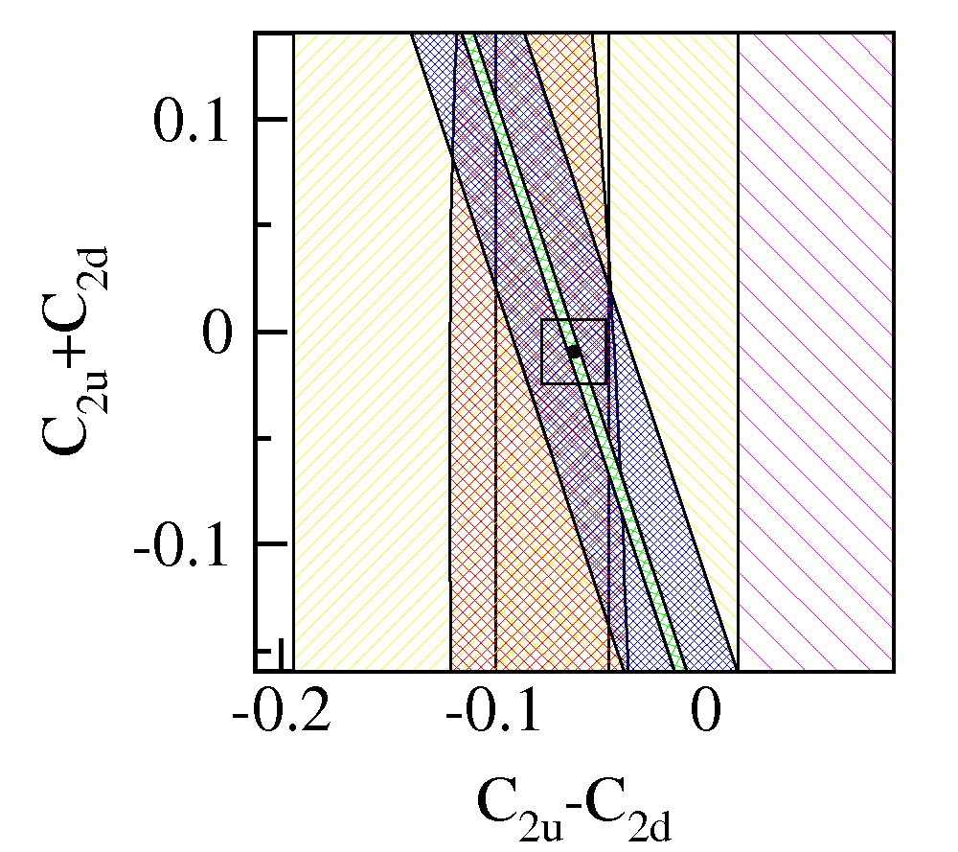
6 GeV Result; SOLID Goal
Measure APV for e-²H DIS to 0.6% fractional error (stat + syst + theory) at high x, y
C2q’s largely unconstrained
11 GeV SOLID
E122
Qweak
SAMPLE
Cs
Red ellipses are PDG fits
This box matches the scale of the C1q plot
Green bands are the proposed measurement of SOLID
unique TeV-scale sensitivity

Slide 9
SoLID PVDIS Projected Result

Slide 10
Mass Limits for Composite Theories
Published Data
SoLID + Qweak final

Slide 11
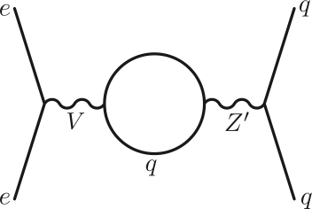
New Physics Examples
Leptophobic Z’
Virtually all GUT models predict new Z’s
LHC reach ~ 5 TeV, but....
Little sensitivity if Z’ doesnt couple to leptons
Leptophobic Z’ as light as 120 GeV could have escaped detection
Since electron vertex must be vector, the Z’ cannot couple to the C1q’s if there is no electron coupling:
can only affect C2q’s
SOLID can improve sensitivity:
100-200 GeV range
arXiv:1203.1102v1
Buckley and Ramsey-Musolf

Slide 12
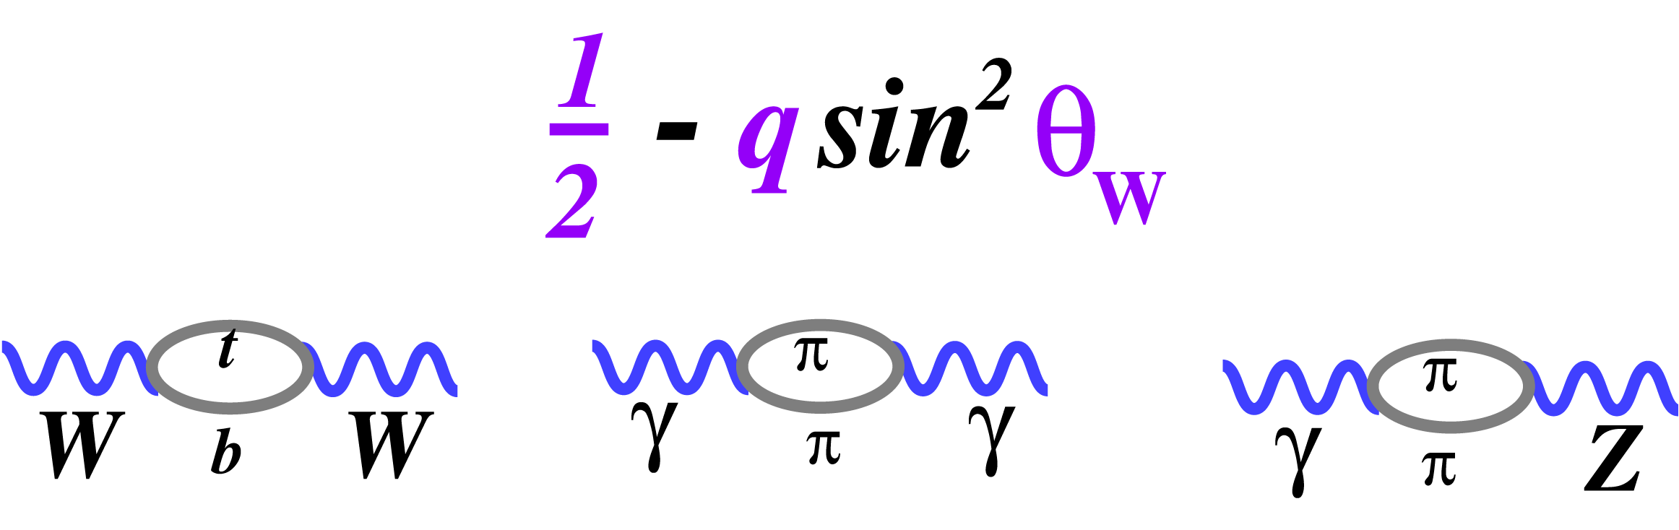
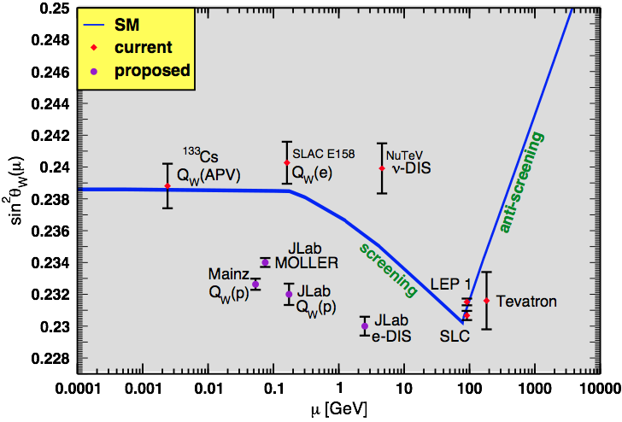

The Weak Mixing Angle
Running of θW : Bookkeeping to check consistency of various measurements
T
γ-γ loop is the running of αEM
W-W loop provides indirect mt
γ-Z loop is the running of sin²θW
Published Measurements
  SLAC E158
  ¹³³Cs Atomic Parity Violation (APV)
  NuTeV result requires careful consideration of nuclear corrections
Current/Future PV Electron Scattering Measurements at JLab
  e-q measurements: QWeak (elastic e-p) and SOLID (DIS)
  Improve on E158 by a factor of 5 (MOLLER)
SOLID

Slide 13
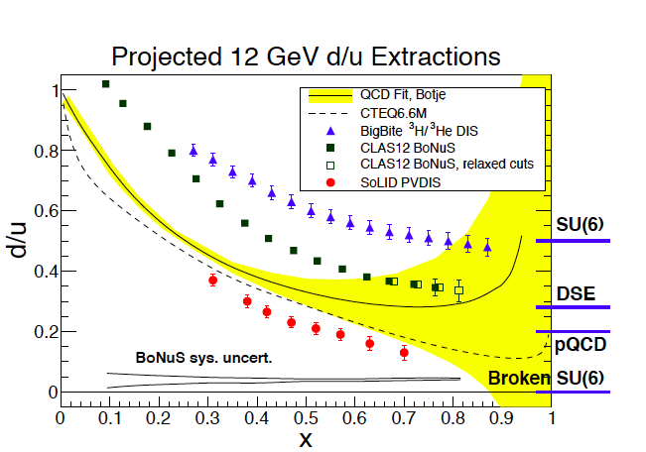

Slide 14
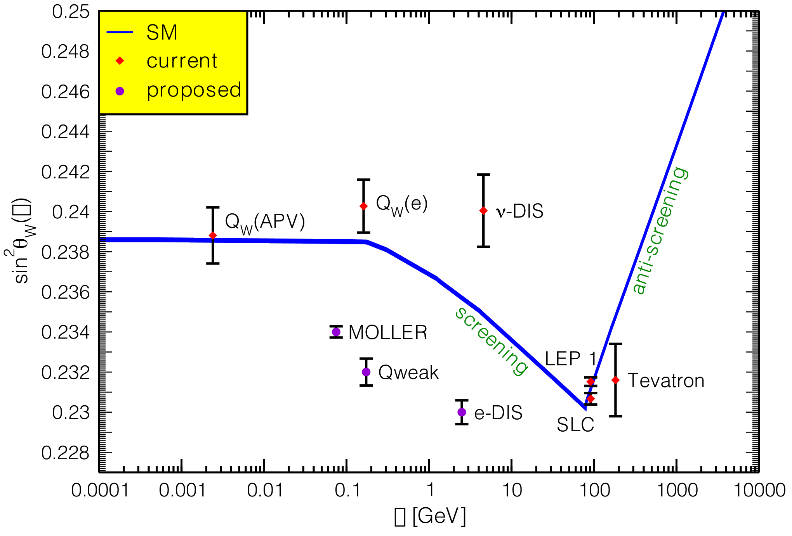
What about NuTeV?
Apologies to J. Erler for photoshopping his plot

Slide 15
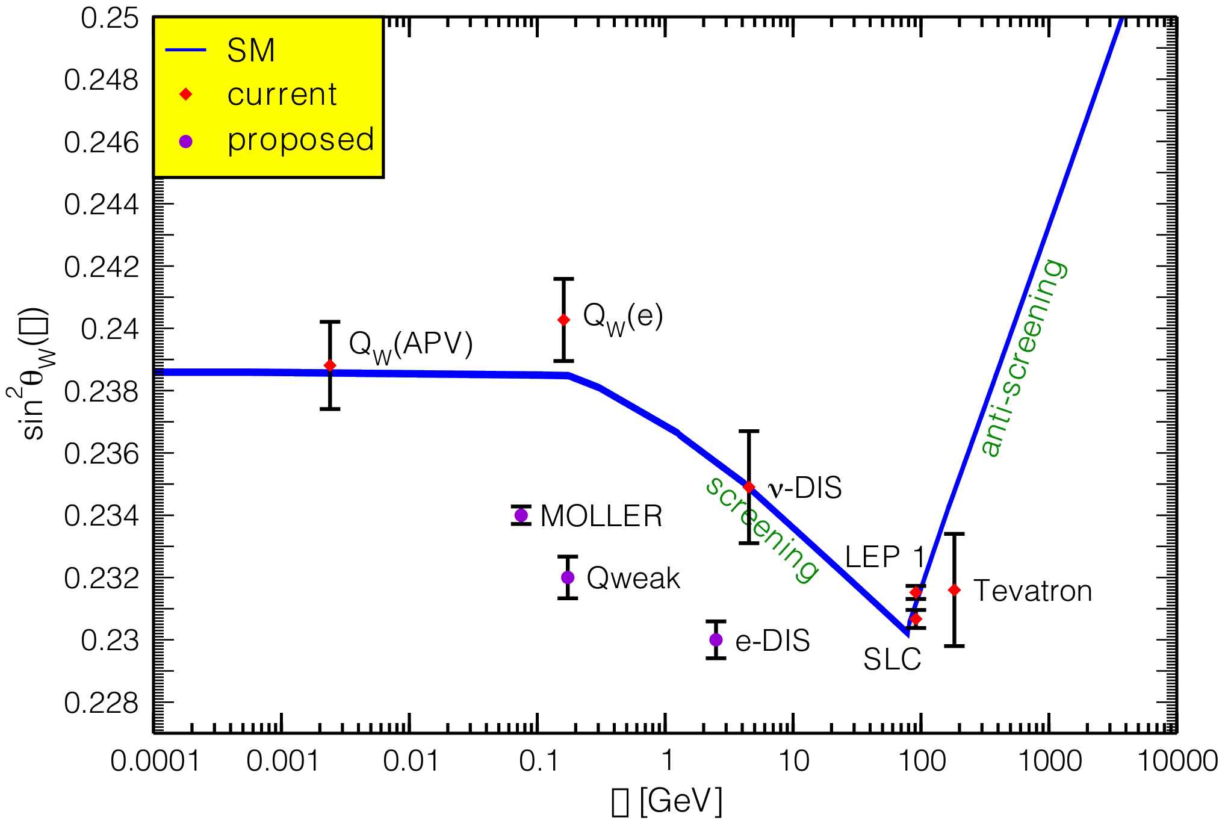
What about NuTeV?
Apologies to J. Erler for photoshopping his plot
p-n CSV and isoscaler CSV
Bentz, Cloet Londergan, Thomas PLB693 462 2010

Slide 16
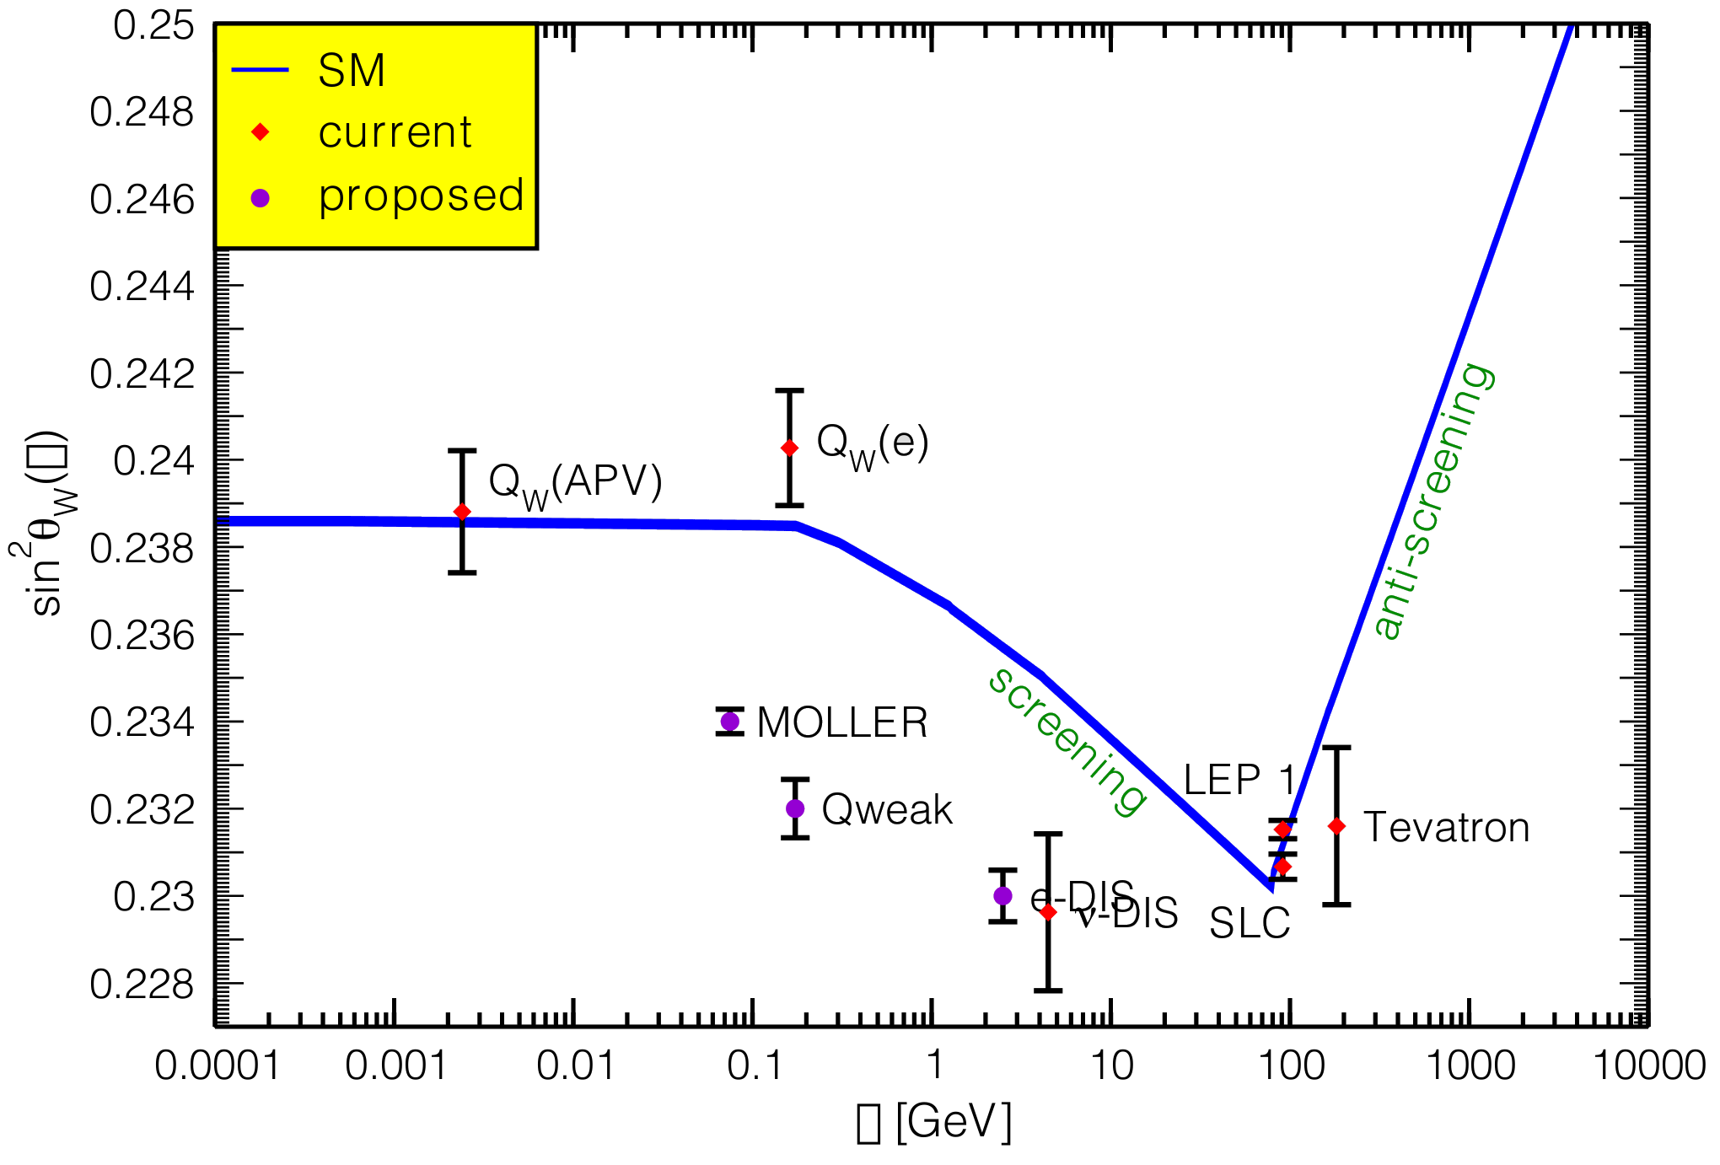
What about NuTeV?
Apologies to J. Erler for photoshopping his plot
p-n CSV and isoscaler CSV
Bentz, Cloet Londergan, Thomas PLB693 462 2010
Flavor Dependent Shadowing
Brodsky PRD70 (2004) 116003

Slide 17



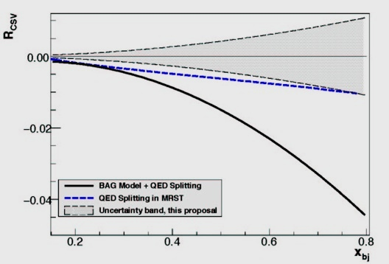
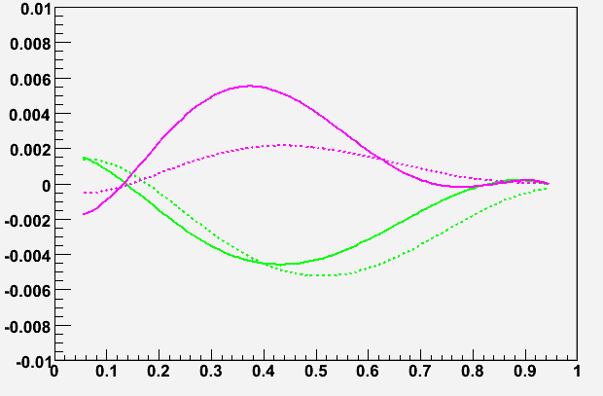
Charge Symmetry Violation
We already know CSV exists:
u-d mass difference δm = m_{d}-m_{u} ≈ 4 MeV
δM = M_{n}-M_{p} ≈ 1.3 MeV
electromagnetic effects
Direct sensitivity to parton-level CSV
Important implications for PDF’s
Could be partial explanation of the NuTeV anomaly
For A_{PV} in electron-²H DIS
Sensitivity will be enhanced if u+d falls off more rapidly than δu-δd as x → 1
SOLID sensitivity
bag model (solid) Radionov et al.
QED splitting (dashed) Glueck et al.
δd
δu
x
Significant effects are predicted at high x

Slide 18
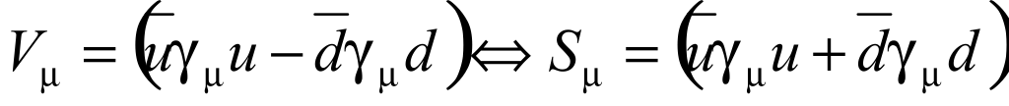
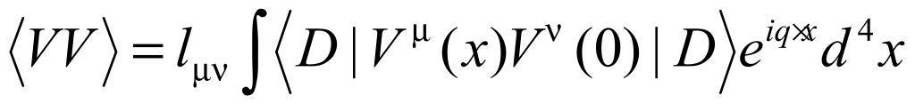


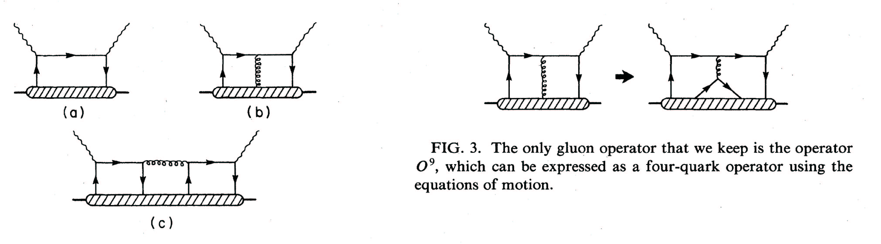
A Special HT Effect
The observation of Higher Twist in PV-DIS would be exciting direct evidence for diquarks
following the approach of
Bjorken, PRD 18, 3239 (78),
Wolfenstein, NPB146, 477 (78)
Isospin decomposition
before using PDF’s
Higher-Twist valence quark-quark correlation
Zero in quark-parton model
(c) type diagram is the only operator that can contribute to a(x) higher twist: theoretically very interesting!
σL contributions cancel
Castorina & Mulders, ‘84
Use ν data for small b(x) term.

Slide 19
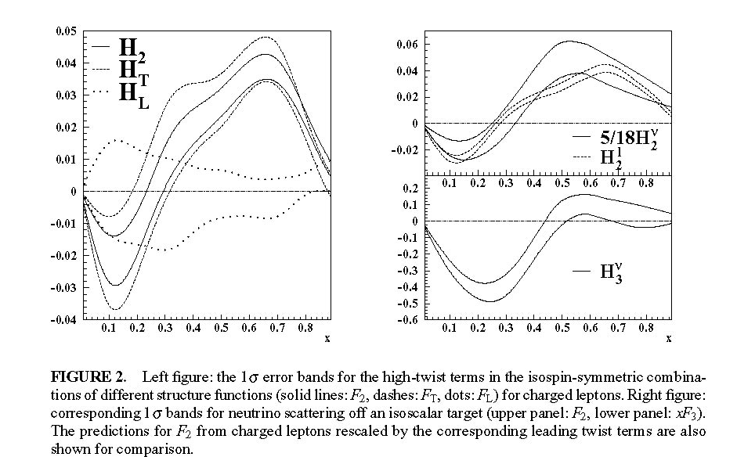
a₃ Term and Neutrino’s
These hadronic corrections can be
obtained from charged-current
neutrino scattering data

Slide 20
Coherent Program of PVDIS Study
Strategy: requires precise kinematics and broad range
 | x | Y | Q²
New Physics | no | yes | no
CSV | yes | no | no
Higher Twist | yes | no | yes
Measure A_{d} in narrow bins of x, Q² with 0.5% precision
Cover broad Q² range for x in [0.3,0.6] to constrain HT
Search for CSV with x dependence of A_{d} at high x
Use x > 0.4, high Q² to measure a combination of the C_{iq}’s
Fit data to:

Slide 21
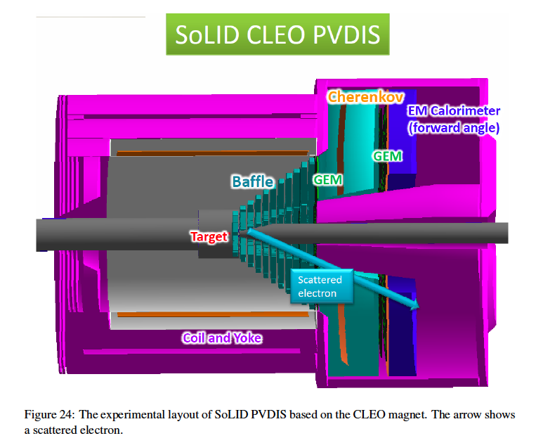

Slide 22
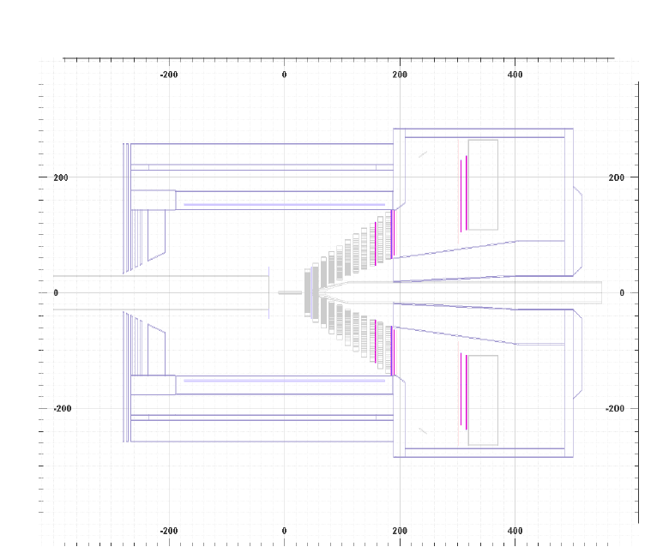

Slide 23
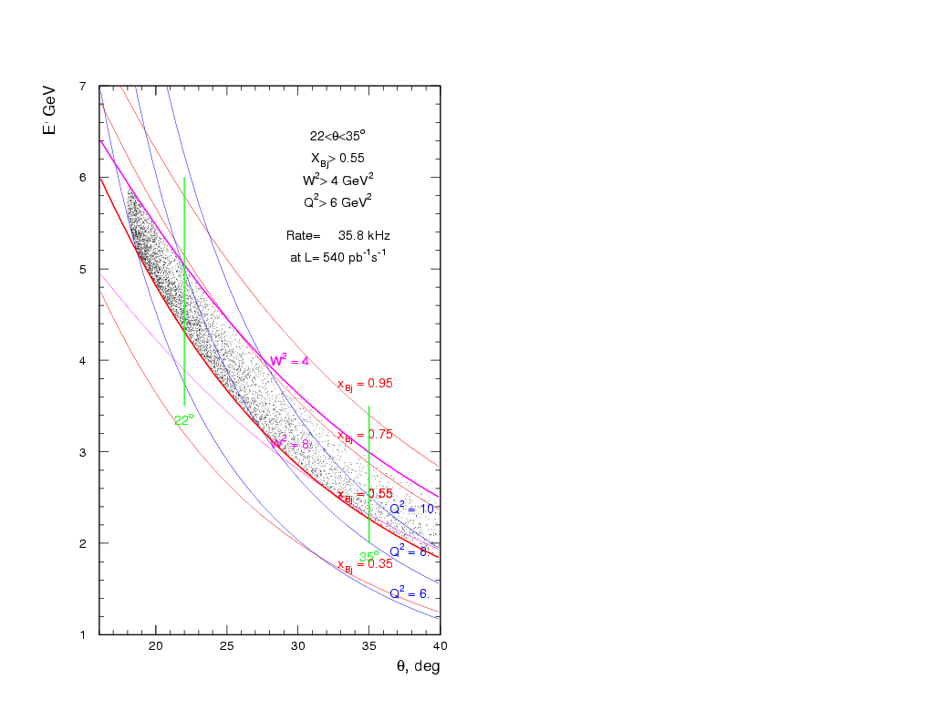
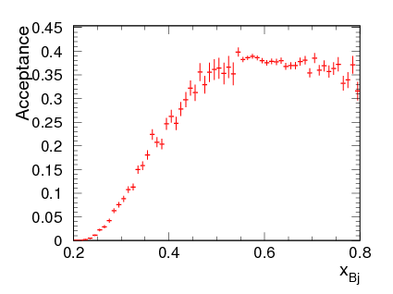
Spectrometer Acceptanace

Slide 24
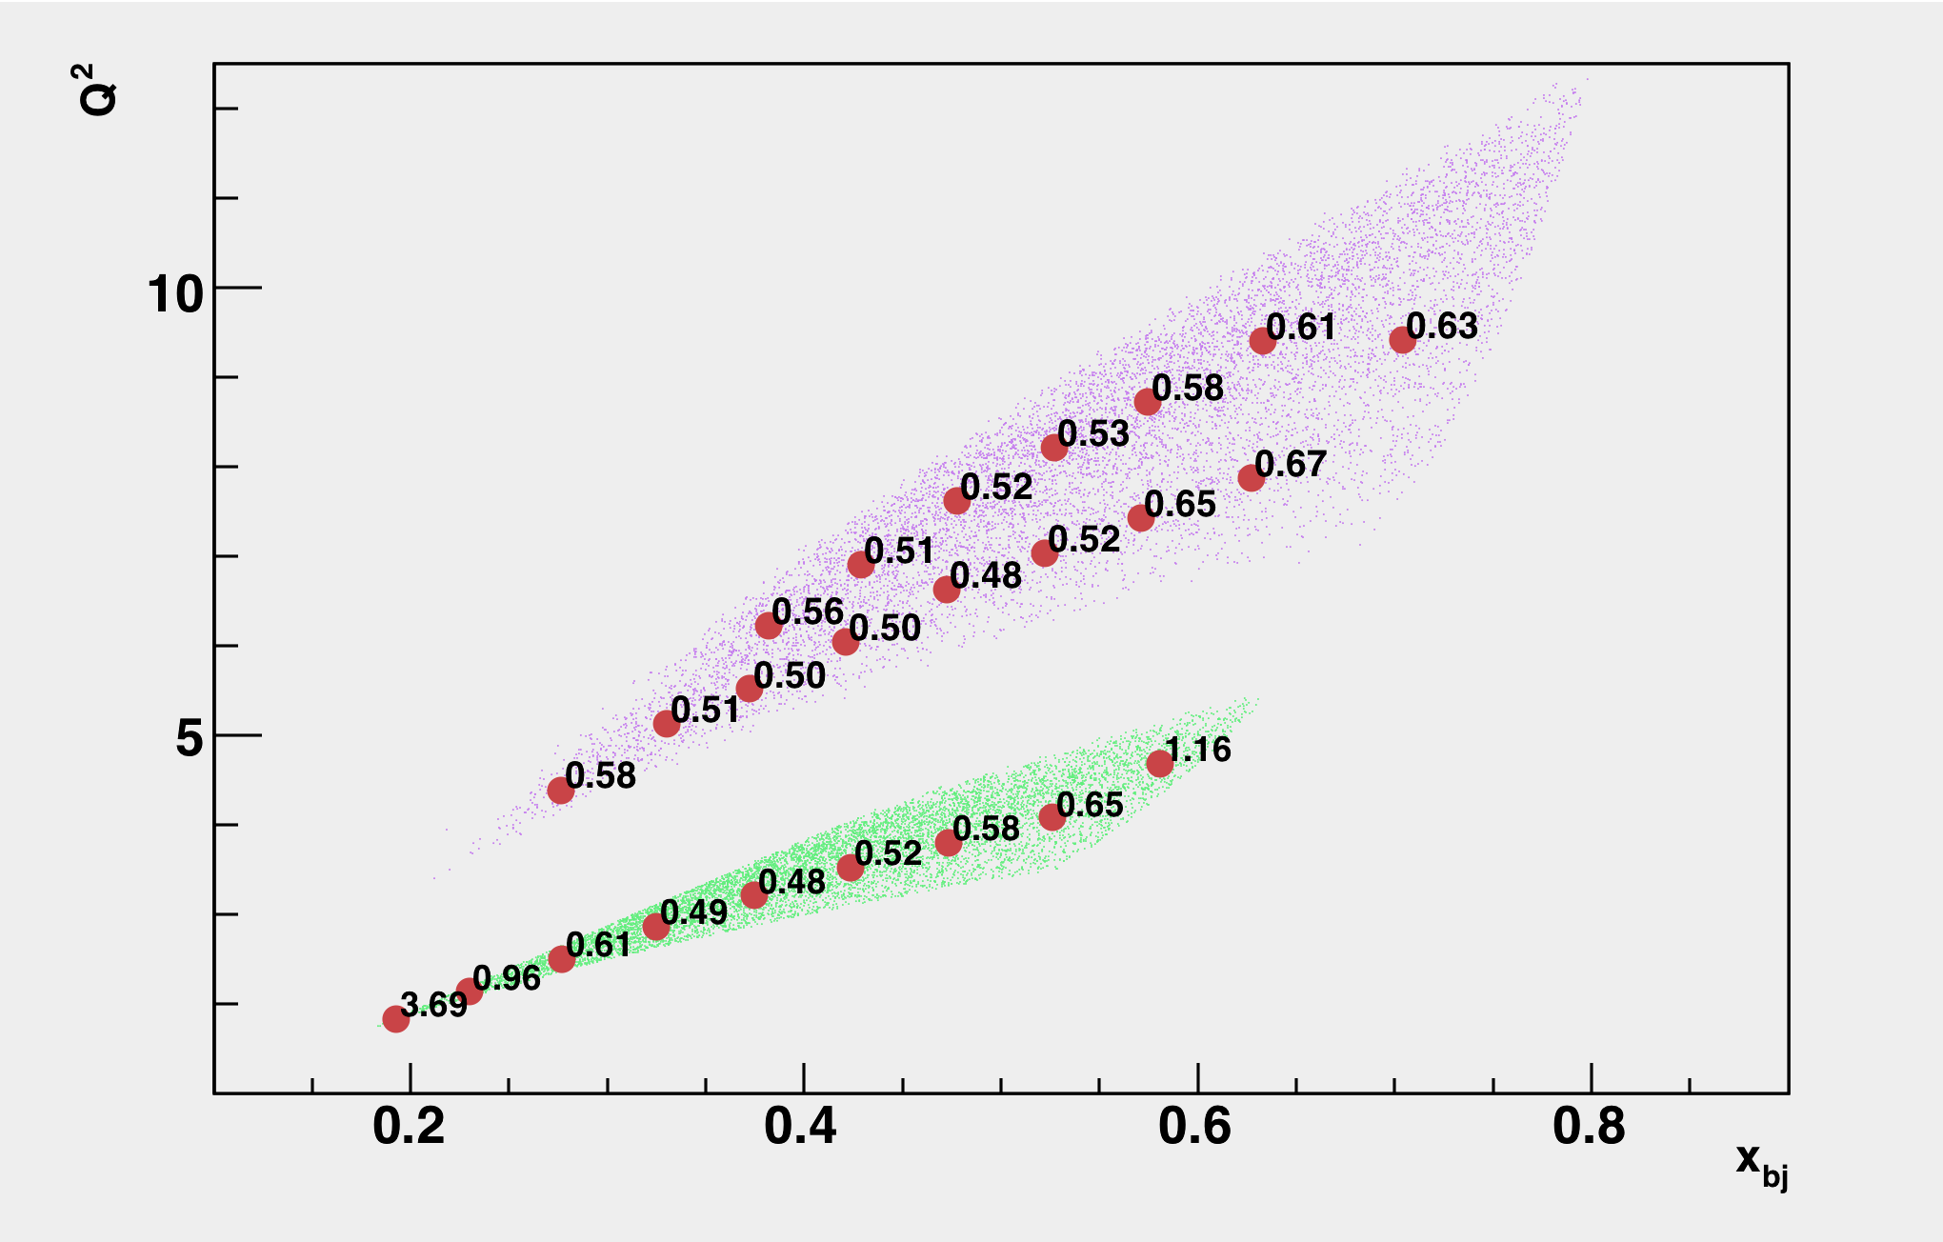

Program of Measurements
Requires 12 GeV upgrade of JLab and a large superconducting solenoid
Requirements
statistical error bar σ_{A}/A (%)
shown at center of bins
in Q², x
High Luminosity with E > 10 GeV
Large scattering angles (for high x & y)
Better than 1% errors for small bins
x-range 0.25-0.75
W² > 4 GeV²
Q² range a factor of 2 for each x
(Except at very high x)
Moderate running times
4 months at 11 GeV
2 months at 6.6 GeV
Strategy: sub-1% precision over broad kinematic range: sensitive Standard Model test and detailed study of hadronic structure contributions
If no CSV, HT, quark sea or nuclear effects, ALL Q², x bins
should give the same answer within statistics modulo kinematic factors!

Slide 25
Error Budget (%)
Statistics
0.3
Polarimetry
0.4
Q2
0.2
Radiative Corrections
0.3
Total
0.6

Slide 26
Running time
Strategy: sub-1% precision over broad kinematic range for sensitive
Standard Model test and detailed study of hadronic structure contributions
Untangle Physics with fit:
Error bar σ_{A}/A (%)
shown at center of bins
in Q², x
Beam Time Request:
LD₂: 245 Days
LH₂: 113 Days
4 months at
11 GeV
Energy(GeV) Days(LD2) Days(LH2) | 4.4 18 9 | 6.6 60 - | 11 120 90 | Test 27 14
2 months at 6.6 GeV
180 Days are Approved

Slide 27
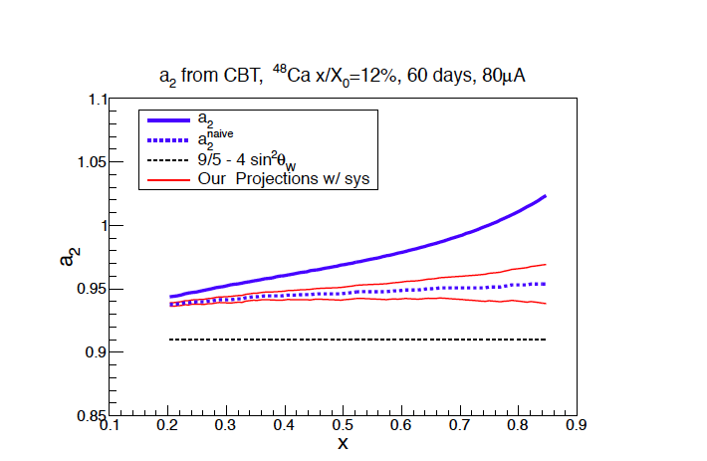
EMC Effect on CSV (New Proposal)

Slide 28
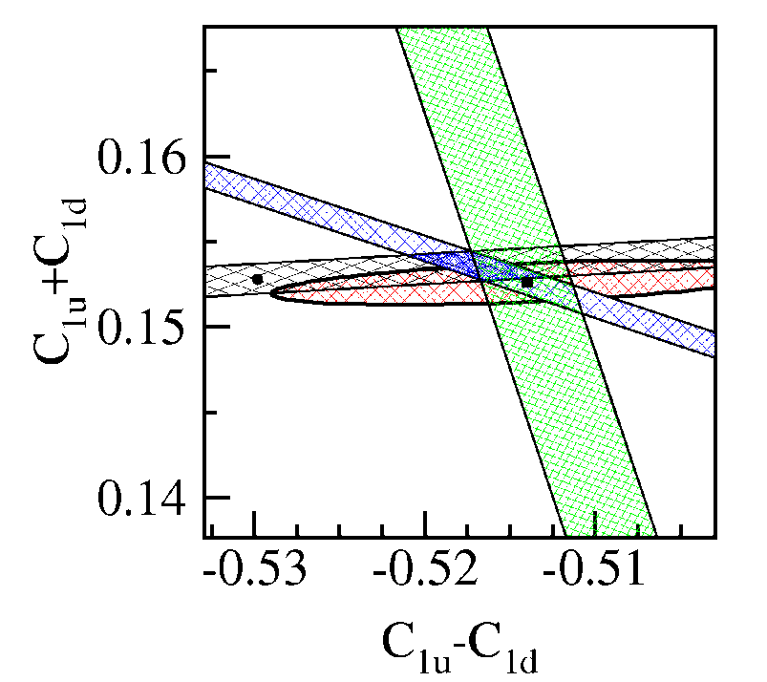
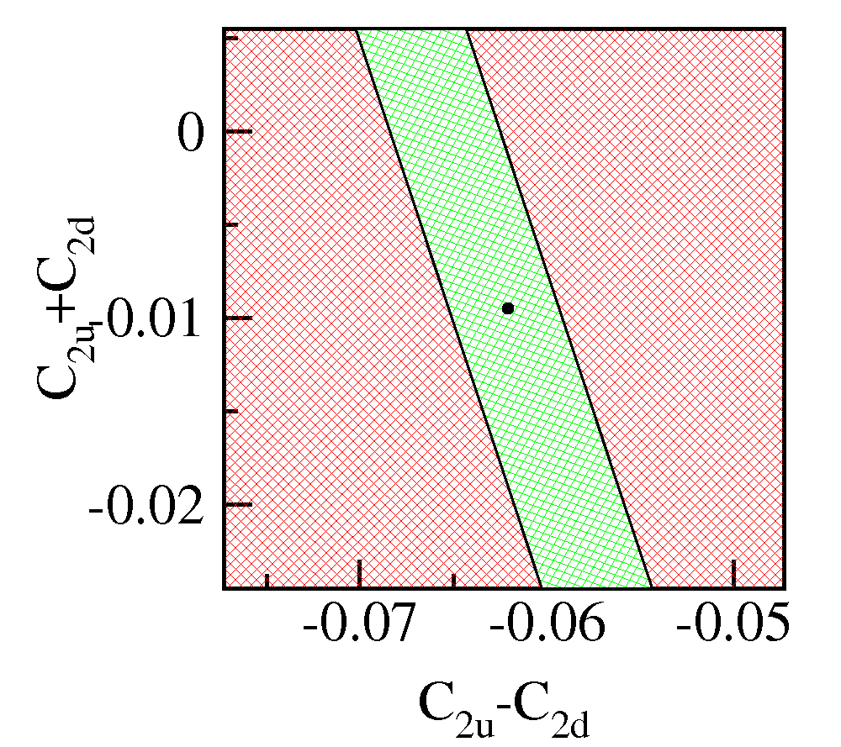
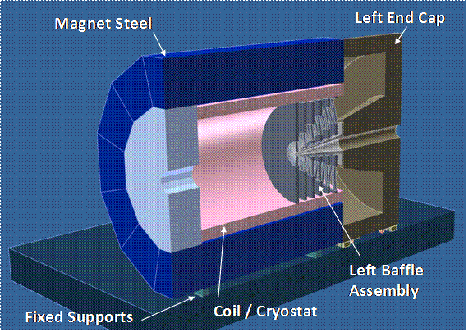
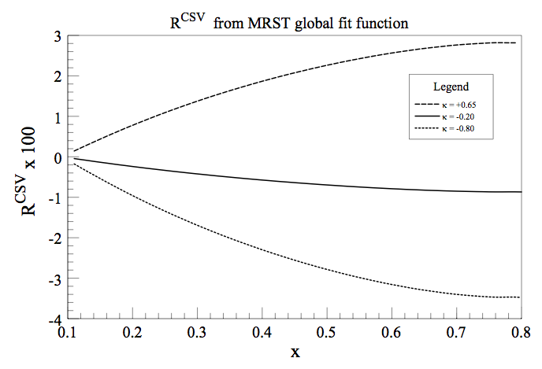
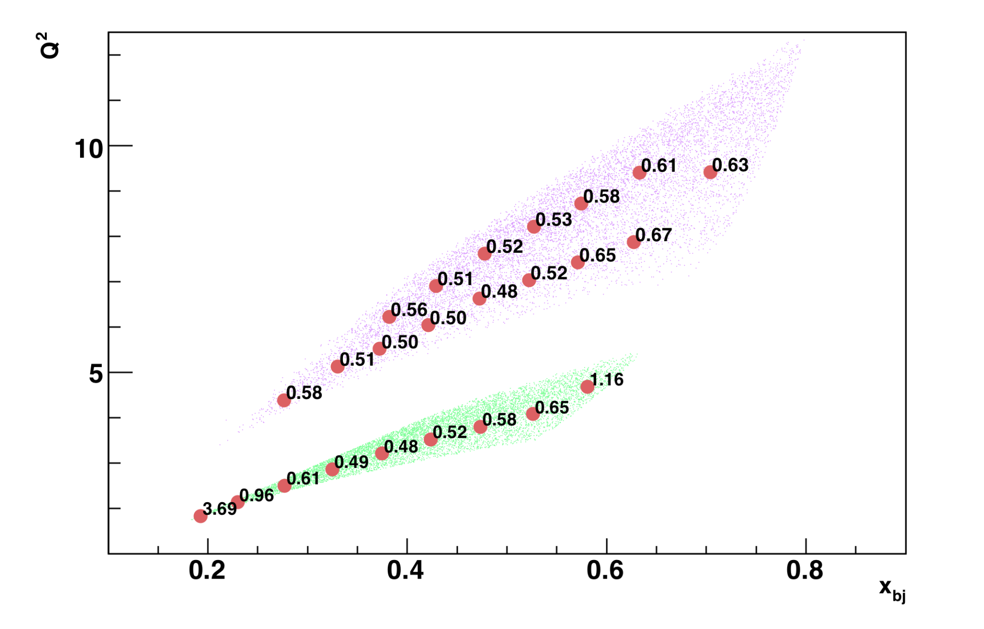
Summary
Precision Data
Qweak
PVDIS
PVDIS
Uncertainty from PDG fit
Cs
Measurements of Parity Violation in Deep Inelastic Scattering contain a wealth of information about:
  The Standard Model
  Charge Symmetry (CSV)
  Higher Twist (HT)
For the complete picture—to unravel the full richness of the physics reach of this process a dedicated—a large-acceptance spectrometer is needed.
SoLID will also provide critical nuclear structure test (NuTeV sin²θ_{W})
Large additional program of SI-DIS planned for SoLID spectrometer
MRST global fit
12 GeV
90% CL
x_{Bj}

Slide 29
