Slide 1
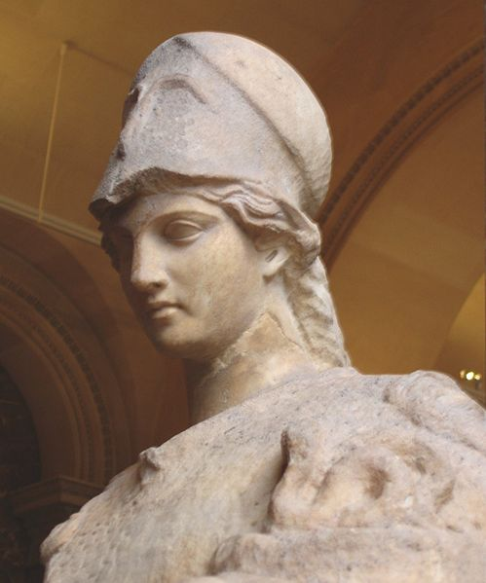
Near Threshold Electroproduction of at 11 GeV
Z.-E. Meziani
on
behalf
of the spokespeople
Kawtar Hafidi (ANL), Xin Qian (Caltech/BNL) , Nikos Sparveris (Temple)
and
Zhiwen Zhao (UVA)
for
the ATHENNA Collaboration

Slide 2
Outline
Physics Motivation
Proposed Measurement & Experimental Setup
Backgrounds and Projected Results

Slide 3
Physics Motivation
Exploring and understanding some aspects of the strong regime of QCD.
Strong gluonic interaction between two color neutral objects and
Uses to probe color fields in the nucleon (minimal quark exchange)
Test the production mechanism of in a nucleon
Probes an important quantity in the description of the mass of the nucleon, namely the conformal (trace) anomaly of low energy interaction
A unique opportunity by exploring the threshold region and taking advantage of the high luminosity of CEBAF and the new energy reach namely 11 GeV

Slide 4
Statements from experts in the field!
“Low-energy J/psi-N interaction is a probe of the scalar gluon form factor of the nucleon. This quantity is of fundamental importance since it is related to conformal anomaly of QCD and to the origin of the nucleon's mass”.
Dima Kharzeev (Stony Brook)
“I am very enthusiastic about the physics of J/psi production at JLab” refer to:http://www-public.slac.stanford.edu/sciDoc/docMeta.aspx?slacPubNumber=SLAC-PUB-14985
Stan Brodsky (SLAC, Stanford)

Slide 5
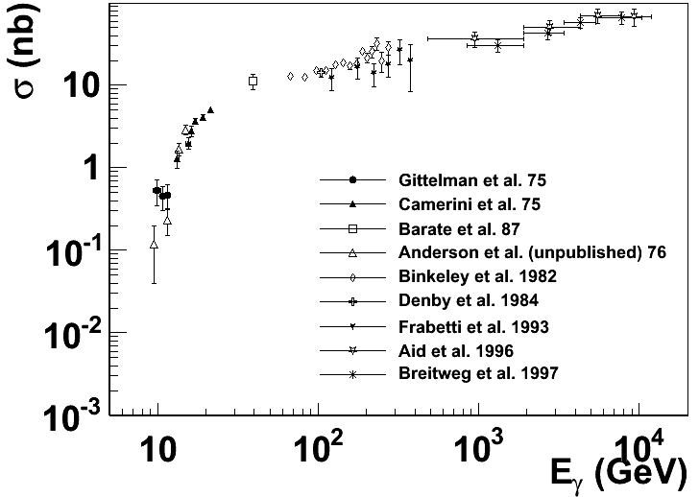
Experimental status
More data exist with inelastic scattering on nuclei, such as A-dependence.
Not included are the most recent results from HERA H1/ZEUS at large momentum transfers and diffractive production with electro-production
SLAC, Cornell, Fermilab, HERA …
The physics focus is this threshold region

Slide 6
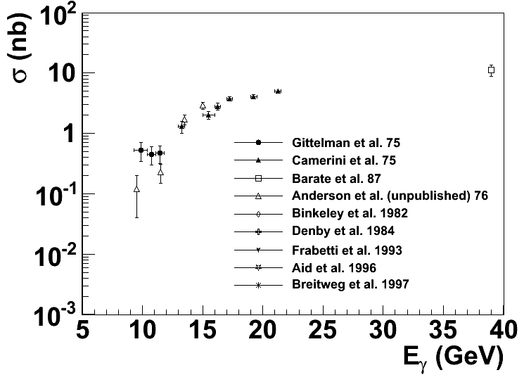
Near Threshold
Enhancement ?
?
Intense experimental effort (SLAC, Cornell … ) shortly after the discovery of J/ψ
But near threshold not much since (~40 years till now)

Slide 7
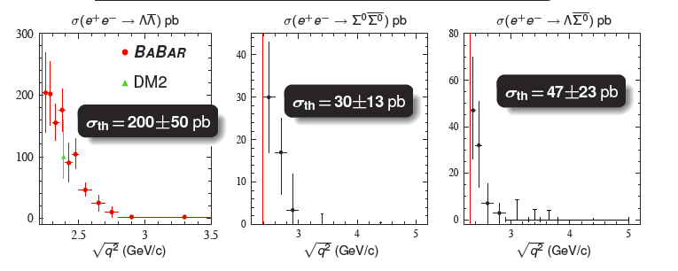
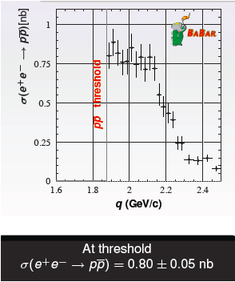
Threshold Enhancement is not rare!
Summary of NPCFiQCD Workshop
http://quarks.temple.edu/~npcfiqcd

Slide 8
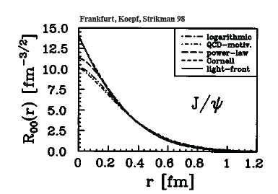
J/ψ as probe of the strong color fields in the nucleon!
J/ψ is a charm-anti-charm system
Little (if not zero) common valence quark between J/ψ and nucleon
Quark exchange interactions are strongly suppressed
Charm quark is heavy
Typical size of J/ψ is 0.2-0.3 fm
Probe of “hard” gluon

Slide 9
Interaction between J/ψ-N
New scale provided by the charm quark mass and size of the J/ψ
Lattice QCD, OPE, Phenomenology …
High Energy region: Pomeron picture …
Medium/Low Energy: 2-gluon exchange
Very low energy: QCD color Van der Waals force
Prediction of J/ψ-Nuclei bound state
Brodsky et al. ….
Experimentally no free J/ψ are available
Challenging to produce close to threshold!
Photo/electro-production of J/ψ at JLab is an opportunity

Slide 10
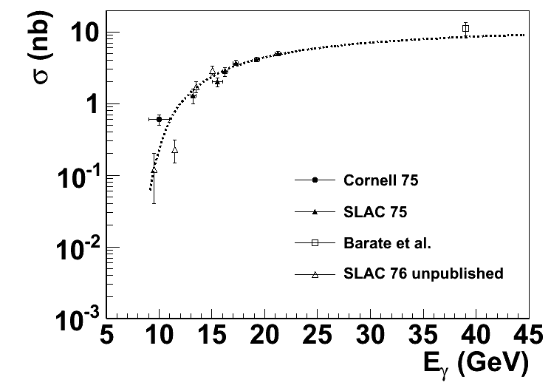
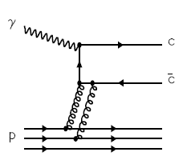
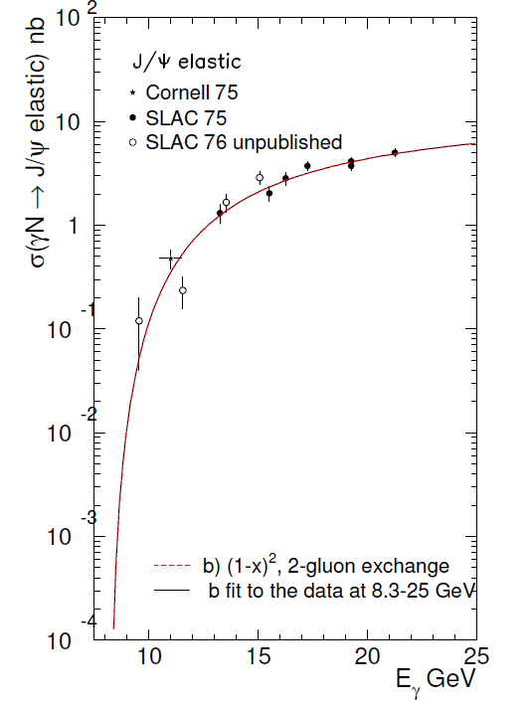
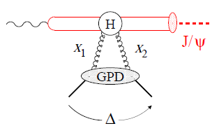
Reaction Mechanism ?
Models-I: Hard scattering mechanism (Brodsky, Chudakov, Hoyer, Laget 2001)
?
Models -II: Partonic soft mechanism (Frankfurt and Strikman 2002)
2-gluon Form Factor
PRD66, 031502 (2002)
Notes:
Slides, Slides, cartoon behavior plots,
Emphasize Luminosity/quality of CEBAF + capability of SoLID
F. F. form factor (see like)

Slide 11
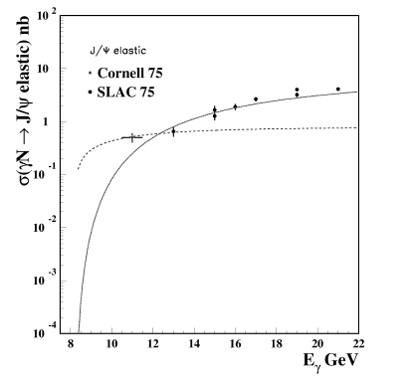
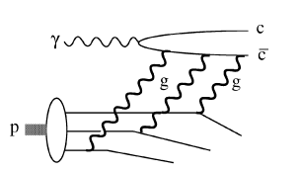
Reaction Mechanism?
Models (I): Hard scattering
(Brodsky, Chudakov, Hoyer, Laget 2001)
Add in 3-gluon scattering
?

Slide 12
Nucleon Mass Puzzle and the Trace Anomaly

Slide 13
Conformal (Trace) Anomaly
Connecting
Trace of energy momentum tensor
“Beta” function energy evolution of strong
interaction coupling constant
Decomposition of Proton mass [X. Ji PRL 74 1071 (1995)]
CM frame
Trace Anomaly
Gluon Energy
Quark Energy
Quark Mass

Slide 14
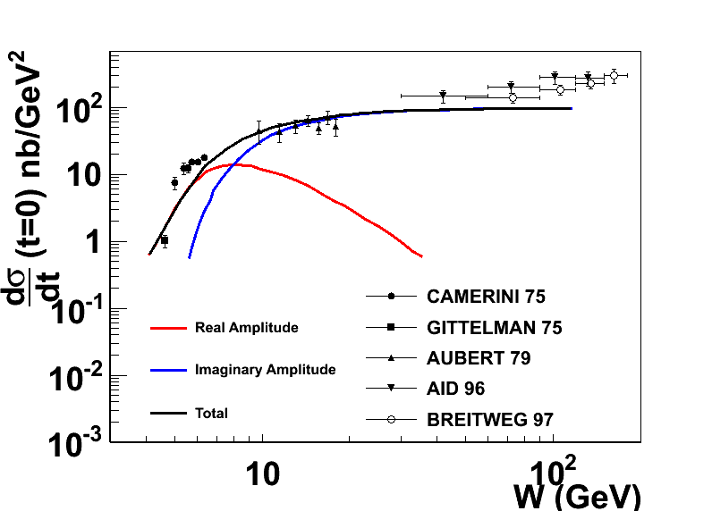
Another view: Reaction mechanism with FSI?
D. Kharzeev. Quarkonium interactions in QCD, 1995
D. Kharzeev, H. Satz, A. Syamtomov, and G. Zinovjev, Eur.Phys.J., C9:459–462, 1999
Imaginary part is related to the total cross section through optical theorem
Real part contains the conformal (trace) anomaly
Dominate the near threshold region
A measurement near threshold could shed light on the conformal anomaly
Notes:
Add the reference of the figure.

Slide 15
Proposal E12-12-006
Measure the t dependence and energy dependence of J/ψ cross sections near threshold.
Probe the nucleon strong fields in a non-perturbative region
Search for a possible enhancement of the cross section close to threshold
Shed some light on the conformal/trace anomaly
Establish a baseline for J/ψ production in the JLab energy range!
Bonuses:
Decay angular distribution of J/ψ
Interference with Bethe-Heitler term (real vs. imaginary)
Future Plans:
Search for J/ψ-Nuclei bound state
J/ψ medium modification

Slide 16
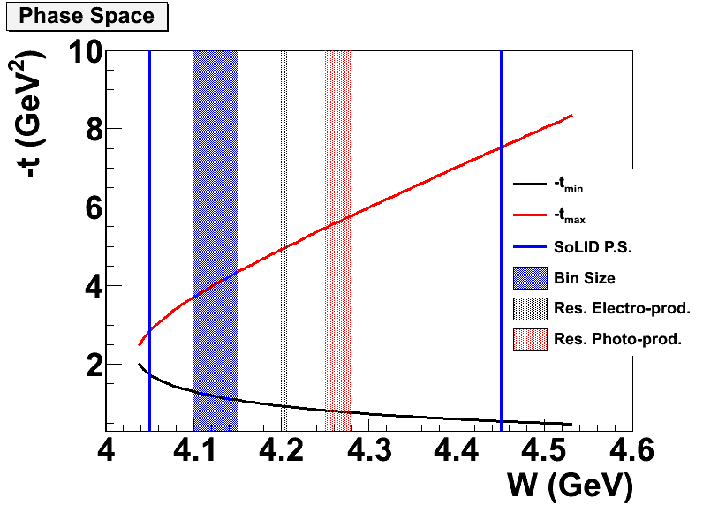
Electroproduction vs Photoproduction
Better resolution near threshold
use of a tagged photon beam
Larger coverage in t
Lower radiation budget
Less background (full exclusivity)
Near threshold
Large Q² smaller W

Slide 17
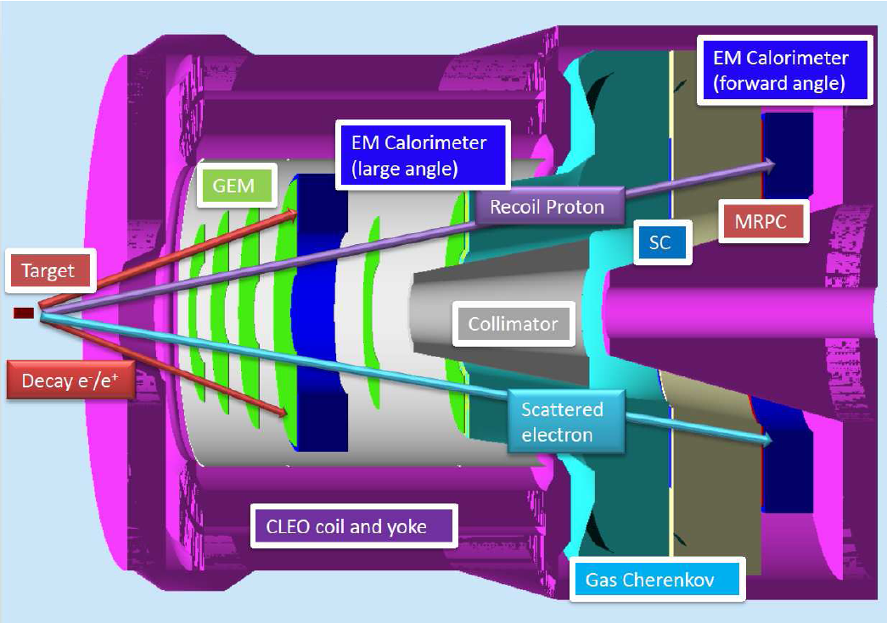
SoLID - Setup
Symmetric acceptance for e⁺ and e⁻

Slide 18
Experimental Overview
50 days of 3 beam on a 15 cm long LH₂ target at
10 more days include calibration/background run
SoLID design overall compatible with SIDIS with some changes
+10 cm of the radius of the first three GEM planes
Move large angle detector upstream by 12 cm
Opening angle at 26 degrees achieved by moving the front yoke forward
Main Trigger: Triple coincidence of e⁻e⁻e⁺

Slide 19
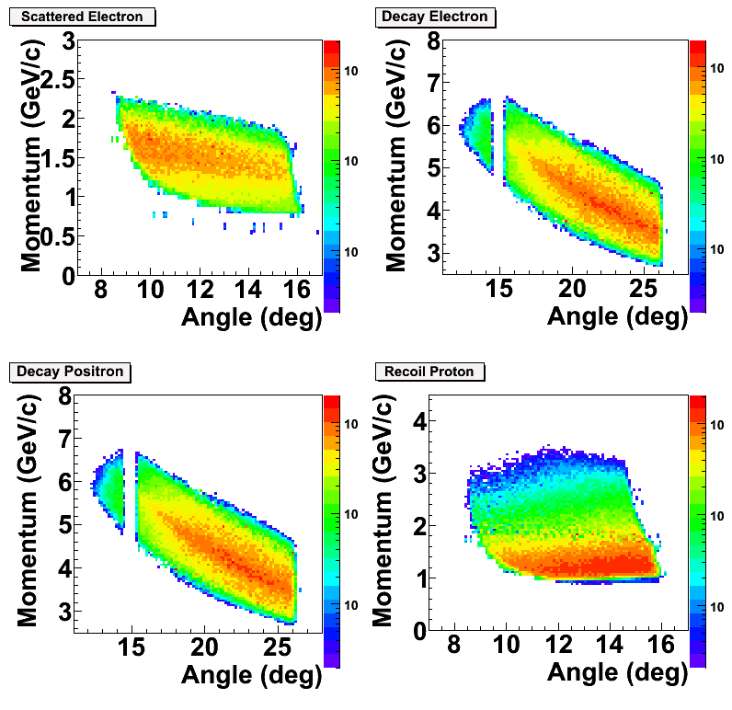
PID and Acceptance
Scattered electron:
GC + Calorimeter @ forward angle
Decay electron/Positron:
Calorimeter only at large angle
GC+Calorimeter at forward angle
Recoil proton:
100 ps TOF: 2 ns separation between p/K @ 2 GeV/c
~8m flight path
Main trigger rate is below 1 kHz with 50 ns coincidence window. Comparing to ~50 kHz design trigger rate for SIDIS.

Slide 20
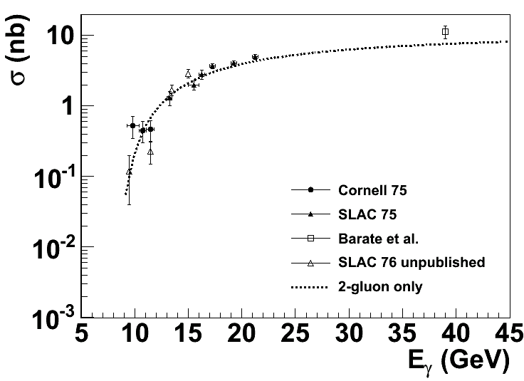
Rates Estimates
Used equivalent photon approximation
is the virtual photon flux and is the jacobian
Cross section is based on
Fits to data at high W
2-gluon
2-gluon + 3-gluon
(better fit include
Cornell data)

Slide 21
Event Counts @ 1x10³⁷ in 50 days
4-fold coincidence:
2g-only: 0.68 k events
2g + 3g: 2.9 k events
3-fold no proton:
2g-only: 2.1 k events
2g+3g: 8.08 k events
 | Time (Hour) | Time (Day)
LH2 at 11 GeV | 1200 | 50
Dedicated Al dummy run | 72 | 3
Optics and detector check out | 72 | 3
Special low luminosity | 96 | 4
Total | 1440 | 60
3-fold
4-fold

Slide 22
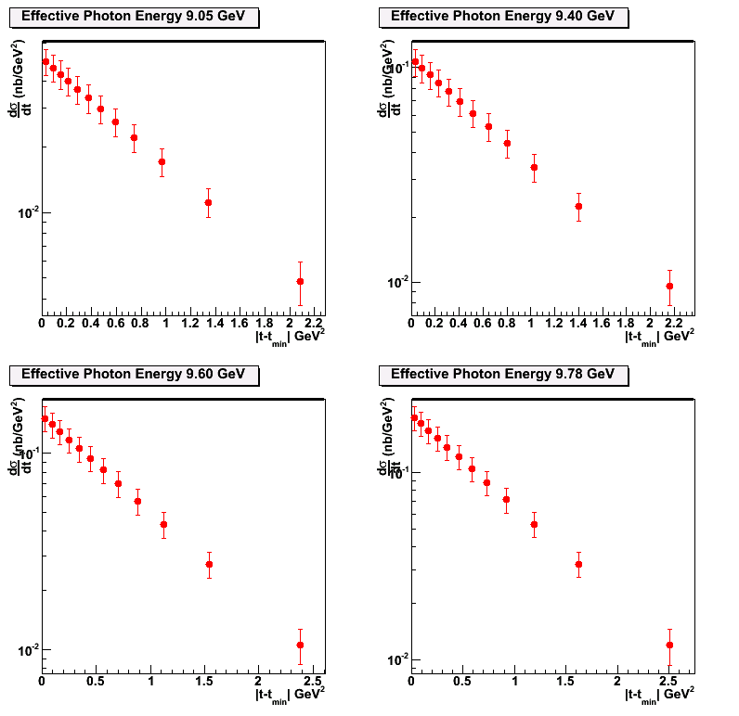
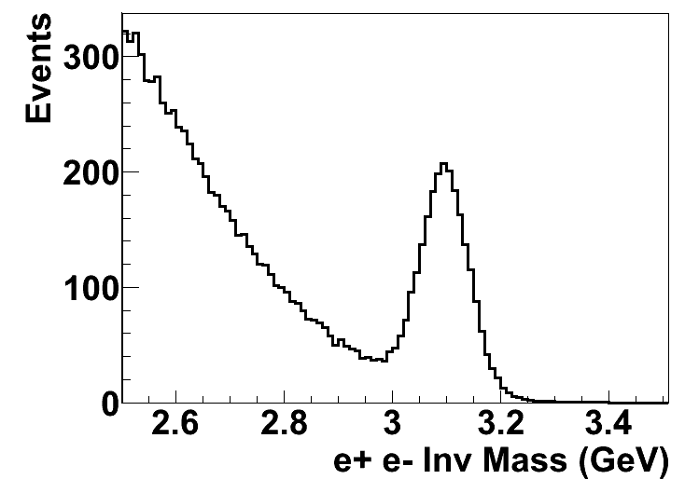
Projections of with 2-g model
Data will be first binned in t at different W (or effective photon energy) to study the t-dependence of the differential cross section
50 Days

Slide 23
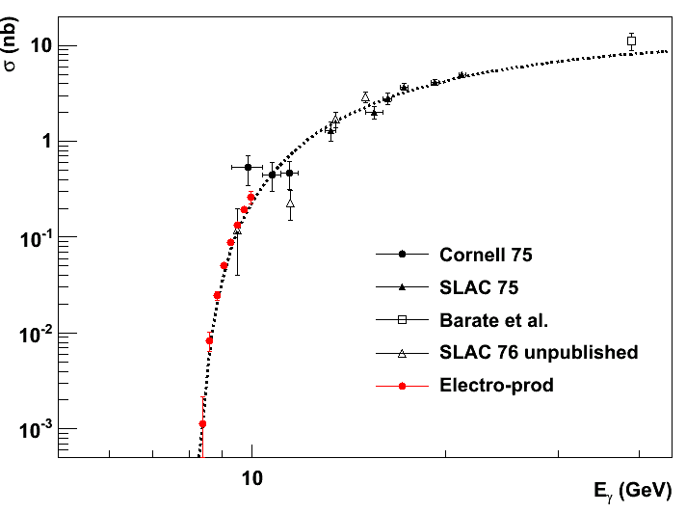
Projection of Total Cross Section
With < 0.01 GeV energy resolution in W and 8 energy bins in W to
study the threshold behavior of cross section.

Slide 24
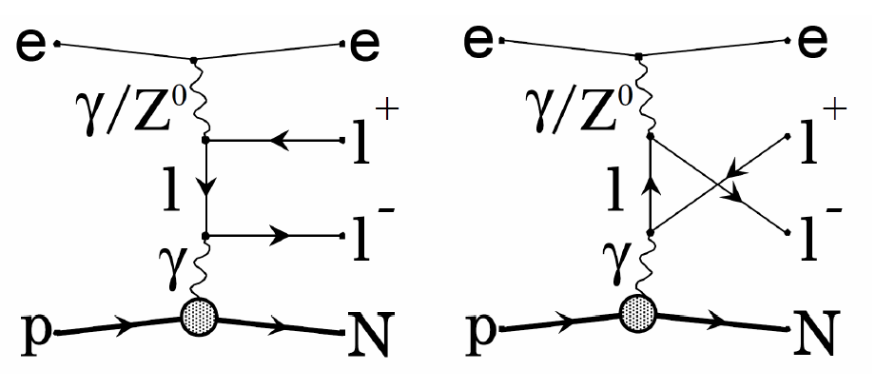
Physics Background
Due to large mass of J/ψ and near-threshold kinematics, little physics background
The main background is Bethe-Heitler term
B-H process calculated with GRAPE-Dilepton program. Compared with 2-gluon model assuming no threshold enhancement.
The t-dependence background level is acceptable.

Slide 25
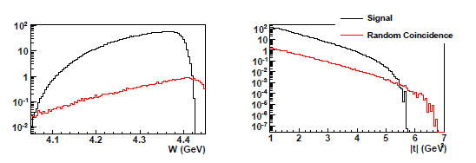
Random Coincidence Background
Studied/guided with Pythia and can be subtracted.
Largest contribution is from photo-J/ψ production random coincidence with a scattered electron.
With the same 2-gluon model, we calculated the random coincidence rate after all cuts and 6 ns window.
Do not expect a problem in both physics and random coincidence background!

Slide 26
Cross Section Validation (with leptonic/photon channels)
 | Bethe-Heitler | ω | ρ | φ | η
Cross Section | 0.1 ub | 1ub | 1ub | 50 nb | 10 ub
Decay Channel and BR | e⁺e⁻ 1.0 | e⁺e⁻ 7.30 10⁻⁵ | e⁺e⁻ 4.71 10⁻⁵ | e⁺e⁻ 2.97 10⁻⁴ | γγ 0.39
Compared to J/ψ | >10 | x2 | x1 | x0.5 | Large
SoLID capability | good | good | good | good | good

Slide 27
Systematic Budget
First experiment whose main goal is to measure a cross section with SoLID.
Goal: a 10-15% measurement.
Acceptance Effect: 10% for triple coincidence
Detector and Trigger Efficiency <2%
Target Luminosity: <2%
Contribution from Al wall <1%
Dummy run + target vertex Cut
Background Contamination ~0.5%
B-H background + Random Coincidence (measured directly)

Slide 28
Cross Section Validation Channel (Hadronic)
e+p elastic channel: (2.2 and 4.4 GeV beam)
SoLID Optics Calibration Channel for e-
SIDIS charged pion + neutral pion xsection (also DIS)
SIDIS program, comparing with Hall C measurement.
Exclusive Channel
Such as π⁰ production (1 hadron + 1 electron)
Missing Mass Technique
ω and ρ production (2 hadron + 1 electron trigger)
Pion Decay Channel (High Q² region)

Slide 29
Beam request
We request 50 days of beam on target to measure the electroproduction and “photoproduction” of J/Psi at threshold
We request 10 days for Al dummy run, Optics and special low luminosity run
In total we request
60 days
 | Time (Hour) | Time (Day)
LH2 at 11 GeV | 1200 | 50
Dedicated Al dummy run | 72 | 3
Optics and detector check out | 72 | 3
Special low luminosity | 96 | 4
Total | 1440 | 60

Slide 30
ATHENNA Collaboration
J. Arrington, N. Baltzell, A. El Alaoui, D. F. Geesaman, K. Hafidi (Co-spokesperson), R. J. Holt, D. H. Potterveld, P. E. Reimer (Argonne National Laboratory, Argonne, IL)
X. Qian (Co-spokesperson) (California Institute of Technology, Pasadena, CA)
K. Aniol (California State University, Los Angeles, CA)
J. C. Cornejo, W. Deconinck, V. Gray (College of William & Mary, Williamburg, VA)
X. Z. Bai, H. X. He, S. Y. Hu, S. Y. Jian, X. M. Li, C. Shan, H. H. Xia, J. Yuan, J. Zhou, S. Zhou (China Institute of Atomic Energy, Beijing, P. R. China)
P. H. Chu, H. Gao, M. Huang, S. Jawalkar, G. Laskaris, M. Meziane, C. Peng, Q. J. Ye, Y. Zhang, X. F. Yan (Duke University, Durham, NC)
P. Markowitz (Florida International University, Miami, FL)
A. Afanasev (The George Washington University, Washington, DC)
F. J. Jiang, H. J. Lu, X. H. Yan (Huangshan University, Huangshan, P. R. China)
J. B. Liu, W. B. Yan, Y. Zhou, Y. X. Zhao (University of Science and Technology of China, Hefei, P. R. China)
K. Allada, A. Camsonne, J.-P. Chen, E. Chudakov, J. Gomez, M. Jones, J. J. Lerose, B. Michaels, S. Nanda, P. Solvignon, Y. Qiang (Jefferson Lab, Newport News, VA)
M. Mihovilovič, S. Širca (Jožef Stefan Institute of University of Ljubljana, Slovenia)
G. G. Petratos, A. T. Katramatou (Kent State University, Kent, OH)
Y. Cao, B.T. Hu, W. Luo, M. Z. Sun, Y.W. Zhang, Y. Zhang (Lanzhou University, Lanzhou, P. R. China)
T. Holmstrom (Longwood University, Farmville, VA)
J. Huang, X. Jiang (Los Alamos National Laboratory, Los Alamos, NM)
J. Dunne, D. Dutta, A. Narayan, L. Ndukum, M. Shabestari, A. Subedi, L. Ye (Mississippi State University, Mississippi State, MS)
E. Cisbani, A. d. Dotto, S. Frullani, F. Garibaldi (INFN-Roma and gruppo collegato Sanitá and Italian National Institute of Health, Rome, Italy)
M. Capogni (INFN-Roma and gruppo collegato Sanitá and ENEA Casaccia, Rome, Italy)
V. Bellini, A. Giusa, F. Mammoliti, G. Russo, M. L. Sperduto, C. M. Sutera (INFN-Sezione di Catania, Catania, Italy)
D. Y. Chen, X. R. Chen, J. He, R. Wang, H. R. Yang, P. M. Zhang (Institute of Modern Physics, Lanzhou, P. R. China)
C. E. Hyde (Old Dominion University, Hampton, VA)
L. El Fassi, R. Gilman (Rutgers University, Piscataway, NJ)
S. Choi, H. Kang, H. Kang, Y. Oh (Seoul National University, Seoul, Korea)
P. Souder and R. Holmes (Syracuse University, Syracuse, NY)
W. Armstrong, A. Blomberg, D. Flay, E. Fuchey, M. Paolone, N. Sparveris (Co-spokesperson), Z.-E. Meziani (Co-spokesperson/Contact), M. Posik, E. Schulte (Temple University, Philadelphia, PA)
K. Kumar, J. Mammei, S. Riordan (University of Massachusetts, Amherst, MA)
T. Badman, S. K. Phillips, K. Slifer, R. Zielinski (University of New Hampshire, Durham, NH)
H. Badhdasaryan, G. D. Cates, M. Dalton, D. Day, D. Keller, V. V. Nelyubin, K. Paschke, A. Tobias, Z. W. Zhao (Co-spokesperson), X. Zheng (University of Virginia, Charlottesville, VA)
F. R. Wesselmann (Xavier University of Louisiana, New Orleans, LA)

Slide 31
Summary
Exploring and understanding important aspects of the strong regime of QCD including the nucleon mass puzzle.
Strong gluonic interaction between two color neutral objects and
Uses to probe color fields in the nucleon (minimal quark exchange)
Test the production mechanism of in a nucleon
Probes an important quantity in the description of the mass of the nucleon, namely the conformal (trace) anomaly of low energy interaction
A unique opportunity by exploring the threshold region and taking advantage of the high luminosity of CEBAF and the new energy reach namely 11 GeV
Future: Physics program likely to expand
J/psi-Nucleus bound state
J/Psi propagation in nuclei

Slide 32
Backup slides

Slide 33
About SoLID-Jpsi Trigger
Requirements:
Satisfy electro-production (Triple coincidence trigger)
Satisfy photo-production (Double coincidence of Jpsi)
Try a double coincidence @ 100 ns

Slide 34
Triple Coincidence
Jpsi electron:
Large angle: >2.5 GeV
Forward angle: > 4.5 GeV
Same for Jpsi positron.
Double Coincidence (photo-production)
Same threshold as above can be used.
Now rate estimation: Nee next slide

Slide 35
Summary of Rates
Large angle:
Electron 35 kHz (2.5 GeV above)
Hadron: 0.6 MHz (2.5 GeV above)
Photon: 400 kHz:
Forward Angle (>4.5 GeV):
Electron: 150 kHz
Hadron: 0.2 MHz
Photon: 120 kHz:
Trigger:
1 Large Angle * (1 Large angle or 1 forward angle)
(435 +600./20.) e3* ( 435+600./20. + 150 + 120./20.+ 200./200.) e3 * 100e-9 = 29 kHz
A 50 ns window can reduce this to 15 kHz
A GEM pad readout
Can be compared with 1 kHz rate for triple coincidence

Slide 36
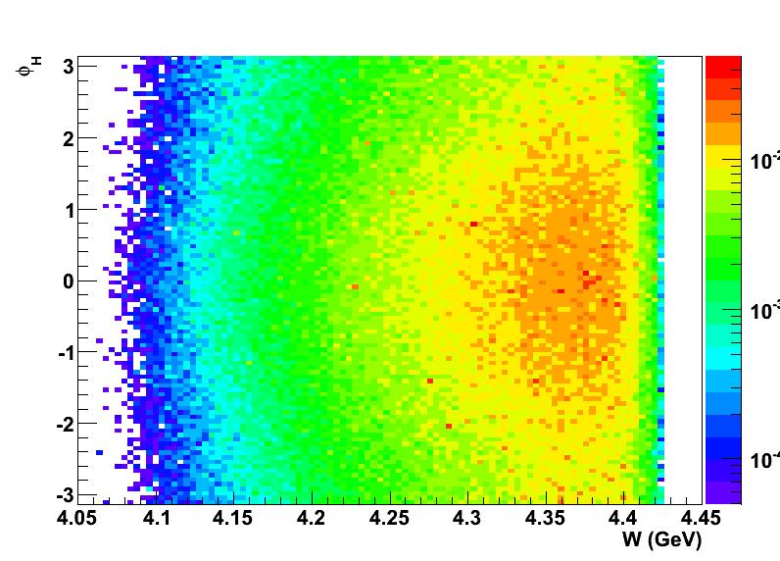
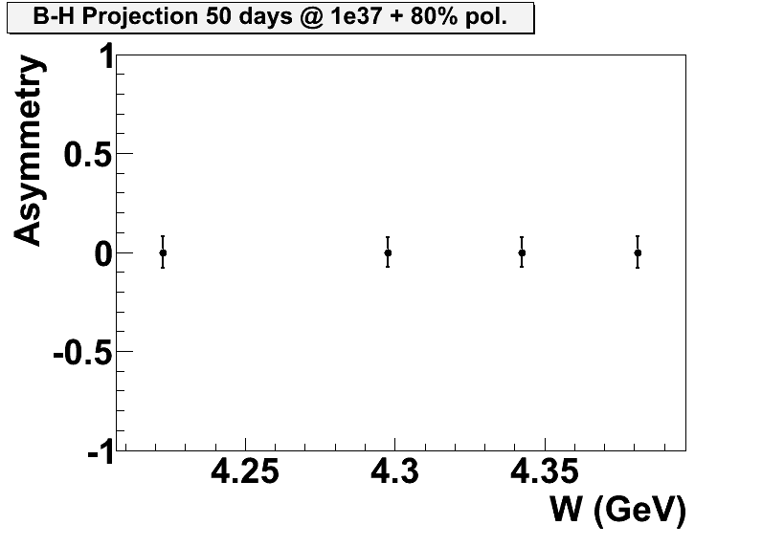
Projection on B-H interference
2-gluon interaction model. 2.1 k events in total. With angular separation included in the projection.

Slide 37
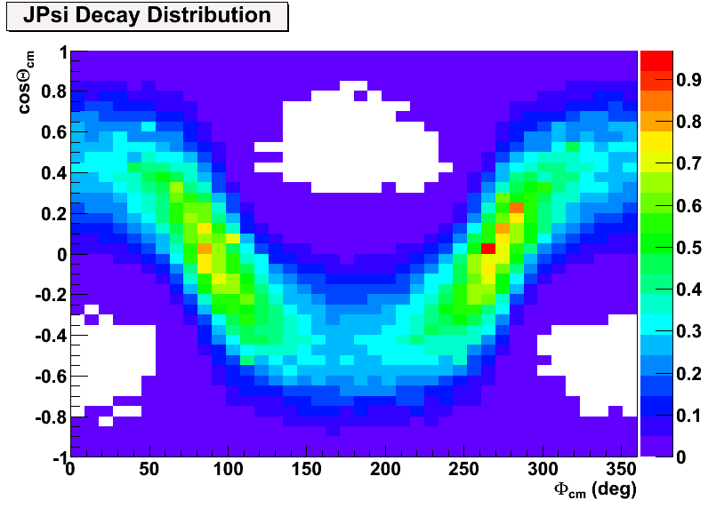
Angular Coverage
Also good coverage of azimuthal angle of J/ψ production angle due to 2π azimuthal coverage in the lab frame.
One can study the J/Ψ Decay Distributions at different kinematics.

Slide 38
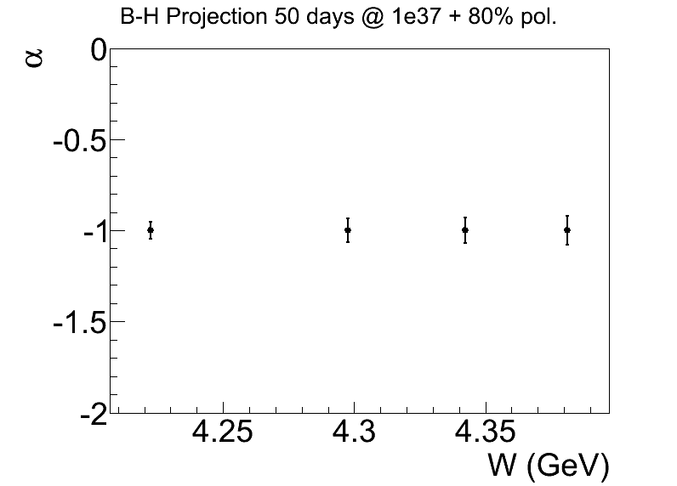
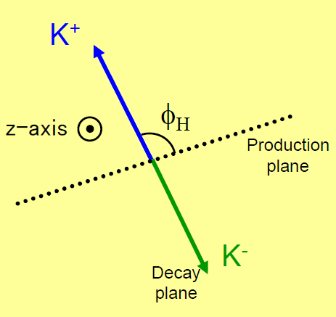
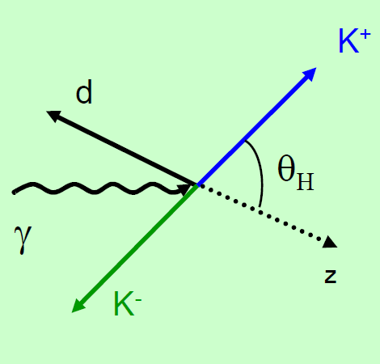
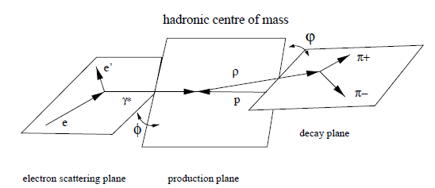
Projection in angular distribution
Alpha is sensitive to the reaction mechanism.

Slide 39
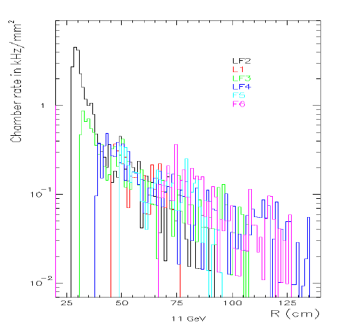
Backgrounds (GEM + MRPC)
Background Rate SoLID-J/Ψ-CLEO
Background Rate SoLID-Spin-CDF
Background rates on GEM are very close to the SoLID-Spin Setup.

Slide 40
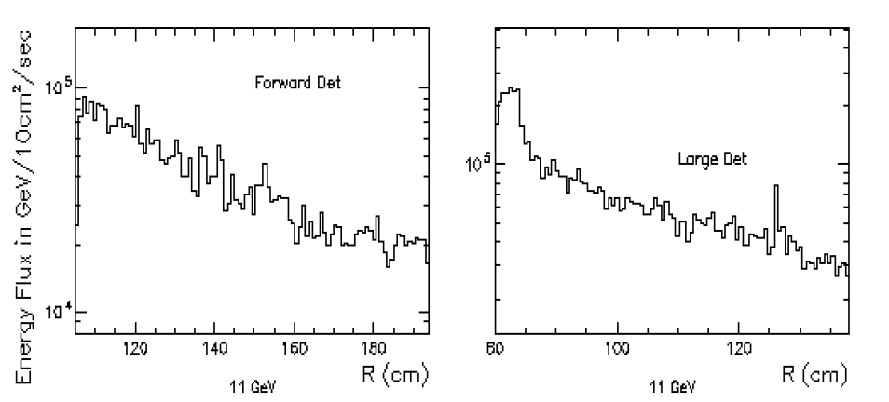
Backgrounds (Calorimeter)
Background Rate SoLID-J/Ψ-CLEO
Background Rate SoLID-Spin-CDF
Background rates on Calorimeter are slightly higher without the target collimator.

Slide 41
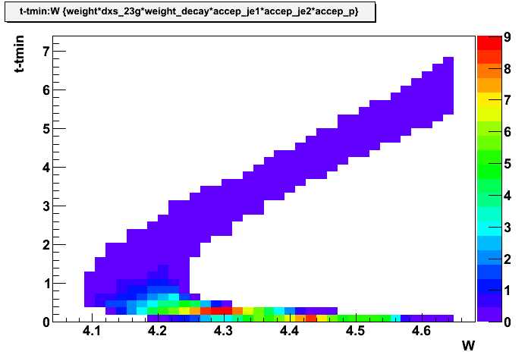
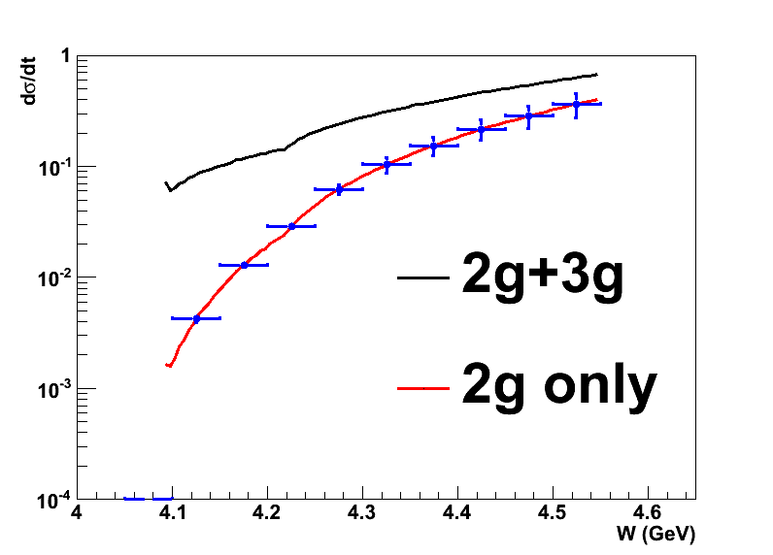
3-fold n.s.e.
2-3g: 70 k events
2 g: 20 k events
For |t-tmin|>0.5 GeV² or W<4.25
2-3g: 25.4 k events
2g: 3.8 k events
Decay Angular distribution at low t
Cross check eletro-production + threshold enhancement
All Events
High t events

Slide 42
Backgrounds (Random Coincidence)
We used e (scattered electron), p (recoil proton), Je (decay electron from J/Ψ) and Jp (decay positron from J/Ψ).
2-fold coincidence includes: (e,p)+(Je,Jp), (e,Je)+(p,Jp), (e,Jp)+(Je,p) and (e,Je,Jp)+(p), (e,Je,p)+(Jp), (e,Jp,p)+(Je), (p,Jp,Je)+(e)
3-fold coincidence includes: (e,p)+(Je)+(Jp), (e,Je)+(p)+(Jp), (e,Jp)+(p)+(Je), (Je,Jp)+(e)+(p), (Je,p)+(e)+(Jp), (Jp,p)+(e)+(Je)
4-fold coincidence is (e)+(p)+(Je)+(Jp)

Slide 43
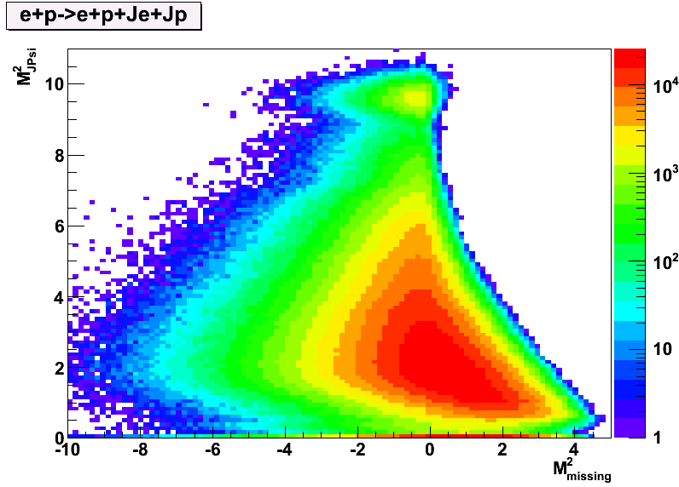
Suppression Factor is 8e⁻⁵ for (e,p) + (Je,Jp)
Random Coincidence Rate is then: 4.3 e-7 Hz
Physics Rate is 0.015 Hz in Pythia

Slide 44
2-Fold Random Coincidence (Can be subtracted)
Channel | Rate of first coin. | Rate of second coin. | Suppression Factor | Effective Rate (Hz)
(e,Je)+(Jp,p) | 0.28 kHz | 67 kHz | 3e-7 | 3.4e-8
(e,Jp)+(Je,p) | 0.035 kHz | 67 kHz | 5e-8 | 7.0e-10
(e,p)+(Je,Jp) | 22.3 kHz | 0.04 kHz | 8e-5 | 4.3e-7
(e,Je,Jp)+(p) | 0.01 kHz | 306 kHz | 9.3e-5 | 1.7e-6
(e,Je,p)+(Jp) | 0.04 kHz | 0.13 kHz | 1.3e-8 | 4e-13
(e,Jp,p)+(Je) | 0.0037 kHz | 460 kHz | 4.7e-7 | 4.8e-9
(Je,Jp,p)+(e) | 0.0048 kHz | 165 kHz | 1.75e-3 | 8.3e-6
Physics Rate is 0.015 Hz in Pythia, 1.2e-3 in our calculation
The background is expected to be < 1% level for (e,Je,Jp,p).
Long extended target at low beam current would help.
Random Coincidence should not be a problem.

Slide 45
Phase Space
Top left: Q2 vs. W
Top Right: t-tmin: W
Bottom Left: t: W
Bottom Right: t vs. Effective photon energy
Here W is calculate in gamma+d system
Effective photon energy is calculated with
W^2= 2*E*mass_d + mass_d^2

Slide 46
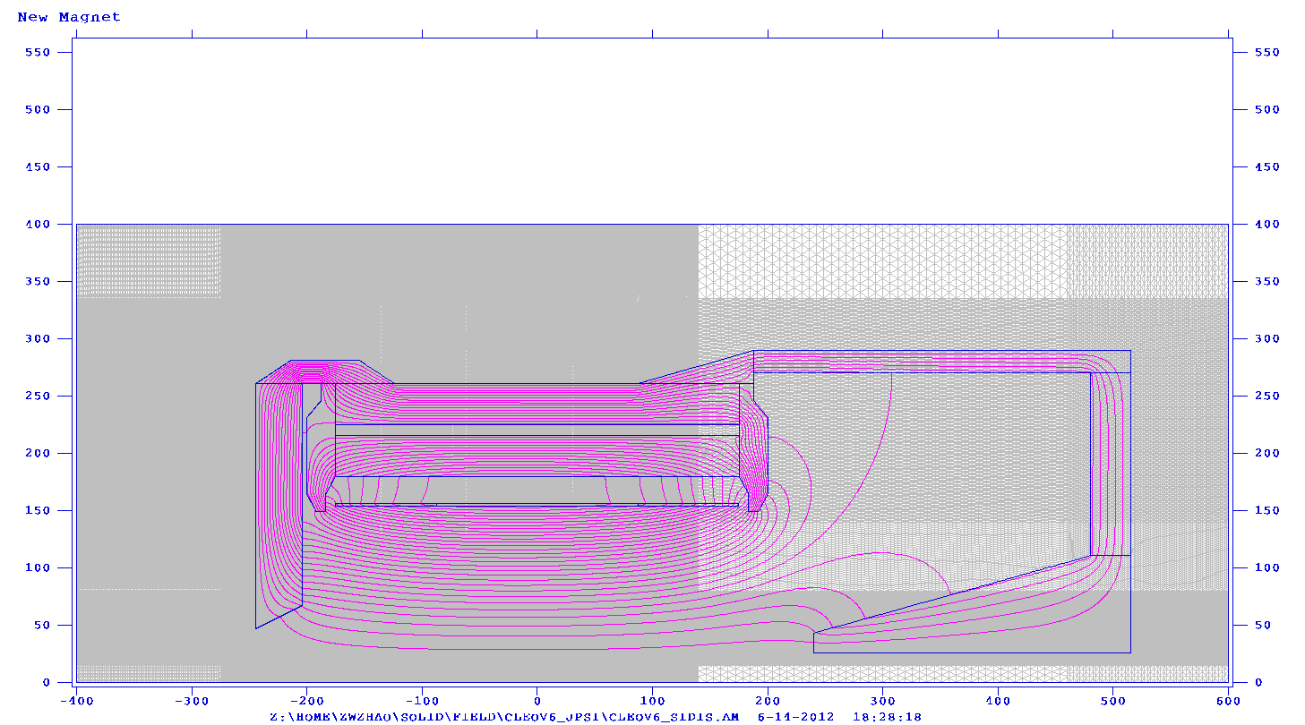
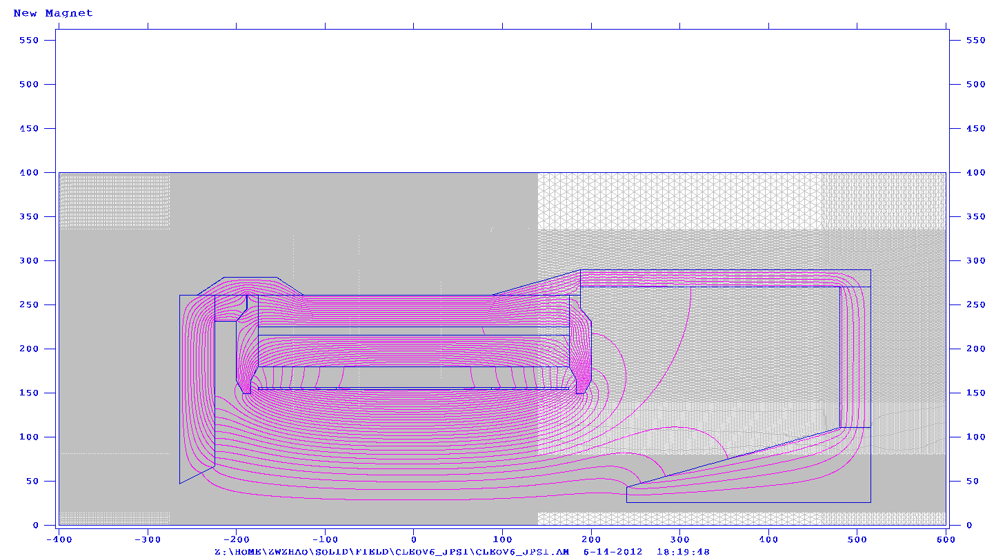
SoLID-SIDIS
target center at -350 cm
SoLID-JPsi
target center at -360 cm
New Ring
67
67
47
47
24⁰
26⁰
- 350
- 244
- 204
- 360
- 264
- 224

Slide 47
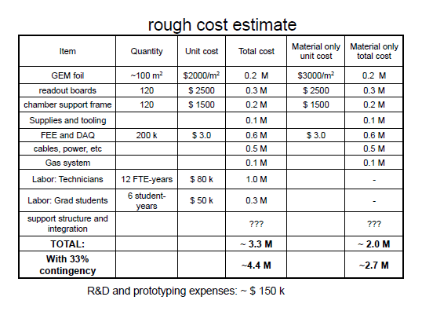
We expect a 5% increment in electronics and 10% increment in area.
The cost of material is 10% of the overall cost.
So total cost increment is about 6%.

Slide 48
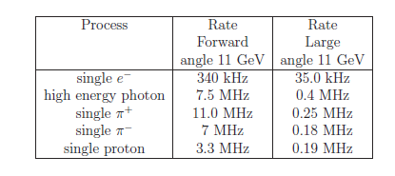
Background Rate

Slide 49
Longitudinal Polarization

Slide 50
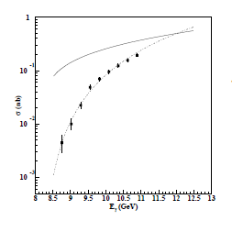
Comparison With Hall B
Hall A
50 days @ 1e37
Electro-production
2.1 k events
All in E<10 GeV
Resolution from scattered electron only
δW~0.008 GeV
Hall B
100 days @ 1e35
Photo-production
1.2 k events
Large part in E>10 GeV
Resolutions from recoil proton as well as decay pair from J/ψ

Slide 51
100 days at 5 10³⁷

