Slide 1
Study of SoLID Baffle, Background and Trigger
Zhiwen Zhao
UVa, ODU&JLab
2014/07/09

Slide 2
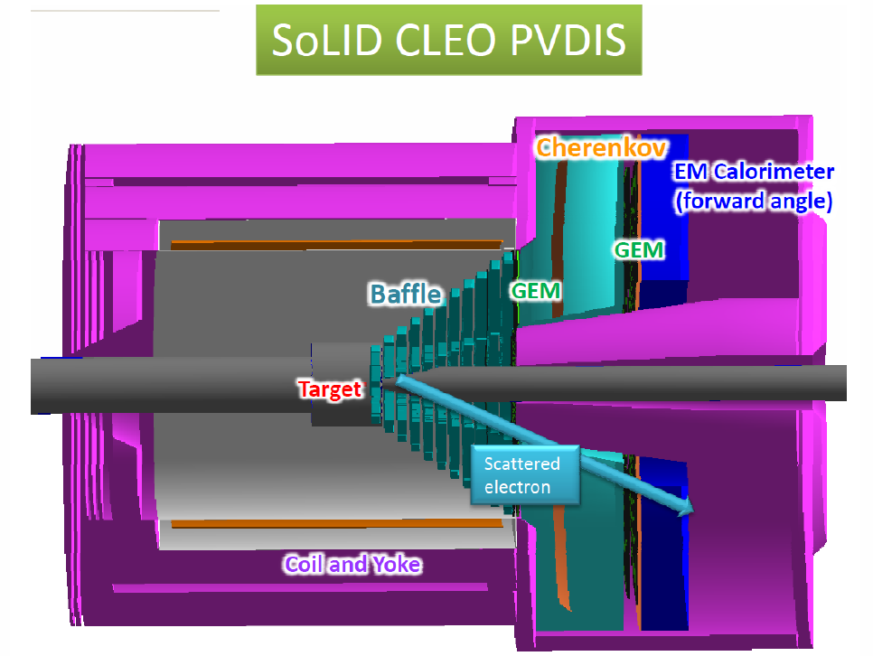
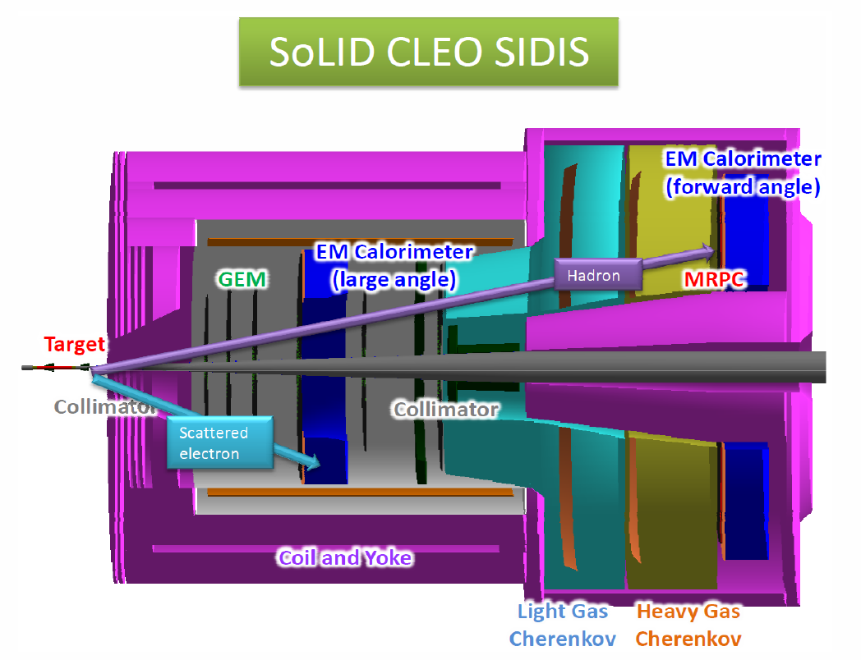
SoLID (Solenoidal Large Intensity Device)
Unique device combines large acceptance and high intensity
Optimize the design accordingly

Slide 3
Estimation of Radiation and Luminosity
 | PVDIS | SIDIS ³He
Beam | 50uA | 15uA
Target | LD2 40cm | 10amg He3 40cm
Window | Al 2*100um | Glass 2*120um
Radiation length (target) | 5.4e-2 | 0.8e-3
Radiation length (window) | 2.25e-3 | 3.4e-3
Radiation length (total) | 5.6e-2 | 4.2e-3
Luminosity (target) | 1.27e39 | 3e36
Luminosity (window) | 1e37 | 3.7e36
Luminosity (total) | 1.27e39 | 6.7e36
Comment | baffle | target window collimator

Slide 4
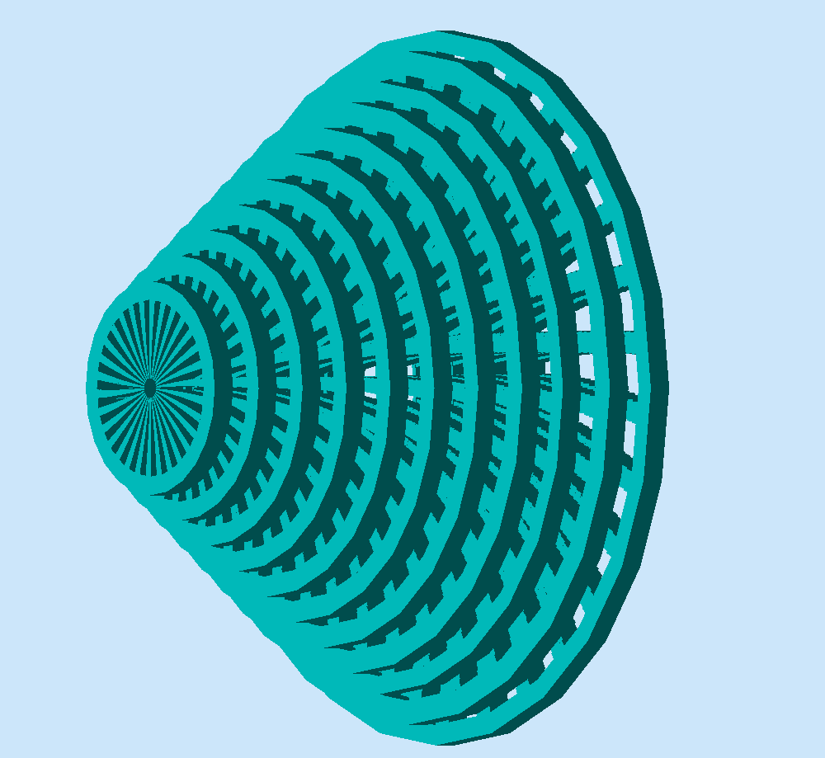
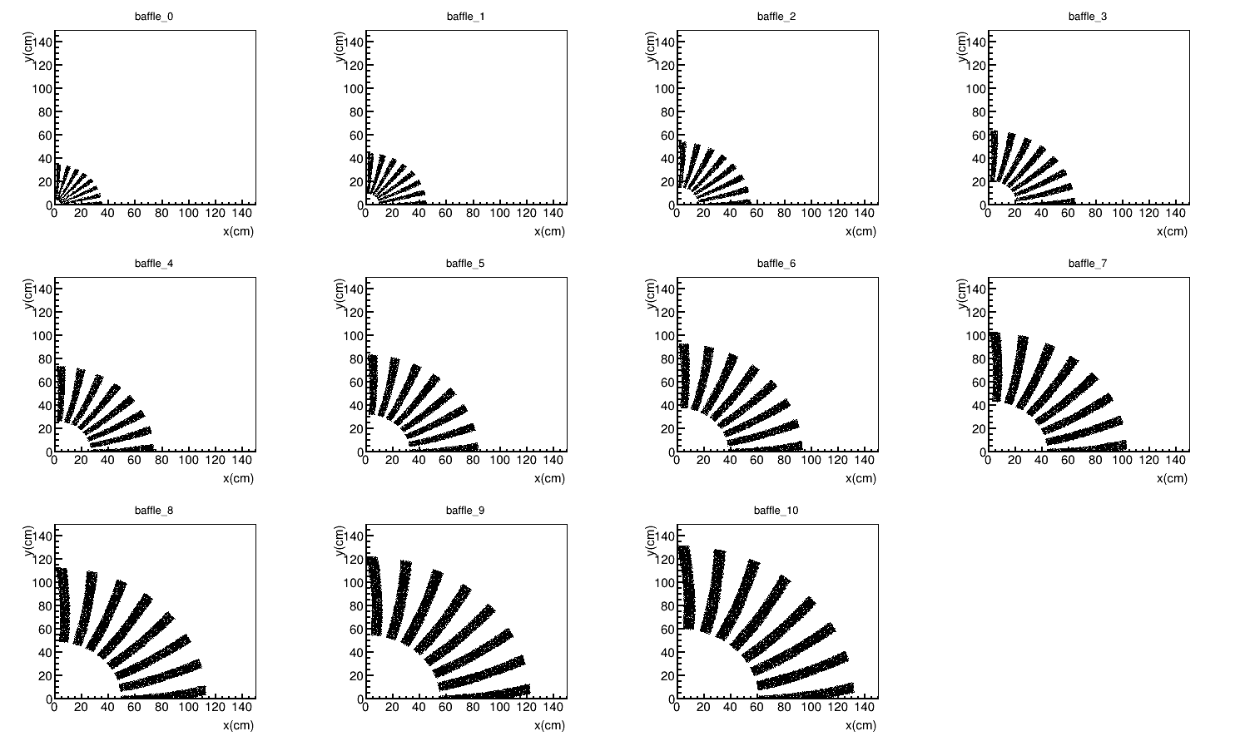
PVDIS Baffle 1st to 11th, 9cm thick lead plane each
Placed right after the target, enough material to block photons, pions and secondary particles.
Design guideline:
Follow charge particle bending in
SoLID CLEO field, preserve the
same azimuthal slice and
block line of sight

Slide 5
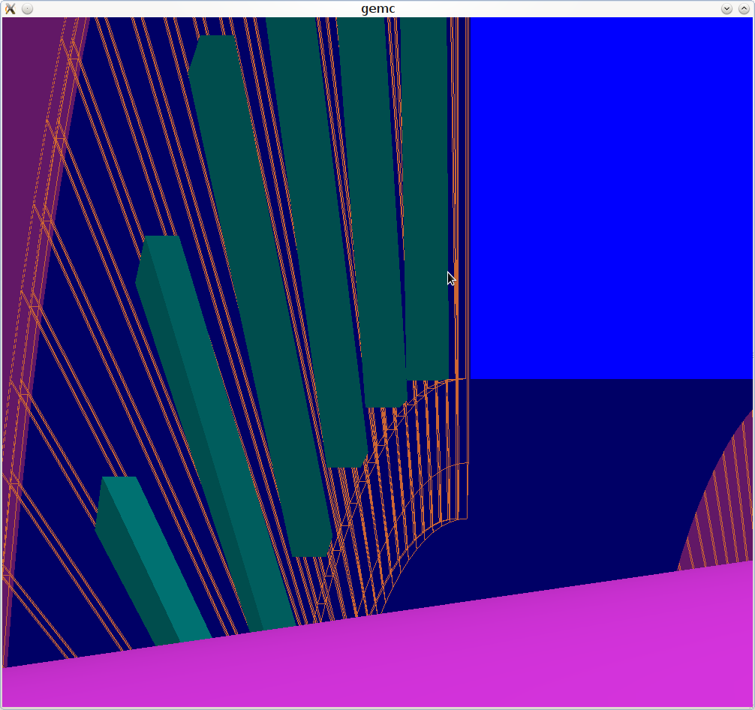
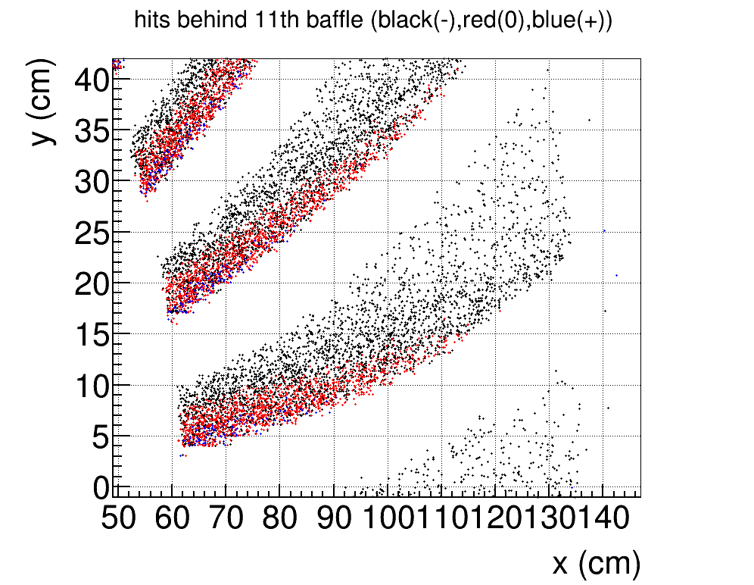
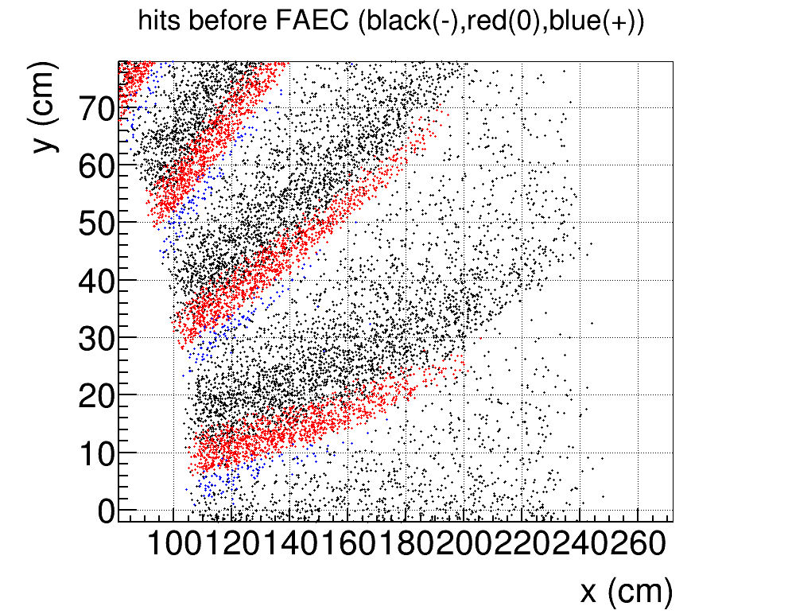
PVDIS Baffle 12th , 5cm lead plane (EC photon block)
High energy electrons has least bending, only separate from photons before EC

Slide 6
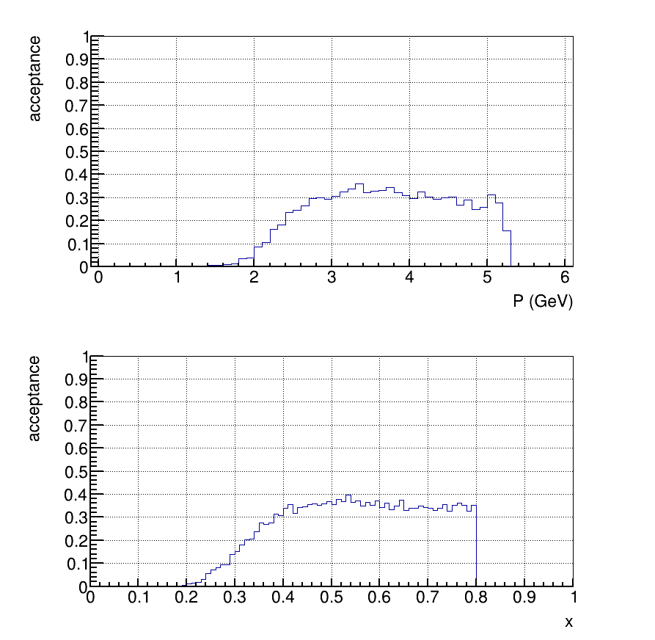
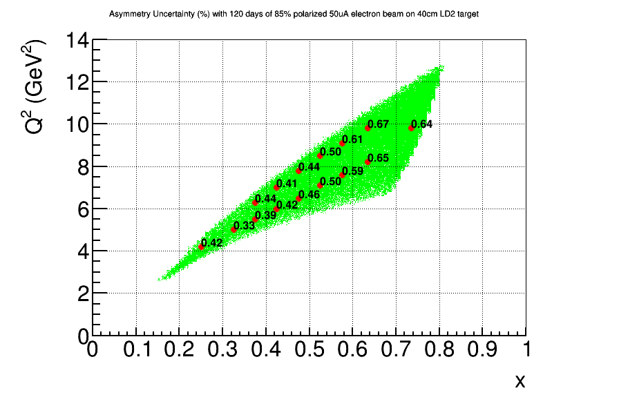
PVDIS Baffle: Impact on e(DIS)
e(DIS) flat ~30% acceptance at high P and high x
Ensure good FOM

Slide 7
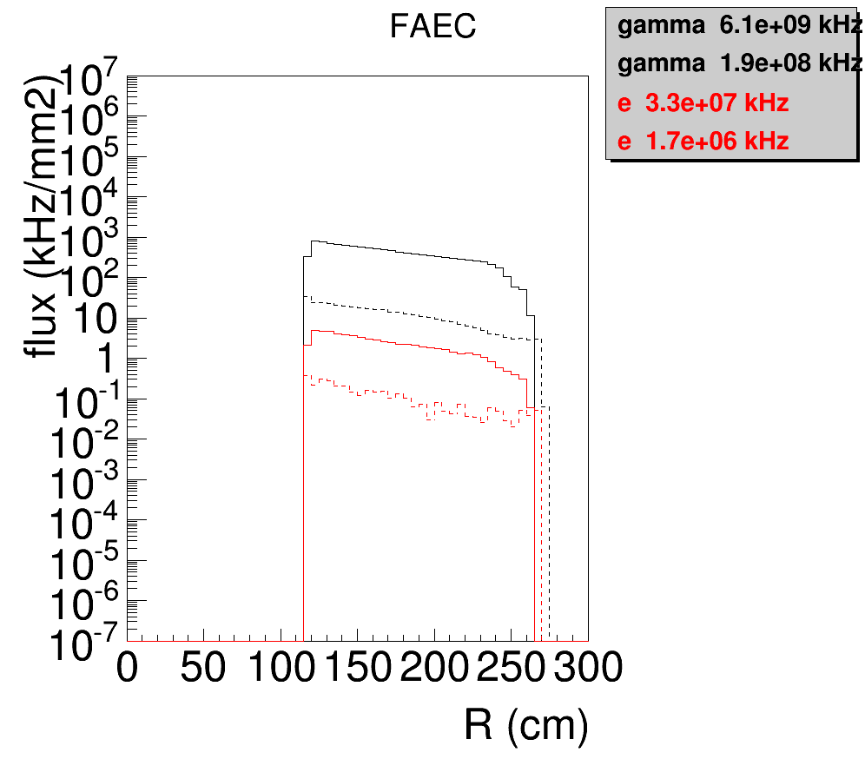
PVDIS Baffle: Impact on Background
EM background on FAEC reduce by factor 20 - 30

Slide 8
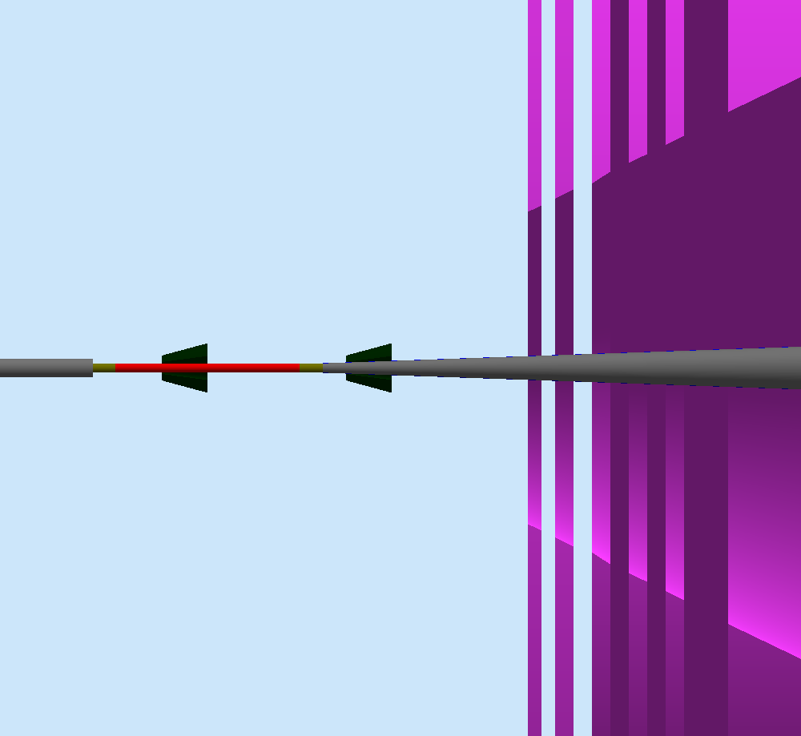
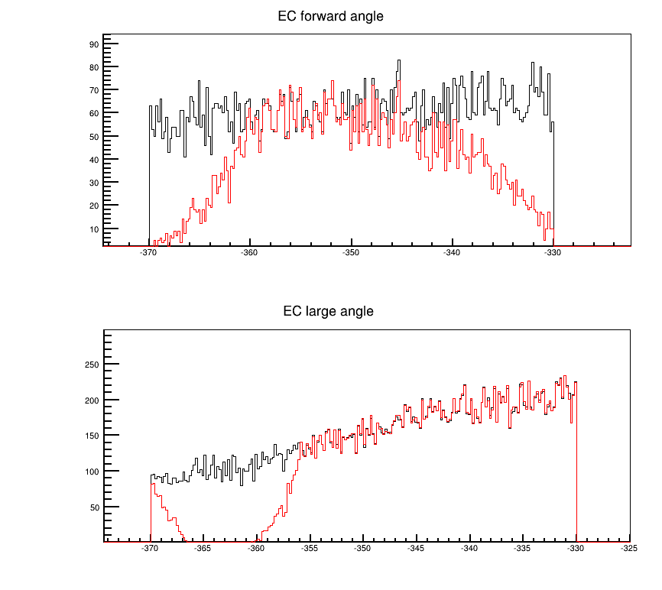
SIDIS ³He Target window Collimators
collimator
A pair of Tungsten collimators are optimized to block both low energy EM particles and hadrons from target windows into forward angle detectors
The accepted particles at forward angle and large angle EC are shown with (red) and without (black) the collimators
target

Slide 9
Backgroud Study Procedure
SoLID full setup in GEMC (Geant4) with realistic materials
EM background produced from 11GeV e- on different targets, according to the physics models in Geant4
Hadron background, generated from event generators (Wiser fit) on both target and target windows, then passed into GEMC to produce secondary particles according to the physics models in Geant4

Slide 10
Trigger Rate Study Procedure
Use simulation results from the background study
Different detectors with trigger conditions
Estimate trigger rate from individual detectors
Estimate random coincidence trigger rate from a set of detectors

Slide 11
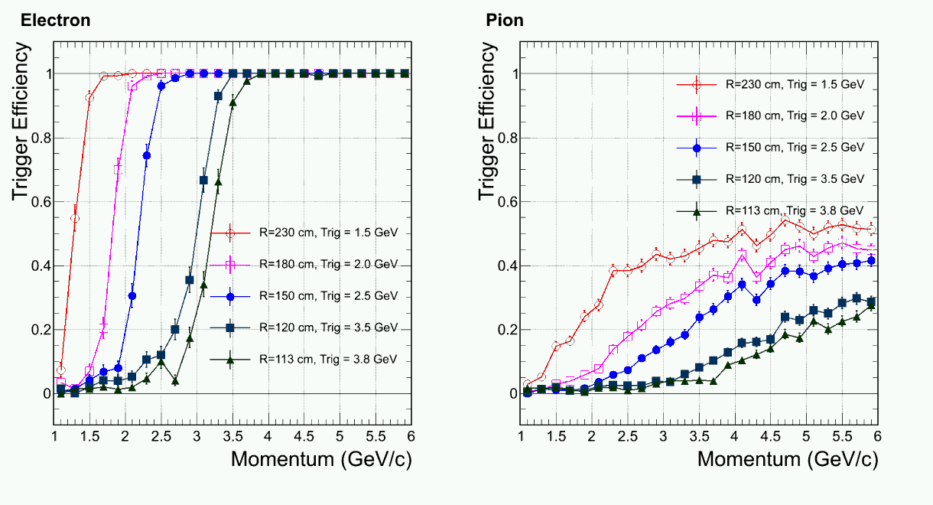
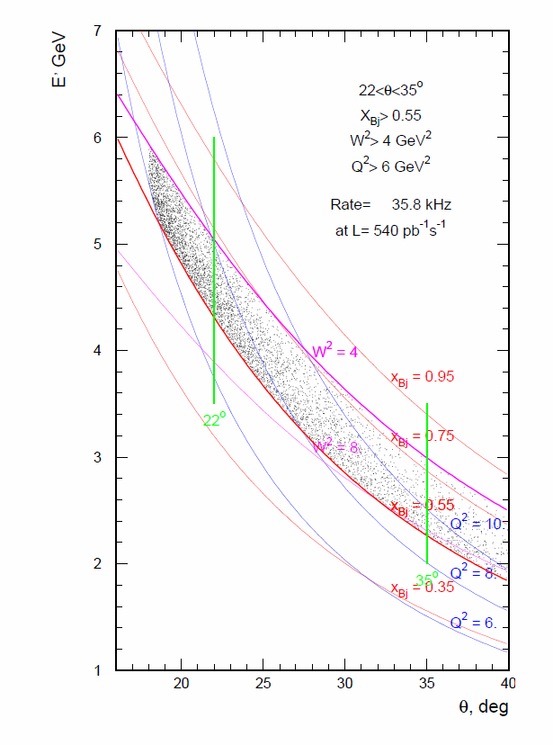
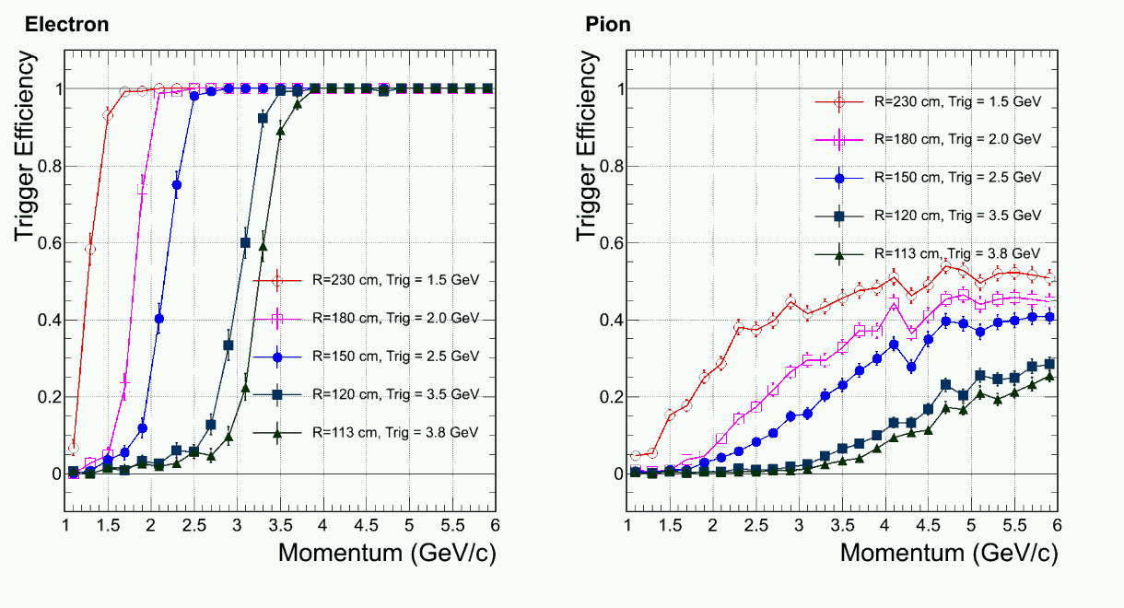
PVDIS FAEC Radius-dependent Trigger
high
3.8
3.5
2.5
2.0
1.5
low

Slide 12
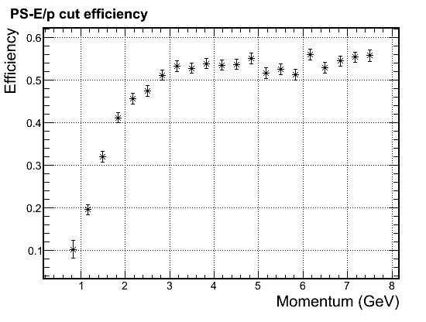
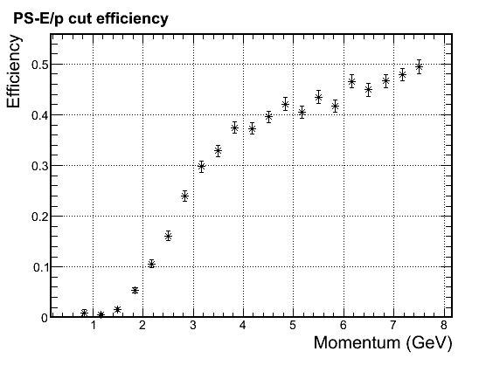
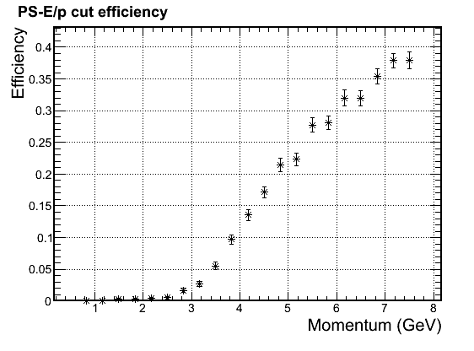
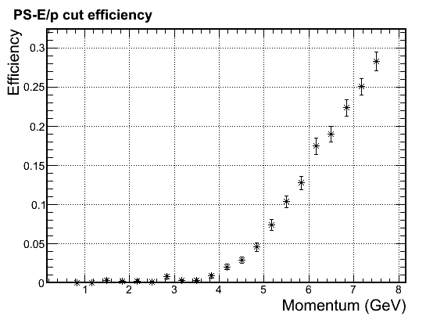
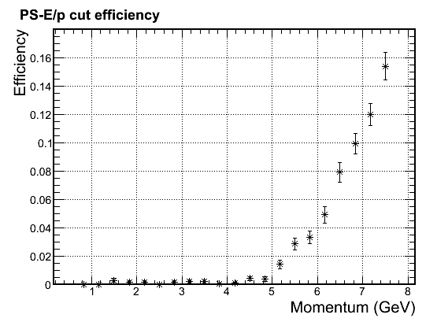
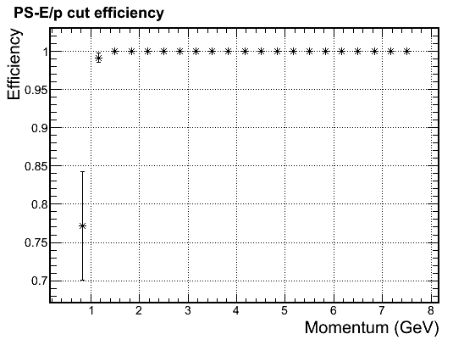
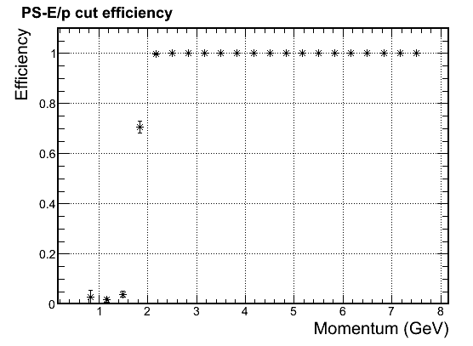
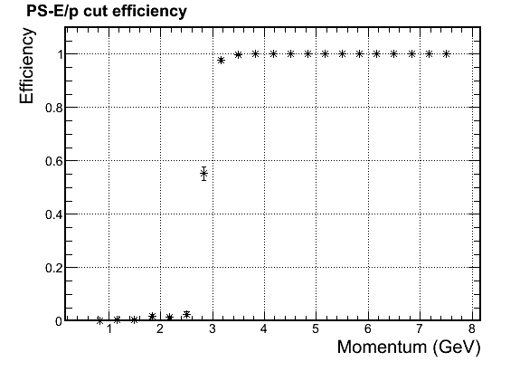
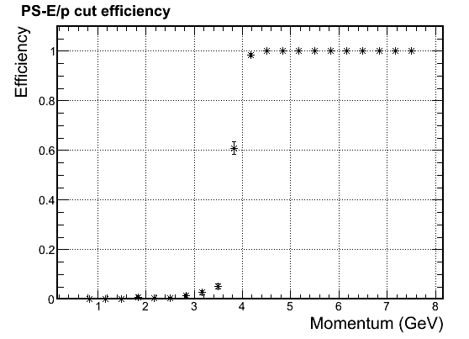
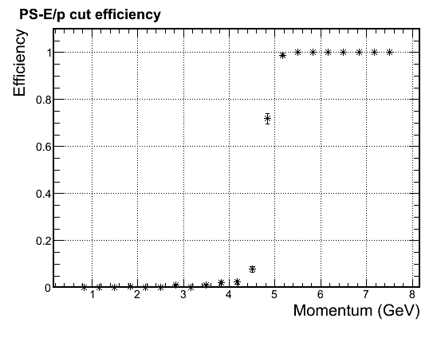
SIDIS ³He FAEC Radius-dependent Electron Trigger
Radius(cm) P Threshold (GeV)
90 - 105 5.0
105 - 115 4.0
115 - 130 3.0
130 - 150 2.0
150 - 200 1.0
200 - 230 2.0
6 point cut, right on Q2=1 line and field bend line
e(DIS) acceptance for SoLID CLEO and 40 long target
pion eff.
e eff.

Slide 13
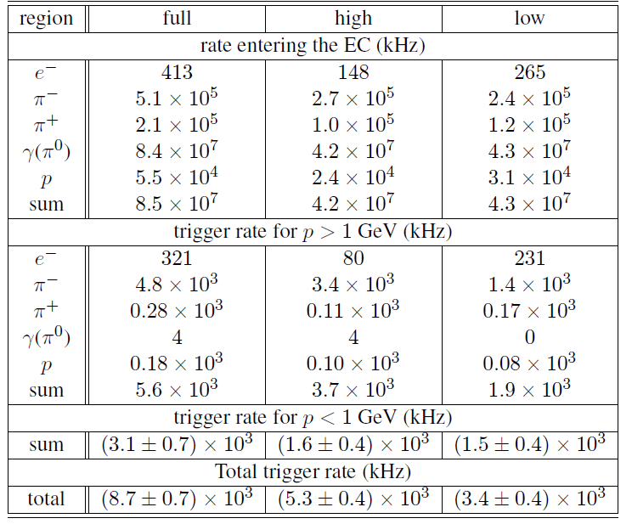
PVDIS FAEC Trigger Rate

Slide 14
PVDIS Trigger Rate
PVDIS setup has 30 sectors, rates below are for one sector
0.29MHz EC trigger rate
2MHz Cherenkov trigger rate
EC+LGCC within a 30ns window
20 kHz = 0.29MHz*2Mhz*30e-9ns

Slide 15
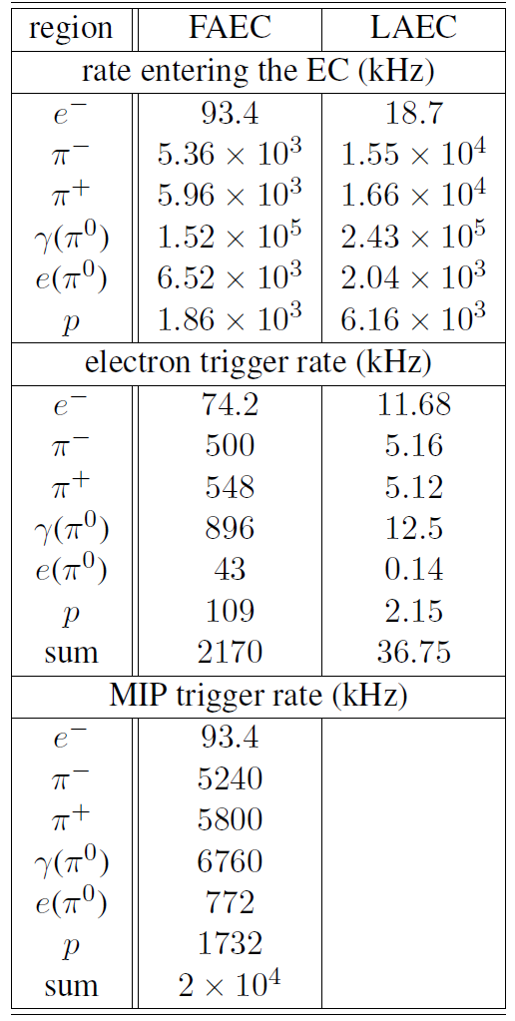
SIDIS ³He FAEC and LAEC Trigger Rate

Slide 16
SIDIS ³He Trigger Rate
Within a 30ns widow, reduction factors are
LGCC ~50 (pion,proton)
MRPC+SPD ~20 (gamma)
SPD ~5 (gamma)
FAEC electron trigger rate
2170 kHz -> 129.7 kHz (LGCC and MRPC+SPD)
LAEC electron trigger rate
37 kHz -> 25.5 kHz (SPD)
FAEC charged particle (MIP) trigger rate
20 MHz -> 14 MHz (MRPC+SPD)
Radom coincidence trigger rate combining electron and charged particle trigger within a 30ns window
65.2kHz = (129.7+25.5)kHz*14MHz*30ns

Slide 17
Summary
Both SoLID SIDIS and PVDIS setups are designed to handle the required luminosity
It could be extended to other physics which needs such luminosity

