Slide 1
Physics for PVDIS
P. A. Souder
Syracuse University

Slide 2
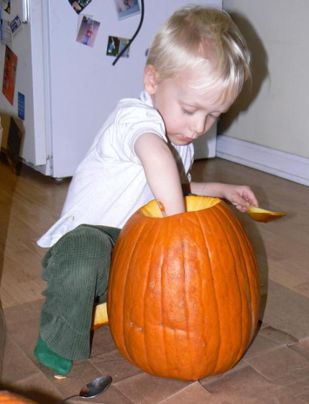

PVDIS Outline
e⁻
e⁻
γ, Z⁰
Longitudinally polarized
Searches for new physics in NP and HEP and role of PVES in general and SoLID in particular.
PVDIS and QCD
  Charge Symmetry
  Higher Twist
  Other Physics and Targets: d_{v}/u_{v} ; Isoscaler EMC effect
Credit: P. Reimer
SoLID Spectrometer

Slide 3
Context for PVDIS
A comprehensive strategy to understand the origin of matter requires:
The Large Hadron Collider, astrophysical observations
as well as
Lower Energy: Q² << M_{Z}²
NP/Atomic systems address several topics; unique & complementary:
Neutrino mass and mixing 0νββ decay, θ₁₃, β decay, long baseline neutrino expts…
Rare or Forbidden Processes EDMs, other LNV, charged LFV, 0νββ decay…
Dark Matter Searches direct detection, dark photon searches…
Precision Electroweak Measurements: (g-2)μ, charged & neutral current amplitudes

Slide 4

TeV-Scale Probe: Indirect Clues
Electroweak Interactions at scales much lower than the W/Z mass
NP: Fundamental Symmetries; HEP: The Intensity/Precision Frontier
High Energy Dynamics
E
SM amplitudes can be very precisely predicted
Λ (~TeV)
higher dimensional operators can be systematically classified
M_{W,Z}
(100 GeV)
courtesy
V. Cirigliano, H. Maruyama, M. Pospelov
Dark Sector
(coupling)⁻¹
Examples: Heavy Z’s, light (dark) Z’s, technicolor, compositeness, extra dimensions, new ideas???, …
How can the Standard Model, with all of its holes,
predict precision measurements so well??

Slide 5
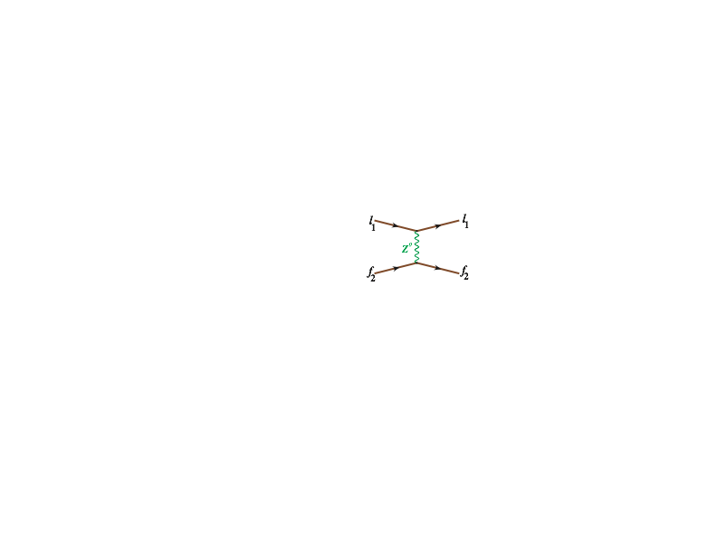
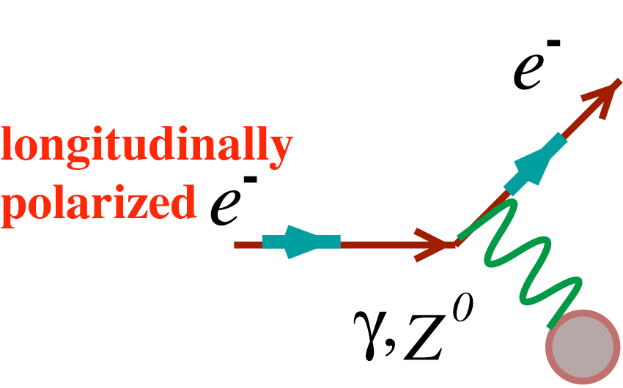
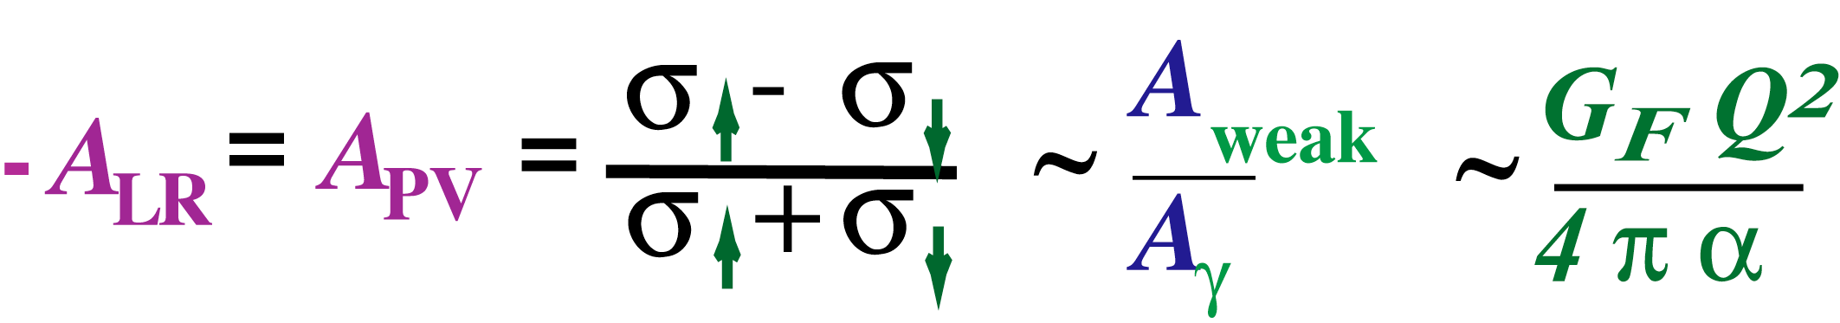

PVES: Example of Weak Neutral Current Interactions
Precision Neutrino Scattering
New Physics/Weak-Electromagnetic Interference
opposite parity transitions in heavy atoms
Spin-dependent electron scattering
Parity-violating Electron Scattering
(g_{A}^{e}g_{V}^{T} +β g_{V}^{e}g_{A}^{T})
g_{V} and g_{A} are function of sin²θ_{W}
to
Specific choices of kinematics and target nuclei probes different physics:
In mid 70s, goal was to show sin²θ_{W} was the same as in neutrino scattering
Since early 90’s: target couplings probe novel aspects of hadron structure (strange quark form factors, neutron RMS radius of nuclei)
Future: precision measurements with carefully chosen kinematics can probe physics at the multi-TeV scale, and novel aspects of nucleon structure

Slide 6
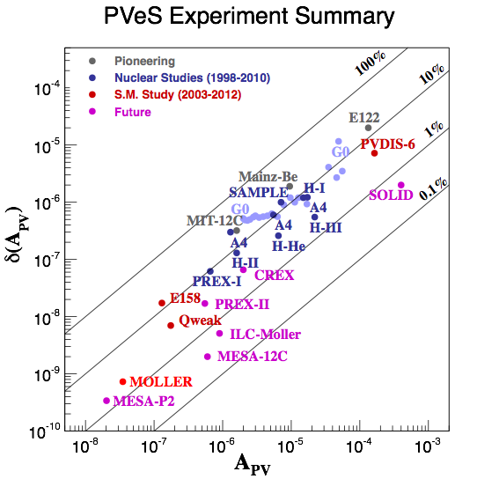
4 Decades of Progress
Continuous interplay between probing hadron structure and electroweak physics
Parity-violating electron scattering has become a precision tool
photocathodes, polarimetry, high power cryotargets, nanometer beam stability, precision beam diagnostics, low noise electronics, radiation hard detectors
Pioneering electron-quark PV DIS experiment SLAC E122
State-of-the-art:
sub-part per billion statistical reach and systematic control
sub-1% normalization control
Physics Topics
SLAC
MIT-Bates
Mainz
Jefferson Lab
Strange Quark Form Factors
Neutron skin of a heavy nucleus
Indirect Searches for New Interactions
Novel Probes of Nucleon Structure
Electroweak Structure functions at EIC

Slide 7
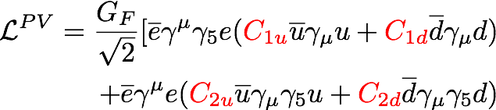
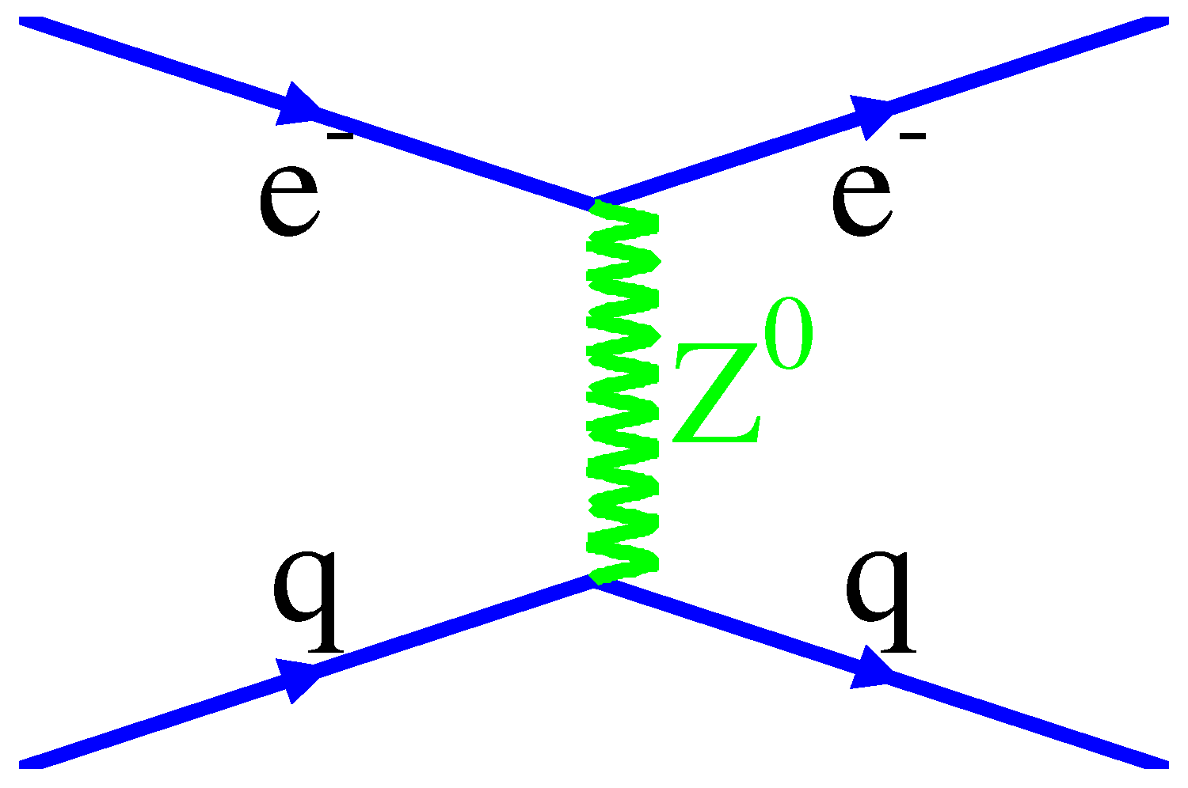
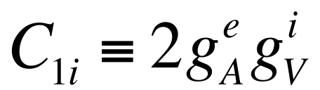
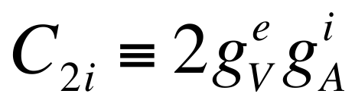


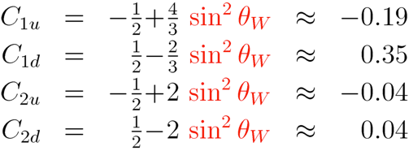

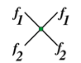
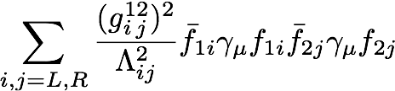


Weak Neutral Current Couplings
Elastic and deep-inelastic PV scattering
A
V
V
V
A
e⁻
A
e⁻
new physics
+
Two equivalent notations!
PV elastic e-p scattering, Atomic parity violation
PV deep inelastic scattering
PV Møller scattering

Slide 8
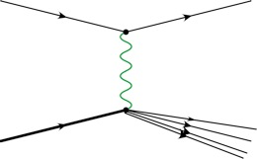

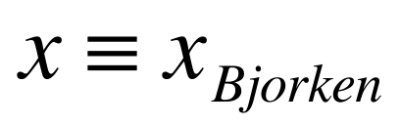
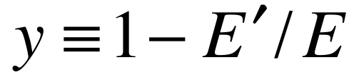
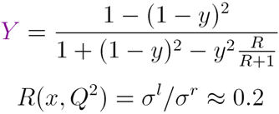
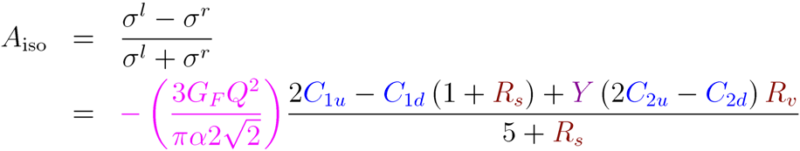
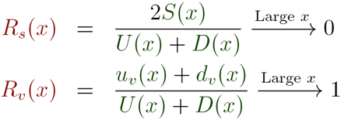
PV Deep Inelastic Scattering
off the simplest isoscalar nucleus and at high Bjorken x
e⁻
e⁻
Z*
γ*
Q² >> 1 GeV² , W² >> 4 GeV²
N
X
At high x, A_{iso} becomes independent of pdfs, x & W, with well-defined SM prediction for Q² and y
Interplay with QCD
Parton distributions (u, d, s, c)
Charge Symmetry Violation (CSV)
Higher Twist (HT)
Nuclear Effects (EMC)

Slide 9

PVES Initiatives: Complementarity
C_{ee}
Different experiments address
different vertices of the triangle
which in turn address
different new physics.
C_{1q}
C_{2q}
SUSY Loops
GUT Z’
Leptophobic Z’
RPV SUSY
Leptoquarks
H++
QW^{e} and QW^{p:}:same absolute shift, smaller for others
High for Qw(Cs), QW^{e}(relative), smaller for others
axial-quark couplings (C2’s) only
Different for all four in sign and magnitude
semi-leptonic only; different sensitivities
QW^{e} only

Slide 10
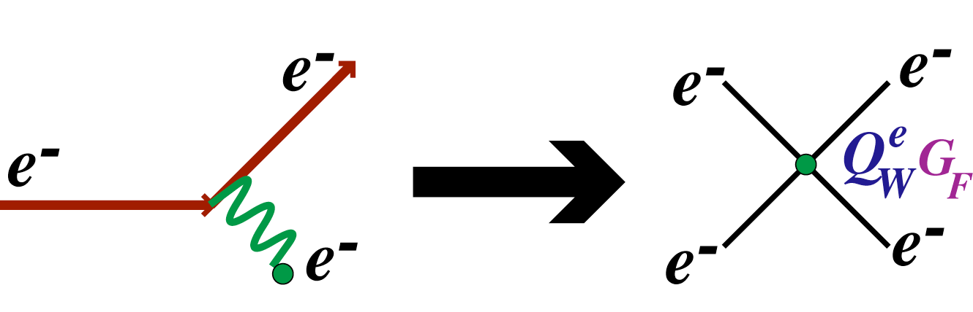

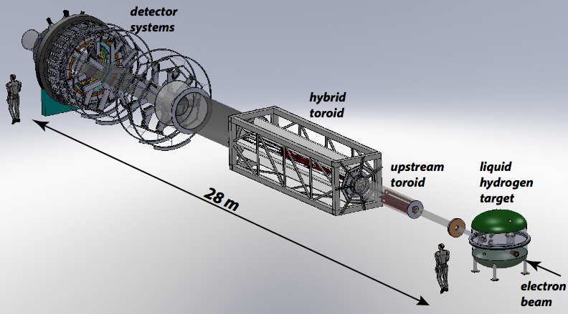



MOLLER at JLab
Using Møller scattering (purely leptonic!), improve on E158 by a factor of 5
11 GeV Møller scattering
Measurement Of Lepton Lepton Electroweak Reaction
11 GeV Beam
5-10 mrad
LH2
~ 20M$ MIE funding required
Science review by DOE NP: September 10 at UMass, Amherst
+
APV = 35.6 ppb
Luminosity: 3x10³⁹ cm²/s
75 μA
80% polarized
δ(APV) = 0.73 parts per billion
δ(Q^{e}W) = ± 2.1 % (stat.) ± 1.0 % (syst.)
8

Slide 11
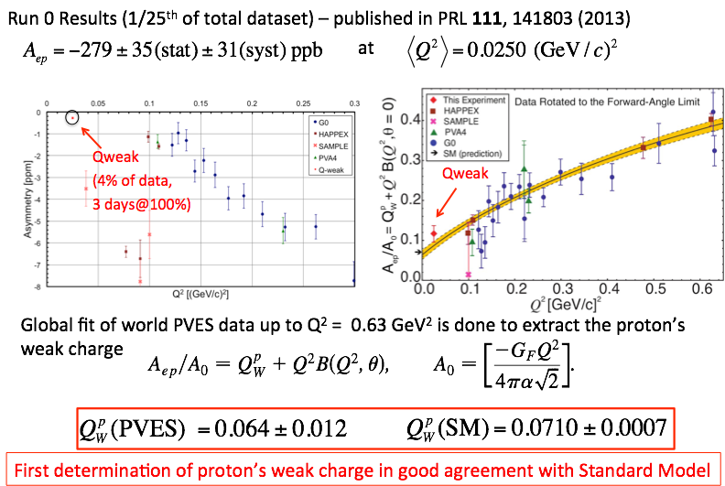
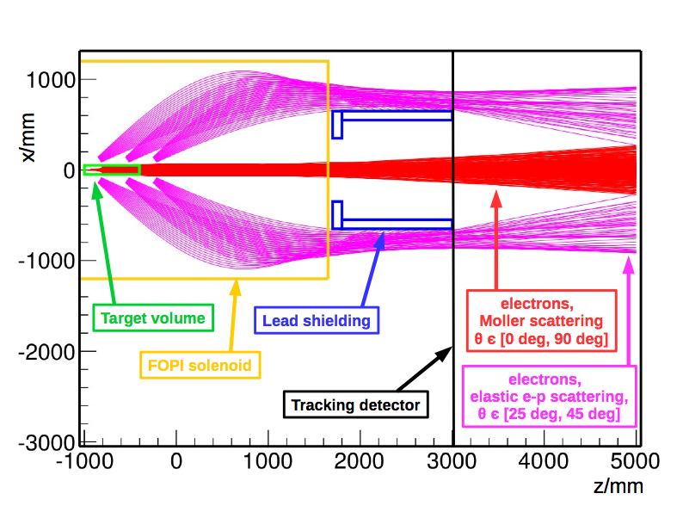

The Weak Charge of the Proton
*
Two Production Runs: Feb-May ’11, Nov ’11-May ‘12
P2 at MESA at Mainz

Slide 12


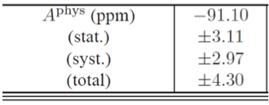
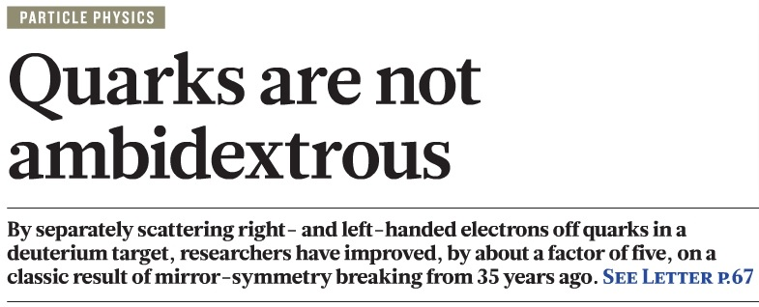
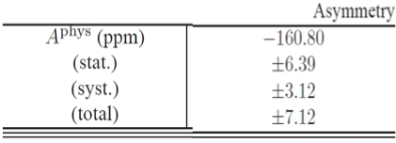
PVDIS on LD2 at 6 GeV
A_{PV} in deep inelastic e-D scattering:
e⁻
e⁻
Q² >> 1 GeV² , W² >> 4 GeV²
a(x): function of C1i’s
Z*
γ*
b(x): function of C2i’s
N
X
For ²H, assuming charge symmetry, structure functions cancel in the ratio:
Physics Run: Oct-Dec 2010
Wang et al., Nature 506, no. 7486, 67 (2014);
6 GeV run results
Q² ~ 1.1 GeV²
W. Marciano
article in Nature
Q² ~ 1.9 GeV²

Slide 13
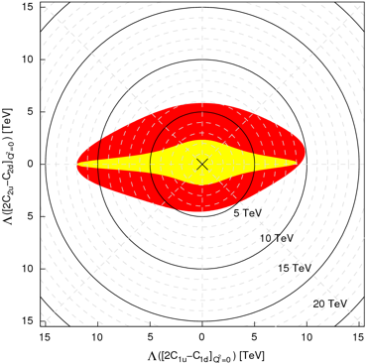
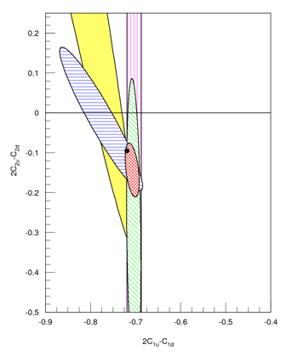
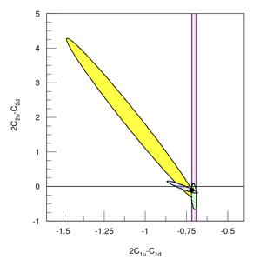
Implications
SLAC E122
PVES/Qweak
JLab 6 GeV
Result
2C_{2u}-C_{2d}
new best
fit
2C_{1u}-C_{1d}
first experimental determination that an axial quark coupling combination is non-zero (as predicted)

Slide 14
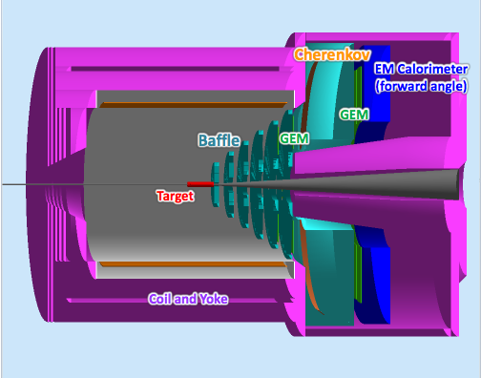

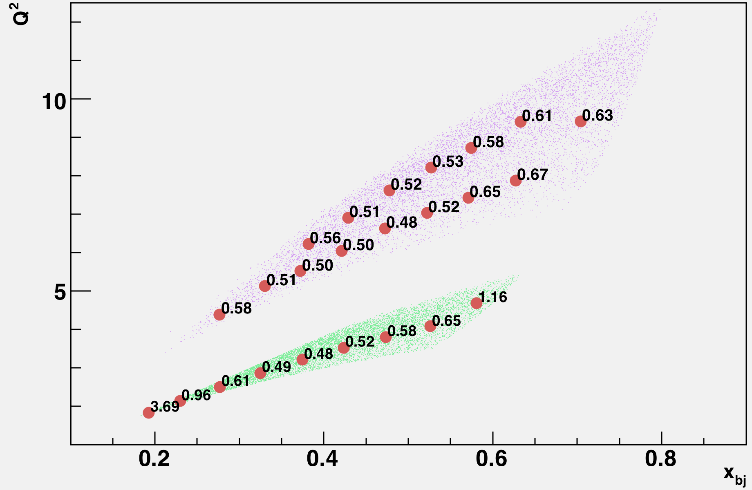



SOLID with the 12 GeV Upgrade
12 GeV Upgrade: Extraordinary opportunity to do the ultimate PVDIS Measurement
e⁻
e⁻
N
Z*
γ*
X
Strategy: sub-1% precision over broad kinematic range: sensitive Standard Model test and detailed study of hadronic structure contributions
statistical error bar σ_{A}/A (%)
shown at center of bins
in Q², x
Requirements
charge
symmetry
violation
standard model test
High Luminosity with E > 10 GeV
Large scattering angles (for high x & y)
Better than 1% errors for small bins
x-range 0.25-0.75
W² > 4 GeV²
Q² range a factor of 2 for each x
(Except at very high x)
Moderate running times
higher twist
4 months at 11 GeV
sea
quarks
2 months at 6.6 GeV

Slide 15
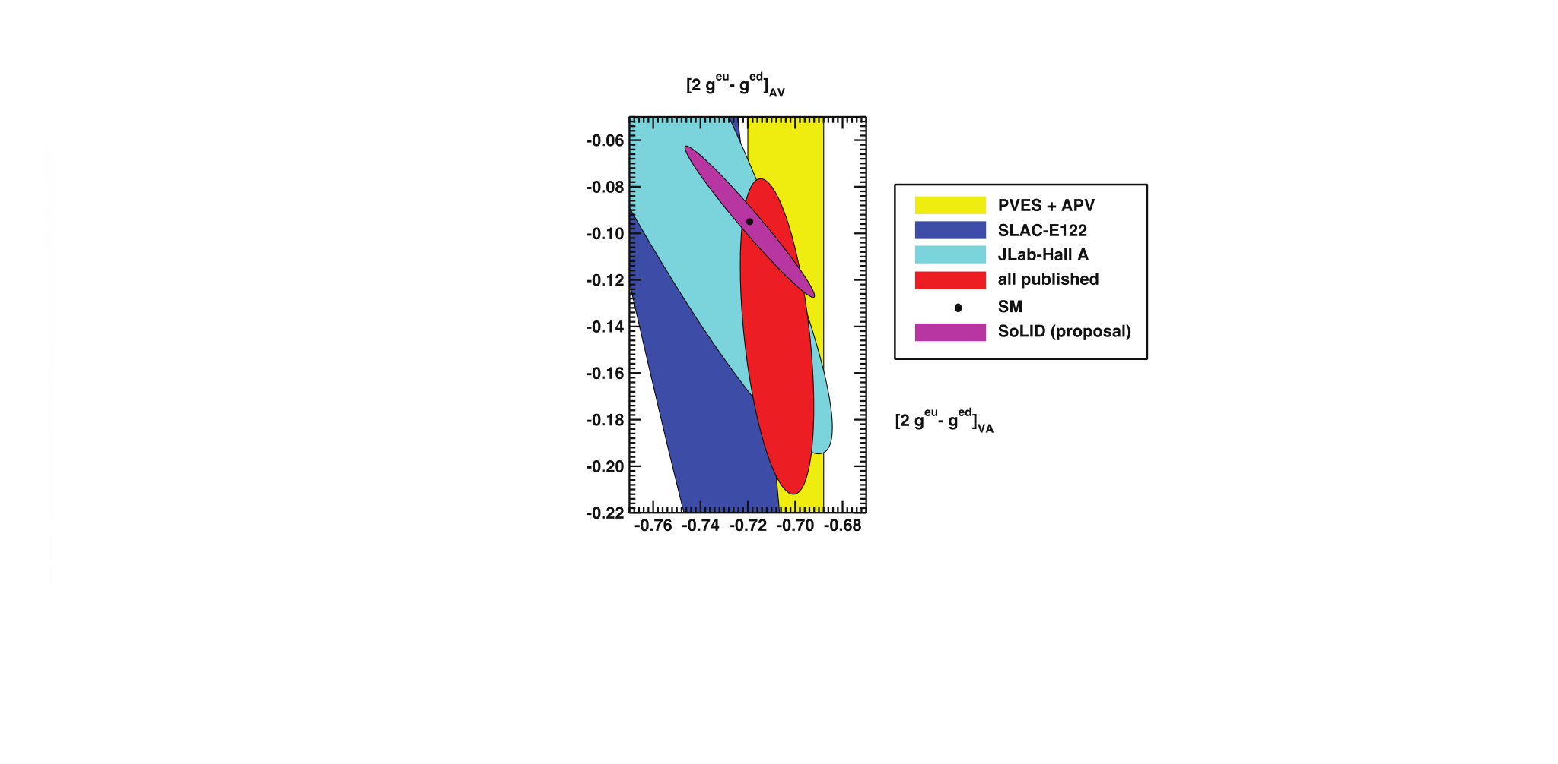
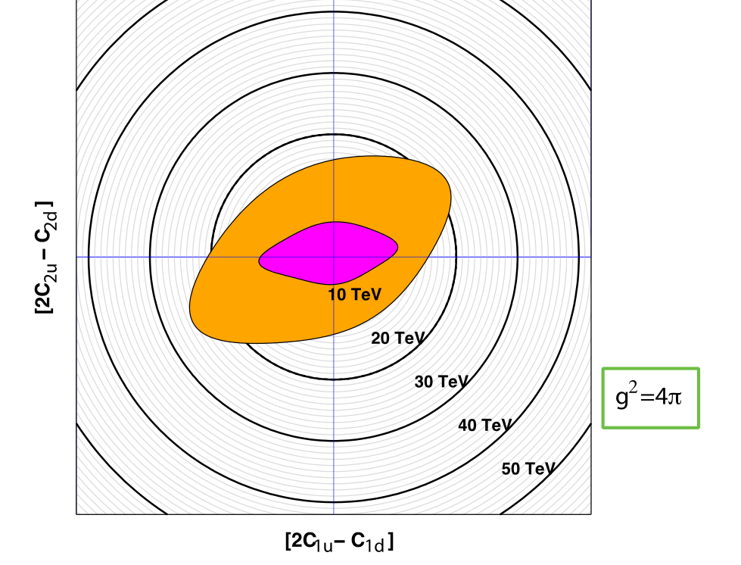
SOLID New Physics Sensitivity
SoLID projection
Courtesy: J. Erler
6 GeV PVDIS
Current World Fit
Final Qweak result + projected SOLID
Qweak and SOLID will expand sensitivity that will match high luminosity LHC reach with complementary chiral and flavor combinations

Slide 16
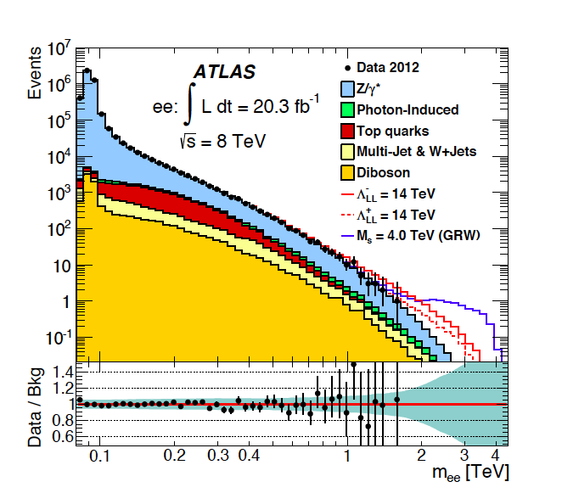
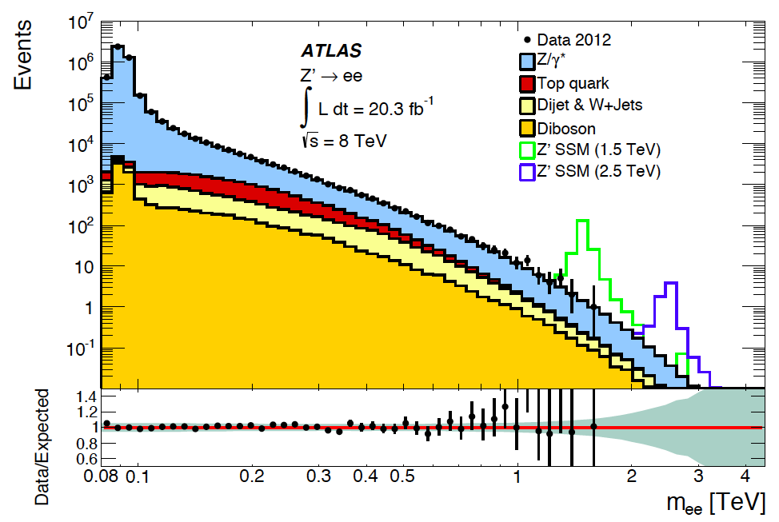
Z’ versus Compositeness
Issue: PVDIS determines g²/Λ²:
LHC sensitivity to g²/Λ² depends on Λ.
Signal dominates
Are Z’s fat because they decay
to invisible particles or b’s?
Noise dominates

Slide 17
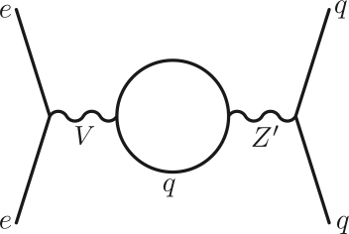
Unique SoLID Sensitivity
Leptophobic Z’
Virtually all GUT models predict new Z’s
LHC reach ~ 5 TeV, but....
Little sensitivity if Z’ doesnt couple to leptons
Leptophobic Z’ as light as 120 GeV might escape detection
Leptophobic Z’ might couple to ark matter
arXiv:1203.1102v1
Buckley and Ramsey-Musolf
Since electron vertex must be vector,
the Z’ cannot couple to the C1q’s if
there is no electron coupling:
can only affect C2q’s
Hard to see low
mass lepto-phobic
Z’s at the LHC
SOLID can improve sensitivity:
100-200 GeV range

Slide 18
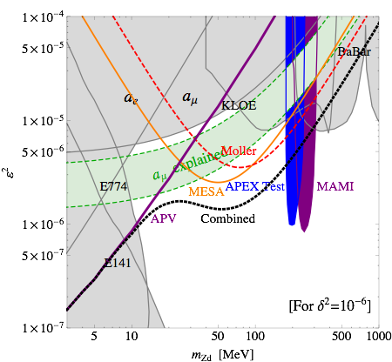

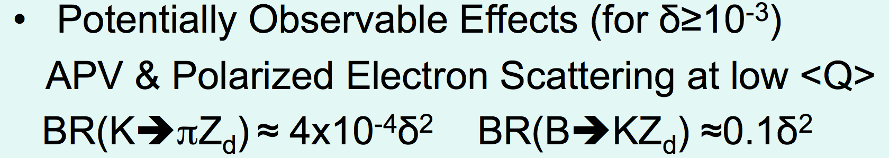
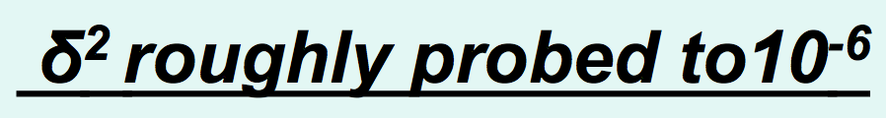
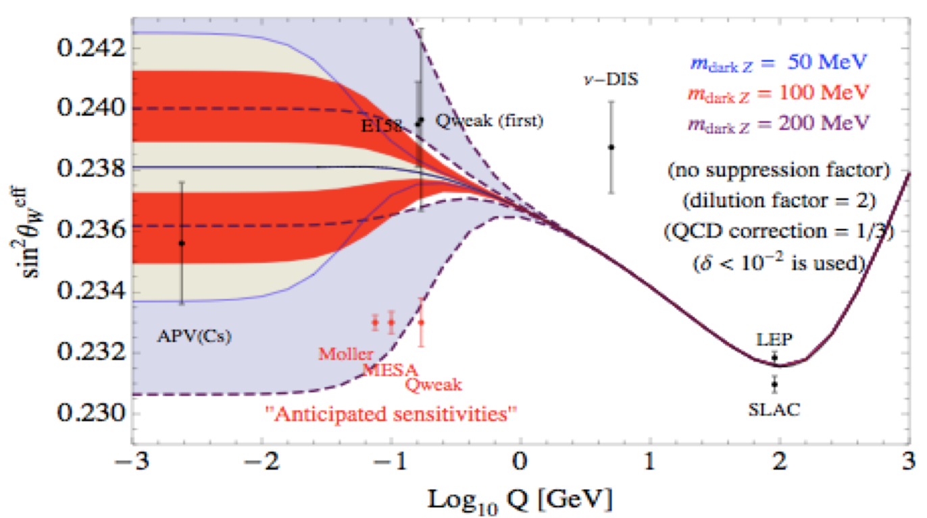
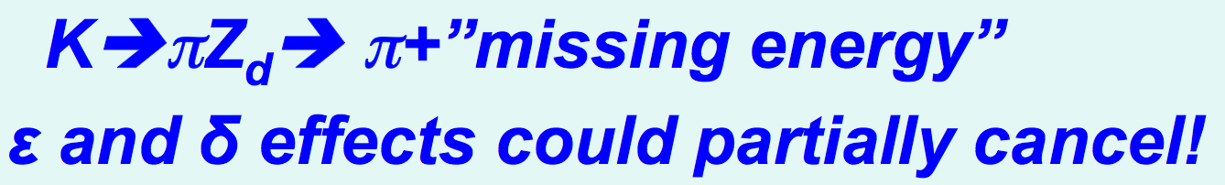
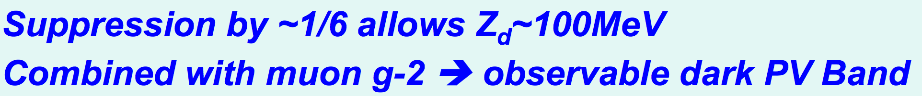
Dark Z to Invisible Particles
Davoudiasl, Lee, Marciano
arXiv:1203.2947v2
Dark Photons: Beyond kinetic mixing; introduce mass mixing with the Z⁰

Slide 19



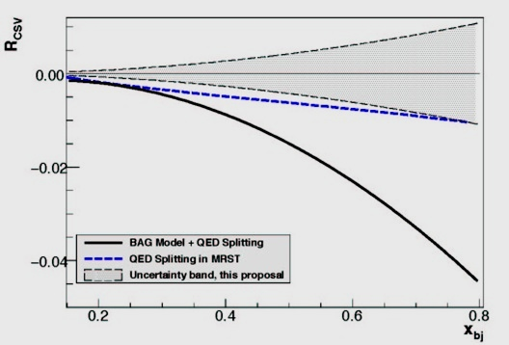
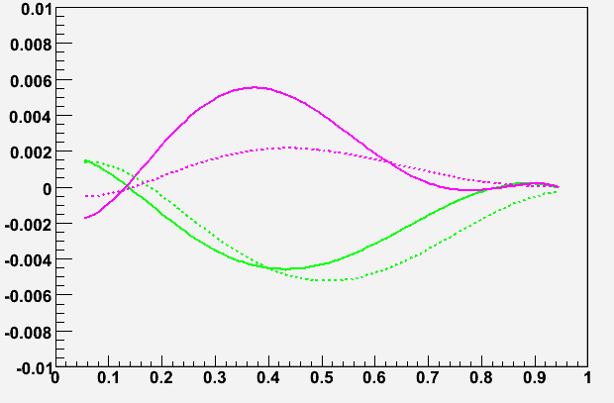
Charge Symmetry Violation
We already know CSV exists:
u-d mass difference δm = m_{d}-m_{u} ≈ 4 MeV
δM = M_{n}-M_{p} ≈ 1.3 MeV
electromagnetic effects
Direct sensitivity to parton-level CSV
Important implications for PDF’s
Explanation of the NuTeV anomaly?
For A_{PV} in electron-²H DIS
Sensitivity will be enhanced if u+d falls off more rapidly than δu-δd as x → 1
SOLID sensitivity
bag model (solid) Radionov et al.
QED splitting (dashed) Glueck et al.
δd
δu
x
Significant effects are predicted at high x

Slide 20
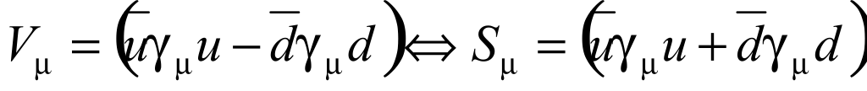
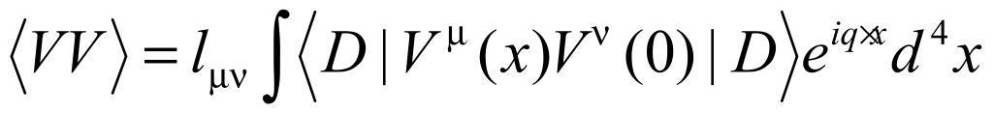


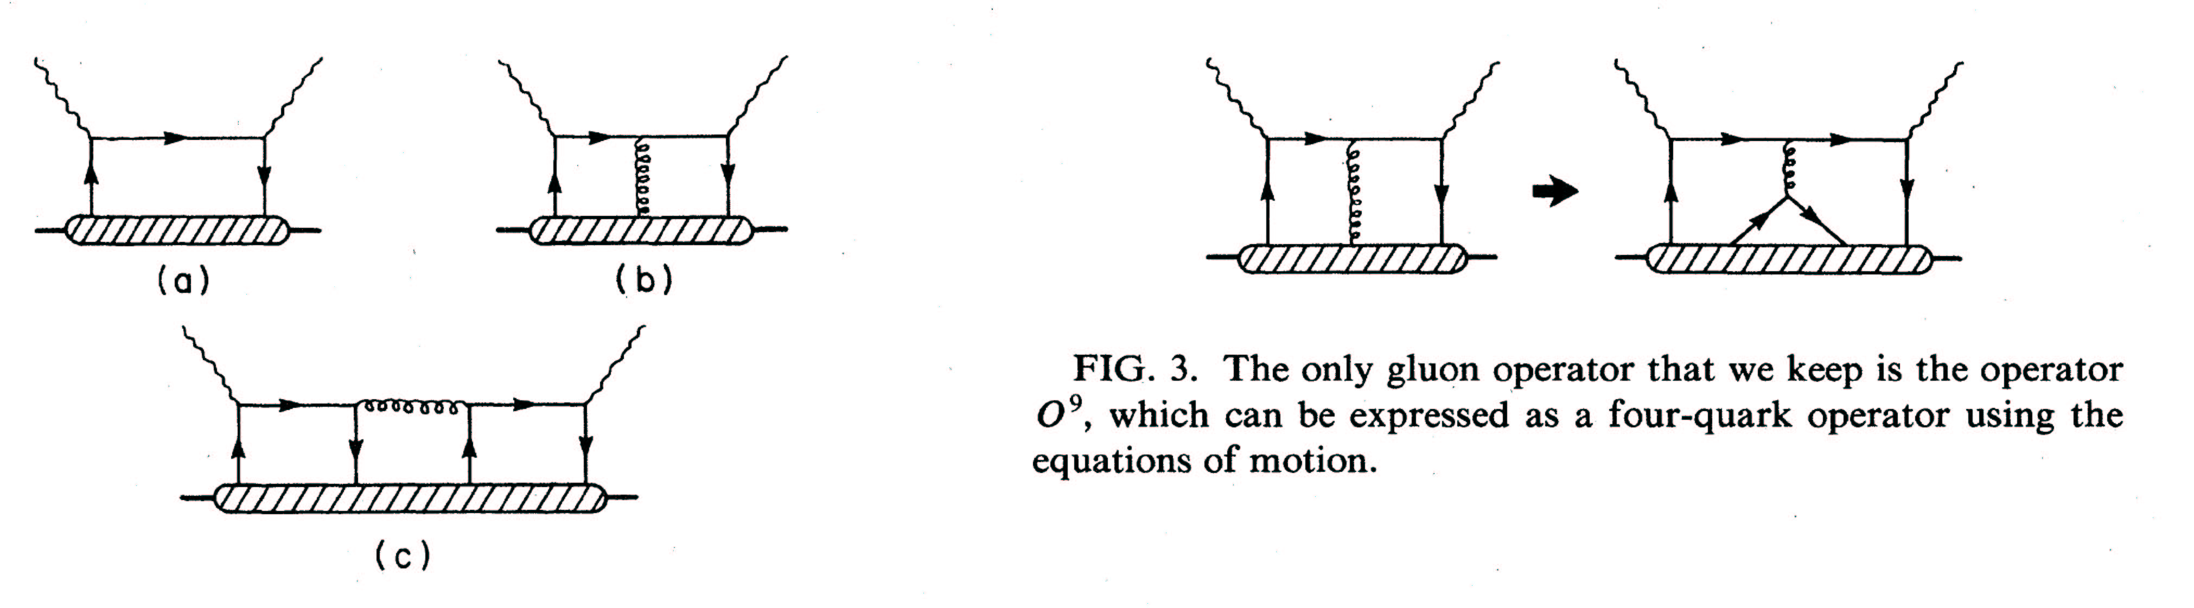
A Special HT Effect
The observation of Higher Twist in PV-DIS would be exciting direct evidence for diquarks
following the approach of
Bjorken, PRD 18, 3239 (78),
Wolfenstein, NPB146, 477 (78)
Isospin decomposition
before using PDF’s
Higher-Twist valence quark-quark correlation
Zero in quark-parton model
(c) type diagram is the only operator that can contribute to a(x) higher twist: theoretically very interesting!
σL contributions cancel
Use ν data for small b(x) term.
Castorina & Mulders, ‘84

Slide 21

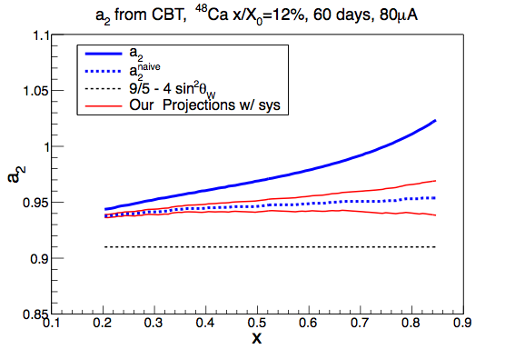
⁴⁸Ca PVDIS
Cloet, Bentz, Thomas, arXiv 0901.3559
Consider PVDIS on a heavy nucleus
  Neutron or proton excess in nuclei leads to a isovector-vector mean field (ρ exchange): shifts quark distributions: “apparent” charge symmetry violation
  Isovector EMC effect: explain additional 2/3 of NuTeV anomaly
  new insight into medium modification of quark distributions
Great leverage for a clean isospin decomposition of the EMC effect in an inclusive measurement
Flavor separation: clean data sparse to date
With hadrons in the initial or final state, small effects are difficult to disentangle (theoretically and experimentally)
Precise isotope cross-section ratios in purely electromagnetic electron scattering: MUCH reduced sensitivity to the isovector combination; potentially see small effects to discriminate models
  a flavor decomposition of medium modifications is extremely challenging
Example Model Prediction
2 month run with ⁴⁸Ca Target
Unique opportunity with SOLID

Slide 22
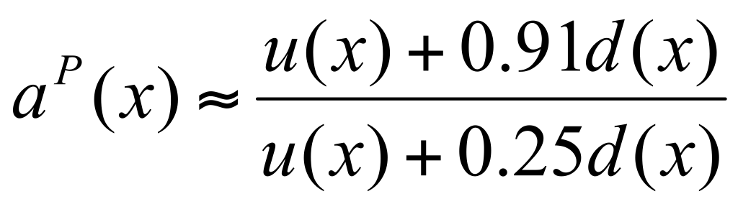
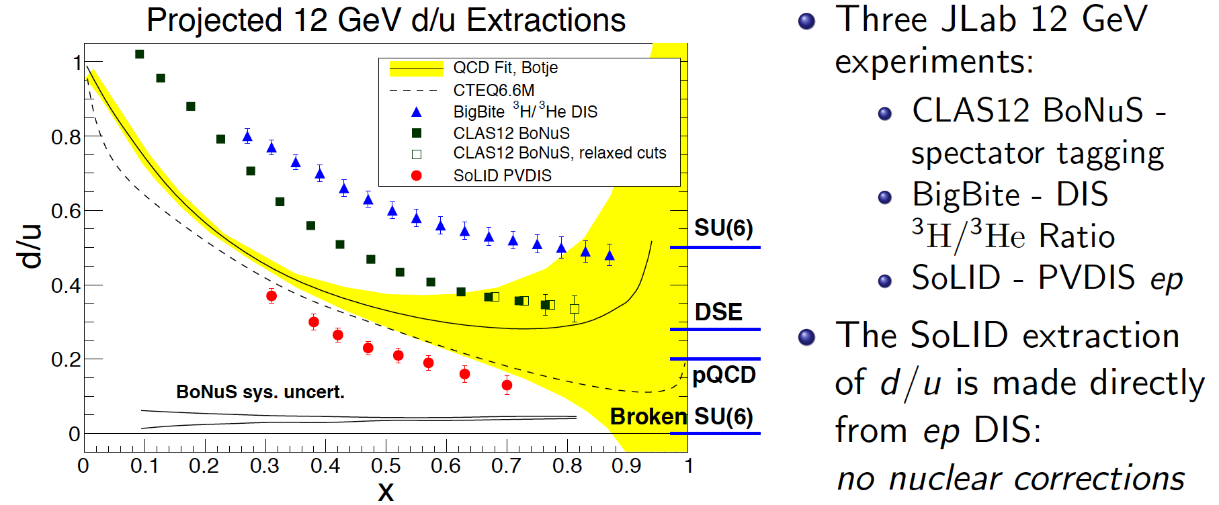
Proton PVDIS: d/u at high x
Longstanding issue in proton structure
(high power liquid hydrogen target)
SU(6):
d/u~1/2
Broken SU(6):
d/u~0
Perturbative QCD:
d/u~1/5
￼

Slide 23
Coherent Program of PVDIS Study
Strategy: requires precise kinematics and broad range
Kinematic dependence of physics topics
 | x | Y | Q²
New Physics | none | yes | small
CSV | yes | small | small
Higher Twist | large? | no | large
Measure A_{d} in narrow bins of x, Q² with 0.5% precision
Cover broad Q² range for x in [0.3,0.6] to constrain HT
Search for CSV with x dependence of A_{d} at high x
Use x > 0.4, high Q² to measure a combination of the C_{iq}’s
Fit data to:

Slide 24
Error Budget (%) and Running time
Total | 0.6
Polarimetry | 0.4
Q2 | 0.2
Radiative Corrections | 0.2
Event reconstruction | 0.2
Statistics | 0.3
Energy(GeV) Days(LD2) Days(LH2) | 4.4 18 9 | 6.6 60 - | 11 120 90 | Test 27 14
180 Days are Approved

Slide 25
Summary
PVDIS fills out the EW couplings: where is the new physics hiding???
PVDIS provides a unique window on QCD:
  CSV at the quark level
  Isovector EMC effect
  Diquark Higher Twist
  d/u for the proton

Slide 26
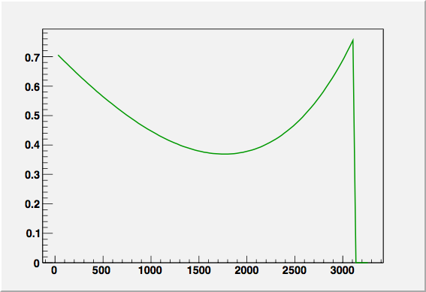


Prcision Compton Polarimetry
E_{e}=11GeV
E_{e}=11GeV
λ=532nm
λ=532nm
Cross-section (barn)
Cross-section (barn)
For scattered electrons in chicane:
two Points of well-defined energy!
Asymmetry zero crossing
Compton Edge
Integrate between to minimize error on analyzing power!
“independent” Photon analysis also normalizable at ~0.5%
k (MeV)
k (MeV)
E_{e}=11GeV
λ=532nm
Asymmetry (%)
k (MeV)
E_{e}=11GeV
λ=532nm
Asymmetry (%)
k (MeV)

Slide 27


SoLID Acceptance for PVDIS

Slide 28



The Higgs and sin²θ_{W}
The observation of the Higgs
boson and the measurement of its mass has eliminated
one of the main uncertainties in precicse predictions of the
Standard Model

Slide 29


SOLID Sensitivity
Does Supersymmetry provide a candidate for dark matter?
B and/or L need not be conserved: neutralino decay
  Depending on size and sign of deviation: could lose appeal as a dark matter candidate
Ramsey-Musolf & Su
Leptophobic Z’
Virtually all GUT models predict new Z’s
LHC reach ~ 5 TeV, but....
Little sensitivity if Z’ doesnt couple to leptons
Leptophobic Z’ as light as 120 GeV could have escaped detection
arXiv:1203.1102v1
Buckley and Ramsey-Musolf
Since electron vertex must be vector, the Z’ cannot couple to the C1q’s if there is no electron coupling:
can only affect C2q’s
SOLID can improve sensitivity:
100-200 GeV range

Slide 30


EW Physics and QCD Interplay
Strange Quark Form Factors
Inelastic backgrounds
  Inelastic e-p scattering in diffractive region (Q² <<1 GeV², W² > 2 GeV²) pollutes the Møller peak
Box diagram uncertainties
  Proton weak charge modified; inelastic intermediate states
Parton dynamics in nucleons and nuclei
  Higher twist effects
  charge symmetry violation in the nucleon
  “EMC” style effects: quark pdfs modified in nuclei
e⁻
electrons
on LH2
Z*
γ*
p
Physics of SOLID

Slide 31




QCD Physics with PVDIS
We already know CSV exists:
u-d mass difference δm = m_{d}-m_{u} ≈ 4 MeV
δM = M_{n}-M_{p} ≈ 1.3 MeV
electromagnetic effects
Direct sensitivity to parton-level CSV
Important implications for PDF’s
Could be partial explanation of the NuTeV anomaly
Zero in quark-parton model
Higher-Twist valence quark-quark correlation
(c) type diagram is the only operator that can contribute to a(x) higher twist: theoretically very interesting!
Castorina & Mulders, ‘84

Slide 32

Projected PVDIS Data
Asymmetries
Coupling constants

Slide 33
A Special HT Effect
The observation of Higher Twist in PV-DIS would be exciting direct evidence for diquarks
following the approach of
Bjorken, PRD 18, 3239 (78),
Wolfenstein, NPB146, 477 (78)
Isospin decomposition
before using PDF’s
Higher-Twist valence quark-quark correlation
Zero in quark-parton model
(c) type diagram is the only operator that can contribute to a(x) higher twist: theoretically very interesting!
u
d
σL contributions cancel
Castorina & Mulders, ‘84
Use ν data for small b(x) term.

Slide 34

QCD: Charge Symmetry Violation
We already know CSV exists:
u-d mass difference δm = m_{d}-m_{u} ≈ 4 MeV
δM = M_{n}-M_{p} ≈ 1.3 MeV
electromagnetic effects
Broad χ² minimum
(90% CL)
MRST PDF global with fit of CSV
Martin, Roberts, Stirling, Thorne Eur Phys J C35, 325 (04)

Slide 35


QCD: Higher Twist--MRST Fits
Order of DGLAP
influences size
of HT
F₂(x,Q²)=F₂(x)(1+D(x)/Q²)
Q²=(W²-M²)/(1/x-1)
Q²_{min}=Q²(W=2)
MRST, PLB582, 222 (04)
x | Q²_{min} | D(x) |  | D/Q²_{min} (%)
 |  | LO | N³LO | LO | N³LO
0.1-0.2 | 0.5 | -.007 | 0.001 | -14 | 2
0.2-0.3 | 1.0 | -.11 | 0.003 | -11 | 0.0
0.3-0.4 | 1.7 | -.06 | -0.001 | -3.5 | -0.5
0.4-0.5 | 2.6 | .22 | 0.11 | 8 | 4
0.5-0.6 | 3.8 | .85 | 0.39 | 22 | 10
0.6-0.7 | 5.8 | 2.6 | 1.4 | 45 | 24
0.7-0.8 | 9.4 | 7.3 | 4.4 | 78 | 47
Asymmetry
Higher twist
falls slowly
compared to PDF’s
at large x.
PDF’s
If C(x)~D(x), there is large
sensitivity al large x.

Slide 36


PVES Initiatives: Complementarity
Courtesy:
M. Ramsey-Musolf
axial-quark couplings
vector-quark couplings
SUSY Loops
GUT Z’
Leptophobic Z’
RPV SUSY
Leptoquarks
Lepton Number Violation
QW^{e} and QW^{p:}:same absolute shift, smaller for others
High for Qw(Cs), QW^{e}(relative), smaller for others
axial-quark couplings (C2’s) only
Different for all four in sign and magnitude
semi-leptonic only; different sensitivities
QW^{e} only

