Slide 1
SoLID DAQ for Transversity and PVDIS
Alexandre Camsonne
SoLID collaboration meeting
November 8th 2014

Slide 2
Outline
PVDIS
  Calorimeter trigger
  Trigger rates
  Event sizes / data rates
SIDIS
  Electronics layout
  Trigger rates
  Event size / data rates
Costs
Tasks list
Timeline
Conclusion

Slide 3
PVDIS

Slide 4
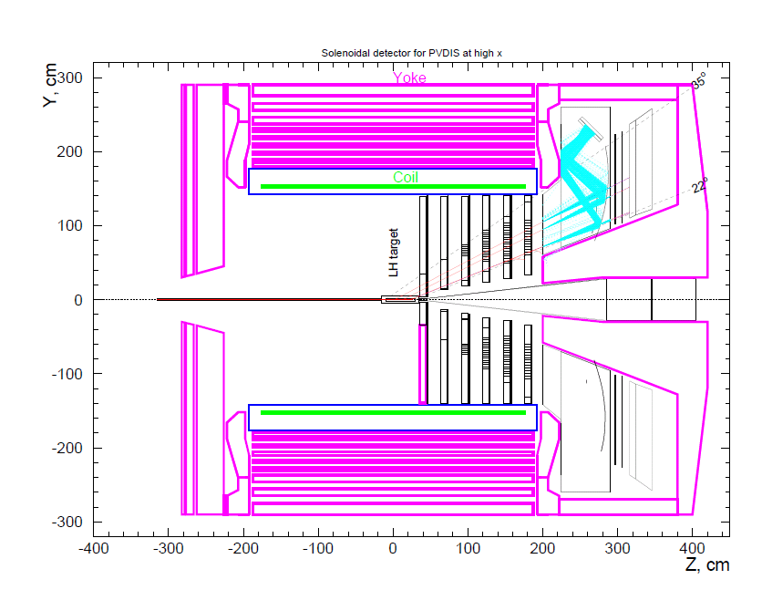
Detector layout and trigger for PVDIS
Trigger
Calorimeter and Gas Cerenkov
200 to 500 KHz of electrons
30 individual sectors
to reduce rate
Max 30 KHz/sector

Slide 5
FADC readout
FADC readout full waveform 10 samples
Only want to readout FADC channel in the cluster to reduce number of channels readout because of background
CTP generates a 64 bit pattern
Send pattern to TI or FADC directly to trigger FADC
Only channels from pattern are put in buffer

Slide 6
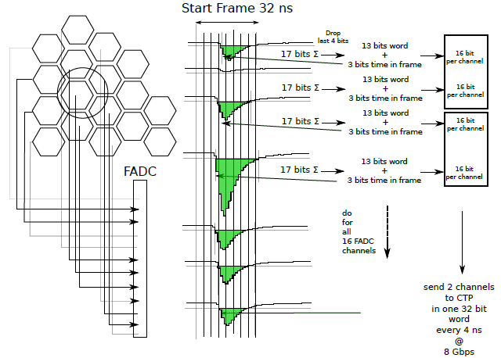
ECAL trigger

Slide 7
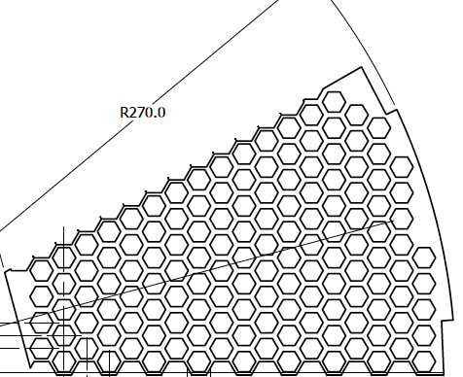
Calorimeter Geometry
Detector segmented in 30 sectors
One crate per sector
CTP
CTP

Slide 8
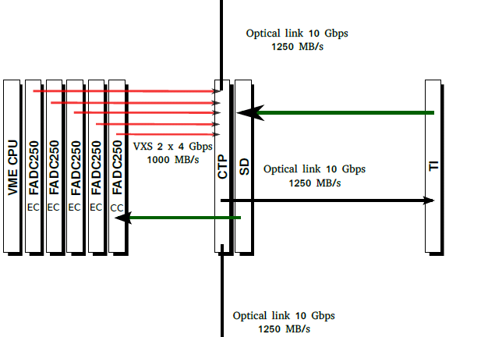
CTP connections
To neighbor CTP
To neighbor CTP

Slide 9
Neighboring sectors
New CTP : has two additionnal optical links
Can send Cerenkov and calorimeter edges to other sectors.
CTP
CTP
CTP
8 Gbp/s optical link
8 Gbp/s optical link
8 Gbp/s optical link
36 calorimeters
9 Cherenkov
=
150ns + 5 ns per m+ 300 ns ( data ) = 500 ns
overhead
=
Trigger decision = 500 ns (Transfer ) + 1us ( clustering ) < 4 us (APV)

Slide 10
Cerenkov L1 trigger
9 PMTs per sectors
Correct gain per channel
Look for channels above low threshold and coincidence between PMTs ( more than one PMT hit usually )
Sum of all channels with higher threshold
Efficiency need to be studied

Slide 11
Event size FADC PVDIS with waveform
Detector | Total number of channels | Number of channels firing | Number of samples | Max size detector bytes | Minimal size detector bytes | Typical size
Shower | 58 | 7 | 10 | 2784 | 336 | 772
Preshower | 58 | 7 | 10 | 2784 | 336 | 772
Gas Cerenkov | 9 | 3 | 10 | 432 | 144 | 432
 |  |  | Max total size | 46KB | 0.816KB | 1.544KB
Max rate | Assuming 100 MB/s per crate | One crate |  | 2.1 KHz | 121 KHz | 60 KHz
FADC data rate for 30 KHz = 60 MB/s

Slide 12
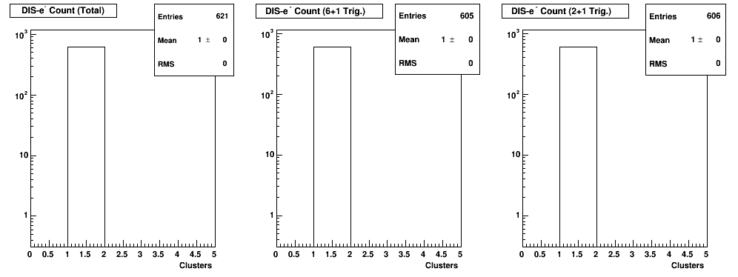
Occupancy

Slide 13
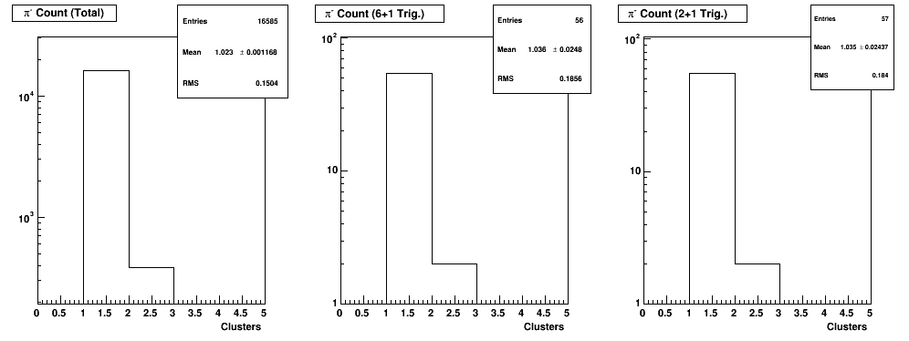
Occupancy

Slide 14
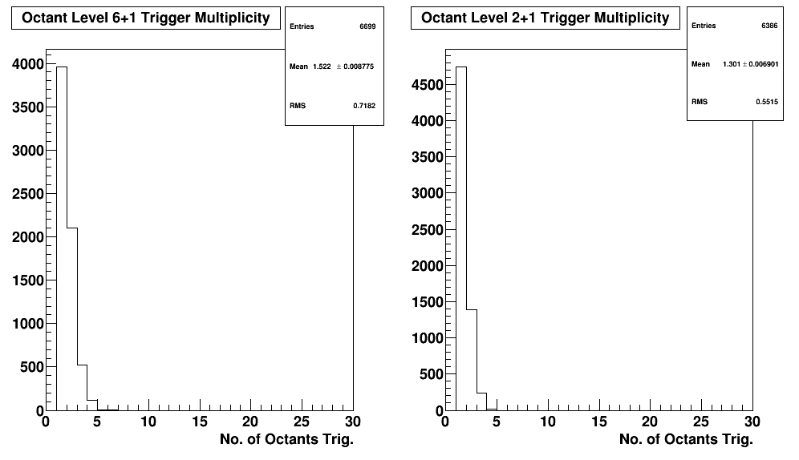
Occupancy over 30 sectors
1.522 clusters
In average
1.3 clusters
In average

Slide 15
GEM event occupancy and size
Sector | Rate | XY | Bytes | 3 samples ( bytes)
0 | 199 | 398 | 184 | 552
1 | 147 | 294 | 96 | 288
2 | 107 | 214 | 80 | 240
3 | 102 | 204 | 72 | 216
4 | 102 | 204 | 72 | 216
Total hits / sector | 657 |  | 432 | 1296
Data rate / sector | 30000 |  | 157680000 | 473040000
Data rate ( sector Mb/s) |  |  | 157,68 | 473.1
Total detector | 19710 |  | 4730.4 | 14191.2
Occupancy detector | 0.14
Data rate to front end reading 3 samples
Use 4 Gigabit link = 512 MB/s not an issue with SRS

Slide 16
GEM event occupancy and size
Sector | Rate | XY | Bytes | 3 samples ( bytes)
0 | 23 | 46 | 184 | 552
1 | 12 | 24 | 96 | 288
2 | 10 | 20 | 80 | 240
3 | 9 | 18 | 72 | 216
4 | 9 | 18 | 72 | 216
Total hits / sector | 63 |  | 504 | 1296
Data rate / sector | 30000 |  | 1512000 | 77760000
Data rate ( sector Mb/s) |  |  | 15.12 | 45.36
Total detector | 1620 |  | 453.6 | 1360.8
Occupancy detector | 0.013
Rates with deconvolution 3 samples readout
Data after processing going to tape

Slide 17
PVDIS electron trigger
Coincidence ECAL and Gas Cerenkov
Singles ECAL | 290 KHz
Singles rates Cerenkov | 1.9 MHz
Accidental 30 ns | 16.5 KHz
DIS electron | 10 KHz max
Total rate | 27 KHz

Slide 18
Summary PVDIS
Simulation and trigger were checked and optimized
Max trigger rate estimated to be 27 KHz ( can handle 60 KHz )
GEM data rate assuming 30 KHz around 480 MB/s
GEM data rate after deconvolution around 46 MB/s
FADC data 60 MB/s
Total about 108 MB/s to L3, total 3.24 GB/s
Use L3 to reduce to 250 MB/s ( similar to Hall D ) need to reduce data by a factor of 12

Slide 19
SIDIS

Slide 20
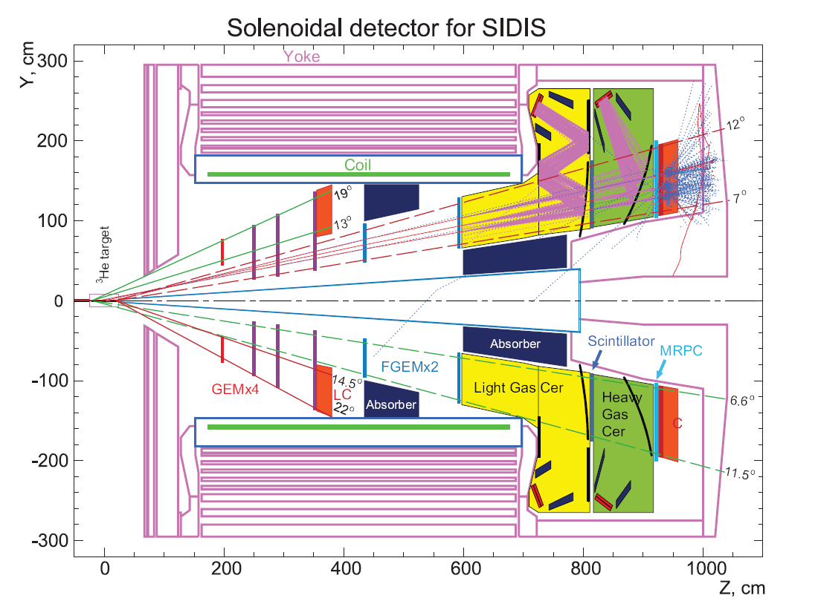
120 KHz
65 KHz
7 MHz pions

Slide 21
Detector layout and trigger for SIDIS
Trigger
Calorimeter
+
Cerenkov
+
MRPC
Coincidences and threshold for global
60 KHz
trigger rates

Slide 22
SIDIS channel count
Detector | Module type | Number of channels | Number of FADC
Forward Calorimeter | FADC | 1150 x 2 | 144
Large angle calorimeter | FADC | 450 x 2 | 57
Light Gas Cerenkov | FADC | 270 | 8
Heavy Gas Cerenkov | FADC | 480 | 17
Scintillator | FADC | 300 | 8
MRPC | TRB3+Input Register | 3300 | 30

Slide 23
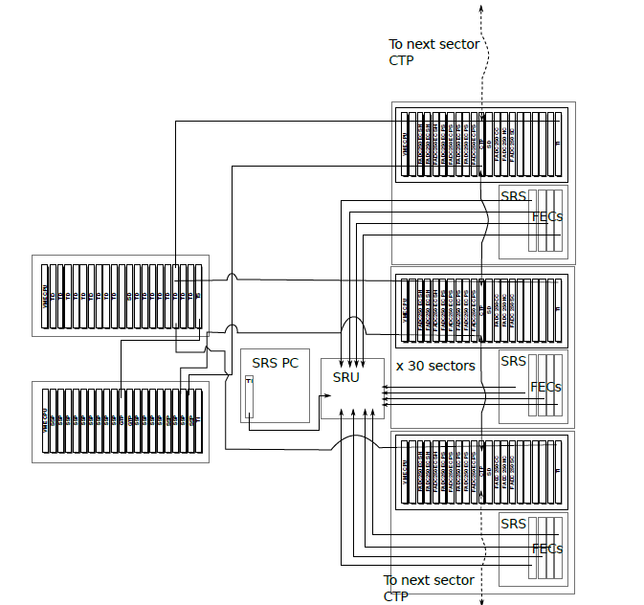
SIDIS

Slide 24
SIDIS J/Psi
Read integral and time
Standard zero suppression
J/Psi, look for two clusters instead of one for trigger close to SIDIS trigger
Trigger of a few KHz

Slide 25
SIDIS: Coincidence @ 30 ns window
Assuming a 30 ns gate
Coincidence rate: 14MHz x 155.5KHz x 30 ns = 65.2 kHz
Total with 4 KHz Physics = 70 KHz
Given the safety margin, expected to handle about 100 KHz.
  Include some single trigger to study detector performance etc.

Slide 26
MRPC readout
1550 detectors = 3300 channels
Rutgers proposes use GSI TRB3
  10 ps resolution 256 channels around 3.5 K$
  Front end PADIWA amplifier discriminator 200 $ for 16 channels
Development Tsinghua and USTC
VETROC trigger interface board to put signal in L1 trigger ( prototype available )

Slide 27
GEM event occupancy and size
Sector | Rate | XY | Bytes | 3 samples ( bytes)
0 | 1 | 2 | 8 | 24
1 | 2 | 4 | 16 | 48
2 | 1 | 2 | 8 | 24
3 | 1 | 2 | 8 | 24
4 | 1 | 2 | 8 | 24
5 | 1 | 2 | 8 | 24
Total hits / sector | 7 | 14 | 56 | 1296
Total detector | 210 | 420 | 1680 | 5040
Data rate / sector |  |  | 168000000 | 504000000
Data rate ( sector Mb/s) |  |  | 168 | 504
Occupancy detector | 0.0015
Using deconvolution gives 168 MB/s for 100 KHz

Slide 28
FADC data
In 50 ns windows, 11 GeV
Detector | Rate | Hits | Type | Data Size per hit
LC | 120 kHz | 1 | Energy, Hits | 8 Byte x 2 (PS/SH)
FC | 200 MHz | 10 | Energy, Hits | 8 Byte x 2 (PS/SH)
LGC | 40 MHz | 3 | Energy, Hits | 8 Byte x 2 (split)
HGC | 60 MHz | 4 | Energy, Hits | 8 Byte x 2 (split)
MRPC | 850 MHz | 45 | Hits | 4 Byte
SC | 300 MHz | 15 | Energy, Hits | 8 Byte
Total |  |  |  | 2.04kB
204 MB/s at 100 KHz

Slide 29
Summary SIDIS
Readout only one sample, time and integral for GEM and FADC
70 KHz coincidence rate
Design for 100 KHz gives 368 MB/s to L3 need less than factor 2 reduction
Study feasibility to take all singles ( 150 KHz )
should be doable but need more L3 processing power

Slide 30
Man power rough estimate
JLAB
Alexandre
Camsonne Yi Qiang
Stony Brook
  Krishna Kumar
  Abbey Deshpandes
  Seamus Riordan
Rutgers
  Ron Gilman
  MRPC readout
Tsinghua
/USTC
  Yi Wang
 |  | Year 1 | Year 2 | Year 3 | Year 4 | Year 5
1 postdoc |  | Test stand | Test stand | Full electronics | Electronics cabling | Experiment
1 student |  | Test stand | Test stand | Full electronics | Electronics cabling | Experiment
1 tech |  | Rack |  | Rack,cables,weldment | Electronics / detector cabling
DAQ |  | Support | Support | Support | Support
Designer |  | Layout | Layout
Electronics |  | Trigger | Trigger | Support | Support | Support

Slide 31
HV and cables
Calorimeter shower | FADC | 1800
Large angle calorimeter preshower | FADC | 114.375
Forward angle calorimeter preshower | FADC | 0
SPD | FADC | 18.75
Light Gas Cerenkov |  | 270
Heavy Gas Cerenkov |  | 480
Total |  | 2714

Slide 32
HV and cables
 | Total | Needed | Cost
Cables | 2714 | 714 | 27 K$
HV boards | 113 | 30 | 194 K$
HV mainframe | 17 | 5 | 57 K$
 |  | Total | 278 K$
Assume we can reuse 2000 HV channels so need around 714 channels

Slide 33
Tasks
Hardware
  Trigger design
  Electronics performance testing
  Shielding
  Cabling layout / installation
  L3 / event filtering
Simulation
  Radiation and shielding
  Background in detector event size
  Background in detector event/trigger rates
  Trigger simulation for logic and timing

Slide 34
DAQ Test stand
Ordered parts / collaboration with Hall A Compton
  2 VXS crates
  4 FADC
  1 CTP, 1SSP
  4 Intel VME CPUs
CODA3 still in the work : test L3 Farm

Slide 35
Time line
2014
  DVCS : test Intel VME CPU for large amount of data
2015
  Small scale setup for testing : FADC + trigger + APV25
  HCAL Trigger development ( SBS funding accepted )

Slide 36
Conclusion
SoLID requires high rates low dead time, flexible trigger capability
Rates optimization for SIDIS but push for highest rate depending of GEM chip performances
GEM electronics R&D
Background and trigger rates where checked and close proposal, data rates are sustainable by the DAQ hardware

Slide 37
Backup slides

Slide 38
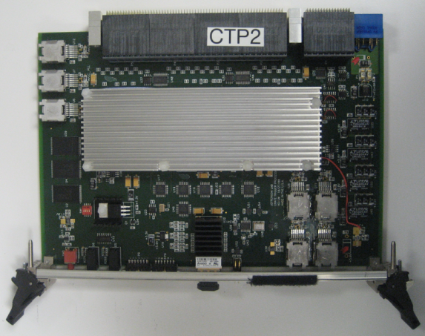
L1 Trigger Diagram
CPU
SSP
SSP
SSP
SSP
SSP
SSP
SSP
GTP
SD
SSP
SSP
SSP
SSP
SSP
SSP
SSP
TI
CPU
TD
TD
TD
TD
TD
TD
SD
SD
TD
TD
TD
TD
TD
TD
TS
VXS Crate
CTP
VXS Crate
FADC250
12 bit @ 250 MHz, 16 ch
Sums amplitude from all channels
Transfer total energy or hit pattern to CTP
Fiber Optics
64 bit @ 125 MHz
CPU
FADC
FADC
FADC
FADC
FADC
FADC
CTP
SD
FADC
FADC
FADC
FADC
FADC
FADC
TI
Crate Trigger Processor
Sums energies from FADCs
Transfer total energy or hit pattern to SSP
VXS Serial Link
16 bit @ 250 MHz: 4 Gbps
VXS Crate

Slide 39
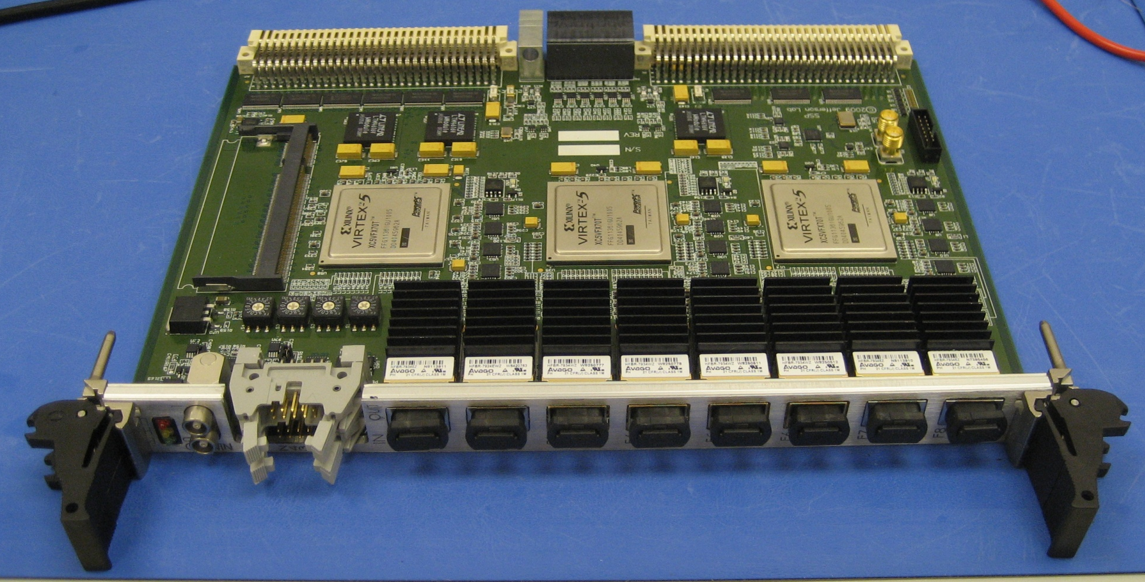
L1 Trigger Diagram
CPU
SSP
SSP
SSP
SSP
SSP
SSP
GTP
SD
SSP
SSP
SSP
SSP
SSP
SSP
SSP
TI
CPU
TD
TD
TD
TD
TD
TD
SD
SD
TD
TD
TD
TD
TD
TD
TS
TS
SSP
VXS Crate
VXS Crate
Sub-System Processor
Consolidates multiple crate subsystems
Report total energy or hit pattern to GTP
Copper Ribbon Cable
32 bit @ 250 MHz: 8 Gbps
CPU
FADC
FADC
FADC
FADC
FADC
FADC
CTP
CTP
SD
FADC
FADC
FADC
FADC
FADC
FADC
TI
Global Trigger Processor
Collect L1 data from SSPs
Calculate trigger equations
Transfer 32 bit trigger pattern to TS
VXS Serial Link
32 bit @ 250 MHz: 8 Gbps
VXS Crate

Slide 40
Level-1 Trigger Electronics
Front-End Crate
Trigger Distribution Crate
Custom Designed
Boards at JLAB
VXS Crate
VXS Crate
Detector
Signals
TD
TS
Fiber Optic Links
Clock/Trigger
(16bits @ 62.5MHz
TS
(16)
(12)
(1)
(1)
(1)
(1)
(1)
VXS Crate
( ) – Number in parentheses
refer to number of modules
Fiber Optic Link
(~100 m)
(64bits @ 125 MHz)
SSP
GTP
fADC250
(8)
CTP Crate Trigger Processor
(2)
(1)
Copper Ribbon Cable
(~1.5 m)
(32bits @ 250 MHz)
SD Signal Distribution
Global Trigger Crate
TI Trigger Interface
Trigger Latency ~ 3 μs
Pipelined detector readout electronics:
fADC
VXS Backplane

Slide 41
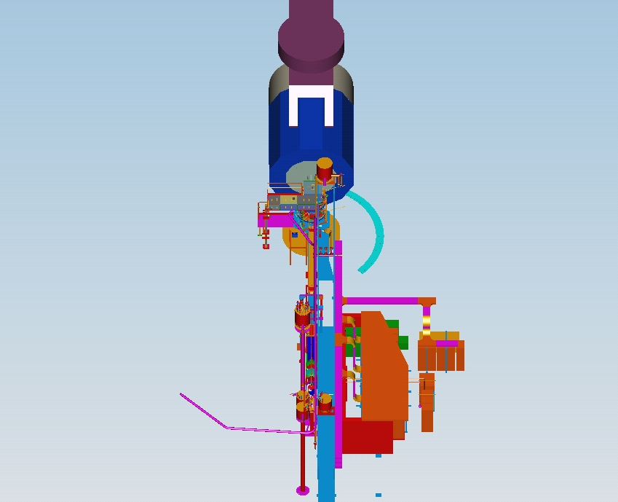
Hall staging
10 racks
+
patch panels

Slide 42
Test run setup
MRPC
  V1290
  JLAB or SIS FADC
GEM / Hadron Blind Detector
  APV25 (UVA)
    SRS readout
    MPD

Slide 43
SIDIS channel count
Detector | Module type | Number of channels | Number of modules
Forward Calorimeter | FADC+TDC | 2x1150 | 119
Large angle calorimeter | FADC+TDC | 2x450 | 58
Light Gas Cerenkov | FADC+TDC | 270 | 8
Heavy Gas Cerenkov | FADC+TDC | 480 | 17
Scintillator | FADC+TDC | 300 | 8
GEM | VME | 164K | 321

Slide 44
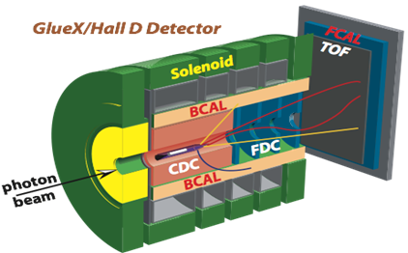
Hall D L1 Trigger-DAQ Rate
Low luminosity (10⁷ γ/s in 8.4 < E_{γ} < 9.0 GeV)
  20 kHz L1
High luminosity (10⁸ γ/s in 8.4 < E_{γ} < 9.0 GeV)
  200 kHz L1
  Reduced to 20 kHz L3 by online farm
Event size: 15 kB; Rate to disk: 3 GB/s
SC
Detectors which can be used in the Level-1 trigger:
Forward Calorimeter (FCAL) | Energy
Barrel Calorimeter (BCAL) | Energy
Start Counter (SC) | Hits
Time of Flight (TOF) | Hits
Photon Tagger | Hits
Electromagnetic background
Hadronic E_{γ} < 8 GeV
Hadronic E_{γ} > 8 GeV
Energy BCAL (GeV)
Energy BCAL (GeV)
Energy BCAL (GeV)
Basic Trigger Requirement:
E_{BCAL} + 4 ∙ E_{FCAL} > 2 GeV
and a hit in Start Counter
Energy FCAL (GeV)
Energy FCAL (GeV)
Energy FCAL (GeV)

Slide 45
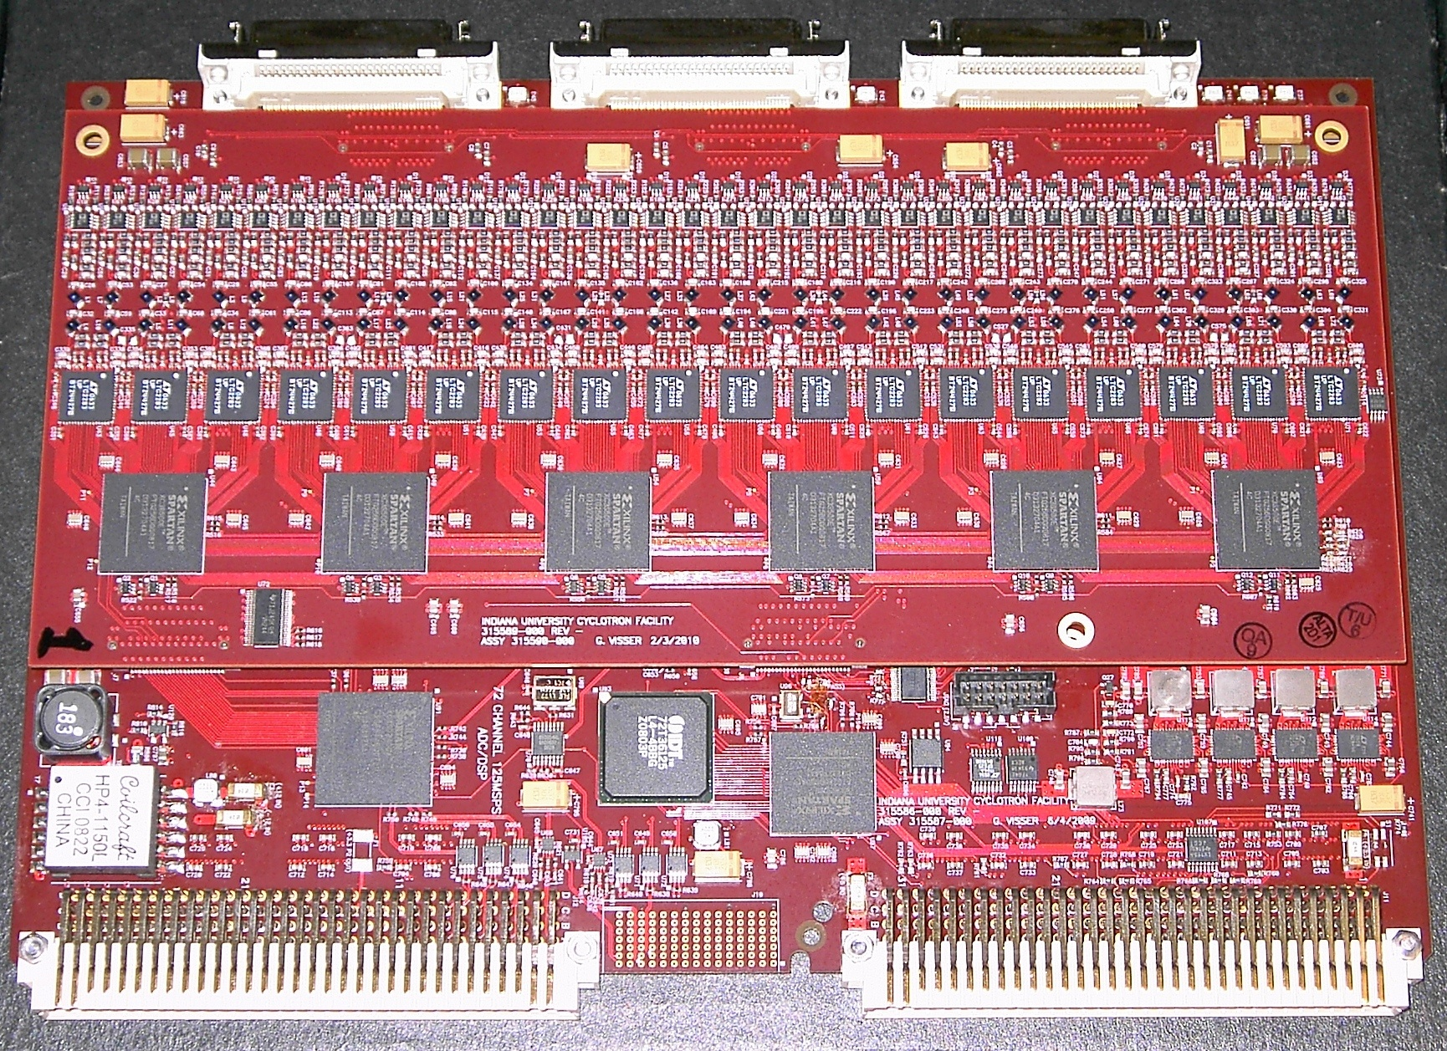
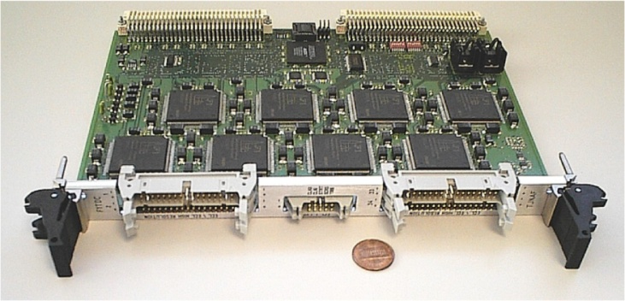
Custom Electronics for JLab
VME Switched Serial (VXS) backplate
  10 Gbps to switch module (J₀)
  320 MB/s VME-2eSST (J₁/J₂)
All payload modules are fully pipelined
  FADC125 (12 bit, 72 ch)
  FADC250 (12 bit, 16 ch)
  F1-TDC (60 ps, 32 ch or 115 ps, 48 ch)
Trigger Related Modules
  Crate Trigger Processor (CTP)
  Sub-System Processor (SSP)
  Global Trigger Processor (GTP)
  Trigger Supervisor (TS)
  Trigger Interface/Distribution(TI/D)
  Signal Distribution (SD)
FADC125
F1-TDC

Slide 46
L1 Trigger Diagram
CPU
SSP
SSP
SSP
SSP
SSP
SSP
GTP
GTP
SD
SSP
SSP
SSP
SSP
SSP
SSP
SSP
TI
CPU
TD
TD
TD
TD
TD
TD
SD
SD
TD
TD
TD
TD
TD
TD
TS
VXS Crate
VXS Crate
Trigger Distribution
Distribute trigger, clock and synchronize signals to TI in each Crate
VXS Serial Link
16 bit @ 62.5 MHz: 1 Gbps
CPU
FADC
FADC
FADC
FADC
FADC
FADC
CTP
SD
FADC
FADC
FADC
FADC
FADC
FADC
TI
TI
Trigger Supervisor
Calculate 8 bit trigger types from 32 bit trigger pattern
Prescale triggers
Transfer trigger and sync signal to TD (16 bit total)
Fiber Optics
16 bit @ 62.5 MHz: 1 Gbps
VXS Crate

Slide 47
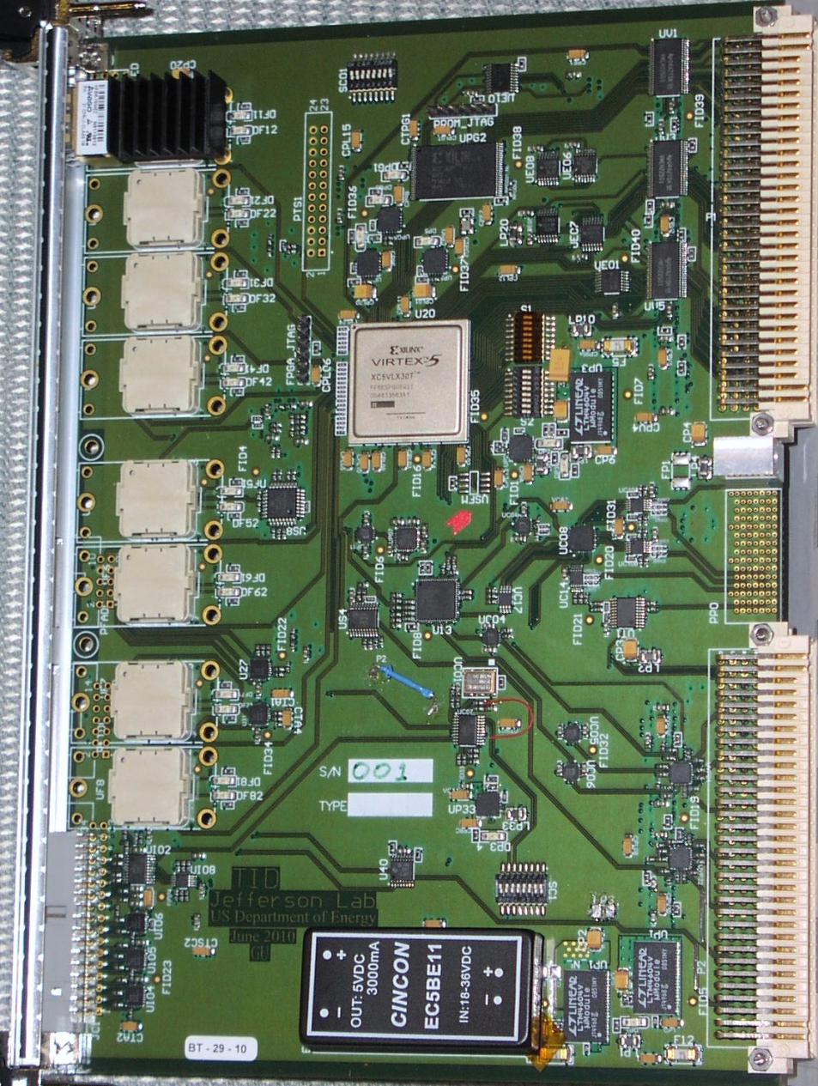
L1 Trigger Diagram
CPU
SSP
SSP
SSP
SSP
SSP
SSP
GTP
SD
SSP
SSP
SSP
SSP
SSP
SSP
SSP
TI
CPU
TD
TD
TD
TD
TD
TD
SD
SD
TD
TD
TD
TD
TD
TD
TD
TS
VXS Crate
VXS Crate
TID
VME Readout Controller
Gigabit ethernet
Trigger Interface
Receive trigger, clock and sync signals from TD
Make crate trigger decision
Pass signals to SD
CPU
FADC
FADC
FADC
FADC
FADC
FADC
CTP
SD
FADC
FADC
FADC
FADC
FADC
FADC
TI
Signal Distribution
Distribute common signals to all modules: busy, sync and trigger 1/2
VXS Crate
VXS Serial Link
4 bit @ 250 MHz: 1 Gbps

Slide 48
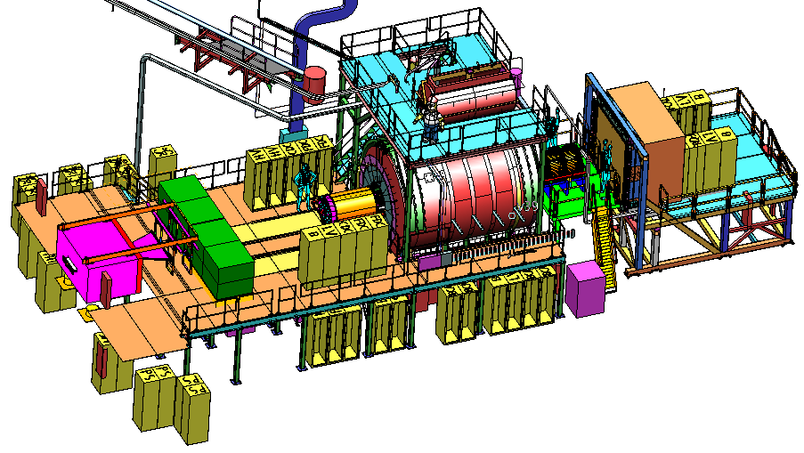
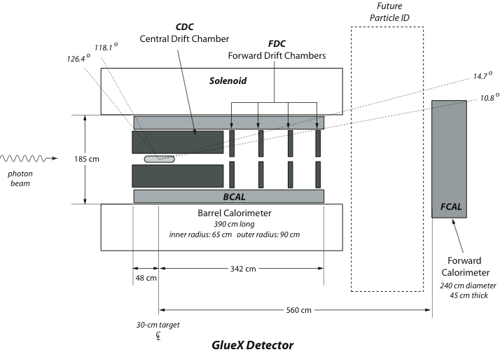
The GlueX Detector
2.2 Tesla
Solenoid
2.2T superconducting solenoidal magnet
Fixed target (LH₂)
10⁸ tagged γ/s (8.4-9.0GeV)
hermetic
TOF
time of flight
SC
start counter
Charged particle tracking
Central drift chamber (straw tube)
Forward drift chamber (cathode strip)
Calorimetry
Barrel Calorimeter (lead, fiber sandwich)
Forward Calorimeter (lead-glass blocks)
PID
Time of Flight wall (scintillators)
Start counter
Barrel Calorimeter

Slide 49
GlueX Data Rate
 | Front End DAQ Rate | Event Size | L1 Trigger Rate | Bandwidth to mass Storage
GlueX | 3 GB/s | 15 kB | 200 kHz | 300 MB/s
CLAS12 | 0.1 GB/s | 20 kB | 10 kHz | 100 MB/s
ALICE | 500 GB/s | 2,500 kB | 200 kHz | 200 MB/s
ATLAS | 113 GB/s | 1,500 kB | 75 kHz | 300 MB/s
CMS | 200 GB/s | 1,000 kB | 100 kHz | 100 MB/s
LHCb | 40 GB/s | 40 kB | 1000 kHz | 100 MB/s
STAR | 50 GB/s | 1,000 kB | 0.6 kHz | 450 MB/s
PHENIX | 0.9 GB/s | ~60 kB | ~ 15 kHz | 450 MB/s
private comm.
JLab
CHEP2007 talk
Sylvain Chapelin
LHC
BNL
*
**
* Jeff Landgraf Private Comm. 2/11/2010
** CHEP2006 talk MartinL. Purschke

Slide 50
CODA3 – What’s different
CODA 2.5 | CODA 3
Run Control (X, Motif, C++) (rcServer, runcontrol) | Experiment Control – AFECS (pure JAVA) (rcPlatform, rcgui)
Communication/Database (msql, cdev, dptcl, CMLOG) | cMsg – CODA Publish/Subscribe messaging
Event I/O C-based simple API (open/close read/write) | EVIO – JAVA/C++/C APIs Tools for creating data objects, serializing, etc…
Event Builder / ET System / Event Recorder (single build stream) | EMU (Event Management Unit) Parallel/Staged event building
Front-End – vxWorks ROC (Interrupt driven – event by event readout) | Linux ROC, Multithreaded (polling – event blocking)
Triggering: 32 ROC limit, (12 trigger bits -> 16 types) TS required for buffered mode | 128 ROC limit, (32 trigger bits -> 256 types) TI supports TS functionality. Timestamping (4ns)

Slide 51
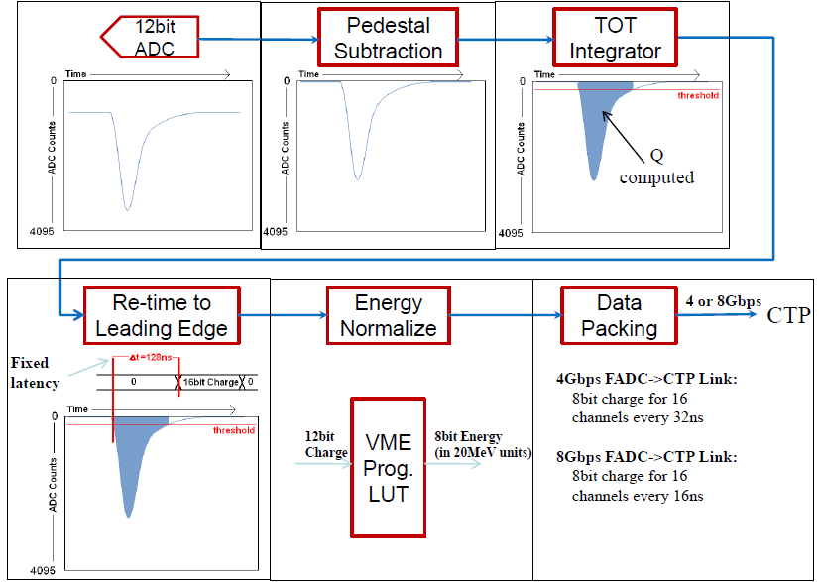
FADC Encoding Example

Slide 52
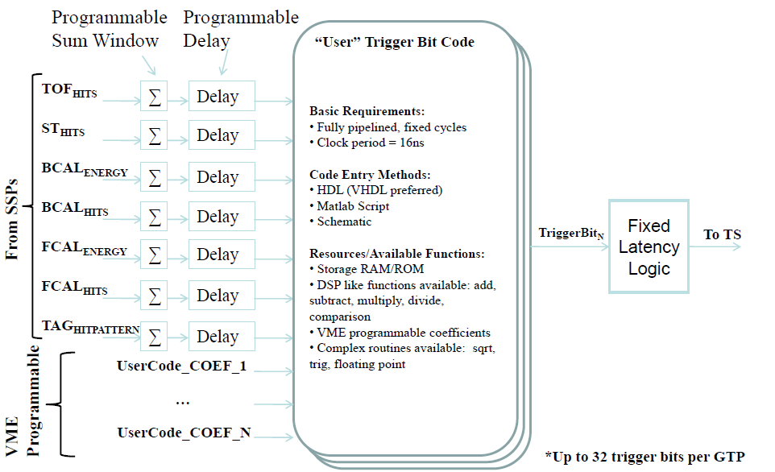
GTP Trigger Bit Example

Slide 53
L3 data reduction
Pile up detection
  Only record sample for event with pile up
Calorimeter clustering
GEM readout
  Timing cut
  Clustering
  Crude tracking

Slide 54
Jefferson Laboratory Pipelined electronics with CODA 3

Slide 55
Pipelined Hall D DAQ
Electron shower
accidental
accidental
3 us latency
Σ
Above
threshold

Slide 56
Pipelined Hall D DAQ
FADC
Calorimeter
CTP
L1 trigger
Calorimeter
+
Cerenkov
+
Pion
In
3 us
CTP
FADC
Light Gas Cerenkov
SSP
GTP
CTP
CTP
Heavy Gas Cerenkov
FADC

Slide 57
Data readout
VME
100 MB/s
Calo
Ethernet
100 MB/s
CPU
Cerenkov
DLO6
Tape
250 MB/s
SAS
250 MB/s
FADC
Scintillator
Event
Builder
L3
Drive
Silo
APV transfer
80 MB/s
CPU
MPD
CPU
GEM
APV
DAQ bottle necks
VME
100 MB/s

Slide 58
L3 Farm
blocked event fragments
partially recombined event fragments
full events
All nodes connected with 1GB/s links
Switches connected with 10GB/s fiber optics
ROC
EB1
Event Builder
stage 1
ROC
L3 Farm
EB2
Event Builder
stage 2
ROC
node
node
ROC
EB1
Event Builder
stage 1
node
Read Out Controllers
ER
Event Recorder
ROC
Raid Disk
ROC
EB2
Event Builder
stage 2
node
node
ROC
node
EB1
Event Builder
stage 1
node
ROC
ROC
Front-End Crates
Staged Event Building
Level-3 Trigger and monitoring
Event Recording
~60 crates
~50MB/s out per crate
N x M array of nodes (exact number to be determined by available hardware at time of purchase)
300MB/s in
300MB/s out

Slide 59
GEM READOUT

Slide 60
GEM readout
APV25 Front GEM ASICs
Up to 164 000 channels
APV 25 : 128 channels
Readout
  VME based readout : 16 APV25 = 2048 channels
  ( ~ 10 $ / channels )
  SRS readout : ethernet /PC based = 2048 channels
  ( ~ 3 $ / channels )
1 crate per sectors for FADC and GEM

Slide 61
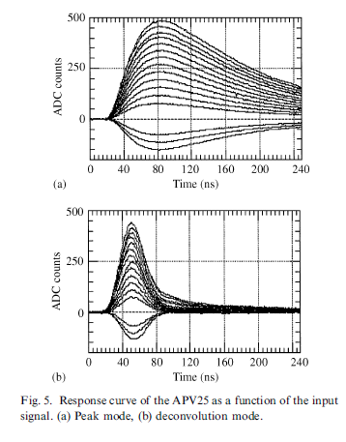
APV25 readout
Switch Capacitor Array ASICS with buffer length 192 samples at 40 MHz :
4.8 us Look back 160 samples : 4 us
Estimated occupancy : 220 hits per trigger, X Y data, 440 strips
GEM : 6 Layers 164 000 channels total, 28 000 channels per planes
Occupancy : 1.6 %
APV readout time :
t_APV = 141 x number_of_sample / 40 MHz
t_APV(1 sample) = 3.7 us.
Max rate APV front end :
270 KHz in 1 sample mode
90 KHz in 3 samples mode
Will be triggered at max 60 KHz in 3 samples
100KHz Max in 1 sample
Deadtimeless electronics / parallel read and write

Slide 62
Other GEM readout chips
APV25 limiting factor
  Need to confirm performance
  Optimize hardware and readout
Chip in development
  CLAS12 Dream CEA/Saclay
  ATLAS VMM1 BNL
  gDSP
  …
SRS readout compatible with other chips
  Ethernet + PC based

Slide 63
Tape size
 |  | Days | Data rate | Seconds | Total data TB | Double | DLO5 in $ | DLO6 in $
E12-11-108 | Pol proton | 120 | 250 | 10368000 | 2592 | 5184 | 259200 | 155520
E12-12-006 | J/Psi | 60 | 250 | 5184000 | 1296 | 2592 | 129600 | 77760
E12-10-006 | Transv. Pol. 3He | 90 | 250 | 7776000 | 1944 | 3888 | 194400 | 116640
E12-11-007 | Long. Pol. 3 He | 35 | 250 | 3024000 | 756 | 1512 | 75600 | 45360
E12-10-007 | PVDIS | 169 | 250 | 14601600 | 3650.4 | 7300.8 | 365040 | 219024
 | Total | 474 |  | 40953600 | 10238.4 | 20476.8 | 1023840 | 614304

