Slide 1
GEM chambers for SoLID
Nilanga Liyanage
University of Virginia

Slide 2
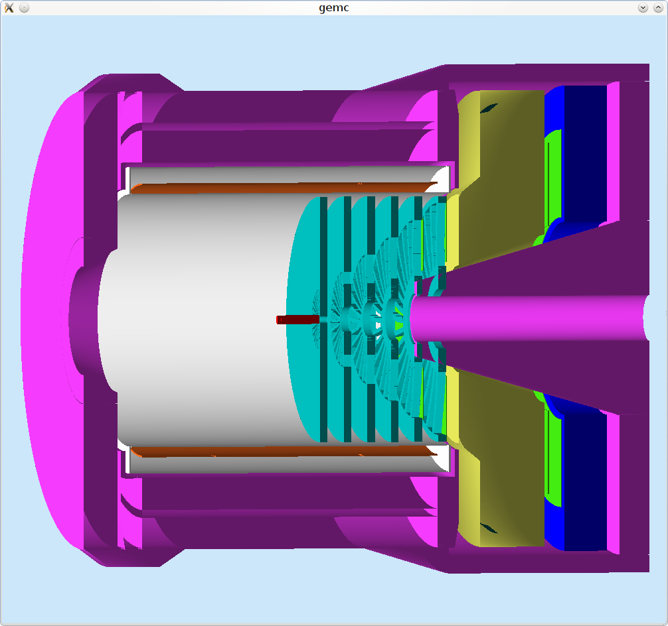
Tracking needs for SoLID (PVDIS)
Rate: from 100 kHz to 600 kHz (with baffles), GEANT4 estimation
Spatial Resolution: ∼0.2 mm (sigma)
Total area: ~37 m² total area (30 sectors x 5 planes, each sector covering 12 degree)
Need to be radiation and magnetic field tolerant
Lumi = 10°³⁹ /cm²/s

Slide 3

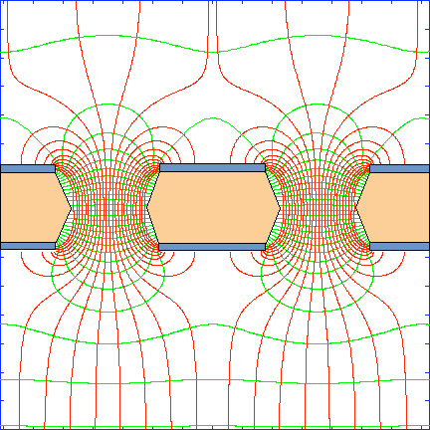
GEM working principle
GEM foil: 50 μm Kapton + few μm copper on both sides with 70 μm holes, 140 μm pitch
Ionization
Multiplication
(x20)
Multiplication
(x20)
Multiplication
(x20)
Readout
Strong electrostatic field in the GEM holes
Recent technology: F. Sauli, Nucl. Instrum. Methods A386(1997)531
COMPASS: A tracker of twenty two 31 cm x 31 cm GEM chambers successfully operated for years
Rates as high as 2.5 MHz/cm²

Slide 4
GEM Rate capability
Multiplication stages shielded from each other: much reduced feed back
Slow moving positive ions localized to holes, away from the induction region
Most of the created electrons contribute to signal: can operate at low gains
Much higher rates compared to wire chambers: ~ 50 MHz/cm²
~ 600 kHz/cm²
Maximum rate expected for SoLID GEM trackers
Triple GEM
Poli Lener, PhD Thesis - Rome 2005

Slide 5
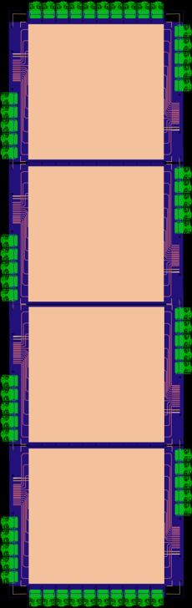
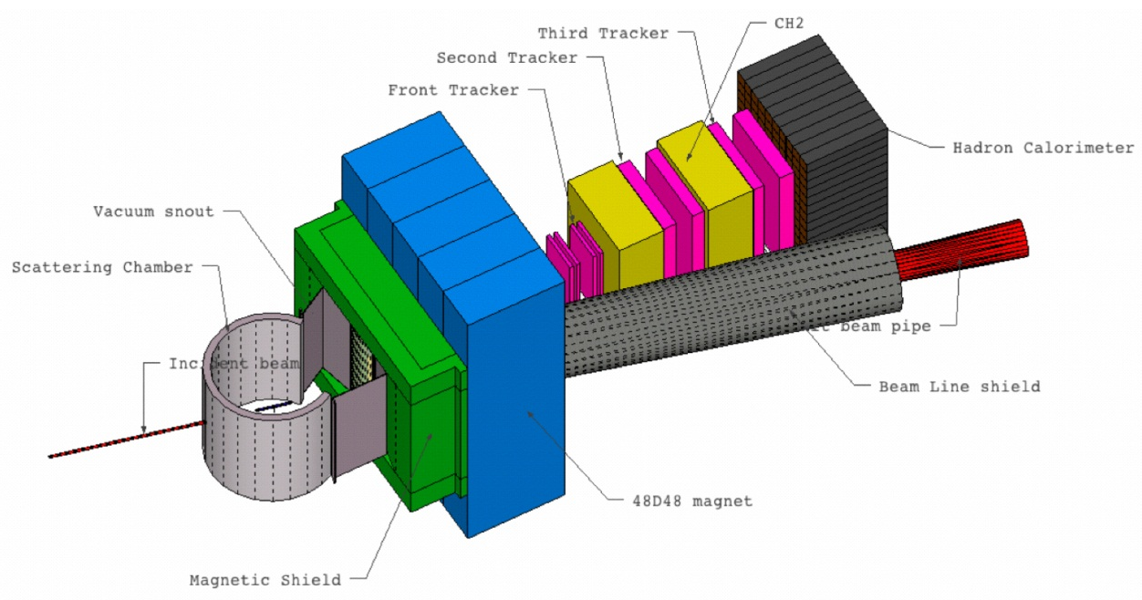
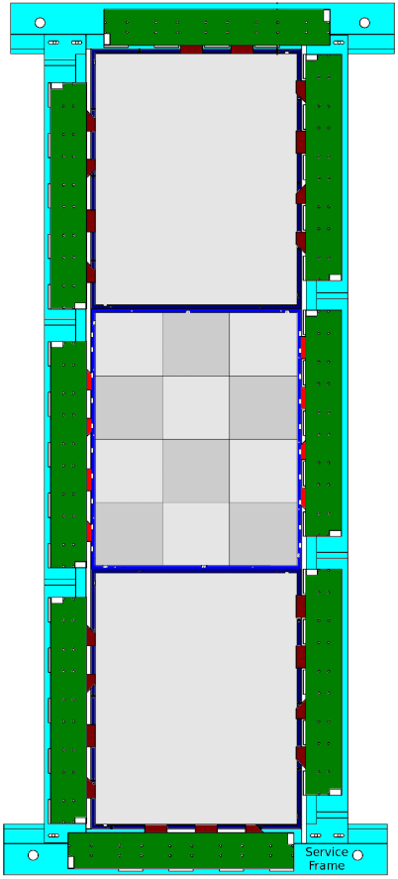
GEM Trackers for SBS
Back Tracker
10 GEM Layers (200 × 60 cm²)
Each Layer = 4 GEM modules (50 × 60 cm²)
R&D and Production @ University of Virginia
Front Tracker:
6 GEM Layers (150 × 40 cm²)
Each layer = 3 GEM modules (50 × 40 cm²)
R&D and Production by INFN Roma, Catania
50 cm
60 cm
50 cm
40 cm
Proton arm layout for GEp (5) experiment
Total Area ~ 16 m²

Slide 6
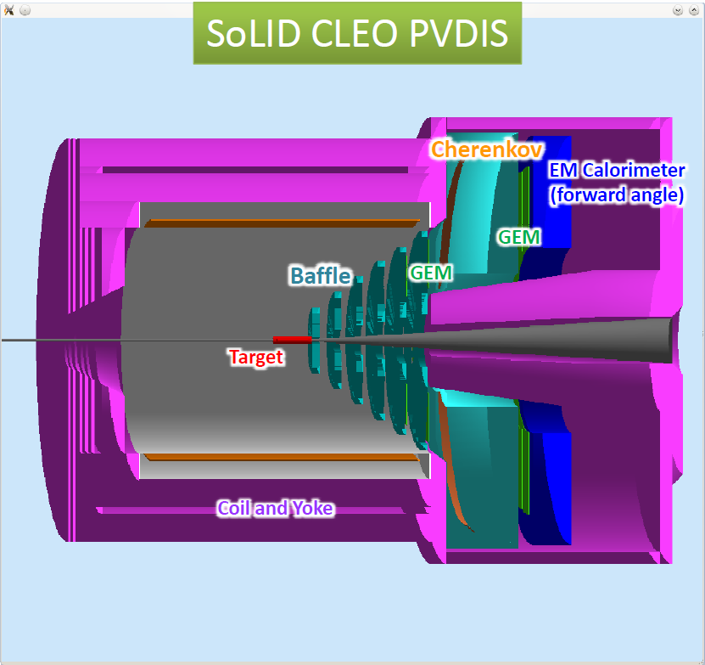
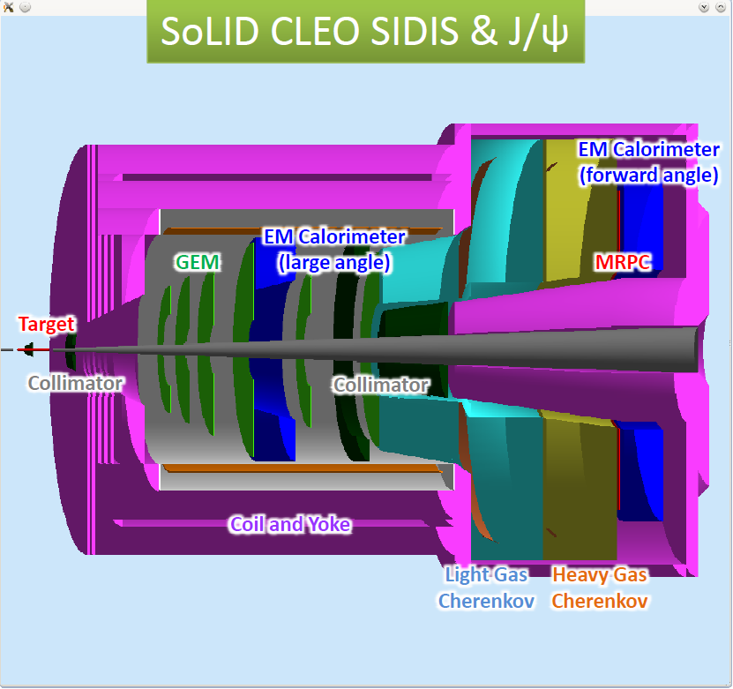

Slide 7
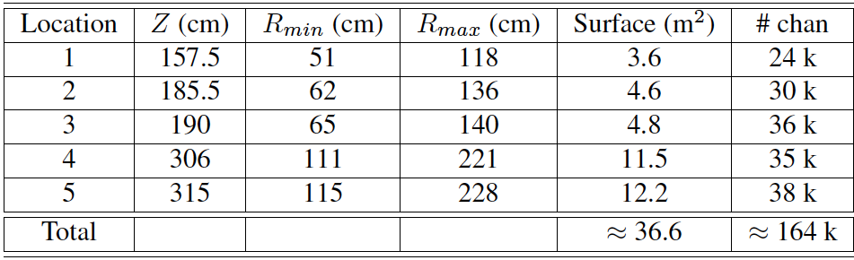
PVDIS GEM configuration
Instrument locations 1,2,3,4, and 5 GEM:
30 GEM modules at each location: each module with a 12-degree angular width.
Largest GEM module size required: 113 cm x (21-44) cm
With ~5% spares, we will need about 170 k readout channels.
Good news: cost of electronics going down – cost per channel for the RD51 SRS APV-25 based readout is ~ $ 3.00 + R&D expenses to optimize electronics for SoLID needs.

Slide 8
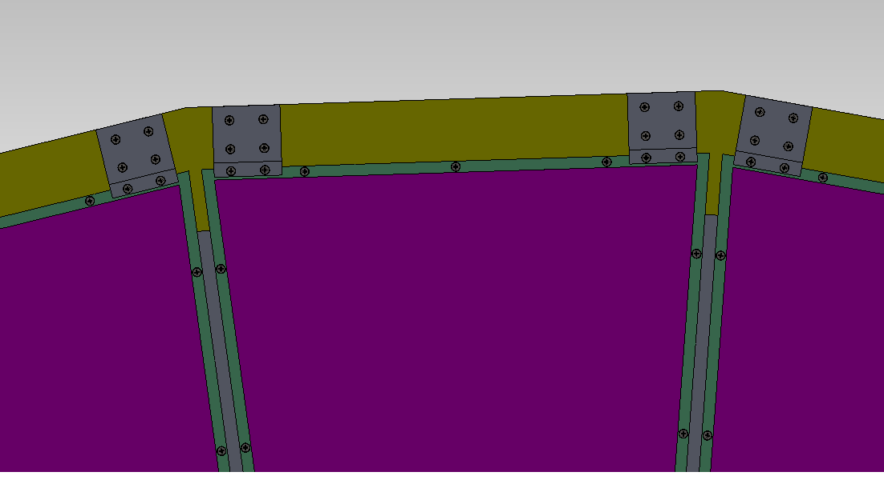
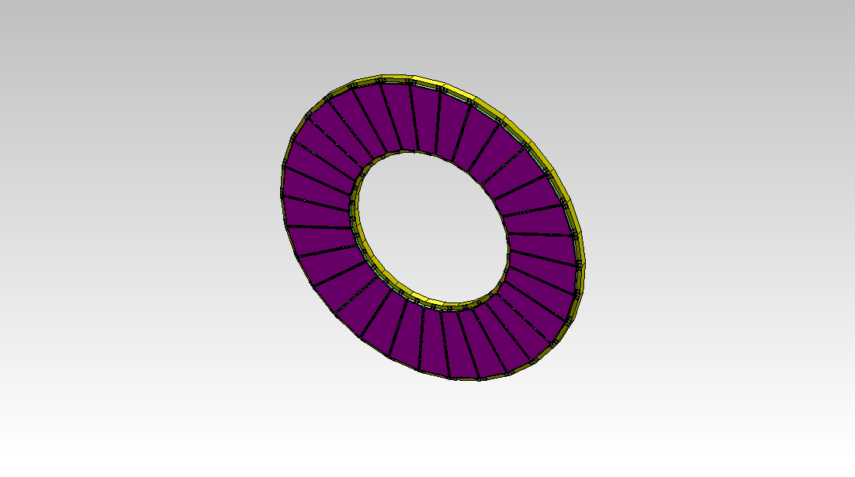
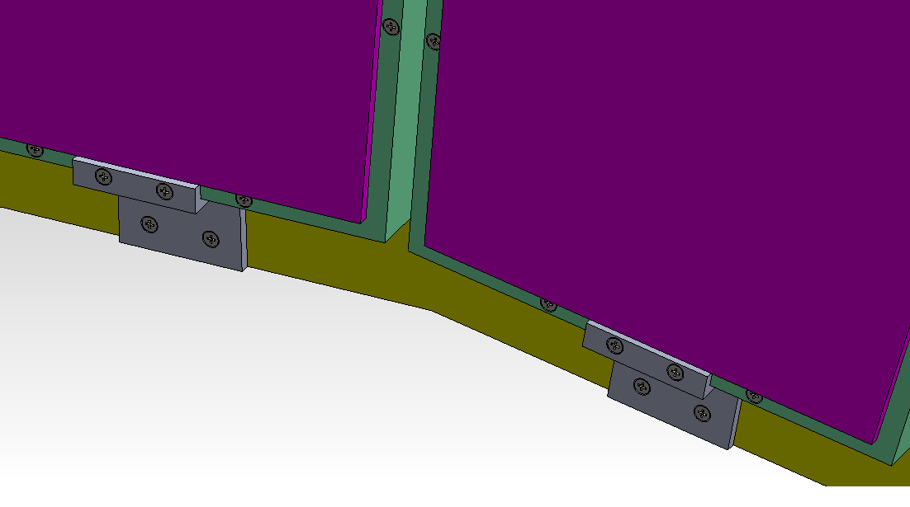
PVDIS GEM configuration

Slide 9
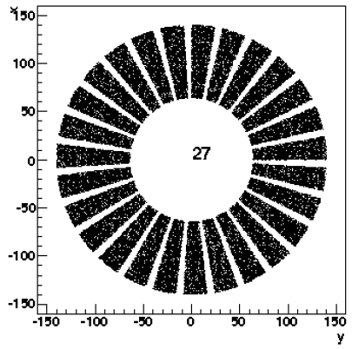
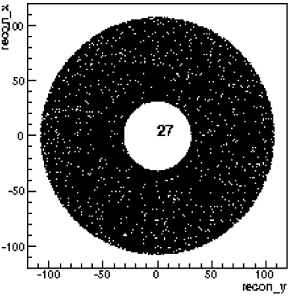
SIDIS GEM configuration
Six locations instrumented with GEM:
PVDIS GEM modules can be re-arranged to make all chamber layers for SIDIS. – move the PVDIS modules closer to the axis so that they are next to each other
More than enough electronic channels from PVDIS setup.
The two configurations will work well with no need for new GEM or electronics fabrication.
Plane | Z (cm) | R_{I} (cm) | R_{O} (cm) | Activearea | # of channels
1 | 197 | 46 | 76 | 1.1 | 24 k
2 | 250 | 28 | 93 | 2.5 | 30 k
3 | 290 | 31 | 107 | 3.3 | 33 k
4 | 352 | 39 | 135 | 5.2 | 28 k
5 | 435 | 49 | 95 | 2.1 | 20 k
6 | 592 | 67 | 127 | 3.7 | 26 k
total: |  |  |  | ~18 | ~ 161 k
SIDIS
PVDIS

Slide 10
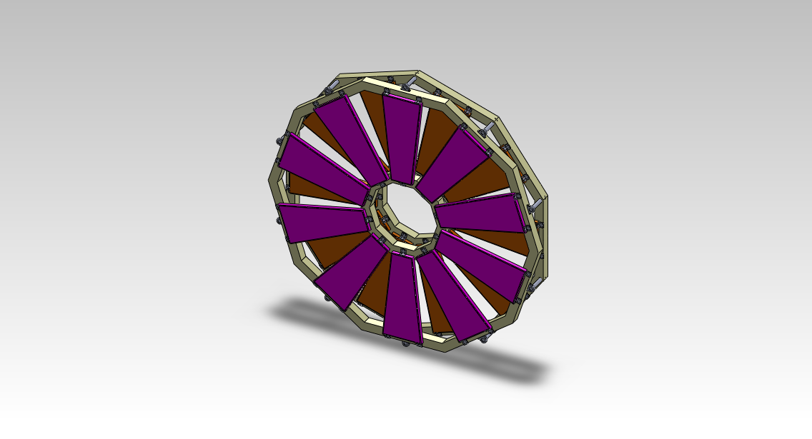
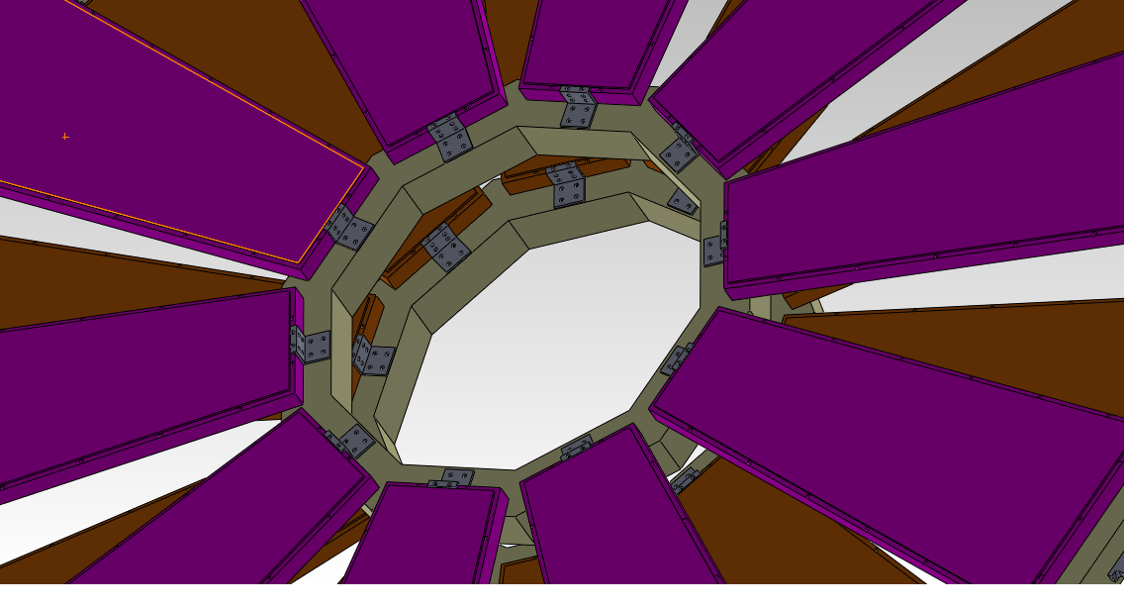
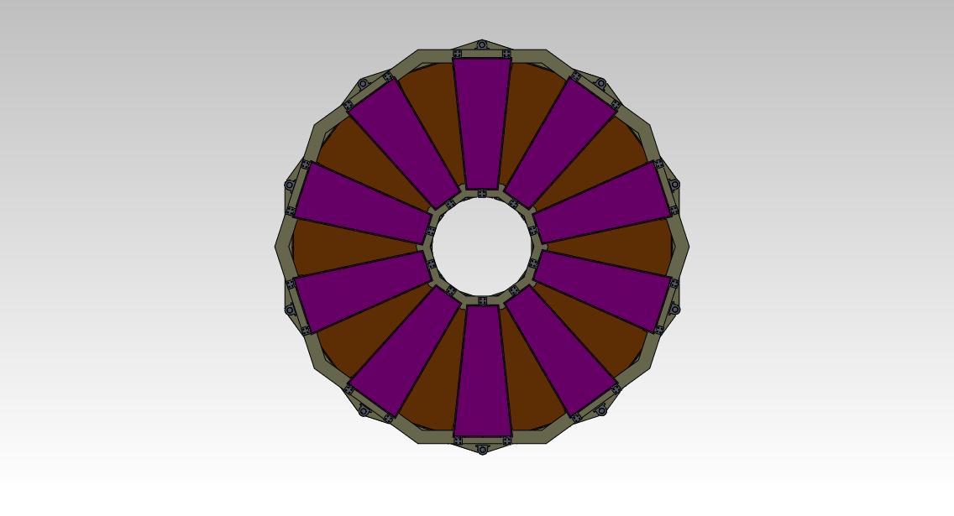
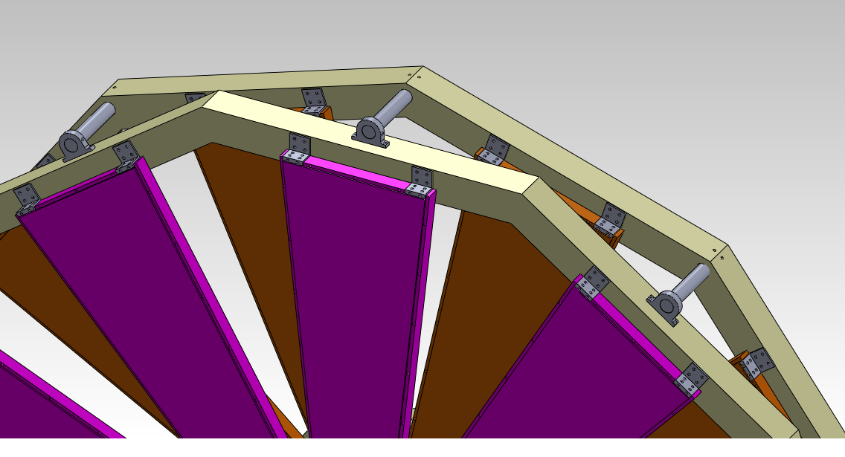
SIDIS GEM configuration

Slide 11
large area GEM chamber challenges
SoLID needs GEM modules as large at 100 cm x 40 cm.
The biggest challenge used to be the non-availability of large area GEM foils.
Not a problem anymore: CERN shop can make foils as large as 200 cm x 55 cm now.
  Previously limited by double mask technique for etching: hard to the two masks accurately: Max area was limited to ~ 45 cm x 45 cm
  . New Single Mask technique allows to make GEM foils as large as 200 cm x 50 cm
One problem may be the production capacity of the CERN shop: especially if a LHC related large GEM project gets underway.
Currently work going on to develop large GEM production capabilities in China.

Slide 12
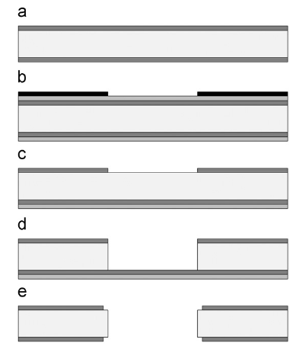
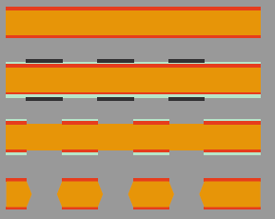
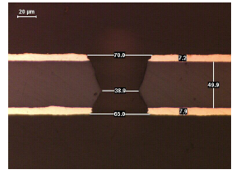
Major recent development at CERN PCB shop towards large GEM foils
Base material only ~ 45 cm wide roll.
Used a double mask technique for etching: hard to the two masks accurately: Max area limited to ~ 45 cm x 45 cm previously.
Bias top surface to – w.r.t chemical bath
Double Mask
Single Mask
Single Mask technique allows to make GEM foils as large as 200 cm x 50 cm

Slide 13
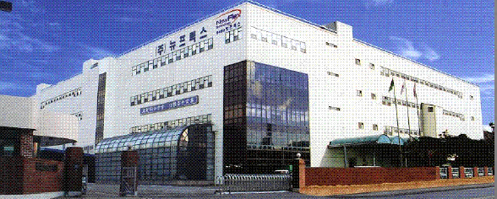
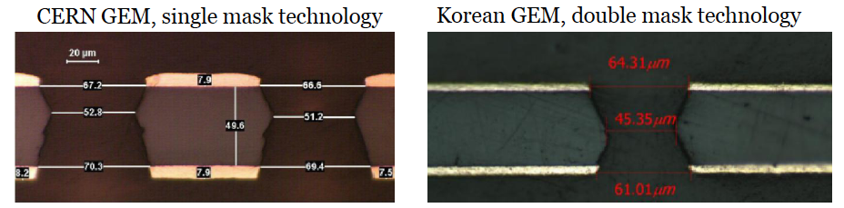
Industrial Production of GEMs
Many anticipated users of GEMs in the near future; CERN shop can’t keep up.
Several Industrial production around the world starting with CERN technology transfer:
  TechEtch, Plymouth, MA, USA : GEM foils up to ~ 40 cm; produced all foils for STAR FGT: currently a proposal led by Bernd Surrow to get TechEtch to do large area single mask GEMs
  NewFlex Technology, South Korea: produced the tested foils up to 10 x 10 cm2; plans for large production up to 1 m foils.
  TechTra in Poland
  India
  China
  …

Slide 14
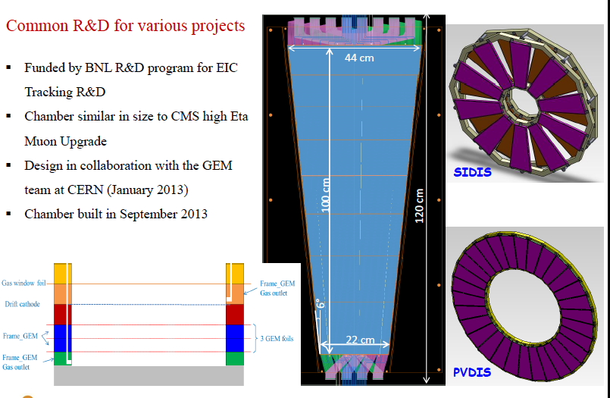
Large Area GEM prototype approaching SoLID dimensions

Slide 15
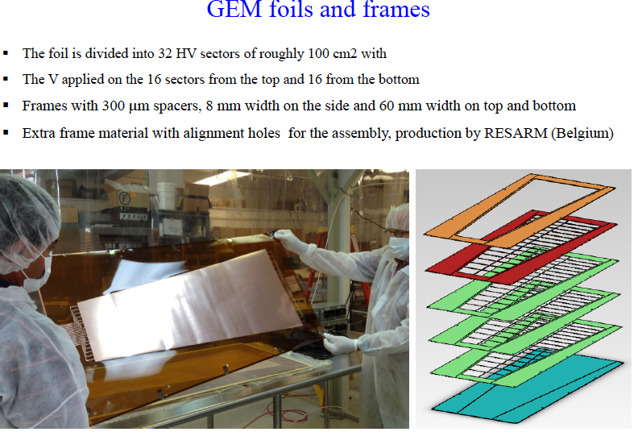

Slide 16
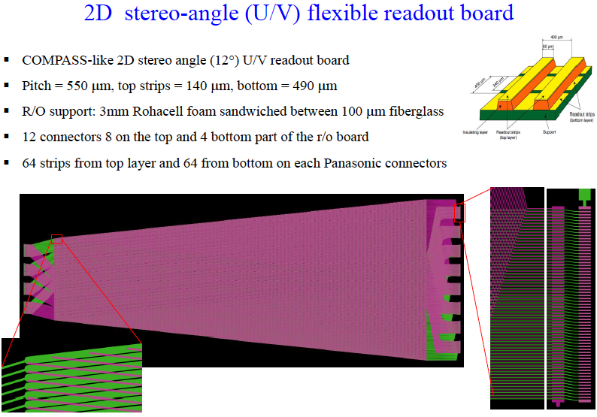

Slide 17
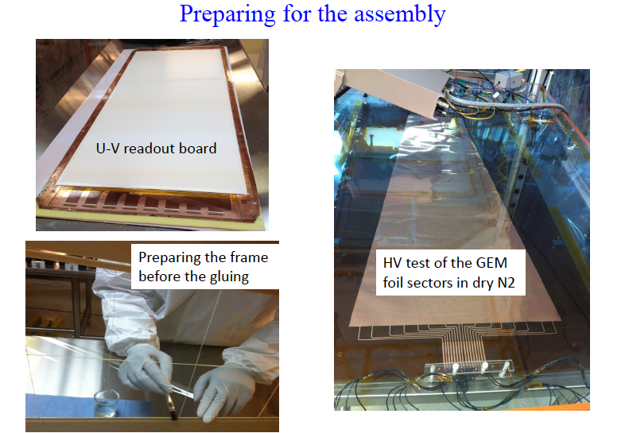

Slide 18
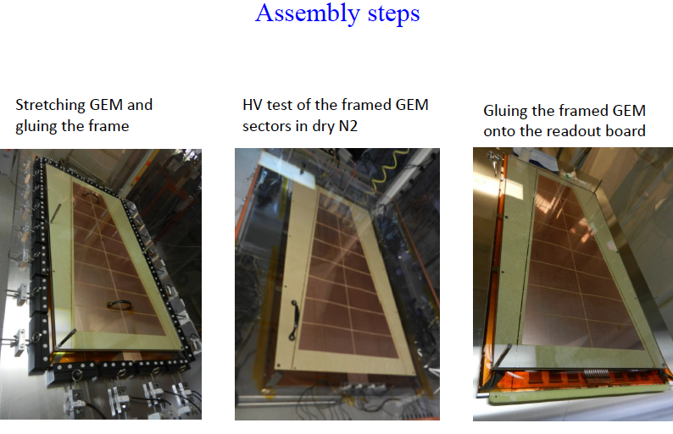

Slide 19
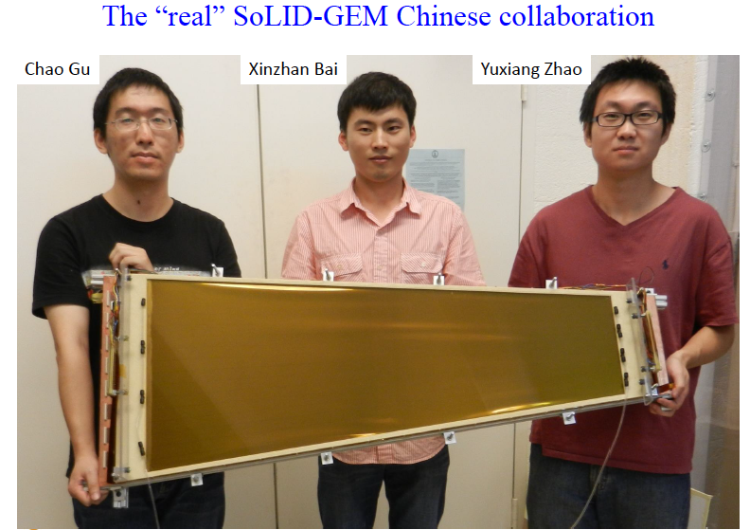

Slide 20
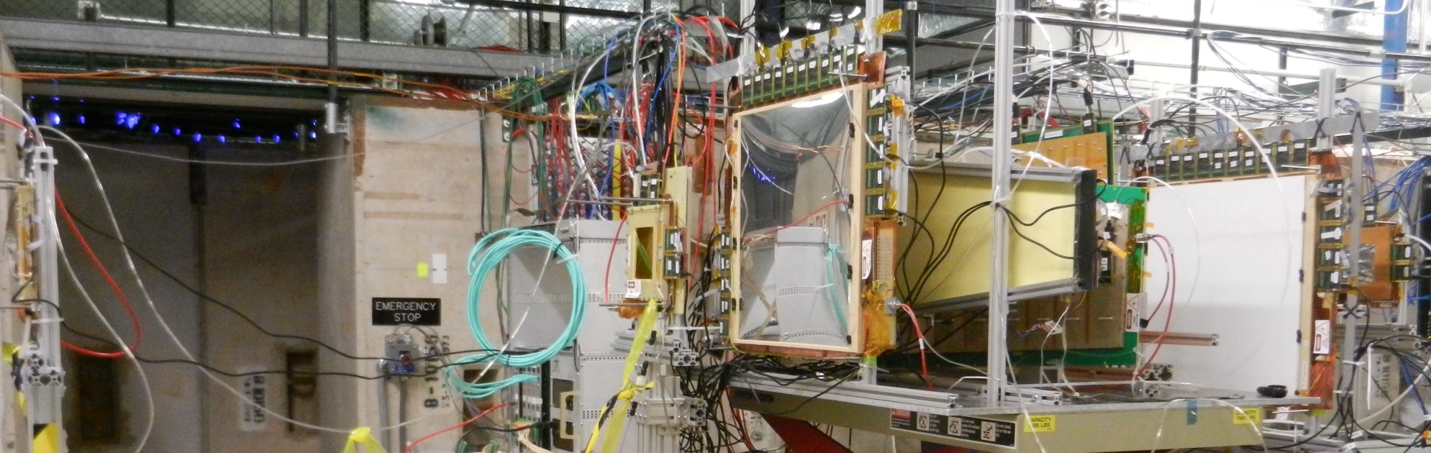
Test Beam @ FNAL (october 2013)
Successful test beam campaign with SBS 50 ×50 cm² prototype alongside the EIC-SoLID GEM prototype
Data analysis for spatial resolution, gain efficiency, gain uniformity, timing of the APV25 signal …
FNAL test beam data reveals big issues (timing of the APV25 vs. gas flow, Quality of readout board vs charge sharing …)
Medium size APV25 electronic tested at moderate trigger rate 400 Hz
Large GEM Test Beam Setup @ (FNAL) UVa an FIT
SBS GEM1
EIC-SoLID GEM
SBS GEM2

Slide 21
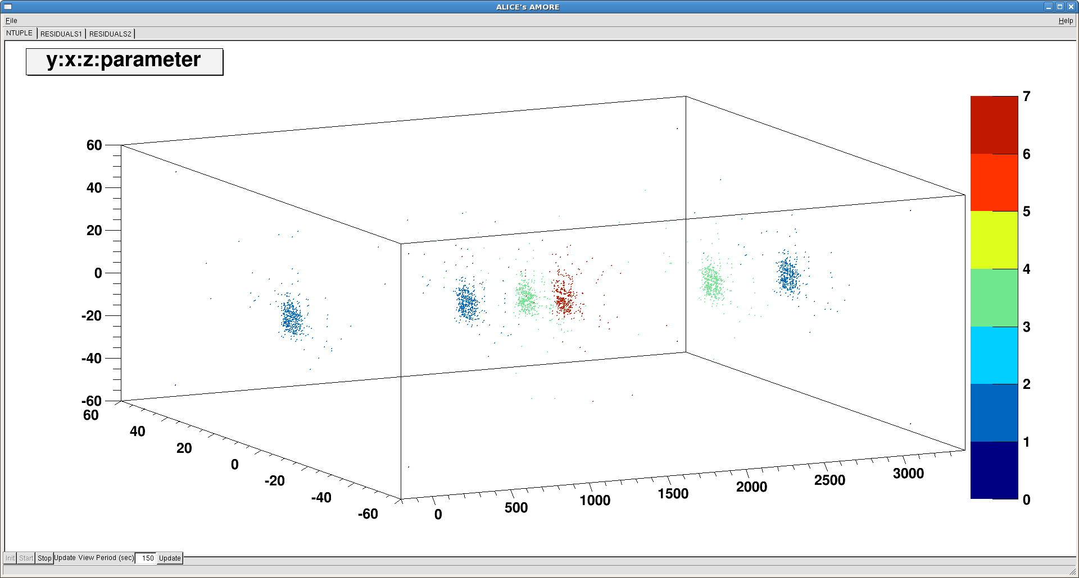
Large Size GEMs in MT6-2B @ FTBF (Fermilab)
EIC-SoLID
TRK_4: SBS2
TRK_0
TRK_1
SBS1
TRK_2

Slide 22
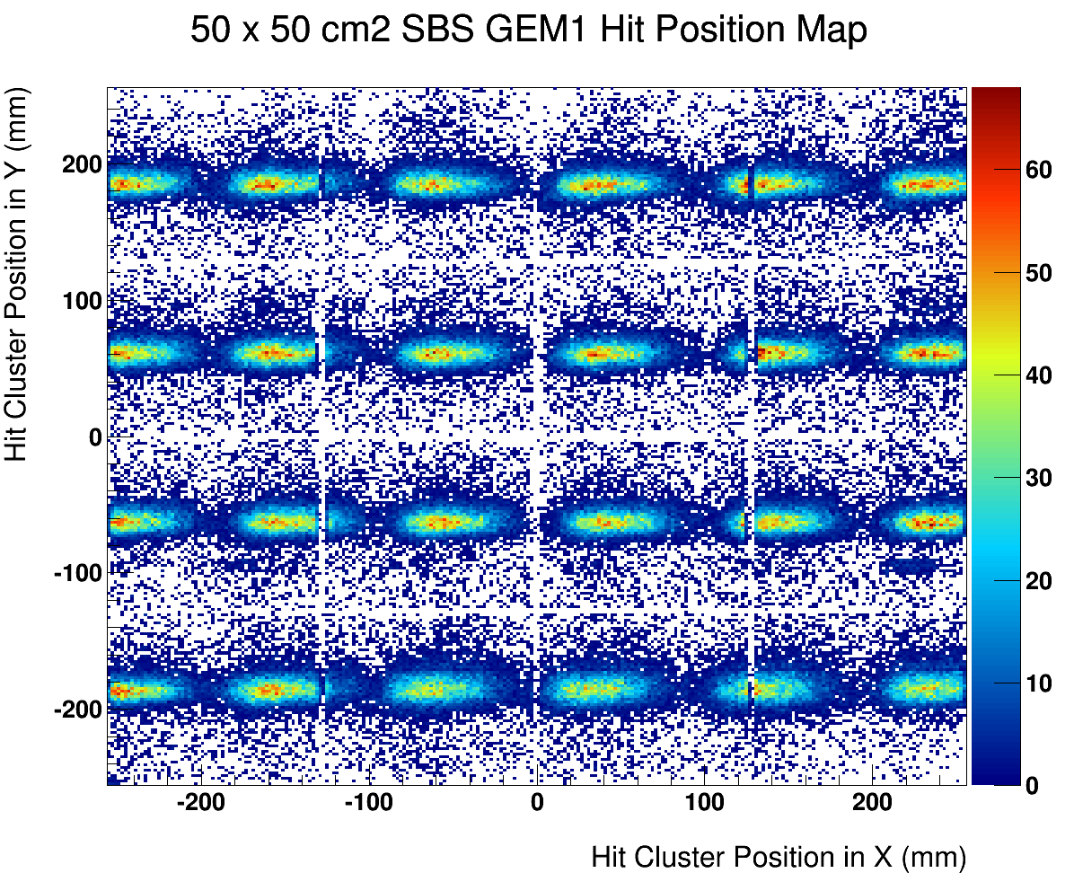
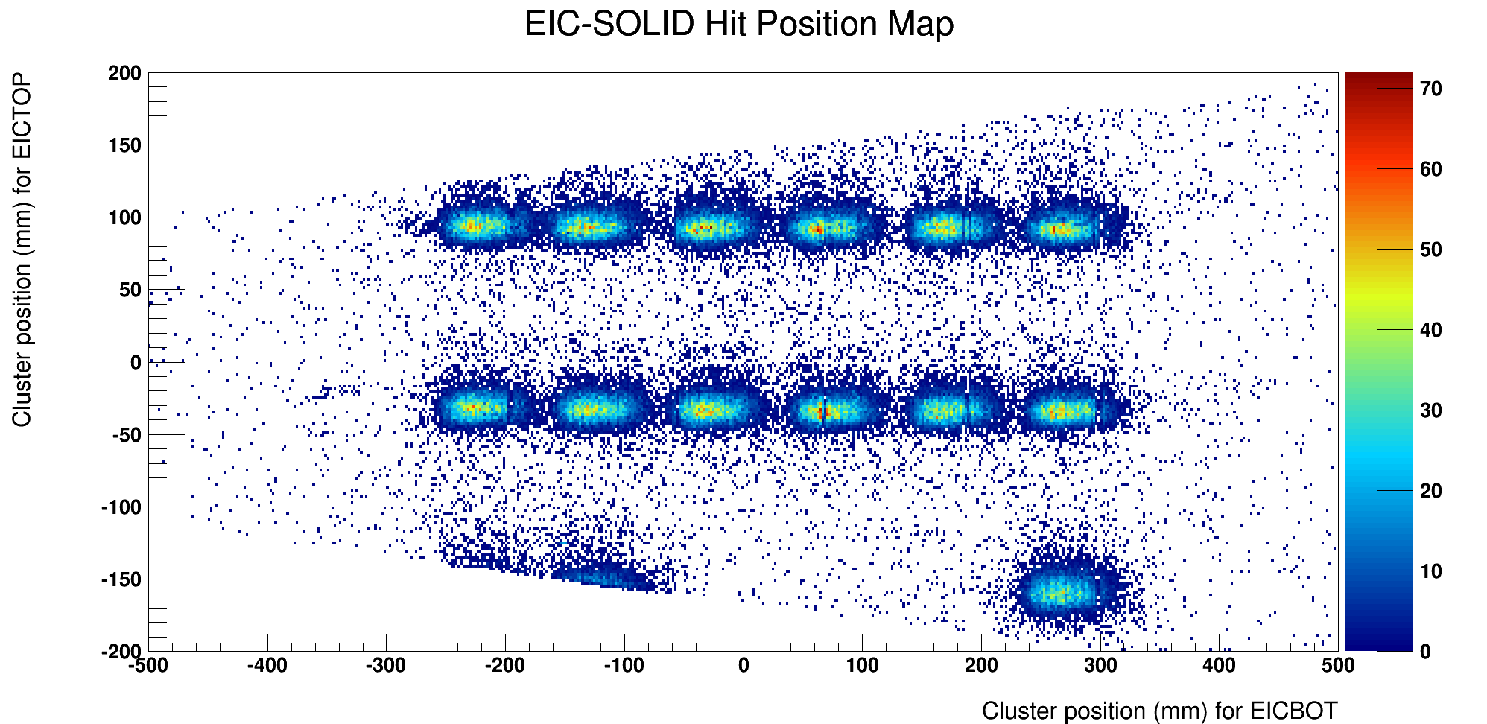
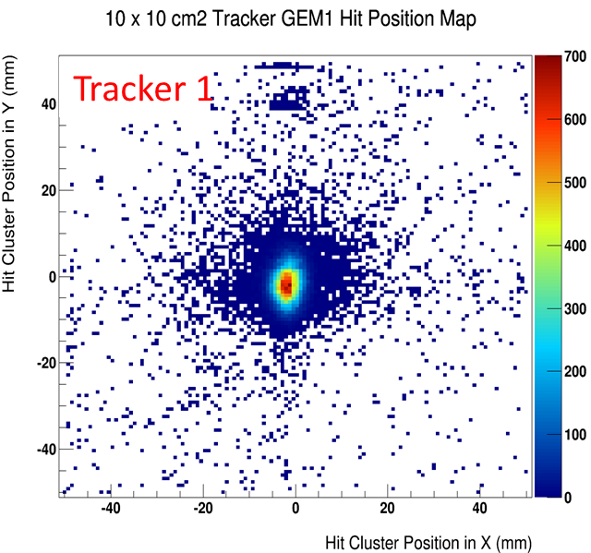
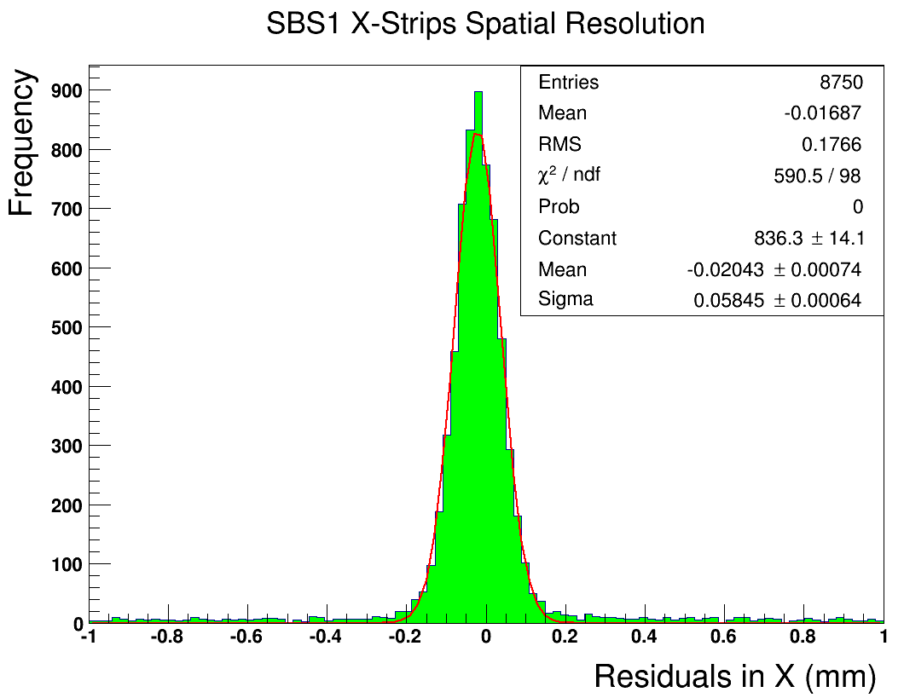
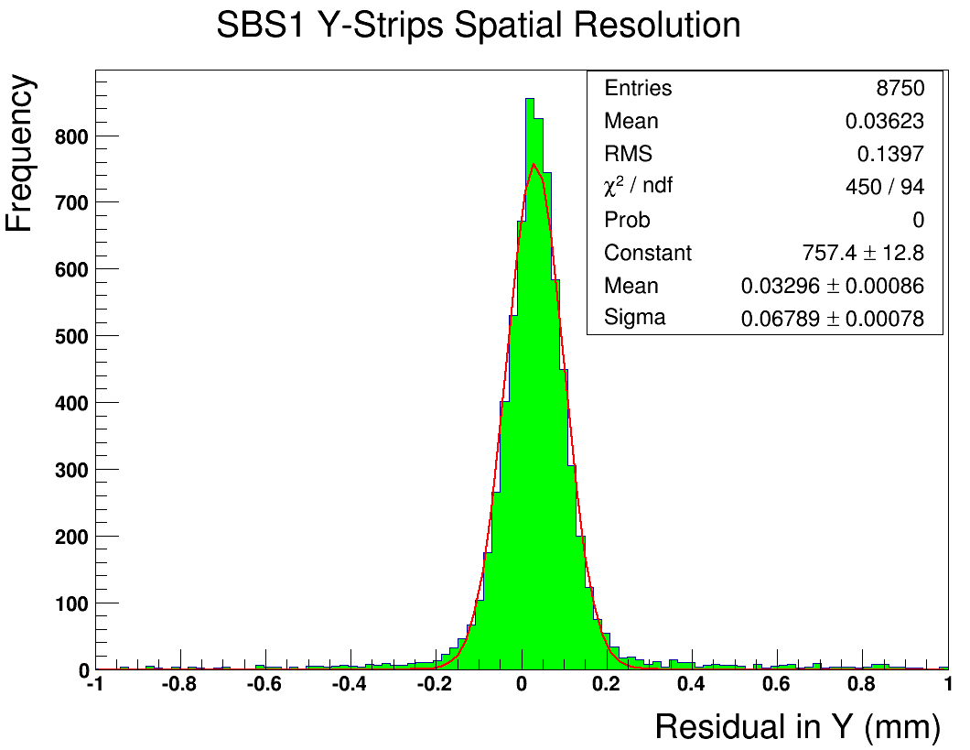
Preliminary Results with Fermilab Test Beam
20 GeV Hadron Beam: Position Scan of SBS1 and EIC Chambers
EIC-SoLID Proto
SBS Proto I
120 GeV Proton Beam: Position Resolution of SBS1 Chambers
σ_{X}
=
58 μm
σ_{Y}
=
67 μm

Slide 23
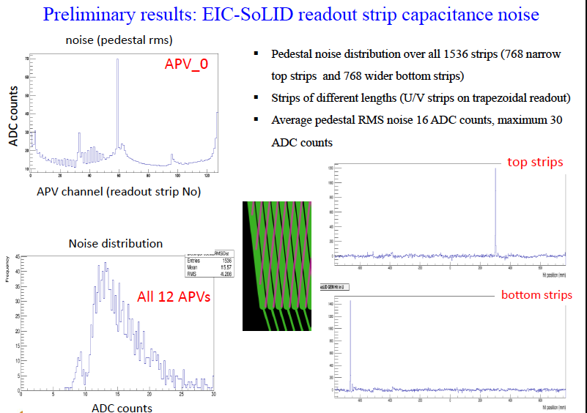

Slide 24
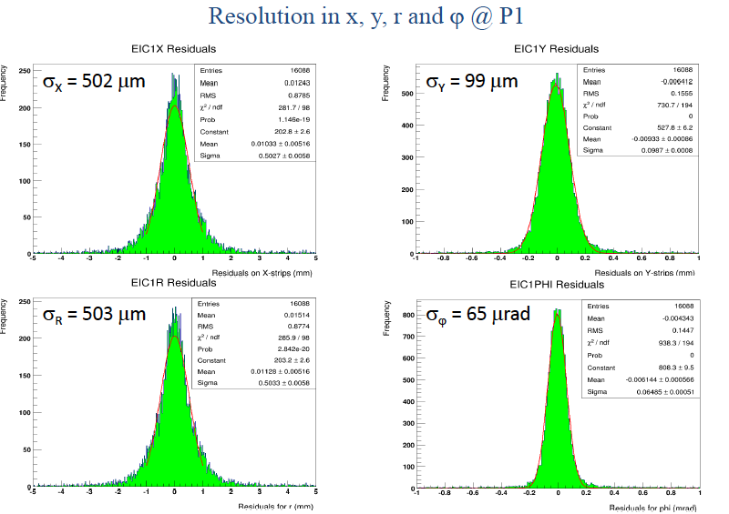

Slide 25
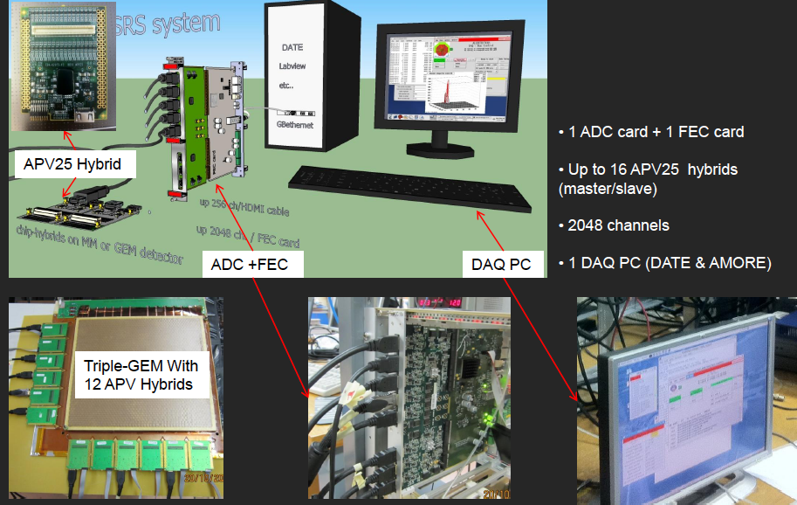
GEM chamber electronics
The RD-51 Scalable Readout System provides a low-cost, common platform that can accommodate different readout chips.
Currently tested with APV25-S1 chip.
The cost is < $ 4 /chan.

Slide 26
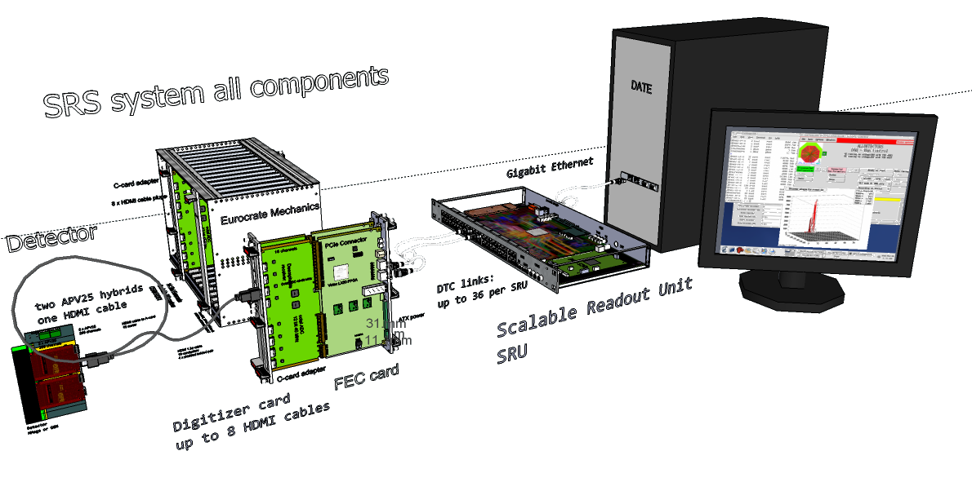
Experience with APV25-SRS @ UVa
SRS with the SRU
Small size (2k channels) in use in the detector lab at UVa lab the last 3 years
Successful run with medium size (8k channels) SRS during test beam at FNAL and JLab
But current system not designed for real experiment-environment like the SBS GEMs
Shortcomings of the current APV25-SRS
APV25 hybrids are not rad hard compliant
HDMI cables length is a limitation for a system that need to be at some distance from the detector area
Limitation on acquisition rate: 5 khz expected for SBS GEp5 experiment
Safety concerned and crate certification issues raised for operation in environment like JLab

Slide 27
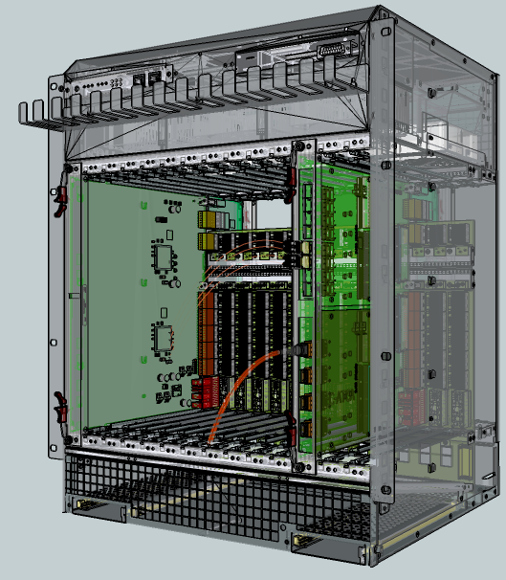
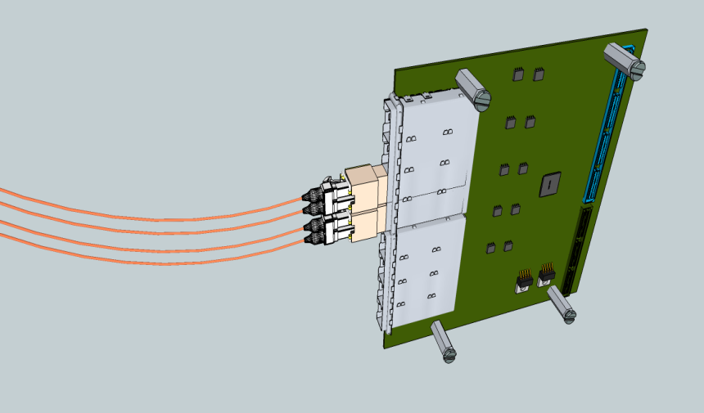
ATCA-SRS architecture
DETECTOR
DETECTOR- FRAME
Cavern
Counting room
Online
High radiation up 1MRad
Magnetic fields up 2T
Moderate radiation 20kRad
Magnetic fields < 1 T
noisy & harsh
environment
Low radiation
Low magnetic field < 5 Gauss
Multi-
Gbit
fibres
SRS –ATCA*
HDMI Micro
Copper link 5m
OC
box
APV25
Bi-dir optical fibres
<200m,
1..10 Gbit SFP
850 nm MM fibre
APV25
FPGA
APV25
Data, Trigger
Clock, Control
APV25
APV hybrids”= frontend
ASICs with SEU-hard
Companion chip*
DTCC protocol:
Data,Trigger,
Clock, Control
4-ch Buck controller
APV25
APV25
Optical SRS-adapter mezzanine**
for ATCA: 8 x SFP+
Low –dissipation , clean
ASIC power 5mW/ch
Unregulated power
4.5 … 15 V /10A
*EicSys GmbH
**short term: ATCA /RTM
with 16 x SFP already available
*initially FPGA

Slide 28
Upgrades needed for SRS
Optical to Copper Box with ADC option
  Link from OC directly to the RTM
  Skip digital mezzanine adapter board
APV-hybrid with radiation tolerant capability
  Remove the voltage regulator
  hybrids powered from OC boxes through HDMI
New development must be compatible with the ATCA version
  High density readout and high rate capability
  certified ATCA crate, safety concerns need to be addressed

Slide 29
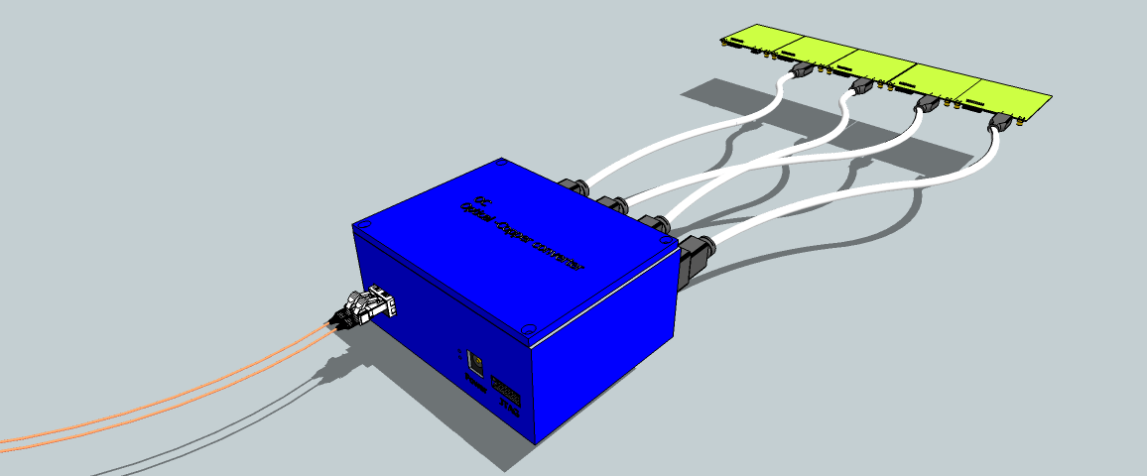
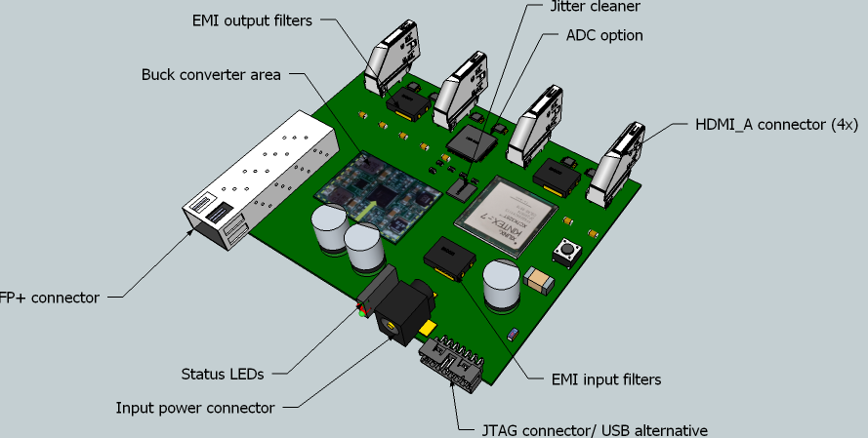
Optical to Copper (OC) Box (with ADC option for APV25)
APV hybrids up 16 chips
optical SFP+
magnetics free
HDMI links
L=5m, D = 4mm
1 optical link (up 200m) ➔ SRS multiplexed DTCC protocol :
1 fiber = 4 x copper = 1k ch.
bidir. optical link 200m
MM, 850 nm
micro-HDMI
shielded ALU box
DC-DC inside
Initial development by RD51 is a digital OC for BNL VMM chip
Key feature of interest for SBS is an “analog” OC box with the ADCs chip on the board
The OC box will also provide the power to the APV25 hybrids
RD51 and EicSys (ATCA manufacturer) to work together for an ATCA version of the analog OC

Slide 30
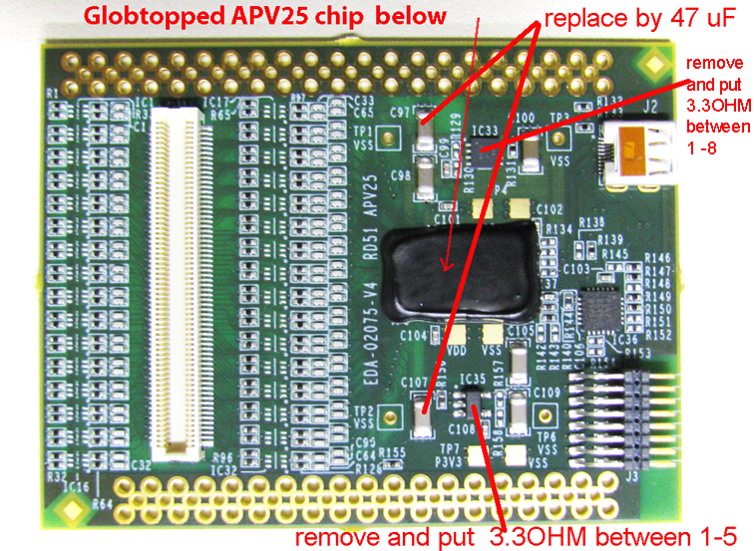
Radiation tolerant APV25-SRS hybrids v5
APV25 chip are specified for rad hard operation up to O (10 MRad), but the linear voltage regulators (LDO) on the hybrids for local power conversion will most likely fail at integrated radiation levels
Ongoing study the feasibility of an LDO-free APV25 hybrid revision (v5) for remote powering via the readout cables. Such a scheme eliminates local voltage regulators from the hybrids.
Current status of the development
APV25 without the voltage regulators and external powering system was tested earlier this year
Powering scheme of the VMM chip via OC box is understood now (supported by ATLAS NSW group)
Same scheme for the analog OC for APV hybrids
Likely 2 versions of APV25-SRS v5 to be available:
  a.) voltage regulators for standard SRS user,
  b.) voltages via the HDMI for OC box users
Support from SBS will be needed

Slide 31
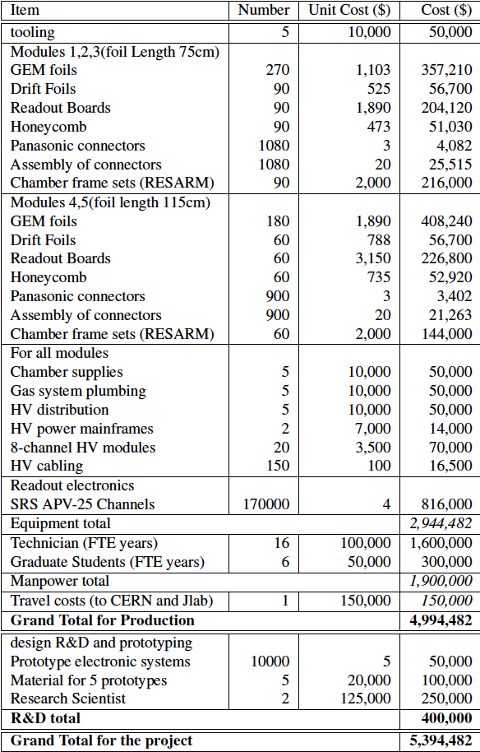
cost estimate

