Slide 1
Status of MRPC-TOF
Wang Yi
Department of Engineering Physics
Tsinghua University, Beijing, China
1

Slide 2
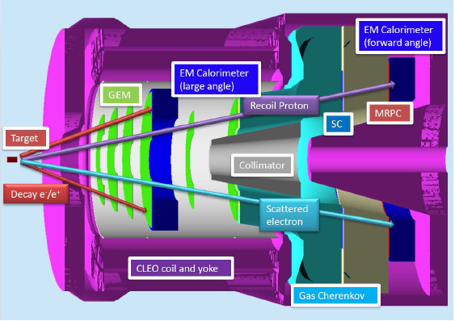
Outline
Requirement of TOF
Conceptual design
  Prototype design
  Cosmic test
  Beam test
Progress on electronics
  ASIC FEE
  FPGA TDC
Production workshop
Conclusions
MRPC-TOF

Slide 3
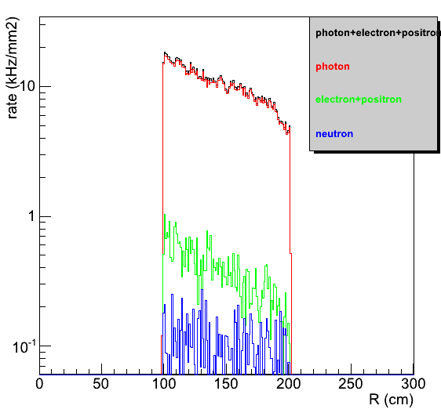
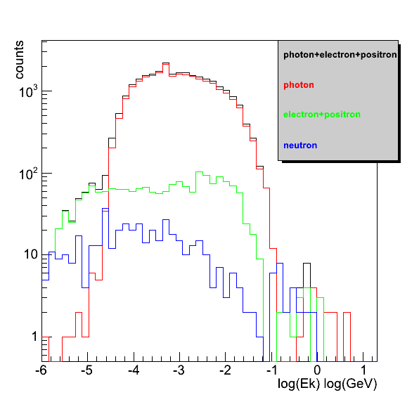
Backgrounds ( γ,e, e⁺ and n)
Simulated by Zhihong Ye
The rate in TOF area <100kHz/cm²

Slide 4
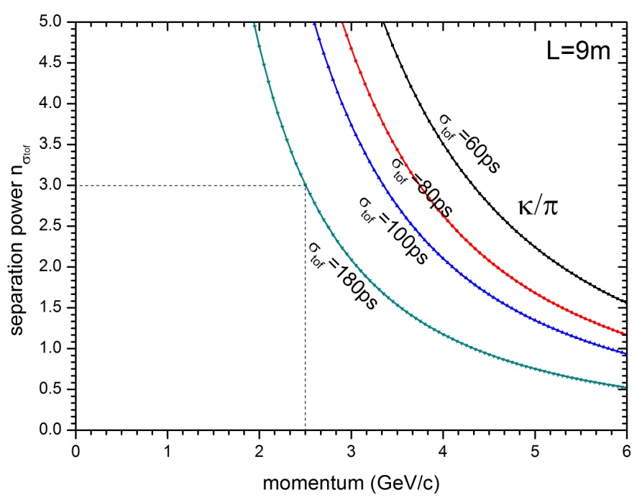
Main requirements for TOF
The MRPC is developed for the TOF of SoLID
Main Requirements for TOF:
  π/k separation up to 2.5GeV/c
  Time resolution < 80ps
  Rate capability > 10kHz/cm²
It can be seen from left panel that 180ps resolution is enough for the π/k separation. So 80ps is sufficient!

Slide 5
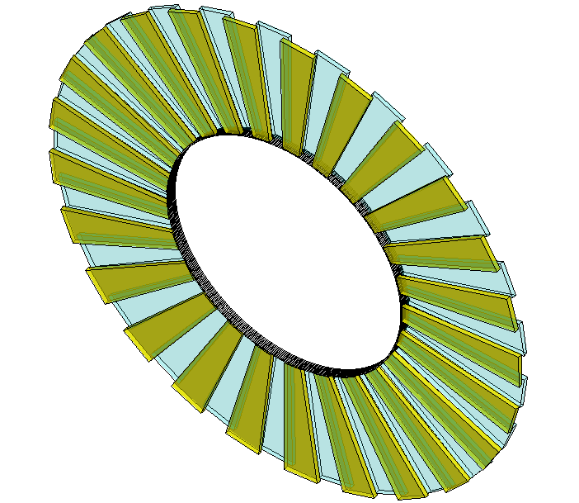
Conceptual design of SOLID-TOF
MRPC TOF wall we designed contain 150 MRPC modules in total, with 50 gas boxes and 3 counters in each box, covering the area of 10m².
MRPC3
28cm
MRPC2
16cm
100cm
MRPC1
Total channel ~3600
The MRPC module we tested is the prototype of smallest one.

Slide 6
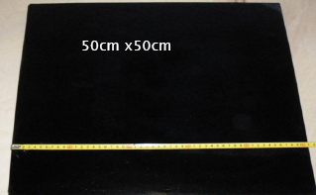
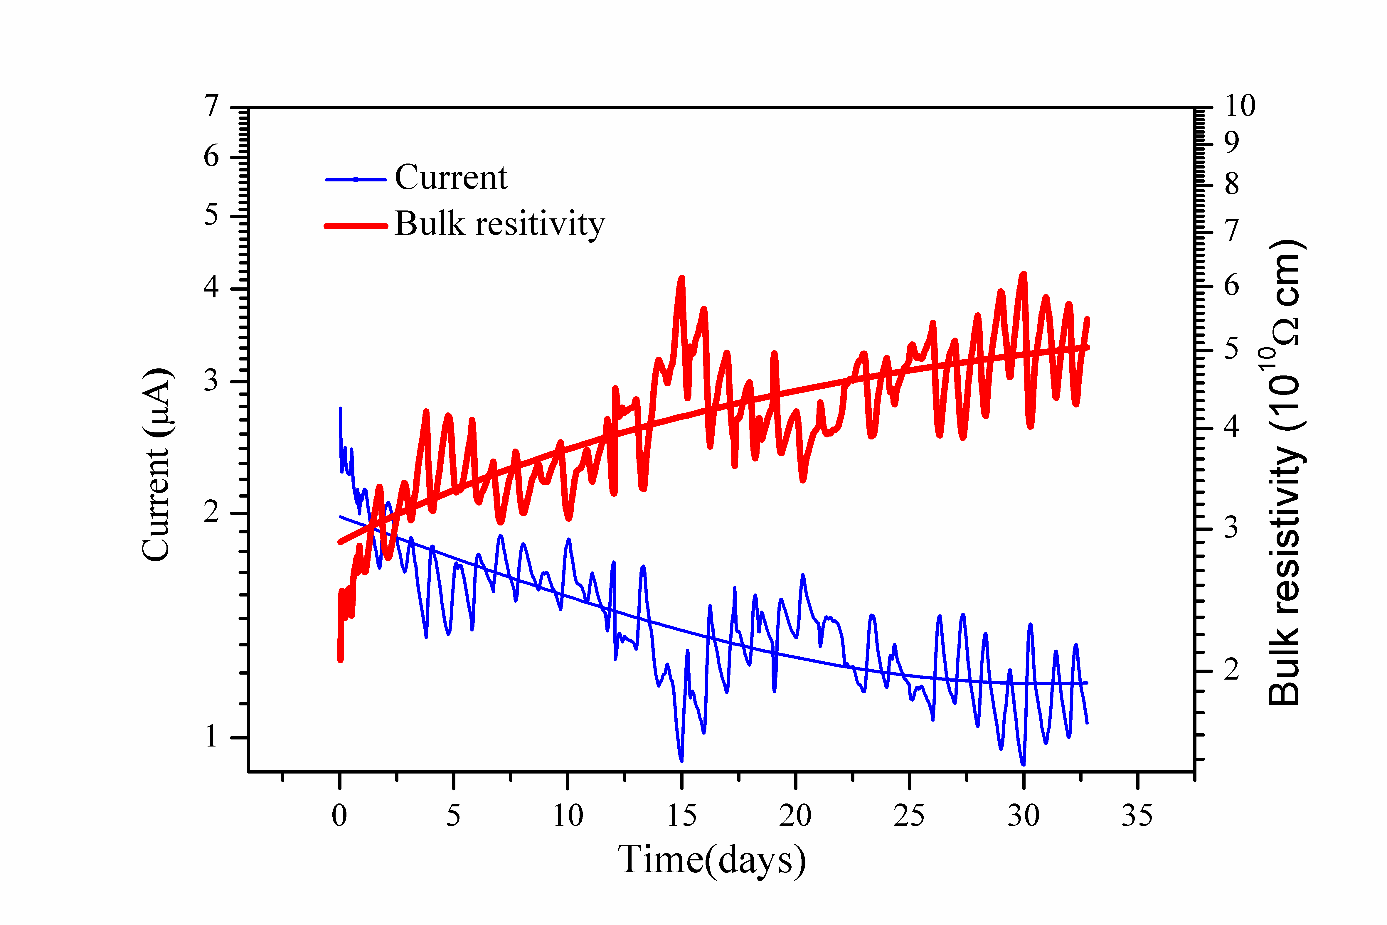
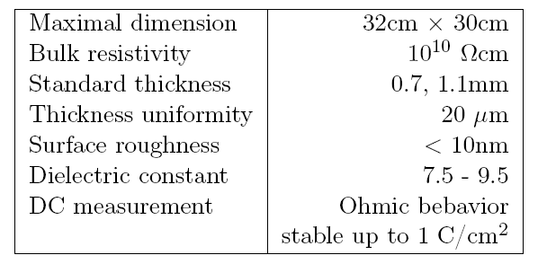
Tsinghua’s activity in high rate TOF
32cm x 30cm
Performance of low resistive glass

Slide 7
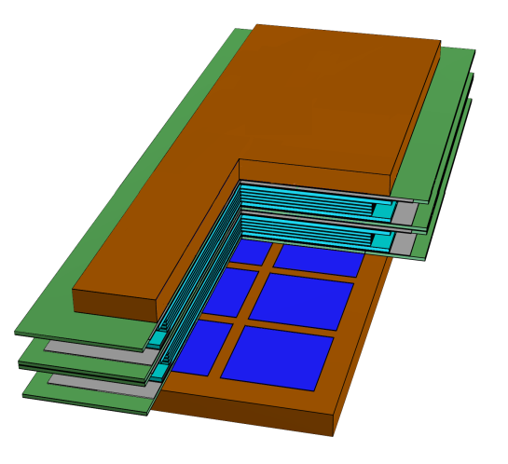
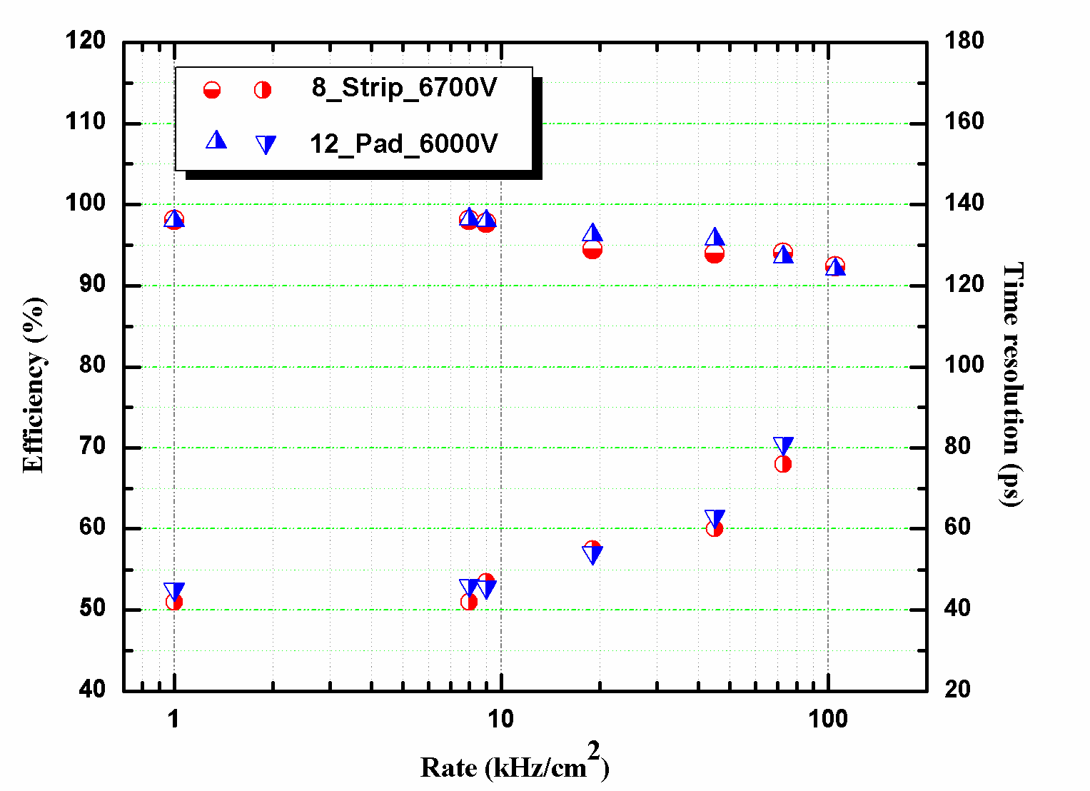
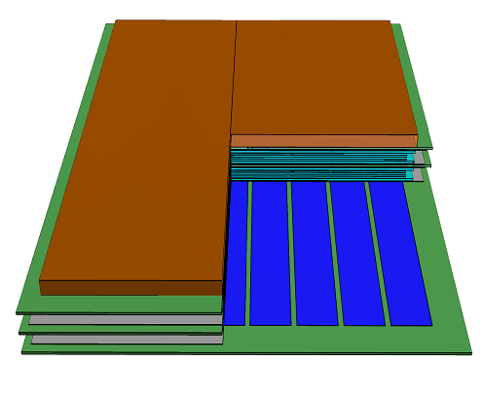
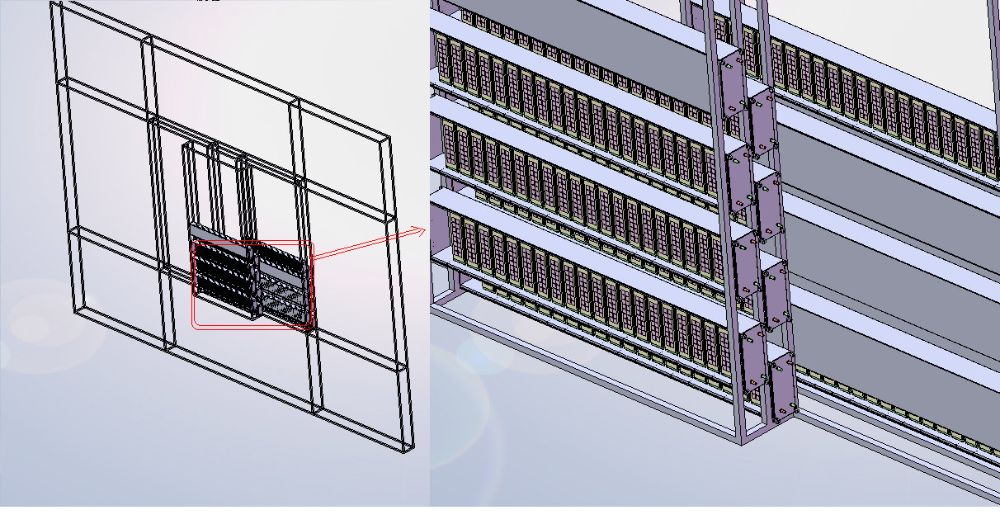
Tsinghua’s activity in high rate TOF
Prototype of high rate MRPC
Performance of high rate MRPC
Super module
Layout of CBM-TOF wall

Slide 8
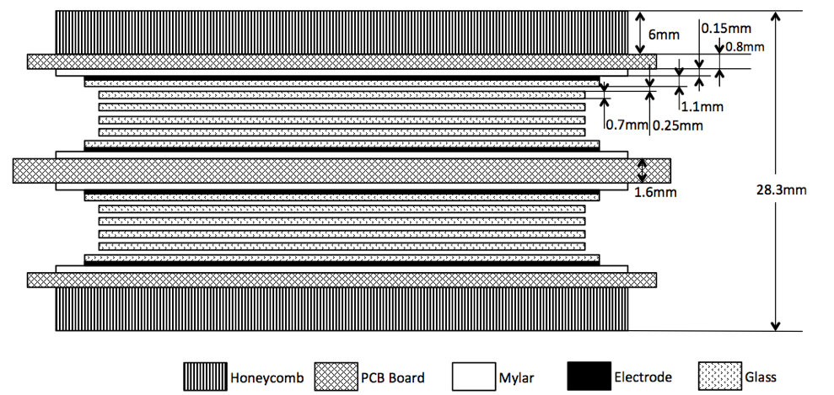
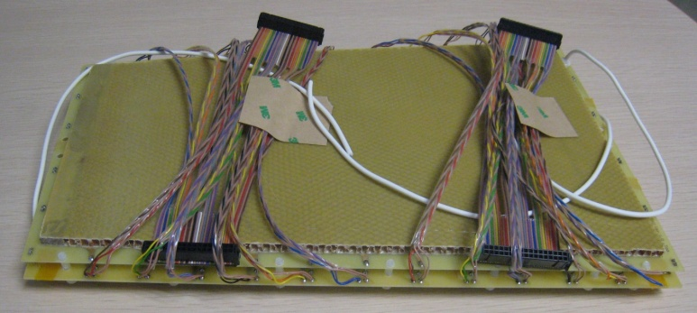
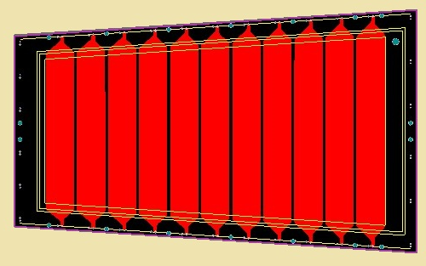
A MRPC prototype for SoLID-TOF
Volume resistivity: ~10¹⁰Ω.cm
25mm
Material dimensions
 | Length/mm | Width/mm | Thickness/mm
Gas gap | - | - | 0.25×10
Inner glass | 320 | 130-171 | 0.7
Outer glass | 330 | 138-182 | 1.1
Mylar | 335 | 153-198 | 0.18
Inner PCB | 350 | 182-228 | 1.6
Outer PCB | 350 | 172-218 | 0.8
Honeycomb | 330 | 153-198 | 6
171mm
219mm
363mm

Slide 9
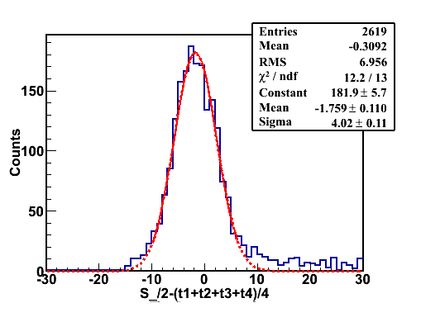
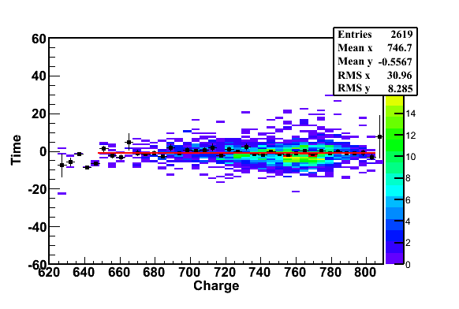
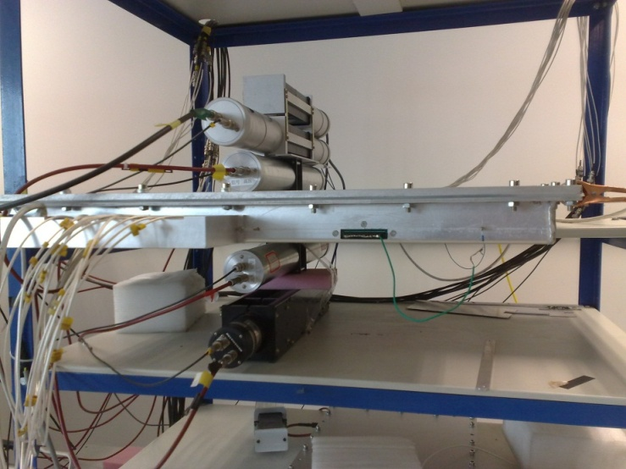
Cosmic test
Cosmic ray test@Tsinghua August, 2011
PMT0
PMT1
PMT2
MRPC
PMT3
PMT4
Cosmic Ray Muon
Efficiency > 95% @ 96kV/cm (6.0kV)
Time resolution: ~ 52ps

Slide 10
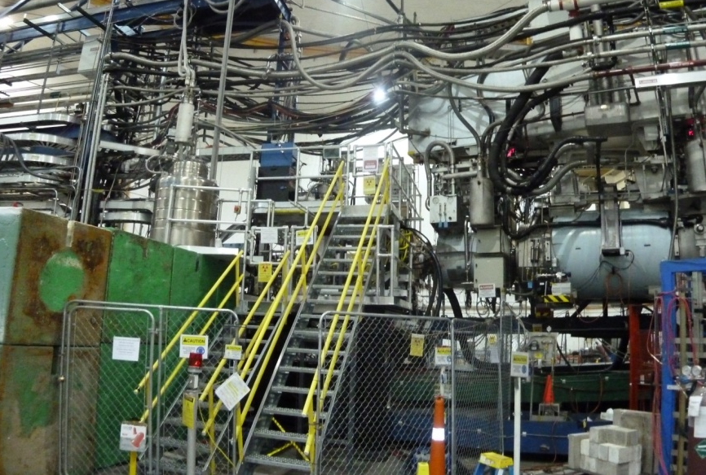
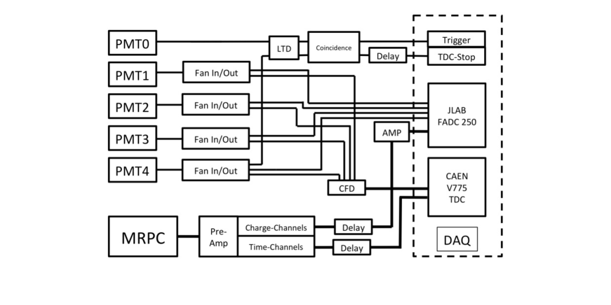
Beam test @ Hall A
High Energy e-
Shield
PMT1
PMT3
Target
PMT0
PMT2
PMT4
Top View
The diagram of DAQ system
Target
Test setup
10

Slide 11
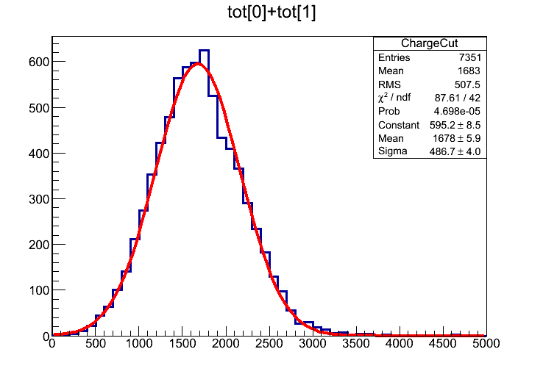
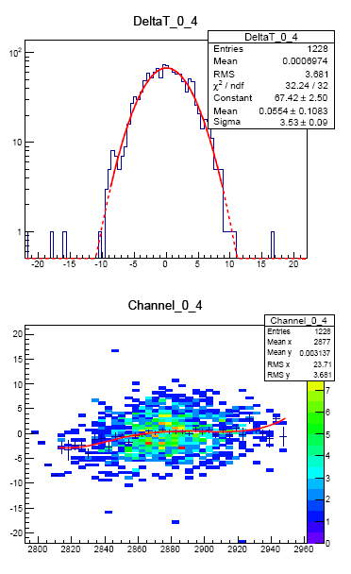
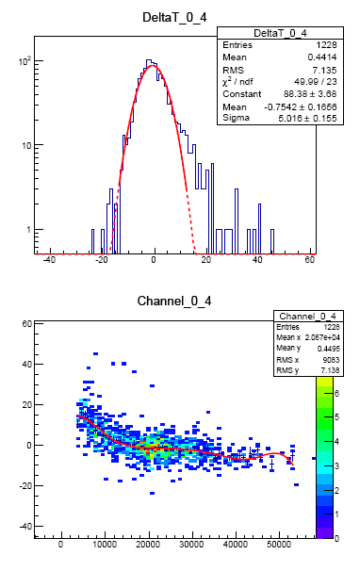
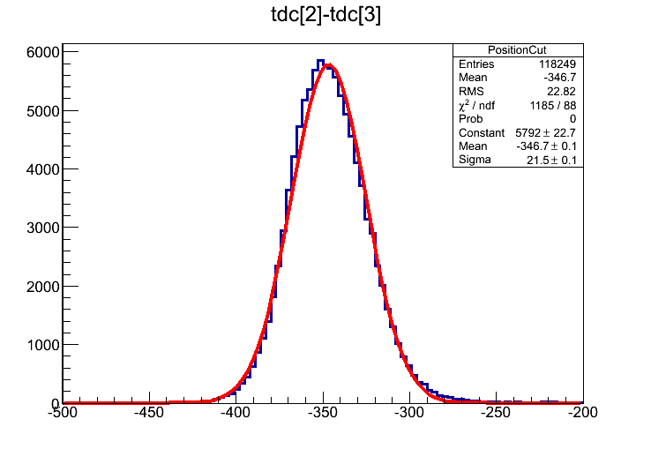
Results : Calibration
Example: r175
Operated on May 13th
High Voltage: ±6800V
Condition: 10m from
target, shielded
Charge Cut：2 σ
Position Cut：2 σ
PMT before calibration
MRPC before calibration
11
Calibration method

Slide 12
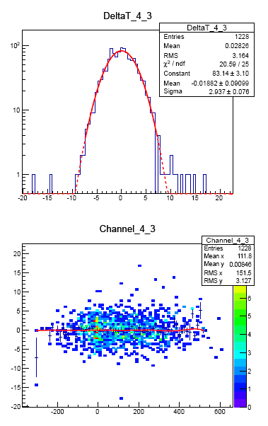
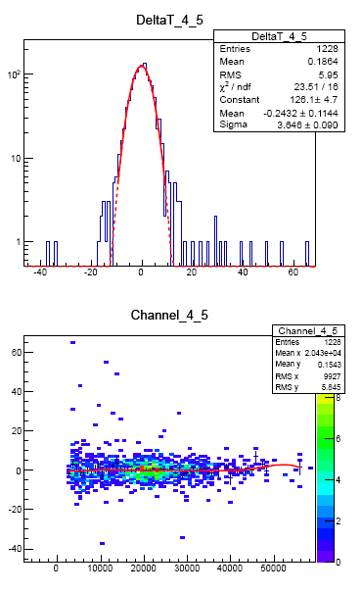
Results: Calibration
Example: r175
Operated on May 13th
High Voltage: ±6800V
Condition: 10m from
target, shielded
Time resolution: 76ps
σ-PMT = 2.937(102.8ps)
σ-MRPC = 3.646(127.6ps)
σ-MRPC = 2.16(75.6ps)
Calibration of PMT
Calibration of MRPC
In this test, T₀ is about 100ps, the time resolution is deteriorated.
12

Slide 13
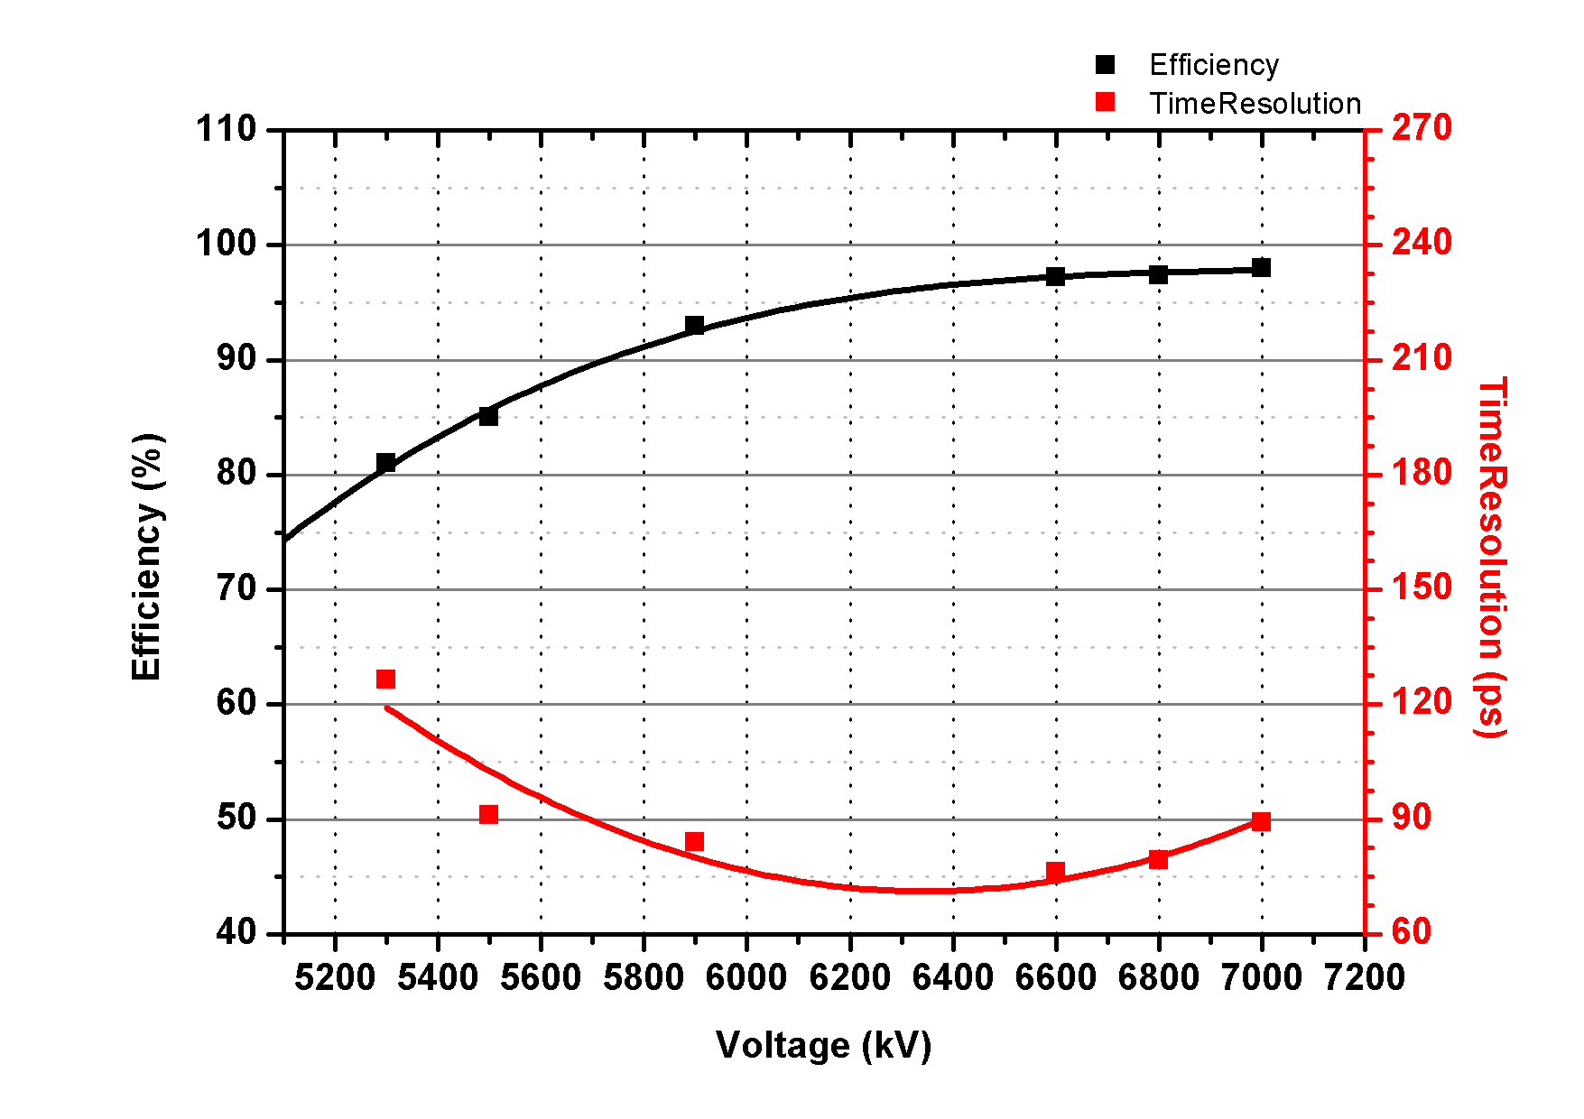
Results : HV Scan
Efficiency: >95%
Time Resolution: ~75ps
13

Slide 14
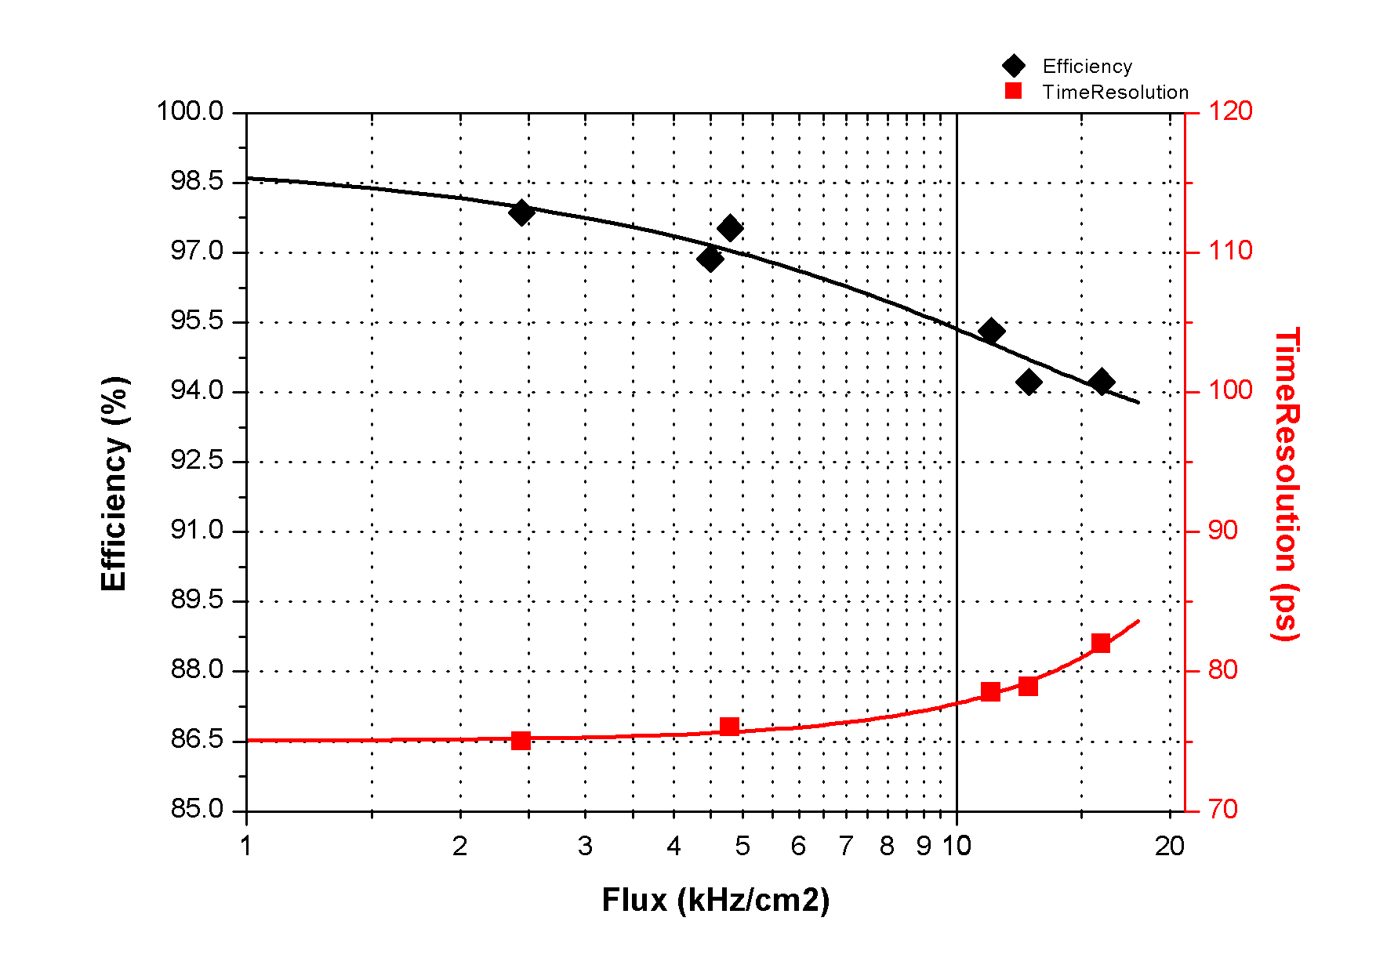
Results: Rate Scan
Voltage: 6800V
Flux:11kHz/cm²
Efficiency:~95%
Time Resolution: 78ps
Flux:16kHz/cm²
Efficiency:~95%
Time Resolution: 82ps

Slide 15
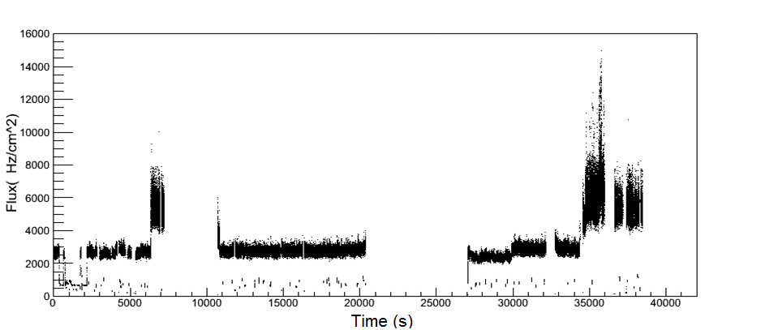
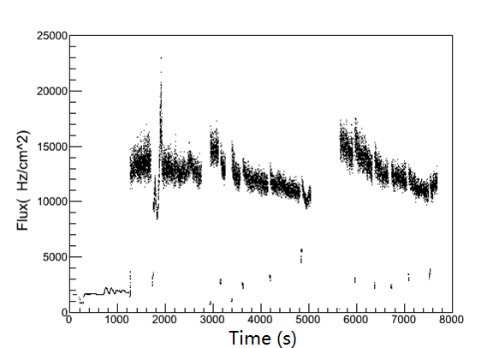
Results: Flux vs. Time
Run188, 6800V (5m to target, shielded)
12kHz/cm²
6kHz/cm²
2.5kHz/cm²
Run193, 6800V (5m to target, not shielded)
During a run, flux is not on a stable level, which from less than 3kHz/cm² to 16kHz/cm².
We can observe the performance by selecting data from different flux.
16-18kHz/cm²
14-15kHz/cm²
15

Slide 16
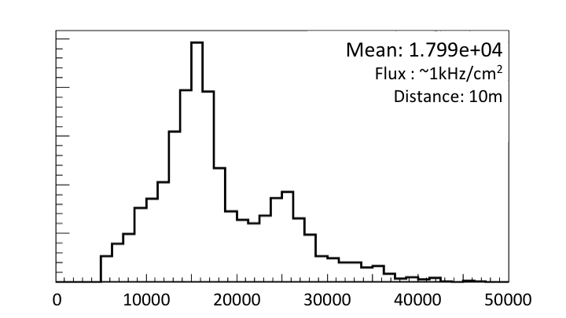
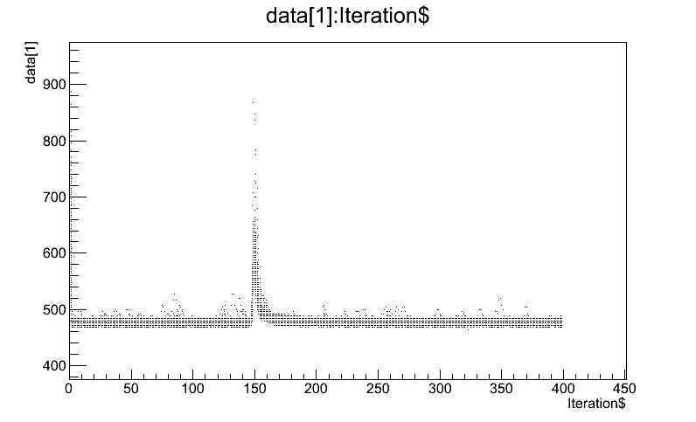
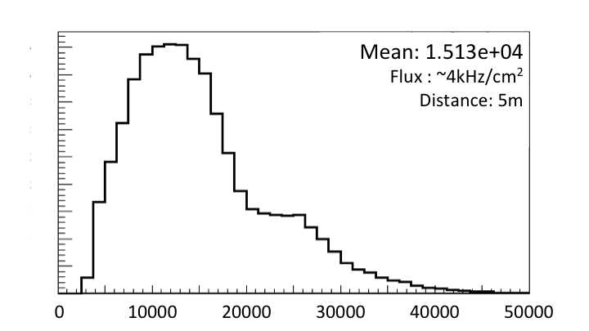
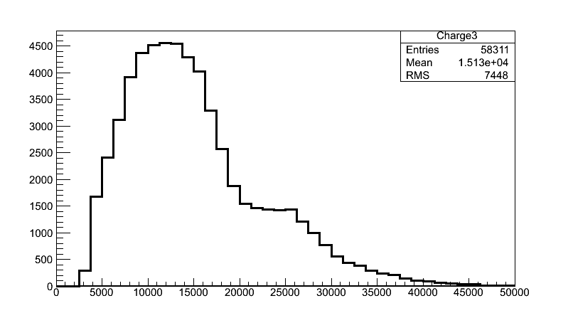
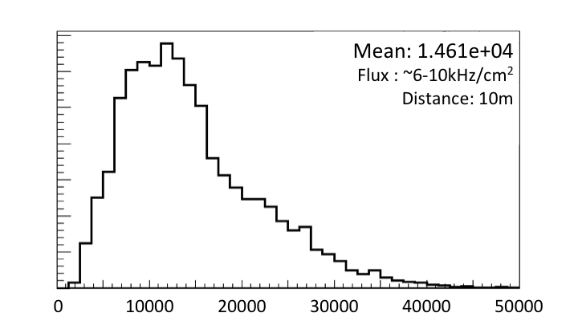
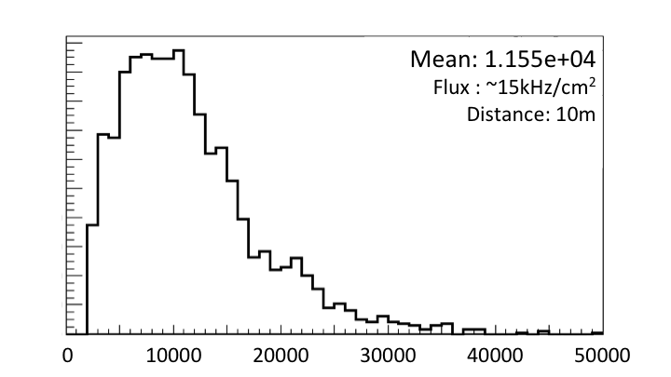
Results: Charge Distribution
Signal
Base Line
Charge spectrum at different rate
Significant reduction of charge distribution can be seen as the background rate increases.
The reduction of electrical field is caused mainly by both background irradiation and electron beams.
Rate capability of the counter is higher than 16kHz/cm².
16

Slide 17
TOF electronics
Fast preamplifier：
Maxim3760 (RICE Univ.)
Ninos (TOT) (ALICE)
Padi (TOT) (GSI)
CAD (TOT)(Tsinghua)
QDC (CAEN, 25fC/bin)
TDC
HPTDC (ALICE, 25ps/ch)
GET4 (GSI, 25ps/ch)
FPGA TDC (GSI and other)
DAQ

Slide 18
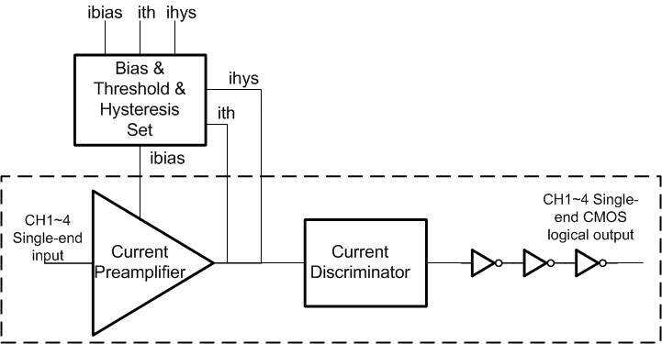
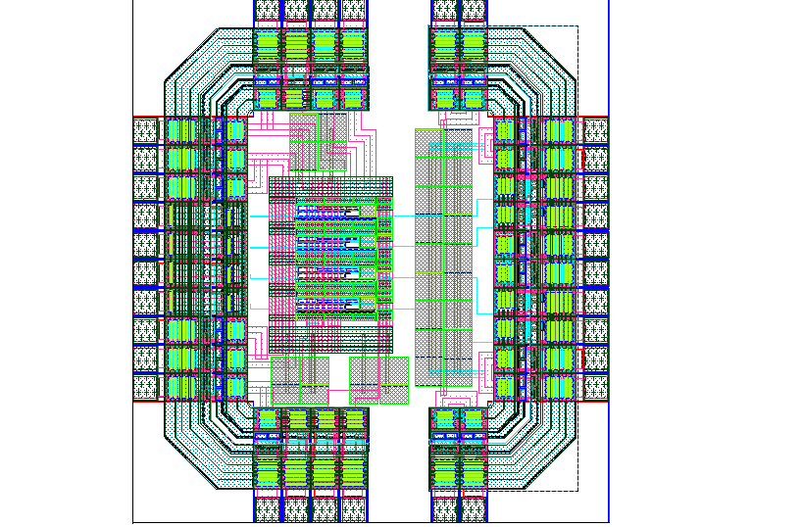
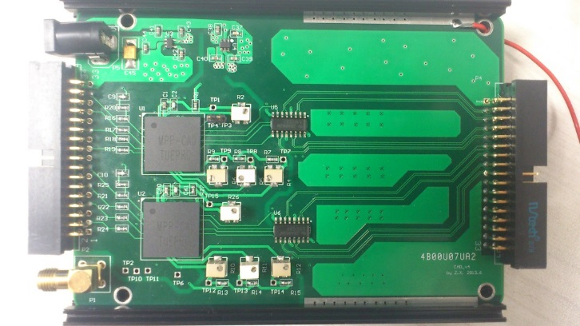
CAD: Tsinghua amplifier
Specifications
Supply Voltage | 3.3 V
Technology | 0.35μm CMOS
Chip Package | BGA package
Preamplifier Current Gain | 2
Preamplifier Bandwidth | >100 MHz
Power Consumption | <10 mW/ch
input | Single-end input
output | Single-end CMOS logical output

Slide 19
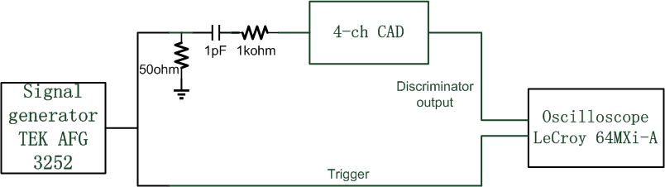
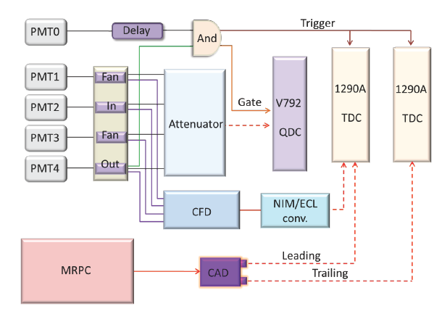
Test with signal generator and MRPC

Slide 20
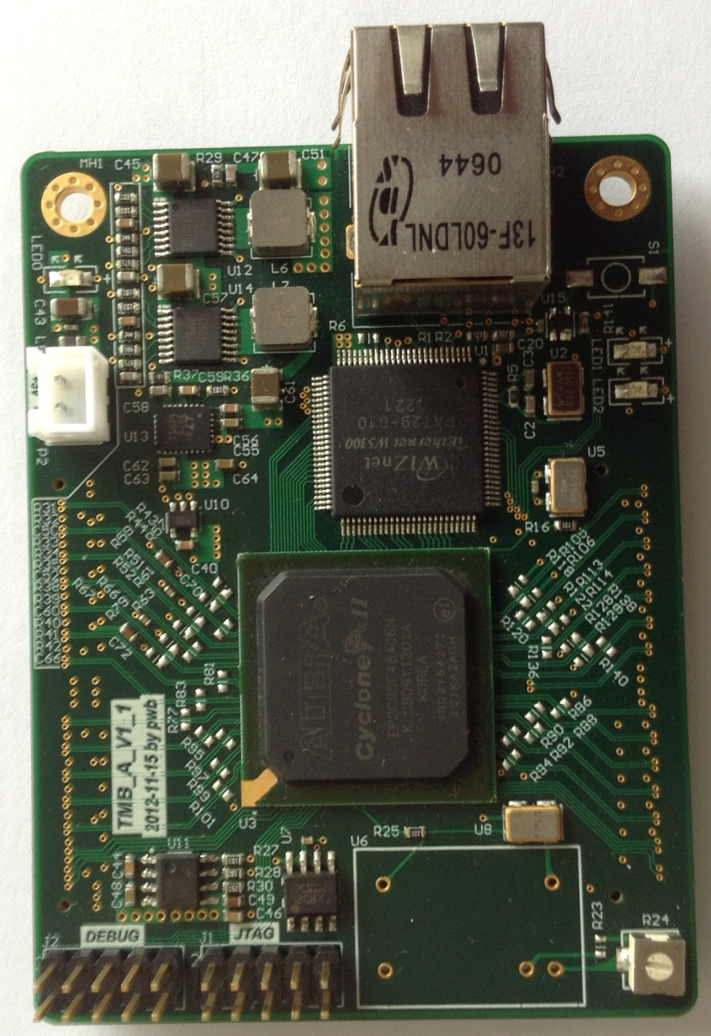
Tsinghua-FPGA TDC
100M Ethernet
Readout with
TCP/IP support
Cyclone-II
FPGA
EP2C35F484C6
Socket for TCXO
(opt.)
24 channels, Ethernet readout
Resolution ~30ps

Slide 21
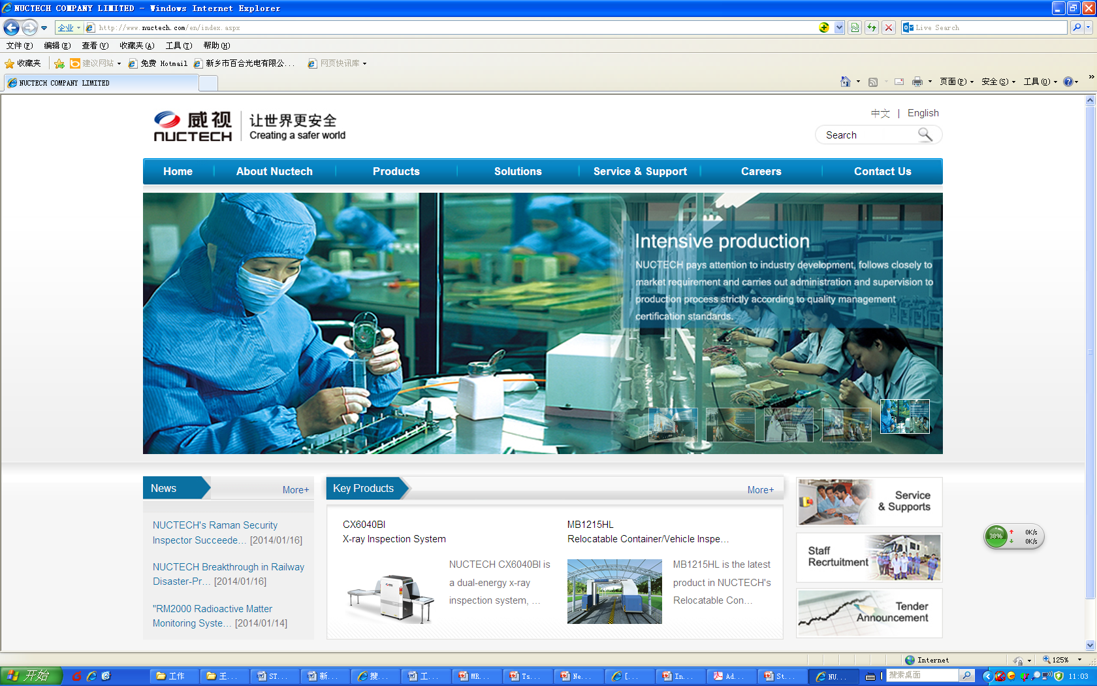
RPC workshop: http://www.nuctech.com/en/index.aspx

Slide 22
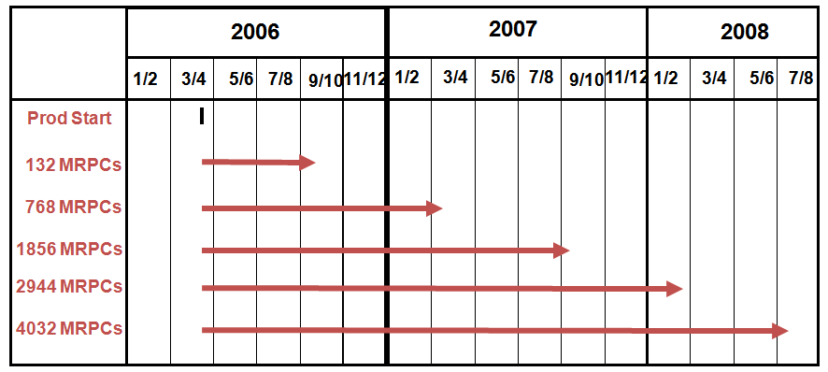
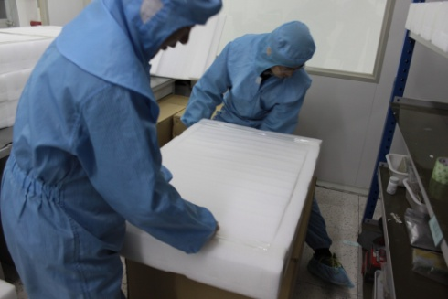
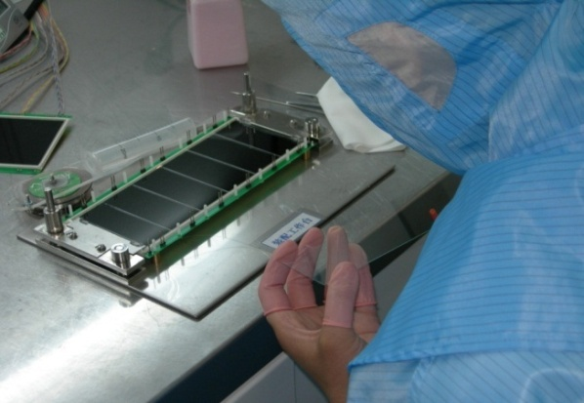
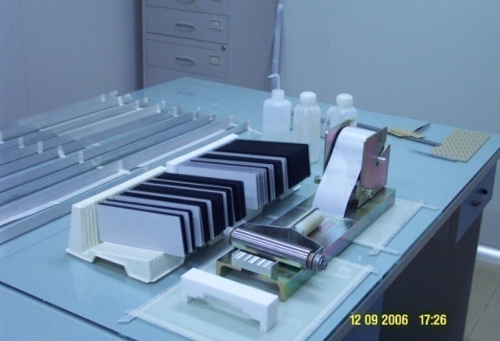
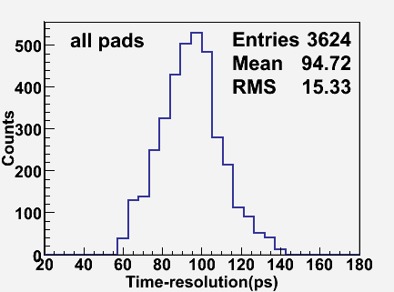
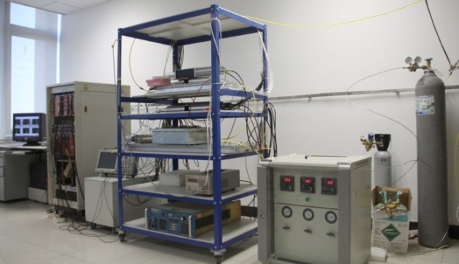
MRPC mass production

Slide 23
Summary
High rate MRPC will be used to construct TOF for SoLID.
A prototype of high rate MRPC was developed. The test results show that the time resolution can reach 70-80ps and the flux is up to 16kHz/cm².
During beam test, the MRPC module was placed at high radiation region for 2 months and no significant performance deterioration was observed. This means that the module can withstand long time irradiation.
Research on ASIC FEE and FPGA TDC goes smoothly.

Slide 24
Thank you!
谢谢大家！

