Slide 1
DDVCS with SoLID
Alexandre Camsonne
Hall A
SoLID collaboration meeting
May 15th 2015

Slide 2
DVCS / Double DVCS
γ∗ + p
γ‘(∗) + p’
l⁺ + l⁻
Guidal and Vanderhaegen : Double deeply virtual Compton scattering off the nucleon (arXiv:hep-ph/0208275v1 30 Aug 2002)
Belitsky Radyushkin : Unraveling hadron structure with generalized parton distributions (arXiv:hep-ph/0504030v3 27 Jun 2005)

Slide 3
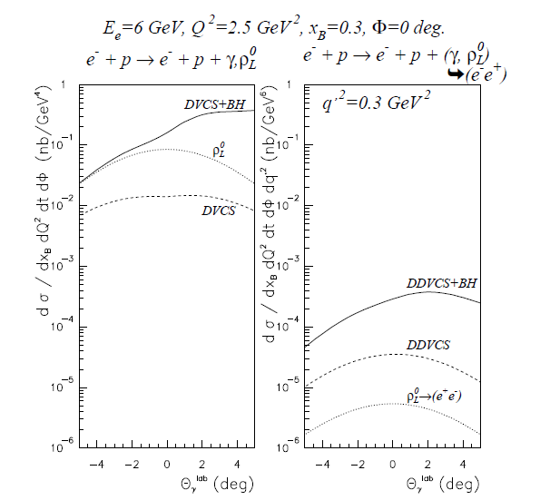
DDVCS cross section
VGG model
Order of
~0.1 pb = 10⁻³⁶cm²
About 100 smaller than DVCS
Virtual Beth and Heitler
Interference term enhanced by BH
Contributions from mesons small when far from meson mass

Slide 4
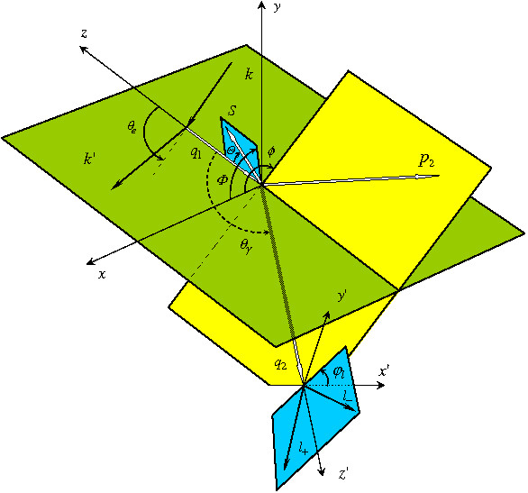
Double Deeply Virtual Compton Scattering
Δ = p1-p2 = q2-q1
p = p1+p2
q = ½ (q1+q2)
scattered electron
Q²= − q²
ξ =
Q²
2p.q
scattered proton
η =
Δ.q
outgoing virtual photon
p.q
Q²= -(k-k’)²
x_{bj}=
Q²
2p₁q₁
lepton pair from virtual photon

Slide 5


Kinematical coverage
JLab 11 GeV
25 GeV
40 GeV
DVCS
η = ξ
2
H^{u}(η , ξ)
2
$$Q^{2}<M_{l^{+}l^{−}}^{}$$
$$Q^{2}>M_{l^{+}l^{−}}^{}$$
DVCS only probes η = ξ
line
Example with model of GPD H for up quark
Jlab : Q²>0
Kinematical range increases with beam energy ( larger dilepton mass )
η
ξ

Slide 6
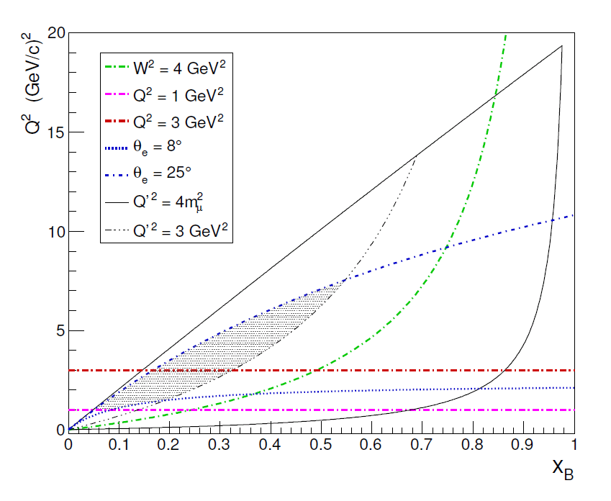
Kinematic coverage

Slide 7
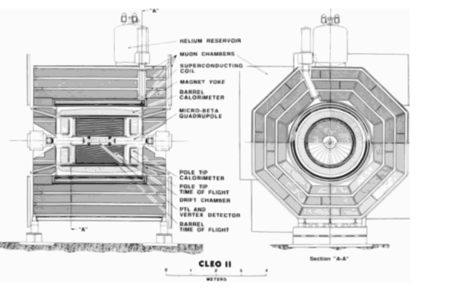
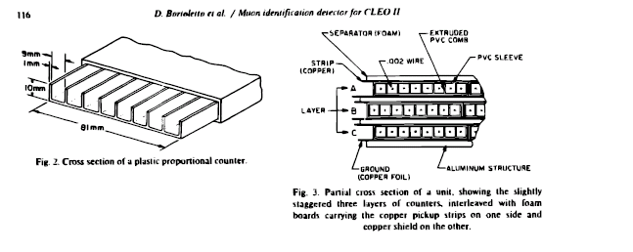
CLEO muon detector

Slide 8
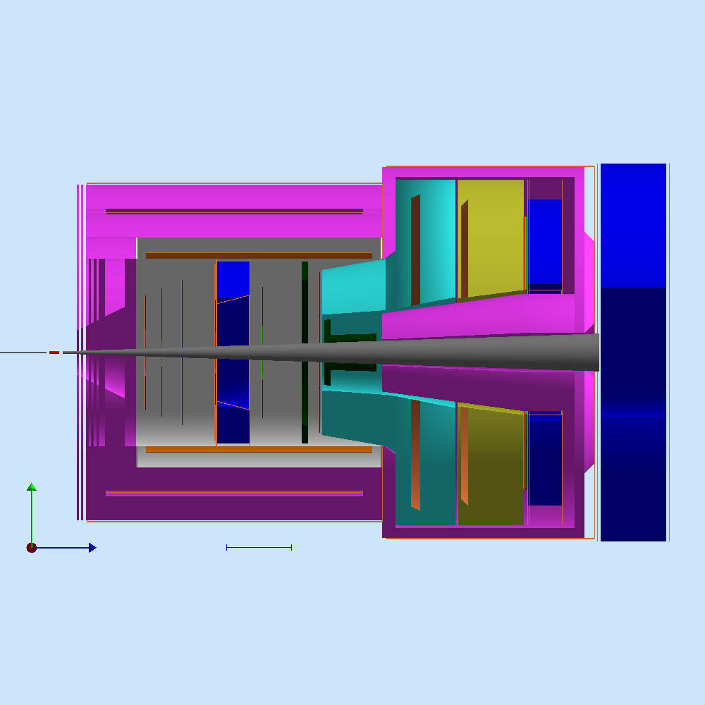
SoLID JPsi Setup
Particle can be accepted by both forward and large angle detectors
large
forward

Slide 9
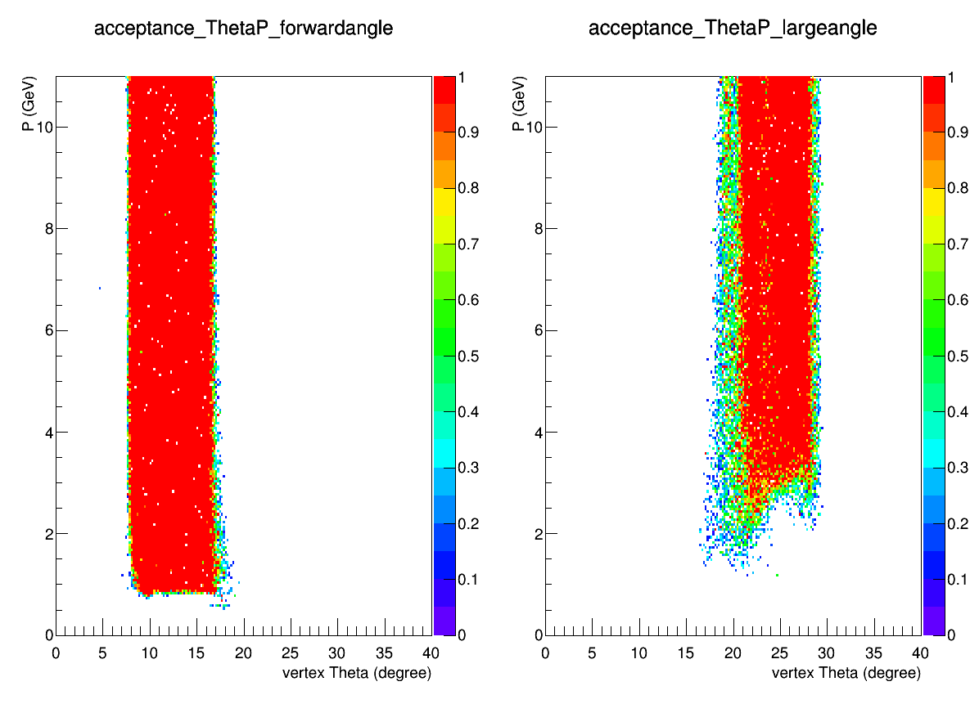
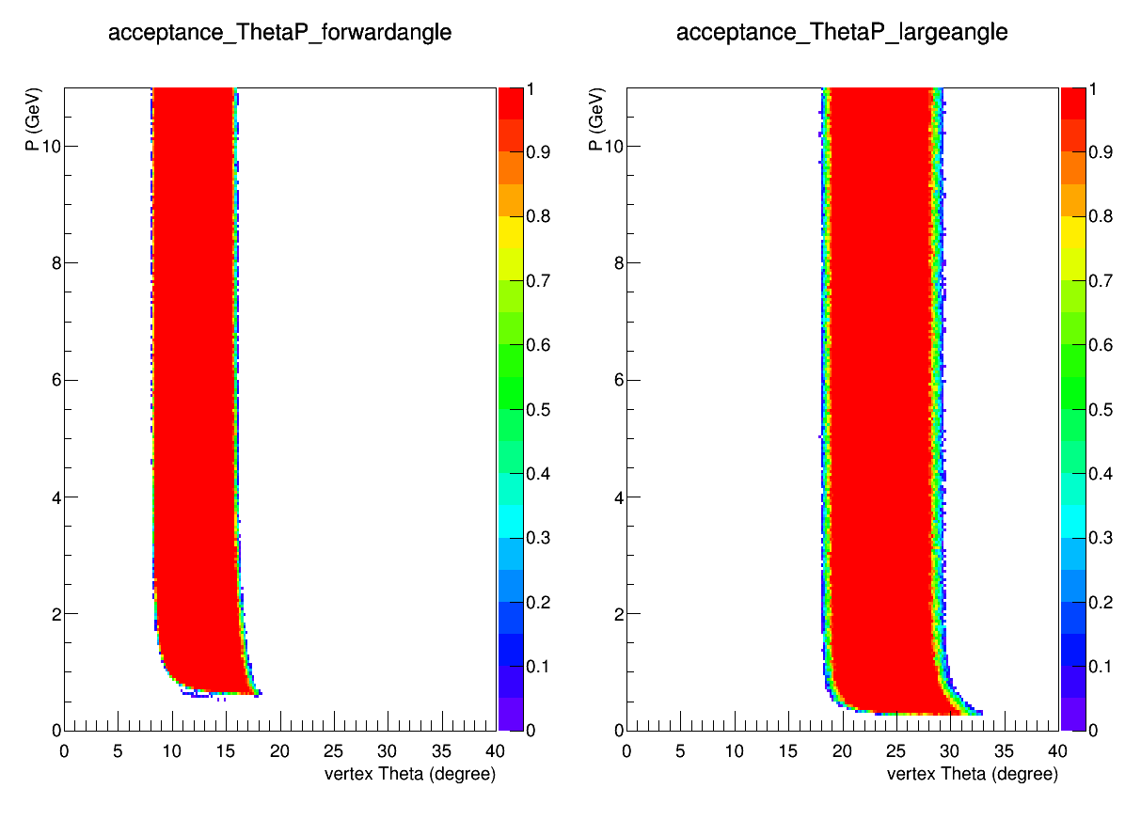
acceptance
Some low energy muon are lost, especially at large angle
muon
e and p

Slide 10
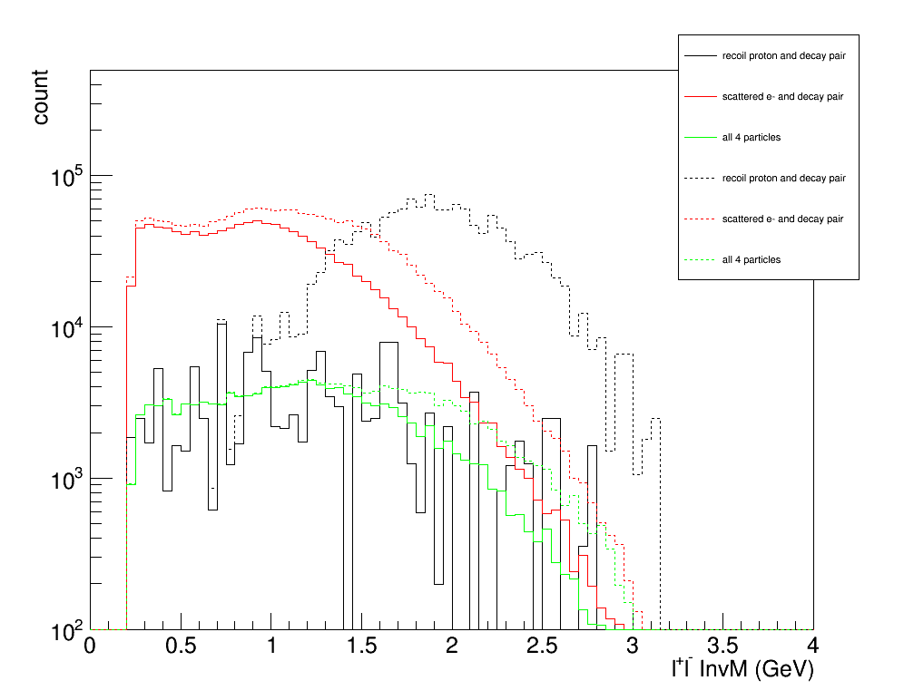
Count Estimation
11GeV, 3uA 1cm LH2 target, 1e37/cm2/s, 50 days, 85% eff.
Decay pair accepted at
both forward and large
Dot line: before cut Q2
Solid line: cut Q2>=1

Slide 11
Topology of detecting scattered ele and decay pair is best
plots in the next slides are only for this topology with cut Q2>1 applied

Slide 12
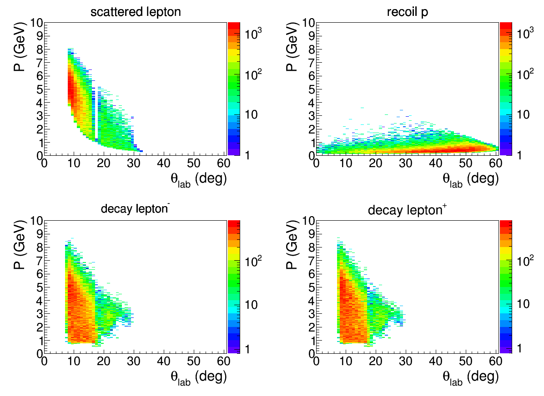
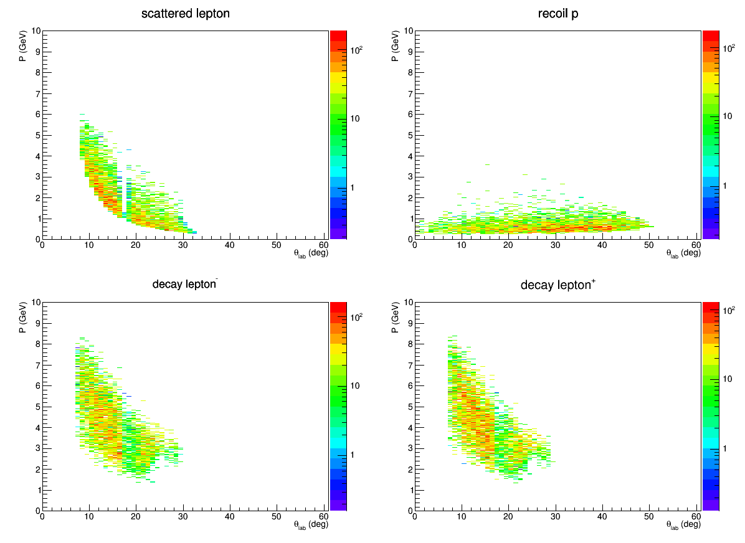
Particle acceptance
Before cut 3<Q’2<9
After cut 3<Q’2<9

Slide 13
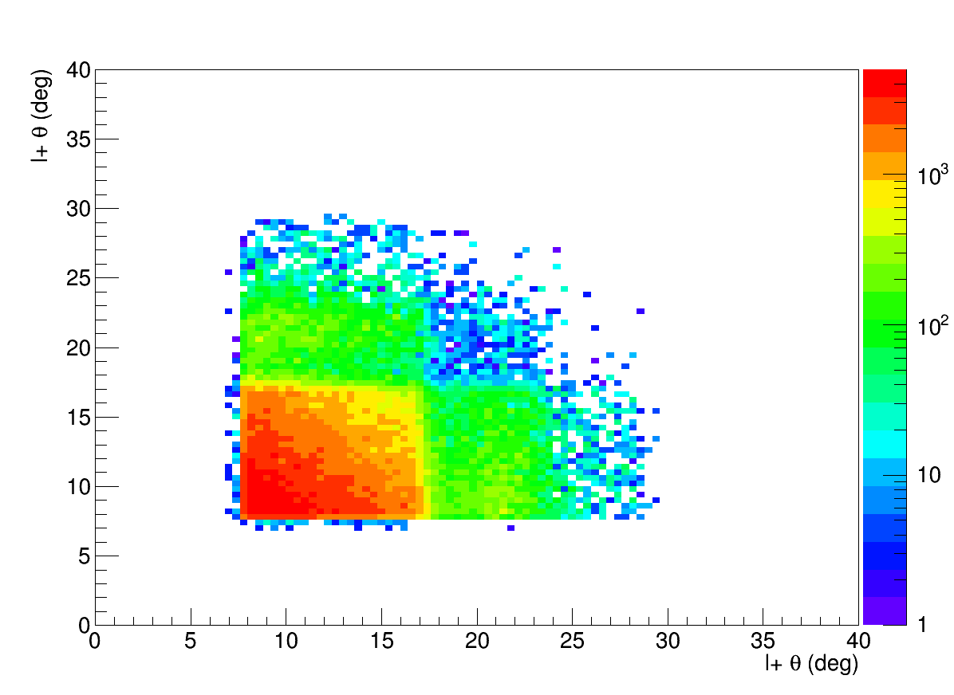
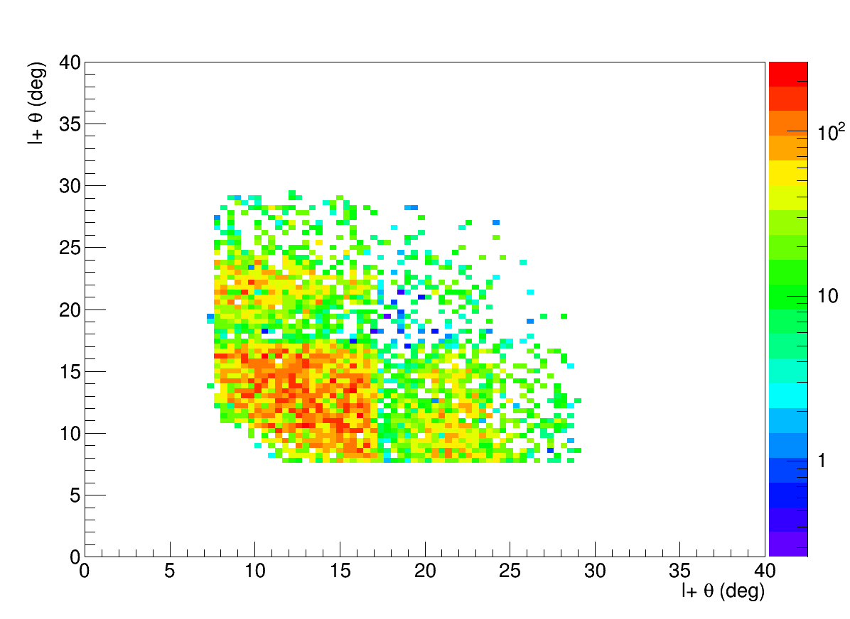
Decay angle
Before cut 3<Q’2<9
After cut 3<Q’2<9

Slide 14
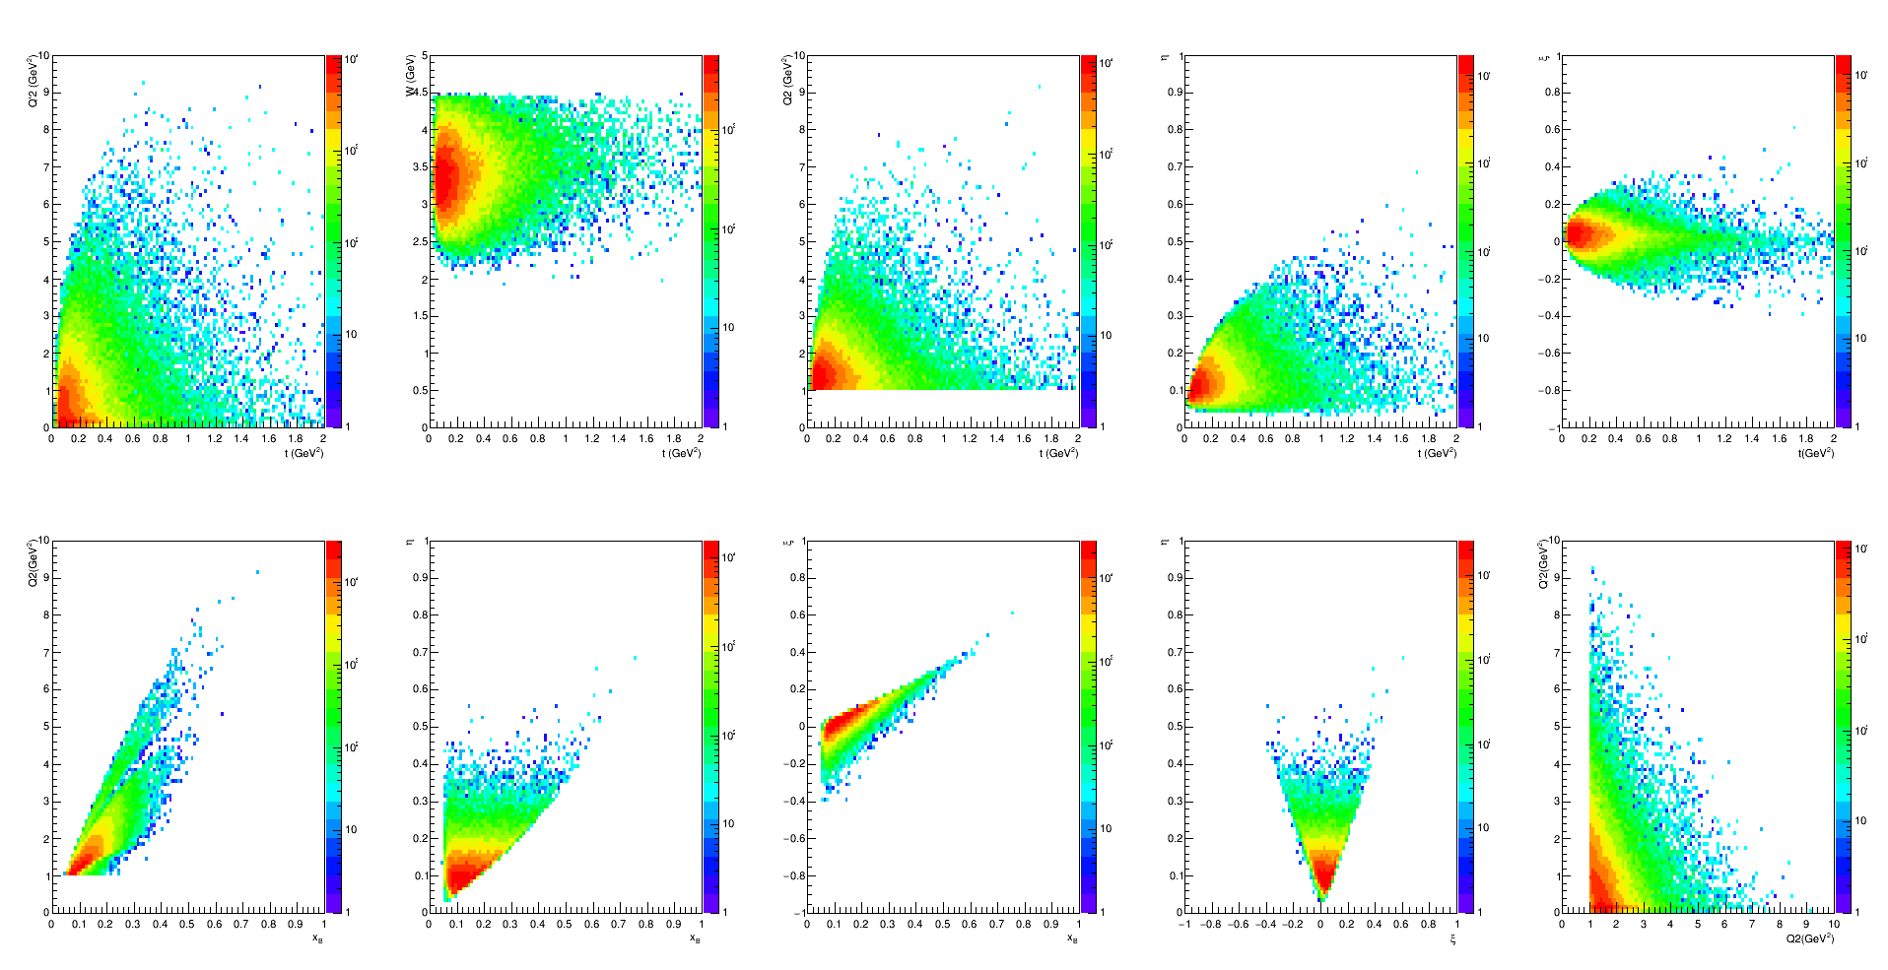
kinematics
Before cut 3<Q’2<9

Slide 15
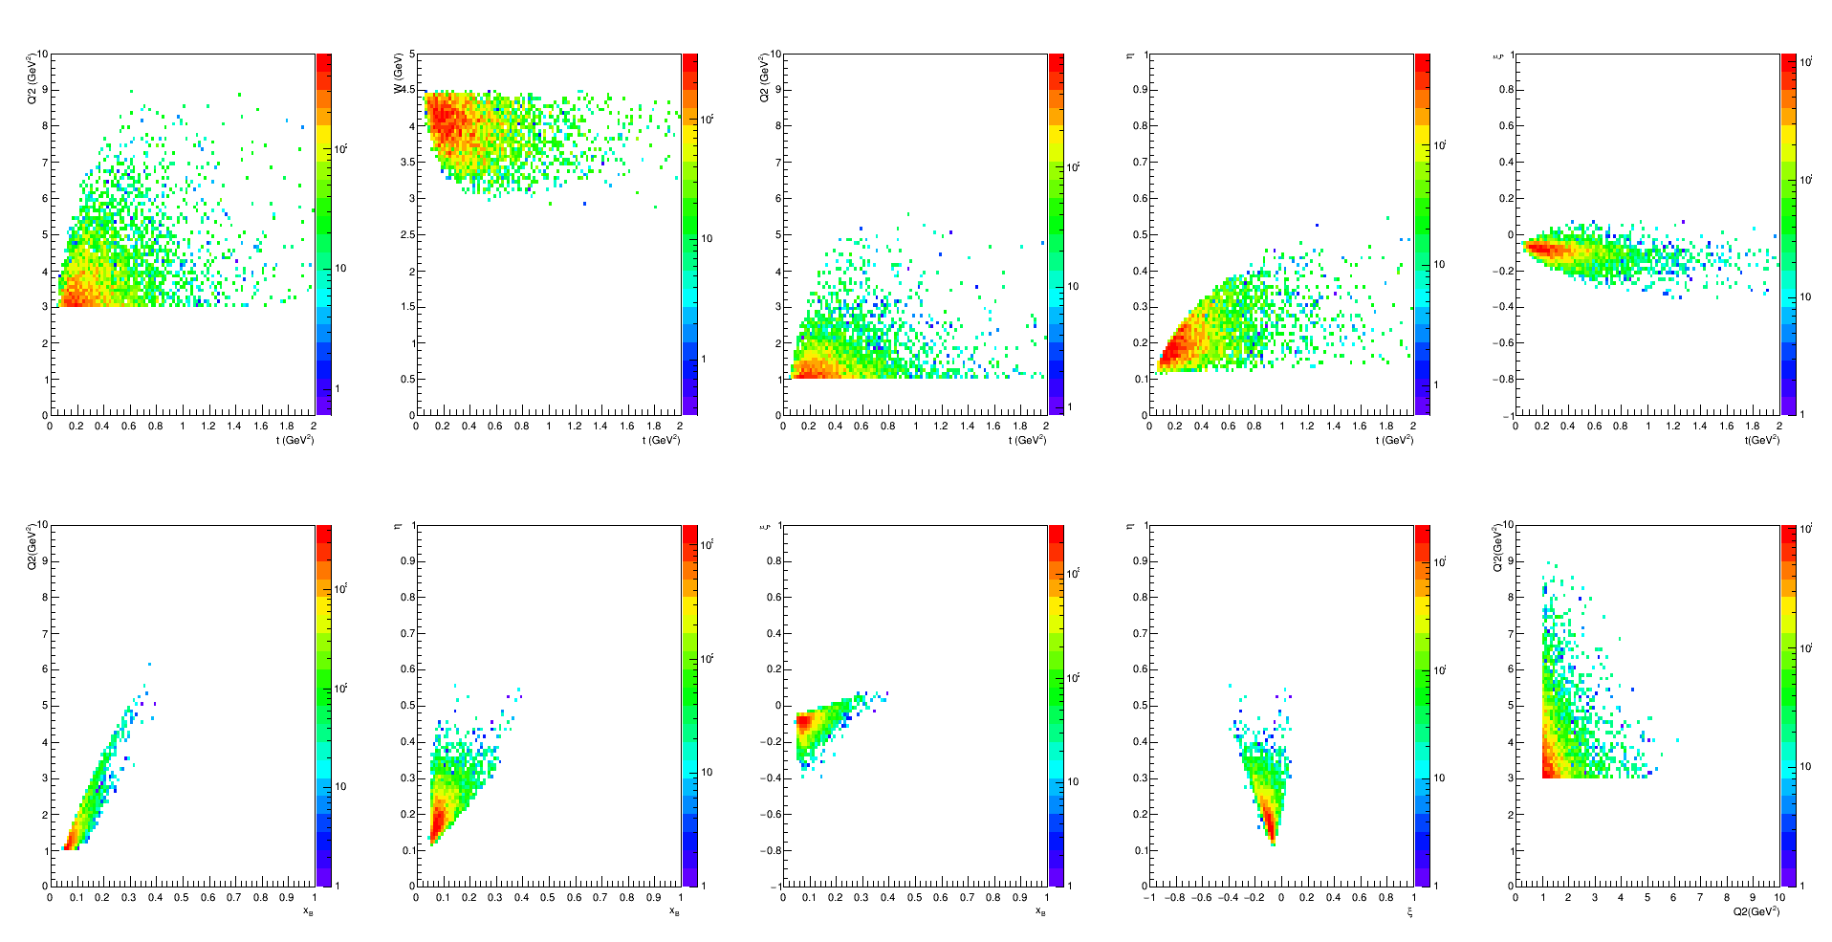
kinematics
After cut 3<Q’2<9

Slide 16
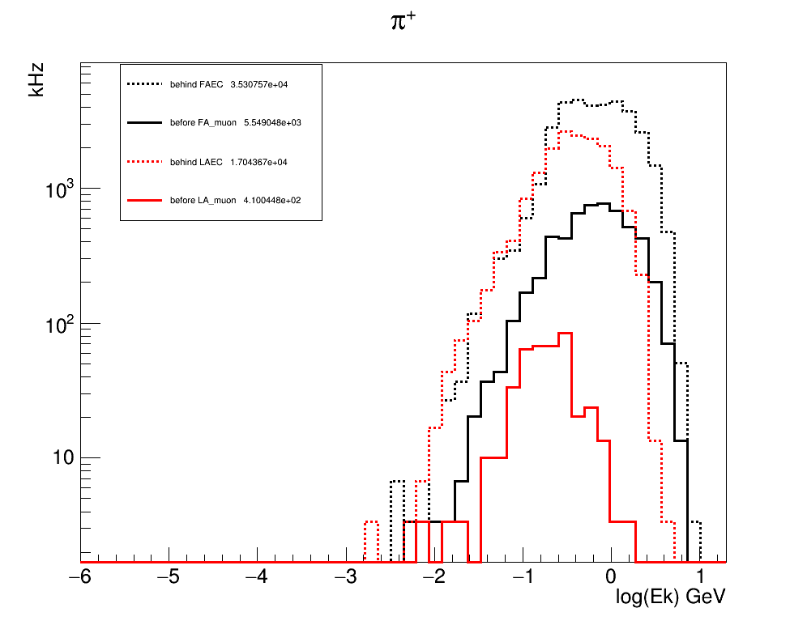
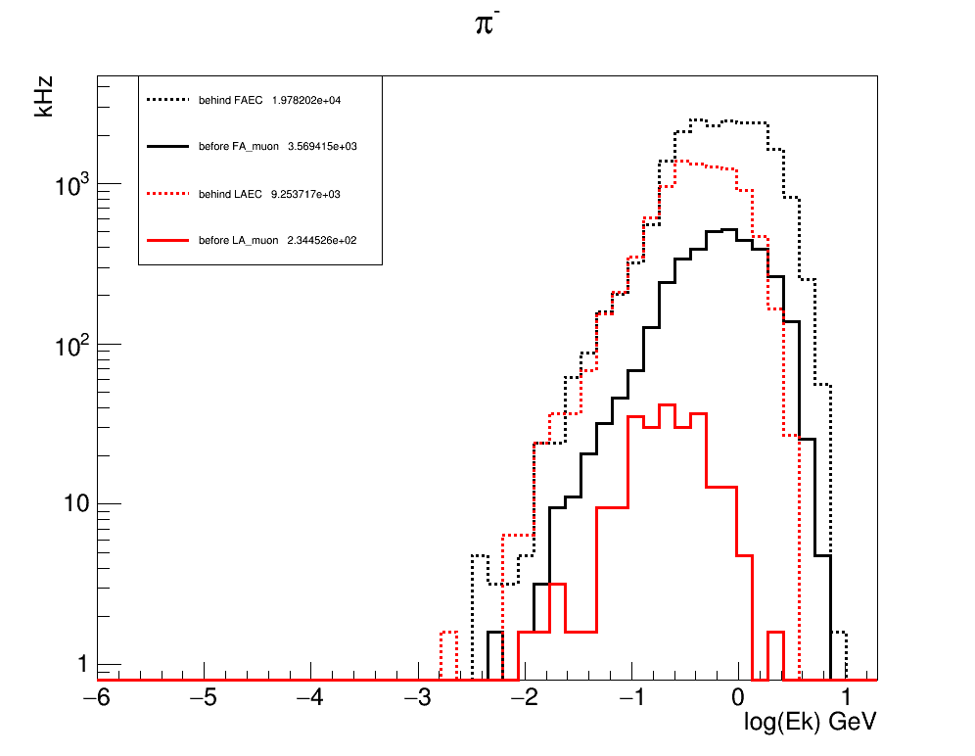
background
Pion rate before and after iron flux return

Slide 17
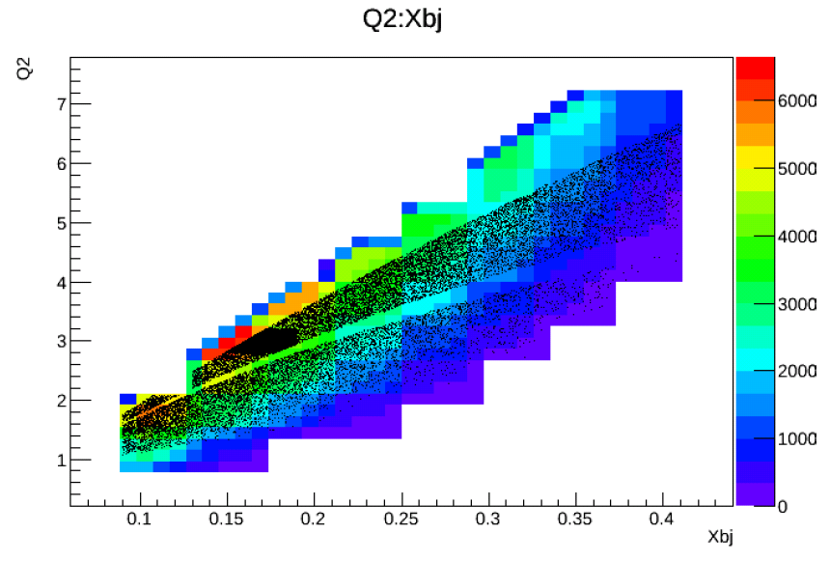
Kinematical coverage JPSi setup

Slide 18
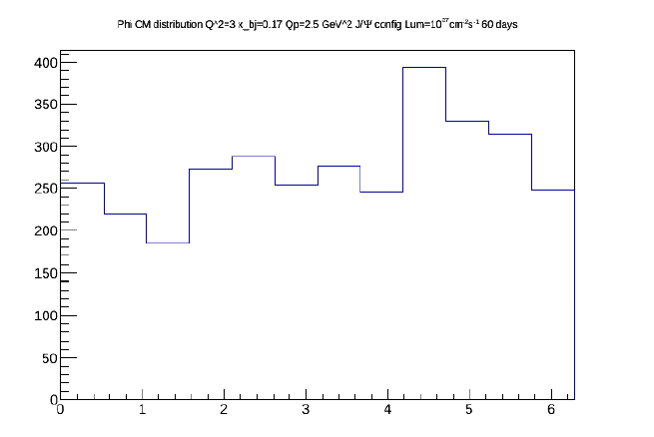
Counts J/psi setup 60 days at 10^37 cm⁻²s⁻¹

Slide 19
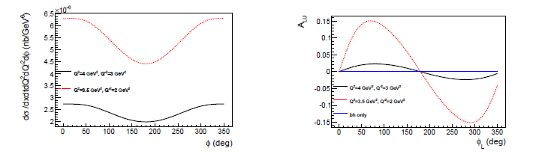
Cross sections / Asymmetry

Slide 20
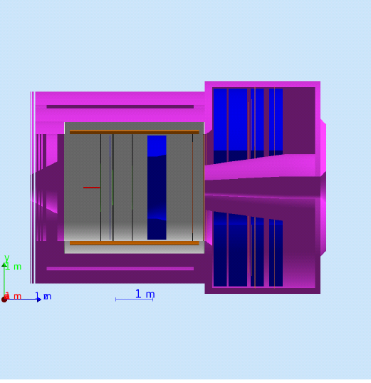
Dedicated setup
Iron plates
Target moved 2m from Jpsi position inside and switch to 45 cm target
Iron plate from 3rd layer yoke in fron and behind calorimeter
Remove Gas Cerenkov
Try to reach 10^38 cm⁻²s⁻¹
10 uA on 45 cm target

Slide 21
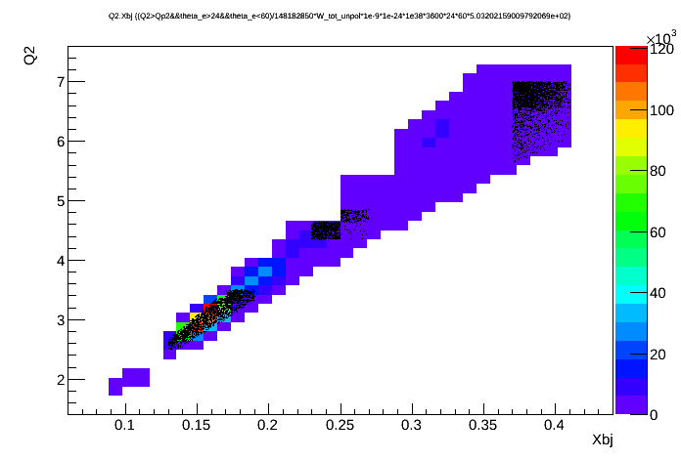
Kinematical coverage

Slide 22
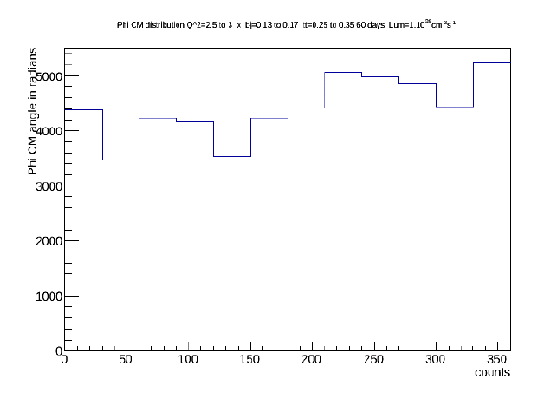
Counts

Slide 23
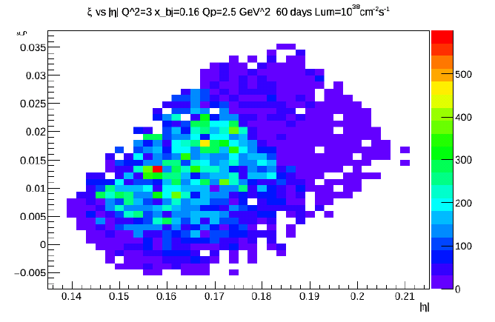
Eta and xi coverage

Slide 24
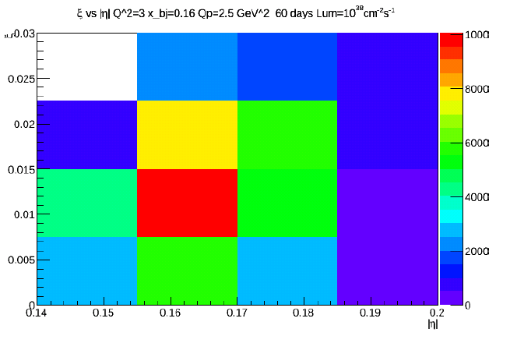
Eta Xi coverage large bin

Slide 25
Higher luminosity ?
Current could go up to 60 uA
Tracker occupancy and photon background
  Reduce amount of Copper in GEM
  Micromegas option
  Build smaller chambers and add more channels
  Study complement with 2D pad readout
  Superconducting tracker option
Calorimetry
  Study liquid scintillator and cryogenics calorimeter option
  Superconducting detector to replace PMT ( 1 ns width pulse to increase rate capability )
Cerenkov
  Superconducting detector to replace PMT ( 1 ns width pulse to increase rate capability )
  HBD type Cerenkov for Large Angle calorimeter
6. 10^38 cm⁻²s⁻¹
Technically doable mostly matter of cost

Slide 26
Conclusion
CLEO muon detector is a good opportunity to look at dimuon physics
Parasitic measurement on J/Psi give a first measurement of DDVCS with low statistics
Dedicated setup could increase luminosity by a factor of 10
High statistics would allow binning in different variables to look a binning in Q’2 to probe xi eta surface with xi different of eta of GPDs

