Slide 1
Introduction to GPDs
SoLID Collaboration Meeting
May 15th 2015
Alexandre Camsonne

Slide 2
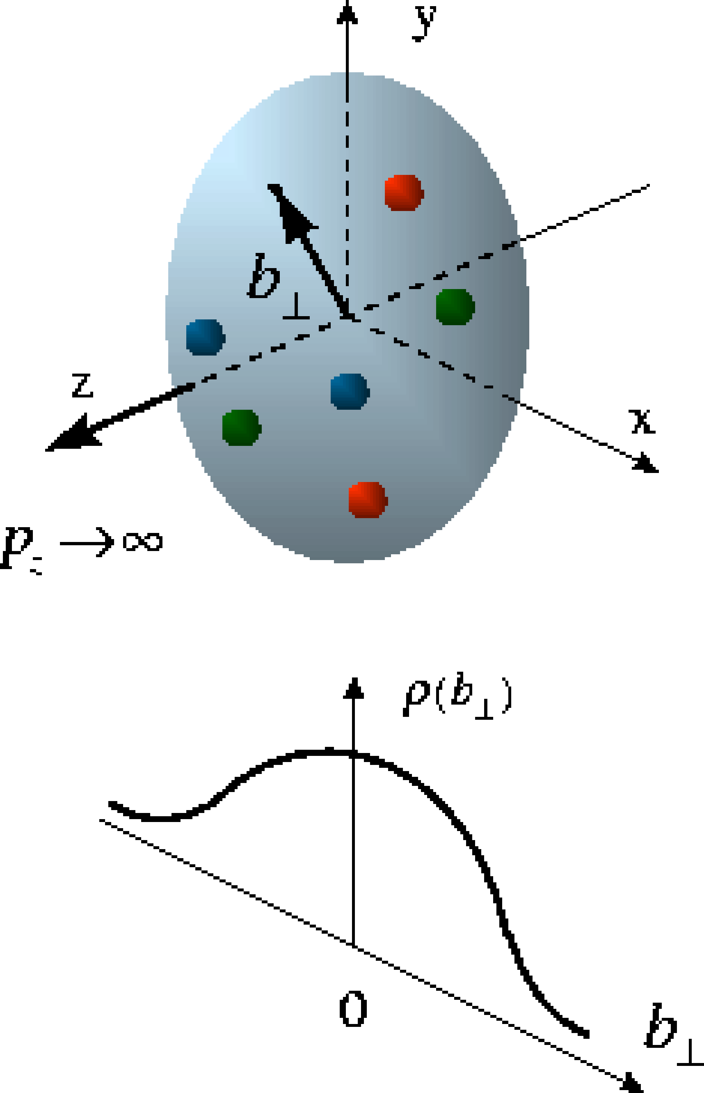
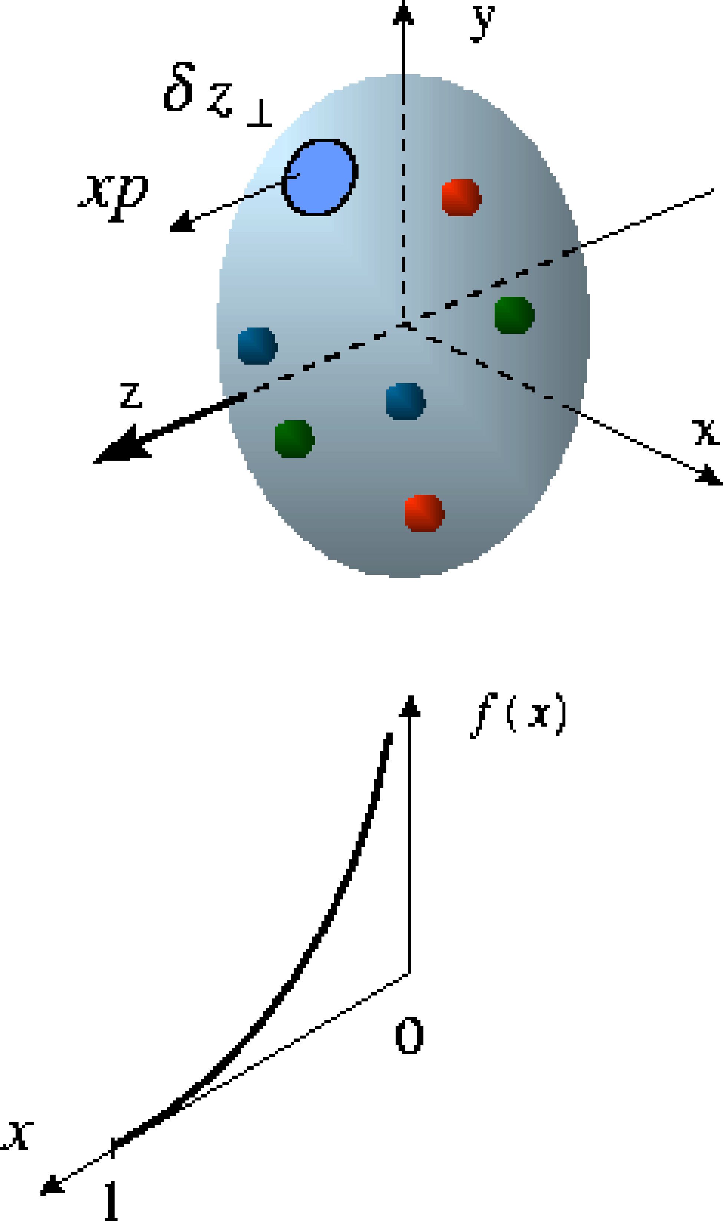
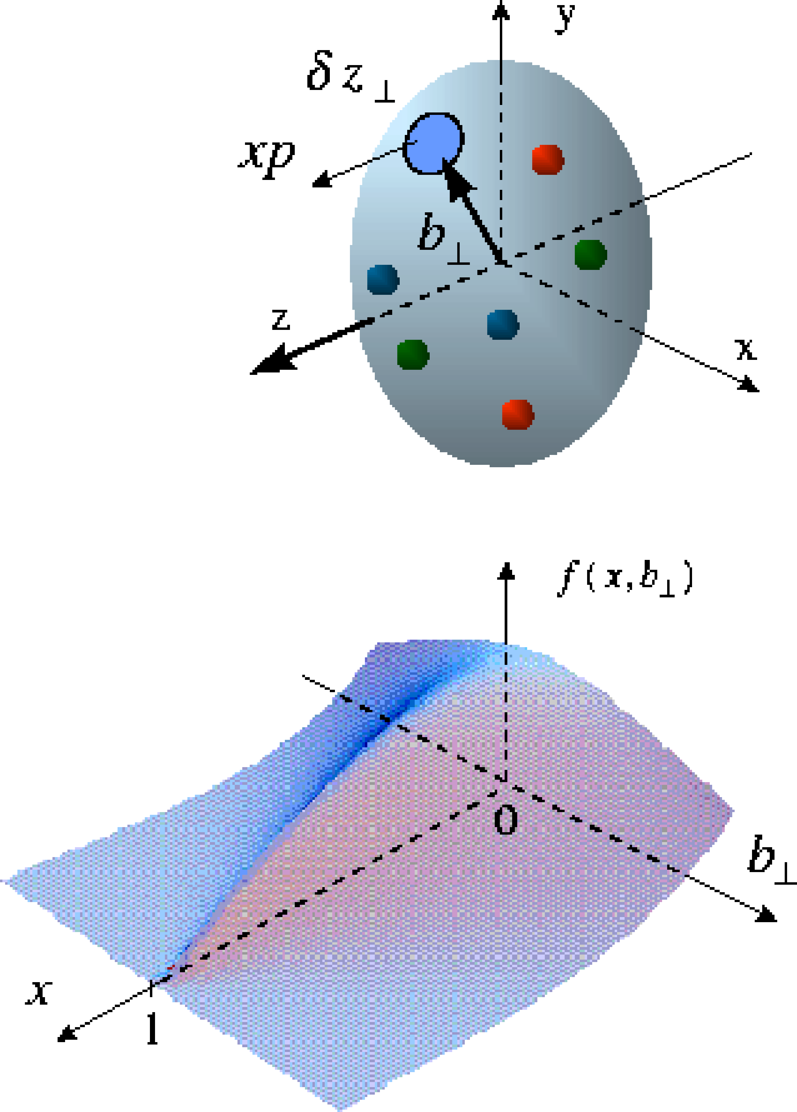
Generalized Parton Distributions (GPDs)
X. Ji, D. Mueller, A. Radyushkin (1994-1997)
Proton form factors, transverse charge & current densities
Structure functions,
quark longitudinal
momentum & helicity
distributions
Correlated quark momentum
and helicity distributions in
transverse space - GPDs

Slide 3
GPDs : x and ξ dependence

Slide 4
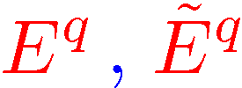
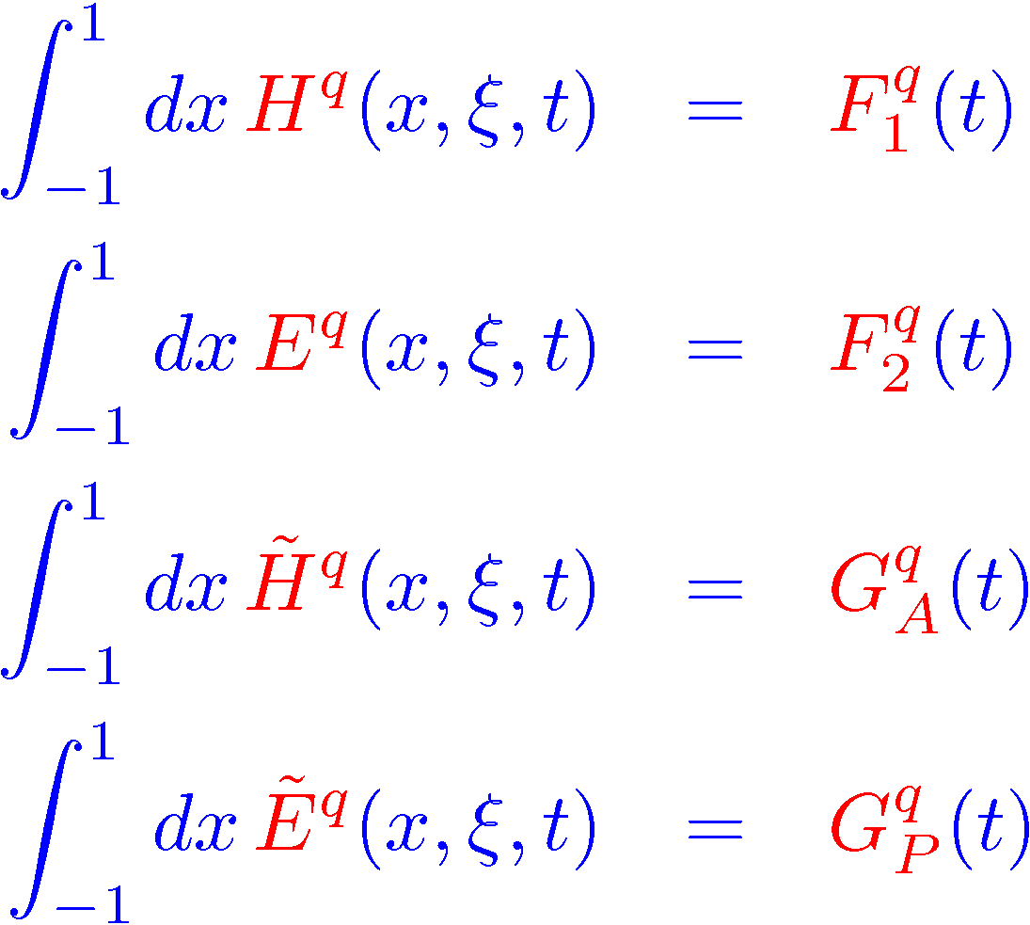
known information on GPDs
forward limit : ordinary parton distributions
unpolarized quark distribution
polarized quark distribution
: do NOT appear in DIS additional information
first moments : nucleon electroweak form factors
Δ
Dirac
Pauli
P - Δ/2
P + Δ/2
axial
ξ independence : Lorentz invariance
pseudo-scalar

Slide 5
GPDs : 3D quark/gluon imaging of nucleon
Fourier transform of GPDs :
simultaneous distributions of quarks w.r.t. longitudinal momentum x P and transverse position b
theoretical parametrization needed

Slide 6
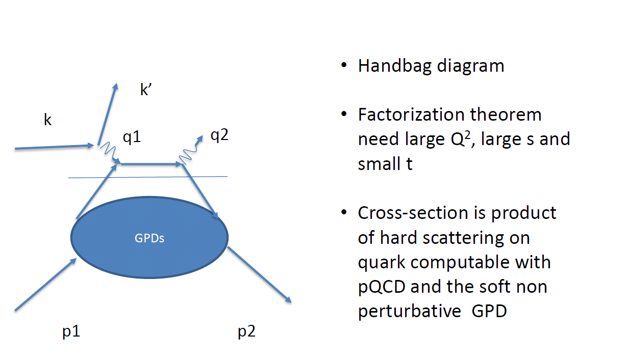
How to access GPDs
Measure exclusive reactions in DIS

Slide 7
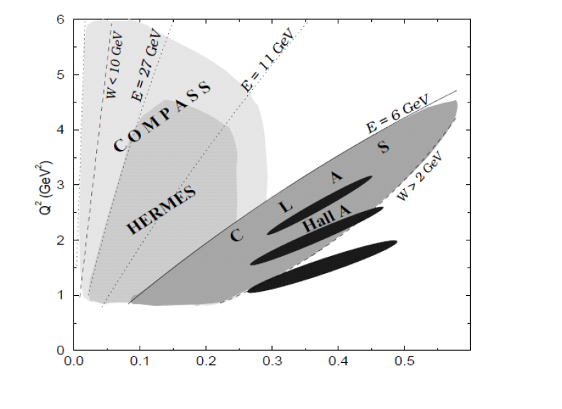
6 GeV experiments

Slide 8
Hall B CLAS 6 GeV

Slide 9
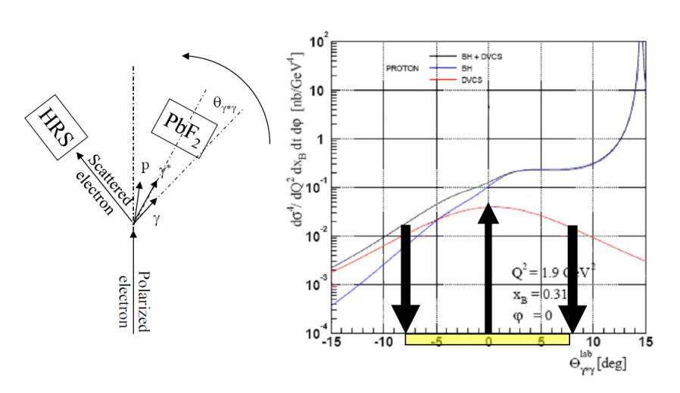
Hall A 6 GeV

Slide 10
CLAS12 DVCS

Slide 11
Hall A/C 12 GeV DVCS

Slide 12
Need different measurements to separate GPDs
Unpolarize Proton beam spin sensitive to Im H
Transverse Polarized Proton sensitive to Im E
Unpolarized neutron sensitive to Im E
Polarized neutron linear combination Im E and Im H
Deep Vector meson production
TCS and DDVCS so probe the GPDs surface
are needed to determine Im and Re of GPDs and have flavor decomposition

