Slide 1
Aging test of glass and MRPC
Wang Yi
Department of Engineering Physics, Tsinghua University
Outline:
aging test of glass
aging test of MRPC
Conclusions

Slide 2
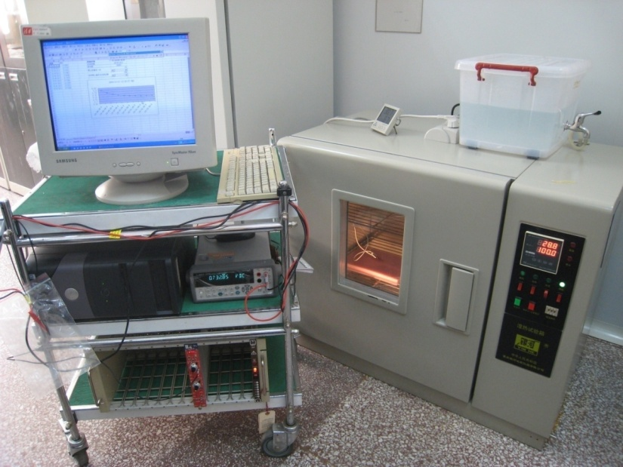
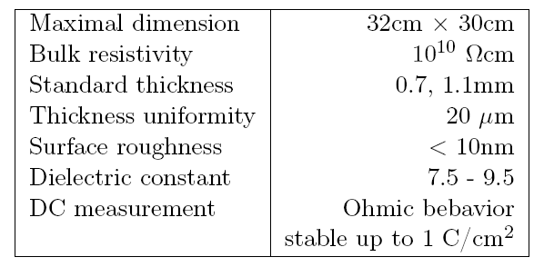
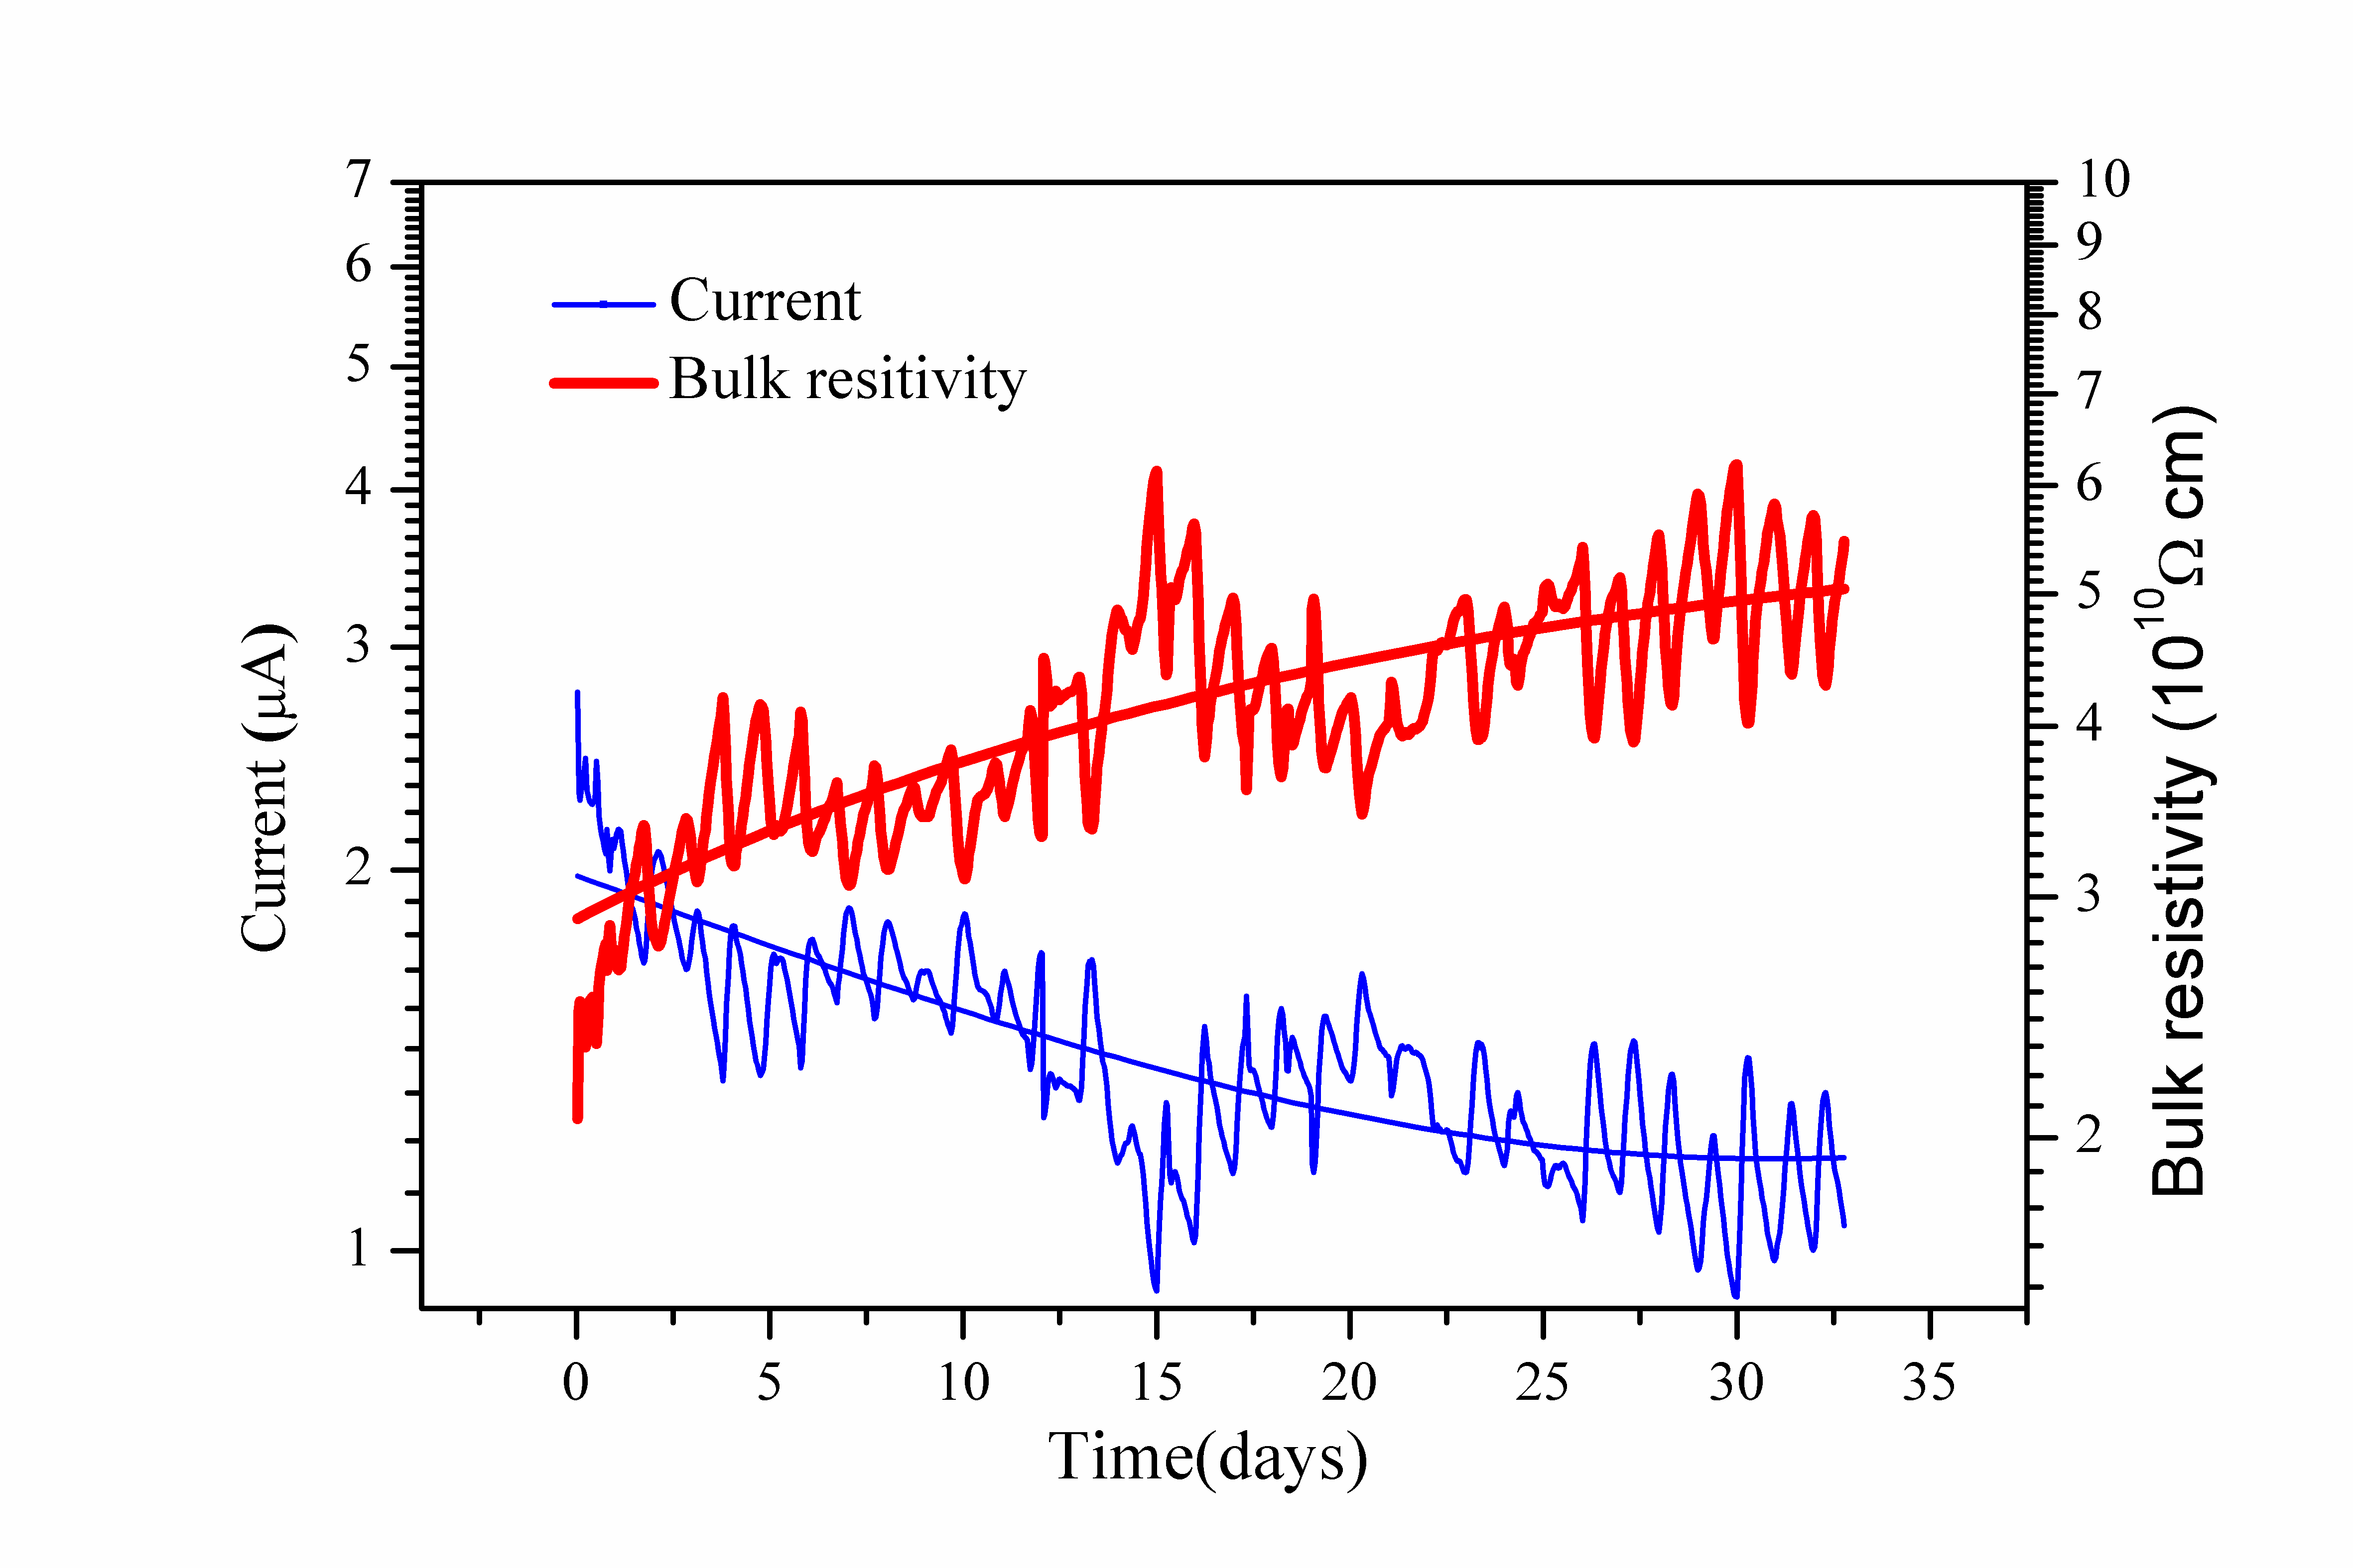
Aging test of low resistive glass
This glass was applied with 1000V for about 32days, integrated charge: 1 C/cm²
--roughly corresponding to the CBM life-time over 5 years operation at the maximum particle rate.
Glass specifications:

Slide 3
Comparasion with other material
Morales talk @RPC2012
3

Slide 4
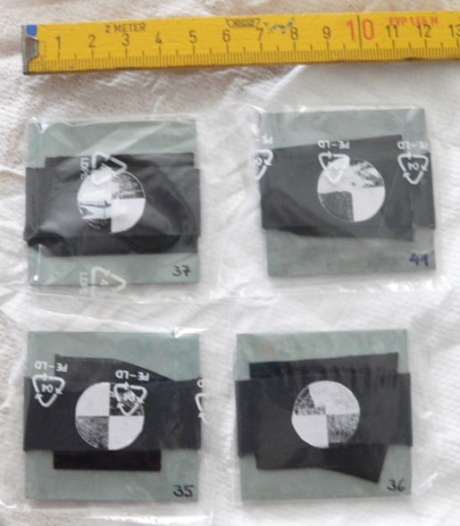
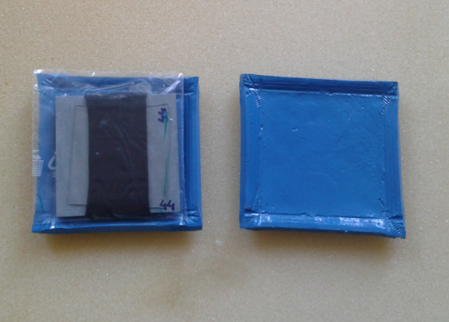
Electrode Material Samples
sample | material | length [cm] | width [cm] | area [cm²] | thickness [cm] | volume [cm³] | weigth [g] | density [g/cm³]
layer-1 | soda-lime glass | 4 | 4 | 16 | 0.05 | 0.8 | 2.0 | 2.5
layer-2 | Si₃N₄ / SiC ceramics | 5 | 5 | 25 | 0.20 | 5.0 | 16.0 | 3.2
layer-3 | semicond. glass | 3 | 3 | 9 | 0.07 | 0.6 | 1.6 | 2.5

Slide 5
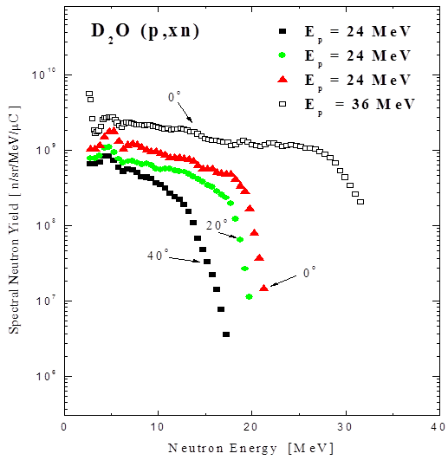
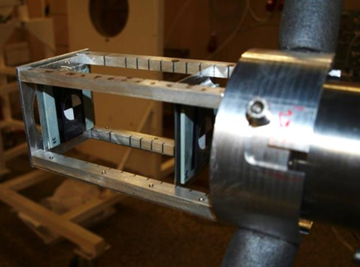
Experimental Facility
Neutron energy spectrum
Cyclotron U-120M (Řež)
Proton energy 36 MeV
Neutron production target Be
Neutron flux 10⁸ - 10¹⁰ n/cm²/s
Neutron energy spectra 1 – 36 MeV
Special thanks to A. Kugler and
O. Svoboda for their strong support.
target support

Slide 6
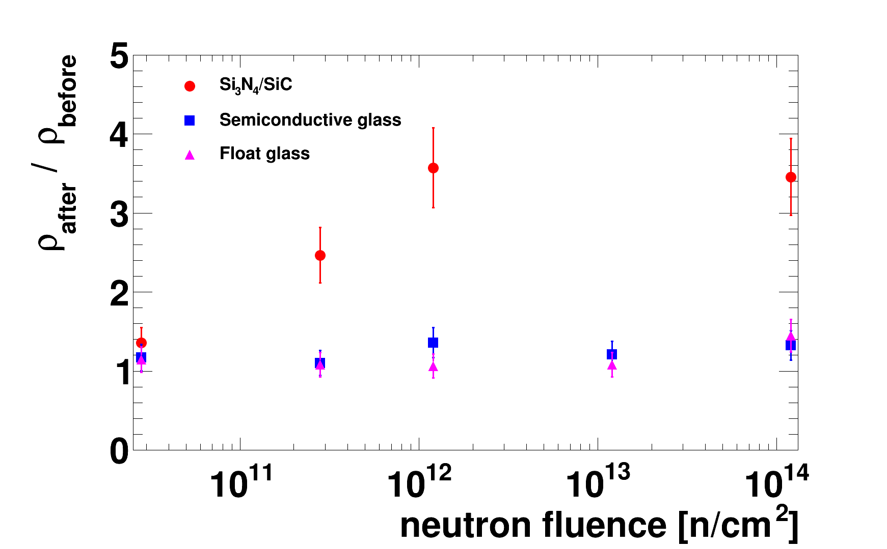
Test result
6

Slide 7
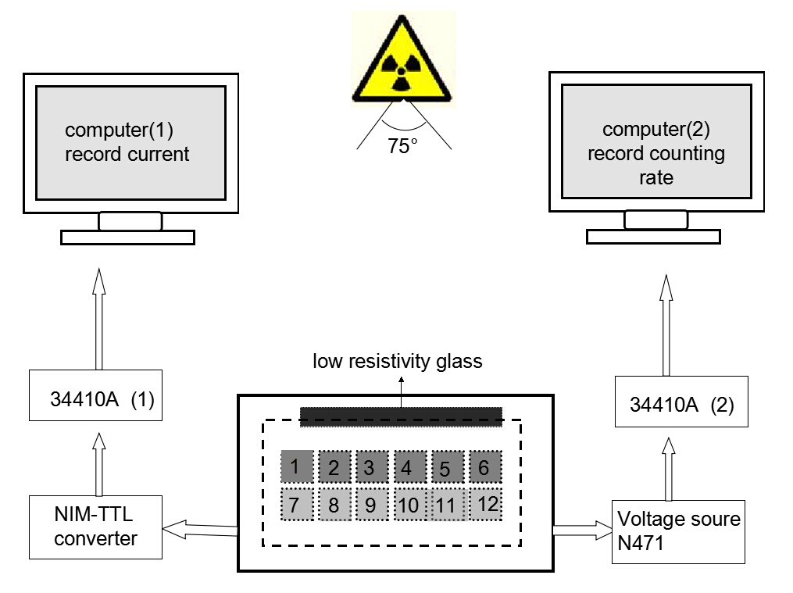
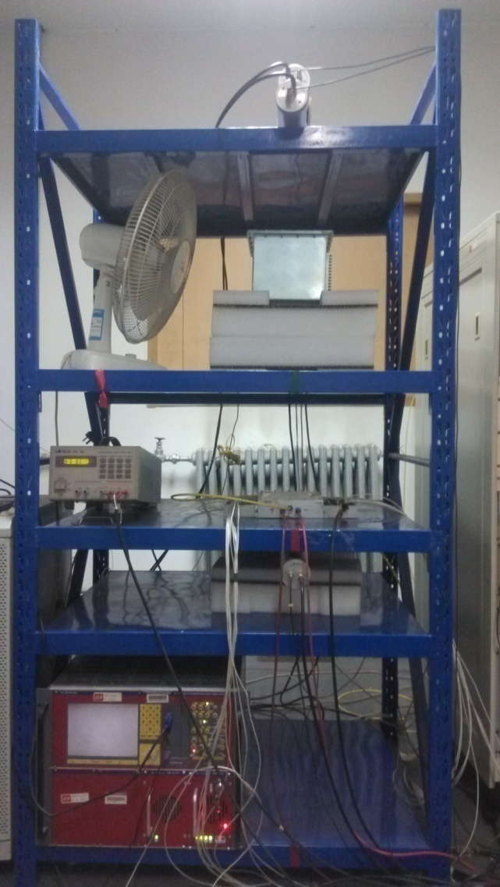
Setup of irradiation test
X-ray Generator
130cm
60cm
Hign rate MRPC
This is online test system. The efficiency and time resolution can be obtained by cosmic ray while irradiated by X-rays. 0.1C/cm² charge is accumulated in 35 days.

Slide 8
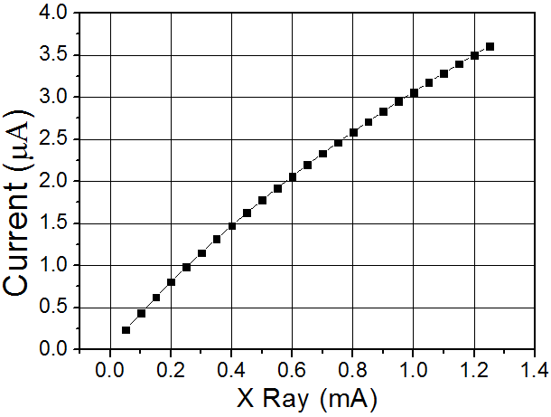
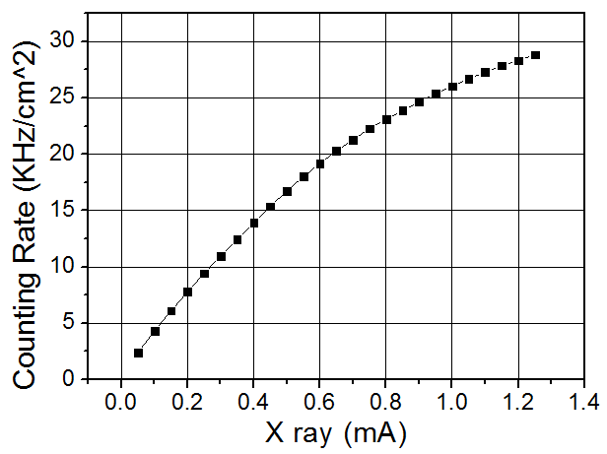
Current VS. X ray strength
Counting rate VS. X ray strength

Slide 9
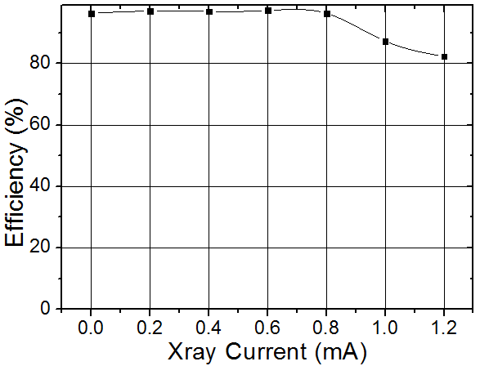
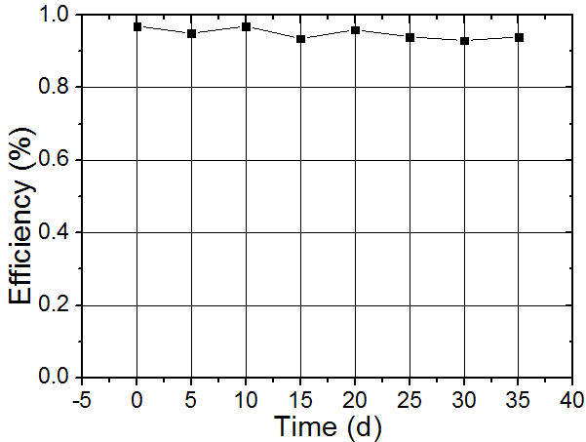
Efficiency
Efficiency VS. X ray strength
Efficiency VS. dosage

Slide 10
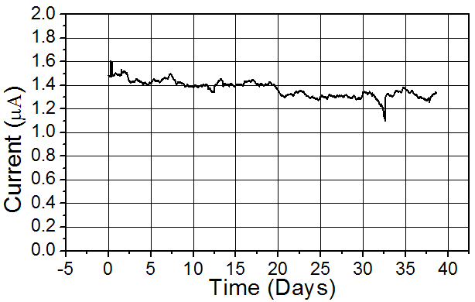
Current

Slide 11
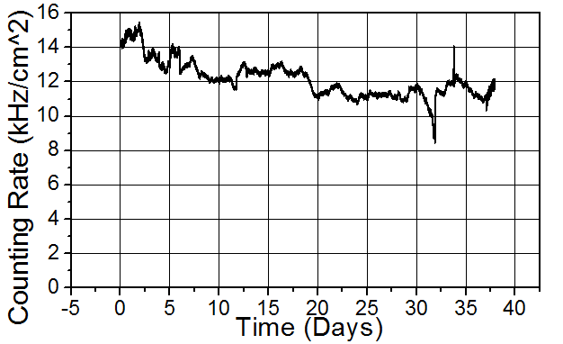
Counting rate

Slide 12
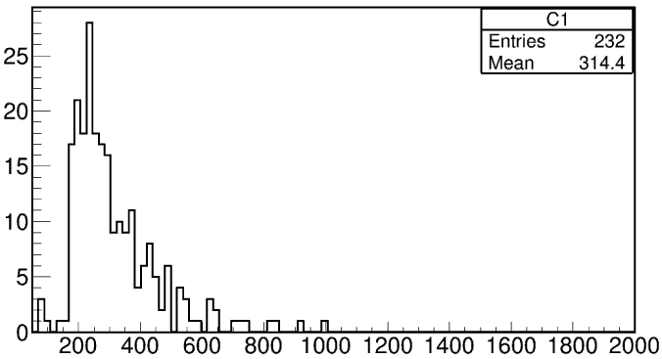
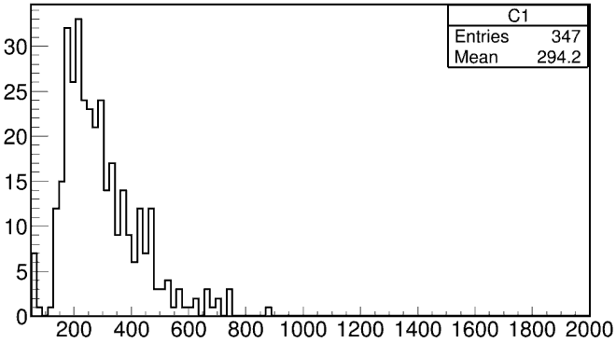
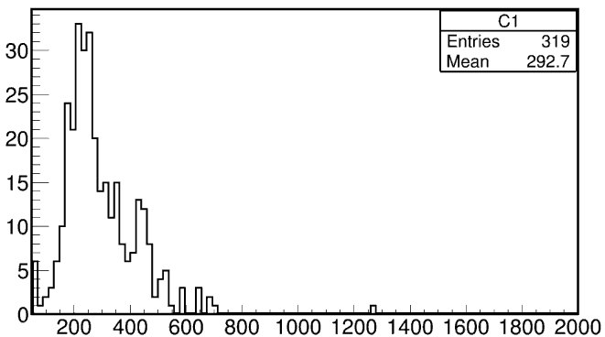
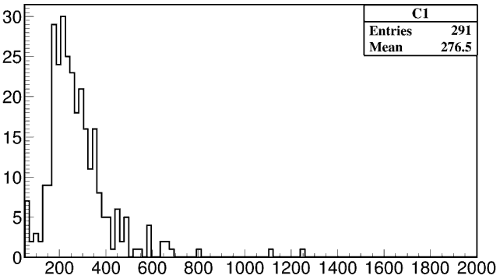
Charge spectrum
First ten days
Before irradiation
Second ten days
Third ten days

Slide 13
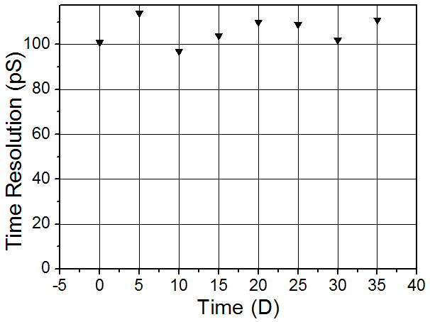
Time resolution

Slide 14
Conclusions
From high voltage, neutron test, we did not find any aging problem for low resistive glass.
We also studied the long term stability of high rate MRPC. 0.1C/cm² charge is accumulated.

Slide 15
Thanks for your attention !

