Slide 1
J/ψ @ SoLID
Zhiwen Zhao
2015/5

Slide 2
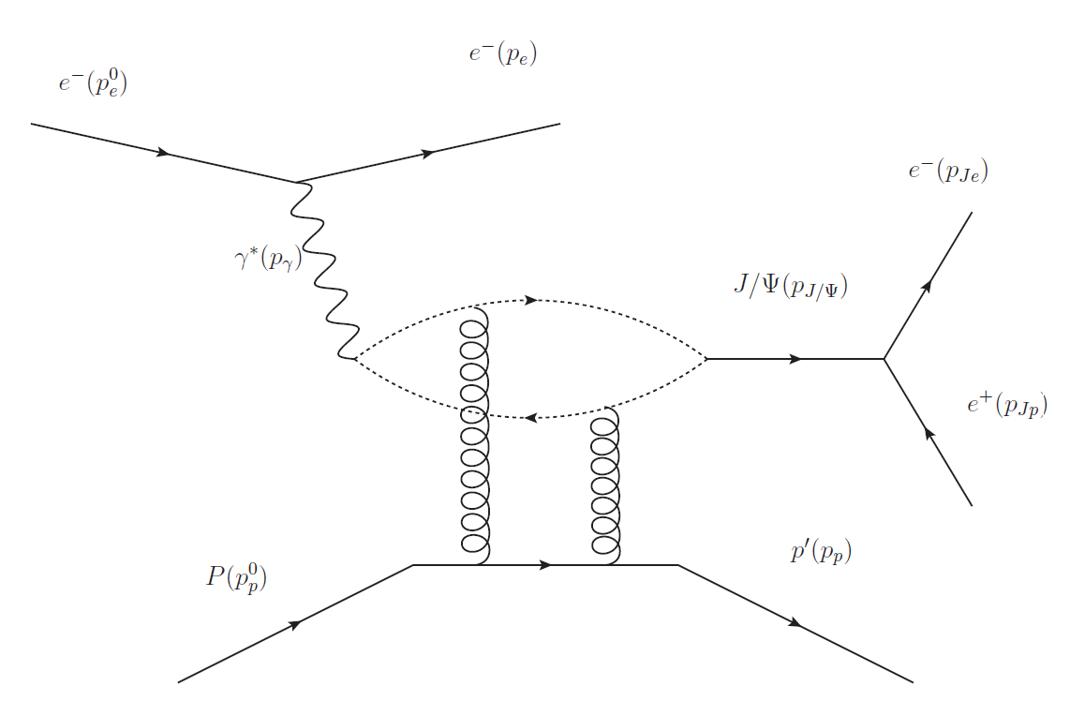
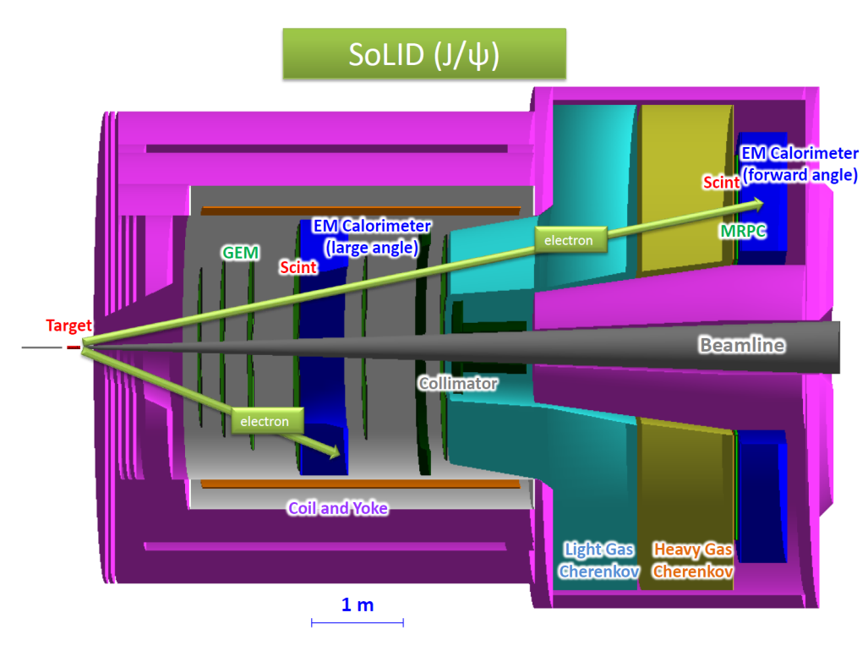
PID
e p → e′ p′ J/ψ(e⁻ e⁺)
γ p → p′ J/ψ(e⁻ e⁺)
electroproduction detect decay e⁻ e⁺ pair and scattered e⁻
photoproduction
detect decay e⁻ e⁺ pair and recoil p
Scattered e⁻ and Decay e⁻/e⁺:
EC + SPD + CC @ forward angle
EC + SPD @ large angle
Recoil p:
100 ps TOF(MRPC): 4 σ separation p/K up to 4.5 GeV and p/pi up to 5GeV @ forward angle
150 ps TOF(SPD): 4 σ separation p/K up to 2GeV and p/pi up to 2.5 GeV @ large angle (new)

Slide 3
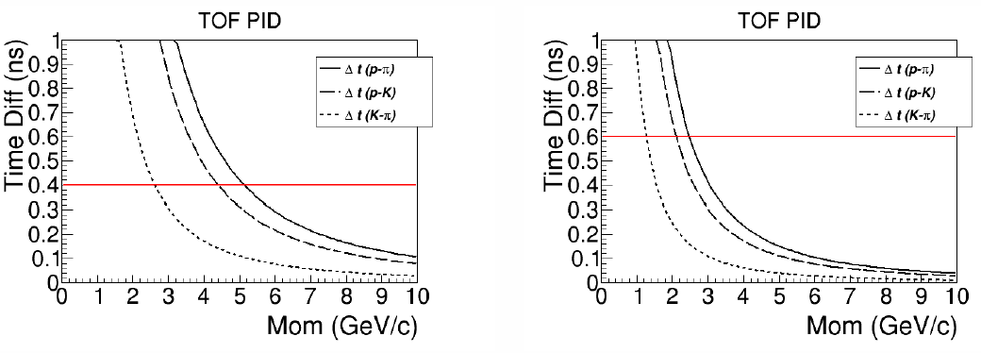
TOF
Recoil p:
100 ps TOF(MRPC): 4 σ separation p/K up to 4.5 GeV and p/pi up to 5GeV @ forward angle
150 ps TOF(Scint): 4 σ separation p/K up to 2 GeV p/pi up to 2.5GeV @ large angle
FA
LA

Slide 4
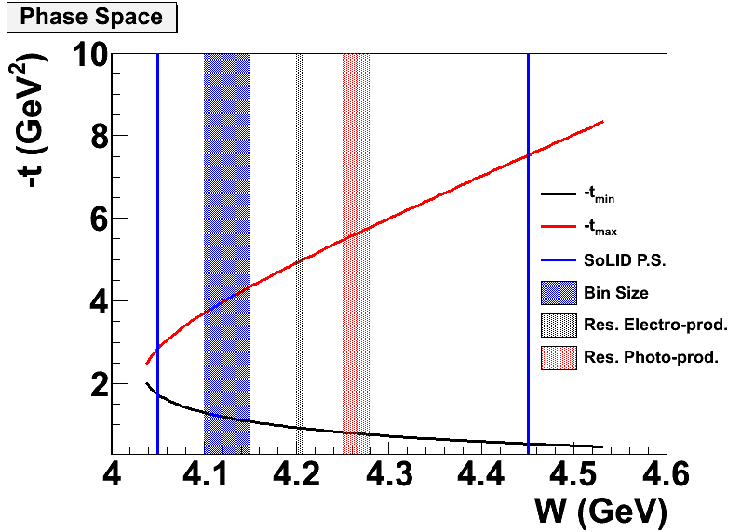
Electroproduction vs. Photoproduction
production | Energy resolution | W reach | Background | Statistics
Electro- | better | lower | less | less
Photo- | worse | higher | more | more
Electroproduction
virtual photon energy solely determined by detection of scattered e⁻, like a tagged virtual photon beam
non-zero Q2 gives lower W reach
More final particle detection can have less background
Photoproduction
photon energy derived from detection of recoil p, decay e-, decay e+
more statistics
Trigger on decay e⁻ and decay e⁺ to include both channels

Slide 5
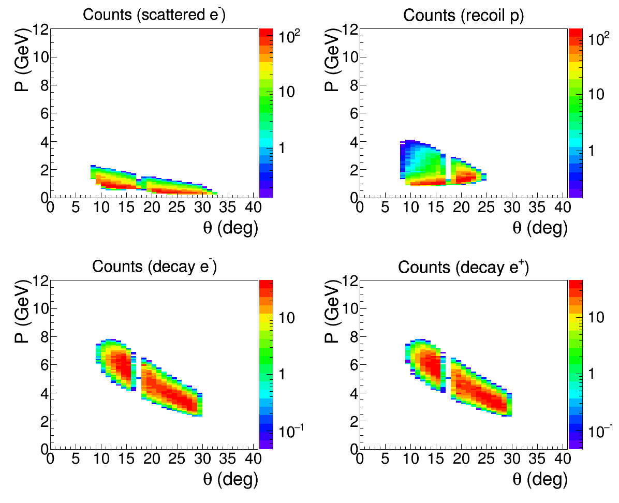
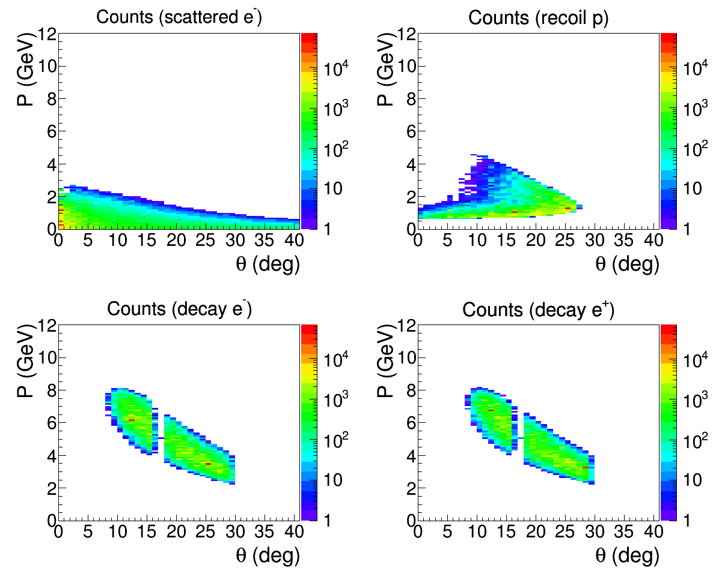
Acceptance (Electroproduction)
Require all 4 particles
Require decay pair only
Possible Trigger 1 (flat): electron trigger by EC with 4GeV threshold at forward angle and 2GeV at large angle to detect decay pair (stars shows trigger energy)
This allows both electroproduction and photoproduction in data collection
Acceptance for photoproduction needs further study
Lower energy electron detection needs further study

Slide 6
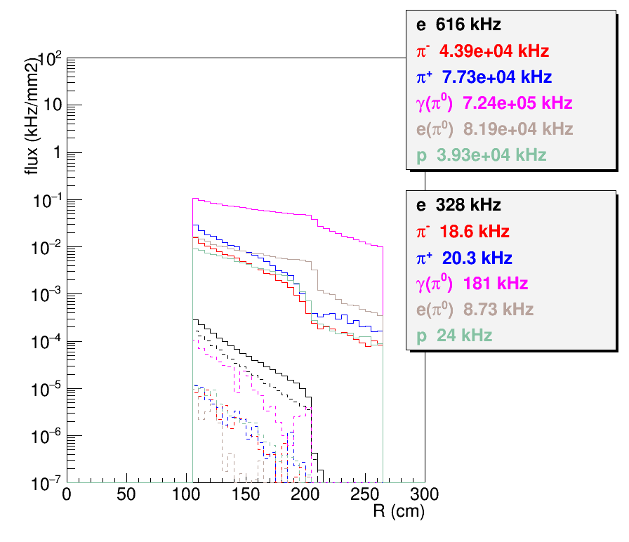
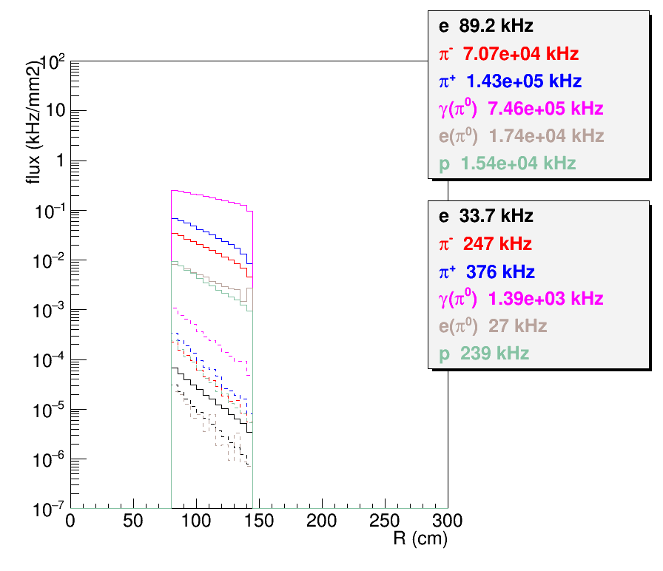
Possible Trigger 1 (flat)
Done in the way similar to the trigger study for SIDIS_He3
Single electron trigger by flat EC > 4GeV at FA and flat EC>2GeV at LA
Histograms showing rate before and after trigger cut
Using SIDIS_He3 EC trigger response for now, but luminosity (1e37/cm2/s) are similar for both and background has no big effect on EC trigger for this level of luminosity)
FAEC
LAEC

Slide 7
Possible Trigger 1 (radial)
MRPC+FASPD can reduce trigger rate from pi0 photon by factor 20
LASPD can reduce trigger rate from pi0 photon by factor 5
LGCC can reduce photon background by 40 and hadron backgroud by 40(rand. Coin.) and 55 (corr. Coin.)
Single electron trigger including both FA and LA is about 1.54MHz
Coincidence of two electron trigger within 30ns time window is 1.54e6*1.54e6*30e-9 = 71kHz, which is below 100kHz SIDIS Setup limit
Single electron trigger
FA (4GeV flat)
335kHz
=328+4+4/40+181/20/40+(18+20+24)/40+(18+20+24)/55
=328(e) + 4(e(π⁰) front) + 0.1(e(π⁰) back) +0.23(γ(π⁰)) + 1.6(hadron rand. coin.) + 1.1(hadron corr. coin.)
LA (2GeV flat)
1200kHz
= 33+27+1390/5+(247+376+239)
= 33(eDIS) + 27(e(π⁰))+ 270(γ(π⁰))+862(hadron)

Slide 8
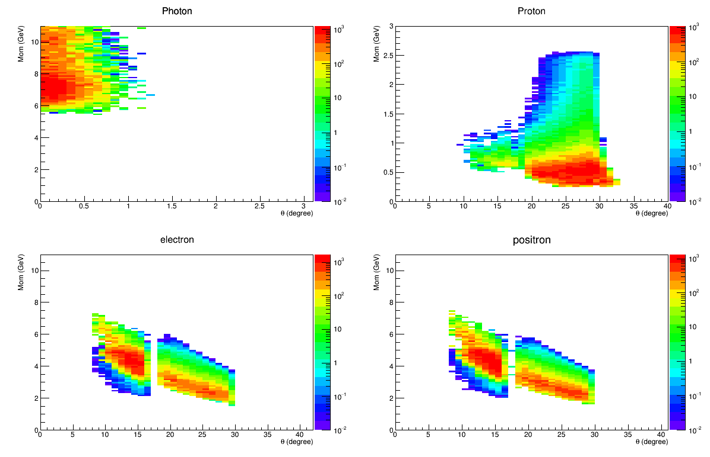
Acceptance comparison
TCS/BH (photo + quasi-photoproduction)
Jpsi (Electroproduction)
Require proton and decay pair
Require decay pair only
Possible Trigger 2 (radial): electron trigger by FAEC with 4GeV (r=105-115cm), 3GeV (r=115-145cm) and 2GeV (r=145-235cm), by LAEC with 3GeV (r=80-100cm) and 2GeV (r=100-140cm) (stars shows trigger energy)
This allows both TCS and JPsi electroproduction and photoproduction in data collection

Slide 9
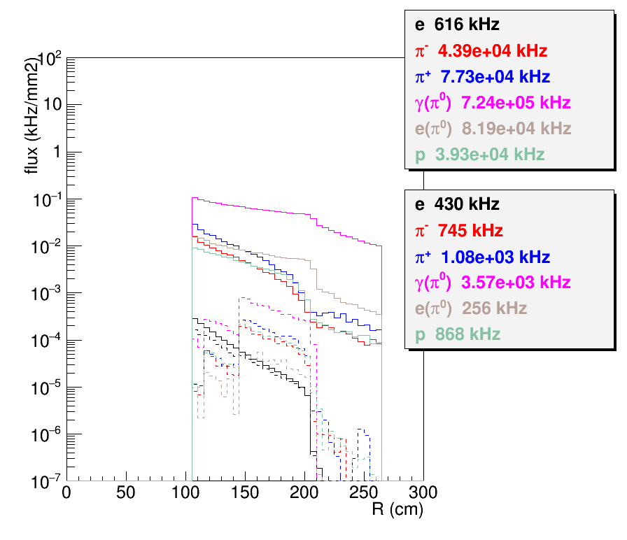
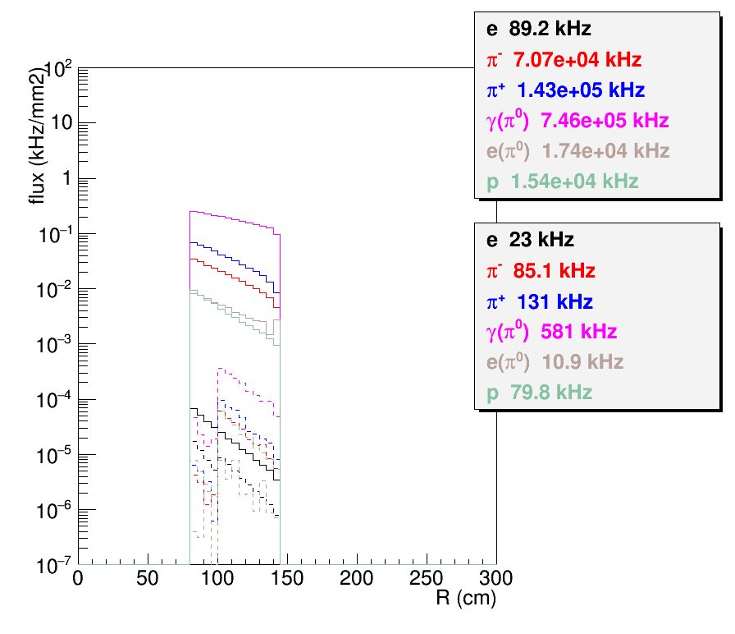
Possible Trigger 2 (radial)
Done in the way similar to the trigger study for SIDIS_He3
Single electron trigger by EC radial
Histograms showing rate before and after trigger cut
Using SIDIS_He3 EC trigger response for now, but luminosity (1e37/cm2/s) are similar for both and background has no big effect on EC trigger for this level of luminosity)
FAEC
LAEC

Slide 10
Possible Trigger 2 (radial)
MRPC+FASPD can reduce trigger rate from pi0 photon by factor 20
LASPD can reduce trigger rate from pi0 photon by factor 5
LGCC can reduce photon background by 40 and hadron backgroud by 40(rand. Coin.) and 55 (corr. Coin.)
Single electron trigger including both FA and LA is about 1.13MHz
Coincidence of two electron trigger within 30ns time window is 1.13e6*1.13e6*30e-9 = 40kHz, which is below 100kHz SIDIS Setup limit
Electron trigger
FA (radial)
682kHz
=430+128+128/40+3570/20/40+(745+1080+868)/40+(745+1080+868)/55
= 430(e) + 128(e(π⁰) front) + 3(e(π⁰) back) +4.5(γ(π⁰)) + 67(hadron rand. coin.) + 49(hadron corr. coin.)
LA (radial)
446kHz
= 23+11+581/5+(85+131+80)
= 23(eDIS) + 11(e(π⁰))+ 116(γ(π⁰))+296(hadron)

Slide 11
Summary
LASPD(TOF) will help proton detection for JPsi
By triggering on electron decay pair, JPsi can do both electro and photoproduction
Radial dependent trigger (40kHz< 100kHz limit) is not only help Jpsi reducing trigger rate, but also allow TCS running in parallel
TCS physics is dominant by BH process which in turn will be helpful for Jpsi normlization

Slide 12
SoLID JPsi Trigger
Trigger on decay electron and positron
Allow both electroproduction and photoproduction in data
EC has radial dependent trigger threshold from 4 – 2GeV (stars)
LGCC, MRPC, SPD help reject other hadrons and photons
Same trigger works for Jpsi and TCS as run group
Jpsi (Electroproduction)
Require decay pair only
Study was done in the way similar to PVDIS and SIDIS trigger rate
Using SIDIS_He3 EC trigger response for now, luminosity (1e37/cm2/s) is similar for both and background has no big effect on EC trigger for this level of luminosity)
Single electron trigger including both FA (682kHz) and LA(446kHz) is about 1.13MHz
Coincidence of two electron trigger within 30ns time window is 1.13e6*1.13e6*30e-9 = 40kHz, which is below 100kHz SIDIS Setup limit

Slide 13
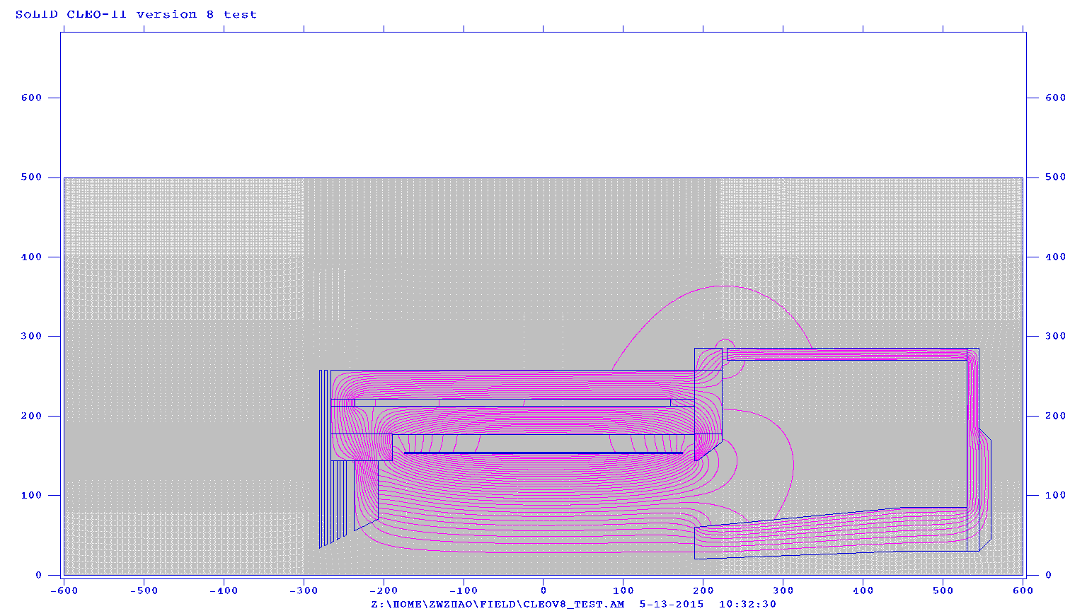
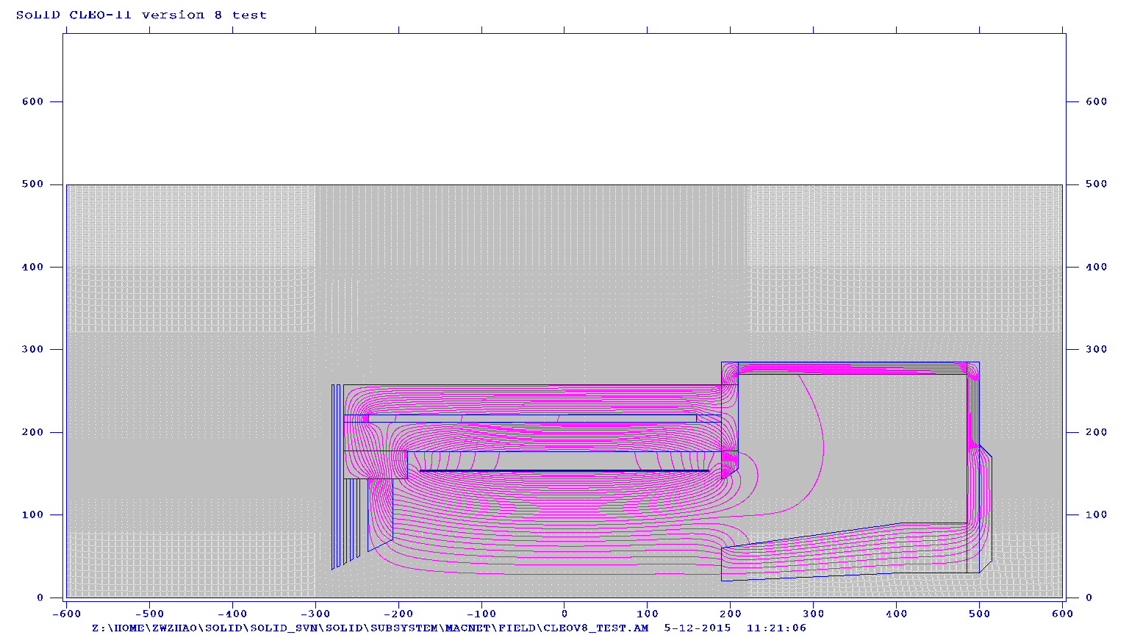
Just ideas, but changes are definitely needed
Downstream collar enlarge by by 15cm in z (engineering need for support)
Endcap move 15cm downstream and enlarge 30cm (SIDIS setup needs room)
Endcap nose back reduce 5cm in r (EC hexagon module needs room)
6cm gap between downstream collar and endcap (let cable out, more cable out at back needed)
Main impact, PVDIS EC large angle performance
Need design with full 3D model and satisfy both physics and engineering requirement
needed by all subsystems to fix their design, must be a coherent effort
More realistic design now, More saving of man power, effort, cost, maybe even physics
new
current

Slide 14
backup

Slide 15
Comments: SoLID Director Review
During review
How does SoLID JPsi comparing to other JPsi programs?
The committee seems like our answer in the next slide, so they didn’t mention it in the final review conclusion

Slide 16
J/ψ@JLab Comparison
Eugene Chudakov, JPsi workshop at Temple in 2012
The estimation assumed luminosity ~1e³⁷/cm²/s similar to the approved SoLID experiment.
The estimation assumed J/ψ cross section 0.01nb at 8.4<E< 9GeV.
The cross section could rise to 0.1nb at 9<E<12GeV, but it won’t change acceptance much, so the comparison will be similar.
In Hall D case, for photon intensity of 10⁸, the production would change to 3/day.
SoLID has higher photon intensity than HallD

Slide 17
Comments: SoLID Director Review
After review, in the final review conclusion
The signal and background trigger rates should be simulated for the J/ψ measurements. (try to answer this time)
Bin migration effects should be simulated for the measurements of the sharply rising J/ψ production cross section near threshold. (need to think about it, will try to answer in near future)

Slide 18
Projection of Total Crossection
Need to work on
Bin migration effects
Lumi 1.2e37/cm²/s
11GeV 3uA e- on 15cm LH2
50 Days
With ~ 0.02 GeV energy resolution for E_{γ} and small binning to
study the threshold behavior of cross section

Slide 19
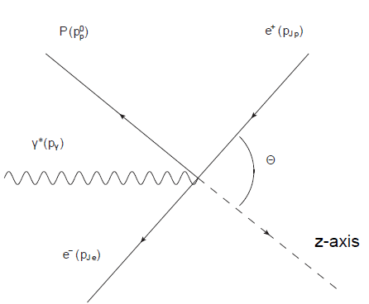
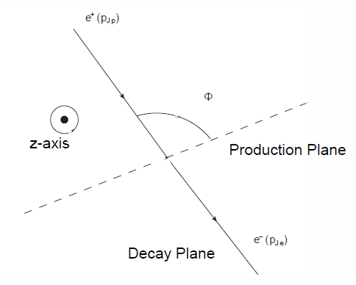
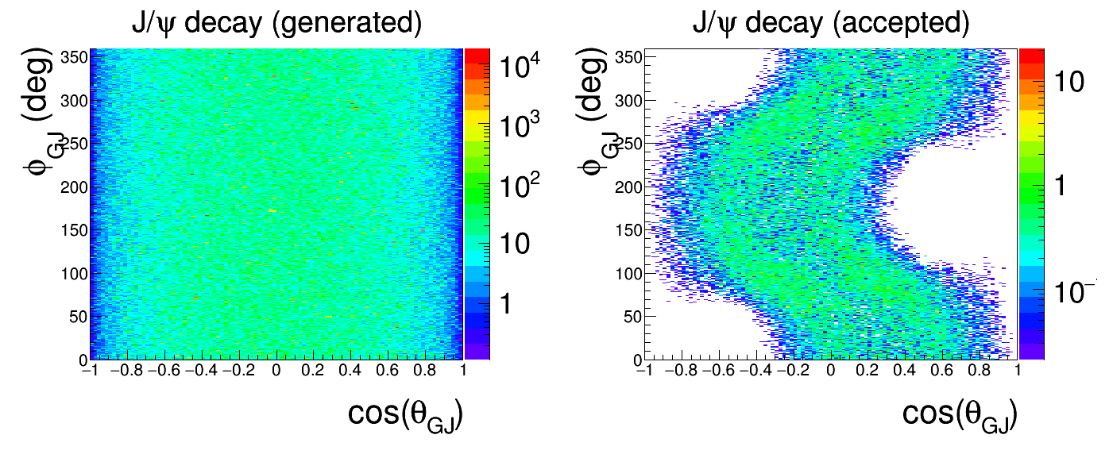
Decay
Look into decay model
What we can learn from decay of J/ψ provide about its production?

Slide 20
Electron trigger
FAEC (2GeV flat)
1115kHz
=509+315+315/40+7300/20/40+6300/40+6300/55
=509(e) + 315(e(π⁰) front) + 8(e(π⁰) back) +9(γ(π⁰)) + 159(hadron rand. coin.) + 115(hadron corr. coin.)
LAEC (2GeV flat)
1200kHz
= 33+27+1390/5+(247+376+239)
= 33(eDIS) + 27(e(π⁰))+ 270(γ(π⁰))+862(hadron)

