Slide 1

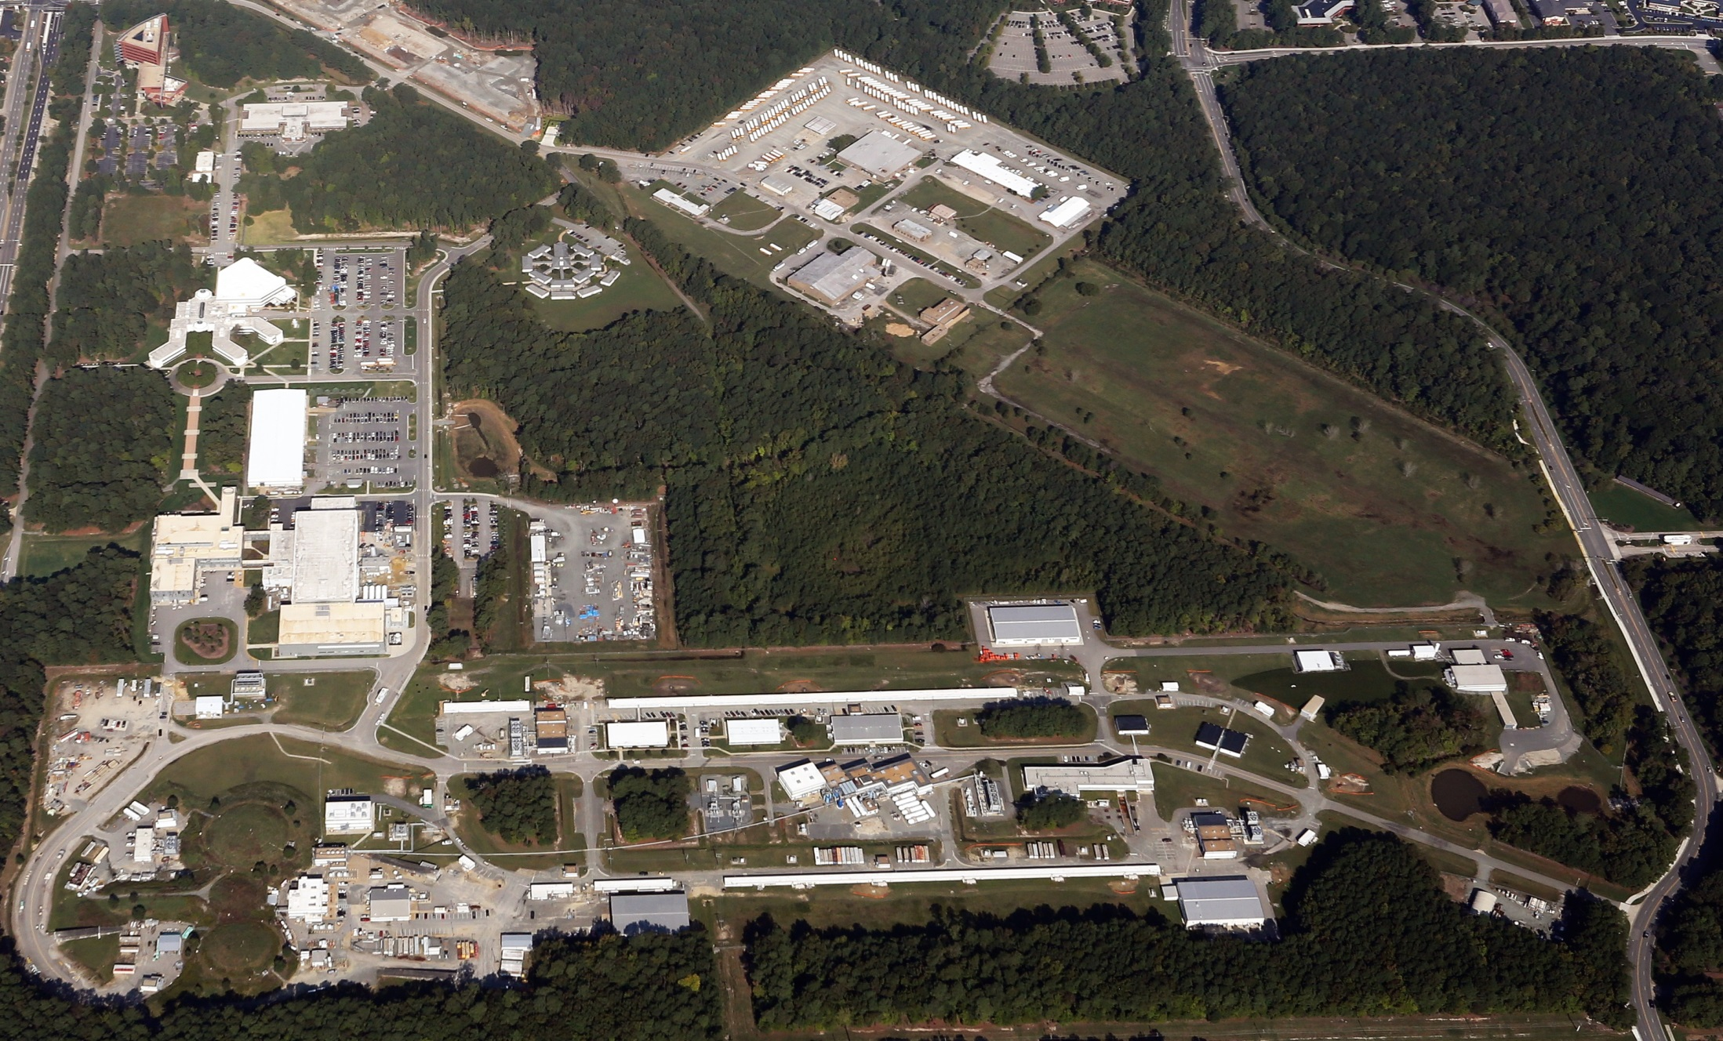
Jefferson Lab Status
Bob McKeown
January 12, 2016

Slide 2
Outline
Upgrade highlights
PAC meetings
Budgets
NSAC Long Range Plan
JLEIC
Outlook

Slide 3
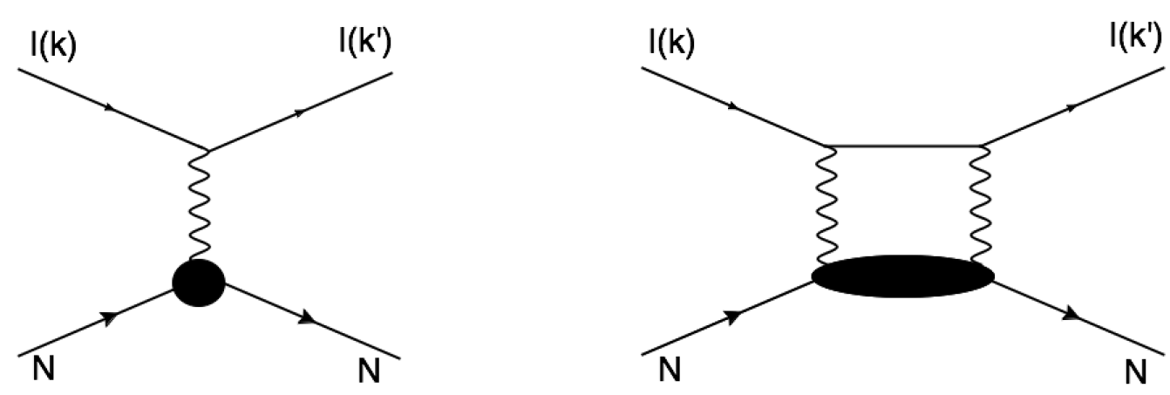
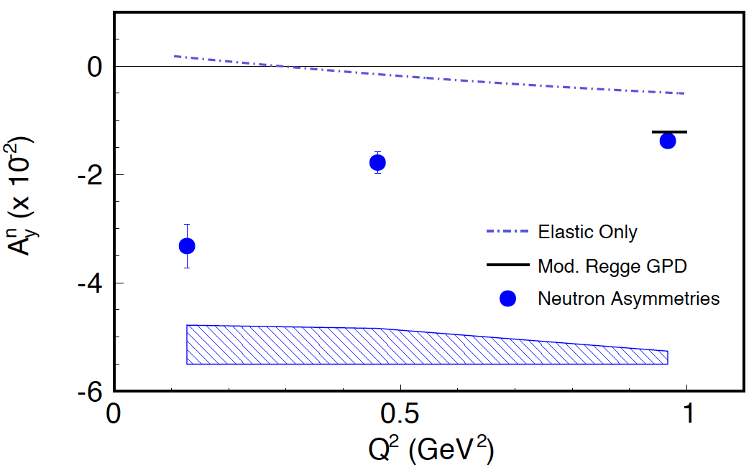
Target Single-Spin Asymmetry in
Experiment E05-015 @ Jefferson Lab Hall A
e’
e
N
Y.-W. Zhang et al. Phy. Rev. Lett. 115, 172502 (2015).
T-Odd observable, forbidden at leading-order.
Non-zero A_{y} has never been observed.
Provides access to moments of nucleon’s Generalized-Parton-Distributions (GPDs) at high-Q².
Notes:
A non-zero Ay is forbidden under the assumption of one-photon exchange. Becomes non-zero due to amplitudes interference between one-photon and two-photon exchange processes.
Measured Neutron Asymmetry (in percent), quasi-elastic scattering off a polarized 3He target.
Systematic on false asymmetry of 3He(e,e’) is less than 2.4*10^-4, the most precise target single-spin measurement.
Dot-dash line is contribution from elastic intermediate state between the two photons.
The short solid line is from GPD model calculation, Chen, Afanasev, Brodsky, C. Carlson, and Vanderhaeghen, Phys. Rev. Lett. 93, 122301 (2004).

Slide 4
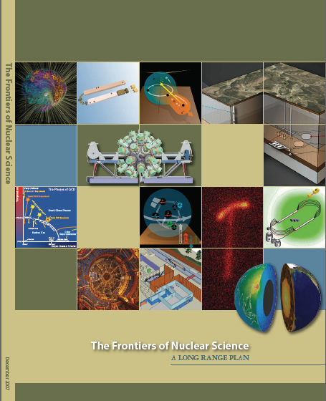
12 GeV Upgrade Project
Completion of the
12 GeV CEBAF Upgrade was ranked the highest priority in the 2007 NSAC Long Range Plan.
Upgrade is designed to build on existing facility: vast majority of accelerator and experimental equipment have continued use.
New Hall
Upgrade arc magnets
and supplies
Add 5 cryomodules
20 cryomodules
CHL upgrade
Add arc
20 cryomodules
TPC = $338M
ETC = ~$13M
Add 5 cryomodules
Project Scope (~96% complete):
Doubling the accelerator beam energy - DONE
New experimental Hall D and beam line - DONE
Civil construction including Utilities - 99.7%
Upgrades to Experimental Halls B & C - ~89%
Enhanced capabilities
in existing Halls
Maintain capability to deliver lower pass beam energies: 2.2, 4.4, 6.6….

Slide 5
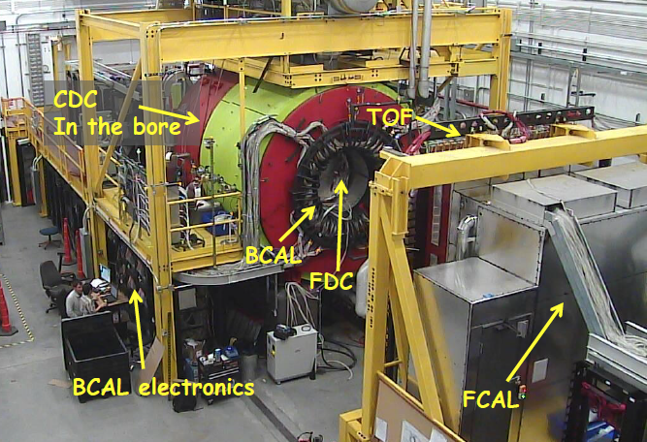
Hall D: 100% Complete
  Fall 2014
  (~19 days)
  10.1 GeV
  Amorphouse radiator
  CH₂ target
KPP achieved – December 2014
  Spring 2015
  (~10 days)
  5.5 GeV
  Diamond
  CH₂ target
  Finishing calibrations
  Physics signals
  GlueX Solenoid: Operational Review in July 2015
  Finding (credit to S. St. Lorant): difference between the SLAC and JLab cooling schemes
Modification to the cooling system (plan discussed with local experts & the reviewers
Decision to do the modifications now, to be finished before the Spring 2016 run
Work is in progress

Slide 6
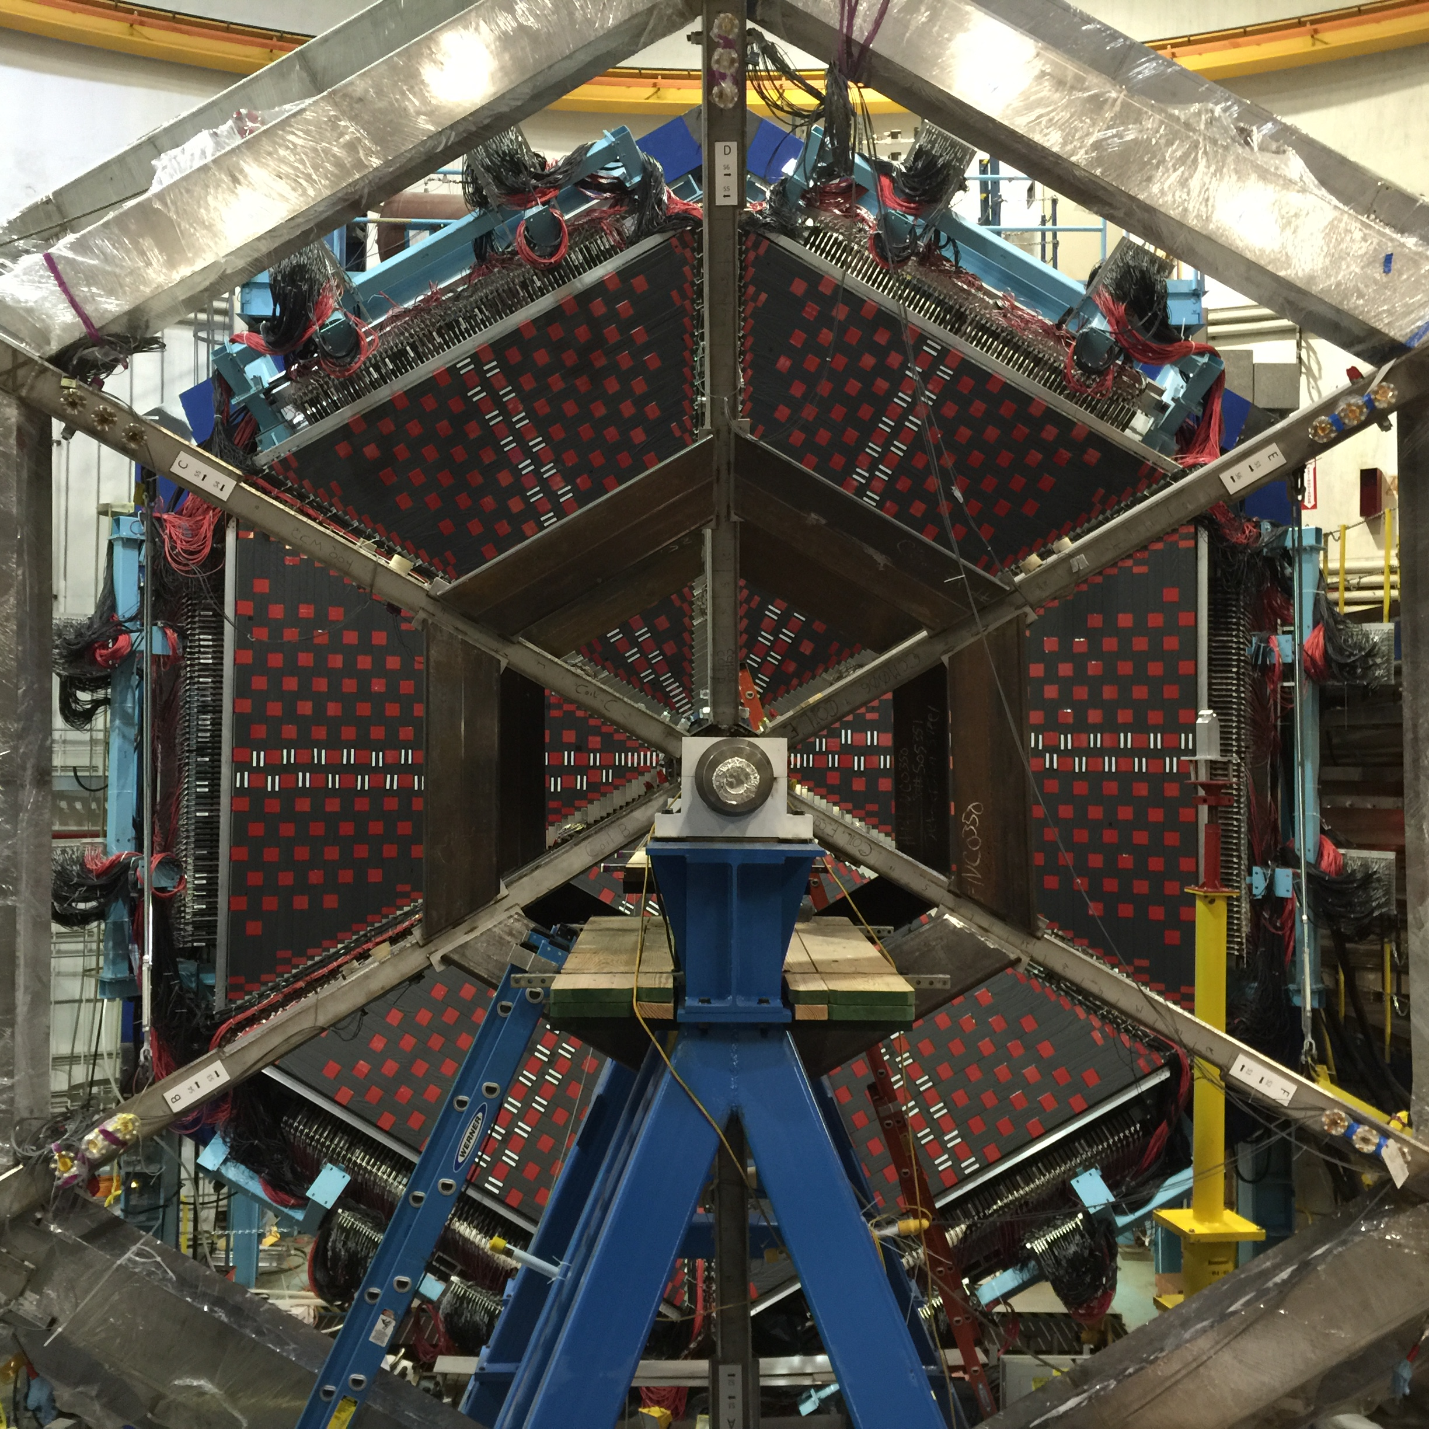
Hall B Status
Detectors
  CLAS12 detectors are complete or in final phase of construction (LTCC).
  Forward Carriage: FTOF1a, FTOF1b, PCAL and EC essentially operational 2+ years prior to scheduled beam commissioning.
Magnets
  All Torus coils mounted to spit and connected through hex beams.
  Solenoid coil #3 winding completed – on critical path.
Software
  Offline software released, validation of reconstruction code using cosmic rays.
1st Workshop on preparation of first CLAS12 physics experiment
10/15/2015

Slide 7
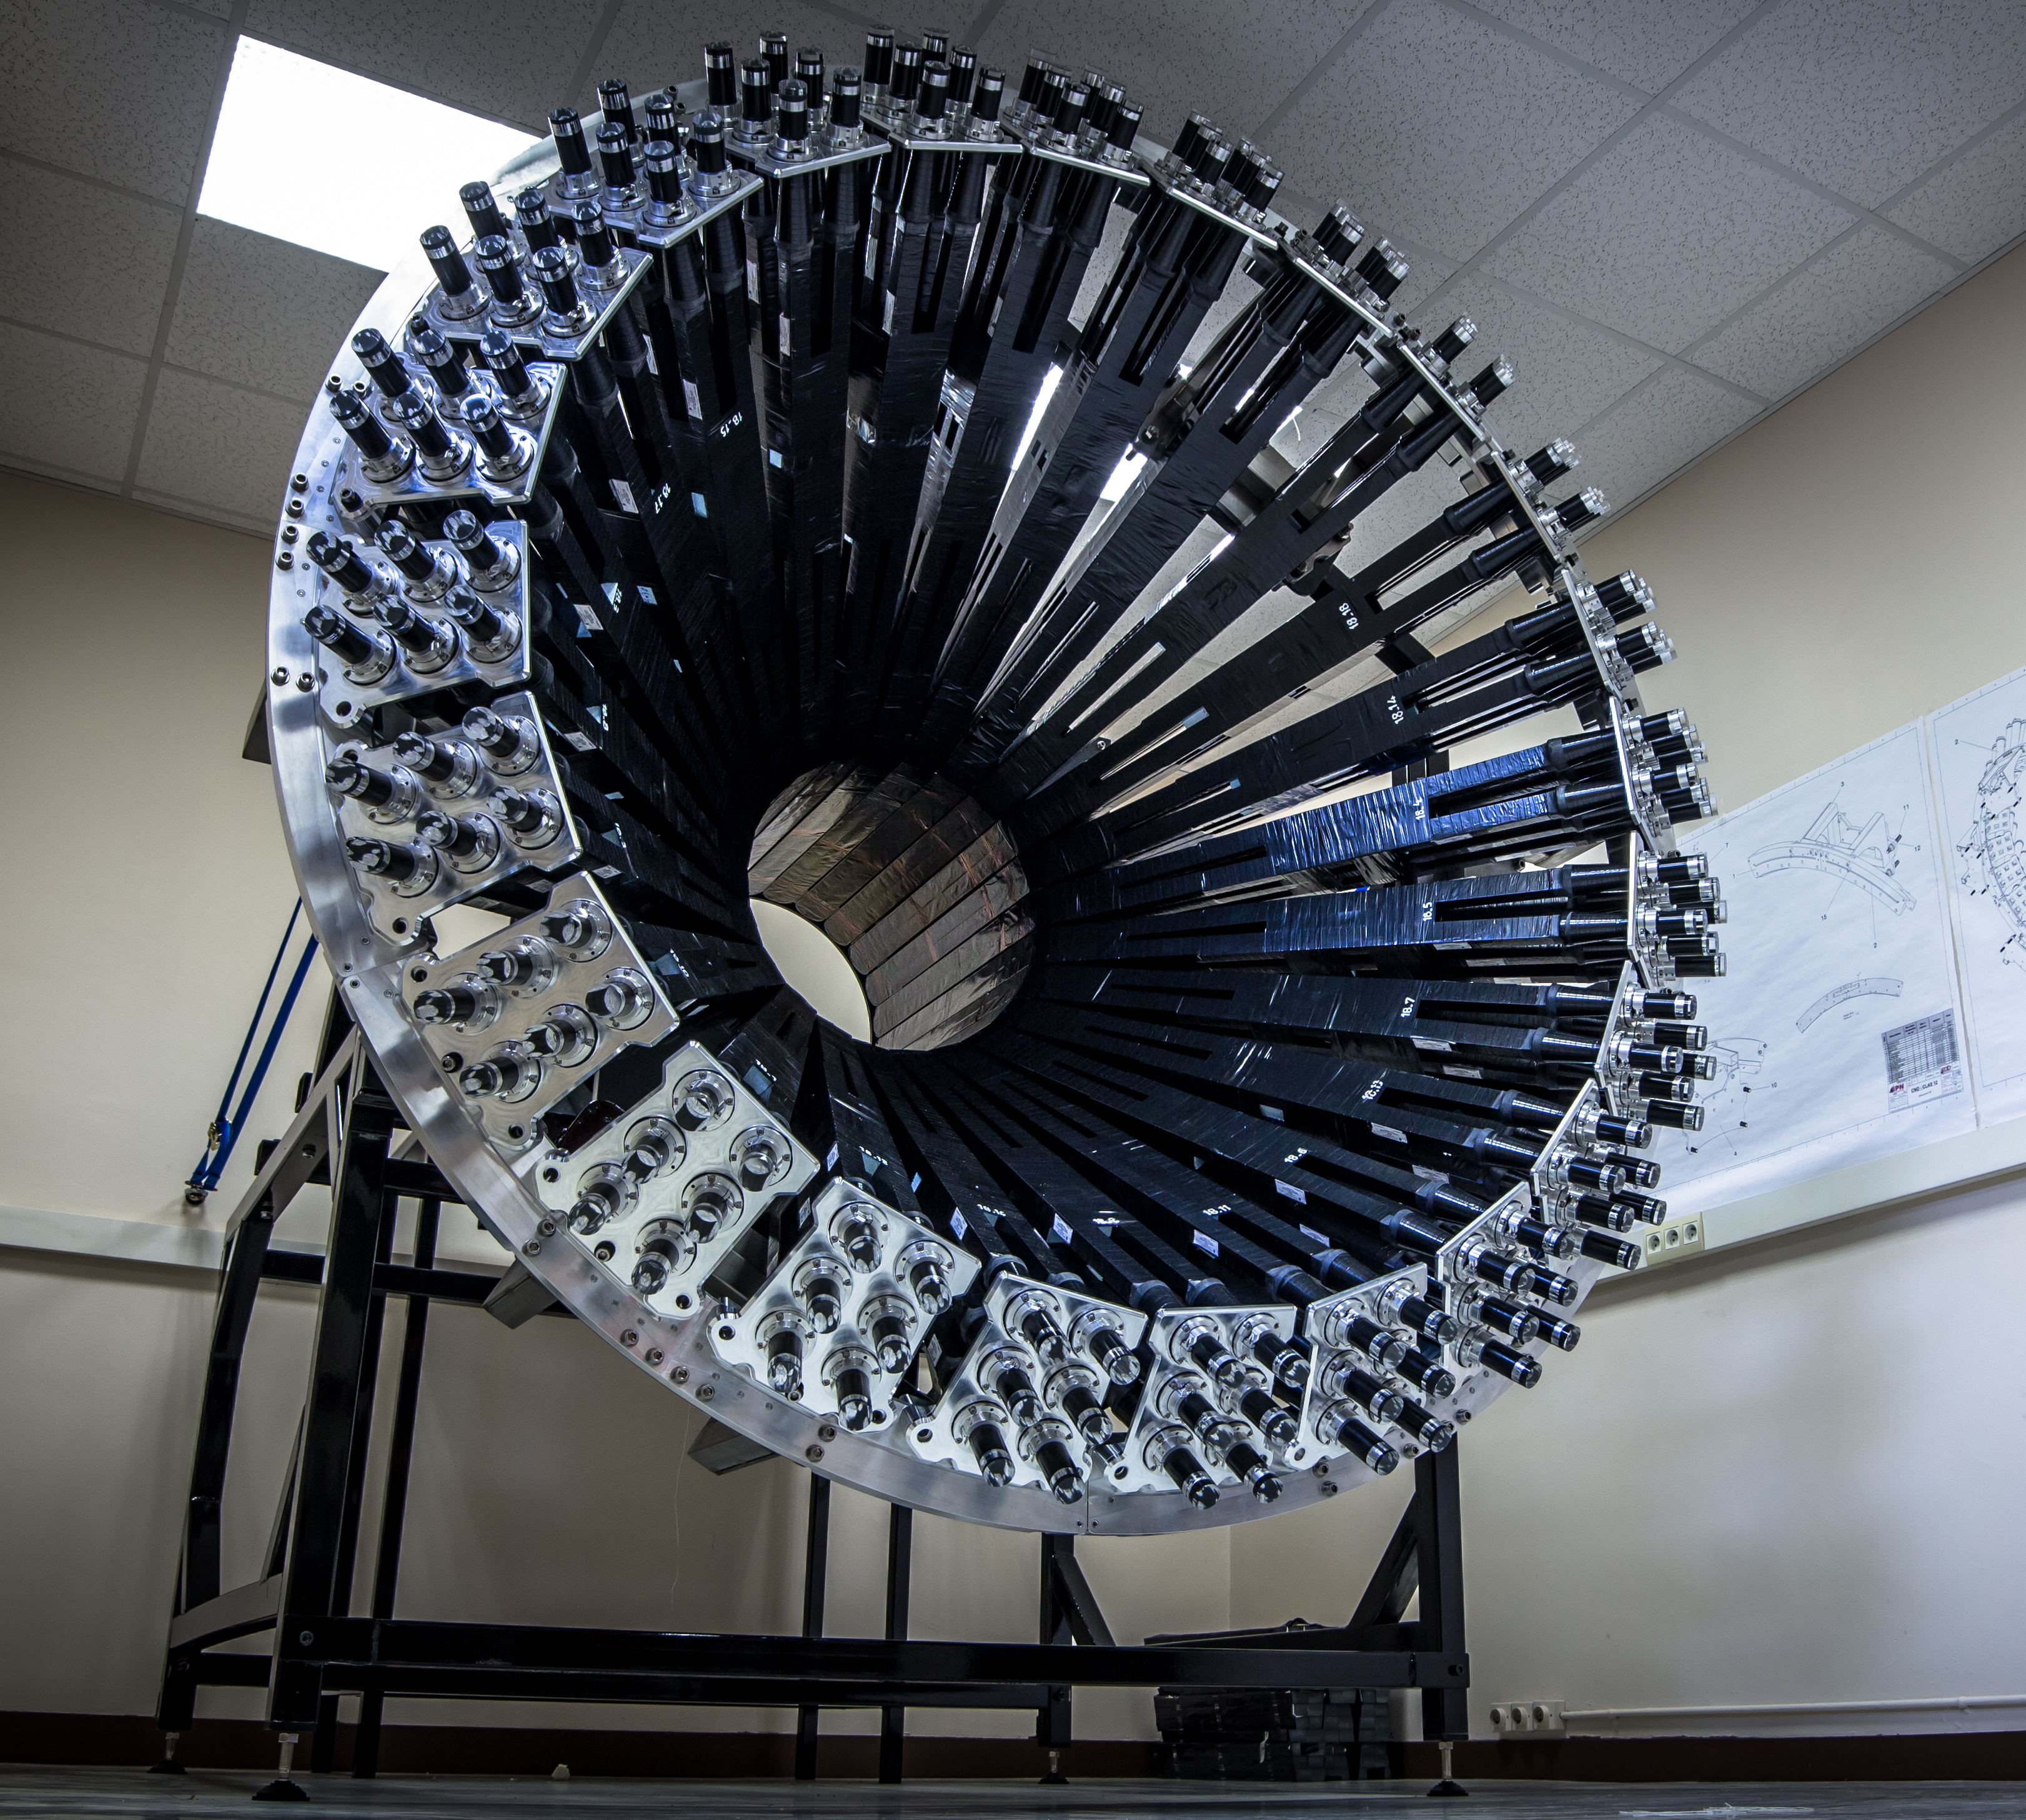
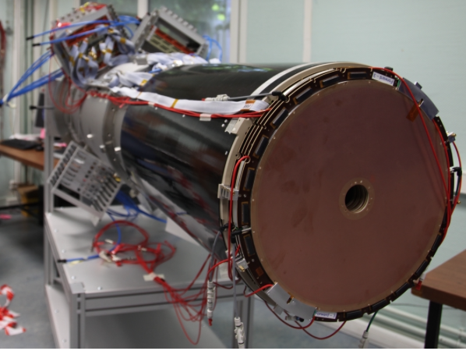
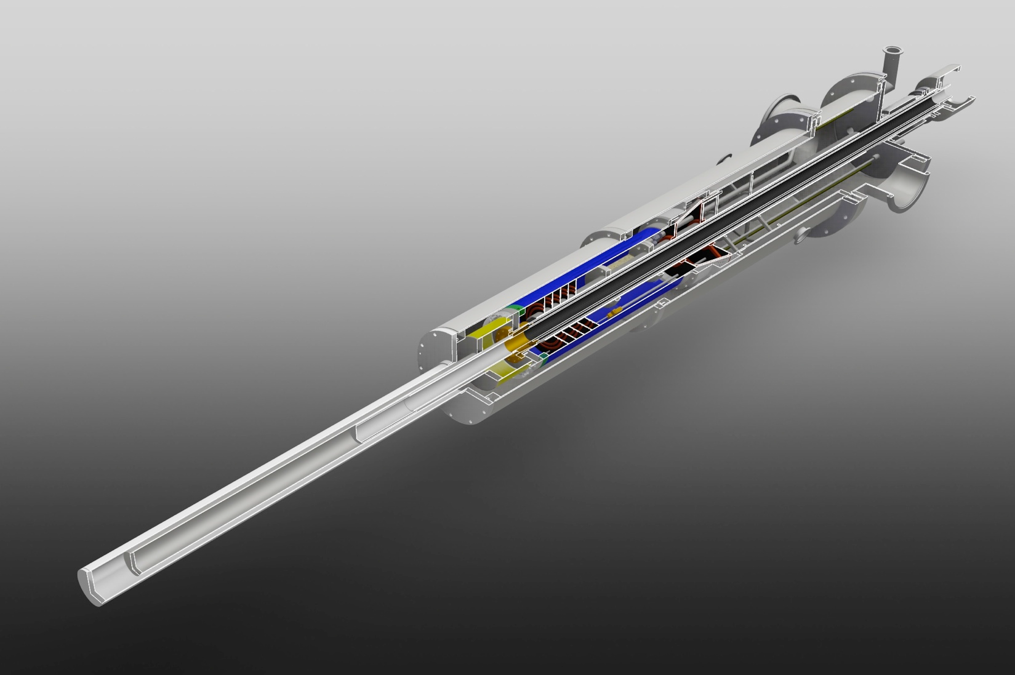
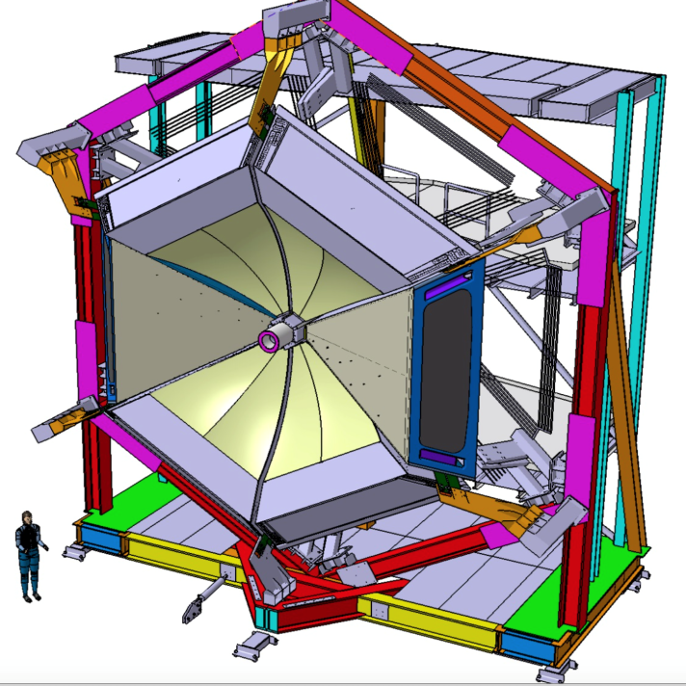
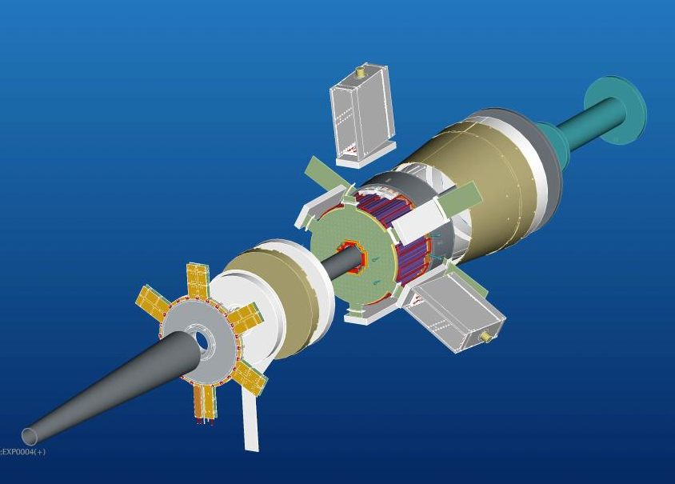
CLAS12 Beyond the Baseline:
User Contributions
Central Neutron Detector
Micromegas
Longitudinally Pol. NH₃/ND₃
All detector parts arrived at JLab 6/2/15
Under Construction
1st barrel and forward trackers to arrive at JLab in Nov/Dec
Forward Tagger
Two RICH Sectors
1st sector under construction and ready by summer 2017
In transit to JLab

Slide 8
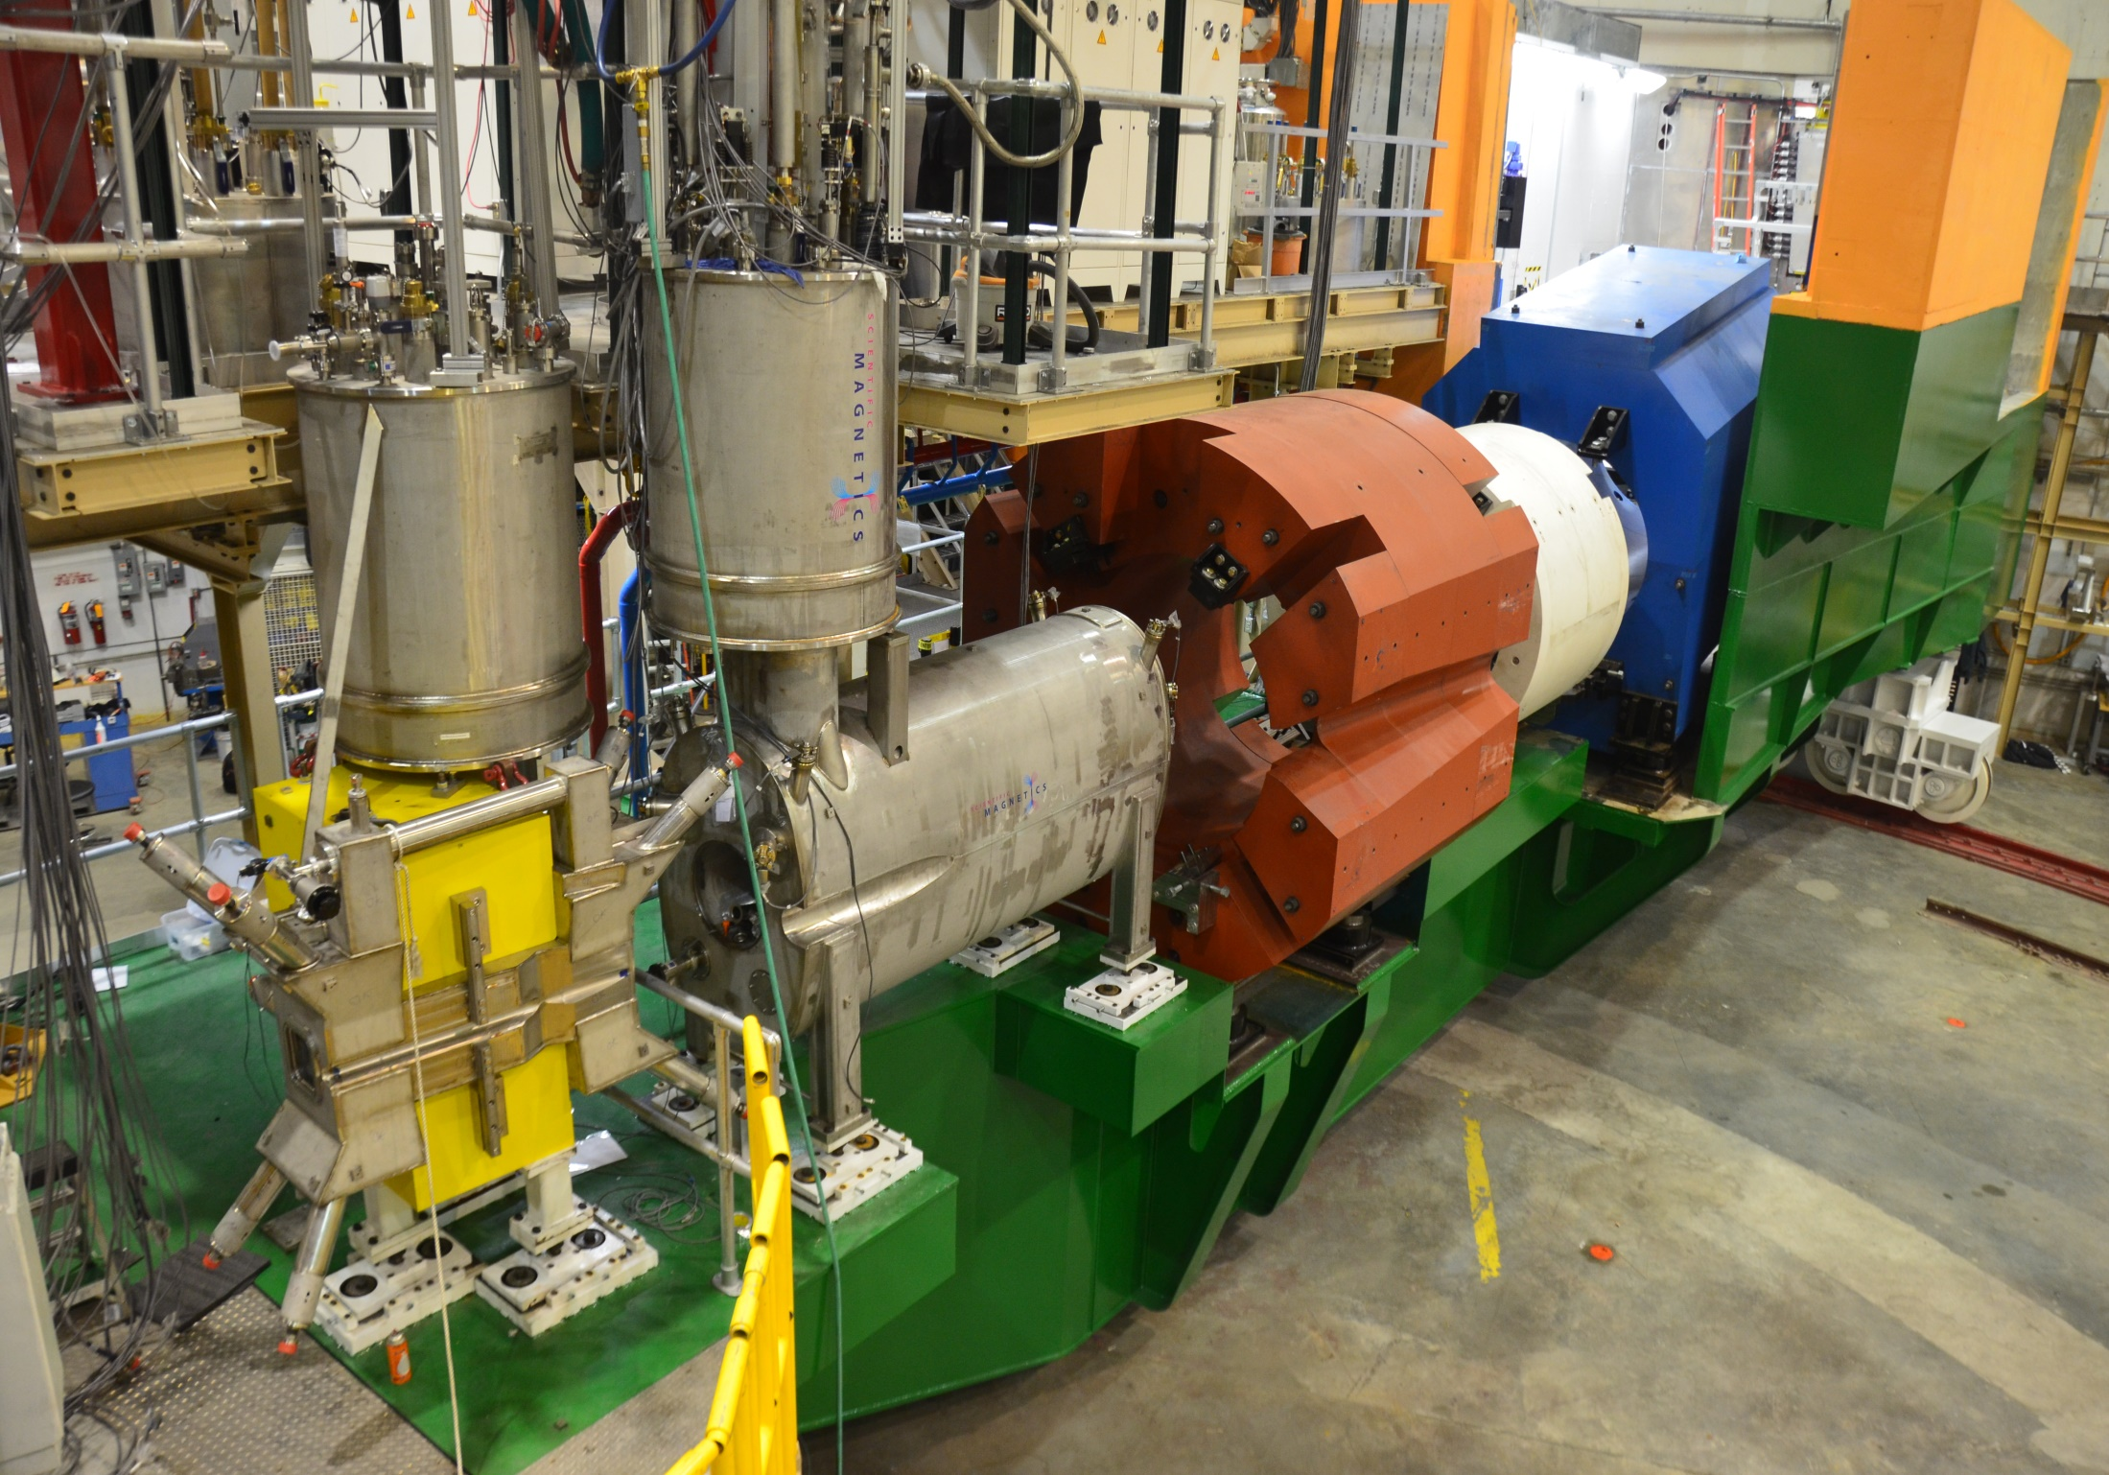
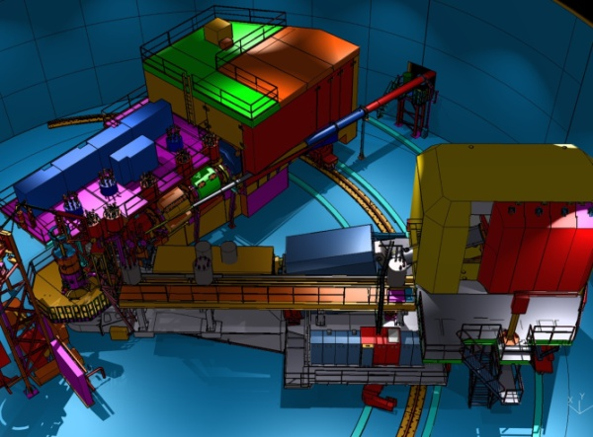
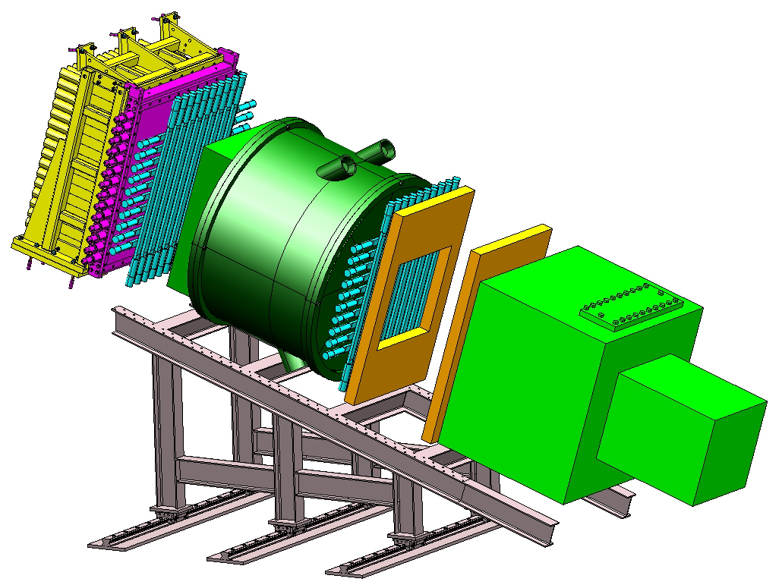
PreShower Counter
S2 Hodoscope
SHMS (New)
S1 Hodoscope
Heavy Gas Cerenkov
HMS (Exists)
Shower Counter
Drift Chambers
Noble-Gas Cerenkov
Hall C : SHMS + HMS

Slide 9
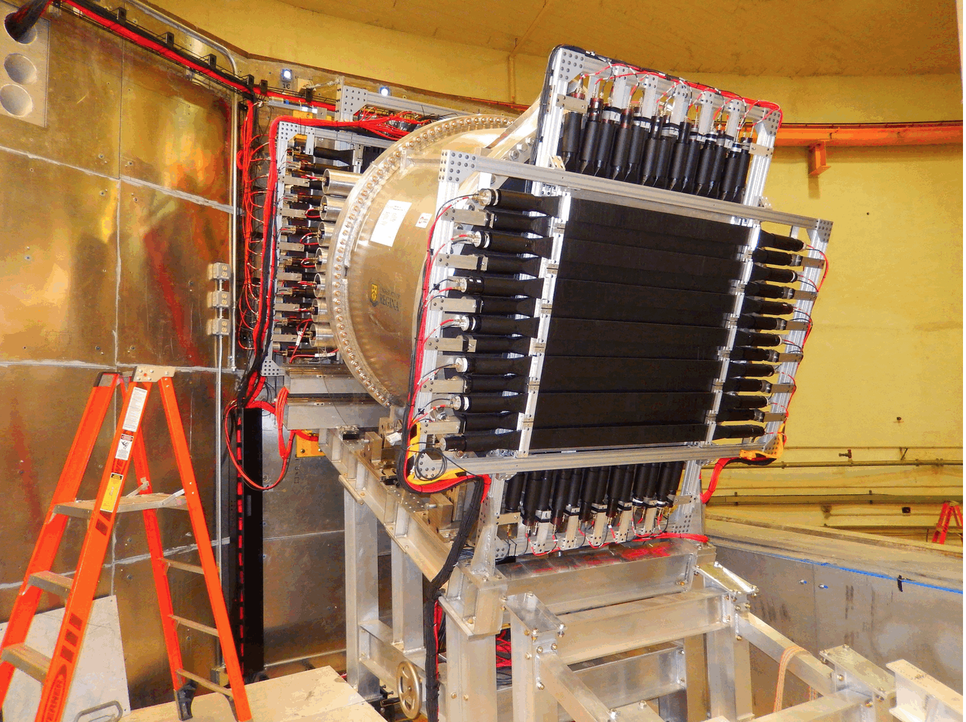
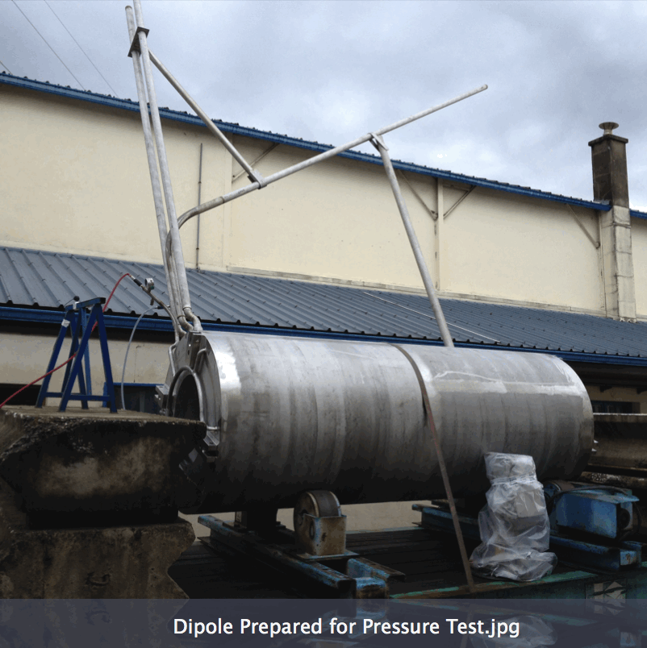
Hall C Status
All Detector Construction is Complete
  “Rear” Detectors have been installed.
  “Front” Detectors are in Experiment Staging Building.
  Remaining detector installations follow final magnet installation.
  Only the Noble-Gas Cerenkov construction is 12-GeV scope. Other detector construction is primarily contributed (significant involvement of universities and outside institutions)
Beamline at 84%
  Upstream Beamline: Done: (Compton, Møller, Magnet-mapping)
Q1 and HB Magnets are Installed
  Q1: Accepted. HB: Testing
The Only Significant Fabrications Remaining are Q2, Dipole, Q3
  Arrivals: early 2016

Slide 10
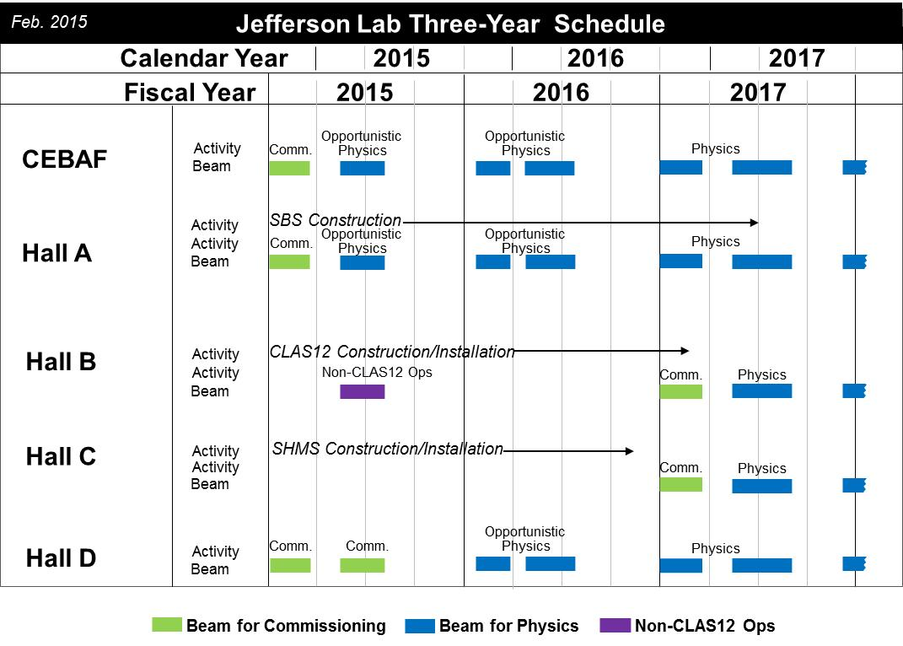

Slide 11
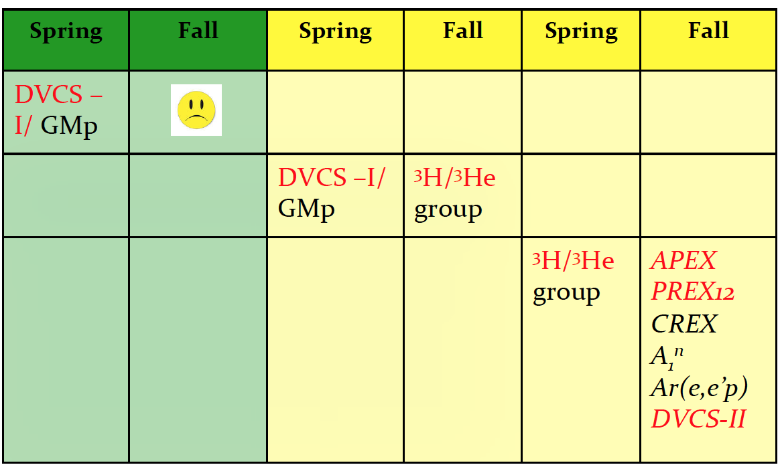
Hall A Projected Experiment Schedule
CY 2015
Presented by T. Keppel at the July 2015 Hall A & C Coll. Meet.
CY 2016
CY 2017
CY 2018
SBS Start?
Moller, SoLID ???
Experiments listed in Italics represent potential schedule options, in no order
Red indicates PAC41 High Impact Experiments including SBS G_{E}^{p}

Slide 12
Hall B Schedule
  On the critical path for 12-GeV Project ➔ 12 GeV Project has priority
  Need to avoid even the appearance that 12 GeV Project does not get full priority under every circumstance
  Best effort to recover some running of HPS and also provide planned running for PRAD
  Hope to run HPS in February
  (but only weekends will be possible this time)
  Hope to install PRad in March
  (if not in conflict with the 12 GeV Project)
  Hope to run PRad in April/May
  (we are considering a potential few-week extension as low-energy, single-Hall operation only, similar in scope as this year in May 2015)

Slide 13
Program Advisory Committee
Charge
  Review new proposals, previously conditionally approved proposals, and letters of intent for experiments that will utilize the 12 GeV upgrade of CEBAF and provide advice on their scientific merit, technical feasibility and resource requirements.
  Identify proposals that represent high quality physics within the range of scientific importance represented by the previously approved 12 GeV proposals and recommend for approval.
  Also provide a recommendation on scientific rating and beam time allocation for proposals newly recommended for approval.
  Identify other proposals with physics that have the potential for falling into this category pending clarification of scientific and/or technical issues and recommend for conditional approval. Provide comments on technical and scientific issues that should be addressed by the proponents prior to review at a future PAC.
PAC43 – July 2015
Results
PAC44 – July 2016

Slide 14
PAC43 Results
NUMBER | TITLE | CONTACT PERSON | HALL | DAYS REQUESTED | DAYS AWARDED | SCIENTIFIC RATE | PAC DECISION
PR12-15-001 | Measurement of the Generalized Polarizabilities of the Proton in Virtual Compton Scattering | N. Sparveris | C | 15 |  |  | C2
PR12-15-002 | The sidereal time variations of the Lorentz force and maximum attainable speed of electrons | B. Wojtsekhowski | Acc | 3.5 |  |  | Defer
PR12-15-003 | Polarization Observables in Wide-angle Compton Scattering at Photon Energies up to 8 GeV | B. Wojtsekhowski | A | 15 |  |  | Defer
PR12-15-004 | Deeply virtual Compton scattering on the neutron with a longitudinally polarized deuteron target | S. Niccolai | B | 125 |  |  | C2
PR12-15-005 | Measurements of the Quasi-Elastic and Elastic Deuteron Tensor Asymmetries | E. Long | C | 44.3 |  |  | C2
PR12-15-006 | Measurement of Tagged Deep Inelastic Scattering | C. Keppel | A | 27 | 27 | A- | C1
PR12-15-007 | Measurements of the Charge and Magnetic Form Factors of the Triton at Large Momentum Transfers | G. Petratos | A | 10 |  |  | Defer
PR12-15-008 | A study of the Lambda-N interaction through the high precision spectroscopy of Lambda-hypernuclei with electron beam | S. N. Nakamura | A | 73 |  |  | C2/D

Slide 15
12 GeV Approved Experiments by Physics Topics
Topic | Hall A | Hall B | Hall C | Hall D | Other | Total
The Hadron spectra as probes of QCD (GlueX and heavy baryon and meson spectroscopy) |  | 1 |  | 3 |  | 4
The transverse structure of the hadrons (Elastic and transition Form Factors) | 5 | 3 | 2 | 1 |  | 11
The longitudinal structure of the hadrons (Unpolarized and polarized parton distribution functions) | 2 | 3 | 6 |  |  | 11
The 3D structure of the hadrons (Generalized Parton Distributions and Transverse Momentum Distributions) | 5 | 9 | 7 |  |  | 21
Hadrons and cold nuclear matter (Medium modification of the nucleons, quark hadronization, N-N correlations, hypernuclear spectroscopy, few-body experiments) | 6 | 3 | 7 |  | 1 | 17
Low-energy tests of the Standard Model and Fundamental Symmetries | 3 | 1 |  | 1 | 1 | 6
TOTAL | 21 | 20 | 22 | 5 | 2 | 70

Slide 16
12 GeV Approved Experiments by PAC Days
Topic | Hall A | Hall B | Hall C | Hall D | Other | Total
The Hadron spectra as probes of QCD (GluEx and heavy baryon and meson spectroscopy) |  | 119 |  | 540 |  | 659
The transverse structure of the hadrons (Elastic and transition Form Factors) | 145.5 | 85 | 102 | 25 |  | 357.5
The longitudinal structure of the hadrons (Unpolarized and polarized parton distribution functions) | 65 | 230 | 165 |  |  | 460
The 3D structure of the hadrons (Generalized Parton Distributions and Transverse Momentum Distributions) | 409 | 872 | 212 |  |  | 1493
Hadrons and cold nuclear matter (Medium modification of the nucleons, quark hadronization, N-N correlations, hypernuclear spectroscopy, few-body experiments) | 180 | 175 | 201 |  | 14 | 570
Low-energy tests of the Standard Model and Fundamental Symmetries | 547 | 205 |  | 79 | 60 | 891
TOTAL | 1346.5 | 1686 | 680 | 644 | 74 | 4430.5
Total Approved Run Group Days (includes MIE) | 1346.5 | 671 | 667 | 644 | 74 | 3402.5
A Decade of Experiments

Slide 17
Jeopardy
Previous policy (6 GeV era):
The laboratory has a three-year Jeopardy Rule that was devised both to reduce the beamtime backlog and to ensure that the ratings of all approved experiments continue to accurately reflect their scientific priority. Jeopardy begins three years after a proposal is approved. Previously approved experiments that have not yet been run or scheduled must return to the PAC for a review of their status.
Will begin the process of “Jeopardy” in the next few years
Have requested input from JLab Users on the process

Slide 18
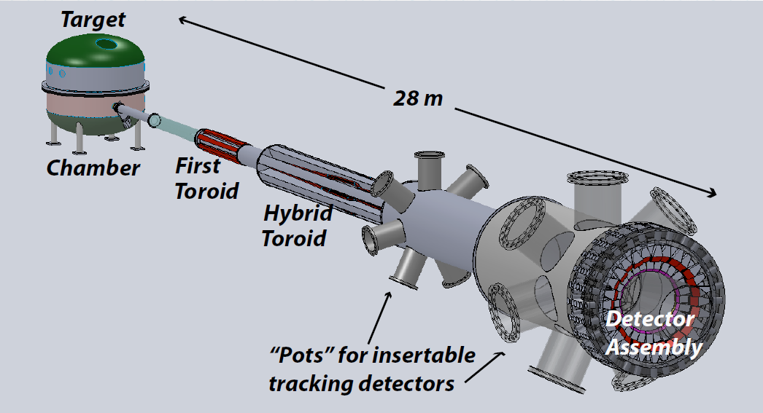
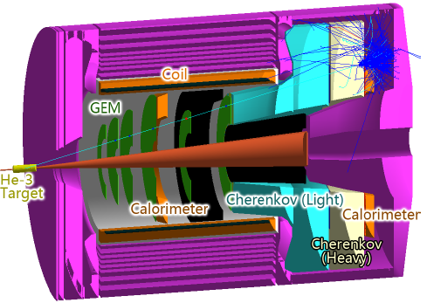
Future Projects
MOLLER experiment
(Possible MIE – FY17-20)
– Standard Model Test
– DOE science review (September 2014) – strong endorsement
- Technical, cost & schedule reviews?
- Now hope for FY18 start
SoLID
– Chinese collaboration
– CLEO Solenoid 
– Director’s review (Feb. 2015)
 lots of good feedback
– Collaboration briefing to DOE-NP
(Nov. 2015)
Note: Feb. budget discussion with DOE/ONP

Slide 19
Budget
ONP Guidance / FY16 President’s Budget Request supports ~ 16 weeks running
  This matched somewhat with some infrastructure work in CHL and UIM which happened during the summer shutdown
  But we would have liked more running in FY16 and tried with Senate and House
Omnibus FY16: JLab allocation is $1.5M below Pres. budget.
- Keep 16 weeks
- Retain staff
- Delay some activities, accelerator spares  increased risk
FY2017
- Letter from 6 Senators supporting Nuclear Physics at LRP level
- “Directors” to visit Cherry Murray, Head of Office of Science on Jan 16.

Slide 20

2015 NSAC Long Range Plan
NSAC = Nuclear Science Advisory Committee
Advise DOE and NSF on future of Nuclear Physics program every 5-7 years
Four recommendations
Two initiatives

Slide 21
NSAC 2015 LRP
RECOMMENDATION IV
We recommend increasing investment in small-scale and mid-scale projects and initiatives that enable forefront research at universities and laboratories.
MOLLER
SoLID

Slide 22
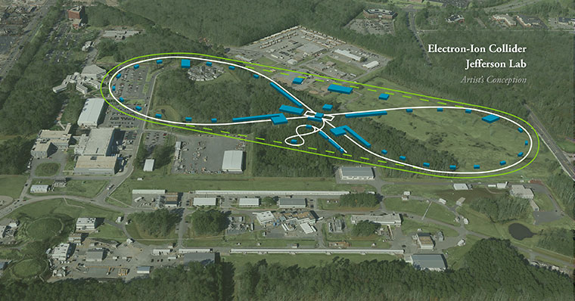
JLEIC: EIC at Jefferson Lab

Slide 23
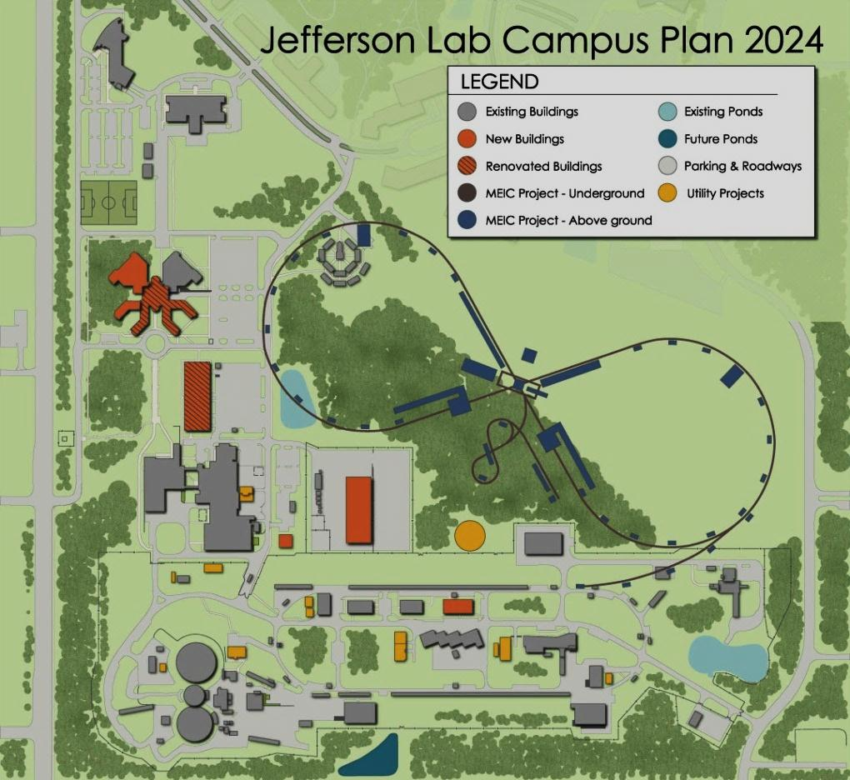
JLEIC: EIC at Jefferson Lab
JLab EIC Figure 8 Concept
Initial configuration:
  3-10 GeV on 20-100 GeV ep/eA collider
  Optimized for high ion beam polarization:
    polarized deuterons
  Luminosity:
    up to few x 10³⁴ e-nucleons cm⁻² s⁻¹
    Low technical risk
    Upgradable to higher energies
    250 GeV protons + 20 GeV electrons
    Flexible timeframe for Construction
    consistent w/running 12 GeV CEBAF
    Thorough cost estimate completed
    presented to NSAC EIC Review
    Cost effective operations
    Fulfills White Paper Requirements
Current Activities
Site evaluation (VA funds)
Accelerator, detector R&D
Design optimization
Cost reduction
Notes:
Deleted
Brightened graphic (no more shame); added current activities from previous version;
Mary Beth please format text

Slide 24

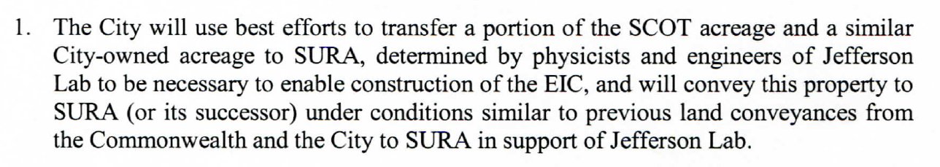

Slide 25
EIC Timeline
Activity Name | 2010 | 2011 | 2012 | 2013 | 2014 | 2015 | 2016 | 2017 | 2018 | 2019 | 2020 | 2021 | 2022 | 2023 | 2024 | 2025
12 GeV Operations
12 GeV Upgrade
FRIB
EIC Physics Case
NSAC LRP
CD0
EIC Machine Design and R&D
CD1(Down-select)
CD2/CD3
EIC Construction
CD0 = DOE “Mission Need” statement
CD1 = technology and site selection (VA/NY)
CD2/CD3 = establish project baseline cost and schedule

Slide 26
EIC Developments
EIC User meeting – Berkeley Jan. 6-9
NAS study being planned
SLAC will be formal collaborator
- responsible for e-ring
Rik Yoshida will join JLab March 2016 to lead the JLEIC physics/detector effort

Slide 27
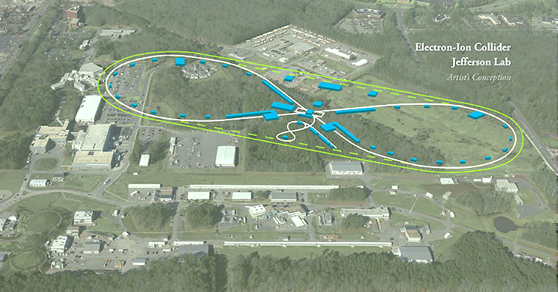
Summary
12 GeV Upgrade making good progress
Commissioning, startup of physics program in progress
Tight FY16 budget but will run 16 weeks
NSAC LRP released
  Good for JLab
  Requires modest budget growth
  Recommends future EIC construction
Exciting Times Ahead

Slide 28
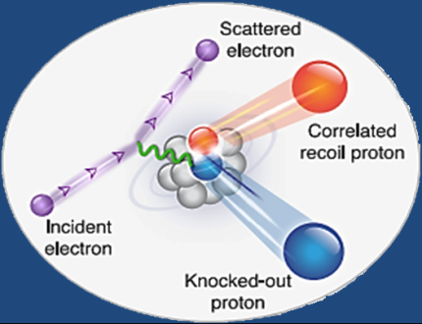

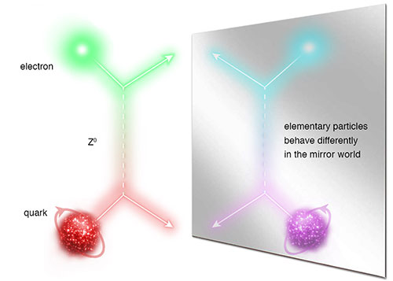
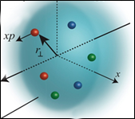
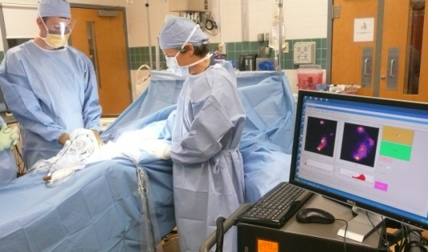
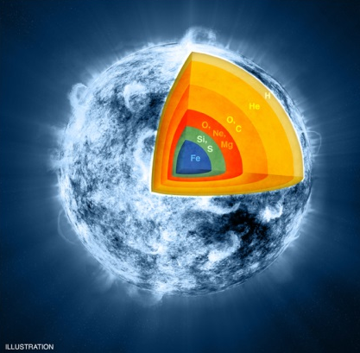
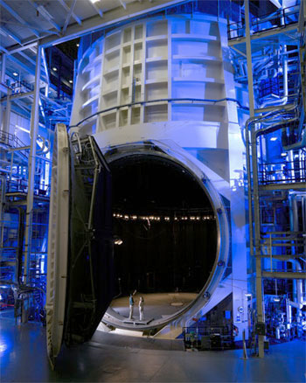
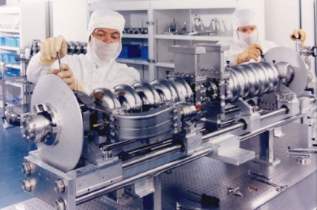
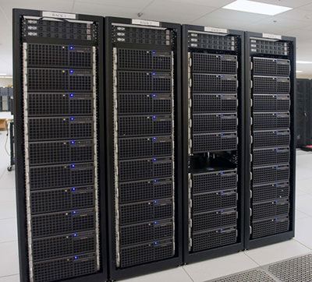
JLab: A Laboratory for Nuclear Science
Z⁰
Nuclear Structure
Fundamental
Forces & Symmetries
Structure of Hadrons
Medical Imaging
Nuclear Astrophysics
Accelerator S&T
Cryogenics
Theory & Computation

Slide 29
NSAC 2015 LRP
RECOMMENDATION I
The progress achieved under the guidance of the 2007 Long Range Plan has reinforced U.S. world leadership in nuclear science. The highest priority in this 2015 Plan is to capitalize on the investments made.
With the imminent completion of the CEBAF 12-GeV Upgrade, its forefront program of using electrons to unfold the quark and gluon structure of hadrons and nuclei and to probe the Standard Model must be realized.
Expeditiously completing the Facility for Rare Isotope Beams (FRIB) construction is essential. Initiating its scientific program will revolutionize our understanding of nuclei and their role in the cosmos.
The targeted program of fundamental symmetries and neutrino research that opens new doors to physics beyond the Standard Model must be sustained.
The upgraded RHIC facility provides unique capabilities that must be utilized to explore the properties and phases of quark and gluon matter in the high temperatures of the early universe and to explore the spin structure of the proton.
The ordering of these four bullets follows the priority ordering of the 2007 plan.

Slide 30
NSAC 2015 LRP
RECOMMENDATION II
The excess of matter over antimatter in the universe is one of the most compelling mysteries in all of science. The observation of neutrinoless double beta decay in nuclei would immediately demonstrate that neutrinos are their own antiparticles and would have profound implications for our understanding of the matter-antimatter mystery.
We recommend the timely development and deployment of a U.S.-led ton-scale neutrinoless double beta decay experiment.

Slide 31
NSAC 2015 LRP
RECOMMENDATION III
Gluons, the carriers of the strong force, bind the quarks together inside nucleons and nuclei and generate nearly all of the visible mass in the universe. Despite their importance, fundamental questions remain about the role of gluons in nucleons and nuclei. These questions can only be answered with a powerful new electron ion collider (EIC), providing unprecedented precision and versatility. The realization of this instrument is enabled by recent advances in accelerator technology.
We recommend a high-energy high-luminosity polarized EIC as the highest priority for new facility construction following the completion of FRIB.

