Slide 1
Address Recommendations: PVDIS

Slide 2
1a: Acceptances, Efficiencies
Č: 95% (105)
ECal: 95% (113)
Tracking 95%
Trigger dead time
Pion Contamination
Net: 80%

Slide 3
Short term jobs
Final background event generator (Rakitha)
Evaluate ECal with final backgrounds (Rakitha)
Plot justifying baffle thickness and material for ECal
Redo tracking estimates with final backgrounds and pulse heights
Reduce angular acceptance of Č
Redo FOM

Slide 4
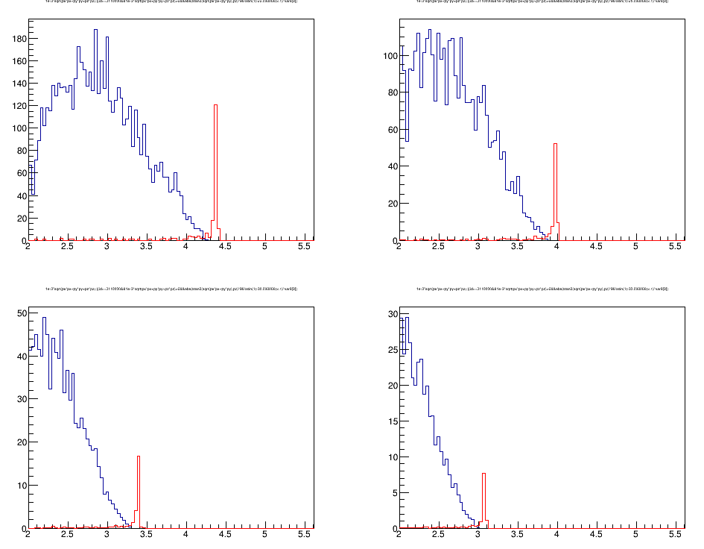
1a: Elastic Scattering

Slide 5
1a: Alignment for Q²
Tools
Cosmic rays
Survey
…
Personnel
ROM

Slide 6
Helicity-Dependent Asymmetries
Tool: Modulate beam intensity ~ 1% (like dithering)
Asymmetries different for each system
Hyperon production is a source?
Pion asymmetries for 6 GeV PVDIS unexplained

Slide 7
Polarimetry: 0.4%
Moller: document 181 v2 (Gaskell)

Slide 8
My Major Concerns
Č trigger asymmetry
Wide angle electrons from π⁰
Asymmetry from hyperons
Λ and Σ partially cancel; need good event generator
Effect of low E photons on tracking
Needed for SBS
Have Nilanga’s data

Slide 9
Longer Term
Radiative corrections
Baffle support
2c Level 3 trigger
2c Full simulation; software framework

Slide 10
Update Science Case
Request for bigger CSV Models (Londergan)
ECT* workshop is in Aug.
Update plots
Include information from full energy LHC
Push radiative correction group

