Slide 1
SoLID LGC Update
Michael Paolone
Edward Kaczanowicz
Zein-Eddine Meziani
Temple university
Solid Collaboration meeting
01/13/16

Slide 2
Recent updates
Michael Paolone, Solid collaboration meeting, 01/12/16
The LGC GEMC code is now updated to the latest version of GEMC (2.2/2.3) and ready for integration.
Possible adjustments to reduce accidental backgrounds.
First steps toward prototype construction just starting.

Slide 3
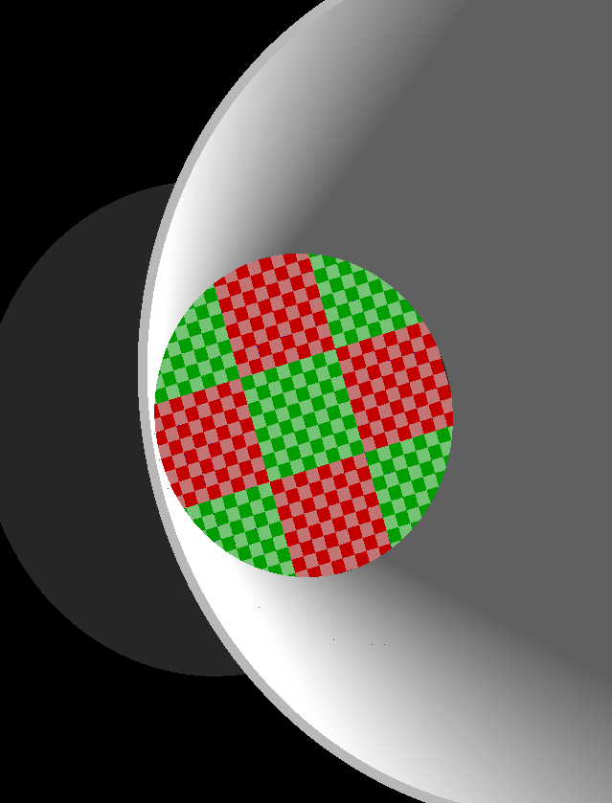
LGC GEMC 2.3 changes
Michael Paolone, Solid collaboration meeting, 01/12/16
Geometries updated.
MaPMT hit processing updated.
New MaPMT configuration: Every single pixel is now an individual sensitive detector.

Slide 4
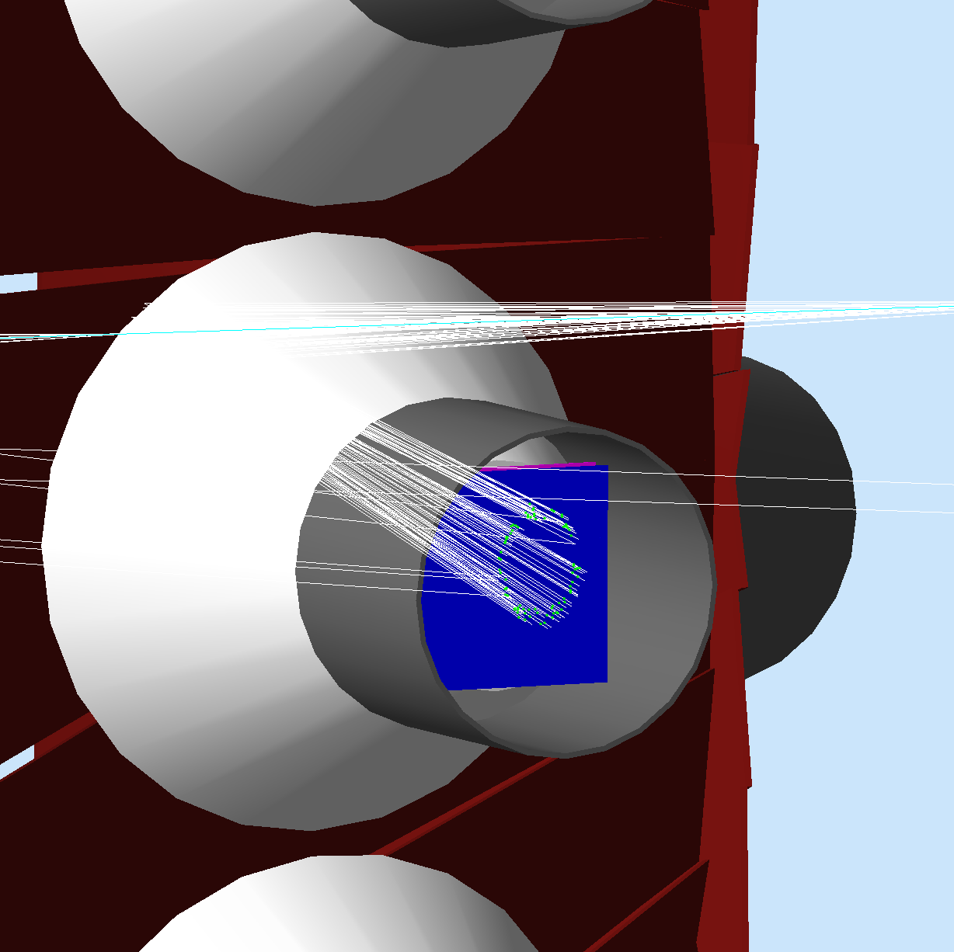
Example event:
Michael Paolone,
Solid collab. meeting, 01/12/16
On the left is an example track.
Blue is 3x3 PMT array
White lines are optical photons
Green points are interactions with the PMT.

Slide 5
Example bank output: One Event
Michael Paolone, Solid collaboration meeting, 01/12/16

Slide 6
Example bank output: One Event
Michael Paolone, Solid collaboration meeting, 01/12/16
Each row is a collection of information for each integrated hit on a pixel.
The first row (highlighted in red) gives the sector hit: In this case, all 42 hits are in sector 7. Sectors count clockwise from top, looking downstream.

Slide 7
Example bank output: One Event
Michael Paolone, Solid collaboration meeting, 01/12/16
PMT number hit:
(top left is always relative to rotation
about beam-z-axis. “Down” is
defined by z-axis and negative-z.)
1
2
3
4
7

Slide 8
Example bank output: One Event
Michael Paolone, Solid collaboration meeting, 01/12/16
1
2
3
4
PMT number hit:
(top left is always relative to rotation
about beam-z-axis. “Down” is
defined by z-axis and negative-z.)
7

Slide 9
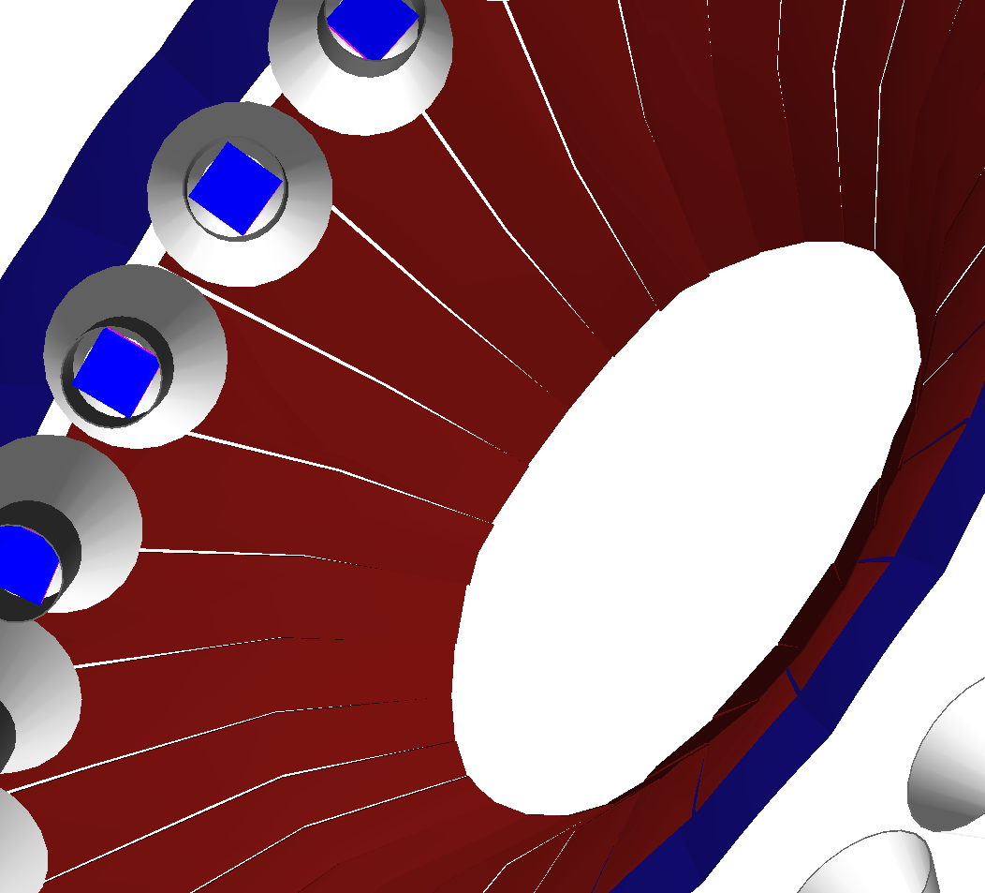
Example bank output: One Event
Michael Paolone, Solid collaboration meeting, 01/12/16
In this way, PMT number
is counted left to right, up to down,
from behind (connector side, not face).
1 2 3
4 5 6
7 8 9
SoLID z-axis
PMT number hit:
(top left is always relative to rotation
about beam-z-axis. “Down” is
defined by z-axis and negative-z.)
1
2
3
4
7

Slide 10
Example bank output: One Event
Michael Paolone, Solid collaboration meeting, 01/12/16
1 2 3 4 5 6 7 8
1
2
3
9
1
2
3
1
2
3
Pixel number hit:
(again, from behind PMT)
4
4
4
17
7
7
7
25
1
2
3
1
2
3
1
2
3
33
4
4
4
41
1
2
3
7
1
2
3
1
2
3
7
7
49
4
4
4
57
7
7
7

Slide 11
Example bank output:
Michael Paolone, Solid collaboration meeting, 01/12/16
How many photoelectrons are detected
(considering quantum efficiency and WLS).

Slide 12
Example bank output:
Michael Paolone, Solid collaboration meeting, 01/12/16
Time (in ns) of interaction.

Slide 13
Example bank output:
Michael Paolone, Solid collaboration meeting, 01/12/16
Integrated hit index (1 through 42, for this event).

Slide 14
Is the acceptance too good?
Michael Paolone, Solid collaboration meeting, 01/12/16
Stray electrons can produce a decent signal:
Starts here
Reflects off mirror in different sector than PMT.

Slide 15
Michael Paolone, Solid collaboration meeting, 01/12/16

Slide 16
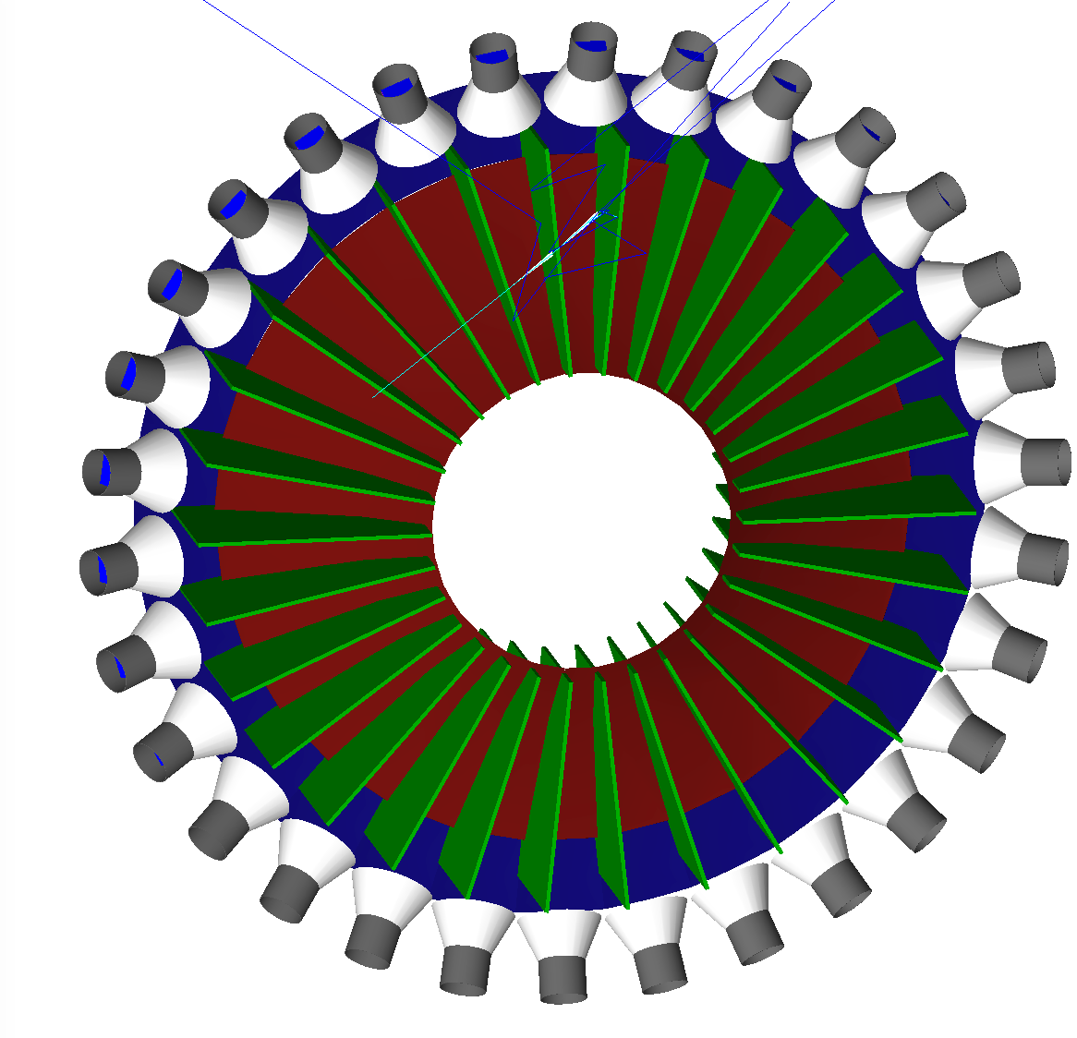
Blinders
Michael Paolone, Solid collaboration meeting, 01/12/16
Blinders could be a solution.
These blinders are likely too “simple”. Need to be adjusted for signal tracks that are bent by magnetic field.

Slide 17
Issues with geometric acceptance limiting
Michael Paolone, Solid collaboration meeting, 01/12/16
Open acceptance was designed to pick up signal tracks over a large angular acceptance for two primary configurations.
For most central tracks, geometric limiting like blinders will not affect efficiency.
For tracks on the edges of acceptance, efficiency may drop substantially.
Need to know the background profile better (more accurate pi0 XS) to compare rates between background and signal events to evaluate geometrical acceptance changes.

Slide 18
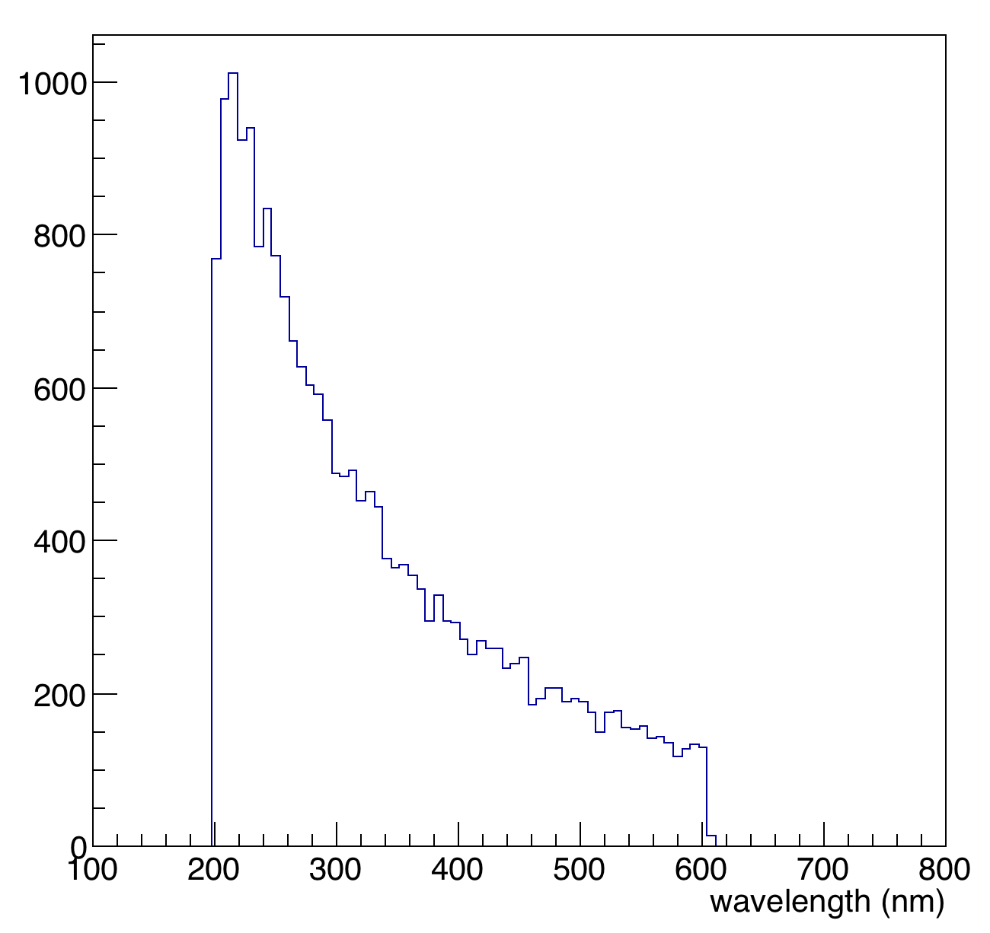
some things to do
Michael Paolone, Solid collaboration meeting, 01/12/16
Update geometry with support structures and MaPMT dead areas.
Investigate optical properties in the 180 to 200nm range.
Investigate acceptance limiting (after new background profiling).
Optical properties of gas and PMTs only defined
between 200 and 600 nm for current simulation in GEMC.

Slide 19
Back-ups

Slide 20
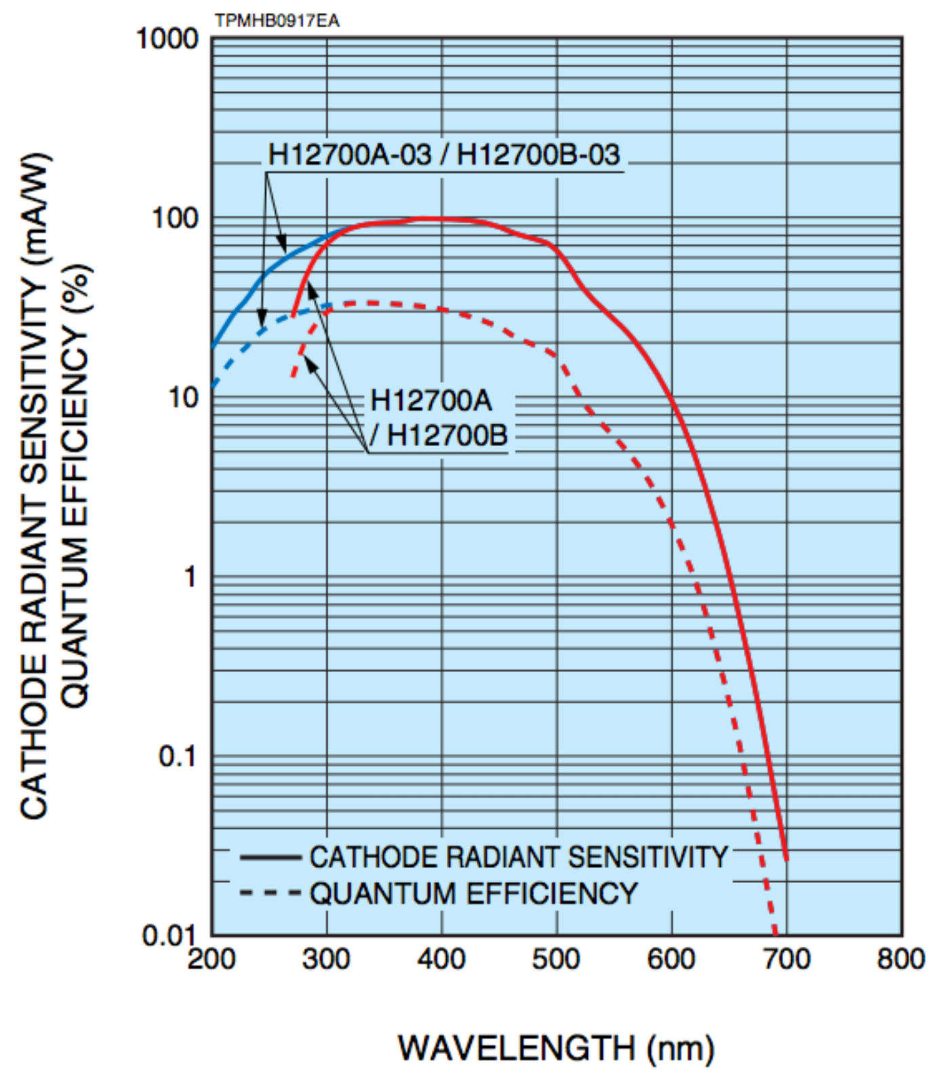
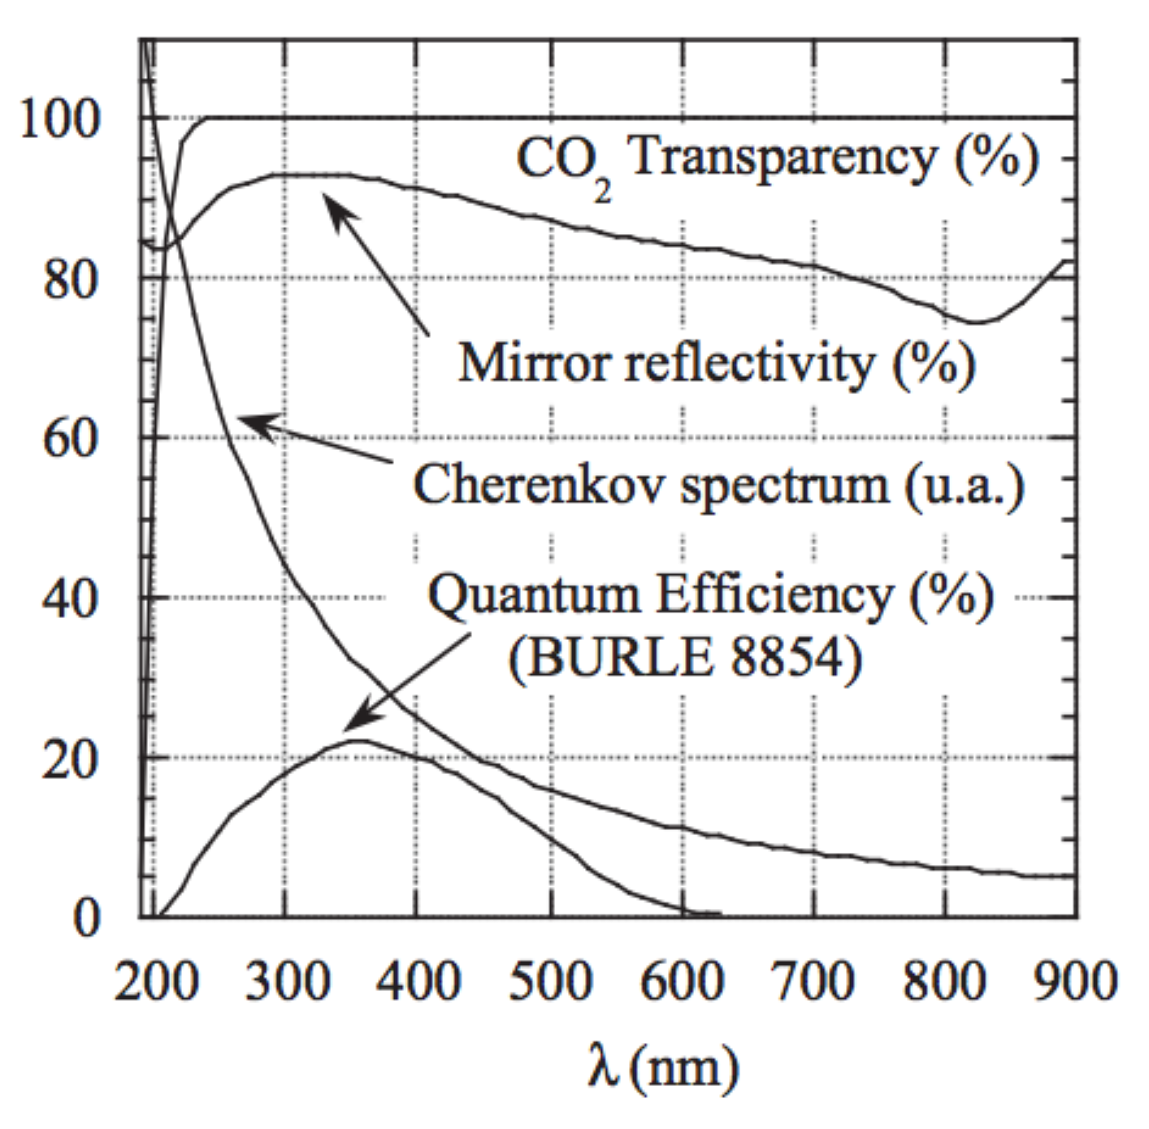
Some optical property plots:
Michael Paolone, Solid collaboration meeting, 01/12/16
From Hall-A gas Cherenkov paper
M. Iodice, PHY98-06.pdf

Slide 21
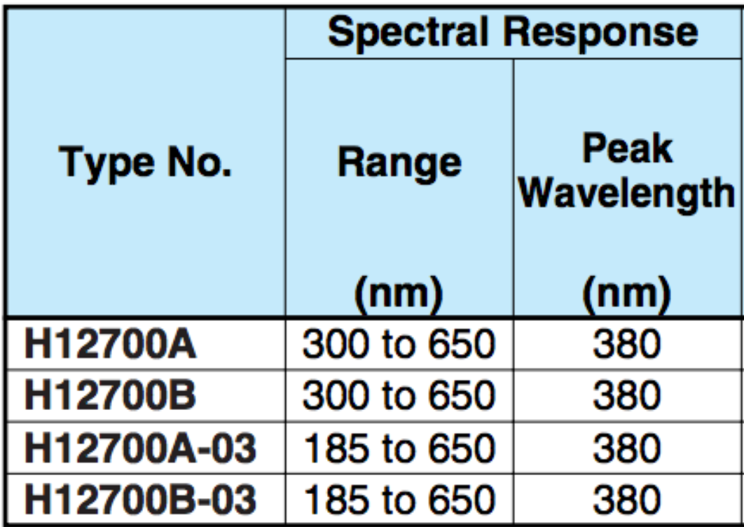
Some optical property plots:
Michael Paolone, Solid collaboration meeting, 01/12/16
From Hall-A gas Cherenkov paper
M. Iodice, PHY98-06.pdf

