Slide 1
SoLID HGC Update
Zhiwen Zhao
2016/01/13

Slide 2
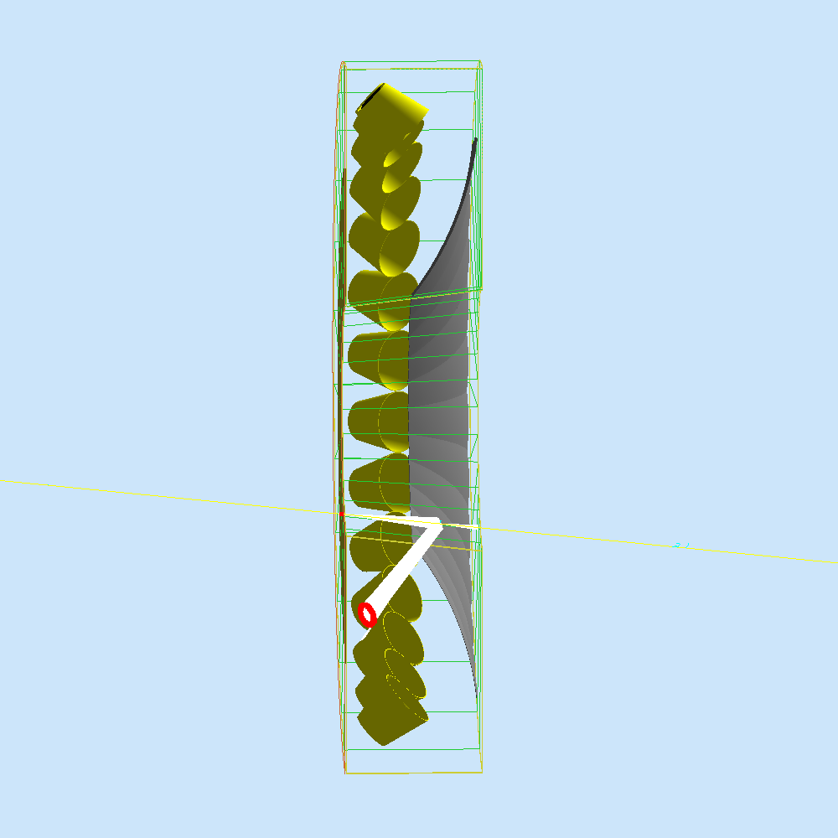
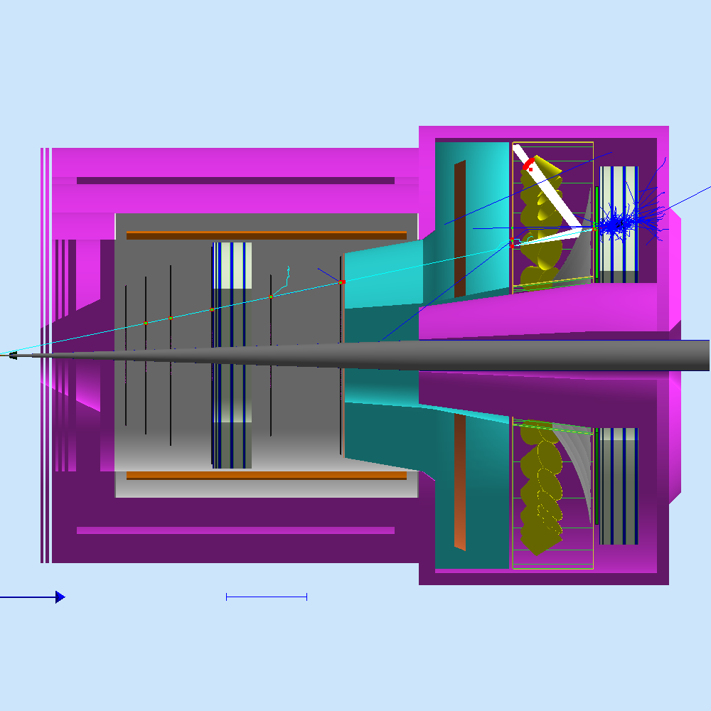
Outline
Gas
Mirror
Reflection cone
Hit pattern
RICH for PID
Cost update

Slide 3
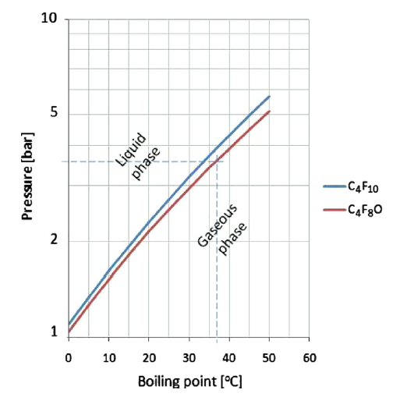
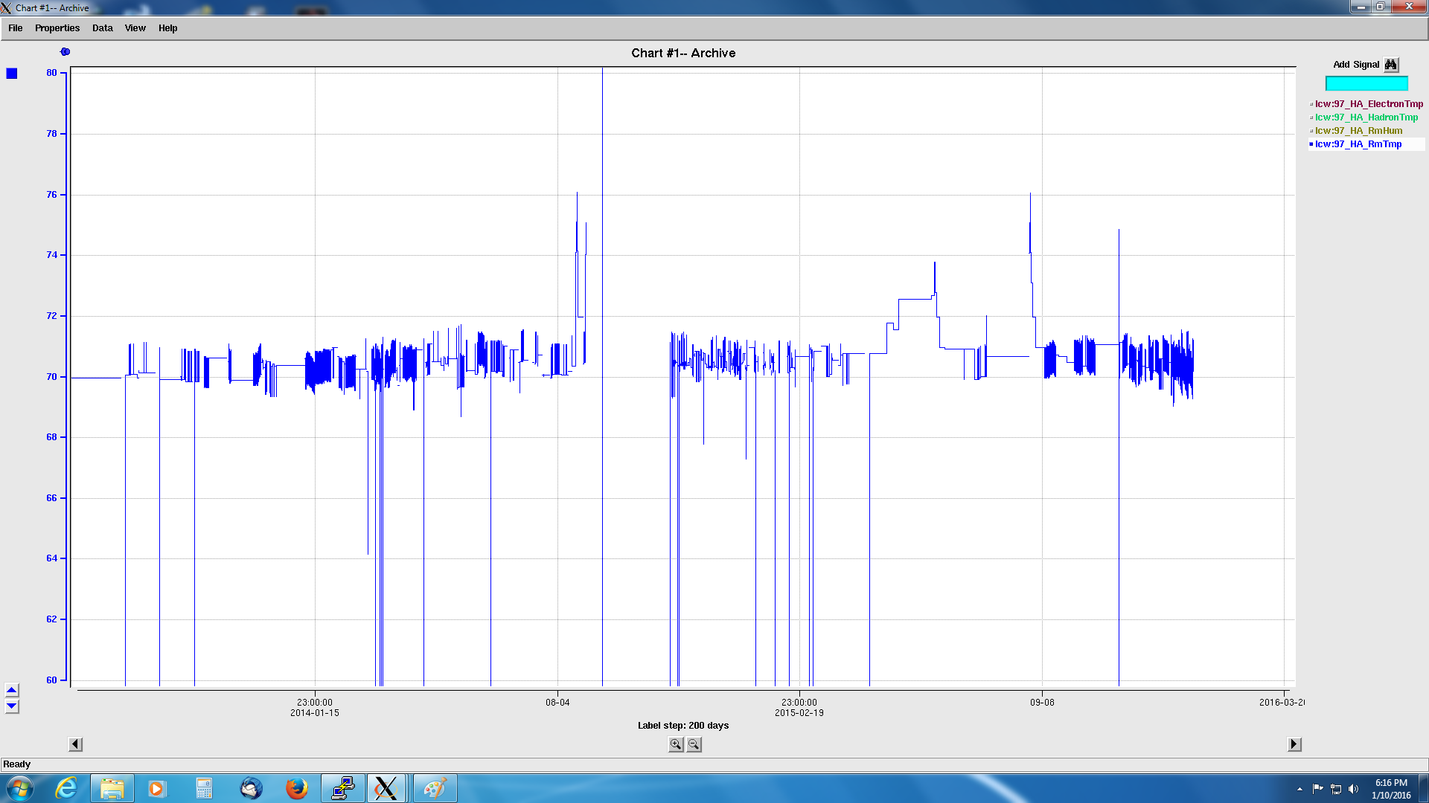
Gas as C4F10
15C(60F) safe at 1.5atm
according to calculation
“EPA has taken the approach with GHG compliance of placing most of the regulatory burden on the manufacturing side of things. In other words, if we are able to purchase C4F10 legally, this can be done without the requirement for obtaining any air permits at this time.“ -- Scott Conley
So far the temperature seems ok. We need to do a test to valid the phase diagram
Hall A temperature for last two years (lcw:97_HA_RmTmp on EPICS)
Minimum at 67F
-- Jack Segal
Gas system would need jlab engineering support both the default recirculation system or the alternative fill-and-seal one

Slide 4
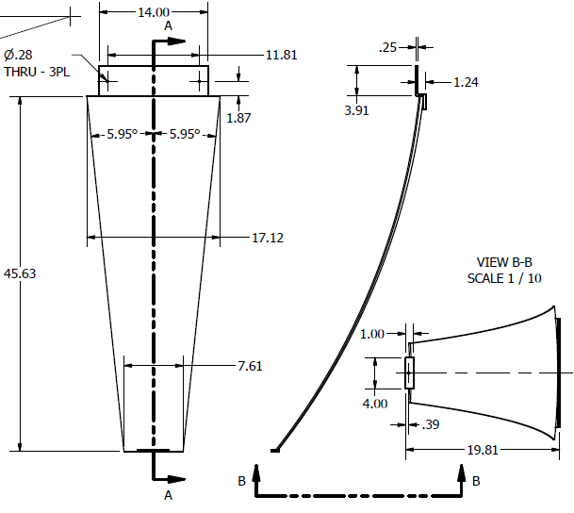
mirror
Radius of curvature (ROC) 2.3m
Area 0.4m2, 12m2 total, proportional to cost
CMA underestimated our size even though we gave them the drawing, this led to new cost 2.5 times of the old.
One time cost mandrel 120k and 21k per mirror, total 750k
high cost to make prototype mirror $80 due to minimum material purchase
They have existing LHCb mirror mandrel (ROC=2.7m), we may study if we can tune our design to use it, like CLAS12 RICH mirror
For PreRD, we are thinking of using many small piece of mirror base (a few cm2), arrange them to cover the full size and coat them to test coating quality

Slide 5
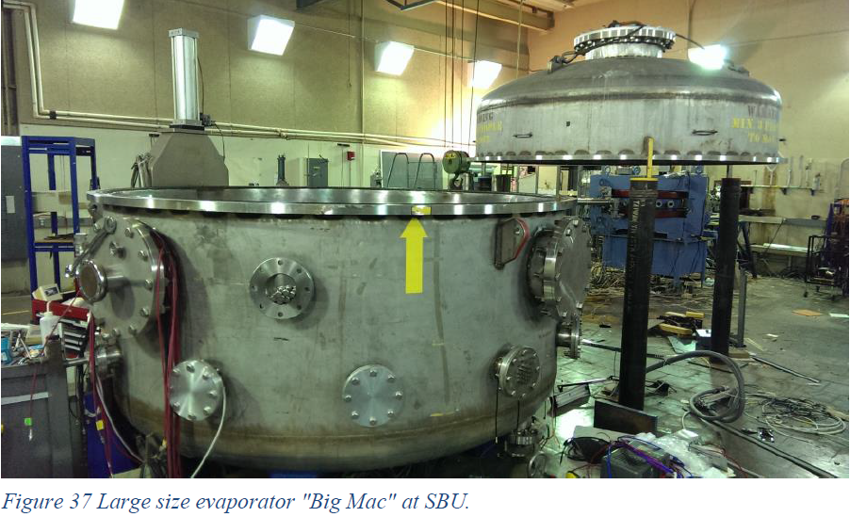
7 feet diameter chamber at SBU under work to coat Al and MgF₂

Slide 6
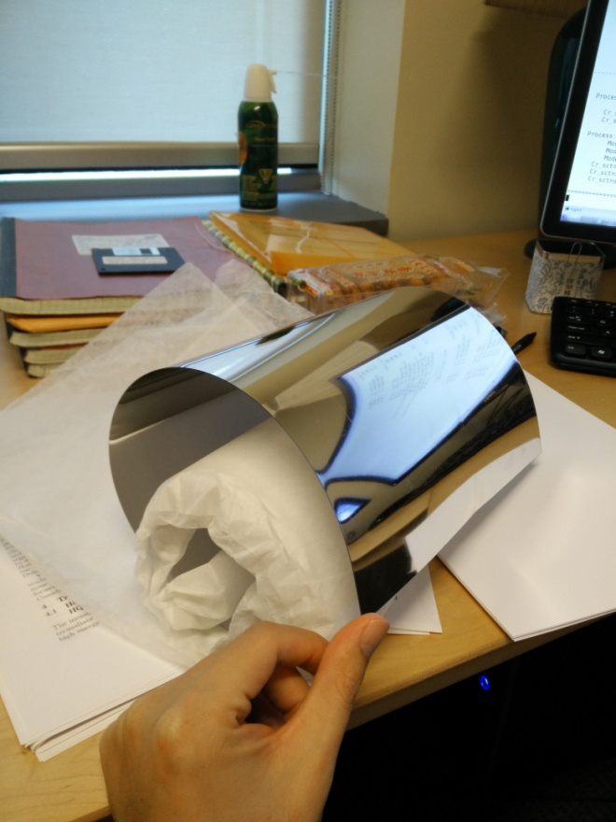
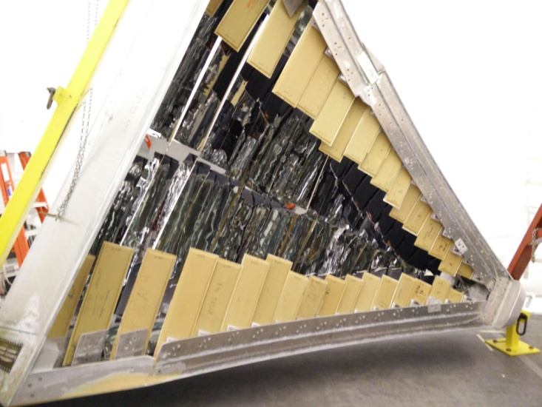
Reflecting cone
Lexan film coated with Al and protection, then roll on base, use for CLAS12 LTCC main mirror with good reflection as shown
We can attach them onto shielding cone directly as reflecting cone

Slide 7
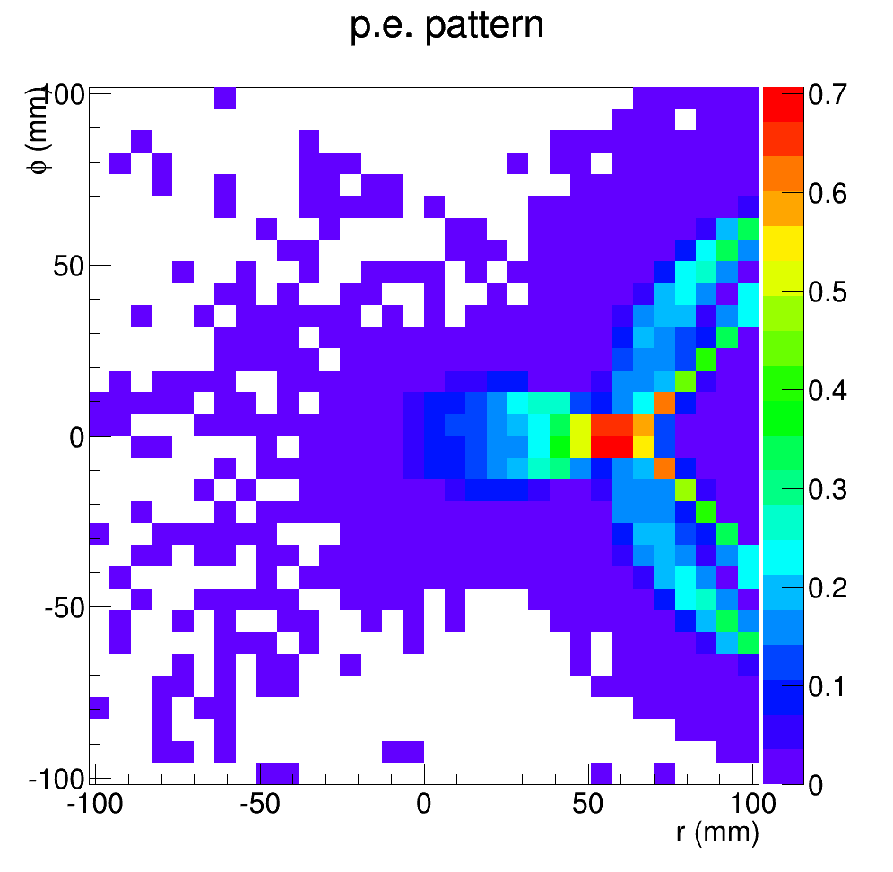
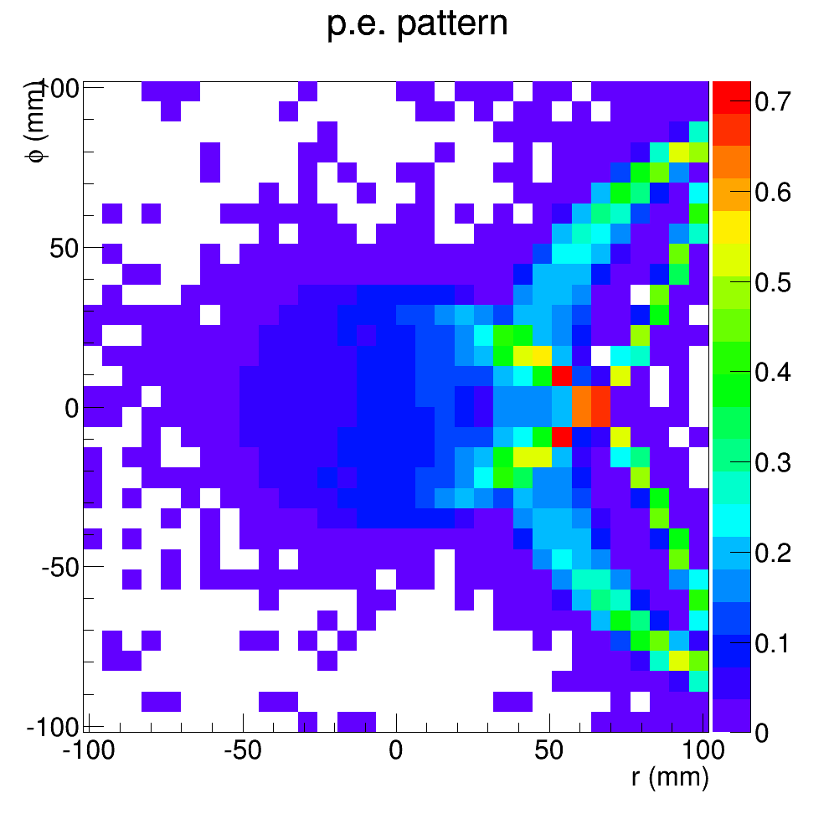
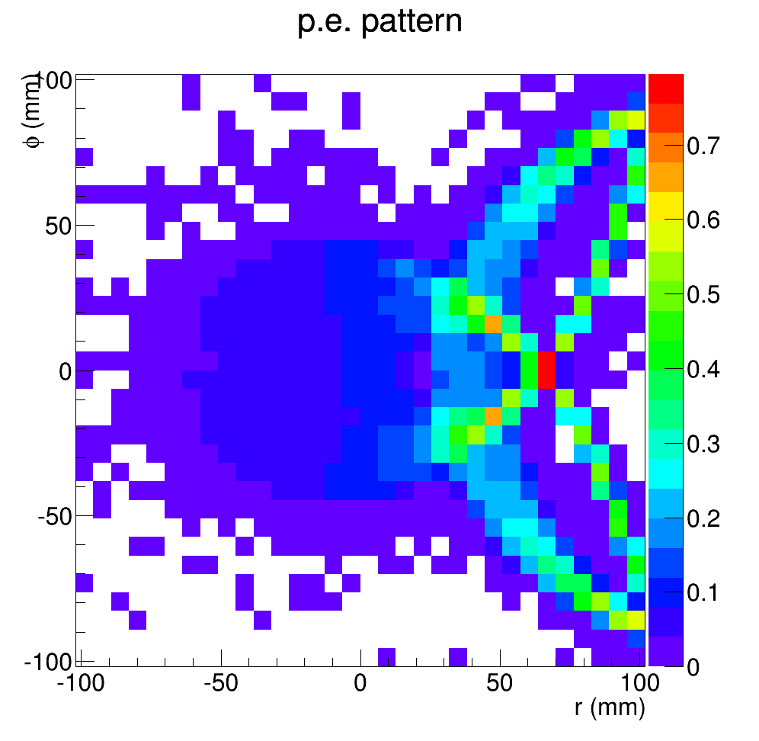
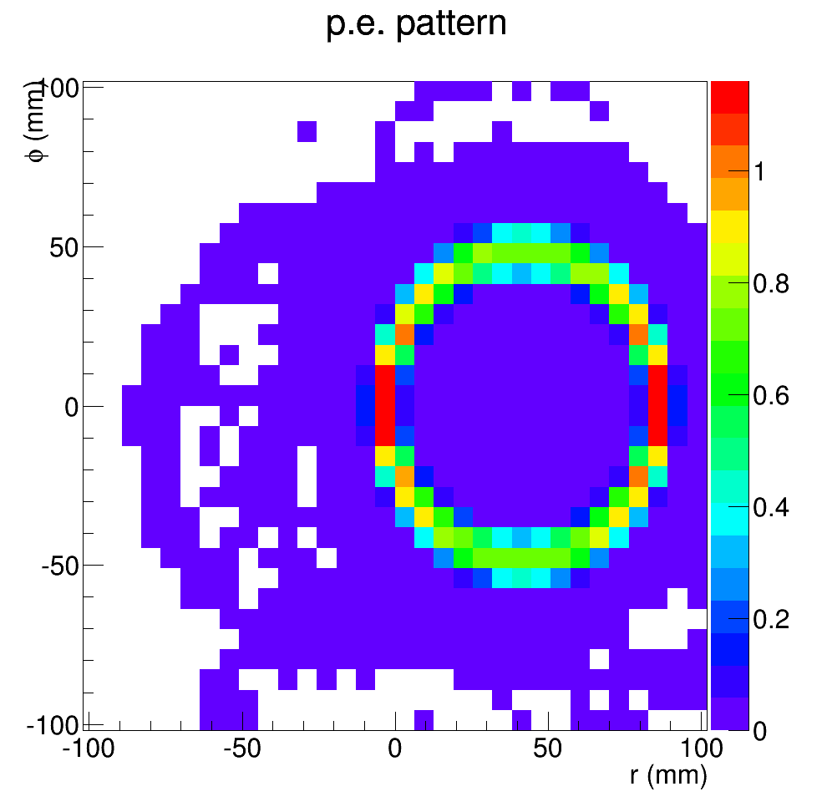
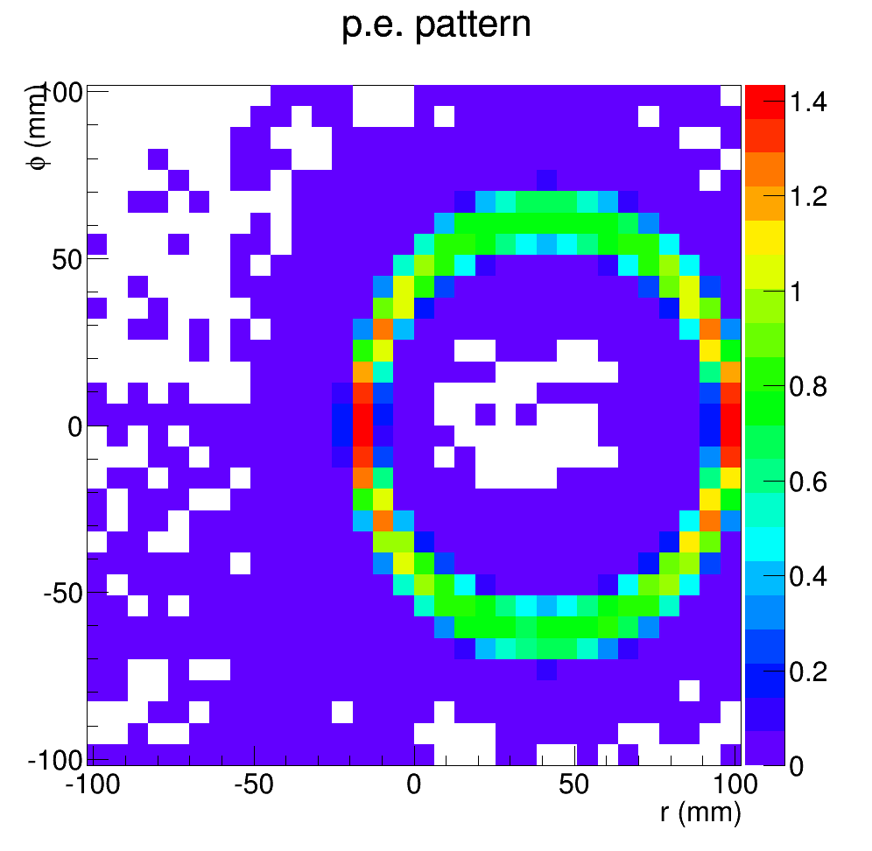
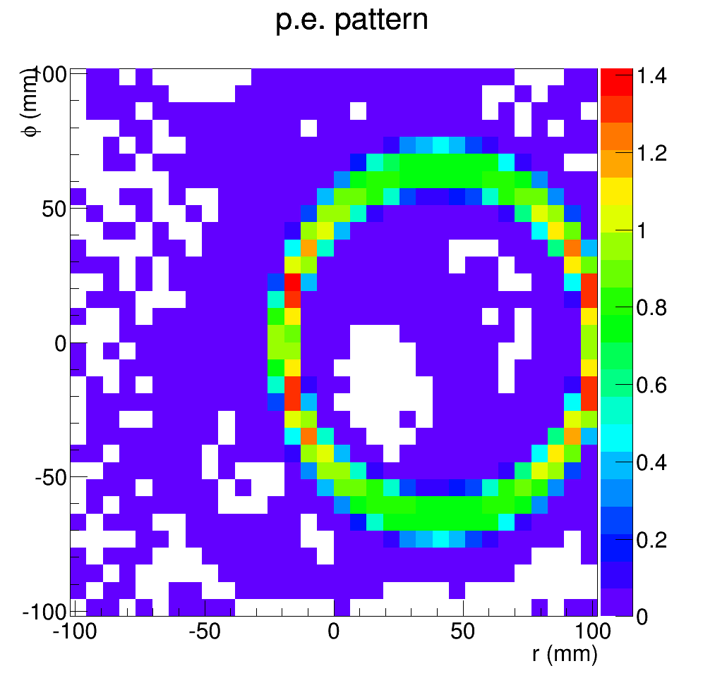
Photon electron hit pattern of pi- from target center toward sector center hit mostly below 1 for any MAPMT pixel as shown by binning Interesting to use MAROC3 with only digital output as record out for counting and possible pattern recognition
3GeV
5GeV
7GeV
8deg
14deg

Slide 8
Play with Aerogel RICH for PID
HGC plans to do kaon suppression from 2.5-7.5GeV
FA-TOF (100ps) can have separation of k/pi at 2.5GeV and p/k at 4.5GeV
Aerogel(n=1.02) has threshold pion 0.67GeV, kaon 2.46GeV, p 4.89GeV
Exactly configuration as HGC, remove gas and add 2cm thickness aerogel at front
Throw particles with various mom from target center toward sector center
photon below 350nm are scattered in aerogel a lot, assume they are blocked
Add QE of H12700-03

Slide 9
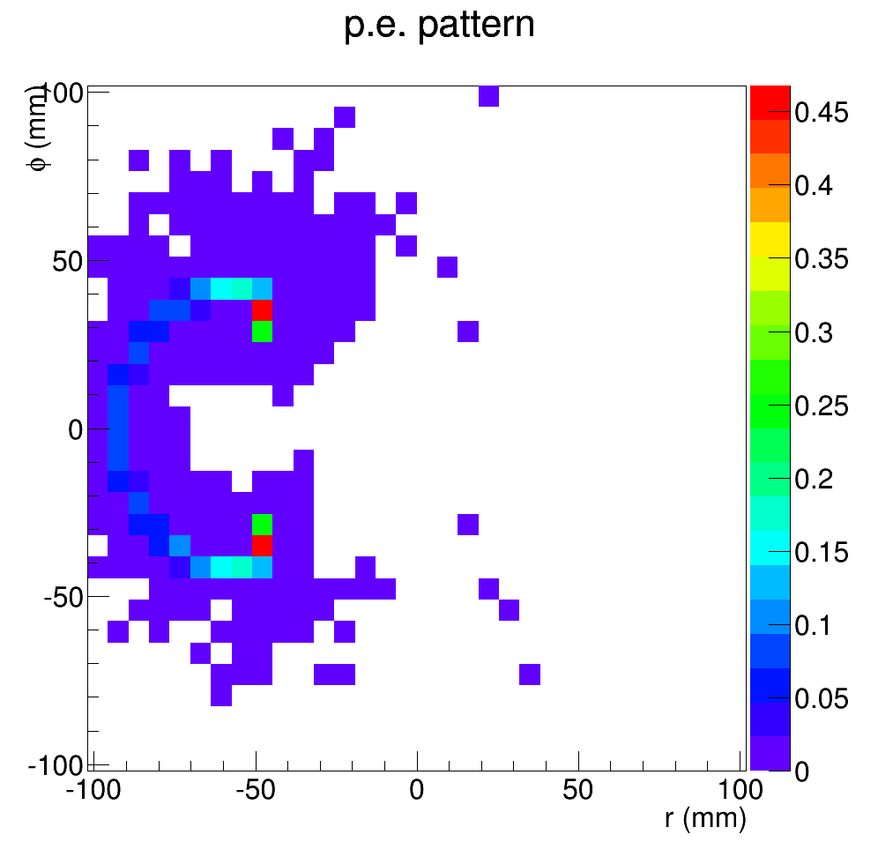
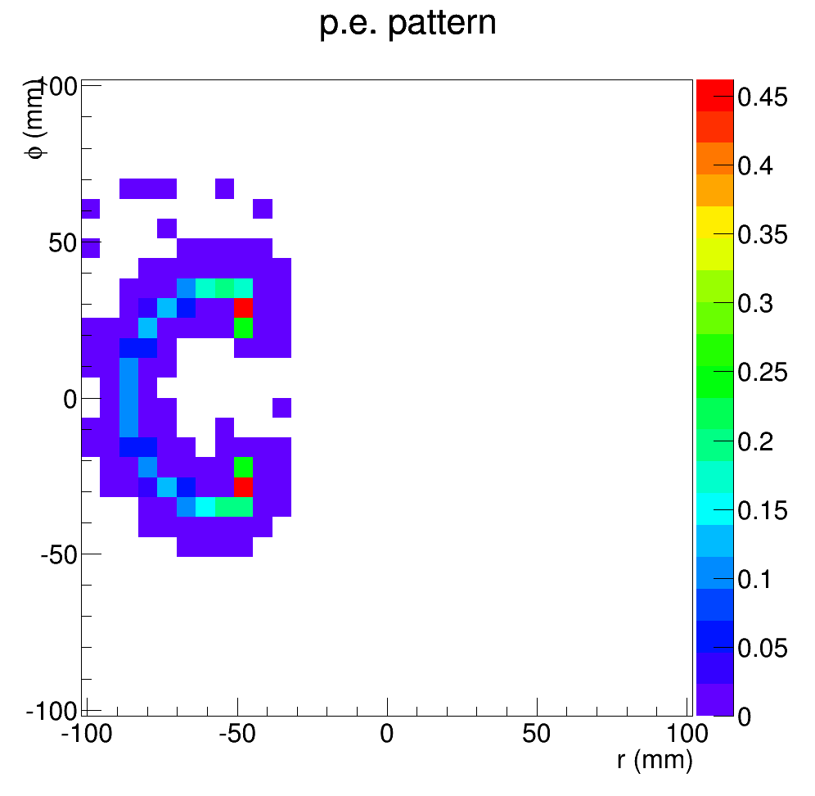
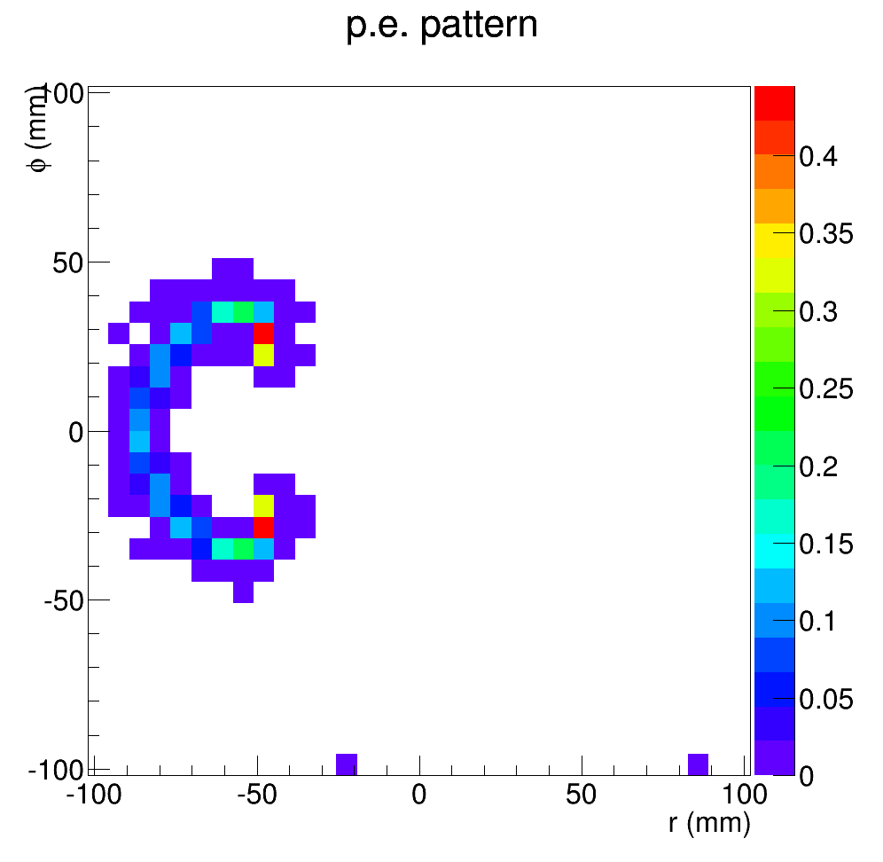
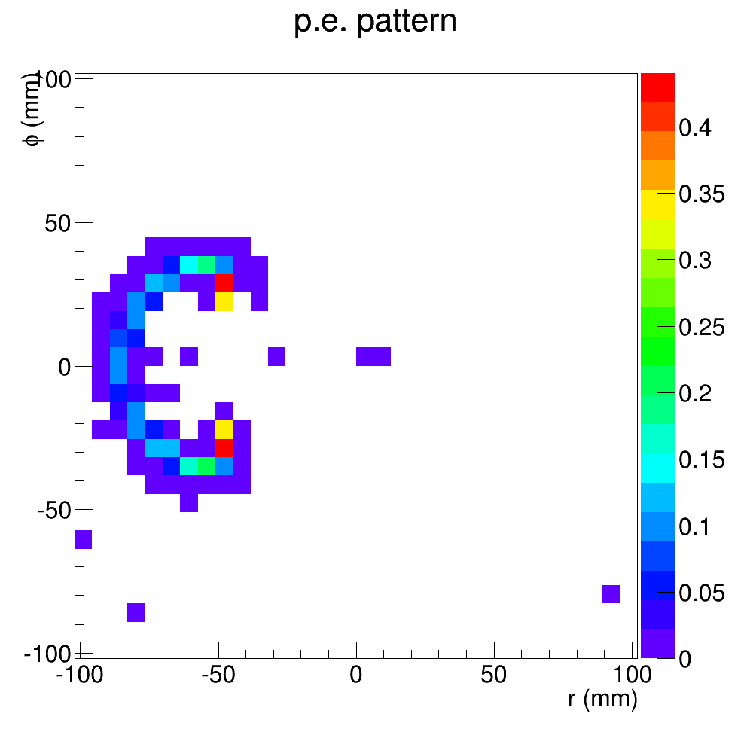
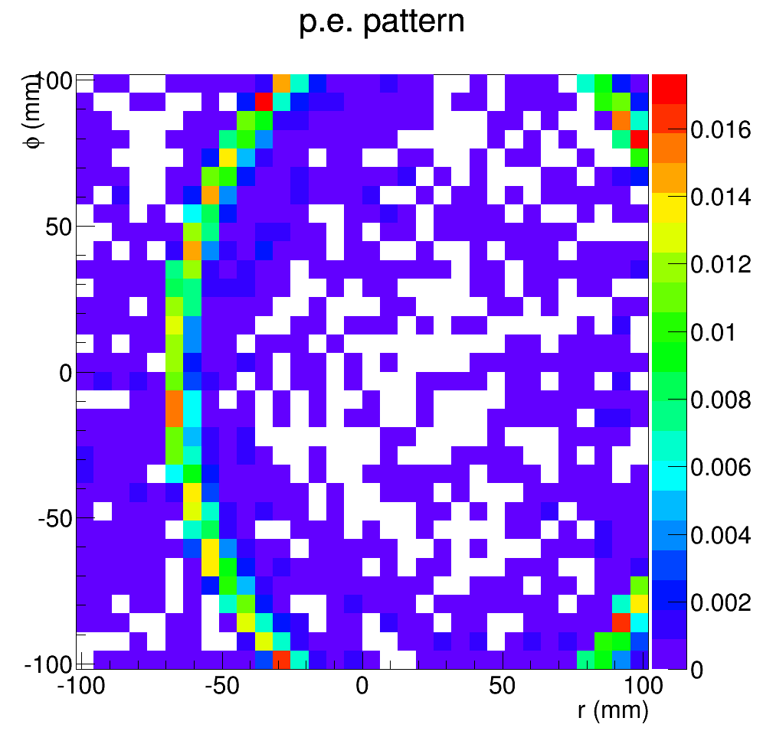
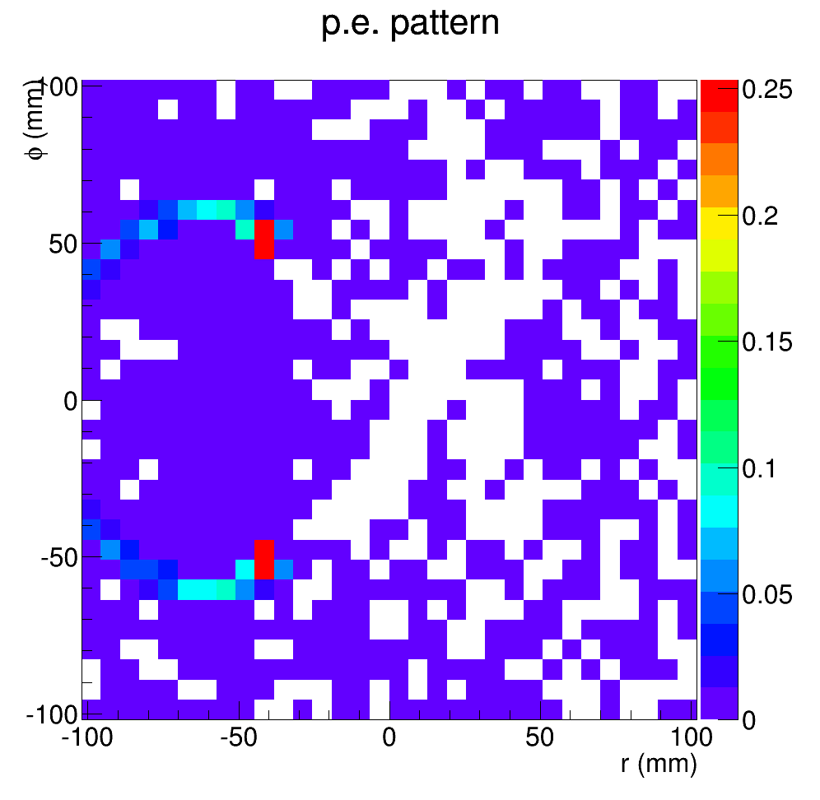
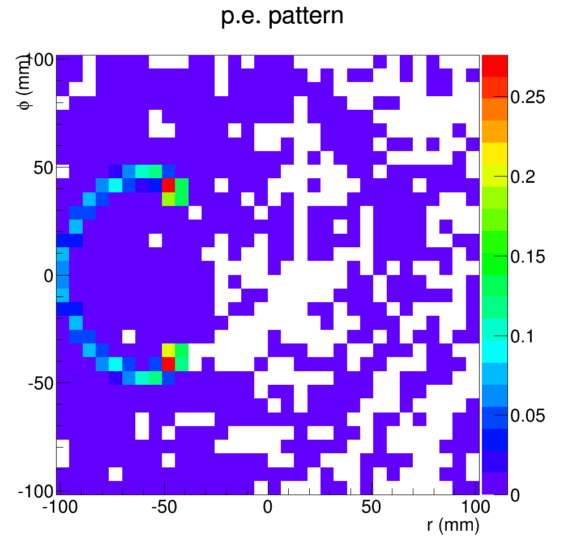
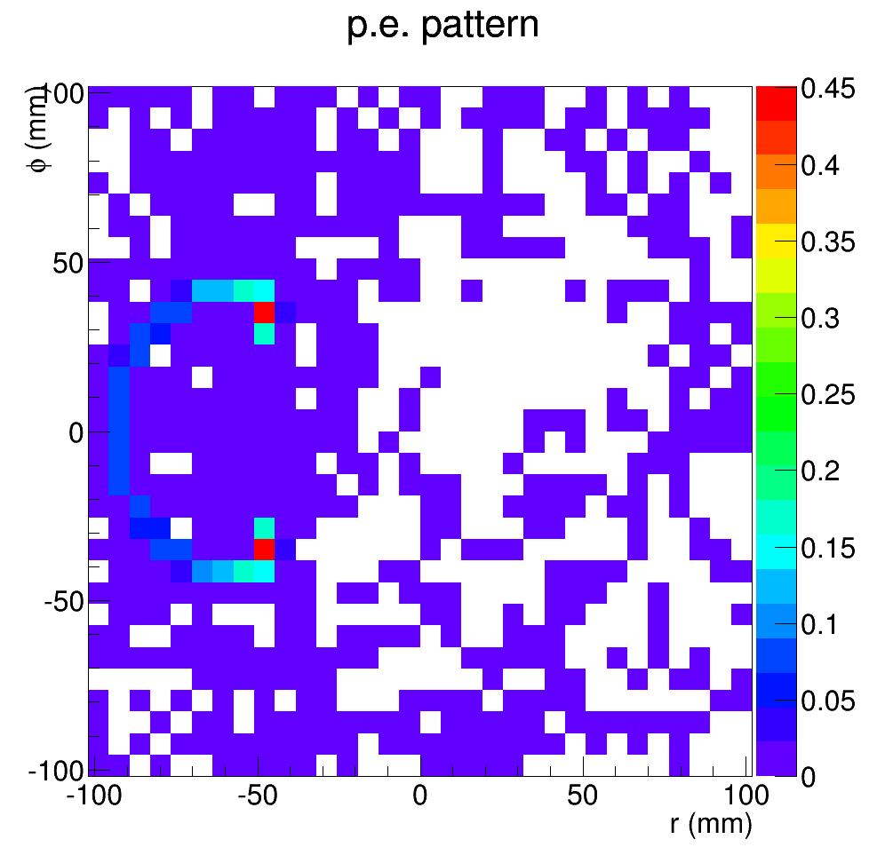
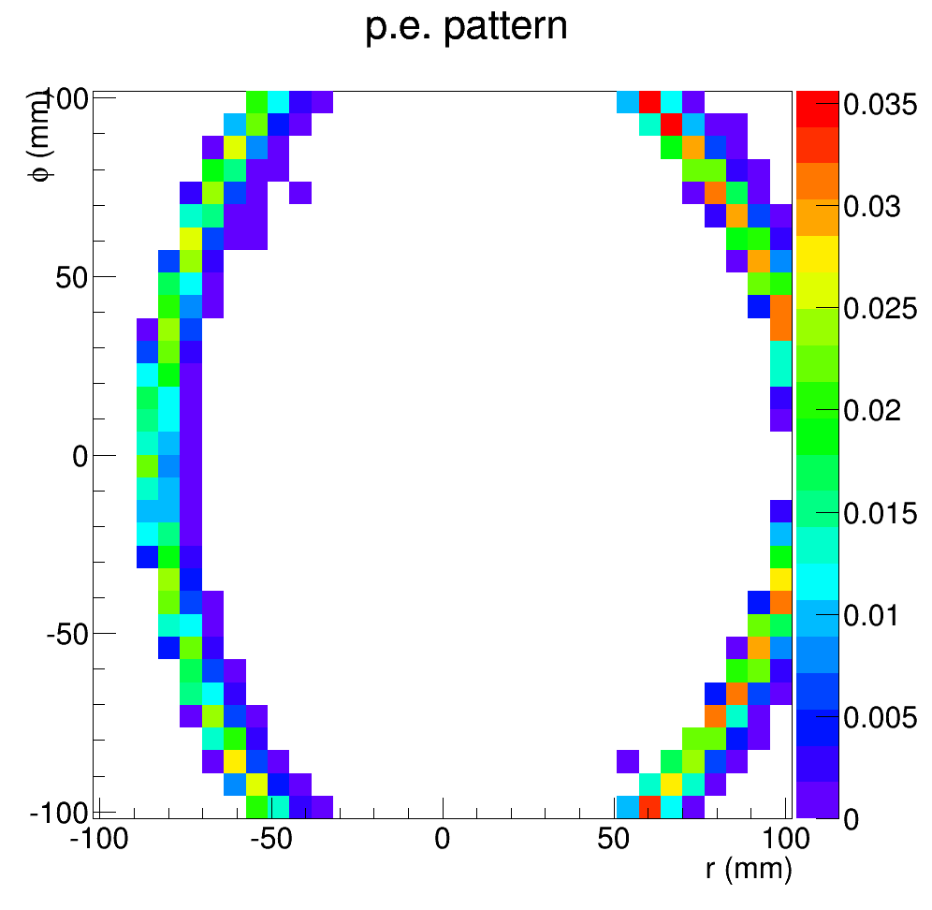
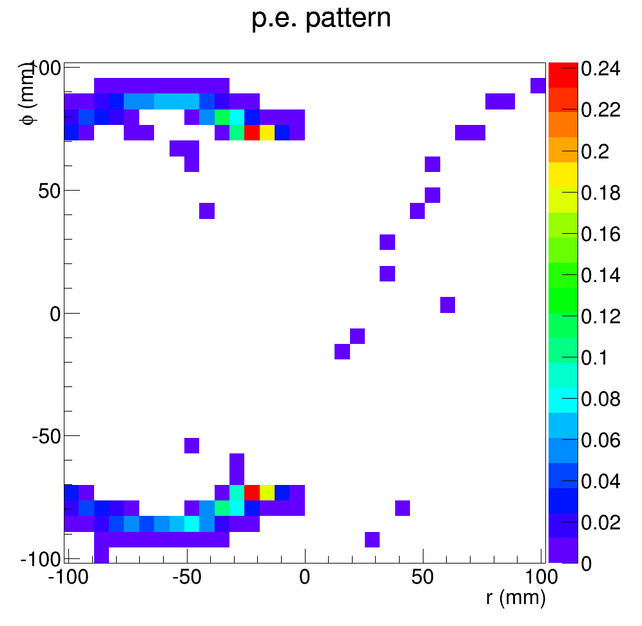
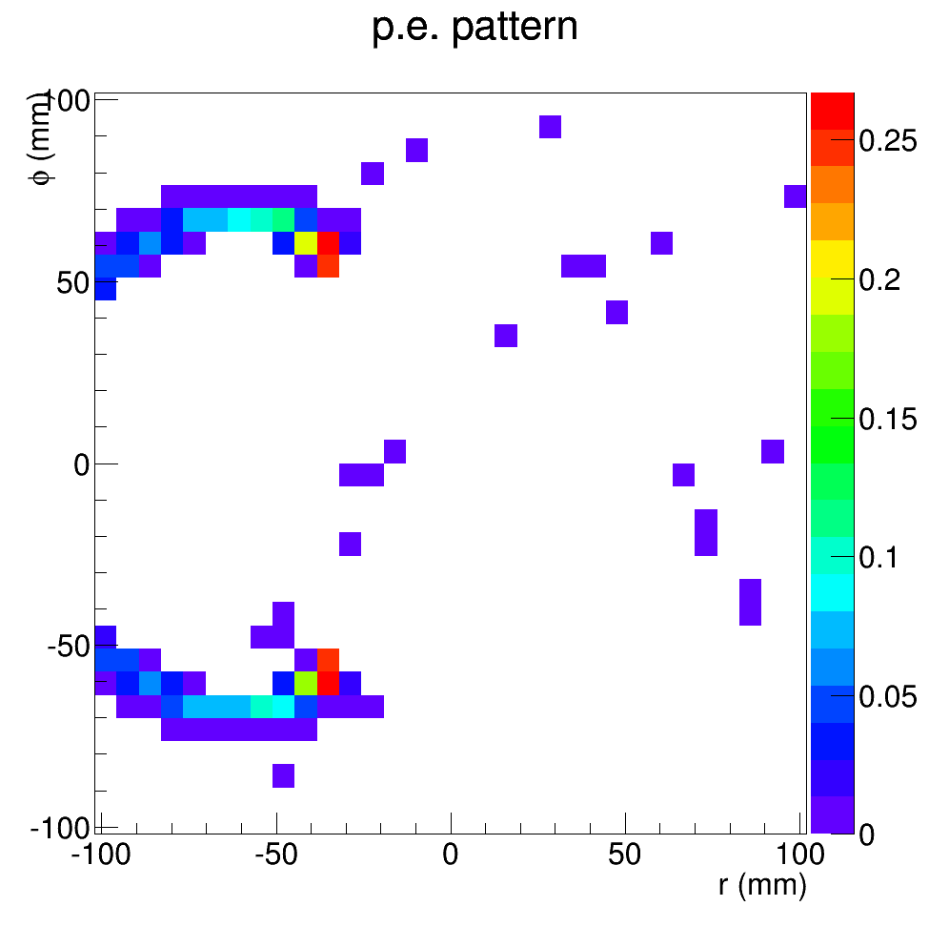
Photo electron hit pattern at 14 deg (interesting)
2.5GeV
5GeV
7GeV
8.5GeV
pi-
k-
9
p

Slide 10
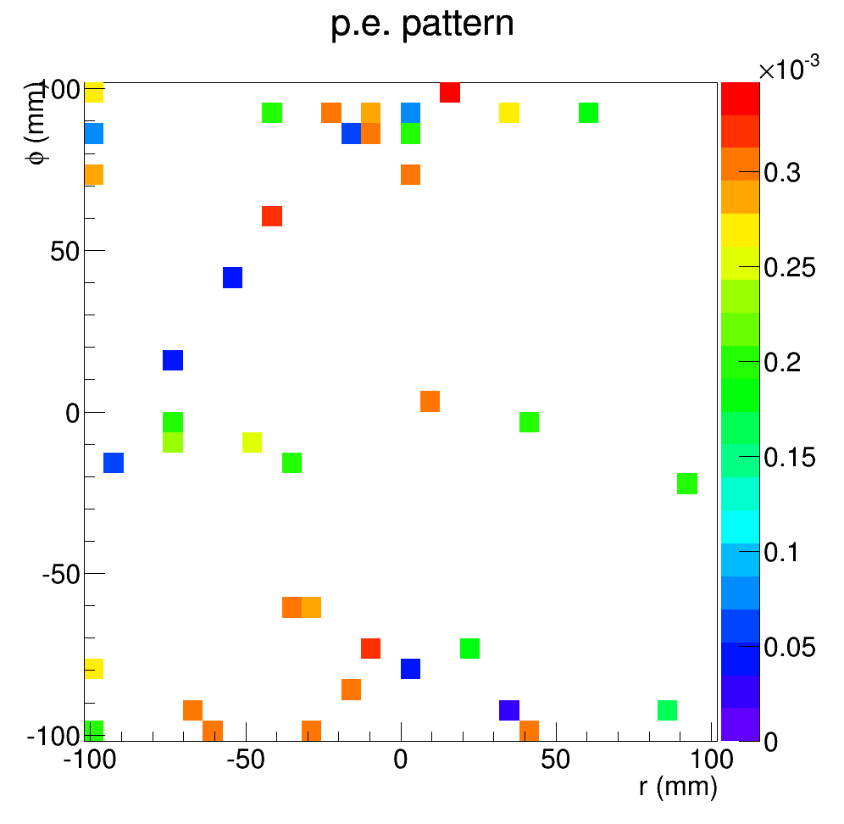
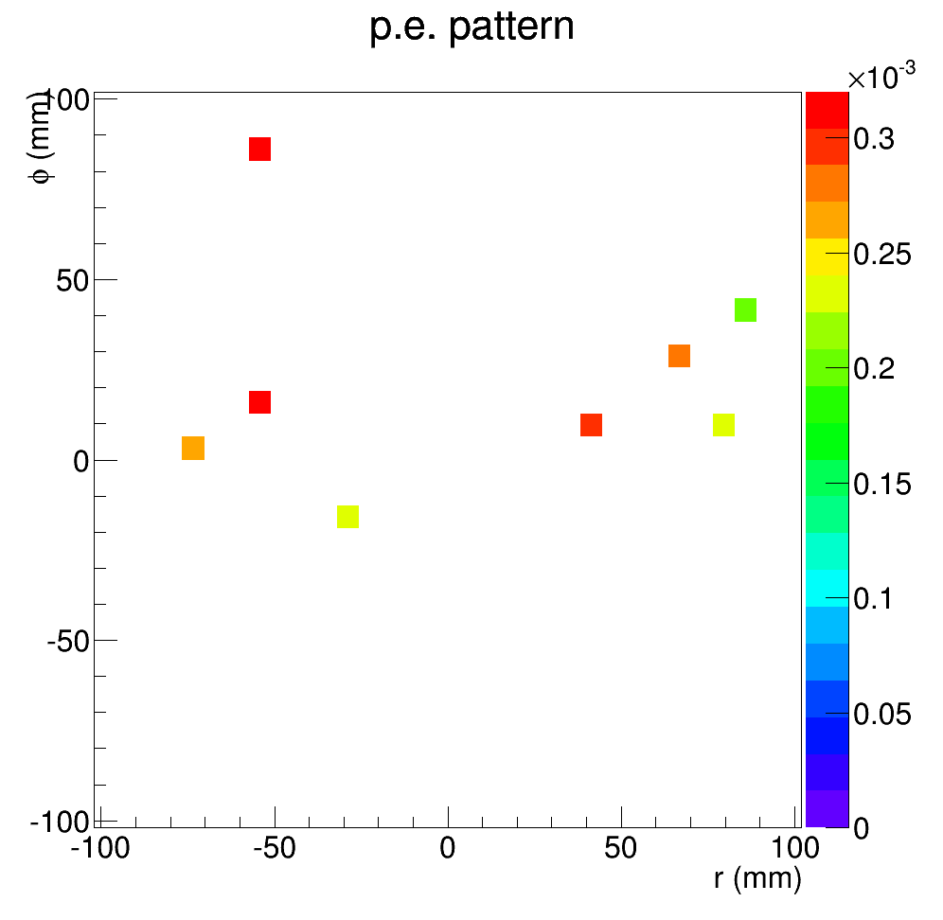
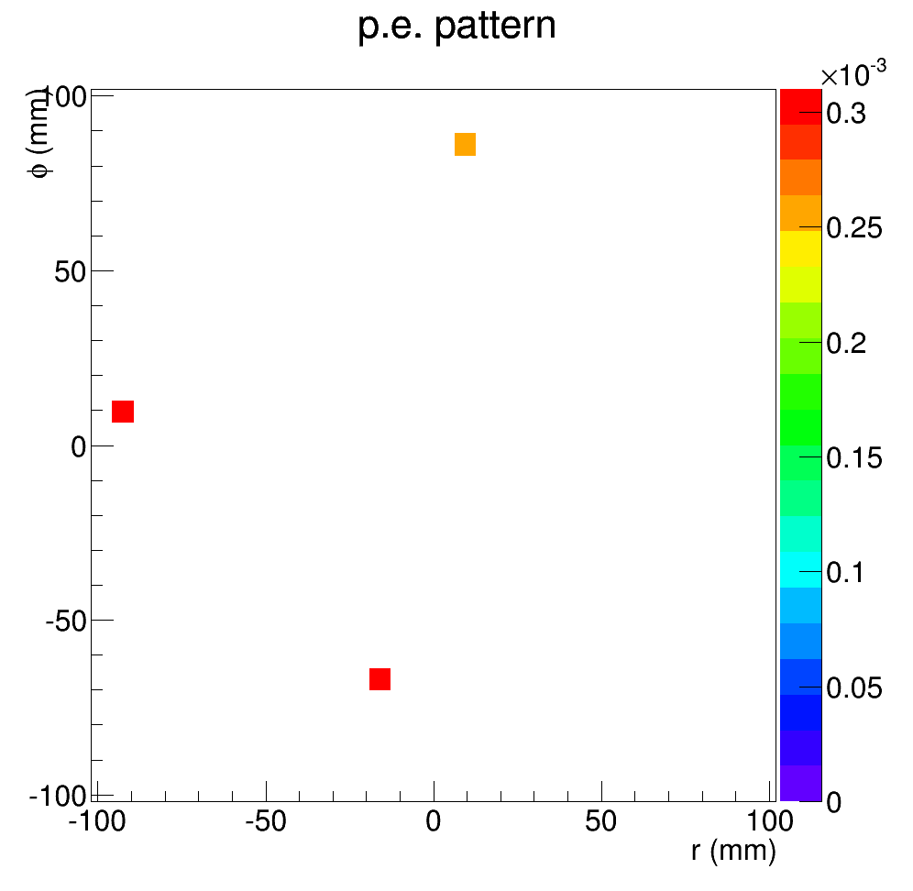
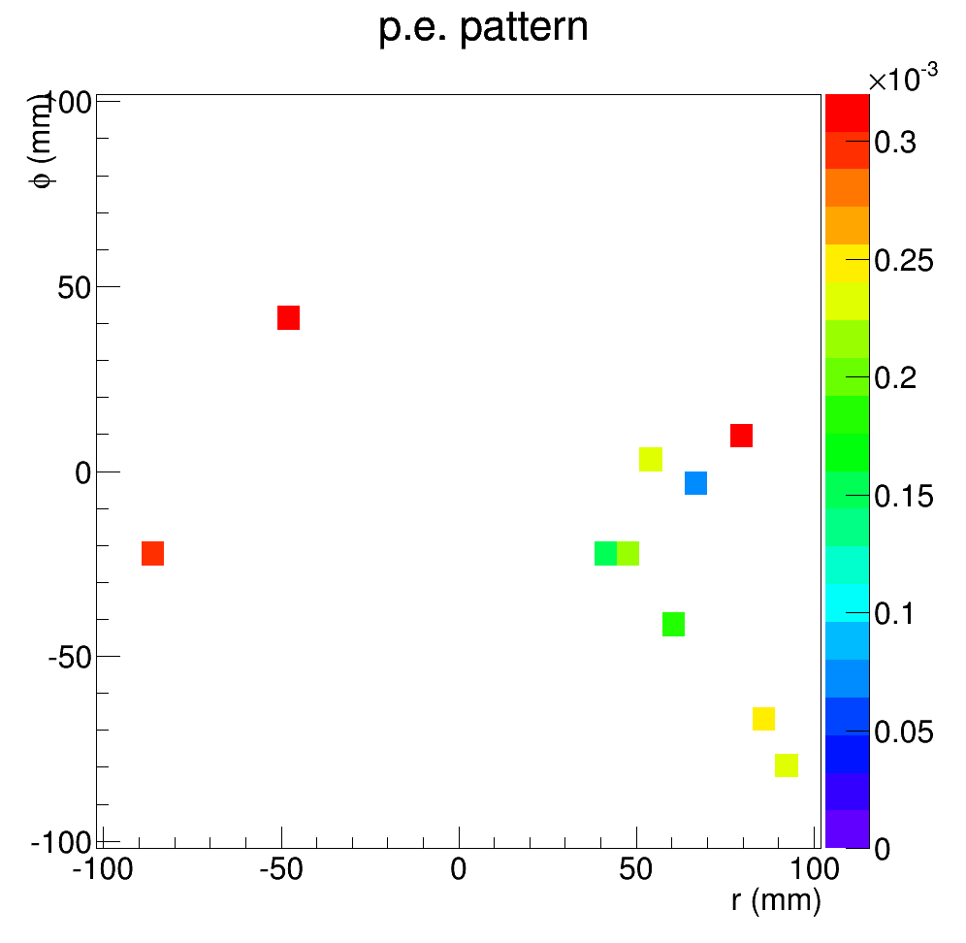
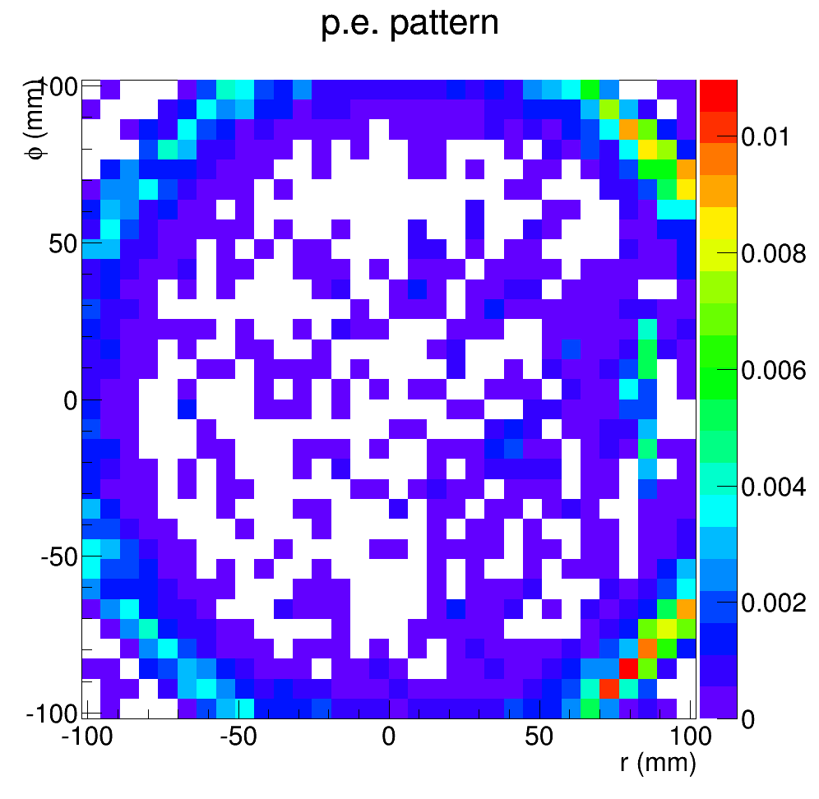
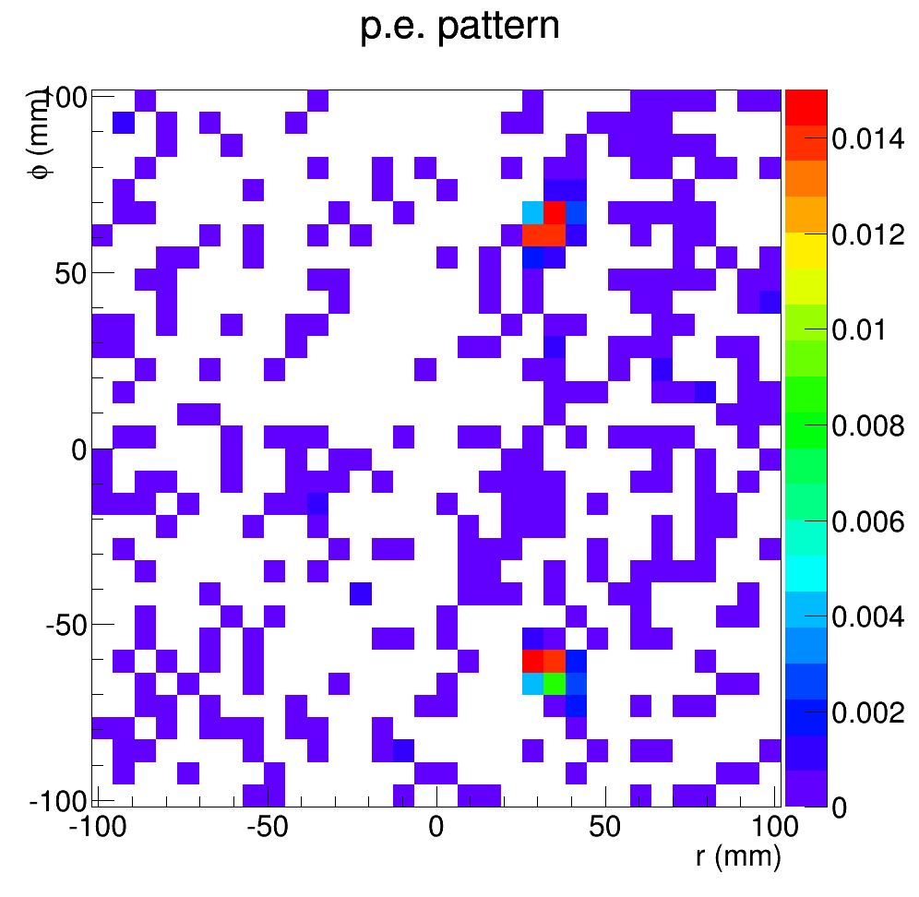
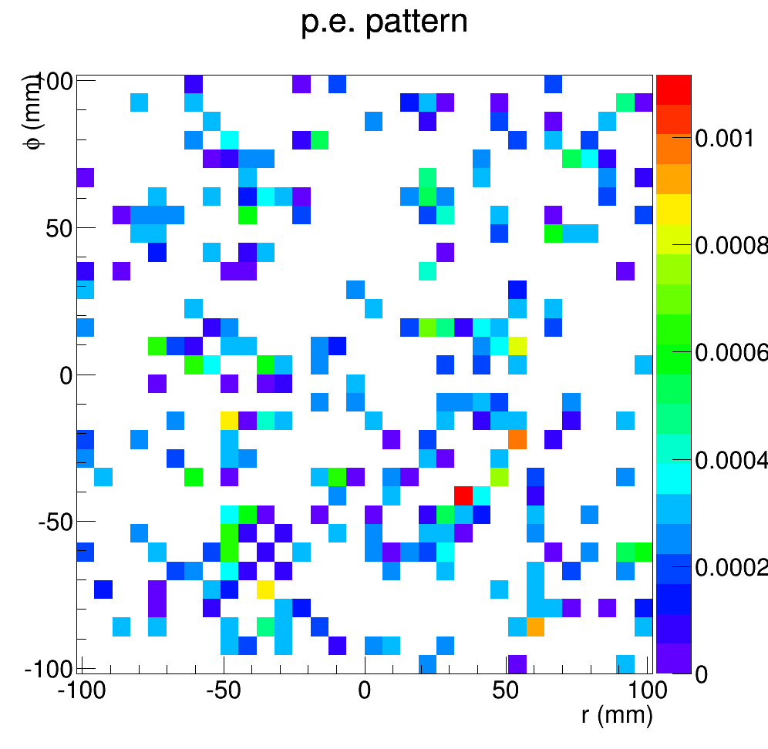
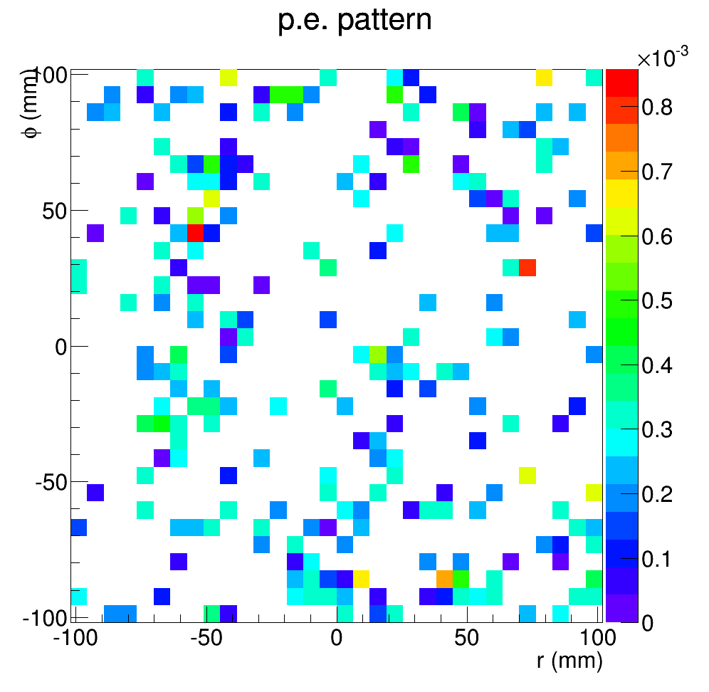
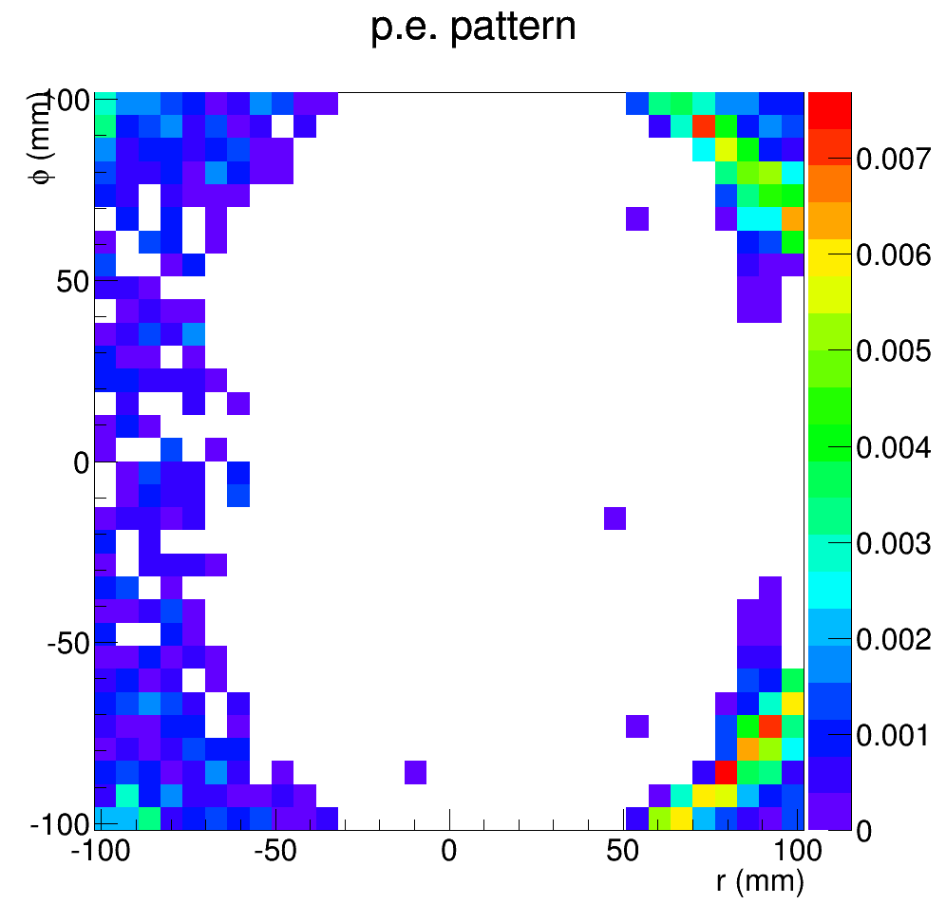
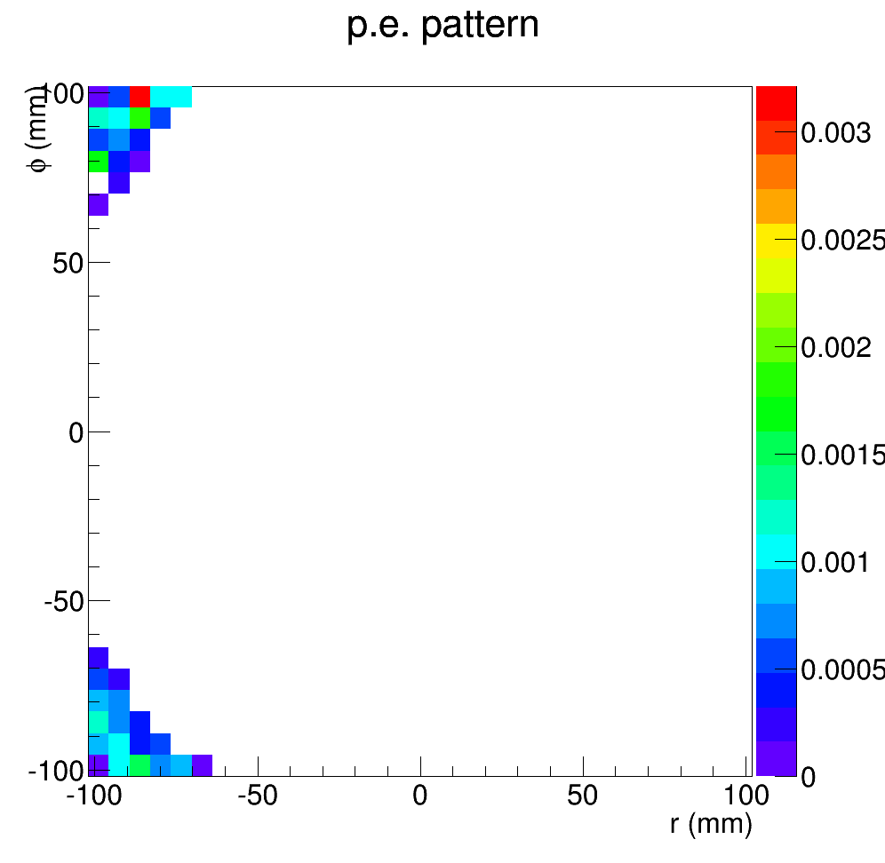
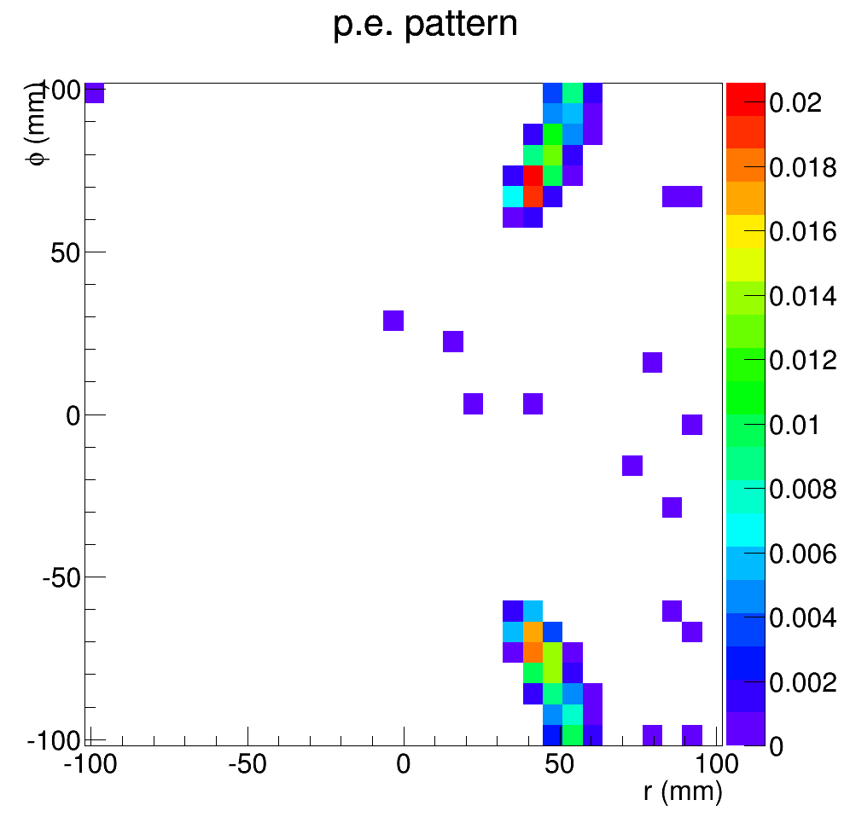
Photo electron hit pattern at 8 deg (not good)
2.5GeV
5GeV
7GeV
8.5GeV
pi-
k-
p

Slide 11
Cost change Overview
Updated quotes for tank, window material, mirror, shielding cone, PMT
Added cost for reflecting cone with coating, PMT WLS coating, readout electronics, test and installation
Garth Huber’s Canadian fund request ($75k), submitted in Oct and waiting for reply in Mar

Slide 12
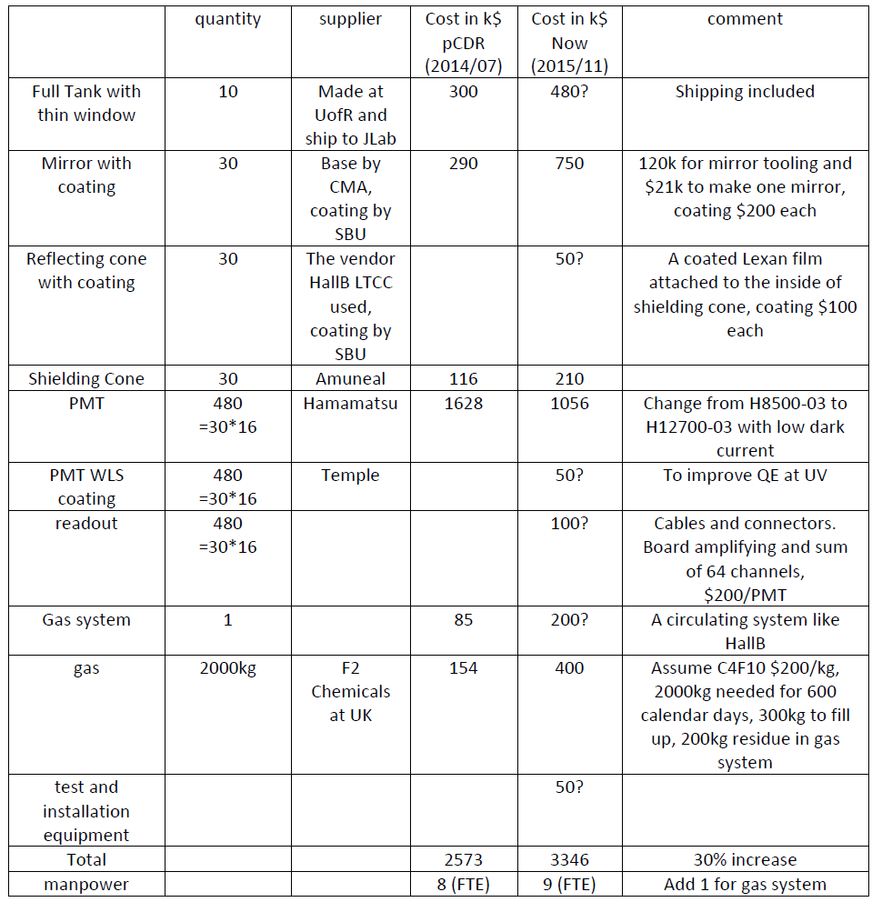
Budget update
Note:
1. The cost items with question marks have larger uncertainty
2. Can the gas cost be counted into operation and thus reduce HGC budget?
3. We are considering seal-and-fill gas system to make it simple and save cost, but the gas needed could be similar.
4. We are considering MAROC3 readout which might help background suppression

Slide 13
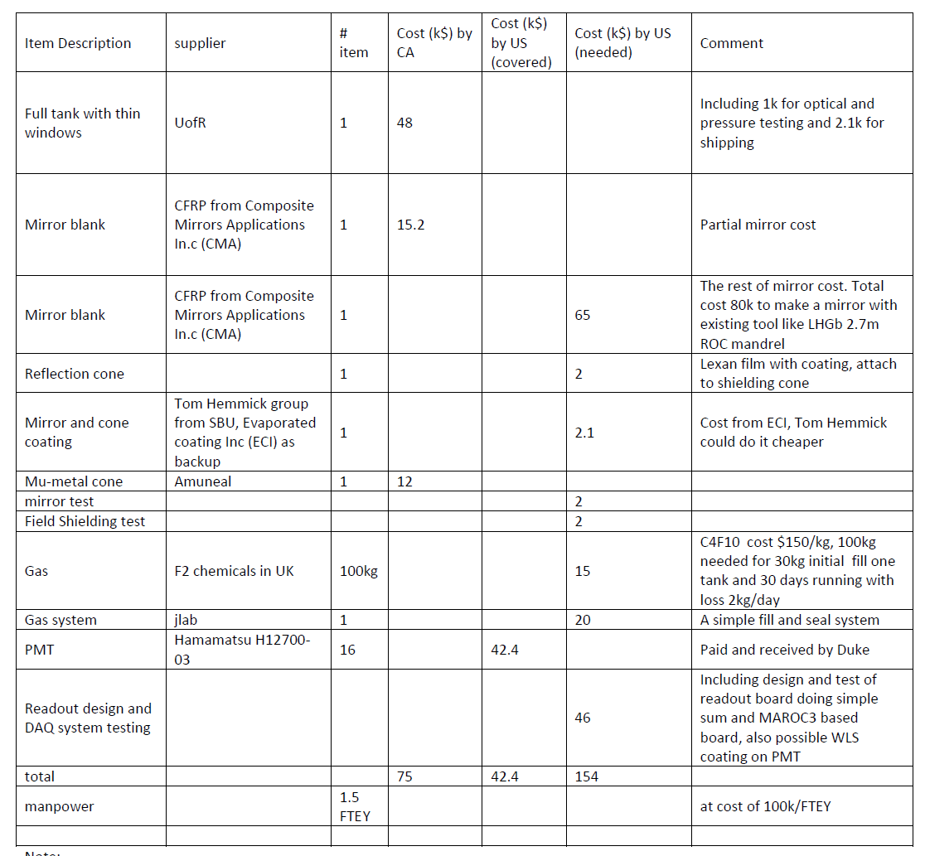
PreRD budget
Note:
1. Goal: the pre-R&D is only for evaluating the design, not building a full scale prototype, until SoLID becomes a DOE project
2. Time frame: CFI funding is for 2 years, SoLID pre-R&D is 3 years at this moment. This mainly affect total manpower

