Slide 1

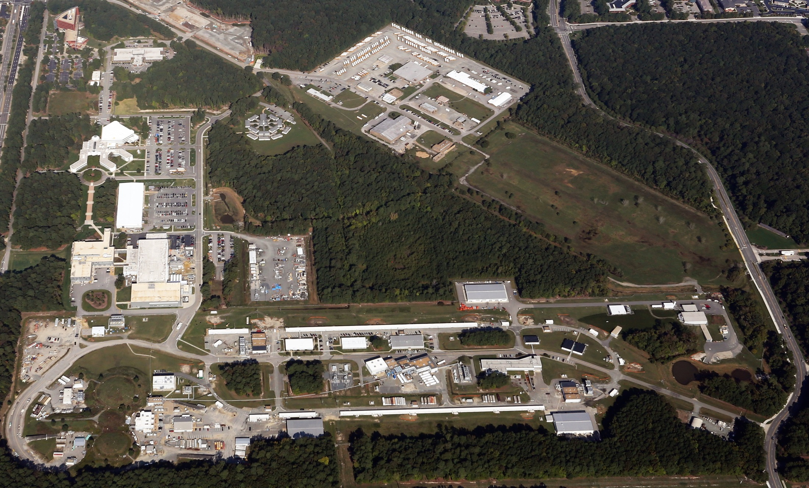
Jefferson Lab Status
Bob McKeown
May 6, 2016

Slide 2
Outline
Upgrade status
PAC
Budgets
JLEIC
Outlook

Slide 3
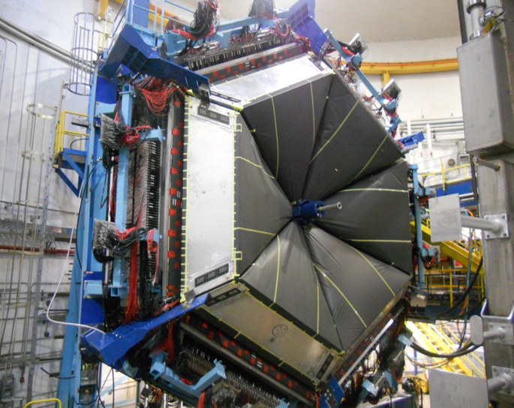
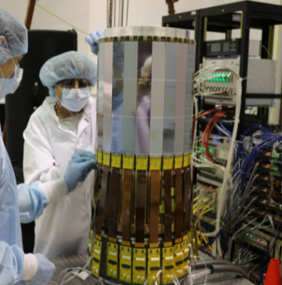
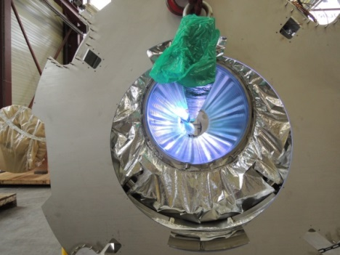
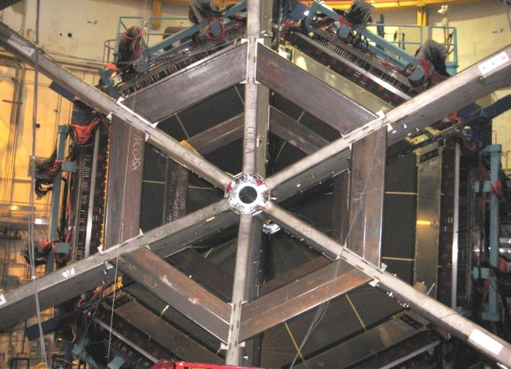
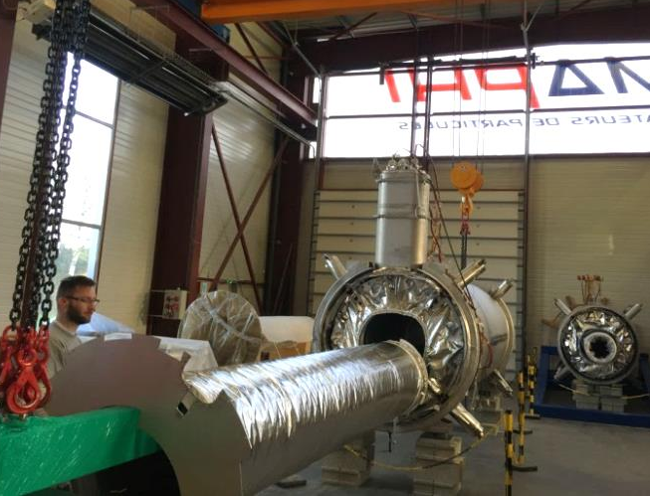
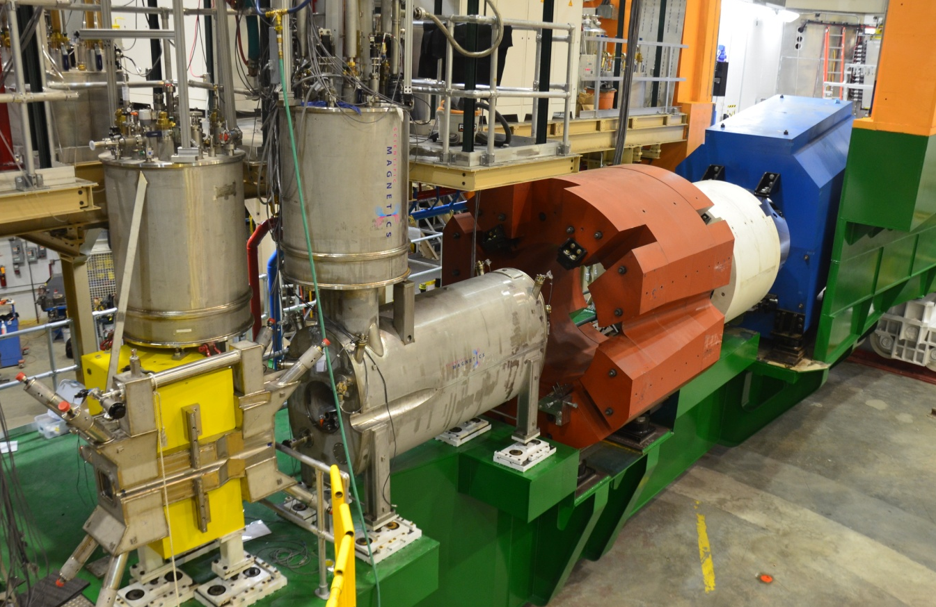
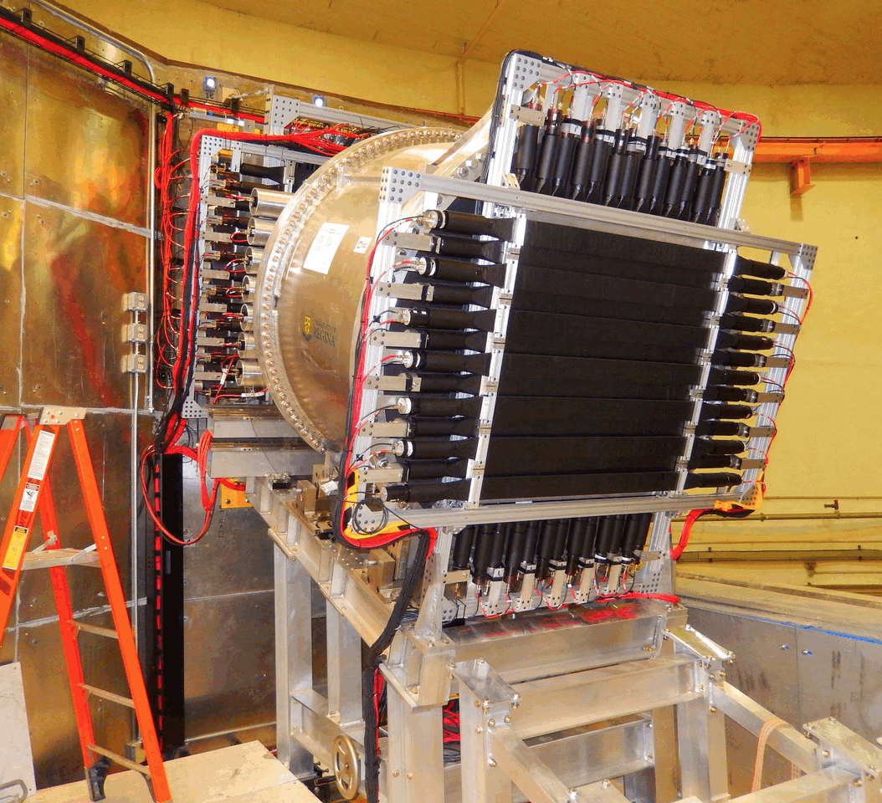
12 GeV Upgrade Project
TPC = $338M
ETC = ~$10M
Project Scope (~97% complete):
Doubling the accelerator beam energy – DONE
New experimental Hall D and beam line – DONE
Civil construction including utilities – DONE
Upgrades to Experimental Halls B & C – ~94%
  Halls B & C Detectors – DONE
Notes:
AL updated 01Apr w/Feb 28th data.

Slide 4
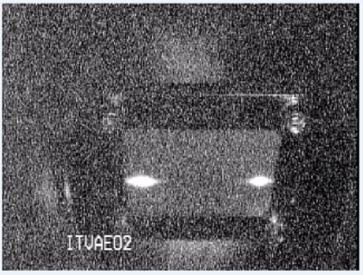
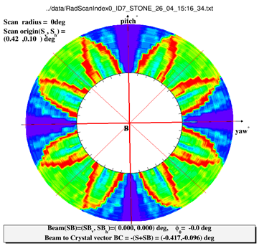
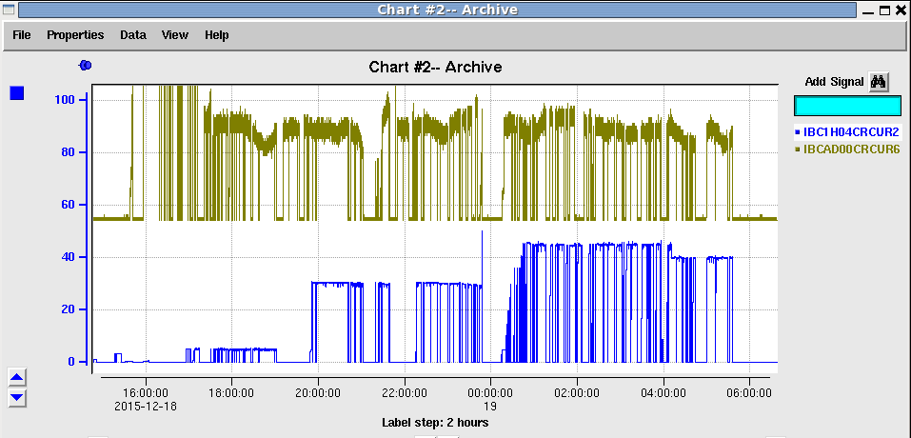
CEBAF 2015 Highlights
A & D beam separated on 5th pass at 9.6 GeV
Spring 2015:
1.9 GeV/pass set-up to support simultaneous Hall A/D ops
Power event damaged cold compressor bearings
Reconfigured CEBAF for one CHL operation; 1.1 GeV/pass
Successful runs: Hall B (HPS) and Hall D (GlueX)
D: 1st production polarized photons
Summer 2015:
He processing SRF cavities complete
Repair CHL1 → SC1 cryo system w/SNS cold compressor
Fall 2015:
5 week run establishes CEBAF at design energy
Measured emittance meets initial year physics specs
12 GeV to Hall D and 11 GeV to Hall A

Slide 5
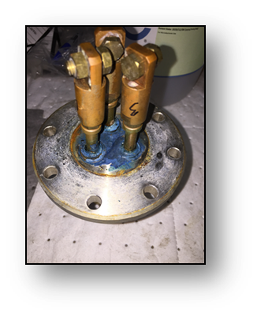
Spring/Summer 2016
Plan: 10 week run
– Deliver up to 11 GeV to Hall A and
– 12 GeV to Hall D for physics,
– 2.2 GeV to Hall B on (some) weekends
• Central Cryoplant issues
– ~3 weeks lost
• Machine Recovery not satisfactory (~2 weeks lost)
– Reset Machine,
– Run extended to April 25, but significant short fall compared to
ambitions
– Performed well during last weeks
• Potential low energy operations in Hall B for Prad experiment
• Test Run of Low Energy Recirculator Facility
– Machine restored with support from Commonwealth funding
– First operations for Nuclear Physics (Darklight) experiment

Slide 6
CEBAF Three-Year Schedule
Feb 2016
Calendar Year
2016
2017
2018
Fiscal Year
2016
2017
2018
Accelerator
Activity
Opportunistic
Physics
Physics
Physics
Beam
Activity
SBS Construction
Hall A
Activity
Opportunistic
Physics
Physics
Physics
Beam
CLAS12 Construction/Installation
Hall B
Activity
Activity
Non-CLAS12 Ops*
Physics
Physics
Beam
Hall C
Activity
SHMS Construction/Installation
Activity
Comm.
Physics
Physics
Beam
Opportunistic
Physics
Physics
Physics
Hall D
Activity
Beam
* Potential PRad Summer 2016 run
Beam for Commissioning
Beam for Physics
Non-CLAS12 Ops

Slide 7
12 GeV Approved Experiments by Physics Topics
Topic | Hall A | Hall B | Hall C | Hall D | Other | Total
The Hadron spectra as probes of QCD (GlueX and heavy baryon and meson spectroscopy) |  | 1 |  | 3 |  | 4
The transverse structure of the hadrons (Elastic and transition Form Factors) | 5 | 3 | 2 | 1 |  | 11
The longitudinal structure of the hadrons (Unpolarized and polarized parton distribution functions) | 2 | 3 | 6 |  |  | 11
The 3D structure of the hadrons (Generalized Parton Distributions and Transverse Momentum Distributions) | 5 | 9 | 7 |  |  | 21
Hadrons and cold nuclear matter (Medium modification of the nucleons, quark hadronization, N-N correlations, hypernuclear spectroscopy, few-body experiments) | 6 | 3 | 7 |  | 1 | 17
Low-energy tests of the Standard Model and Fundamental Symmetries | 3 | 1 |  | 1 | 1 | 6
TOTAL | 21 | 20 | 22 | 5 | 2 | 71

Slide 8
12 GeV Approved Experiments by PAC Days
Topic | Hall A | Hall B | Hall C | Hall D | Other | Total
The Hadron spectra as probes of QCD (GlueX and heavy baryon and meson spectroscopy) |  | 119 |  | 540 |  | 659
The transverse structure of the hadrons (Elastic and transition Form Factors) | 145.5 | 85 | 102 | 25 |  | 357.5
The longitudinal structure of the hadrons (Unpolarized and polarized parton distribution functions) | 65 | 230 | 165 |  |  | 460
The 3D structure of the hadrons (Generalized Parton Distributions and Transverse Momentum Distributions) | 409 | 872 | 212 |  |  | 1493
Hadrons and cold nuclear matter (Medium modification of the nucleons, quark hadronization, N-N correlations, hypernuclear spectroscopy, few-body experiments) | 180 | 175 | 201 |  | 14 | 570
Low-energy tests of the Standard Model and Fundamental Symmetries | 547 | 205 |  | 79 | 60 | 891
TOTAL | 1346.5 | 1686 | 680 | 644 | 74 | 4430.5
Total Approved Run Group Days (includes MIE) | 1346.5 | 826 | 637 | 424 | 74 | 3307.5
A Decade of Experiments

Slide 9
Program Advisory Committee
Charge
  Review new proposals, previously conditionally approved proposals, and letters of intent for experiments that will utilize the 12 GeV upgrade of CEBAF and provide advice on their scientific merit, technical feasibility and resource requirements.
  Identify proposals that represent high quality physics within the range of scientific importance represented by the previously approved 12 GeV proposals and recommend for approval.
  Also provide a recommendation on scientific rating and beam time allocation for proposals newly recommended for approval.
  Identify other proposals with physics that have the potential for falling into this category pending clarification of scientific and/or technical issues and recommend for conditional approval. Provide comments on technical and scientific issues that should be addressed by the proponents prior to review at a future PAC.
PAC44 – July 25, 2016
Proposals due June 6

Slide 10
Jeopardy
Previous policy (6 GeV era):
The laboratory has a three-year Jeopardy Rule that was devised both to reduce the beamtime backlog and to ensure that the ratings of all approved experiments continue to accurately reflect their scientific priority. Jeopardy begins three years after a proposal is approved. Previously approved experiments that have not yet been run or scheduled must return to the PAC for a review of their status.
Will begin the process of “Jeopardy” in the next few years
Have requested input from JLab Users on the process
Proposal for discussion at June user meeting

Slide 11
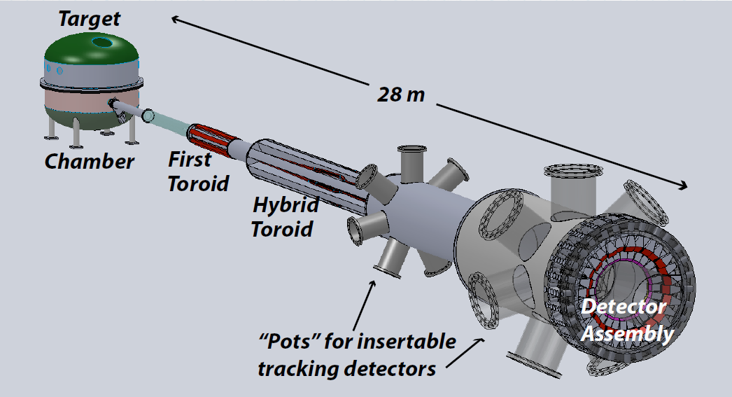
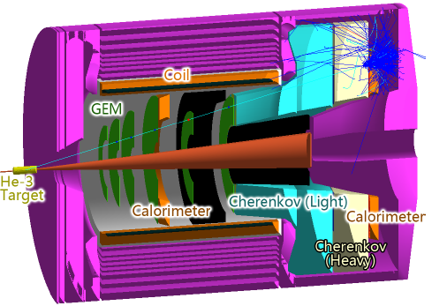
Future Projects
MOLLER experiment
(Possible MIE – FY17-20)
– Standard Model Test
– DOE science review (September 2014) – strong endorsement
– Technical, cost & schedule reviews?
– Now hope for FY18 start
SoLID
– Chinese collaboration
– CLEO Solenoid 
– Director’s review (Feb. 2015)
 lots of good feedback
– Collaboration briefing to DOE-NP
(Nov. 2015)

Slide 12
Budget
Omnibus FY16: JLab allocation is $1.5M below Pres. budget.
– Keep 16 weeks running
– Retain staff
– Delay some activities, accelerator spares  increased risk
FY2017
– Letter from 6 Senators supporting Nuclear Physics at LRP level ($645M)
– “Directors” visit Cherry Murray, Head of Office of Science on Jan 16.
– Pres. Budget release Feb. 9: NP at $636
– $8M included for End Station Cryo upgrade
NP day on the Hill – March 14

Slide 13
(C. Murray – March NSAC presentation)

Slide 14

$2.5M below our plan based
on guidance from last year
 23 weeks running (+3 commissioning)
(C. Murray – March NSAC)
Note: Senate mark = PB, House mark = PB-$16M

Slide 15
JLab Operations Budget
During FY01-FY12, CEBAF ops averaged 34.5 weeks/year (best year FY05 at 42 weeks)
For 12 GeV era we estimate “optimal” operations at
37 weeks per year
FY17 Pres. Budget includes JLab ops at $104M.
– Would fund 23 weeks (+ 3 weeks from 12 GeV project)
FY18+ at cost of living implies 23 weeks/year running
(62% of optimal)
We propose FY18+ at 30 weeks/year (81%), will require ~$6M increase in operations budget.

Slide 16

2015 NSAC Long Range Plan
NSAC = Nuclear Science Advisory Committee
Advise DOE and NSF on future of Nuclear Physics program every 5-7 years
Four recommendations
Two initiatives
Recommend modest budget growth at 4.5% per year

Slide 17
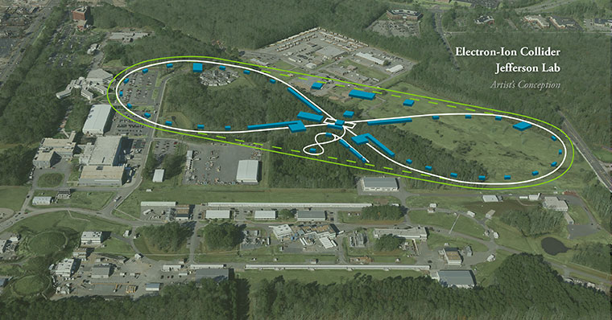
JLEIC: EIC at Jefferson Lab

Slide 18
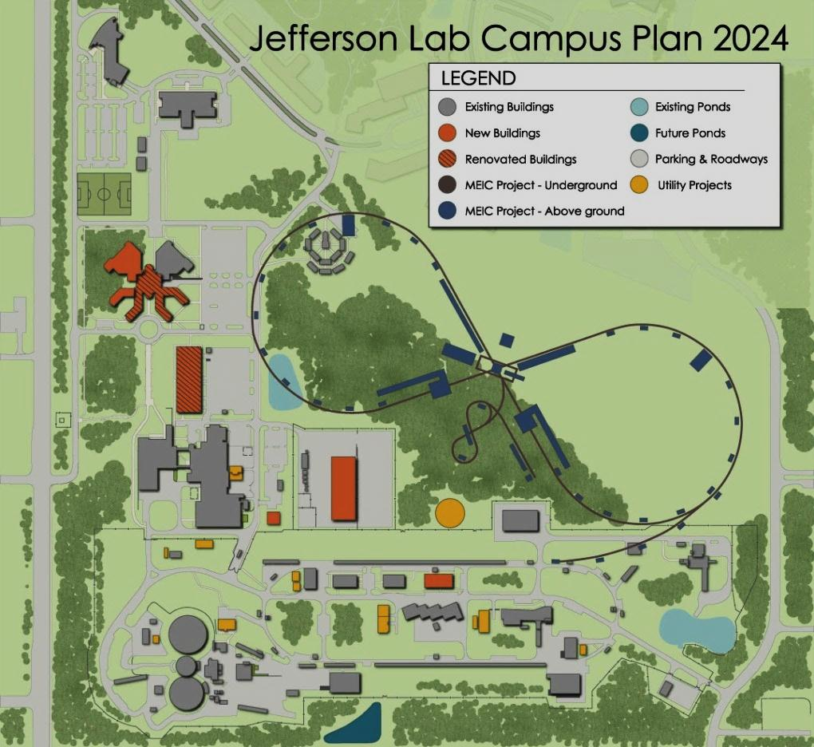
JLEIC: EIC at Jefferson Lab
JLab EIC Figure 8 Concept
Initial configuration:
  3-10 GeV on 20-100 GeV ep/eA collider
  Optimized for high ion beam polarization:
    polarized deuterons
  Luminosity:
    up to few x 10³⁴ e-nucleons cm⁻² s⁻¹
    Low technical risk
    Upgradable to higher energies
    250 GeV protons + 20 GeV electrons
    Flexible timeframe for Construction
    consistent w/running 12 GeV CEBAF
    Thorough cost estimate completed
    presented to NSAC EIC Review
    Cost effective operations
    Fulfills White Paper Requirements
Current Activities
Site evaluation (VA funds)
Accelerator, detector R&D
Design optimization
Cost reduction
Notes:
Deleted
Brightened graphic (no more shame); added current activities from previous version;
Mary Beth please format text

Slide 19
EIC Developments
EIC User meeting – Berkeley Jan. 6-9
NAS study being planned for this year
SLAC will increase involvement in JLEIC
– Responsible for e-ring
Rik Yoshida joined JLab March 2016 to lead the JLEIC physics/detector effort
Next EIC User meeting at ANL July 7-10, 2016
DOE-NP will increase EIC accel. R&D in FY17
– Through ‘tax’ on JLab/BNL
– Peer review planned for summer 2016

Slide 20
EIC Timeline
Activity Name | 2010 | 2011 | 2012 | 2013 | 2014 | 2015 | 2016 | 2017 | 2018 | 2019 | 2020 | 2021 | 2022 | 2023 | 2024 | 2025
12 GeV Operations
12 GeV Upgrade
FRIB
EIC Physics Case
NSAC LRP
NAS Study
CD0
EIC Machine Design and R&D
CD1(Down-select)
CD2/CD3
EIC Construction
CD0 = DOE “Mission Need” statement; CD1 = technology and site selection (VA/NY)
CD2/CD3 = establish project baseline cost and schedule

Slide 21
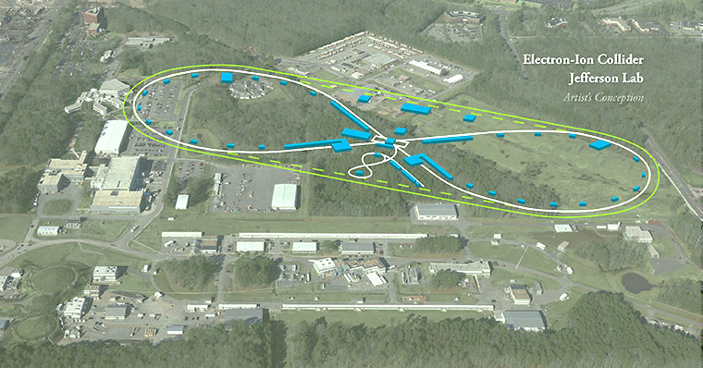
Summary
12 GeV Upgrade making good progress
Commissioning, startup of physics program in progress
Tight FY16 budget but will run 16 weeks
FY17 Pres. budget is less than we hoped for
Concern about ops budget in out years
NSAC LRP released
  Good for JLab
  Requires modest budget growth
  Recommends future EIC construction
Exciting Times Ahead

