Slide 1

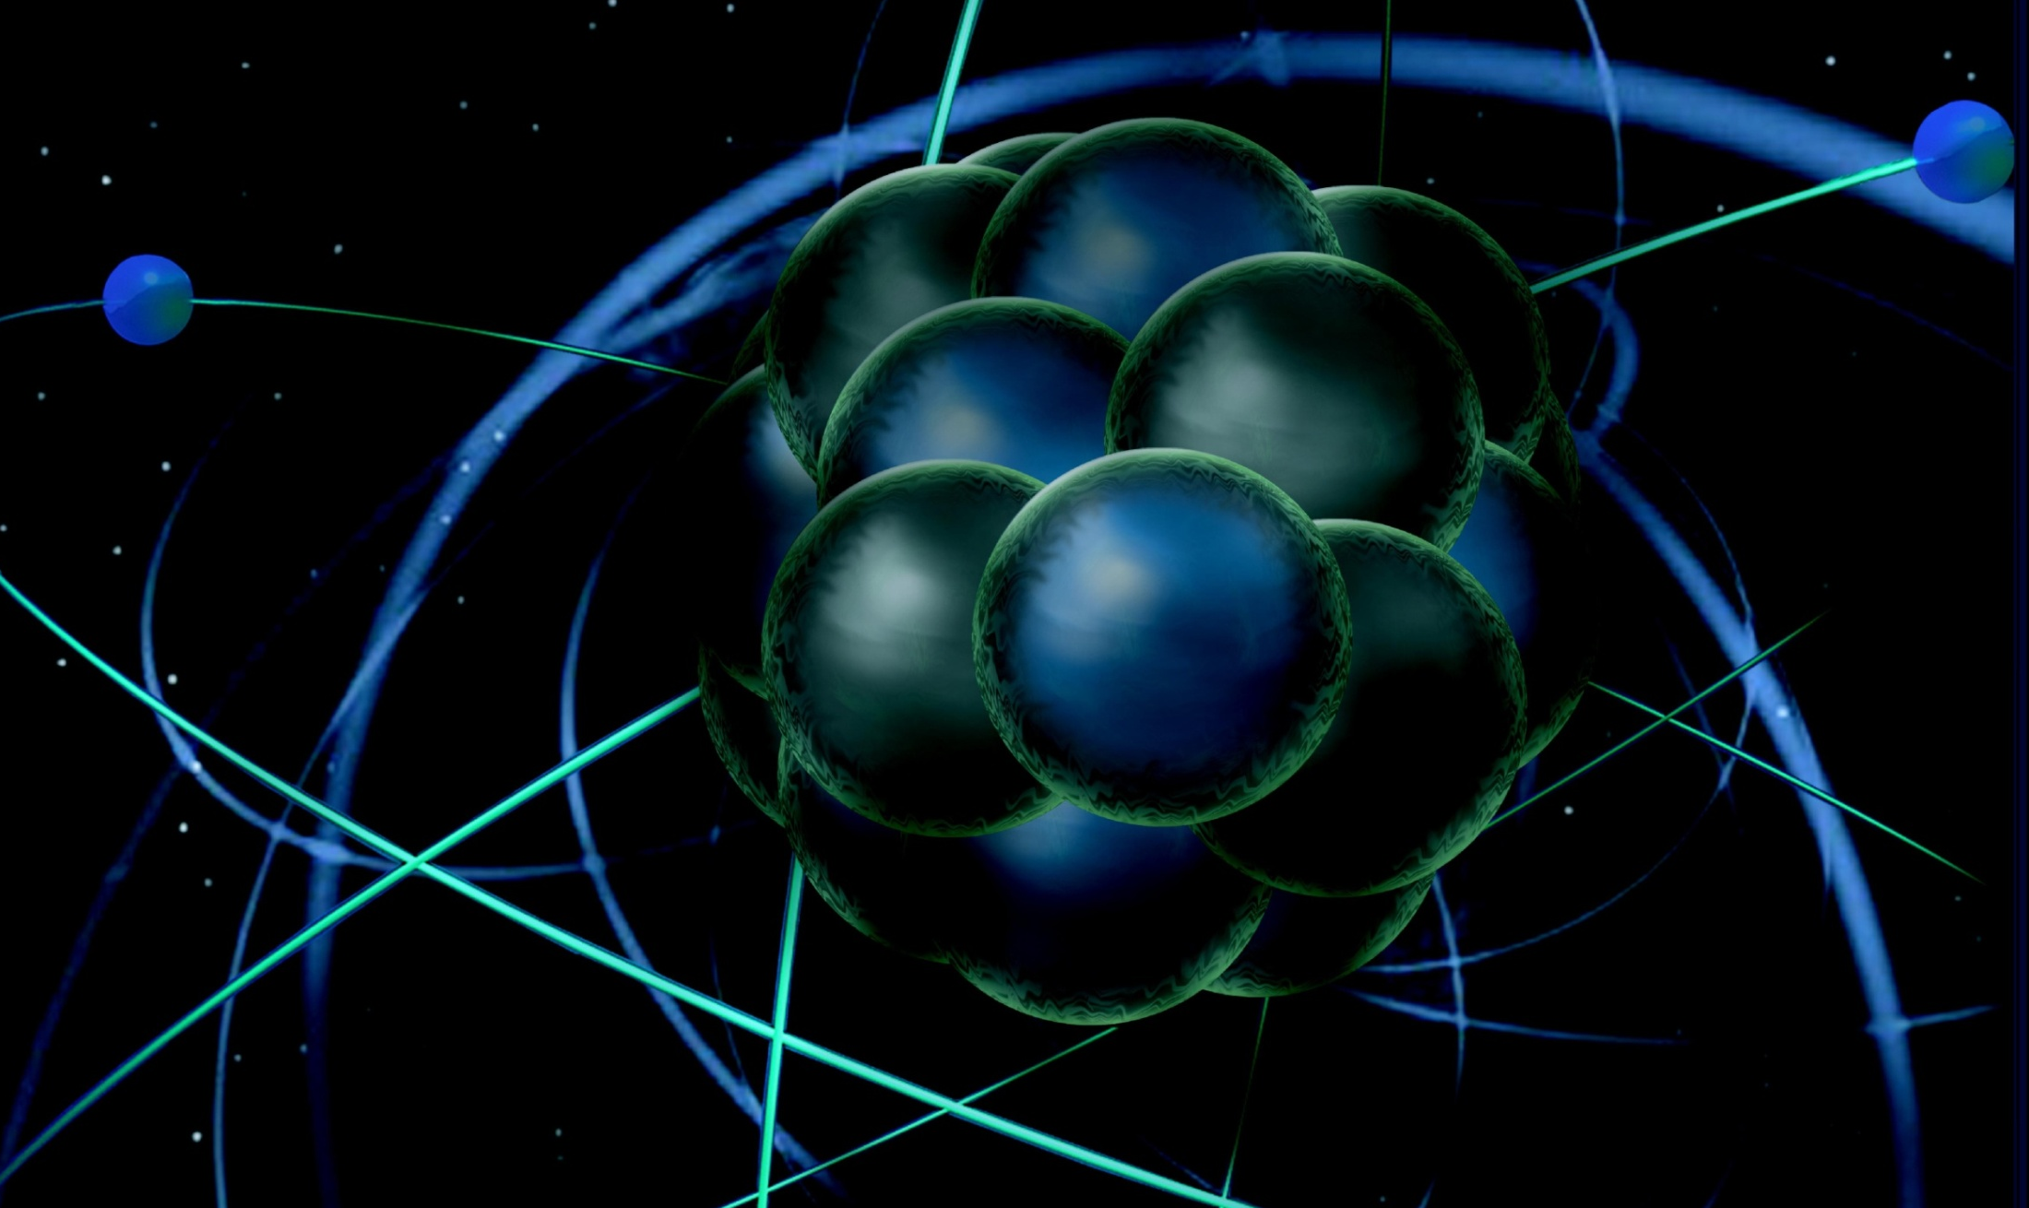
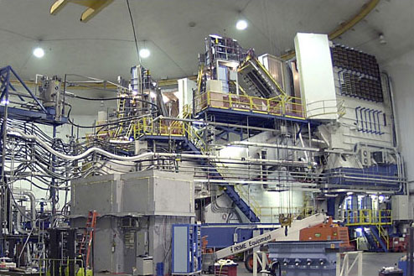
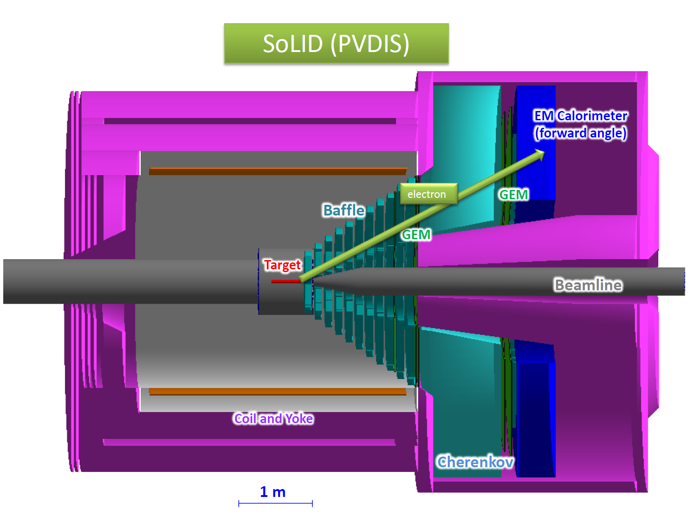
Hall A Update
Thia Keppel
SoLID Collaboration Meeting
May 2016

Slide 2
Hall A Projected Experiment Schedule, updated 5/2016
Experiments in red represent PAC42 “high impact” experiments
Spring | Fall | Spring | Fall | Spring | Fall | Spring | Fall
DVCS –I/ GMp | DVCS –I/ GMp
 |  | DVCS –I/ GMp | ³H/³He group
 |  |  |  | ³H/³He group Ar(e,e’p)* | TBD: nothing! APEX PREX12 CREX A₁^{n} DVCSII | TBD: APEX PREX12 CREX A₁^{n} DVCSII
 |  |  |  |  |  |  | SBS Start?
run “group”
run “group”
CY
2015
X
CY 2016
CY
2017
CY
2018
*best effort

Slide 3

DVCS-I and G_{M}^{p}: Concurrent Experiments in Hall A at 11 GeV
10 calendar weeks in Spring’16
High impact experiment for 3D nucleon imaging
  Deeply Virtual Compton Scattering (DVCS) provides access to Generalized Parton Distributions (GPDs)
Will provide highest available Q² measurement of the DVCS cross section
  Demonstration of scaling critical to full JLab 12 GeV GPD program
DVCS
6.6
8.8
11 GeV
Fall’14
x
x
x
2
3
1 days
G_{M}^{p}
x
x
x
x
6.6
8.8
11 GeV
5 days
4
4
4
x
x
x
x
8.8
11 GeV
13
16 days
13
20
        Both polarimeters operational during DVCS/GMp
High Q² Form Factors
  Reducing G_{M}^{p} uncertainties will enable Super BigBite high impact program of Form Factor Measurements

Slide 4
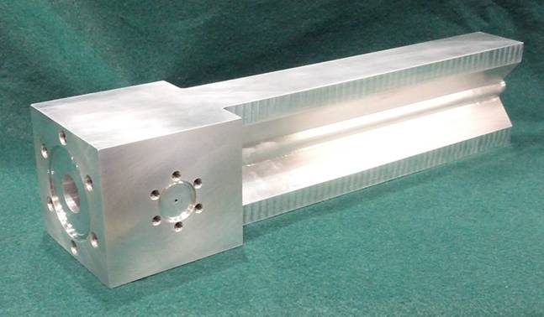
Tritium Experiment Preparations
Four ³H experiments, 2 PAC 40 “high impact”
  12 graduate students
Successful target safety/design review September 2015
Successful ERR March 2016
  Final report issued April 2016
Installation to begin this Summer

Slide 5
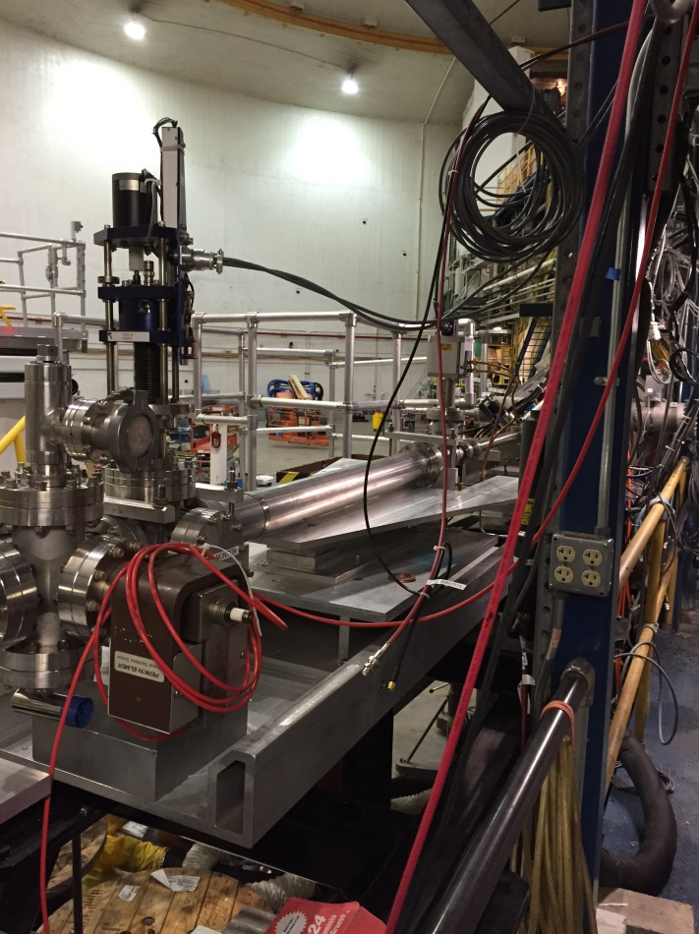
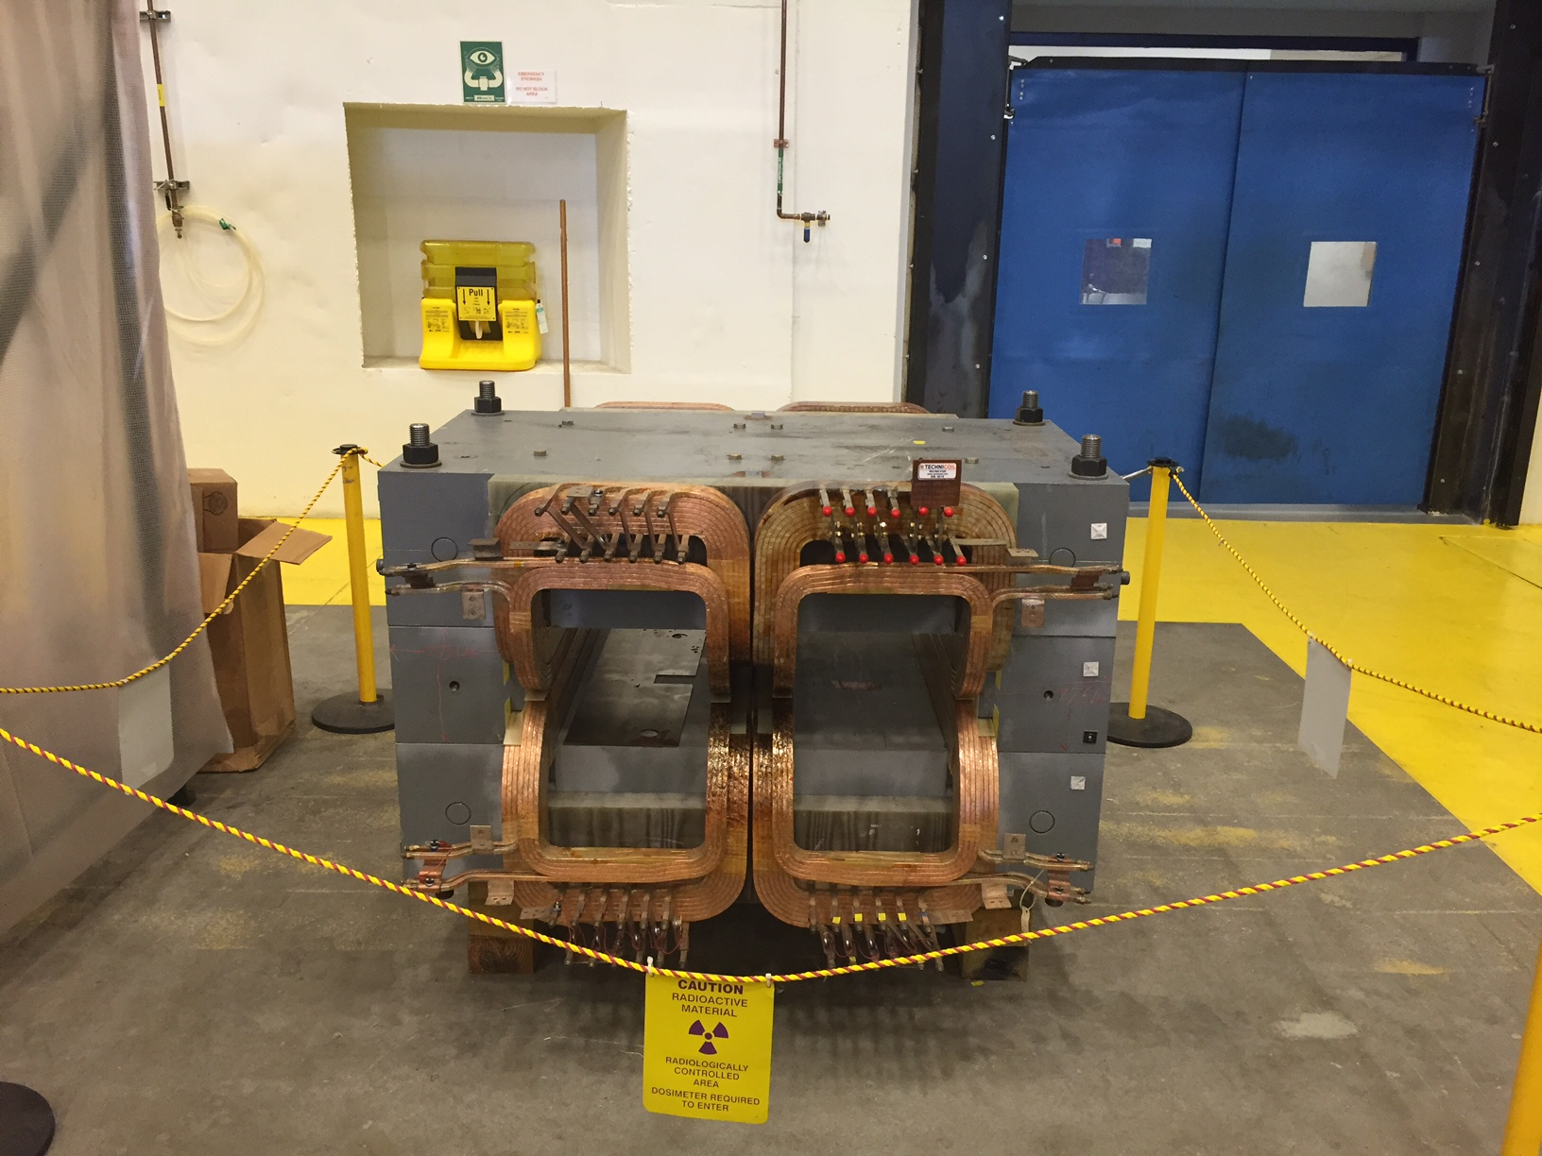
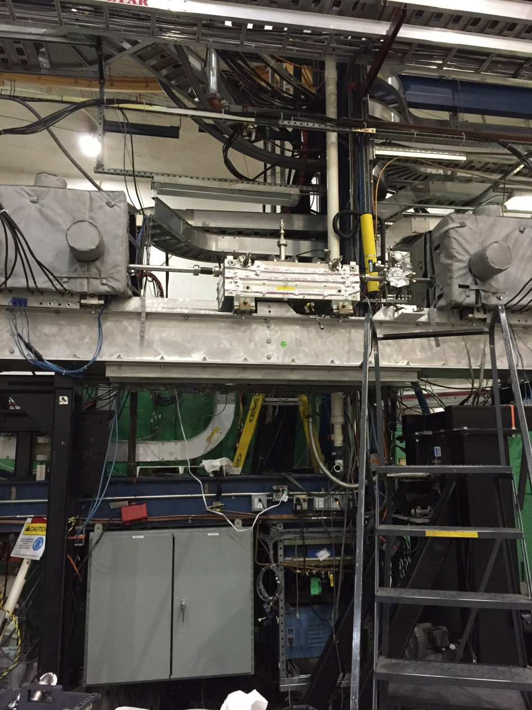
Beyond ³H
    PREX-II/CREX
      ERR early June 2016
      Combined target chamber (CREX upstream),
      Computation fluid dynamics for target design
      Pb and diamond targets, new coils purchased (and here at lab)
      Beamline upgrade testing underway
        Second x,y,Q girder (from Hall C), new “Musson” cavity electronics, Hall C halo monitor, lumi monitors installed in A and in use during DVCS/GMp
        Encourage PVDIS involvement
      Polarimetry
        Push towards higher precision

Slide 6
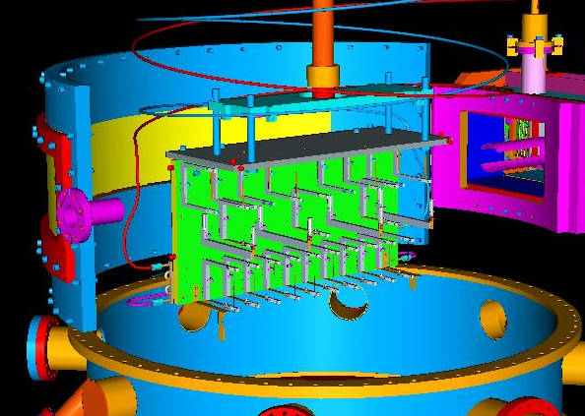
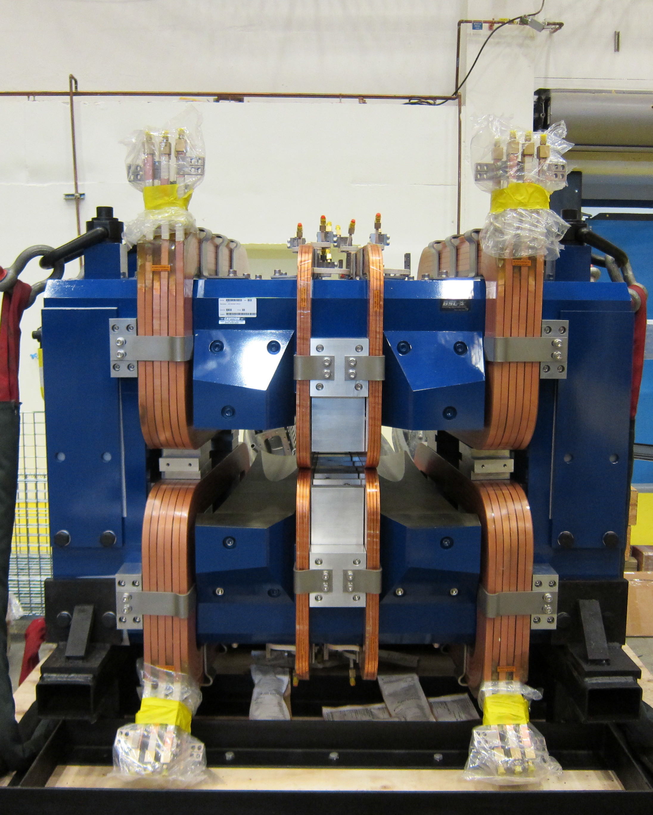
Beyond ³H
    APEX
      Successful ERR April 2016
      New septum magnet purchased by collaboration
        Water fittings, busbar, connections near complete (JLab)
      Computation fluid dynamics for target design
    Polarized ³He target improvements and continued development
      Convection, new lasers, metal windows, …
      Draft design report received in January, final to be completed by June 2016

Slide 7
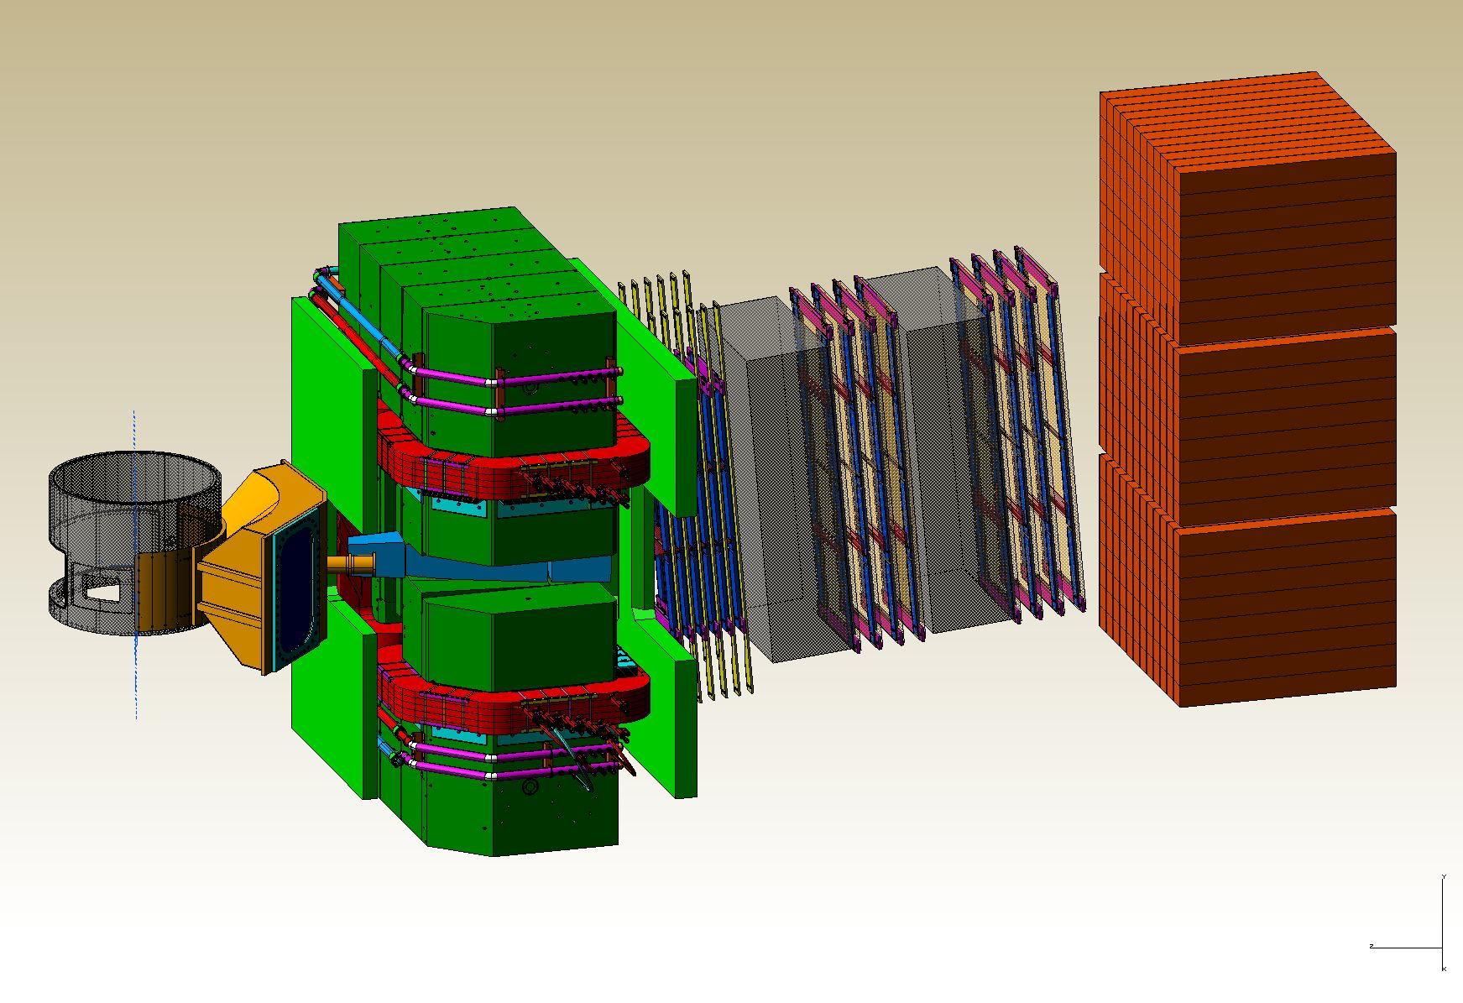
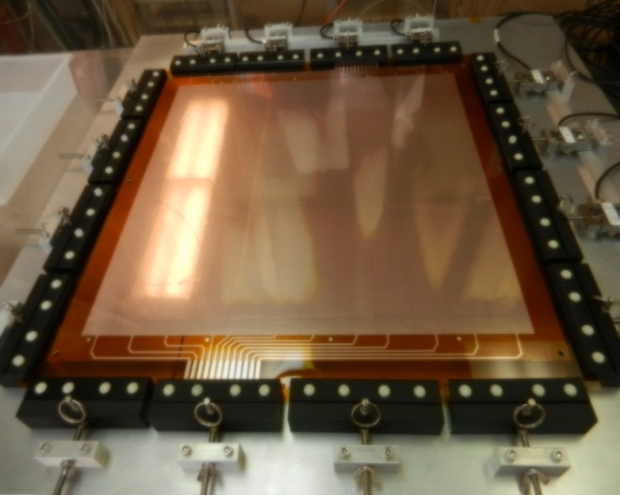
SBS Construction
Project started October 2012 (FY13)
  Successfully passed third annual review November 2015
  Some concerns about thermal annealing/design of ECAL and 3He target timelin
  Overall very positive, project on track
Spectrometer, ECAL work at Jlab
GEM construction at UVA
Coordinate detector at Idaho State
HCAL Hadron calorimeter at CMU and JLab

Slide 8
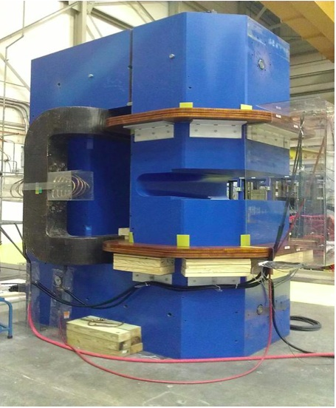
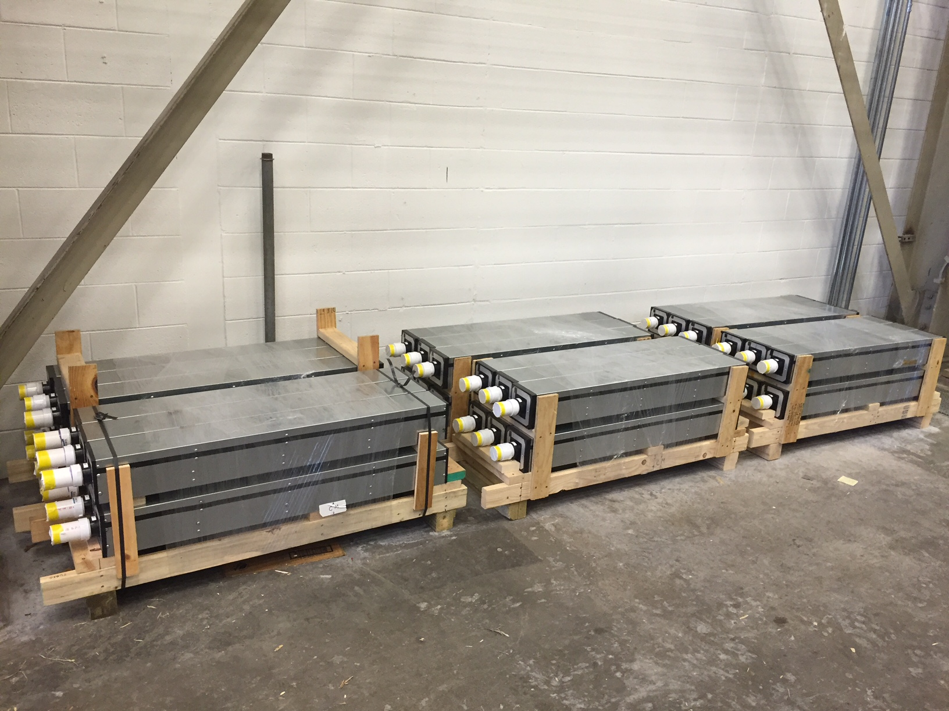
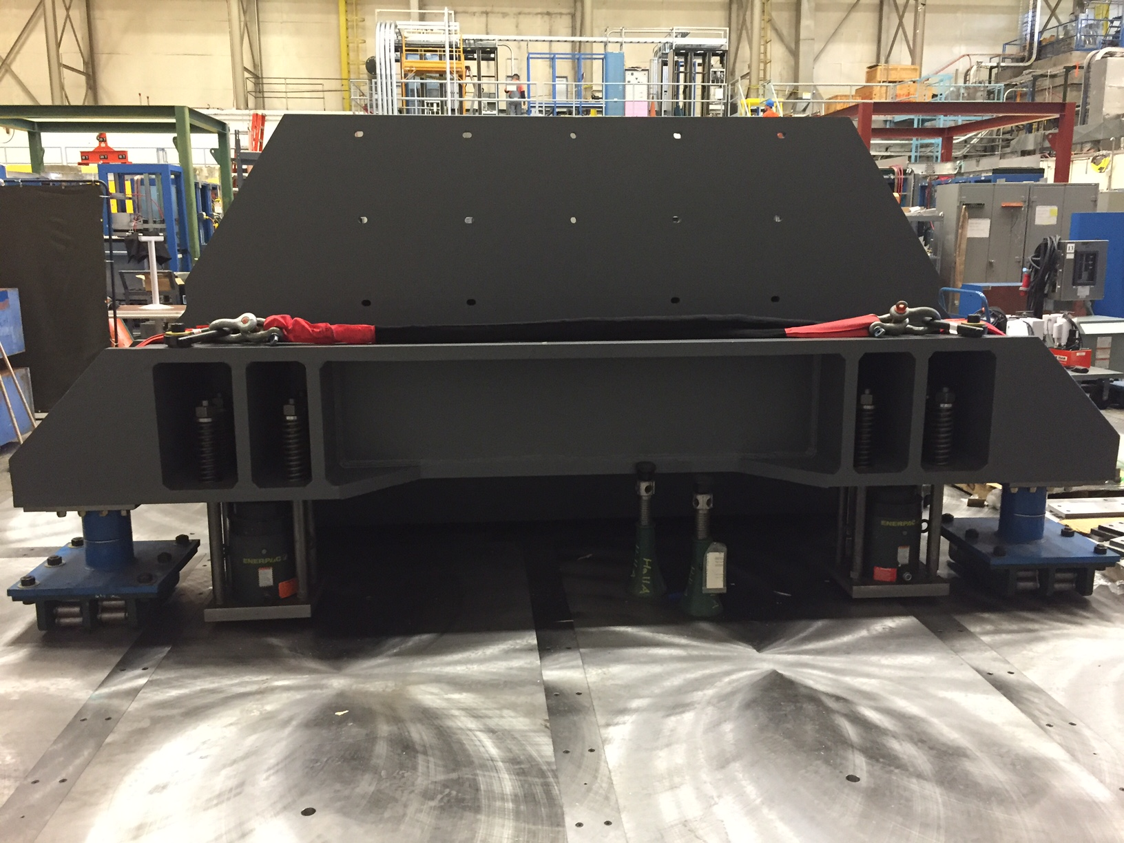

Slide 9
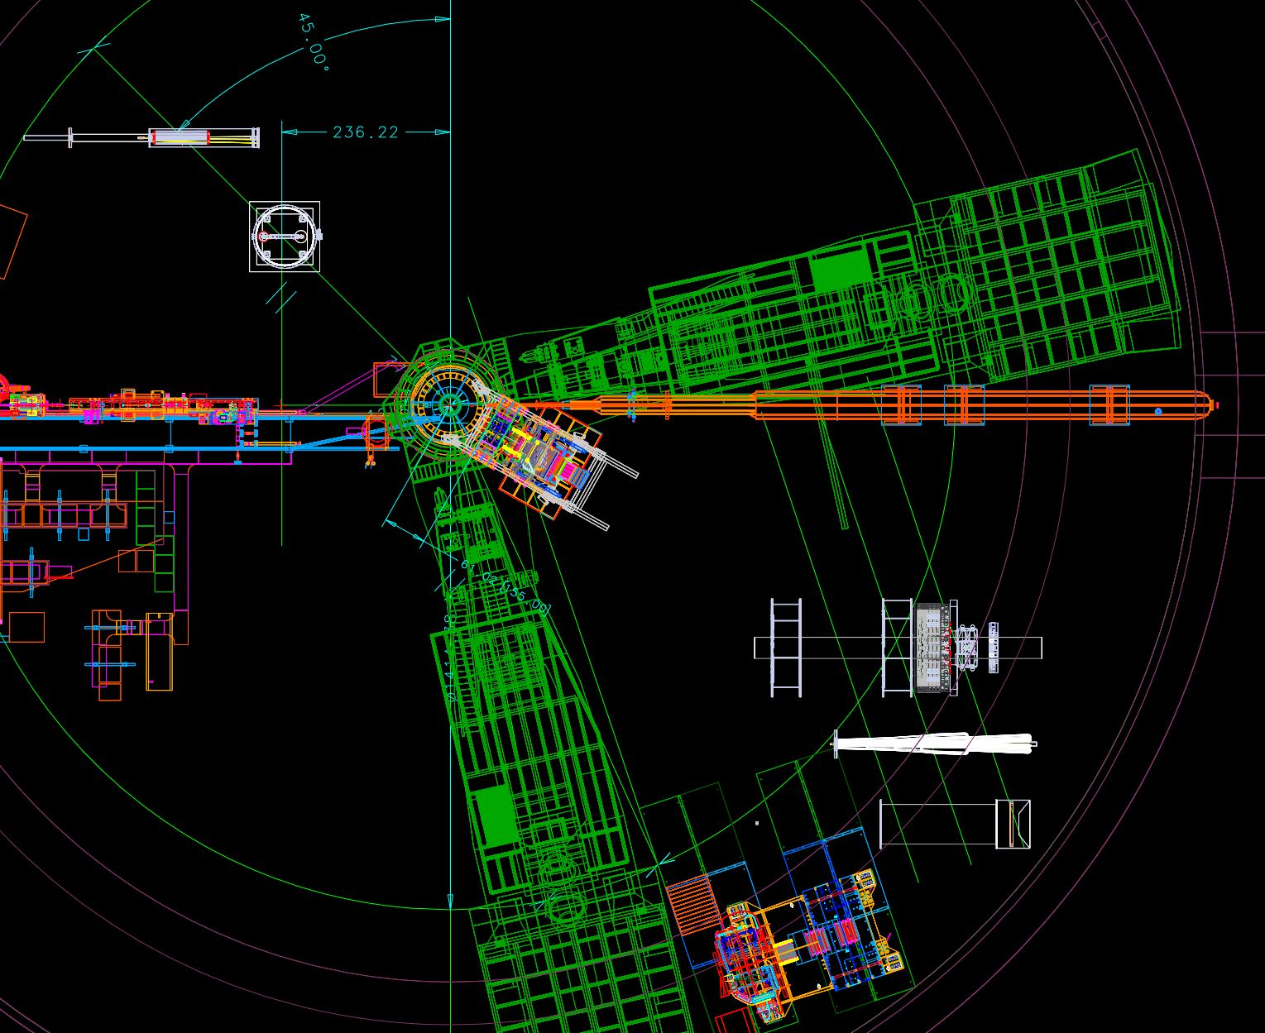
Moving to more future installations – MOLLER and SoLID

Slide 10
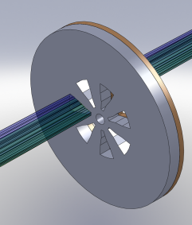
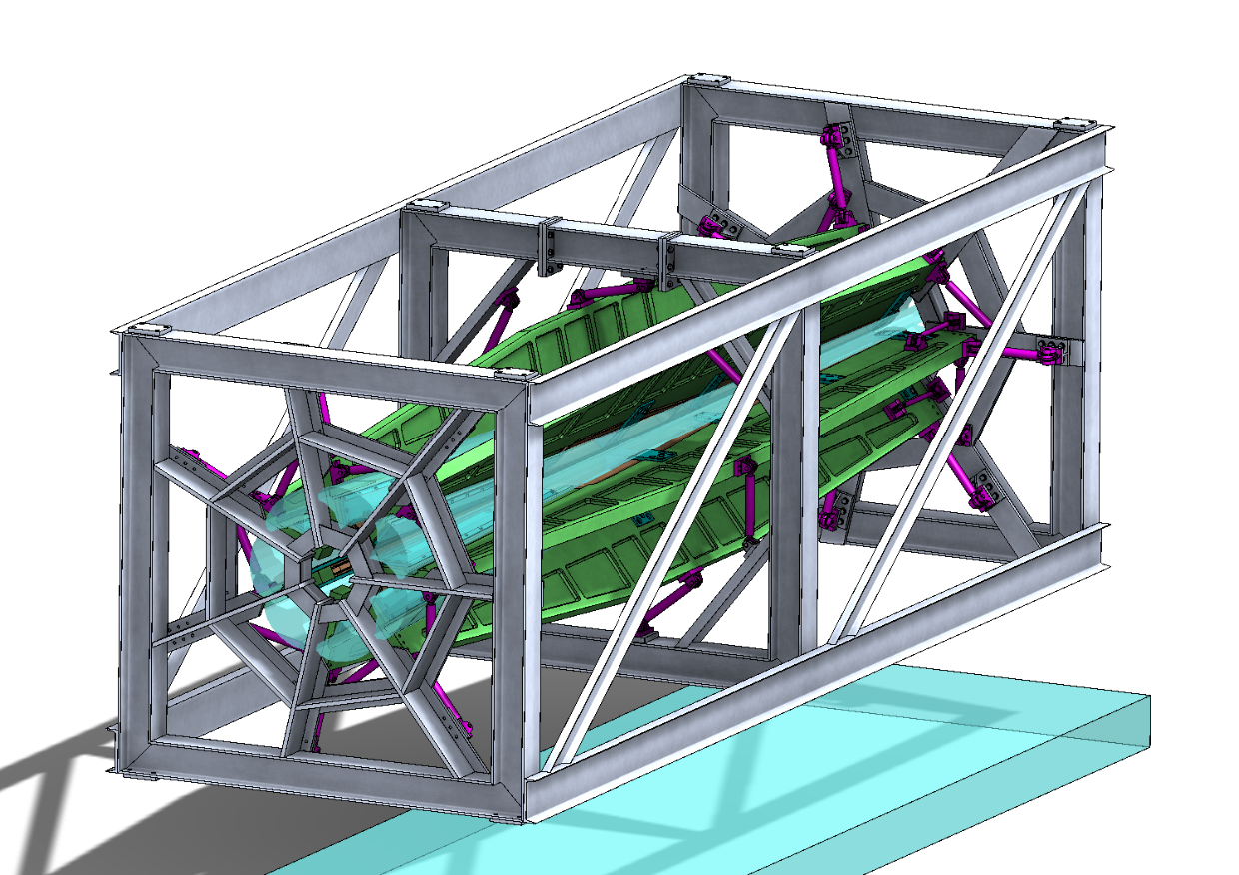
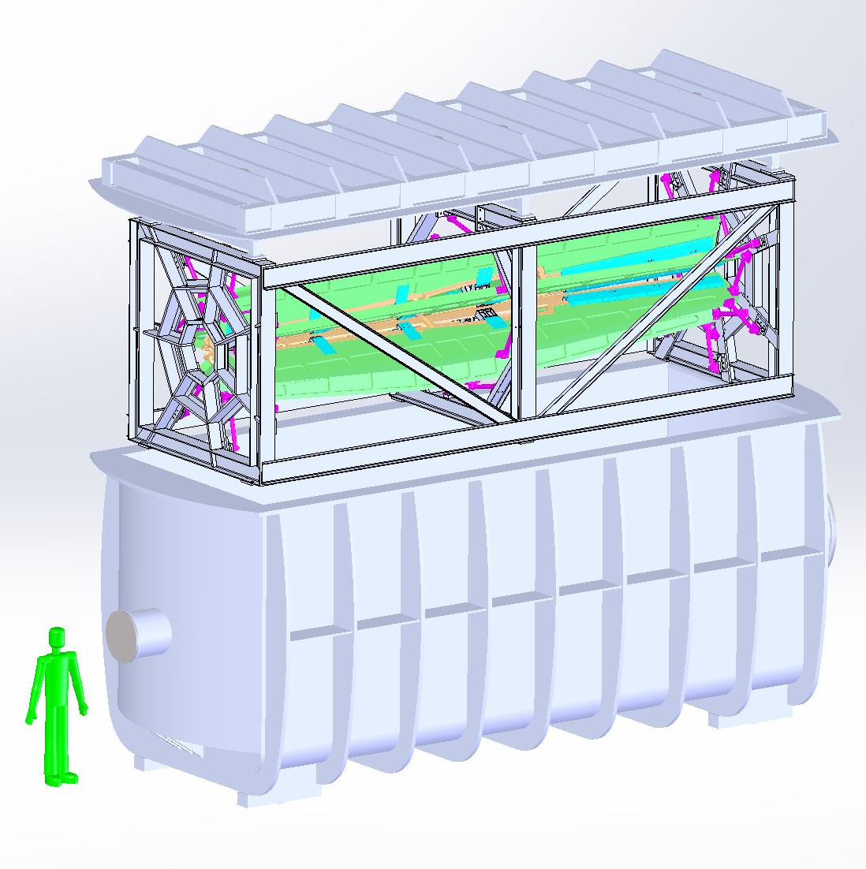
MOLLER
    Successful Science Review September 2014
    Supporting ongoing magnet and collimator development work at MIT
    New Moller polarimeter (in place)
    Preparing for Director’s cost, schedule, technical review in 2016
    Looking towards CD0

Slide 11
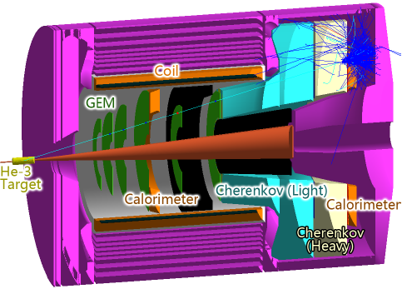
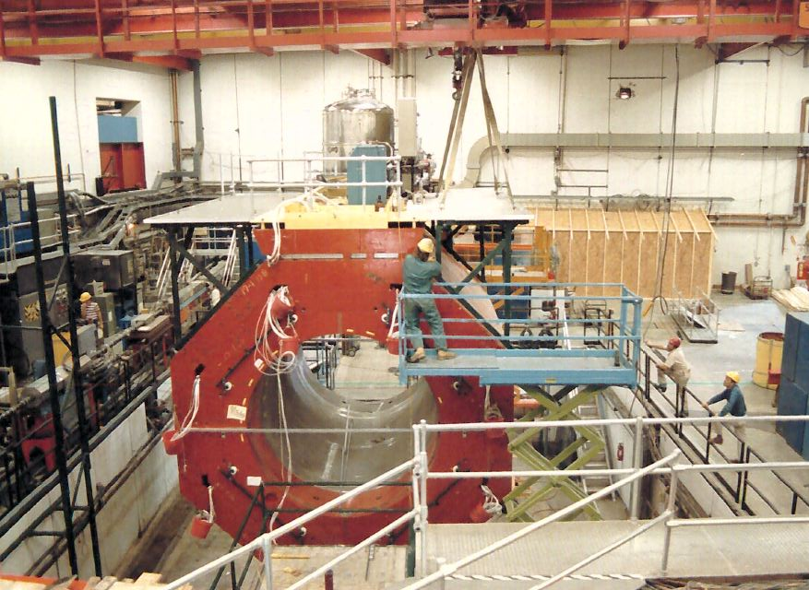
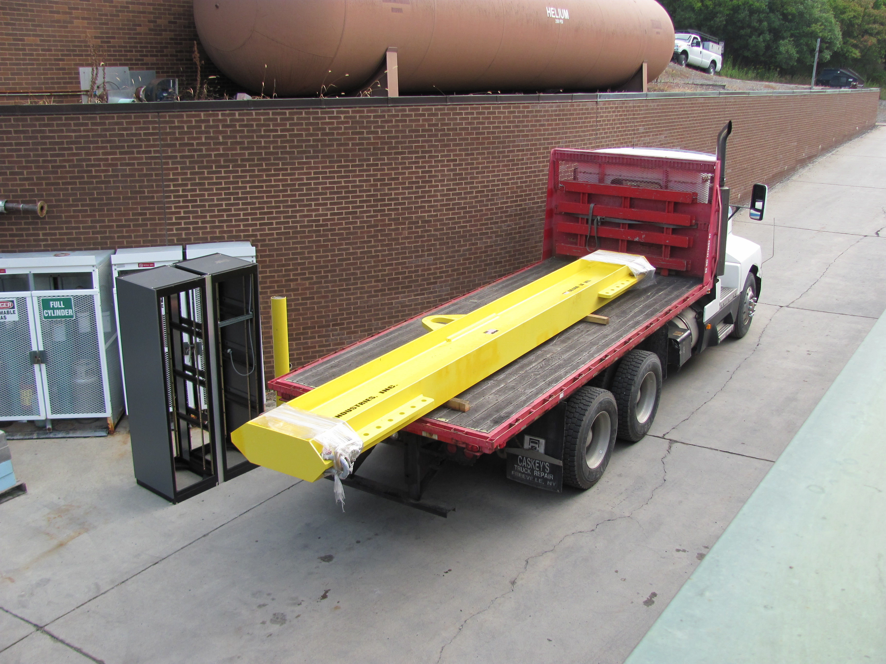
SoLID
    Director’s Review February 23,24, 2015
      addressing recommendations
    TMD Workshop at Stony Brook Jan 2016
    Cornell to disassemble solenoid through Summer 2016
      Assist and observe (Hall A team to have presence at Cornell throughout Summer)
      Anticipate move to JLab FY 2017 (October 2016)
    Looking towards Science Review in 2017, CD0 in 2018

Slide 12
Thanks!

