Slide 1

Time-of-flight with LAPPD MCP-PMTs & MRPC
Junqi Xie, Mickey Chiu
on behalf of Detector R&D group
Argonne National Laboratory
Brookhaven National Laboratory
SoLID Collaboration Meeting, May 6-7, 2016

Slide 2
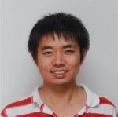
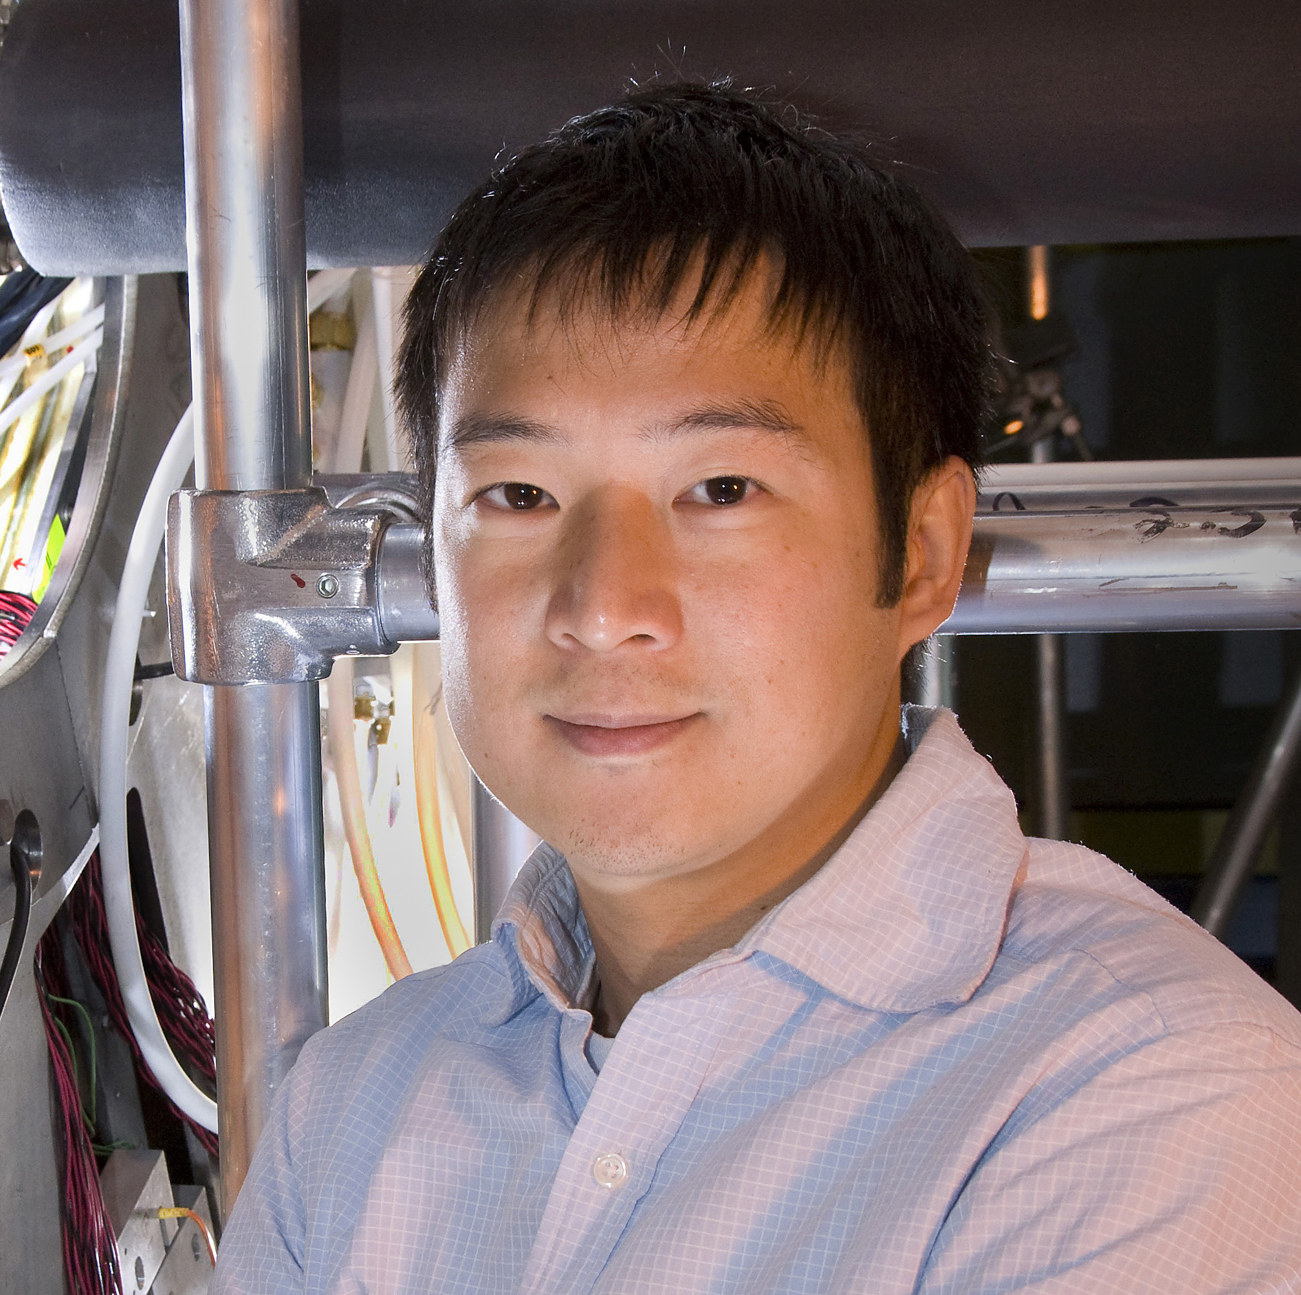
Glad to join SoLID collaboration to contribute
Junqi Xie
Assistant Physicist
Detector R&D group
Argonne National Laboratory
Mickey Chiu
Physicist
Director of Operations, PHENIX
Brookhaven National Laboratory
We are also collaborating in particle identification detectors for sPHENIX and EIC

Slide 3
Time-Of-Flight Detectors
Goal(s):
- Initial plan is to have MRPC <100 ps for pion identification up to 2.5 GeV/c
- Above 2.5 GeV/c Heavy Gas Cherenkov for pion identification
- Kaon identification more demanding requirements:
better separation and higher in momentum
requires <30 ps resolution with the SoLID SIDIS environment
- Tsinghua U: upgrade/improved hardware could make MRPC intrinsic to <20 ps
need readout system upgrade
Expanding collaboration effort
- Joint effort with EIC R&D project, Micky Chiu joined SoLID
EIC R&D achieved <20 ps on bench test, lab test now
options for readout system
- Option with (LA)PPD detector R&D, Junqi Xie joined SoLID
See Junqi’s talk for details
J.P. Chen’s slide

Slide 4
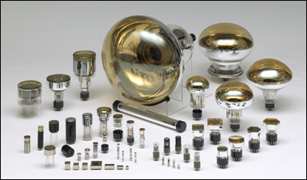
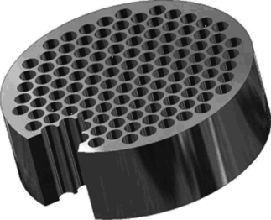
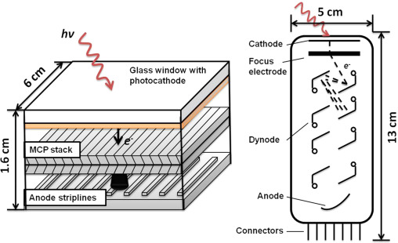
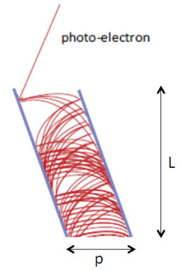
Option 1: MCP-PMTs
Micro-channel plate (MCP) replacing traditional
dynode
Thin plate with micro pores (pore size < 30 μm, thickness ~ 5 mm)
Each pore behaves like an electron multiplier
E field

Slide 5
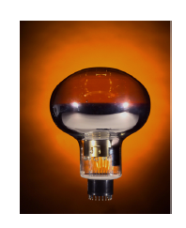
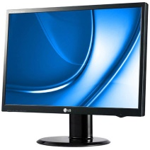
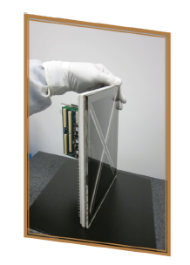
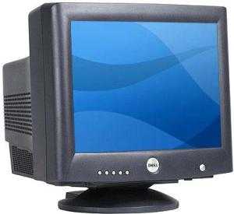
Large Area Picosecond PhotoDetector (LAPPD)
The LAPPD project reinvents photodetectors using transformational technologies.
Goals: low-cost, large-area (20 cm x 20 cm), picosecond-timing
Applications: picosecond timing, millimeter spatial resolution on large-area
High energy physics: optical TPC, TOF, RICH
Medical imaging: PET scanner, X-ray imaging devices
National security: Detection of neutron and radioactive materials

Slide 6
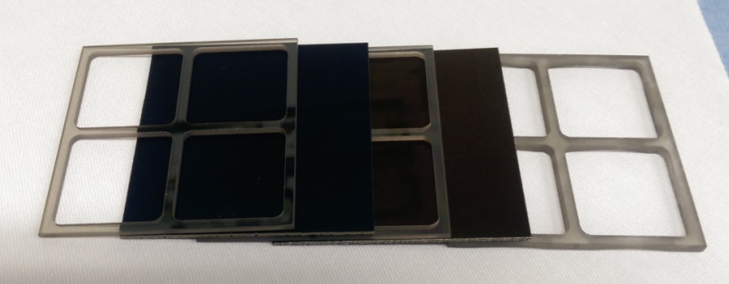
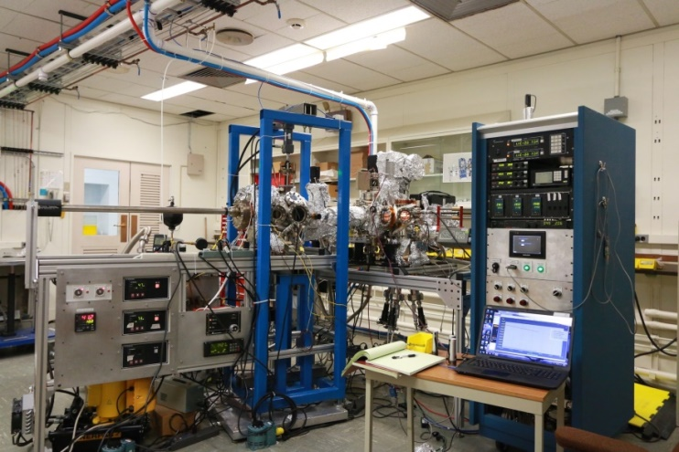
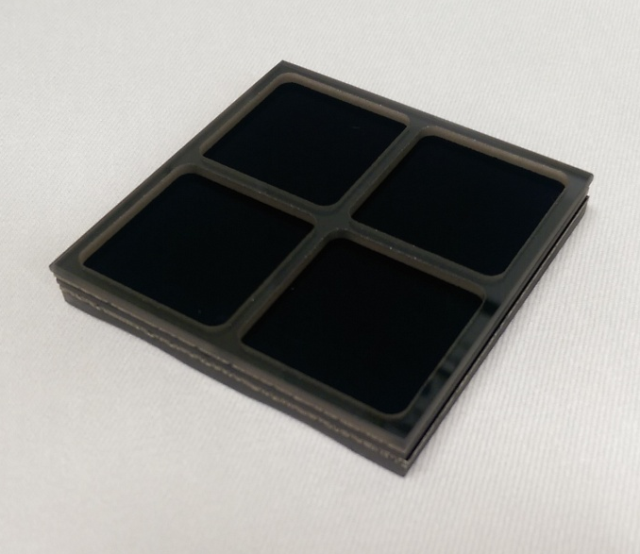
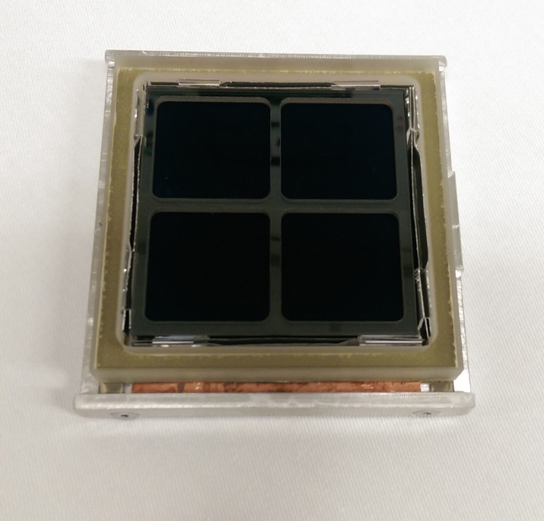
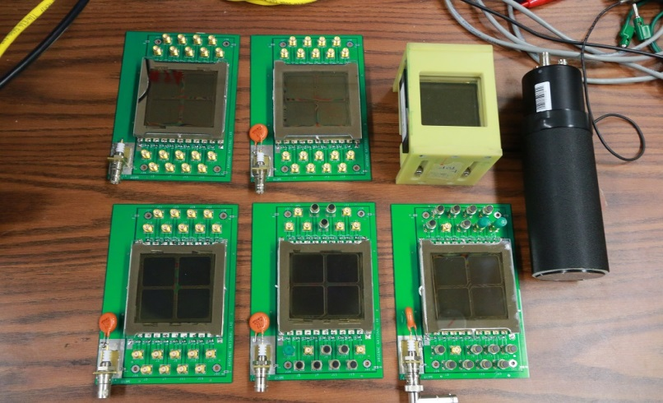
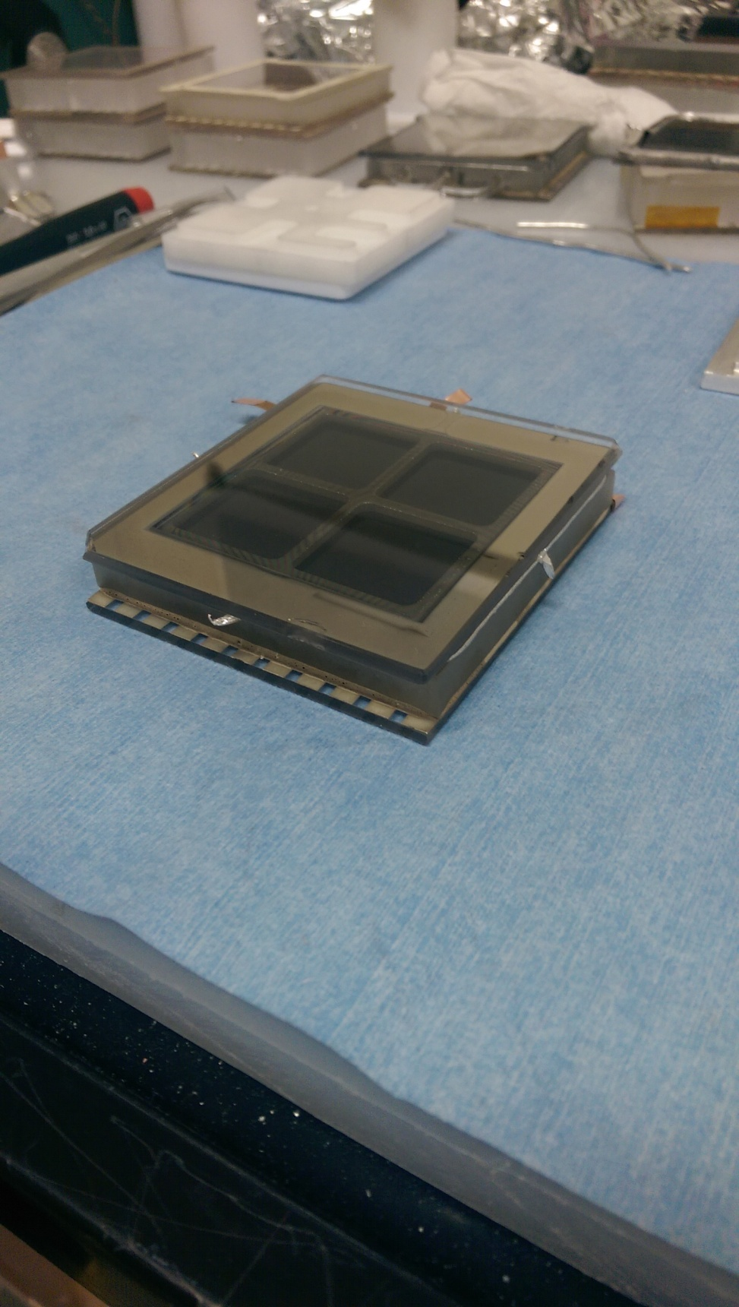
Tube production
MCP & Resistive Grid Spacer Stack
Glass LTA
Completed Tube
11 tubes are produced Jun. – Dec. 2015
Assembling a pre-baking chamber to produce 1 tube/week

Slide 7
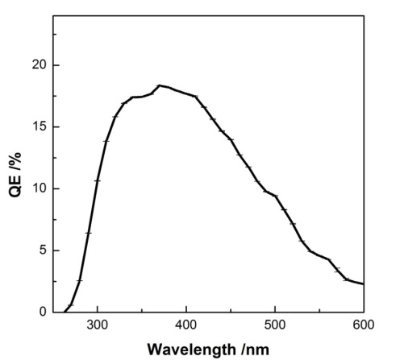
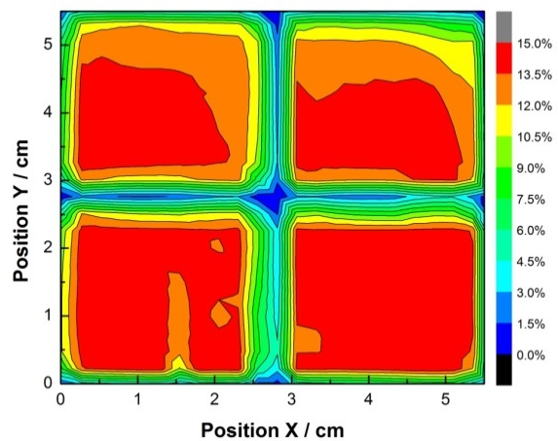
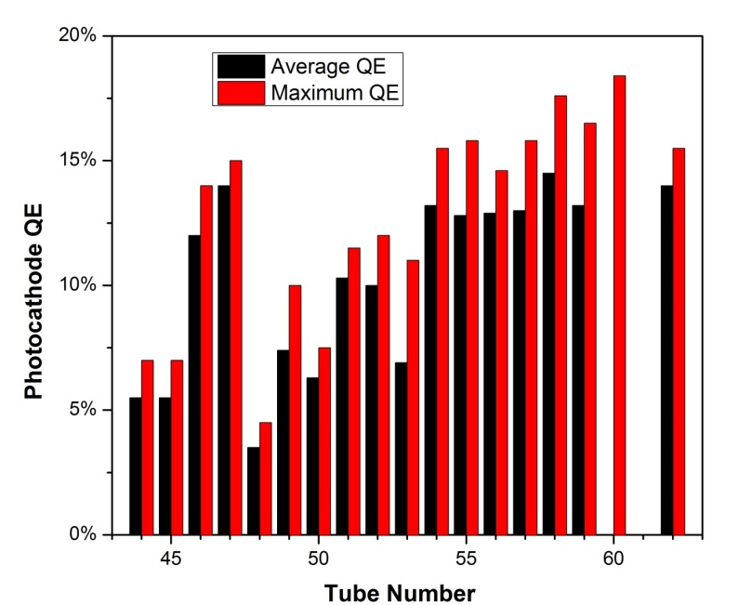
Key performances
Signals / frequency components
Spectra response
0.5 ns
rise time
goal 20%
18%
Signal bandwidth
up to1.3 GHz

Slide 8
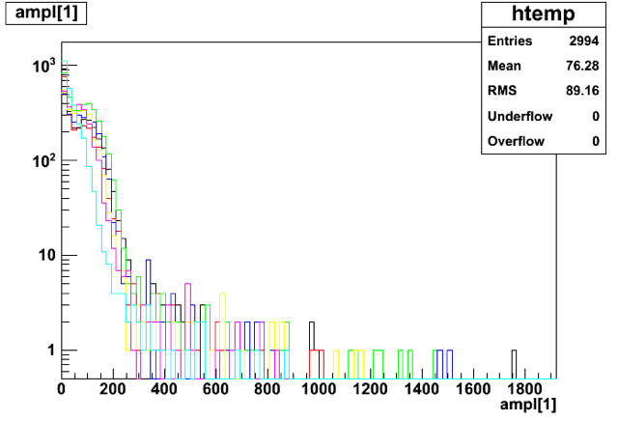
Key performances
Gain
10⁸
Gain as high as 7X10⁷
Time resolution σ_{overall} ~35 ps, TTS <20 ps
Laser start time jitter: σ_{laser} ~30ps
Rate capability: > 75KHz/cm²/s
10⁷
10⁶
Overall time resolution
Rate capability
100 ps
75KHz/cm²/s
50 ps
30 ps

Slide 9
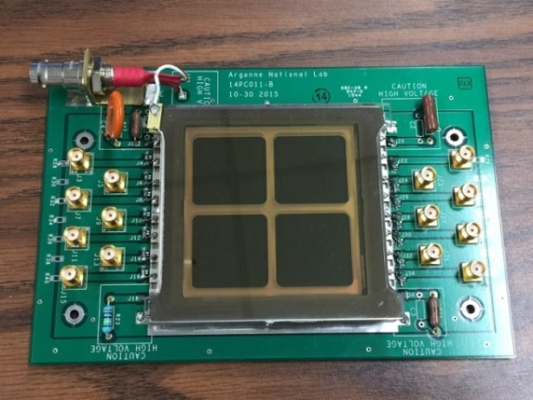
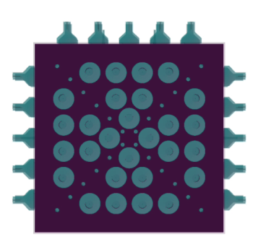
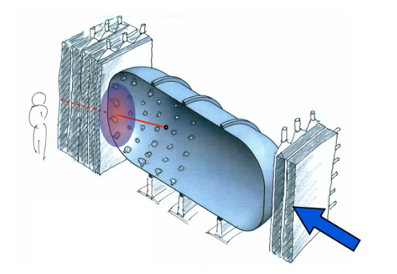
Future development path
Optimization in geometry for fast timing, magnetic field immunity
Pad readout
Background testing at JLab for Solid
……
SoLID, sPHENIX, EIC
Feedback
from users helps to improve
the design
Today
TARDIS
Small-scale adoption
in various experiments
Notes:
Cryogenic user? Have a plan.

Slide 10


Option 2: Multi Gas Gap Resistive Plate Chamber (MRPC)
Invented in 1996, Crispin Williams et al, CERN → New generation of TOF detector
Cost effective compared to scintillator + PMT based TOF
Easy to build a large area detector
Free from the magnetic field effect
Essential Concepts
Floating resistive plates in between electrodes
Space charge limits avalanche growth to be below streamer transition
Recombination cuts ionic charge residual in the gas gap
Differential readout reduces noise and is helpful to obtain good time resolution.
130 mm
active area 70 mm
Working, ~ 80 ps time resol. : ALICE, STAR, PHENIX, FOPI
Achieved for high rates (20 kHz/cm²), ~80 ps time resol: CBM
Aiming for 10 ps time resol. : EIC
Aiming for 10 ps AND high rates? : SOLID
Notes:
Basic slide on mRPC.

Slide 11
Improving Resolution Down to 10 ps?
Crispin Williams et al, NIMA 594 (2008) 39– 43
Gas gap width : 160um
BNL&UIUC Prototype, eRD14, 2015
Gas gap width : 105um
PCB
Glass
Gas gap
Narrower gap width → fast charge dominant in the induced signal → Better timing resolution
Efficiency recovered by adding more gas gaps (as well as more signal)
 | MRPC ( C. Williams et al. ) | MRPC ( UIUC & BNL)
Gas Gap Width | 160um (fishing line) | 105um (diameter of fishing line)
# of Gas Gaps | 4 stack x 6 gas gaps = 24 | 4 stack x 9 gas gaps = 36
# of thin glass layers | 4 stacks x 5 layers = 20 (250um thick glass) | 4 stack x 8 layers = 32 (210um thick glass)
Preamplifier | Differential type, NINO chip (3GHz bandwidth) | LMH6554 2.8-GHz + Evaluation Board
TDC and DAQ | Oscilloscope (Sampling speed of 10Gs) | DRS4-V5(5Gs) + PC
Time resolution | 30 ps with cosmic ray/ 16 ps at T10 beam test CERN | Cosmic ray test / Beam halo test at COMPASS
Notes:
Main points are that making more gaps and thinner gaps will improve the timing resolution. We compare here to the mRPC built by C. Williams (parameters are on the left), and to that built by us for eRD14. Main differences are that we use 105 um gaps (vs 160), and we also have 36 gaps vs 24.

Slide 12
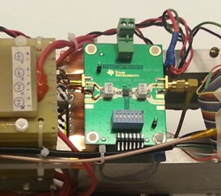
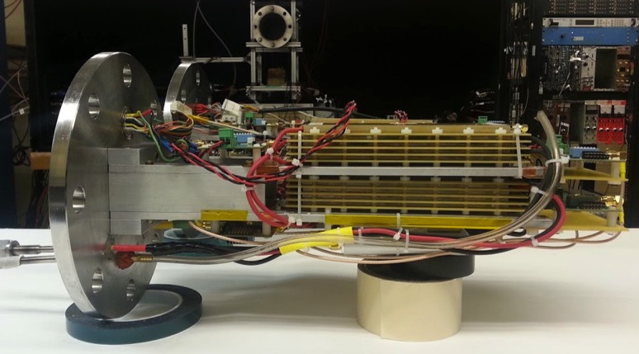
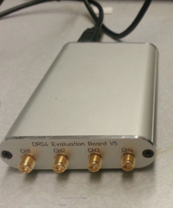
eRD14 Glass MRPCs
Gas chamber in the cosmic ray test stand at UIUC
Differential Preamp.
TI, LMH 6881
2.8GHz bandwidth
28 v/v
MRPC1
MRPC2
Waveform
Analyzer
(DRS4-V5)
5GHz sampling
speed
Gas Input & Output
HV : 20kV ( +11kV, -11kV)
Notes:
Here is a picture of our setup, including our test readout system (TI differential preamp and DRS4 eval board). Major work would need to be done in making a custom readout for any experiment, such as SOLID (also the same case for MCP-PMTs).

Slide 13
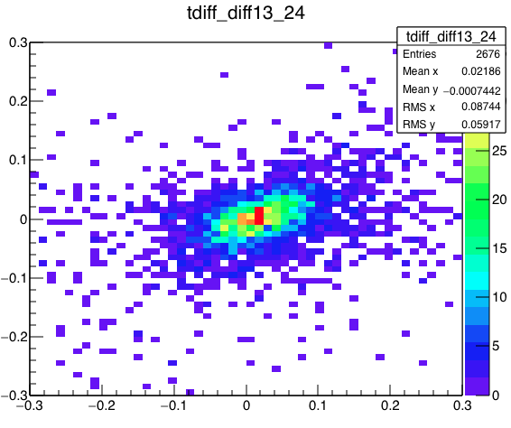
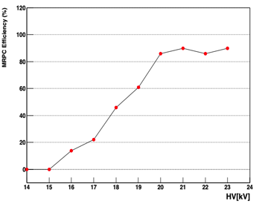
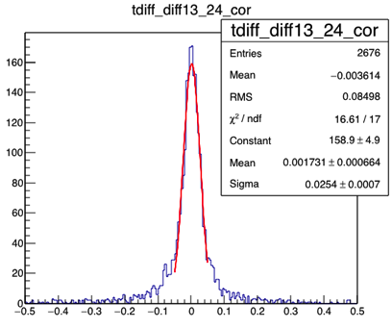
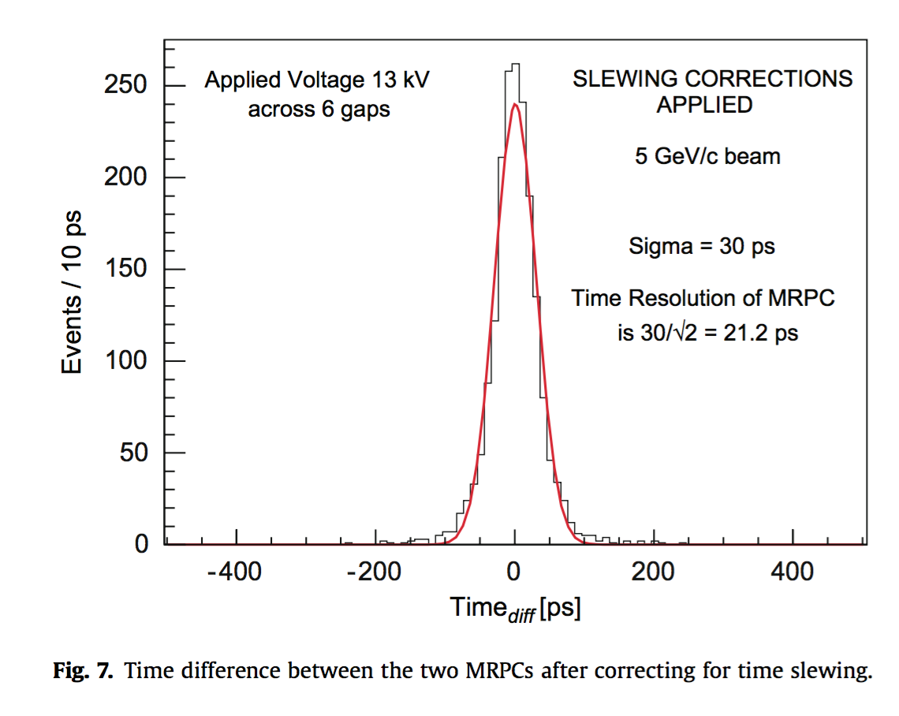
eRD14 mRPC: Efficiency and Time Resolution
Cosmic rays
22kV
Efficiency
[ns]
MRPC1- MRPC2
C. Williams
CERN, 2010
Preamp : NINO, 10 GHz, Oscilloscope
Cosmic rays
22kV
25.4ps / √2
~ 18ps
MRPC1- MRPC2
[ns]
Notes:
Our efficiency, correlation plot, and time resolution plot (starting from upper left). Lower right is the published result from Crispin Williams, so you can compare his ~20 ps with our ~18 ps.

Slide 14
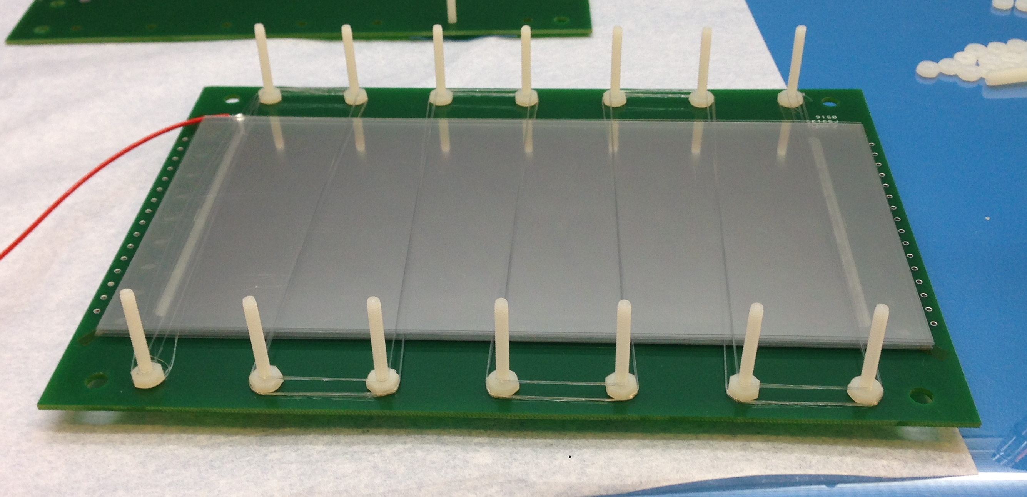
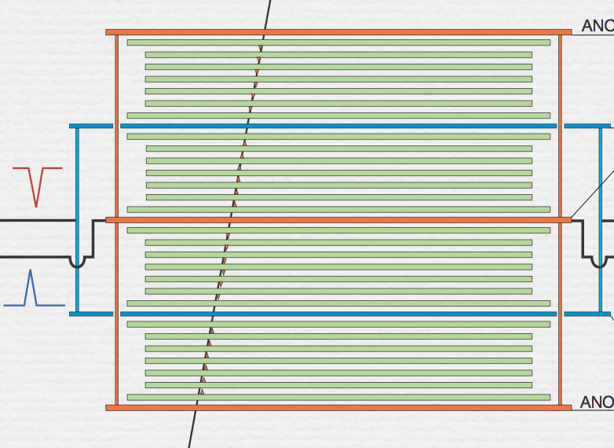
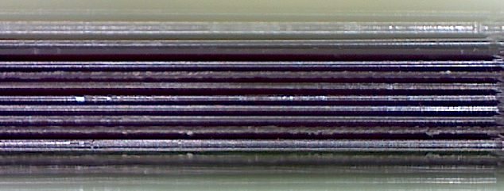
Use different material than glass (eg Mylar)?
Glass mRPC
Mylar mRPC
48 gas gaps!
One way to improve fast signal is to bring signal closer to pickup strips, or have more gaps
Thinner glass gets very expensive (and starts to become flexible)
    Use Mylar instead? Can then replace 210 um glass with 125 um Mylar
  However, rate capability should be bad? Mylar has much higher volume resistivities, 10¹⁹ Ω-cm2
Possible major technical challenge: create flat mylar layer separated from next by ~100 um (solved?)
Notes:
Here I argue why going to Mylar replacing glass should produce a better performing mRPC… The basic idea is that using thinner material such as mylar, you can make the signals closer to the pickup cathodes, or you can create more gas gaps which creates more signal. The mylar we created for the FNAL beam test had 48 gas gaps, compared to 36 for the eRD14 glass one, and 24 for the one built by Crispin Williams.

Slide 15
Summary
The Argonne MCP photodetector program has been highly successful, benefiting from advances in different disciplines.
The success of the photodetector program brings in lots of interests from many areas of science: TOF at collider, HEP neutrino experiments, medical imaging, nuclear physics experiments, national security…
Sent out devices to early users for evaluation and incorporation to experiments.
Progress has been made on MRPC for <20ps timing resolution.
Different material other than glass is planned for even faster MRPC design.
Thanks for your attention!

Slide 16
Backup Slides

Slide 17
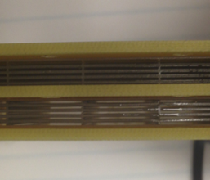
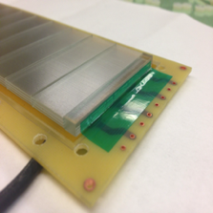
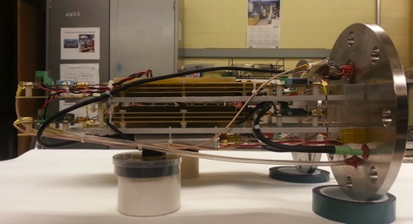
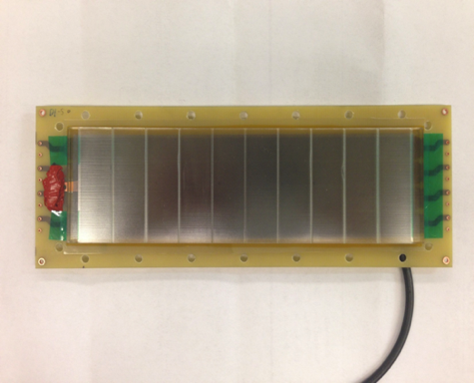
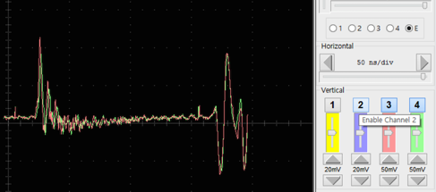
First Signals from the 3D Printed MRPCs
Two 3D printed gas gap MRPC assembled
Signals
2 stacks, 10 gas gaps, 0.3mm gas gap width
(No need to wire fishing lines)
Trigger bias
Signals captured at COMPASS hall
Not enough time to setup 3D MRPC properly for data taking before the COMPSS beam was end
Expected the first time resolution results in the beam test at Fermilab 2016!

Slide 18
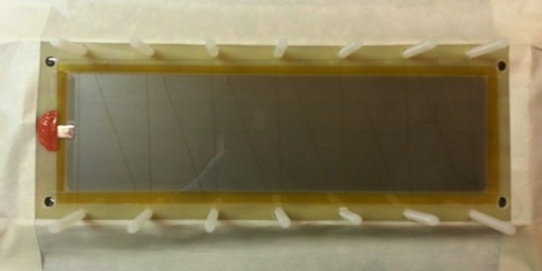
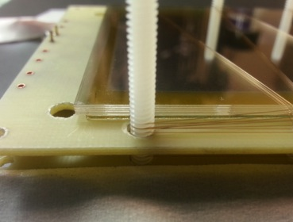
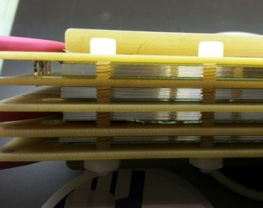
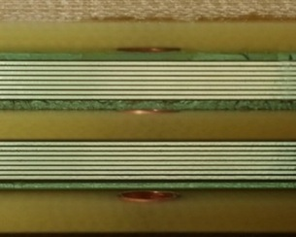
Stacking Glass with Fishing Line
105um diameter of fishing line
Stacking glass plates and fishing lines
Uniform gas gaps
Between glass plates
4 stacks : 36 gas gaps

