Slide 1
Measurement of
Double Deeply Virtual Compton Scattering
in the di-muon channel
DDVCS @ SoLID
Marie Boer, Alexandre Camsonne, Kondo Gnanvo, Nikos Sparveris, Eric Voutier*, Zhiwen Zhao et al.
SoLID Collaboration Meeting
Newport News, May 6-7, 2016

Slide 2
LOI12-15-005
Status
Phase 1 : DDVCS run parasitic to the J/ψ @ SoLID experiment.
Phase 2 : high luminosity dedicated run with specific detector configuration.
“ The PAC endorses the phase of this experiment that would be in the run group led by the E12-12-006, which is at lower luminosity than the second phase. This run would be enough to demonstrate operation of the muon system and observe the reaction, albeit at relatively low Q². Consideration of this phase will still require a run group proposal, vetted by the SoLID collaboration using whatever are the appropriate internal means. The second, high luminosity, phase must be considered as a separate proposal, along with whatever other physics goals might be achieved in the new run group defined by this high luminosity configuration. “
We wish to discuss today phase 1 of the DDVCS@SoLID experiment.
Newport News, May 6-7, 2016
2/…

Slide 3
LOI12-15-005
DDVCS Group
H. Atac⁴, W. Armstrong¹⁵, V. Bellini¹⁰, A. Blomberg⁴, M. Boer⁵, A. Camsonne¹,
G. Charles², J.-P. Chen¹, E. Cisbani⁸, M. Defurne¹², R. Dupré², S. Covrig¹, K. Gnanvo⁶, C. Gu⁶, P. Guèye¹⁴, M. Guidal², T. Hemmick¹⁶, M.K. Jones¹, S. Joosten⁴,
C. Le Galliard², N. Linayage⁶, D. Marchand², M. Mazouz¹³, Z.-E. Meziani⁴, P. Moran⁴, H. Moutarde¹², C. Muñoz Camacho², S. Niccolai², M. Paolone⁴, F. Sabatié¹²,
N. Sparveris⁴, C.M. Sutera¹⁰, A.W. Thomas¹¹, G.M. Urcioli⁹, E. Voutier², Z. Zhao³,
Z. Ye⁷
¹ Jefferson Lab, Newport News, VA, USA ² IPN, Orsay, France
³ Old Dominion University, Norfolk, VA, USA ⁴ Temple University, Philadelphia, VA, USA
⁵ Los Alamos National Laboratory, Los Alamos, NM, USA ⁶ University of Virginia, Charlottesville, VA, USA ⁷ Duke University, Durham, NC, USA ⁸ Istituto Superiore di Sanità, Roma, Italia ⁹ INFN, Roma, Italia ¹⁰ Università di Catania, Catania, Italia ¹¹ ARC, Adelaïde, Australia ¹² CEA Saclay, Gif-sur-Yvette, France ¹³ Faculté des Sciences, Monastir, Tunisia ¹⁴ Hampton University, Hampton, VA, USA
¹⁵ Argonne National Laboratory, Argonne, IL, USA ¹⁶ Stony Brook University, Stony Brook, IL, USA
Newport News, May 6-7, 2016
3/…

Slide 4
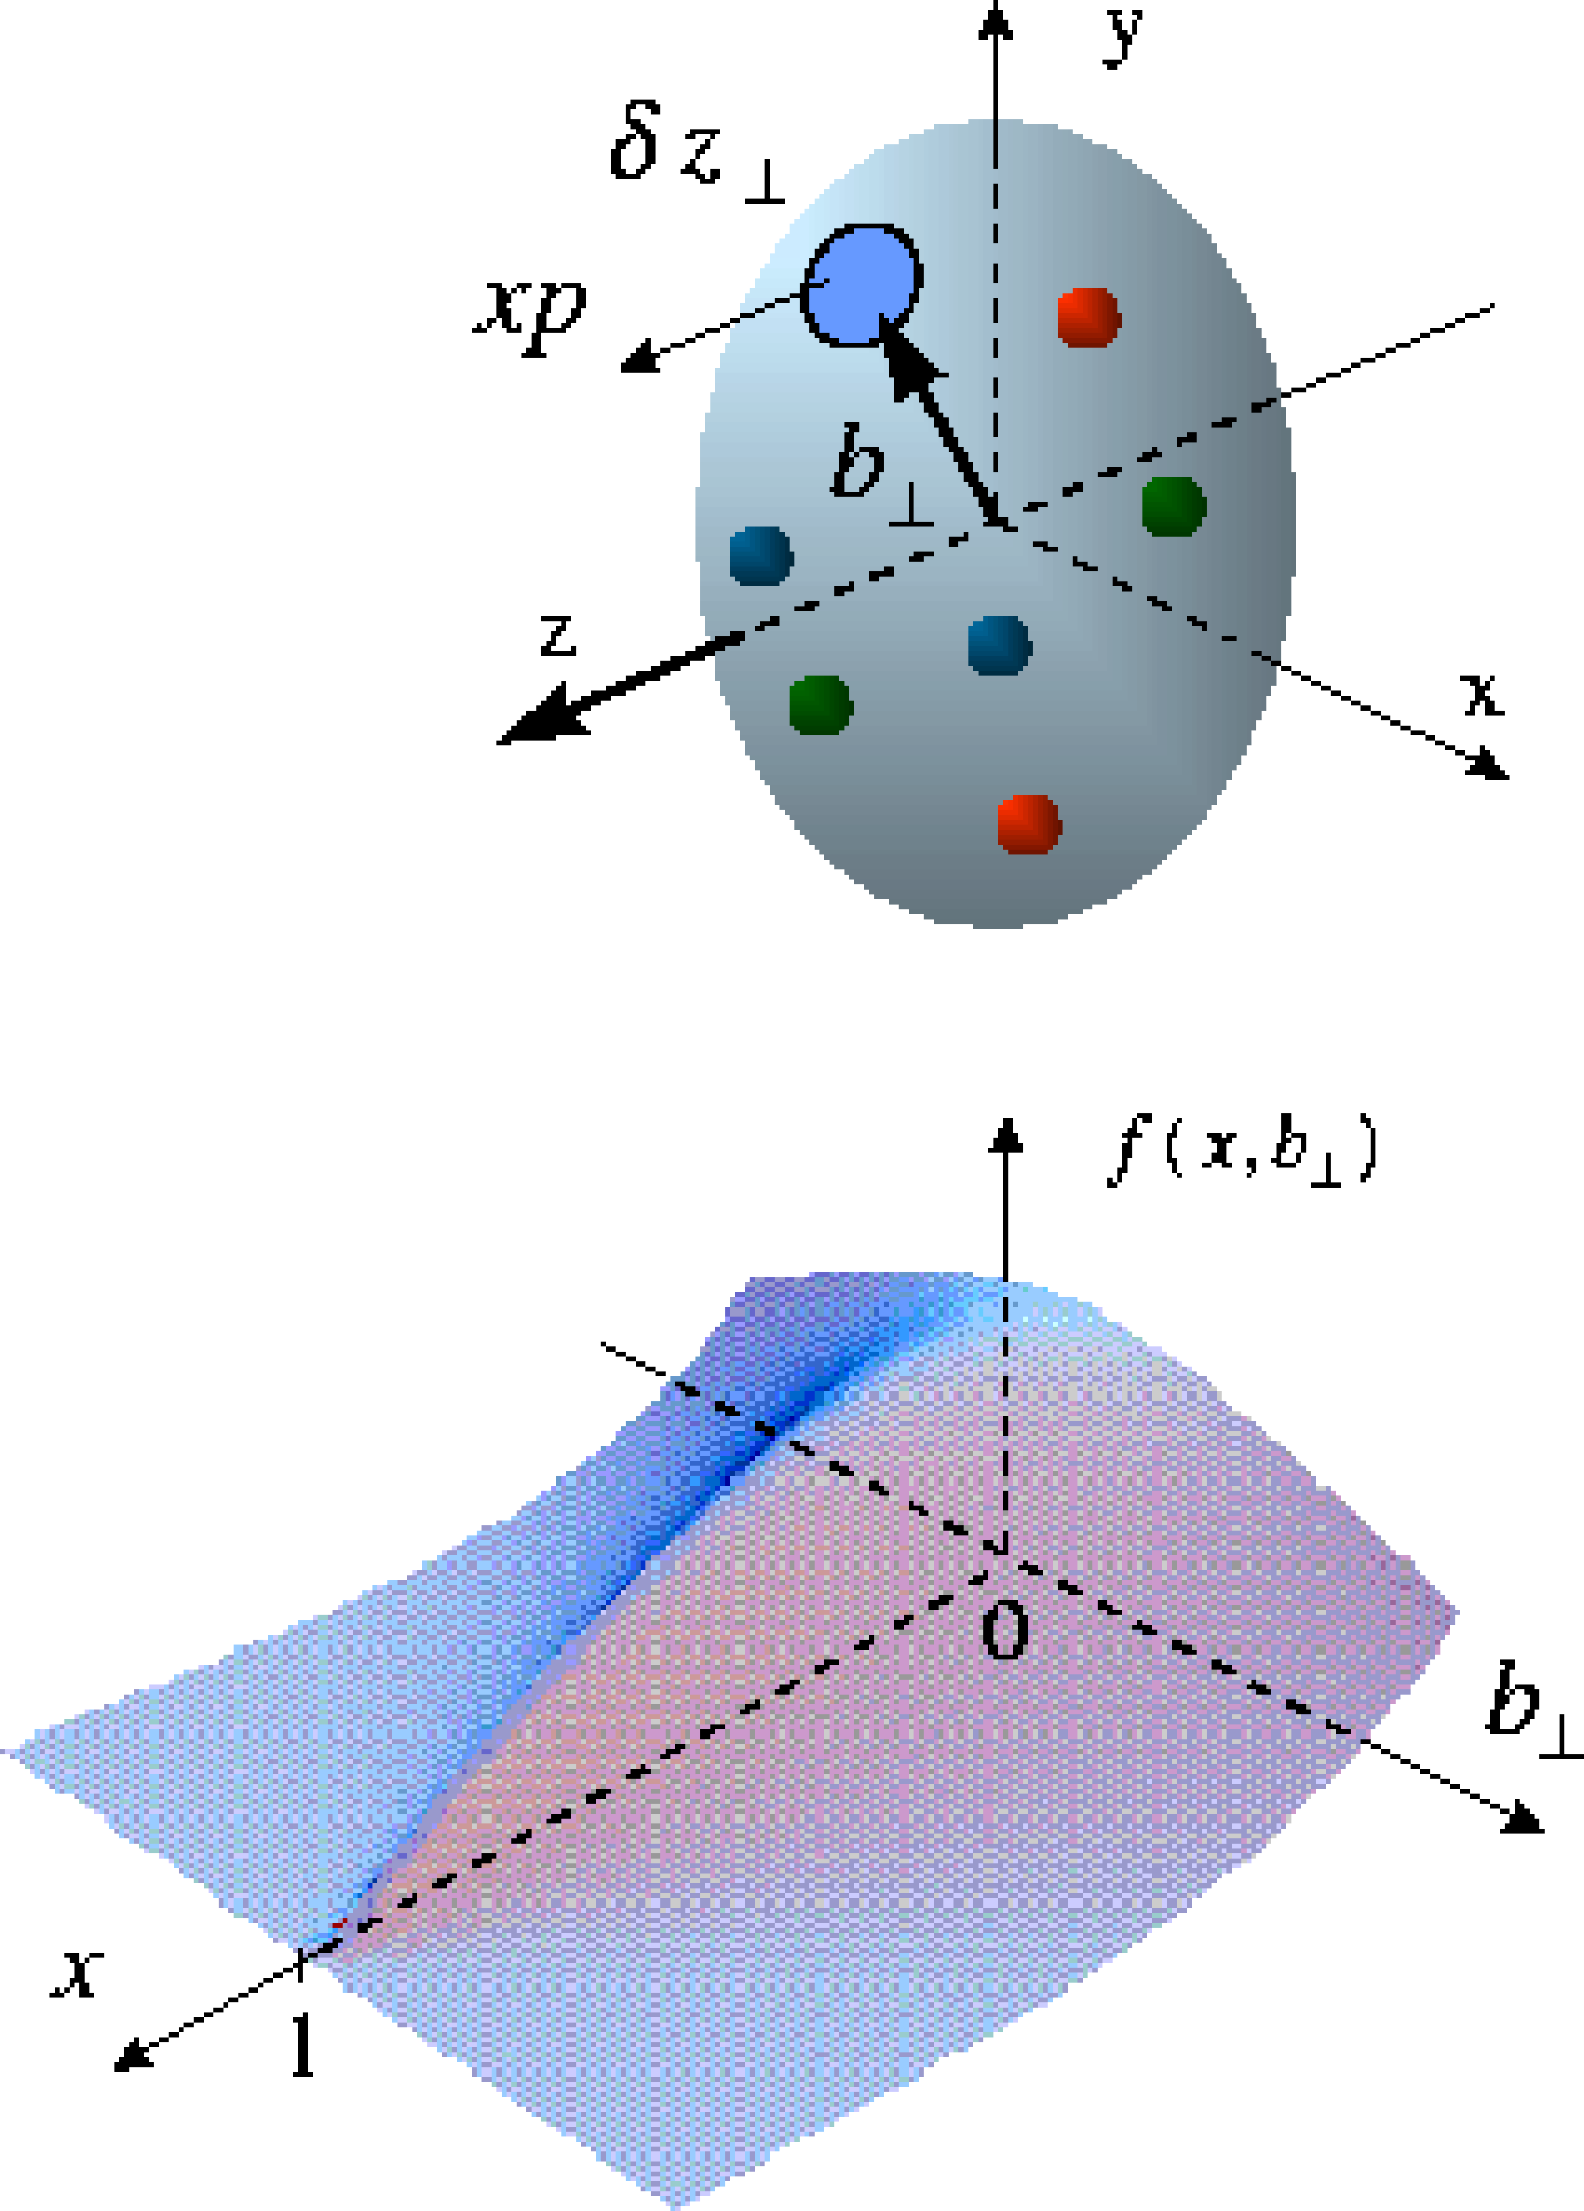
DDVCS
Parton Imaging
GPDs offer the unprecedented possibility to access the spatial distribution and dynamics of partons inside the nucleon.
GPDs = GPDs(Q²,ξ,η,t)
Beyond the already probed (Q²,t) dependences of the nucleon structure, the (ξ,η)-dependences are the new unknown major physics components.
GPDs encode the correlations between partons through the
(ξ,η)-dependences.
As today, DDVCS constitutes the only channel to experimentally access GPDs at η≠ξ.
M. Burkardt, PRD 62 (2000) 071503 M.Diehl, EPJC 25 (2002) 223
GPDs can be interpreted as a 1/Q resolution distribution in the transverse plane of partons with longitudinal momentum x.
Newport News, May 6-7, 2016
4/…

Slide 5
DDVCS
Physics Impact of DDVCS
Generalized Parton distributions
Link to DIS at ξ=t=0
Link to form factors (sum rules)
No similar relations for
Access to quark angular momentum (Ji’s sum rule)
Newport News, May 6-7, 2016
5/…

Slide 6
DDVCS
Physics Impact of DDVCS
Nucleon tomography
The measurement of the uncorrelated ξ-dependence at fixed η will allow for an model independent experimental determination of the transverse parton densities at zero-skewdness, which is today obtained from an model-dependent extrapolation of DVCS data.
Nuclear force distribution
The ξ-dependence at the first Mellin moment of GPDs contains information about the spatial distribution of forces experienced by partons inside the nucleon, encoded within the so-called D-term.
Newport News, May 6-7, 2016
5/…

Slide 7
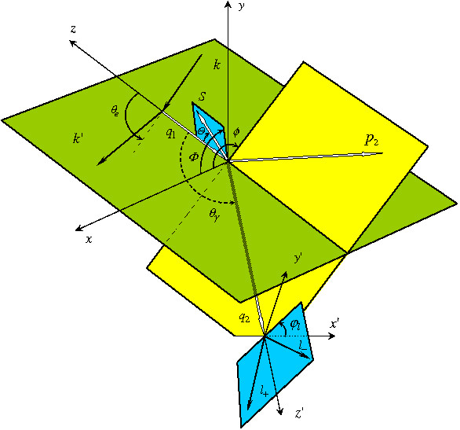
DDVCS
Reaction Process
M. Guidal, M. Vanderhaeghen, PRL 90 (2003) 012001 A.V. Belitsky, D. Müller, PRL 90 (2003) 022001
e + p
e + p + γ∗
Scattered
electron
l⁺ + l⁻
Scattered
proton
Final γ*
Lepton pair
from final γ*
Newport News, May 6-7, 2016
6/…

Slide 8


DDVCS
Kinematic Coverage
JLab 11 GeV
25 GeV
40 GeV
DVCS
η = ξ
2
H^{u}(η , ξ)
2
$$Q^{2}<M_{l^{+}l^{−}}^{}$$
$$Q^{2}>M_{l^{+}l^{−}}^{}$$
DVCS only probes η = ξ
line
Example with model of GPD H for up quark
Jlab : Q²>0
Kinematical range increases with beam energy ( larger dilepton mass )
η
ξ
7/…

Slide 9
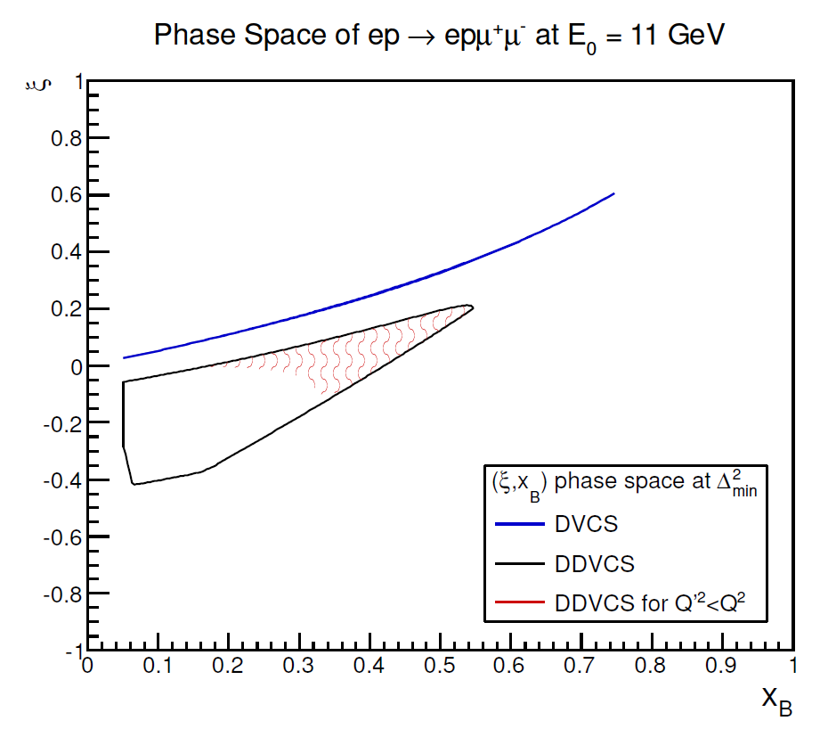
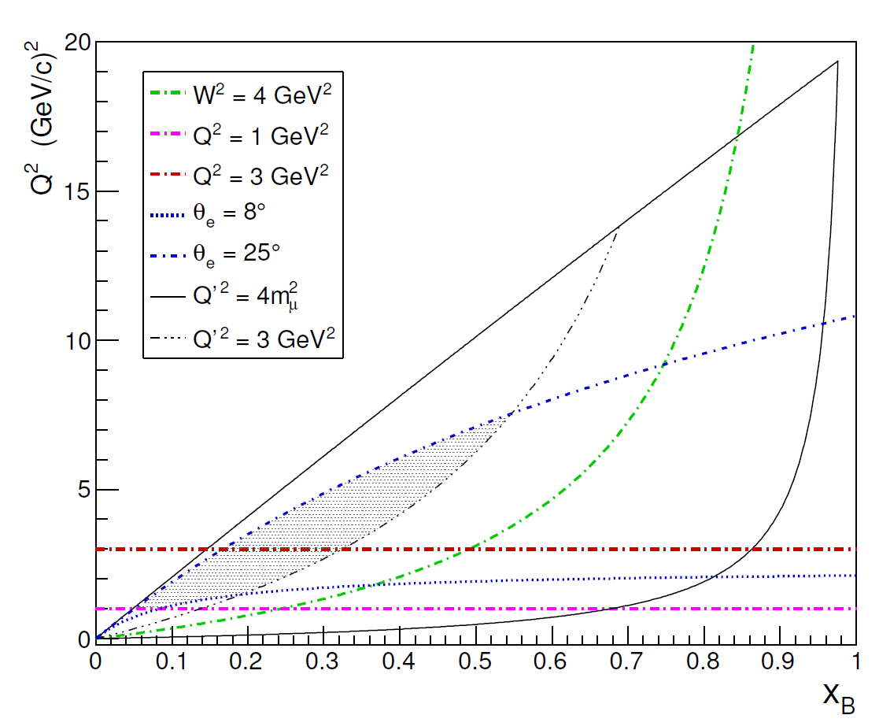
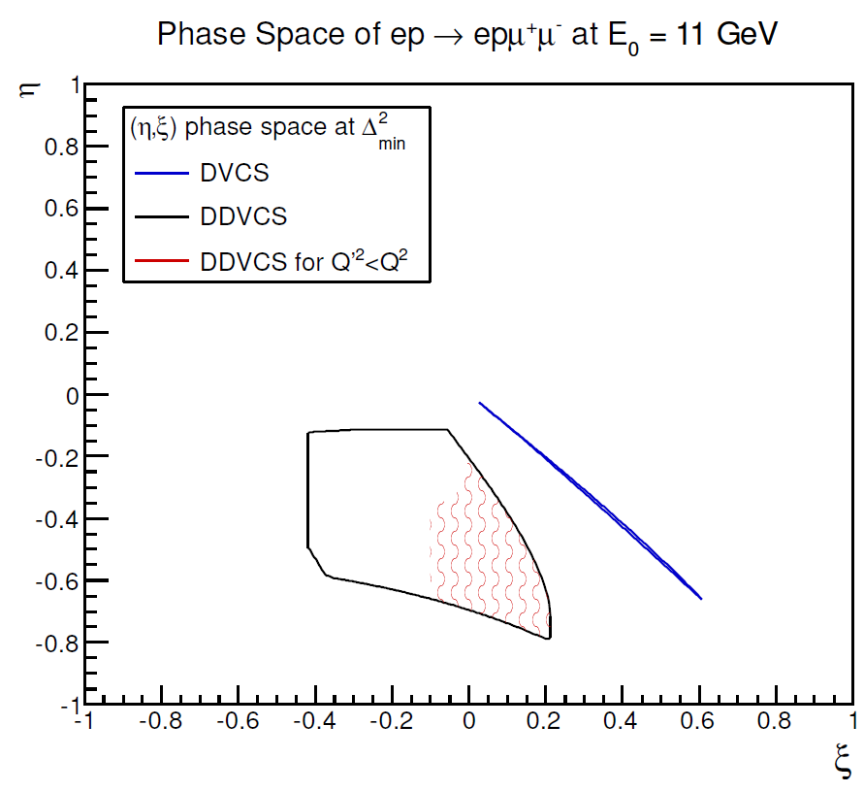
DDVCS
Kinematic Coverage
Ideally want Q’² to be high enough to be away from pion production and have Q’² < Q²
Dedicated experiment
Parasitic experiment first exploratory measurement
Need luminosity and improved Q’² and Q² coverage hence SoLID
Newport News, May 6-7, 2016
7/…

Slide 10
DDVCS
Cross Section
Cross sections, calculated within the twist-2 VGG approach, are about two orders of magnitude smaller than DVCS.
Additional Bethe-Heitler like contributions with different
φ-dependence interfere with the pure small DDVCS amplitude.
Muon pair detection
in the final state allows to
circumvent electron indiscernability.
|BH₁+BH₂+DDVCS|²
|BH₁+BH₂|²
|BH₂|²
|DDVCS|²
Newport News, May 6-7, 2016
8/…

Slide 11
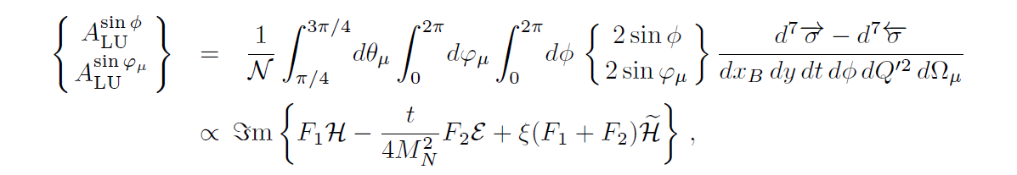
DDVCS
Beam Spin Asymmetry
|BH₁+BH₂+DDVCS|²
The BSA of the DDVCS process allows to access the same linear combination of the Compton form factors than the BSA of DVCS, however at η≠ξ.
|BH₁+BH₂|²
Newport News, May 6-7, 2016
9/…

Slide 12
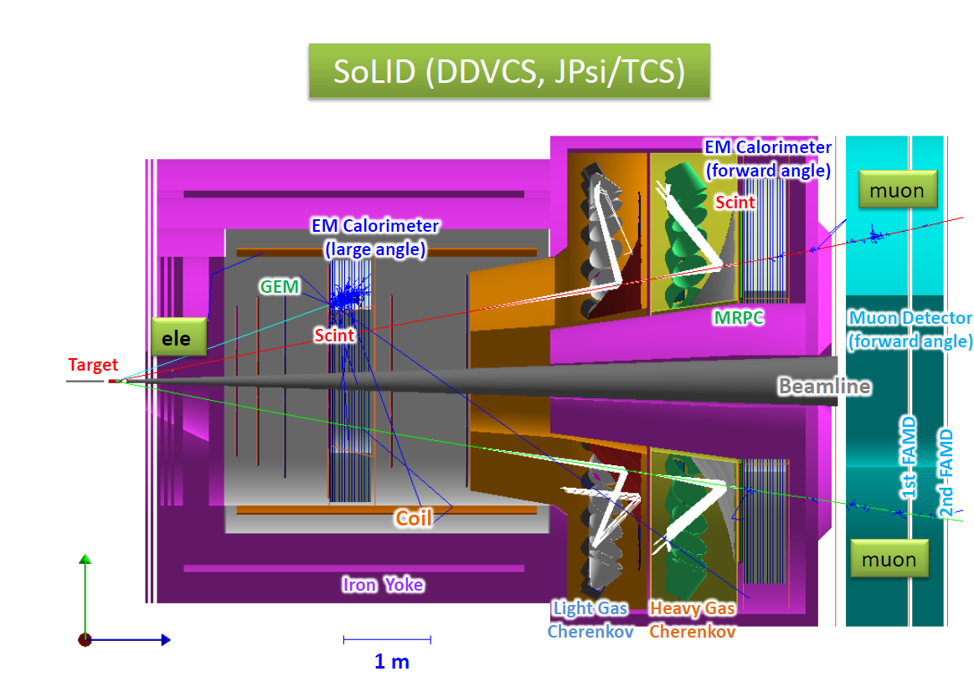
Muon detection @ SoLID
Detector Configuration
3/31

Slide 13
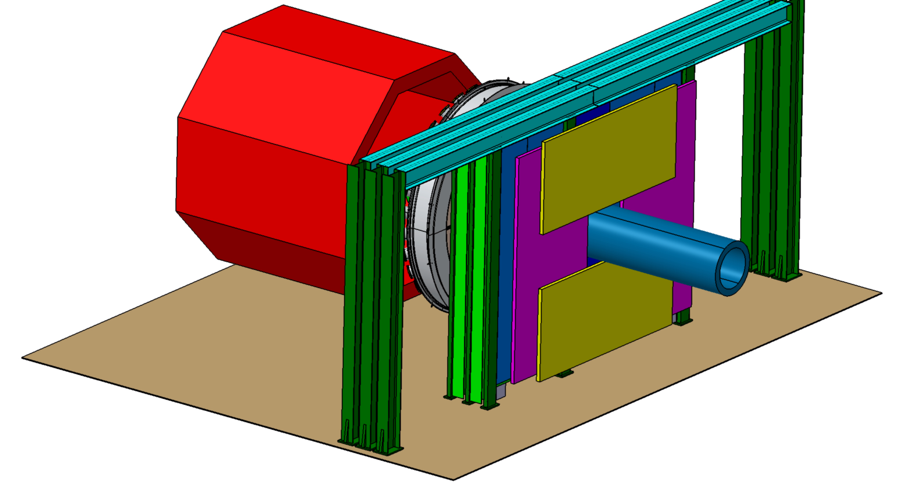
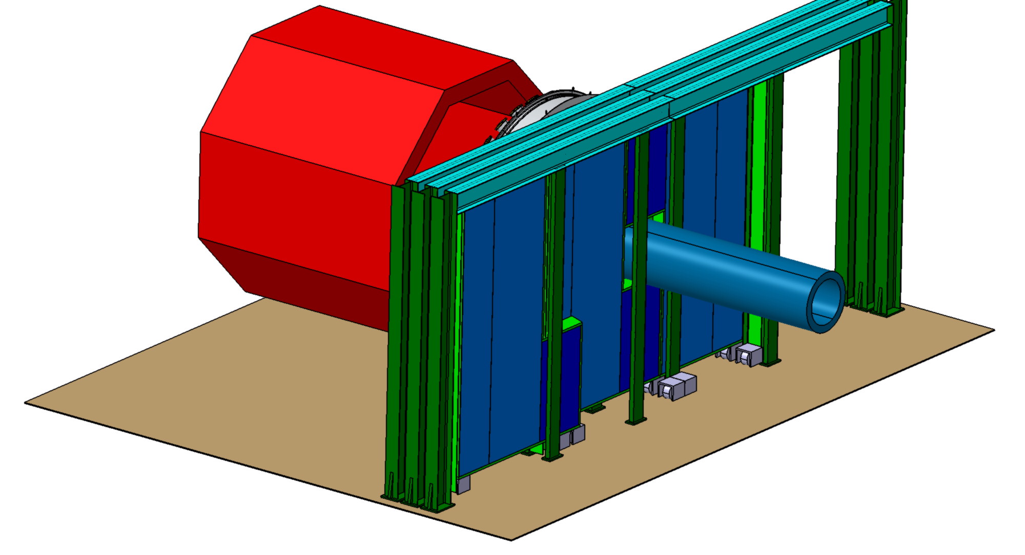
Muon detection @ SoLID
Mechanical Design
Preliminary design from IPNO : Christine Legalliard / Dominique Marchand /Eric Voutier
start to interact with SoLID Hall A designer
Need to figure cable management and interference with End Cap motion
Very rough estimate : 200 K$ to 500 K$
Will have more accurate design if approved
3/31

Slide 14
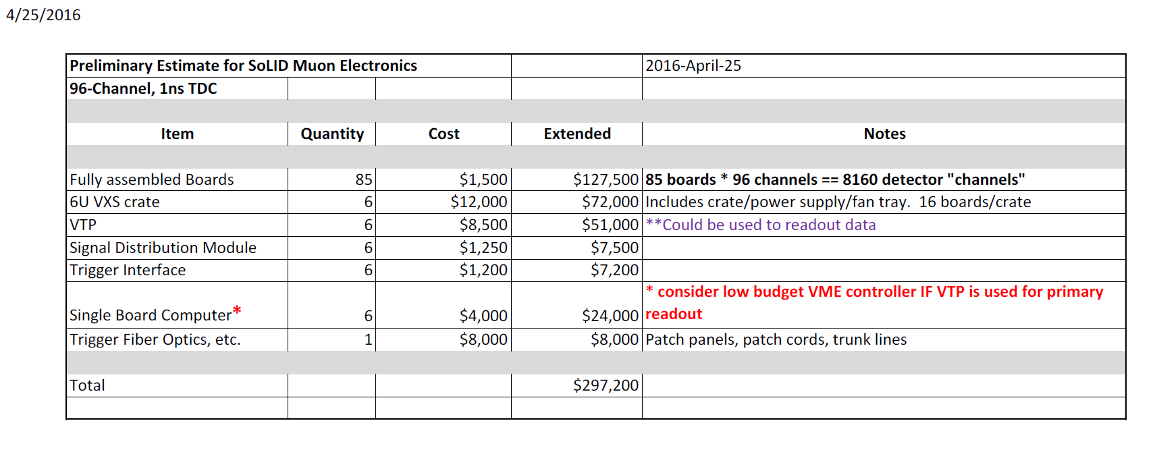
Muon detection @ SoLID
Electronics
3/31

Slide 15
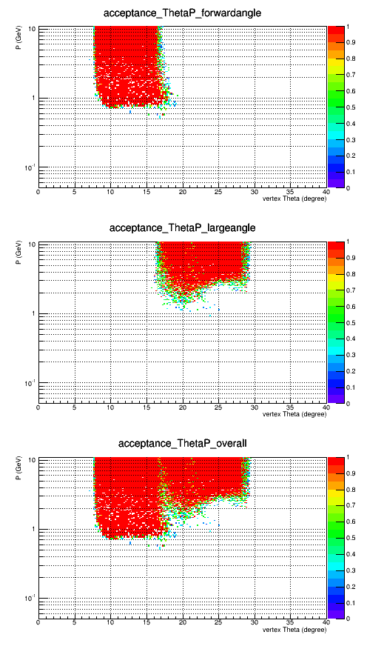
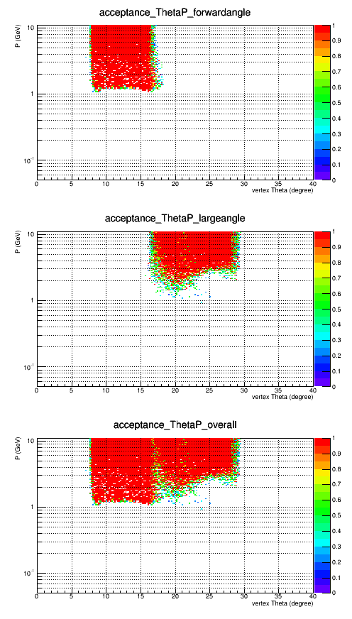
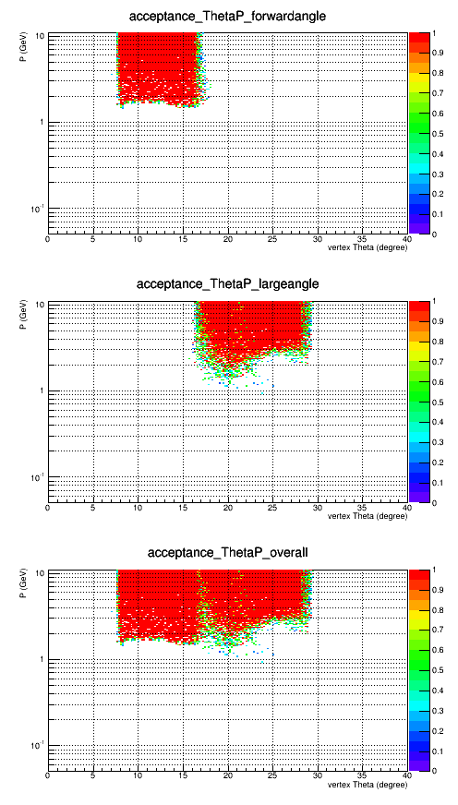
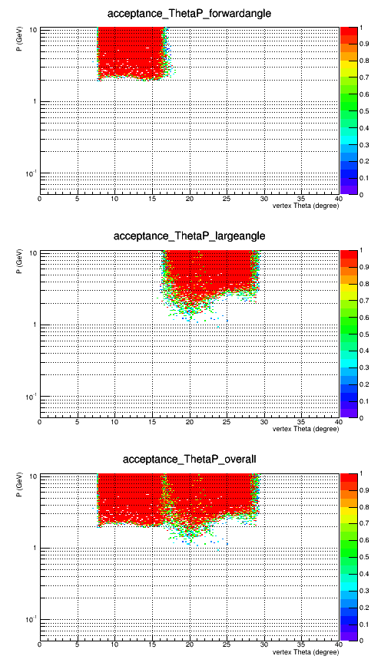
DDVCS @ SoLID
Acceptance
1st FAMD (P>0.7GeV)
2nd FAMD (P>1GeV)
3rd FAMD (P>1.5GeV)
4th FAMD (P>2GeV)
1st LAMD (P>1GeV)
3/31

Slide 16
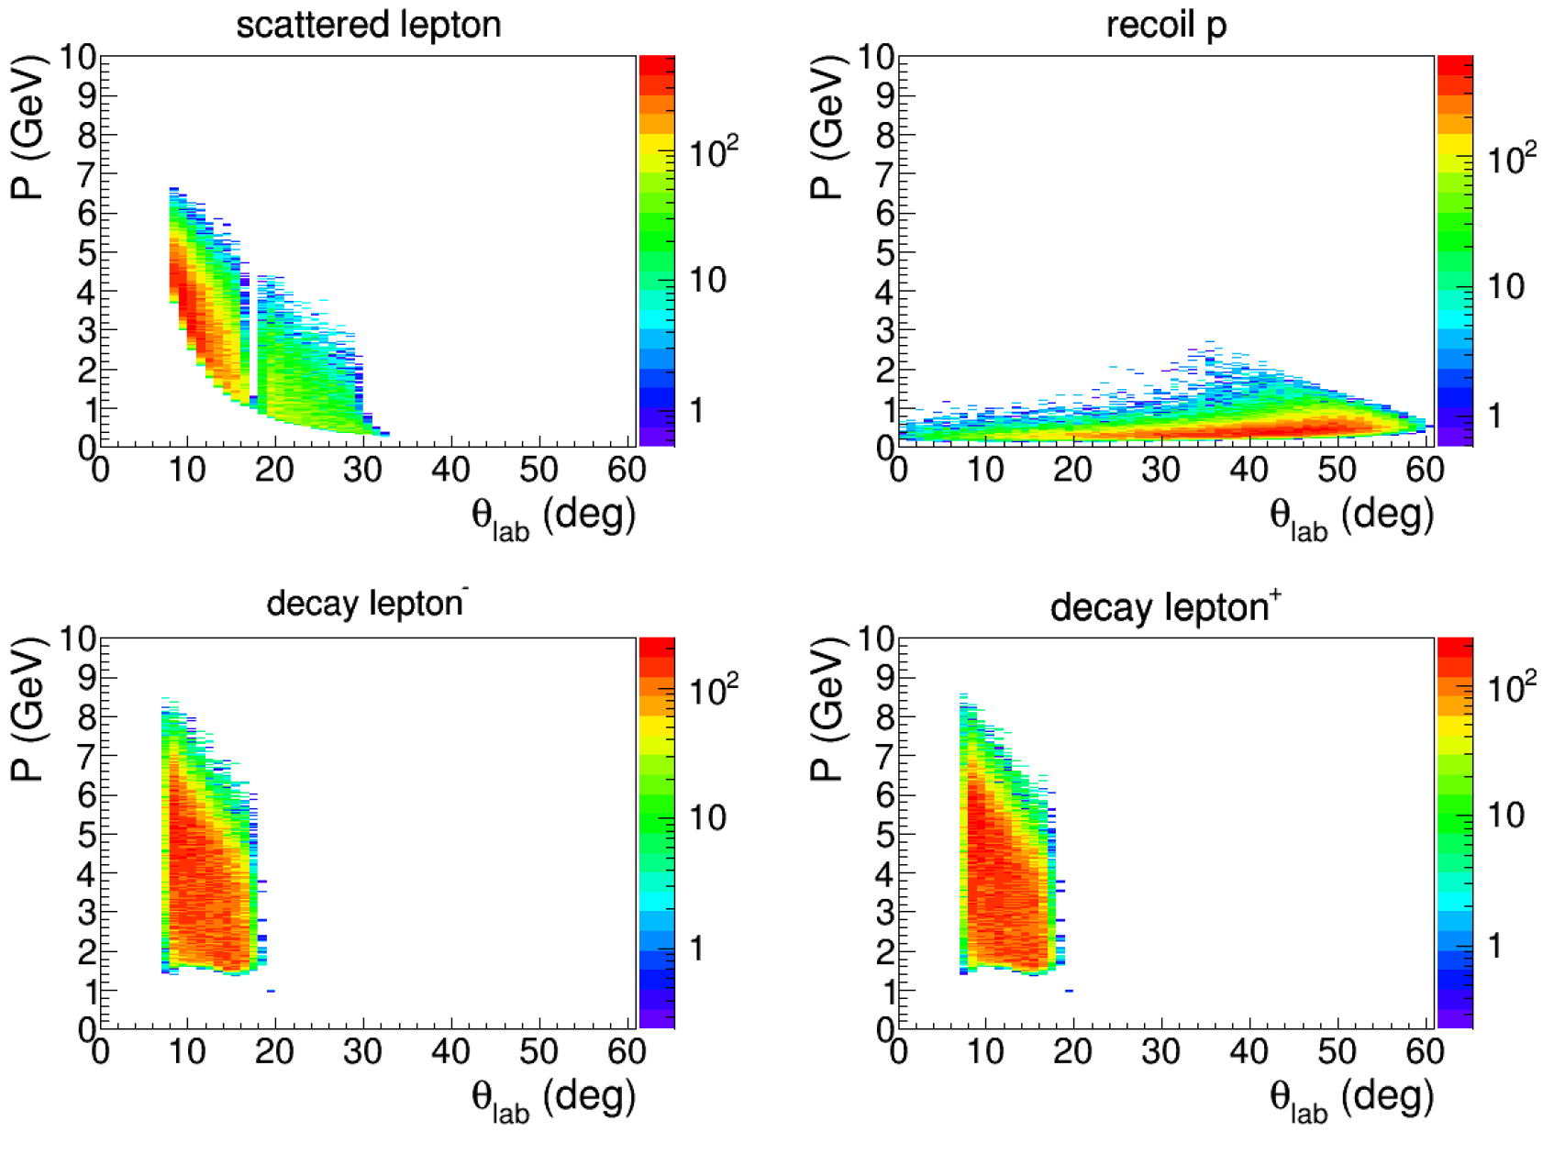
DDVCS @ SoLID
Detector acceptance
3/31

Slide 17
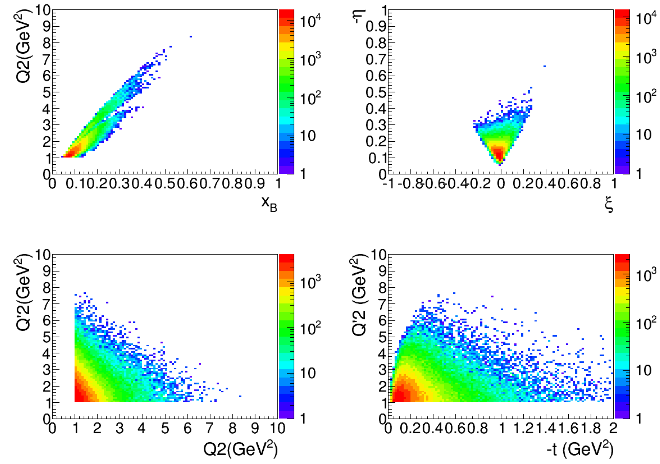
DDVCS @ SoLID
Kinematical coverage
3/31

Slide 18
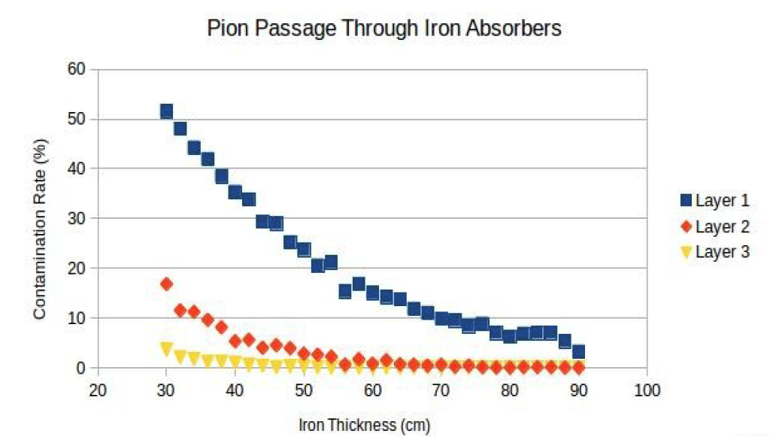
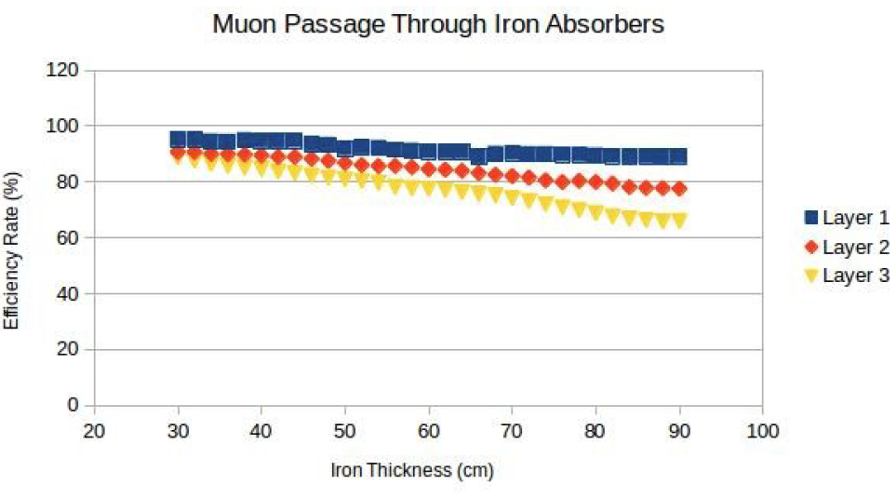
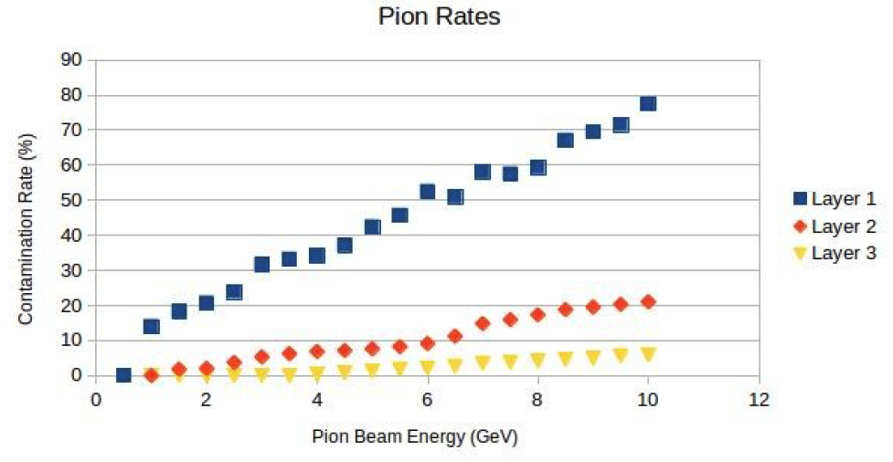
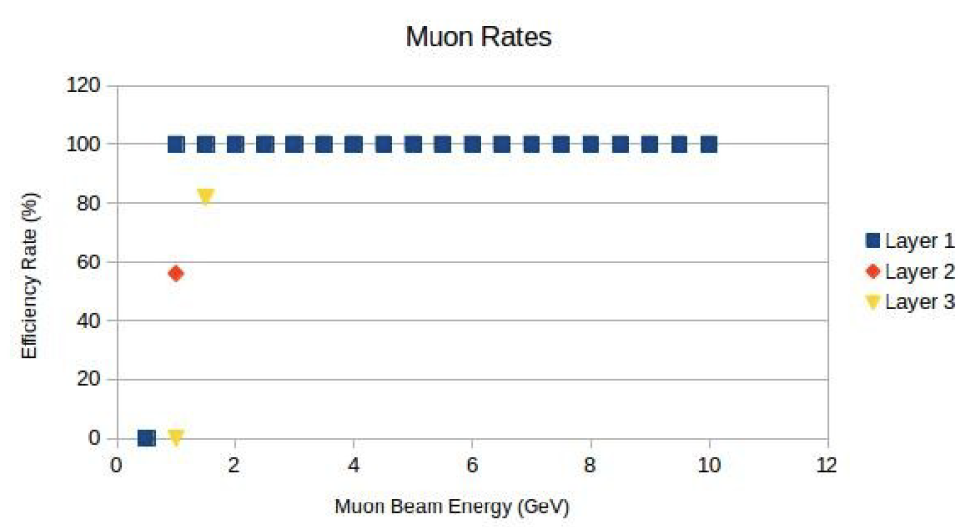
DDVCS @ SoLID
Muon Discrimination
3/31

Slide 19
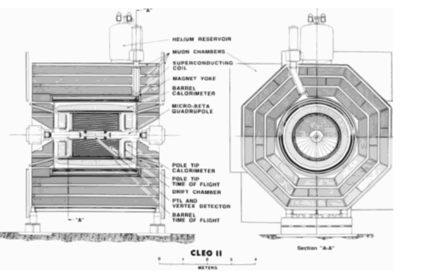
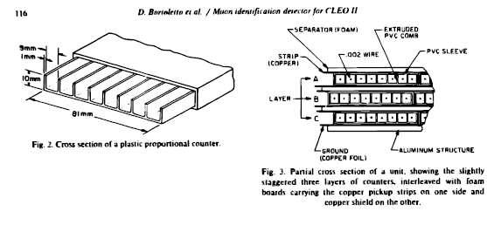
DDVCS @ SoLID
Muon detector and trigger
CLEO muons chambers
as baseline detector
Larocci chambers
Wire based trigger, look for coincidence between two planes
3/31

Slide 20
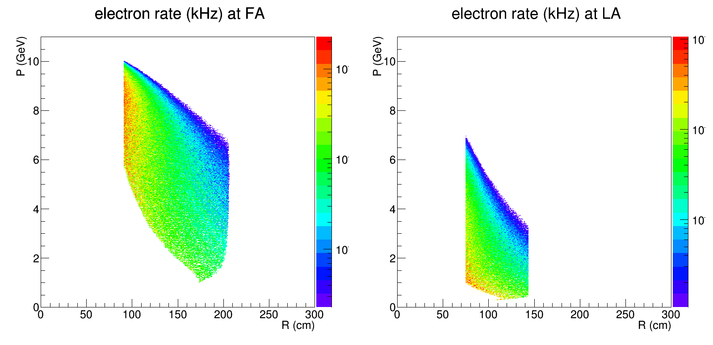
ele Trigger at EC
e- with Q2>1
e- with Q2>1
Jpsi and TCS ele trigger (red): by FAEC with 4GeV (r=105-115cm), 3GeV (r=115-145cm) and 2GeV (r=145-235cm), by LAEC with 3GeV (r=80-100cm) and 2GeV (r=100-140cm)
DDVCS ele trigger on Q2=1 (blue): by FAEC with 4GeV (r=105-115cm), 3GeV (r=115-145cm) and 1GeV (r=145-235cm), by LAEC with 1GeV (r=80-100cm) and 0.5GeV (r=100-140cm) (as we don't have 0.5GeV trigger curve for now, use 1GeV curve instead)

Slide 21
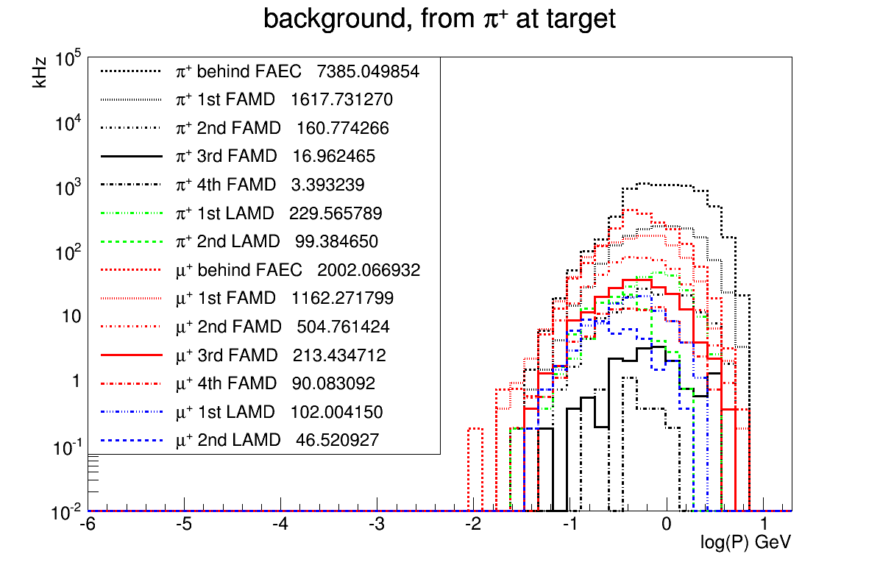
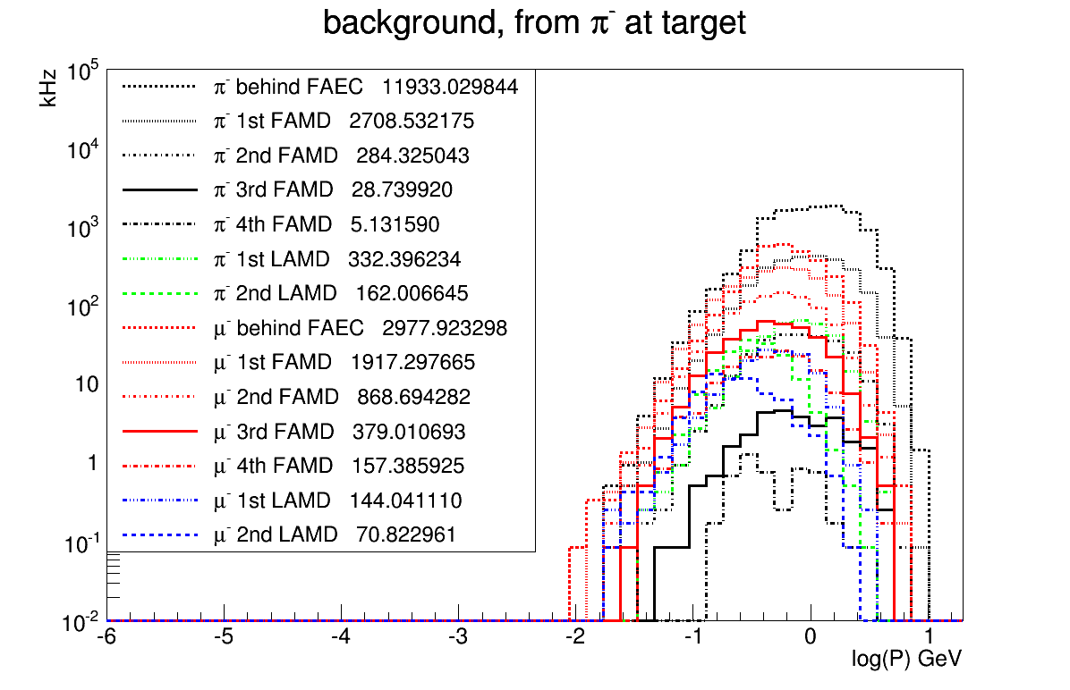
Muon trigger rate
Muon Trigger (2nd FAMD+1st LAMD)²
(((161+284+505+869)+(230+162+102+144))*1e3)^2*30e-9/1e3=181kHz
Muon Trigger (2nd FAMD)²
((161+284+505+869)*1e3)^2*30e-9/1e3=100kHz
Muon Trigger (3rd FAMD+1st LAMD)²
(((17+29+213+379)+(230+162+102+144))*1e3)^2*30e-9/1e3=49kHz
Muon Trigger (3rd FAMD)²
((17+29+213+379)*1e3)^2*30e-9/1e3=12kHz
Muon Trigger (4th FAMD+1st LAMD)²
(((4+5+90+157)+(230+162+102+144))*1e3)^2*30e-9/1e3=24kHz
Muon Trigger (4th FAMD)²
((4+5+90+157)*1e3)^2*30e-9/1e3=2kHz
Use “HallD” pion generator instead of “Wiser”
1st LAMD is before LGC, 2nd LAMD is previous 1st LAMD
Simulation JLAB_VERSION 1.3 instead of 1.2

Slide 22
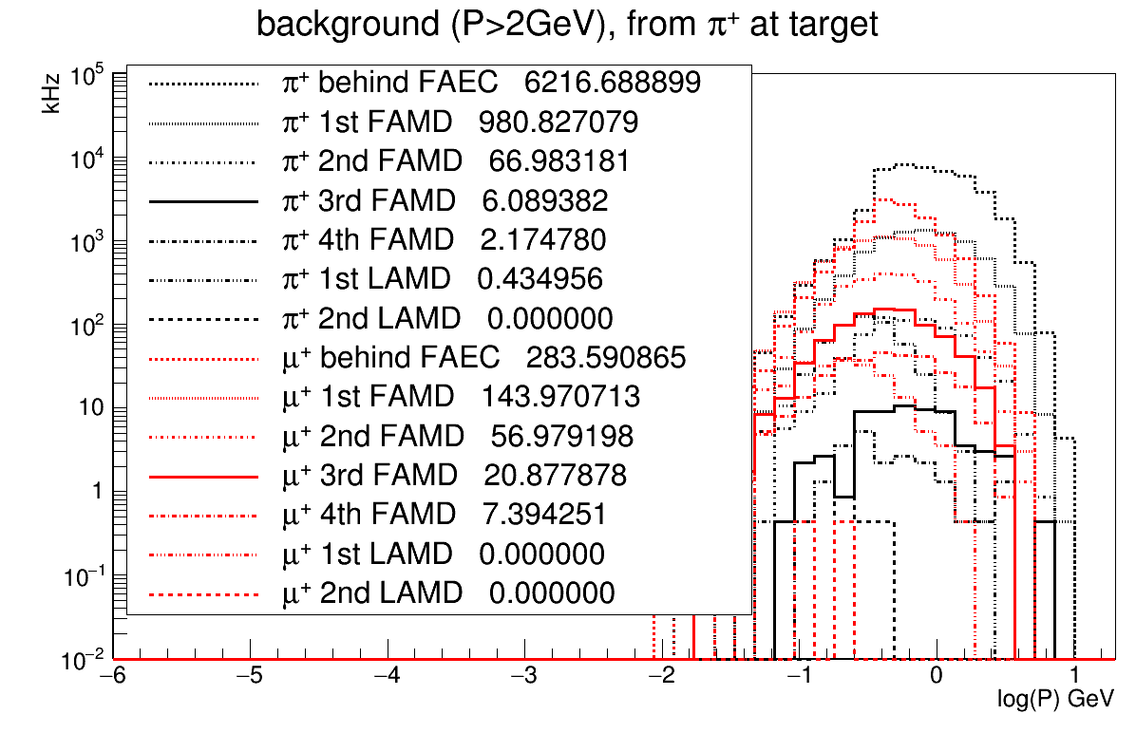
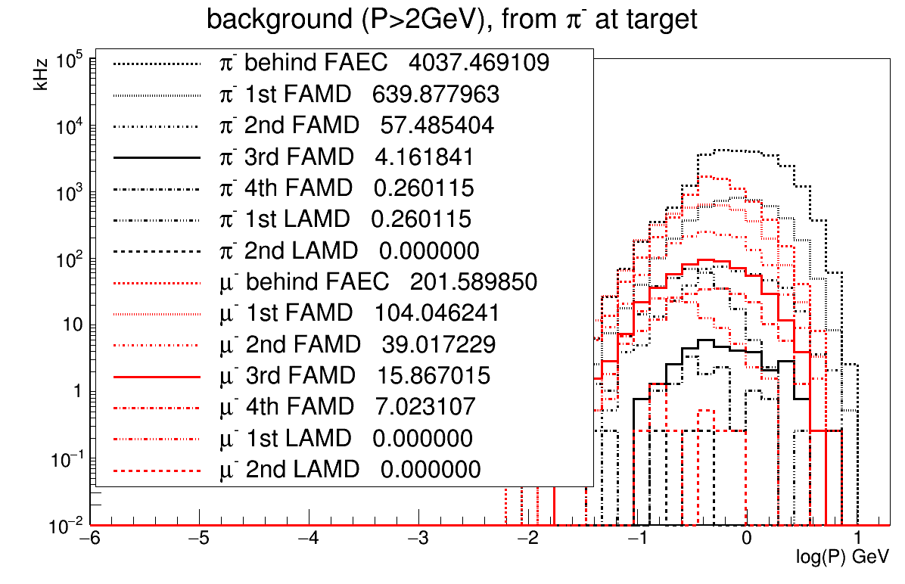
DDVCS @ SoLID
Random coincidence background
At 4th FAMD, pip(2.2kHz), pim(0.26kHz), muonp(7.4kHz),muonm(7.0kHz)
Two hadron 6ns time coincidence (2.2+7.4)*1e3*(0.26+7.0)*1e3*6e-9=0.418Hz
Then hadron and ele 6ns time coincidence
(520)*1e3*(0.418)*6e-9=0.0013Hz
Then vertex cut between 3 particles, 0.0013/3/3=0.000145Hz
Time resolution 1ns, 6 sigma cut is 6ns
Vertex resolution 0.75cm, 6 sigma cut 5cm, factor 3 reduction for 15cm long target
Cut with P>2 GeV because BH muon has P>2GeV at 4th FAMD
3/31

Slide 23
DDVCS @ SoLID
Signal to background
BH signal 0.126Hz at 3rd FAMD
Signal/(random coincidence background)=0.126/0.00762=17
BH signal 0.084Hz at 4th FAMD
Signal/(random coincidence background)=0.084/0.000145=579
3/31

Slide 24
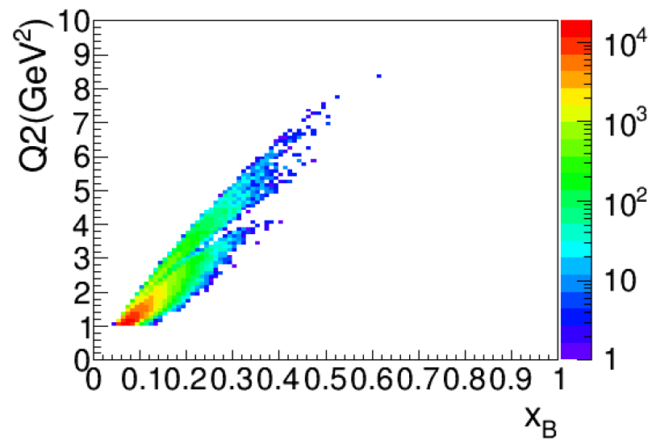
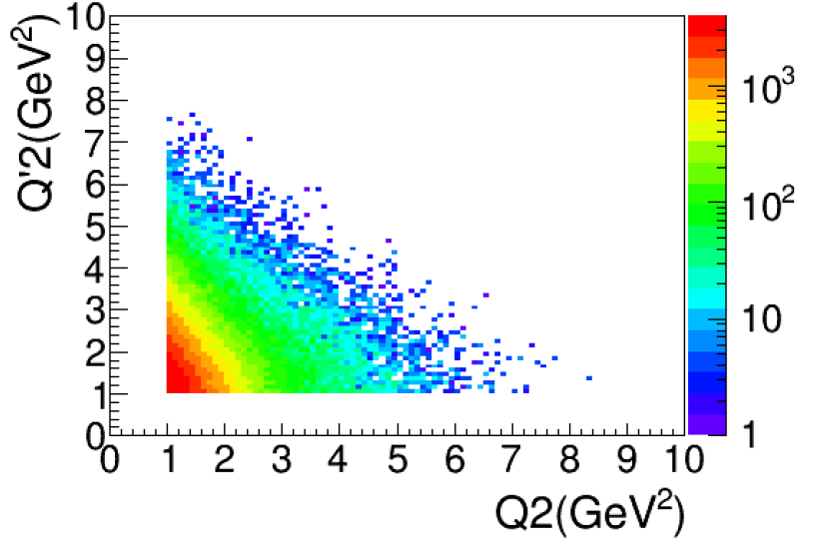
DDVCS @ SoLID
Expected Results
3/31

Slide 25
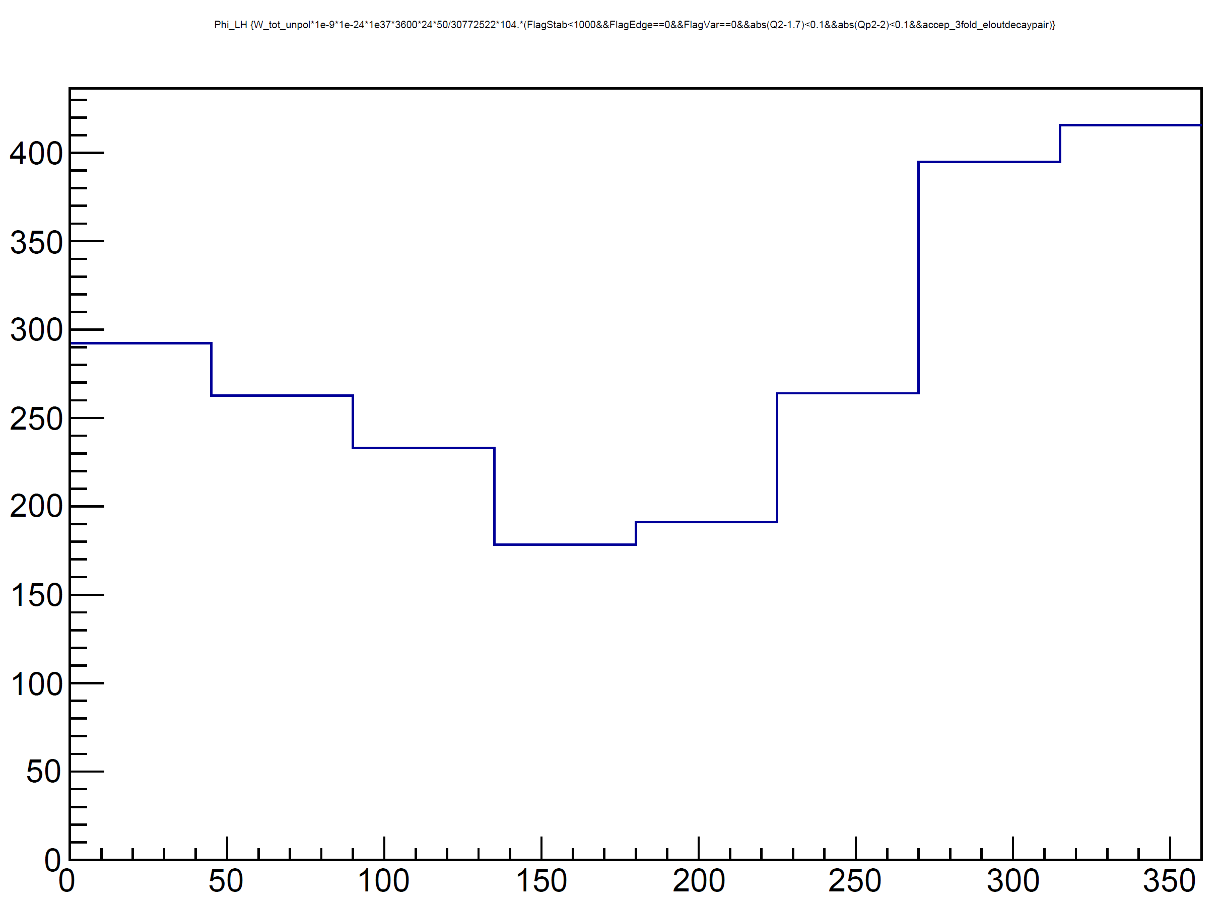
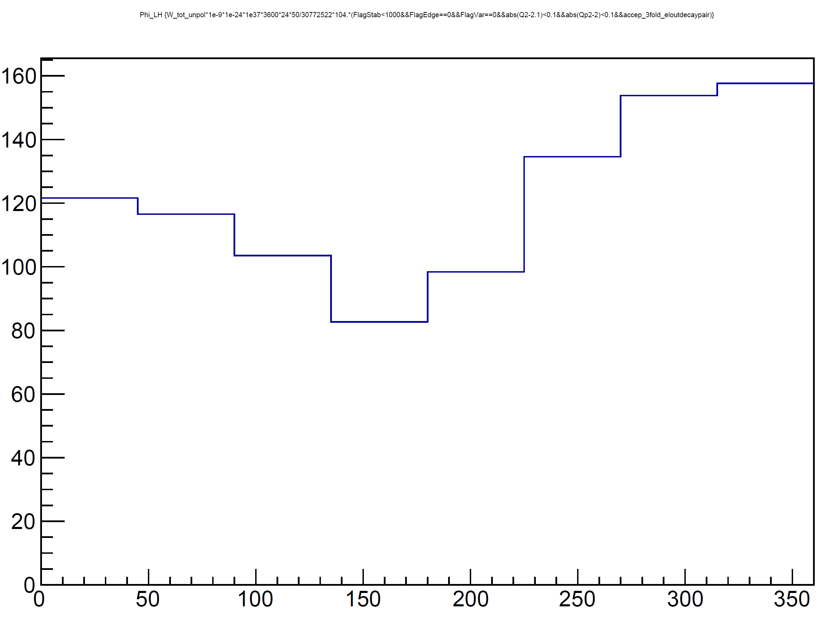
DDVCS @ SoLID
Expected Results
Two bins : 8 bins in Phi
Q² > Q’² : 2.0 GeV²< Q²<2.2 GeV² 1.9 GeV²< Q²<2.1 GeV²
Q² < Q’² : 1.6 GeV²< Q²<1.8 GeV² 1.9 GeV²< Q²<2.1 GeV²
^{Asymmetries from 5 to 10 %}
Optimizing kinematic and binning
3/31

Slide 26
Summary
Conclusion
Addition of muon detection capabilities based on the CLEO muon detector is a good opportunity for the SoLID performances.
It will allow investigation of the experimentally unknown DDVCS reaction channel, of importance for the partonic tomography of the nucleon.
It will enhance the statistical reach of the J/ψ experiment, and will contribute to the physics impact of the J/ψ SoLID run-group.
The DDVCS experiment would run with a specific trigger, and
parasitically to the J/ψ experiment.
ECT workshop dedicated to dileptons production with dedicated session on muon DDVCS
October 24th to 28th 2016
Study Q’²>Q² kinematical range ( not clear GPDs )
Newport News, May 6-7, 2016
3/31

Slide 28
To do list
Optimize kinematic and binning
Check event generator
Check two pions background
Evaluate tracking resolution
Missing mass resolution

