Slide 1
SoLID GEM Detectors in US
Kondo Gnanvo
University of Virginia
SoLID Collaboration Meeting @ JLab, 05/07/2016
Outline
  Overview of SoLID GEM Trackers
  Design Optimization
  Large Area GEMs for PRad in Hall B
  Integration of APV25 readout in CODA

Slide 2
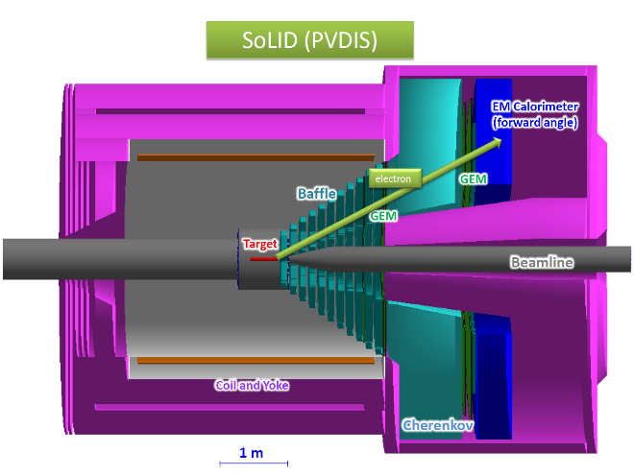
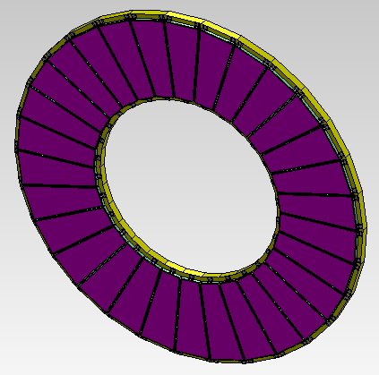
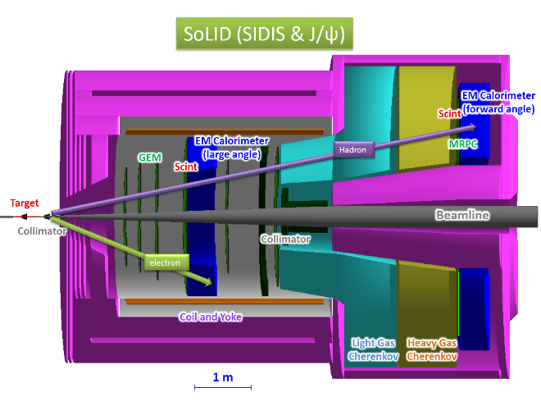
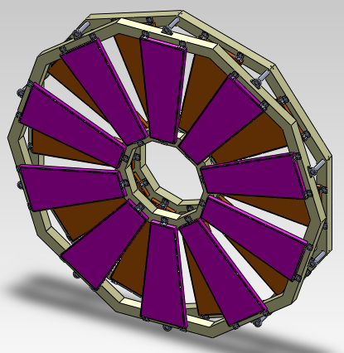
Overview of SoLID GEM Trackers
Tracking requirements for PVDIS
Luminosity ~ 10³⁹/cm²/s
Rate: from 100 kHz/cm² to 600 kHz/cm² (with baffles) from GEANT4 estimation
Spatial Resolution: ~ 100 µm (σ) in azimuthal direction
Total area: ~37 m2 total area (30 sectors × 5 planes, each sector covering 12 degree)
Need radiation and magnetic field tolerant
PVDIS
5 disk layers
Large area GEM challenges
Larger SoLID GEM modules as large as 113 cm × 55 cm
  New Single Mask technique allows to make GEM foils as large as 200 cm × 55 cm
The remaining challenge is large production capacity:
  If all LHC related large GEM project (CMS, ALICE, TOTEM) gets underway, this will require almost 100 % of CERN production capacity
  Currently work going on for large GEM production capabilities in China and in the US.
SIDIS
6 disk layers
Large number of readout channels; but cost of electronics going down – cost per channel for the RD51 SRS APV-25 based readout is ~ $3.00 + U/V stereo angle 2D readout reduce the channel count while maintaining a very good spatial resolution

Slide 3
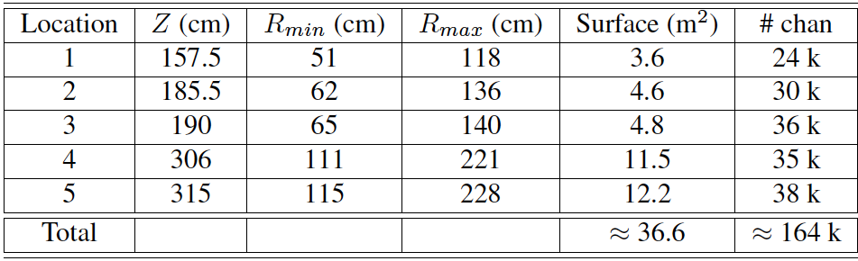
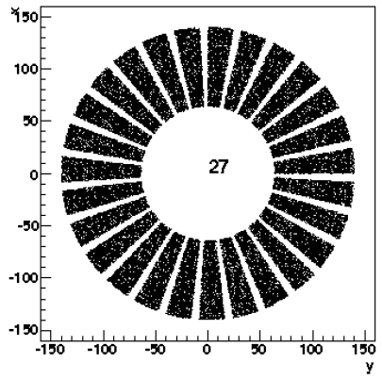
Overview of SoLID GEM Trackers: PVDIS Configuration
Instrument five locations with GEMs ⇨ 30 GEM modules at each location
PVDIS
Largest GEM module size required: 113 cm x 55 cm
about the size of PRad GEM chambers currently in Hall B
With ~5% spares, we will need about 170 k readout channels.

Slide 4
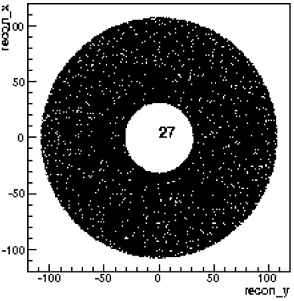
Overview of SoLID GEM Trackers: SIDIS Configuration
Six locations instrumented with GEM trackers:
Original idea: Re-arrange PVDIS module in SIDIS configuration
PVDIS
Plane | Z (cm) | R_{I} (cm) | R_{O} (cm) | Active area (m²) | # of channels
1 | -175 | 36 | 87 | 2.0 | 24 k
2 | -150 | 21 | 98 | 2.9 | 30 k
3 | -119 | 25 | 112 | 3.7 | 33 k
4 | -68 | 32 | 135 | 5.4 | 28 k
5 | 5 | 42 | 100 | 2.6 | 20 k
6 | 92 | 55 | 123 | 3.8 | 26 k
total: |  |  |  | ~20.4 | ~ 161 k
SIDIS
However, GEM module length L is set by the inner and outer radius of the disk layer: L= R_out – R_in
A SIDIS and PVDIS layers can used the same GEM modules only if L is the same, unless there is a tolerance δL on the layer GEM dimensions (for SIDIS) given the module size of a PVDIS GEM module
  L_{SIDIS} = L_{PVDIS} + δL

Slide 5
Design optimization: Can we use the same modules in both PVDIS & SIDIS layers?
Assuming different level of tolerance δL on SIDIS GEM modules:
  δL = 1 cm ⇨ only GEM module #3 used for PVDIS layer #1 can be reused for SIDIS layer #6
  δL = 5 cm ⇨ only GEM modules #3 and #5 used for PVDIS layer #1 & #3 can be re-used for SIDIS layer #6 & #2
  δL = 12 cm ⇨ all 5 PVDIS GEM modules can be re-used in SIDIS Configuration
Basically, we can not use the same modules in both PVDIS and SIDIS configuration if we want to keep from the currents dimensions (R_out – R_in) fixed ⇨ 9 GEM modules design (different size and UV angle) (for both SIDIS and PVDIS
But (from Zhiwen) it looks like we can play with outer radius of SIDIS layers and in that case, the number of modules can be limited to 6

Slide 6
Design optimization: Do we need 30 modules / layers?
Large GEM modules:
All GEM modules with a width of ~ 55 cm ⇨ Current limitation imposed by raw material (width of the roll ~ 61 cm)
we can limit the number of modules in each layer ⇨ Cost saving in materials & labor
Optimize dead-to-active area ratio ⇨ Reduced constraints on the GEM frames widths
Performances of the readout strips
With the U/V stereo angle strips readout ⇨ spatial resolution or occupancy do not depend of the detector width
We can arrange to have HV sector on the foils
Example of SIDIS layer
Example of PVDIS layer
55 cm
55 cm

Slide 7
Design optimization: Do we need 30 modules / layers?
This is a quick estimation of how many modules are needed for each layer for both PVDIS and SIDIS with the assumption that layer #3 and #5 are common for PVDIS and SIDIS ⇨ 151 GEM modules needed for all 9 GEM designs

Slide 8
Large Area GEMs for PRad Experiment in Hall B @JLab

Slide 9
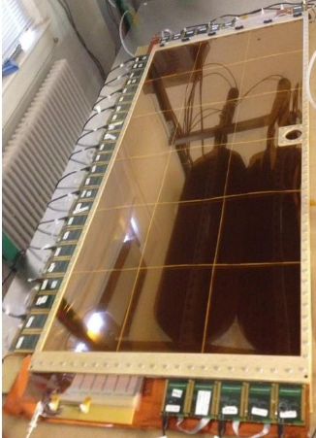
The PRad Experimental Setup in Hall B
Target specs:
cell length 4.0 cm
cell diameter 8.0 mm
cell material 30 μm Kapton
input gas temp. 25 K
target thickness 1x10¹⁸ H/cm²
average density 2.5x10¹⁷ H/cm³
Cell pressure 0.6 torr
Vacuum in target chamber ~5x10⁻³ torr
H₂ target
GEMs:
factor of >10 improvements in coordinate resolutions
similar improvements in Q2 resolution (very important)
unbiased coordinate reconstruction (including transition region)
increase Q2 range by including Pb-glass part
GEMs
HyCal
HyCal specs:
34 x 34 matrix of 2.05 x 2.05 x 18 cm³ PbWO4 shower detectors
576 Pb-glass shower detectors (3.82x3.82x45.0 cm³)
5.5 m from H₂ target (~0.5 sr acceptance)
Resolutions for PbWO4 shower: σ/E = 2.6 %/√𝐸, σ_{xy} = 2.5 mm/√𝐸
Resolution for Pb-glass shower detectors factor of ~2.5 worse
Vacuum box

Slide 10
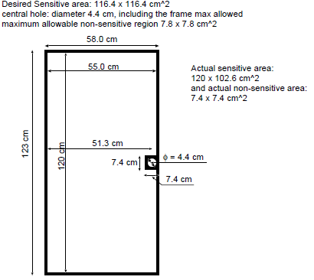
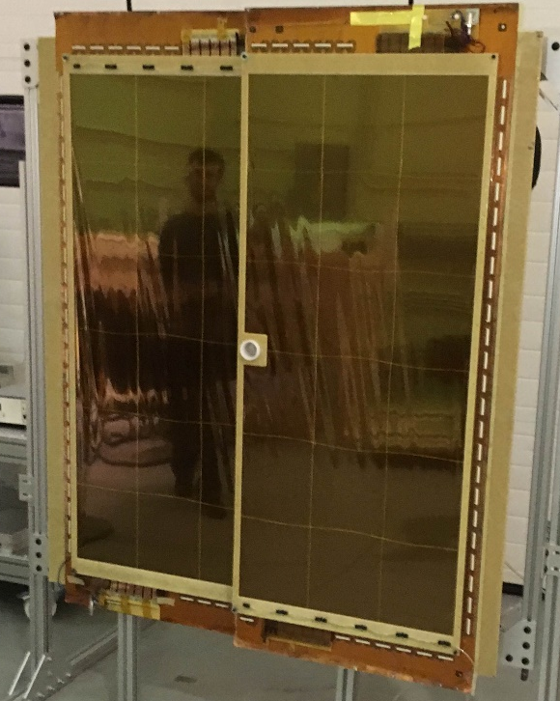
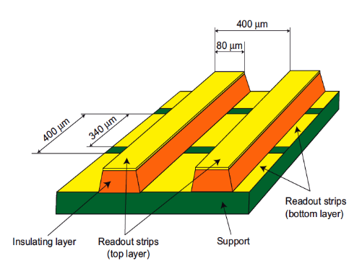
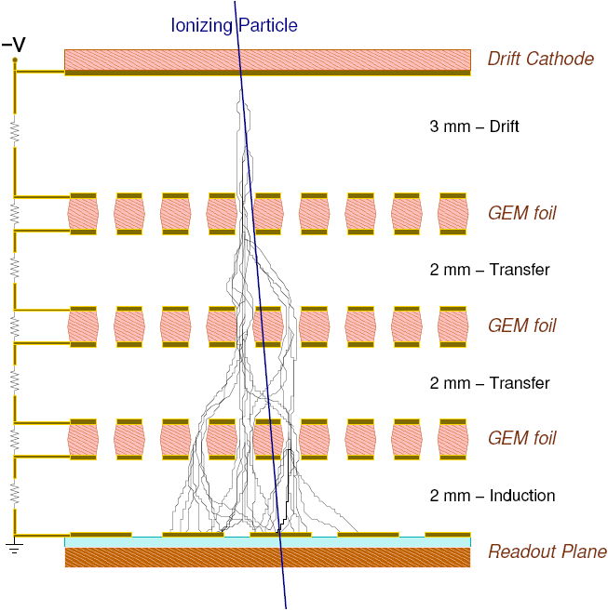
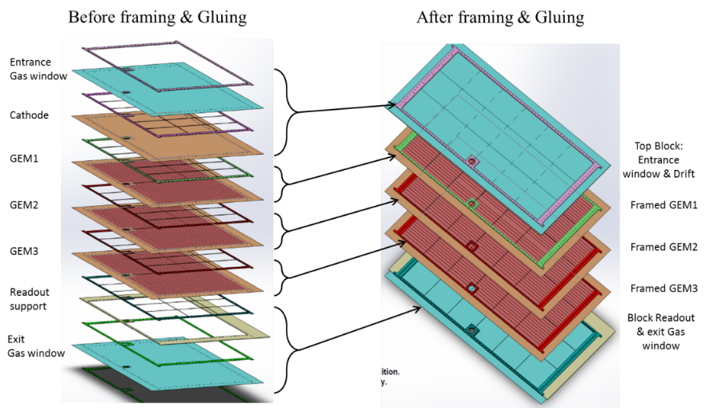
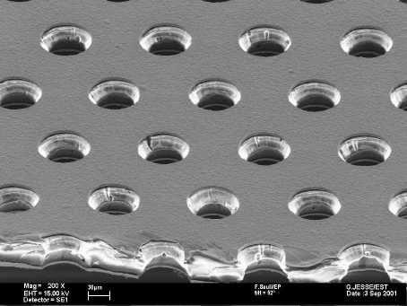
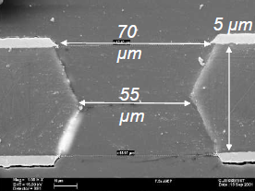
Large Area PRad GEMs: Requirements & Design
PRad GEM chambers:
2 large modules side by side
105 cm
2D strips readout spatial resolution < 70 μm
122.88 cm
GEM foil
F. Sauli, Nucl. Instr. and Meth. A386(1997)531
Exploded view
COMPASS triple-GEM 3-2-2-2 design
Copper
polymide

Slide 11
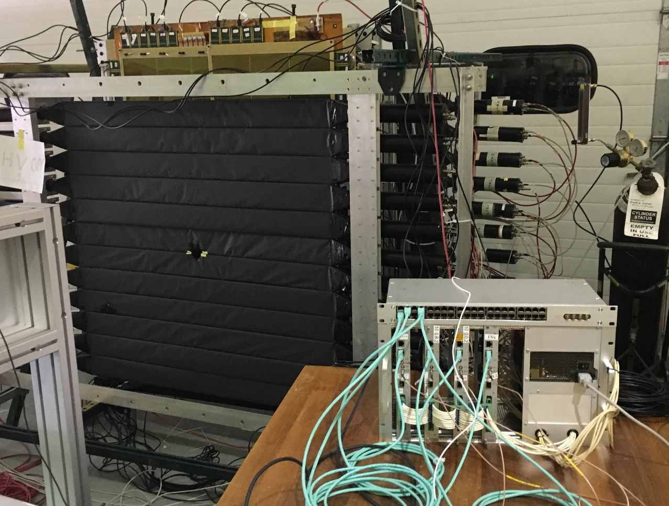
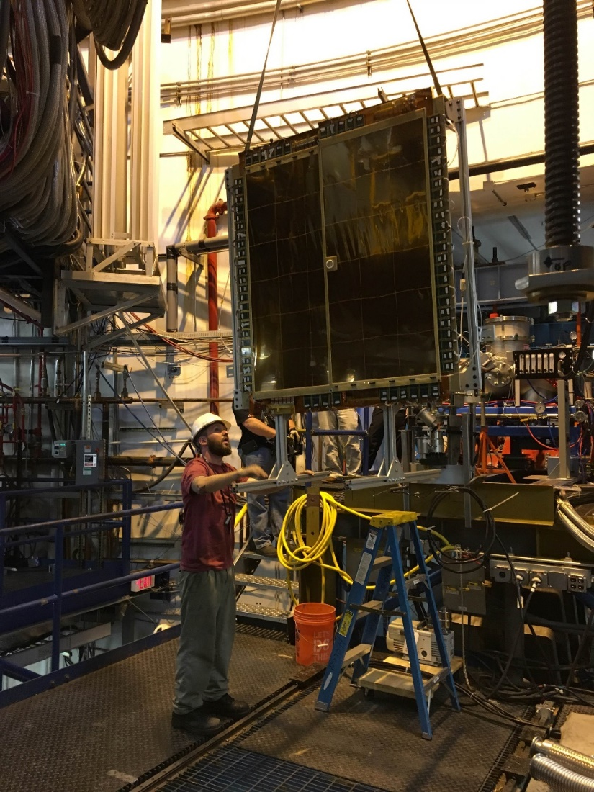
PRad GEMs in Hall B @ JLab
Two chambers were built at UVa and sent to JLab in February 2016
we setup a cosmic run with PrimEx Scintillators layers used for trigger of the APV25 SRS
The chambers are now in Hall B, installed in front of the HyCal
Installation is ongoing and commissionning to start on May 13
PRad GEMs move to the Hall last week
PRad GEMs on cosmic setup in EEL

Slide 12
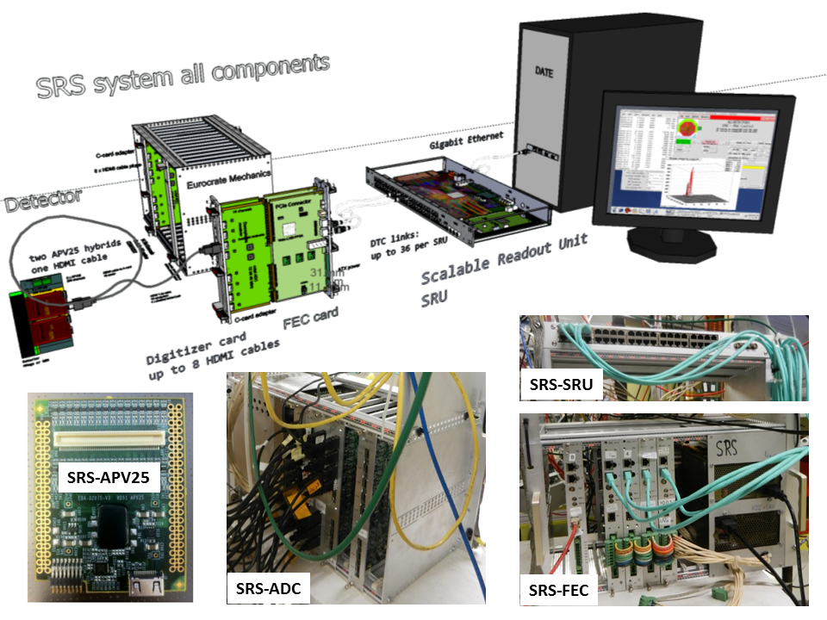
Front-End Electronics for PRad GEMs: The Scalable Readout System (SRS)
Multichannel electronics developed by the RD51 Collaboration for Micro Pattern Gaseous Detectors such as GEMs. It is based on:
SRS-APV25: Front End cards (hybrids hosting the APV25 chip) mounted on the detector ➩ send multiplexed data from128 channels to SRS-ADC cards via standard commercial HDMI cables.
SRS-ADC: card that host the ADC chips, de-multiplex and convert data from up to 16 SRS-APV25 cards into digital format then send them to the SRS-FEC cards
SRS-FEC: is the FPGA board, handles the clock and trigger synchronization of the SRS-APV hybrid cards, send digitized data from ADC to the SRS-SRU via 1 Gb Ethernet Copper link.
SRS-SRU: handles communication between multiple (up to 40) SRS-FEC cards and the DAQ computer. It also distributes the clock and trigger synchronization to the SRS-FEC cards and send the data fragment to the DAQ PC through Gb Ethernet.
Need for the PRad GEMs:
Hardware:
      72 SRS-APV FE cards (36 per GEMs) ⇨ total of 9184 channels to read out
      8 SRS-ADC / SRS-FECs with 9 APVs cards, 3 time samples
      2 SRS-SRUs to collected the data from the FECs transfer to the DAQ PC
      TIpcie: Interface the SRS electronics into JLab DAQ (CODA)
  Firmware upgrade

Slide 13
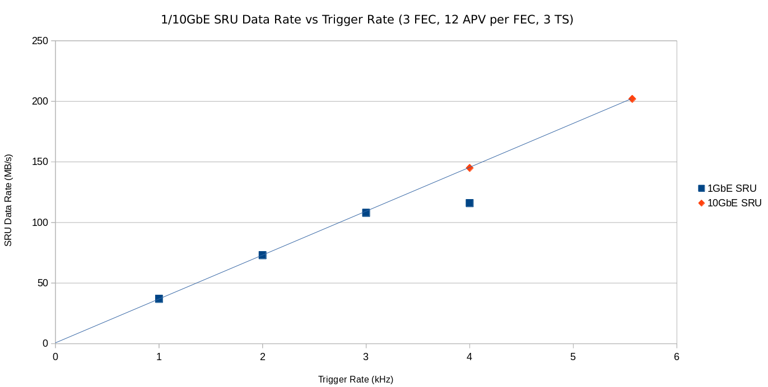
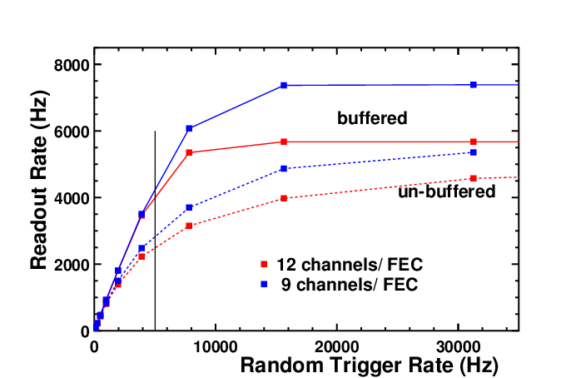
SRS Firmware Upgrades
(B. Moffit, JLab DAQ group - B. Raydo, JLab Fast Electronics Group)
SRS-SRU firmware upgrade:
Standard firmware developped for APV25 had 1Gb Ethernet link
Upgrade of APV25-compatible 10 Gb SRU firmware (JLab DAQ)
Test setup
36 APVs, 3 Time sample, 3 FECs (Event size 38.5 kB)
APV25 calibration pulse with internal trigger
Rate tests with standard 1(Gb) and upgraded (10 Gb) firmware
1 Gb link (SRU): Saturation @ ~3.2 kHz (Max. rate ~ 3.3 kHz)
10 Gb link (SRU): linear data transfer speed up to 5.5 kHz
  ⇨ saturation expected beyond 6 kHz (FEC data to SRU @ 80 MB/s)
SRS-FEC firmware upgrade:
Trigger buffering and Busy signal implementation
Test setup for 5 kHz random trigger rate
9 / 12 APV25 (ADC channels), on 1 FEC with 3 time samples to the SRU (Expected configuration for PRad)
Random pulse generator board
Un-buffered triggers firmware: readout rate of ~2.8 kHz (9 APVs on FEC) ⇨ 44% dead time
Buffered trigger firmware: readout rate of ~4.25 kHz (9 APVs on FEC) ⇨ 15% dead time, OK for PRad
limitation 1 Gb FEC to SRU
SRU 1Gb: limitation 1 Gb link to DAQ PC

Slide 14
Integration of SRS into JLab DAQ
(B. Moffit, JLab DAQ group - B. Raydo, JLab Fast Electronics Group)
PCIexpress Trigger Interface (TIpcie)
PC / Server Integration into JLab Pipeline DAQ
  Standard PC Hardware allows for multiple network cards (1G, 10G, Infiniband)
Fiber Connection (Clock, Trigger, Sync) to Trigger Supervisor
Runs in Standalone (Master) or Larger-Scale DAQ (Slave).
Software librairies for the slow control
C Library written to be used with CODA, but also works standalone (Master mode)
Kernel and userspace driver compatible with EL5, EL6 (i386, x86_64)
Interface to the SRS
APV Data from SRU to the DAQ PC with 10 Gb Ethernet
SRU trigger from the TIpcie, FECs send BUSY signal to Trigger Supervisor
  DAQ PC multiple cores/threads for data processing ⇨ online zero suppression for data reduction factor ~200 ⇨ TIPCie to transfer data to main DAQ PC
Online monitoring of Raw APVdata and GEM hits
Setup test with the Tipcie
The back side of the DAQ PC shows:
TIPCIe blue fiber connection to the TS
Twisted pair connections for triggers.
The 10 Gb card for data transfer with the links connected (black) to the SRU.
TIpcie

Slide 15
Summary / Outlook
SoLID GEM-US program for a two years pre-R&D
  Optimized & finalize the design of GEM modules for all SoLID configuration
    Design ideas to improve performance and lower production cost
  Setup a program to start testing and characterization of Chinese GEM foils
  Investigate needs and option for SoLID GEM readout electronics
  Study the currently available candidate such as BNL VMM or Saclay DREAM chip
Large GEM activities in US (UVa & Temple U)
  Production of Large Area GEM trackers for the SBS in Hall A and PRad in Hall B
    PRad GEM largest GEM detector built. Size comparable to largest SoLID GEM module
  Ongoing intensive GEM R&D for the EIC forward tracking
  Progress in the integration of the APV25 readout electronics into JLab CODA DAQ
    Development for both SRS and MPD readout systems

Slide 16
Back Up

Slide 17
The PRad Experiment @ JLab: ep → ep Scattering
Proton Radius puzzle
PRad Experiment (E12-11-106):
High “A” rating (JLab PAC 39, June 2011)
Experimental goals:
  Very low Q² (2×10⁻⁴ to 4×10⁻²)
  10 times lower than current data @ Mainz
  Sub-percent precision in <r_{p}²> extraction
Specifications for PRad Experiment
Non Magnetic spectrometer
High resolution and high acceptance calorimeter ⇨ low scattering angle [0.7º - 3.8°]
Simultaneous detection of ee → ee (Moller Scattering) ⇨ minimize systematics
High density windowless H₂ gas target ⇨ minimze background
clean CEBAF electron beam (1.1 GeV & 2.2 GeV) ⇨ minimze background

Slide 18
SRS-FEC Firmware Upgrade: Trigger Buffering
(B. Moffit, JLab DAQ group - B. Raydo, JLab Fast Electronics Group)
Non-buffered trigger FEC firmware (original):
Live
Dead
APV
APV
UPD Frame
UPD Frame
~10us
~200us
Dead/busy while APV sends triggered data and dead/busy while UPD packets are sent
For fixed trigger rate, the dead time is basically determined by the UDP data processing (~200 μs)
For random trigger: the mechanism is inefficient
  ⇨ no use of live time with low trigger burst but high trigger burst mean data loss because of dead time
Buffered trigger FEC firmware (new):
Live
Dead
APV
APV
APV
APV
APV
UPD Frame
UPD Frame
~10us
~200us
Dead/busy while APV sends triggered data, no longer dead/busy while UPD packets are sent
UDP processing of APV data is “de-correlated” from APV sending data
When buffers in FPGA (holding captured APV for UDP processing) become full, then the FEC create necessary dead/busy time.
For random trigger, @ high trigger burst, APV data are stocked in buffer and UDP packet is formed during the low trigger burst
Dead/busy time while APV sends data can be eliminated to improve live time, but requires significant changes to FEC firmware.

Slide 19
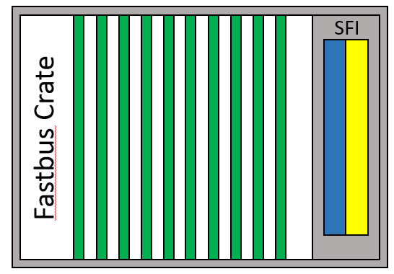
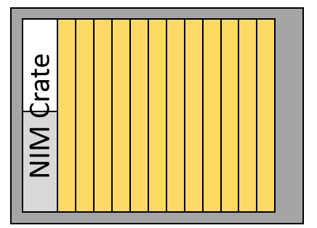
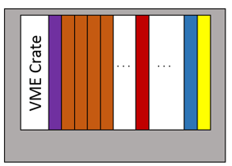
Integration of SRS into JLab DAQ: PRad DAQ Overview
PRad DAQ PC
JLab network Data/Control
10 GbE optical fiber
GEM DAQ PC
SRS-SRU
TIpcie
10 Gb NIC
SRS-FECs
Crate
Linear Sum
Gate for Fastbus ADCs
Trigger to TI slaves
SRS-FEC BUSY signal
Logic and Translation
Trigger to TI master
Timing information to JLab discriminators

