Slide 1
SoLID HGC Update
Zhiwen Zhao
2016/05/07

Slide 2
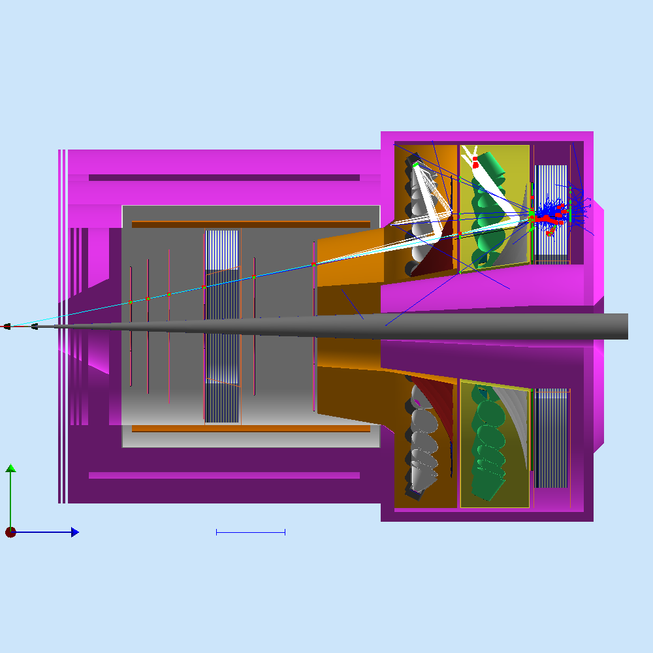
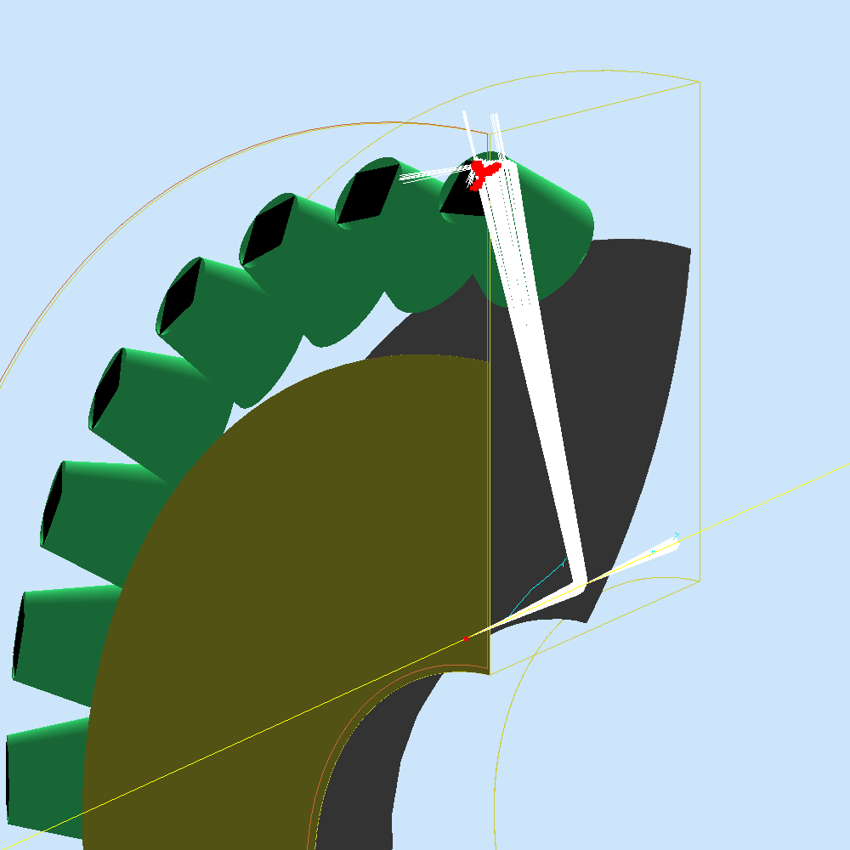
Optimization for forward angle where more SIDIS physics and higher background are

Slide 3
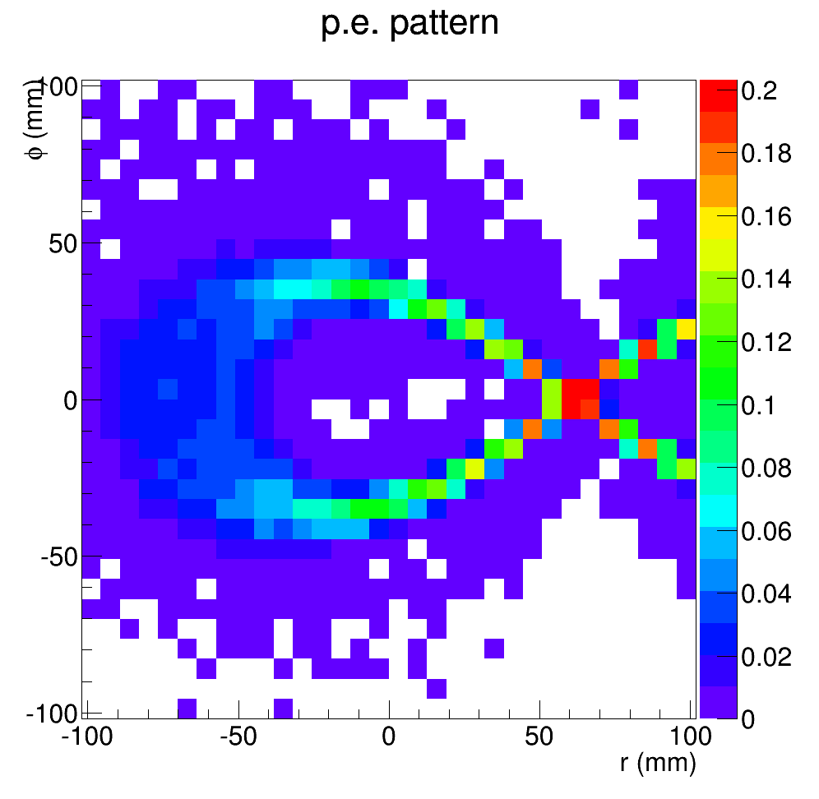
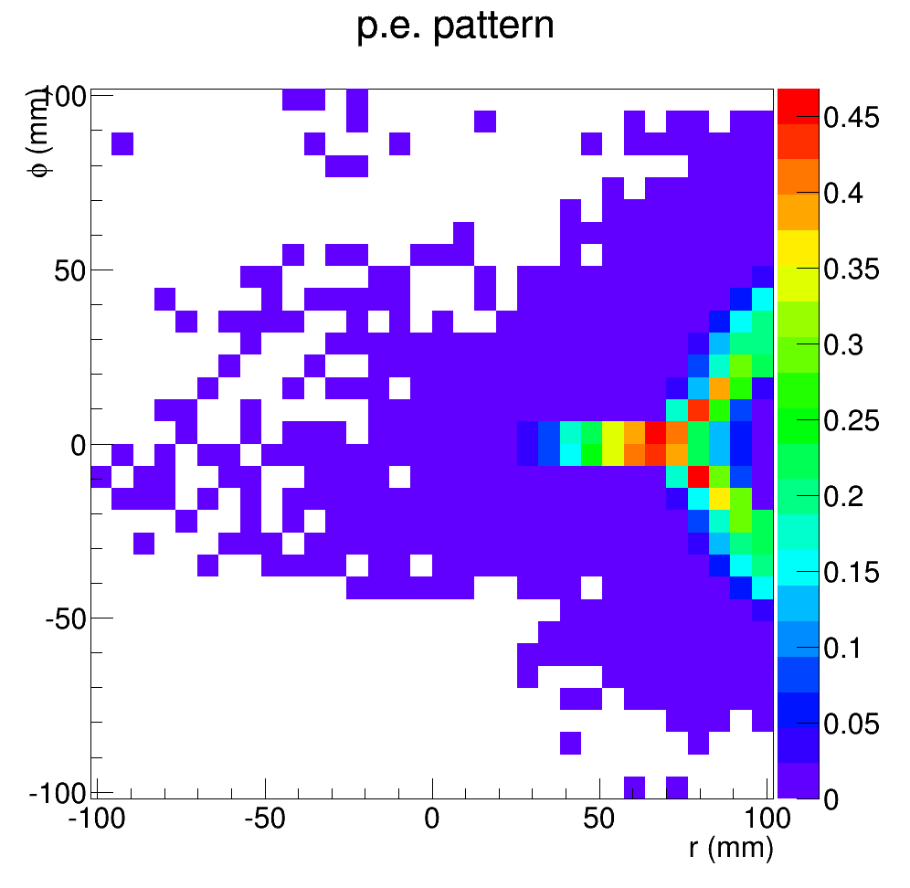
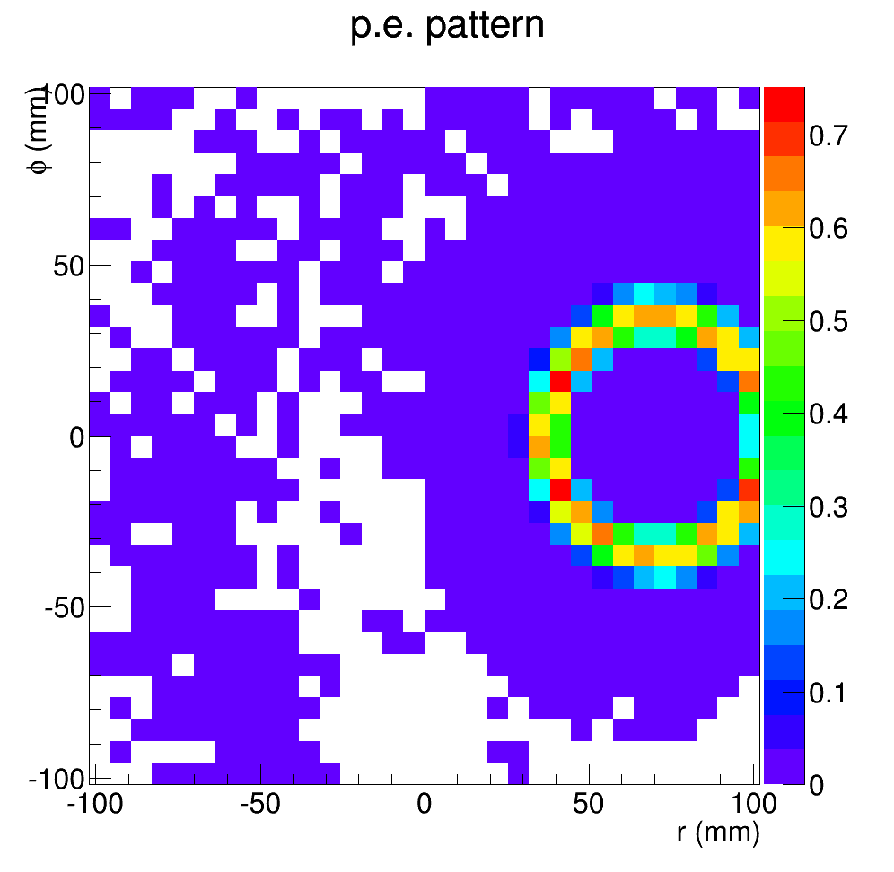
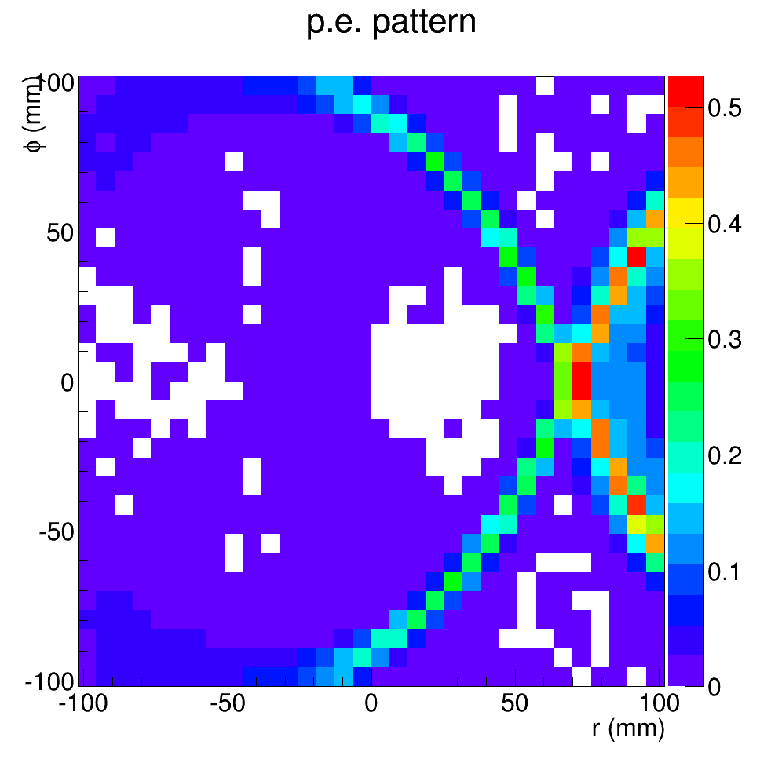
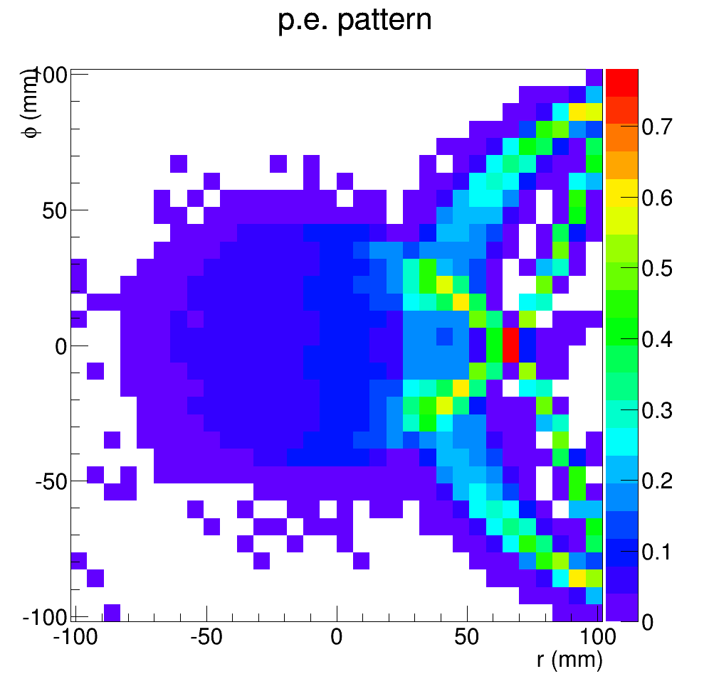
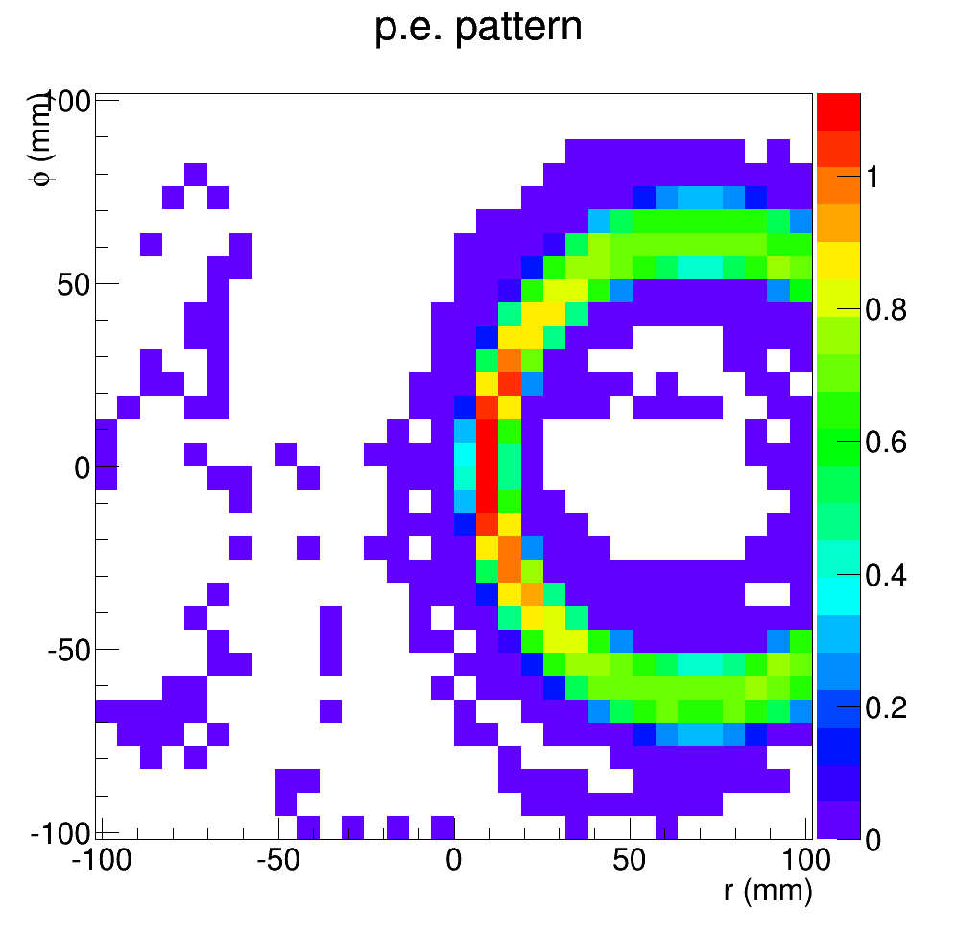
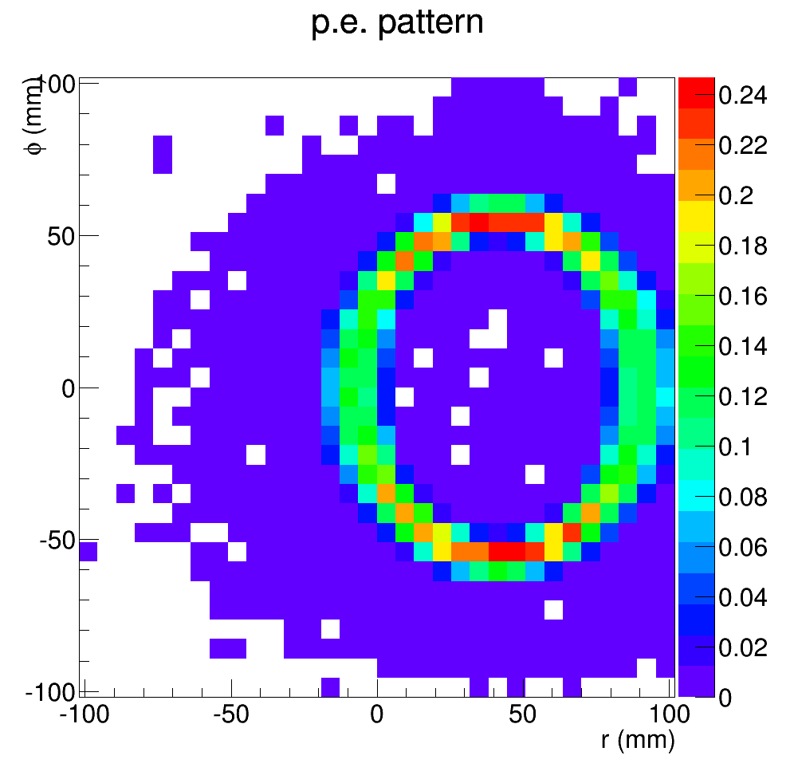
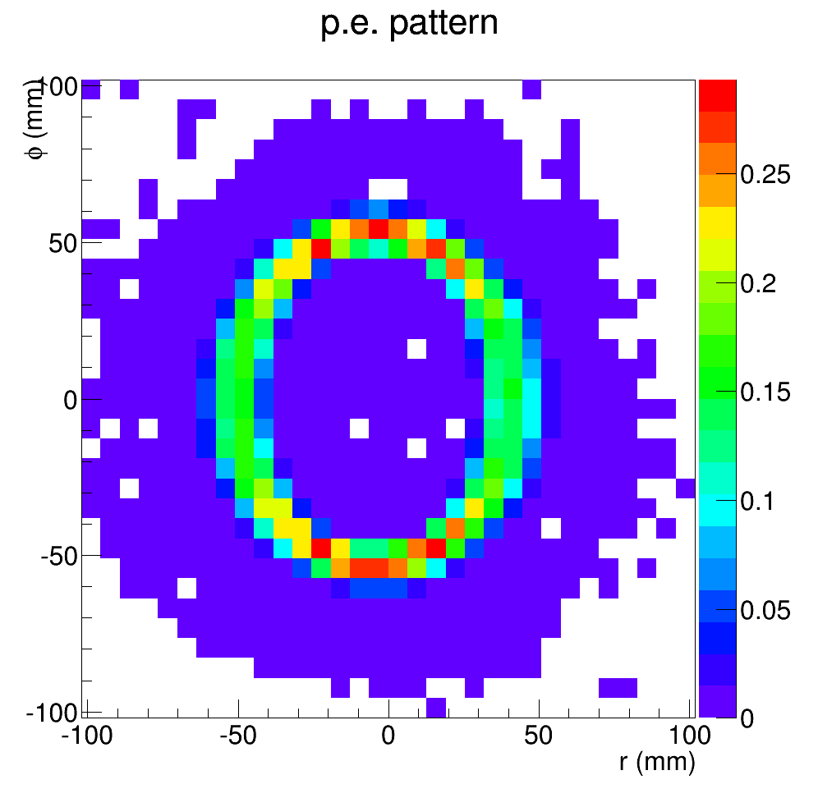
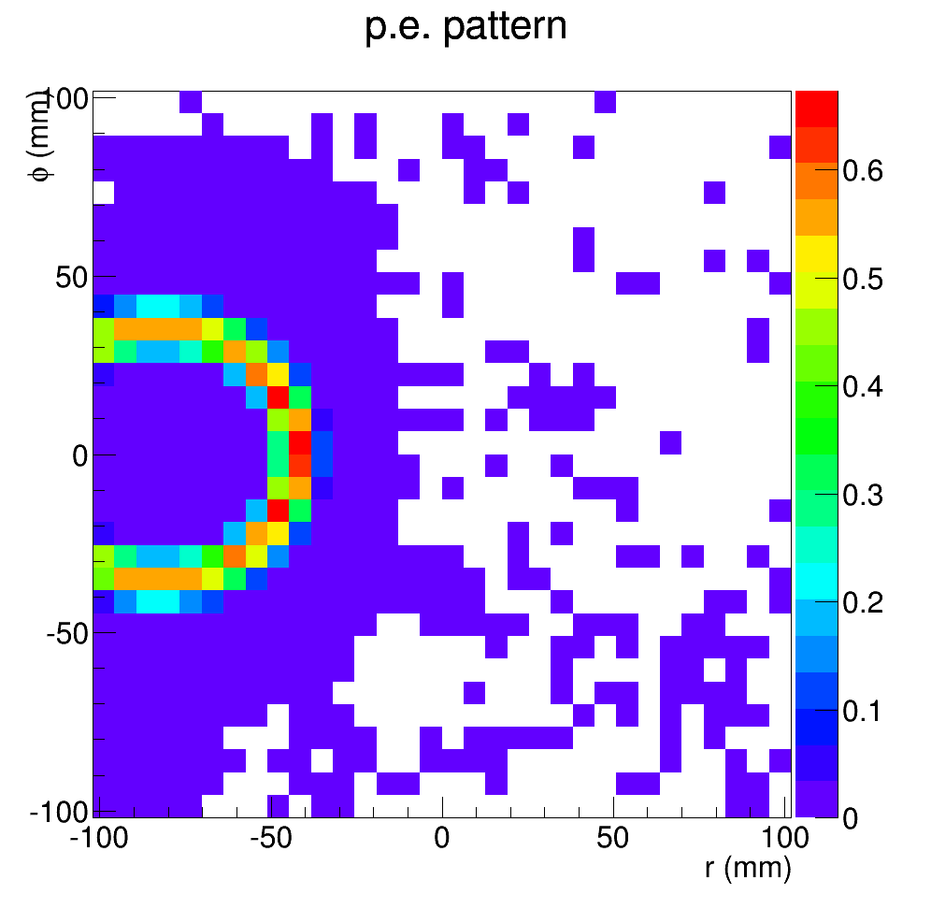
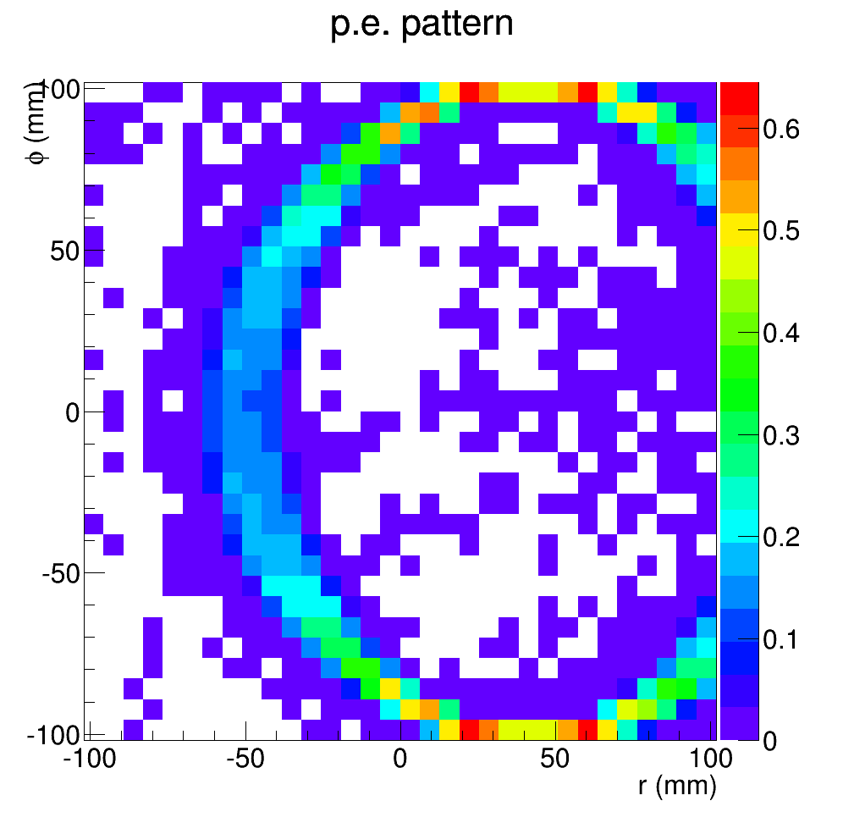
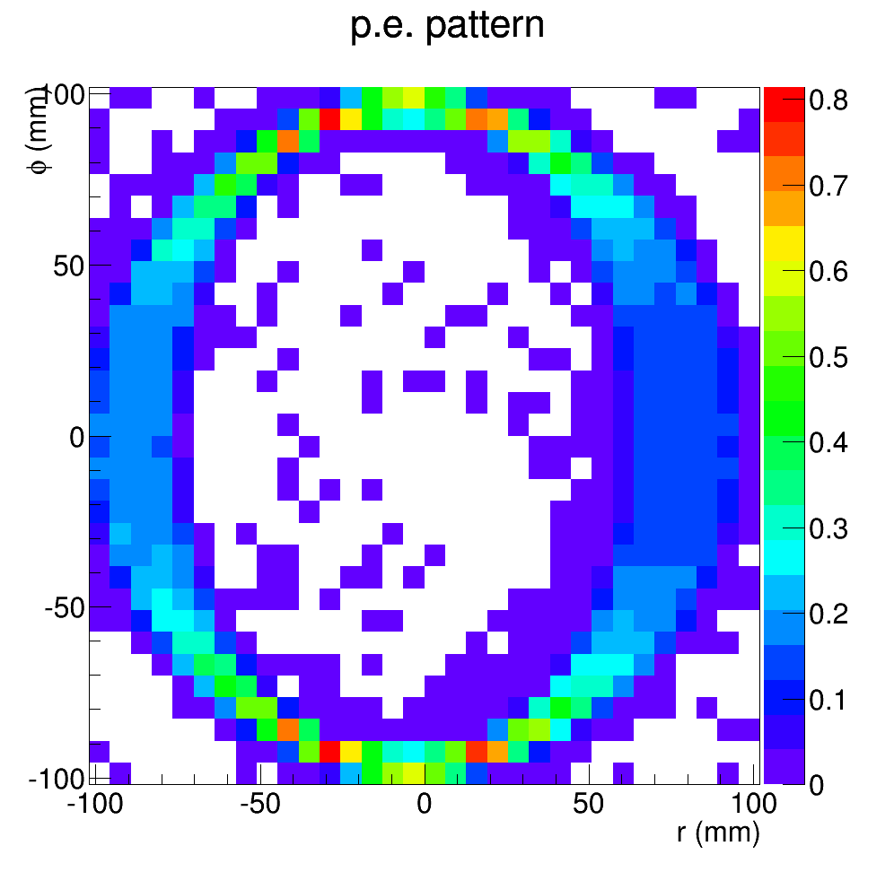
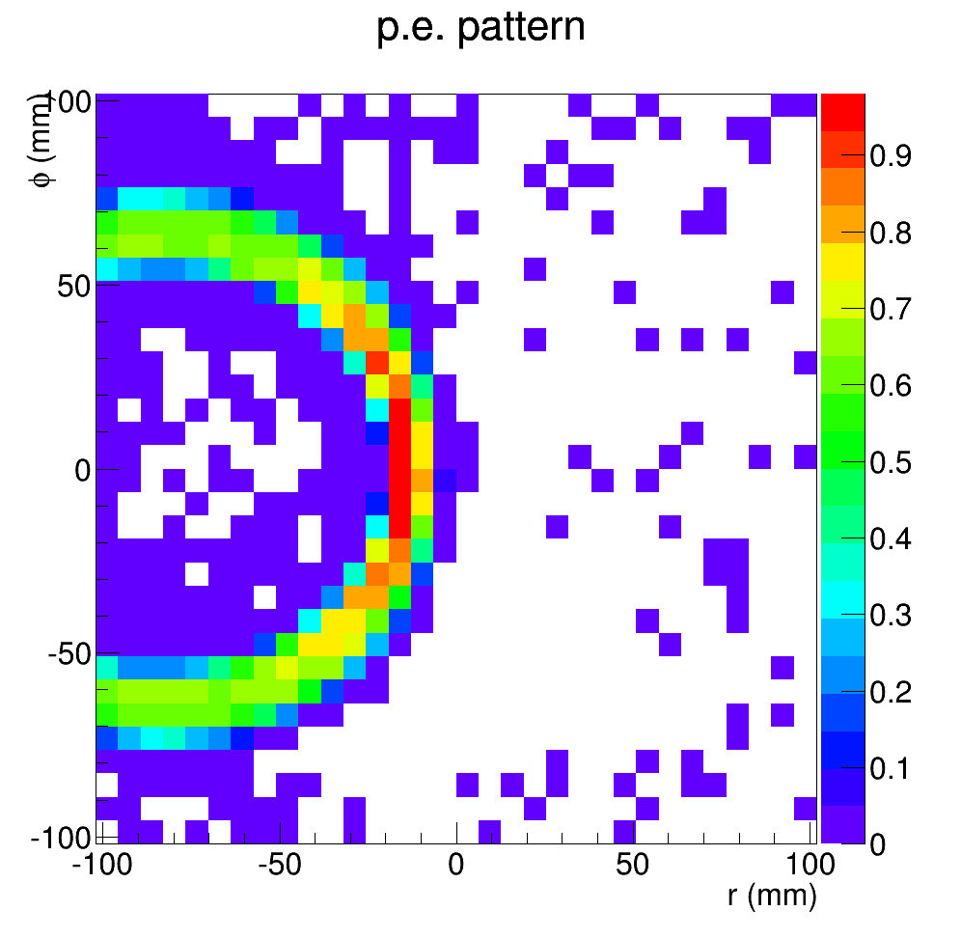
Hit pattern on 4x4 of 2”MAPMT (pionm, at phi=0deg)
2.5GeV
7.5GeV
7.5deg
8.0deg
14.8deg
7.5deg
8.0deg
14.8deg
Old configuration, PMT at r=239.7cm, z=325cm, tilt 44 degree
New configuration, PMT at r=249.7cm, z=335cm, tilt 65 degree
New configuration optimized for forward angle where higher rate, higher background
New configuration relies more on one bounce photons from mirror, less on two bounce photons from cone

Slide 4
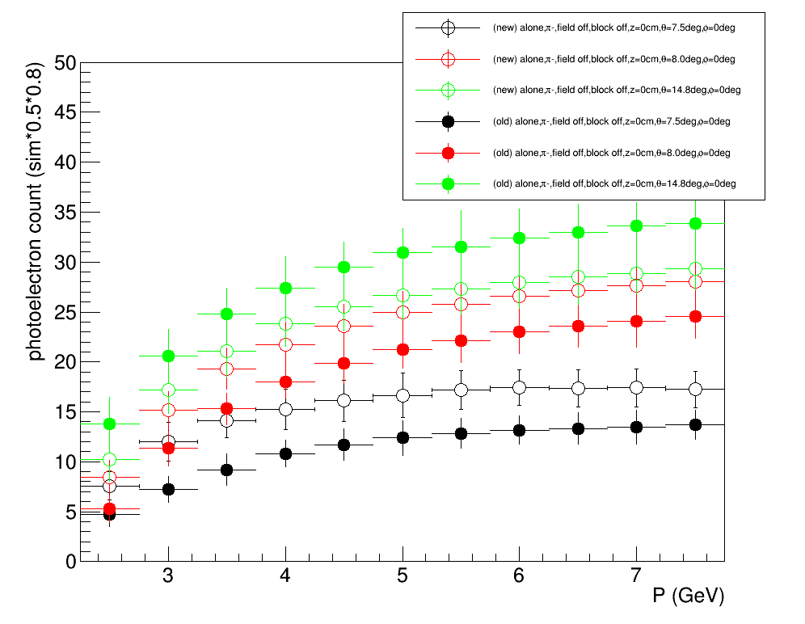
Comparison
Theta= 7.5deg and 8deg, increase by 20-30%
Theta=14.8 deg, decrease by 20-30%

Slide 5
Outlook
Further study the new configuration in simulation, especially on background
Garth Huber’s Canadian fund request (C$100k), The first half approved in March, waiting for the other half and hope to start prototyping frame and window soon
Making board with JLab electronic group and test them late Summer or early Fall
Collaborating on PMT shielding and PMT test with Wuhan University nuclear group

Slide 6
backup

Slide 7
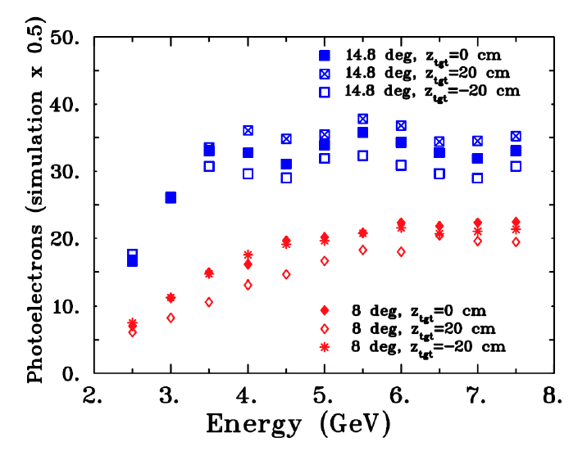
Result in pCDR

