Slide 1
First Measurement of e-³He(log. Pol.) Parity Violating Deep Inelastic Scattering Asymmetry Using an Upgraded Polarized ³He target
Gordon Cates, Xiaochao Zheng, Yuxiang Zhao
LOI12-16-007
yuxiang.zhao@stonybrook.edu

Slide 2
Nucleon Spin structure study using PVDIS
Beam:
Unpolarized electron beam (11 GeV, 60 uA, 180 days)
Target:
Longitudinally polarized ³He target
Luminosity=16 x (stage 2 upgrade)
Pol.= 60%
Detector Package:
Large angle detector package of SIDIS configuration using SoLID
Measurements:
A_{UL} (APV) for inclusive electrons

Slide 3
Outline
Electroweak physics as a tool to study nucleon spin structure
Simulations and projections
Summary and Discussions

Slide 4
Structure functions and PDFs in e-p(n) DIS processes
Experimental observables
PDFs
Unpolarized cross section
Unpolarized pdfs:
~50%
f(x)=q↑(x) + q↓(x)
Unpolarized structure functions
Quark-Parton Model
QPM
F₁^{ү} F₂^{ү}
A_{LL} A_{LT}
Polarized pdfs:
~30%
Spin crisis
Helicity distribution ∆q=q↑(x) - q↓(x)
Polarized structure functions
No g₂ interpretation in QPM
g₁^{ү} g₂^{ү}
SIDIS to access TMDs, DVCS to access GPDs … 3D era … ongoing efforts
JLab: High intensity and high polarization of electron beam and targets
Leadership for the precision spin structure measurements

Slide 5
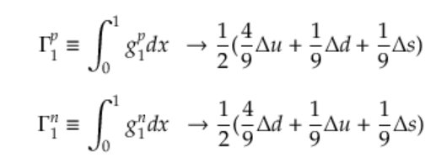
Flavor decompositions
With pure ү exchange in inclusive DIS:
Hmm … No third kind
of nucleon …
Assumption: SU(3) flavor symmetry
Only two combinations of
Δu, Δd , Δs
Δ∑ = Δ u + Δd + Δs
Δ∑ (p)= 0.15
Δ∑ (N)= 0.35
???
Additional inputs from β-decay
of neutron and hyperons
Δu + Δd -2 Δs
Δu + Δd
Scheme dependent …
Other processes can also contribute, but with additional sys. errors and assumptions

Slide 6
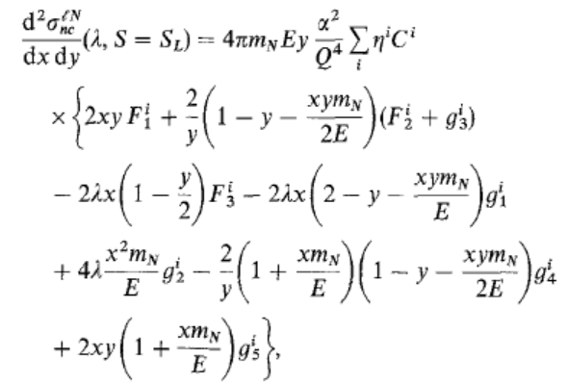
New opportunities with weak neutral currents
Anselmino, Efremov, Leader, Ji …
Phys. Rep. 216 (1995)
With parity violation and Q² << Z²
Inclusive electron measurements
pol. electron & unpol. nucleon:
unpol. electron & pol. nucleon:

Slide 7
New structure functions ---ү-Z interference structure functions
pol. electron & unpol. nucleon:
unpol. electron & pol. nucleon:

Slide 8
New structure functions ---ү-Z interference structure functions
pol. electron & unpol. nucleon:
unpol. electron & pol. nucleon:

Slide 9
New structure functions ---ү-Z interference structure functions
pol. electron & unpol. nucleon:
unpol. electron & pol. nucleon:
Suggestion from theory group for this LOI review

Slide 10
Simulations
GEMC with SIDIS configuration
Beam: Unpolarized electron beam (11 GeV, 60 uA, 180 days)
Target: (need dedicated R&D)
Longitudinally polarized ³He target
Luminosity=16 x (stage 2 upgrade) ~ 1.15e38 /cm²/s on ³He
Pol.= 60%
Stage 2 upgrade = 12 amg density + 60cm length
+ metal-end window + tolerance of 60 uA beam
Luminosity calculation: 15uA beam + 10 amg density + 40cm length = 1e36/cm²/s on ³He

Slide 11
Rate estimation

Slide 12
Predicted asymmetry A_{UL} on ³He
Pol. PDF = NNPDF
Unit in ppm

Slide 13
Uncertainty of predicted asymmetries from NNPDF
dA/A calculations using NNPDF PDF sets
Numbers in unit of %
³He asymmetry

Slide 14
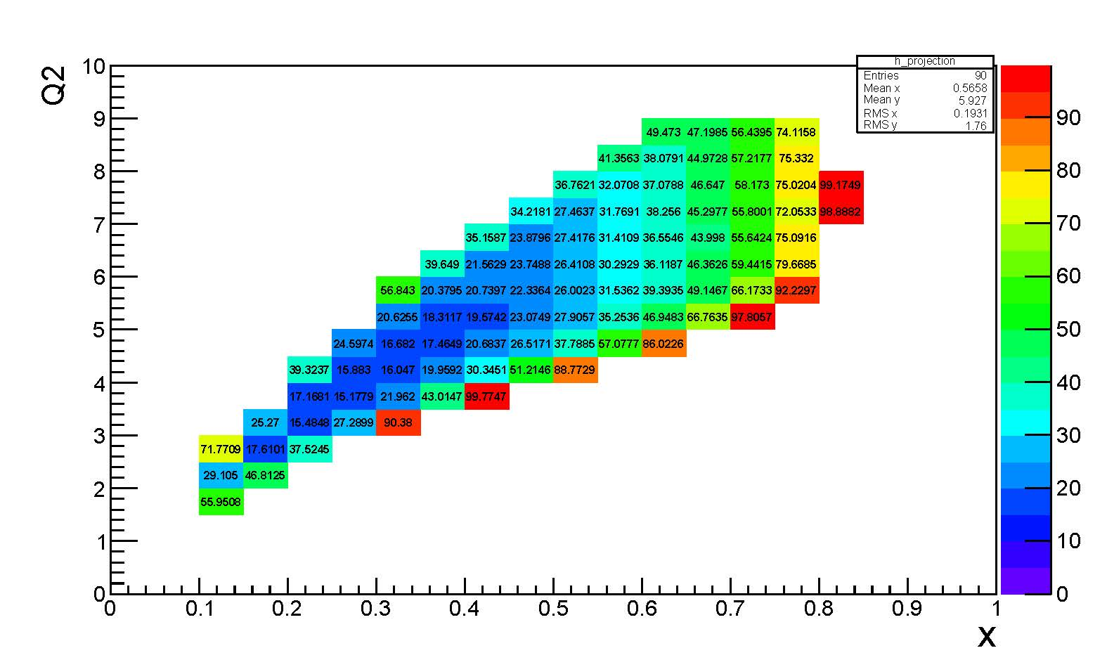
Projections using rate information
dA/A projections
Beam time =180 days
Target pol. = 60%
N₂ dilution = 0.9
³He asymmetry

Slide 15
Projections as a function of x
³He asymmetry
Target pol.=60%
N2 dilution =0.9
Beam time=180 days

Slide 16
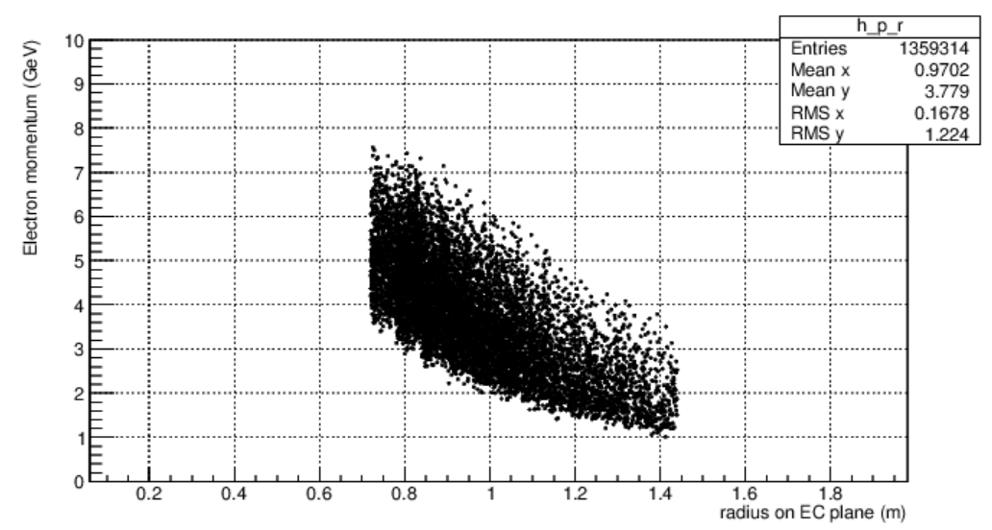
Trigger design and rate
Follow closely with SIDIS electron trigger design
Currently it is a flat P>3 GeV cut, flat threshold on EC
Large angle electron rate: 2.2 MHz = 73 KHz/sector
Q² cut study is under way … more reasonable for our measurement
Q²>3 GeV²

Slide 17
Challenges/dependence of the measurement
Dedicated target R&D
Luminosity improvement
Factor of 16 compared to stage 2 upgrade
4 from cooling, 4 from higher filling density
Target spin flip frequently to control systematic uncertainties
Fall project at SBU with 12 GeV beam line data
180 days of beam time only for physics measurements
No effects on target density loss and beam trip (assoc. with spin pair)
2 years of running???

Slide 18
Summary
Propose to measure A_{UL} with unpolarized electron beam and longitudinally polarized ³He target using SIDIS large angle detector package in SoLID
Highlights of the proposed measurements
First Measurement of polarized electroweak interference structure functiong_{1,5}^{үZ} , new combinations of PDFs with unique weights. Will work out the impact on PDF fit
Direct access to Δ∑
Combined with g₁^{ү} data from proton and neutron, SU(3) symmetry can be tested for the first time

Slide 19
How about EIC…

Slide 20
Luminosity and polarization table (e-p collisions)
e-p collisions | 10x100, 10x250, 15x100, 15x250
Run time luminosity | 10³⁴ /cm²/s
Detector efficiency | 70%
Beam efficiency | 70%
Beam time for running | 2.5 years 5 months per year = 12.5 months
luminosity after all efficiencies | 40 fb⁻¹ per month
Integrated luminosity | 500 fb⁻¹
Proton (electron) beam polarization | 70% (80%)
Uncertainty of proton (electron) beam polarization | 5% (2%)

Slide 21
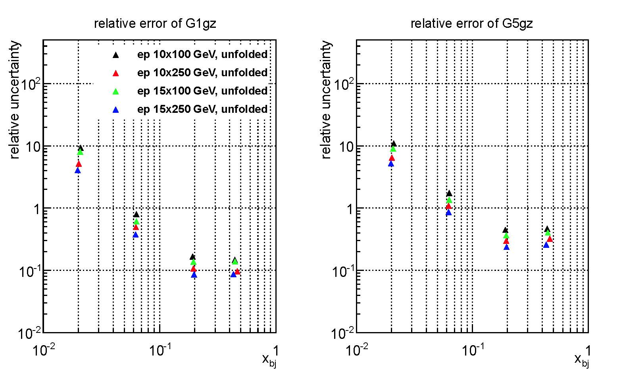
Pol. SFs projections after unfolding

