Slide 1

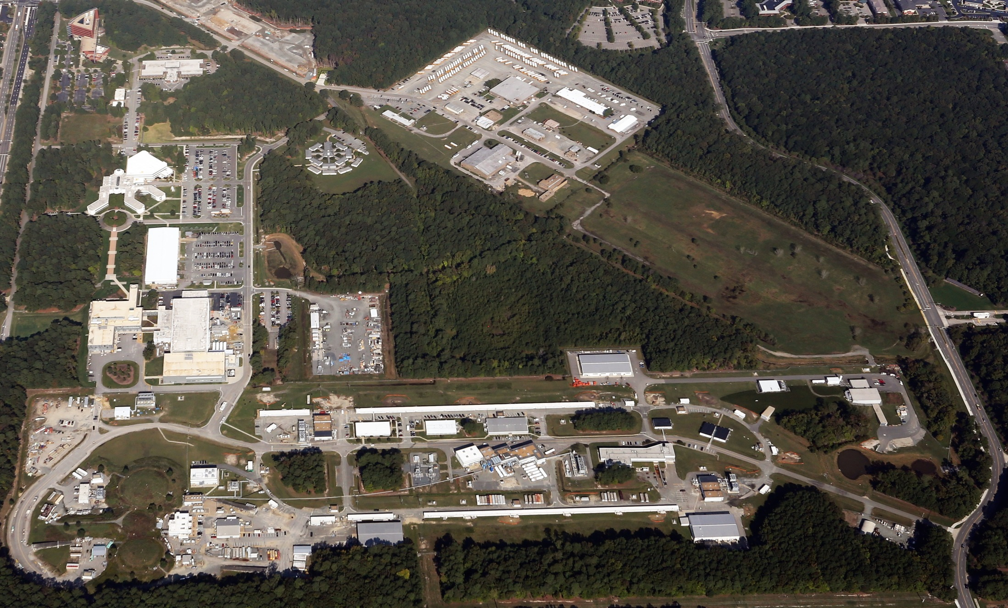
Jefferson Lab Status
Bob McKeown
August 26, 2016

Slide 2
Outline
Some Recent Results
Upgrade status
PAC
Budgets
JLEIC
Outlook

Slide 3
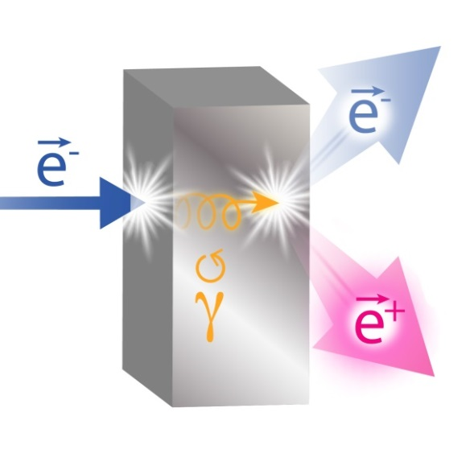
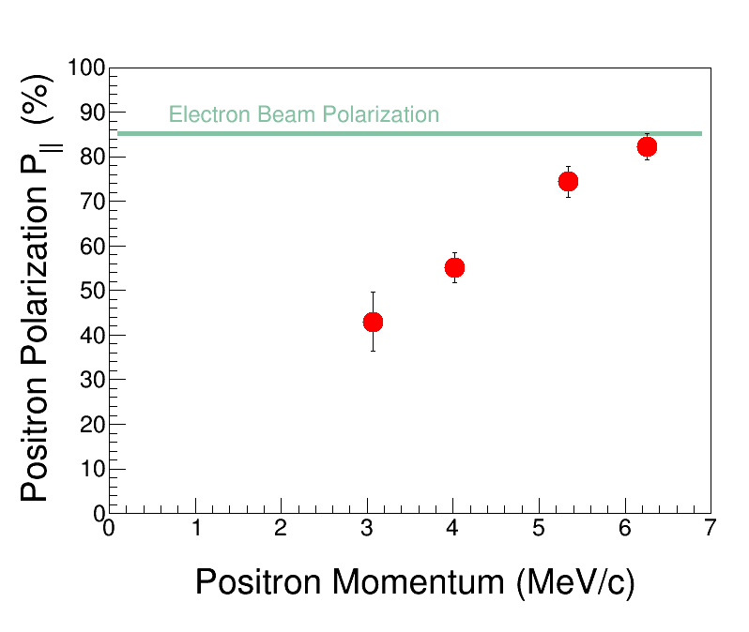

Polarized Positrons for Research
Positrons – the electron’s antiparticle offers new opportunities for research in
Nuclear Physics
Materials Science
The Polarized Electrons for Polarized Positrons (PEPPo) experiment in Jefferson Lab’s CEBAF injector demonstrated a new technique for production of polarized positrons.
D. Abbott et al. (PEPPo Collaboration). “Production of highly polarized positrons using polarized electrons at MeV energies.”
Phys. Rev. Lett. 116, 214801 (2016).
doi: 10.1103/PhysRevLett.116.214801
Notes:
Emphasize that this was an injector experiment.

Slide 4
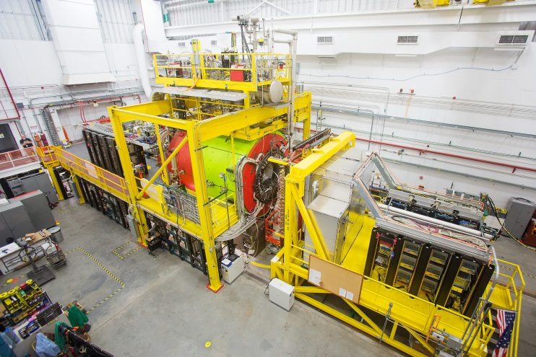
GlueX in Hall D
New experiment to study quark confinement
Commissioning complete
Detector functioning well
Production data-taking started
Poised to discover exotic hybrid mesons

Slide 5
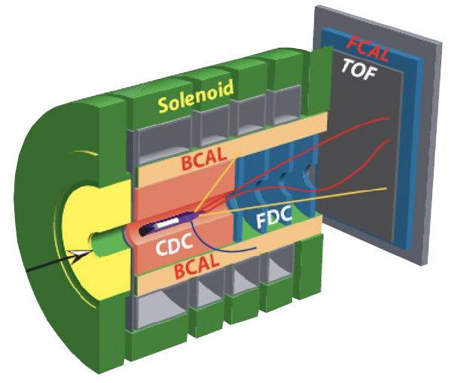

GlueX
Exotic hybrid mesons decay into:
complex photon final states

Slide 6
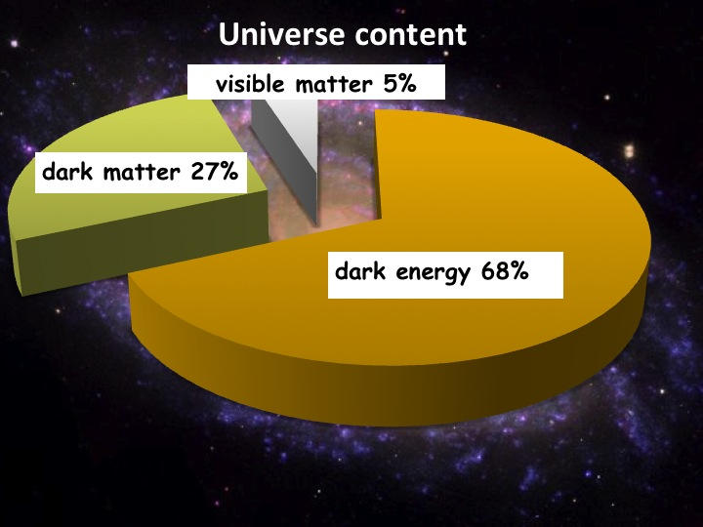

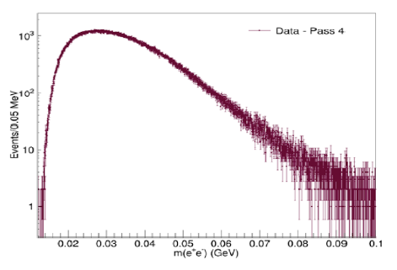
Heavy Photon Search
HPS searches for an electro-produced hidden sector photon (A’) which decays to e⁺e⁻ pairs
A’s could mediate dark matter annihilations and interactions with our matter
HPS identifies A’s with invariant mass and separated vertices
Status:
1 GeV data under analysis
  first results this summer
2 GeV data acquired in spring 2016
  results next year
More running in the future
NP-HEP Collaboration
Measured e⁺e⁻ Masses
Future Program: more HPS, APEX, DarkLIGHT

Slide 7
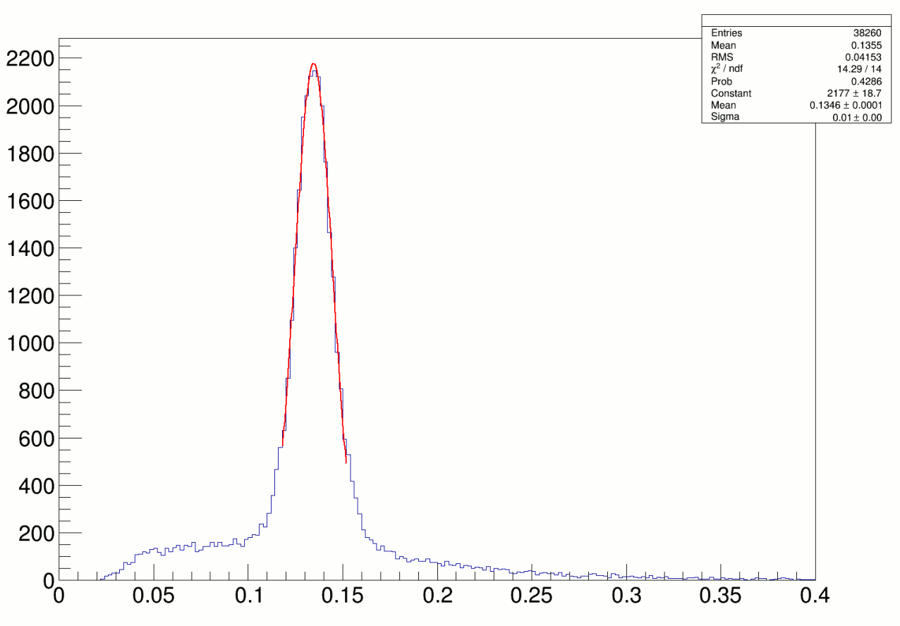
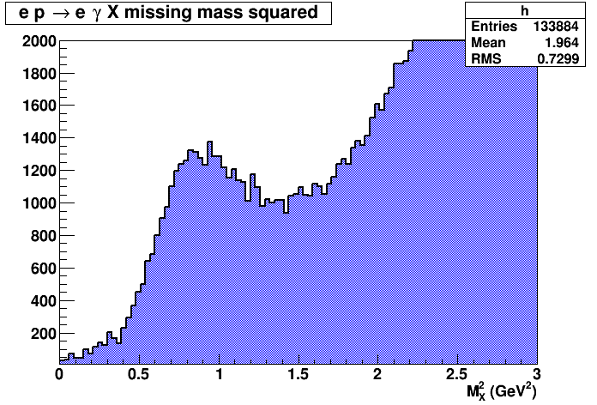
3D Imaging Program at 11 GeV
Hall A
Data reconstructed in calorimeter
Missing Mass Reconstruction
(1.5 h of beamtime)
High impact experiment for nucleon 3D imaging program
16% of experiment completed in 2014-2016

Slide 8
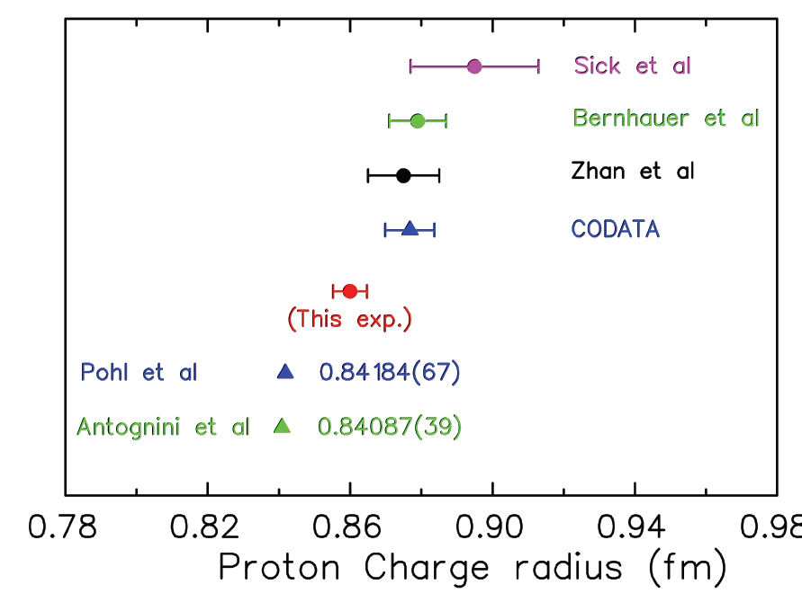

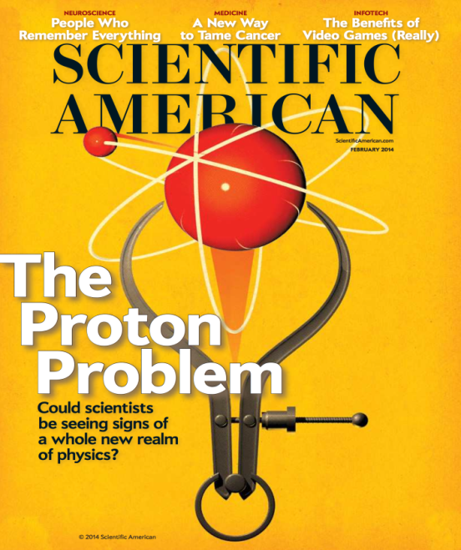
Solving the Proton Radius Puzzle
Elastic e-p
scattering
Atomic H
PRad@JLab:
(projected)
Muonic H
PRad: new experiment to
address proton radius @ JLab
NSF MRI: H₂ gas target
DOE GEM tracking detectors
Successful run in summer 2016!

Slide 9
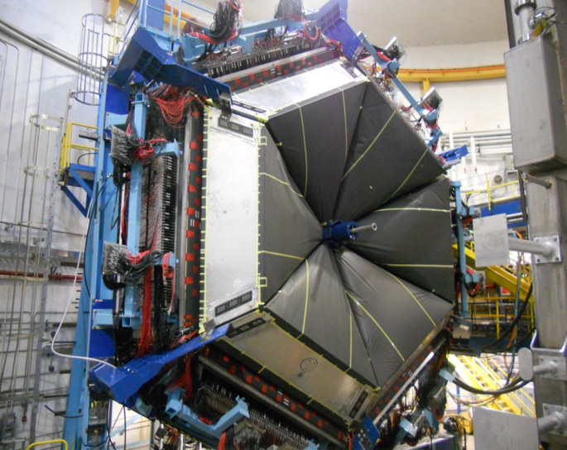
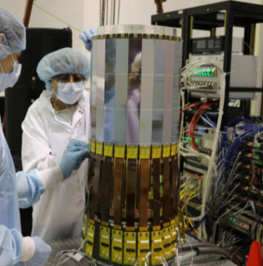
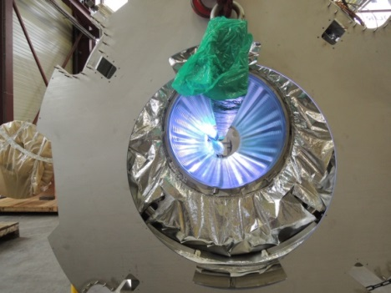
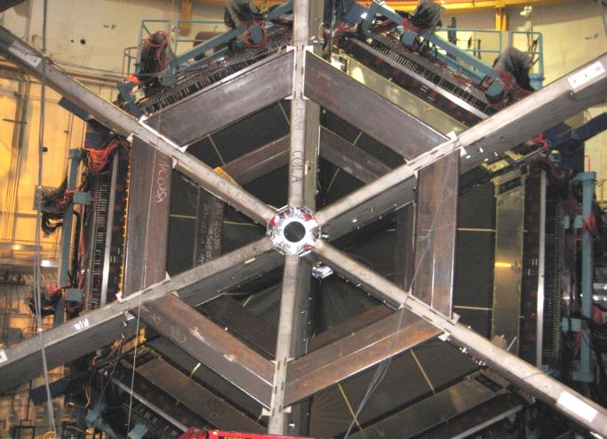
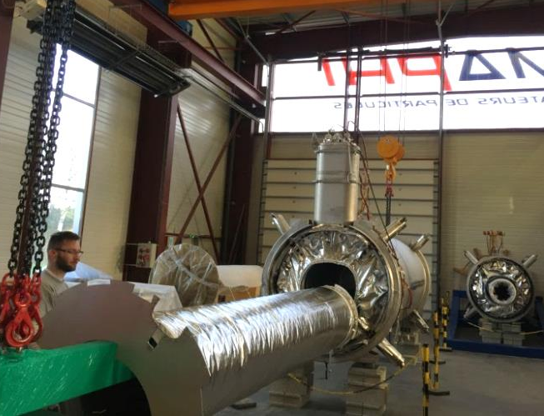
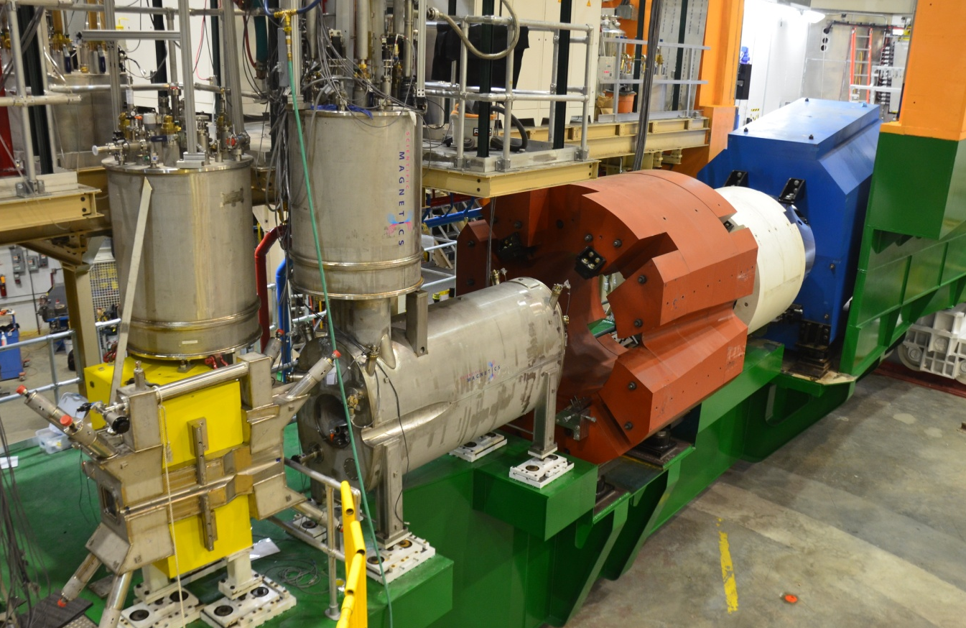
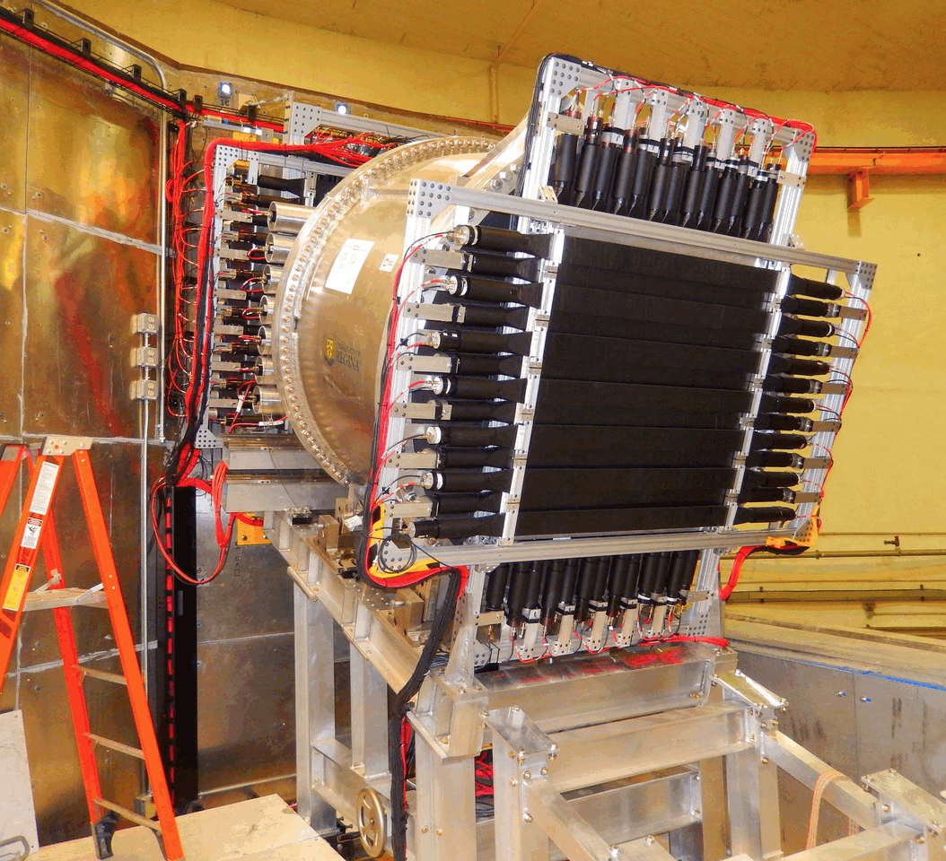
12 GeV Upgrade Project Status
TPC = $338M
ETC = ~$8M
Project Scope (~98% complete):
Doubling the accelerator beam energy – DONE
New experimental Hall D and beam line – DONE
Civil construction including utilities – DONE
Upgrades to Experimental Halls B & C – ~96%
  Halls B & C Detectors – DONE

Slide 10
CEBAF Three-Year Schedule
Feb 2016
Calendar Year
2016
2017
2018
Fiscal Year
2016
2017
2018
Accelerator
Activity
Opportunistic
Physics
Physics
Physics
Beam
Activity
SBS Construction
Hall A
Activity
Opportunistic
Physics
Physics
Physics
Beam
CLAS12 Construction/Installation
Hall B
Activity
Activity
Non-CLAS12 Ops*
Physics
Physics
Beam
Hall C
Activity
SHMS Construction/Installation
Activity
Comm.
Physics
Physics
Beam
Opportunistic
Physics
Physics
Physics
Hall D
Activity
Beam
* Potential PRad Summer 2016 run
Beam for Commissioning
Beam for Physics
Non-CLAS12 Ops

Slide 11
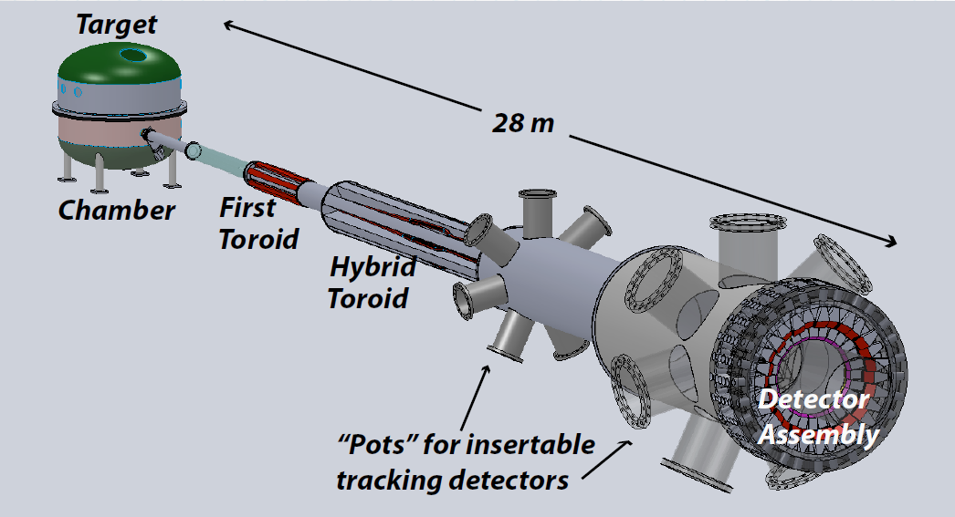
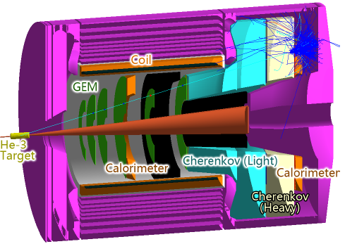
Future Projects
MOLLER experiment
(Possible MIE – FY17-20)
– Standard Model Test
– DOE science review (September 2014) – strong endorsement
– Director’s review to be scheduled for late 2016 –
Technical, cost & schedule
– Now hope for FY18 start
SoLID
– CLEO Solenoid 
– Chinese collaboration
– Director’s review (Feb. 2015)
 lots of good feedback
– Collaboration briefing to DOE-NP
(Nov. 2015)

Slide 12
PAC44
3 returning C2
9 new proposals
1 returning C2 run group
2 new run groups (Hall B)
3 run group additions
9 LOI’s
Scheduled for week of July 25
Proposals were due Monday, June 6, 2015
Charge:
Review new proposals, previously conditionally approved proposals, and letters of intent for experiments that will utilize the 12 GeV upgrade of CEBAF and provide advice on their scientific merit, technical feasibility and resource requirements.
Identify proposals with high-quality physics that, represent high quality physics within the range of scientific importance represented by the previously approved 12 GeV proposals and recommend for approval.
Also provide a recommendation on scientific rating and beam time allocation for proposals newly recommended for approval.
Identify other proposals with physics that have the potential for falling into this category pending clarification of scientific and/or technical issues and recommend for conditional approval. Provide comments on technical and scientific issues that should be addressed by the proponents prior to review at a future PAC.

Slide 13
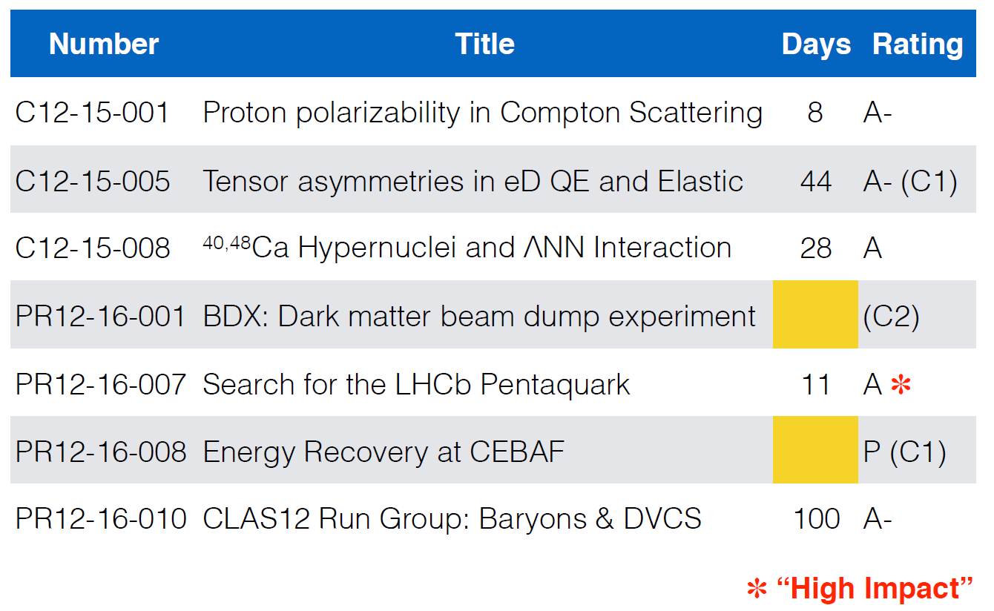
PAC44 Approvals

Slide 14
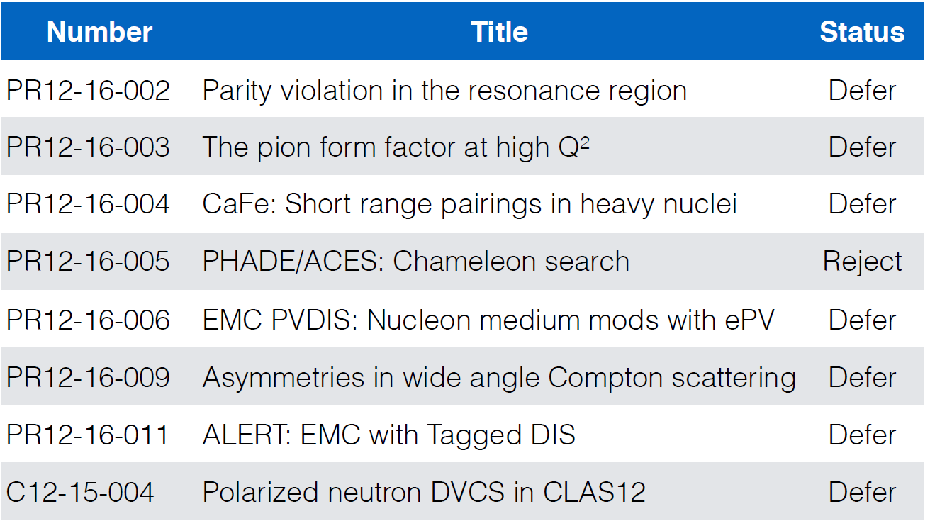
PAC44 Results

Slide 15
12 GeV Approved Experiments by Physics Topics

Slide 16
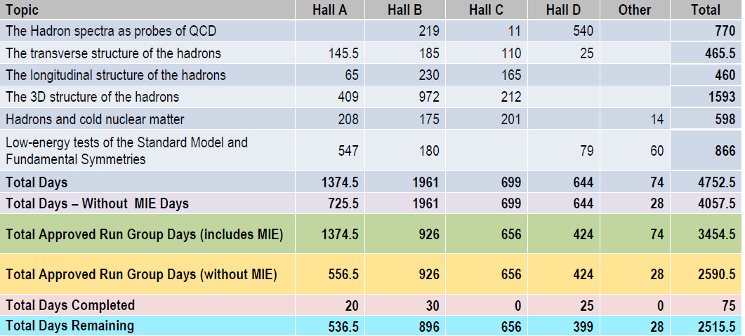
12 GeV Approved Experiments by PAC Days
A Decade of Experiments

Slide 17
Jeopardy
Process
Requested a proposal from UGBOD at January 2016 meeting. UGBOD gave some guidance, but not consensus.
Generated a proposal in April, sent to hall leaders and UGBOD. Got email feedback from UGBOD.
Added explanatory text to address feedback from UGBOD.
May 2016 – reached consensus on present draft for discussion at user meeting.
Rationale
Use normal yearly PAC for ~4 years to address all presently approved proposals that have not been scheduled, plus new proposals in the next few years. Estimate ~5-10 proposals per meeting
Will start in 2019 to reach steady state in 2024 - proposals that have been approved for 4 years or more but are not scheduled will be considered in Jeopardy.
More details in posted document

Slide 18
Budget: FY16; FY17 Discussion
Omnibus FY16: JLab allocation is $1.5M below Pres. budget.
  Keep 16 weeks running; Retain staff
  Delay some activities, accelerator spares  increased risk, little margin
FY2017
  Pres. Budget release Feb. 9: NP at $636M, an increase of $18M (3%)
    Major increases in isotope program ($8M) and RHIC/BNL ($7.5M)
    JLab ops up $5.5M but insufficient for full operation
  Senate mark: $636M
    Language for FRIB construction and RHIC ops
  House Mark: $620M
    Language for FRIB construction, RHIC and CEBAF ops
  Now looking at 6 month CR...

Slide 19
JLab Operations Budget
During FY01-FY12, CEBAF ops averaged 34.5 weeks/year (best year FY05 at 42 weeks)
For 12 GeV era we estimate “optimal” operations at
37 weeks per year
FY17 Pres. Budget includes JLab ops at $104M.
- would fund 23 weeks (+ 3 weeks from 12 GeV project)
FY18+ at cost of living implies 23 weeks/year running
(62% of optimal)
We propose FY18+ at 30 weeks/year (81%), will require ~$6M increase in operations budget.

Slide 20

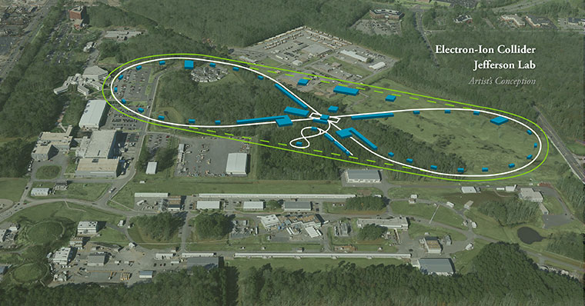
EIC at Jefferson Lab
JLab JLEIC Figure 8 Concept
Initial configuration:
  3-10 GeV on 20-100 GeV ep/eA collider
  Optimized for high ion beam polarization:
    polarized deuterons
  Luminosity:
    up to few x 10³⁴ e-nucleons cm⁻² s⁻¹
    Low technical risk
    Upgradable to higher energies
    250 GeV protons + 20 GeV electrons
    Flexible timeframe for Construction
    consistent w/running 12 GeV CEBAF
    Thorough cost estimate completed
    presented to NSAC EIC Review
    Cost effective operations
    Fulfills White Paper Requirements
Current Activities
Site evaluation (VA funds)
Accelerator, detector R&D
Design optimization
Cost reduction
Notes:
Deleted
Brightened graphic (no more shame); added current activities from previous version;
Mary Beth please format text

Slide 21
EIC Developments
NAS study being planned for this year
SLAC, LBNL will increase involvement in EIC
Rik Yoshida joined JLab March 2016 to lead the JLEIC physics/detector effort
EIC User meeting at ANL July 7-10, 2016
DOE-NP will increase EIC accel. R&D in FY17
– Through ‘tax’ on JLab/BNL
– Peer review planned for summer 2016

Slide 22
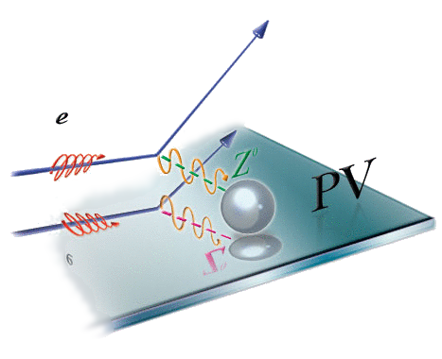
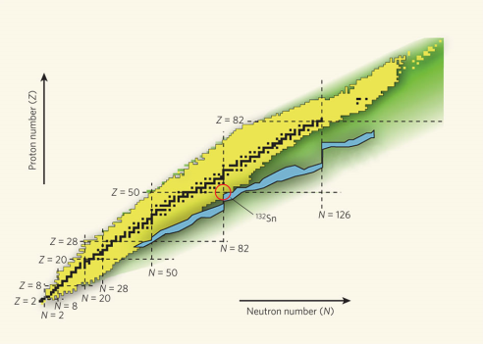
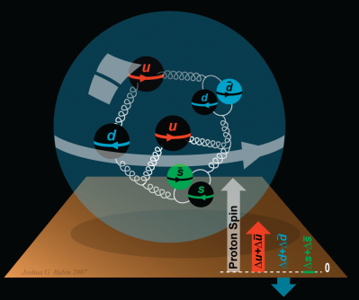
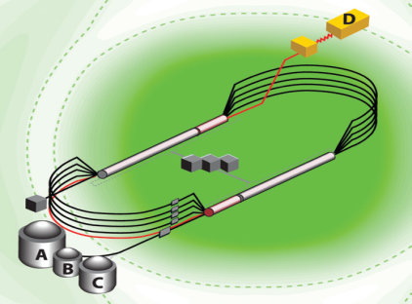

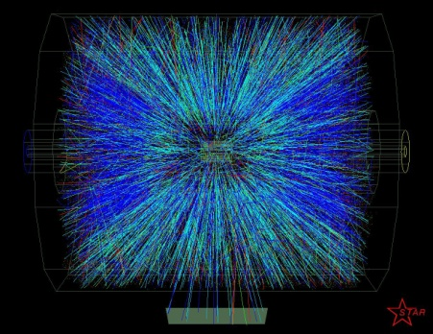
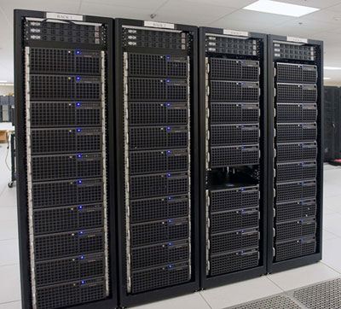
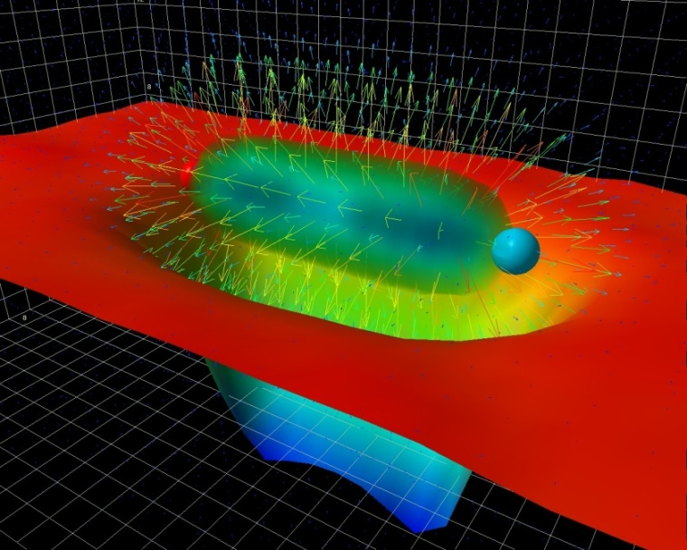
Summary and Outlook
Experiments on the floor have done well – hope for early results soon
Plan to complete upgrade, begin commissioning and full operations during the next year
PAC44 very active, new procedures working well
Jeopardy policy in final stage
Operations budgets appear challenging
EIC science and designs are making good progress

