Slide 1
High time resolution TOF for SoLID
  Wang Yi
Department of Engineering Physics, Tsinghua University
Outline:
  Conceptual design of SoLID-TOF
  Performance and aging
  Structure of narrow-gap MRPC
Cosmic and beam test
Conclusions

Slide 2
Motivation
JLab 6 GeV: precision measurements
high luminosity (10³⁹) but small acceptance (HRS/HMS: < 10 msr)
or large acceptance but low luminosity (CLAS6: 10³⁴)
JLab 12 GeV upgrade opens up a window of opportunities (DIS, SIDIS, Deep Exclusive Processes) to study valence quark (3-d) structure of the nucleon and other high impact physics (PVDIS, J/ψ, …)
High precision in multi-dimension or rare processes requires very high statistics → large acceptance and high luminosity
CLAS12: luminosity upgrade (one order of magnitude) to 10³⁵
To fully exploit the potential of 12 GeV, taking advantage of the latest technical (detectors, DAQ, simulations, …) development
→SoLID: large acceptance detector can handle 10³⁷ luminosity (no baffles)
10³⁹ with baffles

Slide 3
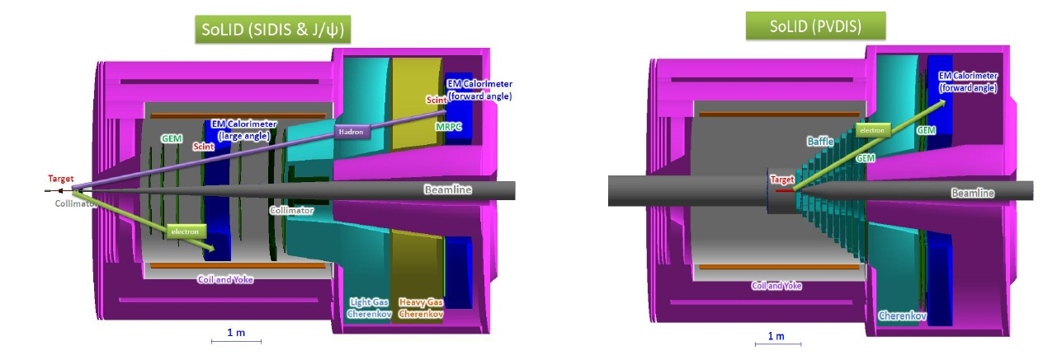
Overview of SoLID
Solenoidal Large Intensity Device
Full exploitation of JLab 12 GeV Upgrade
→ A Large Acceptance Detector AND Can Handle High Luminosity (10³⁷-10³⁹)
Take advantage of latest development in detectors , data acquisitions and simulations
Reach ultimate precision for SIDIS (TMDs), PVDIS in high-x region and threshold J/ψ
5 highly rated experiments approved (+3)
Three SIDIS experiments, one PVDIS, one J/ψ production (+ three run group experiments)
Strong collaboration (250+ collaborators from 70+ institutes, 13 countries)
Significant international contributions (Chinese collaboration)

Slide 4
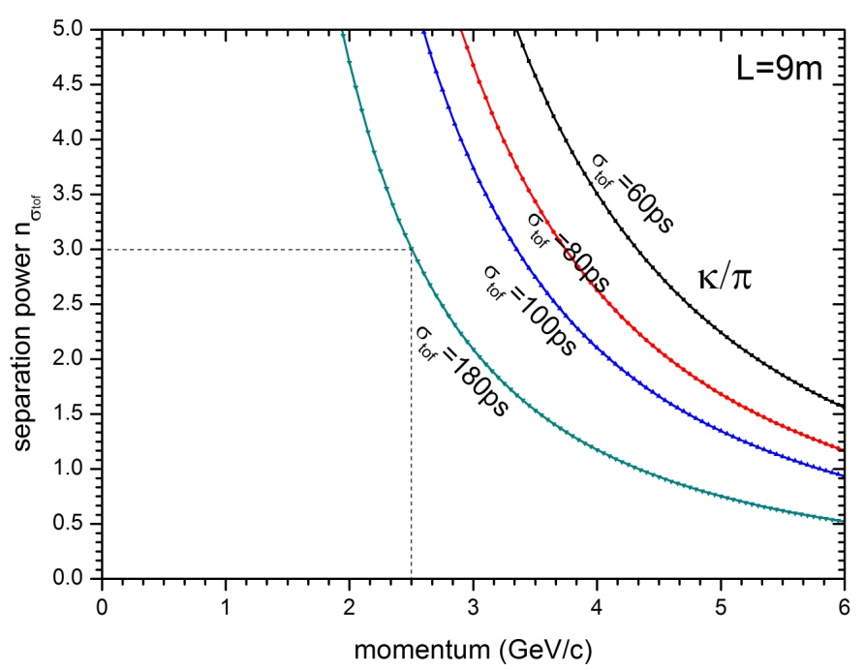
Main requirements for TOF
The MRPC is developed for the TOF of SoLID
Main Requirements for TOF:
  π/k separation up to 2.5GeV/c
  Time resolution < 100ps
  Rate capability > 10kHz/cm²
To separate very few K from π, we require the TOF time resolution as good as possible.
We have to improve the time resolution to about 20ps.

Slide 5
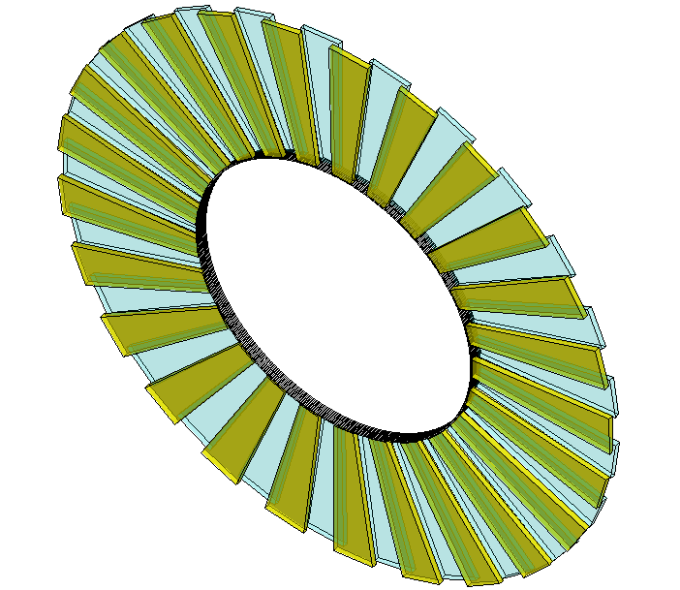
Conceptual design of SOLID-TOF
MRPC TOF wall we designed contain 150 MRPC modules in total, with 50 gas boxes and 3 counters in each box, covering the area of 10m².
MRPC3
28cm
MRPC2
16cmm
100cm
MRPC1
Total channel ~3600

Slide 6
Introduction of MRPC
MRPC is made of thin
glass, large area and cheap
The inner glasses are
floating, take and keep
correct voltage by
electrostatics. it is
transparent to fast signals
Thin gap->good timing
Multi-gap-> high efficiency
Read out
Insulator
Carbon
Resistive plate
Insulator
Read out
Standard parameters:
Resistivity of glass: ~10¹² Ω.cm
Time resolution <100ps
Efficiency >95%
Dark current: a few nA
Noise <1Hz/cm²
Application in nuclear physics experiments
Application in industry（Muon tomography)
Application in medicine（TOF-PET）
6
6

Slide 7
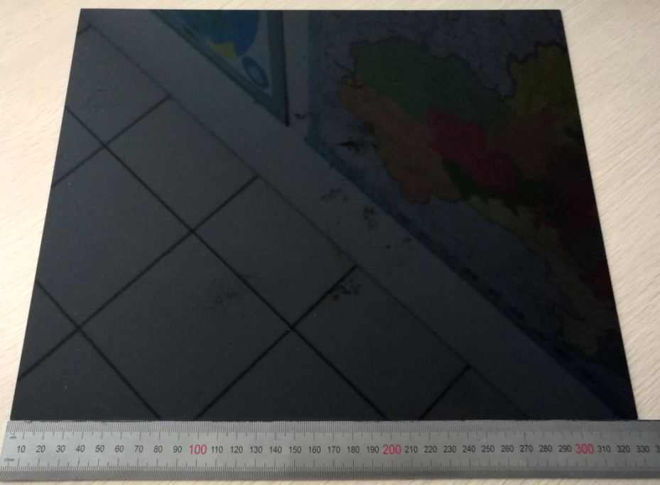
Performance of low resistive glass
Dimension Bulk resistivity Standard thickness Thickness uniformity Surface roughness Dielectric constant DC measurement | 33 x27.6cm² ~10¹⁰Ωcm 0.7, 1.1mm 20μm <10nm 7.5 - 9.5 Ohmic behavior stable up to 1C/cm²
7

Slide 8
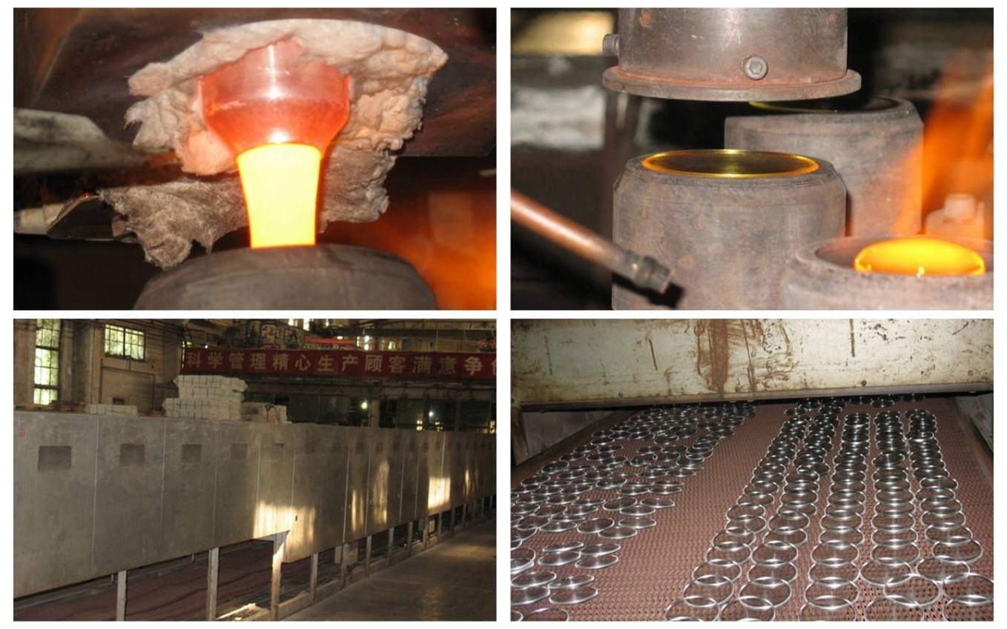
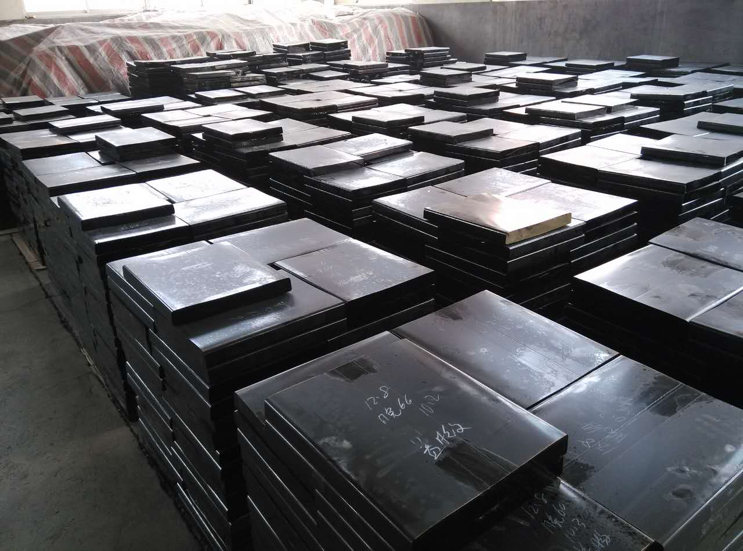
Glass mass production
The roughcast of glass
Continuous melting
Continuous pouring
Continuous annealing

Slide 9
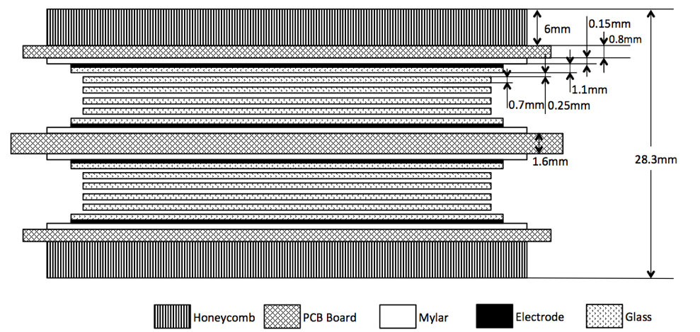
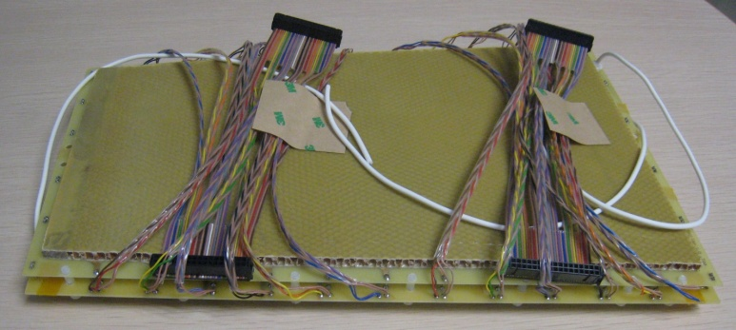
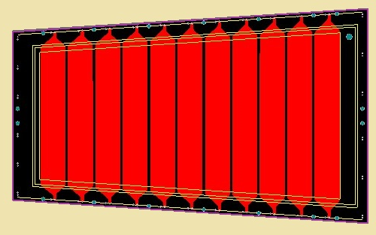
A MRPC prototype for SoLID-TOF
Volume resistivity: ~10¹⁰Ω.cm
25mm
Material dimensions
 | Length/mm | Width/mm | Thickness/mm
Gas gap | - | - | 0.25×10
Inner glass | 320 | 130-171 | 0.7
Outer glass | 330 | 138-182 | 1.1
Mylar | 335 | 153-198 | 0.18
Inner PCB | 350 | 182-228 | 1.6
Outer PCB | 350 | 172-218 | 0.8
Honeycomb | 330 | 153-198 | 6
171mm
219mm
363mm

Slide 10
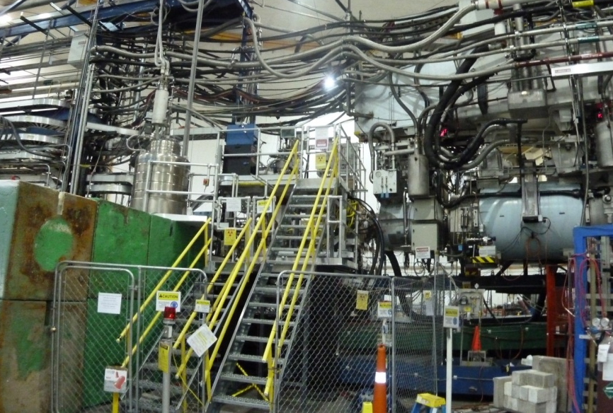
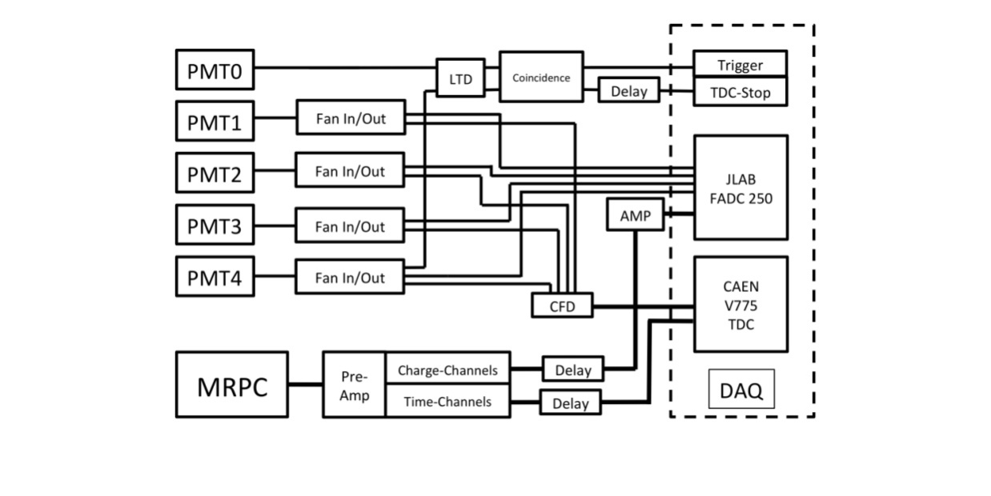
Beam test @ Hall A
High Energy e-
Shield
PMT1
PMT3
Target
PMT0
PMT2
PMT4
Top View
The diagram of DAQ system
Target
Test setup

Slide 11
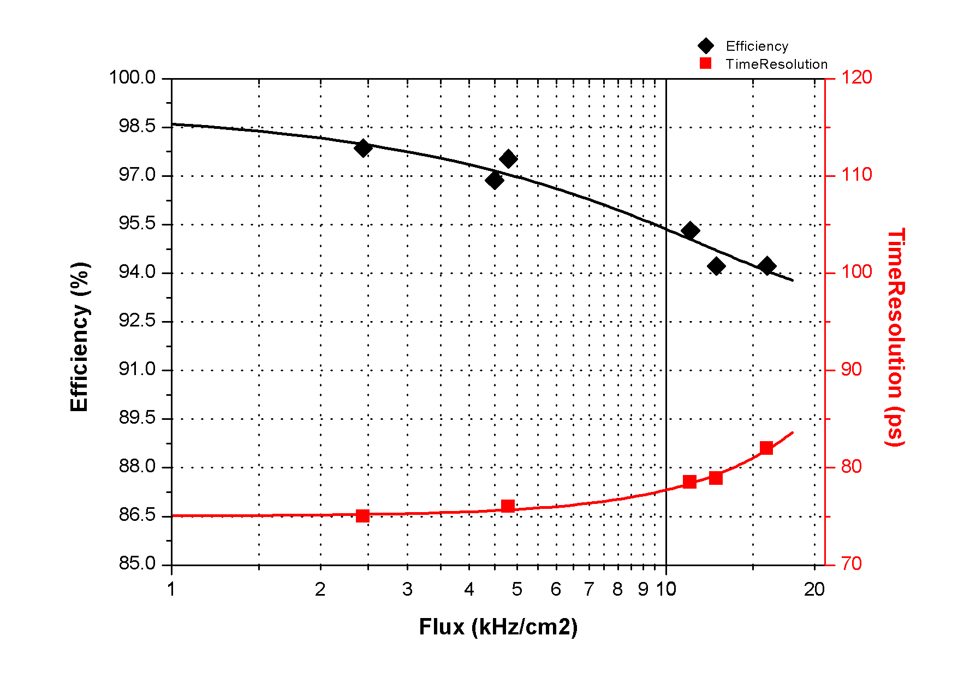
Rate Performance
Voltage: 6800V
Flux:11kHz/cm²
Efficiency:~95%
Time Resolution: 78ps
Flux:16kHz/cm²
Efficiency:~95%
Time Resolution: 82ps
Wan Yi. A MRPC prototype for SOLID-TOF in Jlab.
2013_JINST_8_P03003

Slide 12
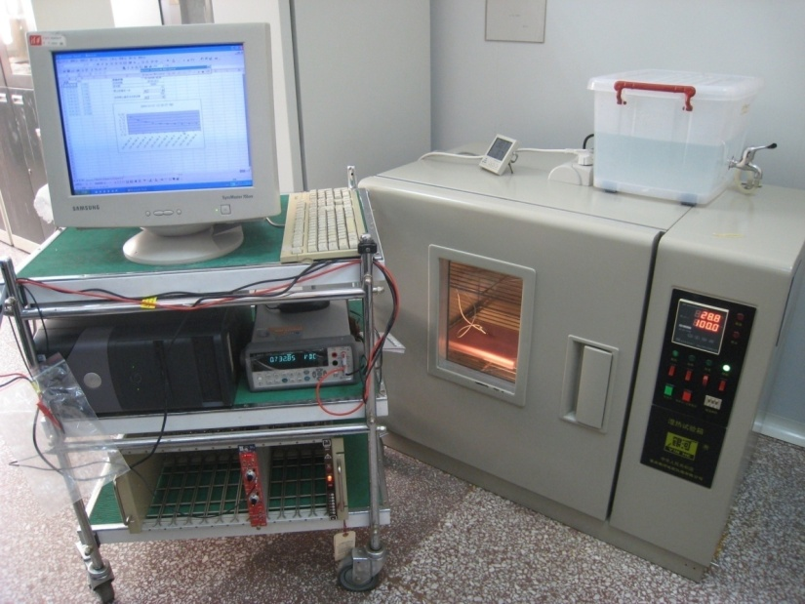
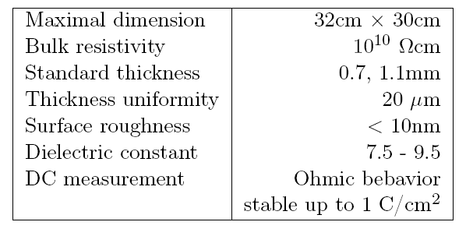
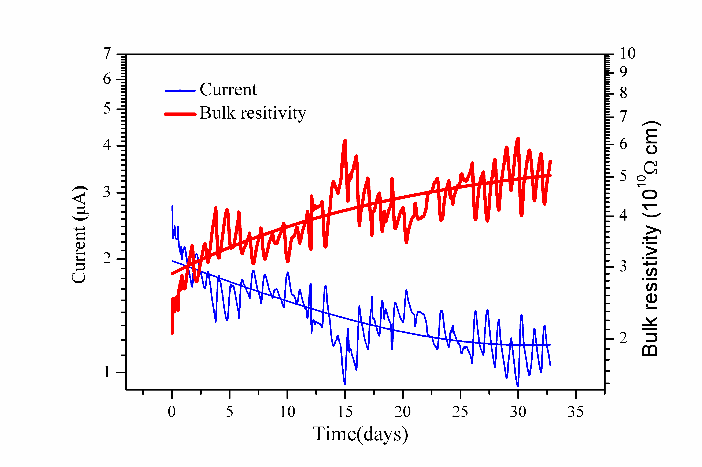
Aging test of low resistive glass
This glass was applied with 1000V for about 32days, integrated charge: 1 C/cm²
--roughly corresponding to the CBM life-time over 5 years operation at the maximum particle rate.
Glass specifications:
12

Slide 13
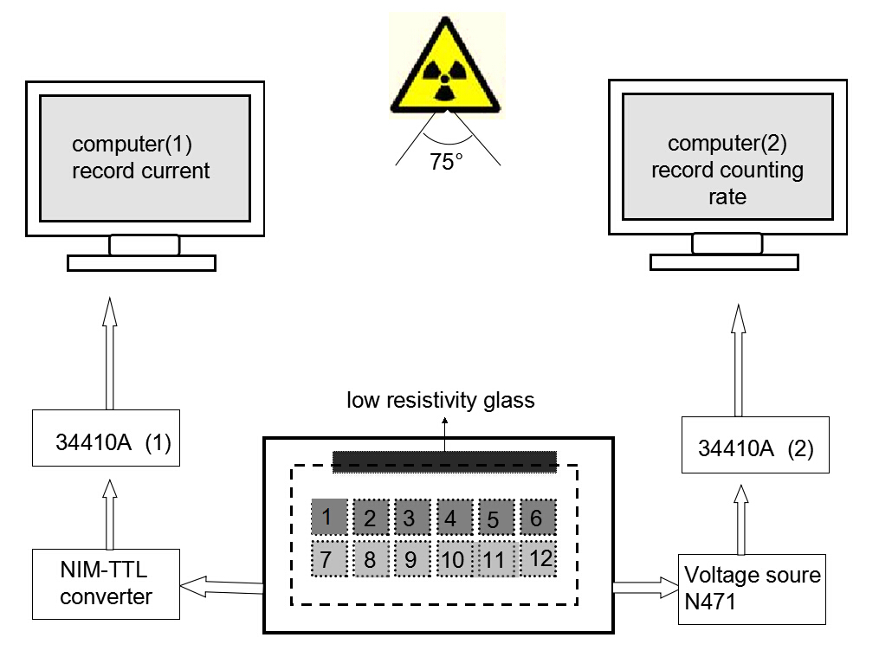
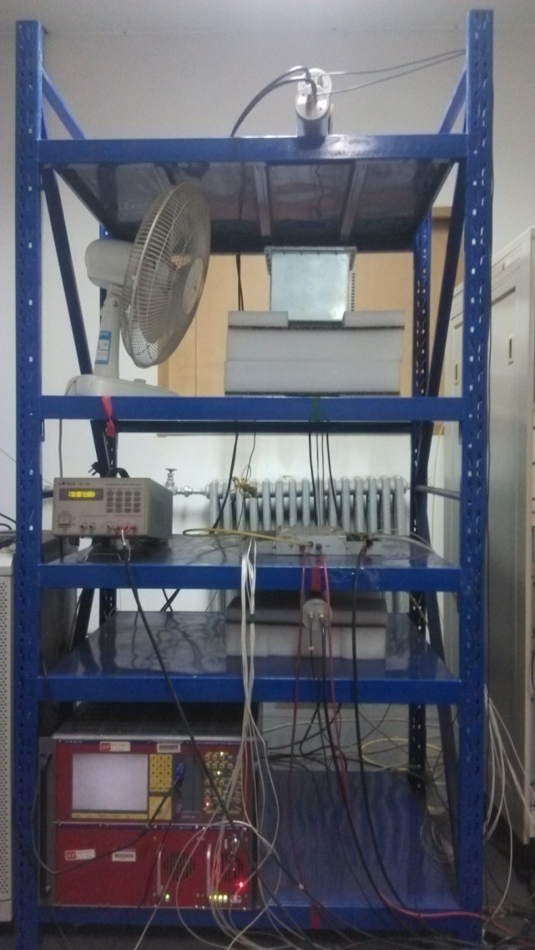
Online irradiation test
X-ray Generator
130cm
60cm
Hign rate MRPC
This is online test system. The efficiency and time resolution can be obtained by cosmic ray while irradiated by X-rays. 0.1C/cm² charge is accumulated in 35 days.
13

Slide 14
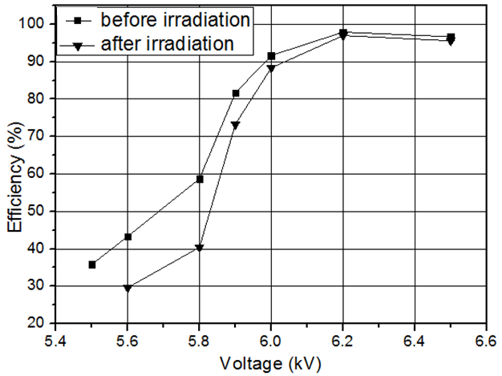
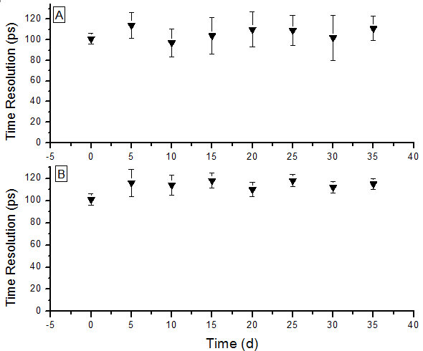
Performance Vs Dosage
~500 events/5days
More events ->Better statistics
14

Slide 15
TOF electronics
Fast preamplifier：
Ninos (TOT) (ALICE)
Padi (TOT) (GSI)
CAD (TOT) (Tsinghua)
Low time jitter faster FEE
TDC
HPTDC (ALICE, 25ps/ch)
GET4 (GSI, 25ps/ch)
FPGA TDC (GSI and other)
Pulse wave form digitizer
DAQ

Slide 16
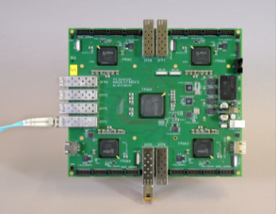
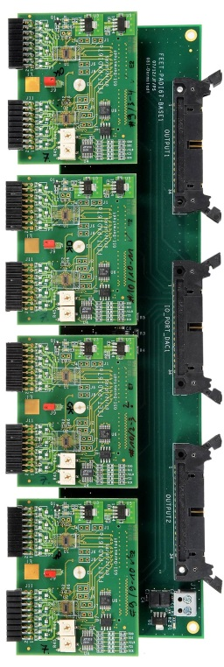
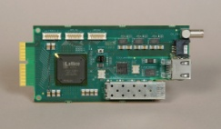
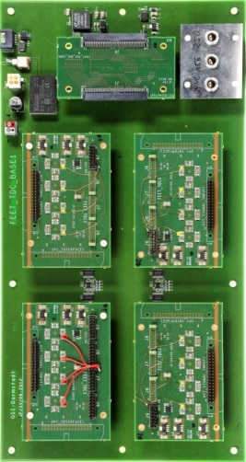
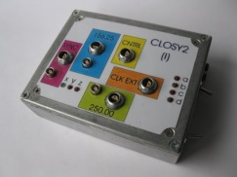
TOF readout chain with PADI and GET4
CLK
MRPC
Preamplifier
&
Discriminator
Preamplifier
&
Discriminator
Time to Digital Converter
ROC
Time to Digital Converter
ROC
DCB
MRPC

Slide 17
Intrinsic resolution of 10gap-MRPC
MRPC
Differential FEE
TDC
START
Time jitter of HPTDC 25ps
NINOs ASIC+Interface card 24ps
MRPC resolution tested 40ps
So the intrinsic resolution of MRPC is:

Slide 18
Resolution of 24 x140μm MRPC
Fast wave form digitizer 30-> 5ps
Low time jitter fast FEE 24-> 5ps
MRPC intrinsic 20-> 13ps
Time resolution of TOF:
18

Slide 19

PID and time resolution
@ 1m distance | Distance | Pion-Kaon Separation | Kaon-Proton Separation
σ_{tot}=100 ps | 1m
σ_{tot}=10 ps | 1m
σ_{tot}=10 ps | 3m
Momentum reach of TOF PID reaches interesting levels if one can achieve ~ 10 ps
TOF Positives
Compact (10-15 cm of space needed), allowing more room for, e.g., RICH
More clean PID
Can contribute to e/h identification using TPC dE/dx
TOF Negatives
Start counter?

Slide 20
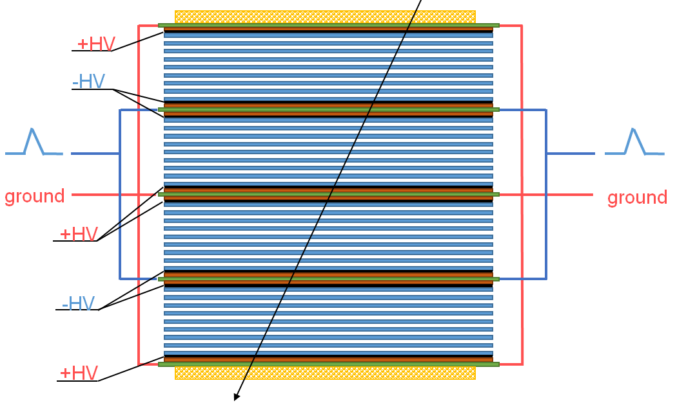
Structure of high time MRPC
Item | dimension/mm
Honeycomb | 90×265×7.5
Outer PCB | 120×298×0.6
Middle PCB1 | 120×298×1.2
Middle PCB2 | 120×328×1.2
Strip length | 268
Strip width | 7
Mylar | 90×268×0.25
Glass | 80×258×0.5
Carbon | 72×250
Gas gap width | 0.104
Number of gas gap | 32
Honey comb plate
PCB
Mylar
Carbon electrode
Glass

Slide 21
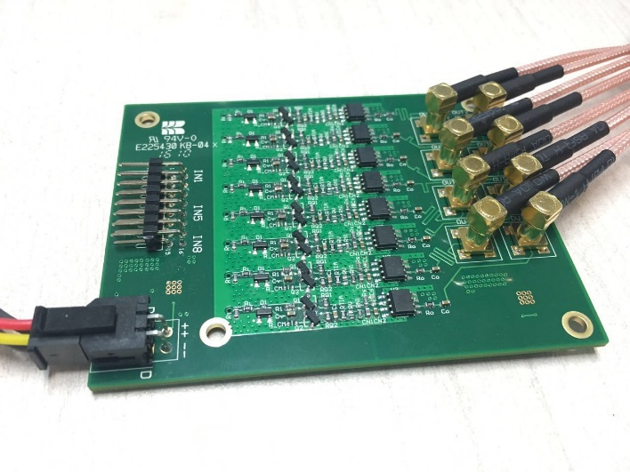
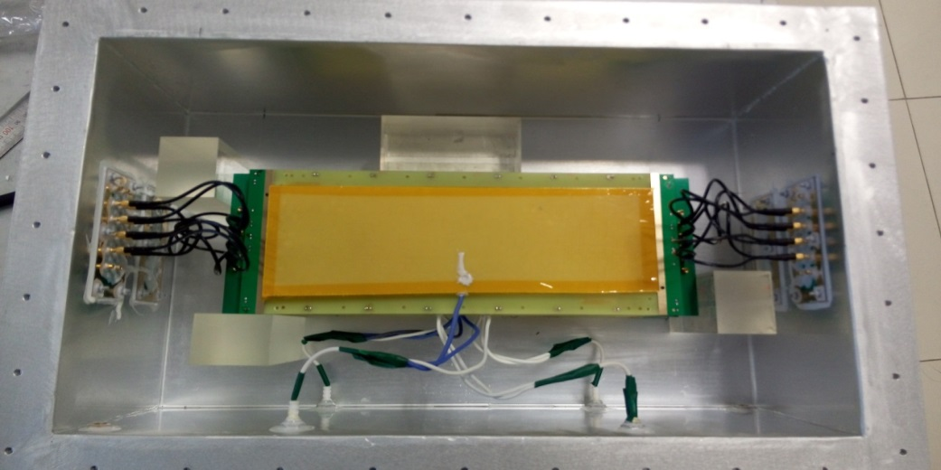
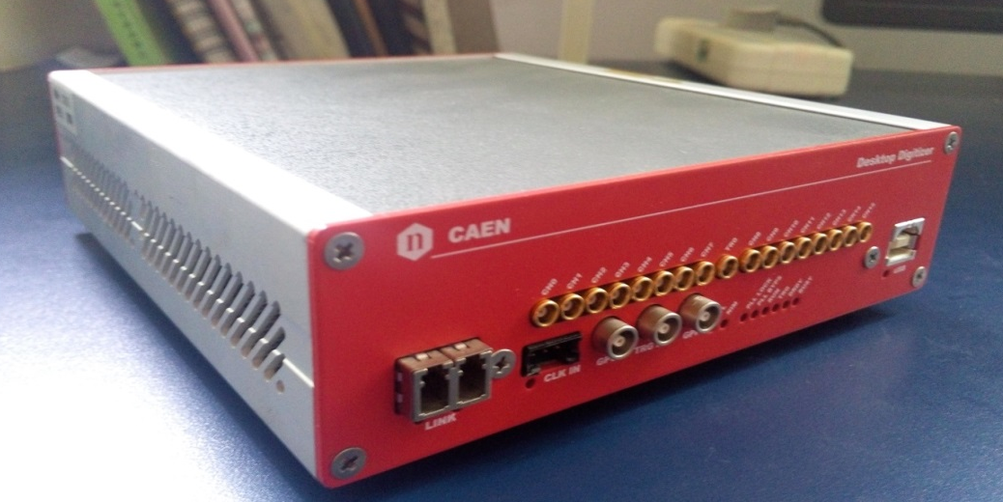
Test equipment
Fast amplifier
Gas box
DRS4-V5 chip
16 channels
12bit 5GS/s
5 points for leading edge of MRPC
Waveform Digitizer
DT5742

Slide 22
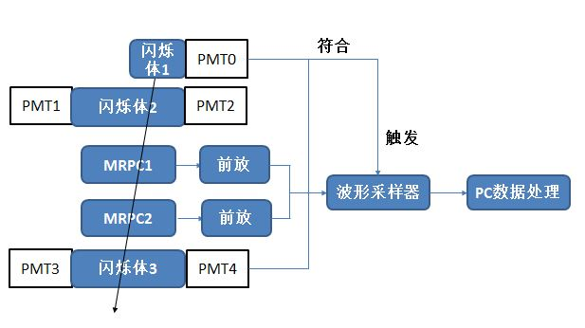
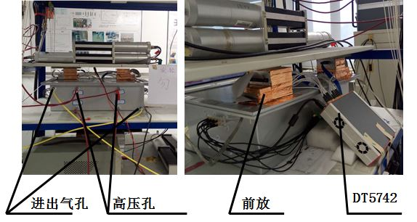
Cosmic test
Gas Mixture : “Freon” (R134a) 90% : Iso 5% : SF6 5%

Slide 23
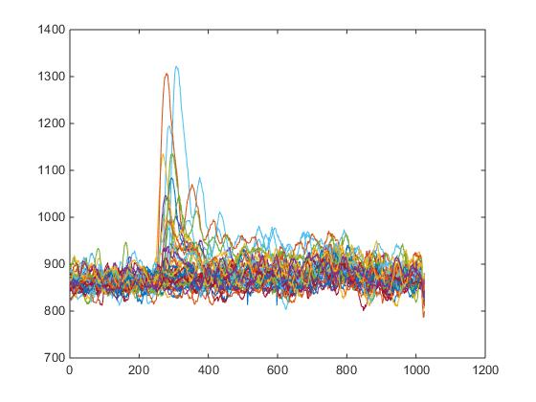
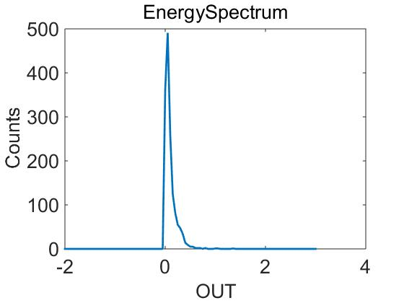
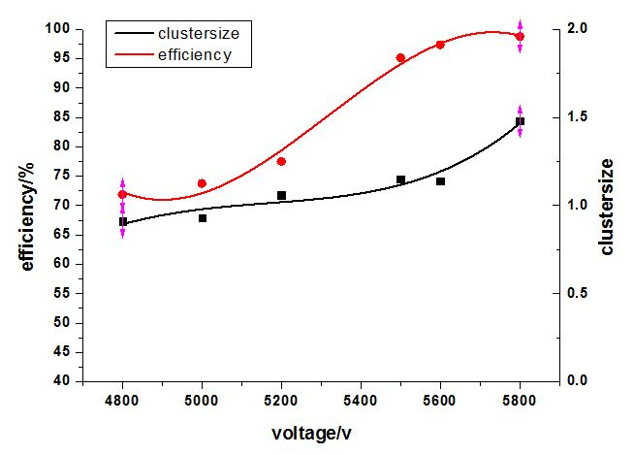
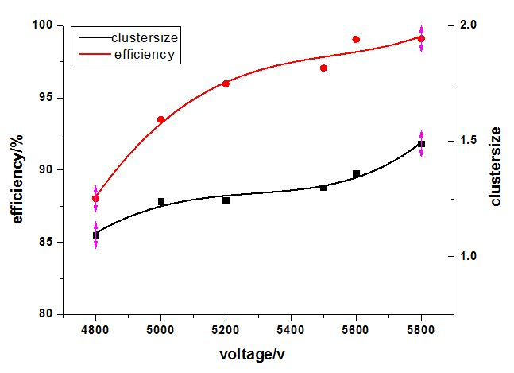
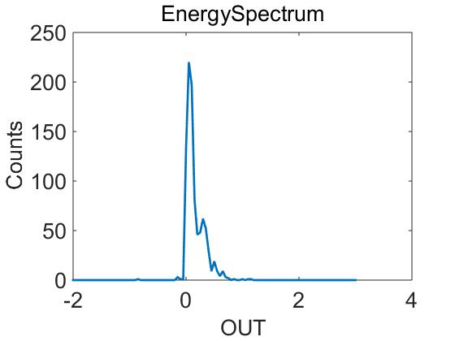
Test results
Efficiency HV=5.5kV
5500V
Charge
5600V
98.37%
99.10%
Charge
Efficiency of MRPC1
Efficiency of MRPC2

Slide 24
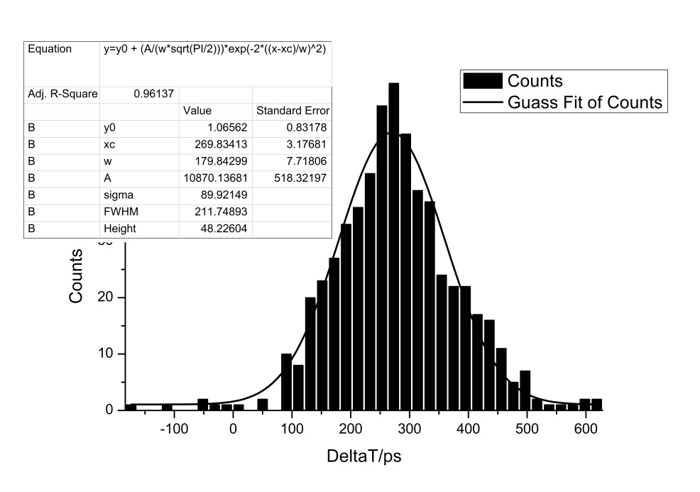
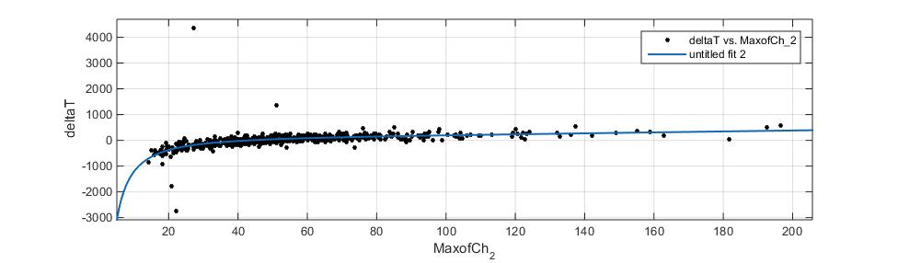
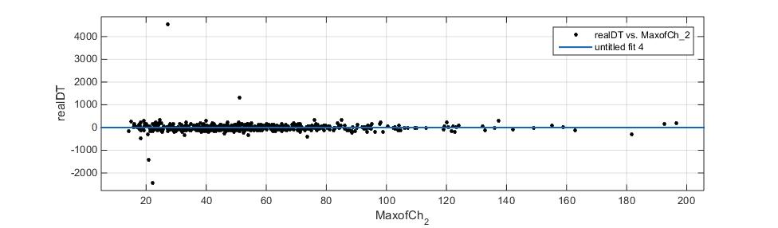
Time resolution
σ =89.92ps
Time difference of two MRPC
Walk correction

Slide 25
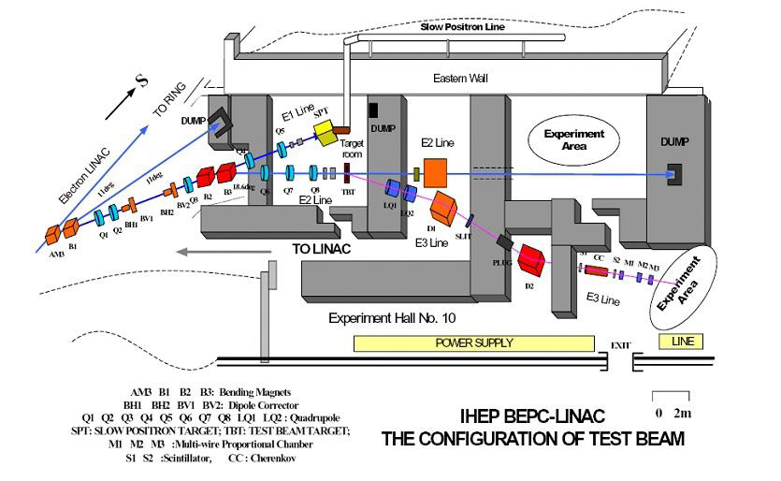
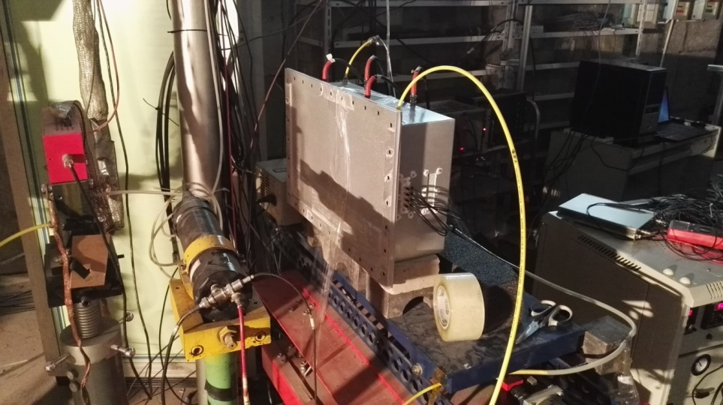
Beam Test at IHEP
Particle |  | e+, e-,π+,π-,p
momentum | e | 200MeV/c~1.3GeV/c
 | π | 400MeV/c~900MeV/c
 | p | 500MeV/c~1GeV/c
rate |  | 10~20Hz
5
0
c
m
5
0
c
m
6
0
c
m
e
,
,
p
S
C
1
C
0
S
C
2
M
W
P
C
MRPC
Trigger

Slide 26
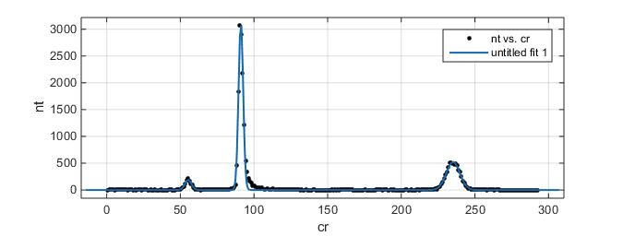
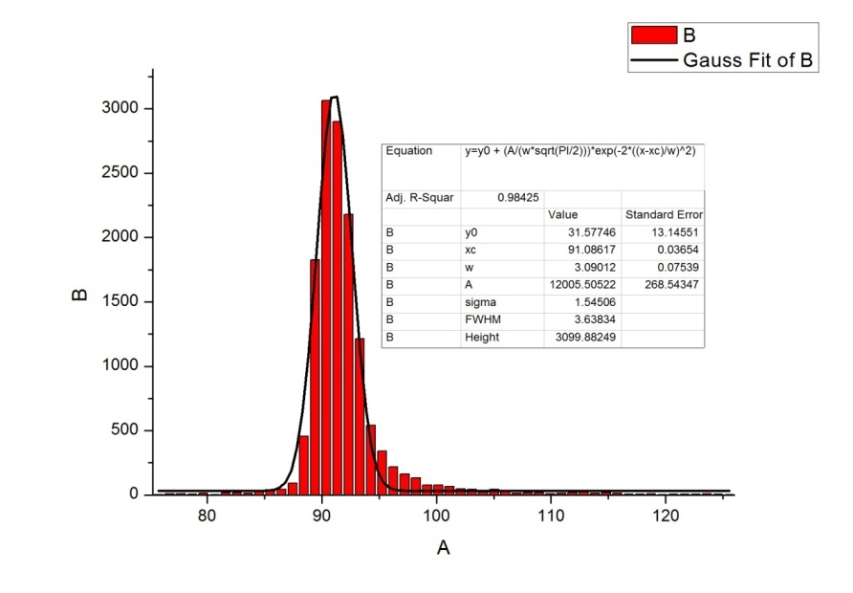
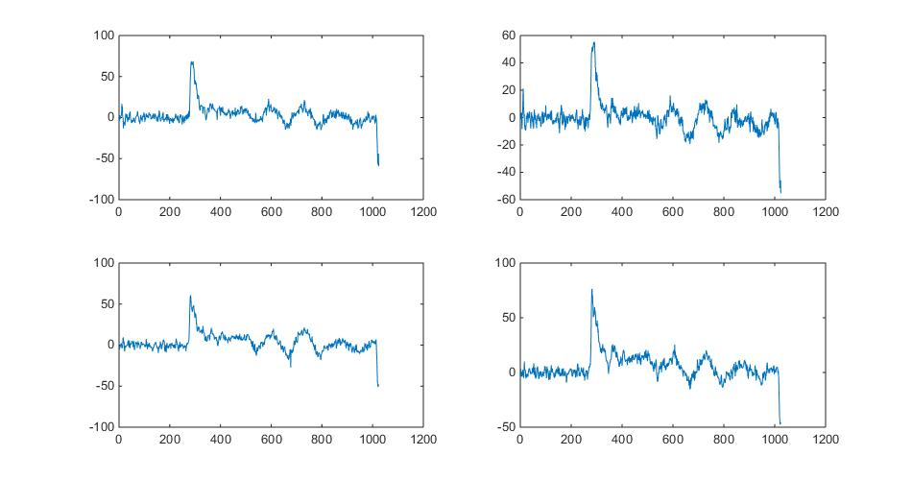
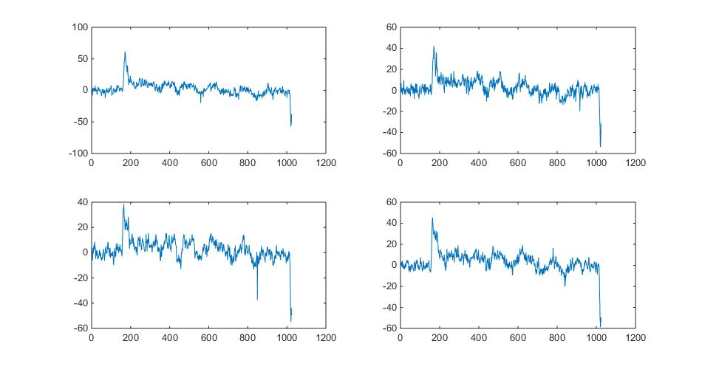
Signal selection
P
Count
π
Time
Time

Slide 27
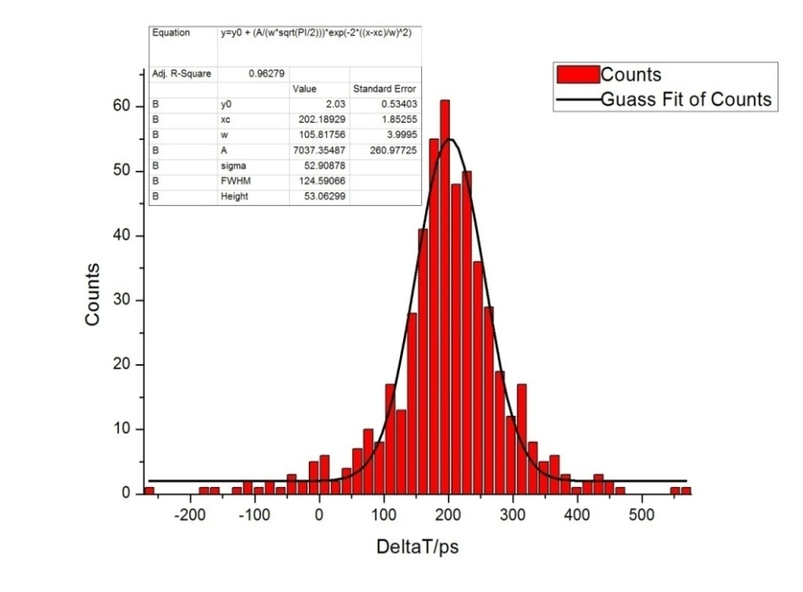
Time resolution
Difference between time of two MRPC: Δt = t₂ – t₁= 52ps
  σ_{t} = Δt/√2 = 37 ps
  Only protons are used
  Used a “Leading Edge Discriminator technique” in software from waveform, slewing correction
  Wings manily due to noise, cross-talk, or something else?
We believe best published result is 20 ps
  Nucl.Instrum.Meth. A594 (2008) 39-43
  Nucl.Instrum.Meth. A629 (2011) 106-110

Slide 28
Conclusions
A SoLID-TOF MRPC prototype is developed, its time resolution is 75ps, rate capability reach 16kHz/cm².
MRPC intrinsic resolution can reach 13ps. Fast FEE and high band width wave form digitizer has to be used to improve TOF resolution -> 15ps.
Very narrow-gap MRPC were designed and tested, its efficiency can reach 98% and time resolution around 37ps. More detailed research should be done to improve time resolution.

Slide 29
Thanks for your attention !

