Slide 1
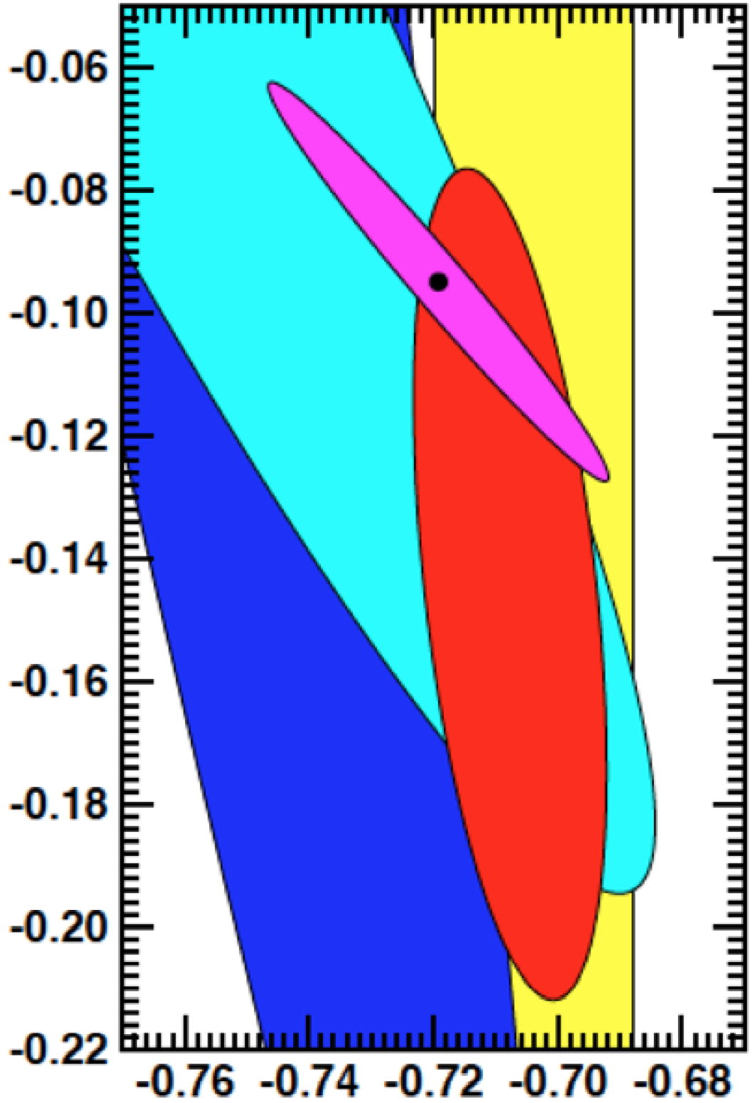
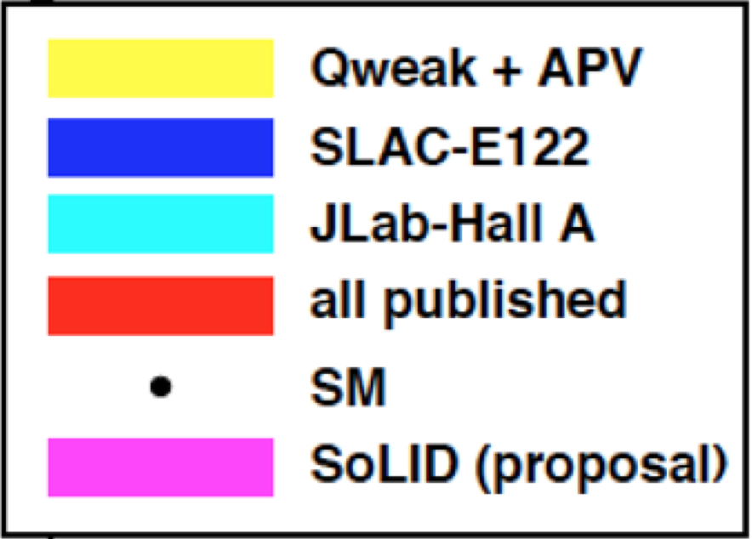
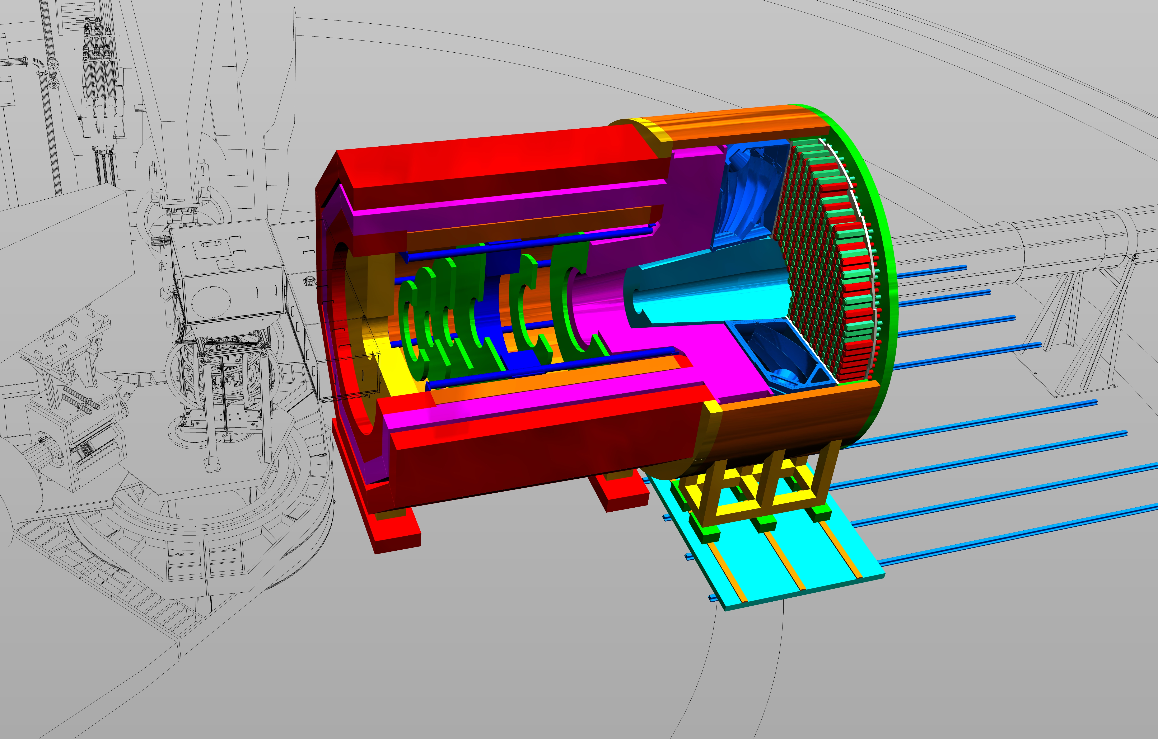
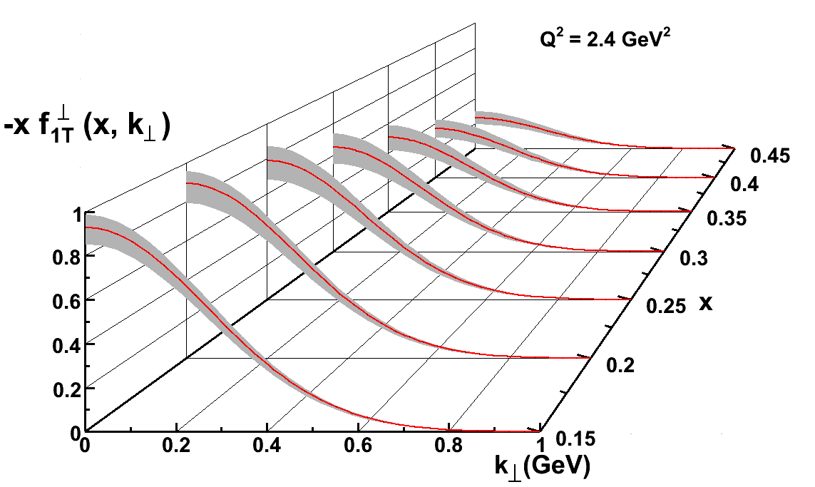
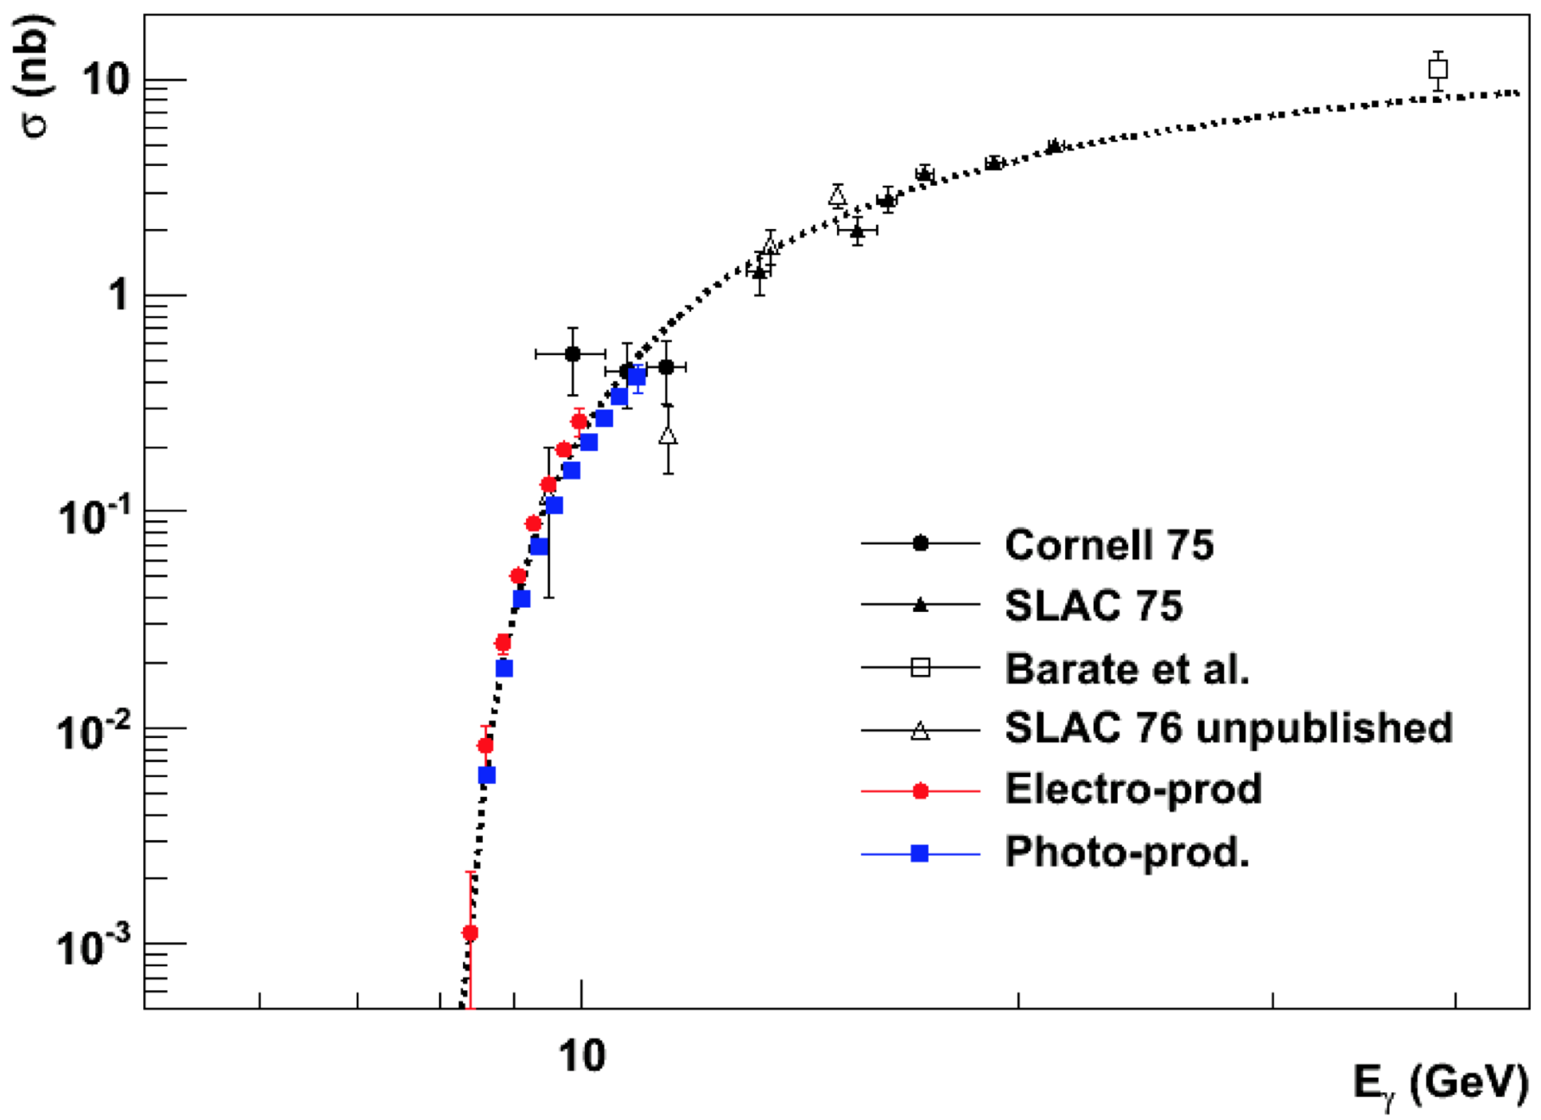
Solenoidal Large Intensity Device (SoLID) Physics
SoLID provides unique capability:
  high luminosity (10³⁷⁻³⁹)
  large acceptance with full φ coverage
2) Precise determination of the electroweak couplings
→ A search for new physics in the 10-20 TeV region, complementary to the reach at LHC.
→ multi-purpose program to maximize the 12-GeV science potential
1) Precision in 3D momentum space imaging of the nucleon
3) J/ψ production cross section
→ Constrain the QCD trace anomaly contribution to the proton mass budget

Slide 2
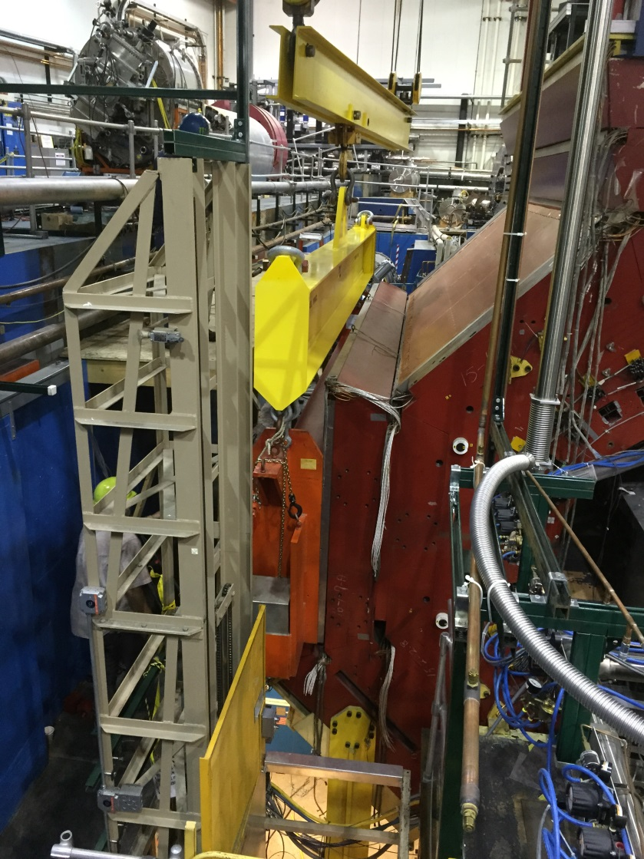
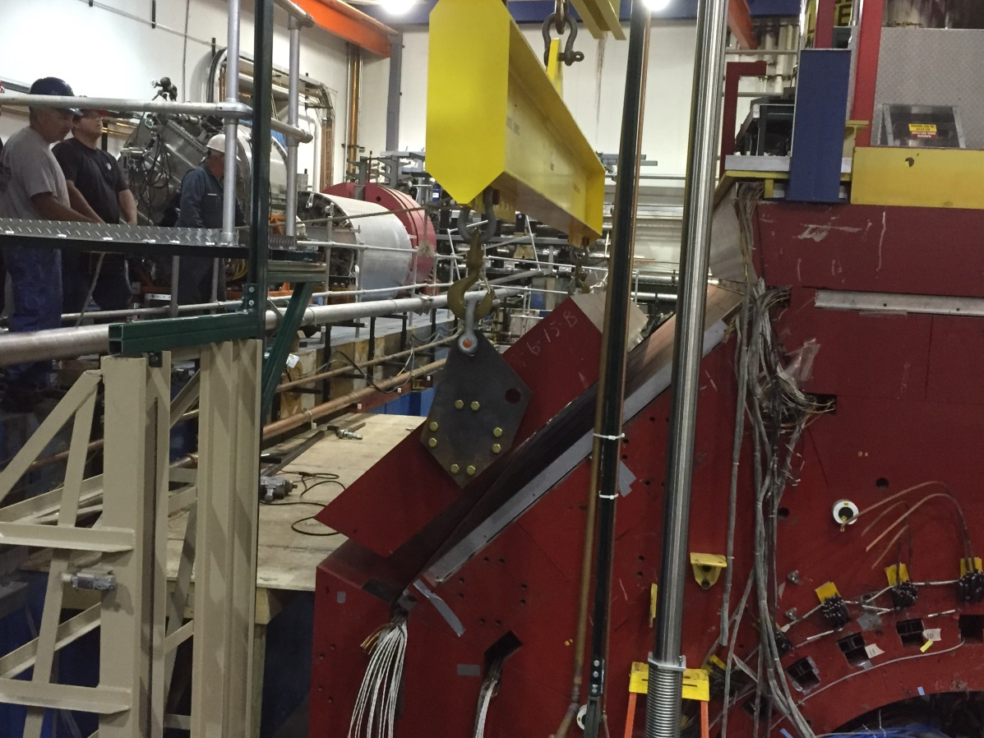
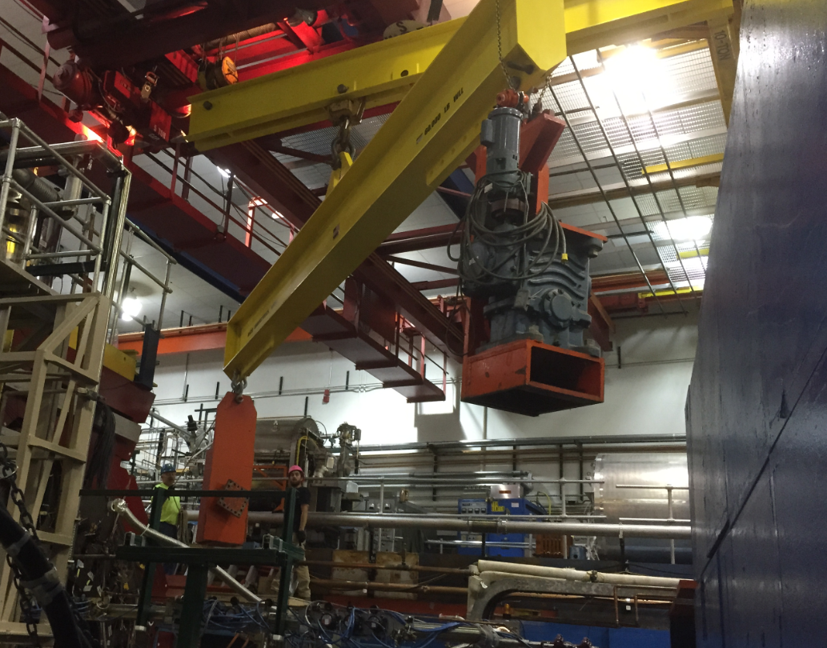
Transport and Storage of CLEO II
Magnet being disassembled and loaded on trucks for shipping by the Cornell personnel with oversight by Jefferson Lab this Summer/Fall CY 2016.
Some hardware designed and engineered (lifting assist, cryostat support,..)
Will require 52 trucks to transport the magnet and related equipment.
We have identified all of the parts of the CLEO magnet, with sizes and weights, anticipating a need for storage of these parts at Jefferson Lab starting Summer 2016, total weight of 1,053k lbs.
The cryostat (44k lbs) and power supply will need to be stored in an environment-controlled area of approximately 400 square feet. Space in the Test Lab and utility needs have been requested.
The remaining steel will be stored in ESB.

Slide 3
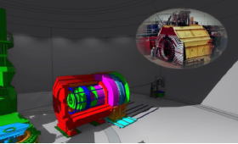
Proposed QCD & Fundamental Symmetries MIE
Jefferson Lab Mission: SoLID
Unique Capability:
  High luminosity (10³⁷⁻³⁹)
  Large acceptance detector with full φ coverage
Item | Date
Director’s Review | February 2015
SoLID User Meeting with DOE/NP | November 2015
Director’s Review Recommendations affecting science reach; progress: simulations of core measurements, DAQ rate capability, detector/magnet integration | February 2016
CLEO-II Magnet Disassembly at CESR | Summer 2016
Follow-Up Director’s Review | Late 2016
Draft MIE Submission – proposed | February 2017
DOE/NP-led Science Review – proposed | Spring 2017
Annual Budget Briefing – proposed budget profile | February 2018
MIE Start | FY2020
Unprecedented precision in 3D momentum space imaging of the nucleon.
A search for new physics in the 10-20 TeV region, complementary to the reach at LHC.
Allowing access to threshold of J/ψ production, allowing access to the QCD conformal anomaly with unmatched precision.
    Assuming the above, we have less than a year to prepare!....
Notes:
BMcK revised 05Feb; AL format edits 06Feb; Dry Run edits 12Feb

Slide 4
Hall A team has limited resources, and a lot to do this coming year!
CLEO-II magnet delivery
DVCS/GMp running
³H preparing to run
Polarized ³He target development
SBS – project ending, but…
ECAL
Detectors being delivered
Assembly testing
More!
PREX2/CREX
APEX
MOLLER
More!
Beyond CLEO-II magnet delivery and refurbishment start:
- Looking at high rate SoLID readout electronics and data acquisition (report in a few weeks)
- Accumulating pipeline electronics amongst the halls, (close to) sufficient for SoLID
- Scientific support
This maxes the Hall and laboratory out for support at this time.

