Slide 1
SoLID DAQ update
Alexandre Camsonne
August 27th 2016
SoLID collaboration meeting

Slide 2
Overview
Recommendations for Director’s review
Hardware available
Document
Updated trigger rates
New FADC readout
PVDIS deadtime
SIDIS event size and data rates
Cerenkov readout
TOF readout options
Simulations needs
L3 farm

Slide 3
Dead time correction PVDIS 1b.2
Test with small scale setup ( ongoing )
Simulation
Discuss with DAQ group for particular features needed
Example : helicity gated deadtimes
Rework CDR to add parity specific electronics
Need to write a separate document about DAQ requirements for DAQ group, Electronics group and potential collaborators on electronics (Saclay)

Slide 4
DAQ observations

Slide 5
Recommendations 2c
a)The plans for the High Level Trigger and b) the needs for slow control (Brad) need to be worked out in detail and the implications for resources need to be evaluated.
The implications of the need for these resources in the context of availability of resources at the laboratory need to be understood.
Closer communication with the other JLab experiments and the JLab computing center is strongly encouraged.
Having a functional simulation and reconstruction routines as soon as possible should be a high priority in the software effort. Such software will pay off many times over in experimental design and avoiding pitfalls. ( Ole )

Slide 6
Hardware
FADC availables ( 4 + 18 = 22 all used)
VXS (3 ) crates and Intel CPU ( 3 )
GTP borrowed , VTP received
VETROC available (2 + 5 ordered )
R&D needed
Trigger setup ( preRD request )
Deadtime measurement for PVDIS ( on going )
( High resolution TDC )
VXS FADC readout ( ongoing DAQ funded )

Slide 7
DAQ document summary
Add parity specific requirements ?
Deadtime
Helicity
BPM/charge measurement
Pion trigger
Address comment :
L3 farm performance and cost
Integrate new FADC fast readout
TOF electronics options
New GEM chip option
Tape price
Network upgrade
Give total price with dependencies and project price
Steve Wood summarizing preCDR and develop in contact with electronics and DAQ group

Slide 8
PVDIS electron trigger
Coincidence ECAL and Gas Cerenkov
 | Old | Hall D
Singles ECAL | 290 KHz | 230 KHz
Singles rates Cerenkov | 1.9 MHz | 803 KHz
Accidental 30 ns | 16.5 KHz | 4.1 KHz
DIS electron | 10 KHz max | 7.7 KHz
Total rate | 27 KHz | 12.1 KHz

Slide 9
Calorimeter FADC readout
New readout scheme through VTP
VME backplane 100 MB/s
VXS 16x500 MB/s
Can transfer a full ADC ( 16 channels * 20 samples =1.3 KB) up to 390 KHz, transfer is not a bottle neck any more
GEM or SILO readout are limiting factor now

Slide 10
Deadtime measurement (1b.2)
Can deadtime affect PVDIS asymmetry ?
Test stand Compton FADC
Helicity gated scalers
TI firmware modification
Generate asymmetry same order of PVDIS
Add random background
Check asymmetry value
Target date August

Slide 11
Dead time correction PVDIS 1b.2
Test with small scale setup ( on going )
Simulation
Discuss with DAQ group for particular features needed
Example : helicity gated deadtimes
Rework CDR to add parity specific electronics

Slide 12
Dead time correction PVDIS 1b.2

Slide 13
Dead time correction PVDIS 1b.2

Slide 14
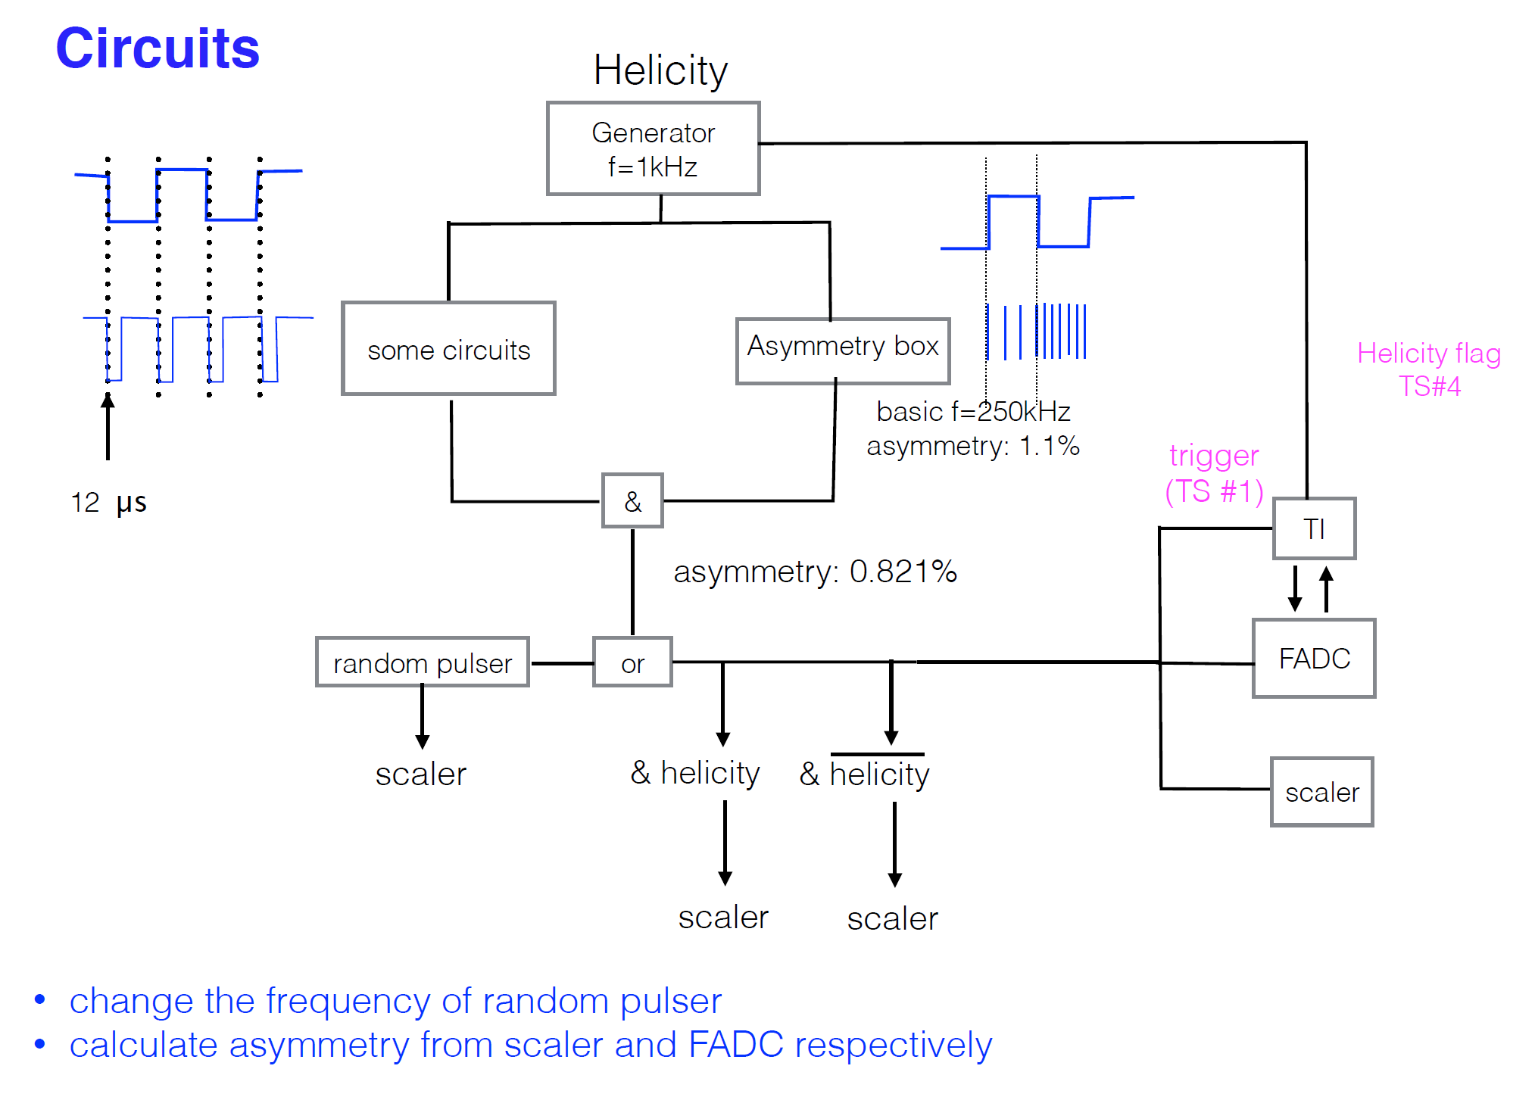

Slide 15
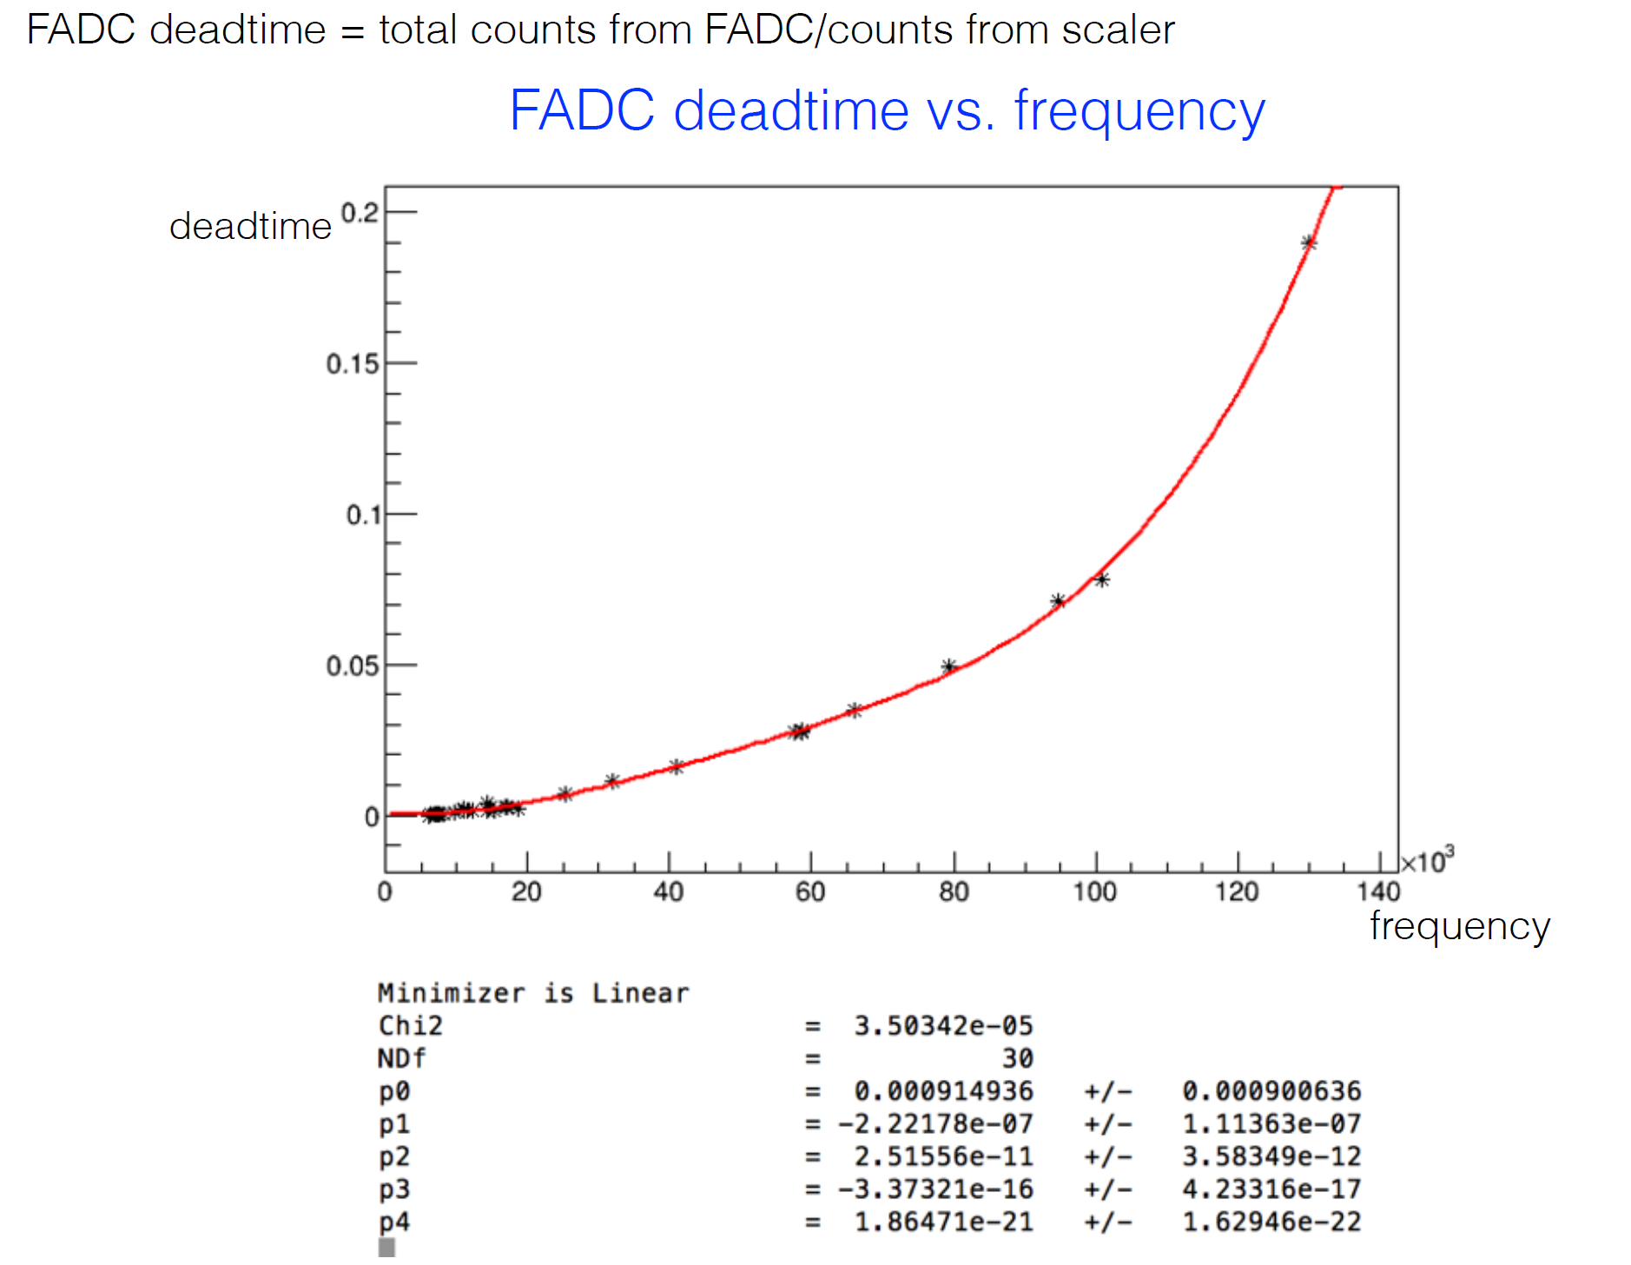
FADC deadtime measurement
Do we need to improve it ?
R&D possible
Around 2 % deadtime

Slide 16
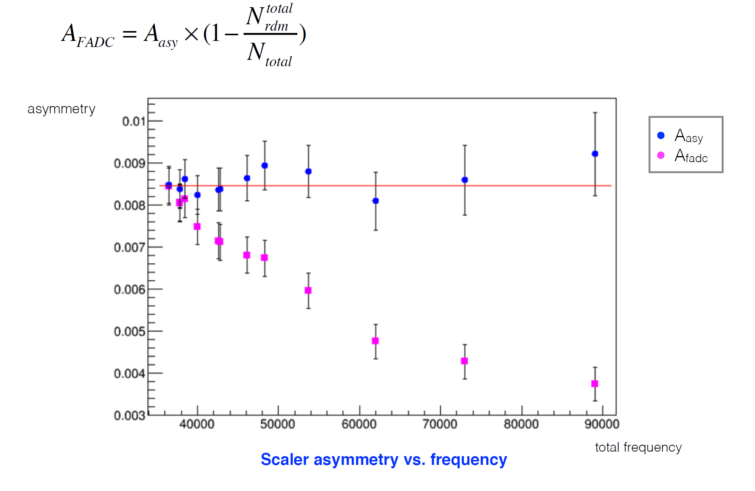
Measured asymmetry

Slide 17
Deadtime measurement (1b.2)
FADC setup to study deadtime
Need to understand the system and model
Not done by August
Continue study with Compton during run

Slide 18
Cerenkov PMT readout
MAROC3 close to what we need
64 channels
Variable gain
Discriminated fast logic signal
Missing : analog sum of 8, need sum of 64
8 sum of 8 available just need to sum them, will check with INFN for modified RICH board, requested 10 K$ preRD money
Radiation hardness is pretty good, need to be tested, possibility of new version to handle Single Event Upset
MAROC default option
MAROC testboard available
Will check design with electronics group for FADC analog output
Possible readout schemes
FADC only ( default )
FADC + VETROC
VETROC only : needs to be evaluated
Preferred : Add TDC readout for each Cerenkov channel 232 VETROC additionnal 700 K$, could improve Cerenkov trigger
Need simulation to evaluate options
Need to follow with electronics group to start testing ( anyone from Cernkov group interested ? )

Slide 19
TOF options
Expected timing resolution 80 to 50 ps
Default readout
NINO + TDC : 20 ps timing resolution
R&D MRPC : 20 ps
Sampling TDC ASICs : PSEC4/5, SAMPIC, DRS4 give 5 to 1 ps resolution
Need new chip DRS5 or PSEC5 to handle SoLID trigger rate ( analog pipeline ) ( might develop for EIC )
Depends on final detector choice
Need to determine effect of photon background, might need sampling to deal with pile up

Slide 20
GEM readout
SRS deployed in Hall B Prad
MPD implemented in CODA
BLT testing few KHz
Optical fiber readout to be implemented for high rate test ( 100 MB/s to 1.6 GB/s )
Preliminary results from Weizhi : one sample no deconvolution not sufficient, new occupancy number
Data reduction on SSP for SBS
On chip deconvolution ( implemented in MPD ) still an option if needed
preRD to get VMM3 chip

Slide 21
SIDIS event size
Occupancies with one sample readout by Weizhi , rates for 100 KHz
GEM | Occupancy | Number of strips | XY strips | Strips per chambers | Event size ( bytes ) | Data rate 100 KHz | MB/s
1 | 2.21 | 453 | 906 | 27180 | 2402.712 | 240271200 | 240.2712
2 | 8.78 | 510 | 1020 | 30600 | 10746.72 | 1074672000 | 1074.672
3 | 3.63 | 583 | 1166 | 34980 | 5079.096 | 507909600 | 507.9096
4 | 2.31 | 702 | 1404 | 42120 | 3891.888 | 389188800 | 389.1888
5 | 1.78 | 520 | 1040 | 31200 | 2221.44 | 222144000 | 222.144
6 | 1.3 | 640 | 1280 | 38400 | 1996.8 | 199680000 | 199.68
Total | 20.01 | 3408 | 6816 | 204480 | 26338.656 | 2633865600 | 2633.8656
GEM dominating ( 35 bigger than initial proposal ) 2.6 GB/s same requirement as PVDIS for L3
Need to look at FADC occupancies

Slide 22
Pre RD hardware : detector test stand
FADC 250 | 4500 | 4 | 18000
VETROC | 4500 | 2 | 9000
TD | 3000 | 1 | 3000
CTP | 7000 | 1 | 7000
SSP | 5000 | 1 | 5000
TID | 3000 | 1 | 3000
SD | 2500 | 1 | 2500
FADC trigger Dist | 4000 | 1 | 4000
VXS crate | 15000 | 1 | 15000
VME CPU | 4500 | 1 | 4500
Optical fiber | 100 | 20 | 2000
Computer | 3000 | 1 | 3000
MPD | 4500 | 1 | 4500
Network router | 10000 | 1 | 10000
Total |  |  | 72500
Added additionnal 10 K$ for MAROC and 15 K$ for VMM3 : total 97 K$

Slide 23
Manpower
JLAB :
Alexandre Camsonne
Robert Michaels ( Compton development )
Steve Wood
Electronics group
DAQ group
Stony Brook
Seamus Riordan
Krishna Kumar
Postdoc
Student
UVA : Danning Di GEM readout ( SBS / Tritium )
University New Hampshire : Shujie Li ( part time )
University of Columbia ( summer ) : Hanjie Lu
Could use a full time student

Slide 24
L3 farm (2c1)
Have digitized data for GEM for SIDIS and PVDIS
Weizhi has tracking algorithm take 2 to 10 ms to process one event so about 1000 nodes for 100 KHz
Need :
Other include detector data
Additionnal reduction algorithm
Implement tracking
Test on Hall D or DAQ cluster
Discussion with HPC/IT

Slide 25
L3 trigger (2c1)
2.5 to 10 ms for tracking using Kalman Filter ( preliminary )
PVDIS : 20 KHz
200 cores per sector
6000 cores total
SIDIS
1000 cores for 100 KHz

Slide 26
L3 trigger (2c1)
Discussed with HPC and IT
Network upgrade :
Current : 2 x 10 Gbit /s = 2 * 1.2 GB/s from counting house to Computer center
Can be upgrade to 40 Gbit/s when cost go down ( ~5 years )
Tape SILO TS3500
16 drives :
6 LTO6 200MB/sx6 + LTO7 300 MB/sx8 = 3.6 GB/s
LTO7 300 MB/s x16 -> 4.8 GB/s
LTO8 472 MB/sx16 -> 7.5 GB/s
Could add second library (150 K$ and each drive 28 K$ )
L3 could be located in CC and dynamically allocated ( free ! )
Need to let IT know the requirements, could invest yearly, need about 2000 today cores

Slide 27
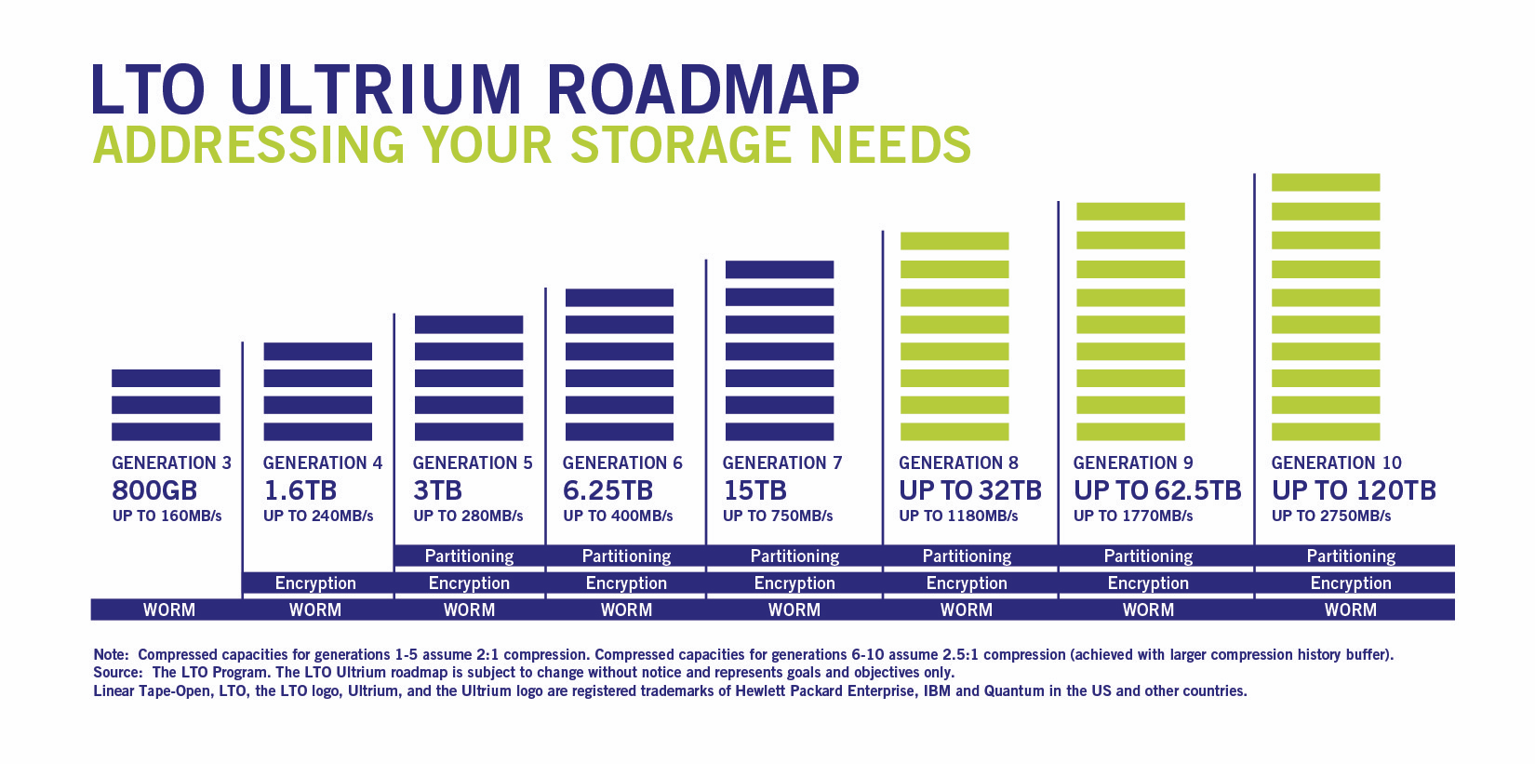
LTO timeline
Bottomline : 3 GB/s is reasonable by 2020, L3 farm optional

Slide 28
Tape costs (2c2)
 |  | Days | Data rate | Seconds | Total data TB | Double | DLO5 in $ 2010 | DLO6 in $ 2012 | DLO7 in $ 2015 | DLO8 in $ 2020?
E12-11-108 | Pol proton | 120 | 250 | 10368000 | 2592 | 5184 | 259200 | 155520 | 62208 | 30375
E12-12-006 | J/Psi | 60 | 250 | 5184000 | 1296 | 2592 | 129600 | 77760 | 31104 | 15187.5
E12-10-006 | Transv. Pol. 3He | 90 | 250 | 7776000 | 1944 | 3888 | 194400 | 116640 | 46656 | 22781.25
E12-11-007 | Long. Pol. 3 He | 35 | 250 | 3024000 | 756 | 1512 | 75600 | 45360 | 18144 | 8859.375
E12-10-007 | PVDIS | 169 | 250 | 14601600 | 3650.4 | 7300.8 | 365040 | 219024 | 87609.6 | 42778.125
 | Total | 474 |  | 40953600 | 10238.4 | 20476.8 | 1023840 | 614304 | 245721.6 | 119981.25
Actual days | Actual years |  | Time in s |  |  | Per year | 394200 | 236520 | 94608 | 46195.3125
948 | 2.60 | 474 | 40953600
About 17K$ per PB, 11K$ per PB for tapes about 250 K$ for 20 PB
Cynthia would like about 70 K$ per year in tape ( 50 K$ per year at 250 MB/s), but 300 K$ is not unreasonable if planned in advance
Numbers don’t include compression ( additionnal factor of 2 )
Expected to go down by a factor 5 by 2020

Slide 29
Beam test
11 GeV beam available
Test detectors :
GEM
Calorimeter
MRPC
Cerenkov
Background measurements
Some hardware available :
FADCs, MAROC
Starting paperwork : getting ready for Calorimeter, GEM, LGC test

Slide 30
Hardware
Trigger test HCAL : 16 FADC + GTP
Trigger test completion in about 2 months
GEM :
5 MPDs
First iteration of CODA library
Implementation optical link readout ( 2 months )
SRS : successfully used up to 5 KHz

Slide 31
Available in October
SBS projects ( DOE review November )
GTP/VTP calorimeter trigger test
GEM : preliminary performance
PVDIS deadtime systematic using Compton test stand, implement simulation if enough time
L3 : most likely possible and not needed

Slide 32
Simulations needs
GEM occupancies and digitization SIDIS for event size, occupancy and tracking (Ole, Zhiwen, Weizhi Duke )
Updated trigger rates PVDIS, SIDIS(Zhiwen, Rakitah)
FADC digitization PVDIS : realistic PID (?)
Cerenkov simulation only timing readout no FADC(?)
Effect 1 sample vs 3 samples GEM (Weizhi ) and 20 samples vs time integral SIDIS (?)
Full FADC trigger simulation
MRPC simulation : response to background

Slide 33
Communication with other groups 2c3
Try collaborate with Hall D
Constant communication with JLAB DAQ and electronics group
Hall C, SBS interested in using VETROC for logic and readout
check experience with APV and FADC from HPS and PRAD
Already planning to reuse HPS trigger scheme

Slide 34
Forgotten recommendation
Bunker design
Radiation
Cooling of bunker to be evaluated / design

Slide 35
Recommendations 2c
a)The plans for the High Level Trigger and b) the needs for slow control (see Brad’s talk) need to be worked out in detail and the implications for resources need to be evaluated.
The implications of the need for these resources in the context of availability of resources at the laboratory need to be understood.
Closer communication with the other JLab experiments and the JLab computing center is strongly encouraged.
Having a functional simulation and reconstruction routines as soon as possible should be a high priority in the software effort. Such software will pay off many times over in experimental design and avoiding pitfalls. ( Ole’s talk )

Slide 36
Conclusion
New results from Simulation
PVDIS rate lower 12KHz, not an issue
SIDIS :
1 sample GEM readout seems to work and with occupancies similar to PVDIS data rate
Up to 3 GB/s most likely can be handled by SILO, L3 most likely not required and could be available mostly for free
To do :
TOF background
Need to check J/Psi and TCS occupancies, rates and efficiencies
MAROC default option for Cerenkov readout
TOF : PSEC5 preferred option, need simulation
PVDIS deadtime : hardware setup, ongoing study
Test run in beam
Start work on document update

