Slide 1
PVDIS Response

Slide 2
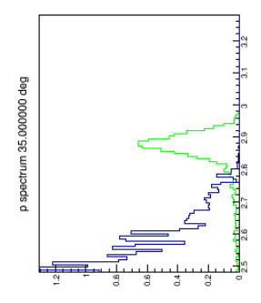
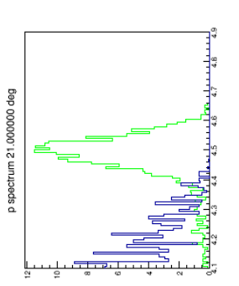
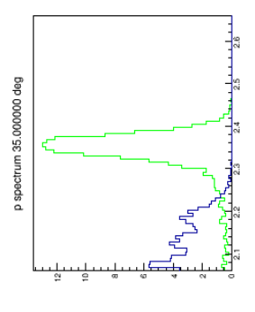
Q² Calibration by Elastic Scattering
6.6 GeV
To get 200/cm/sector at 50uA
E [GeV] t [hrs]
4.4 0.006
8.8 1.6
11 6
4.4 GeV

Slide 3
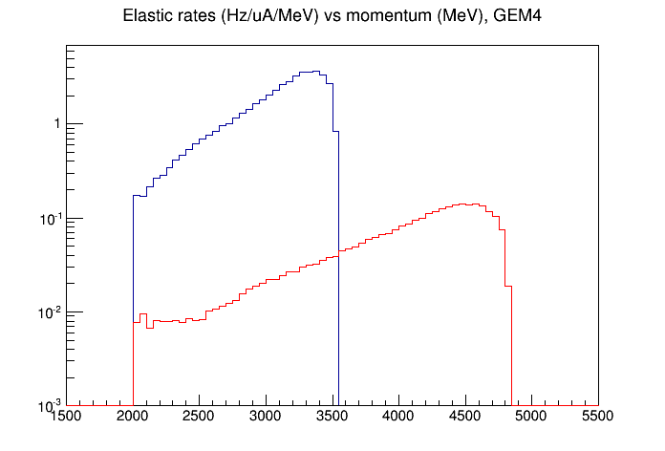
Elastic Rates vs Energy
4.4 GeV
6.6 GeV

Slide 4
Alignment Plan: Use Tracks
Due to the symmetry of the
apparatus, the Q2 is independent
of misalignments. (ROM) Issue is
estimating second order effects.
(Different from SBS)
Tracks
GEM’s
Beam
GEMs are mounted so that
relative positions of all anode
strips are precisely known.
(Don’t mount GEM’s separately
on baffles.)
If tracks were straight,
alignment would be
simple. Tracks are
approximately straight.
Problem:
know alignment
of GEM package
relative to beam axis
(2 angles, 2positions)

Slide 5
Systematics: Polarimetry
We are in good shape.

Slide 6
Qweak Beam Polarimetry
Preliminary Run 2 Polarization
Compton (E_{det}) Møller
Good agreement between Møller & Compton (electron detector)
Compton photon detector: issues with PbWO₄ calorimeter (afterglow?)
Systematics:
- Compton (E_{det}) : $∆$P/P = 0.42% - Møller: $∆$P/P = 0.65%
Combined Total: $∆$P/P = 0.61% (systematics + statistics + scaling)
0.62% systematic uncertainty (combined)
Serious progress!!
(see Bob Michaels’ talk)
Compton: A. Narayan et al, Phys. Rev. X 6.011013 (2016)
Notes:
Scaled Compton to match Moller: scaling was -0.21% with a stats + point-to-point error of 0.29%; included this error in total

Slide 7
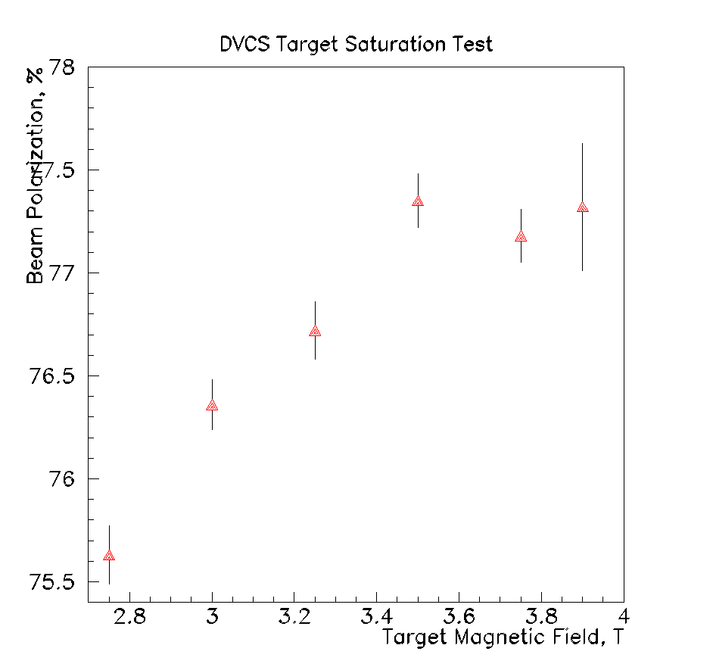
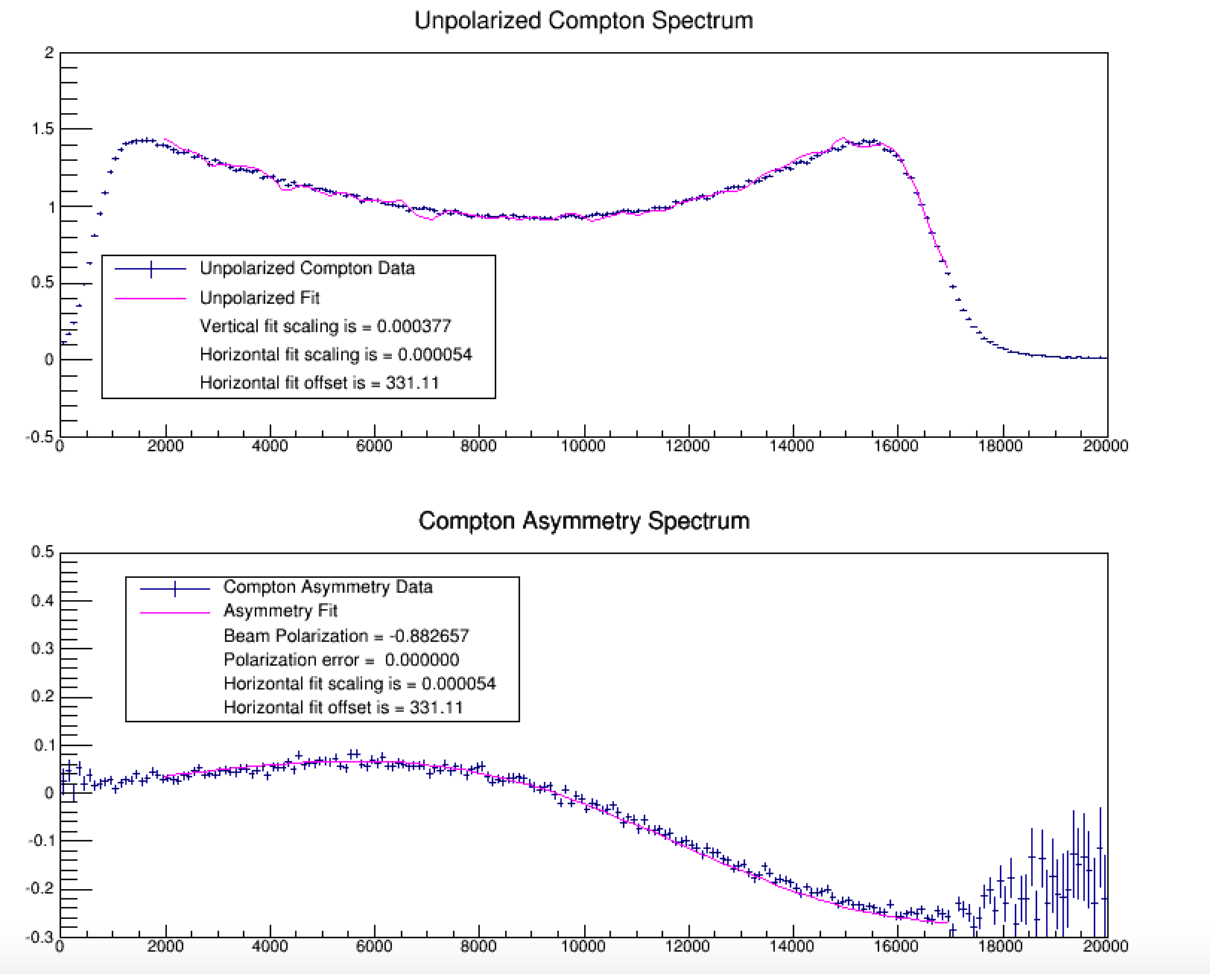
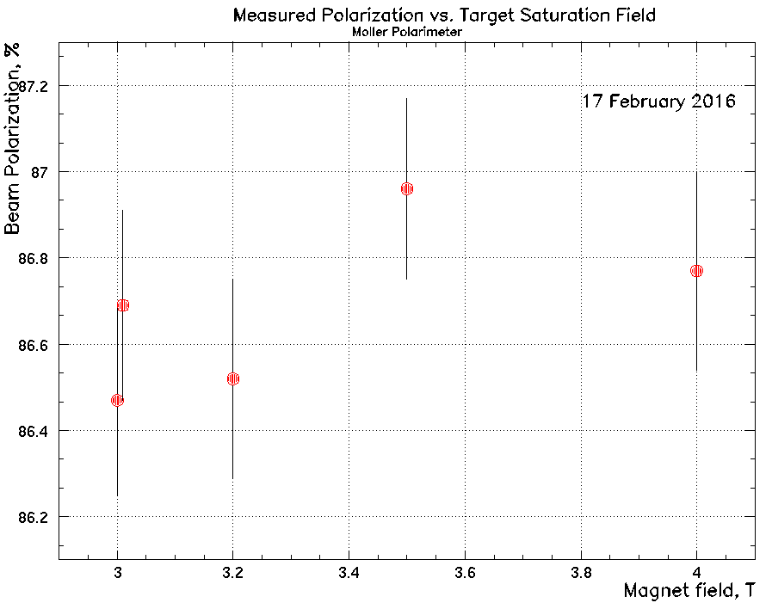
Polarimetry progress in Jlab Hall A
Magnetization of Fe target
Compton spectrometer works
at high energy
Robert Michaels

Slide 8
Acceptance and Efficiencies
Acceptances: given in statistics plot?
Loss in efficiency due to losses in tracking X LGC X ECal ignored in Pre-CDR: use 80%?
Question: do backgrounds introduce loss of efficiency and systematic errors?
Recent progress with ECal: looks good.

Slide 9
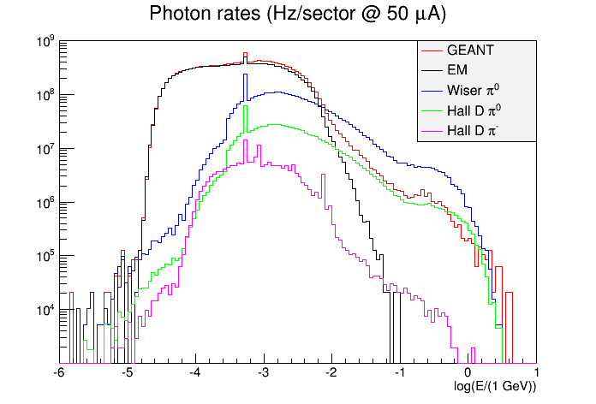

Slide 10
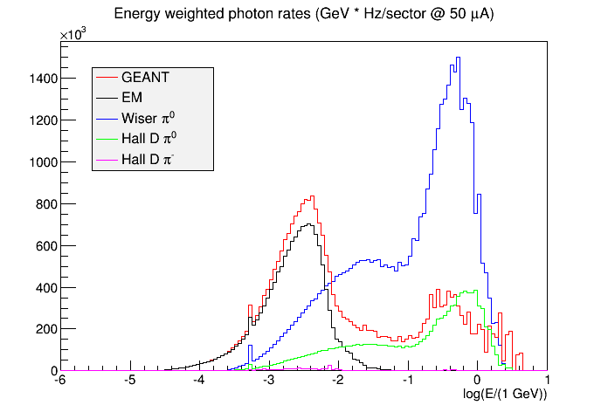
Systematics: Backgrounds

Slide 11
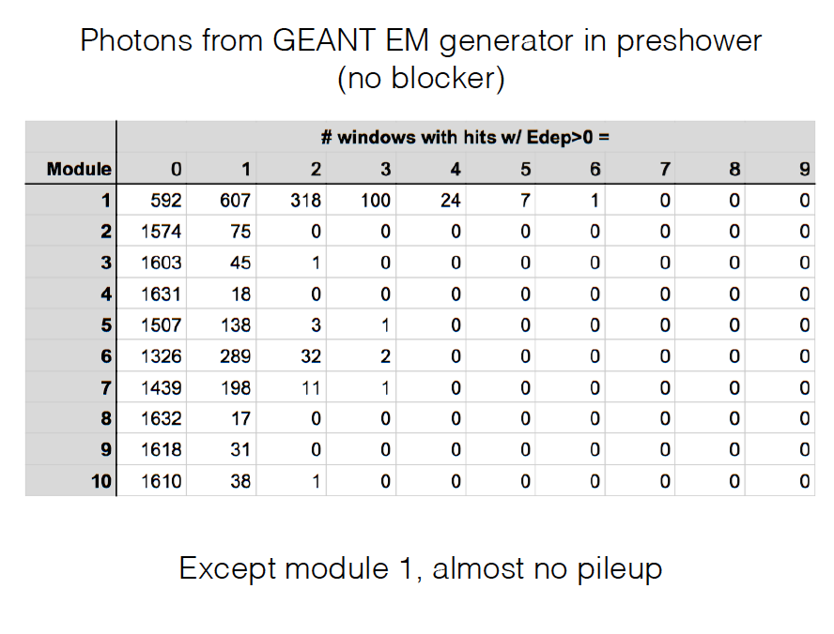
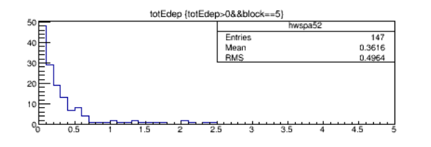
Systematics: Pileup in ECal
Most photons deposit litte energy

Slide 12
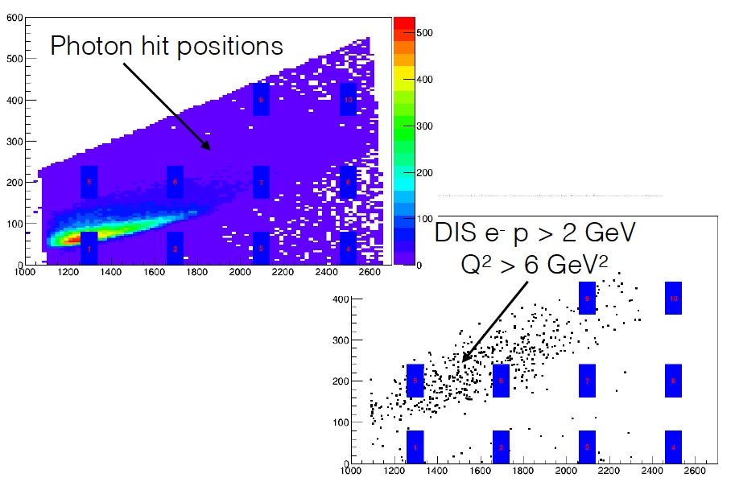
Different blocks have very different pileup issues

Slide 13
Tracking Issues
Tracking is a huge job and present resources are limited.
Wire occupancies might be understood soon.
Non-uniform background distribution
Long anode strips
Large background pulses
Does a gradient is occupancy induce a systematic position shift?

Slide 14
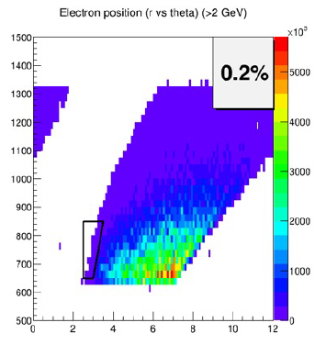
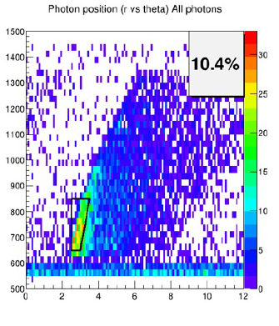
Non-uniform Distribution: GEM 2

Slide 15
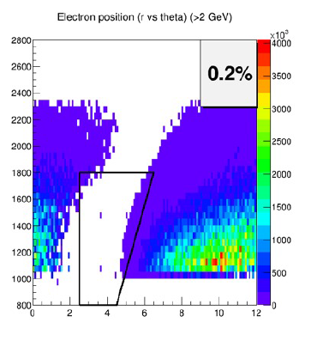
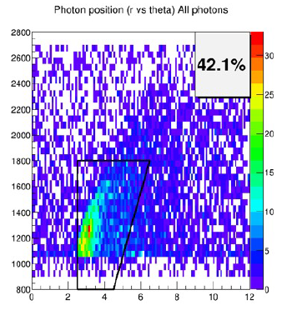
Non-uniform Distribution: GEM 4

Slide 16
LGC Systematics
My major concern: random singles rate
Major contribution: low energy, wide angle electrons
Can this be reduced by optimizing the hardware?

Slide 17
PV Background Asymmetries from Hyperons
Low energy Δ’s source of much γ background.
Low energy hyperons might dominate asymmetry.
π⁰’s from hyperons do not come from beamline.

Slide 18
Estimated size
Fraction of π’s from hyperons. <10%?
Asymmetry of decay. 0.5
Asymmetry in photon energy. <20%??
Polarization of parent photon.? <10%?
Cancellation from Σ’s.

Slide 19
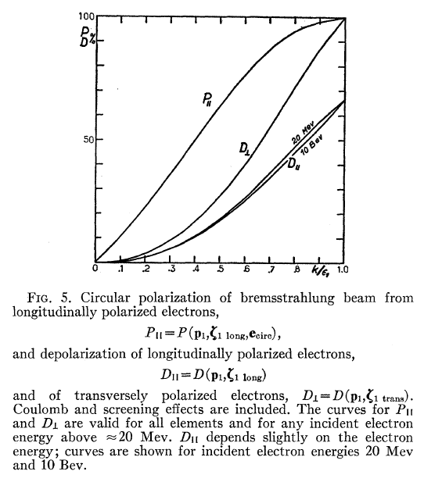
Photon Polarization

Slide 20
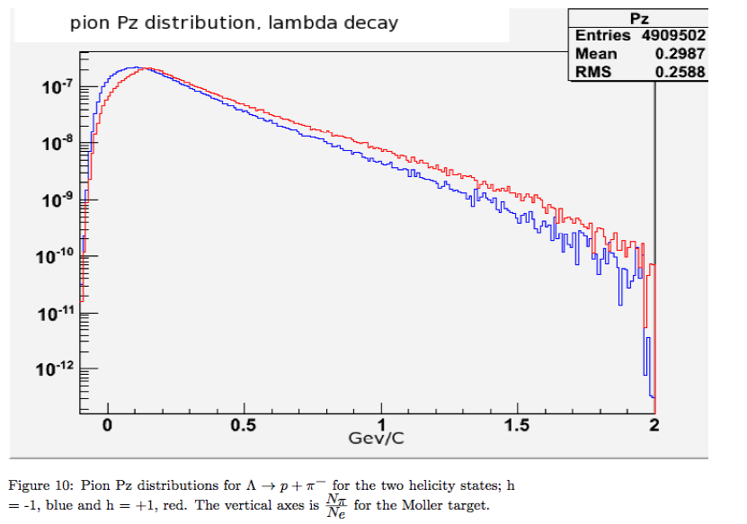
Pion Energy (MOLLER)

Slide 21
What do we need to do for response?
Having useful tracking analysis is unrealistic
Understanding GEM occupancy is enough (month time scale)
Reducing the acceptance of HGC for wide angle, low E electrons and positrons must be done: no estimate.

