Slide 1
TOF readout for SoLID
Alexandre Camsonne
August 27th 2016

Slide 2
Readout options
Amplifier Discriminators front end
NINO (CERN) (8 channels – 32 channels version )
GSI Padiwa (16 channels) 150 $ for 16 channels
MAROC ( Omega IN2P3)
Need to check timing performance of discrimination and amplification

Slide 3
TDCs
HPTDC 25 ps
V1290 (32 channels about 10 K$ )
CAEN planning to develop better TDC
FPGA TDCs
TRB3 11 ps ( 192 channels / 2300 euros )
VETROC JLAB 20 ps ( need development ) 128 channels about 6 K$ ( 5 board ordered for Compton, can test TDC )

Slide 4
Sampling chip
Chip | Sampling Frequency (GHz) | Bandwidth GHz | Number of samples | Number of channels | Readout frequency (MHz) | Resolution (ps)
PSEC4 | 4 to 15 | 1.5 | 256 | 6 | 40 to 60 | 9
SAMPIC | 3 to 8.2 | 1.6 | 64 | 16 – 8 (at 10 GHz) | 80 | 5
DRS4 | 0.7 to 5 GHZ | 0.950 | 1024 | 9 | 33 | 1
DRS5 | 10 | 3 | 4096 | 32 | 300? | 5?
PSEC5 | 5 to 15 | 1.5 to 2 | 32768 | 4 | 500 | 5?
Latest generation with multilevel analog buffer : dead time less up to a few MHz and allow for L2 ( DRS5 )

Slide 5
PSEC5 update
Interesting option
Developed by University of Hawaii for HEP
Belle II
Reasonable radiation hardness 10 to 20 MRad
Funding by both HEP and NP
P5p : prototype for 2017
Commercialization and mass production being studied
Standardization of readout ( similar to SRS for TOF)
Could go down to 15 $ per channel about 3K$ per wafer

Slide 7
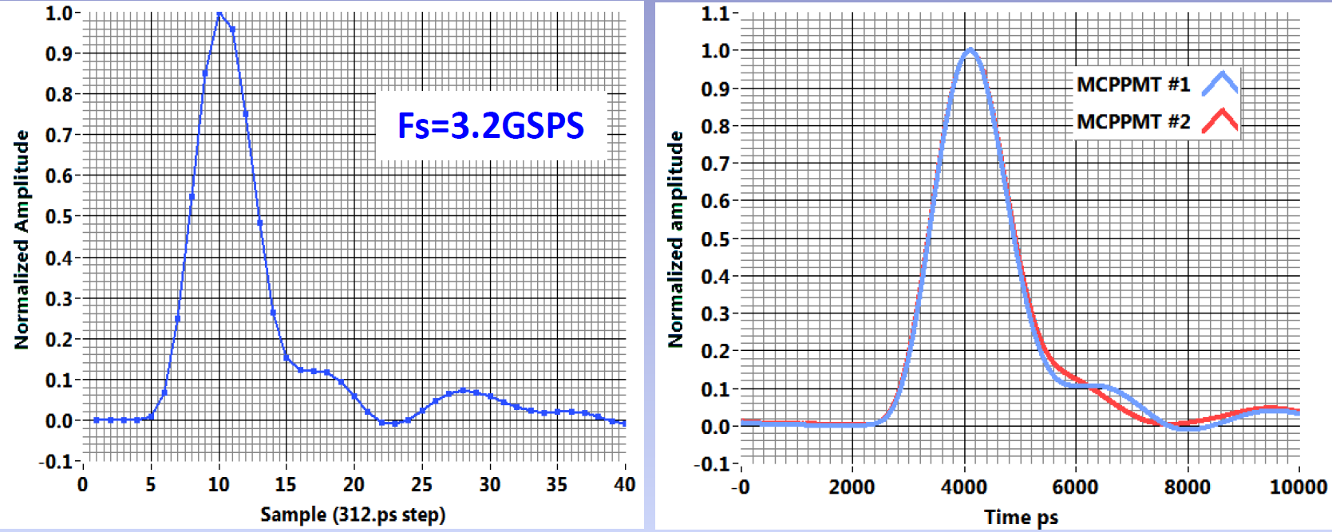
Sampling chips

Slide 8
Concern for TOF
Effect of background on TOF
Pile-up
If need to record waveform :
Deadtime ( sampling chip have deadtime, wait for new generation chip DRS5 prototype 2018 )
Event size
Occupancy
Data reduction
Cost ( develop new electronics )

Slide 9
PreRD request
MRPC
Gas system | 20000
Low Voltage | 3000
HV | 10000
VETROC | 4500
Front-end | 5000
VME64X crate | 11000
VME CPU | 4500
TID | 4000
SD | 4000
 | 66000
Man power | Postdoc | 0.1 | TDC devel
 | Electronics | 0.2 | TDC devel
 | DAQ | 0.2
 | Tech | 0.2 | Gas system
66 K$

Slide 10
PreRD
Develop high resolution TDC with VETROC
Test stand for : additional test run in 11 GeV background environment, better PID ( concern for pion efficiency )
Test sampling chips

Slide 11
Conclusion
Electronics is not a limiting factor for timing resolution ( up to 1 ps)
Baseline : A/D and VETROC for trigger and readout 20 ps resolution
Additionnal development for better than 20 ps
Need simulation to determine the need of sampling electronics
Sampling electronics is better in term of timing and background but need to evaluate additional cost and data size
Would work for MRPC or LAPPD

