Slide 1
Trigger rate estimation
Yuxiang Zhao
Aug-27-2016

Slide 2
Introduction
PVDIS trigger: EC + LGC (x>0.35 && W>2 GeV)
EC response study updated by Rakitha using Hall D generator
LGC with working gas and threshold updated (Michael)
SIDIS trigger
Electron trigger
Forward: EC + LGC + SPD + MRPC (Q² > 1GeV²)
Large: EC + SPD (P > 3 GeV)
Hadron trigger
EC + SPD + MRPC (could be different depending on further study)

Slide 3
PVDIS trigger rate

Slide 4
Singles rate on EC
Singles particles | Rate (MHz) Jin’s curve, wiser generator, extrapolation below 1 GeV | Rate (MHz) Rakitha’s curve, Hall D generator, cut off at 1 GeV
Electron | 0.282 | 0.241
Pim (Hall D) | 5.05 | 4.4
Pip (Hall D) | 1.0 | 0.43
Pi0(Hall D) | 0.031 | 0.015
Total | 6.36=(212 KHz/sector) | 5.09=(170 KHz/sector)
Rate becomes lower by using Hall D generator based simulation

Slide 5
Singles rate on LGC
Threshold: PMT=2, P.E on each pmt=2
singles | Rate (MHz)
Electron | 0.4465
Pim (Hall D) | 0.823
Pip (Hall D) | 0.436
Pi0(Hall D) | 21.76
EM background only (beam on target with hadron processes blocked) | 0.6 (18 out of 1066 windows can produce a lgc trigger)
Total | 24.1 MHZ (803KHz/sector)
Beam on target with all processes on: 42MHz
Different by 17.9 MHz
From difference of pi0 rate between G4 and Hall D generator

Slide 6
Coincidence rate among detectors
PID | Only EC fired | Rate with EC and lgc both fired for the same e or pion event | Efficiency of LGC
Electron | 0.24 MHz | 0.23 MHz | 95.7%
Pim | 4.43 MHz | 0.64 KHz | 0.01%
Pip | 0.43 MHz | 0 (limit: 0.04kHz) | 0.01%
Pi0 | 0.015 MHz | 8.5 KHz | 55%
Well defined particles with EC&LGC = (230 + 0.64 + 0.04 + 8.5) KHz = 239 KHz = 8 KHz/sector
Random coincidence per sector = 170 KHz * 803 KHz * 30ns = 4.1 KHz/sector
Total: (8+4.1) KHz = 12.1 KHz/sector

Slide 7
Concern of particle correlations
High singles rate: pim on EC, pi0 on LGC
How large is the correlation between pim and pi0 ???
Hall D generator can have all possible pions in one event
Looking at EC&LGC coincidence will give us hints on the correlations between pions
0.3% of “all-pion” events will fire EC and LGC at the same time
Seems that correlation of pions on EC and LGC is small

Slide 8
Short summary of PVDIS trigger rate
Study based on Hall D generator
Total rate: (8+4.1) KHz = 12.1 KHz/sector

Slide 9
SIDIS trigger rate
EC response using Hall D generator is under way (Rakitha)
SPD
Forward angle: 60 in phi dimension, 4 in r dimension
Large angle: 60 in phi dimension
Optimization of threshold is ongoing (Sanghwa)
MRPC
60 in phi dimension, 4 in r dimension, each module has 10 layers of gas gap
Using wiser simulation to get start while waiting for Hall D generator based study

Slide 10
Current Thresholds used for individual detectors
EC
Forward angle: Q2 > 1 GeV2
Large angle: P>3 GeV
LGC: 2 PMTs in a sector, 2 P.E for each PMT
SPD: 0.35MeV for energy deposition
MRPC
16eV energy deposition in a gas gap
at least 5 gaps to be fired

Slide 11
SIDIS forward angle electron trigger
Using Wiser simulation to start
Singles particle | EC Rate (kHz) | LGC Rate(KHz) | SPD Rate(MHz) | MRPC Rate(MHz) | All 4 fired Rate(KHz)
electron | 53.9 | 77.2 | 2.0 | 1.16 | 42
Pim | 864 | 82.4 | 15.7 | 14.4 | 6.4
Pip | 1036 | 85.7 | 19.1 | 17.6 | 7.5
Pi0 | 2210 | 2045 | 10.8 | 7.6 | 88.1
Total electron-like trigger rate in forward angle: 144 KHz + random coincidence among detectors
Random coincidence is high, need to define the “track match” area to decrease rate

Slide 12
SIDIS large angle electron trigger
Using Wiser generator to start
Singles particle | EC Rate (kHz) | SPD Rate(MHz) | Both fired Rate(KHz)
electron | 2.9 | 2.56 | 2.8
Pim | 8.2 | 21.9 | 8.2
Pip | 10 | 26.5 | 10
Pi0 | 20.4 | 18.1 | 8
Total electron-like trigger rate in large angle: 29 KHz + random coincidence

Slide 13
To-do list for SIDIS trigger rate estimation
Update EC response using Hall D generator (Rakitha)
Update SPD threshold (Sanghwa)
Update MRPC threshold (Sanghwa?)
Hadron-like trigger rate estimation
Define how to do “track match” at trigger level to reduce random coincidence rate (among detectors)
Efficiency study by combining all the individual detectors in the trigger design
Still long way to go…

Slide 14
Summary
PVDIS trigger rate: (8+4.1) KHz = 12.1 KHz/sector
SIDIS study needs more efforts

Slide 15
Backups

Slide 16
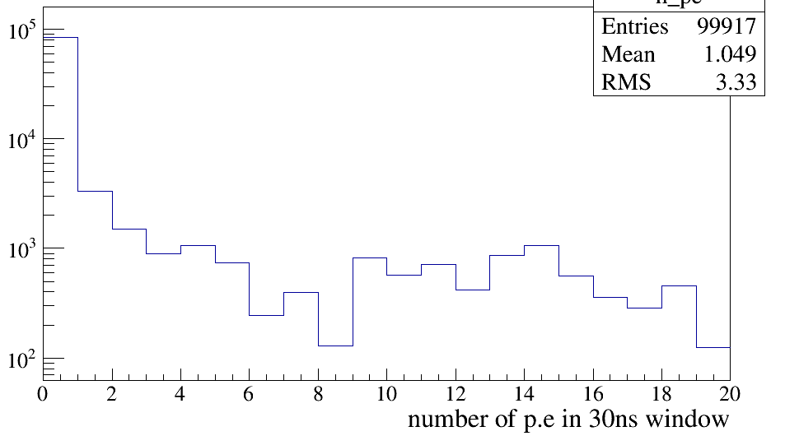
Number of p.e produced by EM on lgc within 30ns
On whole LGC, not per sector
EM is not an issue on lgc, only the pile up effects

