Slide 1
SoLID Simulation
Zhiwen Zhao
2016/08/27

Slide 2
Review Comment (general simulation)
End-to-end simulations with realistic subsystem responses and material budgets
The development of a simulation framework with realistic reconstruction and analysis should be pursued with high priority and increased resources.
Having a functional simulation and reconstruction routines as soon as possible should be a high priority in the software effort. Such software will pay off many times over in experimental design and avoiding pitfalls.
Acceptances, efficiencies, and systematic uncertainties should be simulated for each of the core measurements.

Slide 3
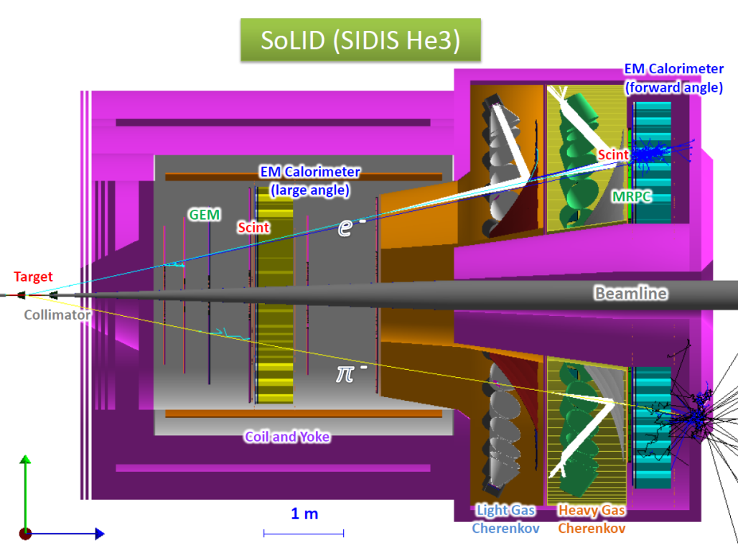
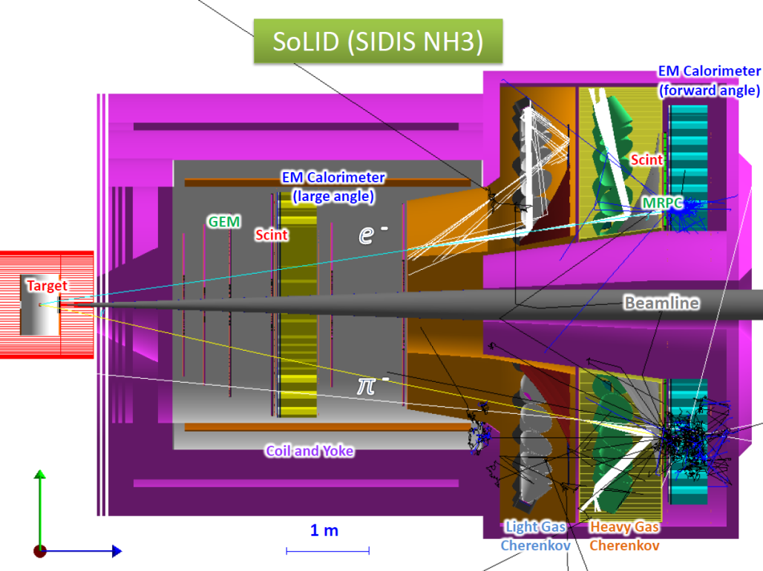
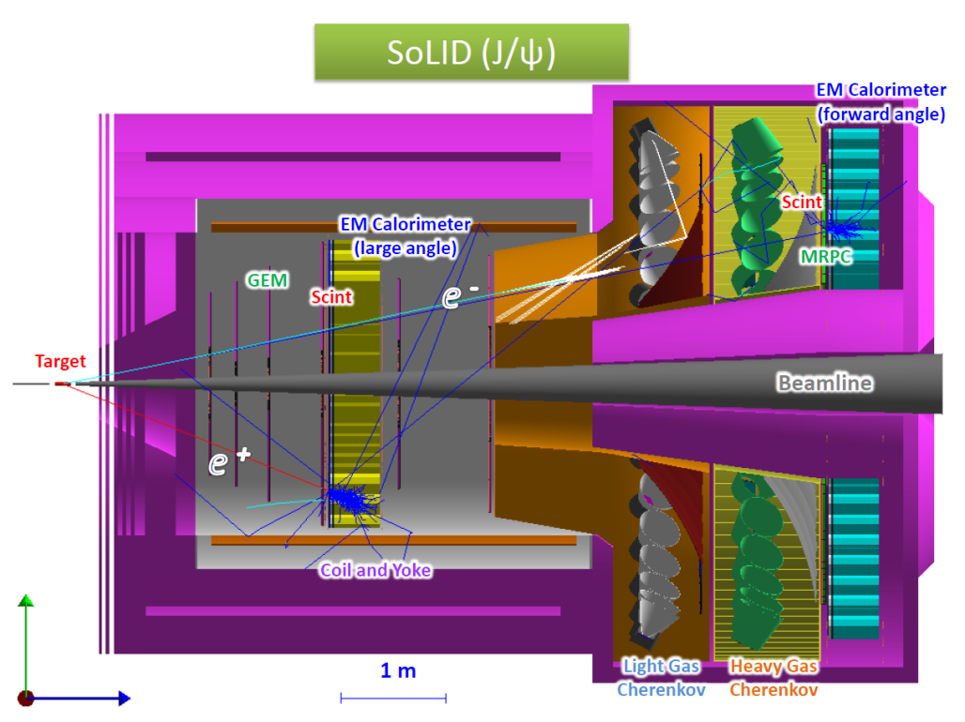
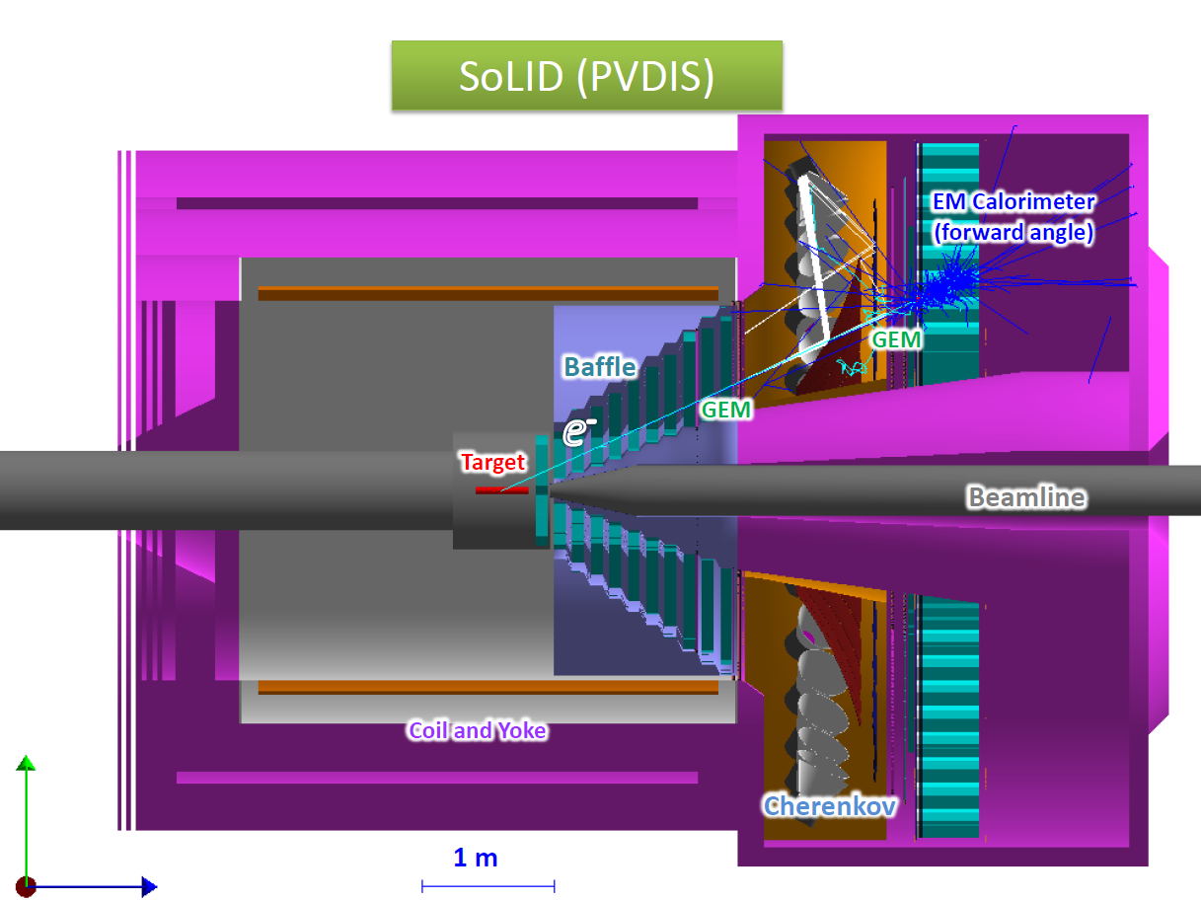
all subsystems with various level of details in the unified simulation “solid_gemc”

Slide 4
Subsystems in simulation (non-detectors)
Target systems have materials where beam and final particles pass
Beamline are just Al pipes with BeO window, need real design
Magnet has coil,cryo,iron flux return according to the 2D field model
Baffle is pure lead
neutron shielding, has for PVDIS, not for all others

Slide 5
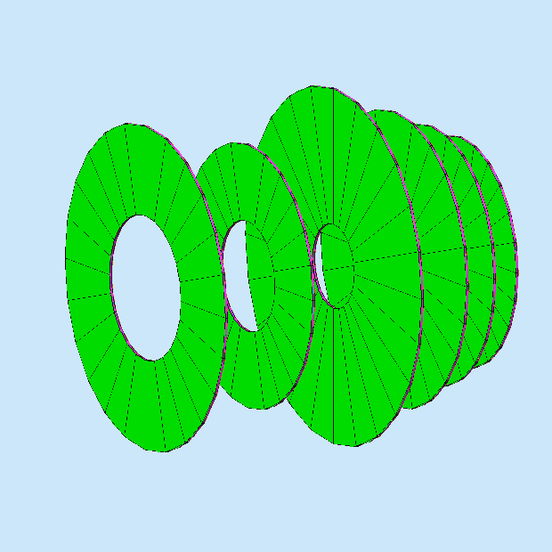
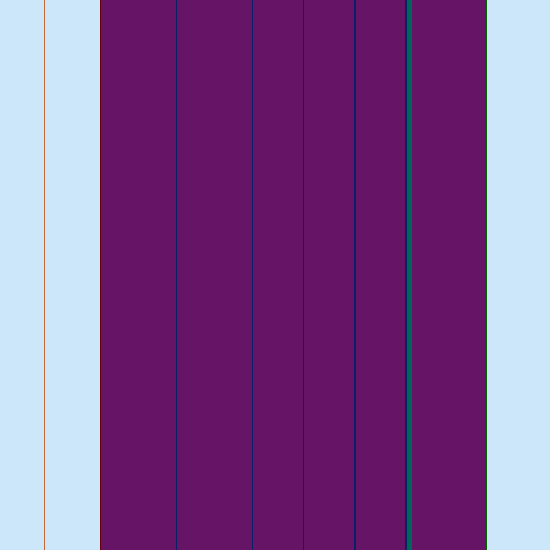
Subsystems in simulation (detectors)
GEM SIDIS
GEM has all layers, no dead area
SPD just a layer of scintilator
MRPC has all layers, no dead area
GEM one layer
All these layer kind of detectors record hit pid,mom,position,vertex,energy deposition

Slide 6
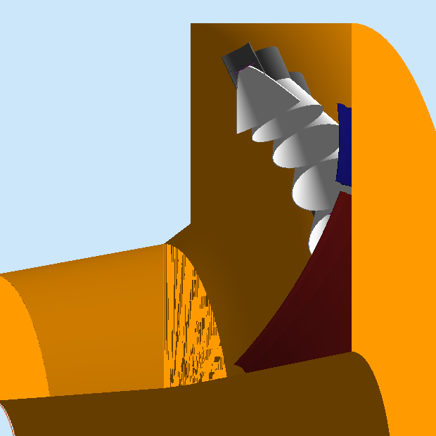
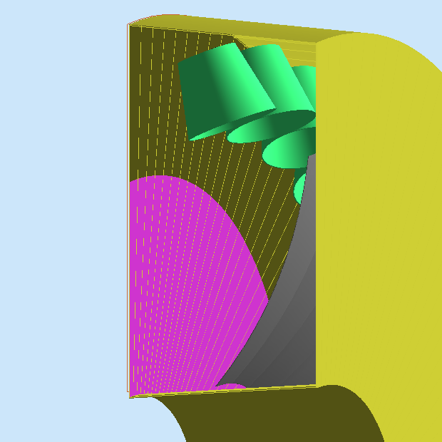
Subsystems in simulation (detectors)
LGC, has tank, window, gas, mirror,cone,PMT window with optical features
HGC, has tank, window, gas, mirror, cone with optical features, no PMT window yet
All these optical photon collecting detectors can record all hits too.
LGC already fully digitized. HGC not yet.

Slide 7
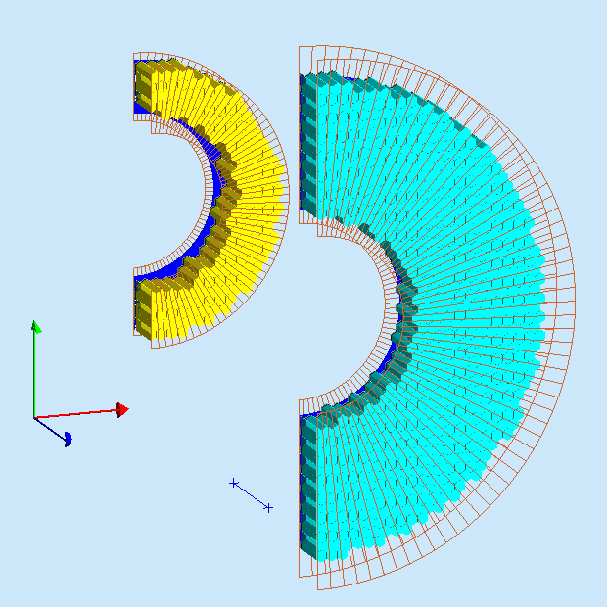
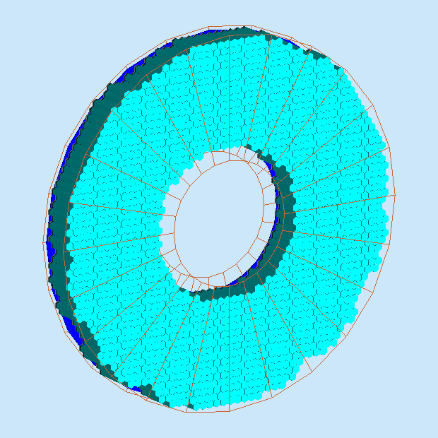
Subsystems in simulation (detectors)
EC
has lead shield, preshower, shower with all layers
No fibers, no PMT yet
PVDIS FAEC layout is done according to ANL drawing, SIDIS FAEC and LAEC layout are done by removing modules from ANL drawing (design needed)
Energy deposition sum in scintilator of preshower and shower are recorded for each module

Slide 8
Use simulation to study
All files with production version and devel version are in SVN
Documentation on wiki
Official binary builds are on farm and we have streamline installation scripts for local machines, we also provide virtual machine ready to use
we have a work flow from various generators to simulation output on farm with semi-auto scripts, anyone can run it with a little setup
For any setup, a set of files are generated at a shared central location and used for studies like acceptance, efficiency, trigger, background, tracking etc. This ensures consistent results

Slide 9
Analysis simulation output
Mainly use output root
All detector responses are recorded in separated trees which follow same index for same event
GEM digitization and tracking are separate codes, even though they read the same output file from simulation
Some simple modulized script
for general study
analysis.C
analysis_tree_solid_ec.C
analysis_tree_solid_mrpc.C
analysis_tree_solid_spd.C
analysis_tree_solid_lgc.C
analysis_tree_solid_hgc.C
analysis_tree_solid_gem.C

Slide 10
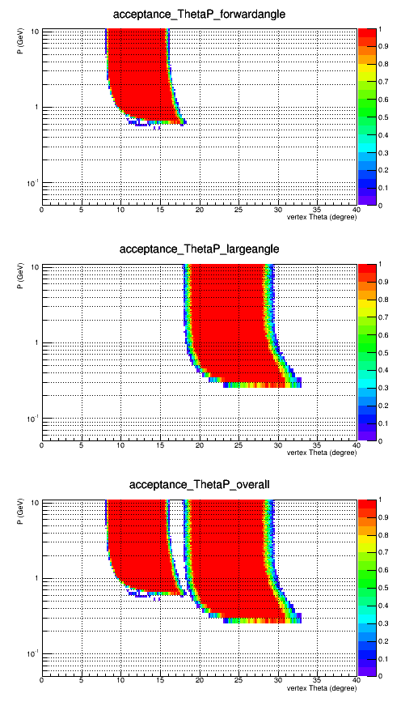
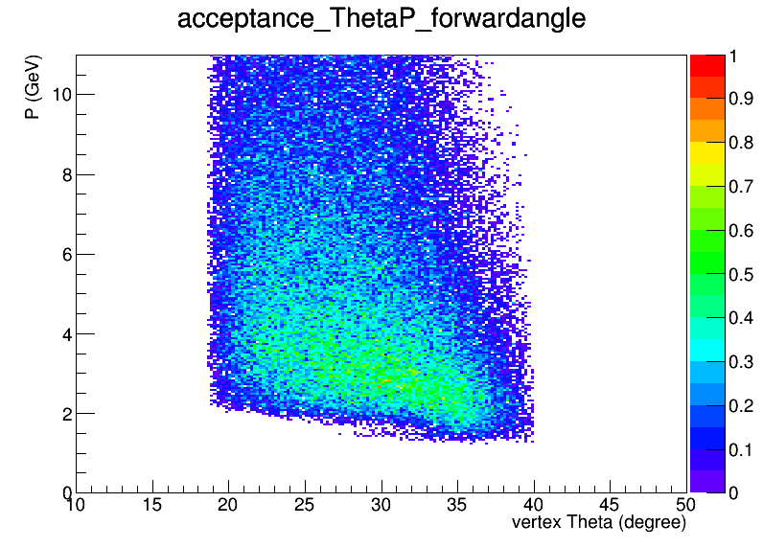
Jpsi and PVDIS Acceptance
Simple setup without secondary
Only field effect, pass EC+GEM
JPsi
P(GeV)
PVDIS e
Theta(deg)

Slide 11
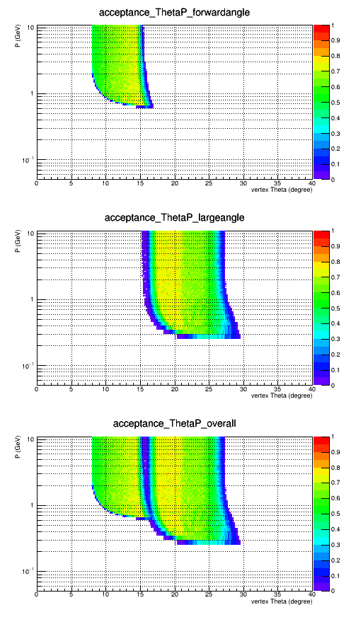
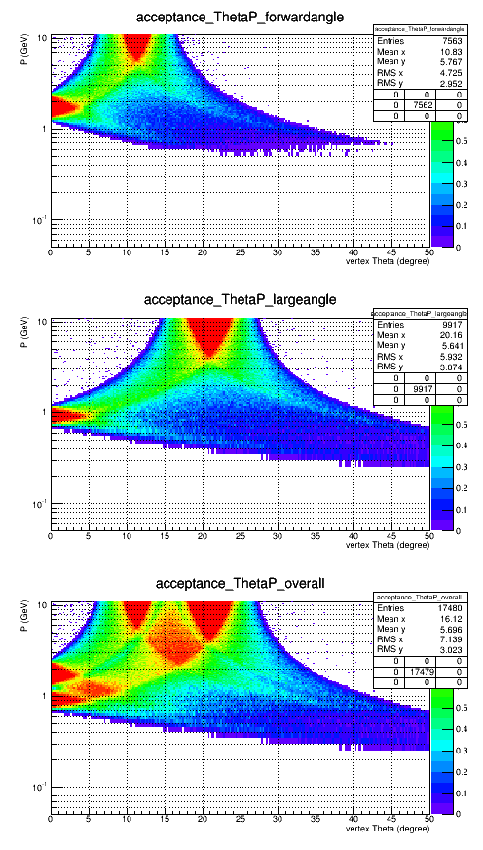
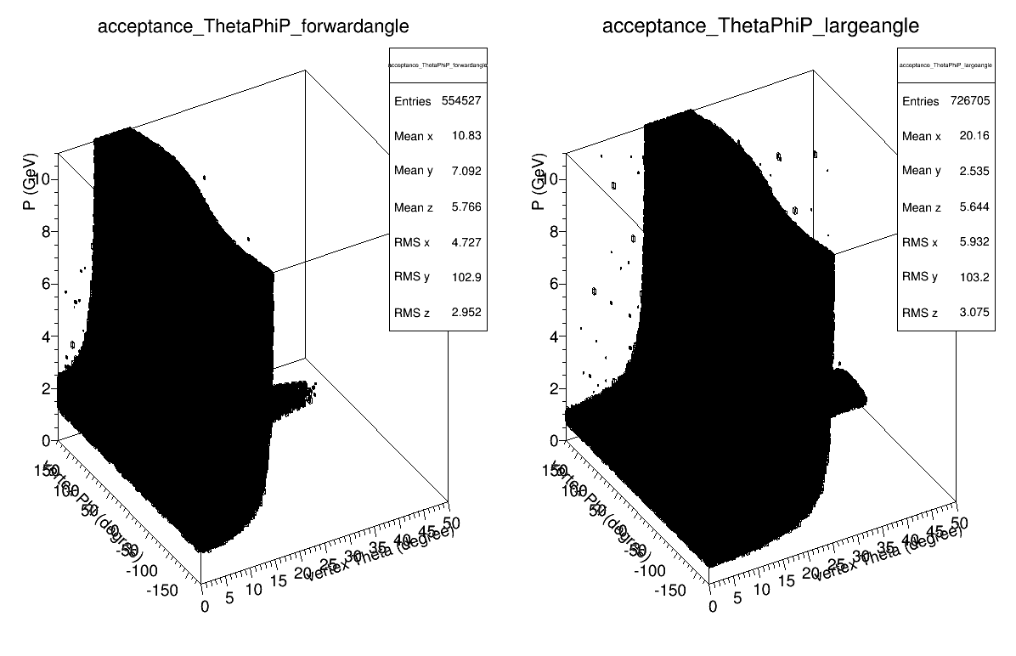
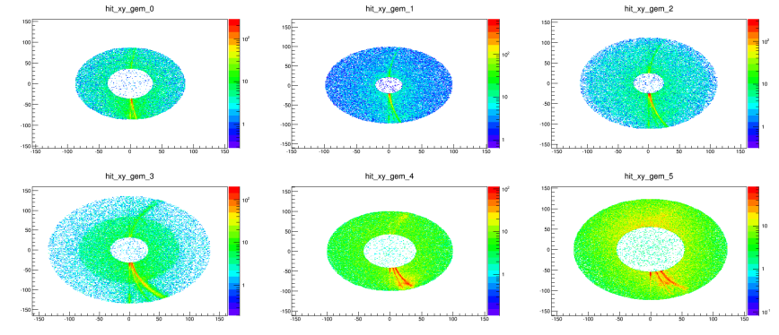
SIDIS Acceptance
Simple setup without secondary
Only field effect, pass EC+GEM
He3
NH3 2D
NH3 3D
P(GeV)
NH3 sheet of flam on GEM
Theta(deg)

Slide 12
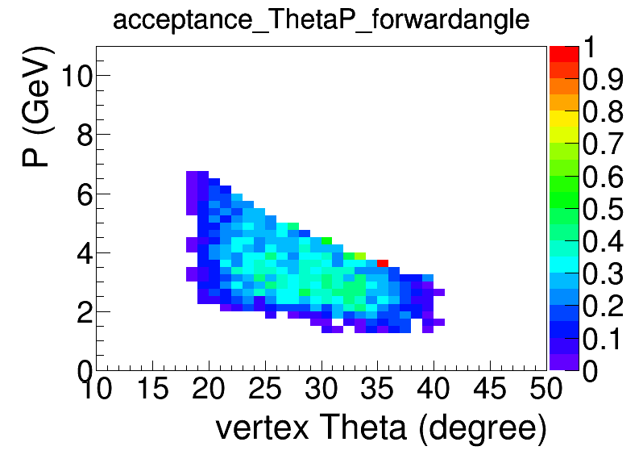
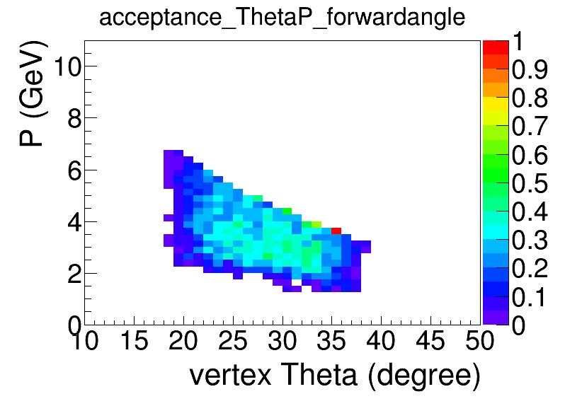
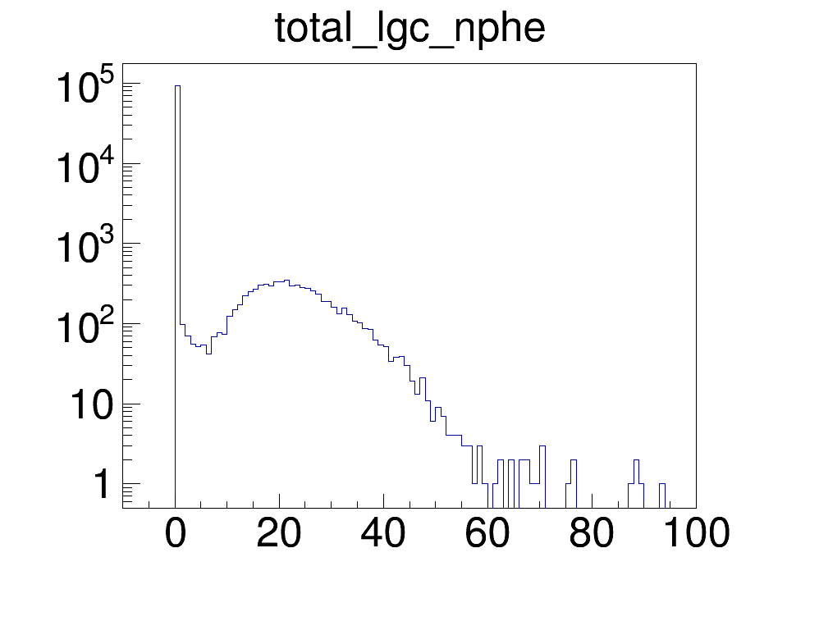
Test toward overall efficiency (PVDIS)
setup with secondary
A simple test, not complete study
Throw eDIS into PVDIS full setup, consider it’s accepted when
it passes all GEM planes and entering EC
In addtion, LGC has number of total photons > 10
Essentially it will need to involve from a simple into a full reconstruction code
EC+GEM
EC+GEM+LGC

Slide 13
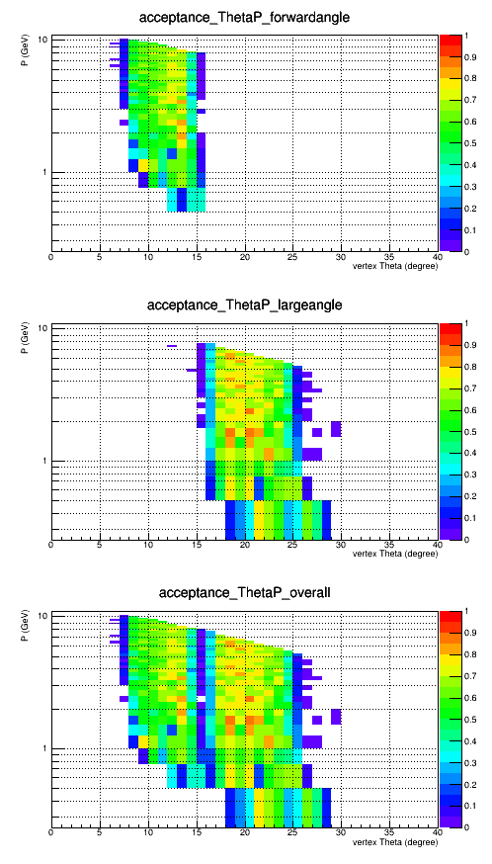
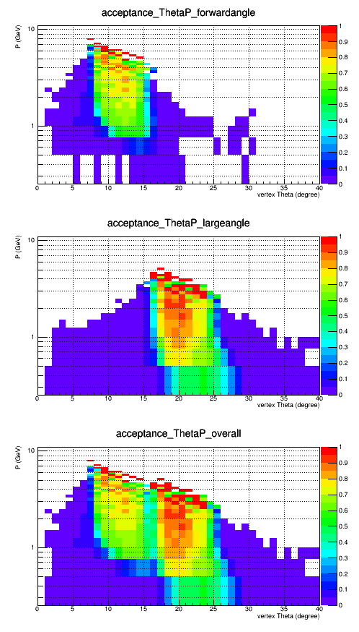
Toward overall efficiency (SIDIS_He3)
setup with secondary
e-
EC+GEM
pi-
A simple test, not complete study
Throw eDIS or pimWiser into SIDIS_He3 full setup, consider it’s accepted when
it passes all GEM planes and entering EC
In addition, LGC or HGC has number of total photons > 10
P(GeV)
Theta(deg)

Slide 14
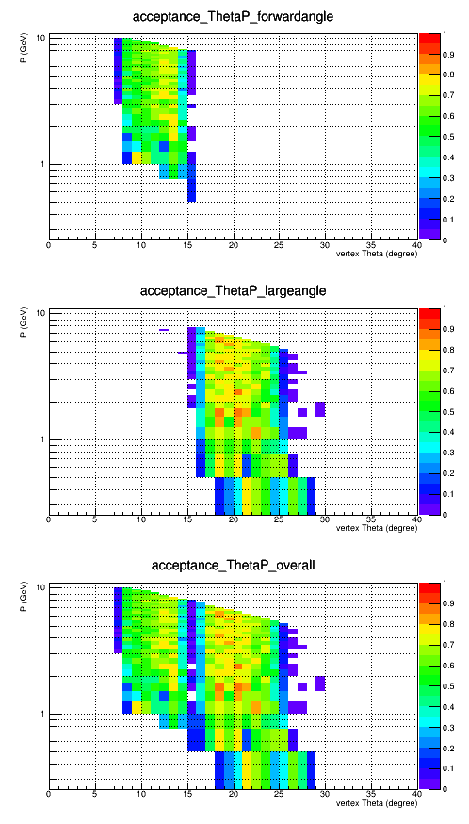
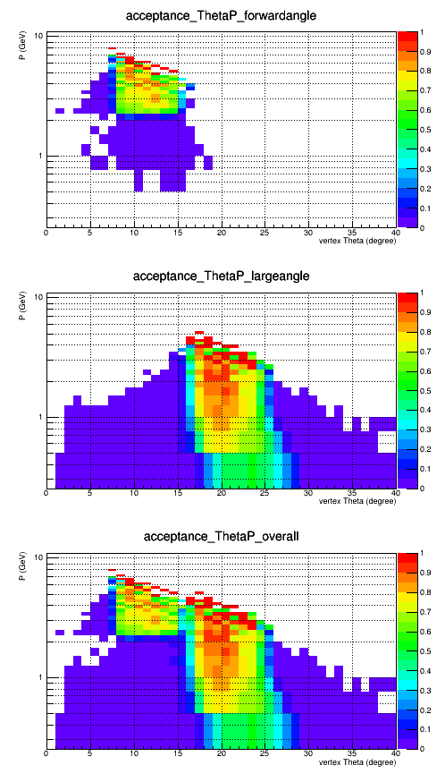
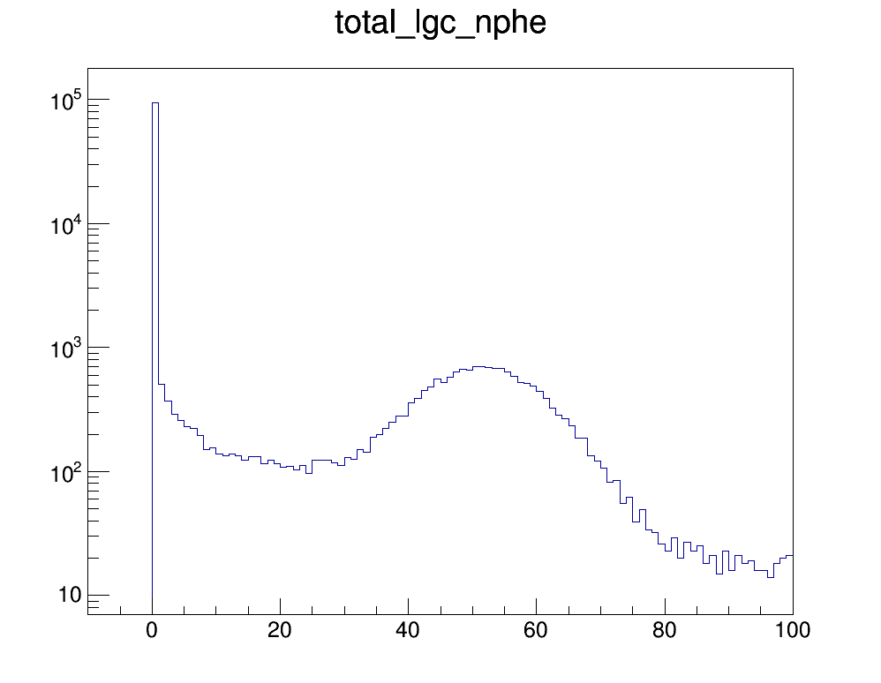
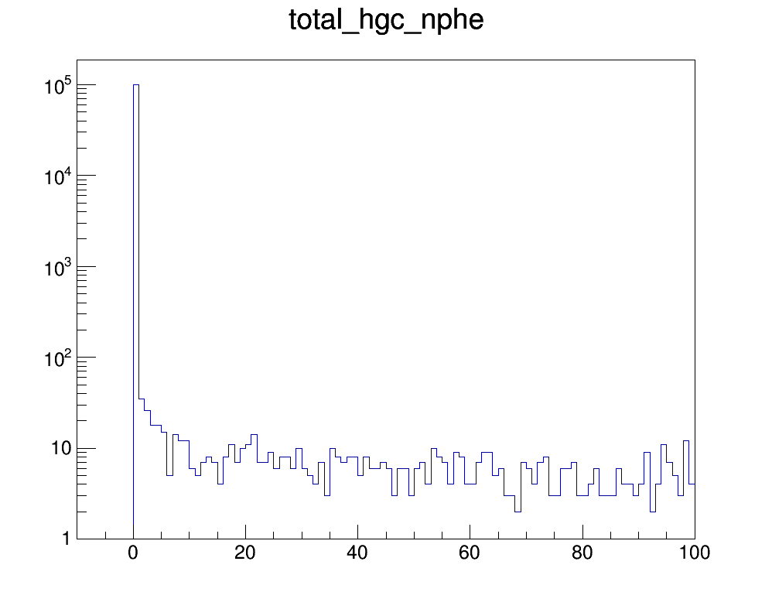
Toward overall efficiency (SIDIS_He3)
setup with secondary
e-
EC+GEM+LGC/HGC
pi-
In addition, LGC or HGC has number of total photons > 10
P(GeV)
Theta(deg)

Slide 15
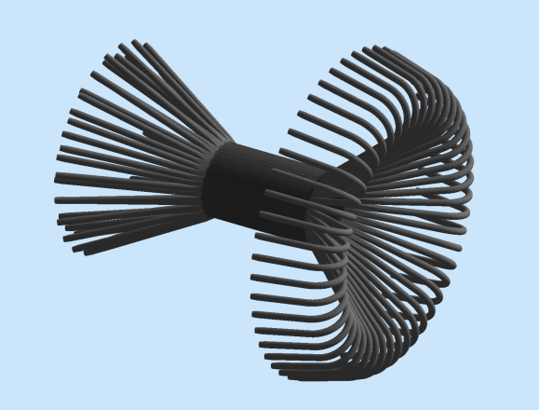
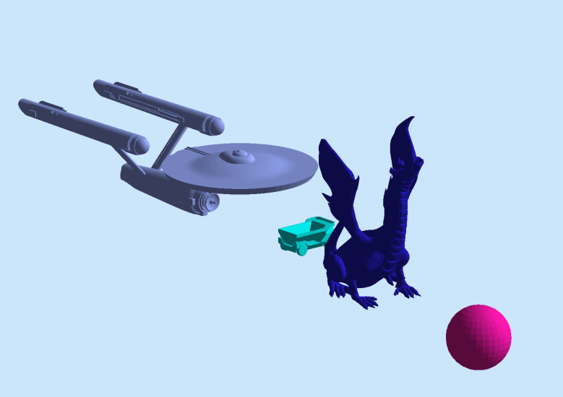
Simulation future plan
Continue using and improving current software and setup for various studies
fastMC: using acceptance,resolution,pid from detailed simulations, for SIDIS and Jpsi setup
Test using “solid_gemc” as simulation engine for art framework
gemc is very much modulized already
solid_gemc uses gemc as library already
Input format can be expended, existing
Geant4 solid in simple form with attribute
CLARA geometry service
GDML with attribute (new)
CAD with attribute (new)
Mixed together

Slide 16
Update from Rakitha
generator updates
Hall D generator code is now standalone code, separate from full Hall D simulation framework
Generates events for PVIDS LH and LD, SIDIS 3He and J/Psi LH configurations to produce LUND files as input for solid_gemc
ECAL Simulation Updates
Finished PVDIS ECAL performance and trigger rates in remoll
Working on SIDIS He3 performance and trigger in solid_gemc while adopting previous analysis tool
Jpsi and SIDIS NH3 later
Happy at Louisiana, staying away from flood

Slide 17
Acceptance | Zhiwen, Kalyan | Done with simple setup, working on more supplicated setup
PVDIS Q2 | Bob | Initial result
SIDIS impact | Tianbo and others | Initial result
J/psi bin migration and signal/background | Michael and others | Initial result
Hadron generator | Rakitha | Done, producing file, adding e would be nice
EC trigger | Rakitha | PVDIS down, SIDIS ongoing, need Jpsi
LGC trigger | Michael | PVDIS and SIDIS, under tuning
SPD trigger | Sanghwa | Initial result
MRPC trigger | Sanghwa | needed
Overall trigger | Yuxiang | PVDIS done, SIDIS e under study, need SIDIS hadron, and Jpsi e
DAQ deadtime | Alex, Bob | ongoing
GEM response parameterization |  | ongoing
GEM Digitization and Occupancy | Weizhi,Ole | done with initial result, need UVa input to finalize
tracking | Weizhi,Ole | Initial result
Baffle optimization | Rich | Initial result

