Slide 1

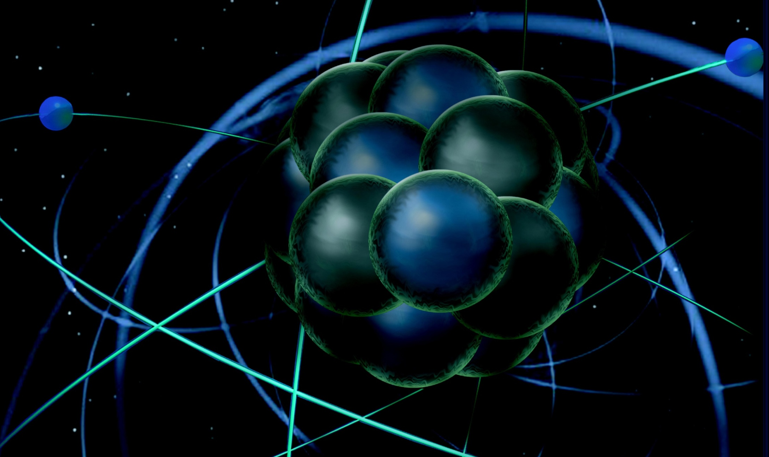
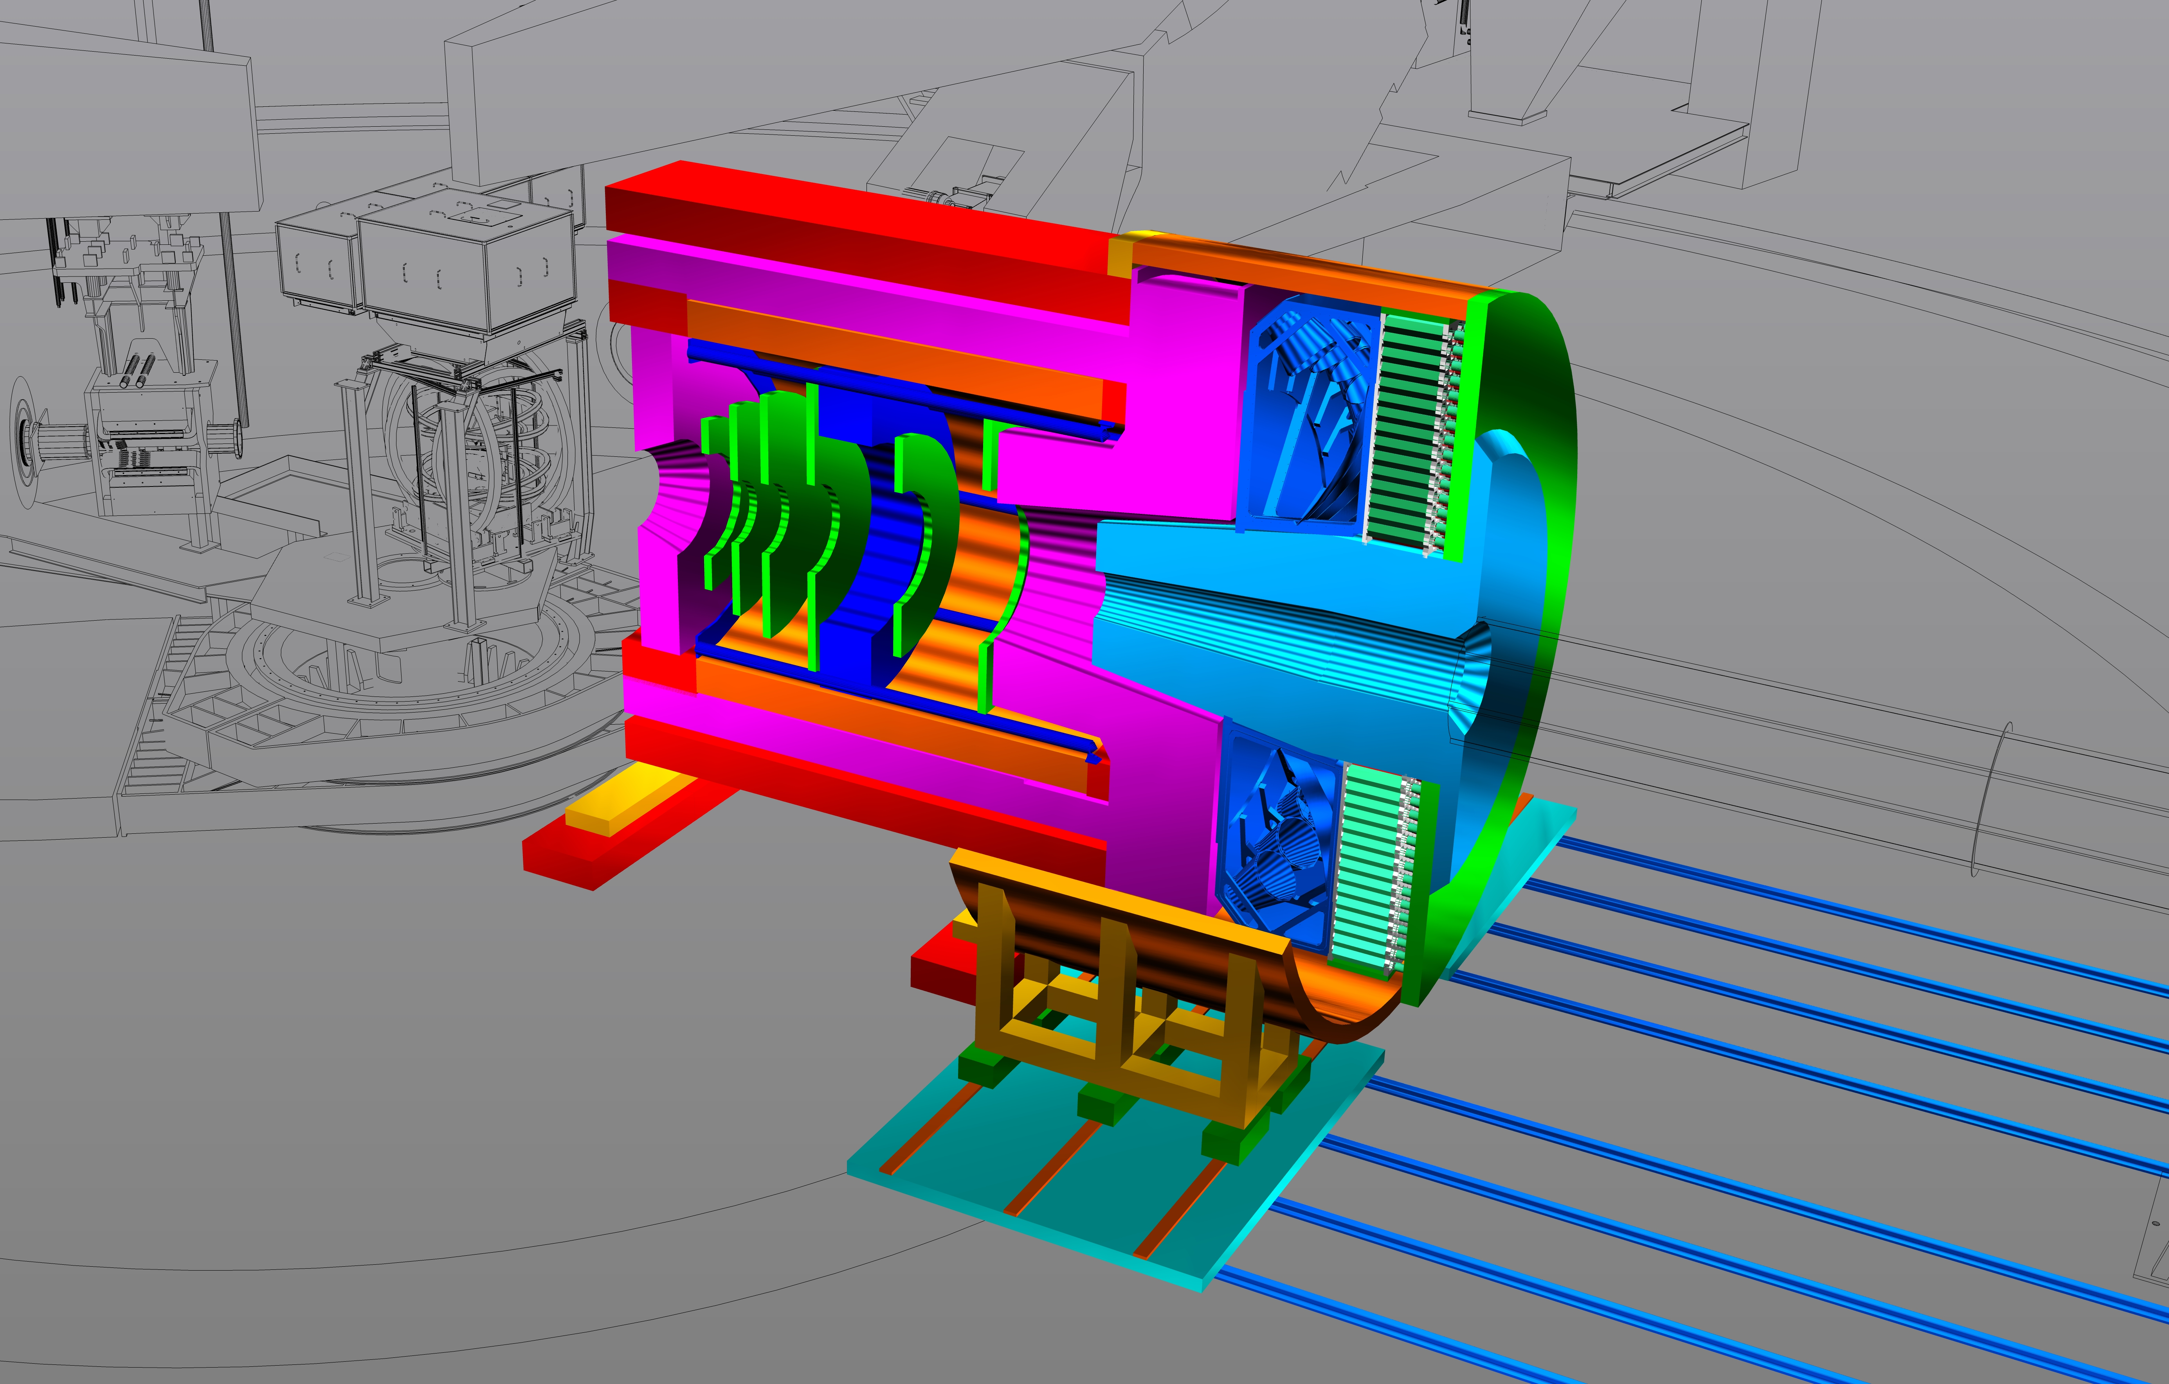
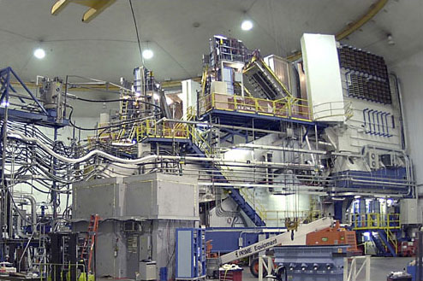
Input from Hall A
Thia Keppel
SoLID Collaboration Meeting
December 2016

Slide 2
Hall A Projected Experiment Schedule, updated 12/2016
Experiments in red represent PAC42 “high impact” experiments
Spring | Fall | Spring | Fall | Spring | Fall | Spring | Fall
DVCS –I/ GMp | DVCS –I/ GMp
 |  | DVCS –I/ GMp | DVCS –I/ GMp
 |  |  |  | ³H/³He group Ar(e,e’p)* | ³H/³He group Ar(e,e’p)*
 |  |  |  |  |  | TBD: nothing! APEX PREX12 CREX A₁^{n} DVCSII | ???
CY
2015
X
CY 2016
CY
2017
CY
2018
*best effort

Slide 3
Hall A Projected Experiment Schedule, updated 12/2016
Experiments in red represent PAC42 “high impact” experiments
Spring | Fall | Spring | Fall | Spring | Fall | Spring | Fall
DVCS –I/ GMp | DVCS –I/ GMp
 |  | DVCS –I/ GMp | DVCS –I/ GMp
 |  |  |  | ³H/³He group Ar(e,e’p)* | ³H/³He group Ar(e,e’p)*
 |  |  |  |  |  | TBD: nothing! APEX PREX12 CREX A₁^{n} DVCSII | ???
CY
2015
X
CY 2016
CY
2017
Disclaimer: This could change drastically and quickly depending on the budget….
CY
2018
*best effort

Slide 4

DVCS-I and G_{M}^{p}: Concurrent Experiments in Hall A at 11 GeV
10 calendar weeks in Spring’16
High impact experiment for 3D nucleon imaging
  Deeply Virtual Compton Scattering (DVCS) provides access to Generalized Parton Distributions (GPDs)
Will provide highest available Q² measurement of the DVCS cross section
  Demonstration of scaling critical to full JLab 12 GeV GPD program
DVCS
6.6
8.8
11 GeV
x
x
x
Fall’14
2
3
1 days
G_{M}^{p}
x
x
x
x
6.6
8.8
11 GeV
5 days
4
4
4
x
x
x
x
8.8
11 GeV
13
16 days
13
20
        Both polarimeters operational during DVCS/GMp
High Q² Form Factors
  Reducing G_{M}^{p} uncertainties will enable Super BigBite high impact program of Form Factor Measurements

Slide 5
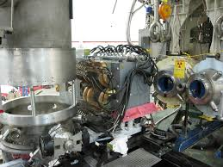
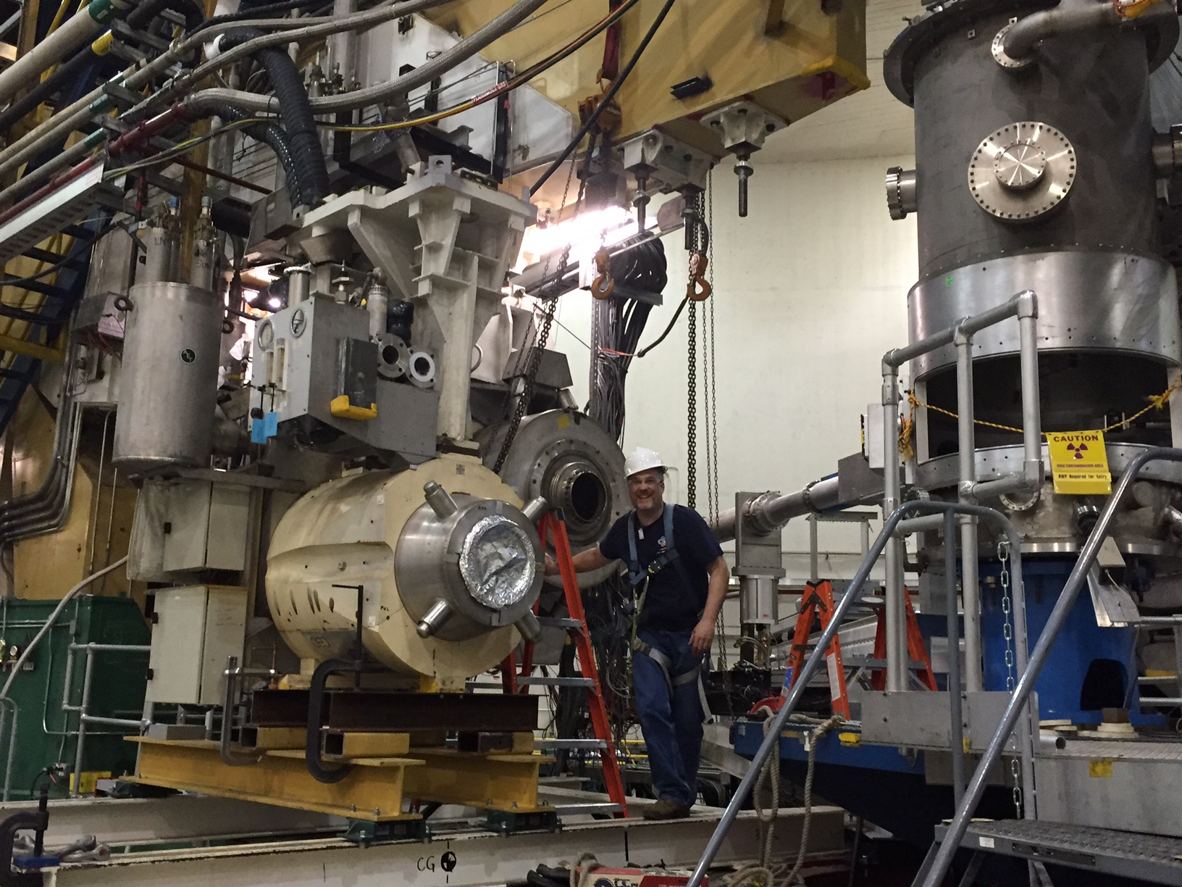
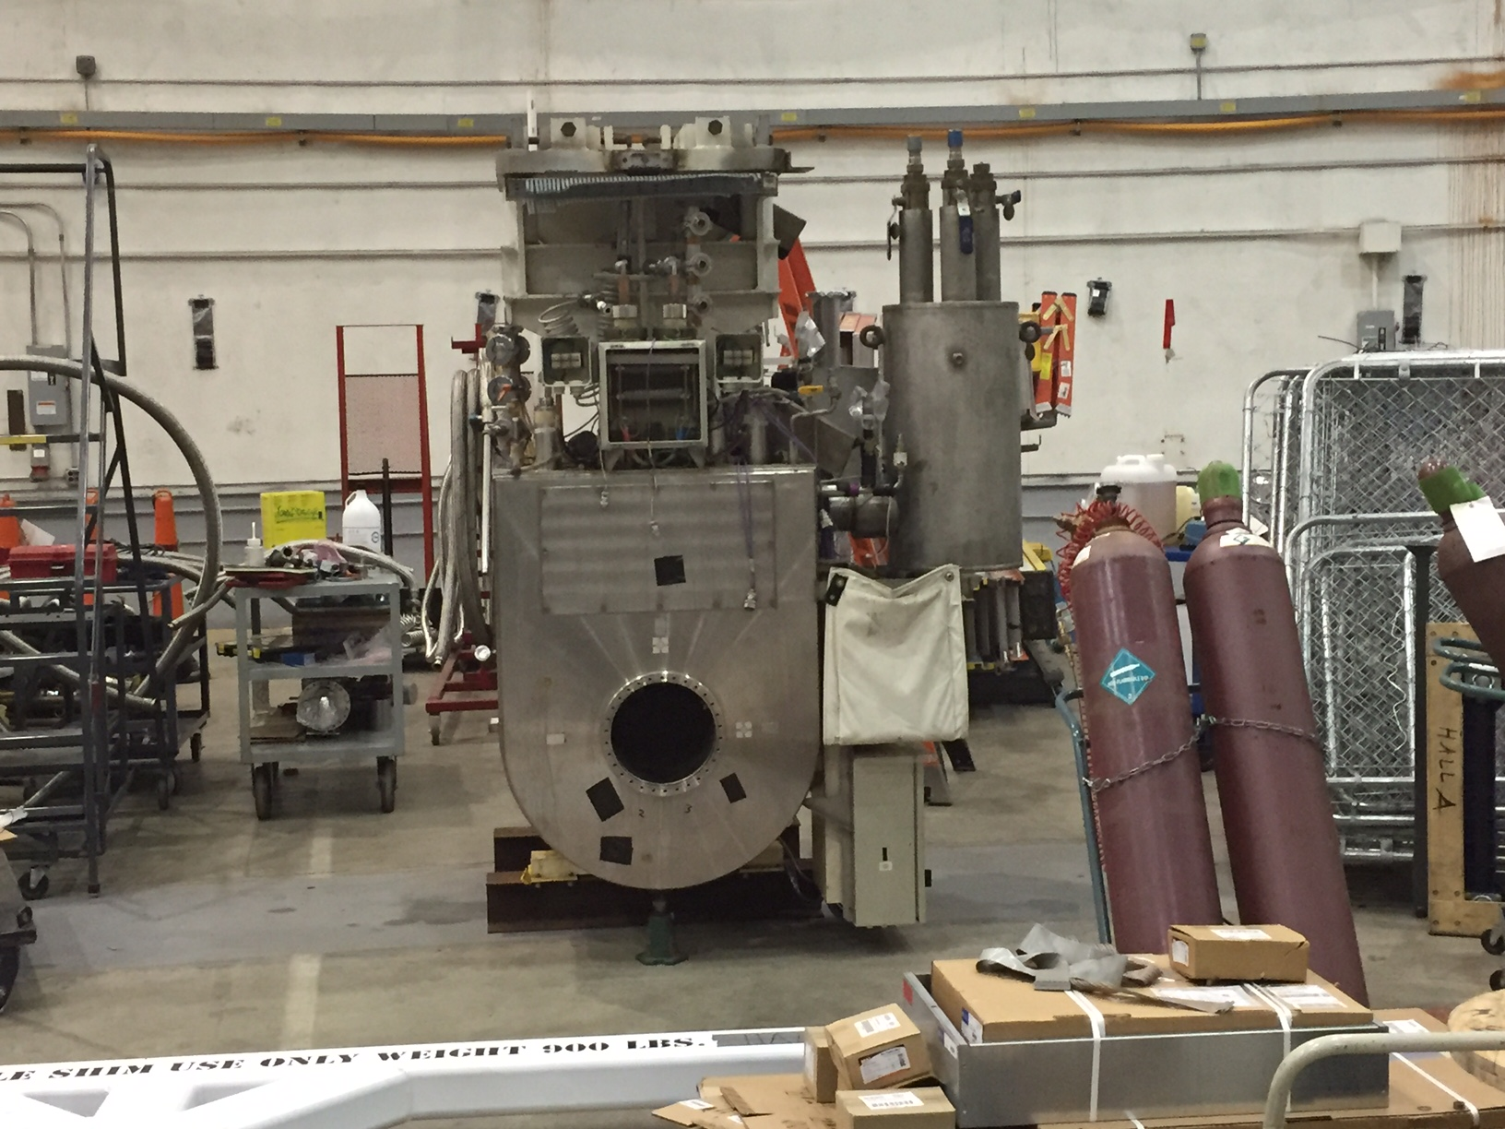
“New” Resistive Q1 Magnets
    SOS quad functioned well on HRS-R
      Multiple optics studies, data obtained by GMp/DVCS
    HRS-L new SOS twin installed Summer 2016
      Will permanently replace superconducting quads
    Mounts to allow forward/backward movement (not being used)
    Power, water upgrades to Hall this Summer 2016
    - useful also for septum experiments, SBS, MOLLER

Slide 6
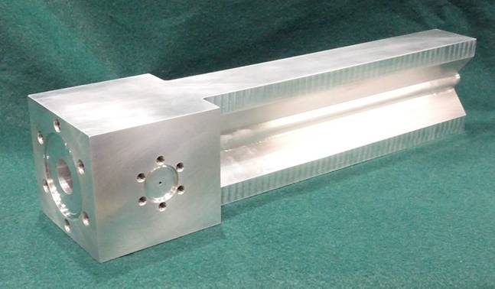
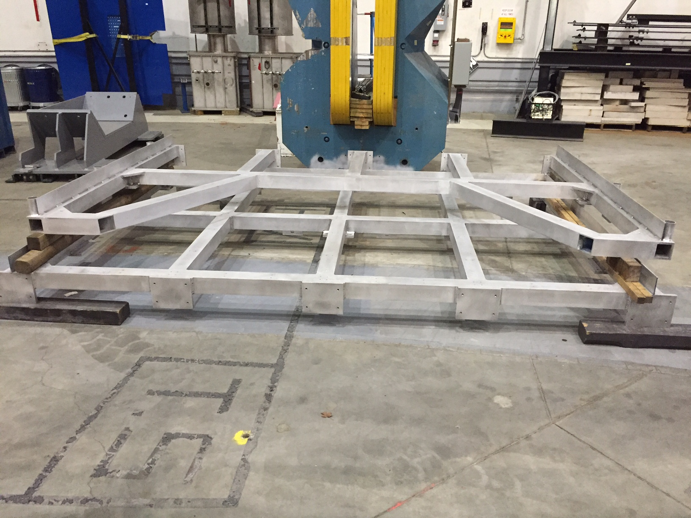
Tritium Experiment Preparations
Four ³H experiments, 2 PAC 40 “high impact”
  12 graduate students
Will try to run Ar(e,e’p) with group as well, best effort
Successful ERR March 2016
  Final report issued April 2016
Installation started in Summer 2016
  Vent system
  Power, water upgrades
  Target engineering
  Target installation platform

Slide 7
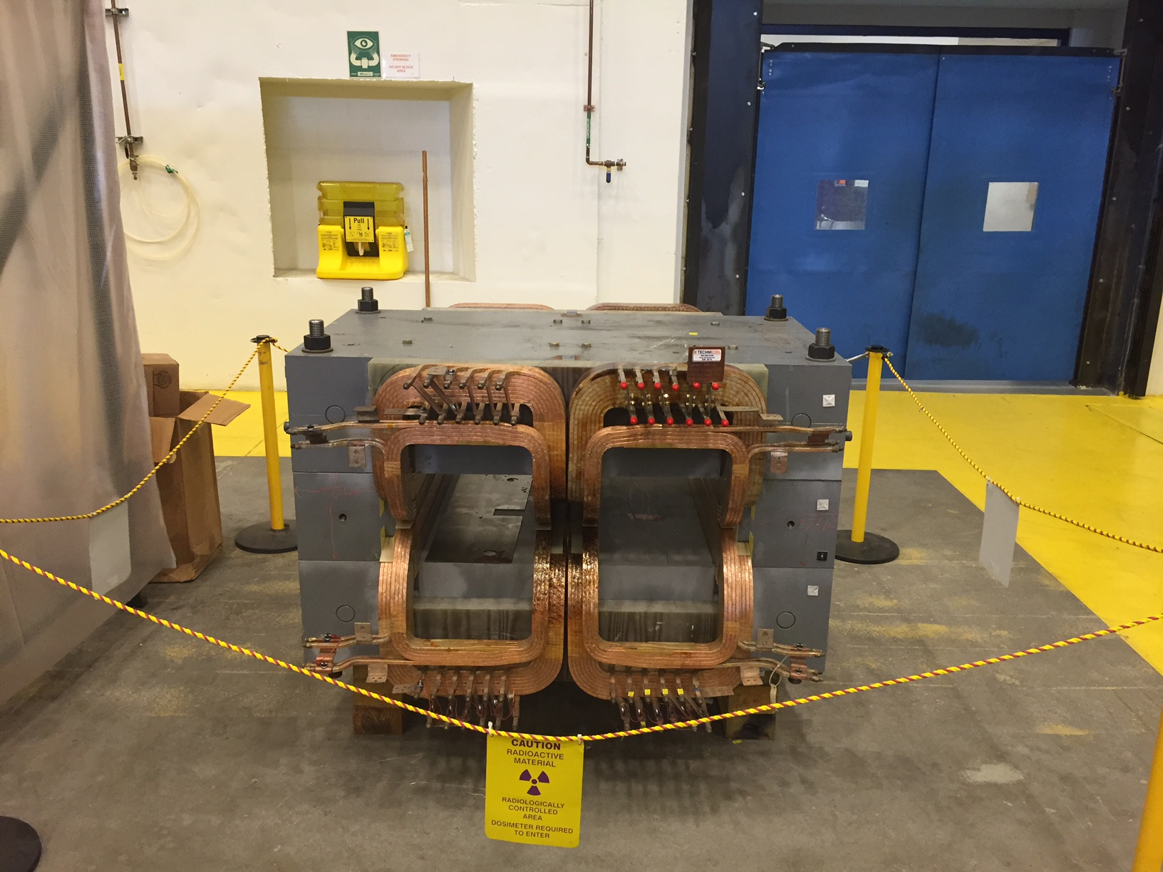
Beyond ³H
    PREX/CREX
        Pb and diamond targets, new coils purchased and at lab
        Combined target chamber, shielding conceptual design
        Computation fluid dynamics for target design
        Beamline upgrades
          Second x,y,Q girder (from Hall C), new “Musson” cavity electronics, Hall C halo monitor installed in A, lumi monitors installed and first pass tests started
        Polarimetry
    APEX
        New septum magnet purchased by collaboration now in test lab, added fittings and
        manifold
        Computation fluid dynamics for target design, heating testing

Slide 8
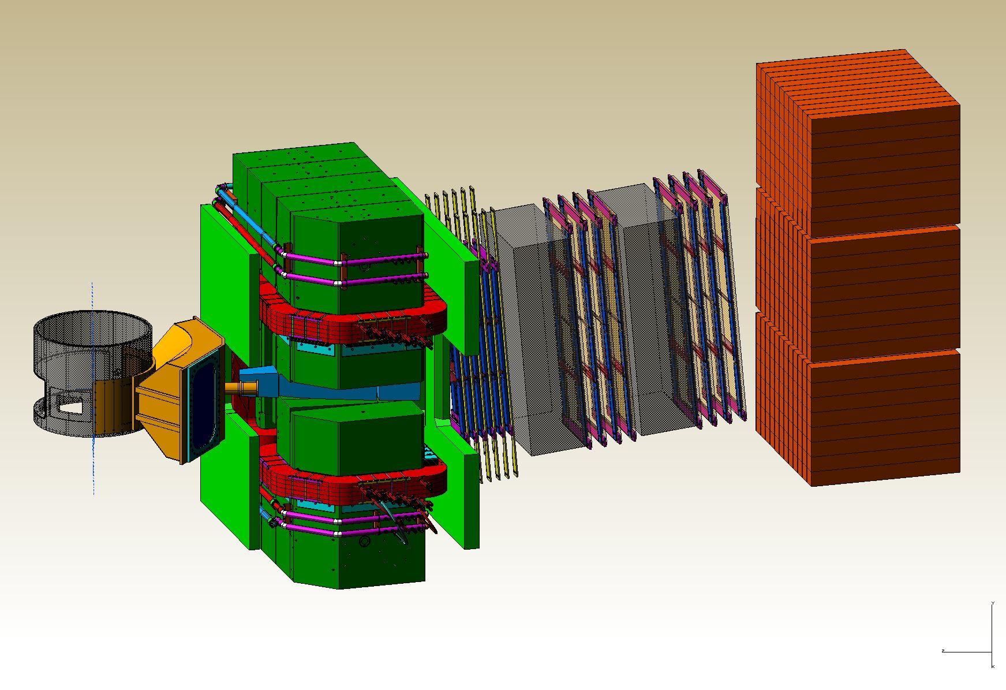
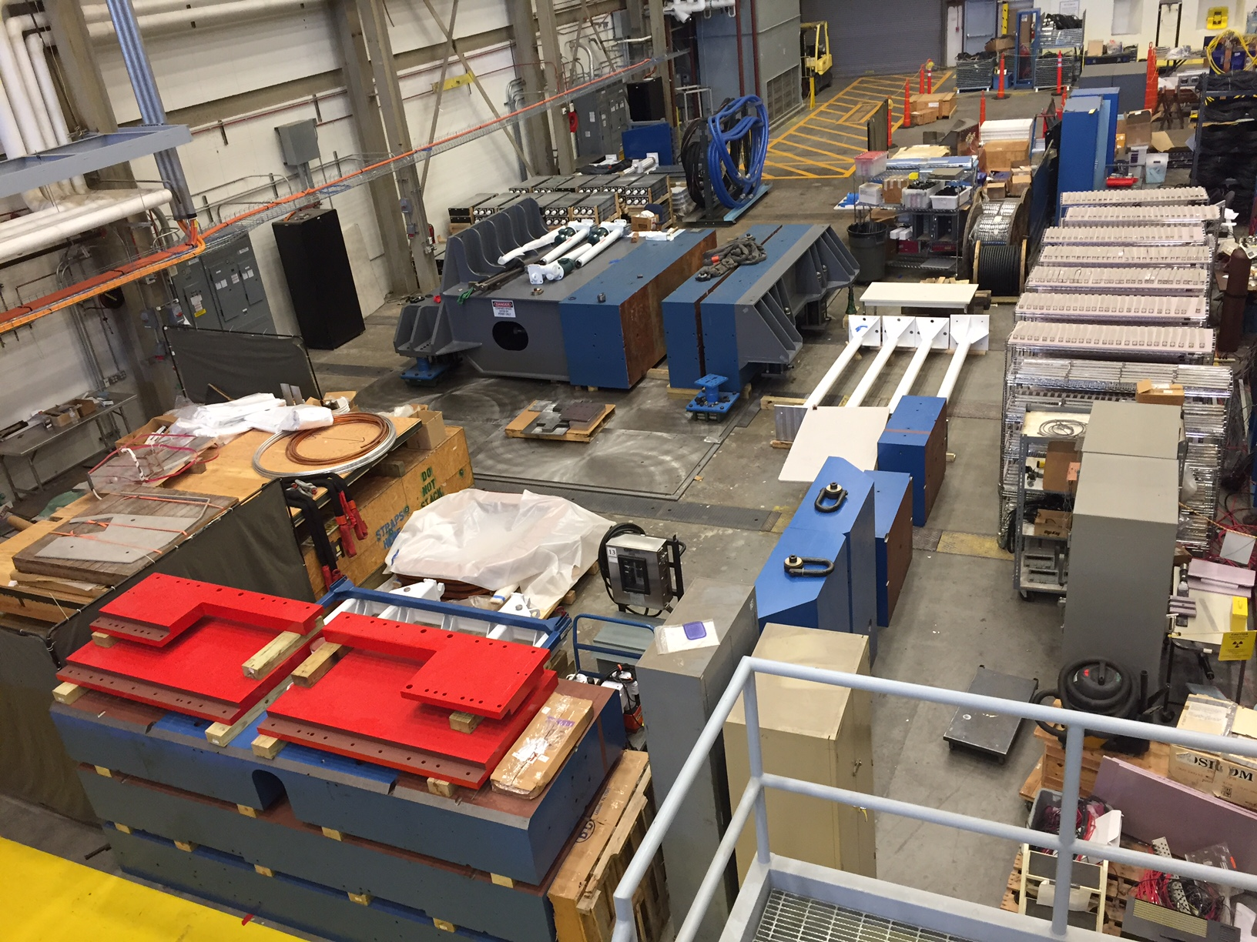
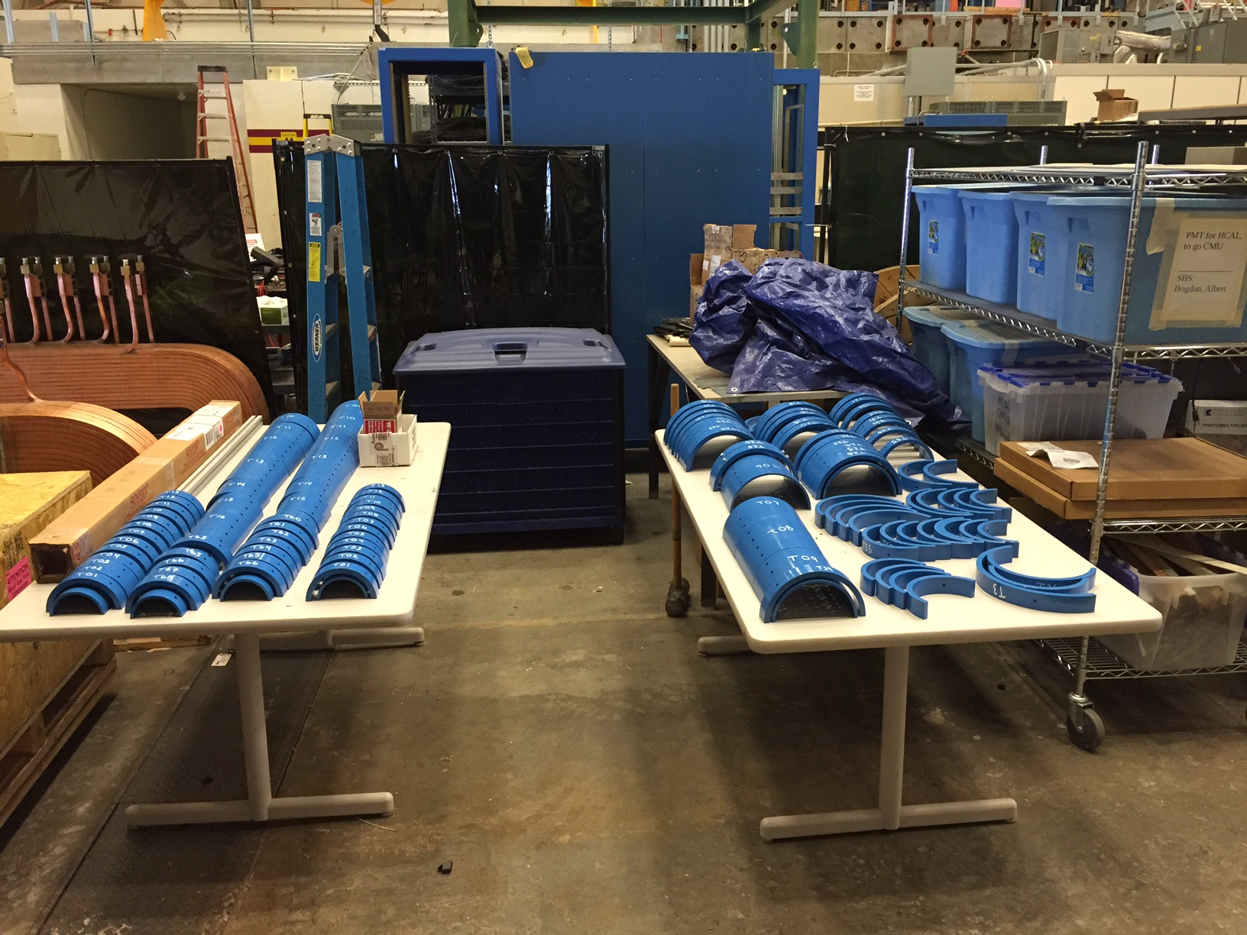
SBS Construction
Project started FY2012
  Successfully passed fourth annual review November 2016
  Preparing for Closeout!
  Overall very positive, project on track
Spectrometer, ECAL work at Jlab
GEM construction at UVA
Coordinate detector from Idaho State
HCAL Hadron calorimeter from CMU

Slide 9
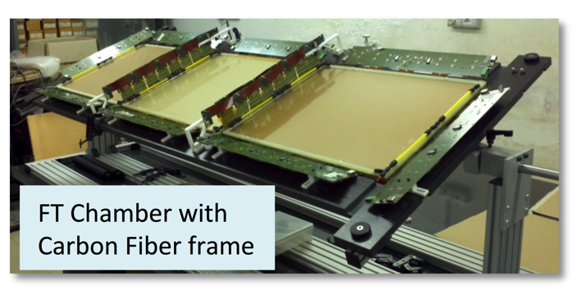
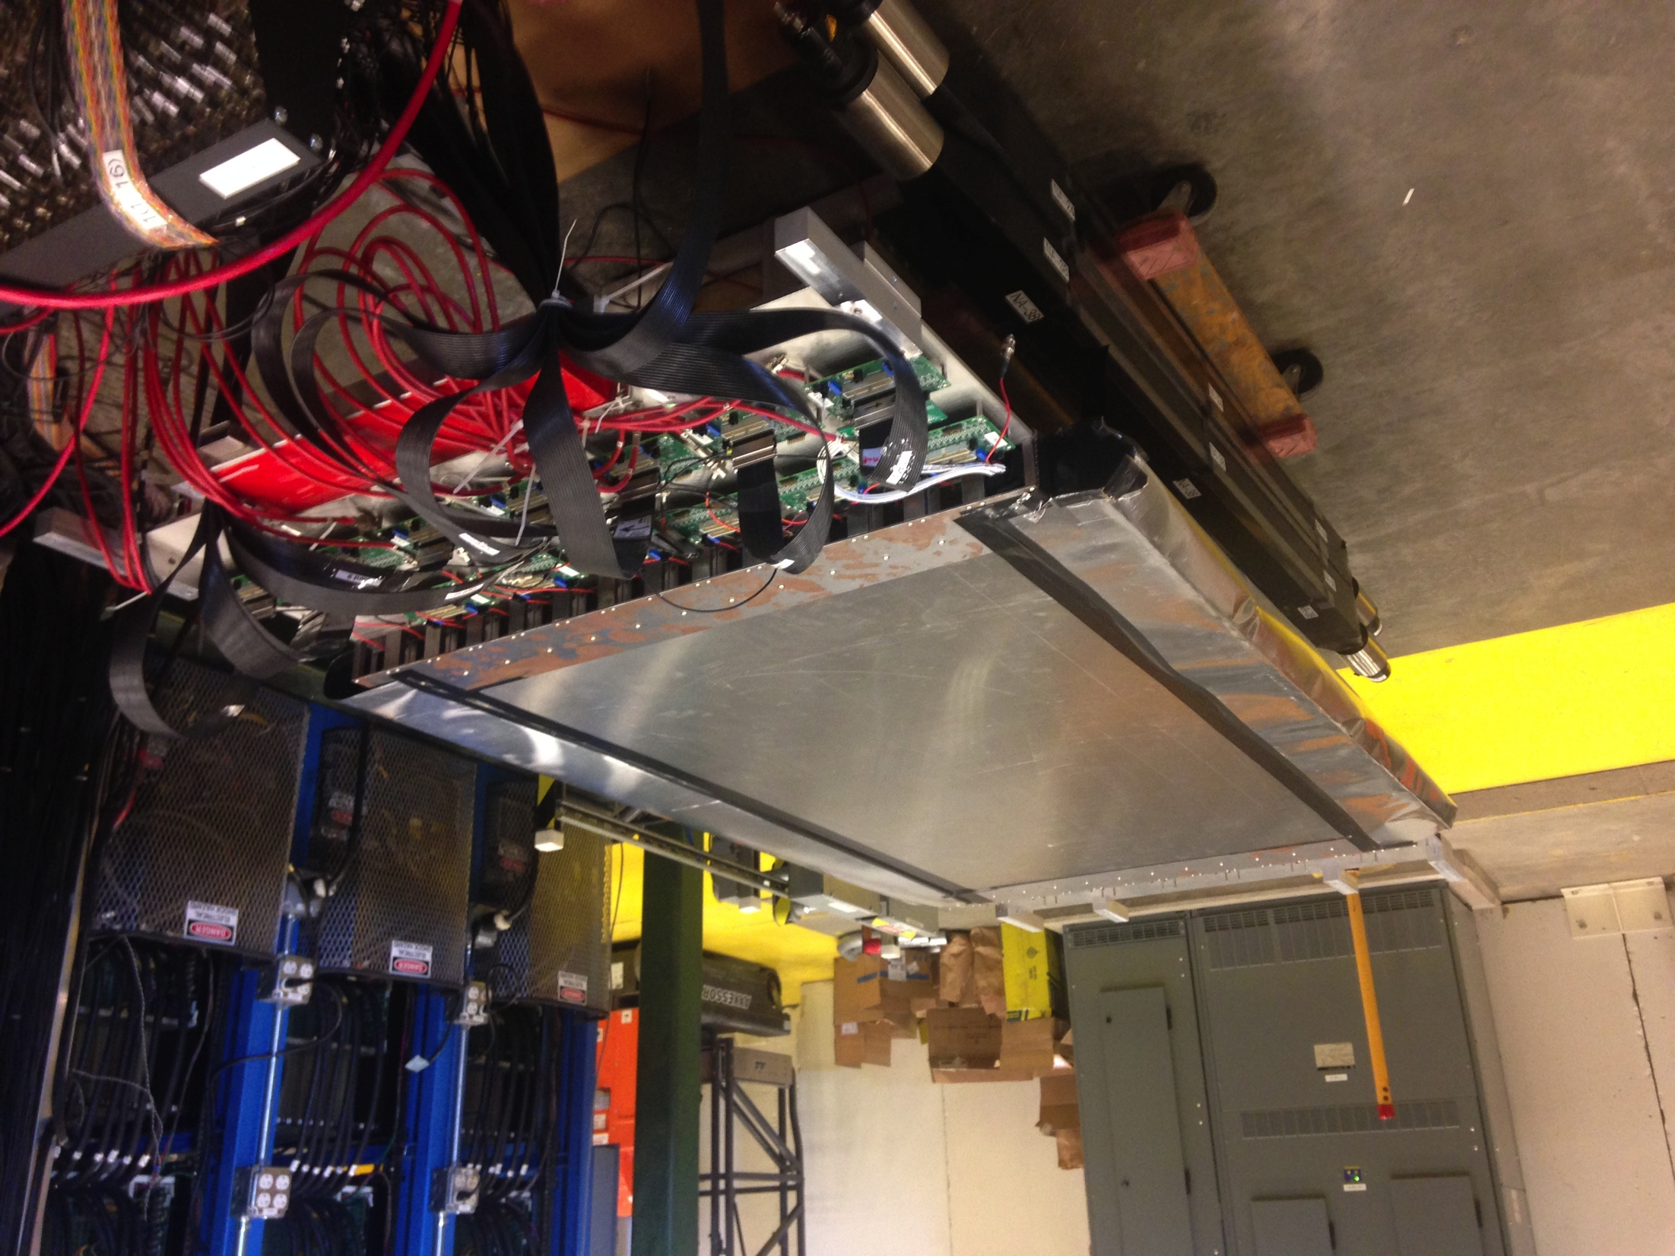
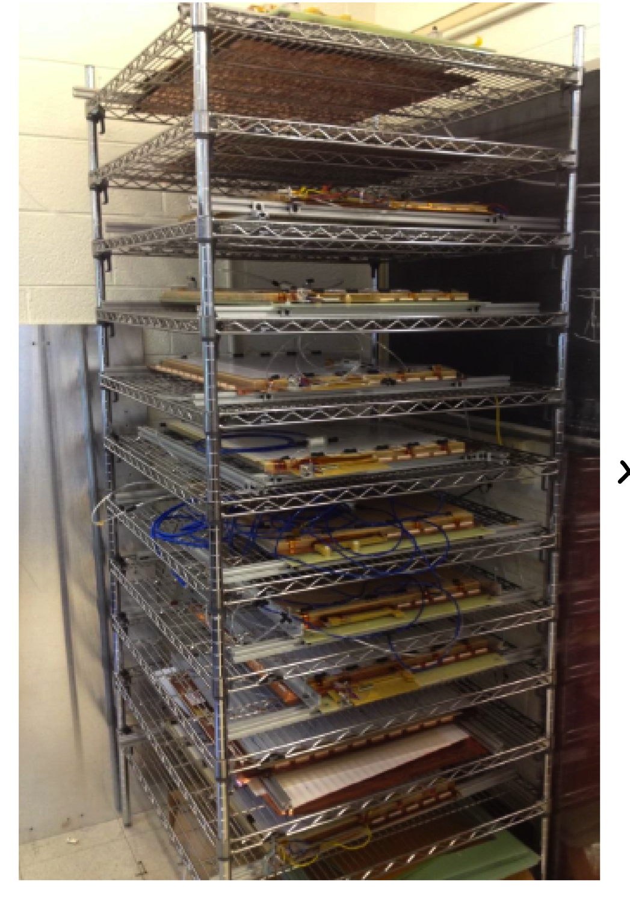
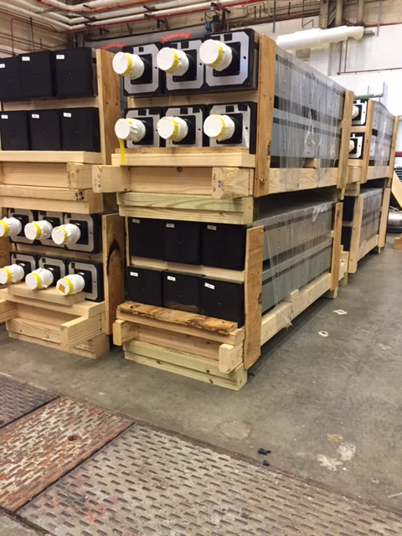
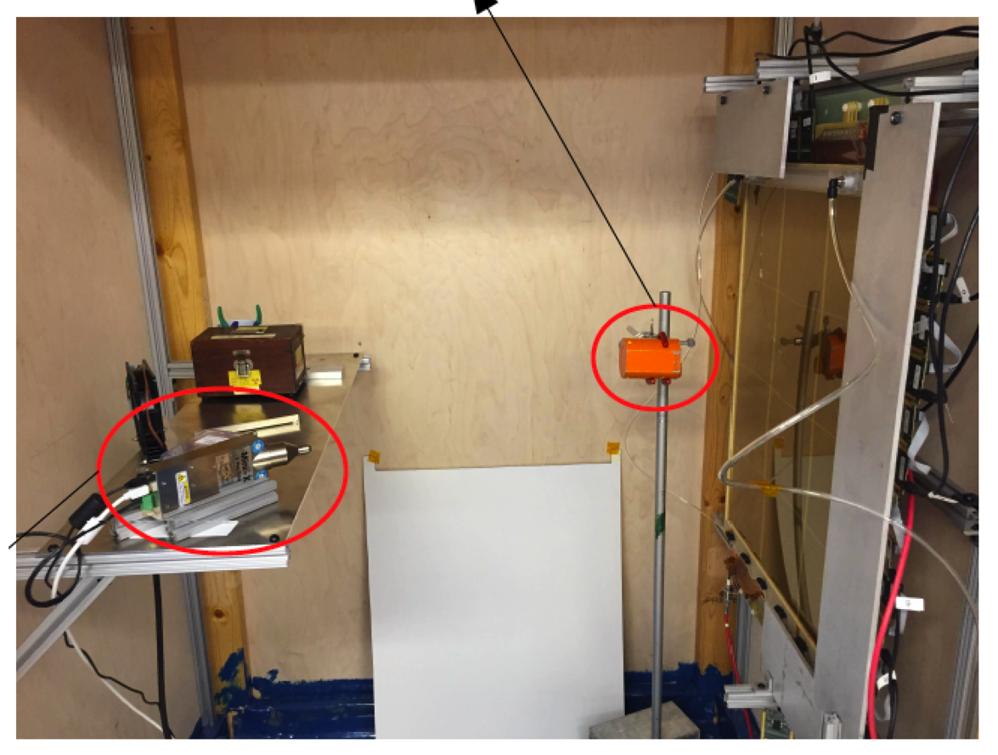
Super Bigbite Spectrometer (SBS) Detectors
CDET module ready for cosmic testing with full data acquisition
INFN Front Tracker GEM chamber with carbon fiber frame at JLab
Rear GEM tracker modules at UVA
UVa High rate X-ray testing setup for GEMs
Hadron Calorimeter modules at JLab

Slide 10
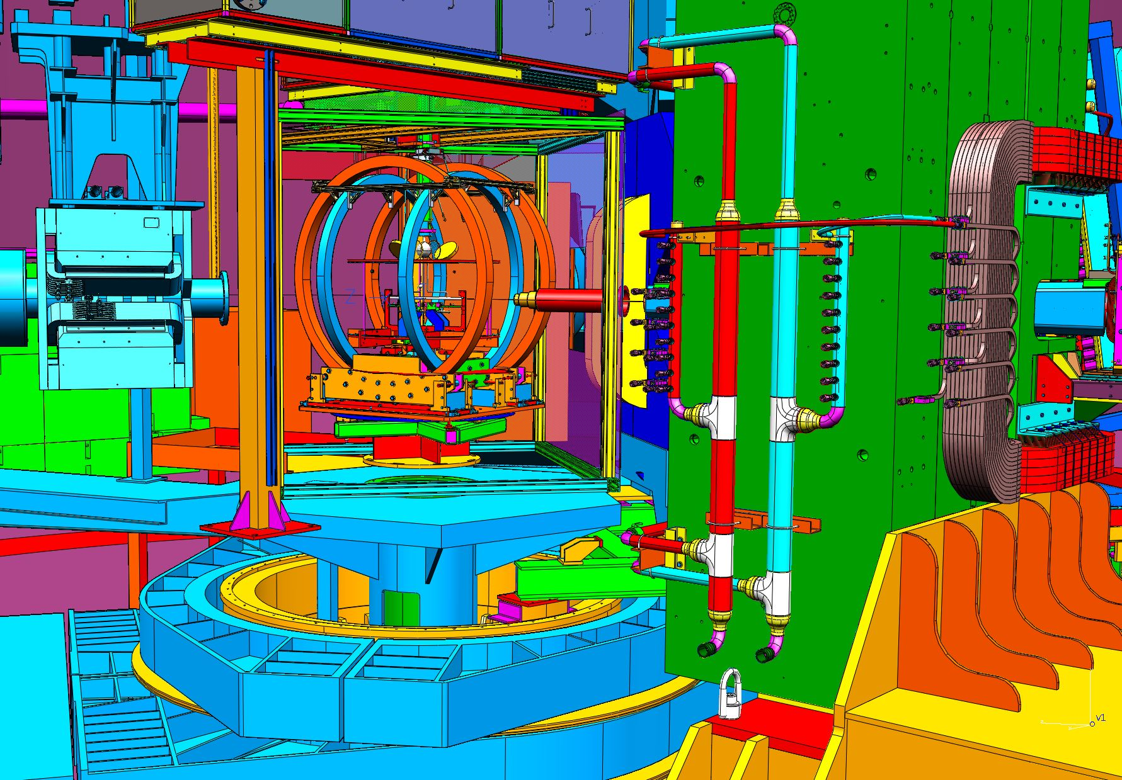
Polarized ³He Stage II Upgrade and Status
Stage II goal:
60 uA on 60 cm , ~10 atm,
L ~ 6.6x10³⁶ cm⁻²s⁻¹
In-beam polarization ~60%,
Polarization measurement precision~ 3%
Approaches:
Re-use existing Helmholtz coils, a new
shielding box to shield SBS fringe field
Convection flow
Target cell, pumping chamber size 4.2”
metal end-windows for target chamber
Two-side optical pumping
Status:
Conceptual Design Complete
Mechanical design started
New optical fibers delivered, started to order lasers/He3 gas
Stage-I 3.5” cell production started
New polarimetry, pulsed-NMR, reached design goal in lab test
Metal window R&D on-gong at UVa
Two-side optical pumping tested

Slide 11
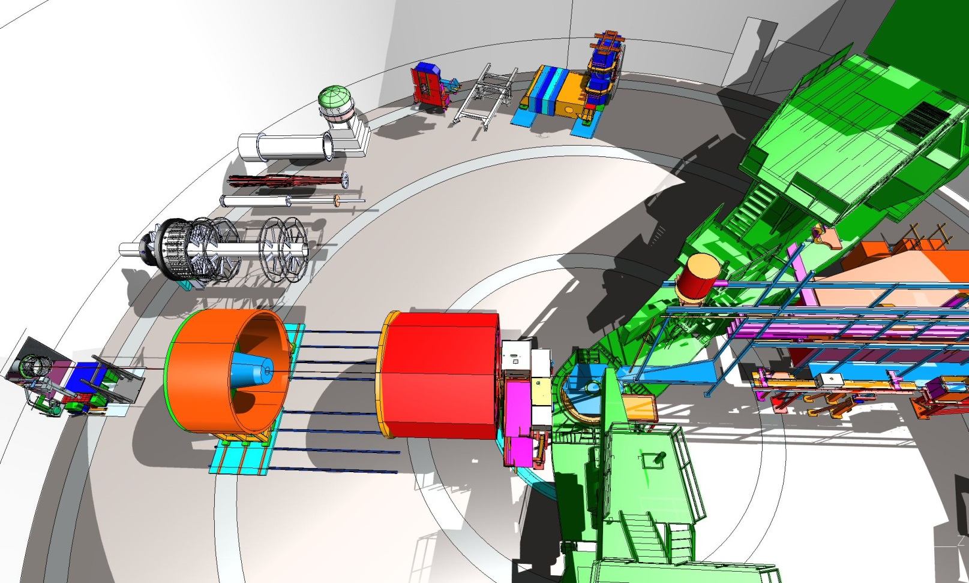
Moving to more future installations – MOLLER and SoLID

Slide 12
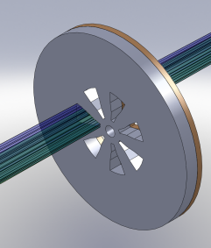
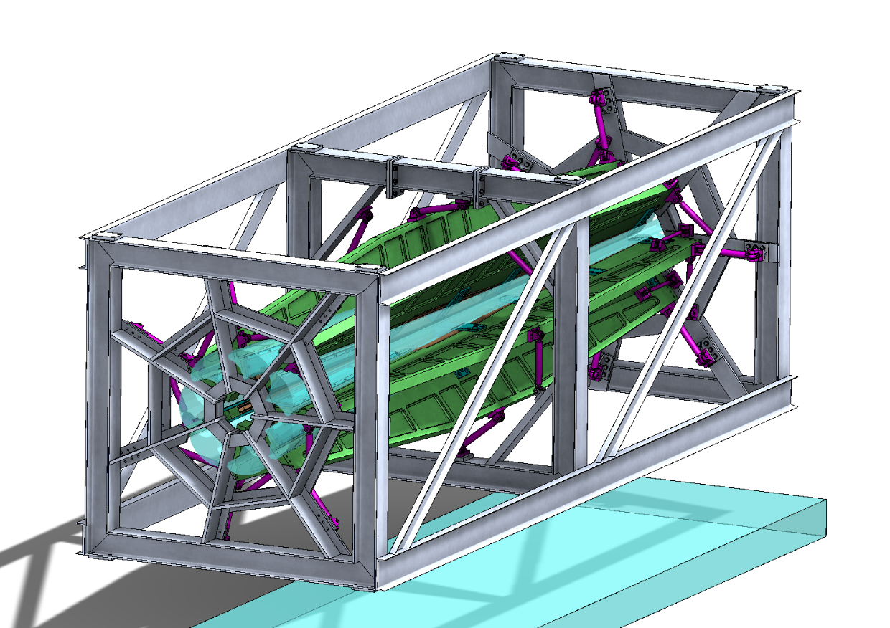
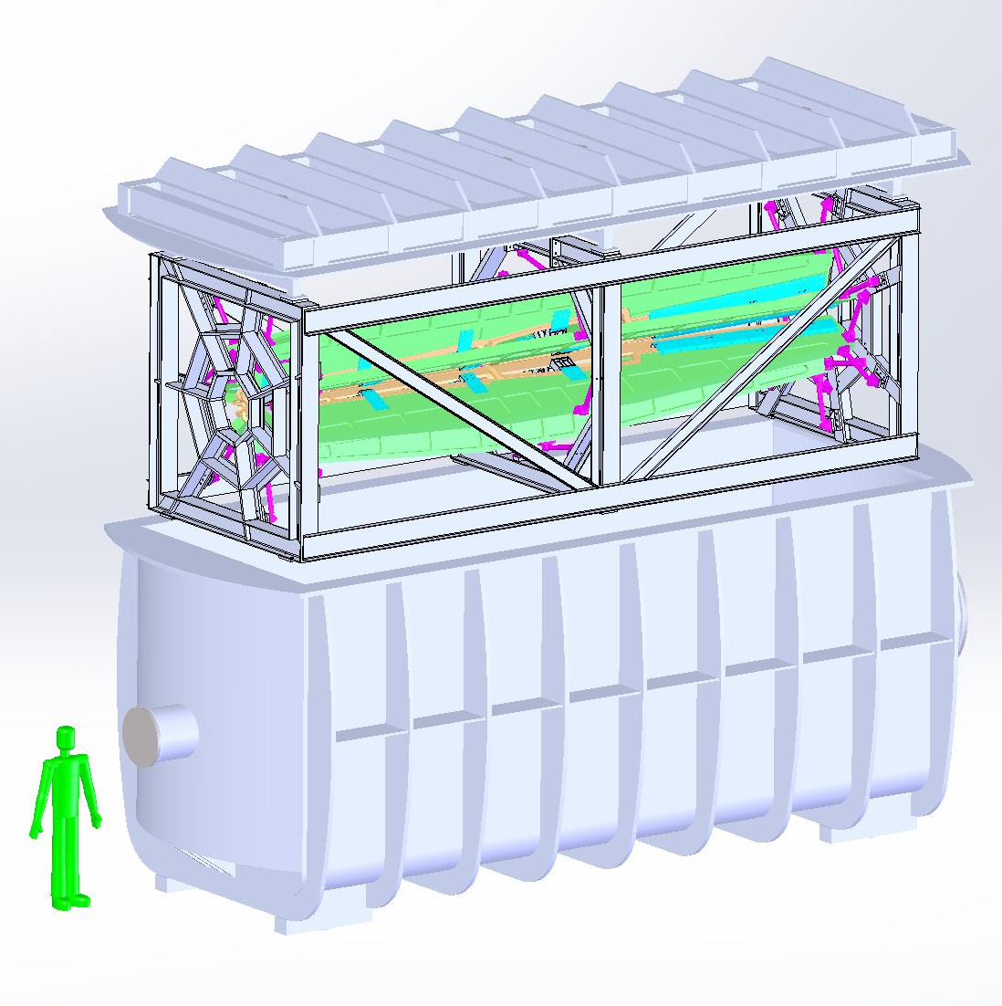
MOLLER
    Successful Science Review September 2014
    Supporting ongoing magnet and collimator development work at MIT
    New Moller polarimeter (in place)
    Preparing for Director’s cost, schedule, technical review this month!
    Looking towards CD0

Slide 13
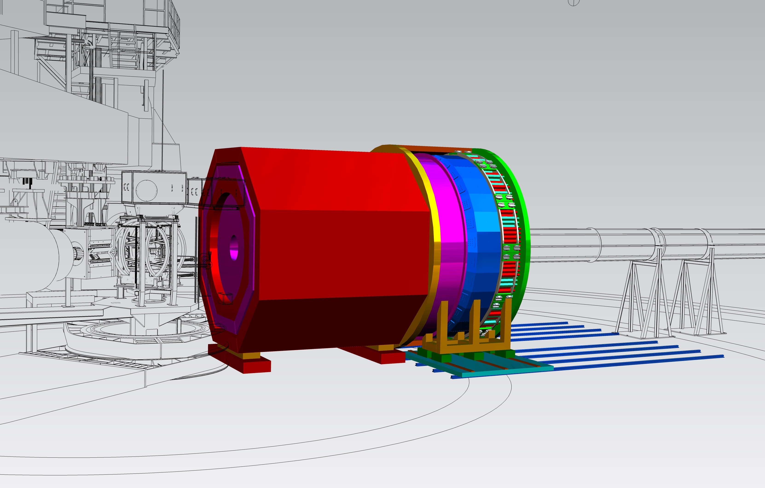
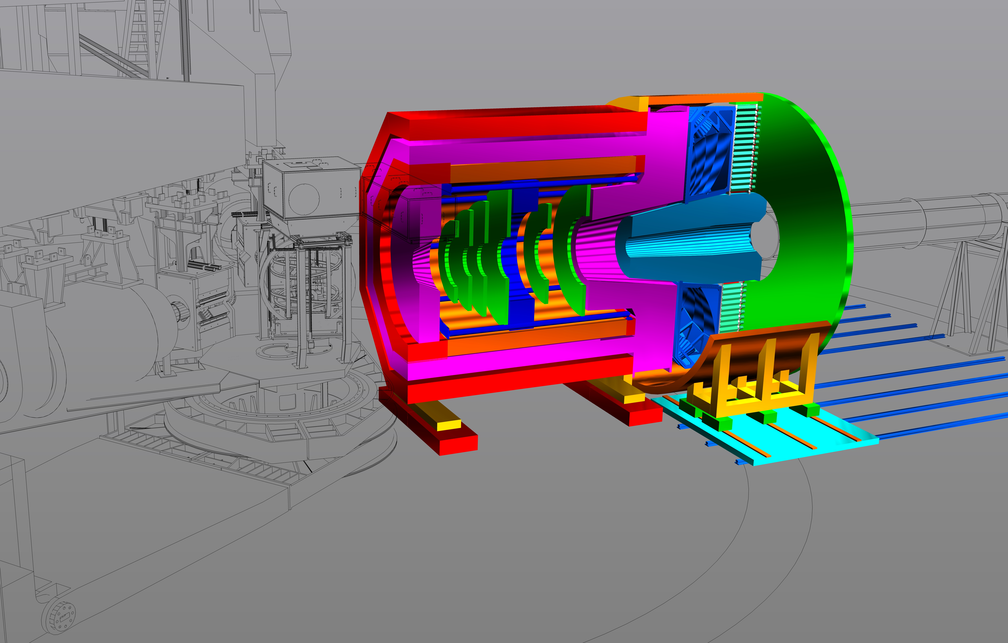
SoLID
Conceptual design support continues (see Robin/Whit talk)…
Also magnetic modeling (see Jay’s talk)…

Slide 14
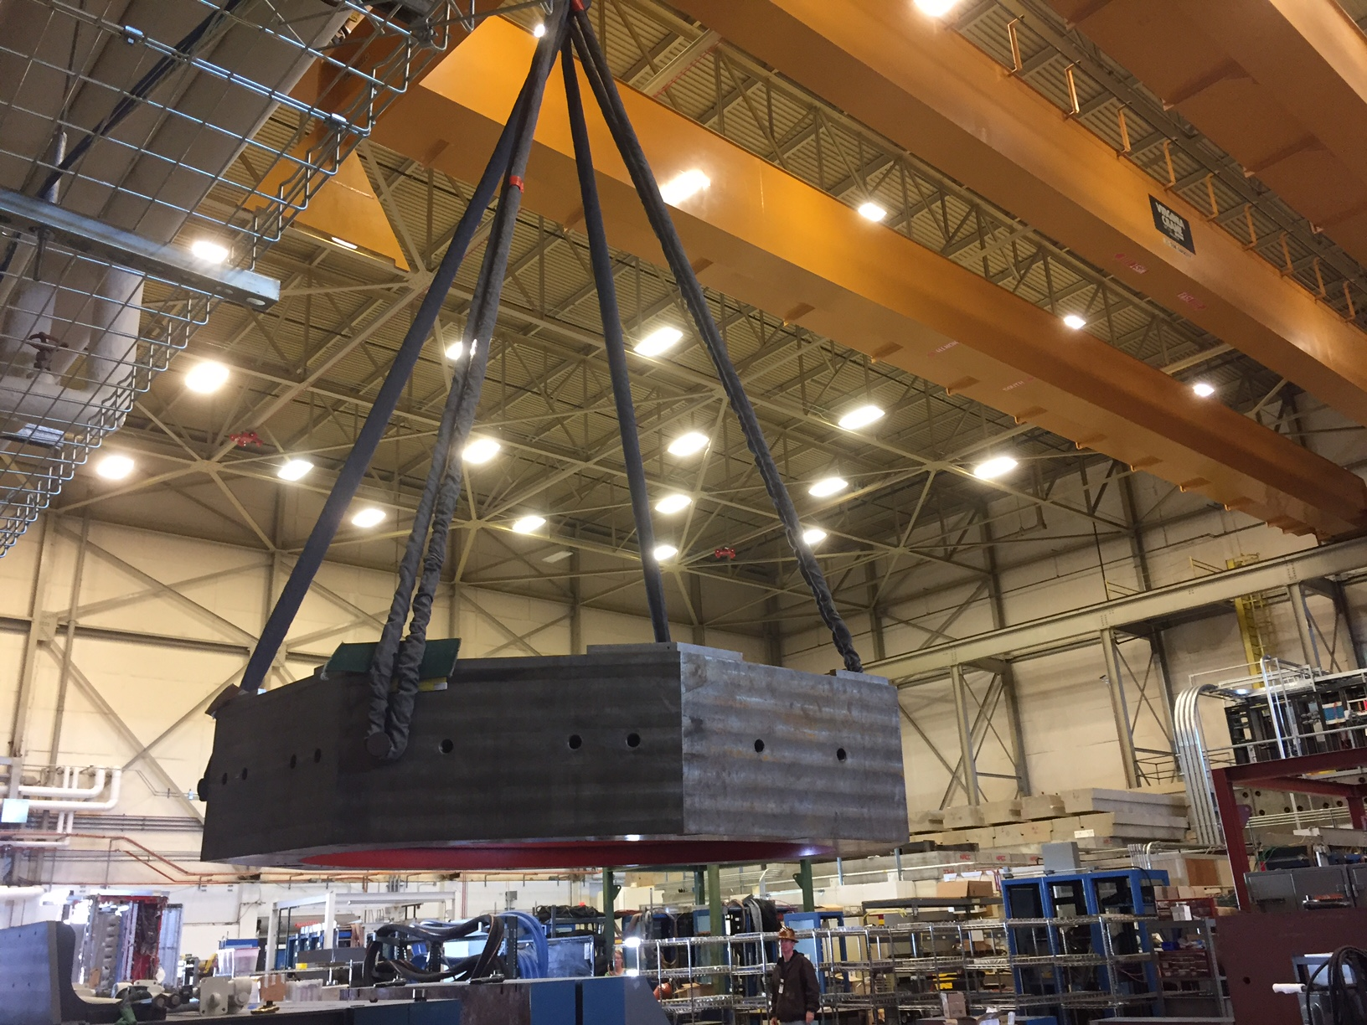
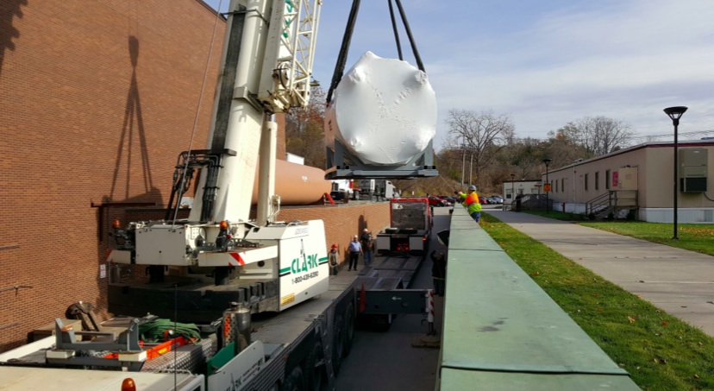
SoLID
And the CLEO magnet has arrived at JLab! Well, started.. still ~50 trucks of steel to come…
Coil collar in JLab test lab
high bay
Cryostat leaving Cornell

Slide 15
SoLID
General comment…
Strongly suggest submitting a draft MIE sooooon… (perhaps at same time as response to Director’s Review)
Thanks!

