Slide 1
SoLID DAQ update
Alexandre Camsonne
SoLID Collaboration meeting
December 3th 2016

Slide 2
Overview
Recommendations for Director’s review
Hardware available
Document
Updated trigger rates
New FADC readout
PVDIS deadtime
SIDIS event size and data rates
Cerenkov readout
TOF readout options
Simulations needs
L3 farm

Slide 3
Dead time correction PVDIS 1b.2
Test with small scale setup ( Compton )
Simulation
Discuss with DAQ group for particular features needed
Example : helicity gated deadtimes
Rework CDR to add parity specific electronics
Need to write a separate document about DAQ requirements for DAQ group, Electronics group and potential collaborators on electronics (Saclay)

Slide 4
Dead time correction PVDIS 1b.2

Slide 7
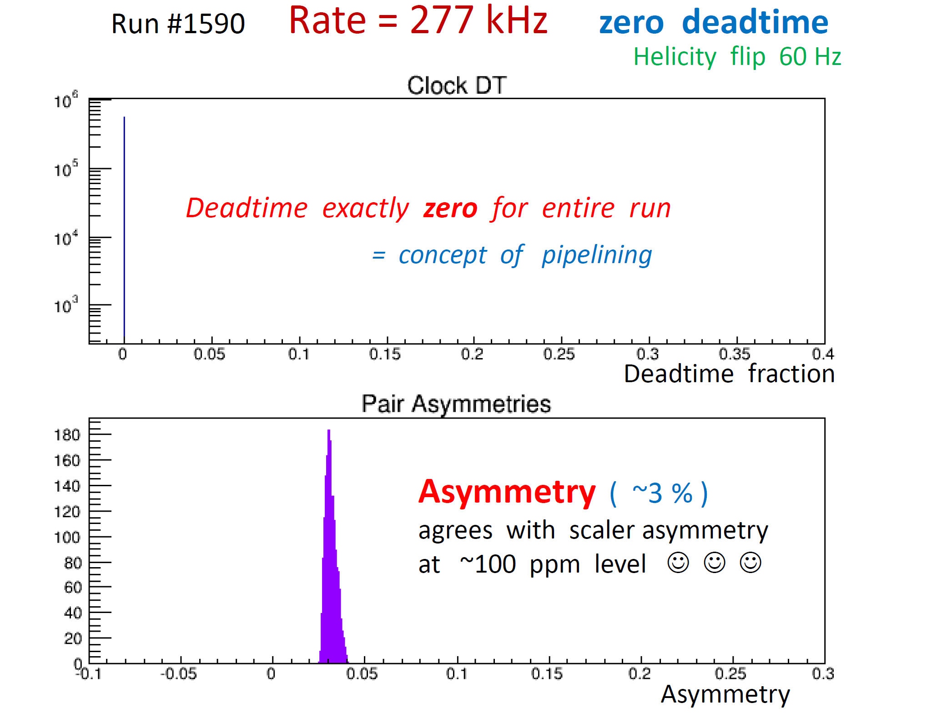

Slide 9
Dead time correction PVDIS 1b.2

Slide 10
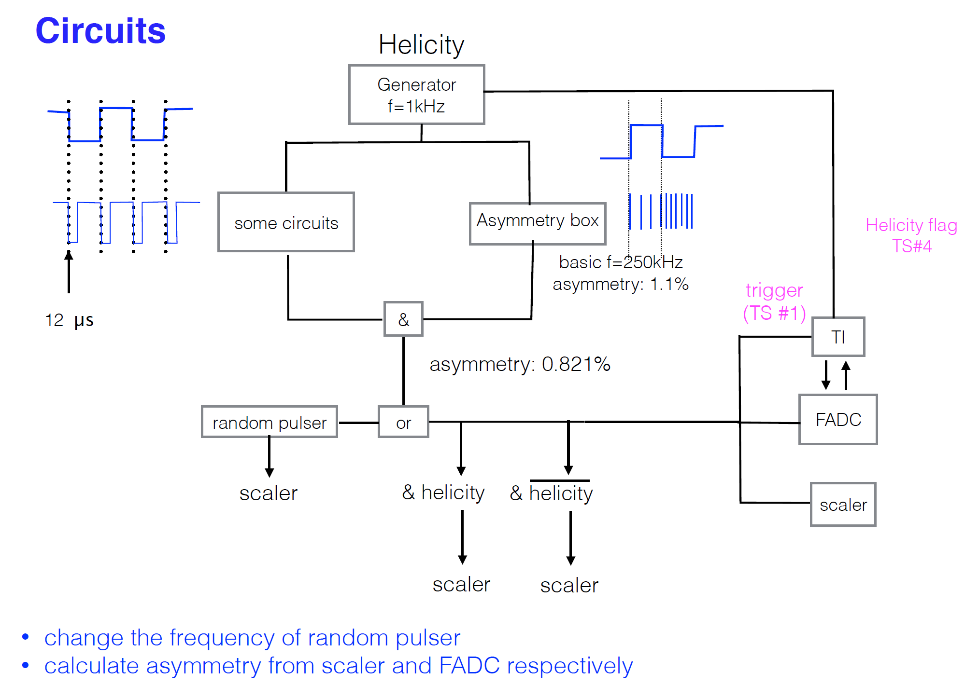

Slide 11
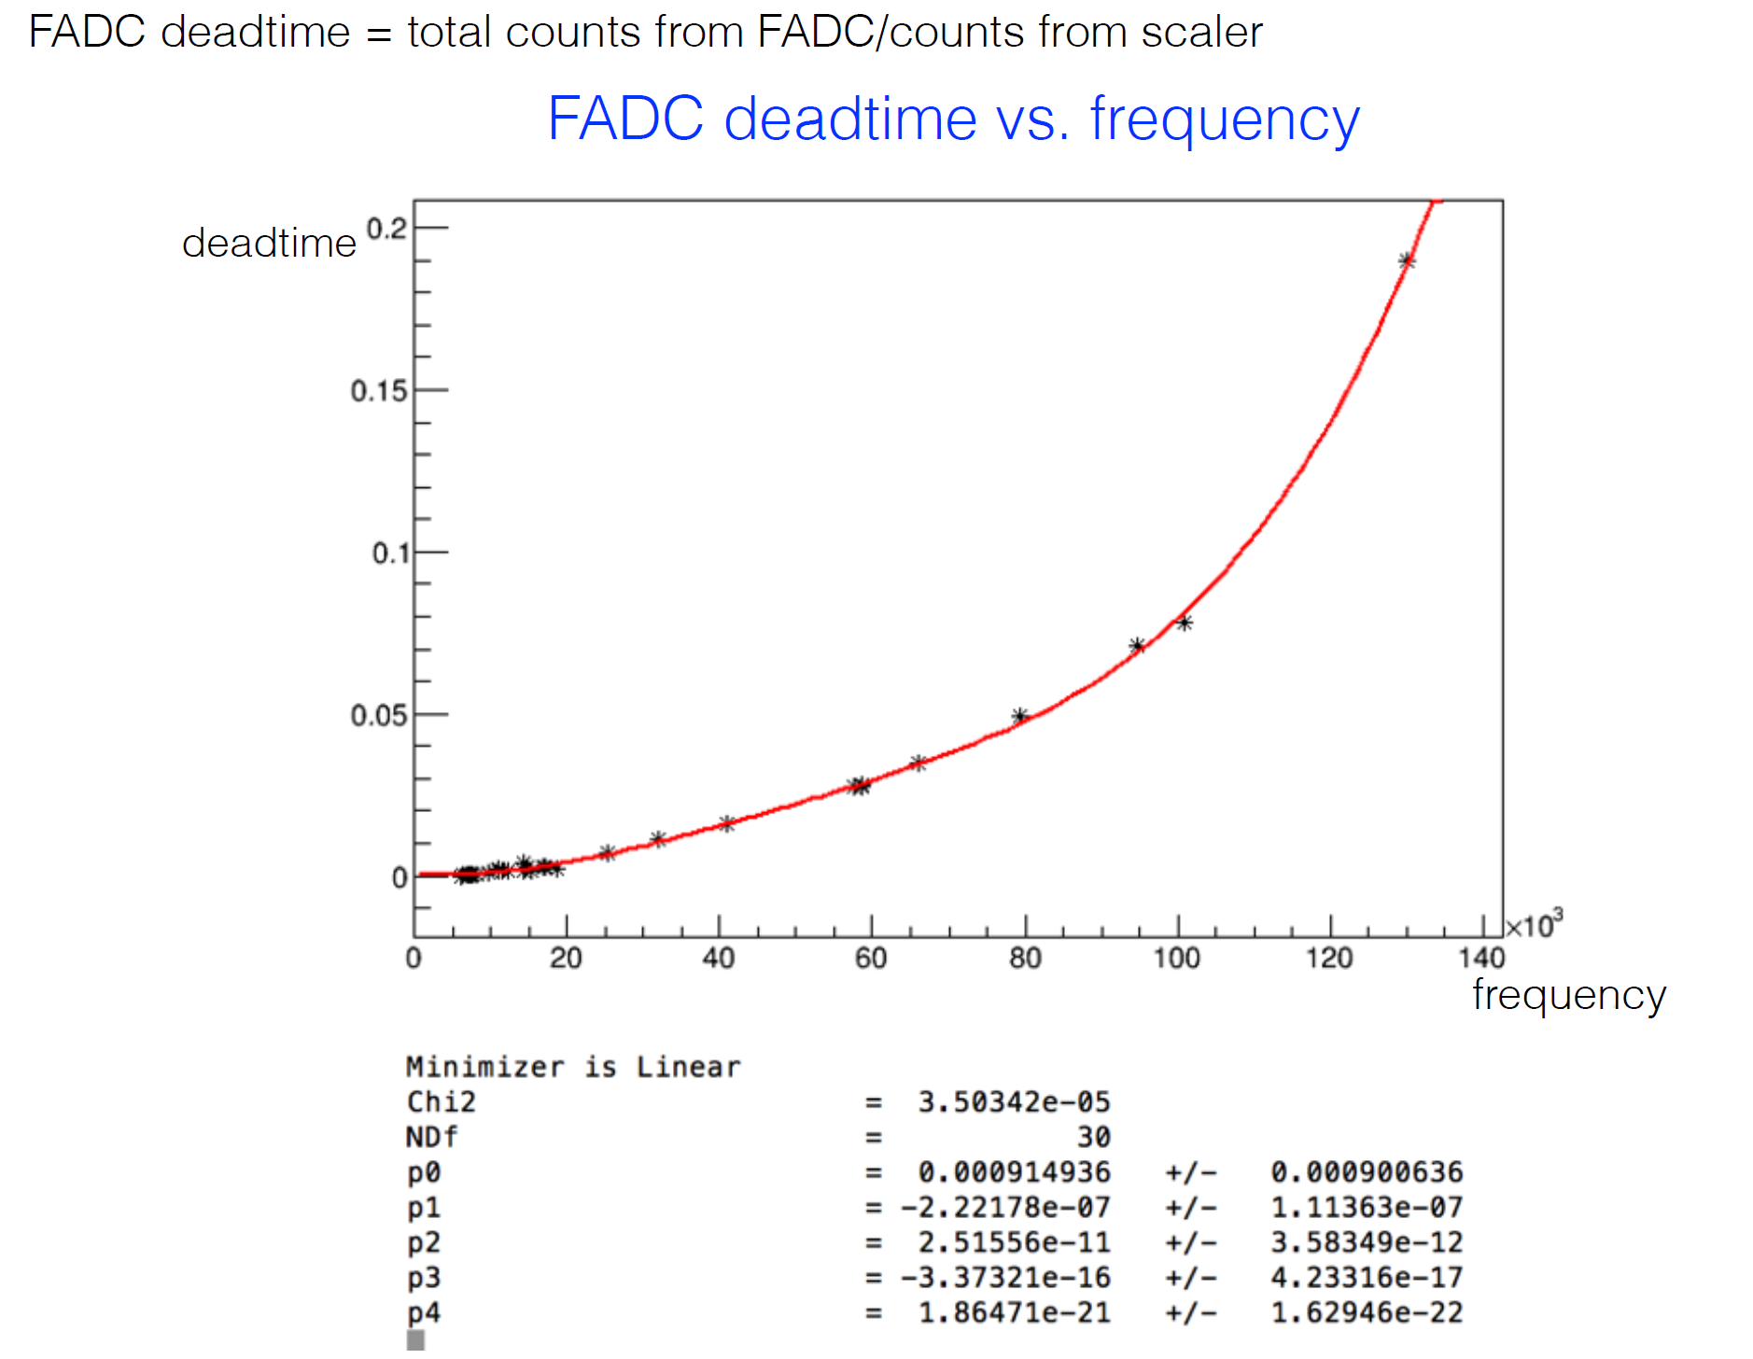
FADC deadtime measurement
Do we need to improve it ?
R&D possible
Around 0.3 % deadtime at 20 KHz

Slide 12
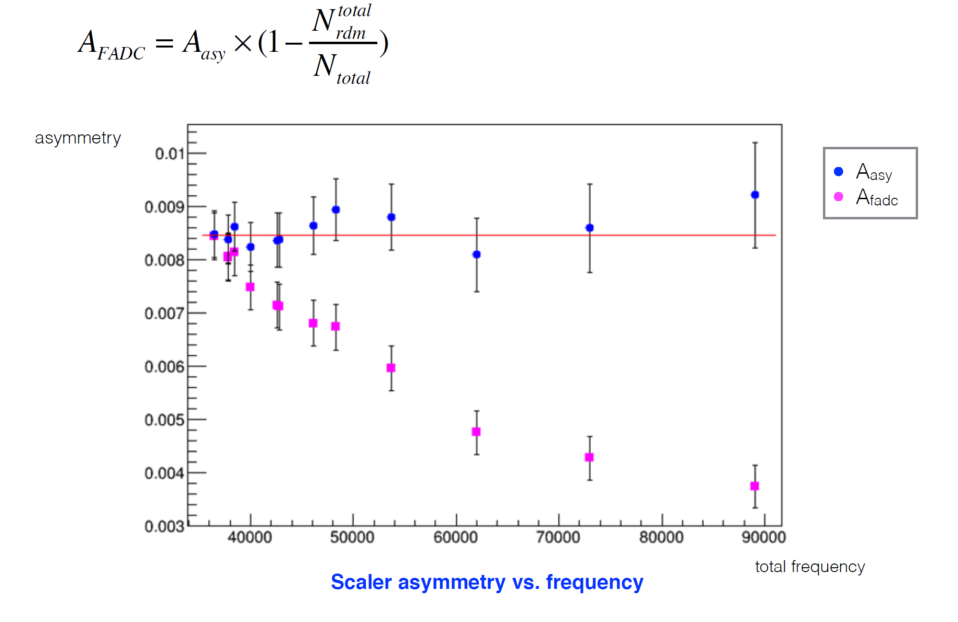
Measured asymmetry

Slide 13
Dead time modelling
Still need to put together full system / program FPGA
First approximation : fixed dead time 150 ns for each trigger
Expected deadtime : 20 KHz * 150e-9 = 0.3 %
Accuracy of measurement 10 % level typical
Correction 0.03 % error sastify PVDIS requirements
Simulation similar to PVDIS ( need to modify )

Slide 14
6 GeV PVDIS
Narrow width 30 ns
Wide width 100 ns
Replace discriminator by Trigger Supervirsor
150 ns width

Slide 15
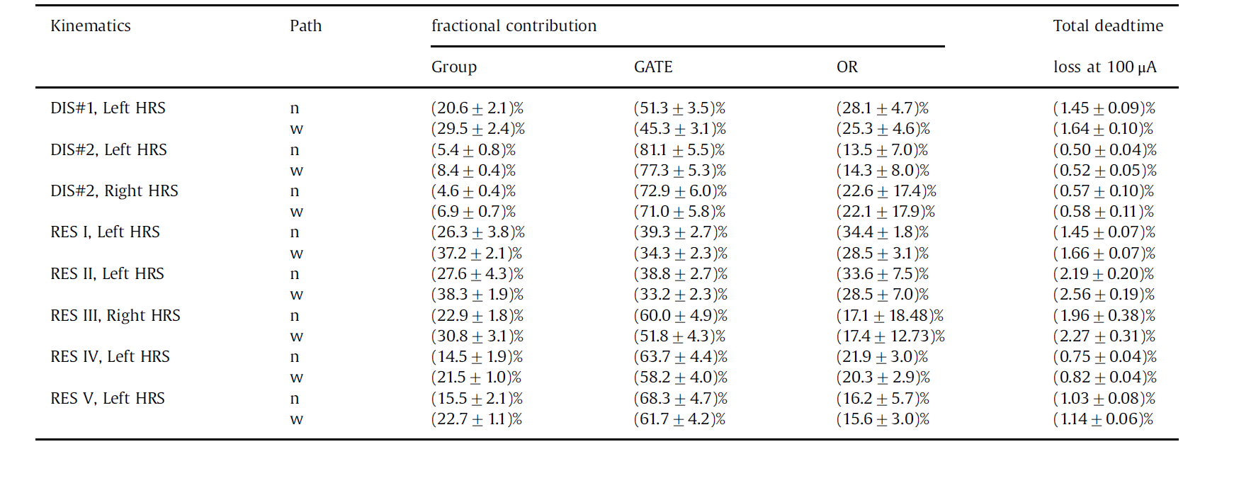
Results for 6 GeV experiment
600 KHz , 50 ns width

Slide 16
DAQ observations

Slide 17
Recommendations 2c
a)The plans for the High Level Trigger and b) the needs for slow control (Brad) need to be worked out in detail and the implications for resources need to be evaluated.
The implications of the need for these resources in the context of availability of resources at the laboratory need to be understood.
Closer communication with the other JLab experiments and the JLab computing center is strongly encouraged.
Having a functional simulation and reconstruction routines as soon as possible should be a high priority in the software effort. Such software will pay off many times over in experimental design and avoiding pitfalls. ( Ole )

Slide 18
Data flow
100 Mb/s
CODA
GEM
VME digitizer
VME CPU
GigE
Event builder
Event
recorder
APV25
GigE
SAS
RAID
Data file
Compression
+
10 GigE
Digital Sum
ECAL
Cerenkov
VME CPU
Silo
FADC

Slide 19
PVDIS electron trigger
Coincidence ECAL and Gas Cerenkov
 | Old | Hall D
Singles ECAL | 290 KHz | 230 KHz
Singles rates Cerenkov | 1.9 MHz | 803 KHz
Accidental 30 ns | 16.5 KHz | 4.1 KHz
DIS electron | 10 KHz max | 7.7 KHz
Total rate | 27 KHz | 12.1 KHz

Slide 20
SIDIS_He3 trigger rate summary
Single e 116+46=162kHz
Random coin 97kHz
True coin rate <70kHz
electron trigger self coin 6kHz
coin from SIDIS 36kHz
coin from hadrons 28kHz (still missing window)
Total coin rate 167kHz + from hadrons of windows
All three true coin rate has overlaps
but can’t know how much
without a complete generator!

Slide 21
JPsi_LH2
hallD generator, SIDIS generator
& Jin’s EC Wiser trigger
hit matching
e_FA(kHz) | EC | EC+LGC | EC+LGC+SPD
electron | 355 | 321 | 300
Pim | 588 | 10.2 | 9.4
Pip | 674 | 8.5 | 7.5
P | 207 | 0 | 0
Pi0 | 1762 | 48 | 26.4
all hadrons, no electron | 3690 | 81 | 56
Total: |  |  | 356
Coincidence trigger
searches through all
possible candidates (N)
and find pairs N*(N-1)/2
Self Coin prescaled by 100
(356+433)/100=8kHz
e_LA(kHz) | EC | EC+SPD
electron | 21 | 19
Pim | 117 | 106
Pip | 179 | 164
P | 123 | 114
Pi0 | 306 | 11
all hadrons, no electron | 814 | 414
Total: |  | 433
Coin trigger rate (kHz) | e_FA | e_LA | (e_FA + e_LA) & (e_FA + e_LA)
e+pip | 250 | 24 | 5
e+pim | 185 | 18 | 3.5
e+pi0 | 217 | 19.5 | 3.6
e+p | 120 | 13 | 1.8
all hadrons, no electron | 56 | 414 | 0.3
Total |  |  | 14.2
Random coin (356+433)*(356+433)*1e3*30e-9=19KHz
True coin 14.2kHz
Total 52kHz

Slide 22
SIDIS event size
Occupancies with one sample readout by Weizhi , rates for 100 KHz
GEM | Occupancy | Number of strips | XY strips | Strips per chambers | Event size ( bytes ) | Data rate 100 KHz | MB/s
1 | 2.21 | 453 | 906 | 27180 | 2402.712 | 240271200 | 240.2712
2 | 8.78 | 510 | 1020 | 30600 | 10746.72 | 1074672000 | 1074.672
3 | 3.63 | 583 | 1166 | 34980 | 5079.096 | 507909600 | 507.9096
4 | 2.31 | 702 | 1404 | 42120 | 3891.888 | 389188800 | 389.1888
5 | 1.78 | 520 | 1040 | 31200 | 2221.44 | 222144000 | 222.144
6 | 1.3 | 640 | 1280 | 38400 | 1996.8 | 199680000 | 199.68
Total | 20.01 | 3408 | 6816 | 204480 | 26338.656 | 2633865600 | 2633.8656
GEM dominating ( 35 bigger than initial proposal ) 2.6 GB/s same requirement as PVDIS for L3
Need to look at FADC occupancies

Slide 23
J/Psi event size ( preliminary )
Occupancies with one sample readout by Weizhi , rates for 50 KHz
 | 50000 KHz | Strip | Total strips | MPDs | Hits | strip detectors | Rate MB/s | Rate per MPD
GEM
1 | 11.7 | 453 | 13590 | 6.635742188 | 106.002 | 3180.06 | 700.6069688 | 70.06069688
2 | 22.8 | 510 | 15300 | 7.470703125 | 232.56 | 6976.8 | 1537.07625 | 153.707625
3 | 15.3 | 583 | 17490 | 8.540039063 | 178.398 | 5351.94 | 1179.099281 | 117.9099281
4 | 12.7 | 702 | 21060 | 10.28320313 | 178.308 | 5349.24 | 1178.504438 | 117.8504438
5 | 13 | 520 | 15600 | 7.6171875 | 135.2 | 4056 | 893.5875 | 89.35875
6 | 10.8 | 640 | 19200 | 9.375 | 138.24 | 4147.2 | 913.68 | 91.368
Total | 86.3 | 3408 | 102240 | 49.921875 | 968.708 | 29061.24 | 6402.554438

Slide 24
J/Psi event size deconvoluted
Occupancies with 3 sample readout by Weizhi , rates for 50 KHz
J/psi deco
GEM Weiszhi | 50000 | Strip | Total strips | MPDs | Hits | strip detectors | Rate MB/s | Rate per MPD
GEM
1 | 2.4 | 453 | 13590 | 6.635742188 | 21.744 | 652.32 | 431.14275 | 43.114275
2 | 5.1 | 510 | 15300 | 7.470703125 | 52.02 | 1560.6 | 1031.459063 | 103.1459063
3 | 3.2 | 583 | 17490 | 8.540039063 | 37.312 | 1119.36 | 739.827 | 73.9827
4 | 2.6 | 702 | 21060 | 10.28320313 | 36.504 | 1095.12 | 723.805875 | 72.3805875
5 | 2.6 | 520 | 15600 | 7.6171875 | 27.04 | 811.2 | 536.1525 | 53.61525
6 | 2.1 | 640 | 19200 | 9.375 | 26.88 | 806.4 | 532.98 | 53.298
Total | 18 | 3408 | 102240 | 49.921875 | 201.5 | 6045 | 3995.367188

Slide 25
PVDIS GEM event size ( Ole’s occupancy )
PVDIS
 |  |  |  |  | Total strips
Sector | Rate | X |  | Y |  |  | XY | Bytes | 3 samples
0 |  | 81.7 |  | 88.3 |  |  | 170 | 680 | 2040
1 |  | 73.3 |  | 75.6 |  |  | 148.9 | 595.6 | 1786.8
2 |  | 68.3 |  | 72.5 |  |  | 140.8 | 563.2 | 1689.6
3 |  | 56.4 |  | 58.2 |  |  | 114.6 | 458.4 | 1375.2
4 |  | 54.5 |  | 56.9 |  |  | 111.4 | 445.6 | 1336.8
Total hits / sector | 0 |  |  |  |  |  | 574.3 | 2742.8 | 8228.4
 |  |  |  |  |  |  |  | 10971.2 | 32913.6
Data rate / sector | 20000 |  |  |  |  |  |  | 54856000 | 164568000
Data rate ( sector Mb/s) |  |  |  |  |  |  |  | 54.856 | 164.568

Slide 26
L3 farm (2c1)
Have digitized data for GEM for SIDIS and PVDIS
Weizhi has tracking algorithm take 2 to 10 ms to process one event so about 1000 nodes for 100 KHz
Need :
Other include detector data
Additionnal reduction algorithm
Implement tracking
Test on Hall D or DAQ cluster
Discussion with HPC/IT
Current 5000 cores
Upgrade to 10000 cores ( 170 $ per cores currently )
Seems reasonable to expect 20000 cores by 2023 ( operation upgrade )

Slide 27
L3 trigger (2c1)
2.5 to 10 ms for tracking using Kalman Filter ( preliminary )
PVDIS : 20 KHz
200 cores per sector
6000 cores total
SIDIS
20 ms
4000 cores for 200 KHz

Slide 28
L3 trigger (2c1)
Discussed with HPC and IT
Network upgrade :
Current : 2 x 10 Gbit /s = 2 * 1.2 GB/s from counting house to Computer center
Can be upgrade to 2x40 Gbit/s = 10 GB/s when cost go down ( ~5 years )
Tape SILO TS3500
16 drives :
6 LTO6 200MB/sx6 + LTO7 300 MB/sx8 = 3.6 GB/s
LTO7 300 MB/s x16 -> 4.8 GB/s
LTO8 472 MB/sx16 -> 7.5 GB/s
Could add second library (150 K$ and each drive 28 K$ )
L3 could be located in CC and dynamically allocated ( free ! )
Need to let IT know the requirements, could invest yearly, need about 2000 today cores

Slide 29
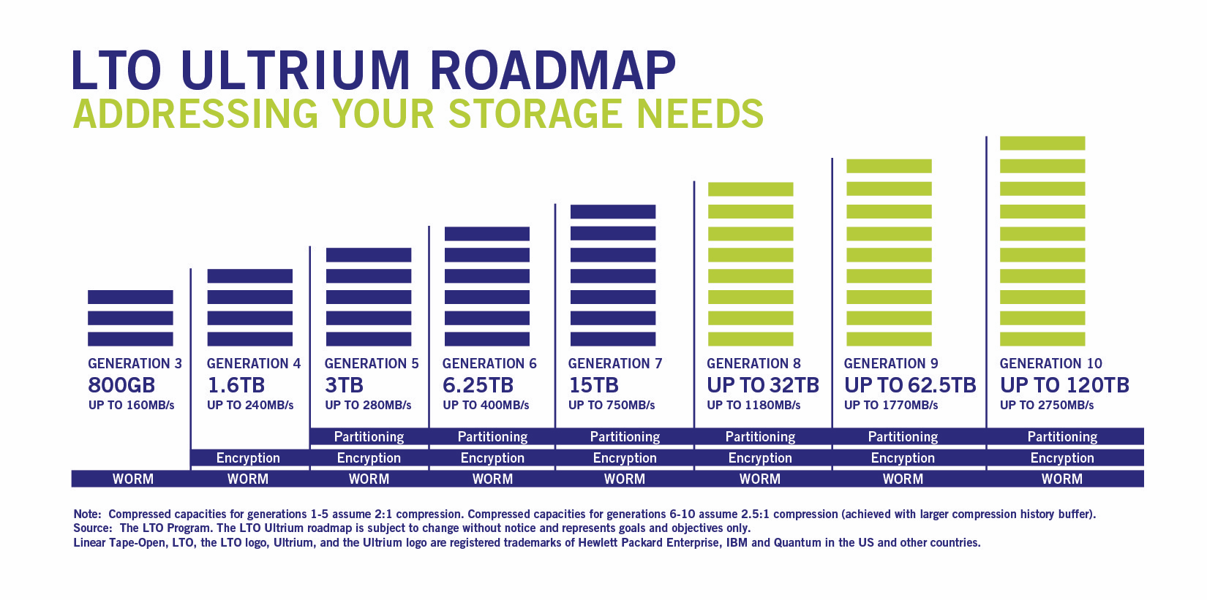
LTO timeline
Bottomline : 3 GB/s is reasonable by 2020, L3 farm optional

Slide 30
Tape costs (2c2)
 |  | Days | Data rate | Seconds | Total data TB | Double | LTO5 in $ 2010 | LTO6 in $ 2012 | LTO7 in $ 2015 | LTO8 in $ 2018 | LTO9 in $ 2020 | LTO10 in $ 2023
E12-11-108 | Pol proton | 120 | 250 | 10368000 | 2592 | 5184 | 259200 | 155520 | 62208 | 30375 | 15552 | 8100
E12-12-006 | J/Psi | 60 | 250 | 5184000 | 1296 | 2592 | 129600 | 77760 | 31104 | 15187.5 | 7776 | 4050
E12-10-006 | Transv. Pol. 3He | 90 | 250 | 7776000 | 1944 | 3888 | 194400 | 116640 | 46656 | 22781.25 | 11664 | 6075
E12-11-007 | Long. Pol. 3 He | 35 | 250 | 3024000 | 756 | 1512 | 75600 | 45360 | 18144 | 8859.375 | 4536 | 2362.5
E12-10-007 | PVDIS | 169 | 250 | 14601600 | 3650.4 | 7300.8 | 365040 | 219024 | 87609.6 | 42778.125 | 21902.4 | 11407.5
 | Total | 474 |  | 40953600 | 10238.4 | 20476.8 | 1023840 | 614304 | 245721.6 | 119981.25 | 61430.4 | 31995
Actual days | Actual years |  | Time in s |  |  | Per year | 394200 | 236520 | 94608 | 46195.3125 | 23652 | 12318.75
948 | 2.60 | 474 | 40953600
About 17K$ per PB, 11K$ per PB for tapes about 250 K$ for 20 PB
Cynthia would like about 70 K$ per year in tape ( 50 K$ per year at 250 MB/s), but 300 K$ is not unreasonable if planned in advance
Numbers don’t include compression ( additionnal factor of 2 )
Expected to go down by a factor 5 by 2020

Slide 31
Updated realistic ( not crazy) data rates
 |  |  |  |  |  |  | 2010 | 2012 | 2015 | 2018 | 2020 | 2023
 |  | Days | Data rate | Seconds | Total data TB | Double | DLO5 in $ | DLO6 in $ | DLO7 in $ | DLO8 in $ | LTO 9 | LTO10
E12-11-108 | Pol proton | 120 | 300 | 10368000 | 3110.4 | 6220.8 | 311040 | 186624 | 74649.6 | 36450 | 18662.4 | 9720
E12-12-006 | J/Psi | 60 | 3000 | 5184000 | 15552 | 31104 | 1555200 | 933120 | 373248 | 182250 | 93312 | 48600
E12-10-006 | Transv. Pol. 3He | 90 | 3000 | 7776000 | 23328 | 46656 | 2332800 | 1399680 | 559872 | 273375 | 139968 | 72900
E12-11-007 | Long. Pol. 3 He | 35 | 3000 | 3024000 | 9072 | 18144 | 907200 | 544320 | 217728 | 106312.5 | 54432 | 28350
E12-10-007 | PVDIS | 169 | 3000 | 14601600 | 43804.8 | 87609.6 | 4380480 | 2628288 | 1051315.2 | 513337.5 | 262828.8 | 136890
 | Total | 474 |  | 40953600 | 94867.2 | 189734.4 | 9486720 | 5692032 | 2276812.8 | 1111725 | 569203.2 | 296460
Actual days | Actual years |  | Time in s |  |  | Per year | 3652587.342 | 2191552.405 | 876620.962 | 428037.5791 | 219155.2405 | 114143.3544
948 | 2.60 | 474 | 40953600
300 K$ of tape over 3 years

Slide 32
Simulations needs
GEM occupancies and digitization SIDIS for event size, occupancy and tracking (Ole, Zhiwen, Weizhi Duke )
Updated trigger rates PVDIS, SIDIS(Zhiwen, Rakitah)
FADC digitization PVDIS : realistic PID (?)
Cerenkov simulation only timing readout no FADC(?)
Effect 1 sample vs 3 samples GEM (Weizhi ) and 20 samples vs time integral SIDIS (?)
Full FADC trigger simulation
MRPC simulation : response to background

Slide 33
Communication with other groups 2c3
Try collaborate with Hall D
Constant communication with JLAB DAQ and electronics group
Hall C, SBS interested in using VETROC for logic and readout
check experience with APV and FADC from HPS and PRAD
Already planning to reuse HPS trigger scheme

Slide 34
Recommendations 2c
1. a)The plans for the High Level Trigger and b) the needs for slow control (see Brad’s talk) need to be worked out in detail and the implications for resources need to be evaluated.
2. The implications of the need for these resources in the context of availability of resources at the laboratory need to be understood.
Counting house network expected to be 10 GB/s
Assuming progresses : around 100 K$ / year for tape at 3 GB/s
CPU requirements about 5000 cores : can be absorbed
3. Closer communication with the other JLab experiments and the JLab computing center is strongly encouraged.
DAQ, Fast electronics, Hall D
4. Having a functional simulation and reconstruction routines as soon as possible should be a high priority in the software effort. Such software will pay off many times over in experimental design and avoiding pitfalls. ( Ole’s talk )

Slide 35
On going work
SBS
MPD optical readout
SSP data reduction
HCAL FADC trigger with VTP
VTP readout
Compton
Systematic on dead time correction
SoLID ( when preRD )
Test stand
Trigger programming and simulation

Slide 36
Plan
Compton deadtime measurement setup ( 3 months )
High statistics to measure ppm level asymmetry
Improve deadtime measurement ( dead time from scaler )
SoLID trigger implementation ( electronics groups when done with SBS ~ March )
Test stand if preRD ( SBS can give preliminary results )

Slide 37
Short term plan On going work
SBS
MPD optical readout 3 months March 2017 (Ben Raydo, Alexandre Camsonne, UVA, INFN)
SSP data reduction 6 months to 1 year September 2017 (Ben Raydo, Alexandre Camsonne, UVA, INFN)
HCAL FADC trigger with VTP 6 months Mid 2017 ( Ben Raydo, Alexandre Camsonne)
VTP readout 6 months Mid 2017 ( Ben Raydo, Bryan Moffit )
Deadtime studies, readout optimization ( Bob Michaels )
Compton
Systematic on dead time correction ( Bob Michaels, ? Lost students )
SoLID ( when preRD )
Test stand
Trigger programming and simulation

Slide 38
Conclusion
New results from Simulation
PVDIS rate lower 12KHz, not an issue
SIDIS :
1 sample GEM readout seems to work and with occupancies similar to PVDIS data rate
Up to 3 GB/s most likely can be handled by SILO, L3 most likely not required and could be available mostly for free ( optimize tape cost vs CPU investment )
To do :
TOF background
Need to check J/Psi and TCS occupancies, rates and efficiencies
PVDIS deadtime : hardware setup, ongoing study preliminary results promising, need conclusive study with test setp

