Slide 1
TOF read-out for high resolution timing
Alexandre Camsonne
SoLID collaboration meeting
December 3rd 2016

Slide 2
Outline
SoLID requirements
Sampling chips
DRS5 example
Option for electronics R&D
Conclusion

Slide 3
Requirements for SoLID
Timing resolution at least 50 ps
Might need better depending on detector performances
At least 60 KHz desired 200 KHz trigger rate
Latency : 4 μs minimum up to 8 μs
3300 channels of MRPC
Deadtimeless
Need trigger signal to send to trigger to pipeline electronics
Single rates : tested up to 20 KHz/cm2
Photon rate per area can range from 1-4kHz/mm2, which is 100-400khz/cm2
If we assume 5% percent photons will fire MRPC, we can have 5-20khz/cm2

Slide 4
Two options
Depends on detector performance : better than 20 ps
  Usual method : discriminator + TDC
    Amplifier discriminator
    TDC : ASIC or new FPGA technique
  Waveform sampling
    No discriminator
    Full bandwidth
    Better timing resolution up to 1 ps
    Need algorithm to extract time
    Or readout full waveform ( very large amount of data)

Slide 5
Sampling chip
Chip | Sampling Frequency (GHz) | Bandwidth GHz | Number of samples | Number of channels | Readout frequency (MHz) | Resolution (ps)
PSEC4 | 4 to 15 | 1.5 | 256 | 6 | 40 to 60 | 9
SAMPIC | 3 to 8.2 | 1.6 | 64 | 16 – 8 (at 10 GHz) | 80 | 5
DRS4 | 0.7 to 5 GHZ | 0.950 | 1024 | 9 | 33 | 1
DRS5 | 10 | 3 | 4096 | 32 | 300? | 5?
PSEC5 | 5 to 15 | 1.5 to 2 | 32768 | 4 | 500 | 5?
Latest generation with multilevel analog buffer : dead time less up to a few MHz and allow for L2 ( DRS5 )

Slide 6
PSEC5 update
Interesting option
Developed by University of Hawaii for HEP
  Belle II
Reasonable radiation hardness 10 to 20 MRad
Funding by both HEP and NP
P5p : prototype for 2017
Commercialization and mass production being studied
Standardization of readout ( similar to SRS for TOF)
Could go down to 15 $ per channel about 3K$ per wafer

Slide 7
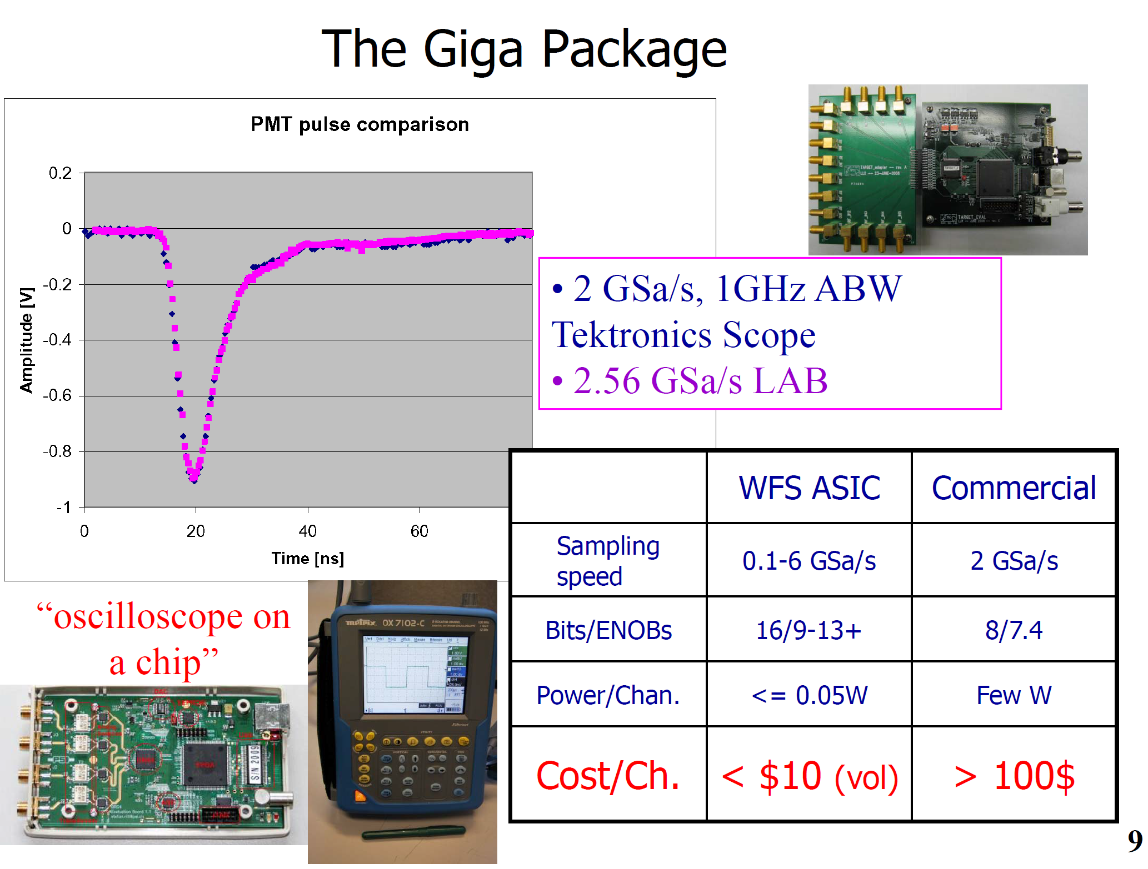

Slide 8
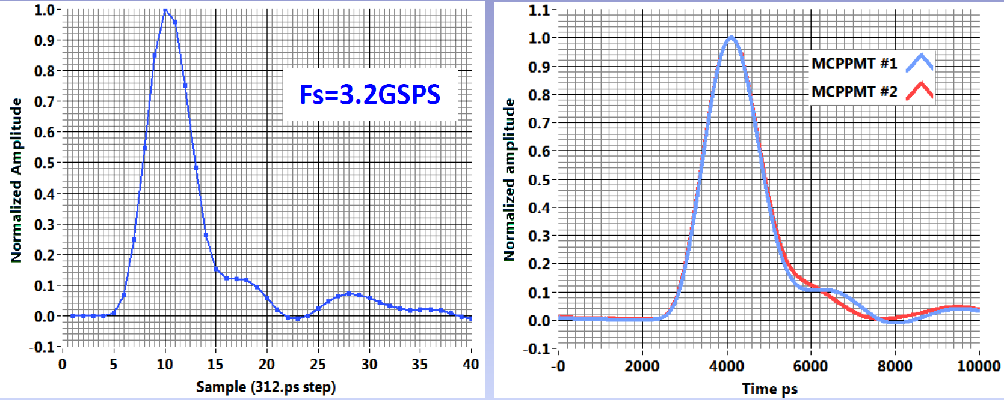
Sampling chips

Slide 9
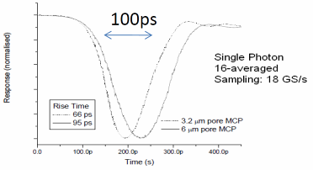
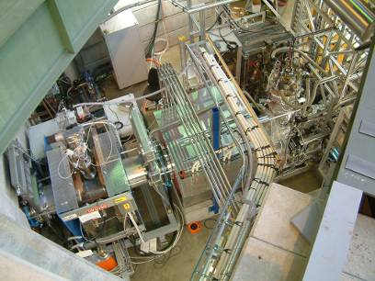
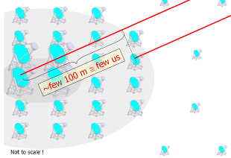
Plans for DRS5
J. Milnes, J. Howoth, Photek
μSR
~MHz event rate
CTA
Increase analog bandwidth ~5 GHz
  Smaller input capacitance
Increase sampling speed ~10 GS/s
  Switch to 110 nm technology
Deeper sampling depth
  8 x 4096 / chip
Minimize readout time (“dead time
free”) for muSR & ToF-PET
  (minor) reduction in analog
  readout speed (30 ns → 20 ns)
  Implement FIFO technology

Slide 10
Next Generation SCA
Short sampling depth
Deep sampling depth
Low parasitic input capacitance
→ High bandwidth
Large area
→ low resistance bus, low
resistance analog switches
→ high bandwidth
Digitize long waveforms
Accommodate long trigger delay
Faster sampling speed for a given trigger latency
How to combine
best of both worlds?

Slide 11
Cascaded Switched Capacitor Arrays
input
shift register
32 fast sampling cells (10 GSPS/110nm CMOS)
100 ps sample time, 3.1 ns hold time
Hold time long enough to transfer voltage to secondary sampling stage with moderately fast buffer (300 MHz)
Shift register gets clocked by inverter chain from fast sampling stage
. . . . . . . . . . . . . . . . . . . . . . . . . . . . . . . . .
fast sampling stage
secondary sampling stage

Slide 12
How noise affects timing
voltage noise
band of signal
voltage noise Δu
timing jitter arising
from voltage noise
timing uncertainty Δt
signal height U
rise time t_{r}
timing jitter is
much smaller
for faster
rise-time
number of samples on slope

Slide 13
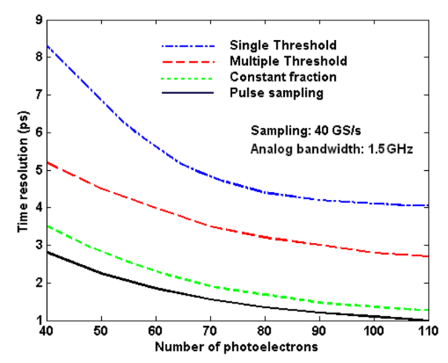
TDC vs. Waveform Digitizing
Constant
Fraction
Discriminator
Q-sensitive
Preamplifier
PMT/APD
Wire
Shaper
TDC
CFD and TDC on same board → crosstalk
CFD depends on noise on single point,
while waveform digitizing can average over several points
Inverter chain is same both in TDCs and SCAs
Can we replace TDCs by SCAs?
→ yes if the readout rate is sufficient

Slide 14
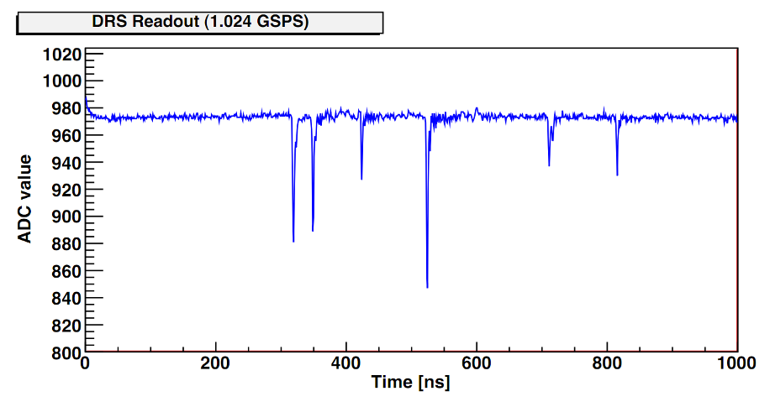
Typical Waveform
Only short segments of waveform need high speed readout

Slide 15
Dead-time free acquisition
DRS5
Self-trigger writing of short
32-bin segments
Simultaneous reading of
segments
Quasi dead time-free
Data driven readout
    Ext. ADC runs continuously
    ASIC tells FPGA when there is new data
Coarse timing from
300 MHz counter
Fine timing by waveform
digitizing and analysis in FPGA
20 * 20 ns = 0.4 μs readout time
→ 2 MHz sustained event rate
Attractive replacement for CFD+TDC

Slide 16
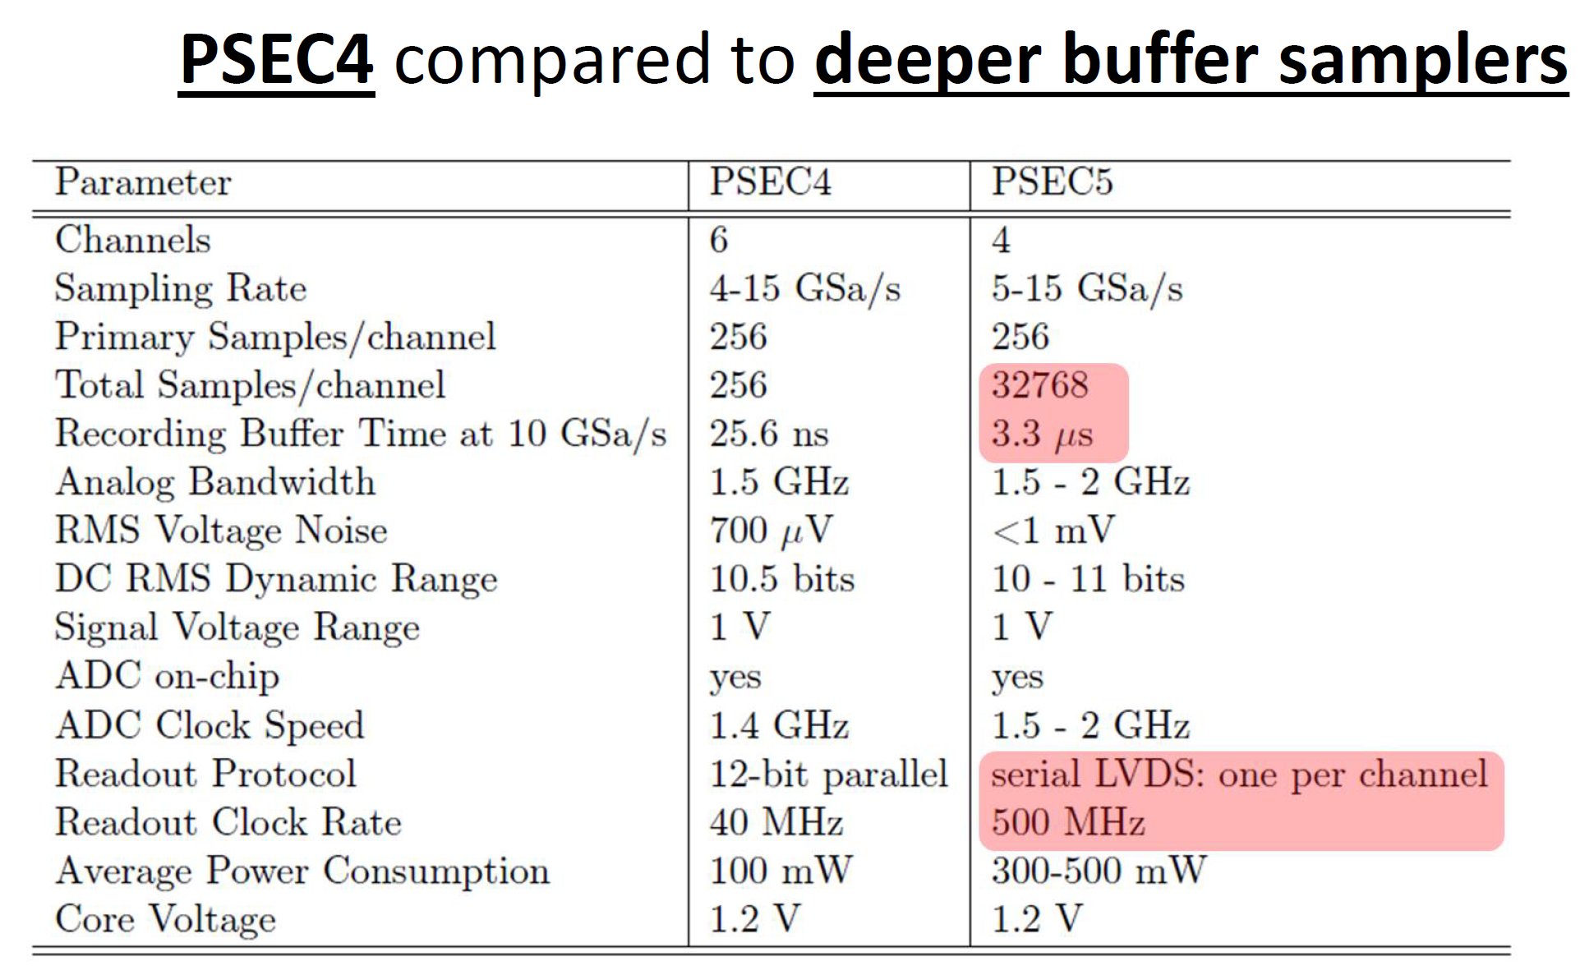
PSEC

Slide 17
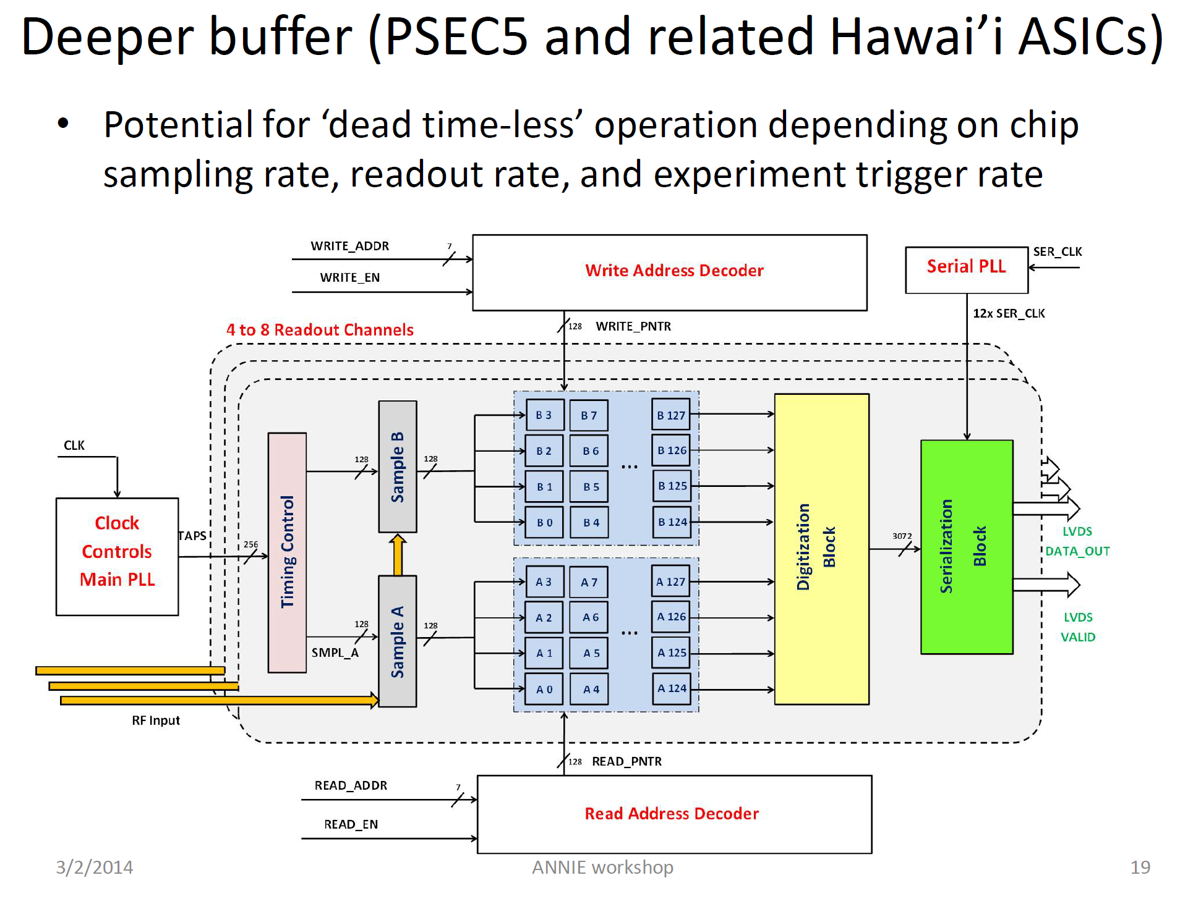
Eric Oberla
http://annie.uchicago.edu/lib/exe/fetch.php?media=2014_3_1_annie_electronics.pdf

Slide 18
Concern for TOF
Effect of background on TOF
  Pile-up
If need to record waveform :
  Deadtime ( sampling chip have deadtime, wait for new generation chip DRS5 prototype 2018 )
  Event size
    Occupancy
    Data reduction
Cost ( develop new electronics )

Slide 19
Options for chinese R&D
First option
  Development A/D ASIC
  Development of TDC
  Possibility A/D/TDC chip
Digitizing
  Develop ASIC
  Reuse ASIC and develop readout

Slide 20
Amplifier
Need cheap fast amplifier to use with readout
High bandwidth
Multichannel

Slide 21
Conclusion
Electronics is not a limiting factor for timing resolution ( up to 1 ps)
Baseline : A/D and VETROC for trigger and readout 20 ps resolution
Additionnal development for better than 20 ps
Need simulation to determine the need of sampling electronics
Sampling electronics is better in term of timing and background but need to evaluate additional cost and data size
Would work for MRPC or LAPPD

