Slide 1
High time resolution TOF for SoLID
Wang Yi
Department of Engineering Physics, Tsinghua University
Outline:
Requirement of SoLID-TOF
Development of high rate and high time TOF
Next to do

Slide 2
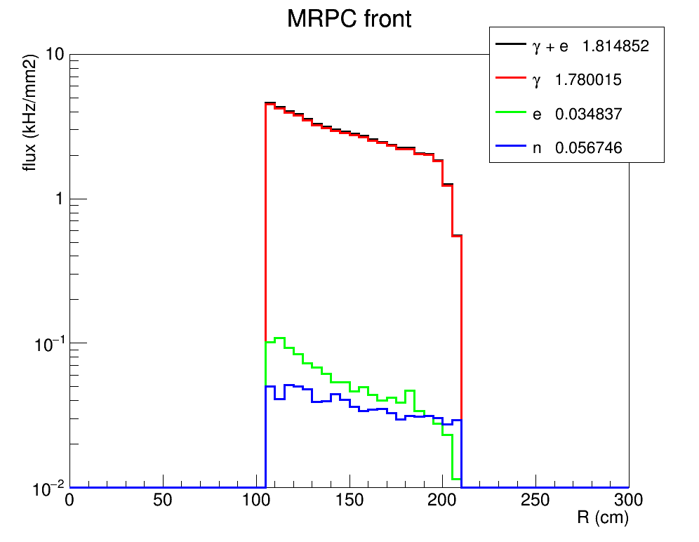
Particle rate entering MRPC
Particle rate in front of MRPC
Dominant by photon in MeV
γ : 250kHz/cm²
e: 5kHz/cm²
n: 3kHz/cm²

Slide 3
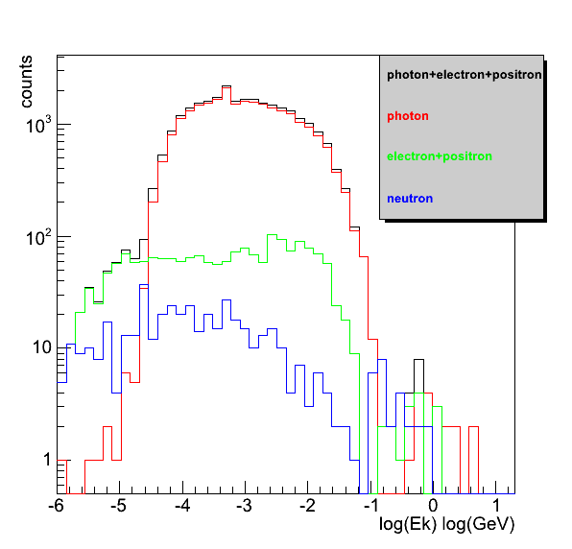
Energy of Photon, electron and neutron
Energy range
γ : 10⁻⁵ – 10GeV
e: 10⁻⁶ – 10GeV
n: 10⁻⁶ – 1GeV

Slide 4
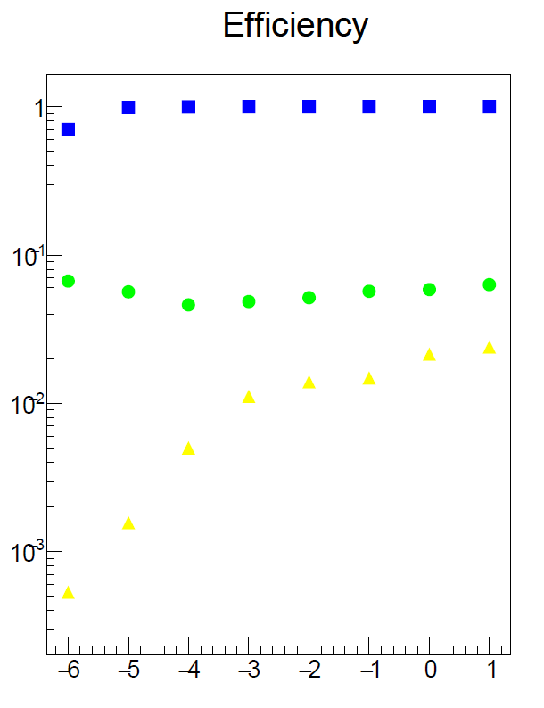
Particle rate detected by MRPC
e
γ
n
Detected particle rate
γ : 12.5kHz/cm²
e: 5kHz/cm²
n: 0.05kHz/cm²
Total: 18kHz/cm²

Slide 5
Main requirements for TOF
The MRPC is developed for the TOF of SoLID
Main Requirements for TOF:
π/k separation up to 7GeV/c & 3 σ
Time resolution < 20ps
Rate capability : 18kHz/cm²
This is big challenge of MRPC-TOF!!

Slide 6
High rate, high time precision TOF

Slide 7
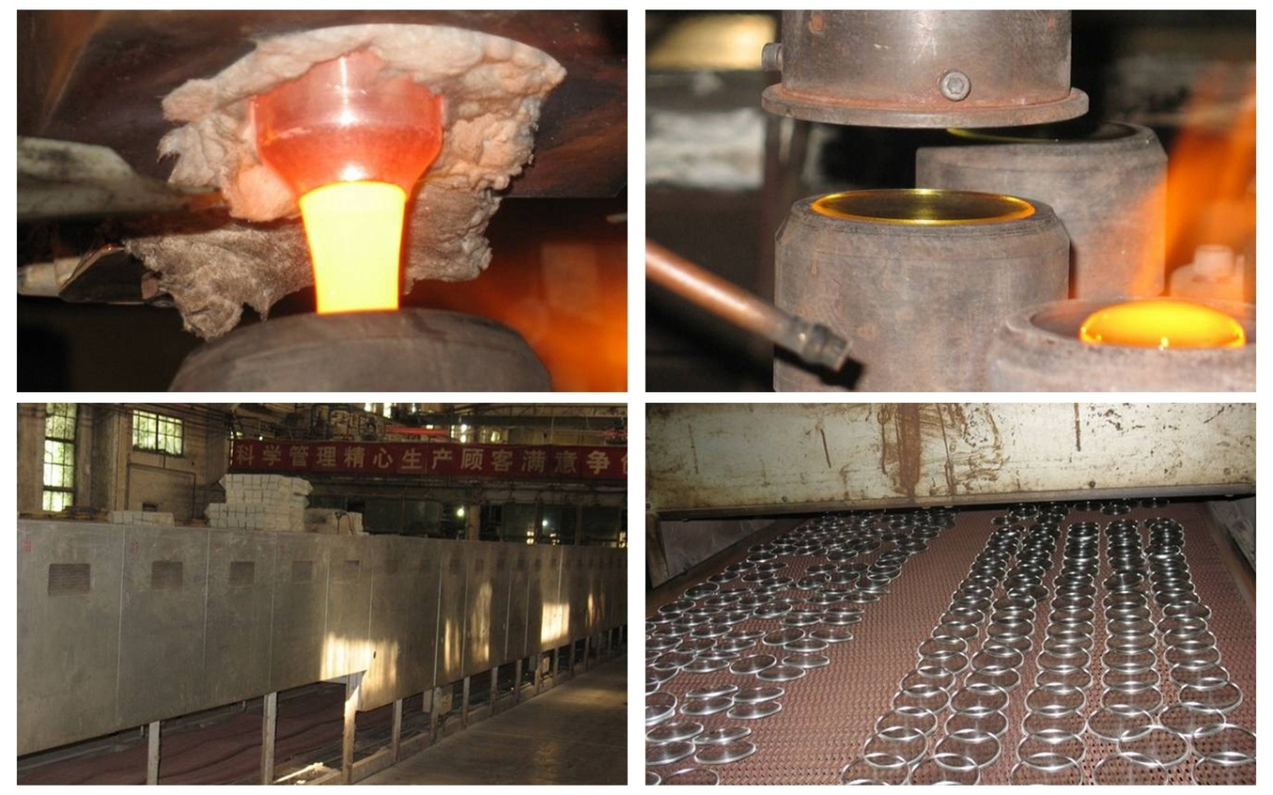
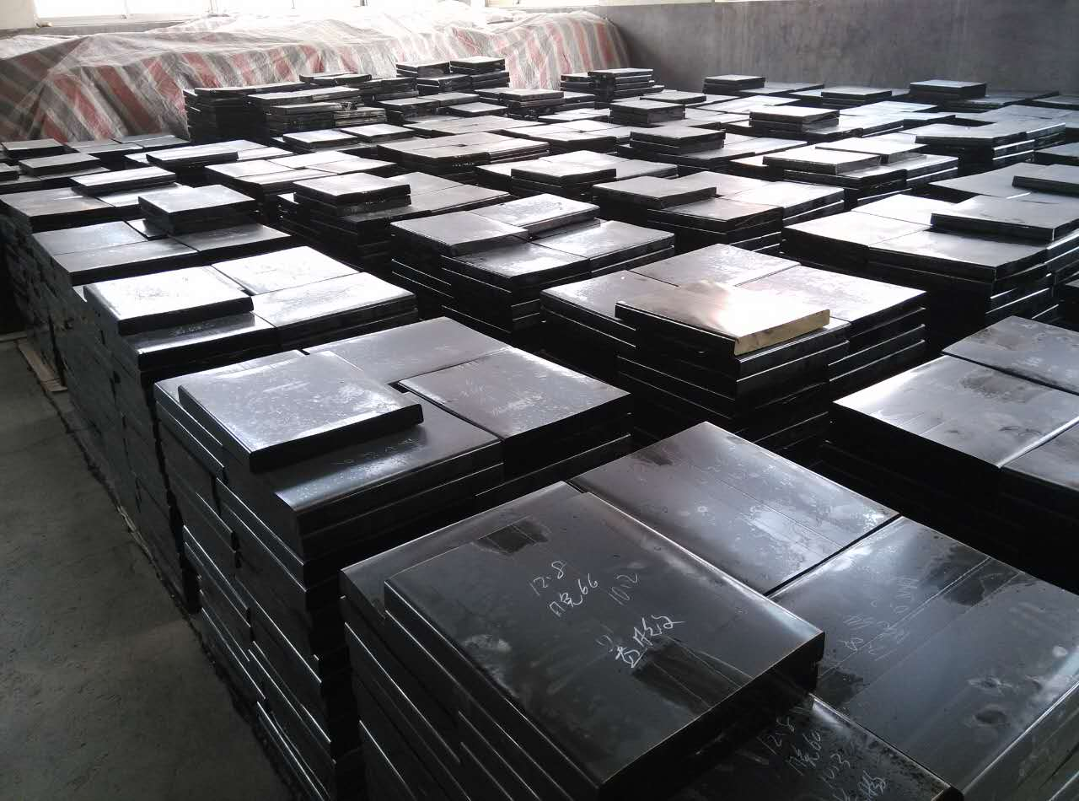
Glass mass production
The roughcast of glass
Continuous melting
Continuous pouring
Continuous annealing

Slide 8
Structure of high time MRPC
Item | dimension/mm
Honeycomb | 90×265×7.5
Outer PCB | 120×298×0.6
Middle PCB1 | 120×298×1.2
Middle PCB2 | 120×328×1.2
Strip length | 268
Strip width | 7
Mylar | 90×268×0.25
Glass | 80×258×0.5
Carbon | 72×250
Gas gap width | 0.104
Number of gas gap | 32
Honey comb plate
PCB
Mylar
Carbon electrode
Glass

Slide 9
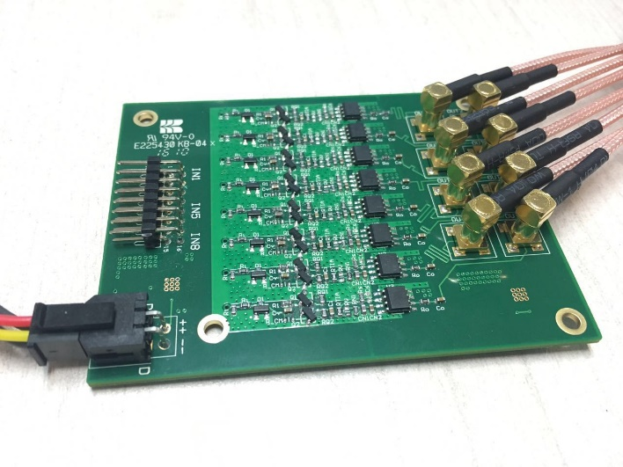
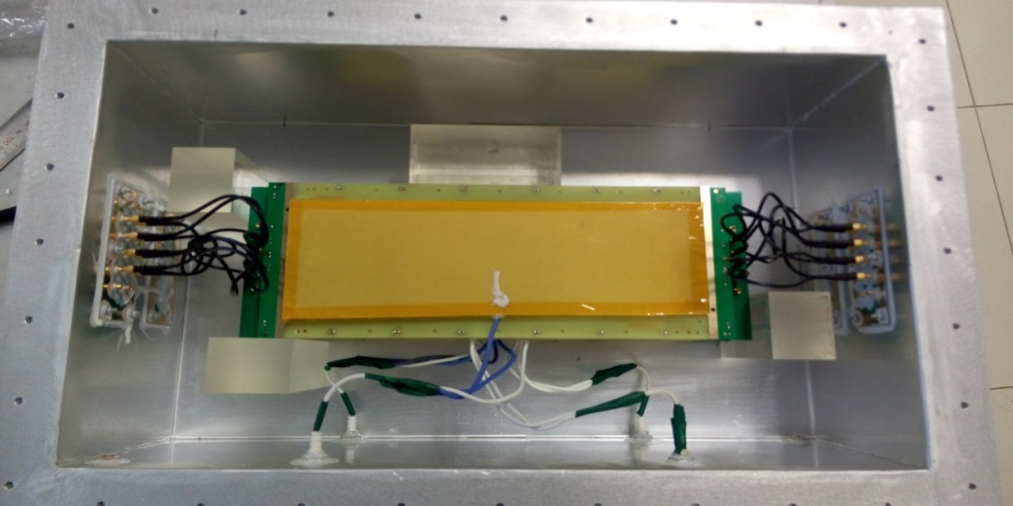
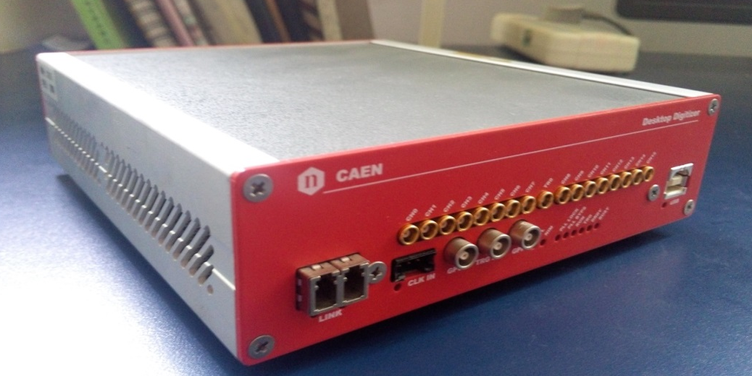
Test equipment
Fast amplifier
Gas box
DRS4-V5 chip
16 channels
12bit 5GS/s
5 points for leading edge of MRPC
Waveform Digitizer
DT5742

Slide 10
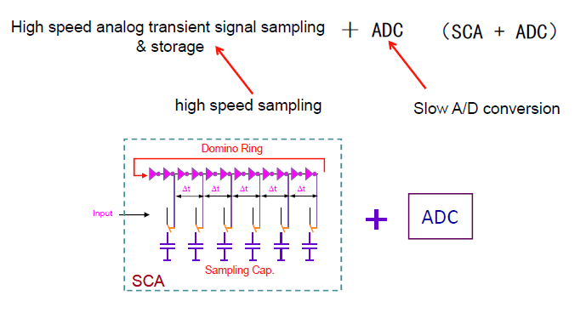
SCA based waveform digitizer

Slide 11
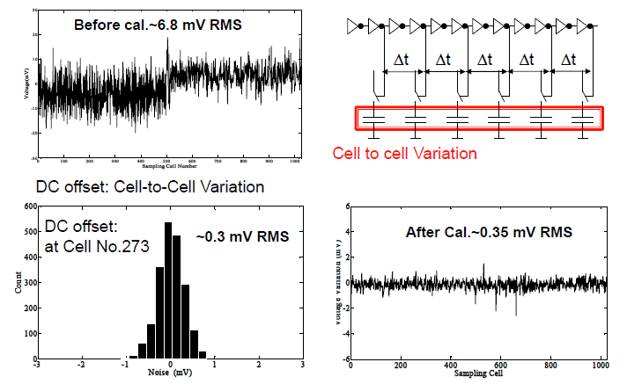
Calibration of DC offset

Slide 12
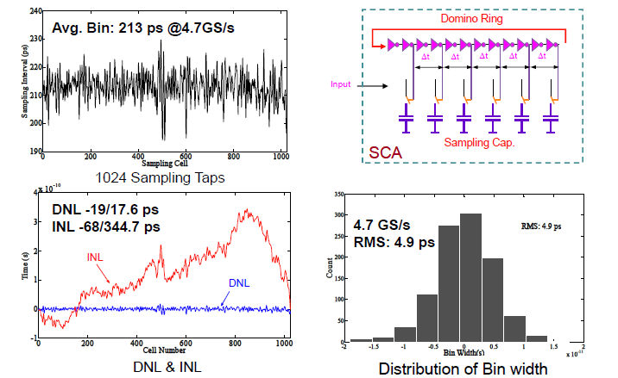
Calibration of sampling interval

Slide 13
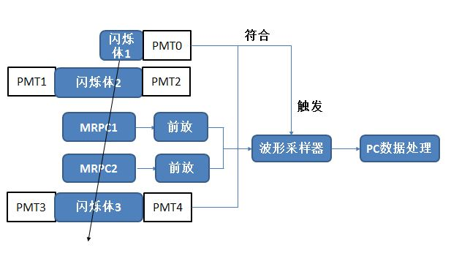
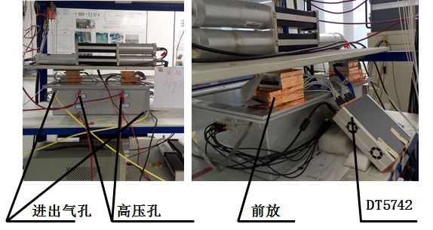
Cosmic test
Gas Mixture : “Freon” (R134a) 90% : Iso 5% : SF6 5%

Slide 14
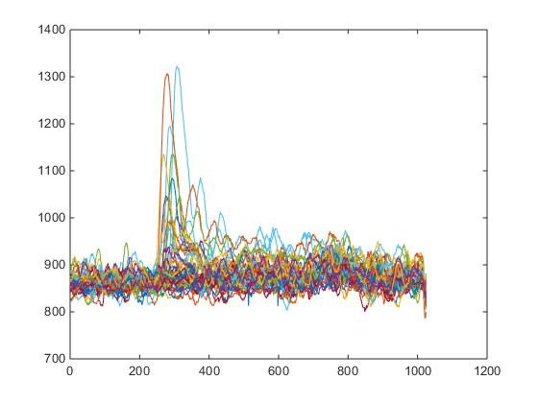
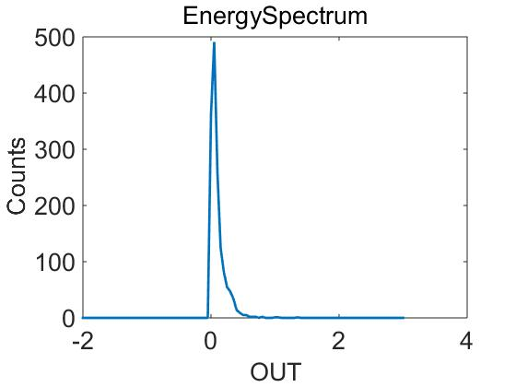
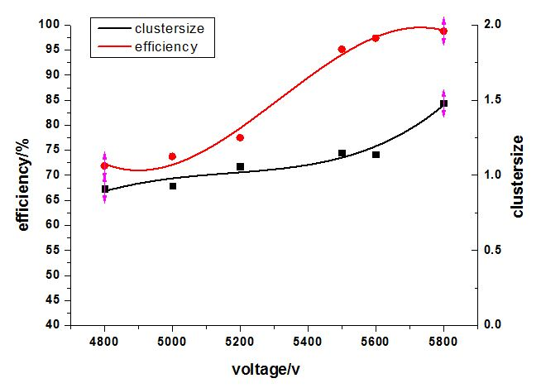
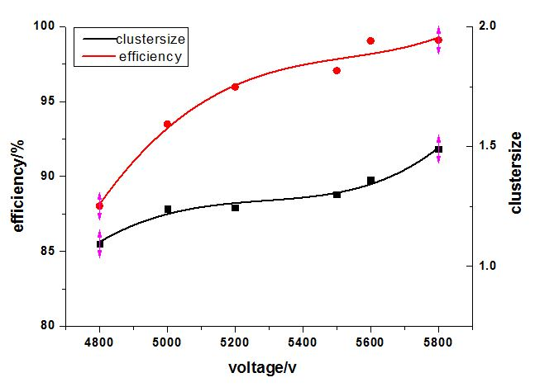
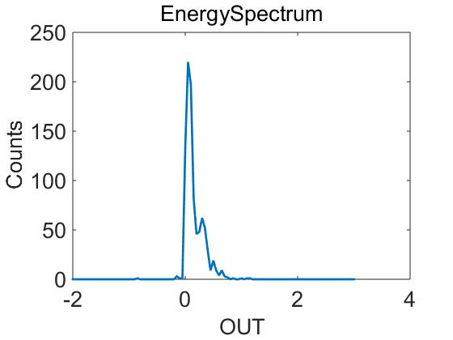
Test results
Efficiency HV=5.5kV
5500V
Charge
5600V
98.37%
99.10%
Charge
Efficiency of MRPC1
Efficiency of MRPC2

Slide 15
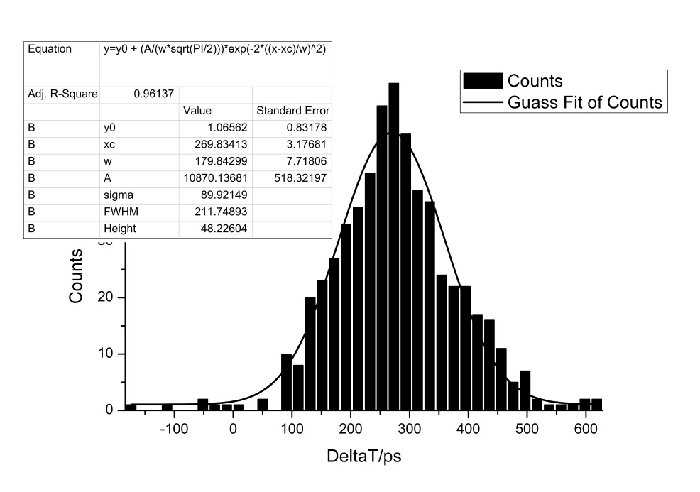
Time resolution
σ =89.92ps
Time difference of two MRPC
Walk correction

Slide 16
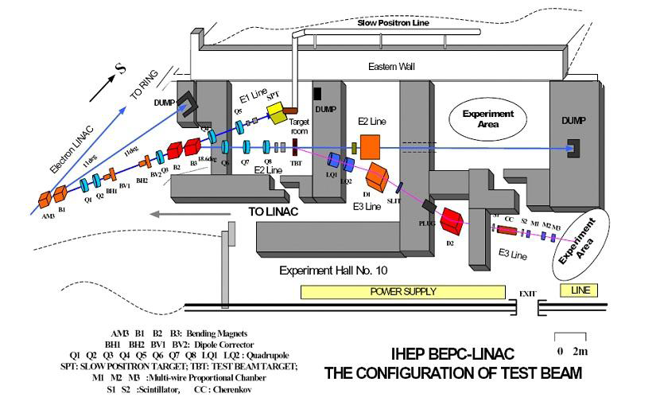
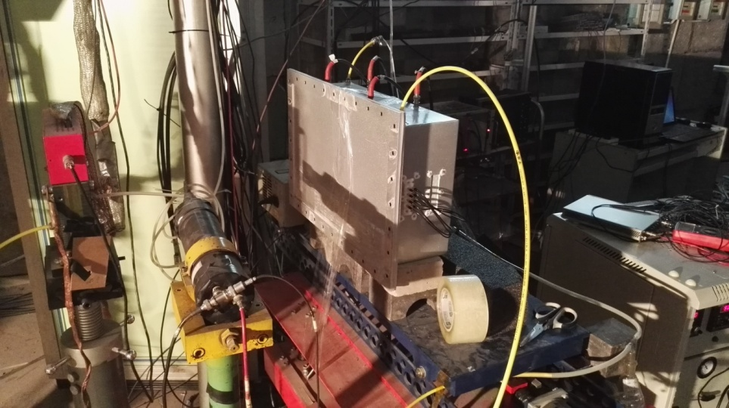
Beam Test at IHEP
Particle |  | e+, e-,π+,π-,p
momentum | e | 200MeV/c~1.3GeV/c
 | π | 400MeV/c~900MeV/c
 | p | 500MeV/c~1GeV/c
rate |  | 10~20Hz
5
0
c
m
5
0
c
m
6
0
c
m
e
,
,
p
S
C
1
C
0
S
C
2
M
W
P
C
MRPC
Trigger

Slide 17
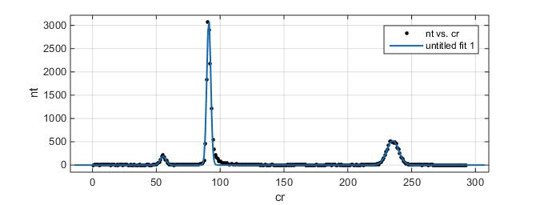
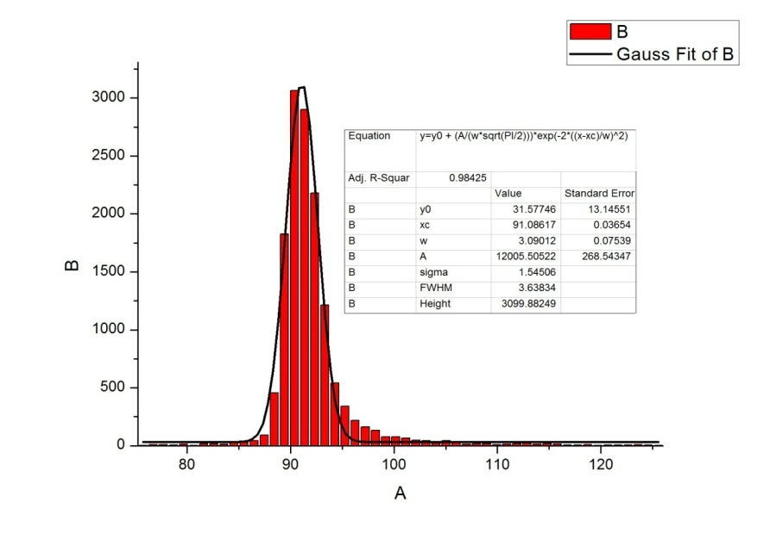
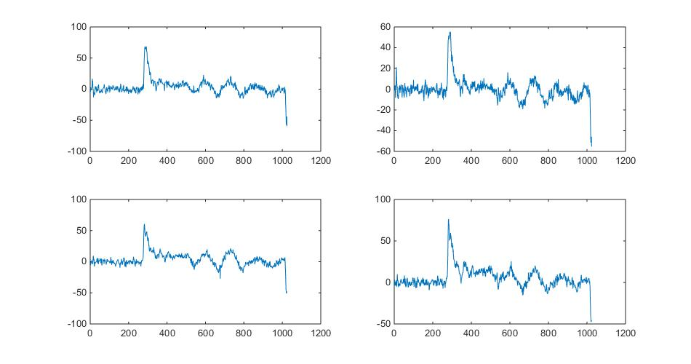
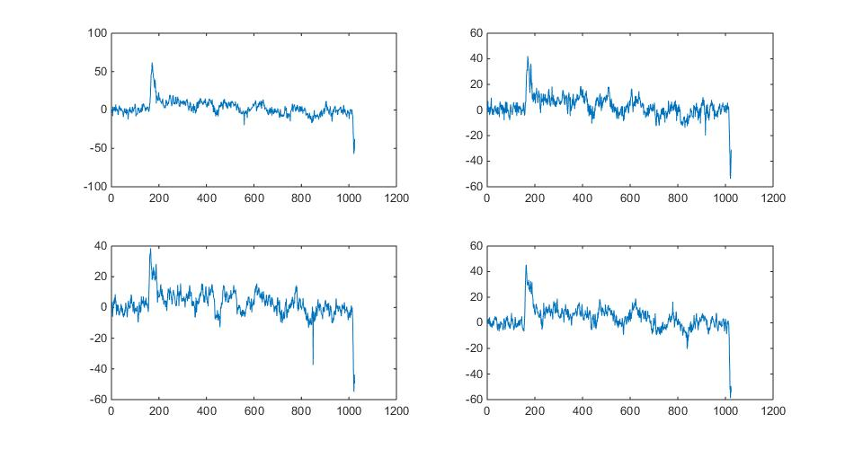
Signal selection
P
Count
π
Time
Time

Slide 18
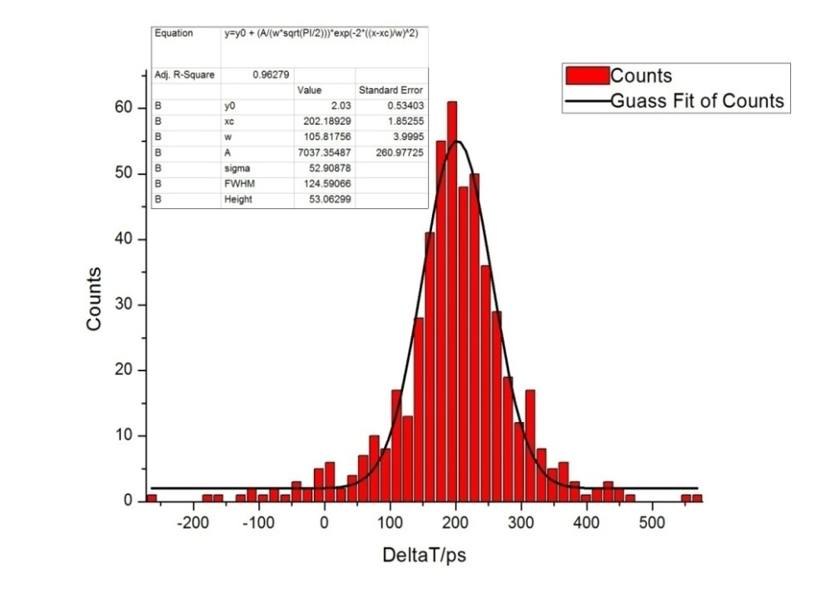
Time resolution
Difference between time of two MRPC: Δt = t₂ – t₁= 52ps
σ_{t} = Δt/√2 = 37 ps
Only protons are used
Used a “Leading Edge Discriminator technique” in software from waveform, slewing correction
Wings manily due to jitter of waveform digitizer, low electric field, noise or analysis method.
We believe best result is 20 ps

Slide 19
Next to do
Detailed calibration of DT5742 (DRS4)
Improve analysis method
Improve connect between MRPC and fast amplifier
Propose R&D NSFC key project (collaborate with CCNU, USTC)

Slide 20
Thanks for your attention !

