Slide 1
SoLID Simulation and Trigger Update
Zhiwen Zhao
2016/12/02

Slide 2
Review Comment (general simulation)
End-to-end simulations with realistic subsystem responses and material budgets
The development of a simulation framework with realistic reconstruction and analysis should be pursued with high priority and increased resources.
Having a functional simulation and reconstruction routines as soon as possible should be a high priority in the software effort. Such software will pay off many times over in experimental design and avoiding pitfalls.
Acceptances, efficiencies, and systematic uncertainties should be simulated for each of the core measurements.

Slide 3
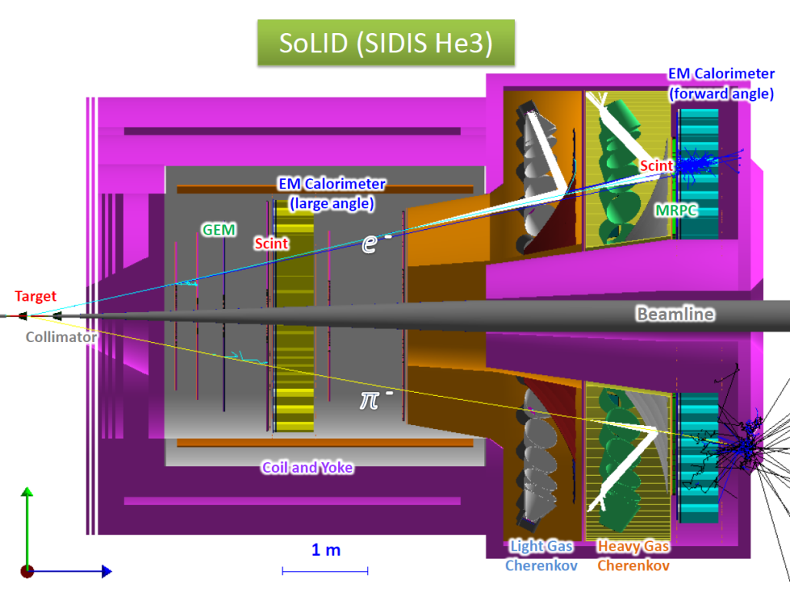
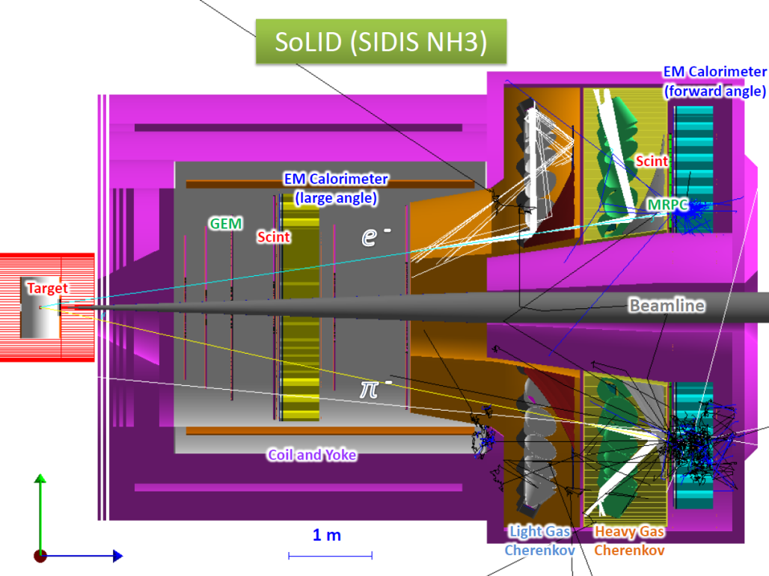
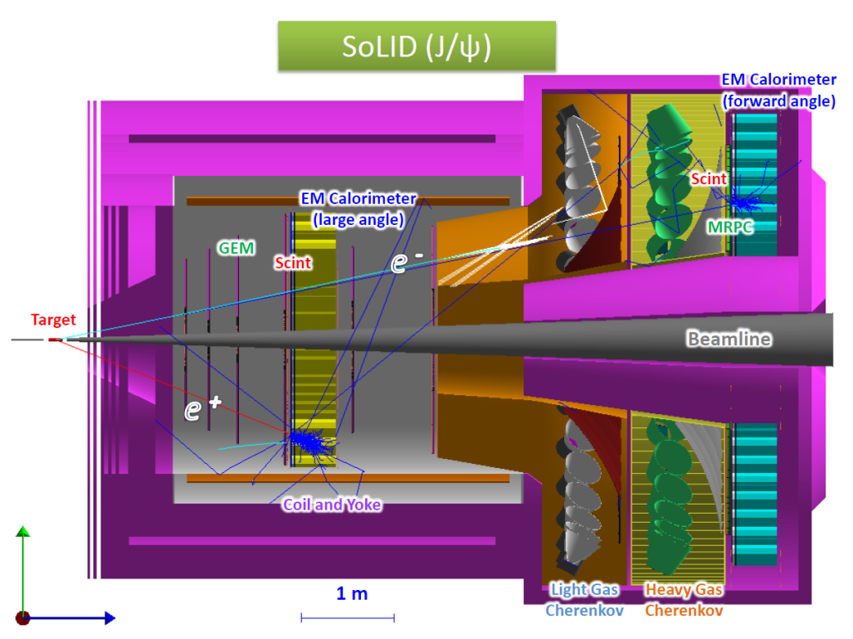
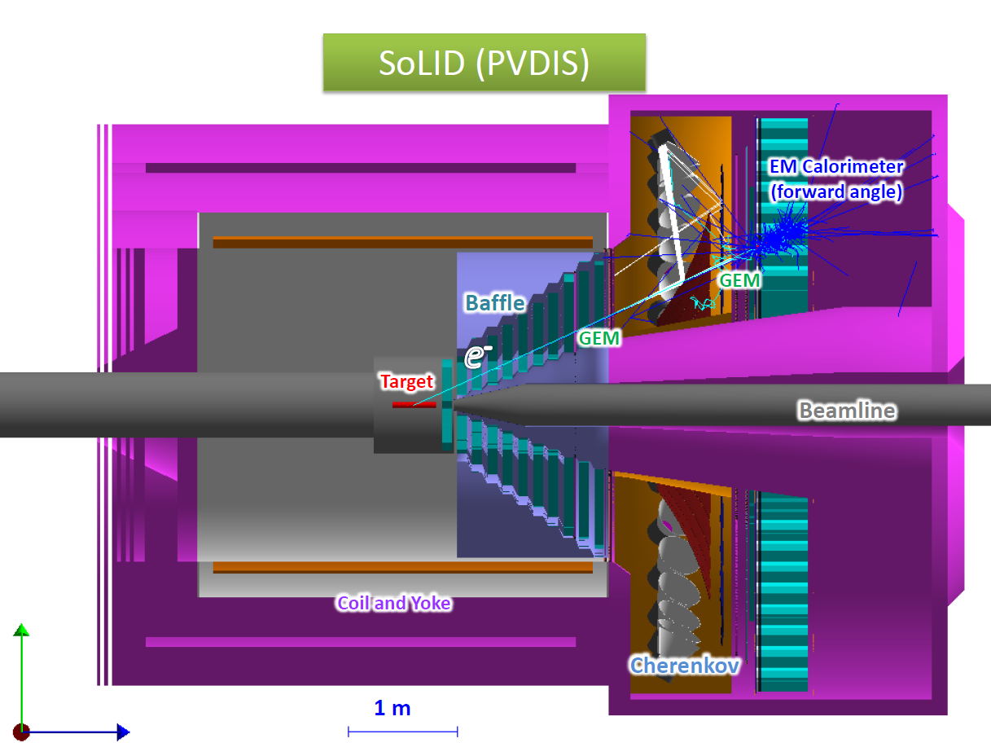
all subsystems with various level of details in the unified simulation “solid_gemc”

Slide 4
PVDIS LD2 Rate
PID | Only EC fired | Rate with EC and lgc both fired for the same e or pion event | Efficiency of LGC
Electron | 0.24 MHz | 0.23 MHz | 95.7%
Pim | 4.43 MHz | 0.64 KHz | 0.01%
Pip | 0.43 MHz | 0 (limit: 0.04kHz) | 0.01%
Pi0 | 0.015 MHz | 8.5 KHz | 55%
Well defined particles with EC&LGC = (230 + 0.64 + 0.04 + 8.5) KHz = 239 KHz = 8 KHz/sector
Random coincidence per sector = 170 KHz * 803 KHz * 30ns = 4.1 KHz/sector
Total: (8+4.1) KHz = 12.1 KHz/sector
Yuxiang Zhao

Slide 5
Trigger condition Trigger logic
SIDIS_He3 trigger
hit matching
e_FAEC: R(105-235)cm, Q2>=1, Jin’s wiser trigger curve
e_LAEC: R(80-140)cm,P>3, Jin’s wiser trigger curve
h_FAEC: R(105-235)cm, cut below MIP, Jin’s wiser trigger curve
e_LGC: at least 2 PMT and each has at least 2 photons, similar to PVDIS
e_FASPD and h_FASPD: Edep>0.5MeV
e_LASPD: Edep>1.5MeV
e_MRPC and h_MRPC are not working yet, so not used
e_FA: e_FAEC & e_LGC & e_FASPD
e_LA: e_LAEC & e_LASPD
h_FA: h_FAEC & h_FASPD
Starting from EC and record all hits pass trigger
Then check matching LGC sectors and two neighboring sectors, if any sector passes, then LHC pass
Then check matching SPD sector
Finally we have individual triggers, we can count single trigger rate without double counting
Then check coincidence trigger with all hits from single trigger
Check e_LA & h_FA
Check e_FA & h_FA and choose to cut on hit distance on FAEC

Slide 6
single (gas(hallD),win up(wiser),win down(wiser))
Jin’s EC Wiser trigger
hit matching
e_FA(kHz) | EC | EC+LGC | EC+LGC+SPD
Electron | 68 (57) | 63(56) | 58(52)+1+2
Pip | 694(643) | 4.2(3.3) | 3.8(3.1)+2.5/2+1.6/2
Pim | 537(492) | 4.0(3.2) | 3.6(3.0) +2.3/2+2.1/2
Pi0 | 1024(120) | 43(31) | 32(30) +1.1/2+5.8/2
P | 202(185) | 0(0) | 0(0) +0/2+0/2
all hadrons, no electron | 2692 | 62 | 47 +?+?
Total: |  |  | 105+4+7=116
electron trigger self coin prescaled by 10
61/10=6kHz
Only primary particle in parenthesis,
In case of pi0, only e+ or e-
Pi0 before LGC 26(26)
Pi0 before GEM 13(12)
e_LA(kHz) | EC | EC+SPD
electron | 4.5(4.3) | 4.1(4)+3.6+2.6
Pip | 8.6(8.5) | 7.9(8.1)+8.4/2+5.6/2
Pim | 6.4(6.0) | 5.9(5.7) +6.1/2+3.7/2
Pi0 | 15.3(0.2) | 0.6(0.2) +0.4/2+0.3/2
P | 2.9(3.2) | 2.8(3.0) +7.6/2+4.8/2
all hadrons, no electron | 38 | 18 +?+?
Total: |  | 22 +14+10=46
h_FA(kHz) | EC | EC+SPD
electron | 140(94) | 100(87) +4+4
Pip | 5855(4898) | 5151(4447) +3405/2+4570/2
Pim | 4925(3787) | 3971(3435) +3300/2+4590/2
Pi0 | 4607(811) | 548(468) +33/2+171/2
P | 3510(3103) | 3164(2831) +2243/2+2563/2
all hadrons, no electron | 17392 | 12805 +?+?
Total: |  | 12913 +4500+6000=23413
Random coin (116+46-10.3-7.06-6.96)*23413*1e3*30e-9=97KHz

Slide 7
Coin
Direct estimation: using SIDIS generator, EC&GEM acceptance histogram and 8deg cut
with or without vertex angle>2.5deg
hit matching
Coin trigger rate (kHz) (EC distance cut for e_FA & h_FA) |  | e_FA | h_FA | e_LA | e_FA & h_FA | e_LA & h_FA | (e_FA & h_FA) + (e_LA & h_FA) | Direct estimation
e+pip | >= 0cm | 36(32) | 127(74) | 4.5(3.5) | [80]36(6.3) | [1.3]1.2(0.71) | [81.3]37.2(7.0) | (7.54)
 | >= 0.1cm | same | same | same | [18]13(6.3) | Same | [19.3]14.2(7.0) | (7.54)
 | >= 32.5cm | same | same | same | [11]9.1(6.3) | same | [12.2]10.3(7.0) | (7.45)
e+pim | >= 0cm | 27(25) | 99(58) | 3.3(2.8) | [58]27(4.7) | [1]0.76(0.53) | [59]27.76(5.2) | (5.51)
 | >= 0.1cm | same | same | same | [13]9(4.7) | same | [14]9.76(5.2) | (5.51)
 | >= 32.5cm | same | same | same | [7.5]6.3(4.7) | Same | [8.4]7.06(5.2) | (5.44)
e+pi0 | >= 0cm | 27 | 42 | 2.6 | 27 | 0.05 | 27.05
 | >= 0.1cm | same | same | same | 3.8 | same | 3.85
 | >= 32.5cm | same | same | same | 0.6 | same | 0.65
e+p | >= 0cm | 22 | 94 | 2.5 | 22 | 0.76 | 22.76
 | >= 0.1cm | same | same | same | 7.9 | same | 8.66
 | >= 32.5cm | same | same | same | 6.2 | same | 6.96
only primary particle in parenthesis,
double counting NOT removed in square bracket
SIDIS coin (9.1+6.3+0.6+6.2)+(36+27+27+22)/10+(1.2+0.76+0.05+0.76)=36kHz

Slide 8
Coin
Direct estimation: using SIDIS generator, EC&GEM acceptance histogram and 8deg cut
with or without vertex angle>2.5deg
hit matching
Coin trigger rate (kHz) (EC distance cut for e_FA & h_FA) |  | e_FA | h_FA | e_LA | e_FA & h_FA | e_LA & h_FA | (e_FA & h_FA) + (e_LA & h_FA) | Direct estimation
e+kp | >= 0cm | 10 | 19 | 1 | 10 | 0.06 | 10.06
 | >= 0.1cm | same | same | same | 1.7 | same | 1.76
 | >= 32.5cm | same | same | same | 0.6 | same | 0.66
e+km | >= 0cm | 1.3 | 6.8 | 0 | 1.3 | 0.002 | 1.302
 | >= 0.1cm | same | same | same | 0.23 | same | 0.232
 | >= 32.5cm | same | same | same | 0.11 | same | 0.112
e+k0 | >= 0cm | 5.4 | 23 | 0.5 | 5.4 | 0.12 | 5.52
 | >= 0.1cm | same | same | same | 1.9 | same | 2.02
 | >= 32.5cm | same | same | same | 1.6 | same | 1.72
all hadrons, no electron | >= 0cm | 47 | 18 | 12805 | 47 | 5.9 | 53
 | >= 0.1cm | same | same | same | 22 | same | 28
 | >= 32.5cm | same | same | same | 17 | same | 23
only primary particle in parenthesis,
double counting NOT removed in square bracket
hadron coin (17)+(47)/10+(5.9)=28kHz

Slide 9
SIDIS_He3 trigger rate summary
Single e 116+46=162kHz
Random coin 97kHz
True coin rate <70kHz
electron trigger self coin 6kHz
coin from SIDIS 36kHz
coin from hadrons 28kHz (still missing window)
Total coin rate 167kHz + from hadrons of windows
All three true coin rate has overlaps
but can’t know how much
without a complete generator!

Slide 10
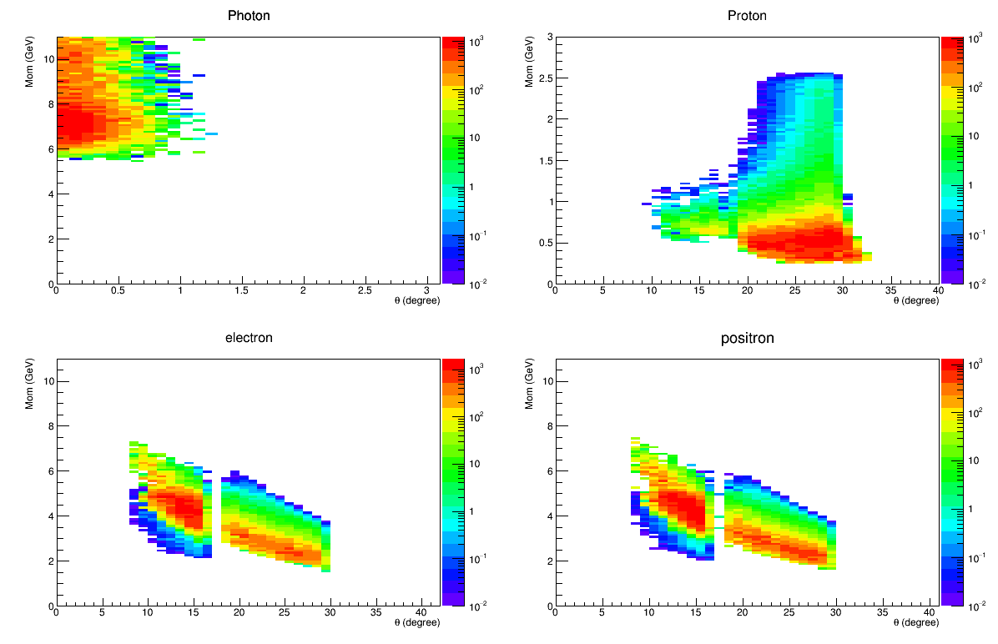
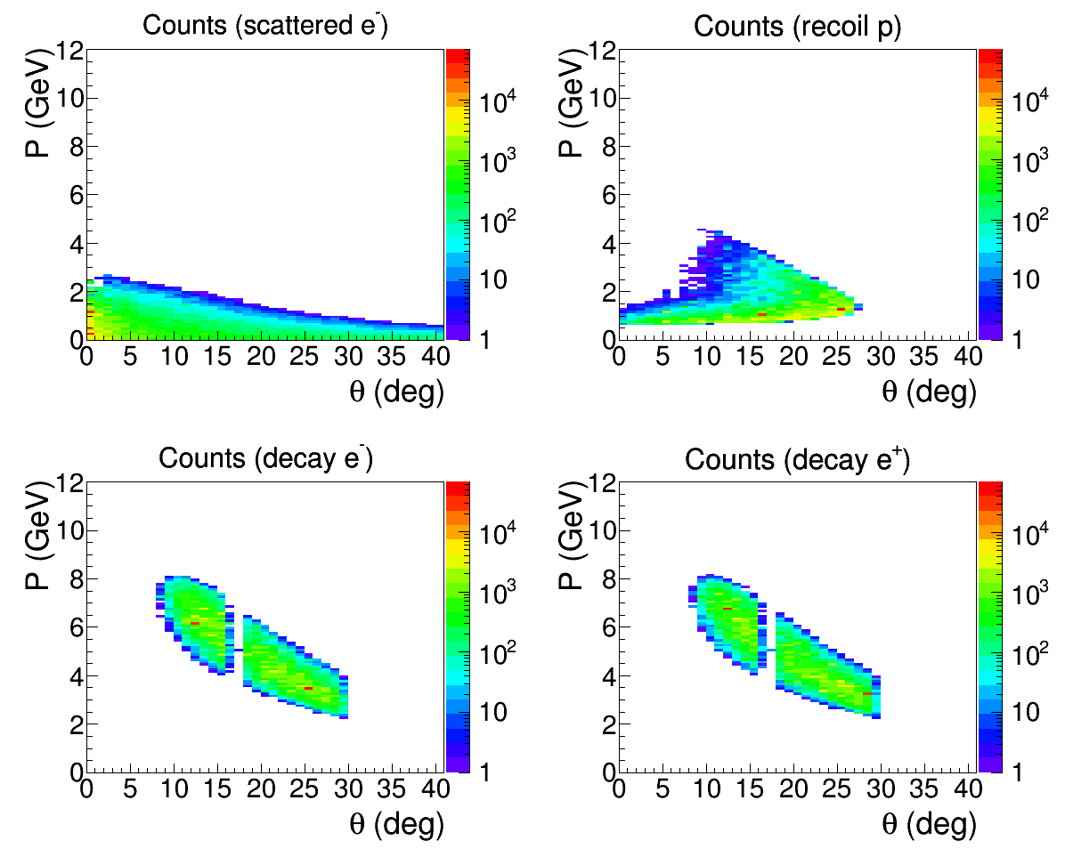
JPsi_LH2 trigger
TCS/BH (photo + quasi-photoproduction)
Jpsi (Electroproduction)
Require proton and decay pair
Require decay pair only
Possible Trigger 2 (radial): electron trigger by FAEC with 4GeV (r=105-115cm), 3GeV (r=115-145cm) and 2GeV (r=145-235cm), by LAEC with 3GeV (r=80-100cm) and 2GeV (r=100-140cm) (stars shows trigger energy)
This allows both TCS and JPsi electroproduction and photoproduction in data collection

Slide 11
Trigger condition Trigger logic
JPsi_LH2 trigger
hit matching
e_FAEC: radial, Jin’s wiser trigger curve
e_LAEC: radial, Jin’s wiser trigger curve
e_LGC: at least 2 PMT and each has at least 2 photons, similar to PVDIS
e_FASPD and h_FASPD: Edep>0.5MeV
e_LASPD: Edep>1.5MeV
e_MRPC and h_MRPC are not working yet, so not used
e_FA: e_FAEC & e_LGC & e_FASPD
e_LA: e_LAEC & e_LASPD
Starting from EC and record all hits pass trigger
Then check matching LGC sectors and two neighboring sectors, if any sector passes, then LHC pass
Then check matching SPD sector
Finally we have individual triggers, we can count single trigger rate without double counting
Then check coincidence trigger with all hits from single trigger

Slide 12
JPsi_LH2
hallD generator, SIDIS generator
& Jin’s EC Wiser trigger
hit matching
e_FA(kHz) | EC | EC+LGC | EC+LGC+SPD
electron | 355 | 321 | 300
Pim | 588 | 10.2 | 9.4
Pip | 674 | 8.5 | 7.5
P | 207 | 0 | 0
Pi0 | 1762 | 48 | 26.4
all hadrons, no electron | 3690 | 81 | 56
Total: |  |  | 356
Coincidence trigger
searches through all
possible candidates (N)
and find pairs N*(N-1)/2
Self Coin prescaled by 100
(356+433)/100=8kHz
e_LA(kHz) | EC | EC+SPD
electron | 21 | 19
Pim | 117 | 106
Pip | 179 | 164
P | 123 | 114
Pi0 | 306 | 11
all hadrons, no electron | 814 | 414
Total: |  | 433
Coin trigger rate (kHz) | e_FA | e_LA | (e_FA + e_LA) & (e_FA + e_LA)
e+pip | 250 | 24 | 5
e+pim | 185 | 18 | 3.5
e+pi0 | 217 | 19.5 | 3.6
e+p | 120 | 13 | 1.8
all hadrons, no electron | 56 | 414 | 0.3
Total |  |  | 14.2
Random coin (356+433)*(356+433)*1e3*30e-9=19KHz
True coin 14.2kHz
Total 52kHz

Slide 13
Todo
Use halld generator for He3 window
Update EC trigger curve and work on EC simulation in general
Modify halld generator including e and hadrons
Add low energy EM better
Add elastic, quasi-elastic?
Add radiative correction?
Need manpower urgently!

