Slide 1

SoLID in the JLab Program
Possible Hall A Schedule
Project Dependencies
SoLID in the context of other commitments
Rolf Ent
February 10, 2021

Slide 2
Possible Hall A Schedule
High-level schedule assumption:
SBS program (3 nucleon form factor experiments and either SBS tagged DIS or SIDIS)
MOLLER installation, engineering run, 3-year run
SoLID installation starts – about 6Q after present technically-driven SoLID project schedule assumption
Plus: any SoLID dependencies that are similar to MOLLER dependencies will be completed well ahead of SoLID

Slide 3
MOLLER depends on several facilities upgrades/improvements
Hall A electrical power and Low Conductivity Water (LCW) upgrades
  Conventional industrial systems; scheduled for FY2020-2021
  Required for SBS experiment running prior to MOLLER
End Station Refrigerator 2 (ESR-2) (for high-power SoLID target operation)
  Required to provide cooling capacity for MOLLER LH₂ target
  Project is scheduled for completion in FY2023
Polarimeter upgrades (to reach <0.5% beam polarization precision)
  Refine existing technology for both Compton and Moller polarimeters
  Leverage time during experiments scheduled for FY2020-2022 to perfect technique
  New GEM tracking detectors for Moller polarimeter are only elements on project
Beam-line and injector (for parity-violating electrons scattering program)
  Injector upgrade underway during current shutdown
  Small helicity-correlated beam asymmetries and acceptable beam halo
  Ongoing instrumentation upgrades scheduled through FY2023
Software, computing, network, and tapes
  Natural evolution of existing resource

Slide 4
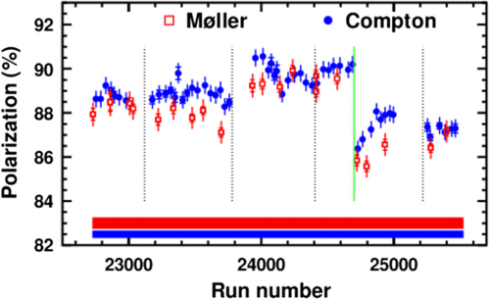
Electron Beam Polarimetry
Polarimetry in 6 GeV era:
HAPPEX 3 (2009): 1% at 3 GeV
PREX (2010): 1% at 1 GeV
QWEAK (2012): 0.62% at 1 GeV
Compton→ dP/P = 0.59%
Møller → dP/P = 0.85%
Hall C: Q-Weak, Run 2
Scale uncertainties
Precision achieved during Q-Weak (Hall C) approaches that needed for MOLLER and SoLID
  Similarities between Hall A and C polarimetry systems allow lessons from Q-Weak to be applied in Hall A
HIPPOL capital project (FY20-FY23) goal: achieve similar capabilities for the Compton polarimetry in Halls A and C (improved laser system, upgraded DAQ, diamond electron detectors).

Slide 5
Dependencies to Base Equipment - I
DAQ electronics: JLab intends to have an electronics pool to share basic DAQ electronics among the four experimental halls. Some of these electronics, mainly 188 FADCs, will be borrowed by SoLID. It was assumed that the mass storage silo will be able to handle 3 GB/s by the time the first SoLID experiment runs.
Need: 295 FADC total:
Plan to borrow 188 from electronics group - exist already
107 FADC in SoLID project budget to purchase, CD-0+2-3 years
Chips to build the current FADC250 probably won’t be buyable then, but the Fast Electronics group plans to build a new ADC with modern parts that is backwards compatible with the current model.
Physics Division in addition plans to purchase further FADC compatible with a streaming readout approach in FY24-FY27.

Slide 6
Farm Growth in Normalized core hours
Typical mode of operation:
Offline data analysis uses farm
Extensive simulations use offsite resources
SoLID requirement (projected) ~ 100 Mcore hours per year
Present cluster: 13000 physical cores.
~18000 Broadwell equivalent.
Present storage: 5 PB disk (LUSTRE)
Expect natural evolution over years with experiments pushing luminosity
Network: presently dual 10 Gb to ESNet
Note: the farm will still grow the next years in anticipation of data at higher intensity and use of newer-generation cores.

Slide 7
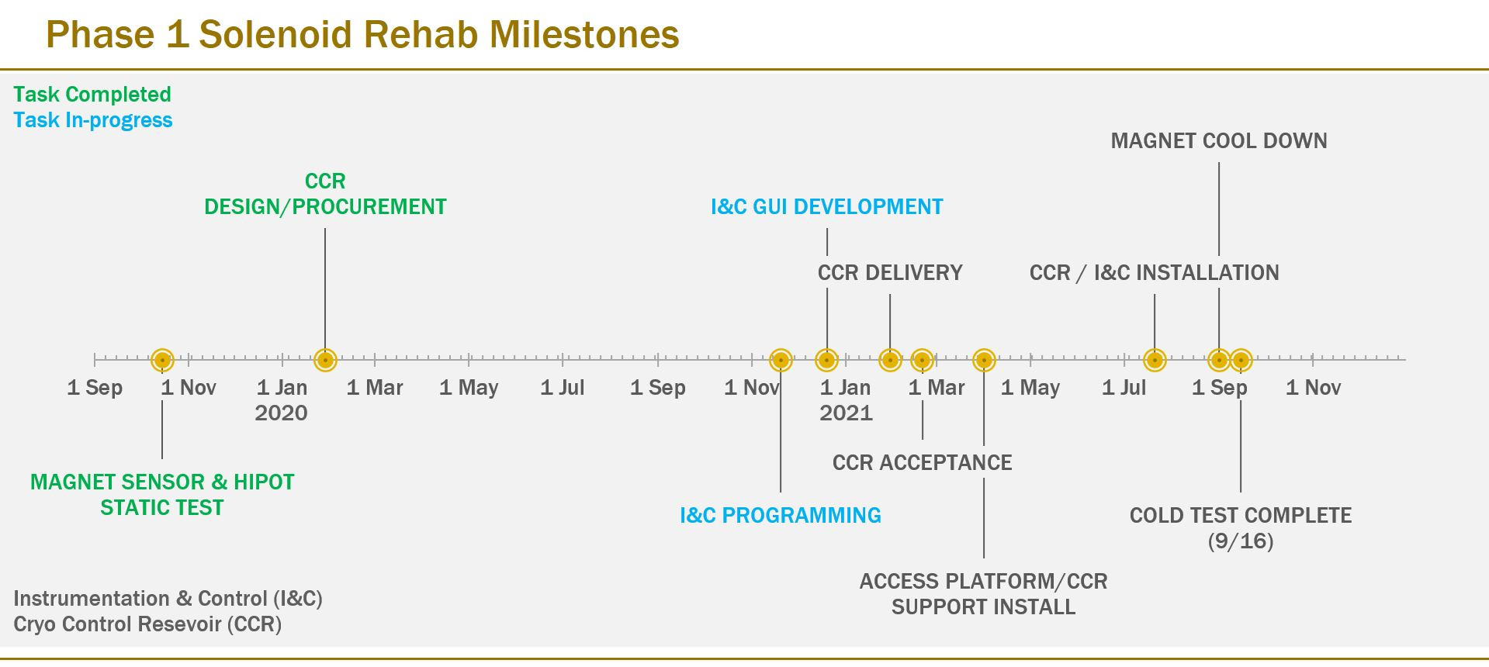
Dependencies to Base Equipment - II
Magnet: JLab formally requested the CLEO-II magnet and received a positive response from Cornell University. JLab, in coordination with Cornell, had the magnet coils, coil collars and cryostat transported to JLab in the fall of 2016. The CLEO-II magnet iron pieces arrived at JLab in August 2019.
Ongoing: preparations for a cold and low-current test later this year

Slide 8
CLEO-II Magnet Refurbishment and Testing
New Instrumentation and Control System FY18
  Design the system completed
  Identify hardware and software requirements completed
  Procurement completed
  Assemble and test of the new I&C
  in progress, preparing for assembly
New Cryo Control Reservoir FY 19-20
  Design to interface w/ CLEO and JLAB ESR system in progress
  Procurement: fabrication completed, in factory-testing phase
  Acceptance testing upon arrival (leak & pressure) – arriving soon
Static Testing of the CLEO Magnet FY 18-20
  Check out of existing instrumentation in the cryostat completed
  HIPOT test of the coil completed
  Tested 50% of the radial loadcells completed (Nov 2020)

Slide 9
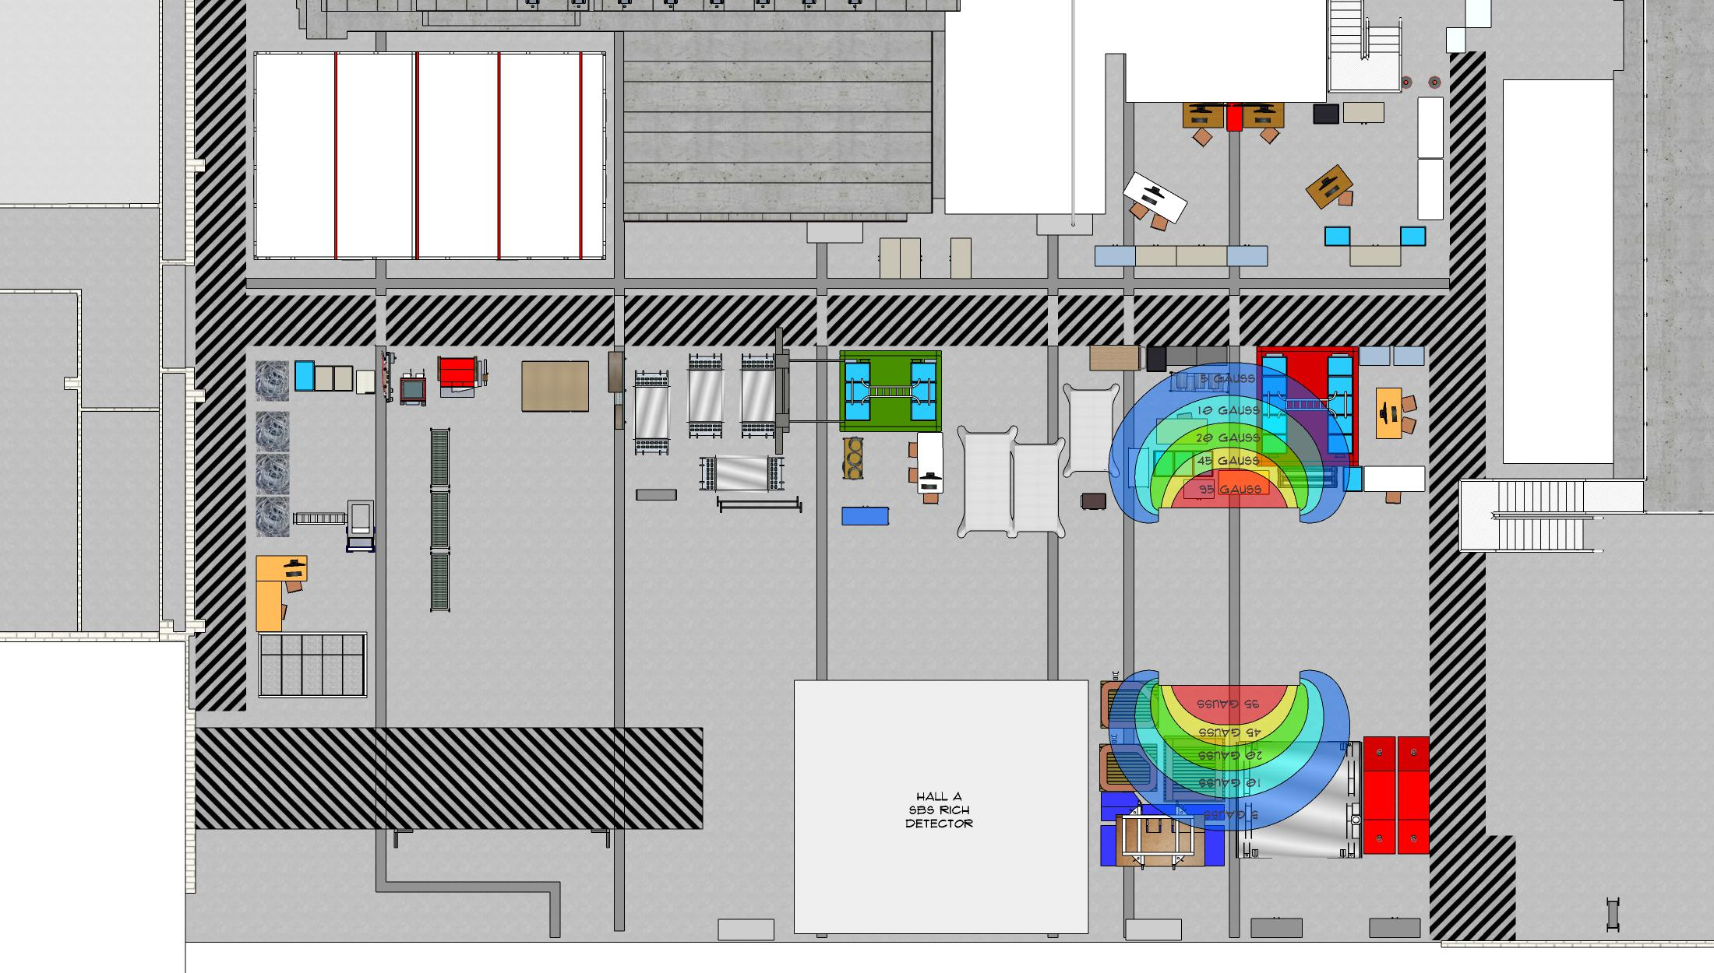
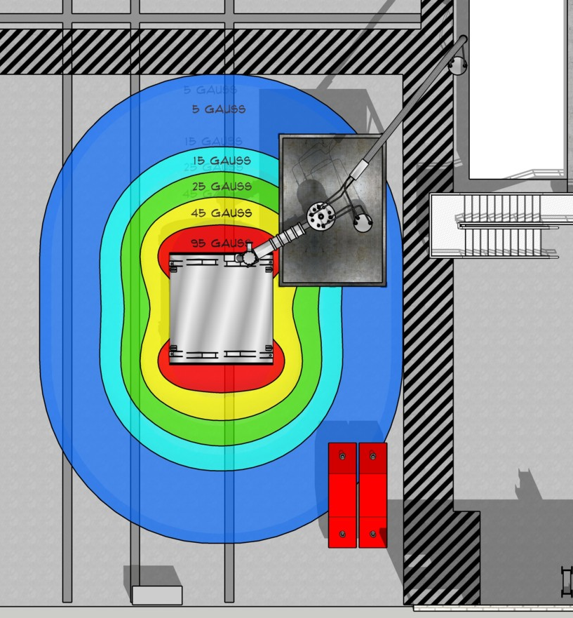
CLEO-II Magnet Refurbishment and Testing
Test Lab Layout – FY20
  Run a careful magnetic analysis of coil in test lab* – completed
  Identify 50 gauss and 5 gauss boundaries* – completed (both for 100 A without steel (left) and 800 A with one layer of steel (right))
  Identify existing transfer lines that can be used in test – completed
  Lock down final magnet position for test – in progress
Support Structures for Cold Test – FY 20-21
  Design platform to support CCR/personnel access – on going
  Design cryo line supports – in progress
Cryo supply
Power supply

Slide 10
Dependencies to Base Equipment - III
Beamline:The Hall A beamline with standard instrumentation is assumed to be in operational condition and is not included in the SoLID base equipment.
        Note: piggybacks on work for MOLLER parity beam line.
Hall: It is assumed that the experiment in Hall A directly before SoLID will be de-installed in advance of, or not interfere with, the SoLID installation. It is not yet known what experiment this will be, as it is dependent on future laboratory scheduling and resources that can not be foreseen at this time. Moreover, de-installation is a standard Hall operations procedure.
Note: per the possible Hall A schedule shown before, this operational task will be the MOLLER deinstallation.

Slide 11
Experiment-Specific Dependencies - I
For SIDIS with a polarized 3He target: The existing polarized ³He target with performance already achieved from the 6 GeV transversity (E06-010) experiment is required. However, modifications to the stand, supports, and services may be required to accommodate integration into SoLID.
    Polarized 3He targets with performance well beyond the 6 GeV transversity experiment ran in Hall C (A1n) and are planned for Hall A with SBS (GEn). However, the stand and support modifications for SoLID have not been looked into yet.
For J/Ψ: The standard cryogenic LH2 target system is assumed. This is standard Hall A equipment; however, the SoLID SIDIS configuration will require rearrangement of the detector system for the target and there may be significant modifications required for both to accommodate integration into SoLID.
    This is a standard operations task for JLab experiments.
For PVDIS: A Compton polarimeter and a superconducting Moller polarimeter (both also required by the MOLLER project) are assumed to be available.
    This piggybacks again on ongoing work in Halls A & C (FY20-FY23).
For PVDIS: modifications to a custom, high-power cryotarget beyond what is required for SBS GEp and MOLLER experiments.
    This is assumed in the capital equipment planning for FY25-FY27.

Slide 12
Experiment-Specific Dependencies - II
For SIDIS with transversely polarized proton: a transversely polarized proton target needs to be developed. The development of such a dynamic nuclear polarized target is required for other approved experiments in the JLab science program. An initial study has been performed by Oxford which concluded that such a target is feasible.
Note that this implicitly also assumes that there is a beam line chicane compatible with a multi-GeV electron beam traversing a small 5 T target magnet system.

Slide 13
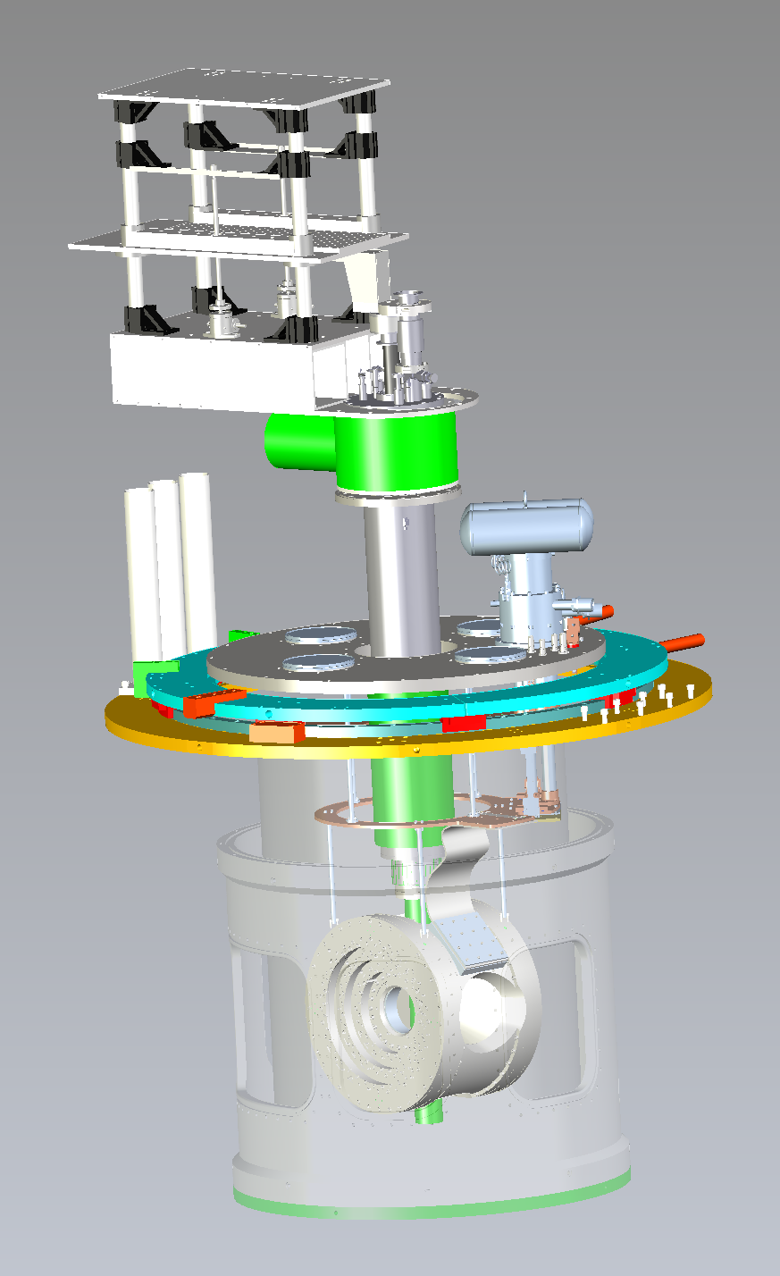
Transverse Polarized Target Status
Solid NH₃ & ND₃ dynamically polarized at 1 K & 5 T
New superconducting 5 T magnet on order
  67% larger aperture in transverse orientation (± 25°)
  Horizontal or vertical field direction
  cryogen-free: cooled by one or more cryocoolers
Existing infrastructure from previous g2p/GEp experiments
  1K refrigerator
  vacuum chamber
  microwaves
New JLab NMR system for polarization measurement
New 12,000 m³/h pumping system
beam
Expected operation in three experimental halls
Hall C (NPS/CPS)
Hall B (Run Group H)
Hall A (SoLID)
field
SoLID requirement beyond transverse target: restore beam line chicane as in g2p/Gep experiment – folded in as capital equipment for outyears (FY24-FY26)

Slide 14
Capital Equipment Projections (annual LMBB slide - draft)
Hall | Capital Equipment | FY22 | FY23 | FY24 | FY25 | FY26 | FY27
 |  | COL | COL | COL | COL | COL | COL
A | SoLID Magnet refurbish (incl. cold test)
 | Tagged DIS Detector Electronics (alternate Hypernuclear Exp. Setup)
 | High-Power Target Infrastructure
B | Transverse target (DNP)
 | High Lumi Region-1 Tracker
 | Double DVCS calorimeter (NEW)*
C | Compact Photon Source
 | High-Precision Polarimetry A/C
 | Transv. Pol. Target Infrastructure
 | SBS-like capability in Hall C (NEW)
D | Forward Calorimeter upgrade (Hi-Res)
 | Klong Beam Line
 | Transition Radiation Detector (NEW)*
All | Fast Electronics (Streaming Mode)
 | Parity DAQ/Beam Diagnostics System
 | General-Purpose Calorimetry*
Relevant for SoLID
(just in case)
LEGEND
Included
Delayed
(w.r.t. last year, due to change of planning)
Backup
Expedited
(w.r.t. last year)
From earlier FY versions, were postponed with other priorities
14

Slide 15
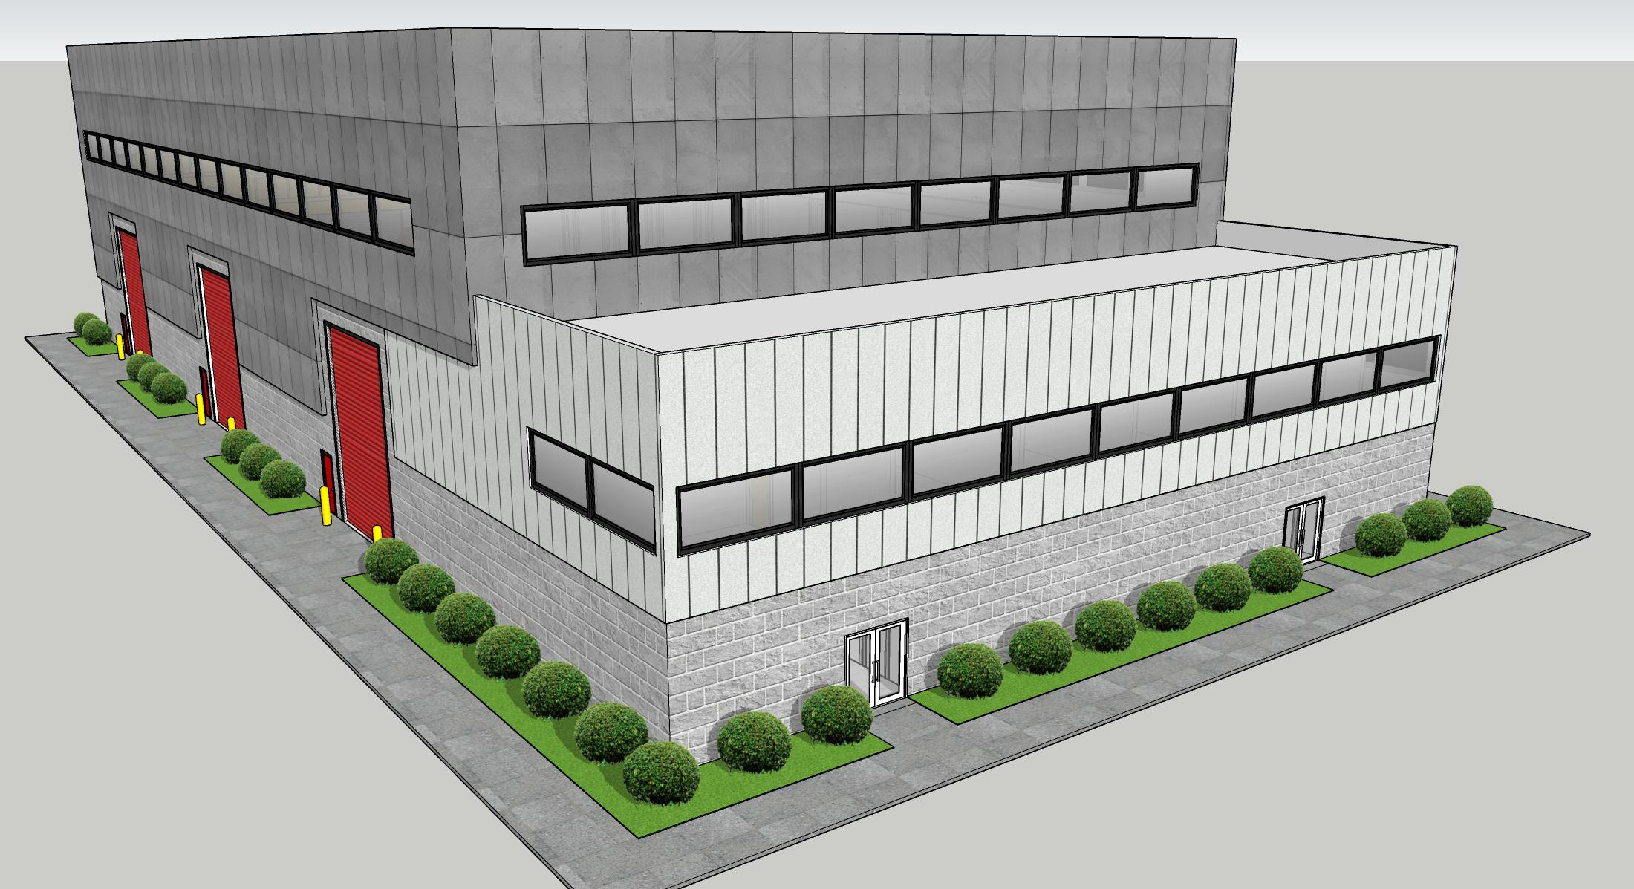
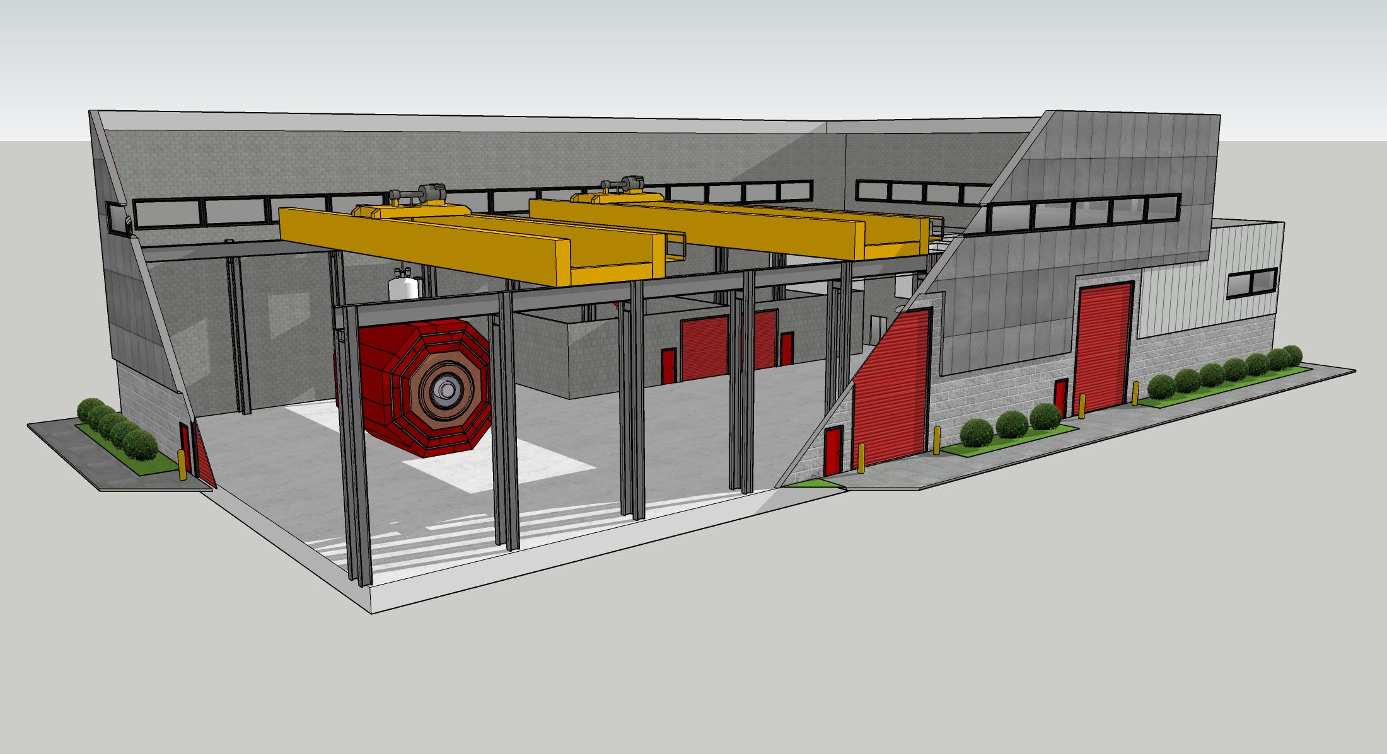
SoLID in the Context of Other JLab Commitments
In the 12-GeV Project era, JLab simultaneously delivered as new detectors:
  Hall D (~$45M PED and construction scope)
  Hall B (~$75M)
  Hall C (~$35M)
EIC detector scope and SoLID scope are similar magnitude
Main issue will be assembly space, as presently JLab does not have the possibility to fully assemble and test SoLID and then move into Hall A.
Thomas Jefferson Infrastructure Improvement Project (CD-0)
New Test Lab Hi Bay Annex
Timeframe compatible with SoLID
Northeastern Perspective
(Technical Staff Area)
Southeastern Perspective
(High Bay with CLEO-II magnet)

Slide 16
SoLID in the JLab Program - SUMMARY
The SoLID science program remains worldwide unique in the valence quark region due to its combination of large acceptance and high luminosity.
The Hall A science program is foreseen to be a few years of SBS experiments followed by MOLLER installation and running, and then the SoLID program.
The technically-driven SoLID schedule as assumed by the collaboration would be about 6Q early with reasonable assumptions for SBS and MOLLER
Many of the base-equipment dependencies of SoLID take advantage of the earlier need for MOLLER (polarization, beam line, ESR-2)
Many of the experiment-specific dependencies take advantage of synergy with the experimental programs in other Halls (fast and/or streaming electronics, computing needs, polarized 3He target, transverse dynamic nuclear polarized target system)
SoLID is compatible with other JLab commitments, and a natural part of the 12-GeV science program.
This is reasonable at this stage of the SoLID project.
As a result, all dependencies are in the planning and/or execution phase to be ready well in advance of SoLID.

Slide 17
Backup

Slide 18
Dependencies to Base Equipment – from pre-CDR
DAQ electronics: JLab intends to have an electronics pool to share basic DAQ electronics among the four experimental halls. Some of these electronics, mainly 188 FADCs will be borrowed by SoLID. It was assumed that the mass storage silo will be able to handle 3 GB/s by the time the first SoLID experiment runs.
Magnet: JLab formally requested the CLEO-II magnet and received a positive response from Cornell University. JLab, in coordination with Cornell, had the magnet coils, coil collars and cryostat transported to JLab in the fall of 2016. The CLEO-II magnet iron pieces arrived at JLab in August 2019.
Beamline: The Hall A beamline with standard instrumentation is assumed to be in operational condition and is not included in the SoLID base equipment.
It is assumed that the experiment in Hall A directly before SoLID will be de-installed in advance of, or not interfere with, the SoLID installation. It is not yet known what experiment this will be, as it is dependent on future laboratory scheduling and resources that can not be foreseen at this time. Moreover, de-installation is a standard Hall operations procedure.

Slide 19
Experiment-specific Dependencies – from pre-CDR
For SIDIS with a polarized 3He target: The existing polarized 3He target with performance already achieved from the 6 GeV transversity (E06-010) experiment is required. However, modifications to the stand, supports, and services may be required to accommodate integration into SoLID.
For J/Ψ: The standard cryogenic LH2 target system is assumed. This is standard Hall A equipment; however, the SoLID SIDIS configuration will require rearrangement of the de- tector system for the target and there may be significant modifications required for both to accommodate integration into SoLID.
For PVDIS: A Compton polarimeter and a superconducting Moller polarimeter (both also required by the MOLLER project) are assumed to be available.
For PVDIS: modifications to a custom, high-power cryotarget beyond what is required for SBS GEp and MOLLER experiments. The scope will be folded into JLab’s planning. ESR2 is assumed to be available as required by the MOLLER project.
For SIDIS with transversely polarized proton: a transversely polarized proton target needs to be developed. The development of such a dynamic nuclear polarized target is required for other approved experiments in the JLab science program. An initial study has been performed by Oxford which concluded that such a target is feasible.

