Slide 1
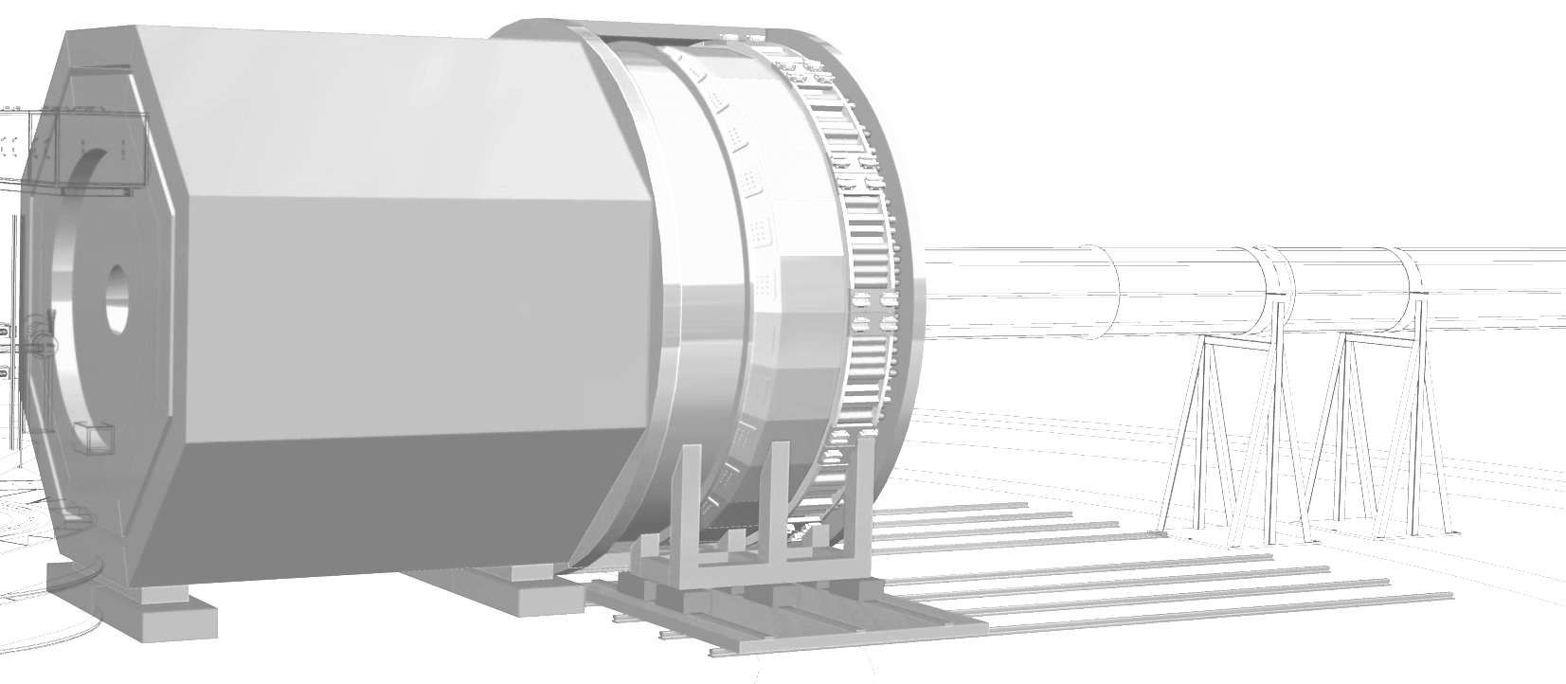

Overview of SoLID
Director’s Review of SoLID
Febuary 9-10, 2020
Jian-ping Chen
Jefferson Lab
Acknowledgement: Thanks to many of my SoLID collaborators for helping with slides:
Alexandre Camsonne, David Flay, Haiyan Gao, Ole Hansen, Garth Hubert,
Nilanga Liyanaga, Zein-Eddine Meziani, Chao Peng, Michael Paolone, Whit Seay,
Paul Souder, Steve Wood, Zhihong Ye, Jixie Zhang, Zhiwen Zhao, Xiaochao Zheng, …

Slide 2
Outline
Introduction and Overview of SoLID:
Physics, Timeline, Collaboration
Technical Requirements
2. Pre-Conceptual Design
Subsystems, Simulated Performance,
Risk Assessments
3. Pre-R&D Activities
Previous Director’s Reviews
Cost and Schedule Estimation
6. Summary

Slide 3
The JLab Director’s Review Charge:
(C1) The significance of scientific questions identified by the SoLID Collaboration.
(C2) The impact of the planned scientific program on the advancement of nuclear physics in the context of current and planned world-wide capabilities, including the US Electron Ion Collider.
(C3) The new experimental and theoretical research efforts and technical capabilities needed to accomplish the proposed scientific program.
(C4) The feasibility of the approach or method presented to carry out the proposed scientific program and the likelihood that significant results can be obtained in the first three years of detector operations.
This presentation will give an introduction/overview,
then provide information related to C3 and C4.

Slide 4
Introduction and Overview of SoLID
Physics, Timeline, Collaboration
Technical Requirements

Slide 5
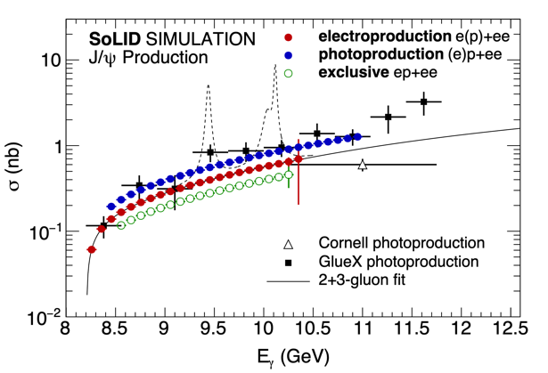
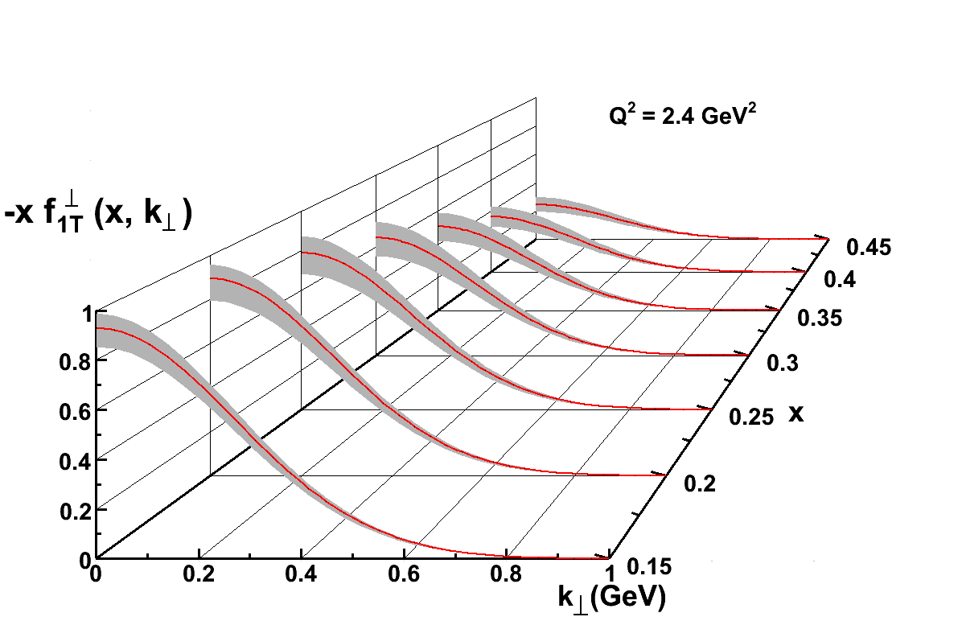
SoLID Physics Overview
Full exploitation of JLab 12 GeV Upgrade to maximize scientific return
A Large Acceptance Detector AND Can Handle High Luminosity (10³⁷-10³⁹)
  SIDIS: 3D momentum imaging of a relativistic strongly interacting confined system (nucleon spin)
  PVDIS: pushing the phase space in the search of new physics and of hadronic physics
  Precision threshold J/ψ - probing strong color fields in the nucleon (proton mass)
Strong collaboration (270+ collaborators from +70 institutions, 13 countries)
  Anticipate international contributions
  Strong theoretical support
SoLID physics complementary and synergistic with the EIC science (proton spin and mass, two important EIC science questions) – high-luminosity SoLID unique for valence quark tomography and precision J/𝝍 production near the threshold

Slide 6
Timeline
- Since 2010: Five SoLID experiments approved by PAC with high rating
3 SIDIS with polarized ³He/p target, 1 PVDIS, 1 threshold J/ψ
Six additional run-group experiments approved
SoLID collaboration, with JLab support, has been continuously working on
pre-conceptual design and pre-R&D
2013: CLEO-II magnet requested, agreed, arrived at JLab 2016,
2014: pCDR submitted to JLab with cost estimation
2015: 1st Director’s Review: positive with many recommendations
- 2017: Updated pCDR submitted to JLab with responses to the recommendations
- 2018: DOE NP visit and discussion: → update cost estimation
- 1/2019: Updated pCDR (new cost estimation) submitted to JLab
9/2019: 2nd Director’s Review: successful with only few recommendations
Late 2019: Pre-R&D plan approved, funding started 2/2020
2/2020: SoLID MIE (with updated pCDR) Submission to DOE
3/2021: SoLID DOE Science (Scheduled)

Slide 7
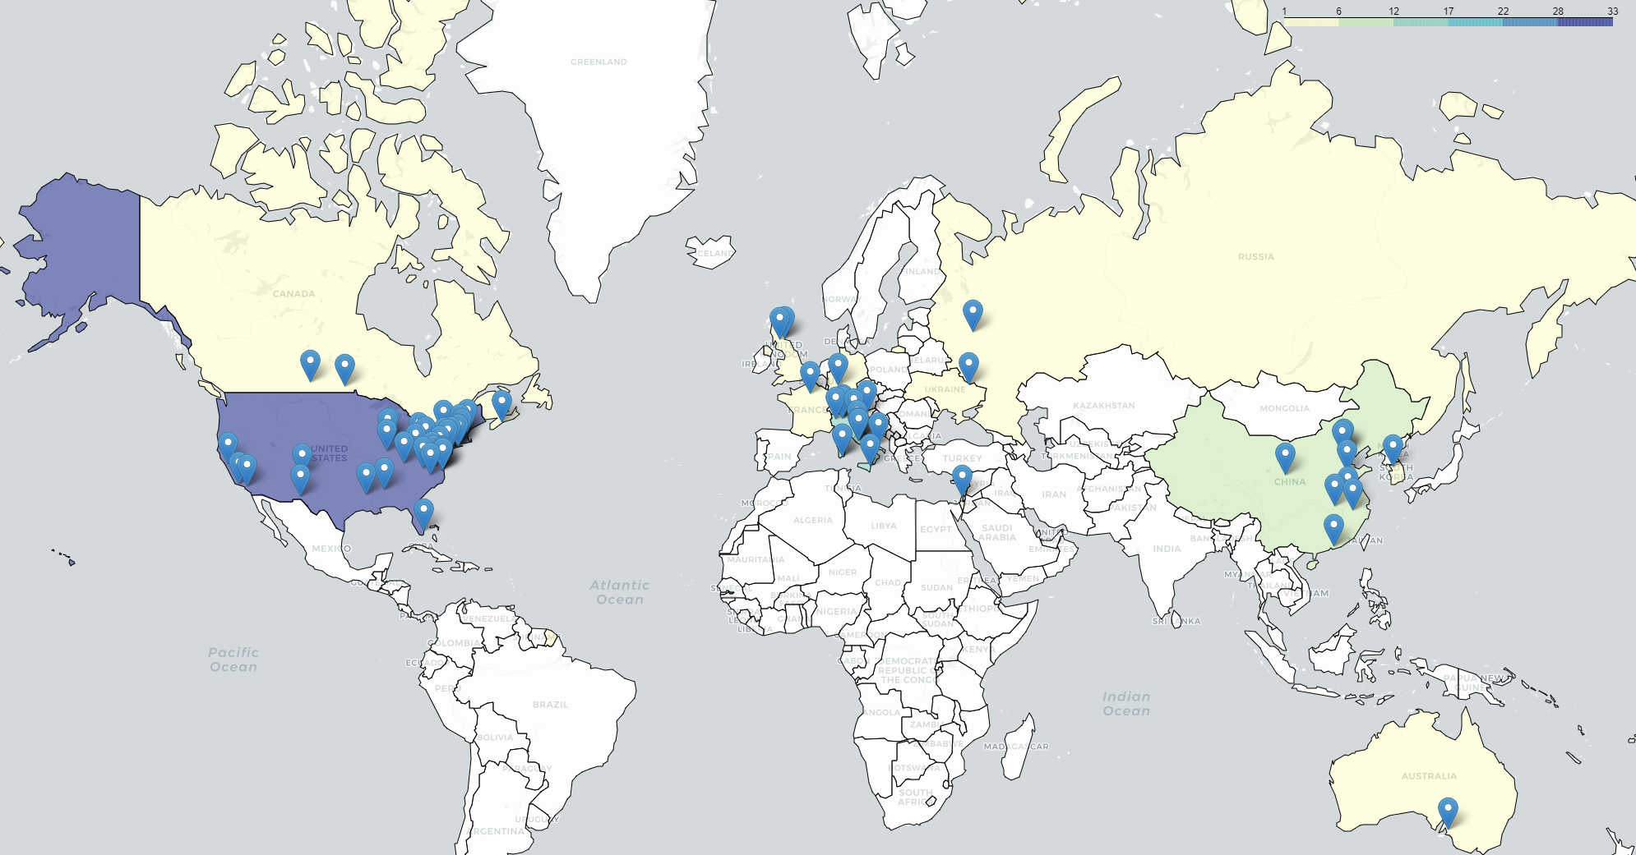
Strong Collaboration
- 270+ collaborators, 70+ institutions from 13 countries
Large international participations and anticipate contributions
Strong theory support

Slide 8
Technical Requirements
High luminosity (10³⁷ for SIDIS and J/ψ, 10³⁹ for PVDIS with baffle)
Particle detection:
PVDIS: single e-
SIDIS: coincidence e and pi+/pi- (K+/K- with enhanced configuration)
J/ψ: e- and e+e- (also e+e- for photoproduction, e-, e+e-, p for systematics)
Large acceptance: 2π in φ angle, θ angle: 8-24 degrees for SIDIS, J/ψ
22-35 degrees for PVDIS
Momentum range: 1 - 7 GeV/c
High rates (100 KHz trigger rate for SIDIS, 600KHz/30 for PVDIS)
High background (~ GHz, dominated by low energy photons/electrons)
High radiation environment
Moderate resolutions (~2% in momentum, 1-3 mr in θ, 6 mr in φ)
Good electron PID
Moderate pion PID (SIDIS)
Demanding Kaon PID (SIDIS-Kaon, enhanced configuration)
High precision with low systematics
* Targets (cryogenic LH2/LD2, T/L polarized 3He, T polarized NH3)
* Beam polarimetry (demanding precision for PVDIS, 0.4%)
* Dependencies (see talk by Rolf Ent)

Slide 9
2. Pre-Conceptual Design
Subsystems, Simulated Performance,
Risk Assessments
Related to Charges C3 and C4

Slide 10
SoLID in Hall A
Plan for installing SoLID in Hall A with other equipment moved out of the way.

Slide 11
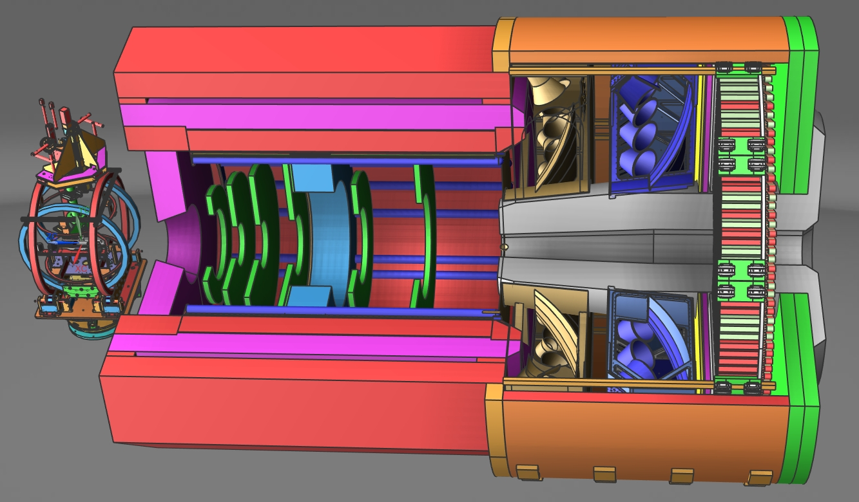
SoLID Apparatus
Polarized ³He (``neutron”) @ SoLID
Requirements are Challenging
High Luminosity (10³⁷-10³⁹)
High data rate
High background
Low systematics
High Radiation
Large scale
Modern Technologies
  GEM’s
  Shashlik ECal
  Pipeline DAQ

Slide 12

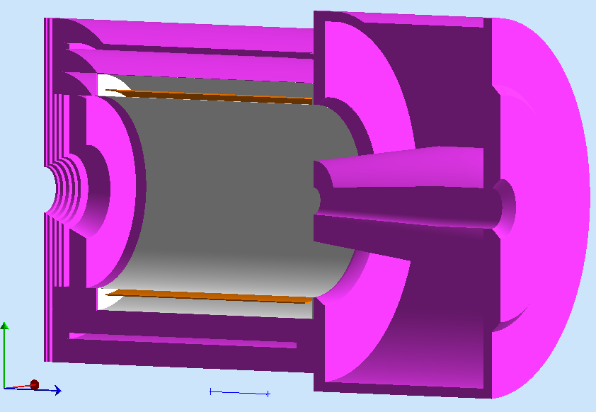
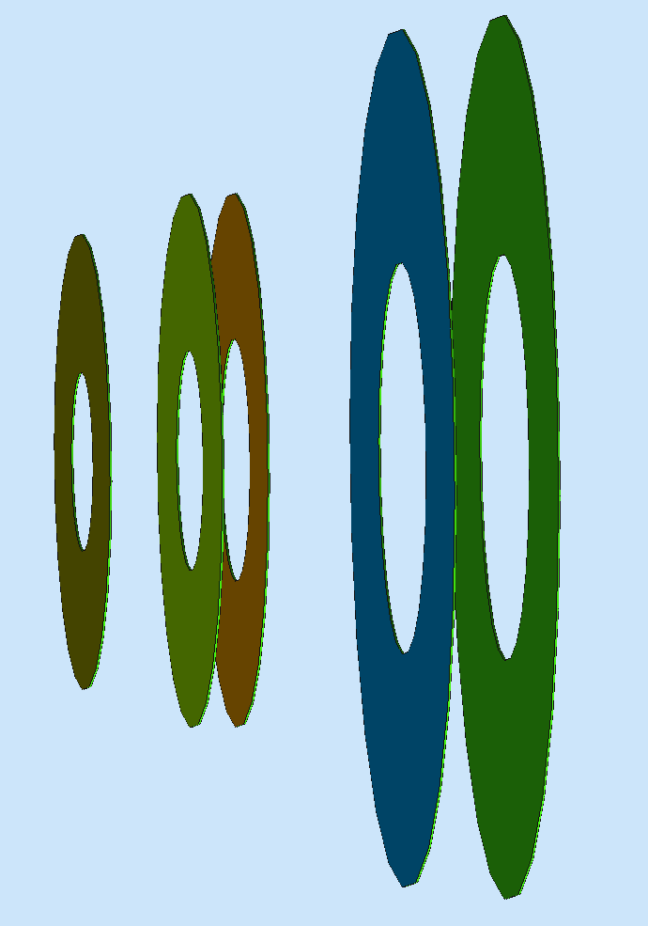
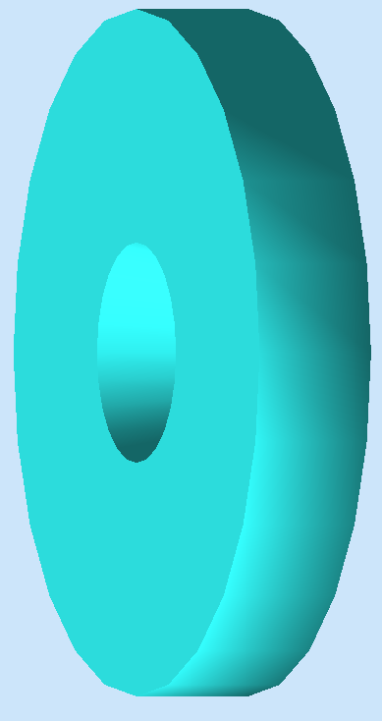
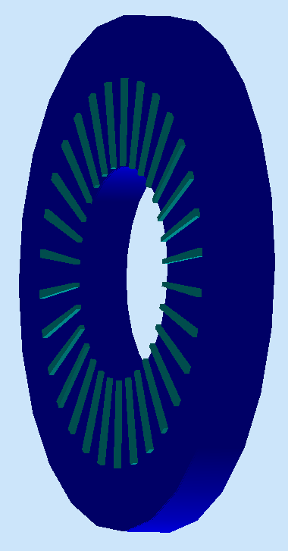
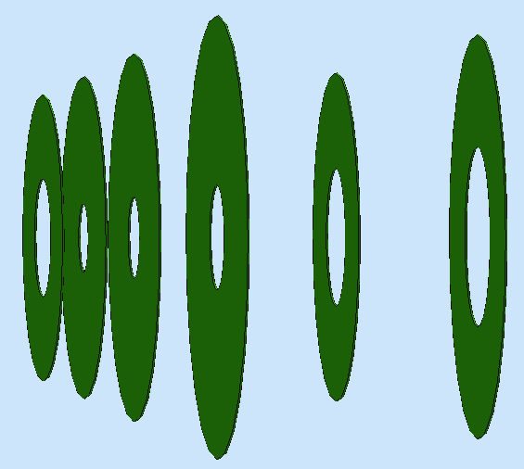

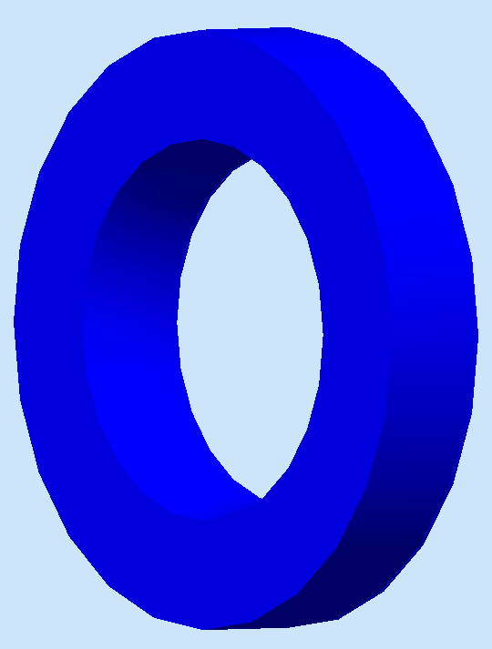
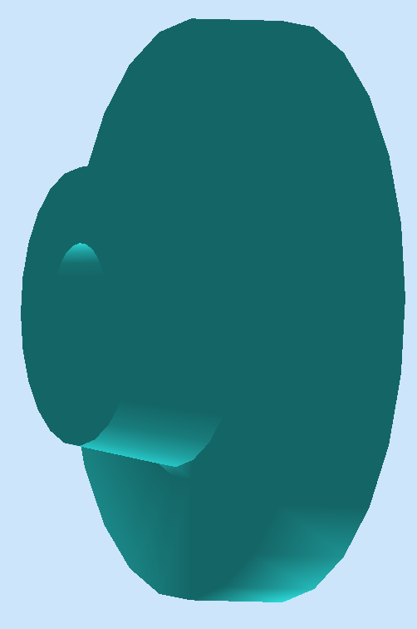
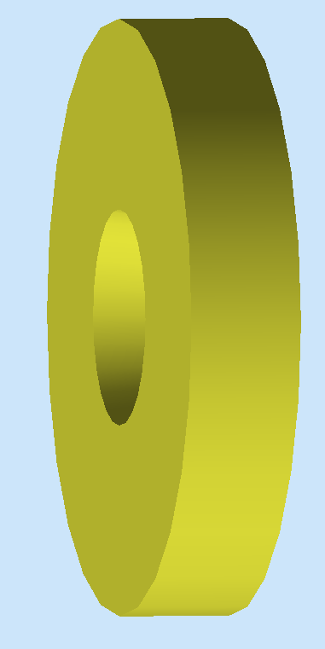


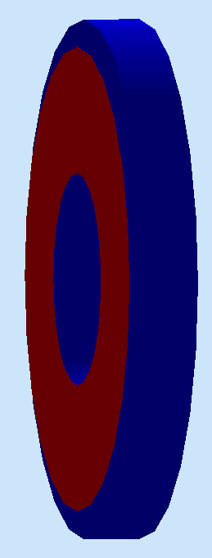
SoLID Detector Subsystems
Uses full capability of JLab electronics
PVDIS: Baffle 3xGEMS LGC 2xGEMs EC
SIDIS&J/ψ:
4xGEMs LASPD LAEC 2xGEMs LGC HGC FASPD (MRPC) FAEC
Pre-R&D items: LGC, HGC, GEM’s, DAQ/Electronics, Magnet

Slide 13
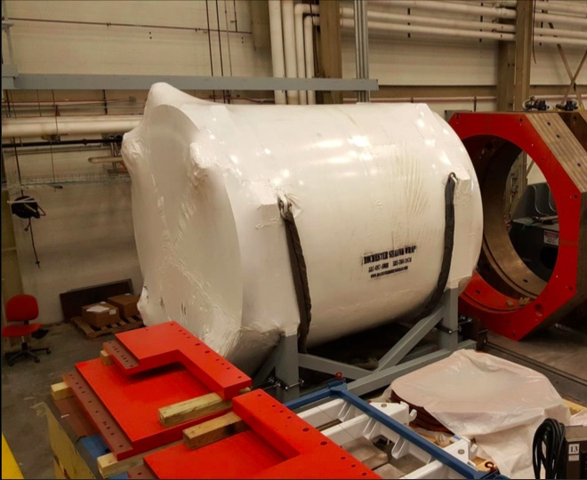
Magnet: Requirement and Design
Requirements:
→Acceptance: P: 1.0 – 7.0 GeV/c;
Φ: 2π; θ: 8º-24º (SIDIS), 22º-35º (PVDIS)
→ Resolution: δP/P ~ 2%
(requires 0.1 mm tracking resolution)
→ Fringe field at the ³He target < 5 Gauss
CLEO II coil at JLab
Use CLEO II magnet with the following
modifications
  Two of three layers of return yoke
  needed
  Add thickness to front endcap
  Add extended endcap
Yoke for SoLID

Slide 14
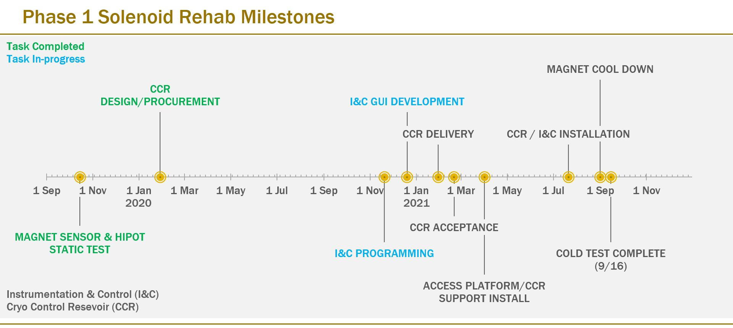
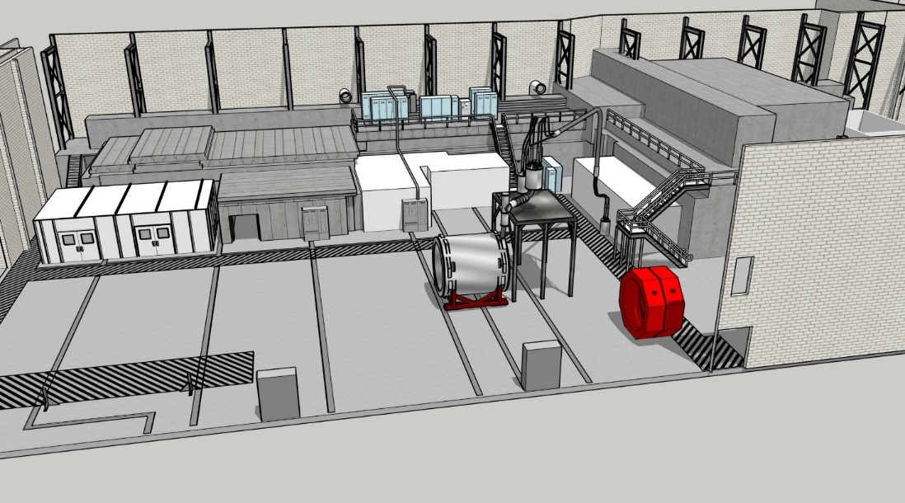
Cold Test Update – Cold Test Milestones
Solenoid rehab will confirm condition of the magnet
Provide risk reduction to the project
Improve magnet cost estimate
Estimated completion Sept 2021
Test Lab Control Room
Cryo Dist Can

Slide 15

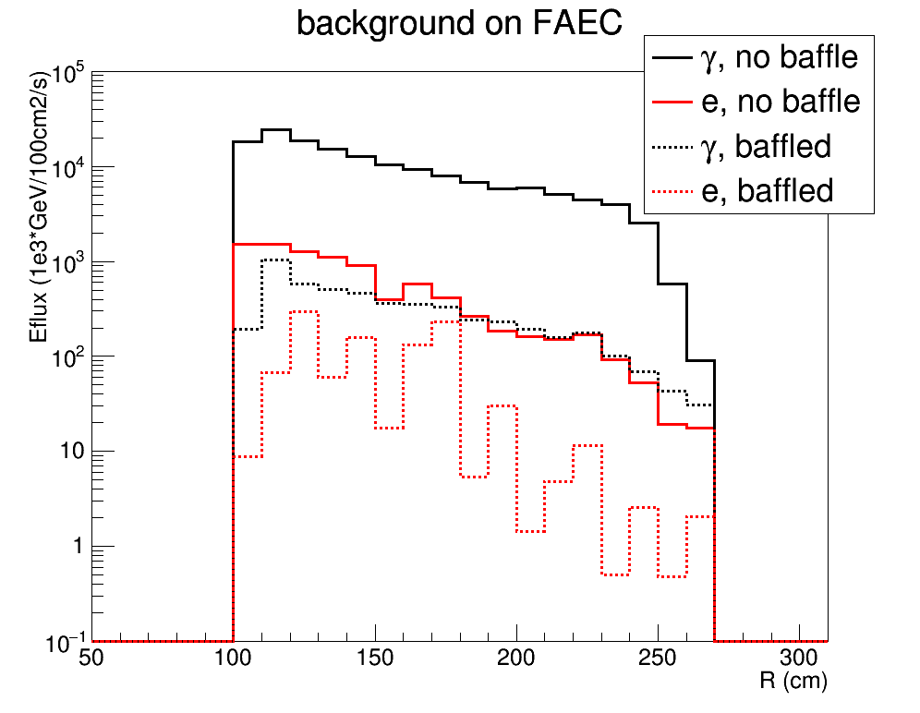
PVDIS Baffle Design
SoLID PVDIS needs to run 1x10³⁹/cm²/s luminosity
Baffle is made of 12 planes of 9cm thick lead with slits following electron bending in SoLID field
It blocks neutral and positive tracks from target, and thus reduces background by 1-2 orders of magnitude and reduces trigger rate to be within DAQ capability
Acceptance ~30% for DIS electrons is maintained at P>3GeV and x>0.4 region

Slide 16
GEM tracking
Rate capabilities > many MHz/cm²
High position resolution
Cover large areas at reasonable cost
Low thickness (~0.5 radiation length)
Used in many experiments (COMPASS, STAR, ALICE, PRad@JLab…) and planned for many future experiments SBS@JLab, CMS upgrade, EIC…)
GEM configuration
GEM Technology
EIC Prototype: similar to SoLID design

Slide 17
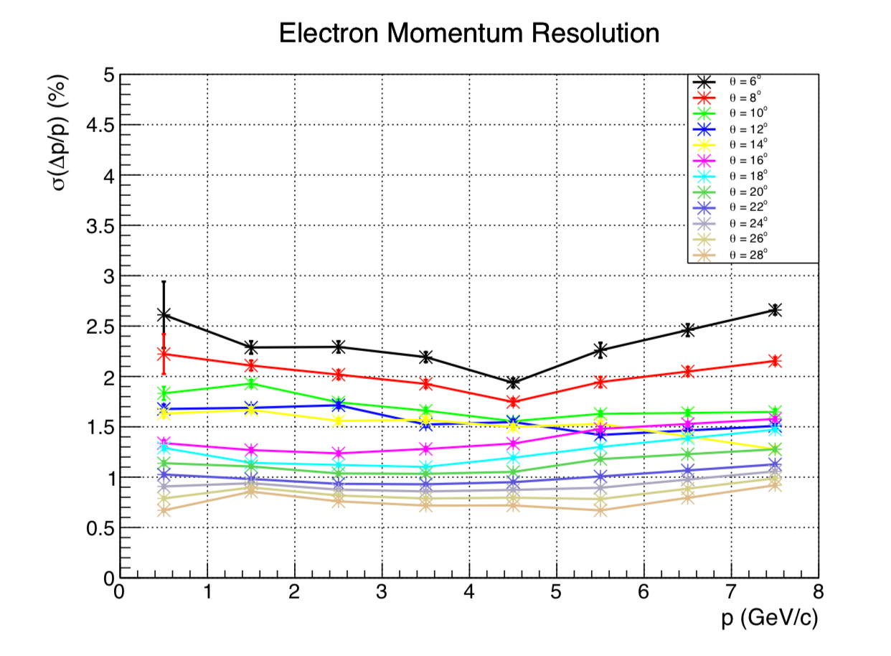

Simulated GEM Performance
<2% for $θ$ > 10º
Electron Momentum Resolution versus angle
Efficiency and accuracy for
PVDIS versus kinematics
Risk:
VMM chips need testing: addressed in Pre R&D plan
APV versus VMM

Slide 18
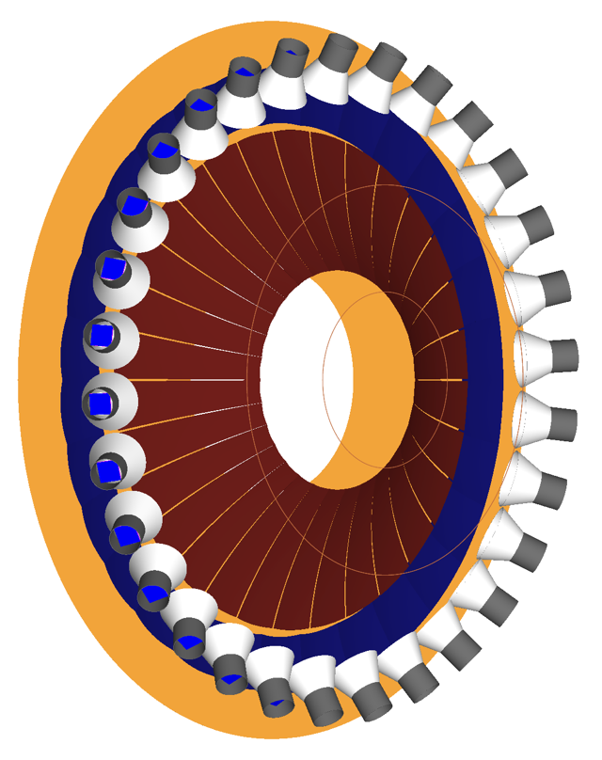
Light Gas Cerenkov: Requirements
General Requirement A: Provide 500:1 electron / pion separation for the major SoLID programs: PVDIS, J/Psi, and SIDIS.
General Requirement B: Provide trigger level input while maximizing efficiency and minimizing cost.

Slide 19
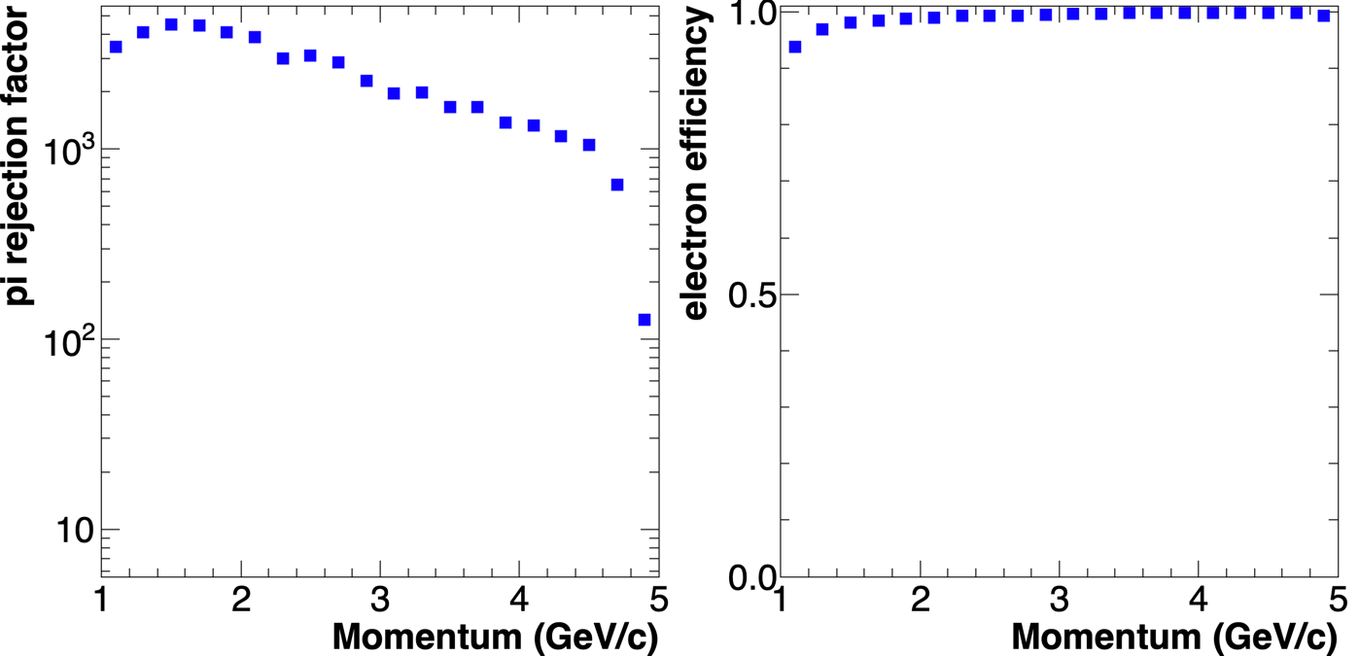
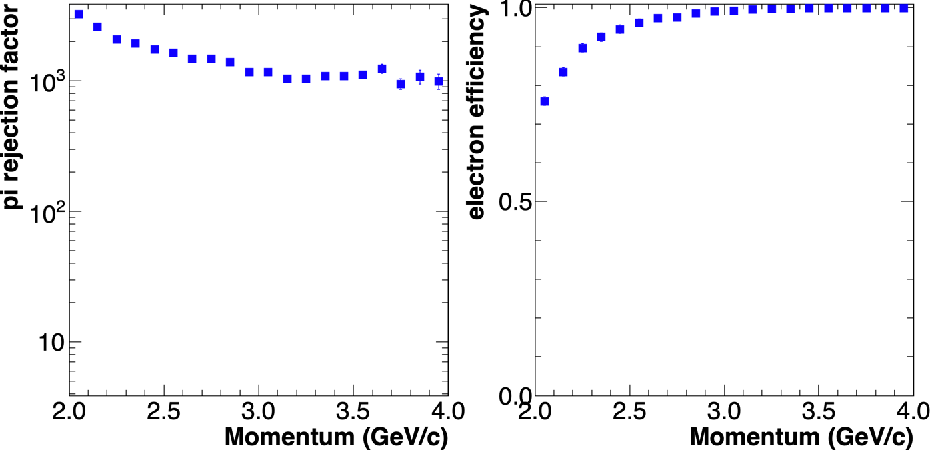
LGC Performance and Risk
With the proposed LGC design, pion rejection factors stay above 500:1 for both configurations.
Pion threshold at 20C and 1 atm:
  N₂: 5.73 GeV/c
  CO₂: 4.67 GeV/c
J/Psi SIDIS
Technical risk: optimizing performance at high rates, addressed in Pre-R&D plan.
PVDIS

Slide 20
Heavy Gas Cerenkov (HGC)
HGC is used to identify charged pions and reject charged kaons.
It is only used for SIDIS experiments.
Field at photonsensor location: ~100G
Radiator: ~1m C4F8 gas at 1.7atm at 20C
Not in trigger
Otherwise, similar to the LGC

Slide 21
Heavy Gas Cerenkov: Simulated Performance
Simulated NPE versus momentum
Kinematic coverage: 2.5GeV < P < 7.5GeV, 8º < θ < 15º, full azimuthal angle
π⁺/π⁻ detection: efficiency >90%, Np.e. > 10
K⁺/K⁻ rejection: factor >10
2.5-3.0GeV, 8-9deg
7.0-7.5GeV, 14-15deg
Simulated Response to pions and kaons

Slide 22
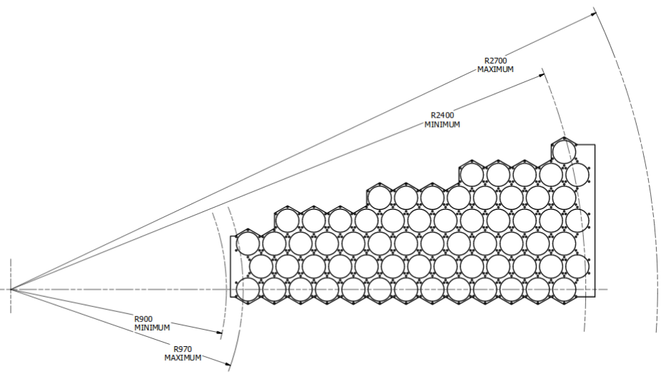
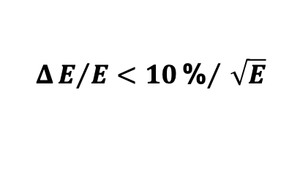
ECal Requirement and Design
$$ΔE/E<10{\text{\%}}/{\sqrt{E}}$$
– Combined with LGC to provide triggering;
– 50:1 pion rejection with 90% electron efficiency;
– provide ~1cm shower position for background suppression;
– radiation hard: >500 krad, high neutron background;
– inside 1.5 T field
– modules swappable between PVDIS and SIDIS

Slide 23
ECAL Performance
Realistic simulation with background and supporting material
FAEC electron
Resolution: for all angles, reached p0~(5-6)% and p2~(5-6)%
FAEC pion

Slide 24
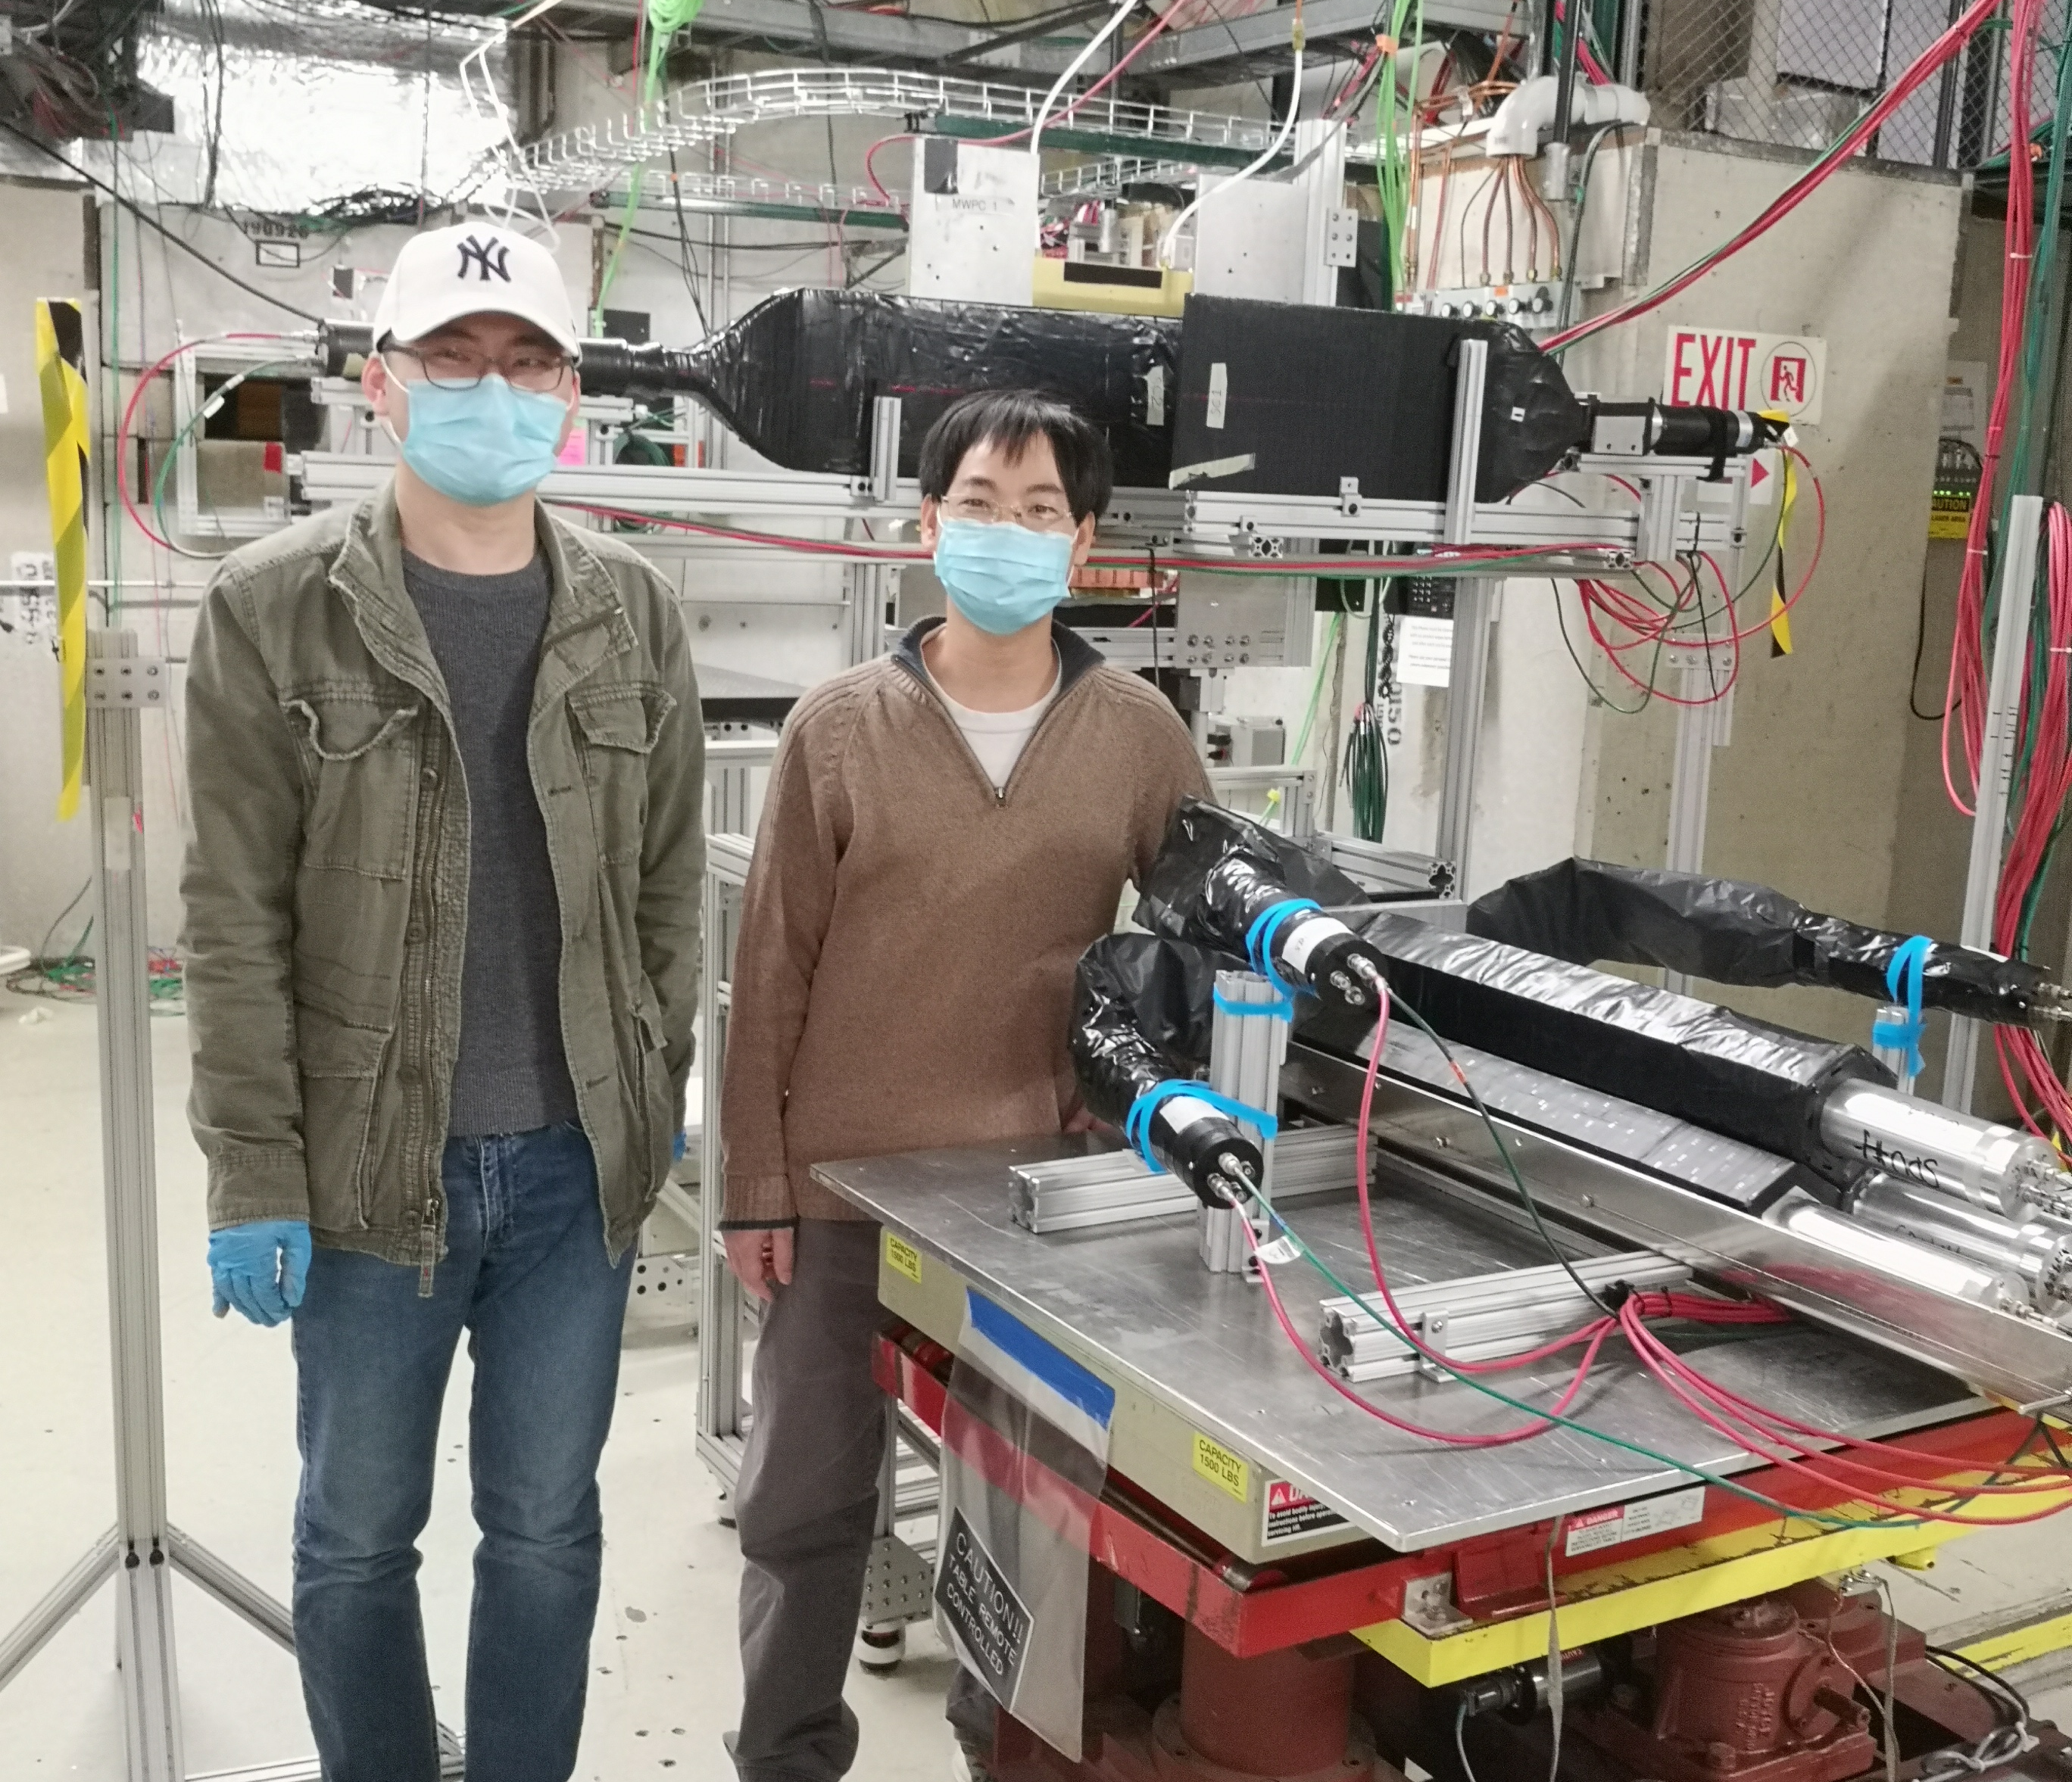
Fermilab Beam Test with Shashlyk Modules
Goal: Understand the detection resolution and efficiency of the Shashlyk modules
Beam time: Jan 13-26, 2021
Setup: 2X₀ lead, 3 preshower, 2-cm Al support, 3 Shashlyk modules; FTBF’s MWPC+Cherenkov
People power: (UVA) Jixie Zhang, Xinzhan Bai; (JLab) Alexandre Camsonne, David Flay;
(ANL) Paul Reimer, Junqi Xie, Manoj Jadhav
scintillator
Beam energy (GeV) | total trigger | total electron trigger (online)
1 | 3.1M | 3.0M
2 | 2.9M | 2.7M
4 | 4.5M | 3.9M
6 | 2.8M | 2.1M
8 | 5.5M | 3.4M
10 | 6.8M | 3.6M
12 | 3.0M | 1.3M
16 | 7.6M | 2.3M
beam
pre-shower
shower

Slide 25
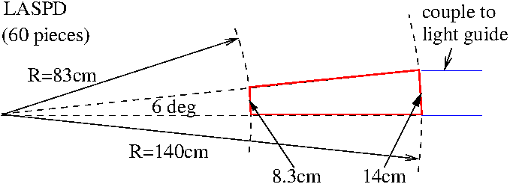
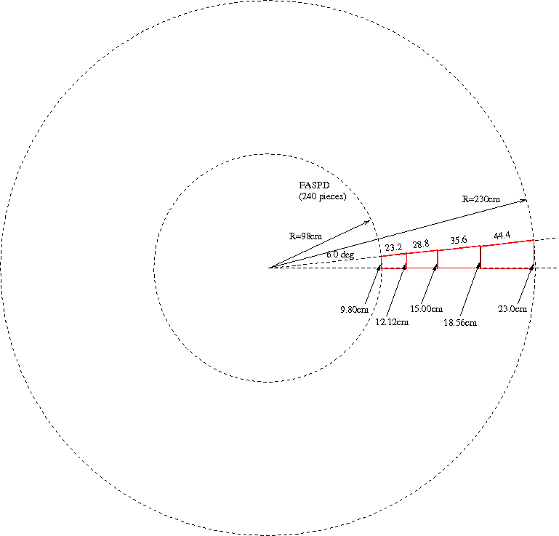
Scintillator Pad Detector: Requirements and Design
LASPD: photon rejection 5:1;
coincidence TOF (150ps)
→ design: 20mm-thick,
60 azimuthal segments,
direct coupling to fine-mesh PMT
FASPD: photon rejection 5:1
→ design: 5-10mm-thick
240 segments (60 X 4)
WLS fiber embedding,
MAPMT (outside magnet)

Slide 26
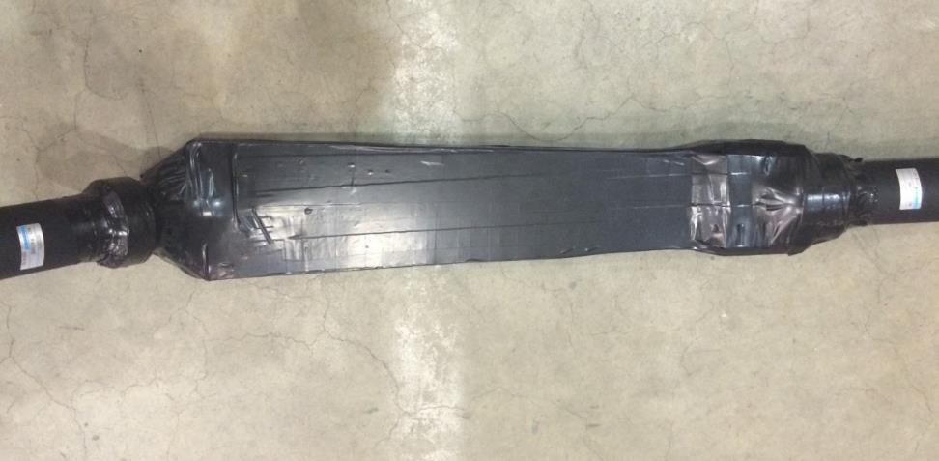
Scintillator Pad Detector: Requirements and Design
LASPD: photon rejection 5:1;
coincidence TOF (150ps)
→ design: 20mm-thick,
60 azimuthal segments,
direct coupling to fine-mesh PMT (for FMPMT study see NIMA 827 (2016) 137-144)
a LASPD prototype equipped with (regular) PMTs
FASPD: photon rejection 5:1
→ design: 5-10mm-thick
240 segments (60 X 4)
WLS fiber embedding,
MAPMT (outside magnet)

Slide 27
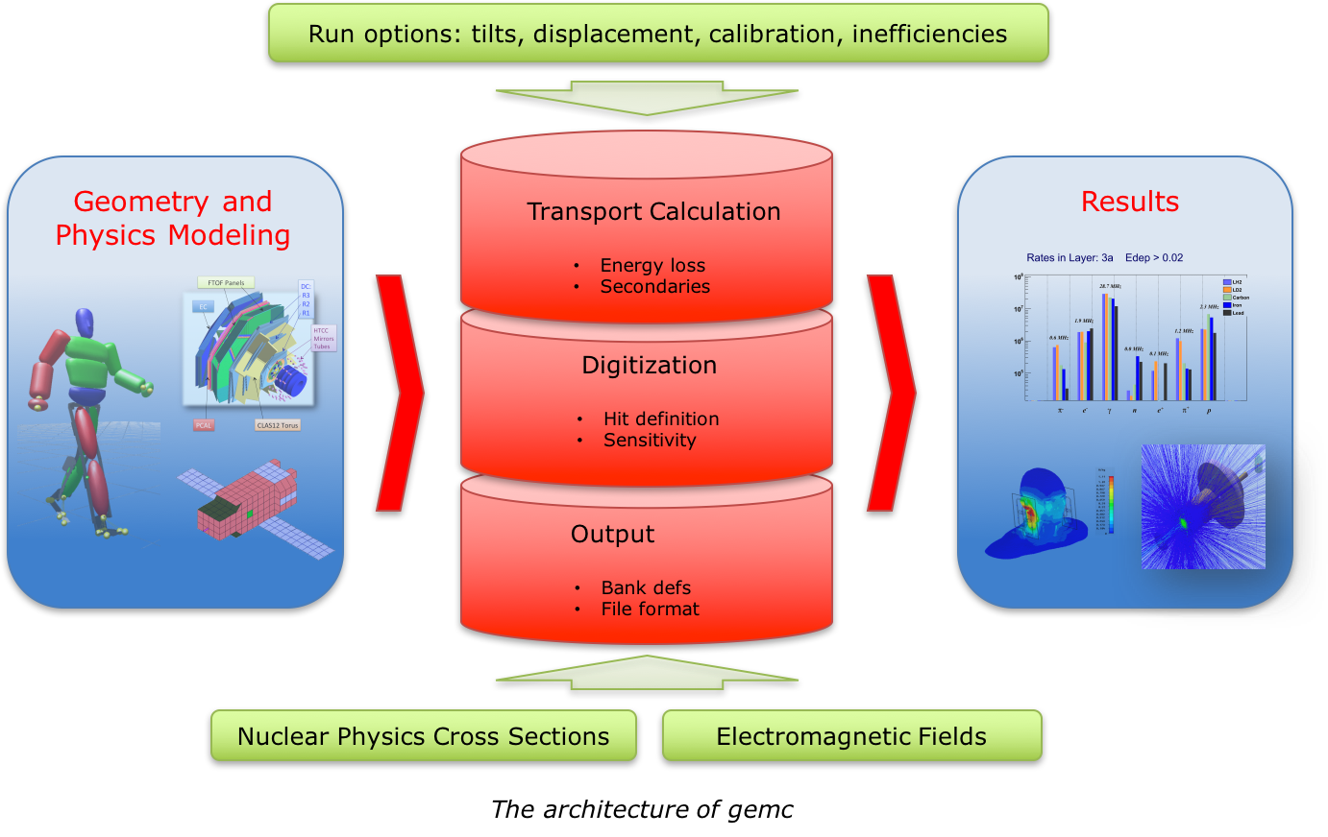
Software and Simulations
Existing simulations: SoLID_GEMC
GEMC is a Geant4-based simulation package, used by CLAS12.
Added SoLID detector description and signal digitization, esp. for GEMs.
Used extensively for SoLID pre-CDR and in current pre-R&D studies.
Variety of physics generators available.
Long-term goals
Develop end-to-end simulation and reconstruction chain.
  Integrated software environment for (almost) all parts of data processing
  Modern, multi-threaded, grid-enabled framework written in C++
  Common conditions data and geometry database API
  Consistent ROOT-based event data file format w/ metadata storage
  Python or JSON/YAML-based job configuration
Provide online and offline analysis software, event display, calibration tools etc. as well as complete set of simulation and digitization modules.
Feasibility studies underway in collaboration with other JLab groups.

Slide 28
DAQ Requirements and Design
DAQ based on 12 GeV FADC base pipelined electronics designed for 200 KHz trigger rates,100 kHz rates demonstrated in Hall B and D
VMM chip based readout for GEMs
  ATLAS Small Wheel Micromegas readout chip : up to 4 MHz trigger rate per channel, limited by occupancy in detector – designed for 200 KHz
  Older chip APV25 used by SBS as backup option
Design goal well within hardware capabilities with some safety margin
  60 KHz/sector for PVDIS, expect 20 KHz/sector, ~ 2 GB/s, 30 sectors
  120 KHz total for SIDIS, expect 100 KHz, ~ 2 GB/s
  100 KHz total for J/Psi, expect 60 KHz, ~ 3 GB/s
Pre-R&D to validate required rates and determine maximum rates achievable
Existing infrastructure
  Network : 10 GB/s
  Silo
    Current setup: data rate 6 GB/s
    IBM TS3500 highly scalable: Data rate upgradable up to 69 GB/s
    Maximum data 250 PB
Rate limitation mostly from storage cost

Slide 29
DAQ Risk Assessment
Technical risk low : existing with current technologies available
(deadtime less pipeline electronics, network, data bandwidth )
for example data rates much smaller than CERN LHC
Making sure all requirements are met within cost
  Simulation with full background
    Trigger rates
    Data reduction algorithms
    Occupancies
    Systematic errors
    Evaluation of amount of data to be recorded
  Small scale prototyping and beam tests to validate simulation and modeling of the DAQ
Addressed in the Pre-R&D plan

Slide 30
Computing Requirements
Raw data rate comparable to GlueX & CLAS12 (~2 GB/s).
Estimated CPU requirements already manageable with today's farm resources
Tape requirements (25–30 PB/yr) significantly higher than current experiments.
J/ψ has ~50% higher storage requirements due to larger event size.
SIDIS-³He
J/ψ
SIDIS-p
PVDIS
2020 Farm Capacity

Slide 31
3. Pre-R&D Activities
Objectives, DAQ,
Cherenkov
Address Charge C4

Slide 32
Pre-R&D objectives
No "show-stoppers", regardless of pre-R&D activities.
Pre-R&D: help steer design, better define contingency.
Better understanding of the capabilities and response of existing technologies
when applied to the SoLID detector can optimize efficiency and reduce cost.
Objectives:
  Better understand the realistic response of our proposed electronics under high-rates expected during SoLID production running.
  Determine the most efficient high-rate electron trigger configuration for SoLID
  Better match true response to Monte Carlo.
Identified pre-R&D items:
  DAQ (JLab, UVa, U-Mass)
  Cherenkov at high rates (ANL, Duke, JLab, Temple and NMSU)
  Magnet cold test (JLab)

Slide 33
SoLID DAQ pre-R&D
5 systems are being tested
  GEM VMM3 testing in high background
    Evaluation board readout almost complete : will test with detector end of December / beginning of January
    128 channels prototype design close to complete
    VMM3 chips ordered
    On track for testing with X-ray source in spring 2021
  GEM APV25 maximum trigger rate with SBS electronics
    Tested 10 KHz 6 samples with 5 APV at 100 % occupancy gives more than 100 KHz with one sample and 30% occupancy for SIDIS
    Parts ordered for full scale testing at 100 KHz 1 sample
    Fast readout development started
  Gas Cerenkov readout and trigger with FADC and MAROC
    Data taken with FADC with MaPMT and FADC
    MAROC prototype being tested on the bench
  FADC fast readout and dead time measurement for PVDIS
    Test stand setup at UMass for FADC and VTP : development of trigger
    Fast FADC readout through VXS started : 16x faster readout than using regular VME
  Time of flight sampling chip
    Board setup and setting up testing with cosmics and source

Slide 34
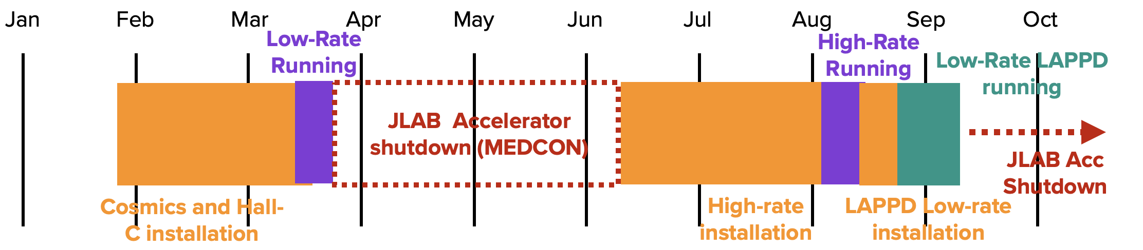
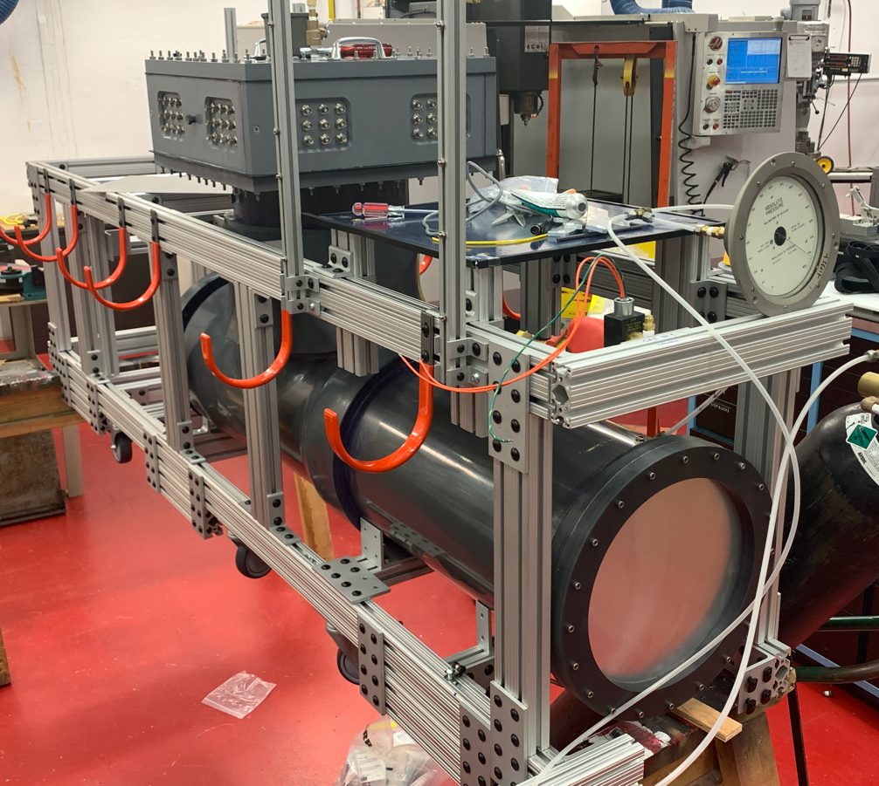
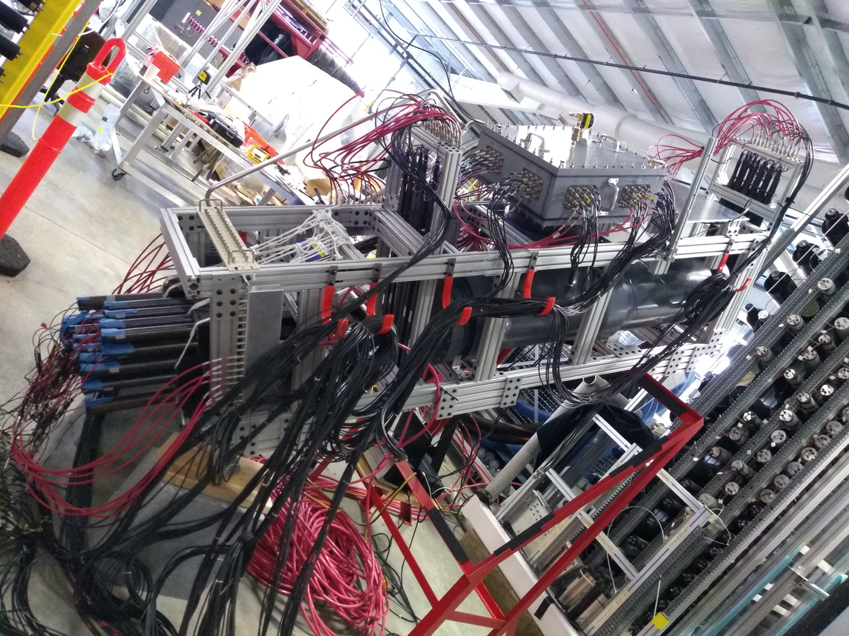
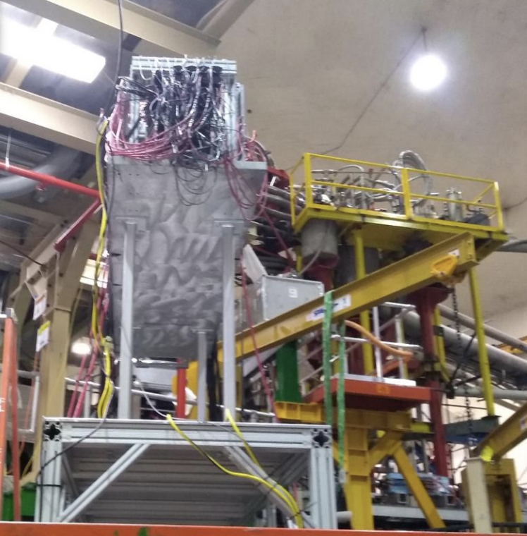
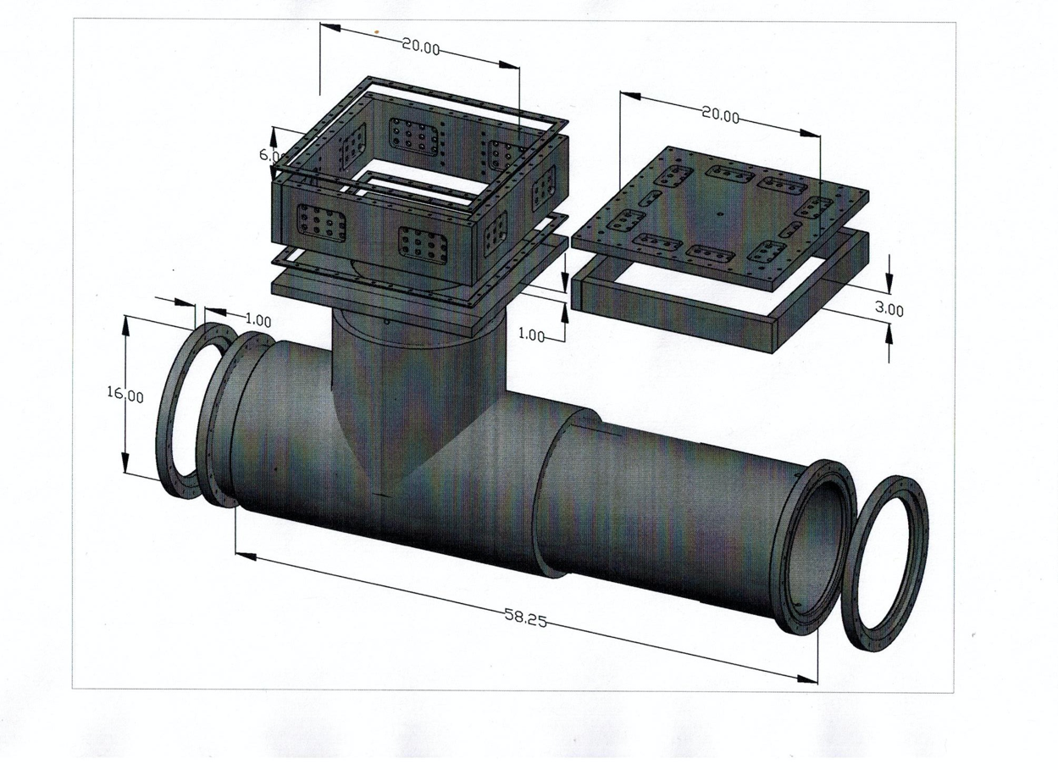
Cherenkov Pre-R&D Timeline
Prototyping Cherenkov detector was designed and construction was completed at Temple in winter of 2019.
In early 2020, Cosmic testing was performed at the ESB and initial data was collected in Hall-C before MEDCON shutdown.
Additional high-rate data was collected in the fall of 2020.
2020
Construction @ Temple U
Cosmic Testing @ ESB
Parasitic running @ Hall-C
Design

Slide 35
Progress on Cherenkov pre-R&D goals
Primary:
  Understand the exact response of Hamamatsu H12700 MaPMTs, aligned in a square array, under high- rate conditions to:
  Best understand the realistic response of our proposed electronics
  Determine the most efficient high-rate electron trigger configuration for in SoLID
  Better match true response to Monte Carlo.
Secondary:
  Test alternate technologies:
    WLS coated LAPPD
    MAROC summing electronics (pixel+quad+sum readout)
  Test components of Cherenkov detectors
    Simple summing board design
    Mirror fabrication (reflective lexan film + carbon fiber blanks)
    C4F8 gas response and interaction with electronics under realistic conditions.
    WLS coated MaPMT response with pixel/quadrant/sum logic.
Remaining goals are being evaluated on the bench.
These goals are either completed, or we collected the data and analysis is underway!

Slide 36
4. Previous Director’s Reviews
Recommendations
Responses

Slide 37
Previous JLab Director’s Reviews
JLab Director’s Reviews were held in 2/2015 and 9/2019
Benefited greatly from the very helpful recommendations
Science Related Recommendations
1. Demonstrate performance and technical capability, develop end-to-end simulations, address technical risks
2. Show impacts with respect to the other world and JLab programs
3. “Investigate the possibility of kaon identification”
(R&D on MRPC with <30 ps performance)
4. “Investigate the feasibility of carrying out a competitive GPD program”

Slide 38
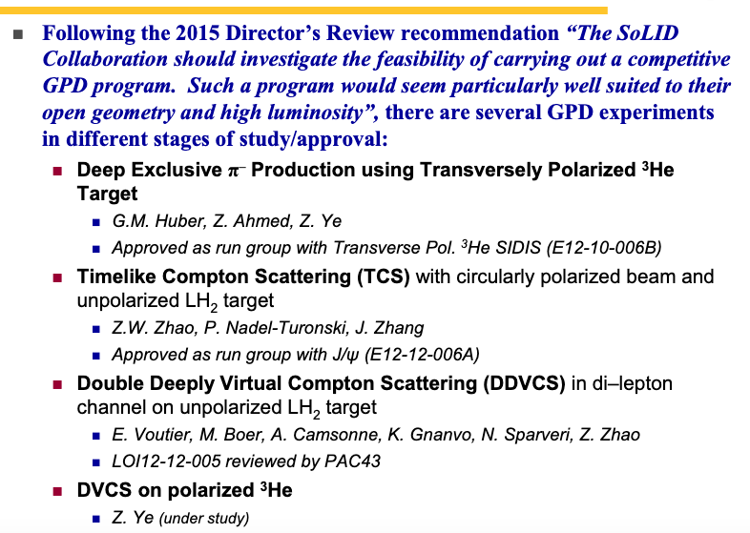
Developing SoLID GPD program
, M. Boer

Slide 39
5. Cost and Schedule Estimations

Slide 40
SoLID Cost Estimation
WBS | Subsystem | Cost –M$ (with overhead)
1.01 | PM | 1.5
1.02 | EM | 10.1
1.03 | LGC | 5.6
1.04 | HGC | 6.0
1.05 | GEM | 5.8
1.06 | DAQ | 6.2
1.07 | Software | 0.7
1.08 | Magnet | 7.8
1.09 | Infrastructure | 9.6
1.10 | OPC
Cost before contingency and escalation: 53.3 M$
With contingency 72.2 M$
With escalation 82.4 M$ (Total Equipment Cost)
Each L2 WBS includes design and construction

Slide 41
SoLID Project Schedule Estimations
Assumptions:
1.5 Years pre-R&D (in progress)
Project starts in FY2022, 2 Years Project Engineering and Design (PED) (FY22-FY23), Construction long-lead items start in FY23
Main construction starts in FY24, 3+ Years construction, complete by end of 2026.
1 Year Installation 2027
Testing/commissioning: start with magnet/testing, then ECal/GEM with DAQ for testing, Then HGC/LGC
Schedule contingency ~ 1 year
Start Physics in 2029

Slide 42
Summary
SoLID: A large acceptance device which can handle very high luminosity to allow full exploitation of JLab 12 GeV potential
→ pushing the limit of the luminosity frontier
After a decade of hard work, we have a mature pre-conceptual design with expected performance to meet the challenging requirements for the three major science programs
SoLID benefited greatly from the previous Director’s Reviews
Technical risks are assessed and addressed in the pre-R&D activities.
Cost and schedule have been evaluated multiple times

