Slide 1
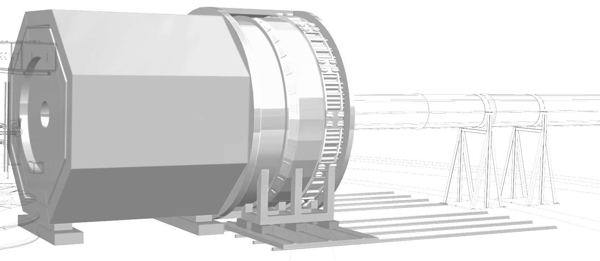



SoLID PVDIS Program
SoLID Director’s Review
Feb. 2021
Paul Souder
Syracuse University

Slide 2
Outline
Overview of BSM tests with PVES
Motivation for PVDIS
PVDIS and Hadron Physics
The PVDIS apparatus
Projected results and errors

Slide 3
Review of Charge
(C1) The significance of scientific questions identified by the SoLID Collaboration and Thomas Jefferson National Accelerator Facility;
(C2) The impact of the planned scientific program on the advancement of nuclear physics in the context of current and planned world-wide capabilities, including whether the scientific reach of the proposed detector could be realized with modest upgrades to existing detectors at Thomas Jefferson National Accelerator Facility;
(C3) The new experimental and theoretical research efforts and technical capabilities needed to accomplish the proposed scientific program; and,
(C4) The feasibility of the approach or method presented to carry out the proposed scientific program and the likelihood that significant results can be obtained in the first three years of detector operations.

Slide 4
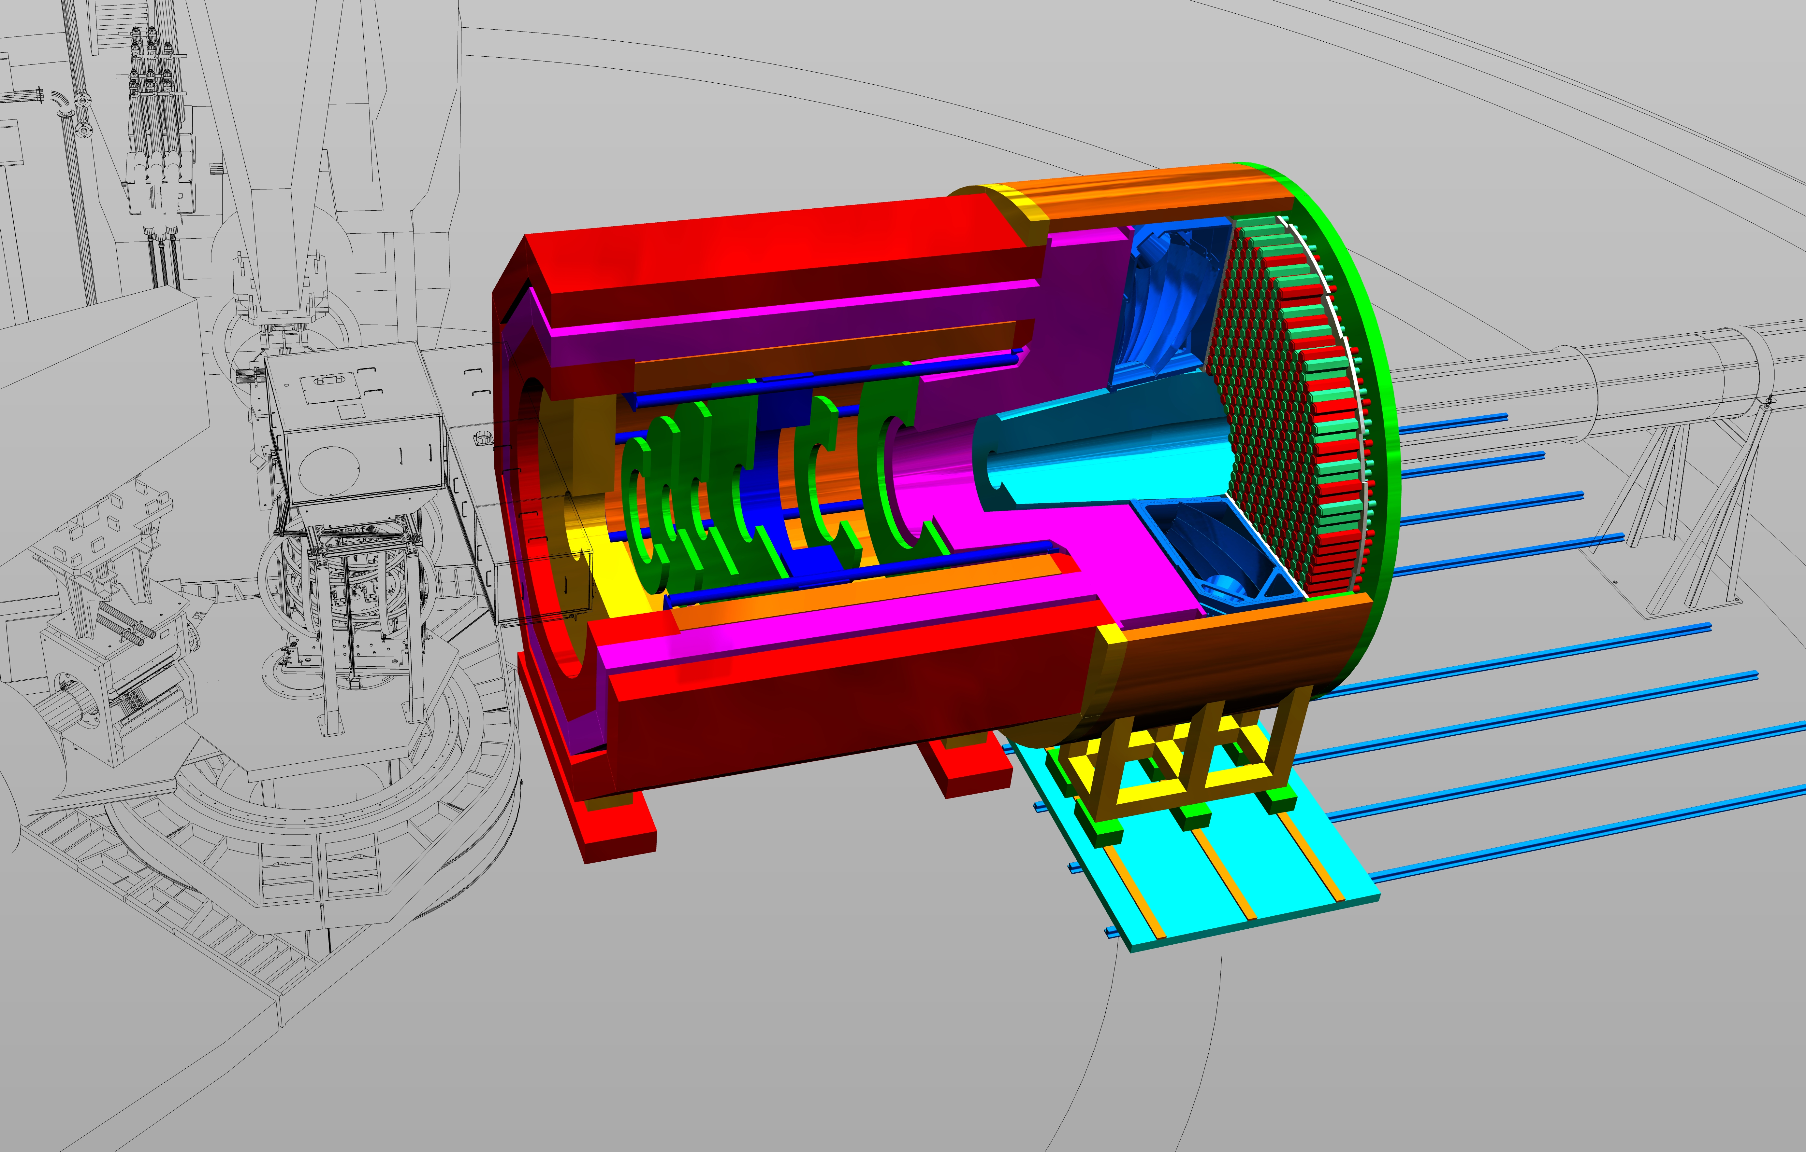
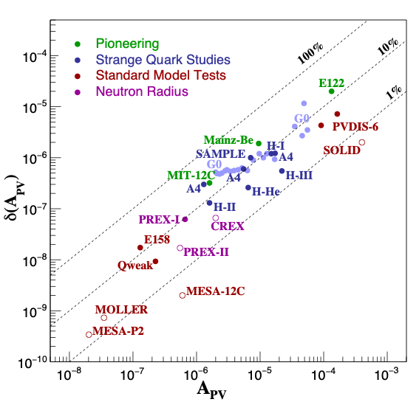
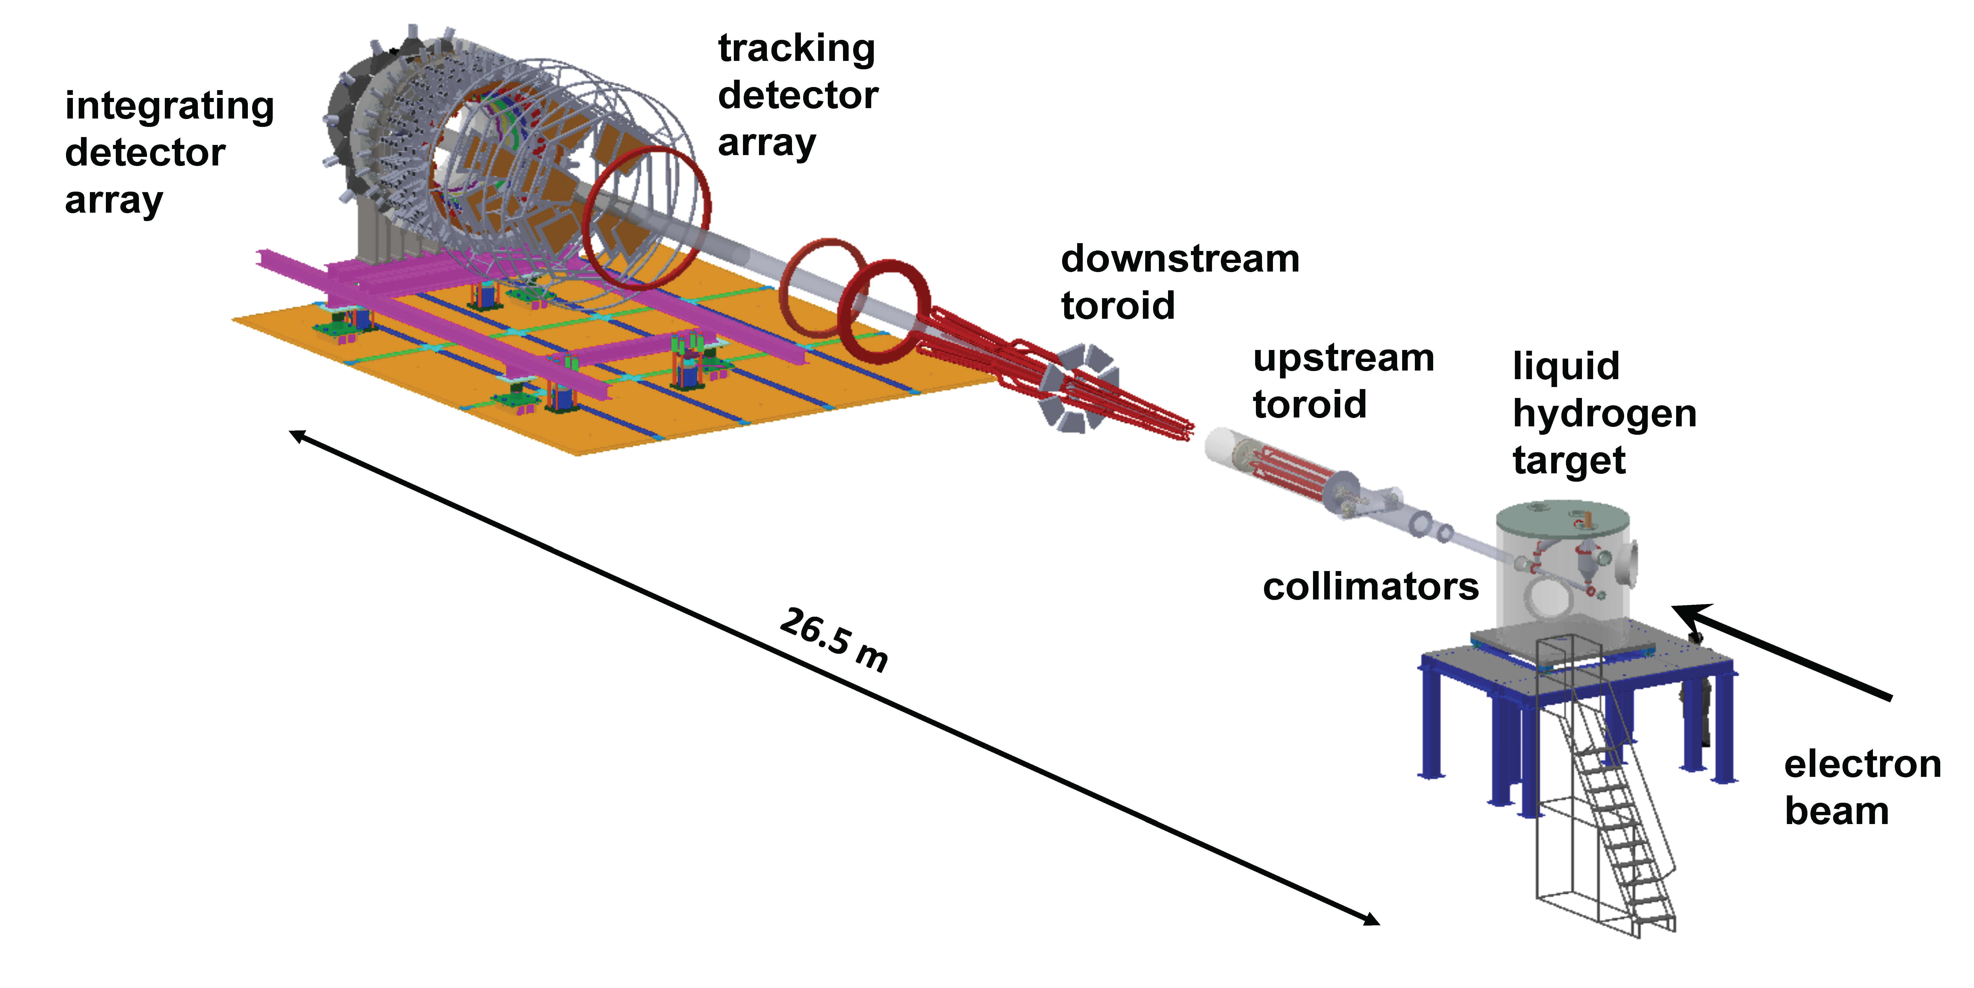
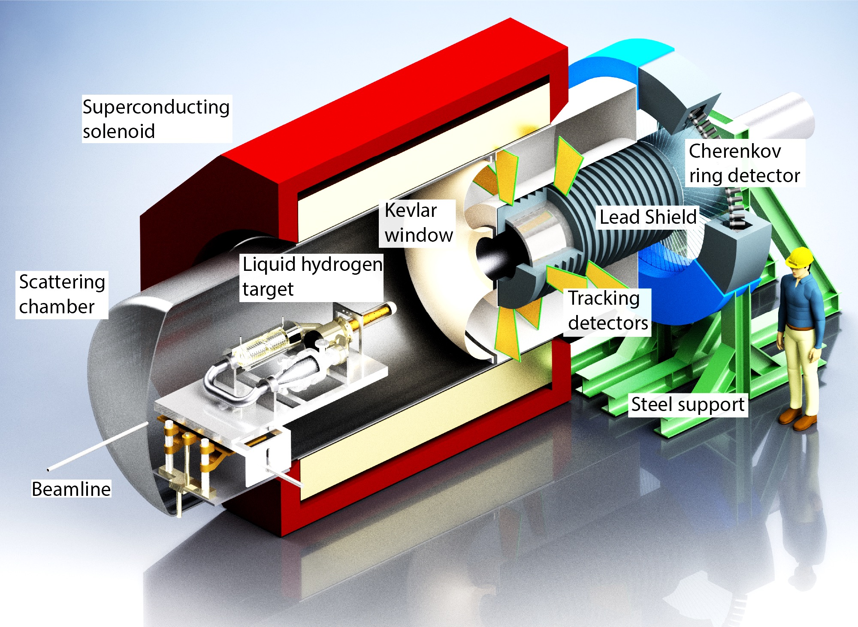
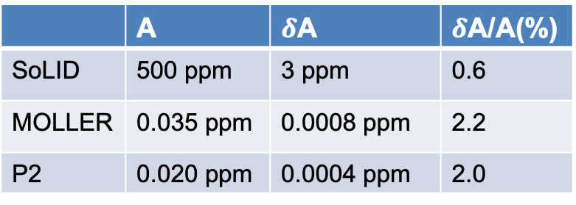
BSM PVES Experiments
C1, C2
 | A | $δ$A | $δ$A/A(%)
SoLID | 500 ppm | 3 ppm | 0.6
MOLLER | 0.035 ppm | 0.0008 ppm | 2.2
P2 | 0.020 ppm | 0.0004 ppm | 2.0
MOLLER, SoLID, and P2 all improve precision

Slide 5
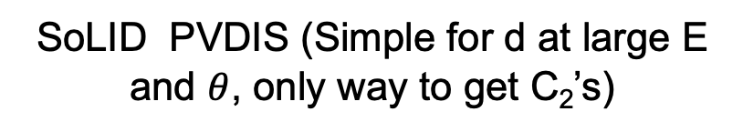

Goals of SoLID, MOLLER, and P2
Moller (Simple formula)
P2: eP (Simple formula at low E and $θ$)
SoLID PVDIS (Simple for d at large E and $θ$, only way to get C₂’s)
Measure all the C’s as precisely as possible

Slide 6
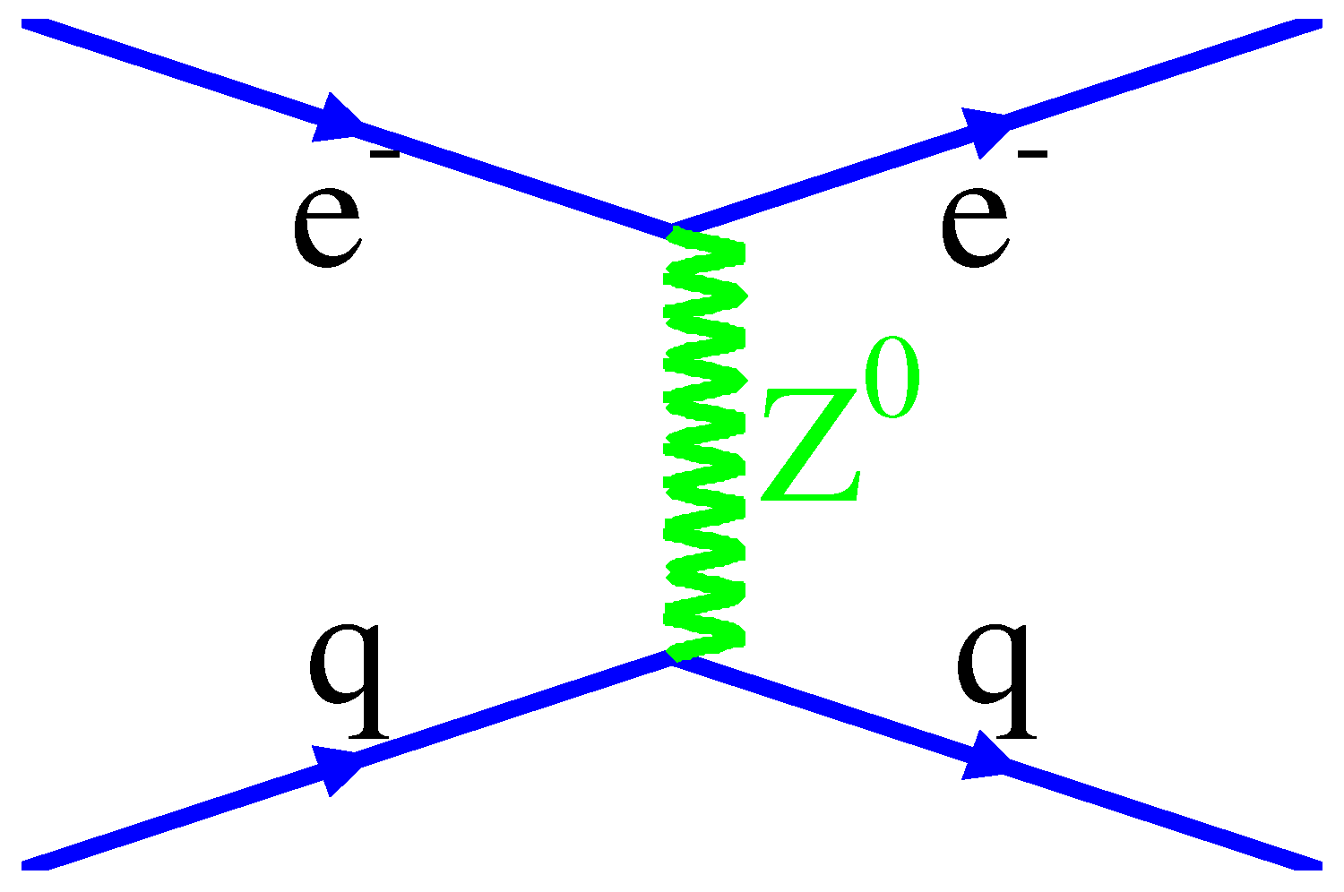
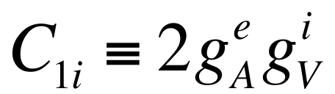
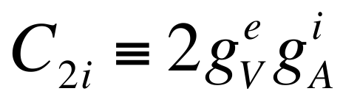

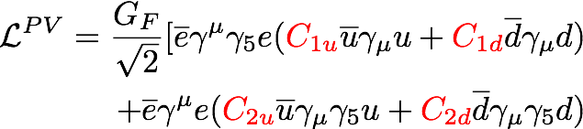
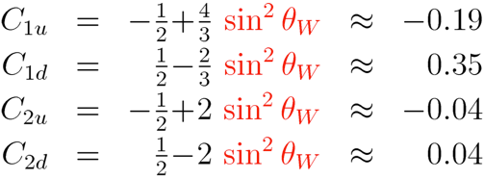
PVES Lagrangian
C1
A
V
V
SMEFT: C_{ij}^{BSM}: are linear combinations of the C^{ij}₆
V
e⁻
A
e⁻
A
SMEFT: Useful for
Global analysis.
C_{ij}=C_{ij}SM+C_{ij}^{BSM}
Tree only
Renormalized

Slide 7

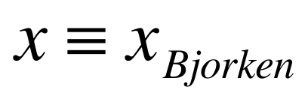
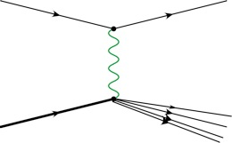
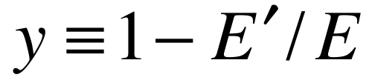
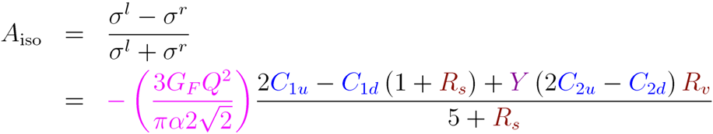
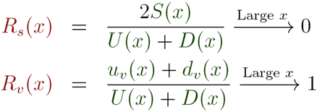
PVDIS for eD Scattering
e⁻
e⁻
Z*
γ*
N
X
Q² >> 1 GeV² , W² >> 4 GeV²
At high x, A_{iso} becomes independent of pdfs, x & W, with well-defined SM prediction for Q² and y

Slide 8
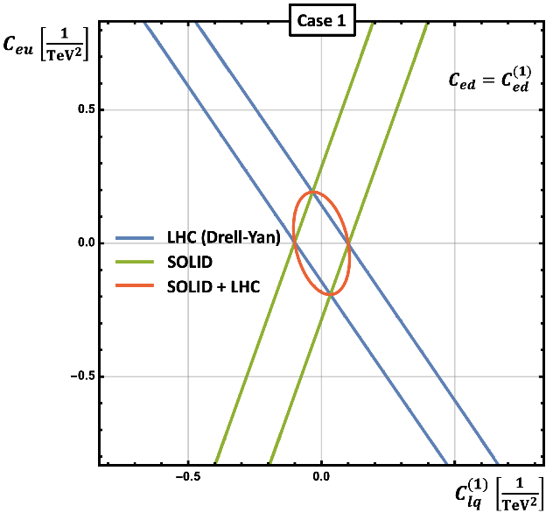
Standard Model Effective Field Theory (SMEFT)
C2
SMEFT identifies
all possible BSM physics
84 d=6; 993 d=8 independent couplings
Goal: Measure each C_{d}^{ij}
as precisely as possible
(Nobody really knows where
the new physics is.)
Thanks to
F. Petriello
SMEFT also identifies regions of
exclusion from world data sets

Slide 9
Projected Results
With this precision,
SoLID makes a unique contribution
to the SMEFT program.
Improvement in
energy reach for
electron-nucleon couplings
Improvement in
couplings

Slide 10
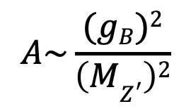
Possible Lepto-Phobic Z’; Example at lower energy
Motivation for introducing new particle:
C2
Baryon number is a global symmetry in the SM (bad).
Theories of local baryon number symmetry are attractive.
They predict a lepto-phobic boson.
They also predict a dark matter candidate.
$$A\sim \frac{(gB)2}{\left(MZ^{′}\right)2}$$
Perez, Phys. Rept. 597, (2015) 1-30
Modifies mainly C₂’s
in PVES
Perez, et al.,
JHEP 07 (2020) 087
Limits depend on branching ratios.
Plot shows that the LHC is interested in Leptophobics

Slide 11

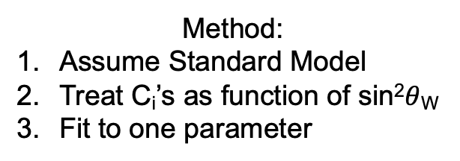
Dark Boson Z_{d} and sin²$θ$_{W}
C2
Davoudiasl, et al. Phys.Rev.D 92 (2015) 5, 055005
Method:
Assume Standard Model
Treat C_{i}’s as function of sin²$θ$_{W}
Fit to one parameter
PVES is the only way to see Z_{d} if
decay is dominated by invisible
particles

Slide 12
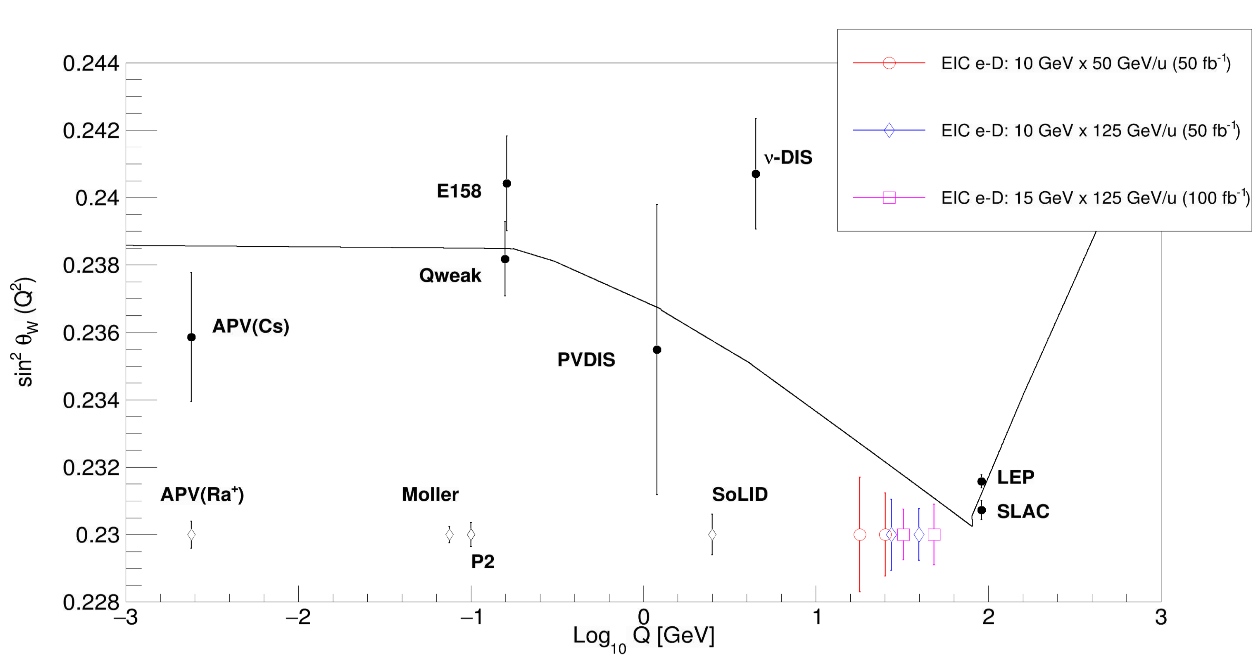
BSM Physics and the EIC
Projection for a total 200 fb⁻¹ e-D Collisions with 3 different
energy configurations (Yellow Report has 60 fb⁻¹.)
Very large
range in x,
particularly
low x. Little
data above x=0.4
All of the SoLID data is at large y and sensitive to C₂;
about 25% of the EIC data is at large y.
EIC emphasizes new structure functions for P and D data.

Slide 13
Theory of Hadronic Physics
C1
Charge Symmetry Violation
Higher Twist
PDF’s: d/u for the Proton with no Nuclear Corrections

Slide 14



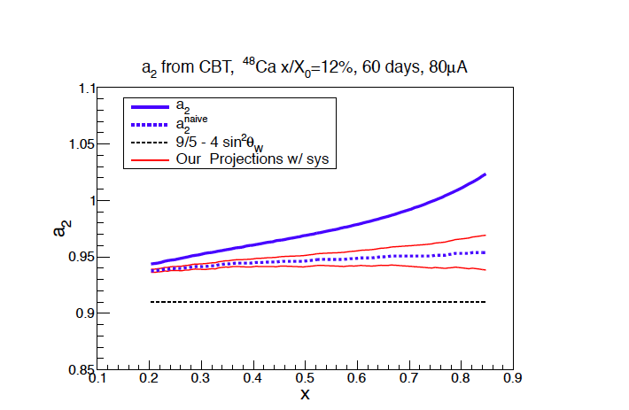
Hadronic Physics: Charge Symmetry Violation
Additional contribution
to NuTeV anomaly?
For A_{PV} in electron-²H DIS
“The paper on PVDIS and the EMC effect highlights a way -- perhaps the best way -- to access the flavor dependent of the EMC effect using PVDIS.” Ian Cloet

Slide 15
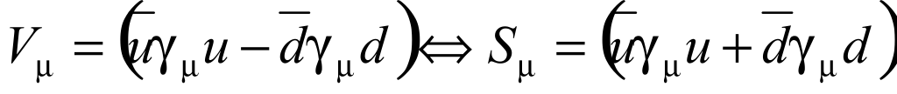
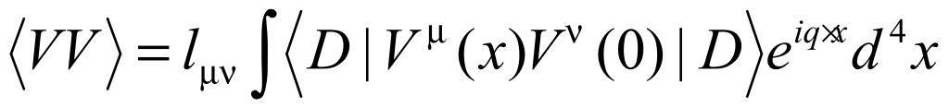


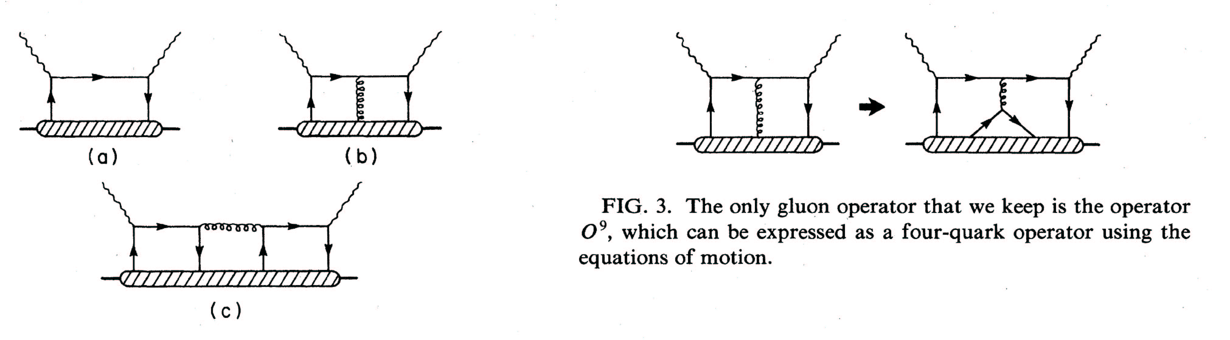
Unique Higher Twist Contribution
The observation of Higher Twist in PV-DIS would be exciting direct evidence for diquarks
following the approach of
Bjorken, PRD 18, 3239 (78),
Wolfenstein, NPB146, 477 (78)
Isospin decomposition
before using PDF’s
Higher-Twist valence quark-quark correlation
Zero in quark-parton model
(c) type diagram is the only operator that can contribute to a(x) higher twist: theoretically very interesting!
u
d
σ_{L} contributions cancel

Slide 16
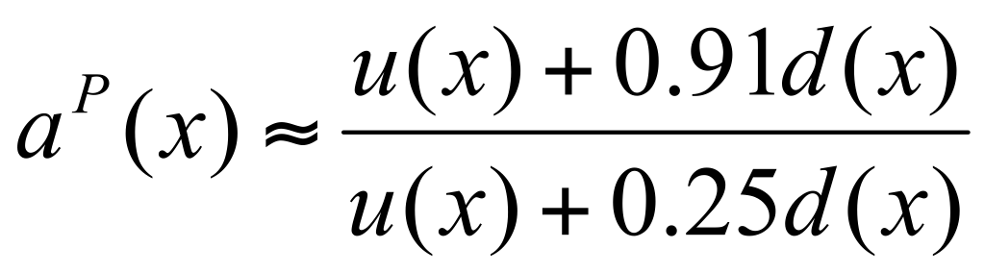
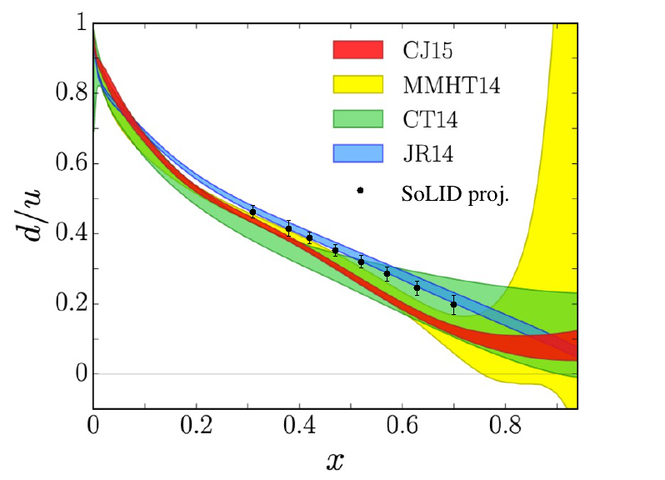
Structure Function Ratio d/u for the Proton
Phys. Rev. D 87
(2013) 094012
PVDIS is complementary
to the rest of the JLab
d/u program.
PVDIS has no nuclear
effects

Slide 17
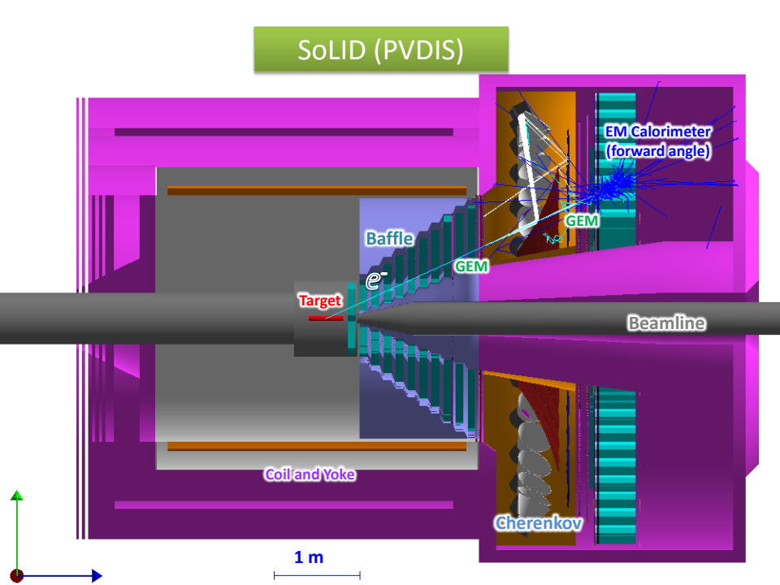
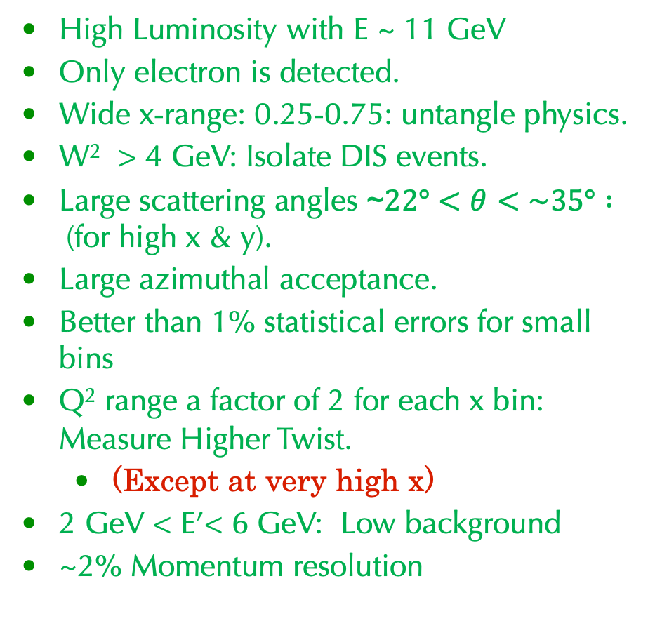
SoLID Apparatus for PVDIS
C3, C4
Kinematic Requirements
High Luminosity with E ~ 11 GeV
Only electron is detected.
Wide x-range: 0.25-0.75: untangle physics.
W² > 4 GeV: Isolate DIS events.
Large scattering angles ~$22°<θ<\sim 35° :$(for high x & y).
Large azimuthal acceptance.
Better than 1% statistical errors for small bins
Q² range a factor of 2 for each x bin: Measure Higher Twist.
  (Except at very high x)
2 GeV < E’< 6 GeV: Low background
~2% Momentum resolution
CLEO magnet with the LD₂ or LH₂ target in the center provides the desired acceptance.

Slide 18
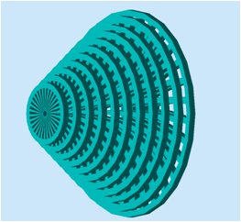
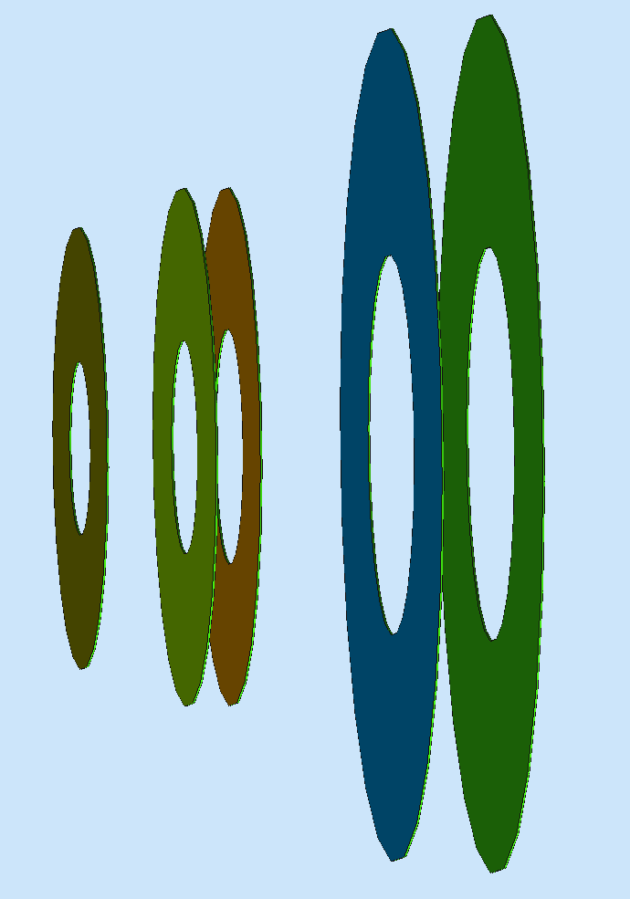
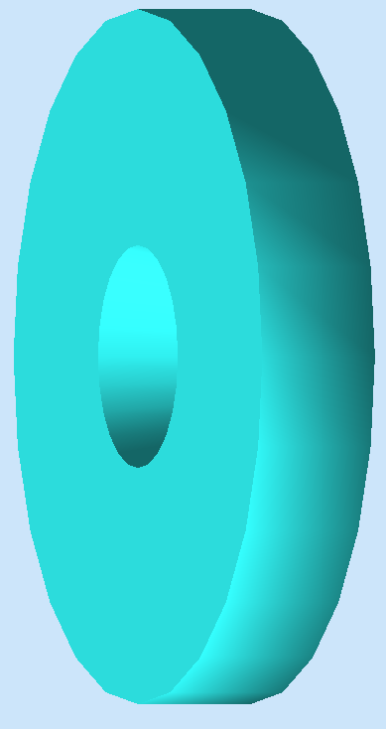
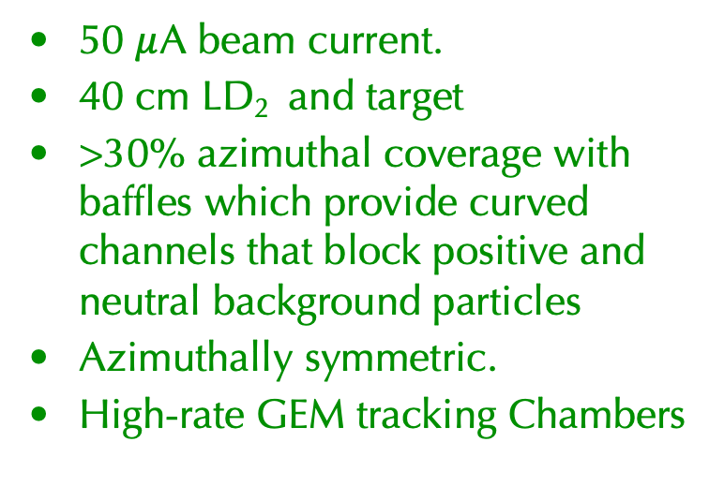
SoLID Apparatus
Achieving High Luminosity
50 $μ$A beam current.
40 cm LD₂ and target
>30% azimuthal coverage with baffles which provide curved channels that block positive and neutral background particles
Azimuthally symmetric.
High-rate GEM tracking Chambers
Baffles GEM Chambers

Slide 19
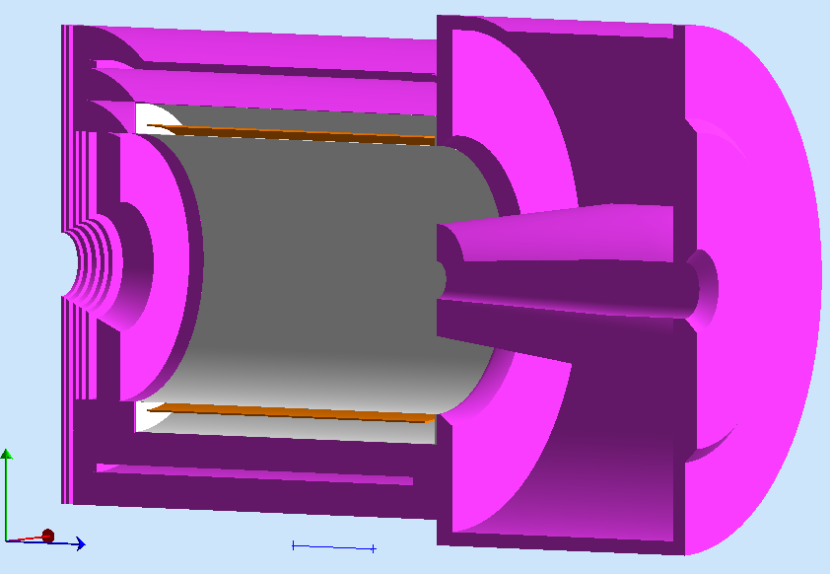
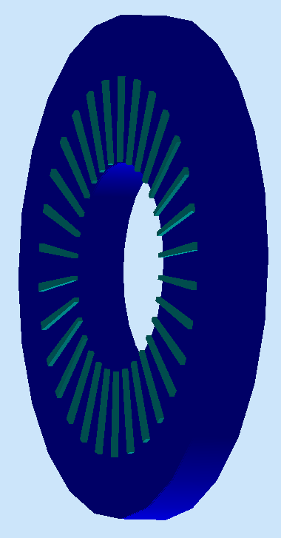
SoLID Apparatus
Requirements for Particle Identification and Trigger
Light Gas Cerekkov: identify electrons for trigger; reject pions.
Shashlyk electromagnetic calorimeter (Ecal) : coincident trigger and further particle identification.
With tracking, tight E/p cuts reduce pion backgrounds.
Baffle 5xGEMs EC
LGC

Slide 20
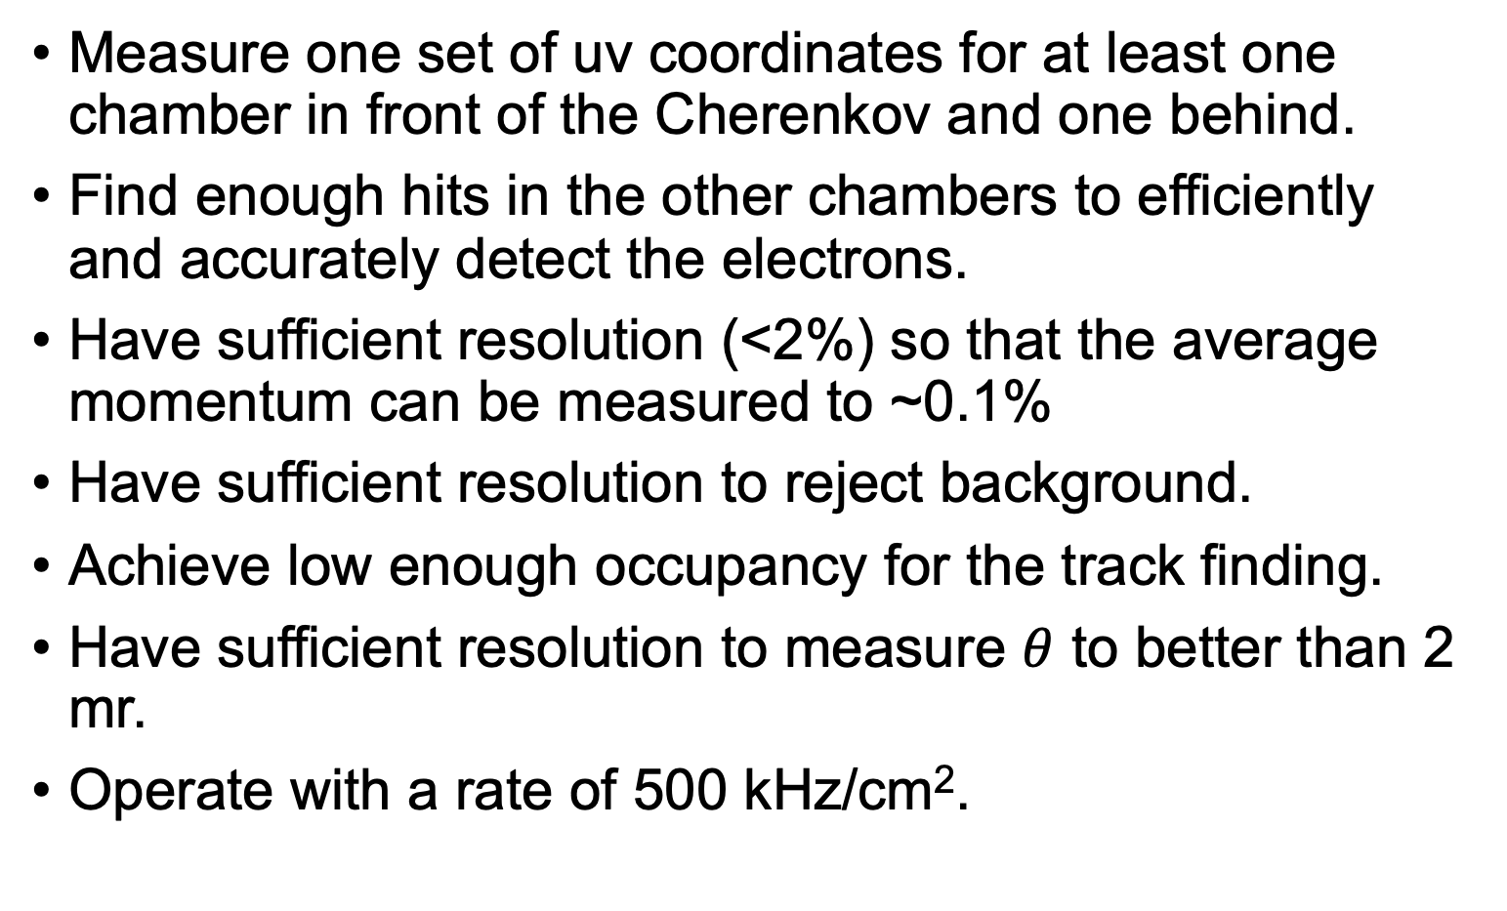
PVDIS Requirements for the GEM’s
Measure one set of uv coordinates for at least one chamber in front of the Cherenkov and one behind.
Find enough hits in the other chambers to efficiently and accurately detect the electrons.
Have sufficient resolution (<2%) so that the average momentum can be measured to ~0.1%
Have sufficient resolution to reject background.
Achieve low enough occupancy for the track finding.
Have sufficient resolution to measure $θ$ to better than 2 mr.
Operate with a rate of 500 kHz/cm².

Slide 21
Light Gas Cerenkov Requirements
Must be relatively short (~1m).
> 95% efficient for electrons.
Reject pions at 10⁻³ level below 4 GeV.
Cerenkov photons detector must operate in moderate magnetic field.
Segmentation into 30 sectors to match baffles.

Slide 22
Ecal Requirements
Sashlyk Pb-scintillation
calorimeter is chosen
Reasonable energy resolution.
Good Segmentation
Sufficient radiation resistance
Fast: ~30 ns timing window
Affordable
Simulated Ecal resolution
versus energy

Slide 23
Pion-Electron Separation After Reconstruction
Pion contamination (%) after tracks are reconstructed with the GEM’s
Contamination in %

Slide 24
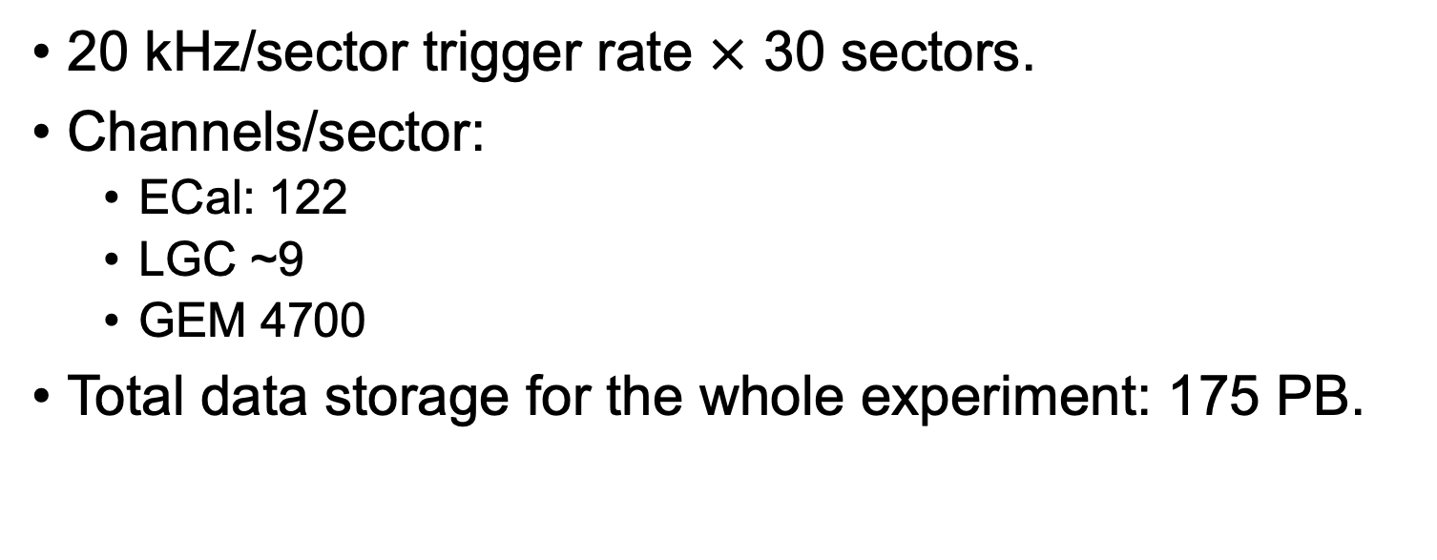
Trigger Rates and Data Requirements
20 kHz/sector trigger rate $×$ 30 sectors.
Channels/sector:
  ECal: 122
  LGC ~9
  GEM 4700
Total data storage for the whole experiment: 175 PB.

Slide 25
Electronic Configuration
Based on Jlab FADC250 flash ADC modules.
  Used for Halls B and D
  PVDIS will use more features, which are being tested as part of the Pre-R&D plan.
One crate for each sector.
ECal trigger uses data from adjacent sectors.

Slide 26
Normalization Systematics:
Beam Polarimetry
Average Q²
Event reconstruction (f)

Slide 27
Precision Polarimetry: $δPb$/$Pb$~0.4%
Method I: Compton Polarimeter:
  Operates at full beam intensity.
  Operates simultaneously with the PVES experiment.
Method II: Moller Polarimeter:
  Independent systematics.
  Operates at low beam current.
  Invasive measurement.
Built on extensive experience with PVES experiments in both Hall A and Hall C.
Capitol Upgrade planned(lasers, new electron detector).
Commissioning will occur during the MOLLER experiment.
An upgrade for the Moller polarimeter is part of the MOLLER MIE.

Slide 28
Overview of Compton Polarimetry
Main elements:
  Chicane
  High finesse polarized laser cavity
  Compton photon detector
  Electron detector

Slide 29
Compton Polarimetry Systematic Errors
Analyzing power: Photons
Systematic Errors
Analyzing Power: Electrons
Zero crossing and Compton
edge provide precision calibration

Slide 30
Moller Polarimetry: Redundant Method
Scatter from polarized electrons in a Fe foil.
Detect both electrons in final state.
Analyzing power depends on kinematics
Upgrade: calibrate with GEM tracking detectors.

Slide 31
Measurement of Momentum for PVDIS
Side view: Theta is
not changed much by the
magnetic field.
View along beamline
Momentum of the electron is determined by how far the track,
if assumed to be straight, misses the beamline

Slide 32

Q² Calibration with Elastic eP Scattering (0.2%)
Measure $θ$ with geometry.
Align with X-rays
Calibrate B field with known beam energy and eP elastic scattering
Elastic events are cleanly separated from the background.

Slide 33
Projected Statistical Precision
11 GeV
Cleanest BSM search
Most sensitive to CSV
6.6 GeV
Most sensitive to HT
180 Days are Approved

Slide 34
Untangling the Physics
Kinematic dependence of physics topics:
 | x | Y | Q²
New Physics | none | yes | small
CSV | yes | small | small
Higher Twist | large? | no | large

Slide 35
Summary of Error Budget
Total | 0.6
Polarimetry | 0.4
Q2 | 0.2
Radiative Corrections | 0.2
Event reconstruction | 0.2
Statistics | 0.3
Energy(GeV) Days(LD2) Days(LH2) | 4.4 18 9 | 6.6 60 - | 11 120 90 | Test 27 14
169 Days are Approved

Slide 36
Calculation of Radiation Damage and Activation
GEANT: Compute particle fluxes.
FLUKA: Tools for activation and radiation damage.
Radiation damage to electronics
Radiation damage to materials

Slide 37
All Radiation Issues Found Acceptable
Radiation damage to GEM electronics.
Activation of hottest regions.
  Baffles
  Exit of magnet
Radiation in the Hall: damage to electronics.
Heat in the magnet cryostat.

Slide 38
Summary
SoLID PVDIS preforms an important BSM search.
PDVIS also probes interesting hadronic physics.
The SoLID spectrometer is capable of performing the measurement with the required precision.

