Slide 1
SoLID Director’s Review Homework
February 9-10, 2021

Slide 2
1. While there are point-by-point answers from the collaboration to the 2015 review in materials on the indico page, we would appreciate a similar list of responses to the 2019 review.
2. Provide a preliminary run plan for the first 3 years of data taking,including a priority of physics targets, time for re-configuring the detector, etc.
3. Clarify what calculations of radiative corrections are needed for the SIDIS program (as well as the PVDIS program).
4. What R&D, if any, is needed prior to installation and operation to insure productive use of SOLID and what resources have been identified to meet these needs?
5. Which detector systems have been tested at the luminosity of 10^{37 –39} cm⁻² s⁻¹ and the occupancy per detector segment expected.
6. What theoretical uncertainties have been considered in the impact studies, how have pseudo-data been treated, which have qT ~ Q and qT < Q instead of qT < <Q
7. Can you give a sense of timescale SoLID needs to be realized due to competing experiments (UPC at RHIC and LHC, longer CLAS12 operations, polarized RHIC, COMPASS, EIC) that would reduce the impact of SoLID?
8. Provide an assessment of the collaboration strength in FTE and competence to build SoLID on the time scale needed to remain competitive with other experiments.
9. What is assumed the colleagues of China are contributing to SoLID.
10. Can you provide more detailed estimates on size and different sources of the systematic errors for J/Psi measurement?
11. Measurement depends on the precise extraction of d\sigma/dt to t=0; what is the resolution in t, how binning impacts the precision of extrapolation, and does this put constraints on required luminosity?
Haiyan Gao
Haiyan Gao
Zein-Eddine Meziani
Zein-Eddine Meziani
Zein-Eddine Meziani

Slide 3
While there are point-by-point answers from the collaboration to the 2015 review in materials on the indico page, we would appreciate a similar list of responses to the 2019 review.
Recommendations from 2019 review:
Make a pre-R&D plan, including a notional schedule, that resolves all significant technical questions if implemented. Include static/warm tests of the magnet.
Complete.
The SoLID pre-R&D plan was approved by the DOE. at the end of 2019. It includes a plan for mitigate risks for the DAQ system and the Cherenkov detectors with an initial schedule of 1.5 year. The funding and activities started in Feb. 2020. The in-beam tests were completed in two bema running period, including both low rates and high-rates tests. Three quarterly progress reports were submitted to DOE. A mid-term review was conducted. The commit was satisfied with the progress and endorses the plan to complete the remaining tasks by the end of the year.
JLab Physics Division has implemented a test plan for the magnet. The hipot static test was completed. A cold low power test was ongoing which is scheduled to be completed by September 2021.
Put in place a strategy for transition to a 413.3-quality documentation package. Insure sufficient resources of appropriate types are assigned. Include a training plan for candidates for critical roles.
On-going.
The SoLID collaboration has started a discussion on a strategy for the transition and has estimated the resource needed to go from pre-R&D to CDR (3 months engineer, 6 months of designer plus 3 months scientist) . A training plan for the project management team (including CAMs) is on hold until after CD0 when SoLID formally becomes a DOE project.

Slide 4
Addressing 2019 Review recommendations (II)
3. Complete resolving the recommendations from the previous review.
Complete.
See Appendix A in the updated pre-CDR
4. Carefully re-examine the experiment’s implementation to determine if any new or enhanced hazards,. I.e., beyond “normal” for JLab, have been incorporated. Adjust the implementation as necessary.
On-going.
The collaboration will continuously review the experiment’s implementation as the design progresses and assess or reassess the processes for hazards. A draft version of the SoLID Project Preliminary Hazard Assessment has been started, based on documentation used by te MOLLER project. This is a project level document that will be updated with each iteration of implementation review.

Slide 5
Addressing the 2019 Review recommendations (III)
5. Review the scope/design for opportunities to reduce costs while meeting the technical requirements. Incorporate the changes into the plan.
Complete.
The possibilities of re-using the SBS GEM readout, reducing one GEM plane, removing the outer layer of ECal, moving part of the labor from JLab to universities, and possible in-kind contributions to the software effort were investigated. The new estimated lower end of the cost range includes consideration of these cost saving possibilities.
6. Update the pCDR to incorporate the improvements identified in the other recommendations. Make the links between “physics” requirements and equipment requirements more crisp. Expand the details of engineering integration.
Complete.
See the updated pre-CDR.

Slide 6
2. Provide a preliminary run plan for the first 3 years of data taking, including a priority of physics targets, time for re-configuring the detector, etc.
Assuming starting data taking from FY2029
Assuming ~ 50% efficiency
10/1/2028-- 6/30/2029 Polarized He3 run (90+35 PAC Days)
7/1/2029-10/30/2029 de-install polarized He3, install LH2 target
11/1/2029-3/30/2030 J/Psi run (60 PAC day)
4/1/2030-8/30/2030 de-install LH2 target, install polarized NH3
9/1/2030-5/30/2031 Polarized proton run (120 PAC days)
6/1/2031-5/30/2032 de-install polarized NH3, reconfigure
SoLID for PVDIS, install LD2/LH2 targets
6/1/2032-5/30/2034 PVDIS run (169 PAC days)

Slide 7
3. Clarify what calculations of radiative corrections are needed for the SIDIS program (as well as the PVDIS program)
Radiative correction studies for SoLID SIDIS, PVDIS (Paul Souder’s talk)
  RC studies incorporated into rich physics program of SoLID
• Important source of syst. uncertainties in SoLID SIDIS experiments
• RC syst. uncertainty ∼(2 - 3)% for SIDIS asymmetry measurements: SoLID preCDR following
Mo and Tsai RMP 41, 205 (1969), Ent et al., PRC 64, 054610 (2001), Akushevich et al., PLB 672 (2009) 35
  Work in progress to create a SIDIS RC standalone event generator
• Based on the paper: I. Akushevich and A. Ilyichev, PRD, 100, 033005 (2019)
• Plan to finish before June of 2021 with a related paper
• Plan to compare with available data from JLab, HERMES, COMPASS
• Exclusive structure functions not available yet: future addition
  Outline of the current work presented in the Whitepaper on Radiative Corrections:
  A. Afanasev, et al. arXiv:2012.09970 [nucl-th]
• Planned with other ongoing RC-related studies for the JLab PAC approved PRad-II
and proposed DRad experiments
• Collaborations with different groups on all these topics underway
  Ultimate task: making a versatile SIDIS master generator including this RC generator
  that allows for the study of model dependence in extracting the TMDs
  SIDIS RC framework for SoLID complementary and synergistic with that of EIC

Slide 8
  A new (factorized) approach to RC studies in inelastic lepton-hadron
  scattering
• T. Liu, W. Melnitchouk, J. W. Qiu and N.~Sato,
[arXiv:2008.02895 [hep-ph]]
• A unified factorization approach to QED and QCD contributions
• Applicable to inclusive DIS and SIDIS
• Important implications for the hard scattering future analyses at the EIC
  Provides a uniform treatment of RCs
• For extraction of PDFs and TMDs
• For other partonic correlation functions from lepton-hadron scattering data
• Impactful on the precision of studies of the nucleon’s 3D structure in momentum
space
  Plan to make another standalone event generator based on these RC studies
• JLab-12GeV/SoLID program can help validate such a new approach
• Help reduce systematic uncertainties associated with RCs for the SoLID results
PVDIS:
Radiative corrections are required. We have discussed this with experts, and have found that we need a team familiar with both electroweak corrections as well as QCD.

Slide 9
4) What R&D, if any, is needed prior to installation and operation to insure productive use of SoLID and what resources have been identified to meet these needs?
Optional R&D:
ECal : testing at high rate (parasitic to SBS running). Regular grant.
GEM : uRwell could reduce cost. Possible general purpose R&D fund from JLab
LAPPD : could improve high rate capability of all detectors because signal is much faster than PMTs (<100 ps) but aging and behavior in high background need to be tested. It’s part of R&D research at Argonne in collaboration with INCOM and other divisions at ANL. Synergetic with magnetic field immune, pixelized photosensors R&D for EIC RICH detectors.

Slide 10
5) Which detector systems have been tested at the luminosity of 10³⁷⁻³⁹cm⁻² s⁻¹ and the occupancy per detector segment expected.
Cherenkovs are tested at high luminosity/high rate.
Trigger was provided by ECal/Scintillator (none-SoLID)
Also provide benchmark tests of simulations.
GEM test is planned with x-ray source to reach the expected rate (spring this year).
ECal/SPD test is planned parasitic to SBS running late this year/next year.

Slide 11
6: What theoretical uncertainties have been considered in the impact studies, how have pseudo-data been treated, which have qT ~ Q and qT < Q instead of qT < <Q
Q² evolution effect included
Impact studies done with different phenomenology (Kang et al., PRD 93 (2016) 014009; Anselmino et al., JHEP 04 (2017) 046; D’Alesio et al., PLB 803 (2020) 135347; Gamberg et al., arXiv:2101.06200) show similar impact
Higher twist effects in extracting leading twist TMDs have been studied
Current fragmentation region (Boglione et al., PLB 766 (2017) 245; Boglione et al., JHEP 10 (2019) 122)
Different collinear PDF sets and Gaussian width values
Question re q_{T}:
(1) On slide #8 of Jianwei Qiu’s talk, QCD factorization theory is solid for all regions:
q_{T} << Q, q_{T} < Q, q_{T} ~ Q, and even for q_{T} >> Q, with established procedure to match between regions
(2) TMD factorization works for q_{T} << Q region. For the TMD factorization, it is reasonable to keep q_{T}/Q < 1/3, like what people do for the large Nc approximation. (more than 30% of the SoLID projected data points falls into this category)
(3) 80% of the SoLID data with q_{T}< Q, and the rest ~ Q. One can work with the QCD collinear and TMD factorization including the matching between regions to extract the TMDs in close collaborations with theorists (including members of TMD collaboration and locally Jianwei and others. SoLID data will provide the consistency test of QCD theory between TMD and collinear factorization approach.

Slide 12
7. Can you give a sense of timescale SoLID needs to be realized due to competing experiments (UPC at RHIC and LHC, longer CLAS12 operations, polarized RHIC, COMPASS, EIC) that would reduce the impact of SoLID?
The SoLID J/psi program compares to CLAS12 favorably. In slide 21, we list an average rate of ~110/day events in photoproduction for 130 days of approved PAC days and compare this to 6974/day at 50 days approved PAC days, which leads to a factor of 24 between SoLID and CLAS12. If we assume, 130 days of unpolarized liquid hydrogen target run every year in CLAS12 (an aggressive number precluding the scheduled scientific program in CLAS12 on other targets) and eight years before SoLID starts operating, SoLID J/psi will still have the highest statistics after 50 days of running in year 9 for photoproduction. Electroproduction of J/psi at CLAS12 would still be tenuous at best.
Regarding the RHIC UPC program comparison we will reach out to colleagues who are involved in the UPC at RHIC program to understand their threshold reach and luminosity and the scope of their program in the next 8 years. Since yesterday we could only find readily posted information about measurements at larger W (gamma p CM) about 25 GeV from public talks of 2016-2017. The reference for deuterium is https://arxiv.org/pdf/2009.11724.pdf
For UPC to be competitive with SoLID it would require a photon-proton luminosity of > 20 fb⁻¹with 4 GeV < W<4.4 GeV (assuming perfect acceptance).
For polarized RHIC, COMPASS, EIC we don’t have direct comparison yet, but we think their complementarity makes the program richer.

Slide 13
8. Provide an assessment of the collaboration strength in FTE and competence to build SoLID on the time scale needed to remain competitive with other experiments.
FTE required for each detector is 3-4. (total 13-19 FTEY in 5 years)
Each detector has several groups (2-7) already participating in pre-conceptual design and pre-R&D,
efforts ramping up
These groups have experience with the type of detector.
Each group usually has 1 scientist (part) , 1-2 postdoc (part), 1-2 students.
ECal: UVa, Shandong, Tsinghua, ANL
LGC: ANL, Temple, NMSU
HGC: Duke, Regina, Stony Brook
GEM, UVa, GWU/Bates, USTC, CIAE, Lanzhou, Tsinghua, IMP
DAQ; JLab, U-Mass, Rutgers
Magnet, Infrastructure/supporting structure, project management: JLab, ANL

Slide 14
9. What is assumed the colleagues of China are contributing to SoLID.
The Chinese group are collaborating on 3 detectors (GEM, ECal and MRPC) and physics.
GEM (USTC, CIAE, Lanzhou, Tsinghua, IMP): pre-R&D
ECal (Shandong, Tsinghua): pre-R&D, detector assembling and testing
MRPC (Tsinghua, USTC): pre-R&D, possible contribution to the main detector for enhanced configuration.
Only MRPC budget is not in the baseline cost (possible contribution from China groups)

Slide 15
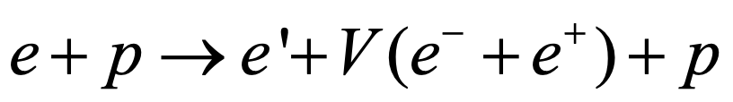
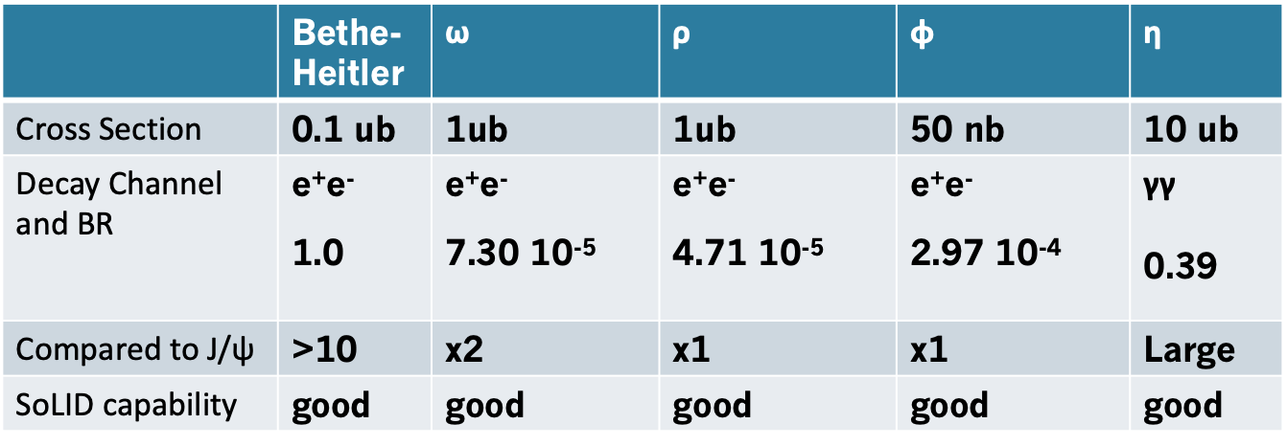
10) Can you provide more detailed estimates on size and different sources of the systematic errors for J/Psi measurement ?
Acceptance effect: 5% for triple coincidence
Detector and trigger efficiency: <2%
Target luminosity: < 2%
Contribution from Al wall <1%
  Dummy target run (scheduled) + vertex cut
Background contamination: ~0.5%
  B-H background + Random coincidences (measured directly)
We intend to validate the cross section at the 5% level.
With the Hall C (HMS, SHMS) measurement
ep elastic channel: (2.2 and 4.4 GeV beam)
  SoLID optics calibration channel for electrons
SIDIS charged pion (also DIS)
  SIDIS program compared with Hall C

Slide 16
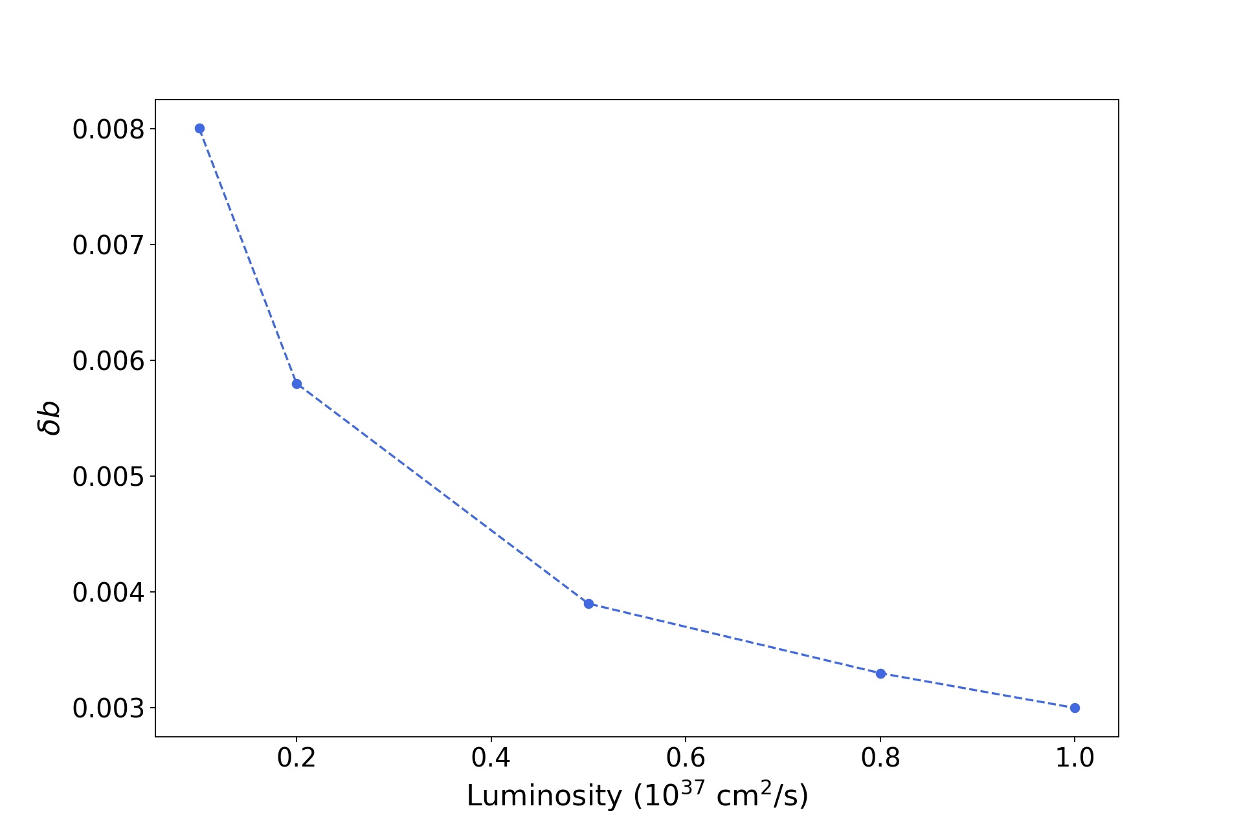
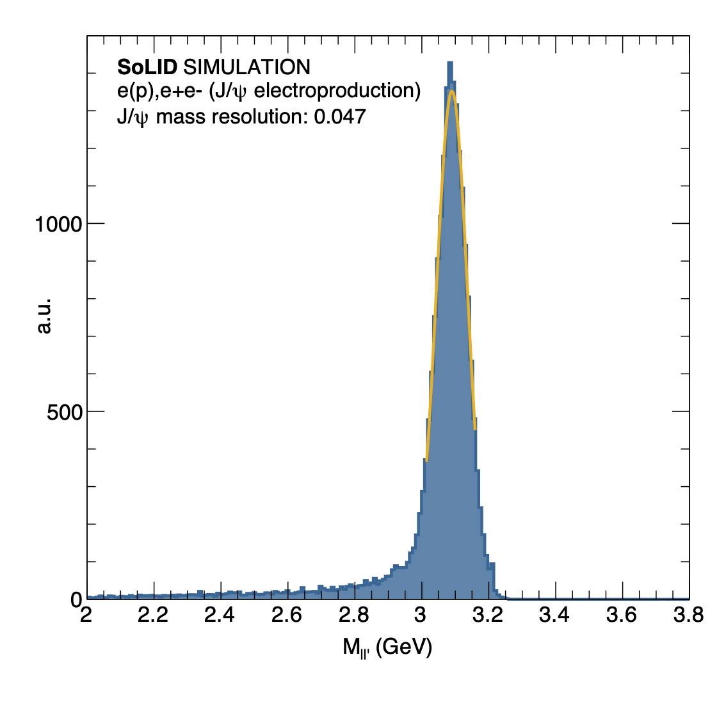
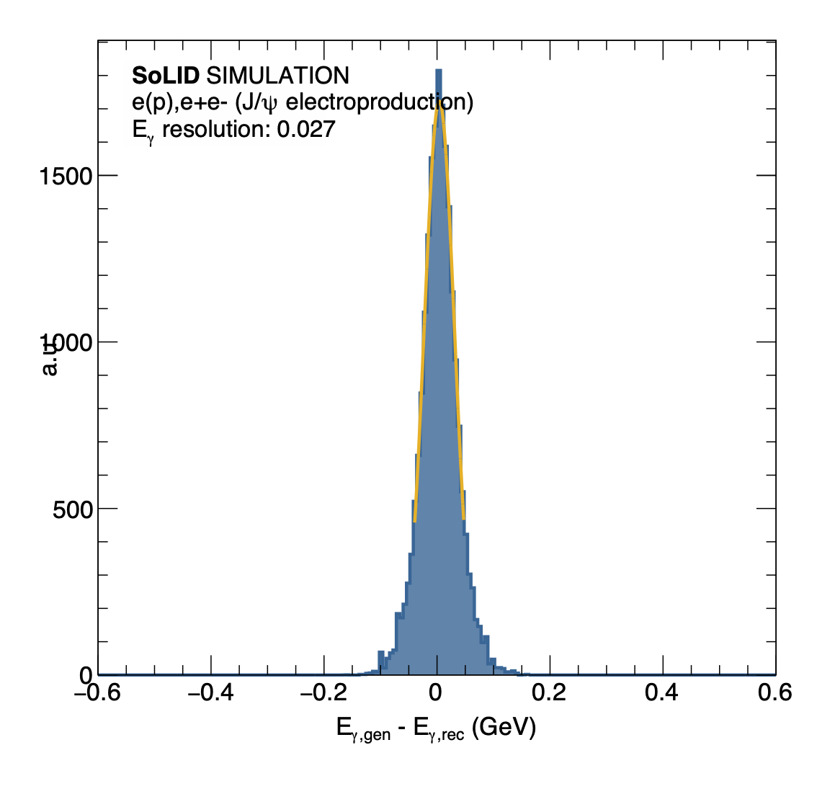
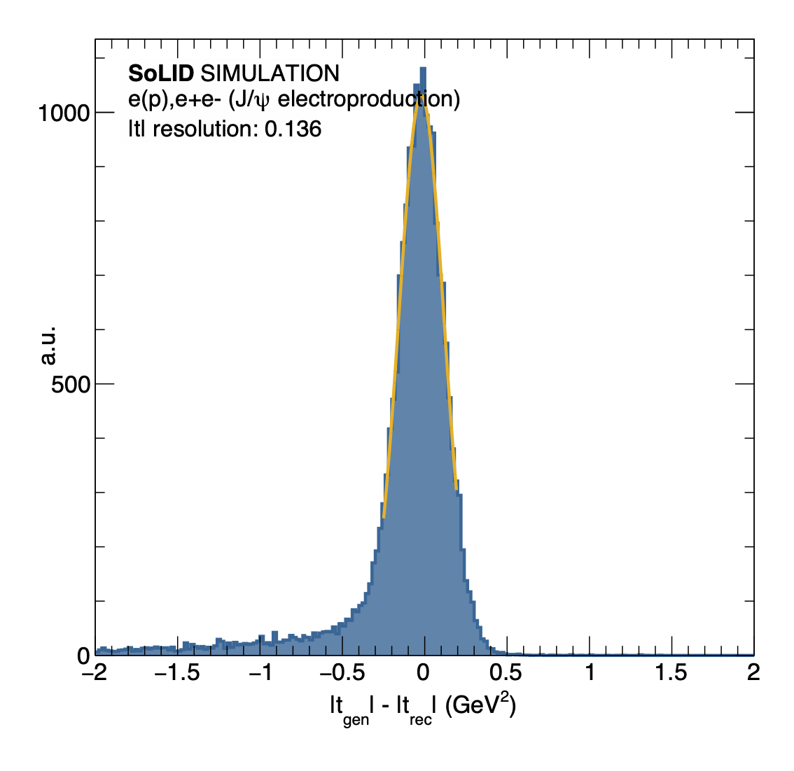
11) Measurement depends on the precise extrapolation of d\sigma/dt to t=0 ; What is resolution in t, how binning impacts the precision of extrapolation, and does this put constraints on required luminosity ?
The plots show the resolution in the J/psi invariant mass (50MeV) , E_gamma (27 MeV) and the t resolution for J/psi electroproduction.
The t-resolution is estimated to be around 0.14 GeV^2. It is the most sensitive one because it compounds the effects of
Detector resolution on the scattered electron
Detector resolution on the J/psi reconstruction
Radiative effects
Our t-bins are shown in 0.4GeV^2 with a resolution of about 0.14 GeV^2.
The t-resolution in case of photoproduction, where we measure the recoil, is 4 times better..
Extrapolation was performed with a known functional form (exponential fit) with data points at |t - t_min| < 1 GeV². Therefore, the statistical uncertainty on the data points are directly propagated to the fit parameter (d\sigma/dt at t = 0). With lower luminosity we would expect worse statistical uncertainty on the b parameter, and there will be no hard limit.
The large t high statistics will discriminate between functional forms for example; dipole vs exponential

Slide 17
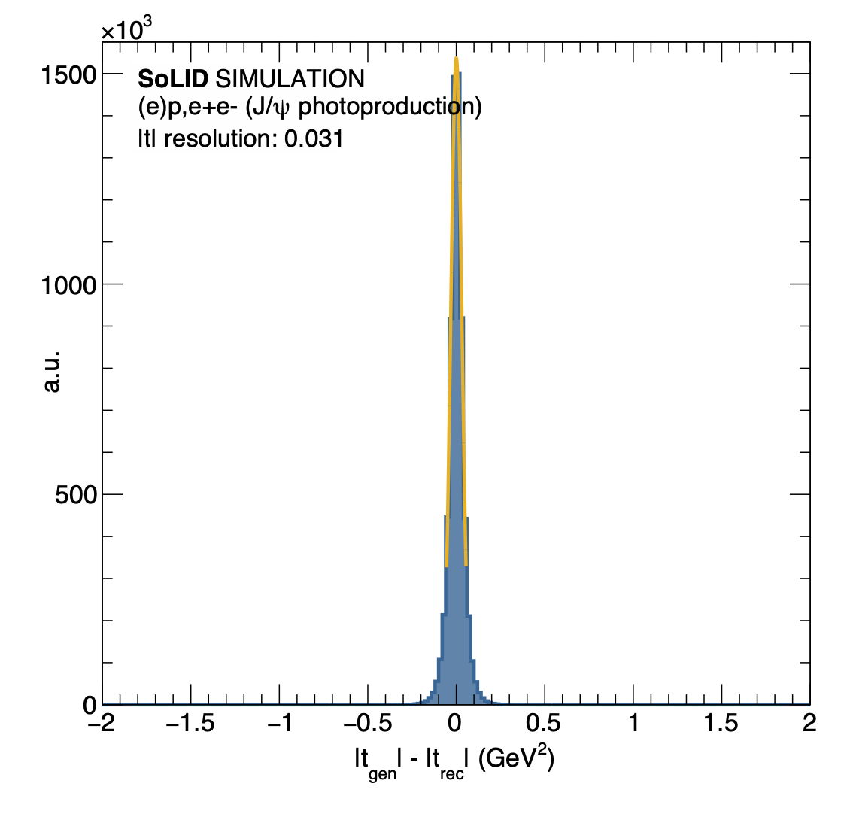
11) continued
Resolution for the photoproduction 3-fold coincidence trigger where the proton is detected together with the decay pair.

