Slide 1
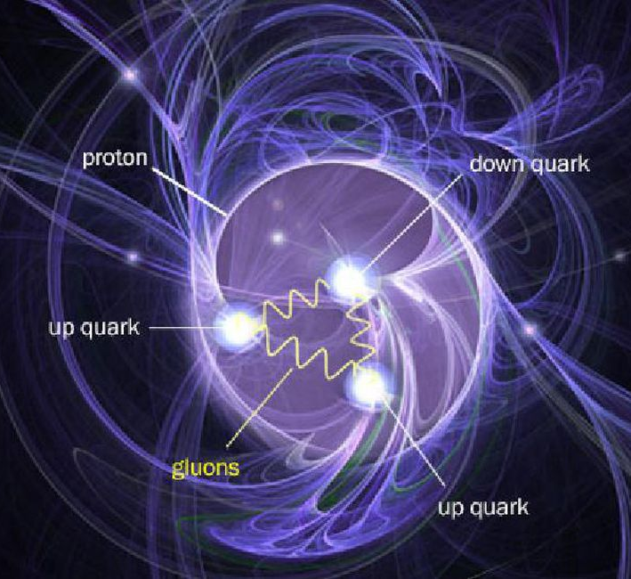
Proton mass and heavy-quarkonium production
Feb. 9,2021
Xiangdong Ji
CNF, SURA/UMD

Slide 2
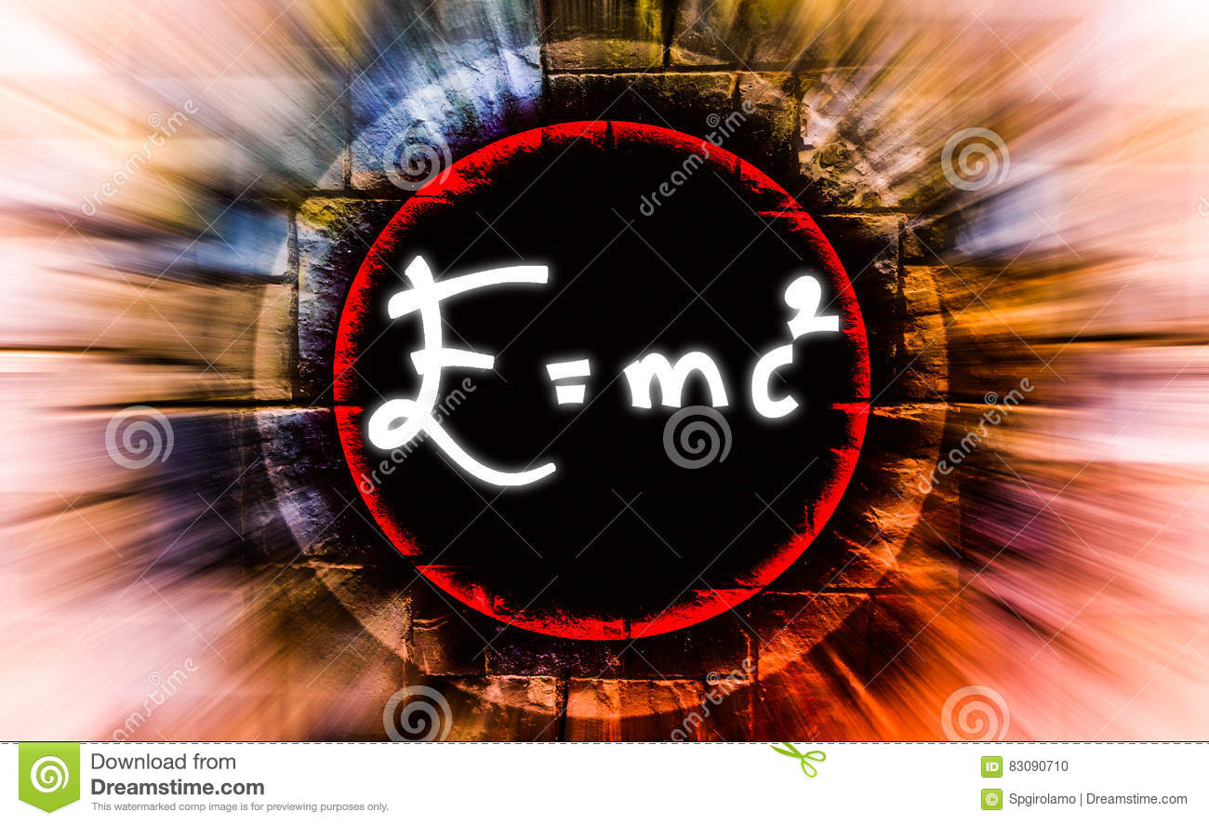
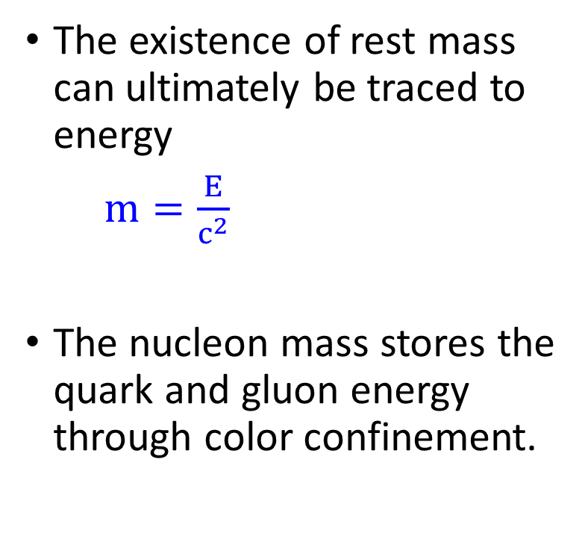
Mass-energy relation
The existence of rest mass can ultimately be traced to energy
$m=\frac{E}{c^{2}}$
The nucleon mass stores the quark and gluon energy through color confinement.

Slide 3
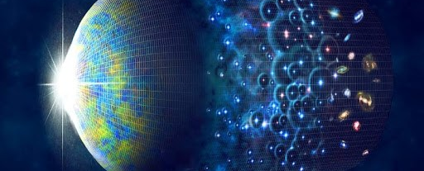
Saving energy in the nucleon mass
As the Universe expands and cools, the only way to store the hot plasma energy is to form color-neutral droplets (nucleons) of quark and gluons, locking the kinetic energies inside.

Slide 4
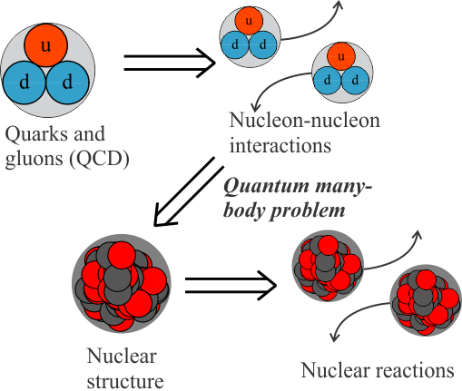
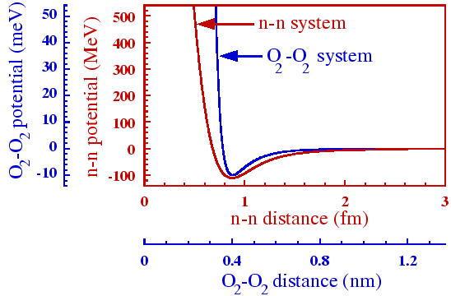
Squeezing the energy out of the nucleon mass

Slide 5
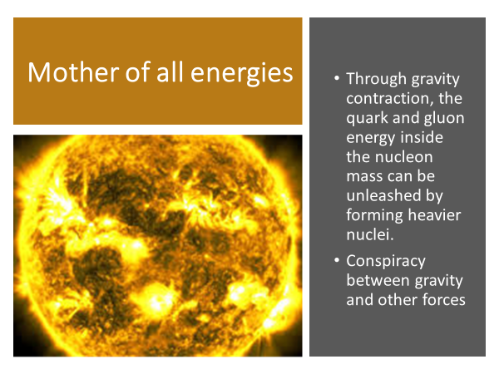
Mother of all energies
Through gravity contraction, the quark and gluon energy inside the nucleon mass can be unleashed by forming heavier nuclei.
Conspiracy between gravity and other forces

Slide 6
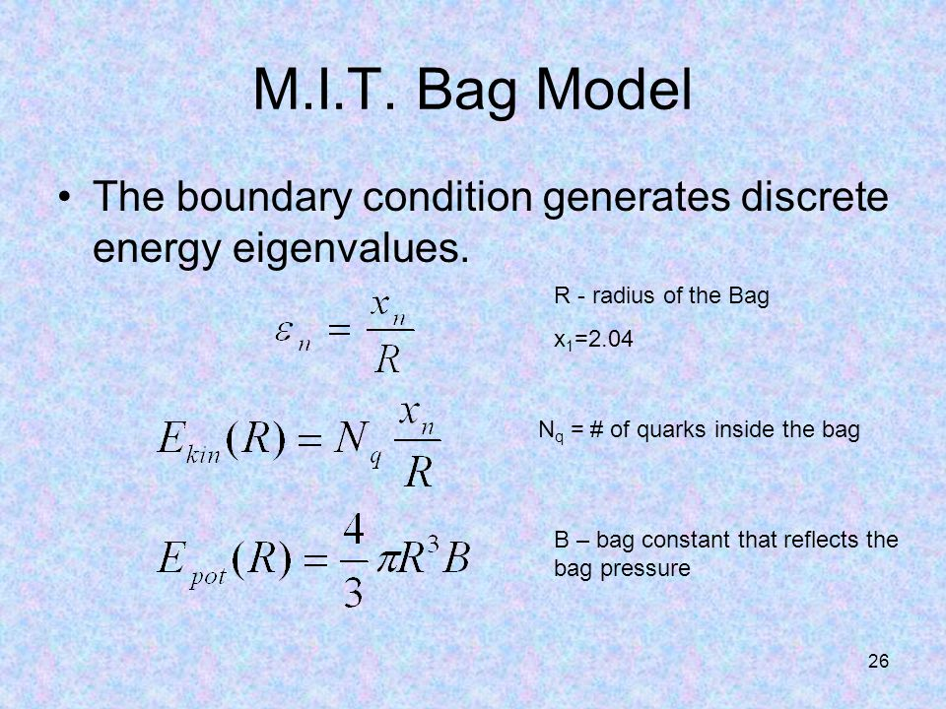
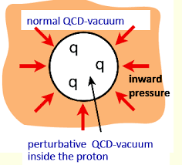

Role of color confinement
Mass = quark kinetic energy + B(scalar-field condensate)

Slide 7
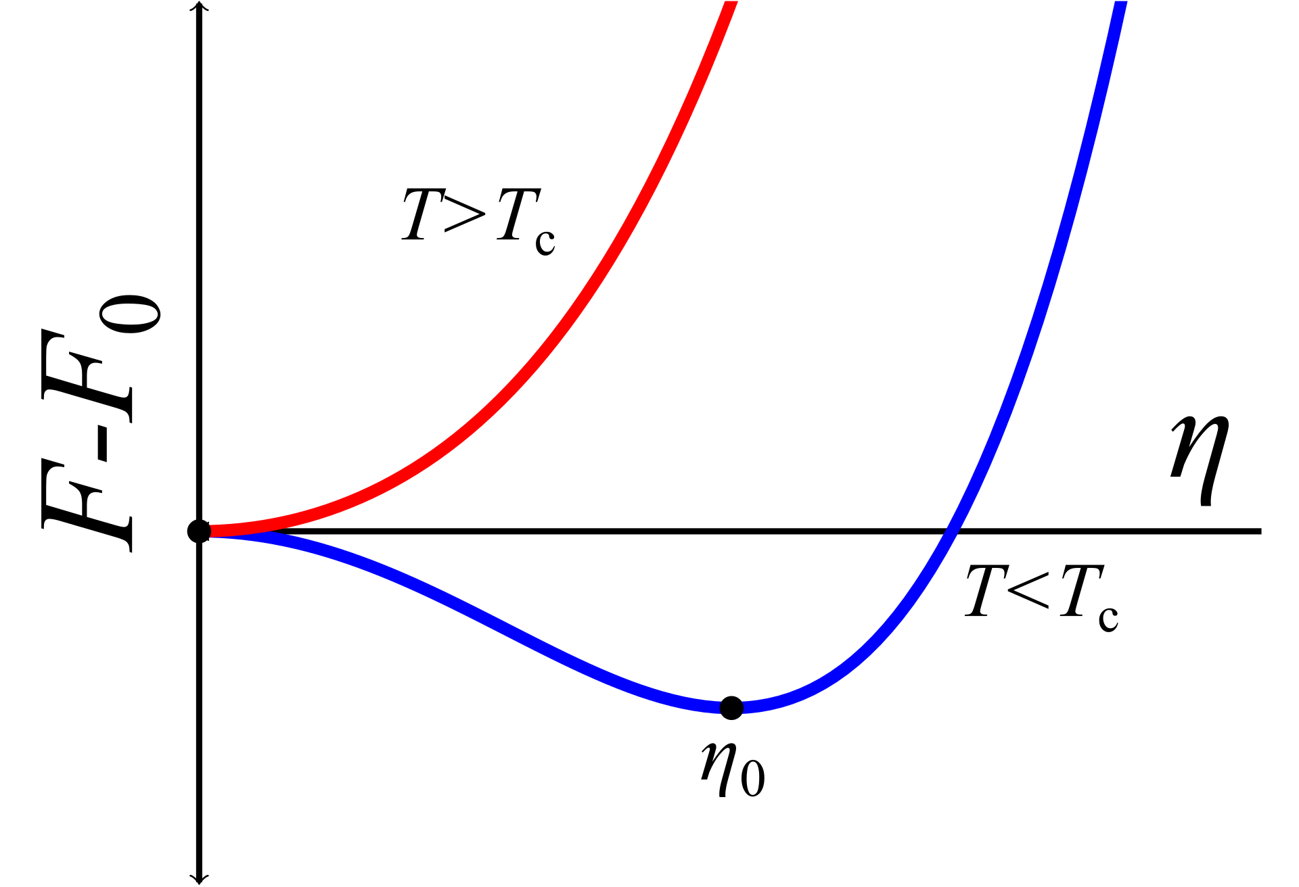
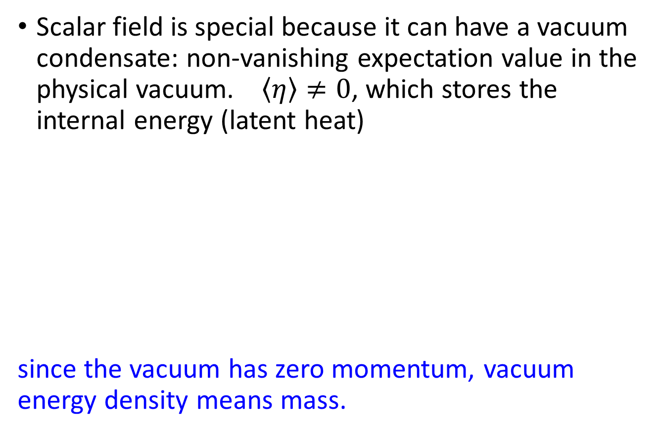
Energy in a scalar field
Scalar field is special because it can have a vacuum condensate: non-vanishing expectation value in the physical vacuum. $\left\langle η\right\rangle ≠0$, which stores the internal energy (latent heat)
since the vacuum has zero momentum, vacuum energy density means mass.

Slide 8
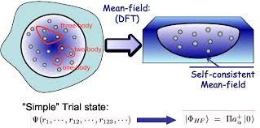
Mean field theory for nuclear structure
Traditional theory for nuclear structure: mean field theory
Two important features:
a) Mean field depth is about ~40 MeV
b) Large spin-orbit splitting for nuclear shells.

Slide 9
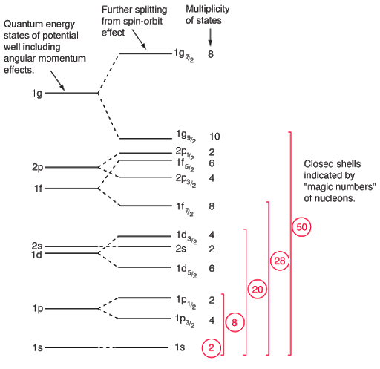
Nuclear shell models (Mayer and Jensen)

Slide 10
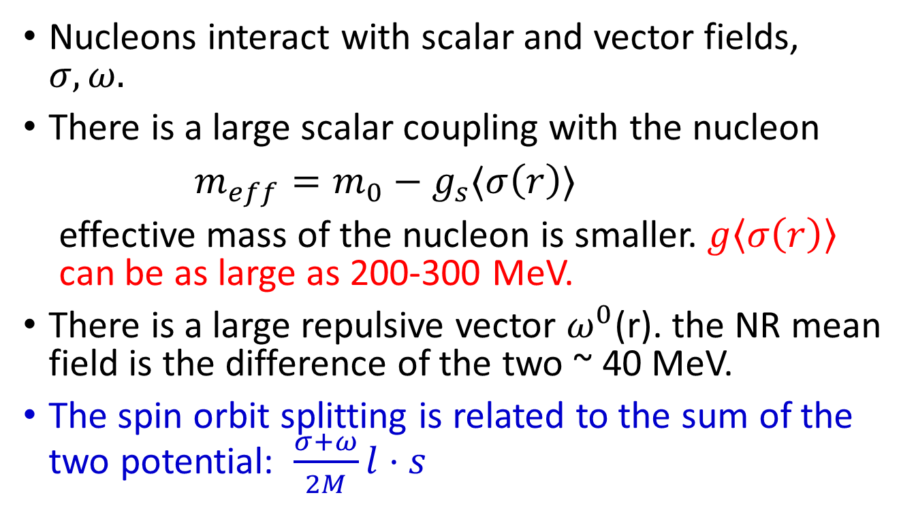
Relativistic mean field theory : Walecka model
Nucleons interact with scalar and vector fields, $σ, ω.$
There is a large scalar coupling with the nucleon
$m_{eff}=m_{0}−g_{s}⟨σ\left(r\right)⟩$
effective mass of the nucleon is smaller. $g\left\langle σ\left(r\right)\right\rangle$
can be as large as 200-300 MeV.
There is a large repulsive vector $ω^{0}$(r). the NR mean field is the difference of the two ~ 40 MeV.
The spin orbit splitting is related to the sum of the two potential: $\frac{σ+ω}{2M}l⋅s$
Notes:
\

Slide 11
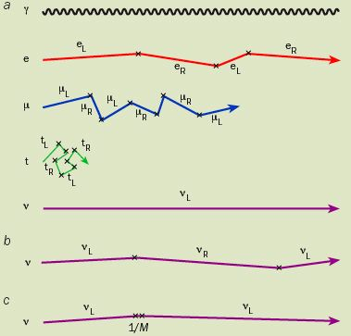
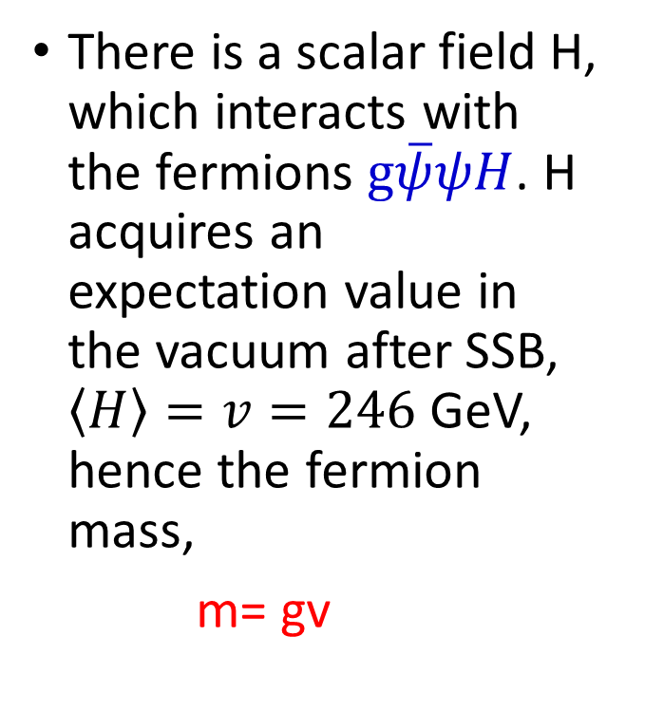
Masses of electrons and leptons: Higgs mechanism
There is a scalar field H, which interacts with the fermions $g\overline{ψ}ψH$. H acquires an expectation value in the vacuum after SSB, $\left\langle H\right\rangle =v=246$ GeV, hence the fermion mass,
m= gv

Slide 12
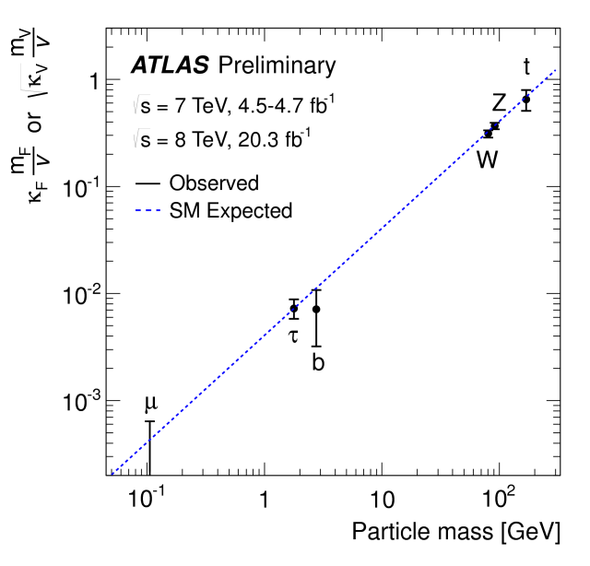
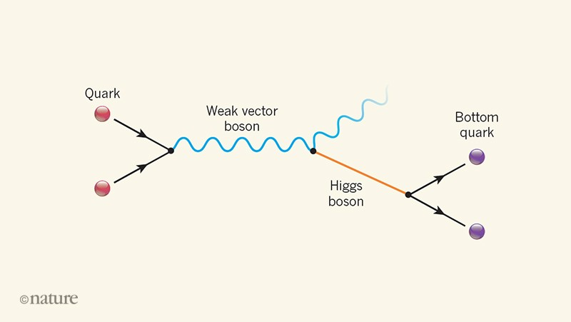

Test of Higgs mechanism
Dynamical Higgs-boson-fermion coupling , g=m/v
$g \overline{ψ}ψh$

Slide 13

Dynamical picture of the fermion mass
Part of the fermion mass comes from the dynamical excitation of the higgs field in the presence of fermion
$m_{f}∼\left\langle f\left|H_{S}\right|f\right\rangle ∼⟨f\left|h\right|f⟩$

Slide 14
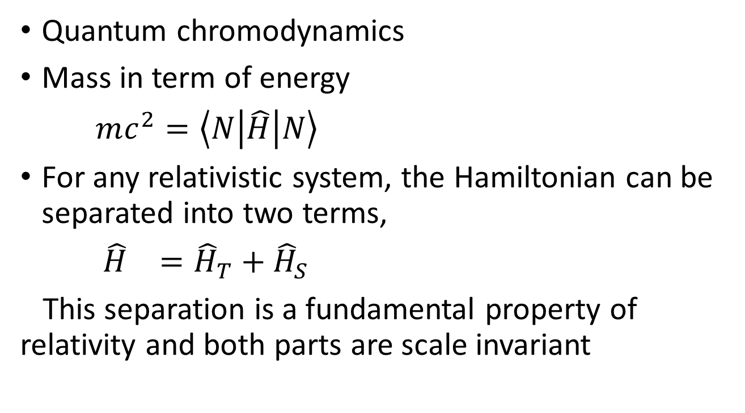
Mass of the nucleon
Quantum chromodynamics
Mass in term of energy
$mc^{2}=\left\langle N\left|\hat{H}\right|N\right\rangle$
For any relativistic system, the Hamiltonian can be separated into two terms,
${\hat{H}}_{}={\hat{H}}_{T}+{\hat{H}}_{S}$
This separation is a fundamental property of relativity and both parts are scale invariant

Slide 15
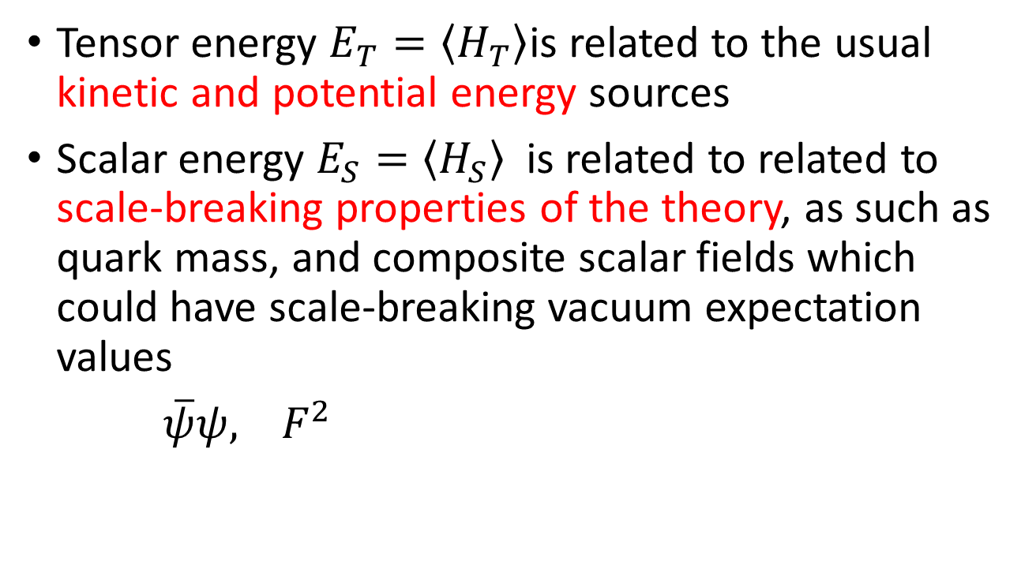
Tensor and scalar energy
Tensor energy $E_{T}=\left\langle H_{T}\right\rangle$is related to the usual kinetic and potential energy sources
Scalar energy $E_{S}=\left\langle H_{S}\right\rangle$ is related to related to scale-breaking properties of the theory, as such as quark mass, and composite scalar fields which could have scale-breaking vacuum expectation values
$\overline{ψ}ψ, F^{2}$

Slide 16
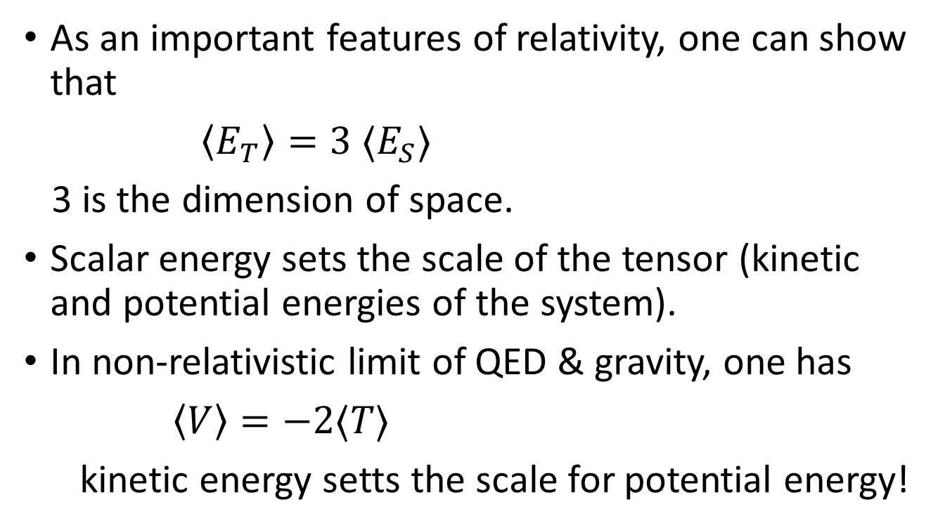
Relativistic virial theorem
As an important features of relativity, one can show that
$\left\langle E_{T}\right\rangle =3 ⟨E_{S}⟩$
3 is the dimension of space.
Scalar energy sets the scale of the tensor (kinetic and potential energies of the system).
In non-relativistic limit of QED & gravity, one has
$\left\langle V\right\rangle =−2⟨T⟩$
kinetic energy setts the scale for potential energy!

Slide 17
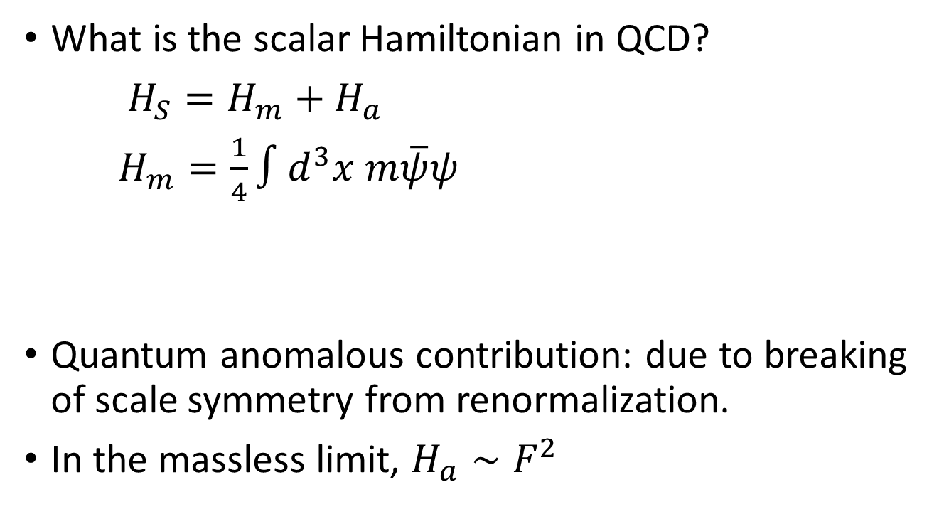
Scalar energy in QCD
What is the scalar Hamiltonian in QCD?
$H_{S}=H_{m}+H_{a}$
$H_{m}=\frac{1}{4}∫d^{3}x m\overline{ψ}ψ$
Quantum anomalous contribution: due to breaking of scale symmetry from renormalization.
In the massless limit, $H_{a}∼F^{2}$

Slide 18



Other QCD energy sources: unpolarized PDF and quark masses
Quark energy
Quark mass
Gluon kinetic energy
Trace anomaly

Slide 19
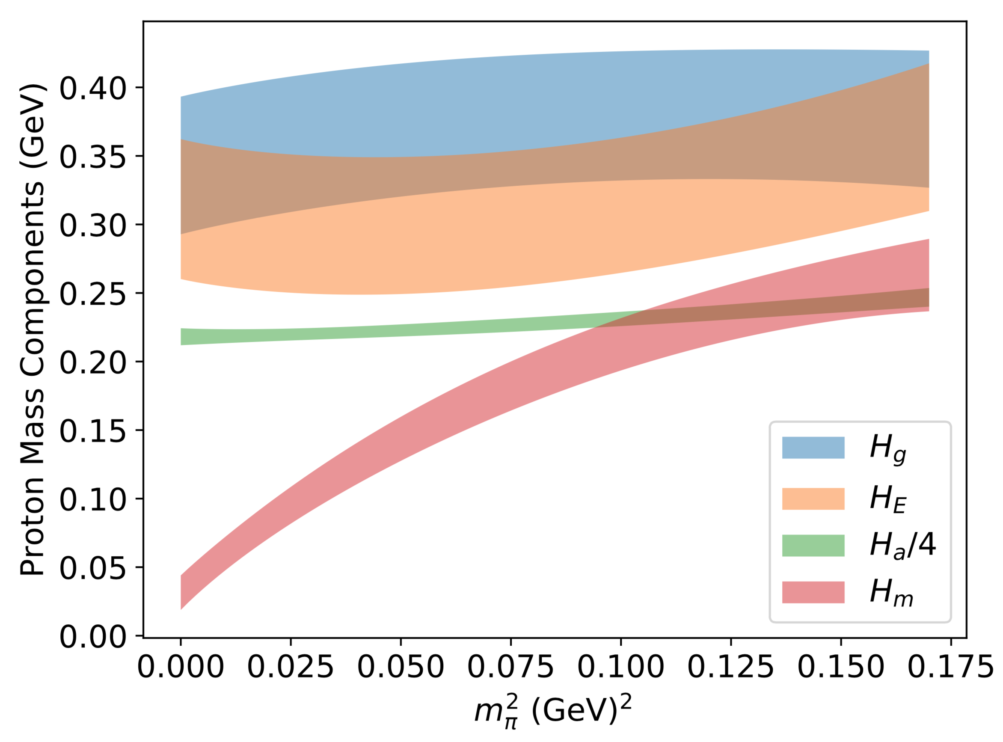
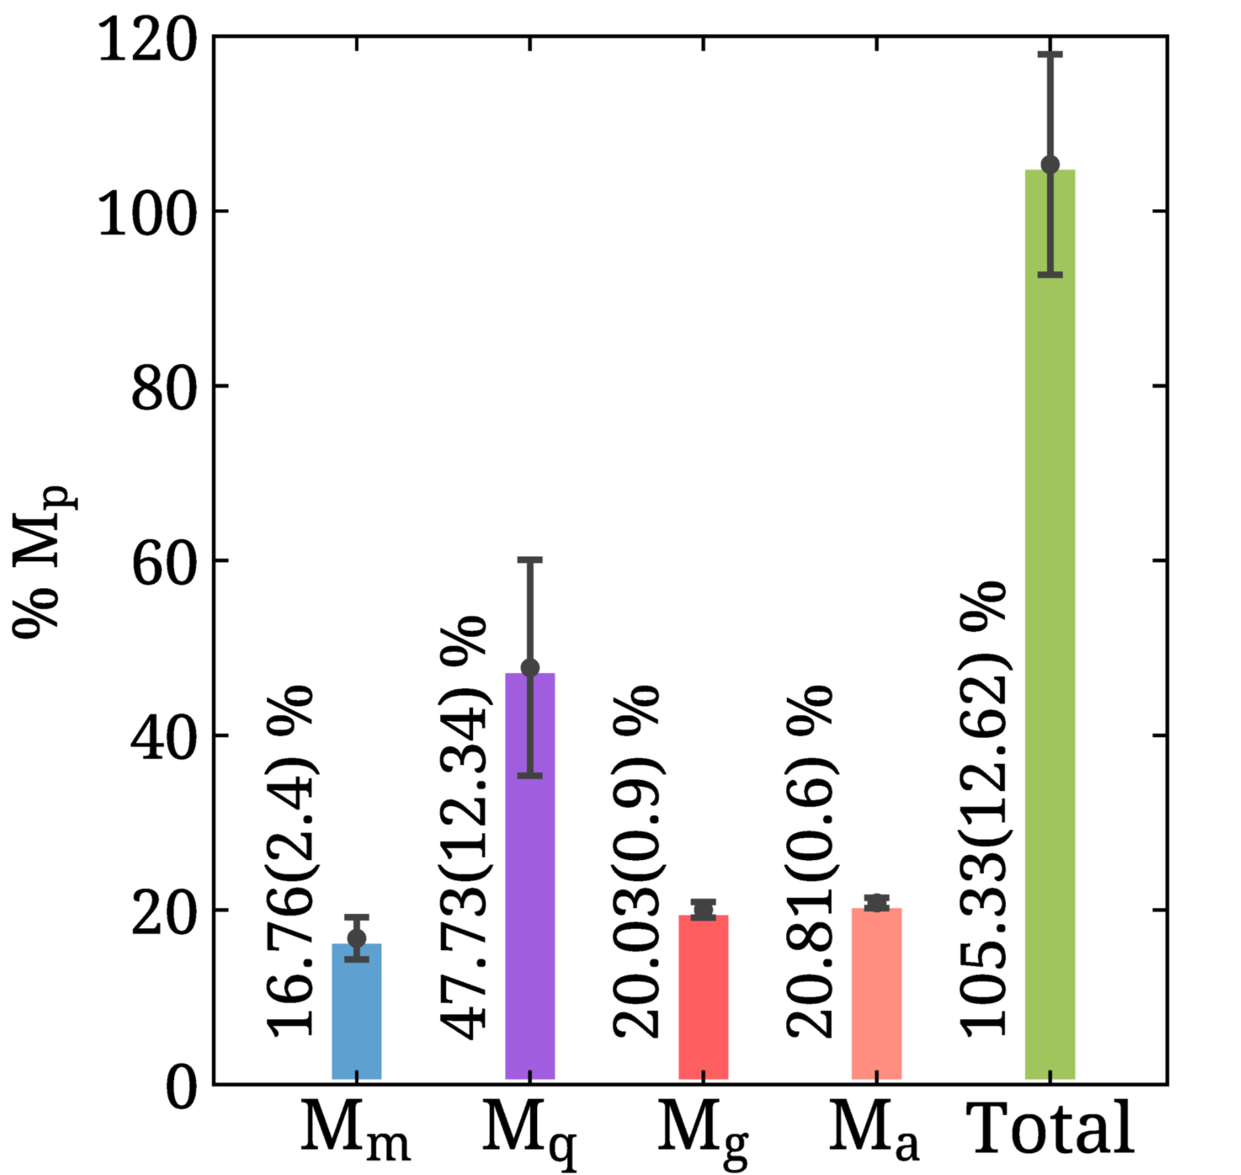
Proton mass on the lattice
Y.-B. Yang et al., (χQCD), PRL 121, 212001 (2018)
Y.-B. Yang et al., (χQCD), PRD94,054503 (2016)
C. Alexandrou et al., (ETMC), PRL 119, 142002 (2017)
C. Alexandrou et al., (ETMC), PRL 116, 252001 (2016)
Trace anomaly: 2101.04942 by Chi-QCD
B² is negative

Slide 20
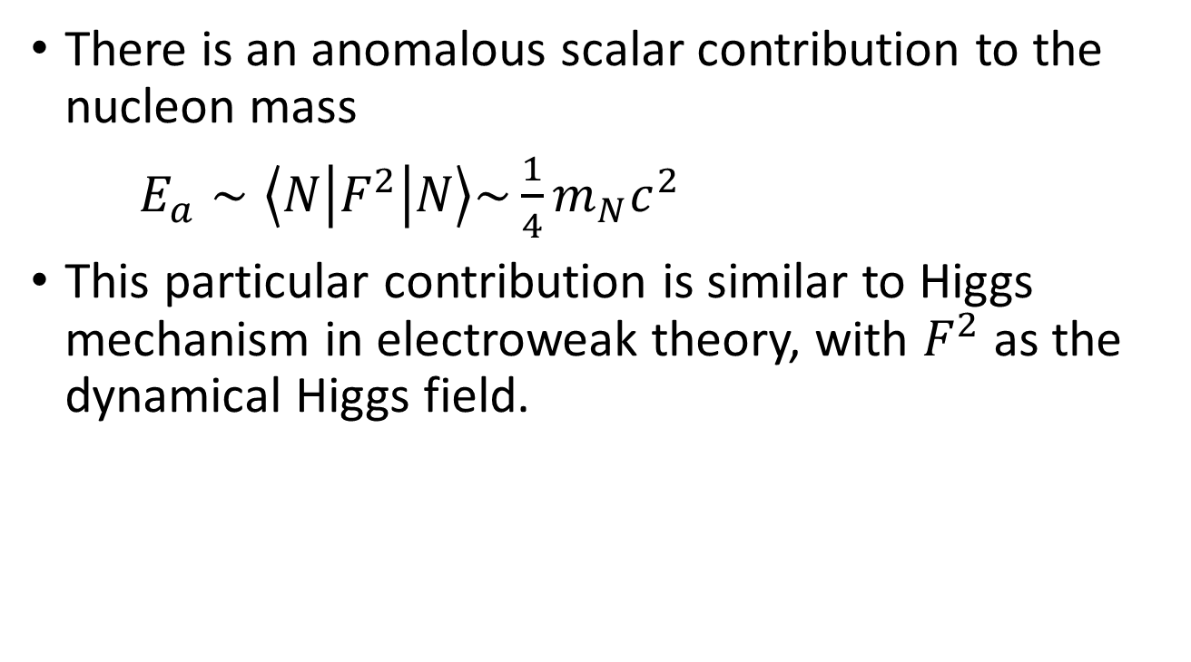
Scalar contribution to the nucleon mass
There is an anomalous scalar contribution to the nucleon mass
$E_{a}∼\left\langle N\left|F^{2}\right|N\right\rangle \sim \frac{1}{4}m_{N}c^{2}$
This particular contribution is similar to Higgs mechanism in electroweak theory, with $F^{2}$ as the dynamical Higgs field.

Slide 21
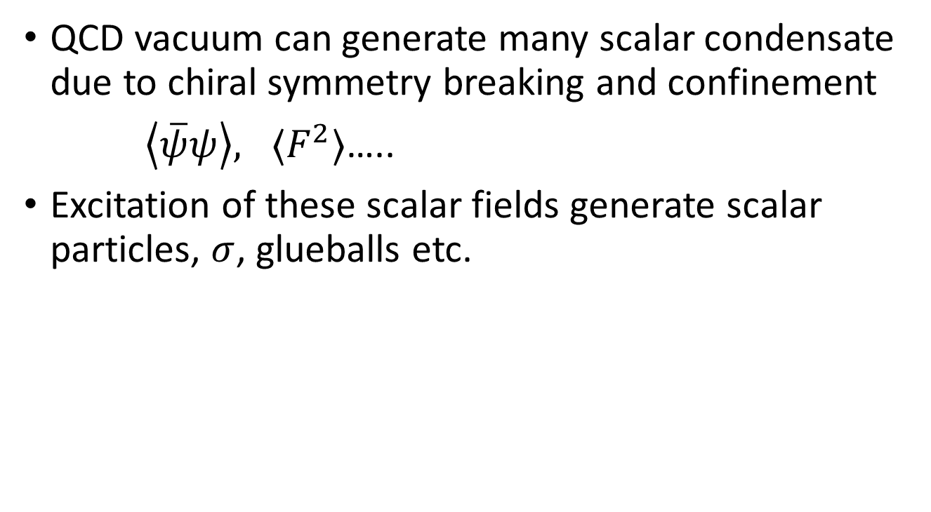
Scalar condensate in QCD vacuum
QCD vacuum can generate many scalar condensate due to chiral symmetry breaking and confinement
$\left\langle \overline{ψ}ψ\right\rangle , ⟨F^{2}⟩$…..
Excitation of these scalar fields generate scalar particles, $σ$, glueballs etc.

Slide 22

Quantum anomalous energy contribution to the nucleon mass
$E_{a}∼\left\langle N\left|F^{2}\right|N\right\rangle$
This matrix element can be calculated through
dynamical scalar excitations

Slide 23

Static response of scalar field F²
Directly measure the static response of the F² in the nucleon or any other particles
$\left\langle H\left|F^{2}\right|H\right\rangle$
Similar to MIT bag constant, B

Slide 24
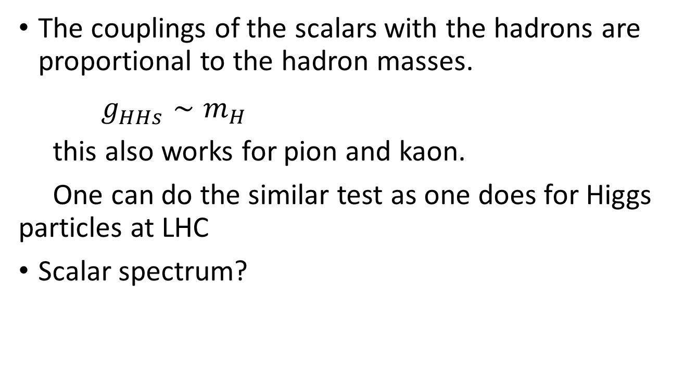
Test of the QCD “Higgs mechanism”
The couplings of the scalars with the hadrons are proportional to the hadron masses.
$g_{HHs}^{}∼m_{H}$
this also works for pion and kaon.
One can do the similar test as one does for Higgs particles at LHC
Scalar spectrum?

Slide 25
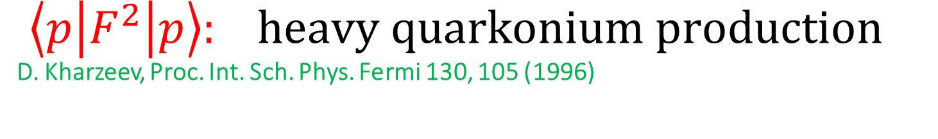

${\left\langle p\left|F^{2}\right|p\right\rangle :}_{}heavy quarkonium production$
D. Kharzeev, Proc. Int. Sch. Phys. Fermi 130, 105 (1996)
Using a color dipole to measure the scalar field static response. Voloshin (1978), ….
This naturally leads to the “probe” through photo or electro-production of heavy quarkonium.
Precision data is needed + VDM

Slide 26
Connection between cross sections and the matrix element
A number of proposals exist, all based on some models
Kharzeev, Vanderhaegen
Hatta, Zahed,
…
The VDM can be tested through kinematic dependences, and possible corrections may be quantifiable theoretically

Slide 27
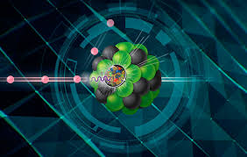

Higher Q²: Looking to EIC
Higher Q² provides a more rigorous connection between cross section and the matrix element. (Boussarie & Hatta et al, Phys.Rev.D 101 (2020) 11, 114004)
J/psi & $Υ$ production

Slide 28
Conclusion
About ¼ of the nucleon mass comes from the scalar field in a way similar to Higgs mechanism.
The contribution can be measured or tested either as a static response (color dipole) or a dynamic response (glueballs, LHC)
The quark and gluon kinetic and potential energy contributions are related to the scalar by virial theorem and can also be measured independently.

