Slide 1


Proposal to JLab PAC 53
Double Deeply Virtual Compton Scattering with SoLIDμ spectrometer
Zhiwen Zhao
SoLID Collaboration Meeting
June 7-8, 2025

Slide 2
Proposal to PAC53 PR12-25-010
And SoLID Collaboration
Spokesperson : Juan-Sebastian Alvarado, Alexandre Camsonne, Marie Boer,
Eric Voutier, Xinzhan Bai, Zhiwen Zhao

Slide 3
Overview
General Parton Distribution
Double Deeply Virtual Compton Scattering
SoLIDµ setup
Muon detector
Simulation study
Physics projections
Beam time request
Summary

Slide 4
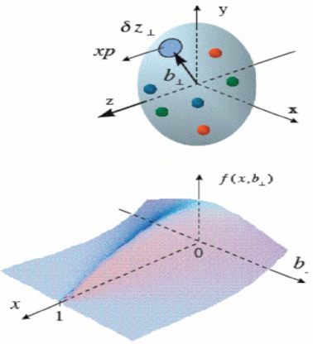
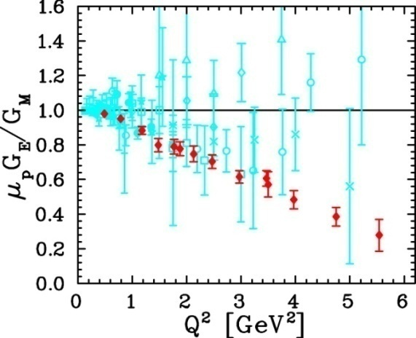
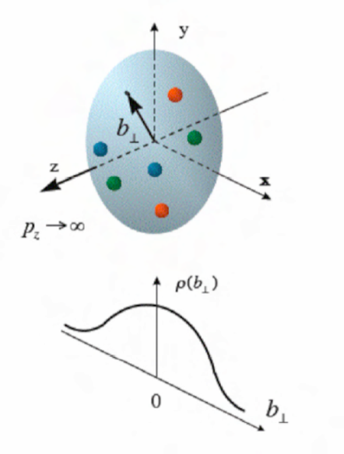
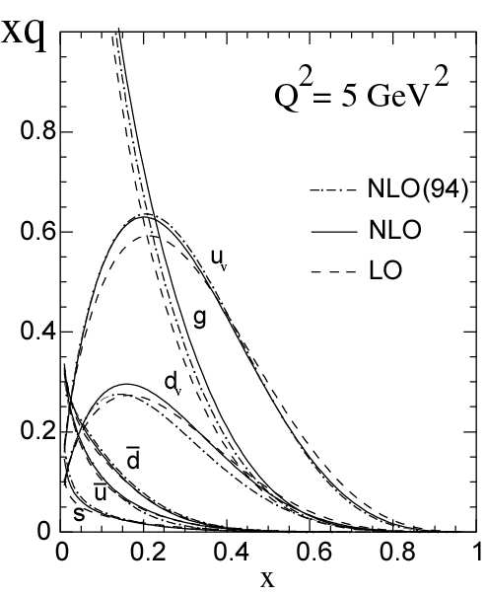
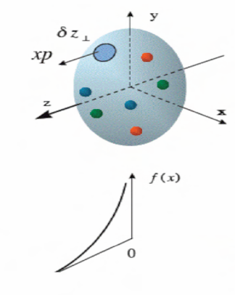
Generalized Parton Distribution (GPD)
A unified descriptions of partons (quarks and gluons) in the momentum and impact parameter space
Elastic form factors Transverse spatial distributions
Parton Distribution Functions Longitudinal momentum distributions

Slide 5
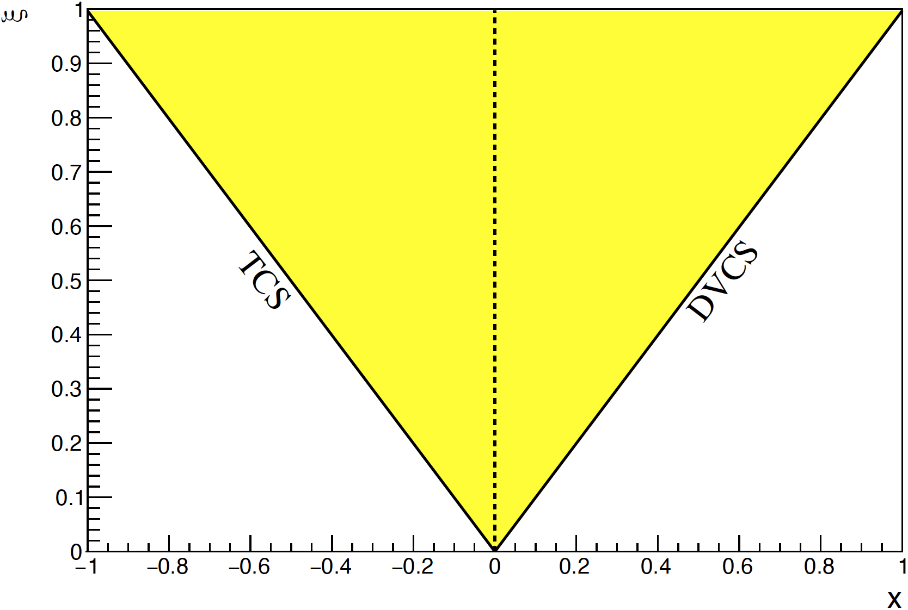
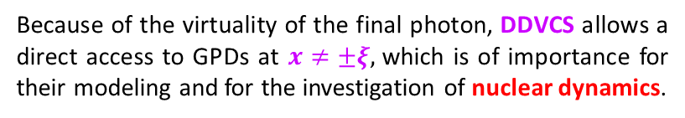
General Compton Process accessing GPD
γ*(q) + p(p) → γ*(q′) + p(p′)
Deeply Virtual CS (γ′ → γ, Q’²=0, ξ’ = ξ)
Timelike CS (γ → γ′, Q²=0, ξ’ = - ξ)
Double DVCS (γ′ → γ′)
Because of the virtuality of the final photon, DDVCS allows a direct access to GPDs at $x≠±ξ,$which is of importance for their modeling and for the investigation of nuclear dynamics.
Compton Form Factor (CFF)
GPD combination
Generalized
Bjorken variable
Skewness
Following the sign change of ξ’ around Q’²=Q², the imaginary part of $𝓗$and $𝓔$ change sign, providing a testing ground of GPD universality.

Slide 6
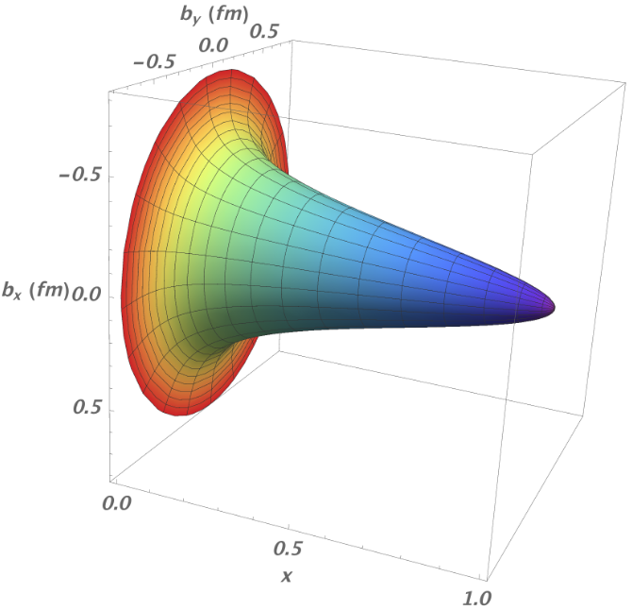
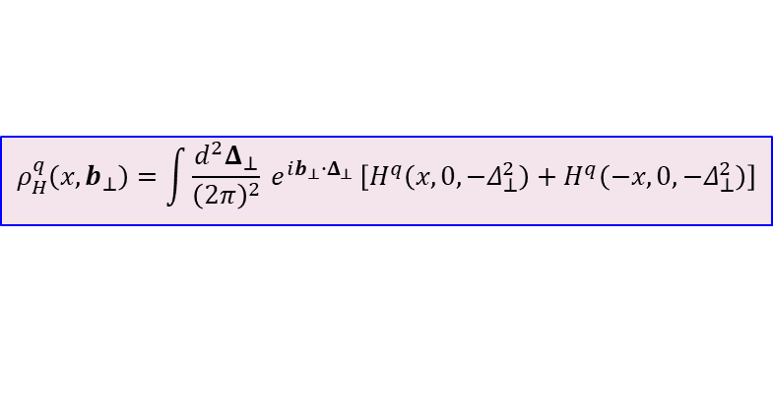
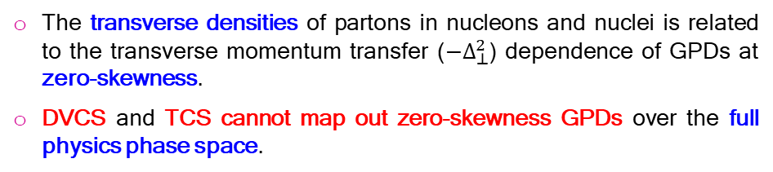
Nucleon Femtography
M. Burkardt PRD 62 (2000) 071503. M. Diehl EPJC 25 (2002) 223 A.V. Belitsky, D. Müller, NPA 711 (2002) 118c J.P. Ralston; B. Pire PRD 66 (2002) 111501
$$ρ_{H}^{q}\left(x,b_{⊥}\right)=\int{\frac{d^{2}Δ_{⊥}}{{\left(2π\right)}^{2}}} e^{ib_{⊥}{∙Δ}_{⊥} }\left[H^{q}\left(x,0,−Δ_{⊥}^{2}\right)+H^{q}\left(−x,0,−Δ_{⊥}^{2}\right)\right]$$
The transverse densities of partons in nucleons and nuclei is related to the transverse momentum transfer (${−Δ}_{⊥}^{2}$) dependence of GPDs at zero-skewness.
DVCS and TCS cannot map out zero-skewness GPDs over the full physics phase space.
The experimental knowledge of the ξ-dependence of GPDs at fixed longitudinal momentum fraction allows to control the zero-skewness extrapolation required for nucleon imaging.
R. Dupré, M. Guidal, M. Vanderhaeghen, PRD 95 (2017) 011501

Slide 7
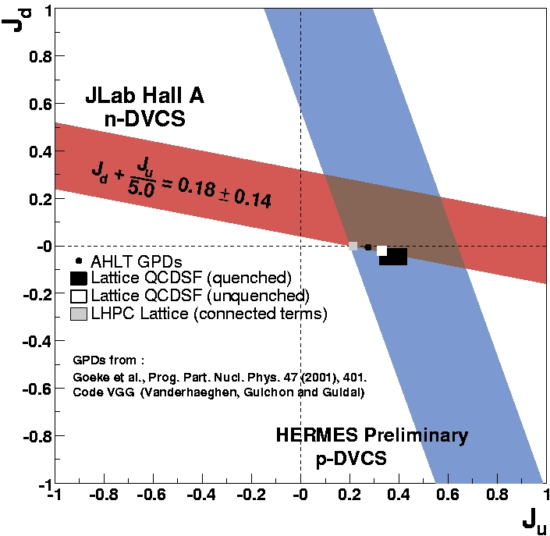
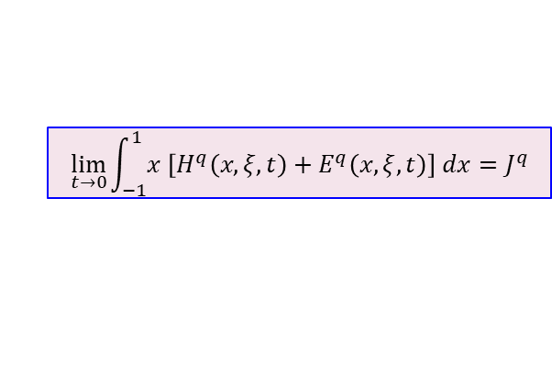
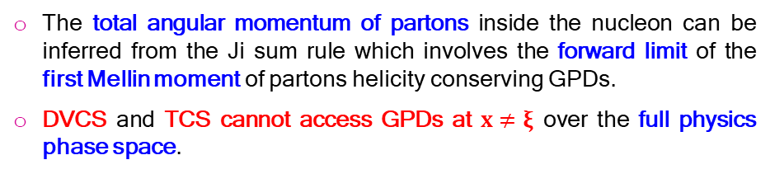
Nucleon Spin
$$\lim_{t→0}{\int_{−1}^{1}{x \left[H^{q}\left(x,ξ,t\right)+E^{q}\left(x,ξ,t\right)\right] dx}}=J^{q}$$
d
The total angular momentum of partons inside the nucleon can be inferred from the Ji sum rule which involves the forward limit of the first Mellin moment of partons helicity conserving GPDs.
DVCS and TCS cannot access GPDs at $x≠ξ$ over the full physics phase space.
A.W. Thomas, PRL 101 (2008) 102003
The experimental knowledge of the ξ-dependence of GPDs at fixed longitudinal momentum fraction is a mandatory step for unraveling the nucleon spin.
u

Slide 8
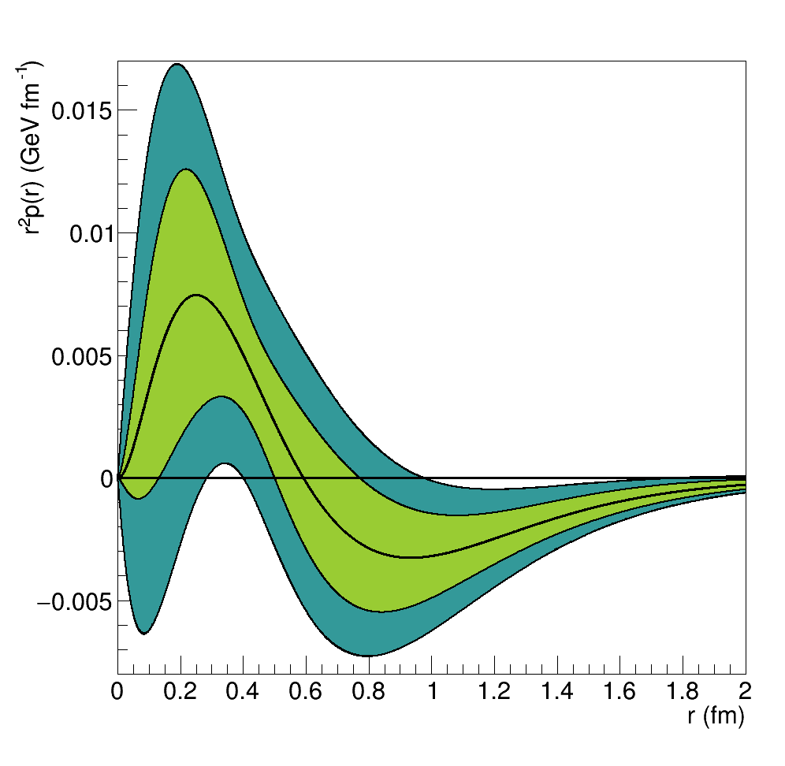
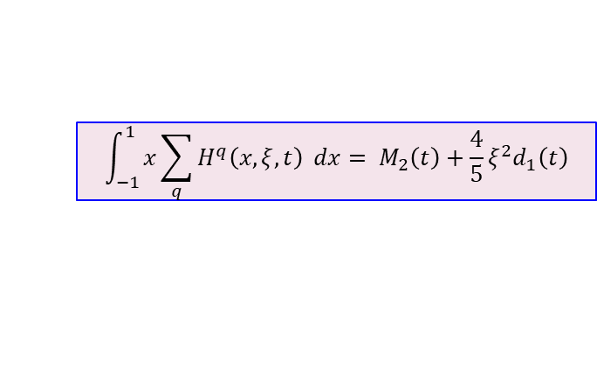
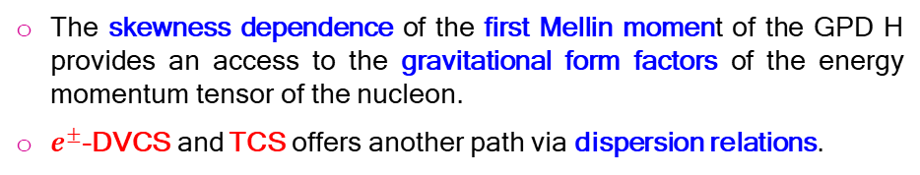
Nucleon Forces
$$\int_{−1}^{1}{x\sum_{q}{H^{q}\left(x,ξ,t\right)} dx}= M_{2}\left(t\right)+\frac{4}{5}ξ^{2}d_{1}\left(t\right)$$
The skewness dependence of the first Mellin moment of the GPD H provides an access to the gravitational form factors of the energy momentum tensor of the nucleon.
$e^{±}$-DVCS and TCS offers another path via dispersion relations.
The ξ-dependence of GPDs reveals the internal dynamics of the nucleon.
V. Burkert, L. Elouadrhiri, F.-X. Girod, Nat. 557 (2018) 396; arXiv:2104.02031

Slide 9
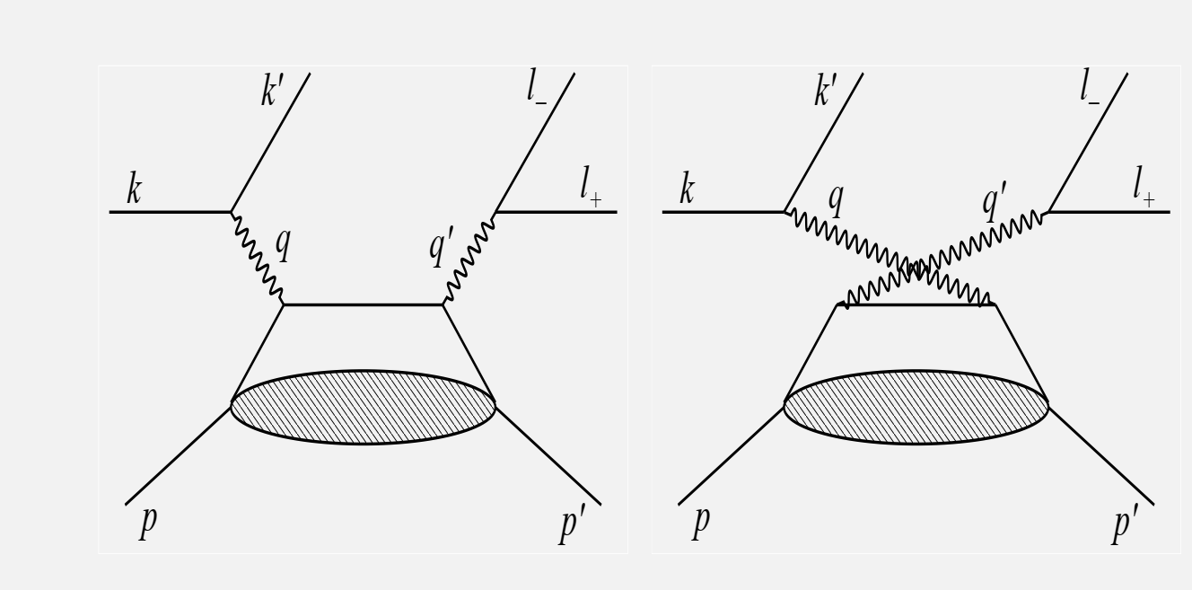
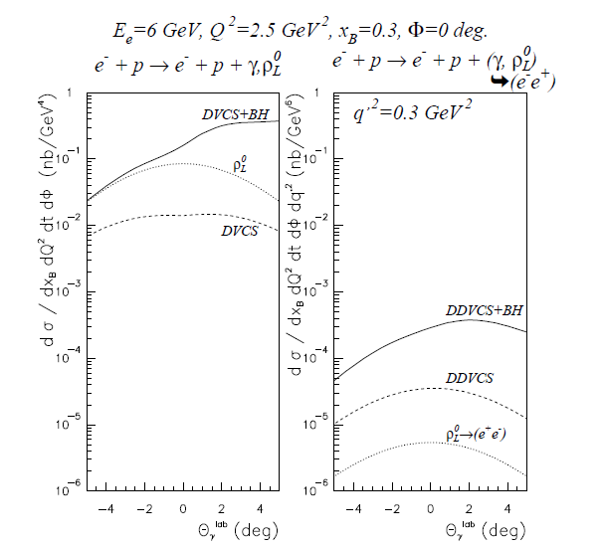
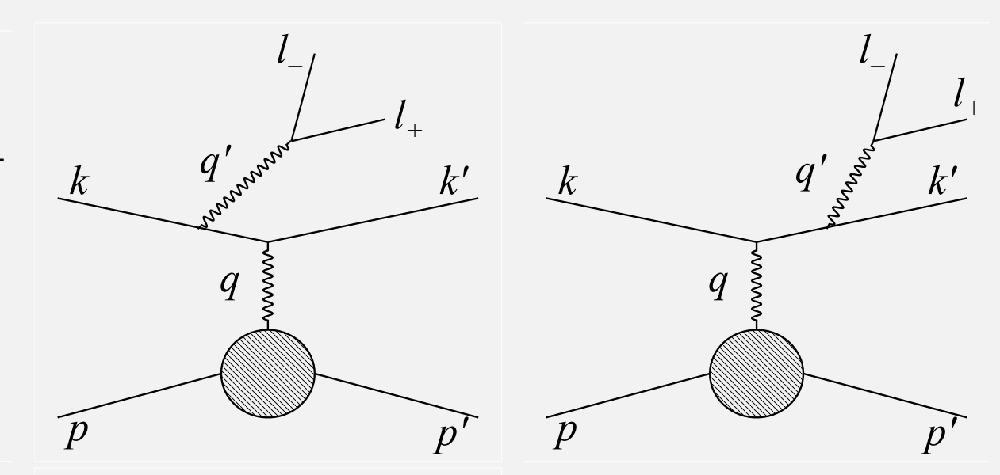
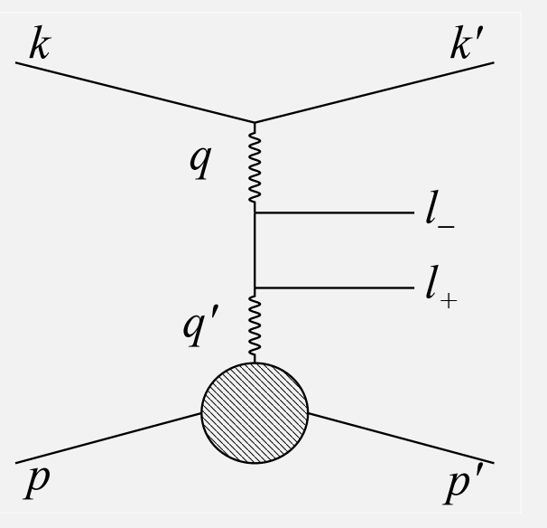
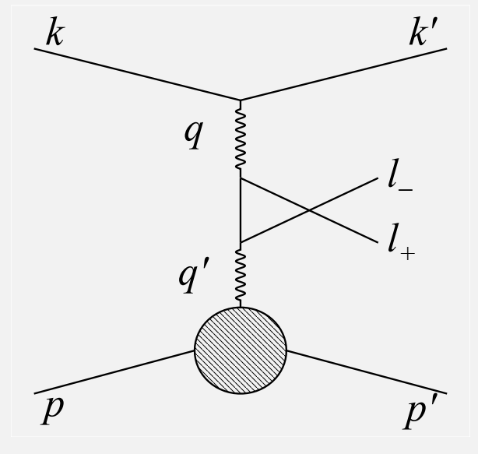
Elementary Cross Section
DDVCS cross section is about 1/100 of DVCS and involves two Bethe-Heitler
$${d^{7}σ}_{P}^{e}={d^{7}σ}_{BH_{1}}+d^{7}σ_{BH_{2}}+{d^{7}σ}_{DDVCS}+P{ d}^{7}{\tilde{σ}}_{DDVCS}{+{{ d}^{7}σ}_{INT_{2}}+P{ d}^{7}\tilde{σ}}_{INT_{2}}−e \left[{d^{7}σ}_{BH_{12}}\text{+}{{ d}^{7}σ}_{INT_{1}}{+ P{ d}^{7}\tilde{σ}}_{INT_{1}}\right]$$
DDVCS
BH1
BH2

Slide 10
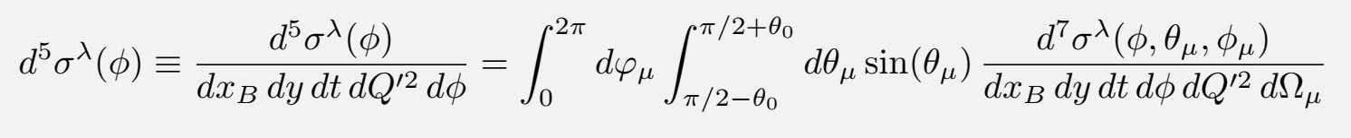
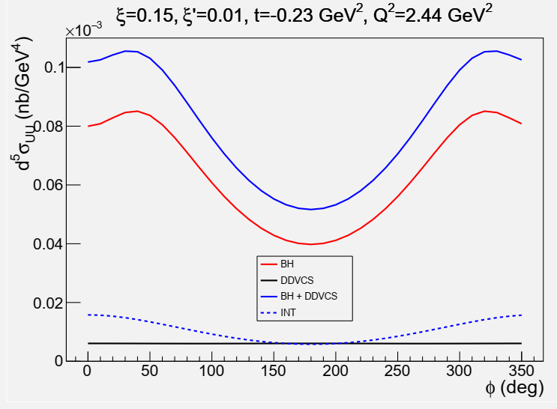
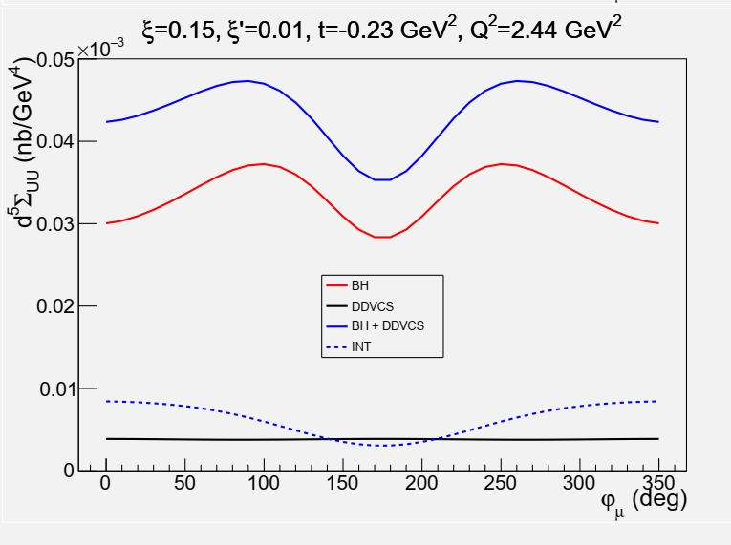
Integrated Cross Section
5-fold observables obtained from the integration over the polar angle of the muon and the azimuthal angle of the final virtual photon or the initial virtual photon are required, also minimizing the contribution of the BH₂ process.
DVCS-like
TCS-like
DVCS-like
TCS-like

Slide 11
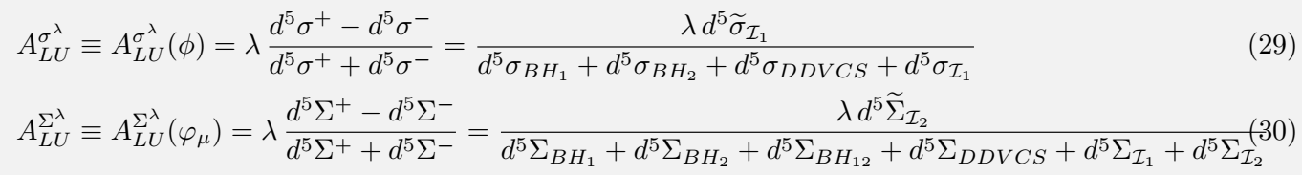

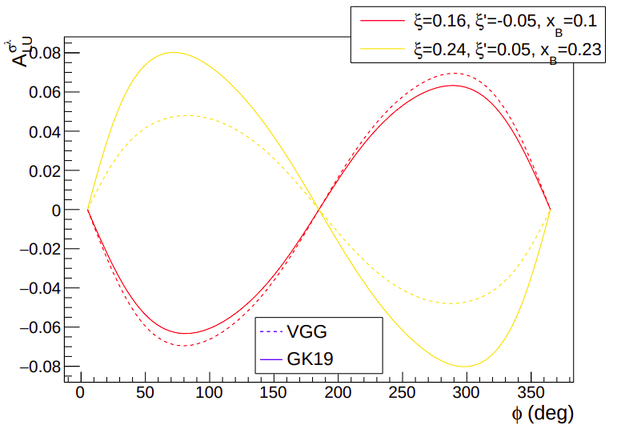
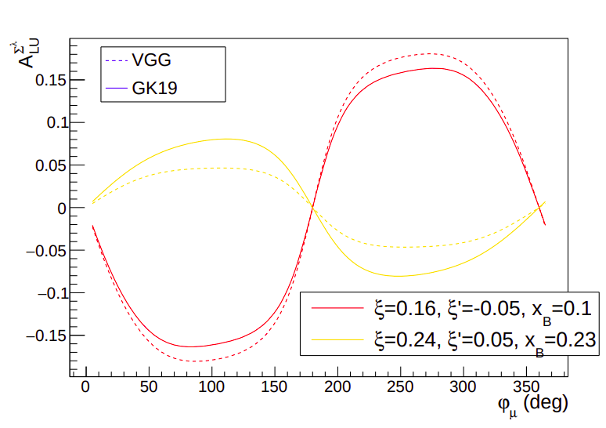
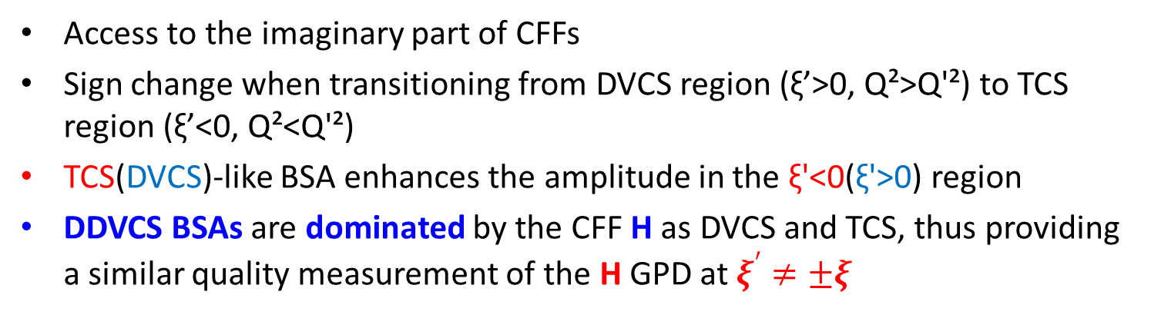
Beam Spin Asymmetry
DVCS-like BSA
TCS-like BSA
Access to the imaginary part of CFFs
Sign change when transitioning from DVCS region (ξ’>0, Q²>Q'²) to TCS region (ξ’<0, Q²<Q'²)
TCS(DVCS)-like BSA enhances the amplitude in the ξ'<0(ξ'>0) region
DDVCS BSAs are dominated by the CFF H as DVCS and TCS, thus providing a similar quality measurement of the H GPD at $ξ^{′}≠±ξ$

Slide 12
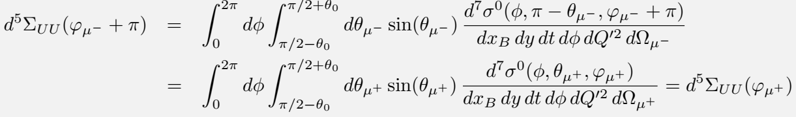
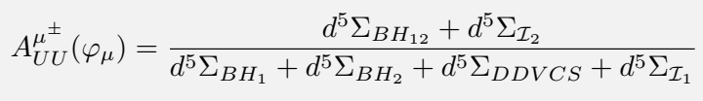
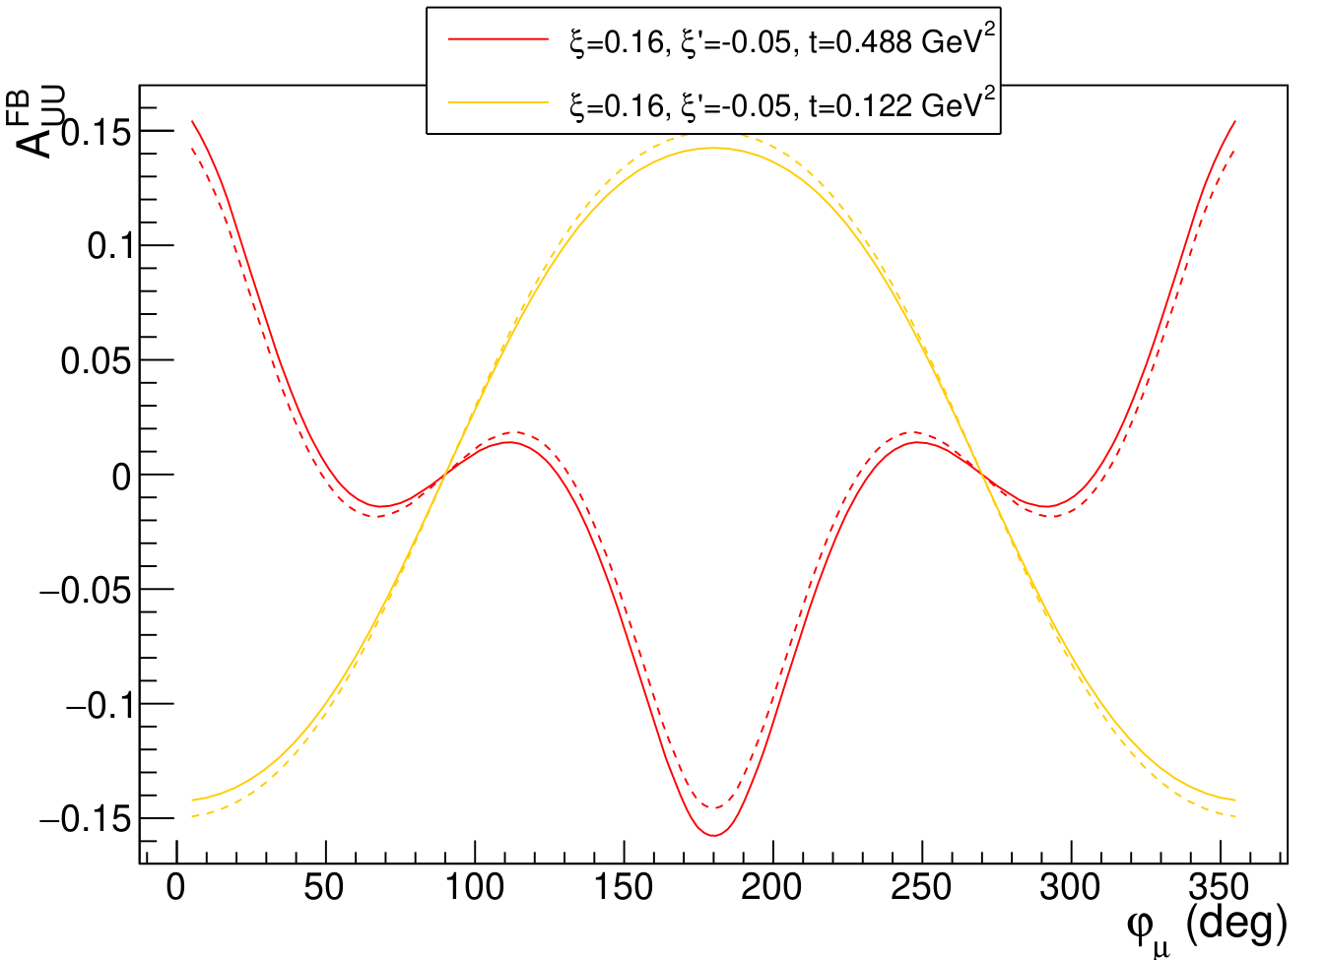
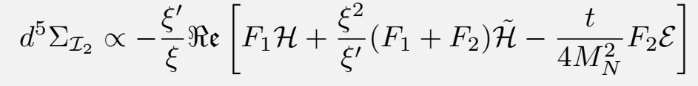
Muon Charge Asymmetry
aka Forward Backward Asymmetry
Access to the real part of CFFs
The Muon Charge Asymmetry (μCA), similar in nature to the forward-backward asymmetry of TCS, is predicted to have significant amplitude and rich harmonic composition
Curvature sign change is a highly-discriminating feature for models
DDVCS μCA is dominated by the CFF H and access a CFF combination different from BSA. This feature distinguishes DDVCS from DVCS and TCS

Slide 13
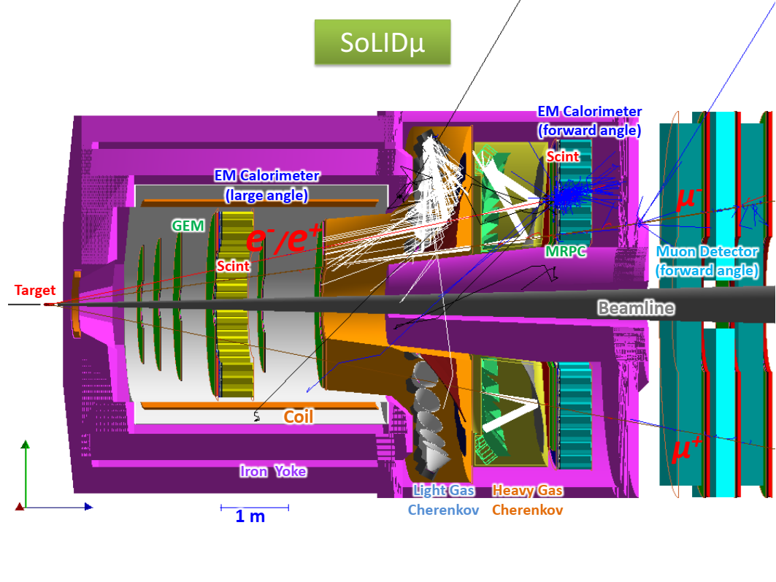
Experimental Setup
Based on SoLID J/Psi and TCS setup with forward angle muon detector added to form SoLIDμ spectrometer
Sharing beam time with added muon channels for J/Psi and TCS
Forward Angle (FA) covers 8.5-16.5deg and Large Angle (LA) covers 18-30deg

Slide 14
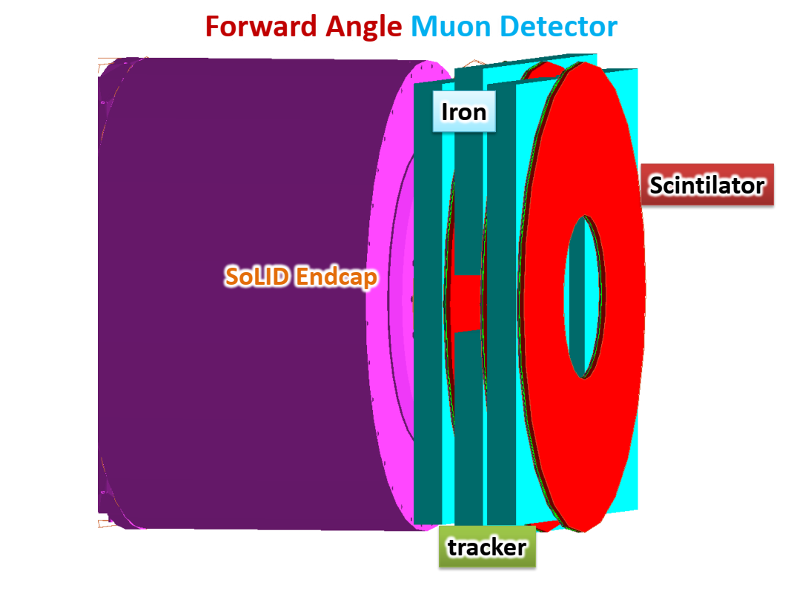
Forward Angle Muon Detector (FAMD)
3 layers of iron for pion blocking
3 layers of µRWell trackers for tracks in FAMD to connect with tracks in SoLID inner GEM trackers
  track resolution from SoLID inner trackers only
3 layers of scintillators for muon PID with pion suppression and for trigger

Slide 15
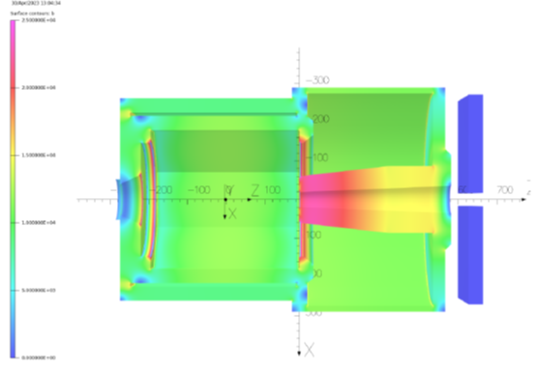
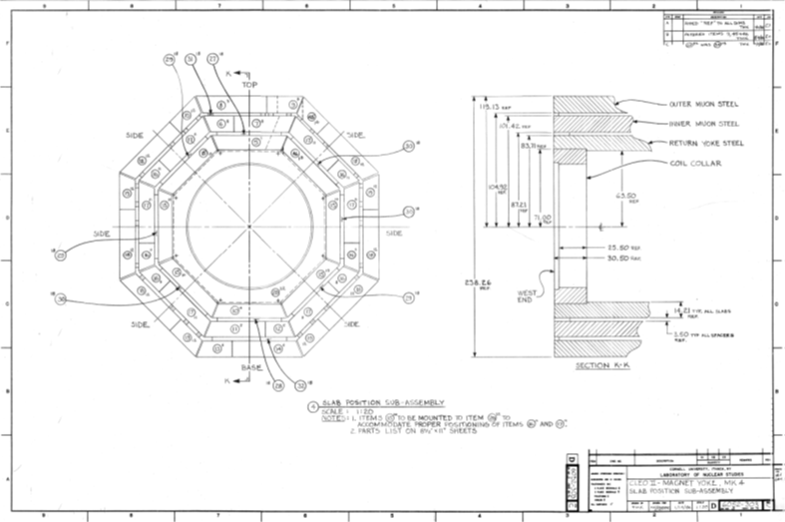
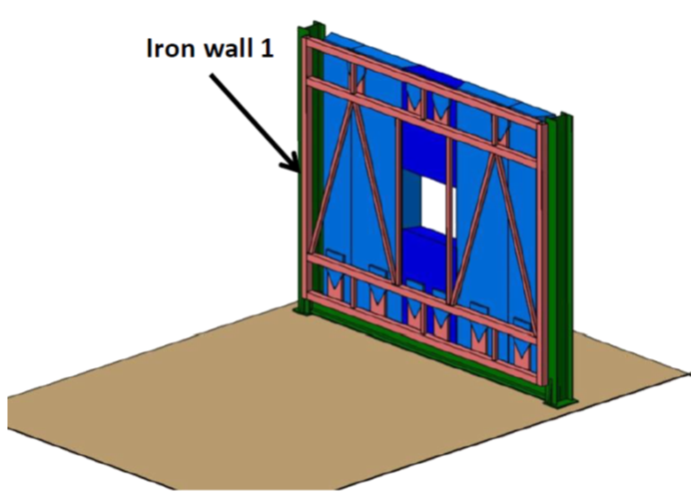
Iron of FAMD
TOSCA field model
Reuse 6 of 8 CLEO octagon outer layer iron
Each one is about 36x254x533cm
No problem with space
Field (<10G),force(<1N),torque(<2Nm) are small
CLEO drawing
Conceptual support design

Slide 16
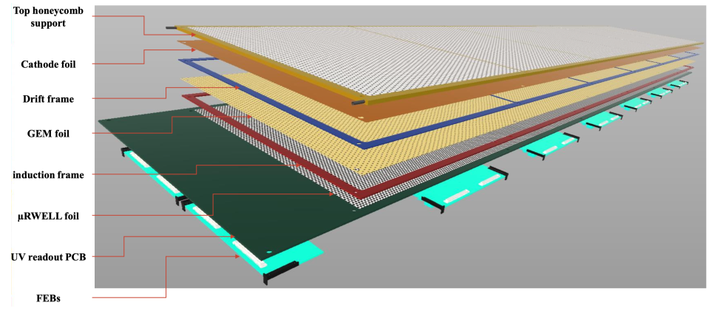
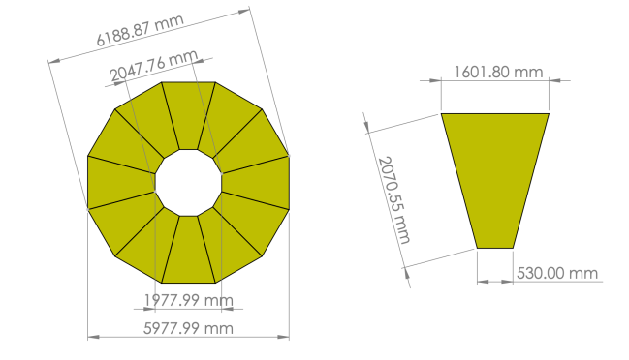
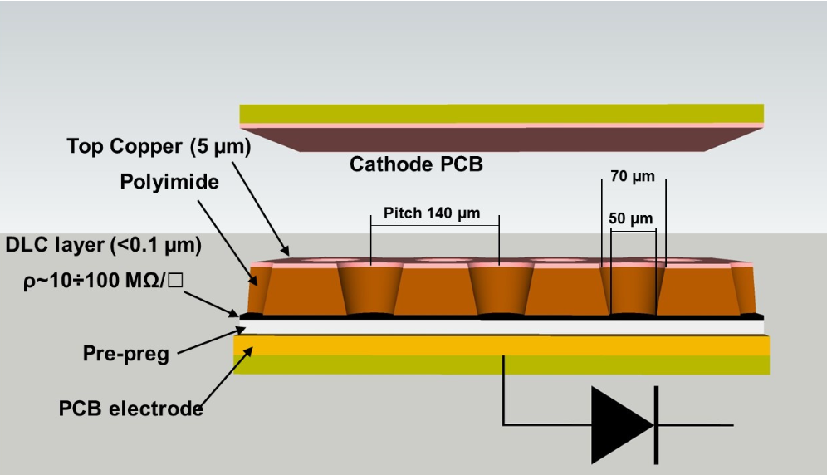

µRWell trackers of FAMD
µRWell with good rate capability and lower cost than GEM
VMM electronics
2D UV strips with capacitive charge sharing to have rate 30KHz/cm2 and position resolution of 1 mm
$μ$RWELL Detector for EPIC outer barrel tracking layer
$μ$RWELL Detector – G. Bencivenni et al 2019 JINST 14 P05014
A plane of $μ$RWELL detectors for muon detection

Slide 17
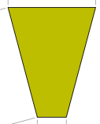
Scintillators of FAMD
Each plane has 60 azimuthal segments
Readout with light guide and PMTs from both inner and outer radial ends
Thickness 5cm and 150 ps time resolution
Design similar to CLAS12 forward scintillator and SoLID large angle scintillator with similar performance
30cm
185cm
10cm

Slide 18
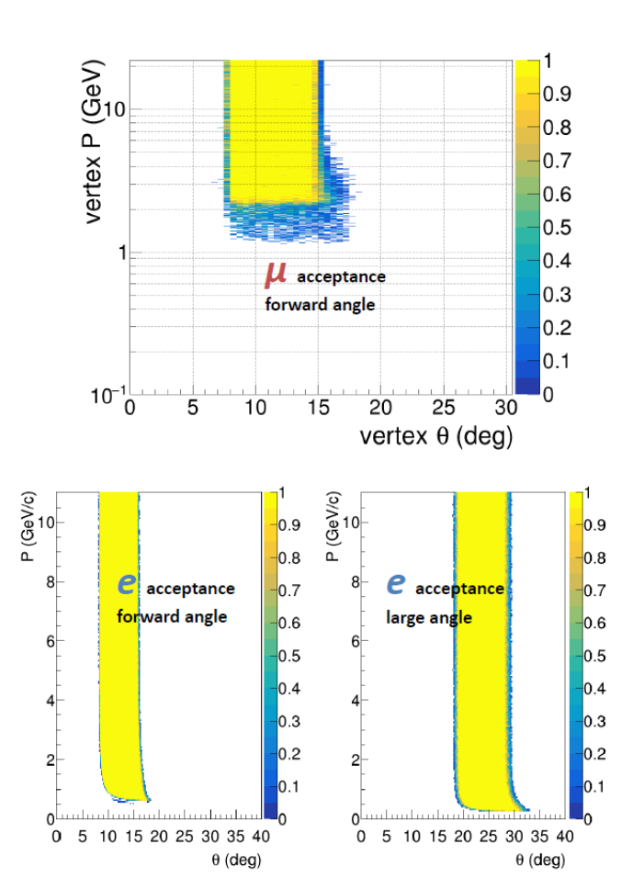
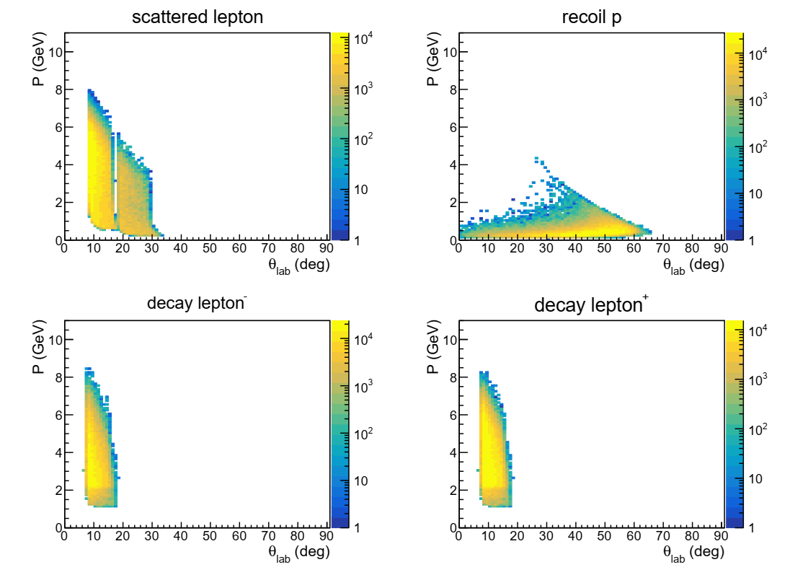
Event Acceptance
BH generator "grape-dilepton" used by HERA and verified by CLAS12
Best topology 3fold(e+mu+mu): scattered e- at FA+LA, both muons at FA, proton not detected (shown below)
Additional topology 4fold(e+mu+mu+p): scattered e- and recoil proton at FA+LA, both muons at FA

Slide 19
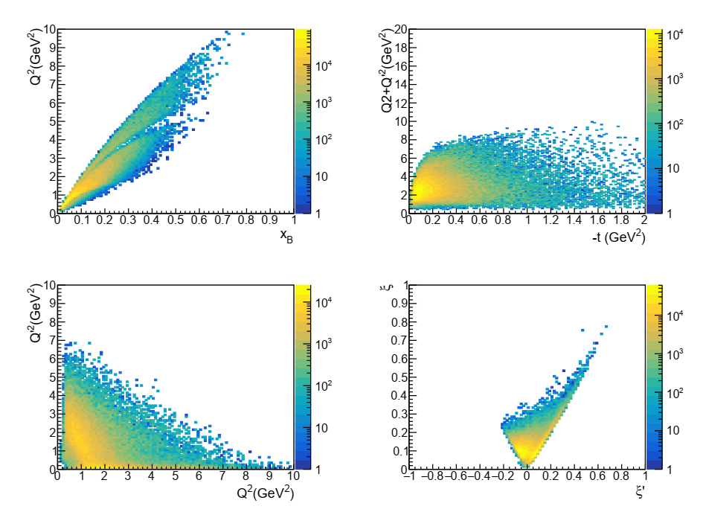
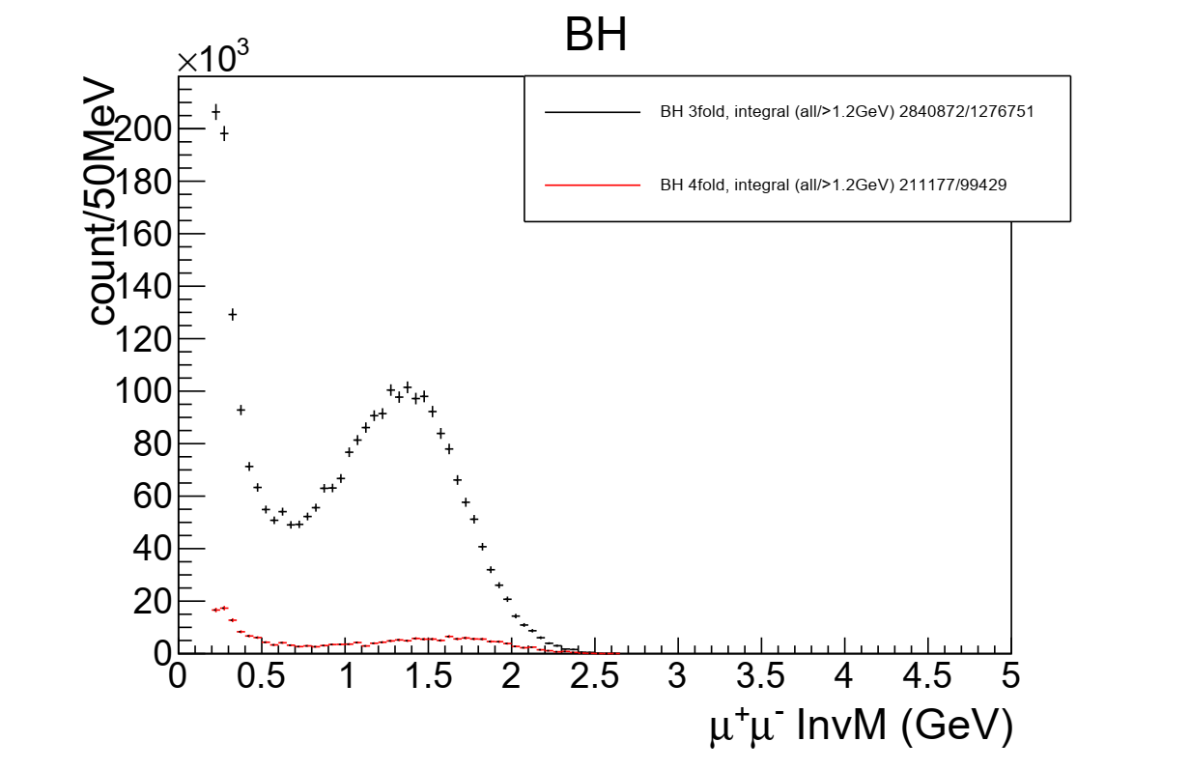
Event Distribution
BH generator "grape-dilepton" used by HERA and verified by CLAS12
3fold BH events covers large kinematic range
0.7 overall detection efficiency
Enough counts for 1.2e37/cm2/s lumi and 100 days to have multidimensional binning

Slide 20
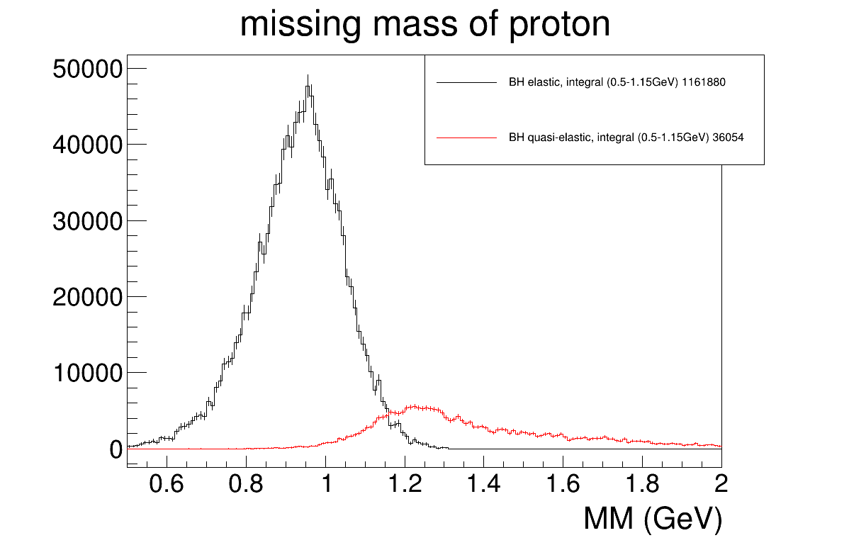
Exclusivity cut
Both BH with 4 final particles (elastic) and more than 4 particles (quasi-elastic) are generated by "grape-dilepton"
Missing proton mass of 3 fold BH events with resolution from SoLID inner GEM trackers, for resonance free region (muon pair InvM>1.2GeV)
3-4% background left after cutting MM>1.15GeV

Slide 21
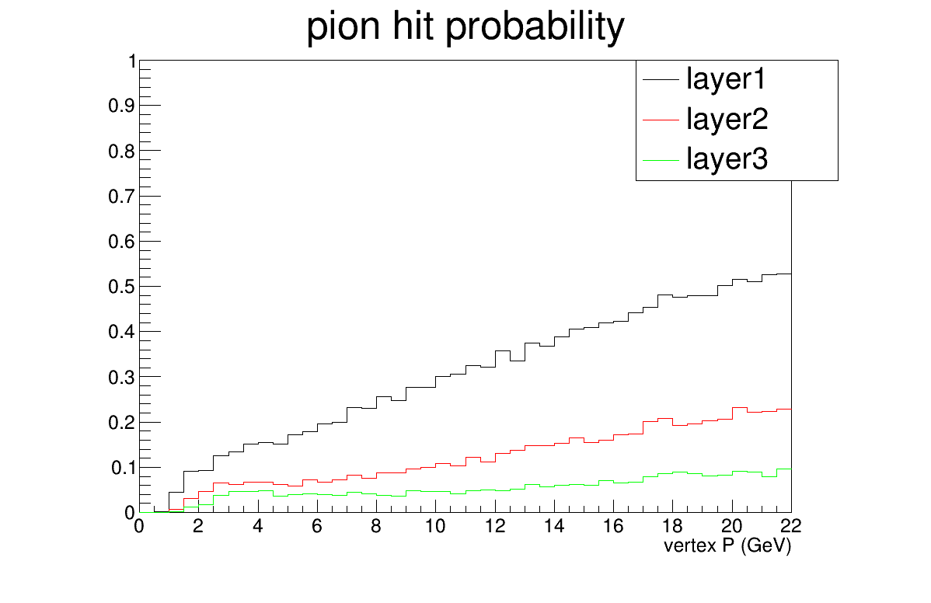
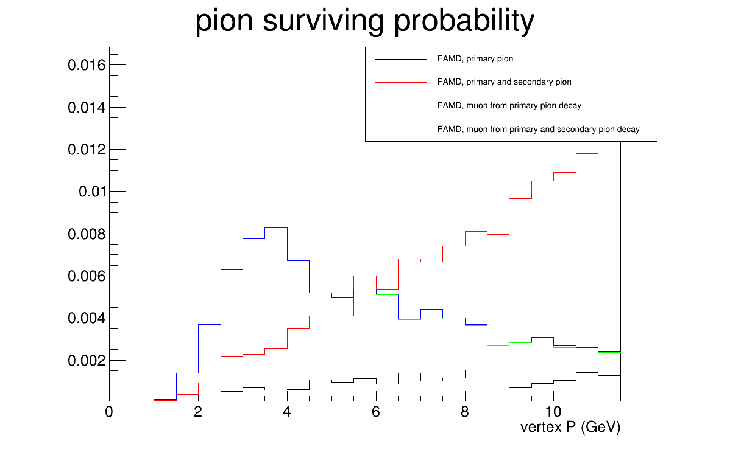
Pion blocking
Geant4 simulation of pions from target with some probabilities creating hits at FAMD
"pion hit probability", hits of charged particles entering each layer, used for FAMD detector and trigger rate estimate
"pion surviving probability", hits of pion and muon at the last layer of FAMD and a track passing all SoLID inner GEM trackers, used for physics event rate estimation

Slide 22
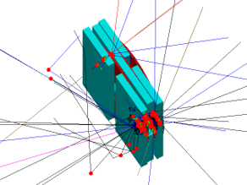
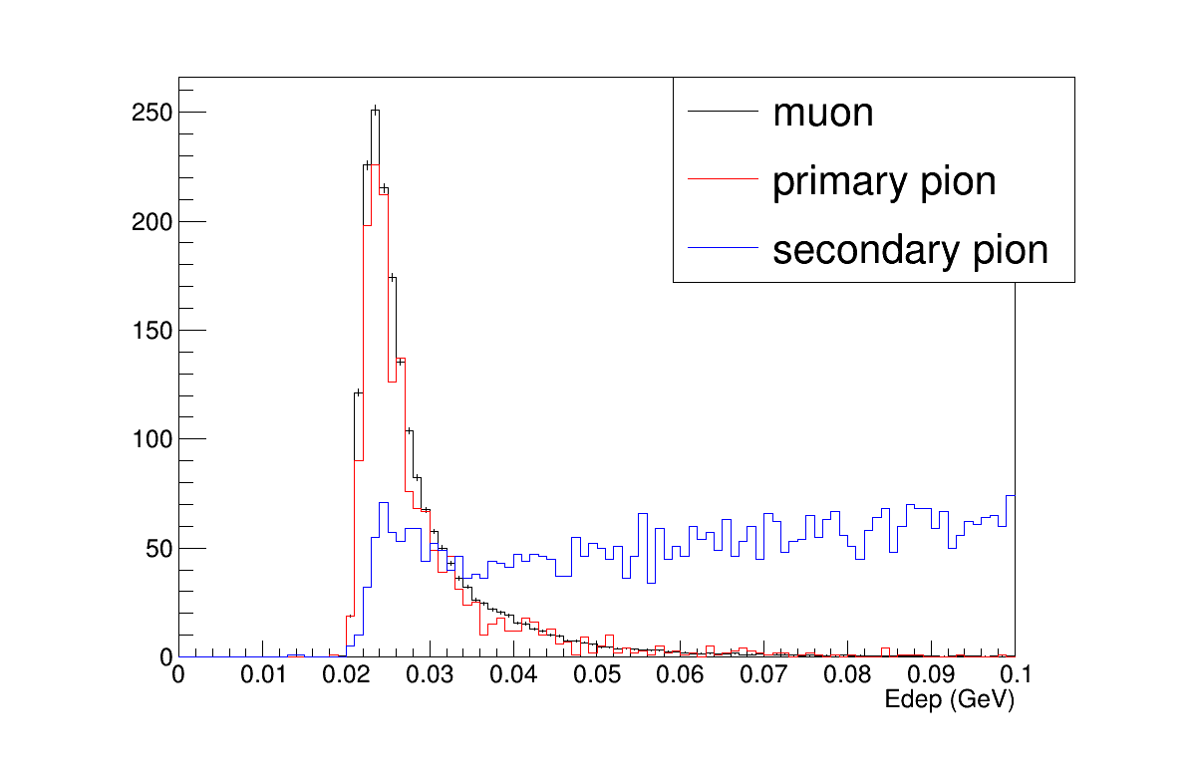
Pion suppression within FAMD
Muons behave as Minimum Ionizing Particle (MIP)
Pions often deposit more energy over 3 layers of scintillators.
Use moderate pion suppression factor 2 from energy cut
muon
pion

Slide 23


Single pion background
Combining single pion generator "evgen_bggen" (pythia+MAID) events with "pion hit probability", study charged particle rate at 3 layers. Full simulation confirmed the result
Single particle trigger 600khz rate with hits in all 3 layers of scintillators in nearby phi sectors
Coincidence of two hits from 2 single particle trigger from 2 different phi sectors within 50ns time windows leads to 18khz final trigger rate
Fake coin rate from single pion is below 1khz. BH di-muon events have two muons separated at least by 60 degrees in phi angle for the main physics region (muon pair InvM>1.2GeV)

Slide 24

Two pion exclusive background
Main physics background from two pion exclusive channel (missing mass cut won't reject it because pions and muons have similar mass)
Combine event generator "twopeg" (fit to CLAS data) and "pion hit probability" with pion suppression factor 2, study "2pi" rate and compare to BH rate
5-7% background

Slide 25

Experimental projections
100 days would allow for measurements on a five-dimensional grid

Slide 26

BSA experimental projections
First time measurements of the BSA sign change
Possibility to constrain GPD models

Slide 27

BSA experimental projections
First-time exploratory measurement constraining shadow GPD models

Slide 28

µCA experimental projections
Observation of the CFF real part with curvature change

Slide 29



µCA experimental projections
Sample cos(φ) extraction with a 11% error
µCA has contributions from cos(φ) and cos(3φ) modulations
cos(φ) can be extracted from fits
As BH is known, it can be subtracted

Slide 30




Systematic effects
The definition of experimental observables at the 5-fold differential level is required to compensate the cross-section smallness and to minimize the contribution of the BH₂ process
$$A_{LU}^{Σ^{λ}}=\frac{1}{λ} \frac{Y_{+}−Y_{−}}{Y_{+}+Y_{−}}$$
$$Y_{±}\left(φ_{μ}\right)=\frac{1}{Q_{±}} \frac{1}{∆Ω_{e}\left(φ_{μ}\right) ∆θ_{μ}\left(φ_{μ}\right)} \int_{0}^{2π}{dφ}\int_{π/4}^{{3π}/4}{dθ_{μ}\sin\left(θ_{μ}\right)}\frac{N_{±}\left(φ_{μ},φ,θ_{μ}\right)}{ε_{e}\left(φ\right) ε_{μ}\left(φ_{μ},θ_{μ}\right)}$$
$$Y^{±}\left(φ_{μ}\right)=\frac{1}{∆Ω_{e}\left(φ_{μ}\right) ∆θ_{μ^{±}}\left(φ_{μ}\right)} \int_{0}^{2π}{dφ}\int_{π/4}^{{3π}/4}{dθ_{μ}\sin\left(θ_{μ}\right)}\frac{N^{±}\left(φ_{μ},φ,θ_{μ}\right)}{ε_{e}\left(φ\right) ε_{μ^{±}}\left(φ_{μ},θ_{μ}\right)}$$
$$A_{UU}^{μ^{±}}=\frac{Y^{+}−Y^{−}}{Y^{+}+Y^{−}}$$
BSA systematics originates from the knowledge of : the electron beam polarization, the electron detection efficiency, and the muon detection efficiency.
μCA systematics originates from the knowledge of : the electron detection efficiency, the muon detection efficiency, and the muon solid angle.

Slide 31





Systematic effects
Systematics of the measurements will be controlled via simulations and the measurement of reference processes. The solenoidal field and the symmetrical configuration of SoLIDμ offer further cross-checks
Muon solid angle : extensive simulations based on the SoLIDμ GEANT4 model ($δ∆θ_{μ}/∆θ_{μ}\sim 3\%$)
Electron detection efficiency : measurement of DIS and elastic electron scattering ($δε_{e}/ε_{e}\sim 7\%$)
Muon detection efficiency : measurement of Bethe-Heitler and comparison of the $e^{±}$and${ μ}^{±}$ decay of specific meson (φ, J/Ψ) ($δε_{μ}/ε_{μ}\sim 15\%$)
Bin independence hyptothesis
$$Y_{±}\left(φ_{μ}\right)≡\sum_{i=1}^{N_{φ}}{\sum_{j=1}^{N_{θ_{μ}}}{\frac{n_{±}^{ij}}{ε_{e}^{i} ε_{μ}^{j}}}}$$
$$δA_{LU}^{Σ^{λ}}=\sqrt{{\left[A_{LU}^{Σ^{λ}}\right]}^{2}{\left(\frac{δλ}{λ}\right)}^{2}+\frac{1}{2λ^{2}} \frac{1}{N_{φ}}{\left(\frac{δε_{e}}{ε_{e}}\right)}^{2}+\frac{1}{2λ^{2}}\frac{1}{N_{θ_{μ}}}{\left(\frac{δε_{μ}}{ε_{μ}}\right)}^{2}}$$
0.04
λ = 0.85
$$Y^{±}\left(φ_{μ}\right)≡\frac{1}{∆θ_{μ^{±}}} \sum_{i=1}^{N_{φ}}{\sum_{j=1}^{N_{θ_{μ}}}{\frac{n_{ij}^{±}}{ε_{e}^{i} ε_{μ^{±}}^{j}}}}$$
$$δA_{UU}^{μ^{±}}=\sqrt{{\left(\frac{δ∆θ_{μ}}{∆θ_{μ}}\right)}^{2}+\frac{1}{N_{φ}}{\left(\frac{δε_{e}}{ε_{e}}\right)}^{2}+\frac{1}{N_{θ_{μ}}}{\left(\frac{δε_{μ}}{ε_{μ}}\right)}^{2}}$$
0.06
$\left(N_{φ},N_{θ_{μ}}\right)$ are the kinematic dependent number of bins, typically (20,10)
CLAS12 di-e data and sim of BH in resonance free region are used to check absolute efficiency and its error.
GlueX has done similar thing
SoLIDμ should use both resonance and resonance free region and cross check both di-e and di-mu channels to help systematics study

Slide 32

Beam time request
Only trigger on di-muon to take DDVCS, J/Psi and TCS di-mu data at the same time
Independent di-e data taking happening at the same time

Slide 33

Summary
complement SoLID J/Psi setup with a forward angle muon detector to form SoLIDμ spectrometer
measure DDVCS in the di-muon channel
use the J/Psi beamtime 60 days and request additional 50 days
first time measurement of DDVCS (mainly BSA, and exploratory µCA) over a broad kinematic range
first time to access GPD $\left|x\right|<ξ$ as input for models
J/Psi and TCS will have additional di-muon data and more di-e data

Slide 34
Backup

Slide 35




Muon Detector Tracker
Utilize $μ$RWELL detectors for muon tracking layers
  Current $μ$RWELL detector rate capability – ~200 $KHz/cm^{2}$ (High-rate version in development – 10$MHz/cm^{2}$)
  Discharge resistant thanks to integrated DLC layers – a huge improvement on electronics stability – less interruption on DAQ during running
  No spacers needed compared with GEM detectors – no dead area
A similar technology adopted by EIC
  Our muon detector unit would be roughly in the same size as EIC prototypes
  Total cost (3 complete layers covering a total of 75 $m^{2}$) around 900K
$μ$RWELL Detector – G. Bencivenni et al 2019 JINST 14 P05014
A plane of $μ$RWELL detectors for muon detection
$μ$RWELL Detector for EPIC outer barrel tracking layer

Slide 36



Muon Detector Tracker
Use capacitive charge sharing technique to reduce total readout channels while maintain the same space resolution
Works for all readout patterns – strip, pad, zigzag, …
With Capacitive charge sharing:
Space resolution : 1 mm
Total readout channel can be reduced to around 22K for all 3 layers combined
Detector rate will be determined by the final readout strip width, larger strip width leads to lower detector rate capability
For 22K readout channels, 1 mm space resolution, with capacitive charge sharing technique – rate capability: $\sim 30 KHz/cm^{2}$ (assume 300 ns signal integral time)
Concept for capacitive charge sharing – K. Gnanvo et al, Nuclear Inst. and Methods in Physics Research, A 1047 (2023) 167782

Slide 37

SoLIDµ vs µCLAS12
100 days comparison

Slide 38


SoLIDµ vs µCLAS12
µCLAS12
SoLIDµ
Angles in the muon center-of-mass frame
Larger coverage with SoLIDµ

Slide 39
Background asymmetry
signal channel asymmetry As=0.1 and rate Rs
background channel asymmetry Ab=0.5 () and rate Rb
Background/signal rate Rb/Rs=0.05 with error ER=0.01
Rel_Error of As = (As-Ab)/(1-Rb/Rs)^2*ER/As
            = (0.1-0.5)/(1-0.05)^2*0.01/0.1=-0.045
With those conservative assumptions, background only give about 5% error on signal asymmetry

Slide 40

Cost

Slide 41

Binning

Slide 42
TAC report
1. This proposal will use SoLID with addition of 3-layers of muon detectors, which reuse the iron plates from CLEO (now at JLab) with new tracking detectors and scintillators. Part of the running (10 days calibration, 50 days production) is parasitic to the approved SoLID-J/psi (E12-12-006) experiment and additional 50 days beam time is requested.
2. The proposed measurement, aiming for a first dedicated precision DDVCS measurement, will also enhance the approved SoLID-J/psi and TCS measurements.
3. The J/psi configuration of the SoLID setup has gone through several JLab/DOE reviews and prototype tested with pre-R&D activities. The muon detector is a new design with its performance simulated. A rough estimation of cost was provided.
4. When estimating the additional trigger rate from “di-muon” events (18KHz) it was assumed that the two single rates in 3rd layer are uncorrelated and that a 50 ns time window was used to obtain the accidental coincidence rate. However, there could be single surviving pion/muon events with a correlated additional hit (secondary particle from single pion/muon hitting materials before 3rd layer and then the secondary particle producing a hit in 3rd layer in coincidence with the single pion/muon event). These type of “di-muon” events will not be reduced by the 50 ns window. Is there an estimate of the rate of these correlated two-hit events that would be included in the “di-muon” trigger rate?
5. To not be overwhelmed by low energy electrons, the J/psi trigger has ECal threshold cuts. The acceptance plots (figures 14-16) seem to not have the low momentum limits corresponding to the ECal threshold cuts. Are the physics projections corresponding to the acceptance of these plots or the acceptance with ECal trigger cuts?
6. The control of systematics of the detector efficiency and acceptance needs more careful study. Simulations alone will not be enough. Calibrations with measurements of specific physics channels may work well for the electron detection, but not clear how well they will work for the muon detector. No clear justifications were given for the “worst case scenario” or the “more reasonable case” (page 37).

Slide 43





Coordinates Layer 1
Iron wall 1
Ch 1 +
Ch 1 -
Reference = Magnet
Ch 2 +
Y
X
Z
Ch 2 -

Slide 44





Coordinates Layer 2
Iron wall 2
Ch 3 -
Ch 3 +
Ch 4 +
Reference = Magnet
Y
X
Z
Ch 4 -

Slide 45
Higher luminosity ?
Current could go up to 80 uA
Target length up to 1 meter ( ~1.8 10^39 cm⁻²s⁻¹ )
Tracker occupancy and photon background
  Reduce amount of Copper in GEM
  Micromegas option
  Build smaller chambers and add more channels
  Study complement with 2D pad readout
  Superconducting tracker option
  Radiation hardened silicon and MAPS
Calorimetry
  Study liquid scintillator and cryogenics calorimeter option
  Superconducting detector to replace PMT ( 1 ns width pulse to increase rate capability )
Cerenkov
  Superconducting detector to replace PMT ( 1 ns width pulse to increase rate capability )
  HBD type Cerenkov for Large Angle calorimeter
6. 10^38 cm⁻²s⁻¹
Technically doable mostly matter of cost

Slide 46

Kinematical coverage 11 GeV
Zhiwen Zhao (GRAPE)

Slide 47

Kinematical coverage 11 GeV
Zhiwen Zhao (GRAPE)

Slide 48

Kinematical coverage 22 GeV
Zhiwen Zhao (GRAPE)

Slide 49

Kinematical coverage 22 GeV
Zhiwen Zhao (GRAPE)

Slide 50
11 GeV vs 22 GeV
Zhiwen Zhao (GRAPE)

Slide 51
Zhiwen Zhao (GRAPE)

Slide 52
11 GeV vs 22 GeV
Zhiwen Zhao (GRAPE)

Slide 53
11 GeV vs 22 GeV
Much better Q2 Q’2 coverage
Want Q2 and Q’2 large enough for factorization
Zhiwen Zhao (GRAPE)

