Slide 1




PR12-25-010, JLab PAC 53
Double Deeply Virtual Compton Scattering with SoLIDμ spectrometer
Juan-Sebastian Alvarado, IJCLab
Alexandre Camsonne, Jlab (contact)
Marie Boer, Virginia Tech
Eric Voutier, IJCLab
Xinzhan Bai, JLab
Zhiwen Zhao, Duke (presenter)
and SoLID Collaboration
July 21, 2025

Slide 2
Outline
Generalized Parton Distribution
Double Deeply Virtual Compton Scattering
SoLIDµ setup
Muon detector
Simulation study
Physics projection
Beam time request
Summary

Slide 3
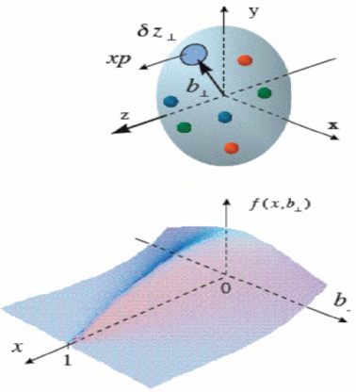
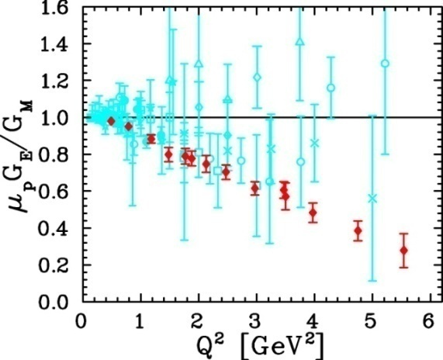
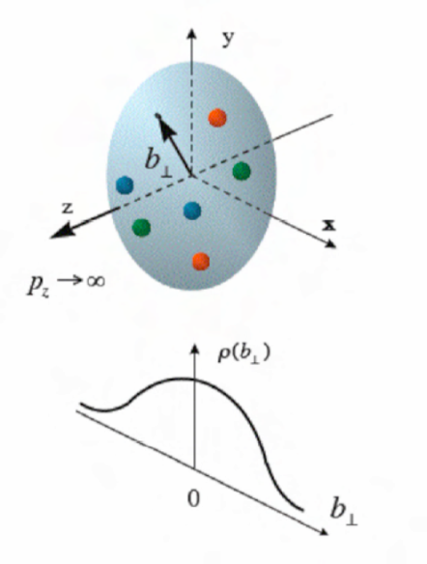
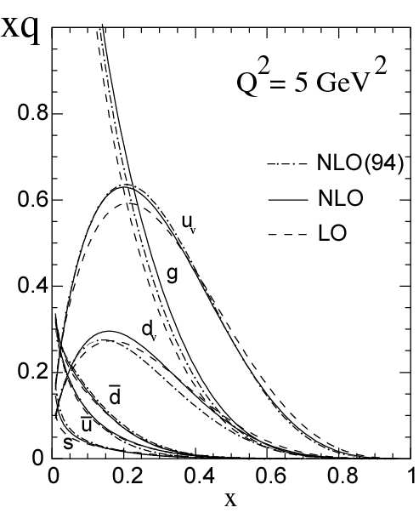
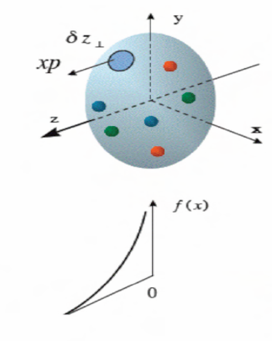
Generalized Parton Distribution (GPD)
A unified description of partons (quarks and gluons) in the momentum and impact parameter space
Elastic form factors Transverse spatial distributions
Parton Distribution Functions Longitudinal momentum distributions
Notes:
GPD describe 3D nucleon structure in long momentum and transverse spatial distribution

Slide 4
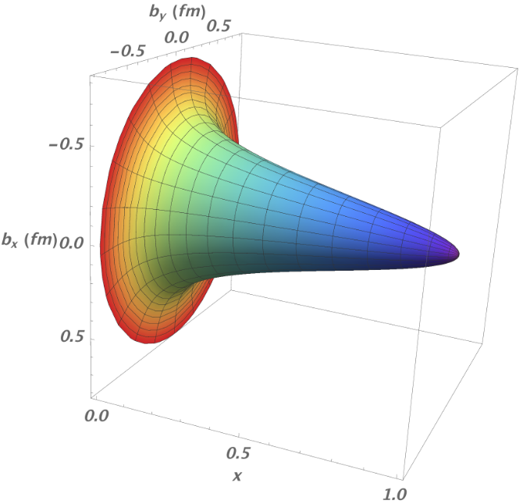
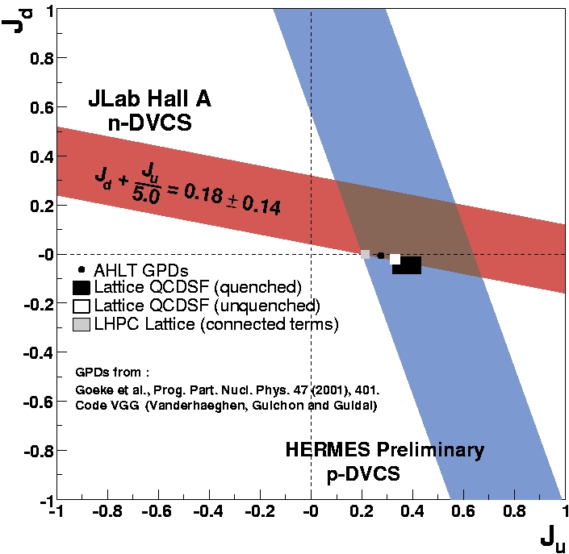
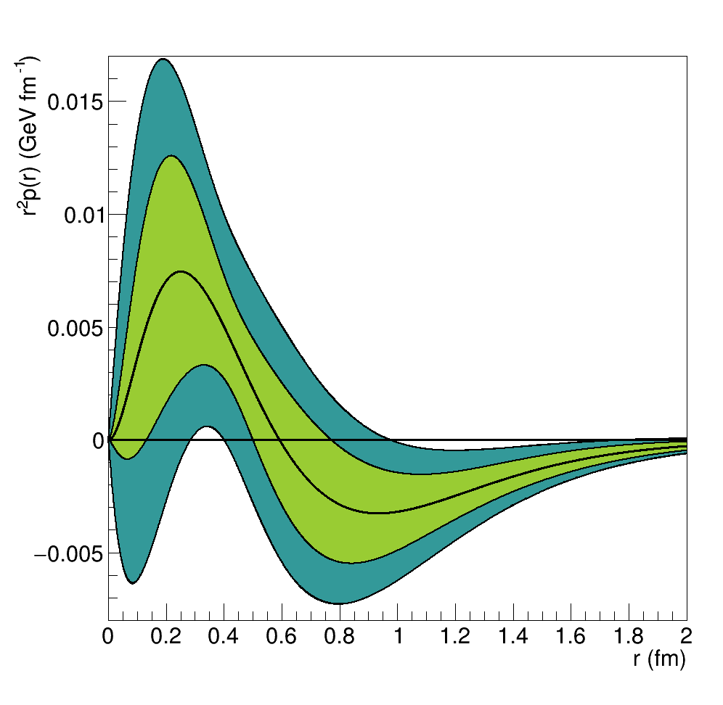



Nucleon Structure and GPD
GPDs encode correlations between partons and contain information about internal dynamics of hadrons like angular momentum or distribution of the forces experienced by quarks and gluons
imaging
$$ρ_{H}^{q}\left(x,b_{⊥}\right)=\int{\frac{d^{2}Δ_{⊥}}{{\left(2π\right)}^{2}}} e^{ib_{⊥}{∙Δ}_{⊥} }\left[H^{q}\left(x,0,−Δ_{⊥}^{2}\right)+H^{q}\left(−x,0,−Δ_{⊥}^{2}\right)\right]$$
d
spin
$$\lim_{t→0}{\int_{−1}^{1}{x \left[H^{q}\left(x,ξ,t\right)+E^{q}\left(x,ξ,t\right)\right] dx}}=J^{q}$$
gravitational form factor
$$\int_{−1}^{1}{x\sum_{q}{H^{q}\left(x,ξ,t\right)} dx}= M_{2}\left(t\right)+\frac{4}{5}ξ^{2}d_{1}\left(t\right)$$
A.W. Thomas, PRL 101 (2008) 102003
u
The experimental knowledge of the ξ-dependence of GPDs at fixed longitudinal momentum fraction is a crucial step for unraveling the 3D structure and internal dynamics of the nucleon

Slide 5
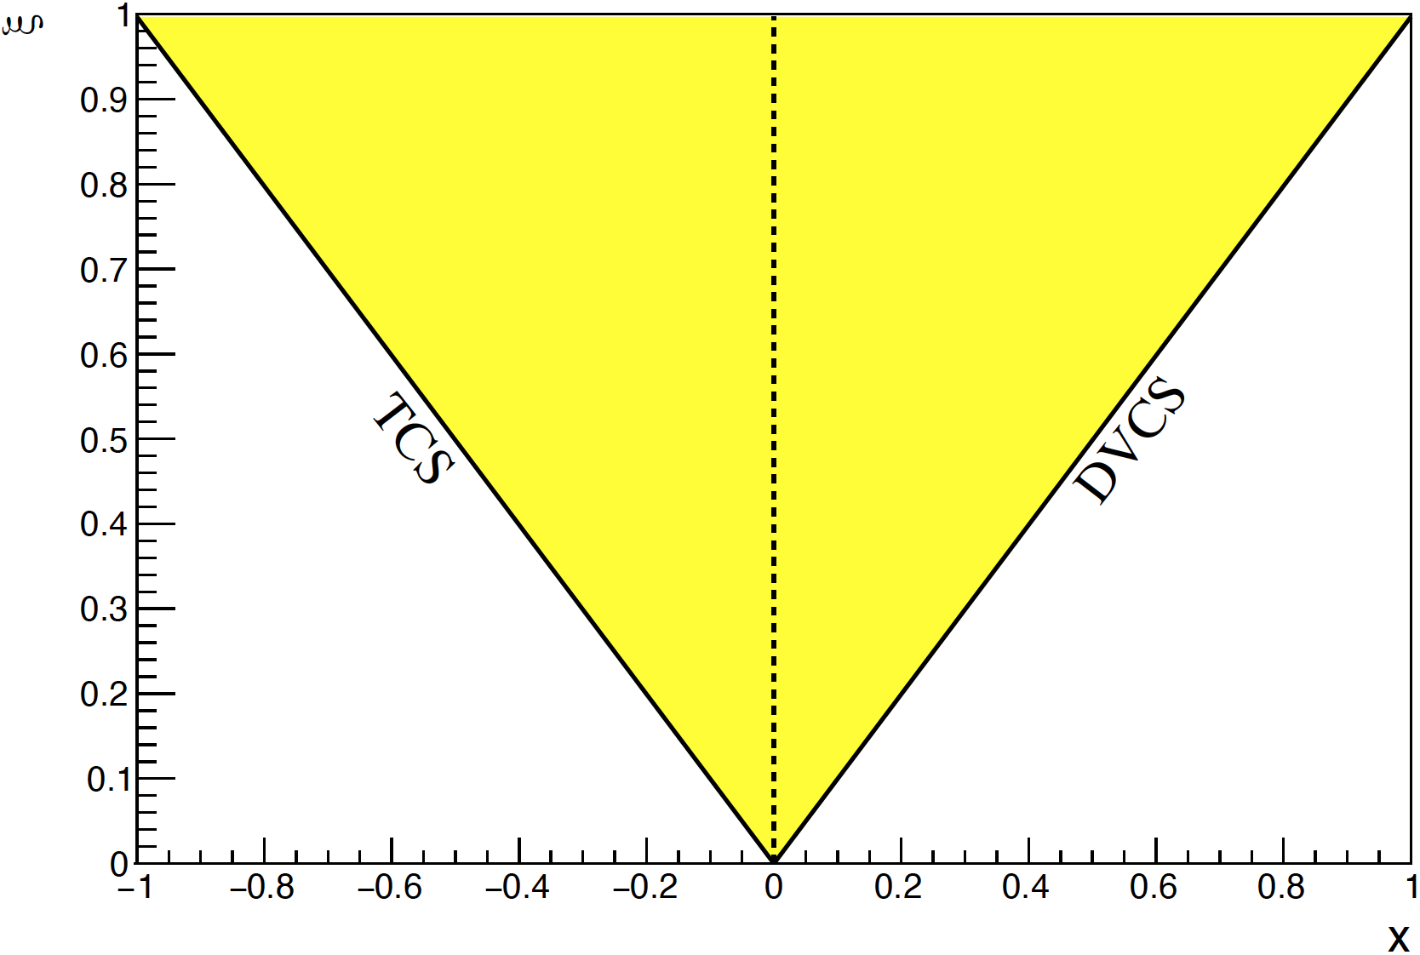


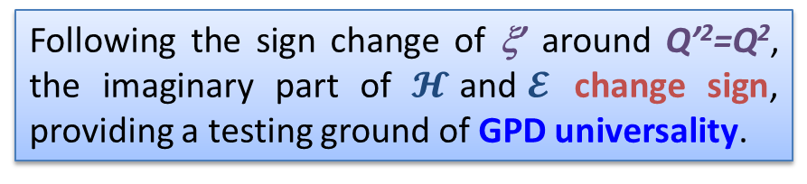
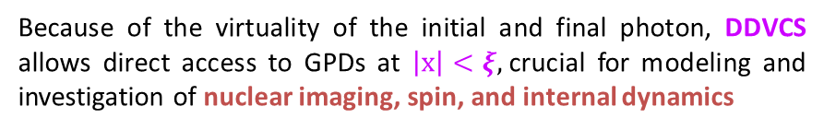
General Compton Process accessing GPD
γ*(q) + p(p) → γ*(q′) + p(p′)
DVCS (γ* → γ, Q’²=0, ξ’ = ξ)
Timelike CS (γ → γ*, Q²=0, ξ’ = - ξ)
Double DVCS (γ* → γ*, Q² Q’² ξ’ ξ vary)
Because of the virtuality of the initial and final photon, DDVCS allows direct access to GPDs at $\left|x\right|<ξ,$crucial for modeling and investigation of nuclear imaging, spin, and internal dynamics
Compton Form Factor (CFF)
GPD combination
Generalized
Bjorken variable
Skewness
Following the sign change of ξ’ around Q’²=Q², the imaginary part of $𝓗$and$𝓔$ change sign, providing a testing ground of GPD universality.
Notes:
DDVCS with both virtual photon provide gpd access beyond the diagonal lines.

Slide 6
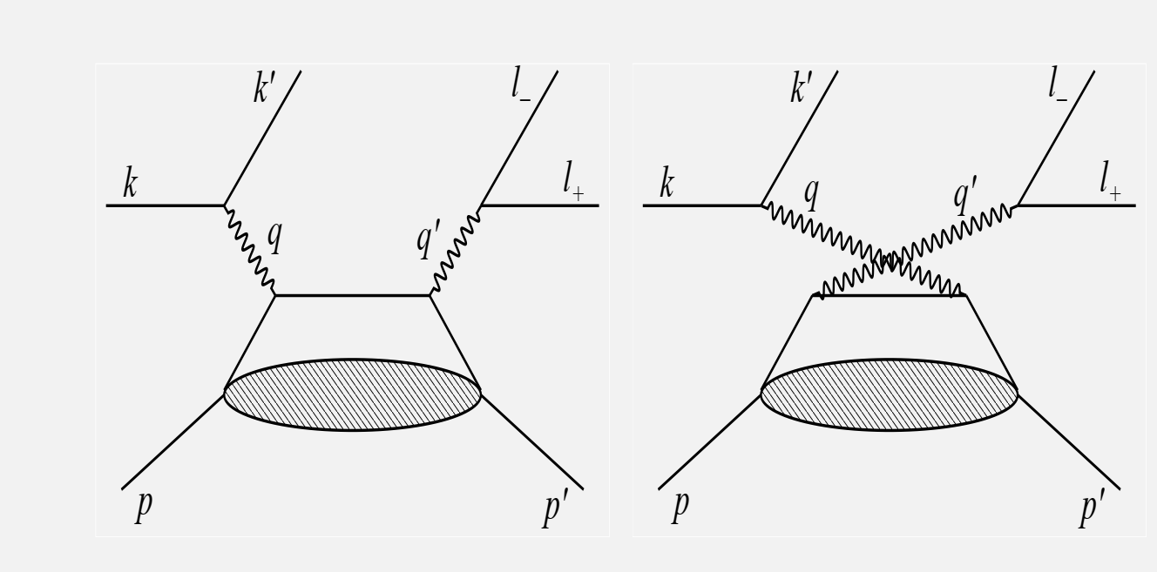
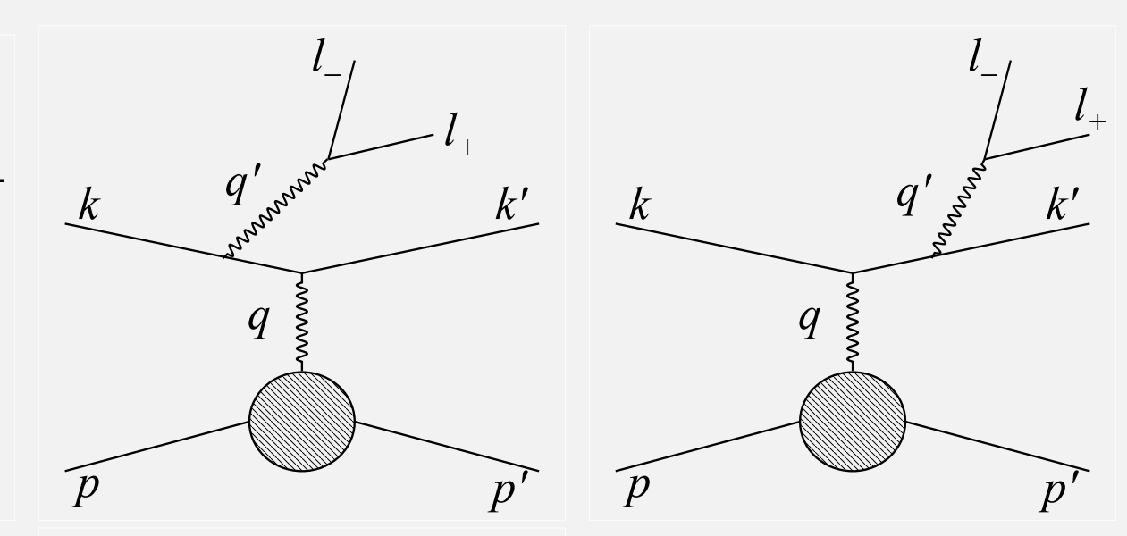
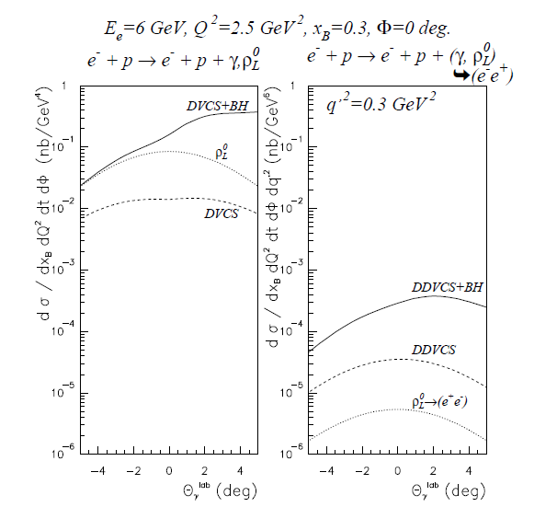
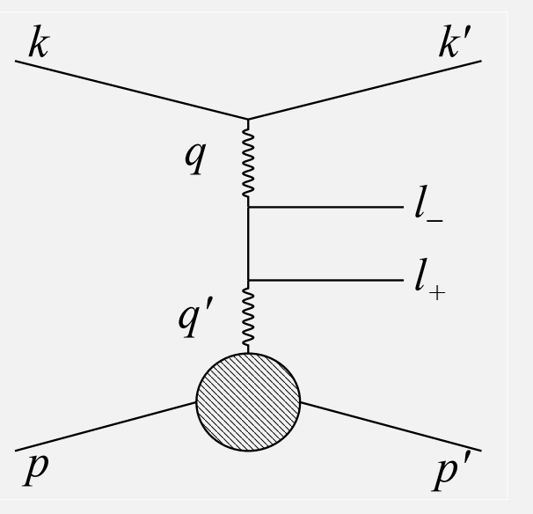
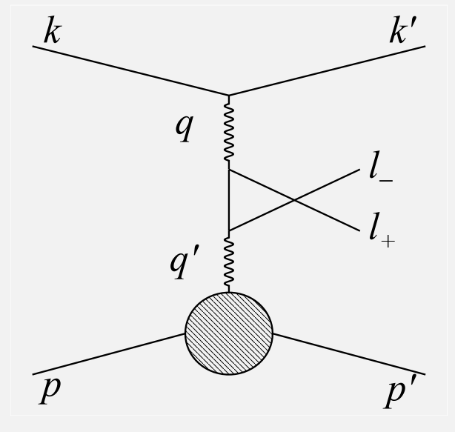
Elementary Cross Section
DDVCS cross section is about ~1/100 of DVCS, involves two Bethe-Heitler (BH) processes
$${d^{7}σ}_{P}^{e}={d^{7}σ}_{BH_{1}}+d^{7}σ_{BH_{2}}+{d^{7}σ}_{DDVCS}+P{ d}^{7}{\tilde{σ}}_{DDVCS}{+{{ d}^{7}σ}_{INT_{2}}+P{ d}^{7}\tilde{σ}}_{INT_{2}}−e \left[{d^{7}σ}_{BH_{12}}\text{+}{{ d}^{7}σ}_{INT_{1}}{+ P{ d}^{7}\tilde{σ}}_{INT_{1}}\right]$$
DDVCS
BH1
BH2

Slide 7
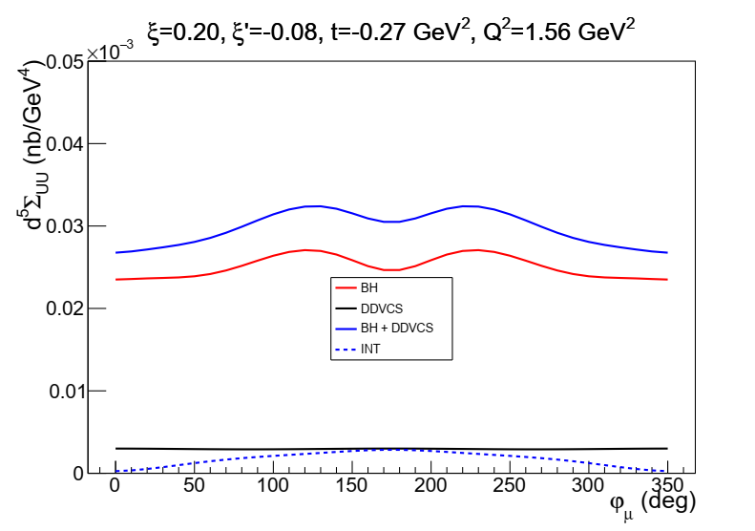
Integrated Cross Section
5-fold TCS-like observables obtained from the integration over the polar angle of muon and the azimuthal angle of initial virtual photon, also minimizing the contribution of the BH₂ process
θ₀=π/4
TCS-like xs
Our study focuses on using TCS-like observables for projection to allow access to both terms above
DVCS-like observables obtained by integrating over muon phi angle may also be considered as crosscheck
Notes:
TCS-like observables allow access to both both terms

Slide 8

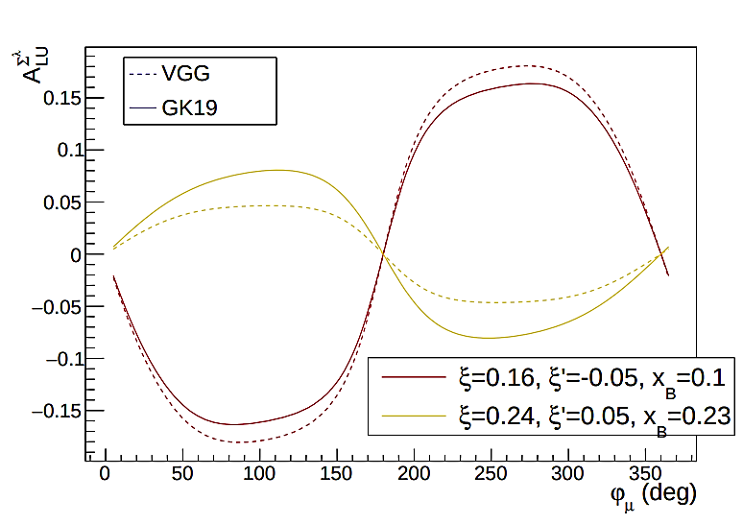
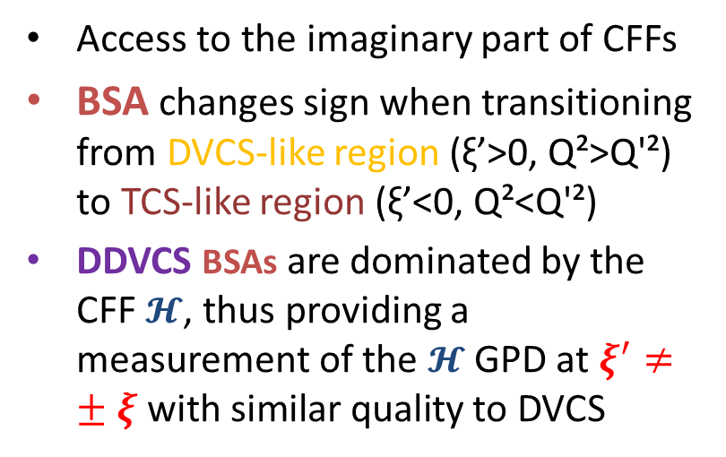
Beam Spin Asymmetry
BSA in two regions
Access to the imaginary part of CFFs
BSA changes sign when transitioning from DVCS-like region (ξ’>0, Q²>Q'²) to TCS-like region (ξ’<0, Q²<Q'²)
DDVCS BSAs are dominated by the CFF $𝓗$, thus providing a measurement of the $𝓗$ GPD at $ξ^{′}≠±ξ \text{with} \text{similar} \text{quality}$ to DVCS

Slide 9



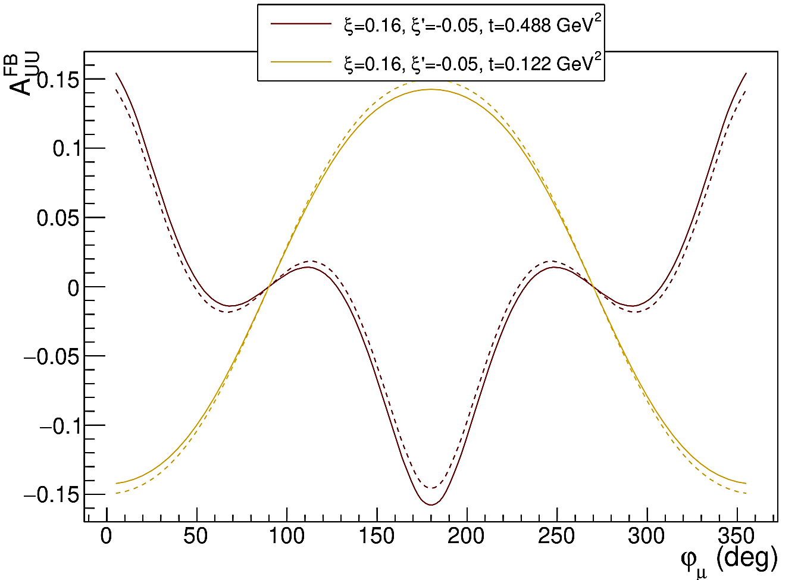

Muon Charge Asymmetry
aka Forward Backward Asymmetry
μCA in two regions
Access to the real part of CFFs (no dispersion relation has been established)
μCA predicted to have significant amplitude and rich harmonic composition, like the forward-backward asymmetry of TCS
Curvature change is a highly-discriminating feature for models
DDVCS μCA access a CFF combination different from BSA. This feature distinguishes DDVCS from DVCS and TCS.

Slide 10
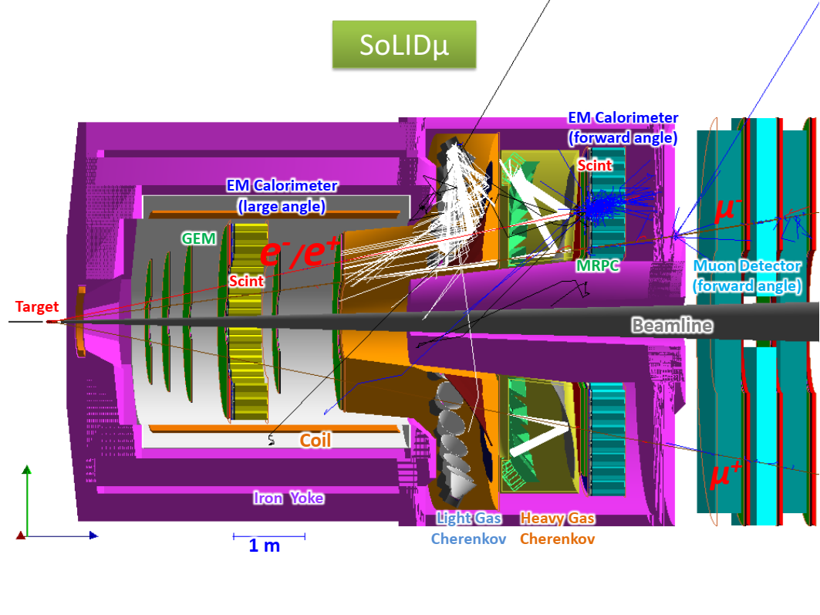
Experimental Setup
SoLID can detect e⁻, e⁺, proton, pion
Based on SoLID J/Psi and TCS setup (1.2e37/cm2/s) with forward angle muon detector added to form SoLIDμ spectrometer
Sharing beam time with approved J/Psi and TCS di-e experiment
Forward Angle (FA) covers 8.5-16.5deg and Large Angle (LA) covers 18-30deg

Slide 11
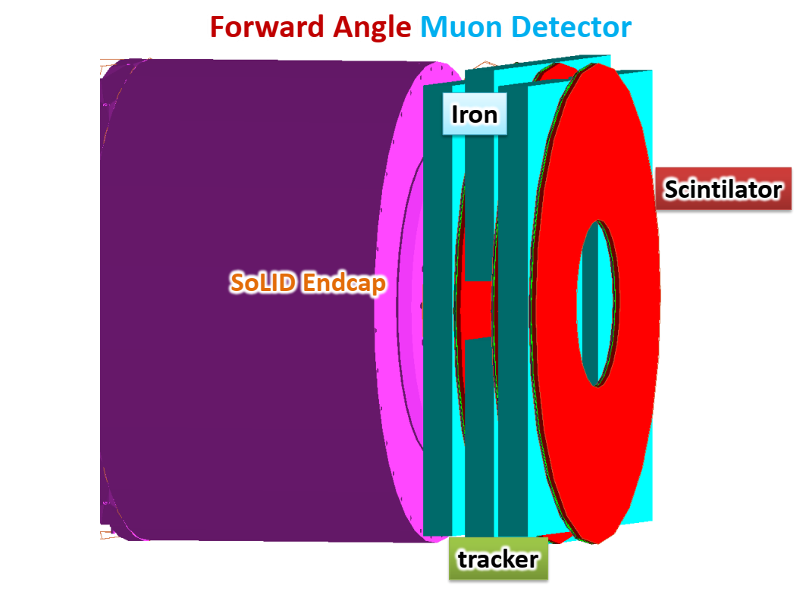
Forward Angle Muon Detector (FAMD)
3 layers of iron+tracker+scintillator (Rin=1m, Rout=3m)
Iron for pion blocking
µRWell trackers to connect with tracks in SoLID inner GEM trackers
  track resolution from SoLID inner trackers only
scintillators for muon PID with pion suppression and trigger

Slide 12
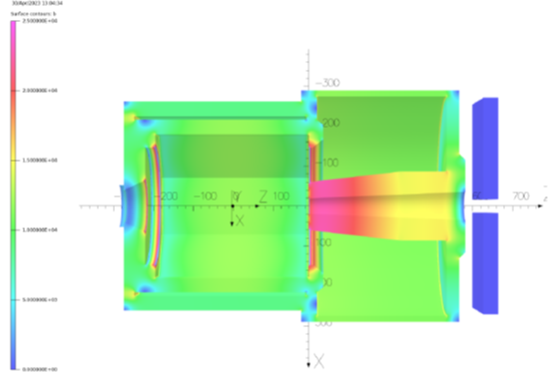
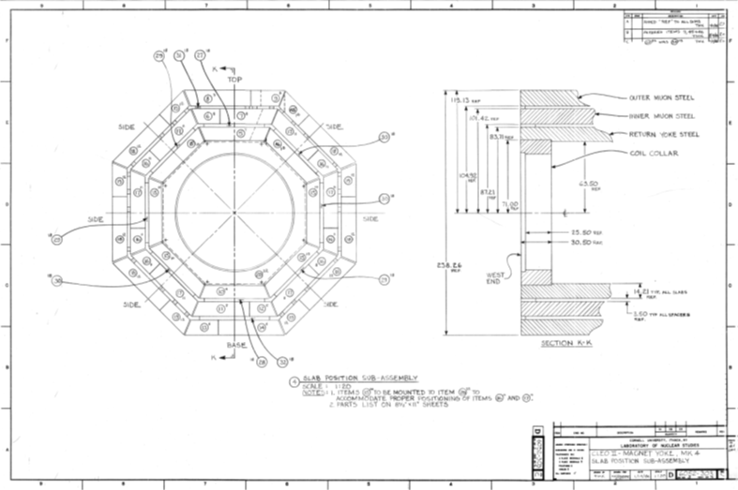
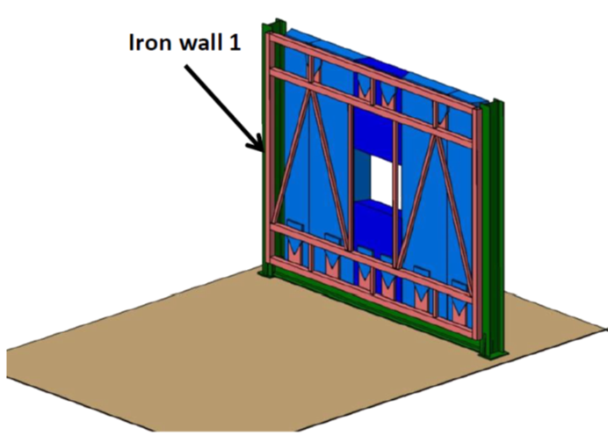
Iron of FAMD
TOSCA field model
Reuse 6 of CLEO octagon outer layer iron
Each one is about 36x254x533cm
No problem with space
Field (<10G),force(<1N),torque(<2Nm) are small
CLEO drawing
Conceptual support design

Slide 13
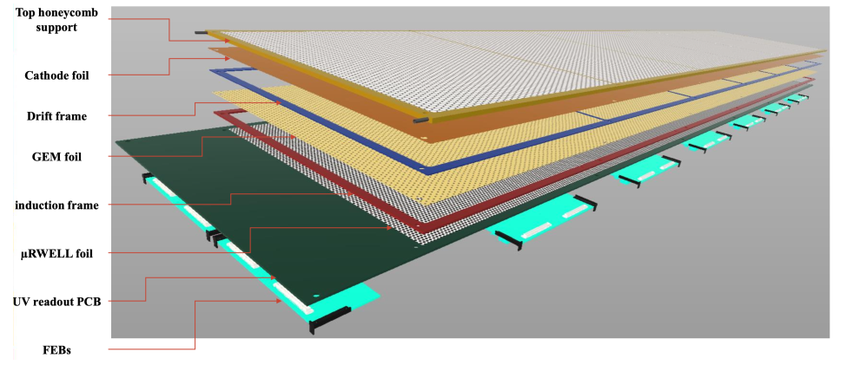
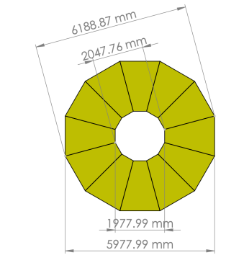
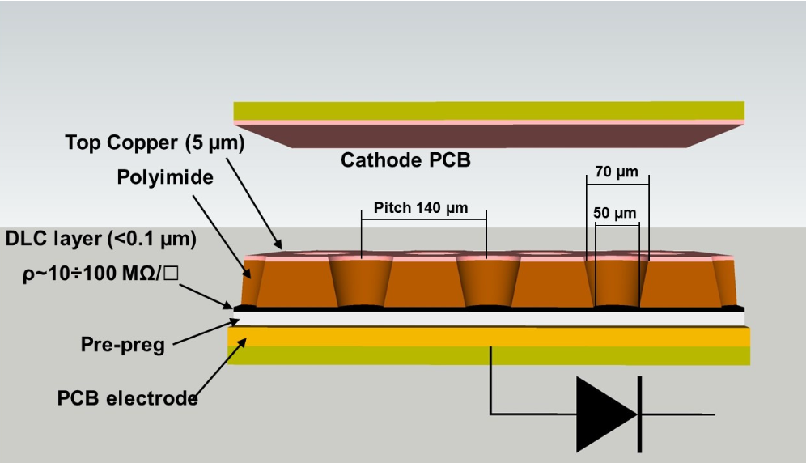
µRWell trackers of FAMD
µRWell tracker with good rate capability and lower cost than GEM
VMM electronics for readout
2D UV strips with capacitive charge sharing to have rate 30KHz/cm2 and position resolution of 1 mm
$μ$RWELL Detector for EPIC outer barrel tracking layer
$μ$RWELL Detector – G. Bencivenni et al 2019 JINST 14 P05014
A plane of $μ$RWELL detector

Slide 14
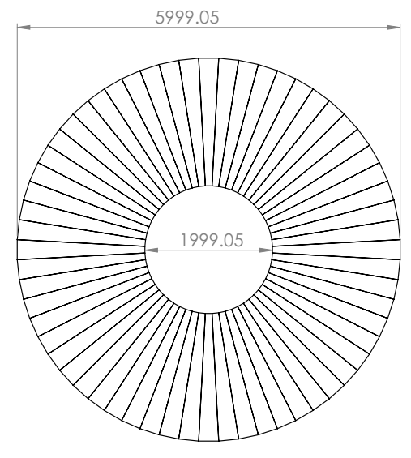
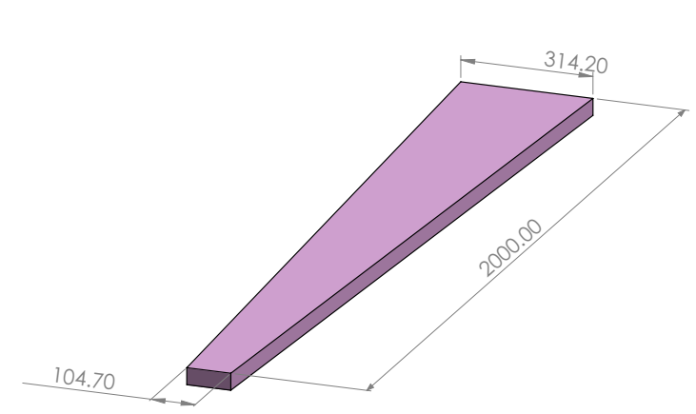
Scintillators of FAMD
3 layers of scintillator planes
Each plane has 60 azimuthal segments
Readout with light guide and PMTs from both inner and outer radial ends
Design similar to CLAS12 forward scintillator and SoLID large angle scintillator with similar performance
570cm
30cm
200cm
185cm
Thickness 5cm
10cm
A plane of scintillator detector
A module of scintillator detector

Slide 15
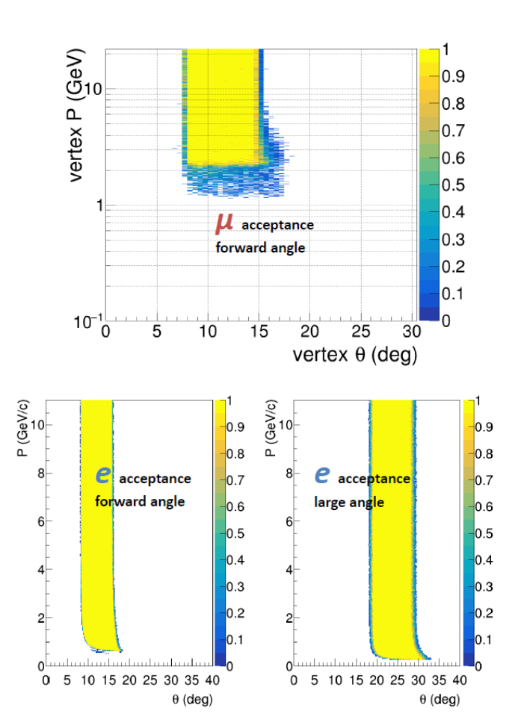
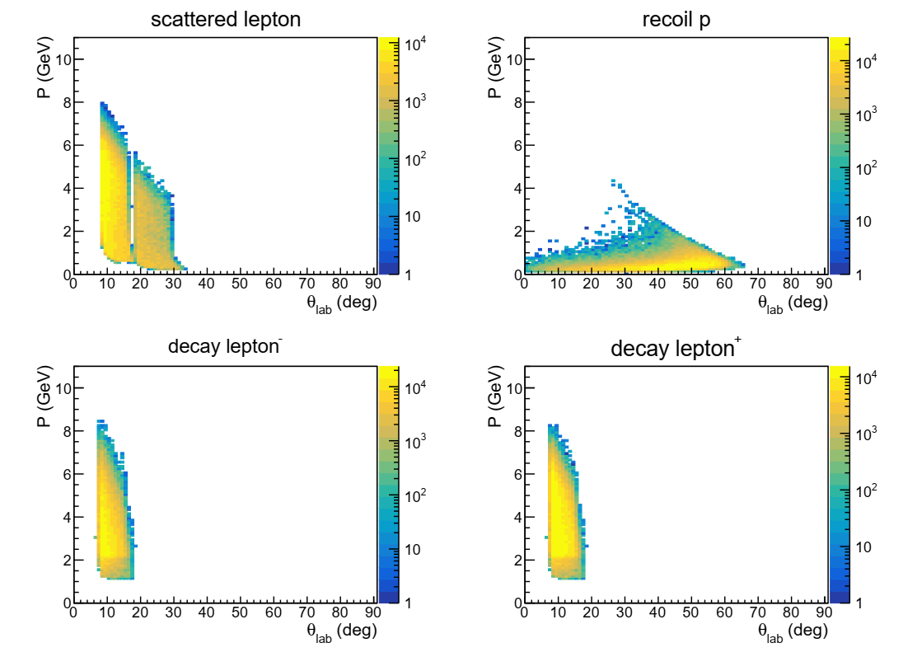
Event Acceptance
BH generator "grape-dilepton" used by HERA and verified by CLAS12
particle acceptance
Best topology 3-fold(e+mu+mu): scattered e- at FA+LA, both muons at FA, proton not detected
Additional topology 4-fold(e+mu+mu+p): recoil proton at FA+LA (clean)
accepted BH 3-fold events
full azimuthal coverage and large acceptance
Solenoid field helps control systematics

Slide 16
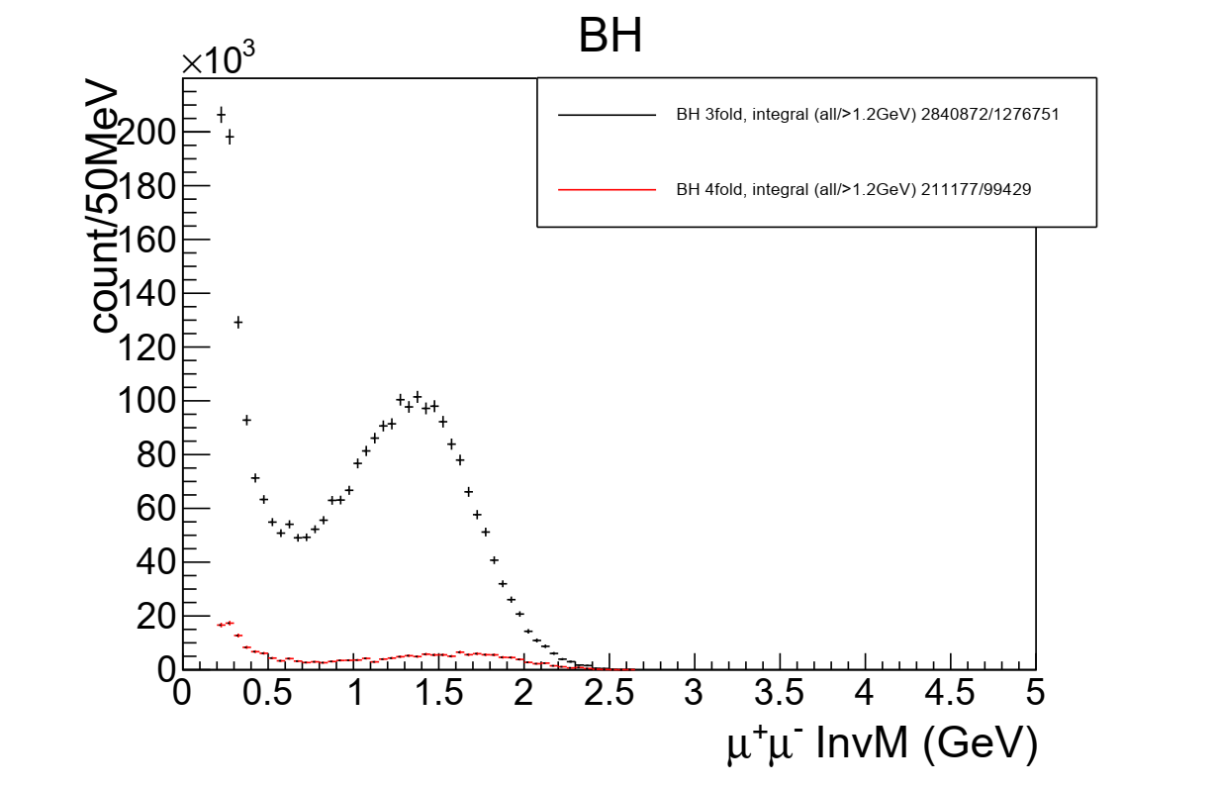
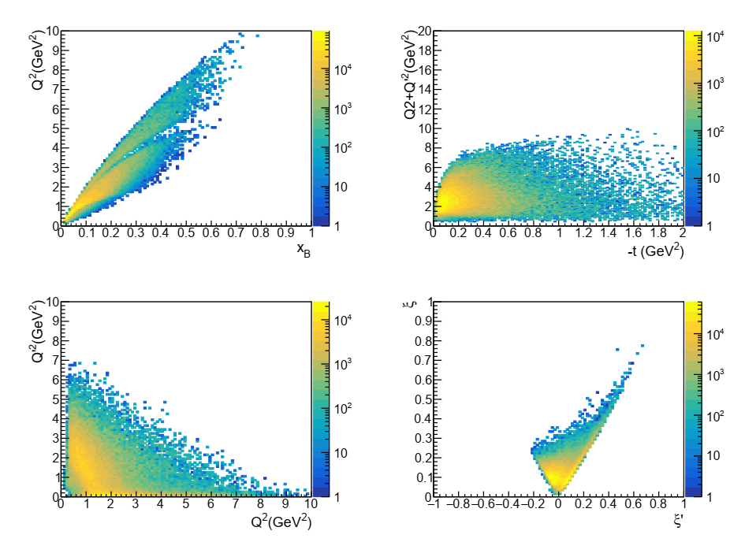
Event Distribution
3-fold BH events covers a large kinematic range
0.7 overall detection efficiency
Enough counts with 1.2e37/cm2/s luminosity and 100 days to have multidimensional binning
accepted BH 3-fold events

Slide 17
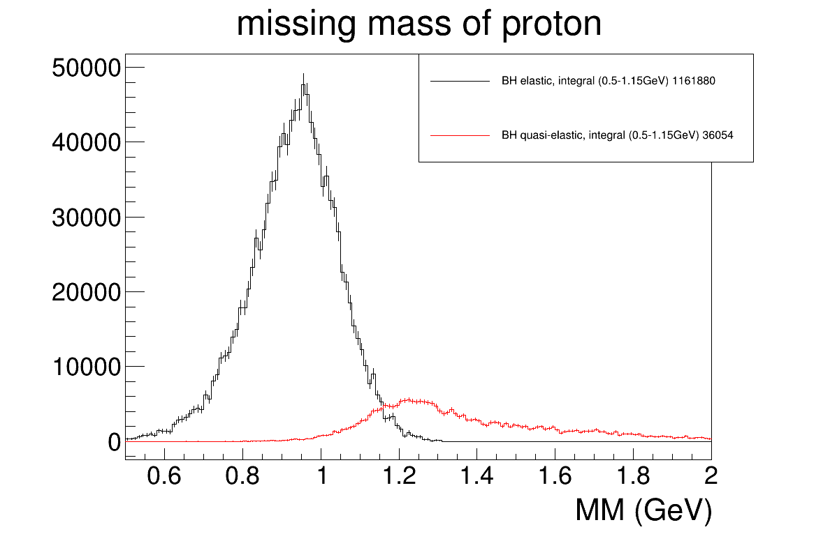
Exclusivity cut
Both BH with 4 final particles (elastic) and more than 4 particles (quasi-elastic), generated by "grape-dilepton"
Missing proton mass of 3 fold BH events with resolution from SoLID inner GEM trackers, for resonance free region (muon pair InvM>1.2GeV)
3-4% background after cutting MM>1.15GeV

Slide 18
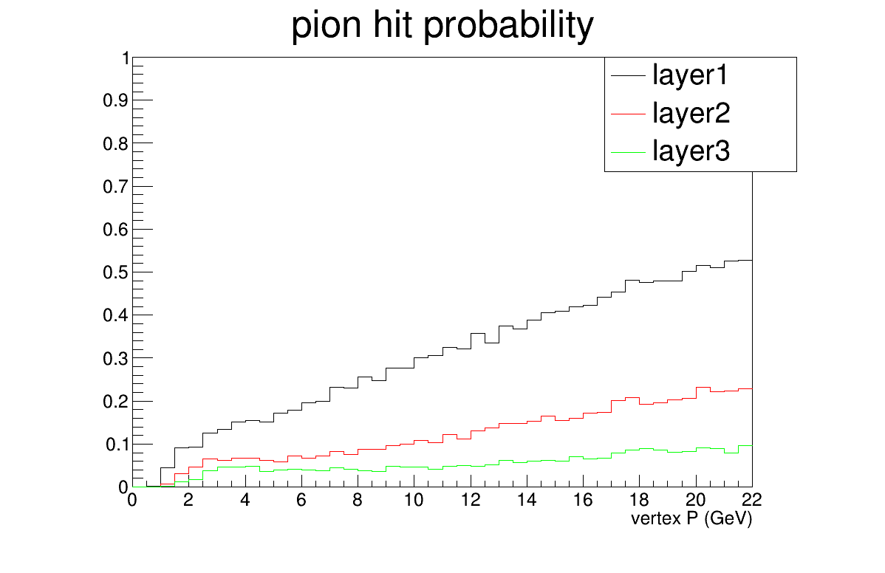
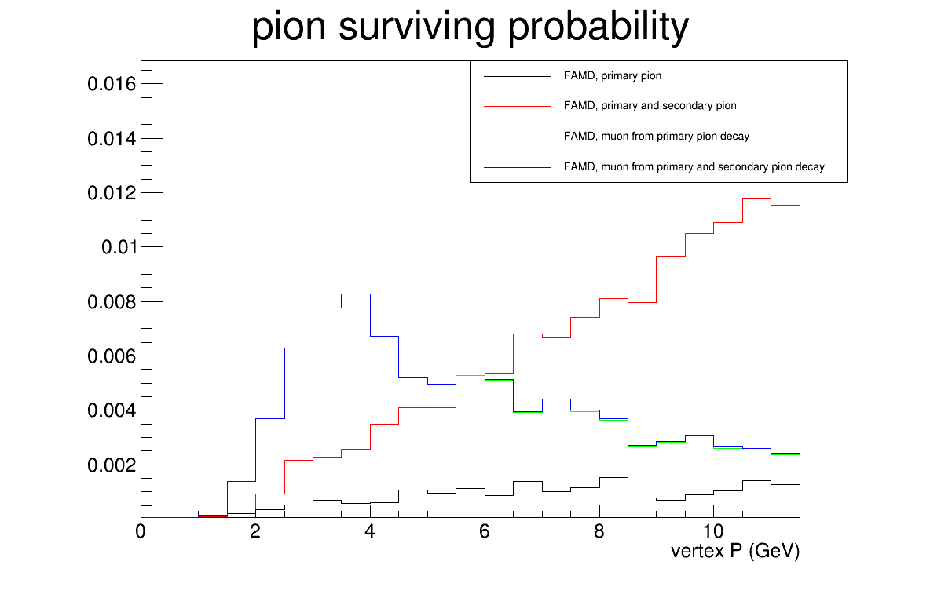
Pion blocking
Geant4 simulation of pions from target with some probabilities creating hits at FAMD
"pion hit probability", hits of charged particles entering each layer, used for FAMD background and trigger rate estimate
"pion surviving probability", hits of pion and muon at the last layer of FAMD with tracks passing all SoLID inner GEM trackers, used for physics event rate estimation

Slide 19
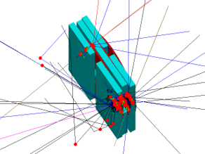
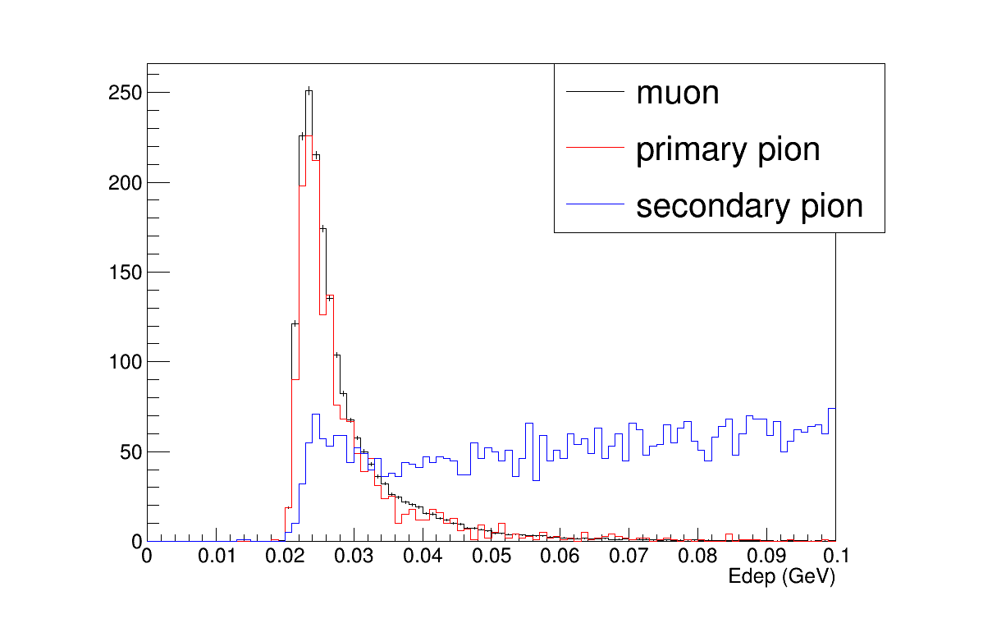
Pion suppression within FAMD
muon
Muons behave as Minimum Ionizing Particle (MIP)
Pions often deposit more energy over 3 layers of scintillators.
Use a moderate pion suppression factor 2 from energy cut
pion

Slide 20
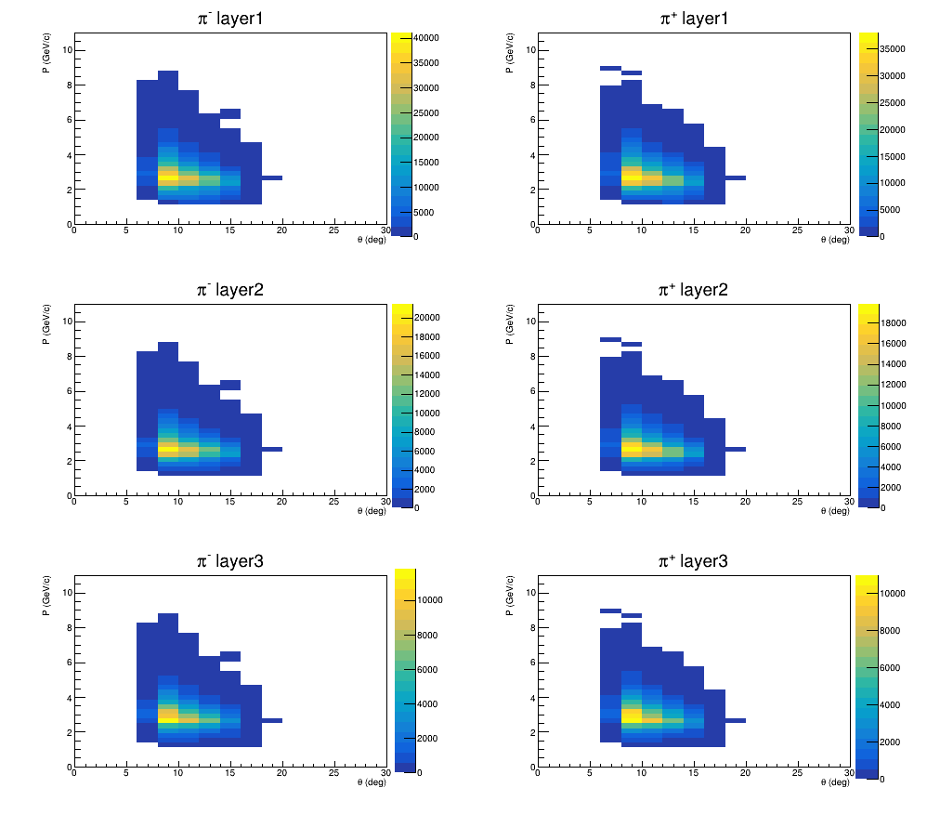
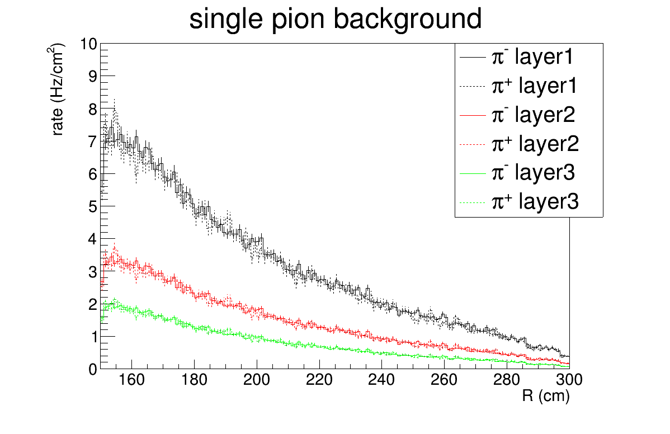
Single pion background
Combining single pion generator "evgen_bggen" (pythia+MAID) events with "pion hit probability", study charged particle rate at 3 layers. Full simulation confirmed the result
Single particle trigger 600khz rate with hits in all 3 layers of scintillators in nearby phi sectors
Coincidence of two hits from 2 single particle trigger from 2 different phi sectors within 50ns time windows leads to 18khz final trigger rate
Fake coin rate from single pion is below 1khz. BH di-muon events have two muons separated at least by 60 degrees in phi angle for the main physics region (muon pair InvM>1.2GeV)

Slide 21
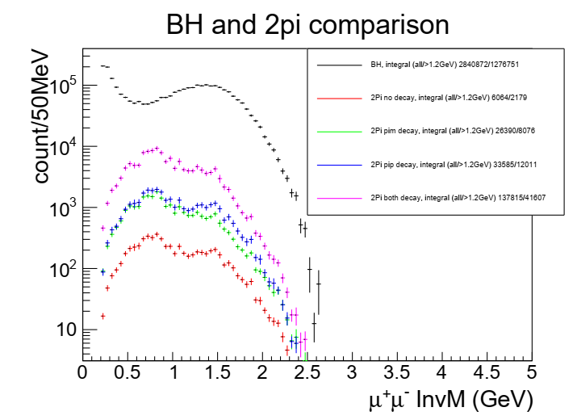
Two pion exclusive background
Main physics background from two pion exclusive channel (missing mass cut won't reject it because pions and muons have similar mass)
Combine event generator "twopeg" (fit to CLAS data) and "pion hit probability" with pion suppression factor 2, study "2pi" rate and compare to BH rate
5-7% background, while the channel be measured by the internal SoLID detector at the same time to control systematics

Slide 22
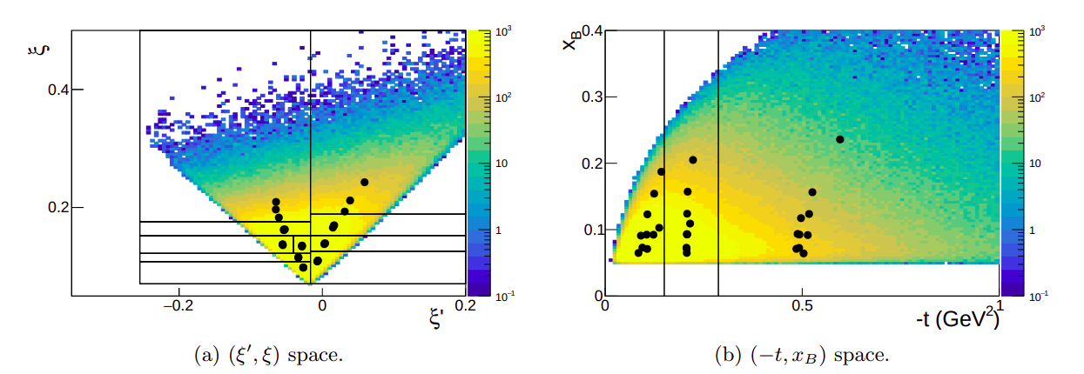
Experimental projection binning
100 days would allow for measurements on a five-dimensional grid (ξ’ ξ t x_{B} φ_{μ})
Covers both DVCS-like region (ξ’>0, Q²>Q'²) to TCS-like region (ξ’<0, Q²<Q'²)

Slide 23
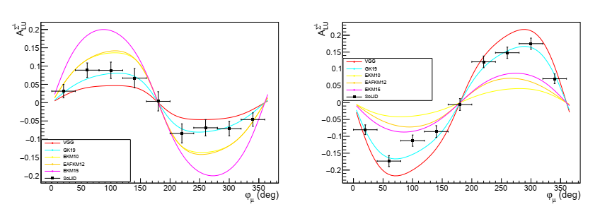
BSA experimental projections
DVCS-like region
TCS-like region
arXiv:2502.02346
First time measurement of the BSA sign change between the two regions
Possibility to constrain GPD models
All projection plots include statistical and polarization errors

Slide 24
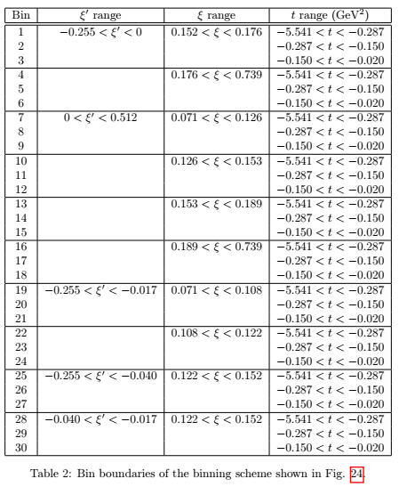
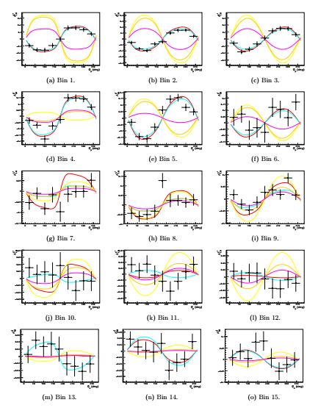
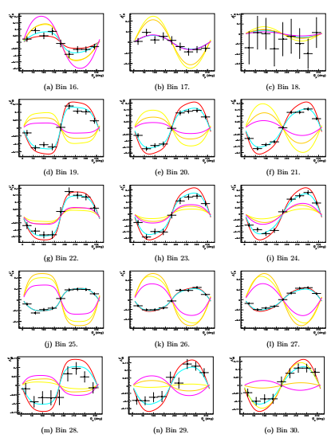
BSA experimental projections
All plots over the entire kinematic range

Slide 25
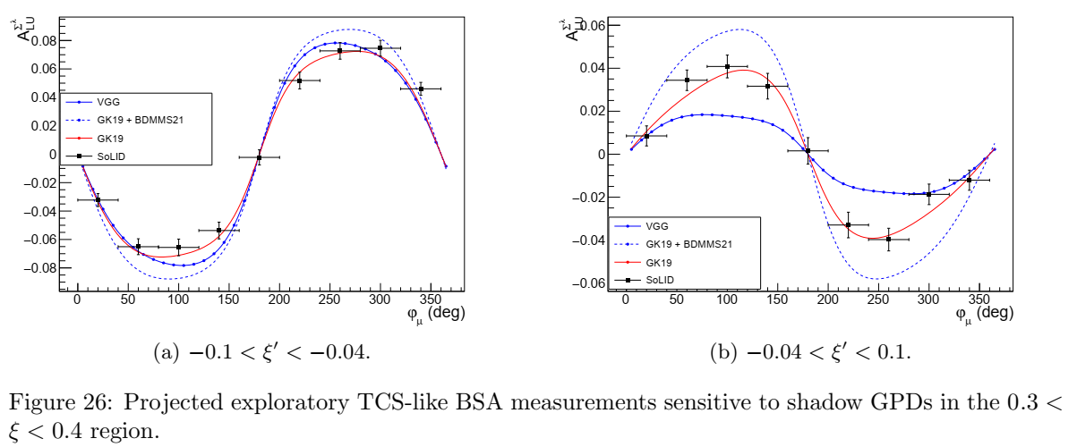
BSA experimental projections
First time exploratory measurement of BSA constraining shadow GPD models (a class of functions with null CFF and forward limit contributing to GPD solutions in the deconvolution problem)
Phys. Rev. D 103 (2021) 114019
Notes:
Shadow GPD models are parametrizations providing null Compton Form Factors and a vanishing forward limit appearing as solutions to the GPD inverse problem. Processes sensitive to the x-dependence of GPDs like DDVCS are required for setting strong constraints on them

Slide 26
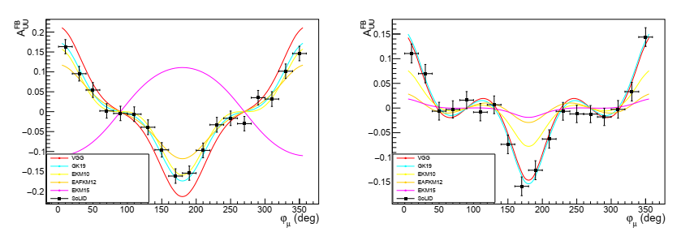
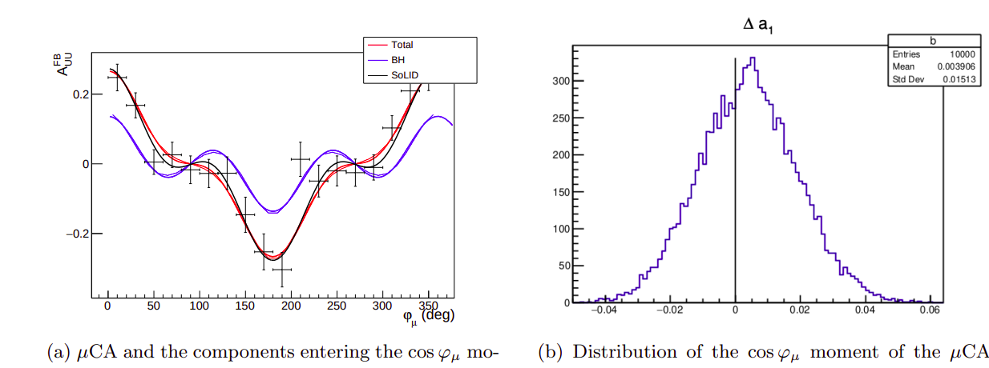

µCA experimental projections
First time exploratory measurement of µCA to access the CFF real part with curvature change
known BH contribution is small in certain regions and can be subtracted
µCA has contributions from cos(φ) and cos(3φ) modulations
cos(φ) component can be extracted from fitting

Slide 27




Systematic effects
BSA systematics originates mainly from electron beam polarization, electron detection efficiency, and muon detection efficiency
$$A_{LU}^{Σ^{λ}}=\frac{1}{λ} \frac{Y_{+}−Y_{−}}{Y_{+}+Y_{−}}$$
$$Y_{±}\left(φ_{μ}\right)=\frac{1}{Q_{±}} \frac{1}{∆Ω_{e}\left(φ_{μ}\right) ∆θ_{μ}\left(φ_{μ}\right)} \int_{0}^{2π}{dφ}\int_{π/4}^{{3π}/4}{dθ_{μ}\sin\left(θ_{μ}\right)}\frac{N_{±}\left(φ_{μ},φ,θ_{μ}\right)}{ε_{e}\left(φ\right) ε_{μ}\left(φ_{μ},θ_{μ}\right)}$$
$$Y_{±}\left(φ_{μ}\right)≡\sum_{i=1}^{N_{φ}}{\sum_{j=1}^{N_{θ_{μ}}}{\frac{n_{±}^{ij}}{ε_{e}^{i} ε_{μ}^{j}}}}$$
$$δA_{LU}^{Σ^{λ}}=\sqrt{{\left[A_{LU}^{Σ^{λ}}\right]}^{2}{\left(\frac{δλ}{λ}\right)}^{2}+\frac{1}{2λ^{2}} \frac{1}{N_{φ}}{\left(\frac{δε_{e}}{ε_{e}}\right)}^{2}+\frac{1}{2λ^{2}}\frac{1}{N_{θ_{μ}}}{\left(\frac{δε_{μ}}{ε_{μ}}\right)}^{2}}$$
λ = 0.85
0.04
Bin independence hyptothesis
$\left(N_{φ},N_{θ_{μ}}\right)$ are the kinematic dependent number of bins, typically (20,10)
Control systematics through reference channels
SoLID will have crosssection measurement before this experiment
For e- detection, use inclusive DIS and elastic measurements
For muon detection, use both resonance and resonance free region and cross check both di-e and di-mu channels
Pion channel measurement are also taken at the same time
CLAS12 BH di-e data and sim comparison

Slide 28

Beam time request
Main trigger on di-muon to take DDVCS, J/psi and TCS di-mu data at the same time
Independent di-e trigger for approved J/psi and TCS di-e data taking at the same time
Comprehensive program including muons and electrons within same runs. It can also help cross check systematics

Slide 29

Summary
This proposed experiment
complement SoLID J/psi setup with a forward angle muon detector to form SoLIDμ spectrometer
measure DDVCS in the di-muon channel
share approved J/psi beamtime 60 days and request additional 50 days
Its physics impact
first time measurement of DDVCS (mainly BSA and exploratory µCA) over a broad kinematic range
first time to access GPD $\left|x\right|<ξ$ as input for models and global fitting

Slide 30
Proposal to PAC53 PR12-25-010
and SoLID Collaboration
Spokesperson : Juan-Sebastian Alvarado, Alexandre Camsonne, Marie Boer,
Eric Voutier, Xinzhan Bai, Zhiwen Zhao

Slide 31
Backup

Slide 32

GPD Parameterization
GPDs are universal quantities and reflect nucleon structure independently of the probing reaction.
At leading twist–2, four quark chirality conserving GPDs for each quark type and gluon.
Because quark helicity is conserved in the hard scattering regime, the produced meson acts as a helicity filter.
Need a variety of Hard Exclusive Measurements to disentangle the different GPDs.
Compton Scattering:
Sensitive to all four GPDs.
Deep Exclusive Meson Production:
Vector mesons sensitive to spin–average H E.
Pseudoscalar sensitive to spin–difference , .

Slide 33


Nucleon Femtography
M. Burkardt PRD 62 (2000) 071503. M. Diehl EPJC 25 (2002) 223 A.V. Belitsky, D. Müller, NPA 711 (2002) 118c J.P. Ralston; B. Pire PRD 66 (2002) 111501
$$ρ_{H}^{q}\left(x,b_{⊥}\right)=\int{\frac{d^{2}Δ_{⊥}}{{\left(2π\right)}^{2}}} e^{ib_{⊥}{∙Δ}_{⊥} }\left[H^{q}\left(x,0,−Δ_{⊥}^{2}\right)+H^{q}\left(−x,0,−Δ_{⊥}^{2}\right)\right]$$
The transverse densities of partons in nucleons and nuclei is related to the transverse momentum transfer (${−Δ}_{⊥}^{2}$) dependence of GPDs at zero-skewness.
DVCS and TCS cannot map out zero-skewness GPDs over the full physics phase space.
The experimental knowledge of the ξ-dependence of GPDs at fixed longitudinal momentum fraction allows to control the zero-skewness extrapolation required for nucleon imaging.
R. Dupré, M. Guidal, M. Vanderhaeghen, PRD 95 (2017) 011501

Slide 34



Nucleon Spin
$$\lim_{t→0}{\int_{−1}^{1}{x \left[H^{q}\left(x,ξ,t\right)+E^{q}\left(x,ξ,t\right)\right] dx}}=J^{q}$$
d
The total angular momentum of partons inside the nucleon can be inferred from the Ji sum rule which involves the forward limit of the first Mellin moment of partons helicity conserving GPDs.
DVCS and TCS cannot access GPDs at $x≠ξ$ over the full physics phase space.
A.W. Thomas, PRL 101 (2008) 102003
The experimental knowledge of the ξ-dependence of GPDs at fixed longitudinal momentum fraction is a mandatory step for unraveling the nucleon spin.
u

Slide 35


Nucleon Forces
$$\int_{−1}^{1}{x\sum_{q}{H^{q}\left(x,ξ,t\right)} dx}= M_{2}\left(t\right)+\frac{4}{5}ξ^{2}d_{1}\left(t\right)$$
The skewness dependence of the first Mellin moment of the GPD H provides an access to the gravitational form factors of the energy momentum tensor of the nucleon.
$e^{±}$-DVCS and TCS offers another path via dispersion relations.
The ξ-dependence of GPDs reveals the internal dynamics of the nucleon.
V. Burkert, L. Elouadrhiri, F.-X. Girod, Nat. 557 (2018) 396; arXiv:2104.02031

Slide 36



Integrated Cross Section
5-fold observables obtained from the integration over the polar angle of the muon and the azimuthal angle of initial virtual photon or final virtual photon are required, also minimizing the contribution of the BH₂ process
DVCS-like xs
(integral of φ_{μ})
TCS-like xs
(integral over ϕ)
DVCS-like xs
Our study focuses on using TCS-like xs for projection
TCS-like xs

Slide 37





Muon Charge Asymmetry
aka Forward Backward Asymmetry
Access to the real part of CFFs (no existing dispersion relation)
μCA predicted to have significant amplitude and rich harmonic composition, like the forward-backward asymmetry of TCS
Curvature change is a highly-discriminating feature for models
DDVCS μCA access a CFF combination different from BSA. This feature distinguishes DDVCS from DVCS and TCS.

Slide 38




Muon Detector Tracker
Utilize $μ$RWELL detectors for muon tracking layers
  Current $μ$RWELL detector rate capability – ~200 $KHz/cm^{2}$ (High-rate version in development – 10$MHz/cm^{2}$)
  Discharge resistant thanks to integrated DLC layers – a huge improvement on electronics stability – less interruption on DAQ during running
  No spacers needed compared with GEM detectors – no dead area
A similar technology adopted by EIC
  Our muon detector unit would be roughly in the same size as EIC prototypes
  Total cost (3 complete layers covering a total of 75 $m^{2}$) around 900K
$μ$RWELL Detector – G. Bencivenni et al 2019 JINST 14 P05014
A plane of $μ$RWELL detectors for muon detection
$μ$RWELL Detector for EPIC outer barrel tracking layer

Slide 39



Muon Detector Tracker
Use capacitive charge sharing technique to reduce total readout channels while maintain the same space resolution
Works for all readout patterns – strip, pad, zigzag, …
With Capacitive charge sharing:
Space resolution : 1 mm
Total readout channel can be reduced to around 22K for all 3 layers combined
Detector rate will be determined by the final readout strip width, larger strip width leads to lower detector rate capability
For 22K readout channels, 1 mm space resolution, with capacitive charge sharing technique – rate capability: $\sim 30 KHz/cm^{2}$ (assume 300 ns signal integral time)
Concept for capacitive charge sharing – K. Gnanvo et al, Nuclear Inst. and Methods in Physics Research, A 1047 (2023) 167782

Slide 40

SoLIDµ vs µCLAS12
100 days comparison

Slide 41


SoLIDµ vs µCLAS12
µCLAS12
SoLIDµ
Angles in the muon center-of-mass frame
Larger coverage with SoLIDµ

Slide 42

BH and trigger

Slide 43

Systematic effects
Systematics of the measurements will be controlled via simulations and the measurement of reference processes. The solenoidal field and the symmetrical configuration of SoLIDμ offer further cross-checks
Muon solid angle : extensive simulations based on the SoLIDμ GEANT4 model ($δ∆θ_{μ}/∆θ_{μ}\sim 3\%$)
Electron detection efficiency : measurement of DIS and elastic electron scattering ($δε_{e}/ε_{e}\sim 7\%$)
Muon detection efficiency : measurement of Bethe-Heitler and comparison of the $e^{±}$and${ μ}^{±}$ decay of specific meson (φ, J/Ψ) ($δε_{μ}/ε_{μ}\sim 15\%$)

Slide 44
Background asymmetry
signal channel asymmetry As=0.1 and rate Rs
background channel asymmetry Ab=0.5 and rate Rb
Background/signal rate Rb/Rs=0.05 with error ER=0.01
Rel_Error of As = (As-Ab)/(1-Rb/Rs)^2*ER/As
            = (0.1-0.5)/(1-0.05)^2*0.01/0.1=-0.045
With those conservative assumptions, background only give about 5% error on signal asymmetry

Slide 45


Slide 46

Cost

Slide 47

Binning

Slide 48





Coordinates Layer 1
Iron wall 1
Ch 1 +
Ch 1 -
Reference = Magnet
Ch 2 +
Y
X
Z
Ch 2 -

Slide 49





Coordinates Layer 2
Iron wall 2
Ch 3 -
Ch 3 +
Ch 4 +
Reference = Magnet
Y
X
Z
Ch 4 -

Slide 50
E12-12-006: Near Threshold J/Psi production on LH2 target
Most precise measurement near threshold

Slide 51

E12-12-006A: TCS with circular polarized beam and LH2 target
SoLID TCS will have at least 1 order larger statistics than CLAS12 and usher TCS study into precision era with multi-dimensional binning
    SoLID has 250 times more integrated luminosity than the CLAS12 TCS published result
    SoLID acceptance to TCS events is about ¼ of CLAS12. But with full azimuthal coverage, (ideal for the forward backward asymmetry)
    Crosssection measurement (moment)
SoLID TCS could lead to study of NLO correction
SoLID TCS coverage

Slide 52


